Slide 1


International intergovernmental organization
Joint Institute for Nuclear Research
STRATEGY
C O M M U N I C A T I O N
Dr. Irek Suleymanov, JINR Coordination Group for Communication Strategy, 2023

Slide 2
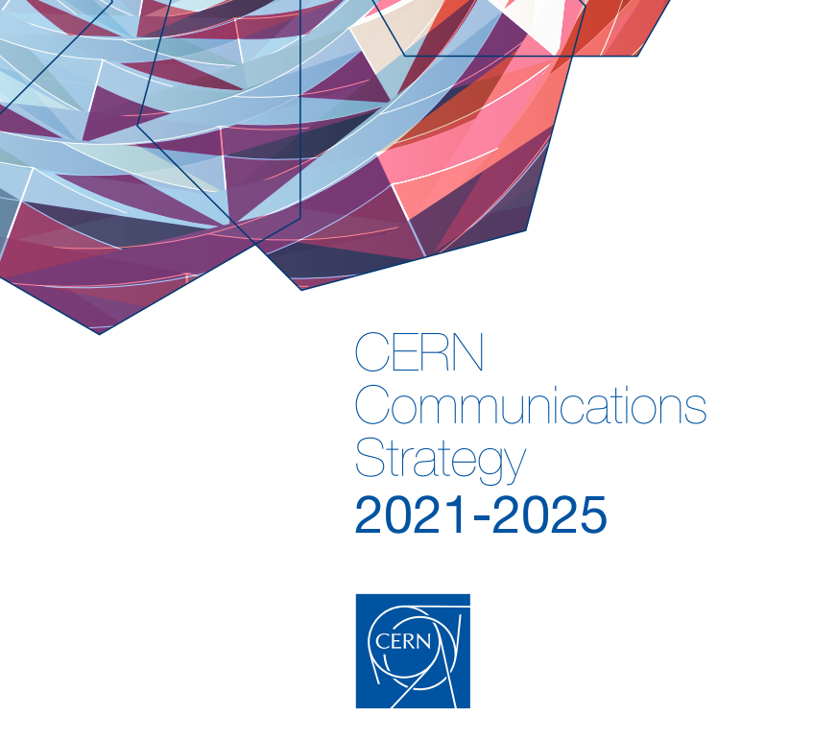
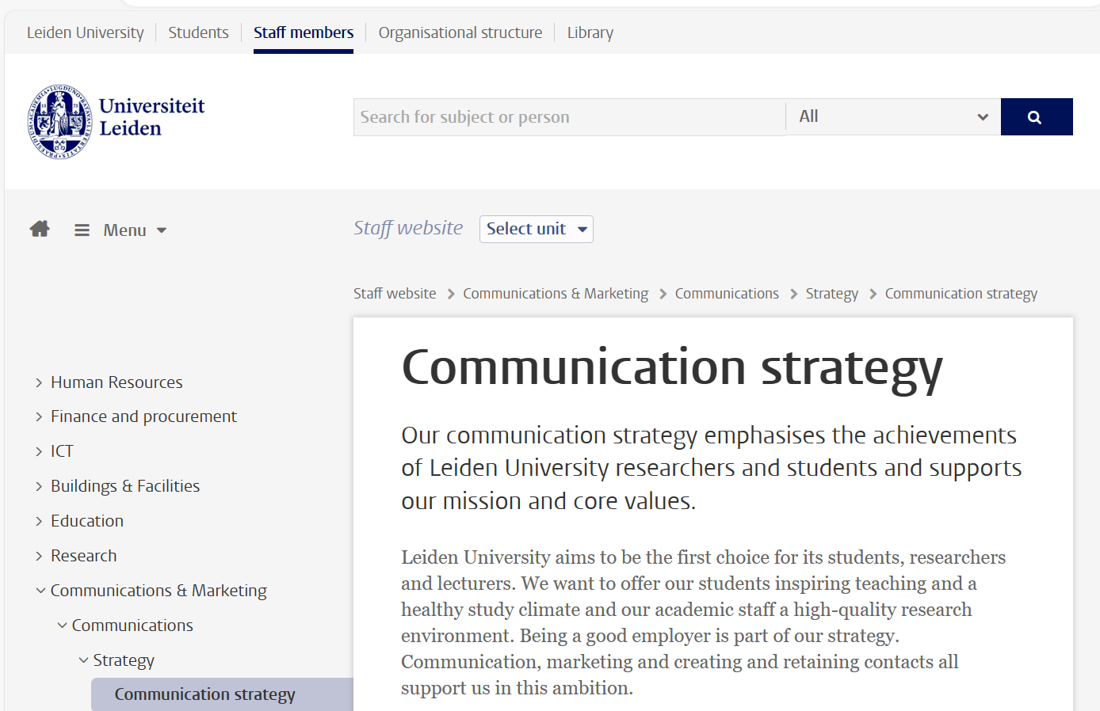
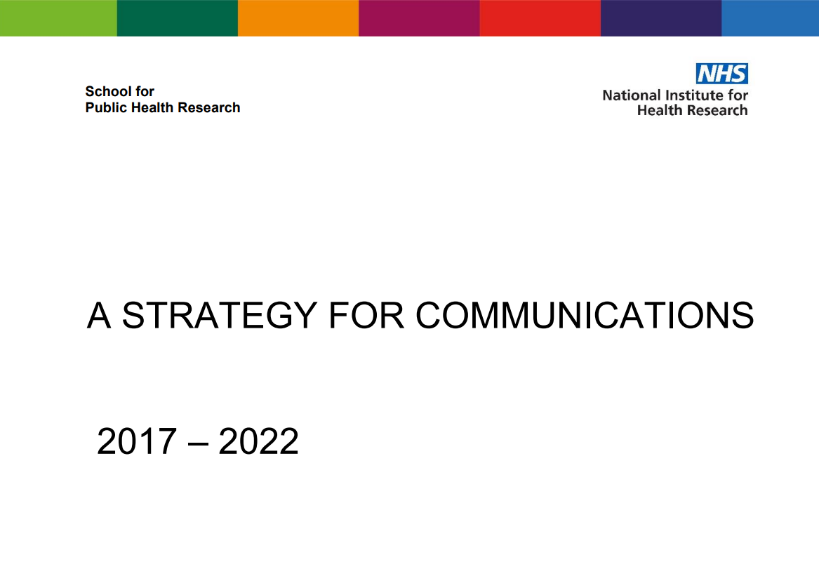

Slide 3
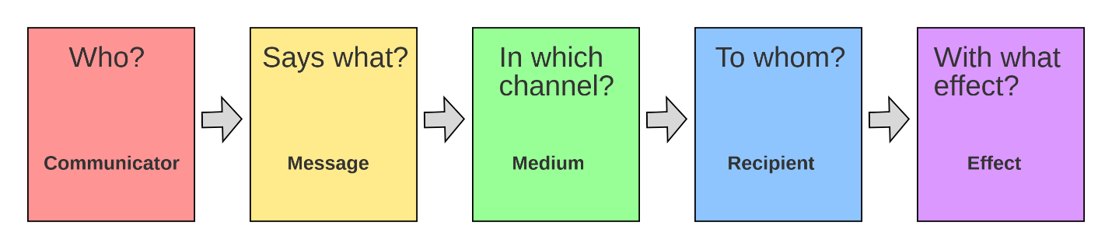
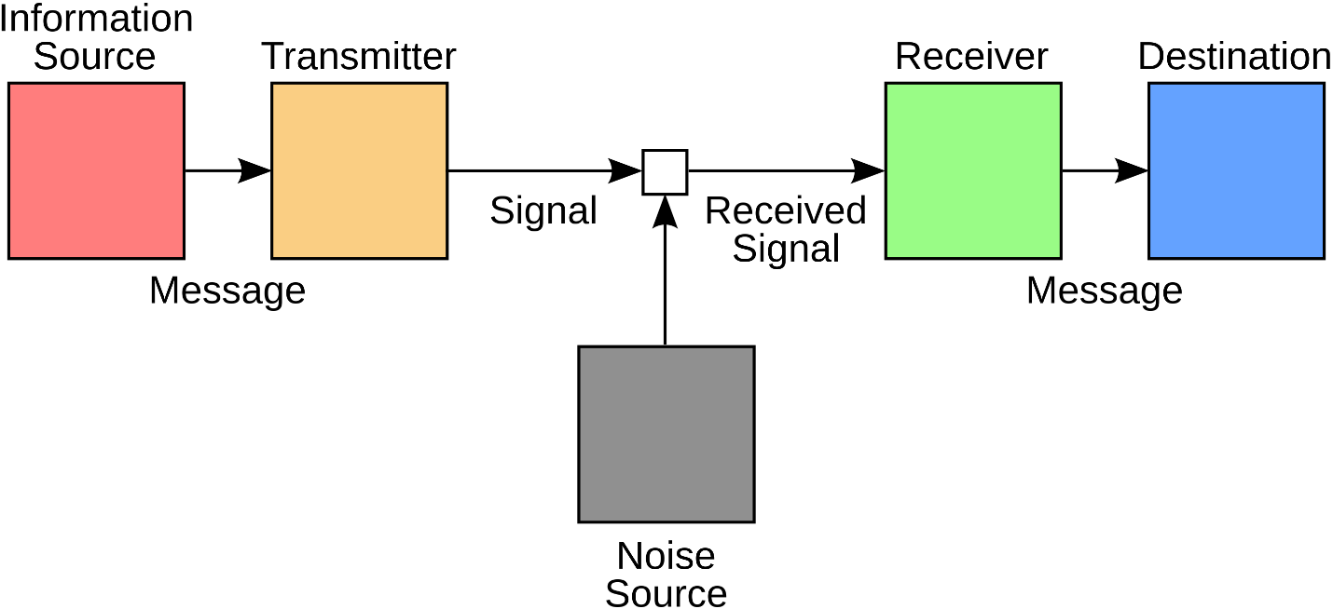
Communication is …
…the transmission of ideas and information.
…conveying the true nature of the organization, the issues it deals with, and its accomplishments to the community.

Slide 4

What is Strategy?
It is the integrated set of choices that positions the business in its industry so as to generate superior financial returns over the long run.
(Rivkin)
Operational effectiveness is not strategy:
– performing similar activities better than rivals.
– performing different activities from rivals’ or similar activities in different ways:
• Variety-based positioning
• Needs-based positioning
• Access-based positioning
–trade-offs, choosing what not to do.
(Porter)
Notes:
Just to give you some of the background to this…
I’d now like to draw you attention to
Это интегрированный набор вариантов выбора, который позиционирует бизнес в своей отрасли
, чтобы обеспечить превосходную финансовую отдачу в долгосрочной перспективе.
(Ривкин)
Операционная эффективность – это не стратегия:
– выполнение аналогичных действий лучше, чем у конкурентов.
– выполнение действий, отличных от действий конкурентов или подобных действий, разными способами:
• Позиционирование на основе разнообразия • Позиционирование на основе
потребностей • Позиционирование на основе
доступа
– компромиссы, выбор того, чего не следует делать.

Slide 5
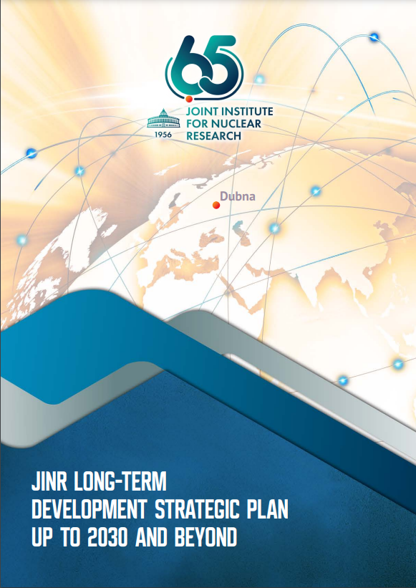
what for?
Successful communication is an ongoing process that should begin planning for as soon as your organization begins planning its objectives and activities.
Notes:
One thing you will immediately notice is that…
The lesson we can learn from this is…
My next slide shows …
зачем?
Успешная коммуникация — это непрерывный процесс, планирование которого следует начинать, как только ваша организация начинает планировать свои цели и деятельность.

Slide 6

The overall goal of the Institute’s development strategy
Priority of communication strategy
creation of favorable environment in the target segments of the information field in order to implement the JINR Long-Term Development Strategic Plan up to 2030 +
a leading position at the forefront of science in a number of selected fields of basic research
Other development priorities:
The communications strategy
describes the main approaches and key tools:
Increasing the contribution of the JINR research program to the finding solutions to the global challenges faced by JINR MS
Appeal and competitiveness of JINR
Enhancing of human capital, favorable work environment;
Strengthening the JINR community, sustainable development of JINR as an international organisation and a platform for science diplomacy.
of the Institute's PR activities
of communication support of the JINR Directorate’s interactions with decision-makers
of science diplomacy to develop sustainable and fruitful collaboration with the Institute's key target groups.

Slide 7
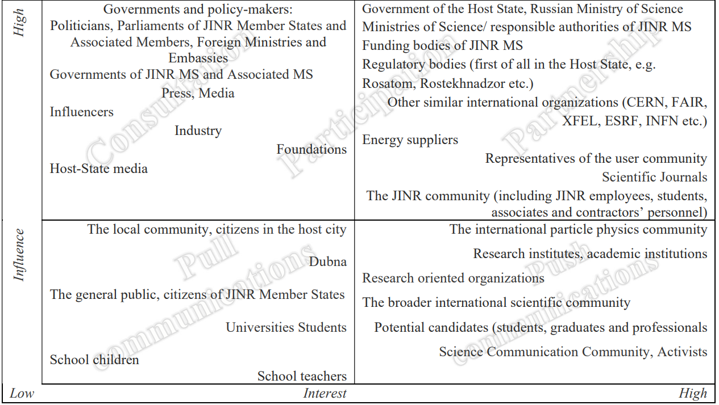
Notes:
One thing you will immediately notice is that…
The lesson we can learn from this is…
My next slide shows …
зачем?
Успешная коммуникация — это непрерывный процесс, планирование которого следует начинать, как только ваша организация начинает планировать свои цели и деятельность.

Slide 8






objectives within the target audience segments
Local community
(city, region)
Scientific community
Demonstration of the contribution of the JINR international team to the development of the city and its international significance.
Promotion of the slogan “Dubna is a space for international science”.
Dissemination of knowledge. Development of the Institute's communicative function to foster scientific collaboration with scientists from around the world.
01
02
Decision makers
Institute staff,
people from JINR orbit
06
03
Targeted information support on the JINR agenda. Coverage of the results of the integration of the Member States’ S&T priorities into the JINR agenda.
Strengthening and spreading the values and strong corporate culture of JINR. Facilitating higher employee satisfaction and motivation.
05
04
University students, teachers,
schoolchildren
General public of partner countries
Support for the development of a partner network of target universities and schools, recruiting employees from partner countries, and strengthening the community of JINR “ambassadors”.
Raising awareness of the significance of the scientific agenda results, JINR initiatives, and the advantages of a country's participation in JINR activities for its society and economy.
.

Slide 9






Methodology
The draft Communications Strategy was developed at the site of the Coordination Group for Communications Strategy.
Six expert panels corresponding to the main target audiences -
Decision makers
General public of partner countries
Institute employees,
individuals within the JINR orbit
Scientific community
University students, teachers,
schoolchildren
Local community
(town, region)

Slide 10
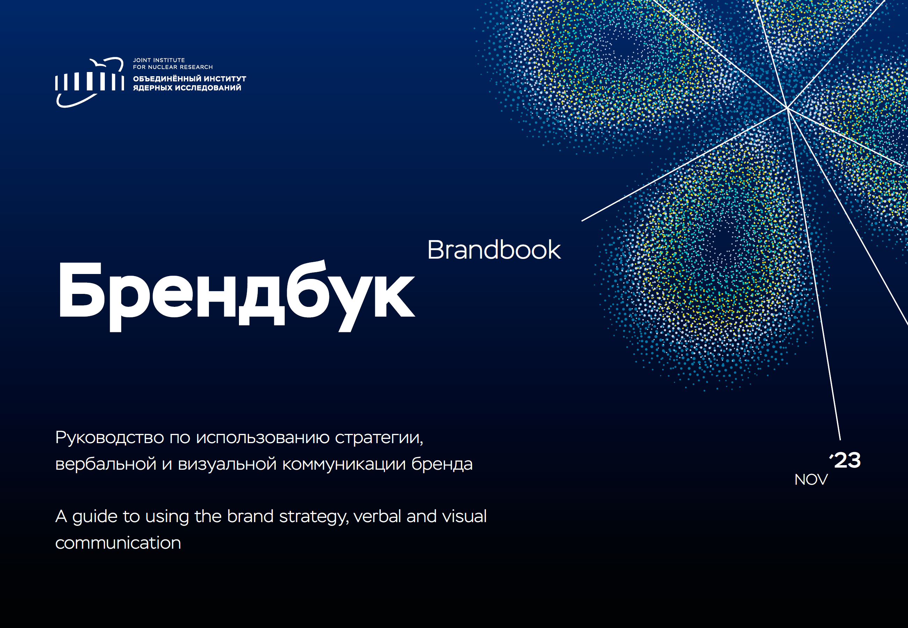
Brand strategy
Basic identity elements
Brand graphics
Merch
Competition (spring 2022) for the preparation of a brand design:
5 design companies from 3 JINR member countries.
Winner - OpenCore

Slide 11
Key communication guidelines
Mission
Vision of the future
Addressing the challenges of basic and applied science, organizing international cooperation in order to shape the global scientific agenda and acquire new knowledge for the global common good
A reputable international centre for scientific and cultural exchange,
fostering a research environment that integrates scientists worldwide
in order to make discoveries for the benefit of humanity
Principles
New achievements as a result of the consolidation of scientists’ efforts worldwide for the benefit of humanity
Diversity – multiculturalism, multidisciplinarity, a wide range of scientific schools and research topics
Openness – open-mindedness, mutual understanding, tolerance, support and teamwork
Freedom (professional and creative) – boundless intellectual freedom and integration into the international scientific environment
Love and Devotion to basic science, the bearer of knowledge as a common good
Positioning
Global positioning slogan
A multidisciplinary centre attracting intellectual talent from around the world
Science brings nations together

Slide 12

Scientific community
Target audience
Communication objectives
Communication messages
Communication channels
All scientists worldwide
JINR employees
Collaborators on joint projects
Potential new employees
Dissemination of knowledge
Development of the Institute as a platform for
scientific cooperation and information exchange on
issues of the current research agenda
JINR is an international intergovernmental organisation.
JINR is a pleasant and secure place to work, learn and
develop as a professional.
A well-developed infrastructure, research user programmes,
and research assistance are available at JINR.
JINR conducts research in a variety of currently relevant
areas.
Simple, straightforward explanations of JINR's scientific
achievements
Scientific publications and events
An updated “JINR News” bulletin, as well as JINR
scientific journals
The JINR website
JINR Information Centres
Publications in the media.
Content available on
various social media and video platforms

Slide 13

Decision makers
Target audience
Communication objectives
Communication messages
Communication channels
JINR is an international inter-governmental organisation with its own legal status, registered with the UN.
JINR consolidates the national S&T priorities of its Member States.
JINR facilitates development of science, education, and technology in all MS.
Membership in JINR means being a member of a prestigious club of scientific pioneers who shape and implement the global scientific agenda.
JINR belongs to each Member State.
All MS have equal voting rights in the planning and implementation of the Institute's development.
Science brings nations together.
Dubna is our common home on the Volga.
Regular formats (CP etc.)
Visits to other countries and events on their territory, visits of decision-makers to JINR
Mailings to Plenipotentiaries
International forums
The JINR website
Digital personal accounts for Plenipotentiaries and other decision-makers
Outreach projects in MS
Events for members of the diplomatic corps and relevant agencies
JINR Information Centres
Plenipotentiaries of the Governments of JINR MS
Governments and relevant agencies of MS, potential MS and Associate Members
Organisations and institutions responsible for national S&T
Policies
Governments of other partner countries and governing bodies of multilateral associations and international organisations
Diplomatic corps of partner countries
Industrial partners, associations of technology related enterprises, etc.
Decision-makers’ support for JINR initiatives
Information support for the engagement of new
partner countries
Complementary/pragmatic integration of the
Member States' S&T priorities into the Institute’s agenda
Development of cooperation with industrial partners

Slide 14

University students, teachers, schoolchildren
Target audience
Communication objectives
Communication messages
Communication channels
Students majoring in relevant fields and familiar with
JINR activities
Students majoring in relevant fields but unfamiliar
with JINR activities
High school students planning to enrol in relevant
university programmes
Teachers specialising in relevant fields
Recruiting employees (researchers and engineers)
from Member States
Determining target universities (schools)
Disseminating information about JINR and the
current state of science
Creating a JINR “ambassador” network (via teachers)
Popularising the image of a scientist, enhancing the prestige of the profession of a researcher
The path from school to employment at JINR is clear
through cooperation with specialised departments and JINR engagement programmes.
JINR is a world-leading centre in various areas of science.
Working at JINR means working on the cutting edge of science.
Working at JINR is prestigious and promising, and increases
one’s competitiveness in the global market.
Participation in career forums at universities
JINR Information Centres
Social media
Participation in exhibitions and forums
Popular science lectures

Slide 15
General public of partner countries
Target audience
Communication objectives
Communication messages
Communication channels
All socially active individuals over the age of 12:
— in JINR Member States,
— in countries with which JINR has signed
cooperation agreements,
— in coordinating countries that act as a unifying force and supervise cooperation with
neighbouring countries in their region
Raising the awareness of target audiences about
the public benefits of scientific progress in general terms
Raising the awareness of target audiences about
JINR, its infrastructure, projects and achievements
Demonstrating the benefits that a country gains by
becoming a JINR Member State
Increasing the loyalty of target audiences
Engaging youth in science
JINR is an international centre for basic and applied research where scientists from various countries work together,
united by the common goal of promoting science and technology in an environment of complete openness and transparency, as well as of equality of the collaborating states.
JINR is a consolidation of economic and intellectual resources aimed at enriching the scientific knowledge of participating
states, providing access to the latest unique technologies, achievements, and discoveries.
JINR carries out its activities in partnership with IAEA, supports the exchange of scientific achievements in the field of peaceful nuclear energy, implements a guarantee system which ensures that civilian nuclear programmes are not used for military purposes, and promotes health and safety regulations in the field of nuclear energy, as well as the monitoring of compliance with the aforementioned regulations.
The media, national and international news agencies
JINR internal resources that reinforce key messages
Direct interaction with target audiences at public events
Digital media (JINR website, social networks, newsletter)

Slide 16

Local community (town, region)
Target audience
Communication objectives
Communication messages
Communication channels
JINR is an international project of great importance for the Russian Federation, the region, and the town; an organisation registered with UN; all MS enjoy equal rights.
JINR is Dubna’s largest taxpayer, a backbone enterprise, which maintains and develops a significant part of the town’s infrastructure for the benefit of all its residents.
Dubna is a town of international science.
JINR is the driving force of the town's development.
Dubna’s friendly and open atmosphere is the town’s hallmark
and a source of pride for its residents.
Local media and Dubna social networks
JINR information channels (website, newspaper, social networks)
Targeted information products for various groups of the community
Events organised on the public platforms of JINR and its partners
Preparation of content for partner channels, other
forms of cooperation with partner information resources
Town residents
Decision-makers and authorities at the municipal and regional levels, in neighbouring areas and regions
Management of companies, organisations, and associations influencing decisions relevant to the Institute
Public associations (formal and informal), individuals who shape public opinion and are conductors of ideas and information
Local specialists — potential employees of JINR
Tourists, guests of the city, and official delegations
Writers and film-makers creating works about Dubna
Ensuring support for the decisions necessary for
JINR at the municipal and regional level
Harmoniously developing Dubna as a common home for JINR's multinational community, as well as a hospitable platform for international cooperation
Increasing the appeal of JINR as an employer and
an S&T partner

Slide 17

Institute employees, individuals within the JINR orbit
Target audience
Communication objectives
Communication messages
Communication channels
Current JINR employees: researchers, engineers,
workers, and experts
People within the JINR orbit, including alumni —
individuals who have worked at and/or cooperated
with JINR (including participation in internships,
conferences, practices), but are not currently JINR
Employees
Retirees — people who have completed their
professional career
Creating and maintaining a corporate culture
Providing timely and accurate information about
JINR
Establishing feedback mechanisms in order to
ensure comfortable working conditions
Enhancing the positive image of the Institute as an
international scientific organisation
Optimising the use of all the Institute’s resources
Establishing mechanisms for the continuity of JINR
systems of scientific views and cultural traditions
What matters most at JINR are the people.
JINR is a major international scientific centre conducting
research at the forefront of science.
JINR provides the opportunity to jumpstart a scientific
career.
Working at JINR is prestigious.
The Institute creates a comfortable working environment for
all members of the JINR international community.
This is where the future is shaped.
JINR is an open organisation that values everyone it has the
opportunity to work with.
Digital media (JINR website, social networks, etc.)
Mass media (Institute’s, municipal, regional and
federal media)
Digital JINR
Information handout materials
Thematic schools, meetings, excursions, workshops

Slide 18
Implementation of the communication strategy
Digital communication platform with a built-in hierarchy of Internet resources
Press tours for the media
Information campaign “Do Science @ Dubna ”
JINR Science Exhibition & Communication Hall
Scientific tourism at JINR
Exhibition area "Science and Art".
Public Relations and Science Communication
Coordinating
of activities of JINR specialized departments
Common approaches
Creation and development of an information support system for decision-makers
Support of interaction with public authorities of partner countries
Updating, implementation and promotion of the Institute’s corporate identity
Development of tools for targeted compilation of information
Create a digital platform for the JINR Protocol Office
consistent development of unified methodological approaches
Events
in key areas
Development of science diplomacy tools
Improving formats “Dubna Green Chamber Talks”, JEMS
Initiation of new projects in the field of science diplomacy („Scientific Davos in Dubna”) and popularization of science under the auspices of UNESCO and other relevant specialized UN agencies etc.
Inclusion
Informing and involving employees of the Institute

Slide 19

Results expected by 2030
Continuous increase in the number of publications about JINR
Continuous increase in audience reach in Member States
Continuous increase in the number of citations from materials on JINR resources made in other sources
Achievement of a consistently positive tone of references to JINR
Continuous increase in the share of references to JINR in the general flow of publications about the industry
Comprehensive representation of key JINR messages in the relevant media space
Strengthening the positive media favourability index
Increasing the visibility of JINR branding elements
Public Relations and Science Communications
Formation and development of an information support system for decision makers
Positive dynamics in the level of engagement with the authorities of MS
Promptness of initiatives of proactive engagement with authorities
Strengthening the authorities’ positive perception of the Institute
Enhancing the Institute's credibility and strengthening its influence in professional communities in partner states, as well as in relevant international organisations
Development of science diplomacy tools
Expanding and diversifying the structure of the partner network in the field
of science diplomacy
Strengthening JINR’s visibility and credibility as a platform for science diplomacy
Increasing the number of specialised events and publications
Positive trends in the number of key messages on science diplomacy in the total number of publications mentioning JINR

Slide 20
Monitoring the implemantation of the strategy
Scientific community
Decision makers
University students, teachers,
schoolchildren
General
public of partner countries
Local
community
(town, region)
Institute employees,
individuals from JINR orbit
Number of interactions between JINR laboratories and other
countries and organisations
Number of applications and participants of JINR events and
postdoctoral programs
Assessment of public awareness of JINR achievements
Percentage of decision-makers positively evaluating the development of decision support services
Number of subscriptions to expert materials
Number of key messages on science diplomacy that reference the
Institute in the information space of JINR Member States
Analysis of the share of graduates employed at JINR
Growth dynamics in the number of people who have heard about JINR for the first time
Growth dynamics in the number of people who return to JINR for more information
Dynamics of publications mentioning JINR in the media (by Member State)
Audience reach evaluation by Member State
Web resources audience analytics by Member State
The size of the audience of JINR information resources, estimated with the use of approved tools, expert evaluation, etc.
The number of community members who take a positive view of the role of JINR and the importance of the Institute’s achievements for
the town
Local media favourability index
Percentage of employees who positively assess the level of informing and effectiveness of JINR's digital and communication
platforms
Number of events with the participation of alumni
Number of events with the participation of retirees

Slide 21
Benefits and Risks
Advantages
Risks
Intergovernmental scientific organisation
The interdisciplinary nature of scientific schools cultivated by great scientists who laid the foundation for the Institute
A large complex of modern facilities that make it possible to conduct research on the cutting edge of science
World-class scientists are full-fledged employees of the Institute, not just its visitors
Training of young scientists (creating a talent pool for Member States)
Politicisation of the area of S&T cooperation
Mistakes in content targeting and format
Mistakes in the choice of promotion channels
Ignorance of the traditions and political climate of certain countries
Detrimental media coverage in different countries
Inability of the audience to understand the information presented by the Institute

Slide 22
International intergovernmental organization
Joint Institute for Nuclear Research
Strategy
COMMUNICATION
JINR Coordination Group for Communications Strategy, 2023

