Slide 1
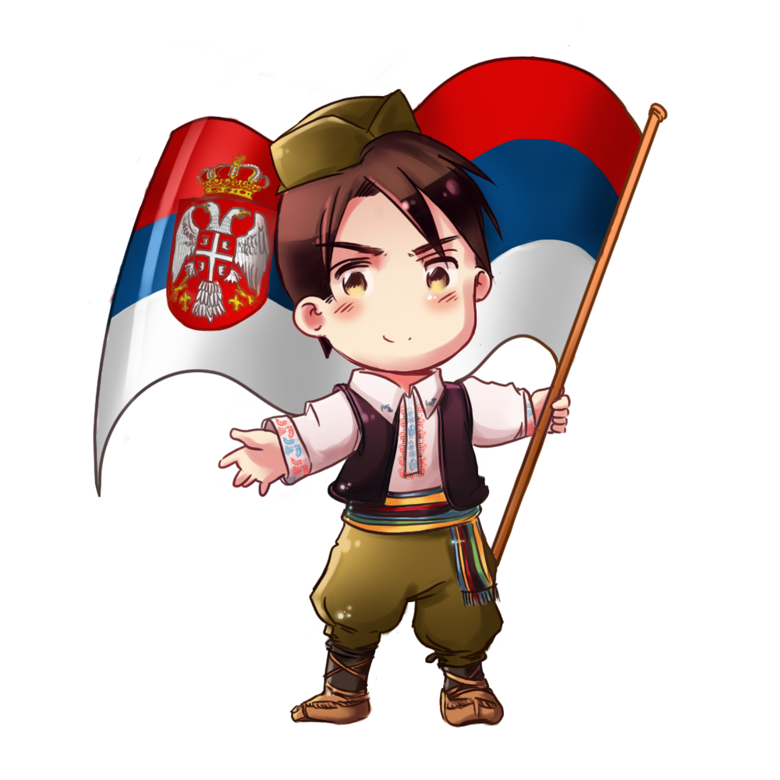
SERBIA

Slide 2
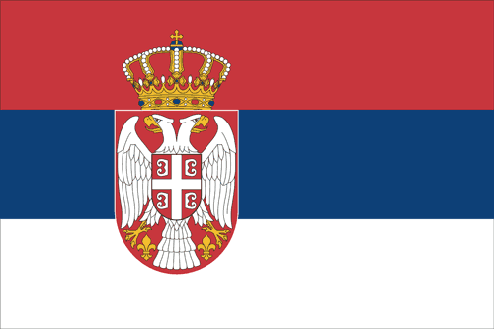
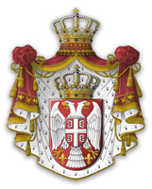
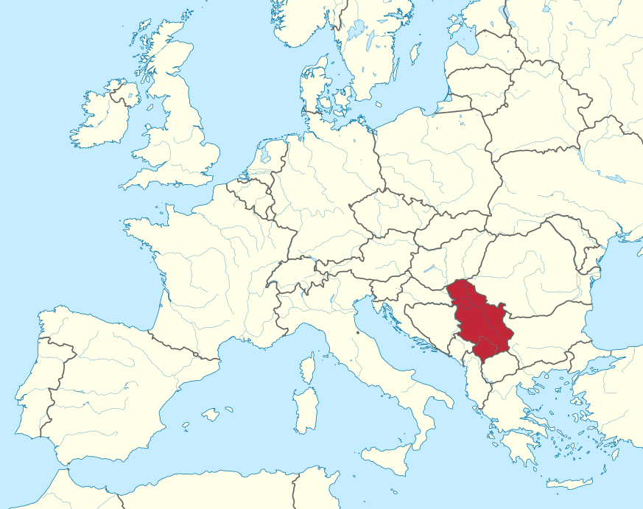


Slide 3
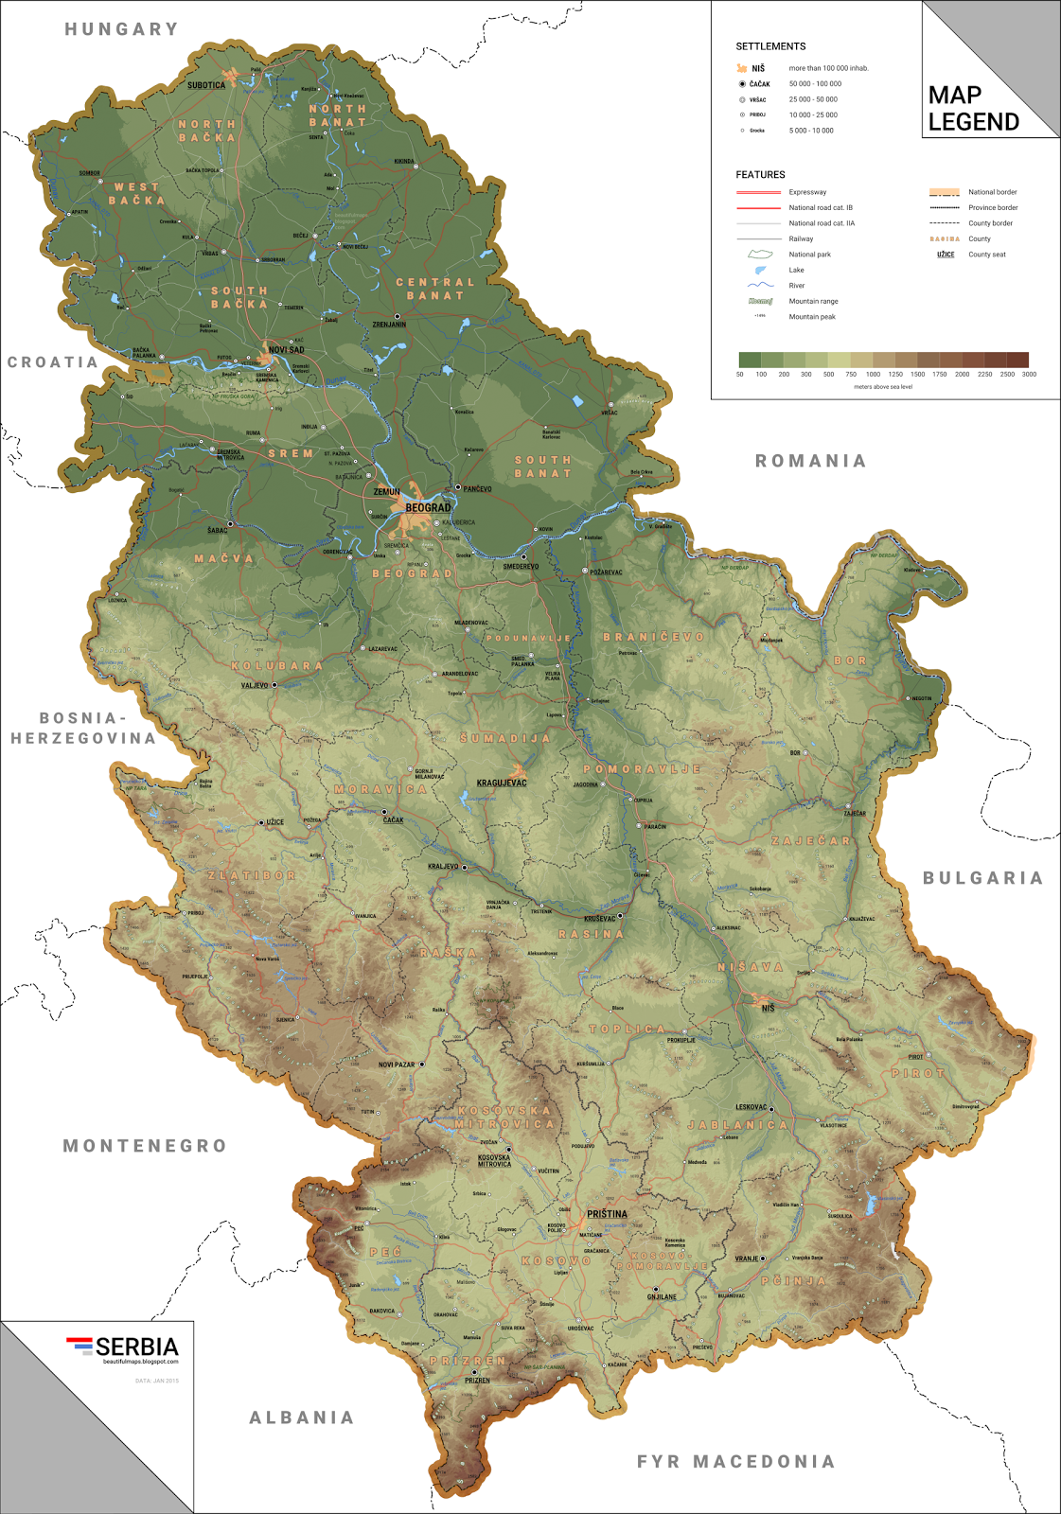
Population: 6.8 million citizens
Area: 88.499 km² (113. in the world)
Capital: Belgrade (1.4 milion)
Flat land and mountains
The biggest rivers Danube and Sava
5 National parks
Large numbers of lakes and rivers
Currency: Serbian dinar
Religion: Ortodox christianity

Slide 4
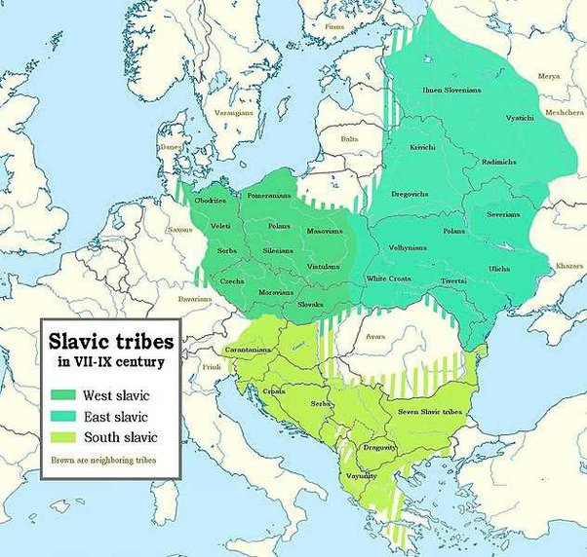
Slavic tribes
Migration of slavic tribes to the Balkans in 6th centrury
South slavic

Slide 5
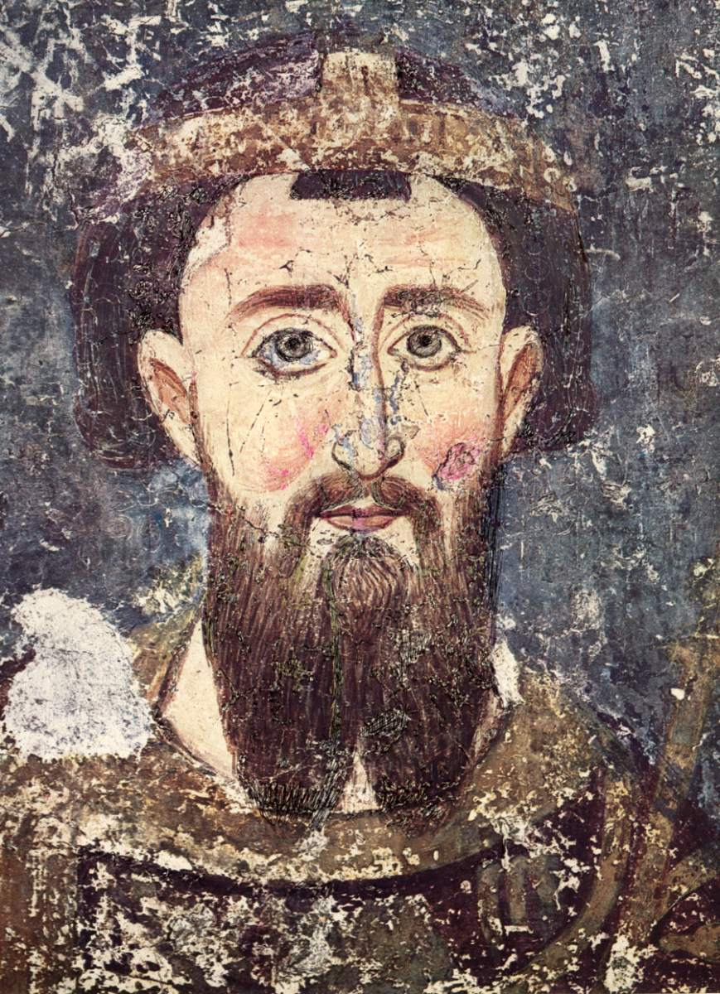
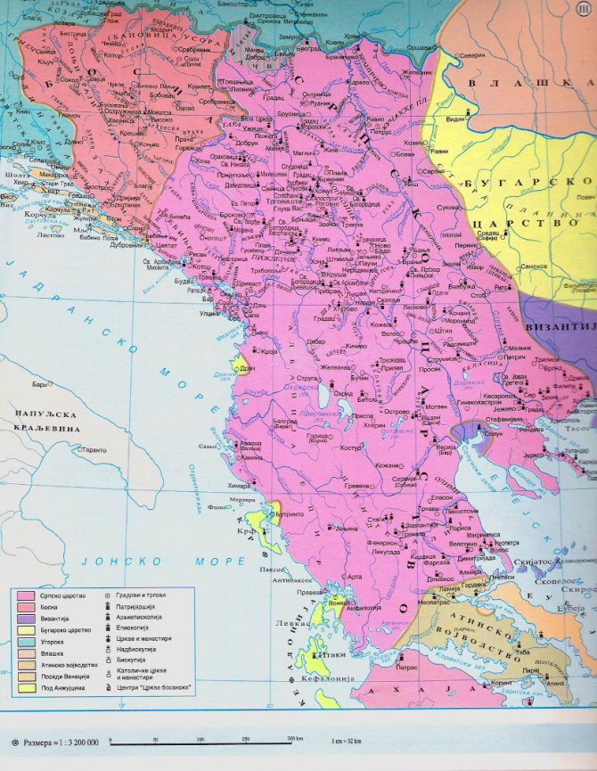
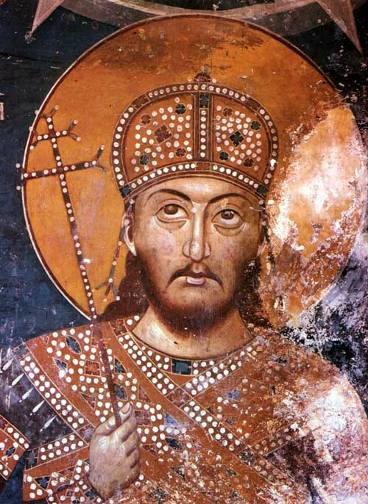
Middle age Serbian state

Slide 6
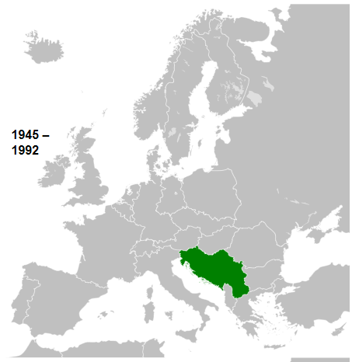
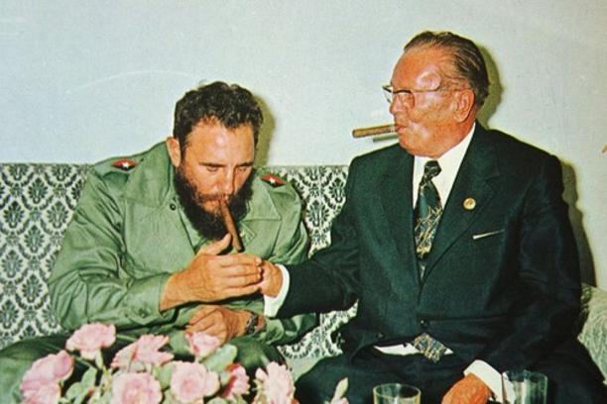
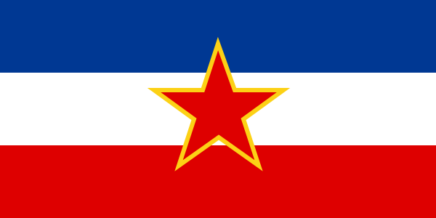
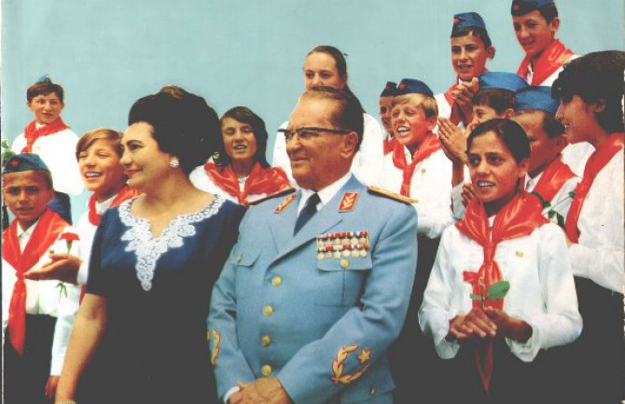

SFR Yugoslavia

Slide 7
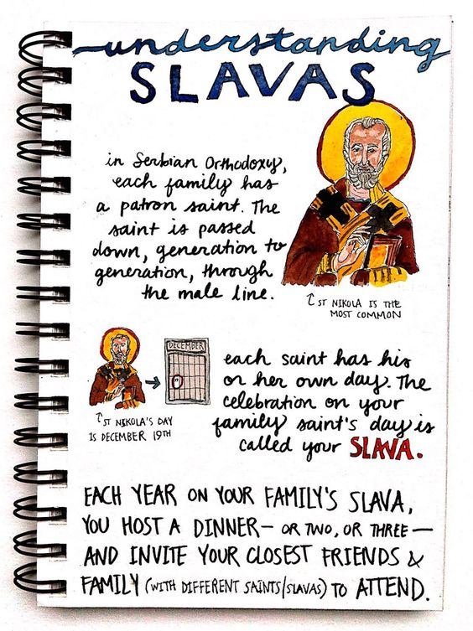
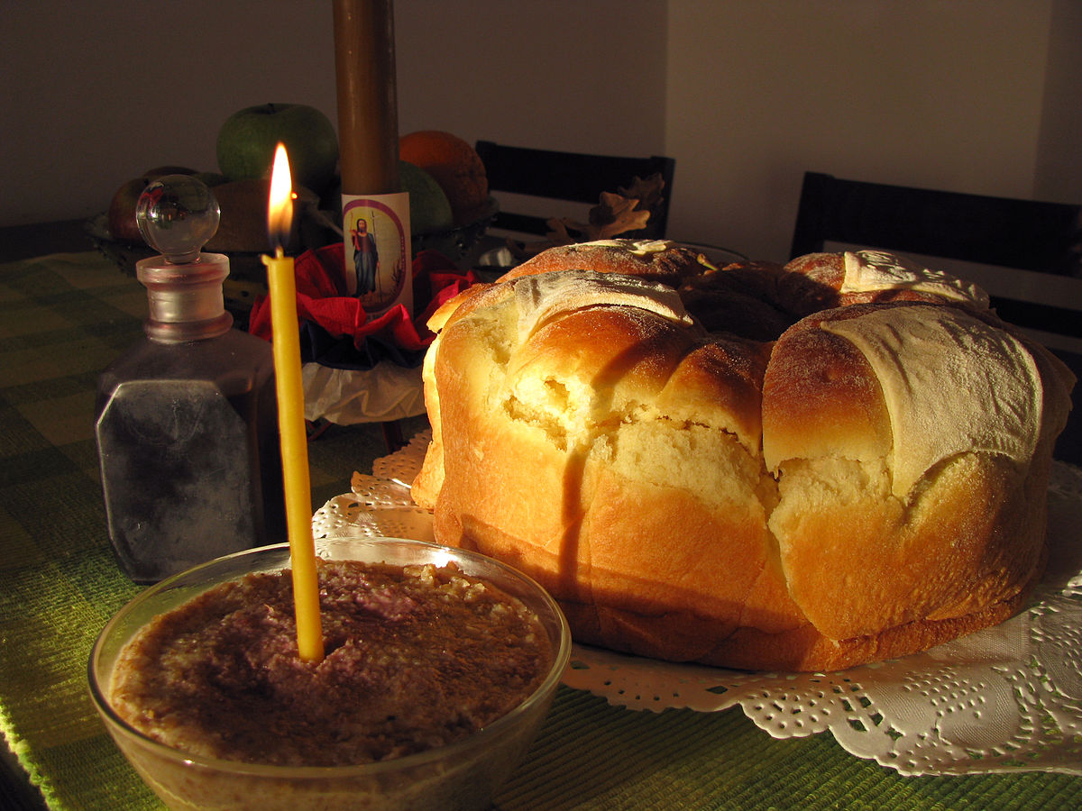
Tradition

Slide 8
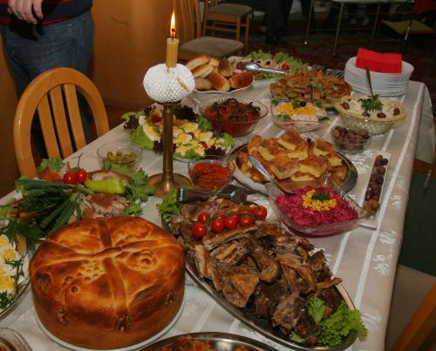
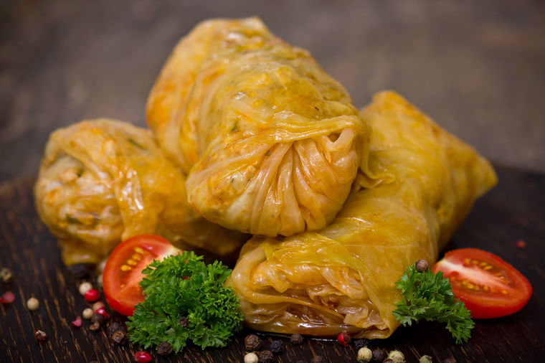
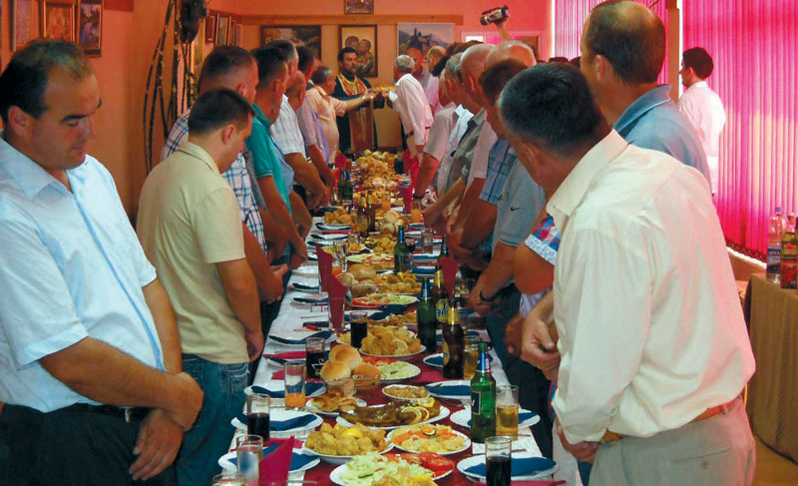
There is not “slava” without “sarma”!

Slide 9
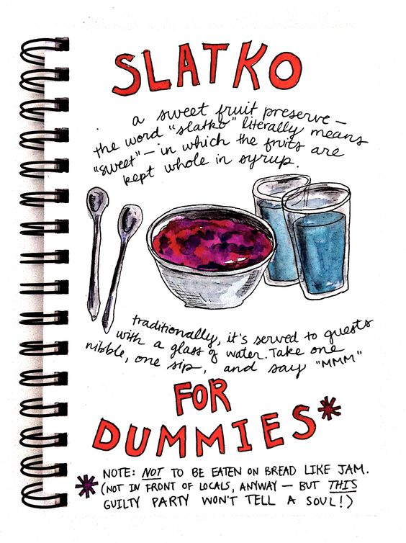
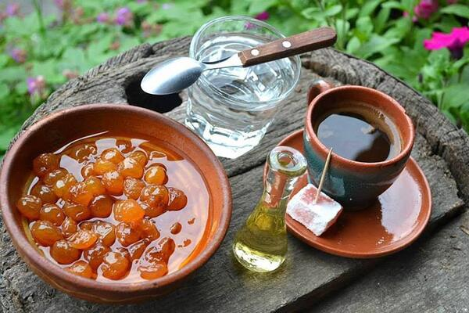
slatko+kafa+rakija
Sweet+coffe+brandy

Slide 10
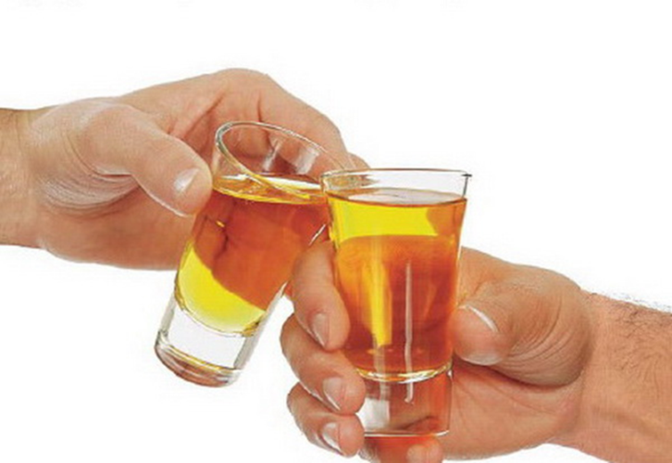
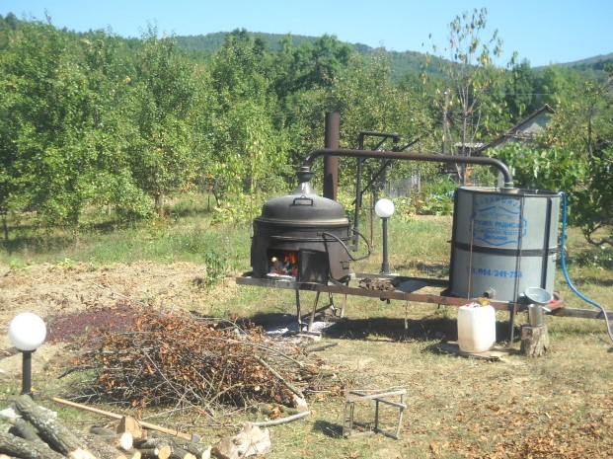
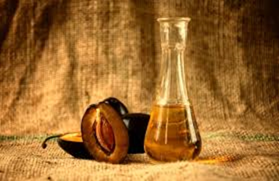
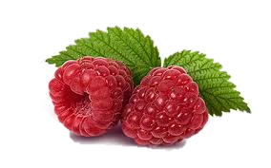
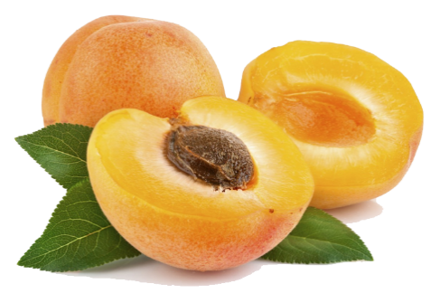
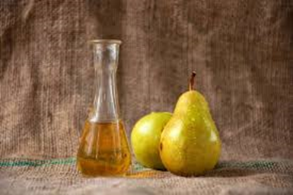
Rakija-fruit brandy
Živeli!
Distillation of fermented fruit
~40% of alcohol

Slide 11
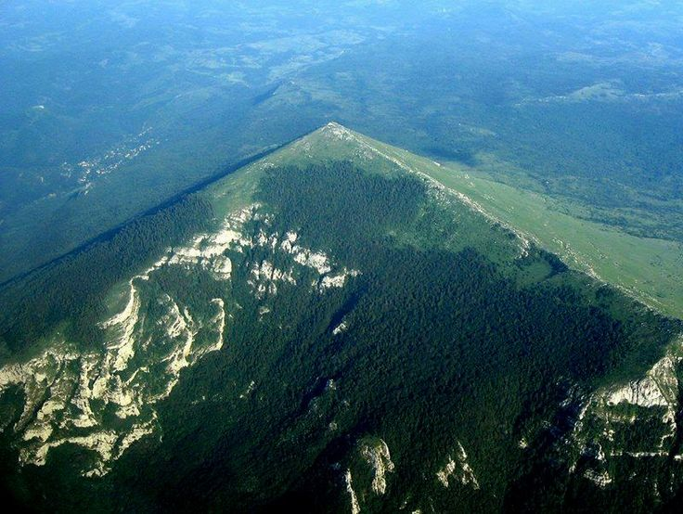
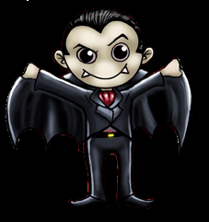
You probably didn’t know…
We have natural pyramid?
The only Serbian word that has been accepted worldwide is VAMPIR
We have the most perfect phonetic
alphabet in world. The only rule is :
„one voice – one letter"

Slide 12
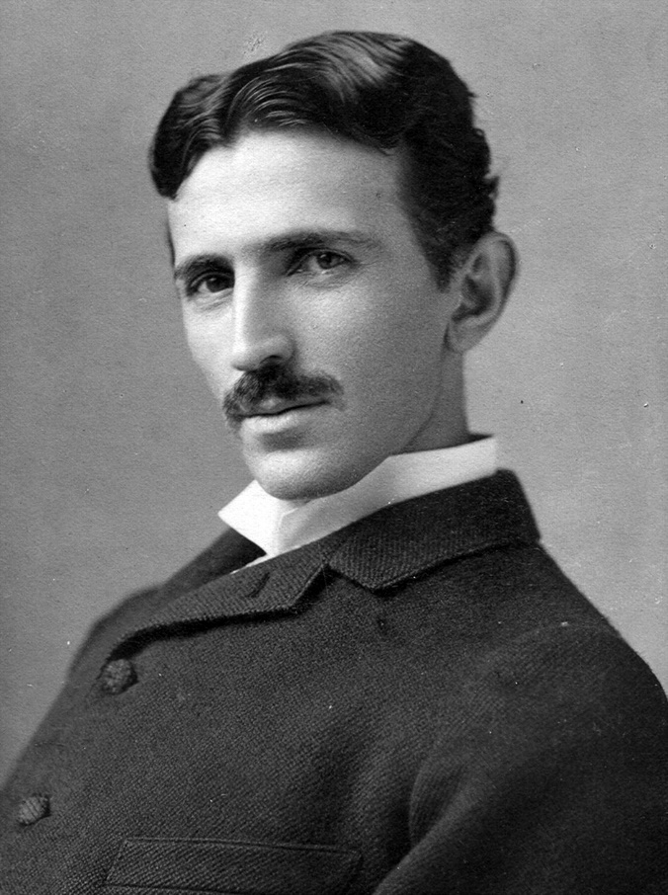
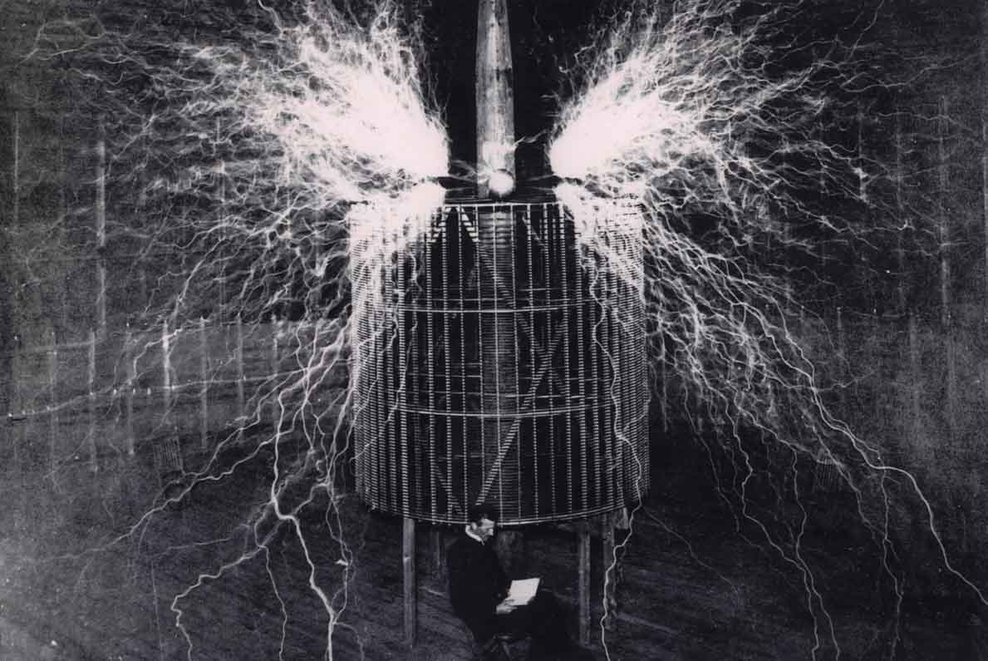
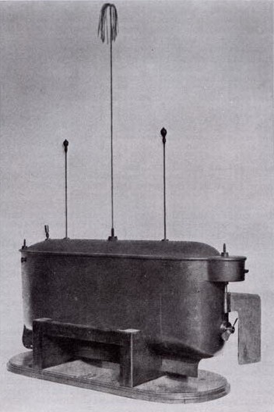
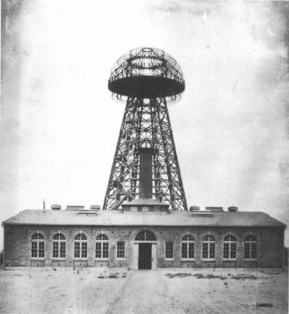
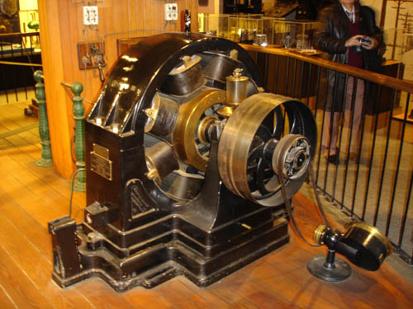
Nikola Tesla

Slide 13
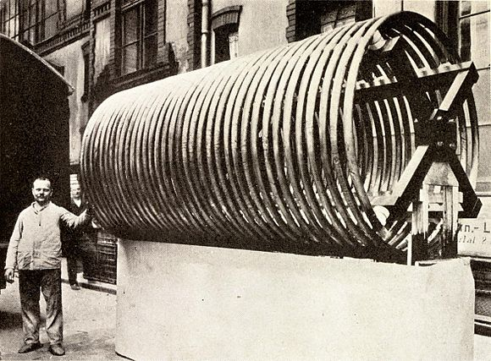
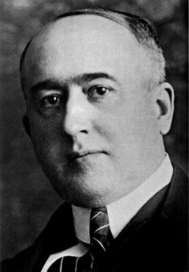
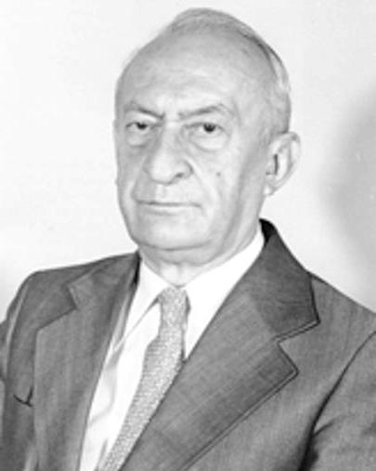
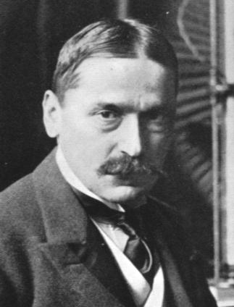
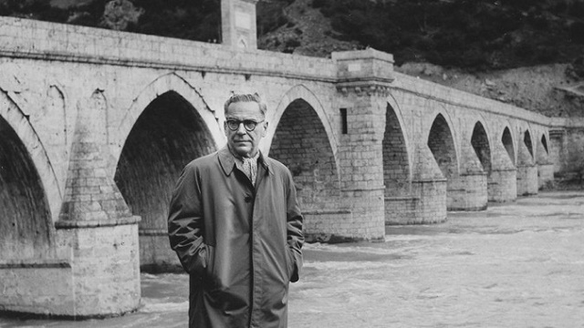
Famous Serbs
Milutin Milankovic
Mihajlo Pupin
Pavle Savić
Ivo Andrić

Slide 14
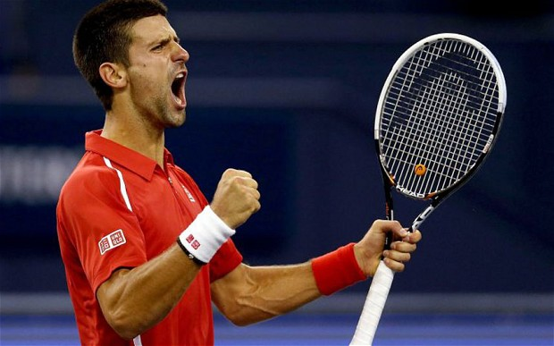
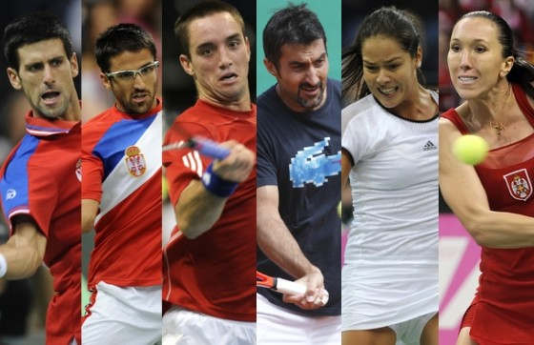
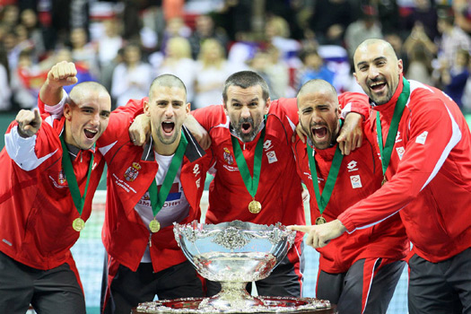
Tennis

Slide 15
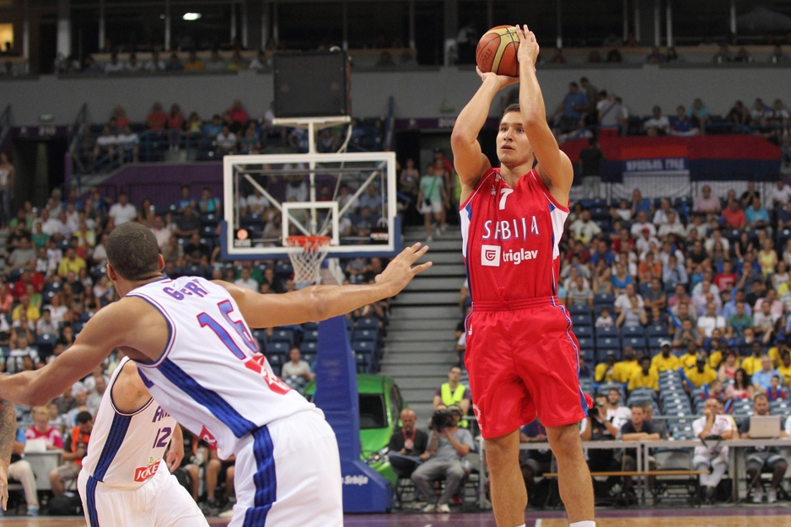
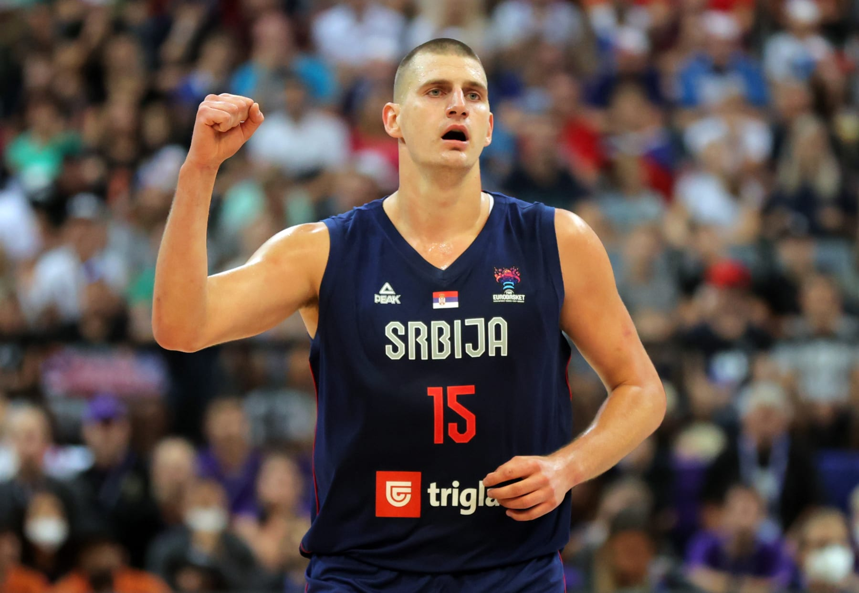
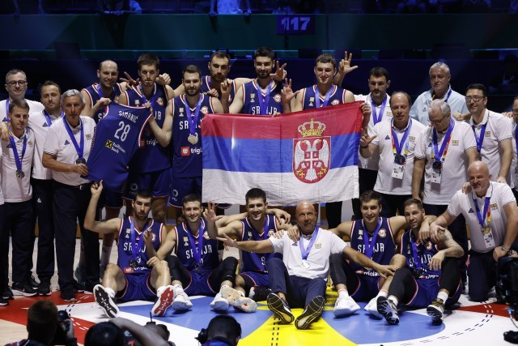
  Basketball

Slide 16
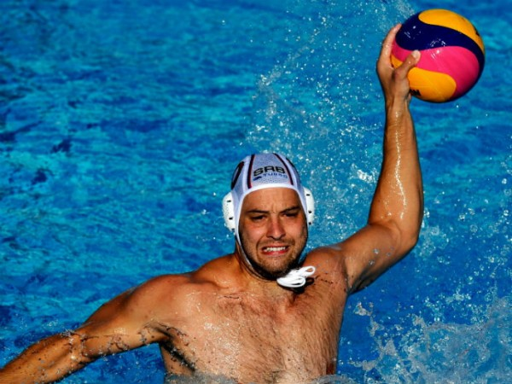
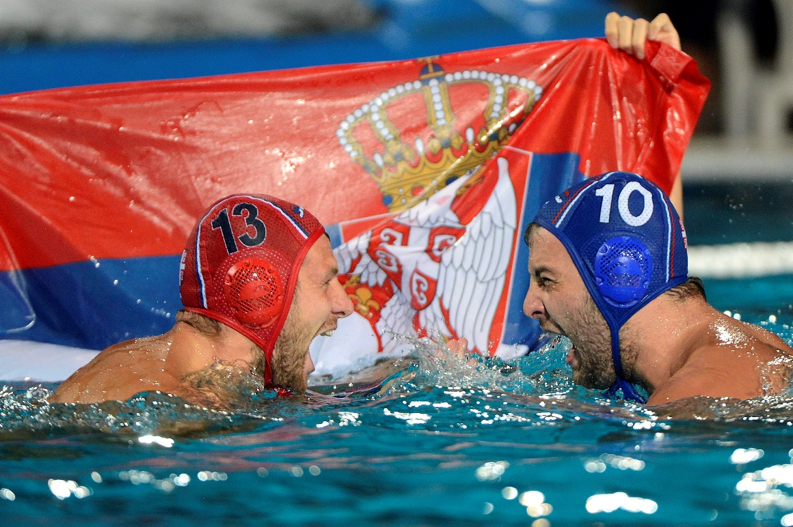
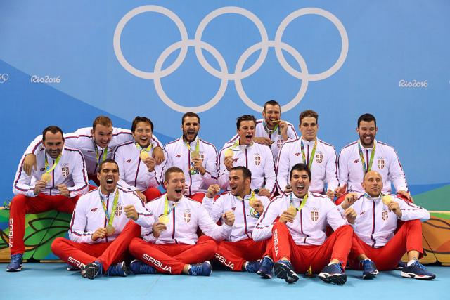
  Waterpolo

Slide 17
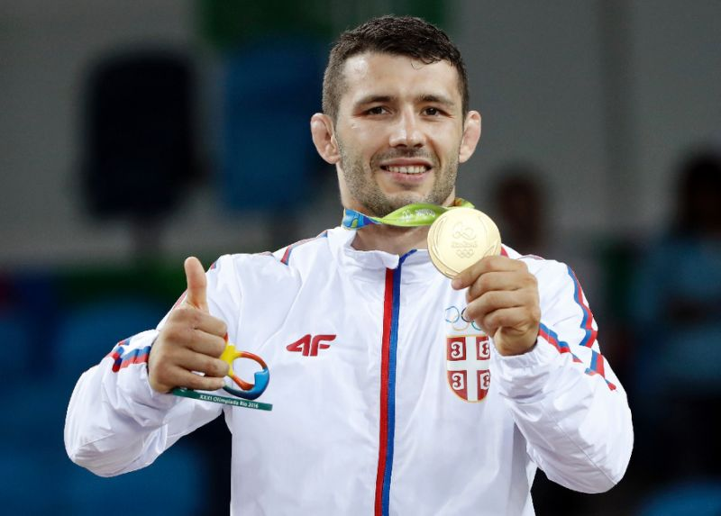
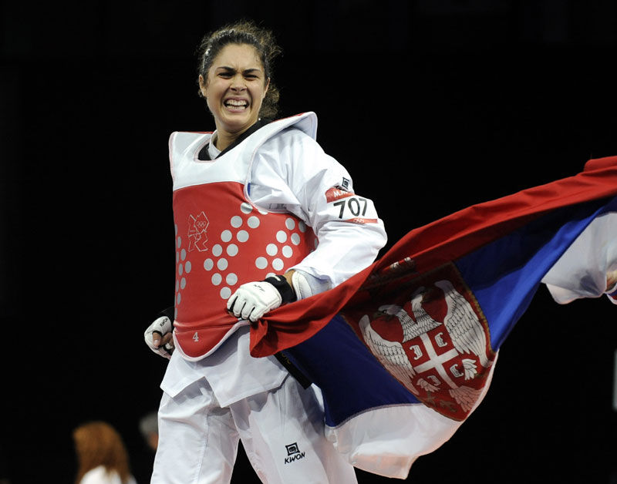
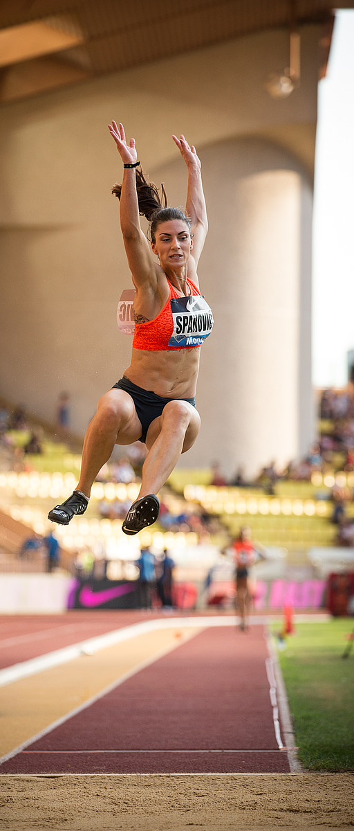


Slide 18


  Education system

Slide 19




  Education system

Slide 20






Slide 21
Master studies
Spectrochemistry
Electrochemistry and Chemical kinetics
Biophysical chemistry
Environmental physical chemistry
Physical chemistry of materials
Radiochemistry

Slide 22

PhD studies

Slide 23




  Vinča Institute of Nuclear Sciences
Founded in 1948.
Shortly after, the institute was dedicated to the realization of the state nuclear research program, which was completed in 1968.

Slide 24


  Vinča Institute of Nuclear Sciences

Slide 25


  Vinča Institute of Nuclear Sciences
https://www.vinca.rs

Slide 26




  Vinča Institute of Nuclear Sciences

Slide 27

  Vinča Institute of Nuclear Sciences
~ 500 researchers
University of Stanford announced list of the most cited researchers in last year – 7 from Vinča Institute of Nuclear Sciences

Slide 28


Slide 29
Thank you for your attention!

