Slide 1
Q&A: Science and Education in India
Presented by Rishav Pandey,
Larsen and Toubro Limited,
Faridabad, India

Slide 2
My Institute: Jabalpur Engineering College

Slide 3
Jabalpur Engineering College (JEC) is an institute located in Jabalpur, Madhya Pradesh, India. It is the oldest technical institution in central India and the 15th-oldest in India. It is the first institute of India to have started the Electronics & Telecommunication engineering education in the country, and also the last educational institution to be set up by the British in India.
Departments:
Artificial Intelligence & Data Science
Mechatronics Engineering
Civil Engineering
Electrical Engineering
Mechanical Engineering
Electronics & Telecommunications
Department of Applied Chemistry
Department of Applied Mathematics
Computer Science & Engineering
Information Technology
Industrial & Production Engineering
Department of Humanities
Department of Applied Physics

Slide 4
Ongoing Projects:
CORE (Centre of Relevance & Excellence) by TIFAC (Department of Science & Technology, Govt. of India)
CIIILP (Canada-India Institute Industry Linkage Project)
Indo-Italian Research project
DSP Lab, Texas Instruments
Sun Microsystems Training Centre
Cisco Regional Academy of Networking Programme
Centre for National & Academic Networking for Continuing Education with AICTE
Renewable Energy Park – Govt. of India
Centre of Fuzzy Logic System by Govt. of India
Microzonation of selected cities of India by Geological Survey of India

Slide 5
STA (State Technical Agency) and Remote Sensing Centre of Prime Minister's Rural Road Project – Govt. of India
Research Project of Robotics & Manufacturing, Ministry of Science & Technology
Software Technology Park of India, 2 MBPS HSDC Node, Ministry of Information Technology
Fuller Energy Awards (State level) Selection
M.P. Chamber consultancy clinic of Katni with MPCON
Mini Tool Room, Ministry of Commerce & Industries, Government of India
ERNET- AICTE Facility for Distance Learning & Digital Library
Remote Sensing Resource Centre, Indian Space Research Organisation (ISRO)
MOUs signed with national & international organisations e.g. Infosys, Wipro, TCS, IBM, Cisco etc., for promoting training of students.

Slide 6
Research and Development in India
Indian Space Research Organisation (ISRO)
Council of Scientific and Industrial Research (CSIR)
Defence Research and Development Organization (DRDO)
Indian Council of Medical Research (ICMR)
Bhabha Atomic Research Centre (BARC)
Indian Council of Agricultural Research (ICAR)
Tata Institute of Fundamental Research (TIFR)
National Innovation Foundation (NIF)
National Research Development Corporation (NRDC)
National Institute of Biomedical Genomics (NIBMG)

Slide 7
Research Institutes
1) Indian Institute of Science - Bengaluru - Karnataka
2) Indian Institute of Technology Madras - Chennai - Tamil Nadu
3) Indian Institute of Technology Delhi - New Delhi - Delhi
4) Indian Institute of Technology Bombay - Mumbai - Maharashtra
5) Indian Institute of Technology Kharagpur - Kharagpur - West Bengal
6) Indian Institute of Technology Kanpur - Kanpur - Uttar Pradesh
7) Indian Institute of Technology Roorkee - Roorkee - Uttarakhand
8) All India Institute of Medical Sciences, Delhi - New Delhi - Delhi
9) Indian Institute of Technology Guwahati - Guwahati - Assam
10) Tata Institute of Fundamental Research - Mumbai - Maharashtra

Slide 8
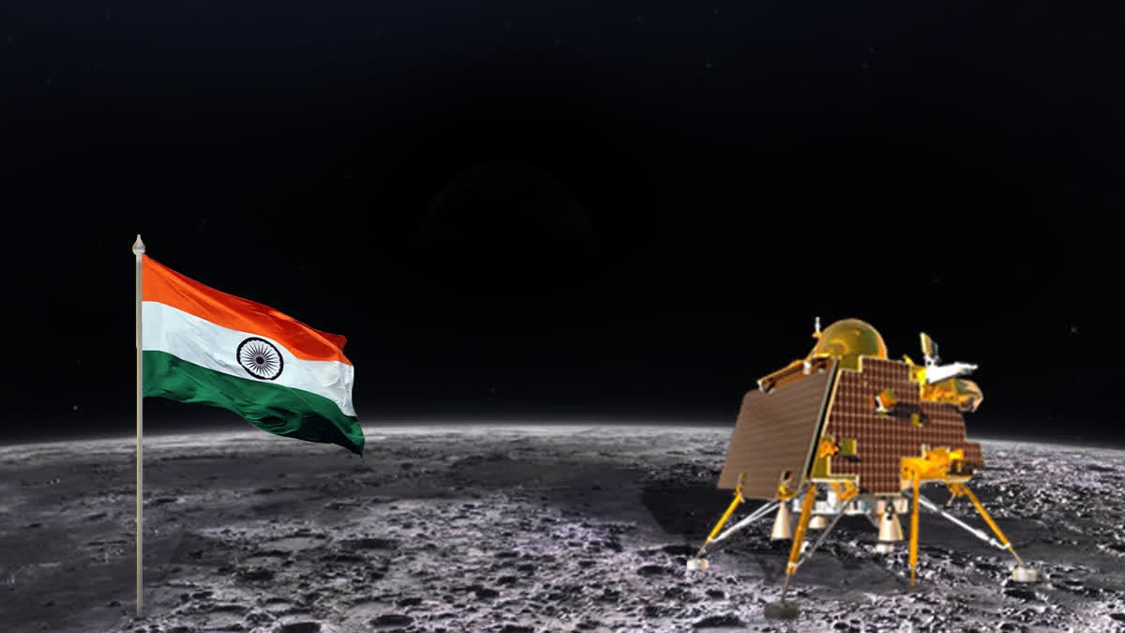
India On The Moon

Slide 10
Beautiful places to visit in India

Slide 11
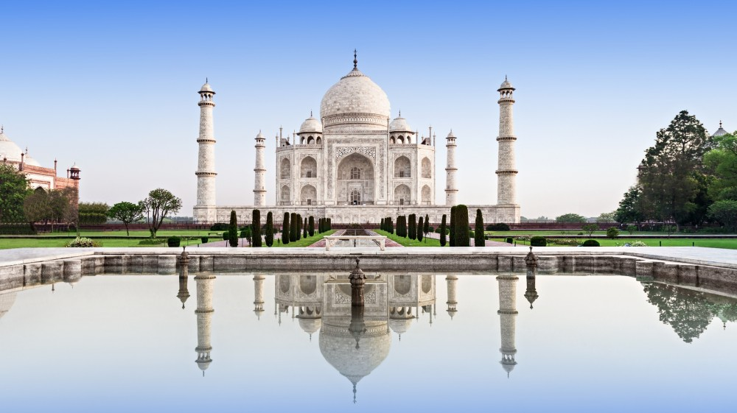
Agra

Slide 12
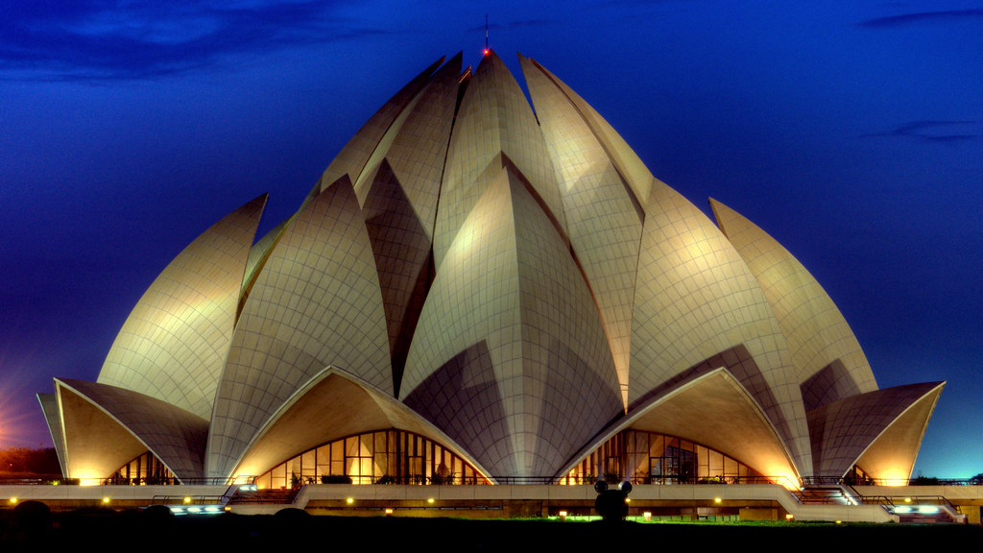
Delhi

Slide 13
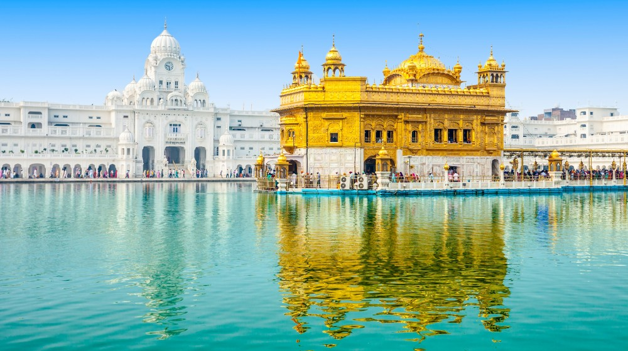
Golden Temple Amritsar

Slide 14
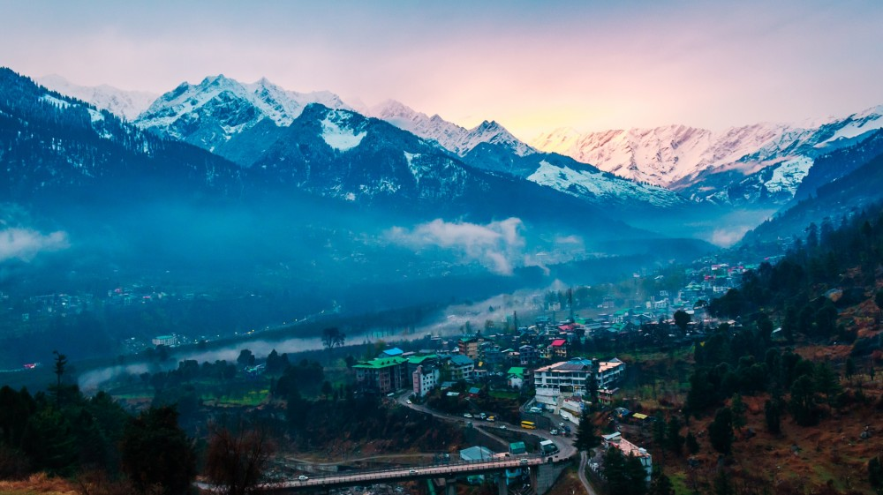
Manali

Slide 15
Kashmir

Slide 16
Varanasi

Slide 17
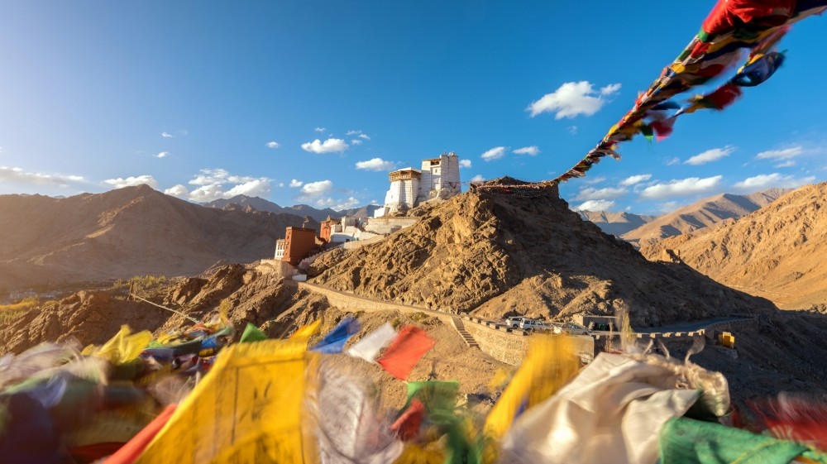
Leh

Slide 18
Meghalaya

Slide 19
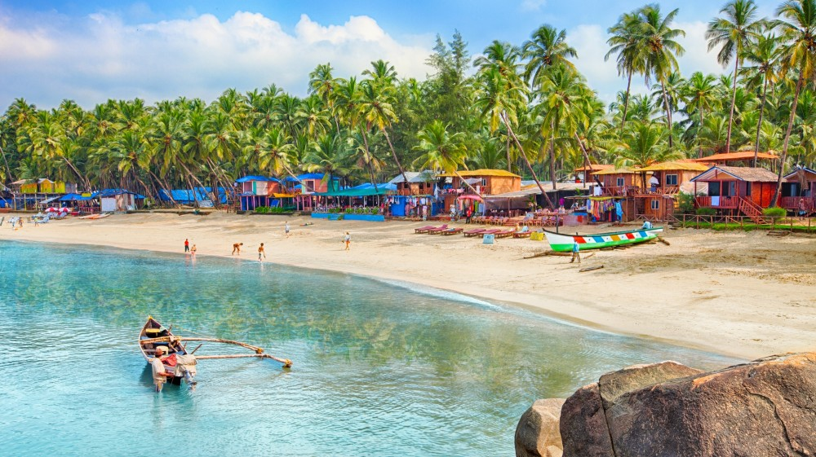
Goa

Slide 20
Alleppey

Slide 21
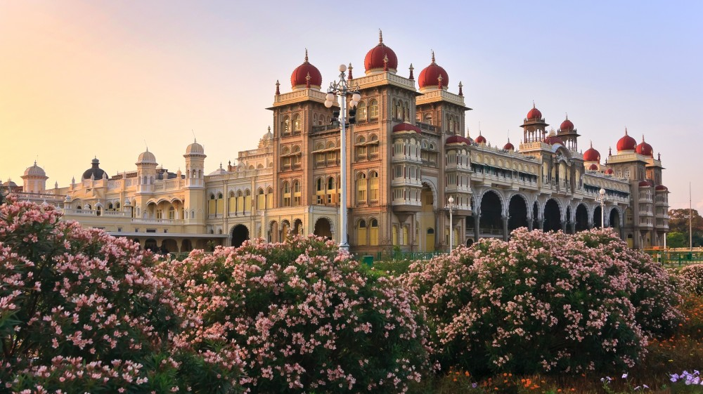
Mysore

Slide 22
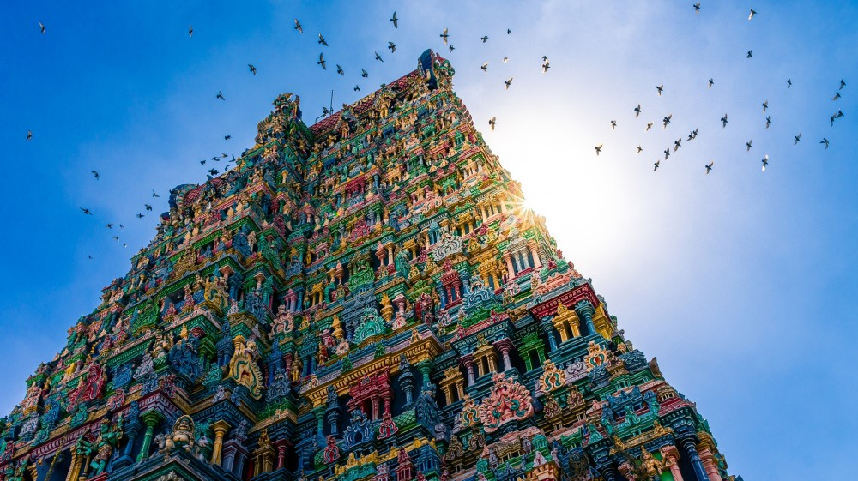
Meenakshi Temple, Madurai

Slide 23
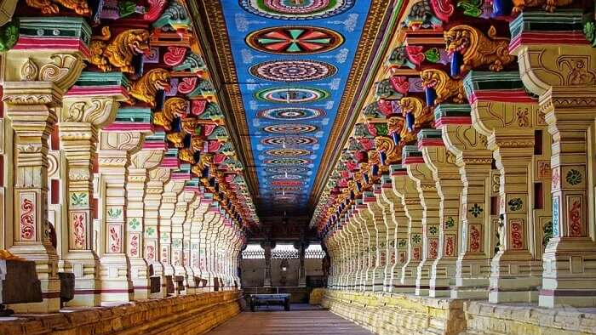
Rameshwaram

Slide 25
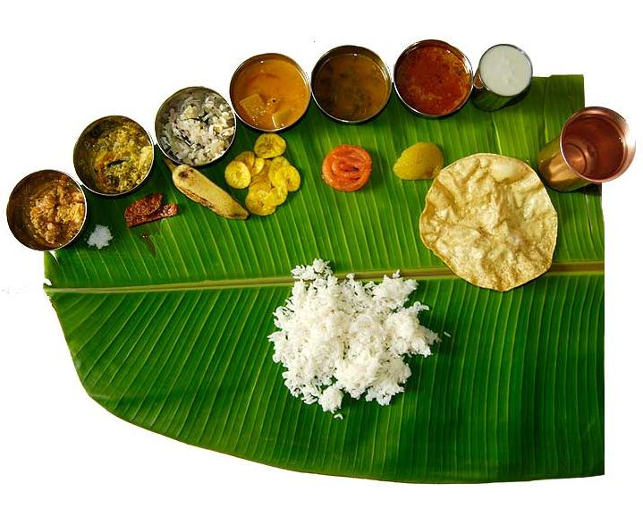

Slide 26
Vasudhaiva Kutumbakam
- The world is one family

