Slide 1





Status of Yoke production
N.Topilin
The first collaboration meeting
of the MPD and BM@N experiments at the NICA Facility
April 11-13, 2018, JINR, Dubna

Slide 2
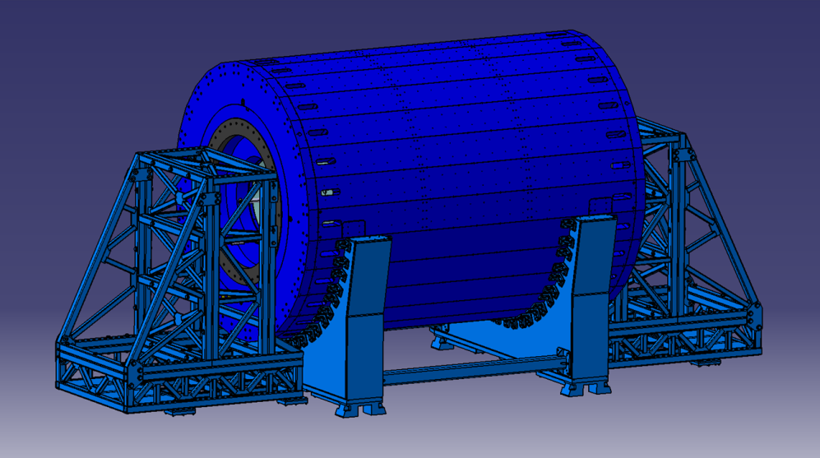
MPD Yoke (L=8970 mm, Ø6625 mm)
28 plates
16 t each
2 support rings
43.7 t each
2 poles
47 t each
Total: 630 t
Material:
Steel 10 (AISI 1010)
forging
Cradle (Yoke support) – 74 tons, ordinary steel St.3 (Fe 360)
2 Pole transport supports – 15 tons each

Slide 3
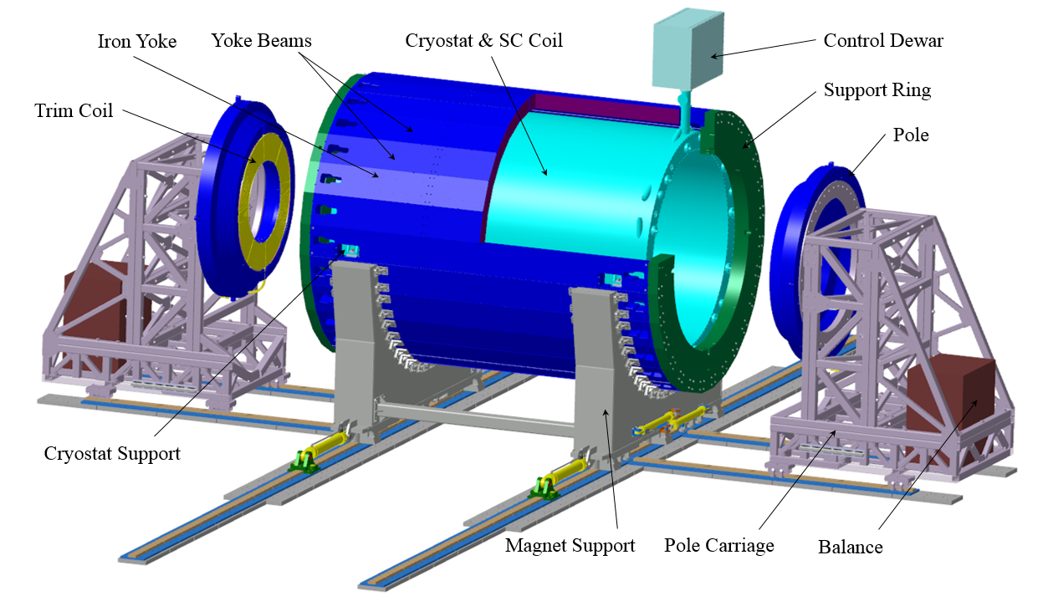
JINR-VHM (Ostrava, Czech Republic)
Contract (Dec. 2015)

Slide 4
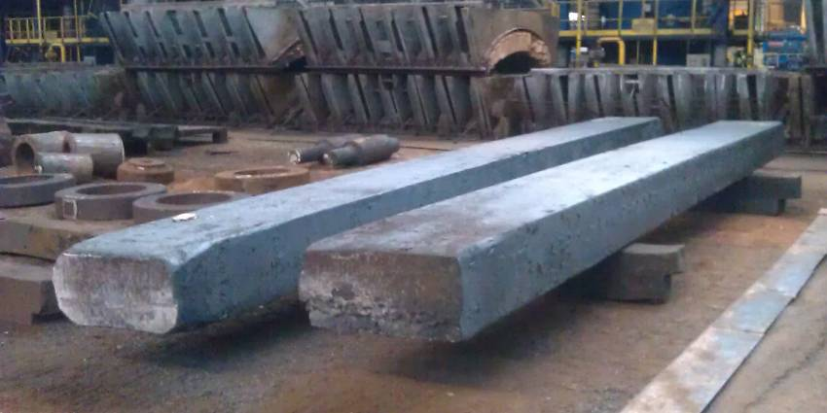
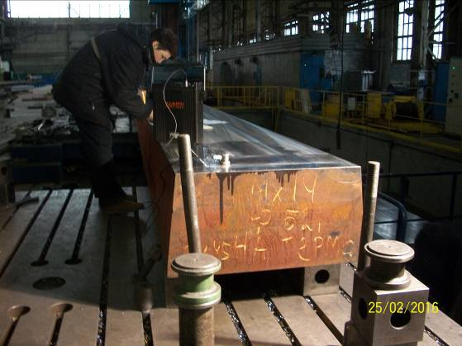
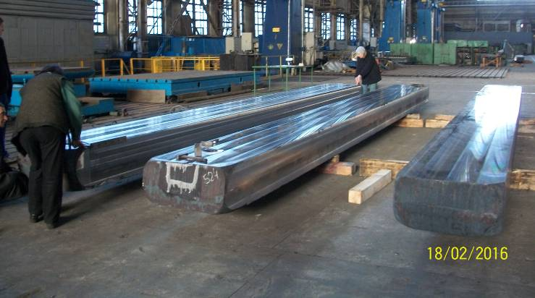
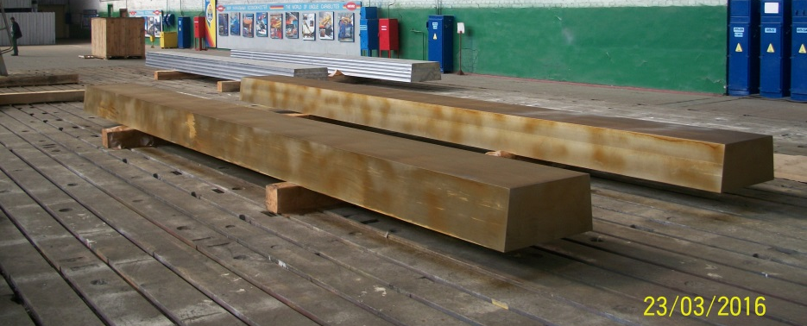
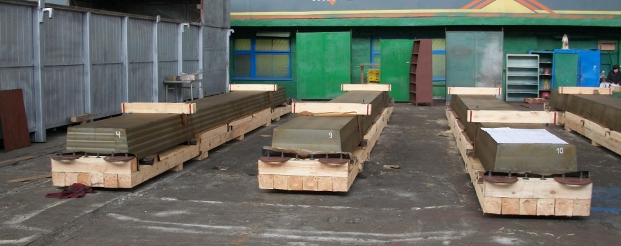
Plates production on NKMZ (Kramatorsk, Ukraine)
Mechanical properties:
Sigma 0.2 = 225 - 354 N/mm²
Average = 241 N/mm²
Technical Order = 210 N/mm²
Carbon C
GOST on steel 10 0.07 - 0.14 %
Technical Order 0.08 - 0.10 %
Forging (really) 0.08 - 0.10 %
All other elements are inside tolerances
Ultrasonic control: good

Slide 5
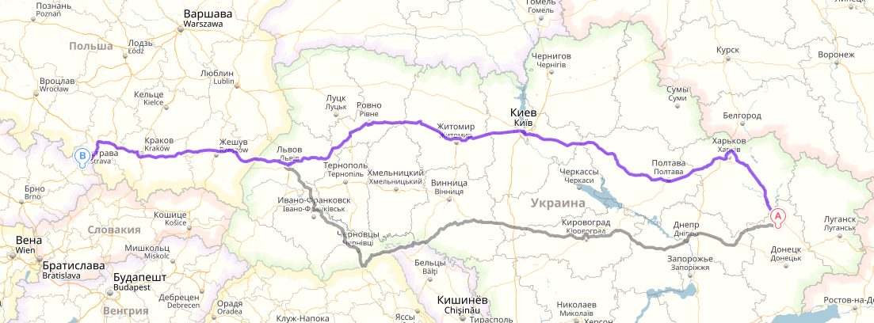
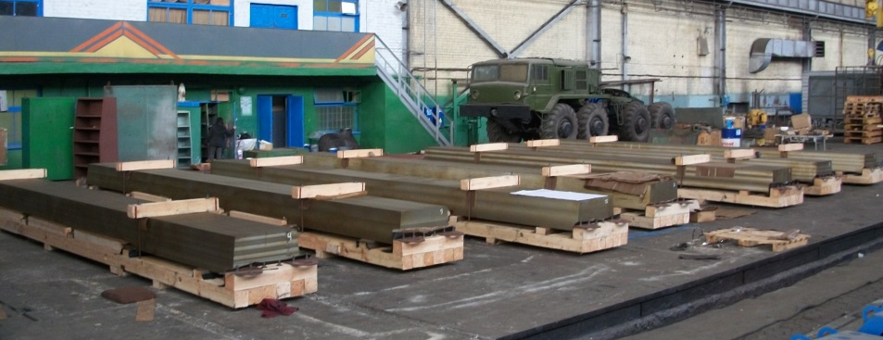
Forging transportation from NKMZ (Kramatorsk, Ukraine) to VHM (Vitkovice, Czech Republic) -1700 km, 29 trucks

Slide 6
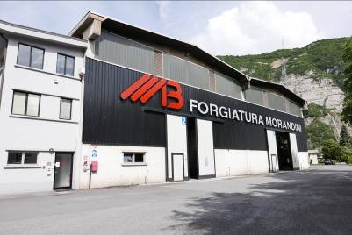
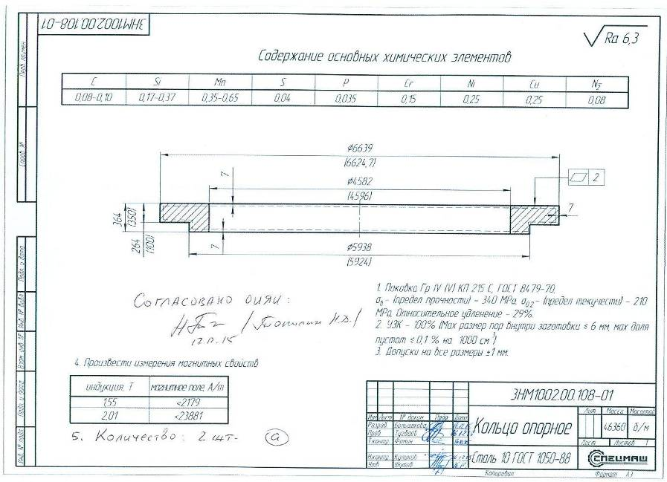
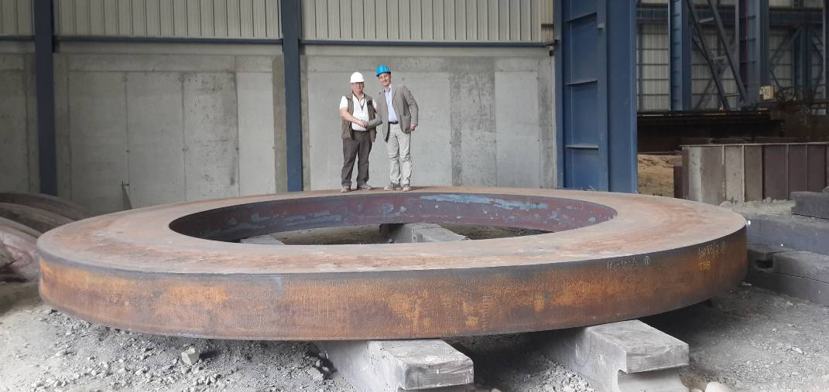
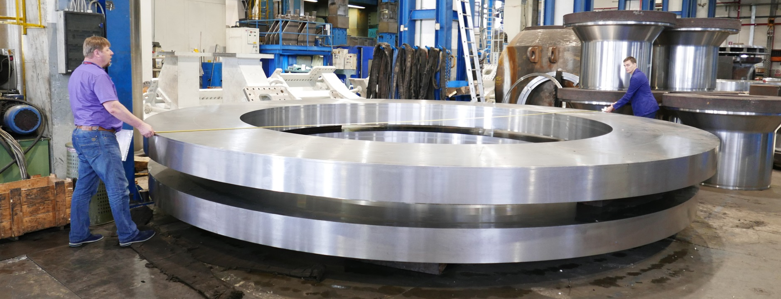
Support rings (Forgiatura Morandini)
4 May 2016
14 June 2016

Slide 7
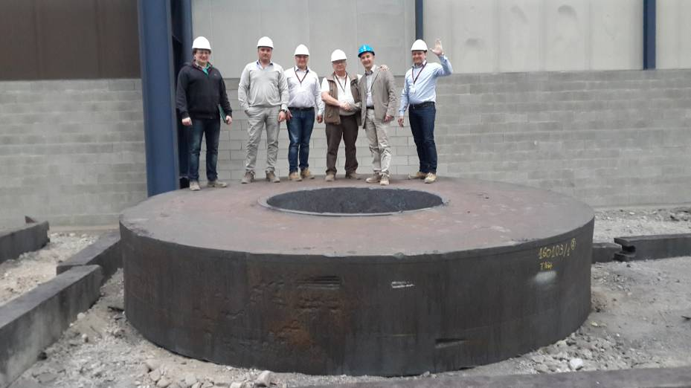
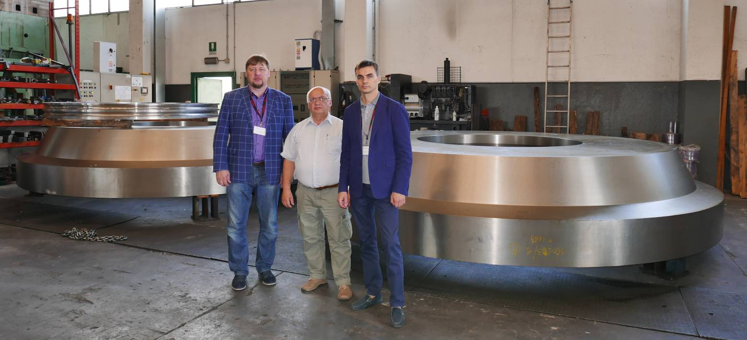
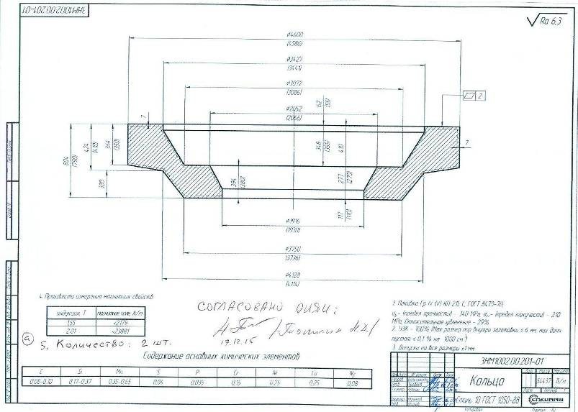
Poles
Carbon C
GOST on steel 10 0.07 - 0.14 %
Technical Order 0.08 - 0.10 %
Forging (really) 0.08 - 0.09 %
All other elements are inside tolerances
4 May 2016
Mechanical properties:
Sigma 0.2 = 231-292 N/mm²
Average = 255 N/mm²
Technical Order = 210 N/mm²
Ultrasonic control: good
14 June 2016

Slide 8
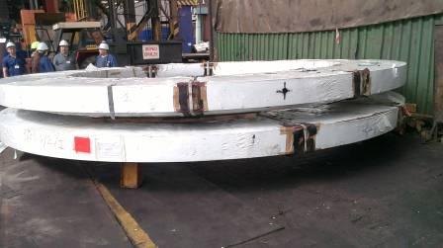
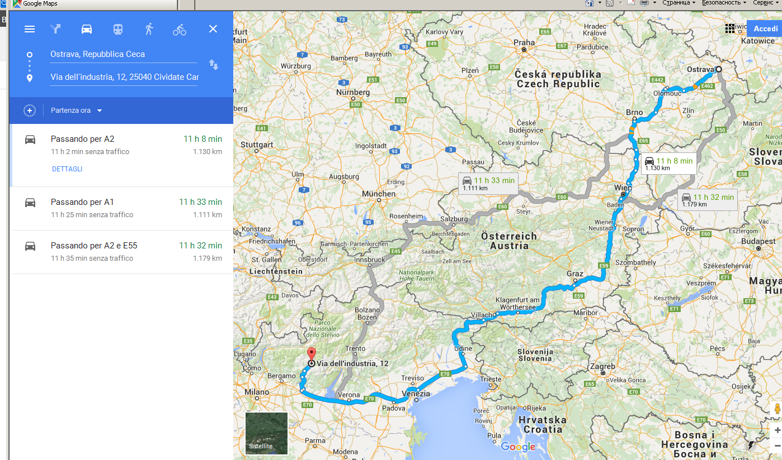
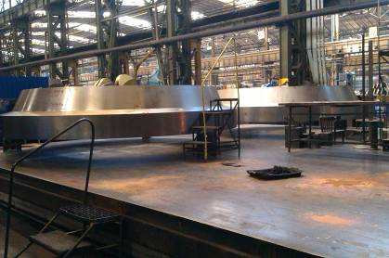
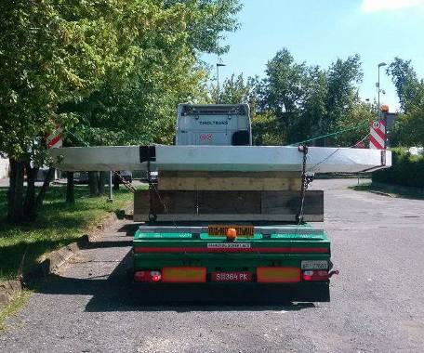
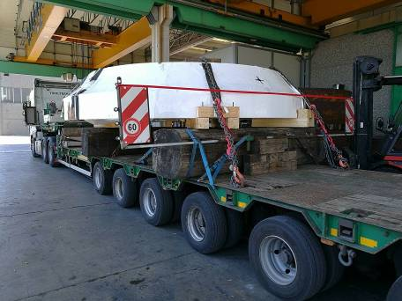
Forging transportation from Italy to VHM (Vitkovice, Czech Republic)
1130 km

Slide 9
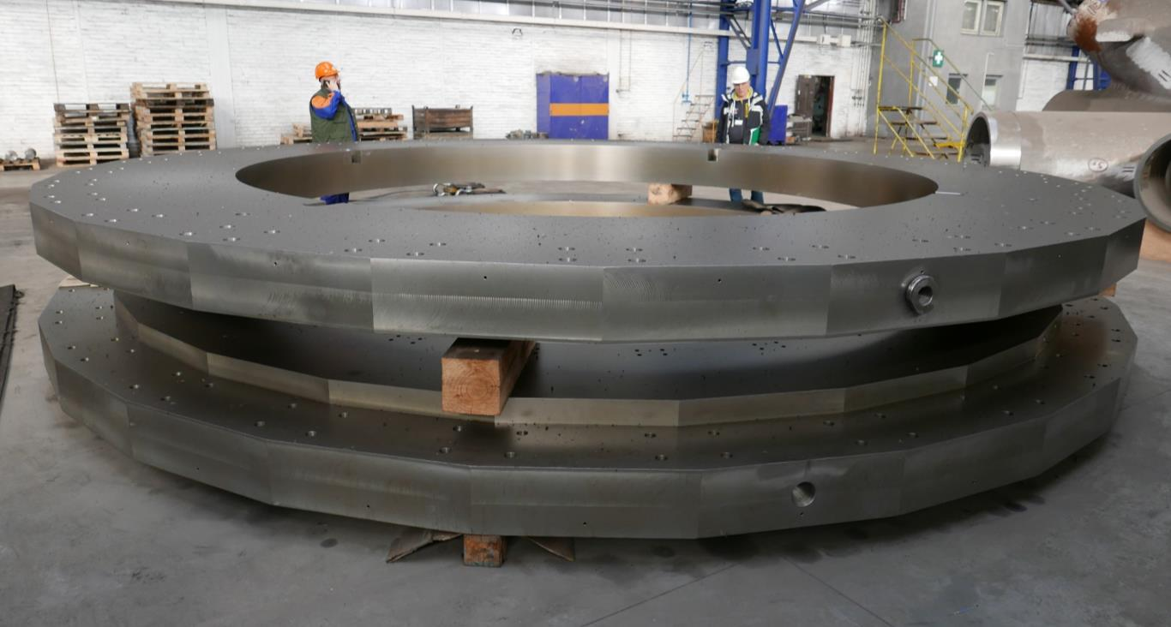
Support rings: Ø 6.63 m, 43.7 tons each need to have holes machining, sandblasting, painting
Vitkovice Heavy Machinery, Ostrava

Slide 10
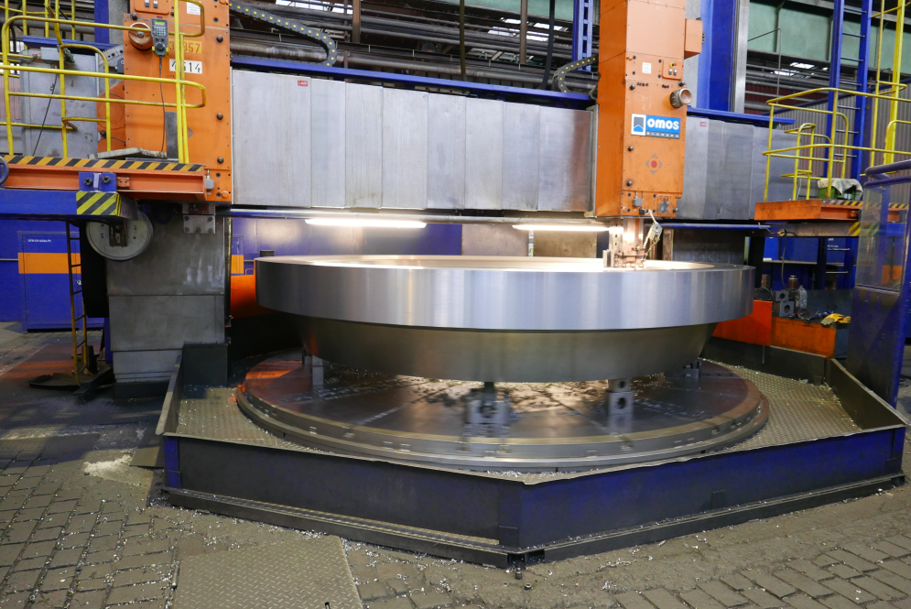
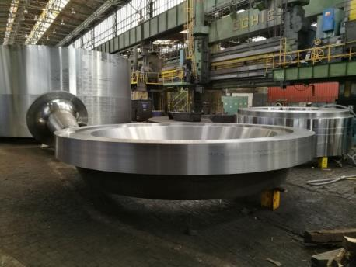
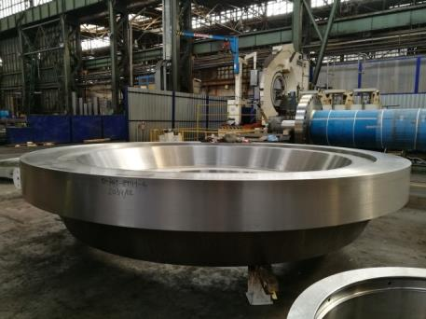
2 Poles: Ø 4.5 m, 47 tons each
28, February 2018

Slide 11
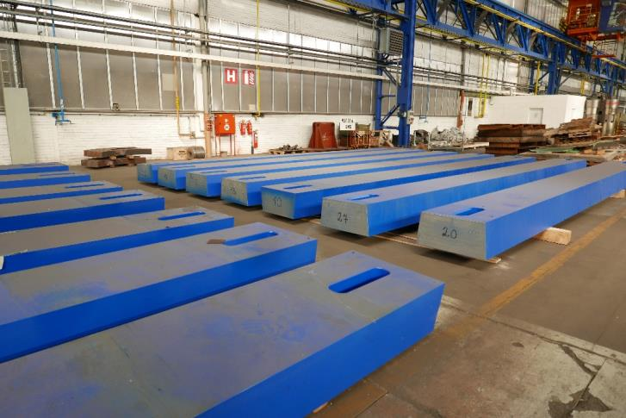
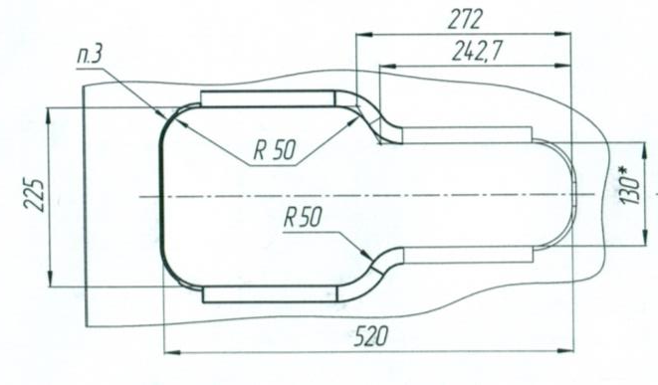
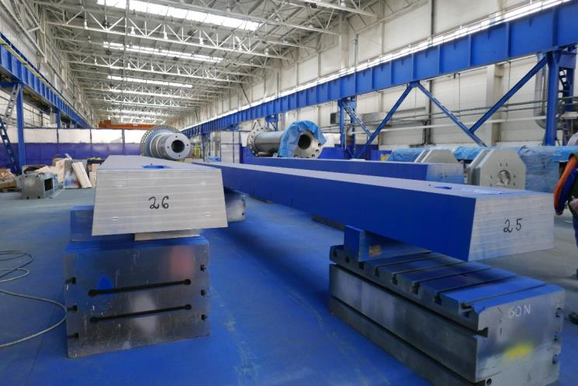
Yoke plates: 0.35x0.74x8.47, m3; 16 tons each
25 from 28 are ready
13 bottom plates have nominal length 8470 mm
All top one have length on 9 mm shorter
Length tolerances: 0…-0.1 mm for all the plates
We plan the slots machining

Slide 12
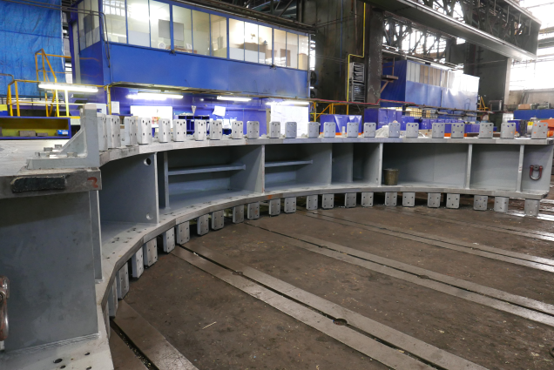
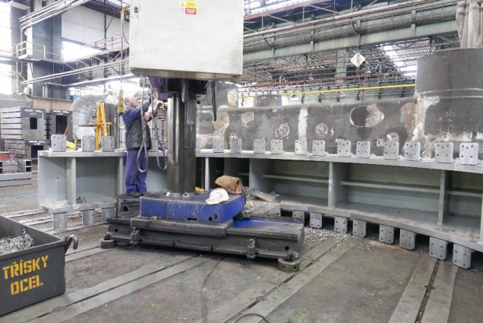
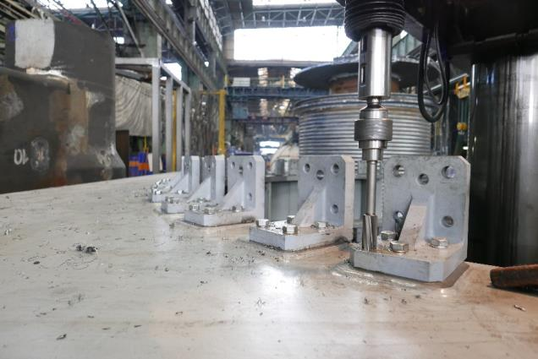
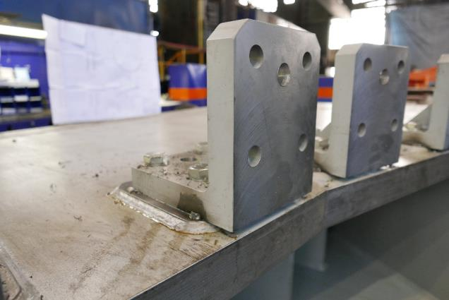
Cradles 2 main parts are in progress: 1.47x4.15x7.68, m; 34 tons in total
VHM inserts pins and weld brackets

Slide 13
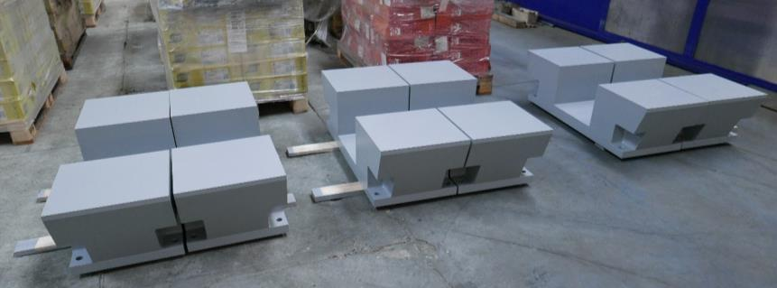
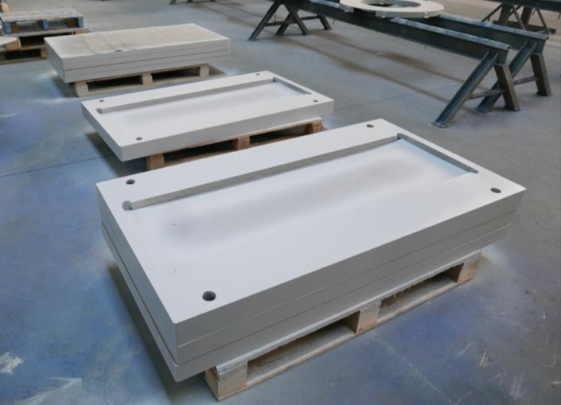
Cradle bottom parts
6 cradle support
Spacer plates between bottom surface
of cradle and Roller Skates

Slide 14
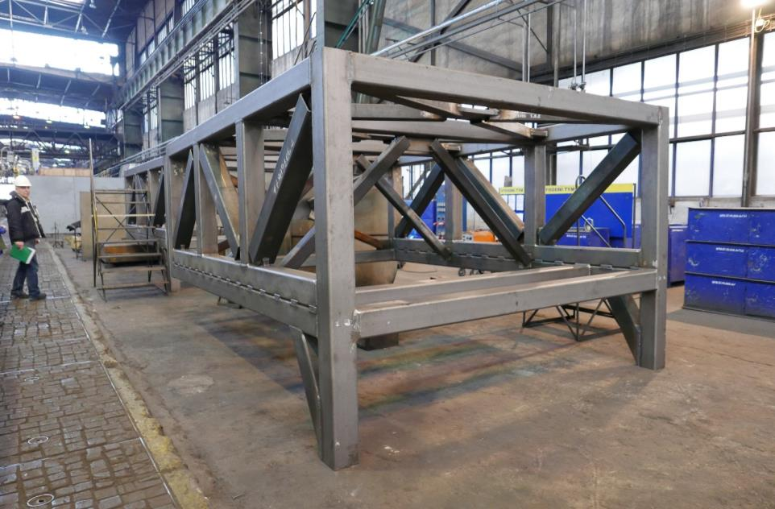
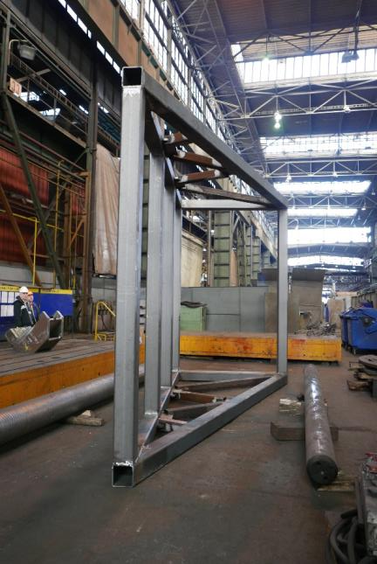
Poles transport supports
Front stand
Back stand

Slide 15
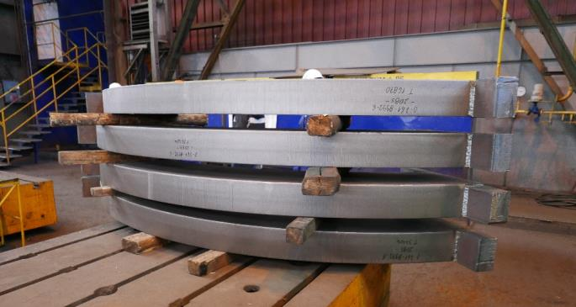
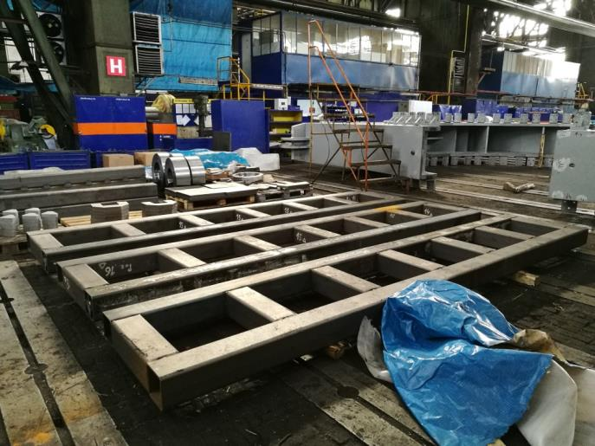
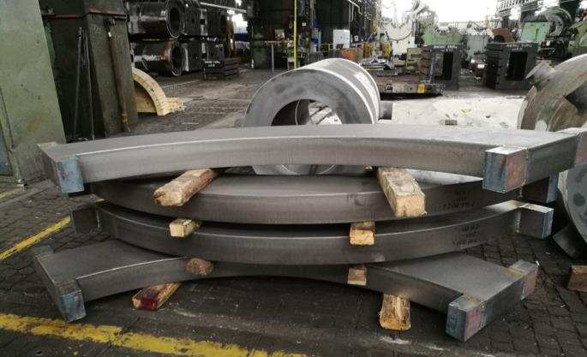
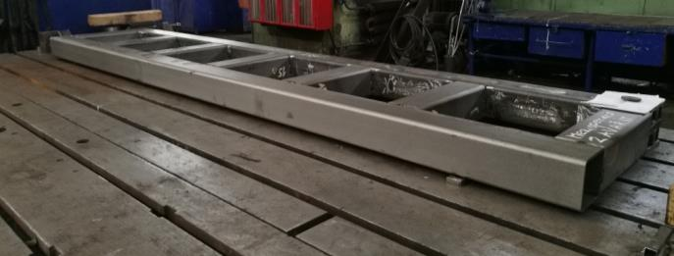
Poles transport supports
Rings billets
Bottom base parts

Slide 16
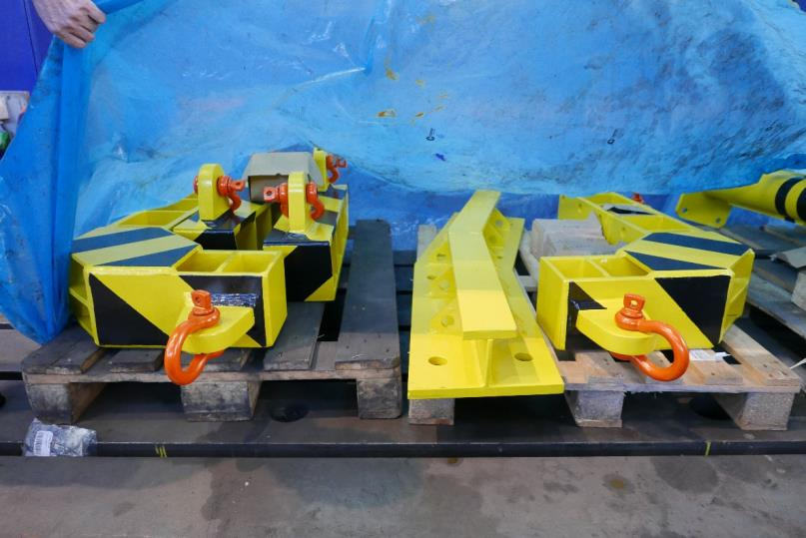
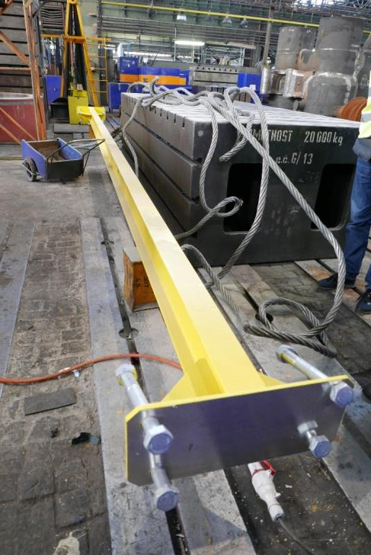
Technological tool
Lifting beams
Base plate for face surface
Top beam

Slide 17
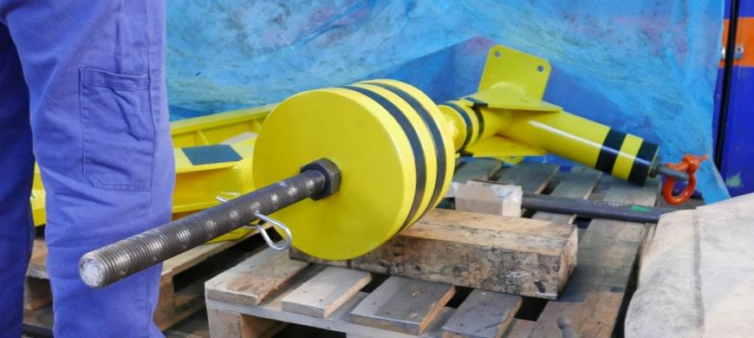
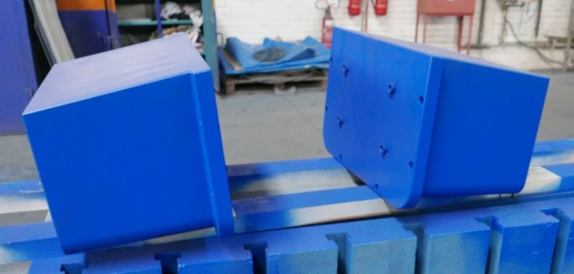
Technological tool
Lifting beam for plugs inserting-removing in vertical plates
Plugs

Slide 18
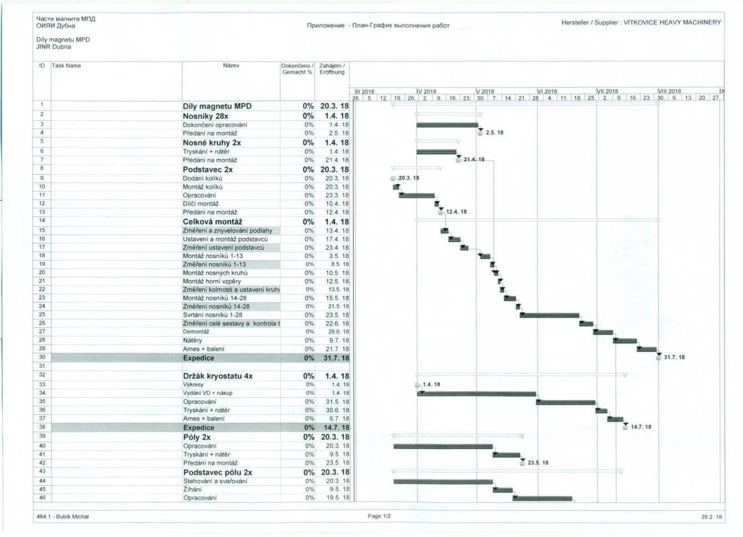
Plan of work at VHM
Restart to work – 20 March 2018
Floor measurement – 13 April
Cradle installation – 17 April
Support rings
installation – 10-13 May
Cradle measurement – 23 April
13 plates installation – 03-08 May
13 plates measurement – 08 May
Yoke test 22 June
14-28 plates installation – 15-21 May
1-28 plates measurement – 21 May
700 Pins installation – 23 May- 22 June

Slide 19
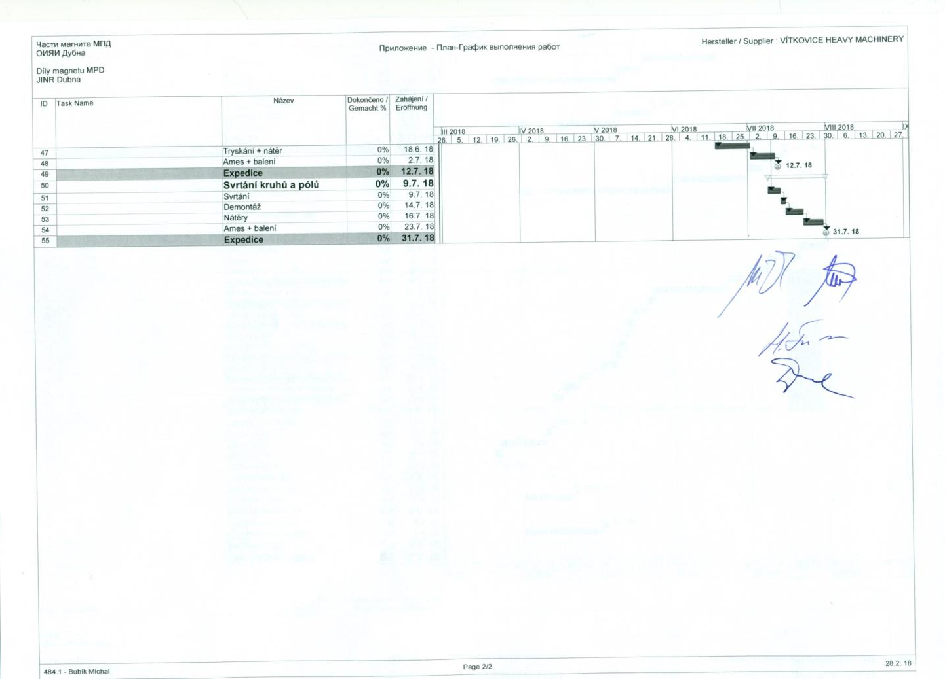
Work finish – 31 July
Transport by “AET Trans” – S-Petersburg in the period August - September

Slide 20
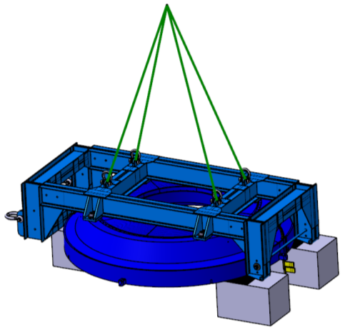
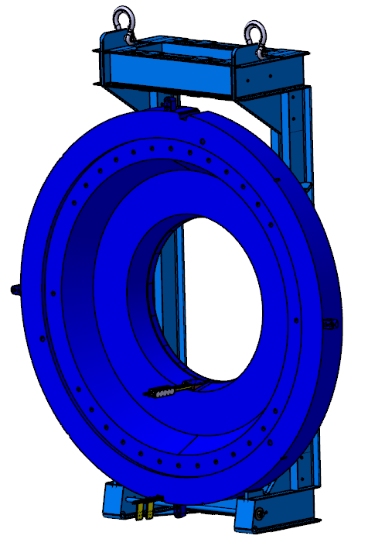
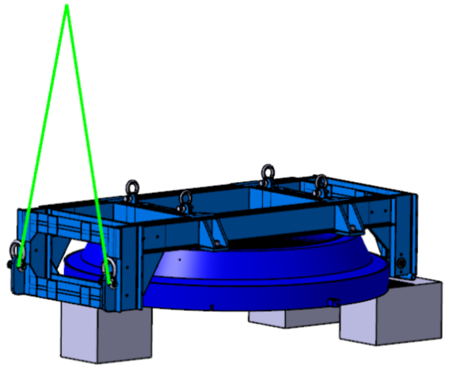
Pole turn-over device (by Sergei Gerasimov)
Appendix 1
Trim coil installation
Frame fixing
Squeezing
(pressing) bolt
Full contact
between pole and
Frame
Bolts have
tension stresses only

Slide 21
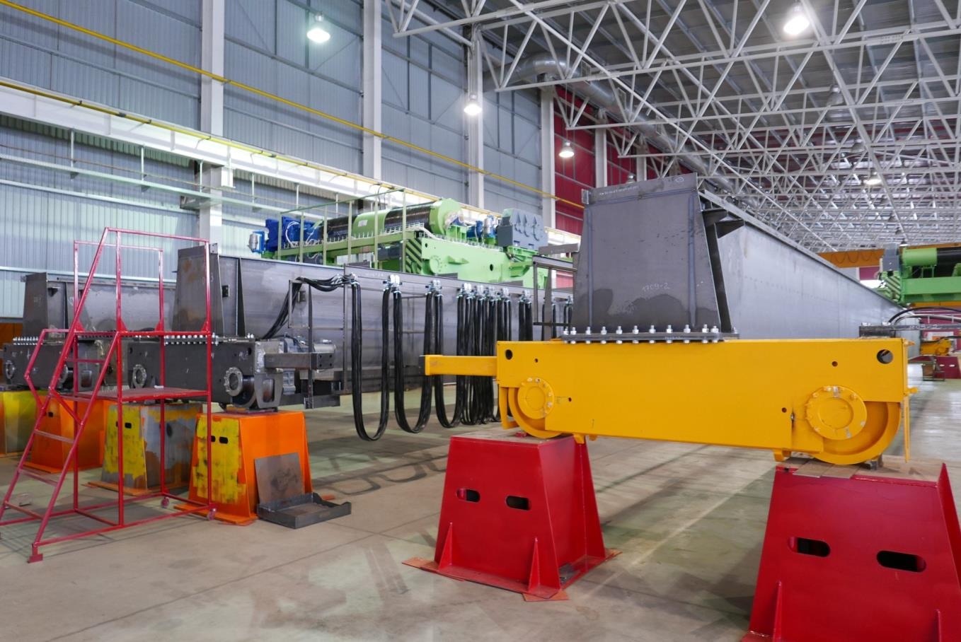
Two 80/20 tons Cranes by “URALKRAN” are ready
Appendix 2

Slide 22







Yoke assembly
1 – Control assembly at VHM - May 2018 and test of ridging at VHM – June 2018
2 – Final assembly at Dubna – 2018 - 2019
Appendix 3
E. Belyaeva (DD LHEP)
Δ estimation, mm |  |  | Test result
Neva-Magnet | Progresstekh- Dubna | LHEP DD | VHM
5,6 | 4,5 | 0,1

Slide 23

MPD Hall layout
Appendix 4

Slide 24


Thanks for your attention
MPD Trench 10 April 2018

Slide 25
cosmonautics day and international day of human space flight

