Slide 1
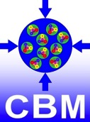




The Silicon Tracking Systems for CBM/FAIR and BM@N/Nuclotron
The first collaboration meeting of the MPD and BM@N experiments at the NICA Facility

Slide 2
Outline of the presentation
Introduction
Silicon Tracking System Detectors
Detector components
System integration
Towards BM@N STS

Slide 3
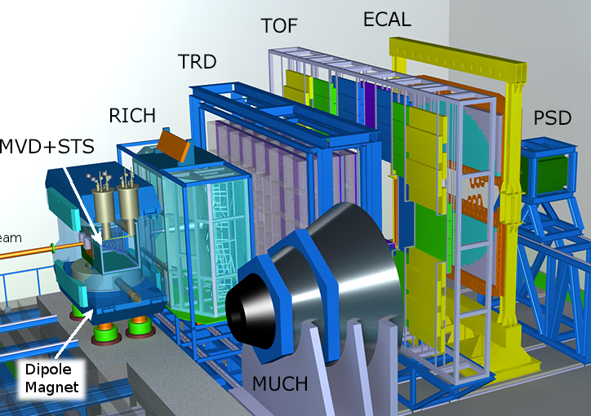
Compressed Baryonic Matter (CBM) experiment
10 MHz interaction rate allows differential measurements of rare and exotic probes at high statistics
Beams of heavy ions with energies up to 11 A GeV (Au, SIS100)
Nuclear matter densities of up to 8 ρ₀ can be reached similar to those found in NS mergers
Triggerless read-out
Complex signatures require software triggers
The CBM experimental setup with detector systems
CBM
Silicon Tracking System

Slide 4
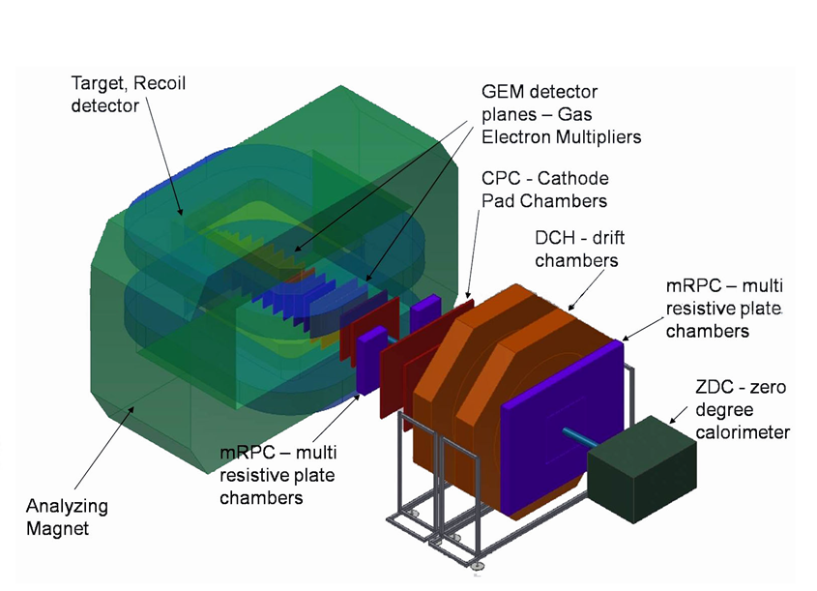
Baryonic Matter at Nuclotron (BM@N) experiment
~5 kHz interaction rate
- up to 50 kHz (> 2021)
Beams of light and later (with booster) heavy ions with energies in range 2 to 6 A GeV
p+p and p+A reactions studied for the reference
6 layers of GEM & 3 layers of Si ⇒ later upgraded to 7 GEM / 4 Si
Triggered read-out
The BM@N experimental setup with detector systems
BM@N
Silicon Tracking System

Slide 5
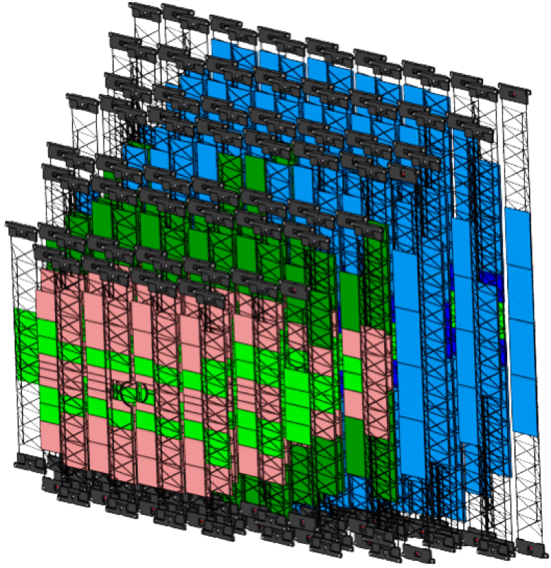
Silicon Tracking Systems
Key detectors to reconstruct charged particle tracks and resolve their momentum with Δp/p ≈ 1-2%
8 (CBM)/4 (BM@N) tracking stations comprising ~900 (CBM)/~300 (BM@N) silicon microstrip sensors
Fast electronics produce up to ~40/~20 kW of thermal power in the close vicinity to the sensors
CBM
BM@N
View of the CBM-STS detector without thermal enclosure and services

Slide 6
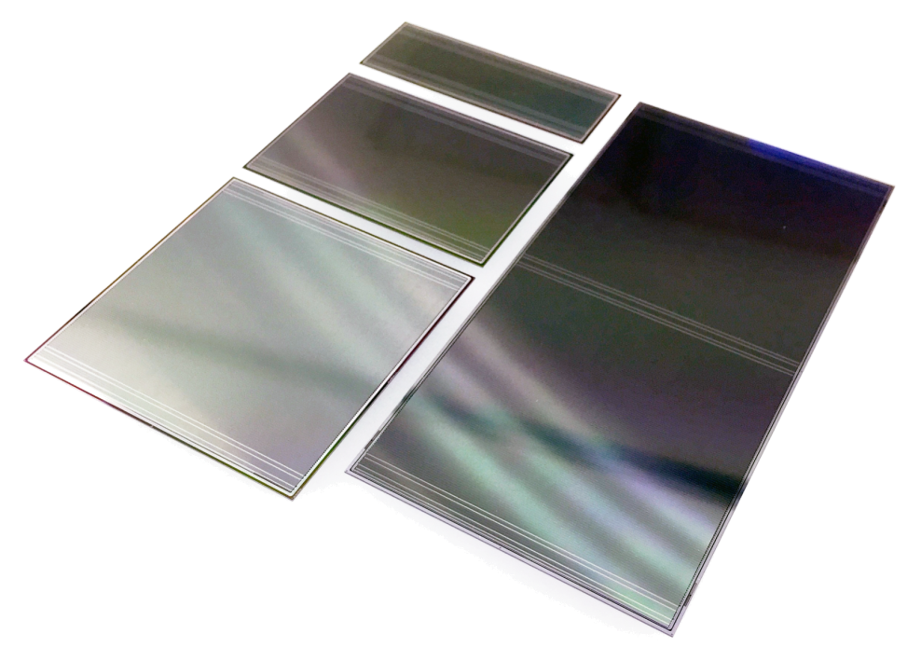
Silicon microstrip sensors
State-of-the-art microstrip sensor technology
Provide spatial hit resolution of about 25 μm
Come in 4 major sizes from 2 manufacturers
BM@N have already procured the sensors, CBM procurement to take place
Various QA procedures are developed both for CBM&BM@N
A photograph of prototype silicon sensors. 4 different sensor sizes are shown.

Slide 7
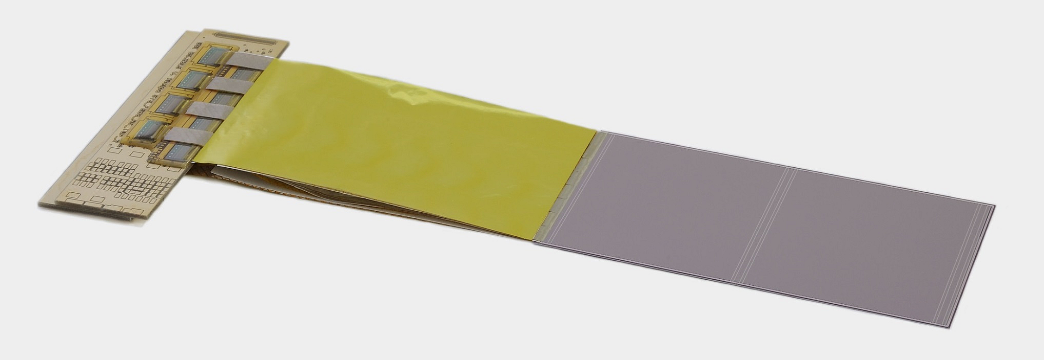
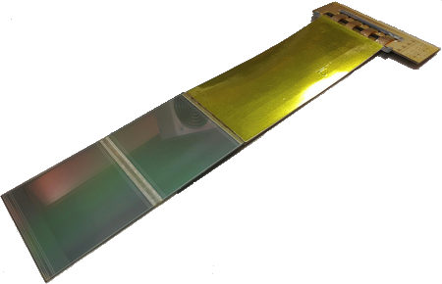
Detector modules
Modules consist of a sensor, a bundle of microcables and ASICs placed on the Front-End-Board
Each sensor side is tab bonded to 8 microcables, which in turn are bonded to 8 STS-XYTER ASICs
Module assembly workflow was developed and established
Pre-final assembly tools were designed and manufactured, have to be finalized
Prototype detector modules assembled in GSI and JINR (daisy-chain, bottom panel)

Slide 8
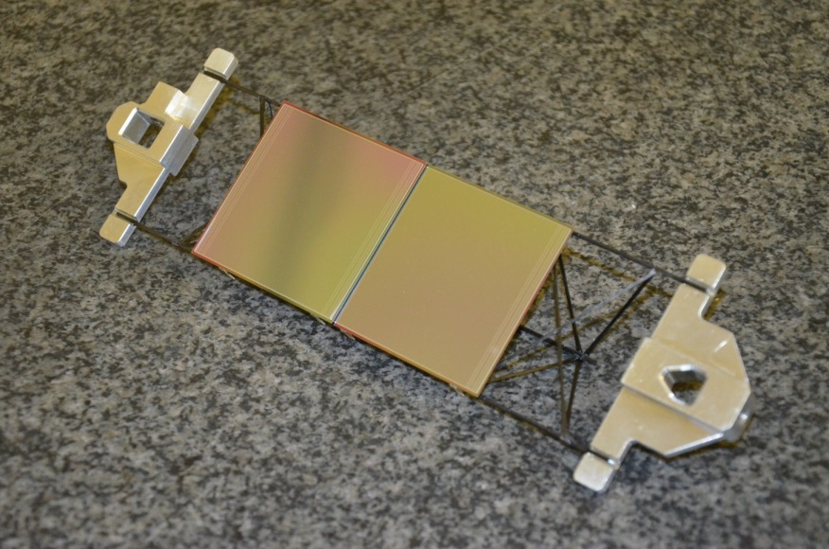
Sensor Ladders
Lightweight carbon fiber ladders will provide the means to arrange the sensors in units and stations
Sensors are mounted to the ladders with special fixtures – fiber-glass L-Legs
Assembly fixtures were developed for both detectors allowing for high mechanical placement precision
Mock-up prototype ladders assemblied for CBM (top) and BM@N (bottom panel)

Slide 9
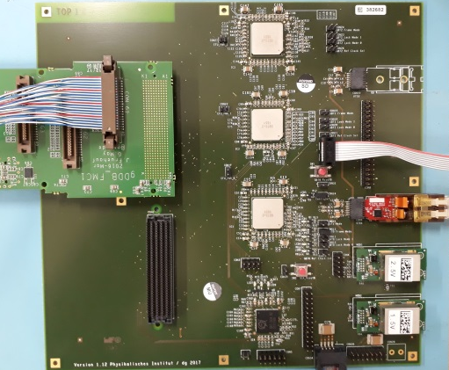
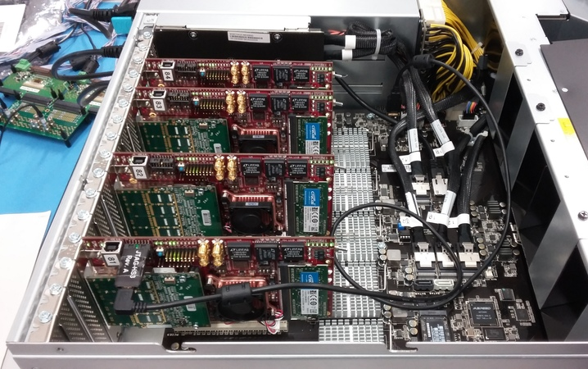
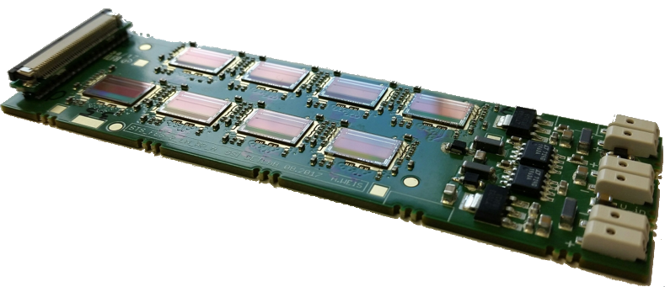
Detector read-out chain
* CBM specific, BM@N has GBTx emulators and its own DAQ system
STS modules
8 STS-XYTER v2.0 on FEB-8
Common GBTx Readout Board
based on radiation hard GBT and Versatile Link components developed at CERN
→ all components purchased
fully featured prototype currently being tested and commissioned (CROB - larger than final board)
FLES IN node with FLIBs
will be available for mCBM by Q2/2018
Copper
link
Optical link
on detector
off detector

Slide 10
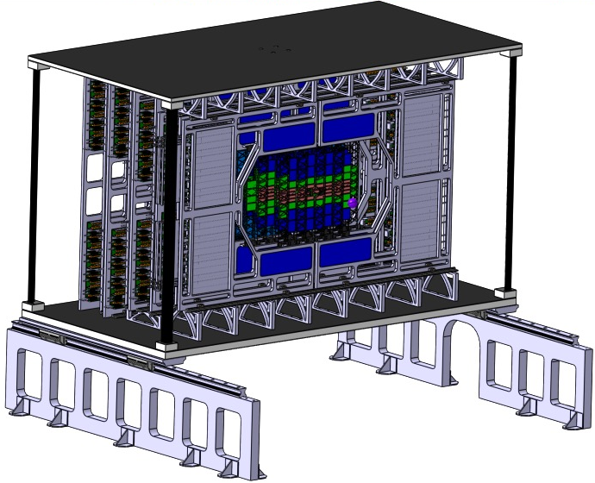
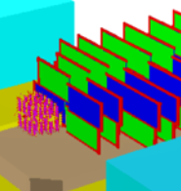
System Integration & Cooling
The CBM-STS conceptual engineering design is highly developed
Elaborated BM@N-STS engineering design in preparation
STS are compact detectors with high degree of component density
While CBM-STS uses bi-phase CO2 cooling, BM@N targets one-phase water-glycol cooling
System inegration concepts for CBM STS (top) and BM@N STS (bottom panel)

Slide 11
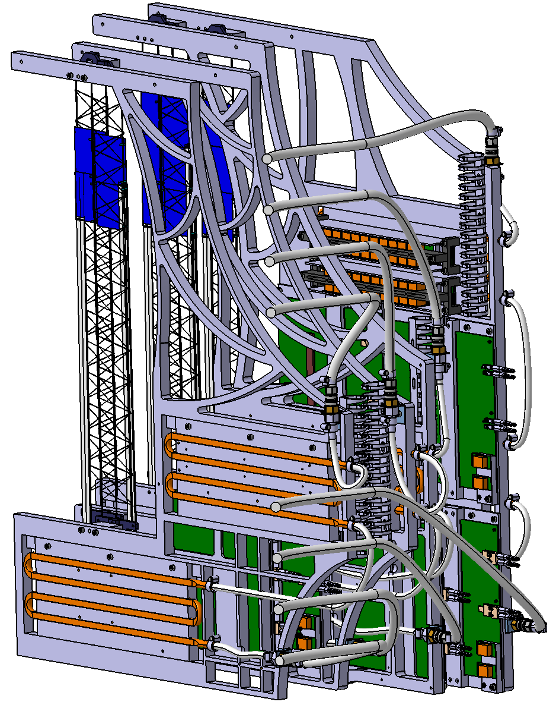
System Integration – mini-STS
Activities towards prototype station assembly, construction of mSTS for mCBM@SIS18
(GSI, 2018)
Small scale pilot version of the detector involving pre-final components – before BM@N and CBM.
Very important project requiring joint effort of all groups involved.
JINR team will provide 2 detector layers with ladders from JINR production, for runs in 2019.
mSTS system mechanical design, fully detailed

Slide 12
CBM-STS Key project institutes
  GSI-FAIR, Darmstadt, Germany;
  JINR, Dubna, Russia;
  Uni Tübingen, Germany;
  KIT, Karlsruhe, Germany;
  AGH, Cracow, Poland;
  JU, Cracow, Poland;
  WUT, Warsaw, Poland.
  Assembly Centers (Modules):
  GSI-FAIR, JINR-VBLHEP, KIT
  Assembly Centers (Ladders):
  GSI-FAIR, JINR-VBLHEP
CBM-STS Project Timeline:
  * the same clarity is needed for BM@N,
  to come next
  2013 – Technical Design Report
  2018 – Production Readiness
  (Sensors, Electronics, System Integration)
  Detector construction until 2022
  Commissioning until 2023

Slide 13
Summary
CBM-STS has about 10 years of experience in sensor R&D, detector workgroups, engineering, electronics, simulations...
BM@N is very beneficial for CBM:
  proposed as FAIR Phase-0 project
  unique opportunity to test the RO-chain, train assembly, try-out integration on components, tracking, operation
  physics
The BM@N project timeline is tight:
  in a couple of years the detector should be operational
  requires a coordinated effort from all groups participating

Slide 14
Outlook and BM@N-STS Tasks
A joint workgroup meeting has taken place at 12.04.2018
Synergies between CBM-STS and BM@N-STS were identified
BM@N-specific details of system integration, read-out electronics, data acquisition, software, power supplies, controls, etc. were discussed
A work-meeting in Dubna was scheduled for early July 2018 to define the project plan with major milestones, associated work packages and group contributions

