Slide 1
Status of the MPD project
Viacheslav Golovatyuk
(JINR)

Slide 2
Outline
Event parameters at NICA energies
MPD Layout for stages 1 – 2
Status of the main subsystems:
- Solenoid and Magnet Yoke
- TPC, TOF, FFD, FHCal
MPD Integration
Conclusions

Slide 3
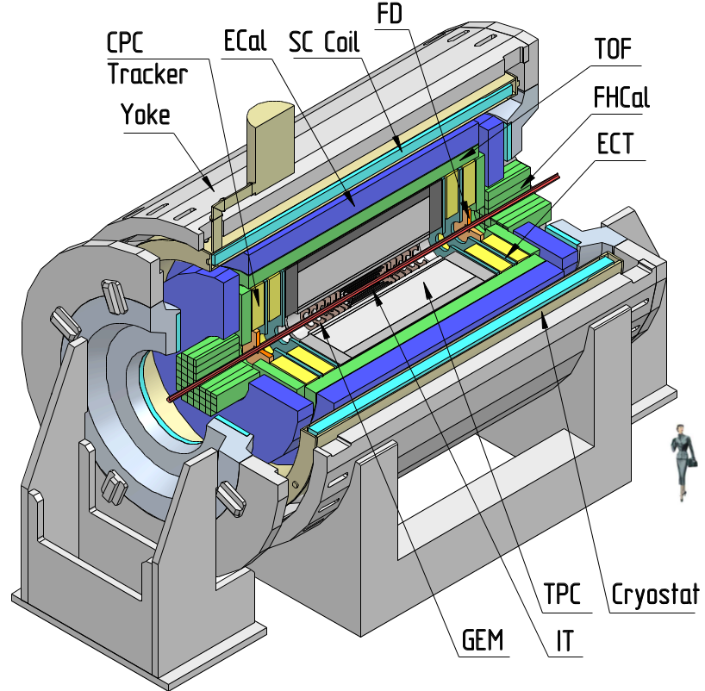
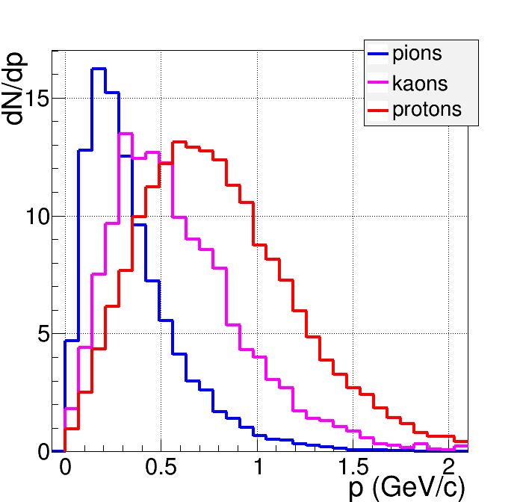
MultiPurpose Detecor for Au+Au collisions @ NICA
Hermeticity, 2π acceptance in azimuth
3-D tracking (TPC, ECT)
High resolution vertexing (IT)
Powerful PID (TPC, TOF, ECAL)
- π/K up to 1.5 GeV/c,
- K/p up to 3 GeV/c,
- γ, e : 0.1<p<3 GeV/c
Low material budget
High event rate (up to ~ 6 kHz)

Slide 4
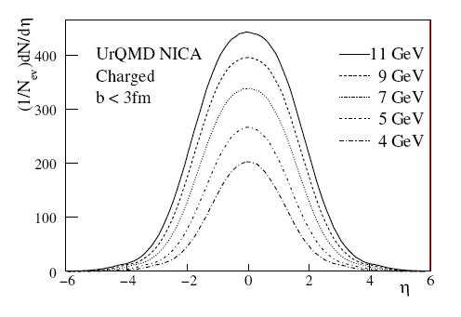
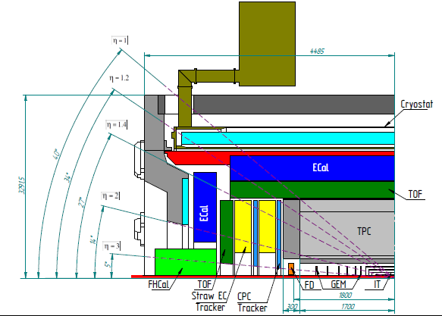
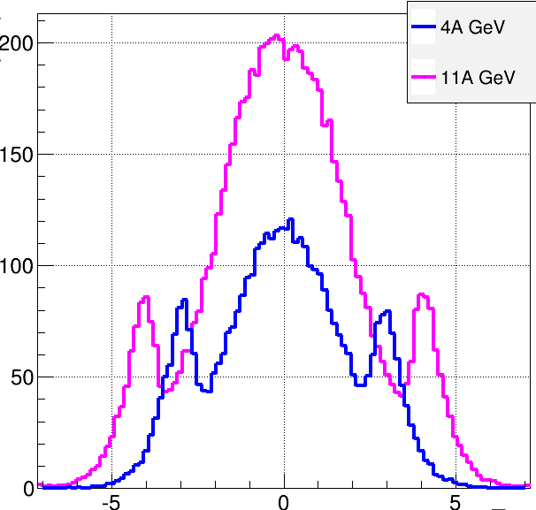
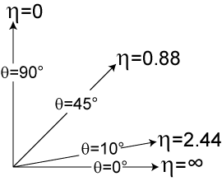

Au+Au collisions at NICA (model predictions)
Charged
b<11 fm
dN/dη
TPC
Forward Tracker
TOF
FFD
FHCal
η

Slide 5
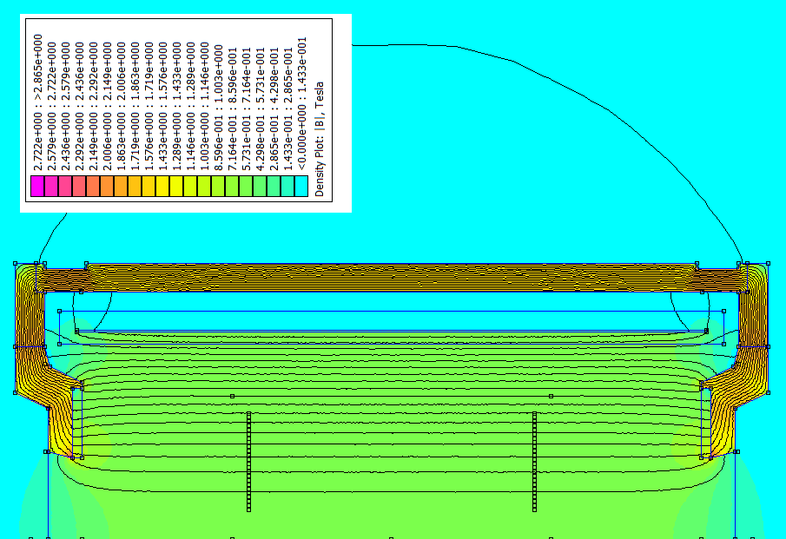
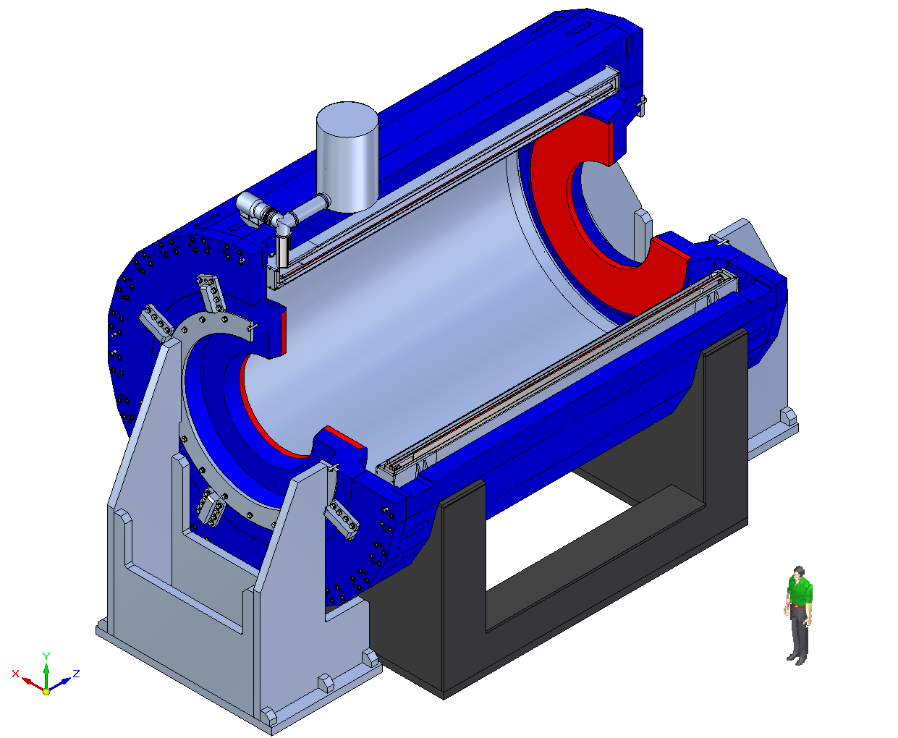
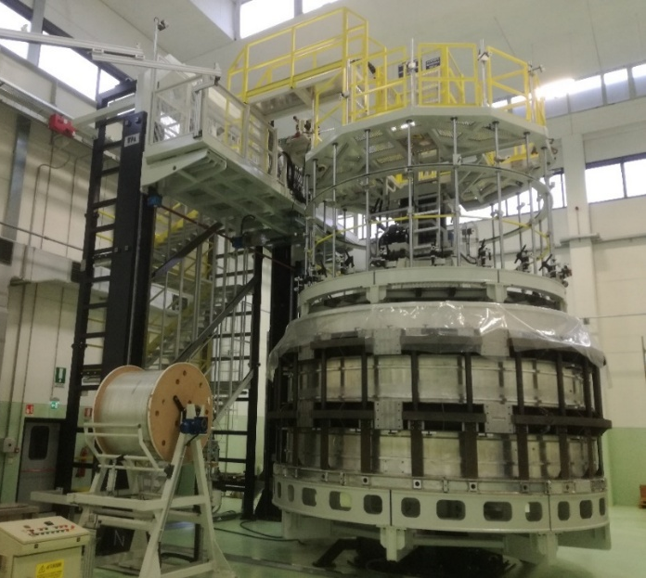
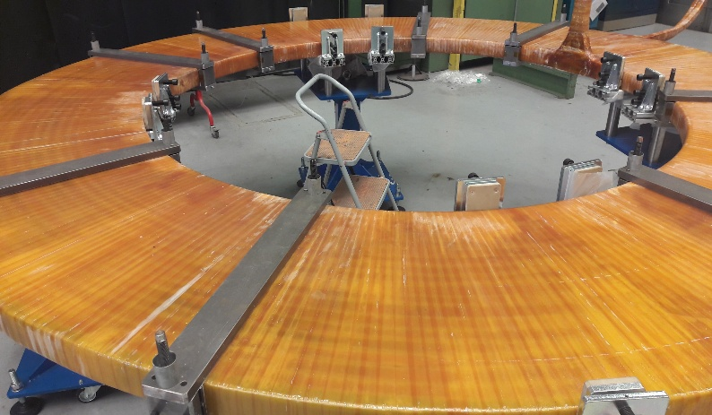
MPD superconducting solenoid
B₀=0.5 T
weight ~ 900 t
Control Dewar,
SC coil
TPC region
Trim Coil
Cryostat
high level (~ 3x10⁻⁴) of magnetic
field homogeneity
ASG superconductors (Genova, Italy): General responsibility
Schedule of Solenoid activities
Manufacture - 04.01.2016-06.08.2018
Finishing Solenoid tests in AGS - 06.06.2018
Packaging and Transport - 04.04.2018-22.10.2018
Assembly in JINR - 23.10.2018-17.04.2019
Magnetic field measurements - to be finished at IV q 2019

Slide 6
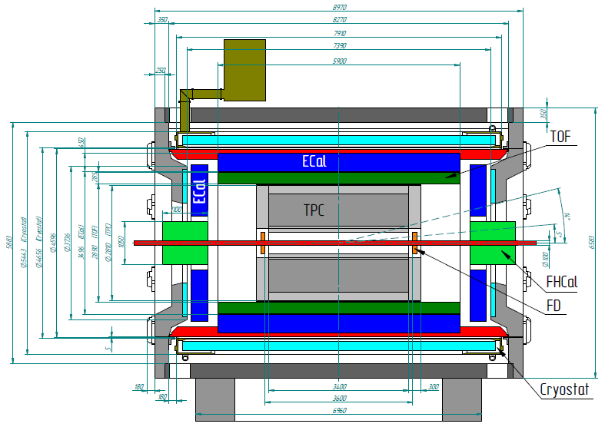
MPD 1st stage

Slide 7
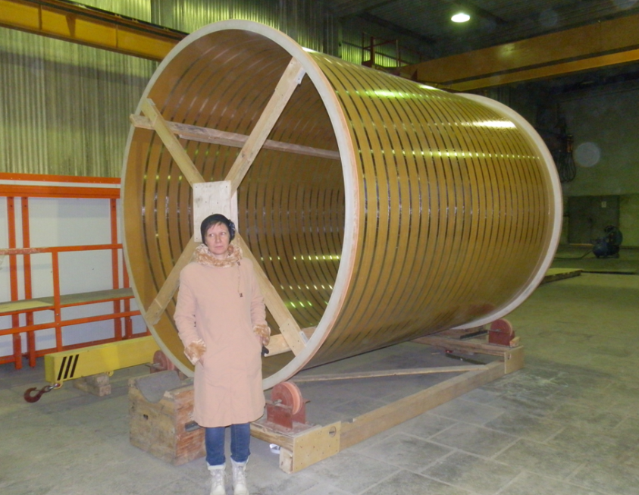
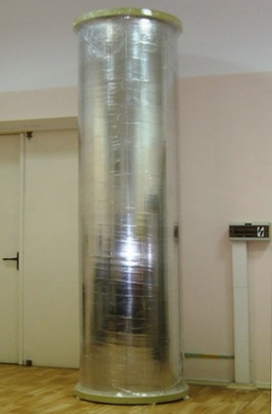
MPD Time Projection Chamber
Item | Dimension
Length of the TPC | 340cm
Outer radius of vessel | 140cm
Inner radius of vessel | 27 cm
Outer radius of the drift volume | 133cm
Inner radius of the drift volume | 34cm
Length of the drift volume | 170cm (of each half)
HV electrode | Membrane at the center of the TPC
Electric field strength | ~140V/cm;
Drift gas | 90% Ar+10% Methane, Atmospheric pres. + 2 mbar
Gas amplification factor | ~ 10⁴
Drift velocity | 5.45 cm/µs;
Drift time | < 30µs;
Temperature stability | < 0.5°C
Number of readout chambers | 24 (12 per each end-plate)
Segmentation in φ | 30°
Pad size | 5x12mm² and 5x18mm²
Number of pads | 95232
Pad raw numbers | 53
Maximal event rate | < 7 kHz ( Lum. 10²⁷ )
Electronics shaping time | ~180 ns (FWHM)
Signal-to-noise ratio | 30:1
Signal dynamical range | 10 bits
Sampling rate | 10 MHz
Sampling depth | 310 time buckets
Length: 3.4 m
Diameter: 0.540 m
Length: 3.4 m Diameter: 2.660 m

Slide 8
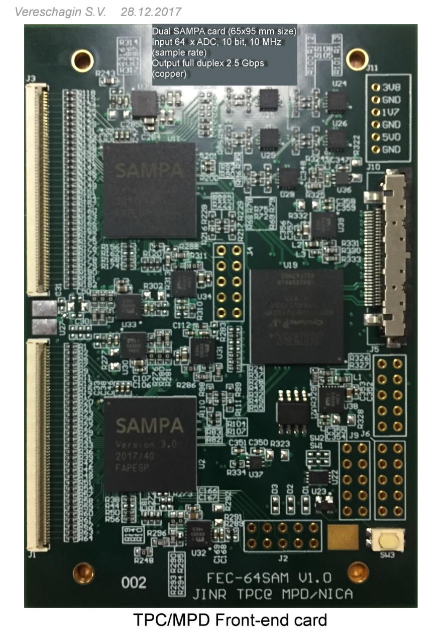
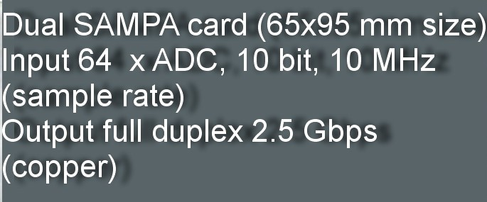
MPD TPC FEE: FEC64SAM v1.0 based on SAMPA rev.3
Dubna plans:
SAMPA second iteration – July 2016
Delivery 10pc to Dubna – October 8 2016
design MPD TPC FE-SA64 board rev.01 – ok!
test SAMPA evaluation board – in progress
test FE-SA64 board rev.01
design FE-SA64 board rev.02
test FE-SA64 board rev.02
SAMPA third iteration– May 2017
design FE-SA64 board rev.03
test FE-SA64 board rev.03
design FE-SA64 serial board rev.04
test FE-SA64 serial board rev.04
SAMPAs-FPGA communication – ok!
Trigger and synch – ok!
Plans:
- data transmission
from FPGA to kit – in progress
- board parameters study – will be done

Slide 9


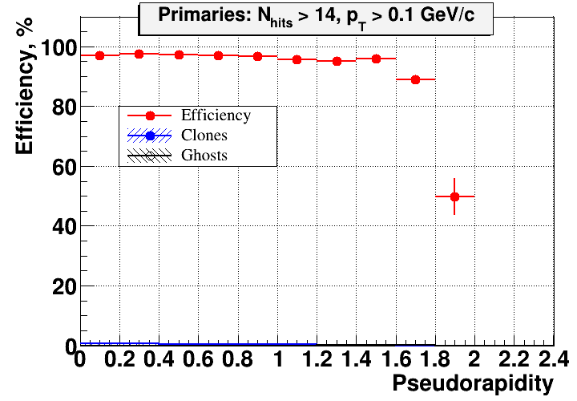
Track reconstruction efficiency
Primary
A. Zinchenko

Slide 10
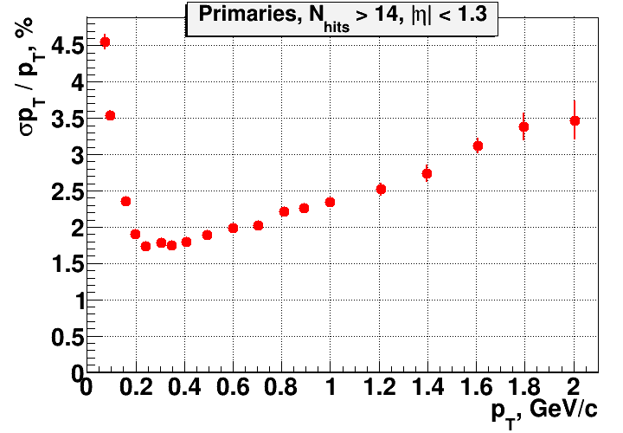
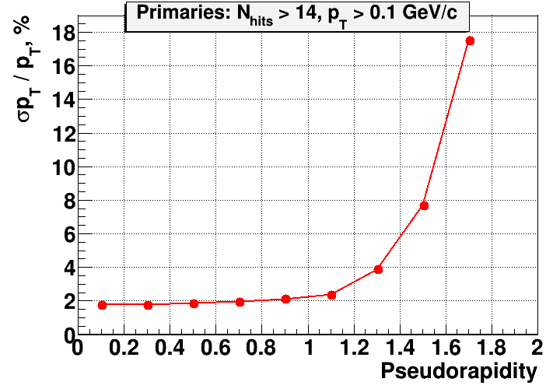
Momentum resolution
A. Zinchenko

Slide 11
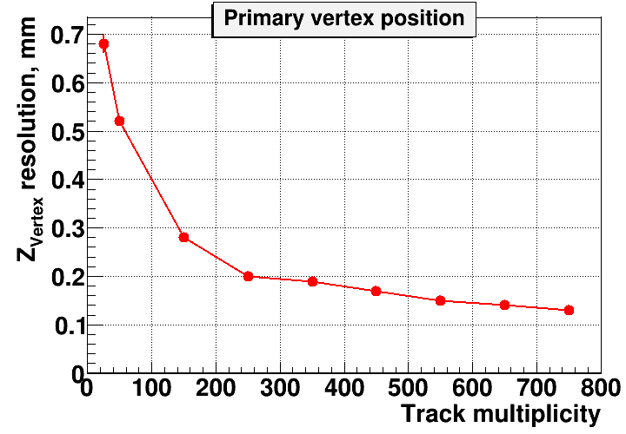
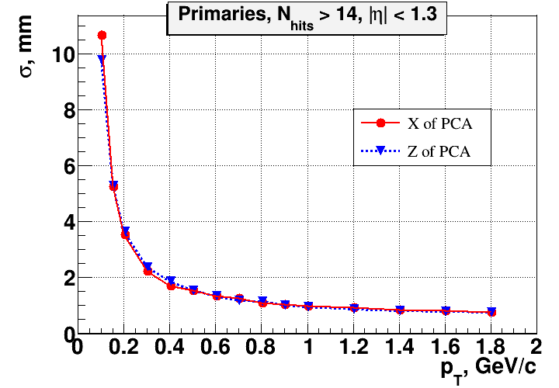
Track pointing accuracy
A. Zinchenko

Slide 12
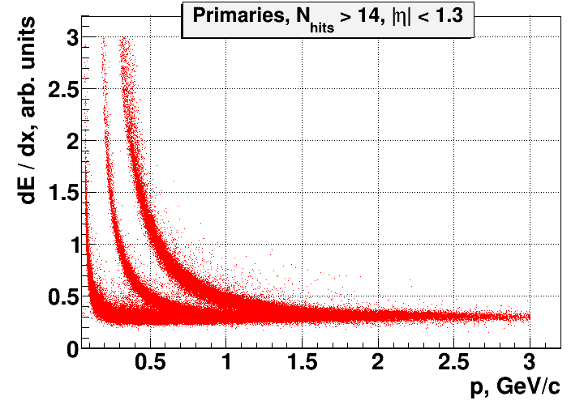
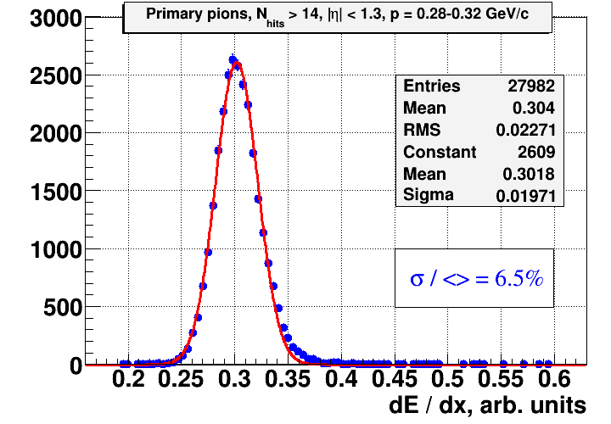
dE / dx measurement
A. Zinchenko

Slide 13
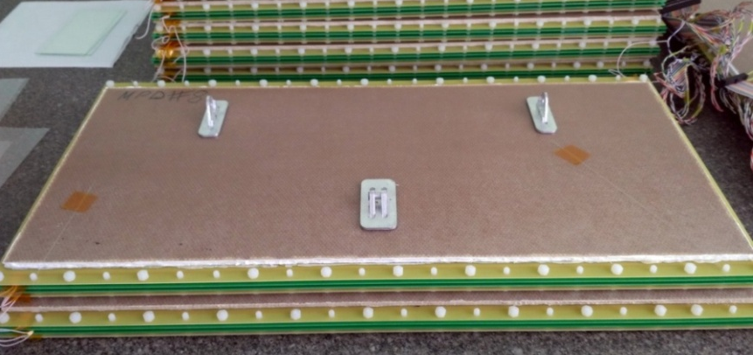
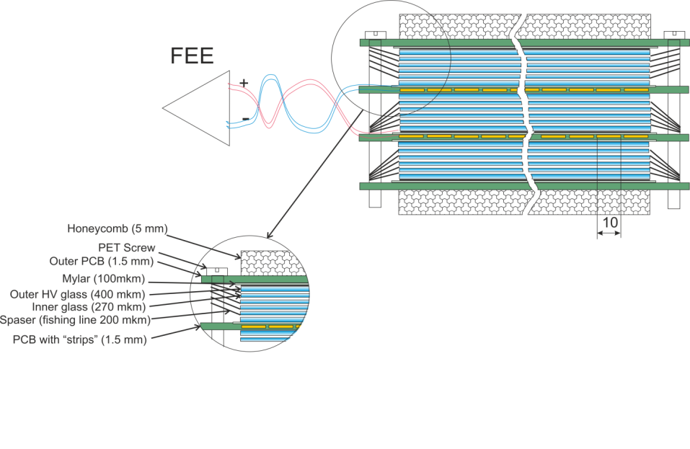
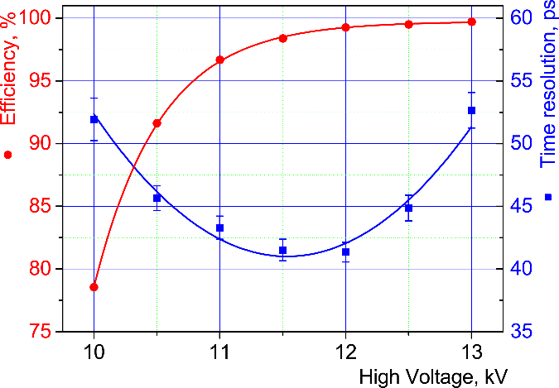
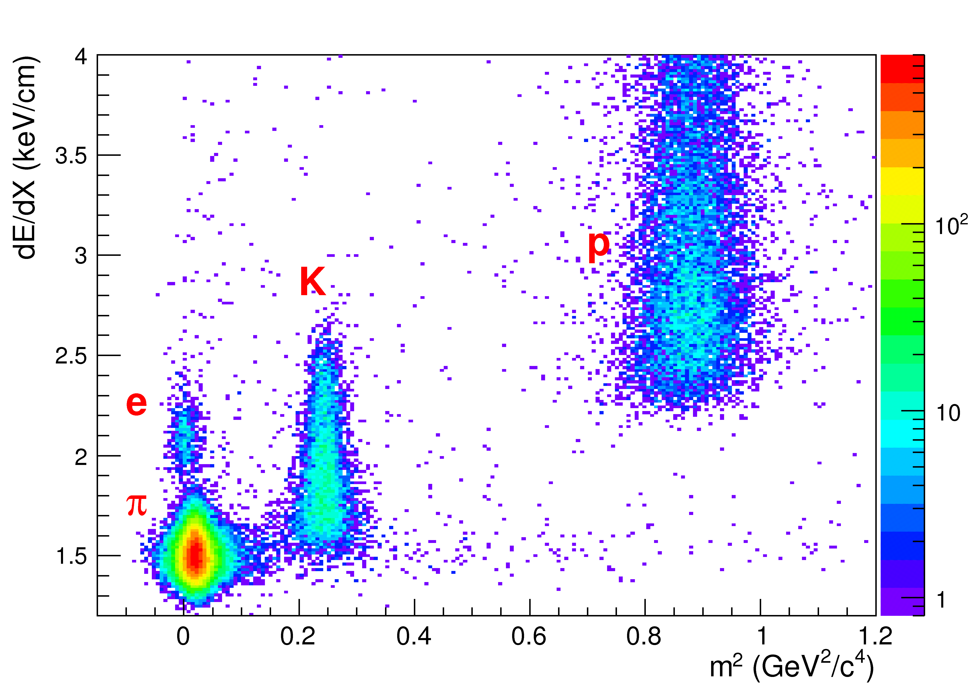
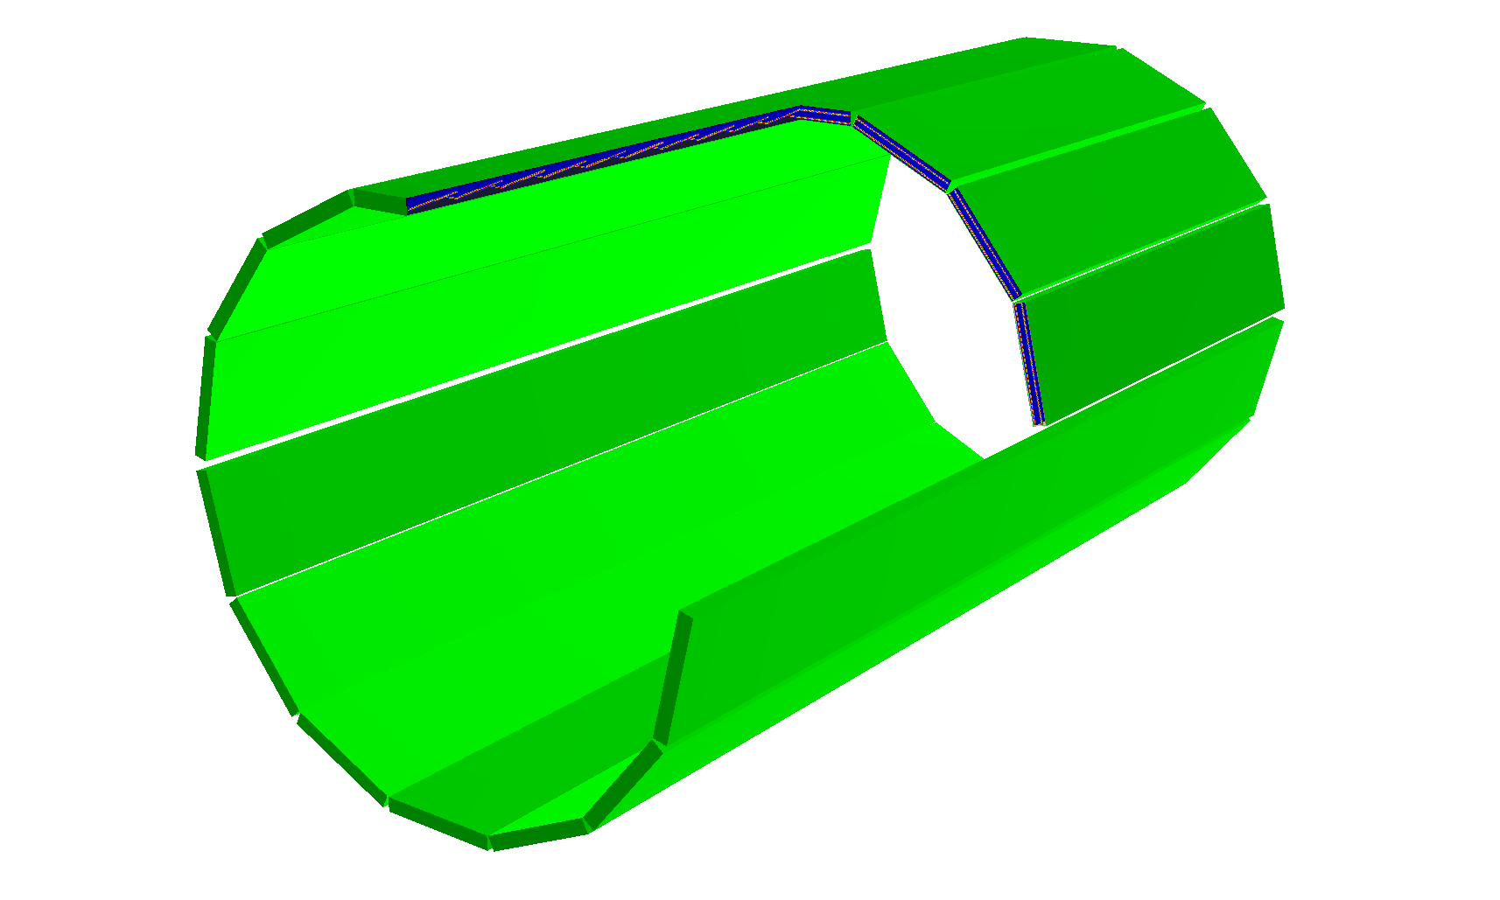
MPD TOF
Dimensions of sensitive area
600 x300 mm²
Main parameters of the TOF system.
 | Number of detectors | Number of readout strips | Sensitive area, m² | Number of FEE cards | Number of FEE channels
MRPC | 1 | 24 | 0.192 | 2 | 48
Module | 10 | 240 | 1.848 | 20 | 480
Barrel | 280 | 6720 | 51.8 | 560 | 13440 (1680 chips)

Slide 14
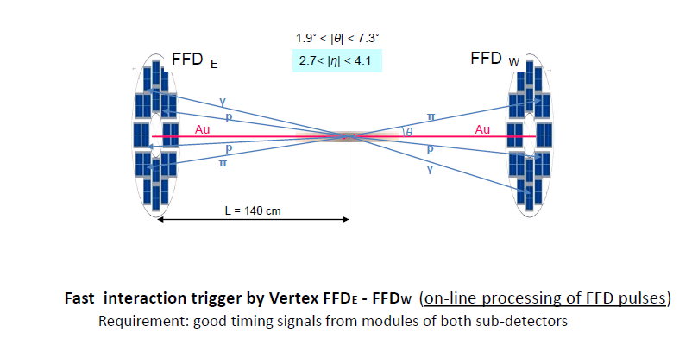
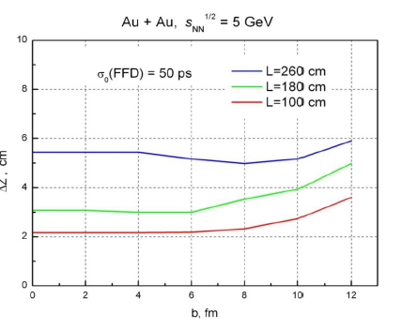
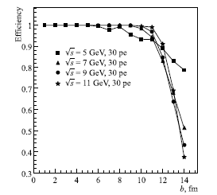
Fast Trigger L₀ for MPD
FFD provides information on
- interaction rate ( luminosity adjustment )
- bunch crossing region position
15 mm quartz radiator
10 mm Lead converter
The FFD sub-detector consists of
20 modules based on
Planacon MCP-PMTs
80 independent channels plus
Beam crossing fast signal from Collider is needed in trigger for determination of FFD efficiency for peripheral collisions
The vertex resolution for Au-Au collisions at √s=5GeV/n for three distances from interaction point

Slide 16
Beam-Beam Monitor (MexNICA Collaboration )
Fast timing scintillation hodoscope with APD readout. Required resolution –better 40 ps)

Slide 17
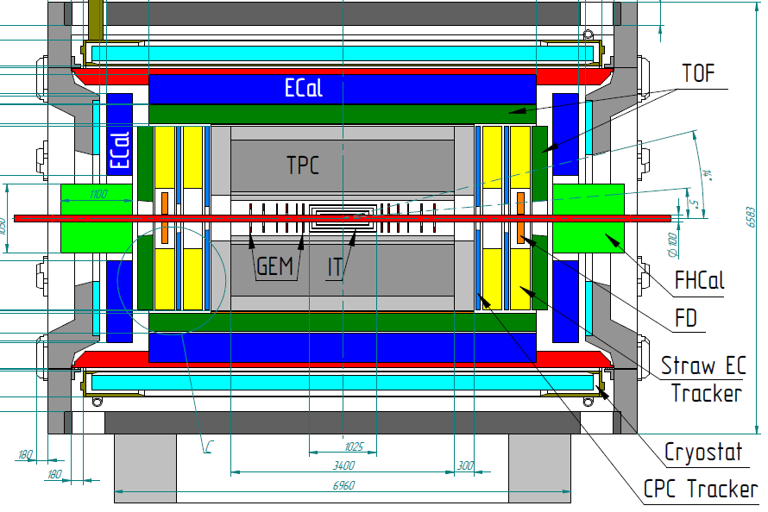
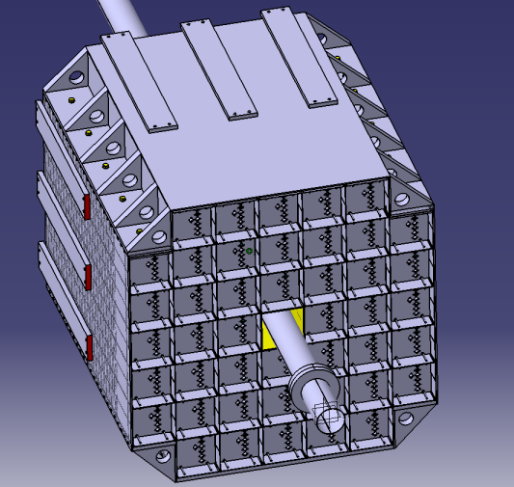
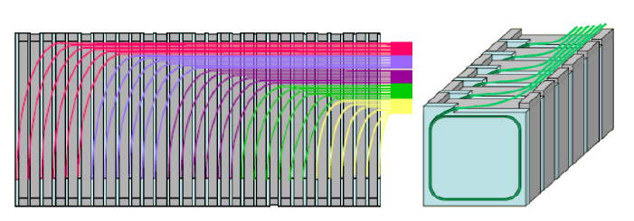
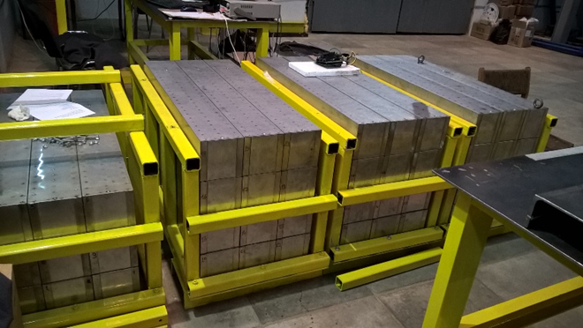
FHCal can be used for beam tuning
Leaders: A.Ivashkin, F.Guber (INR, Troitsk) + MiPhi
Two-arms at ~3.2 m from the interaction point.
Each arm consists of 45 individual modules.
Module size 150x150x1100cm³ (55 layers)
Pb(16mm)+Scint.(4mm) sandwich
7 longitudinal sections
6 WLS-fiber/MAPD per section
7 MAPDs/module

Slide 18
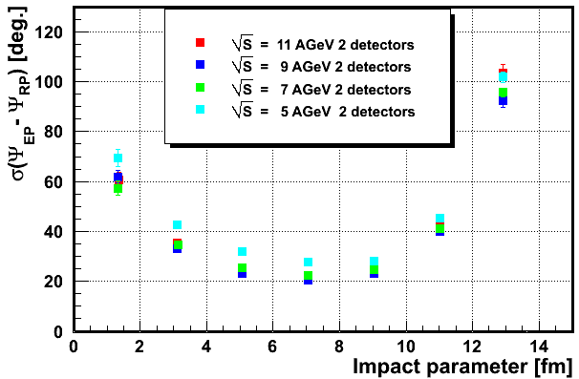
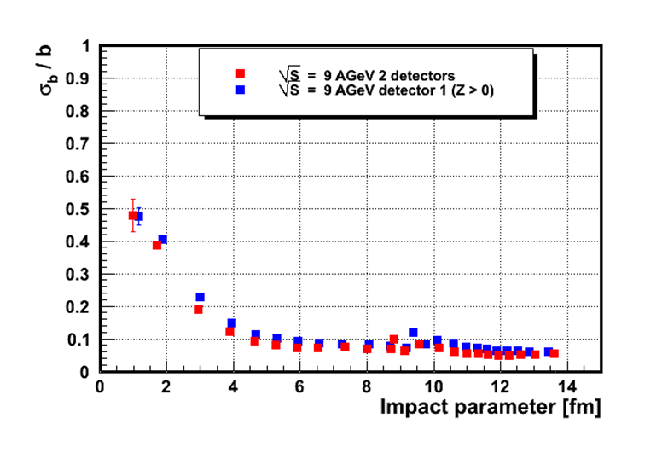
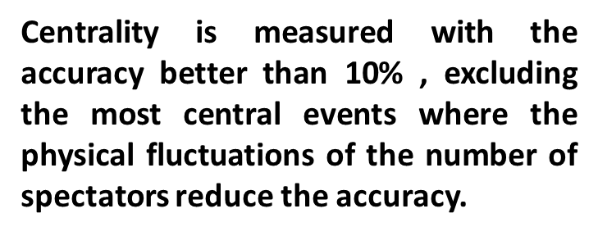

Reaction plane and impact parameter resolution
The accuracy of reaction plane reconstruction is practically the same as in the case 10x10 cm² modules
In range 26-31 degrees

Slide 19
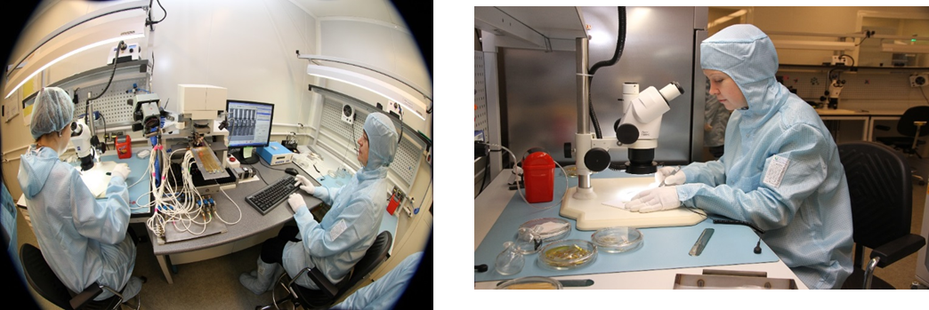
ITS for MPD Experimen
Consortium includes JINR, NICA (BM@N & MPD) , FAIR, Russian, Poland and Ukrine Insitutes + CCNU Central China Normal Univ – Wu Han and Feng Liu
IMP- Institute of Modern Physics - Lan Zhou and Nu Xu
USTC – Hefei - Zebo Tang
Λ⁰ → p + π –
Ω¯ → Λ + K¯
└→ p + π –
Ξ¯ → Λ + π –
└→ p + π –
D⁰ → K¯ + π ⁺
MPD ITS based on ALICE type staves
.

Slide 20
Plans of participation of China Institutes in the MPD Project
Stage 1 (2019-2021)
ECal – THU – Tsinghua University., Yi Wang
SDU –Shandong University
HU- Huzhou University Fuqing Wang
IT and ECal readout (fast electronics) – CCNU, IMP, USTC
TOF module production USTC, Tsinghua
Computing - CCNU
Stage 2 (2021- 2025)
IT production CCNU, IMP, USTC
TOF Forward USTC, Tsinghua
IPP – Institute of Plasma Physics, Hefei – coord. Yuntao Song
IMP- Institute of Modern Physics - Lan Zhou and Nu Xu
CCNU Central China Normal Univ – Wu Han and Feng Liu
USTC – Hefei - Zebo Tang
TGU Three Gorge University, - Yi Chang, Shenqin Feng (simulation)

Slide 21
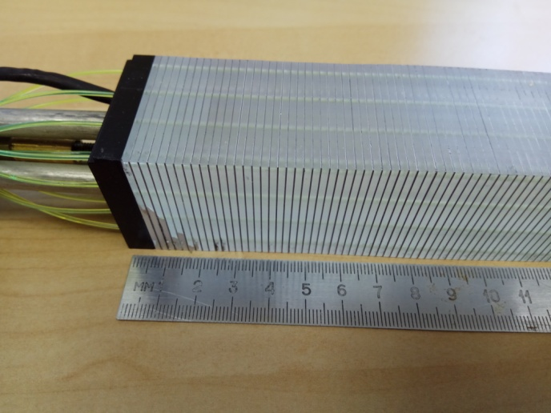
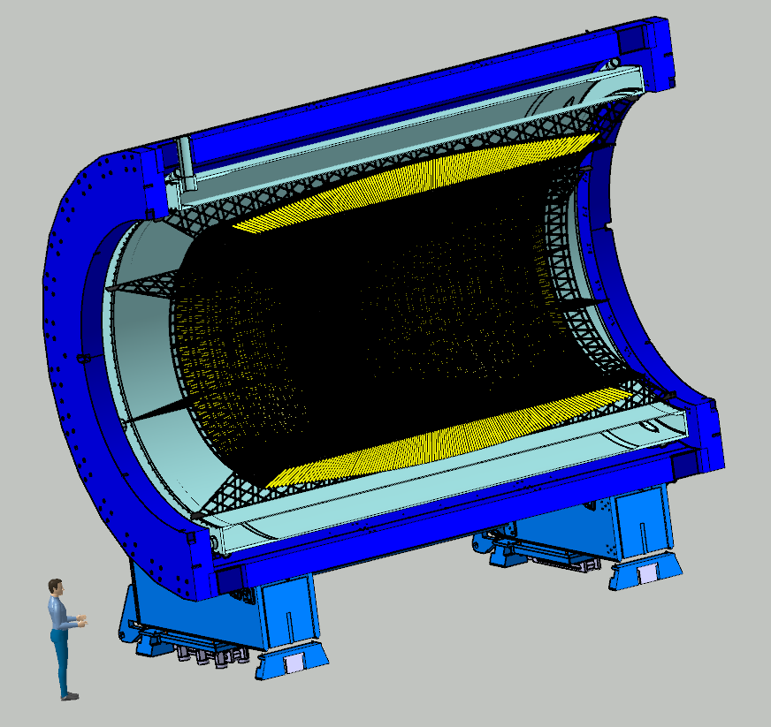
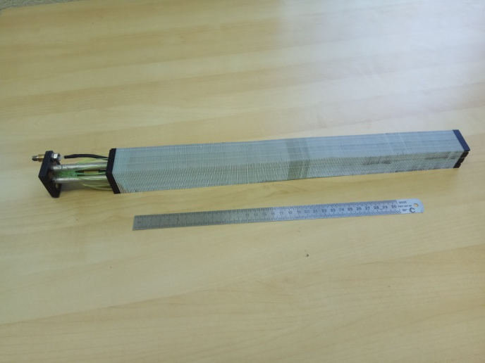
Electromagnetic Calorimeter (ECAL) for Multi Purpose Detector (MPD)
ECal – THU – Tsinghua University., Yi Wang
SDU –Shandong University
HU- Huzhou University Fuqing Wang
Prototype of one module
Barrel ECAL ~ 43000 ECAL modules

Slide 22
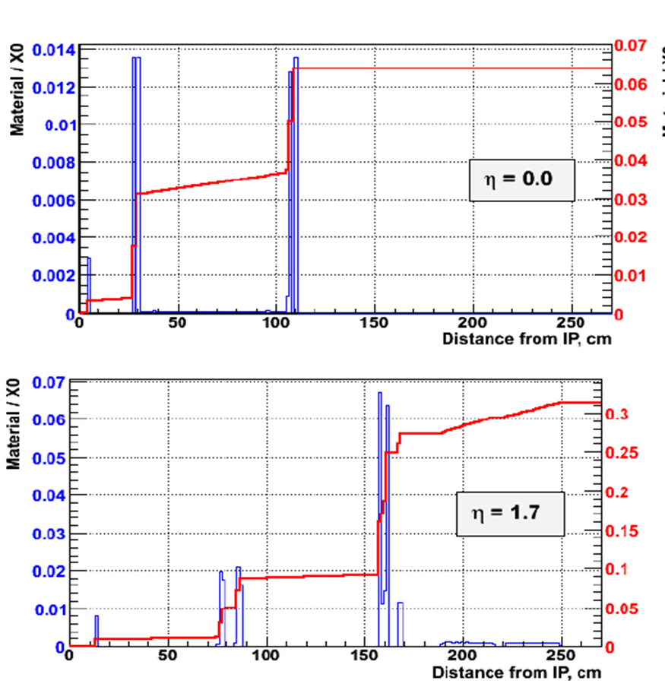
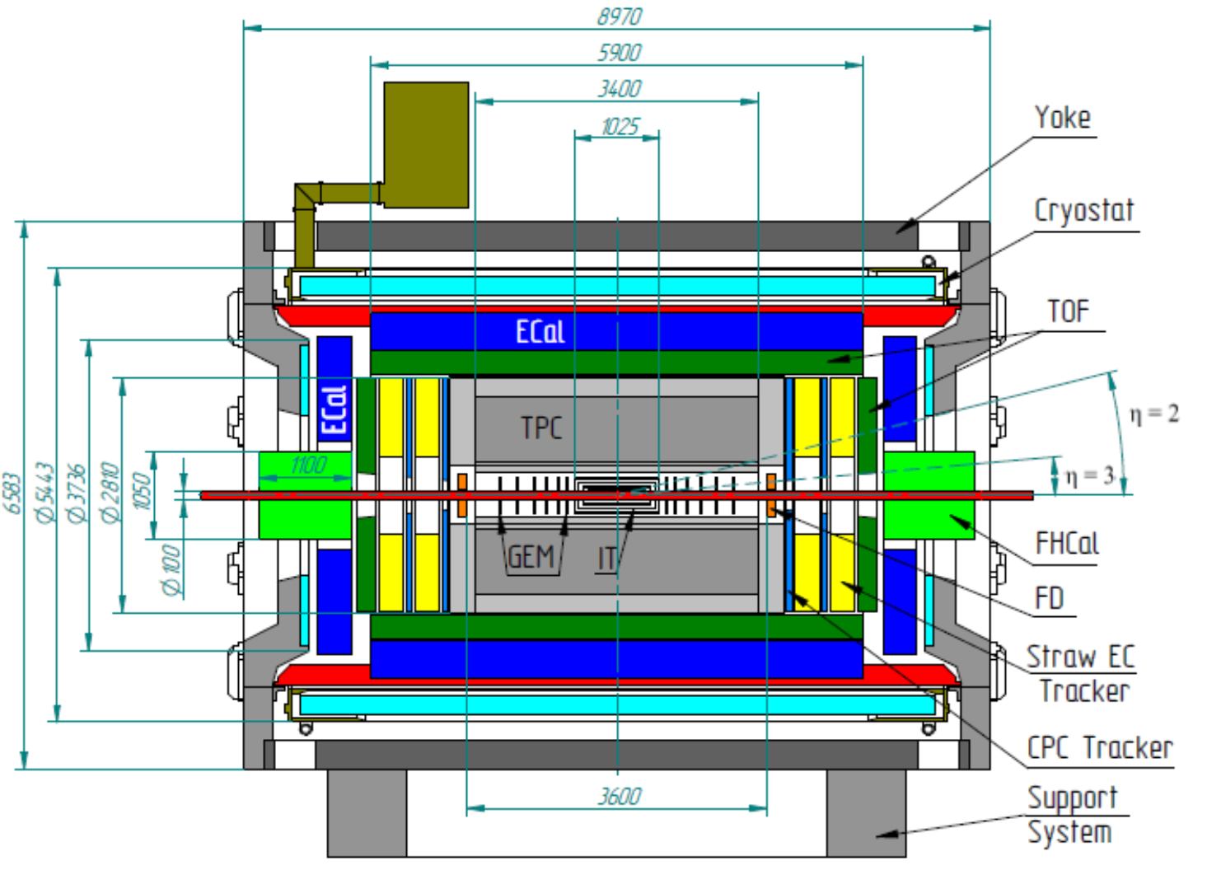
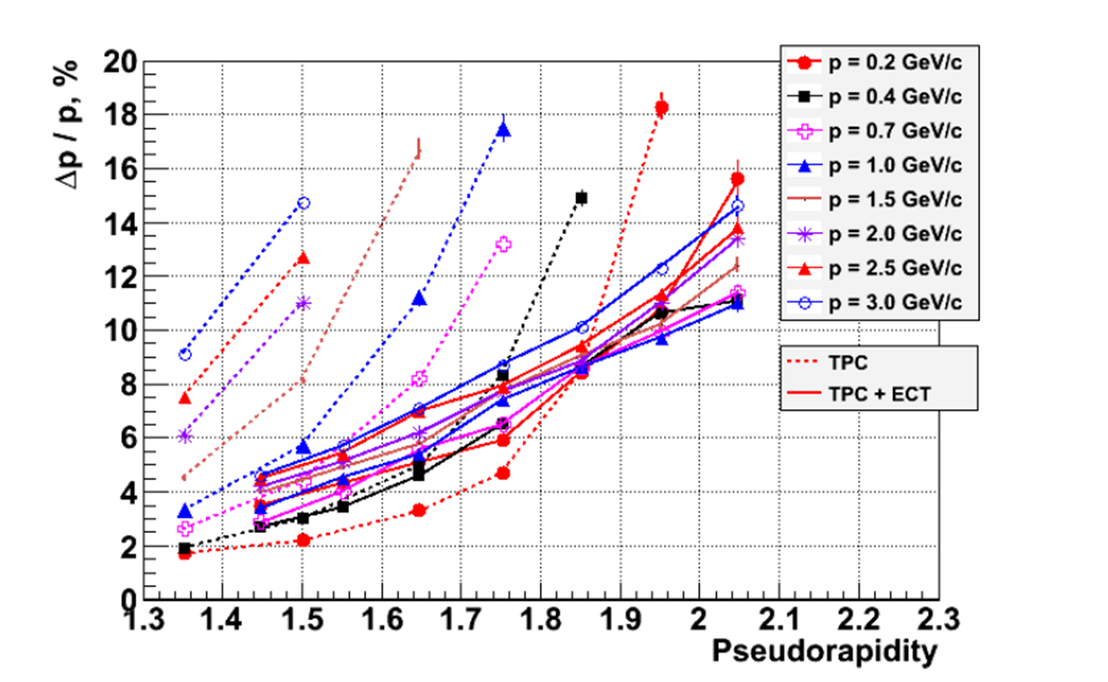
Forward tracker based on thin gap MWPC with pad (strip) readout.
Technical University of Santa Maria in Valparaiso, Chile (S.Kovalenko)
and Petersburg Nuclear Physics Institute, Gatchina (O.Fedin)

Slide 23
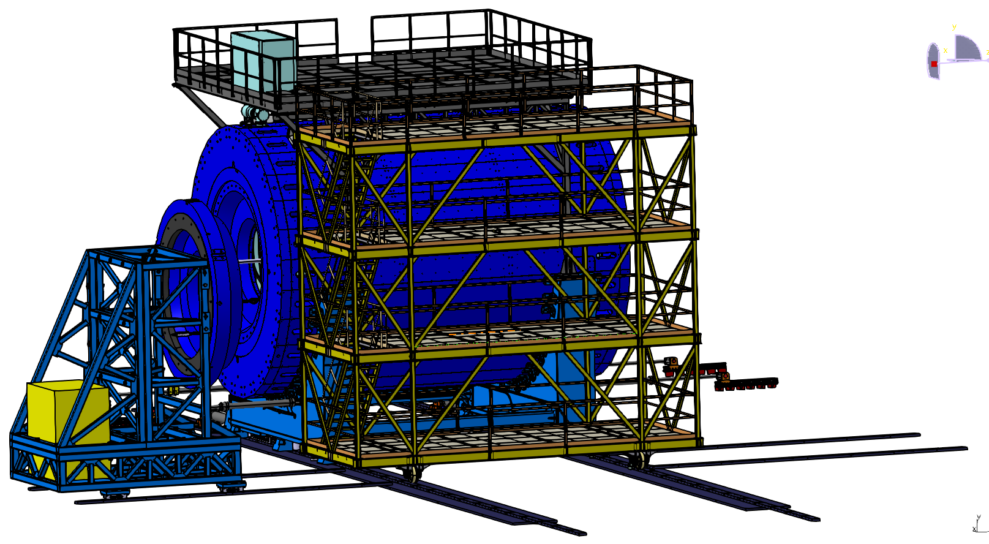
PLATFORM Technical Description
MPD with platforms for electronics and cryogenics
WUT, Warsaw (Coordinator -Marek Peryt) – Rack organization on the MPD platforms
Figure 17; PLATFORM, LEVEL 1-4

Slide 24
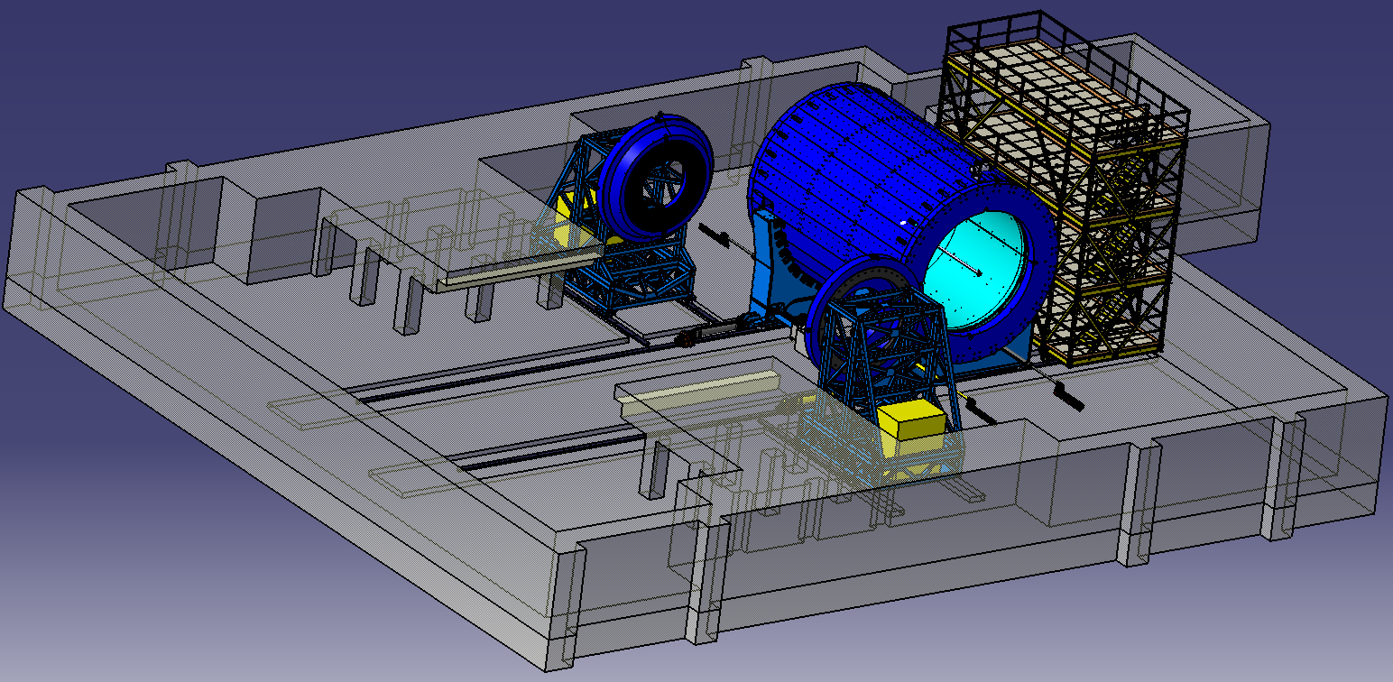
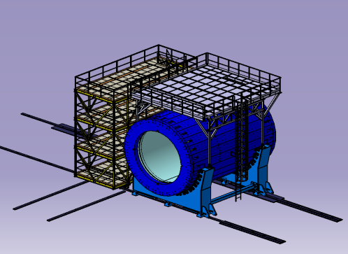
Positions of MPD in the experimental zone
Beam pipe
FFD and FHCal for Luminosity tuning
Final focus lenses
Position 1 - Working position, Detector on the beam
Position 2 - Endcaps roll away zone
Position 3 – Detector Assembling area
The FFD and FHCal are panned to be used for Collider luminosity tuning

Slide 25
Summary
Substantial progress in MPD project realization in 2017 – 1Q 2018 (Magnet, Solenoid, TPC,
TOF, FFD, FHCAL)
The (final) choice for the TPC FEE based on SAMPA chip becoming real. It allows us to
start design forward trackers and calorimeters.
MPD Collaboration → toward the formal foundation
Thank you for your attention!

Slide 26
Spares

Slide 27
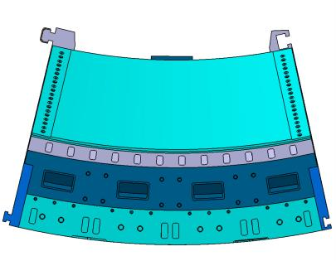
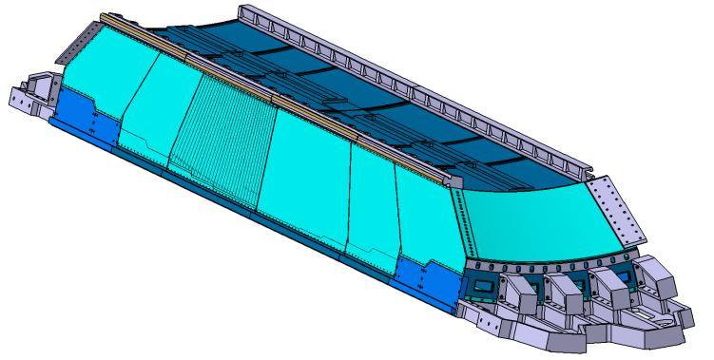
ECAL guides
Each of the sectors has two pairs of guides and grooves, which are situated in the sector’s corners.

Slide 28
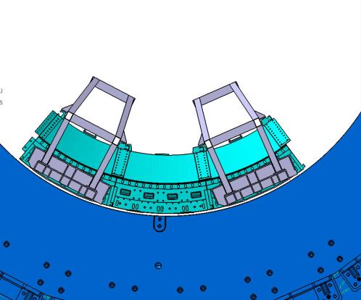

Flange Installation of
the first ECAL

Slide 29


The fitting of the truss to ECAL
Deformation of the module with flanges siting on the support ring
Max deformation is 4,84mm

Slide 30




MPD Magnet Yoke: construction status
Leader: N. Topilin
28 plates (16 t each) – 26 ready
2 support rings (42.5 t each) - ready
Lodgment (Yoke support): 70 t, ordinary steel St.3 (Fe 360) – in progress
Plates
Rings
Lodgment

Slide 31

One half of cut away of MPD with beam optics
Beam diameter inside of MPD -40 mm, length -400 cm (central part 1,5m – beryllium)
Center of the Detector
Final focus lenses
ᴓ40 mm
Beam position monitor (pick up)
Collimator

Slide 32
Layout of MPD central beam pipe
Basic and Project configuration
Al (AW-2219)
The thickness of Al beam pipe D60 – (1-1,5) mm
ᴓ 80
ᴓ 130
Interaction Point
2200
4485*
Central part
Be section
Al (AW-2219)
ᴓ 60
ᴓ 80
ᴓ 130
850
Interaction Point
2200
4485*
All dimensions in mm. Wall thickness 800μm for dia 60 and 80 mm. The thickness of wall for pipe with diameter 100 mm is not limited by physicists

