Slide 1
Forward Hadron Calorimeter FHCal for MPD and BM@N
A.Ivashkin
Institute for Nuclear Researches RAS, Moscow
on behalf of the FHCal MPD group
1st MPD/BM@N collaboration meeting, April 11-13, 2018.

Slide 2
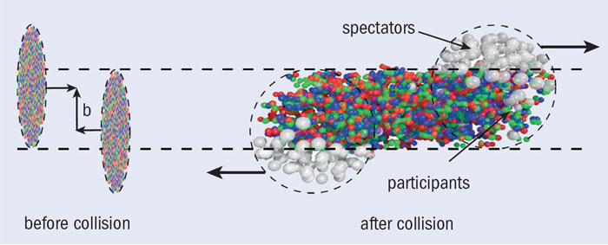
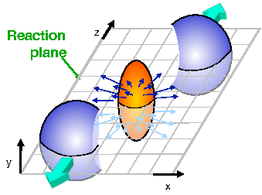

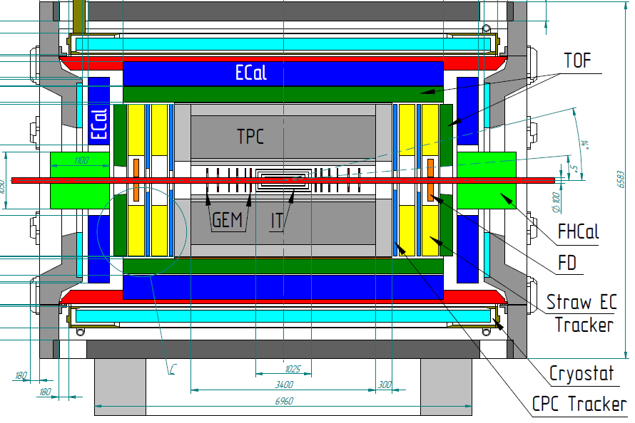
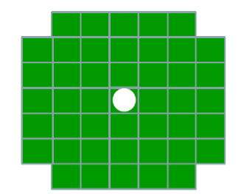
The Forward Hadron Calorimeter in MPD setup.
FHCal will detect the spectators to measure the geometry of ion collisions.
The centrality of the collisions:
The reaction plane:
Event plane
FHCAL
Spectator spot
Two arms of hadron calorimeters at opposite sides in forward regions.
At the distance 3.2 meters from the interaction point.
Acceptance corresponds to pseudorapidity 2.0<η <5.0

Slide 3
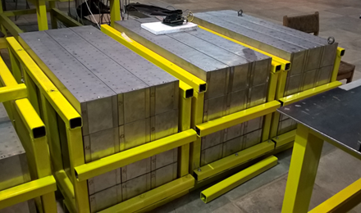
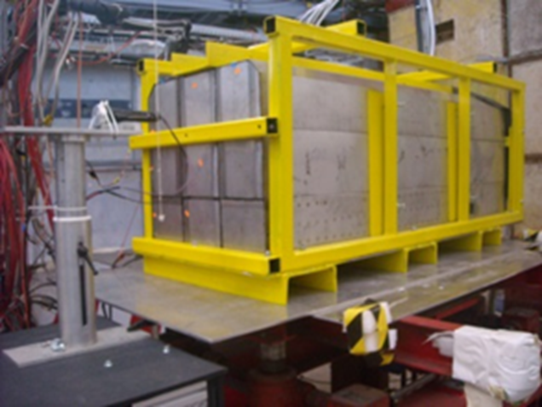
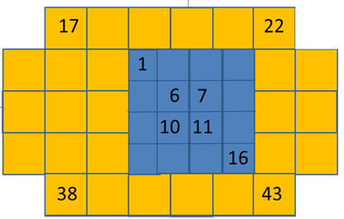
Main stages of FHCal project.
FHCal TDR (INR-MEPhI-JINR).
The final version is (almost) ready.
Collaboration of 3 institutes.
Contribution of CBM/FAIR.
Production of FHCal modules (INR, Moscow)
Beam tests of modules at CERN
(MoU between JINR and CBM)
Use of FHCal/CBM modules for BM@N
(MoU between JINR and CBM)

Slide 4
Structure of FHCal – two left/right arms.
Modular Lead/Scintillator sandwich compensating calorimeter. Sampling ratio Pb:Scint=4:1.
Each arm:
45 modules;
Beam hole;
Weight – 9 tons.
Each module:
Transverse size - 15x15cm² ;
Total length - 106 cm.
Interaction length ~4 λ_{int};
Longitudinal segmentation – 7 sections;
1 section ~ 0.56λ_{int};
7 photodetectors/module;
Photodetectors – silicon photomultipliers (SiPM).
Light from scintillator tiles is captured by WLS-fibers and transported to SiPM.

Slide 5
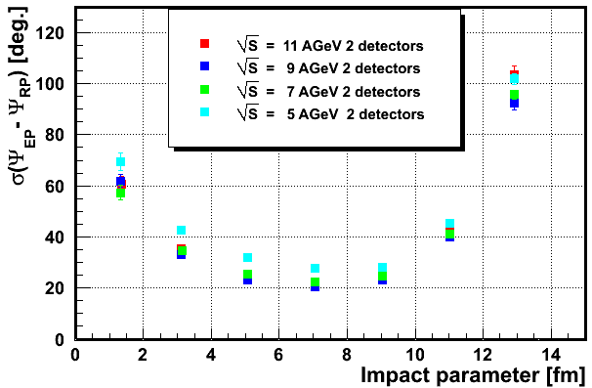
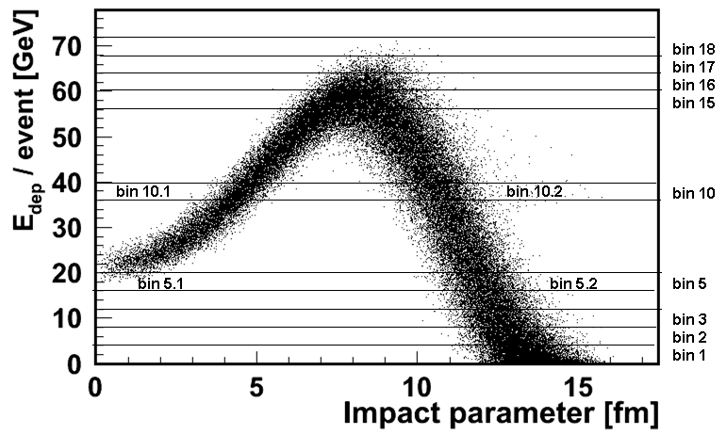
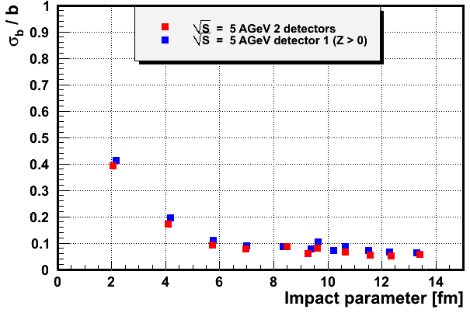
Event plane and centrality resolution.
Modules 15x15 cm² are optimum choice and fit the transverse size of hadron showers (interaction length of lead+scint. λ_{I}~20 cm).
The event plane resolution of 20⁰-25⁰: two arms of FHCal (maximum spectator multiplicity) and no influence of magnet field.
Energy deposition in FHCal isn’t monotonic due to beam hole and can’t resolve the central and peripheral events.
The ambiguity in centrality determination can be resolved by taking track multiplicity in TPC.
Or by using other observables in FHCal.

Slide 6
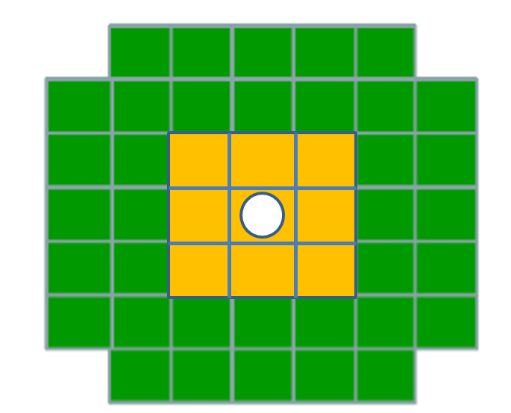
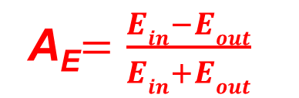
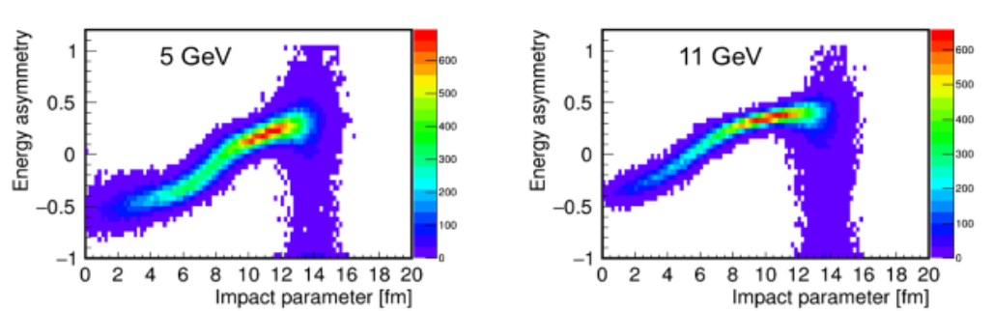
Other FHCal observable for the centrality measurement.
π⁺ π⁻
π⁺ π⁻
π⁺ π⁻
Mainly, fragments are produced in peripheral collisions and located near beam hole.
E_{out}
while pions are produced
in central collisions.
d ³He
t ⁴He
E_{in}
Depending on centrality there must be difference in the energy depositions in inner and outer parts of calorimeter.
Let’s construct energy asymmetry:

Slide 7

Calculation of centrality from energy asymmetry – energy correlation.
E_{out}
E_{in}
The resolution of impact parameter for central events is determined by low spectator multiplicity.
Only energy bins are used for the calculations.
More advanced two-dimensional analysis can improve the resolution.
Inspite of beam hole FHCal can resolve the central and peripheral events.

Slide 8
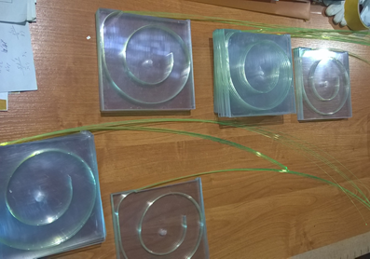
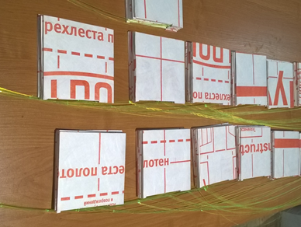
Stages of FHCal production: scintillators.
FHCal scintillator tiles and modules are assembled in workshop of INR, Moscow.
Scintillator tiles with WLS-fibers.
Scintillator tiles in TYVEC reflector.
Tests of different grooves and reflectors
Permanent quality control of scintillator tiles,
WLS-fibers and gluing is performing with ⁹⁰Sr β-source.

Slide 9
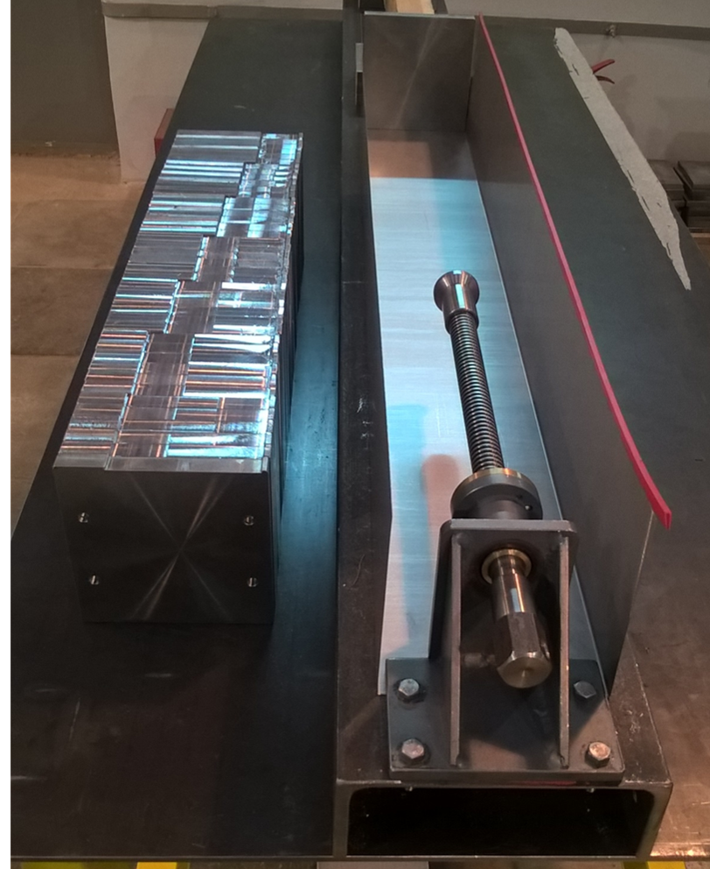
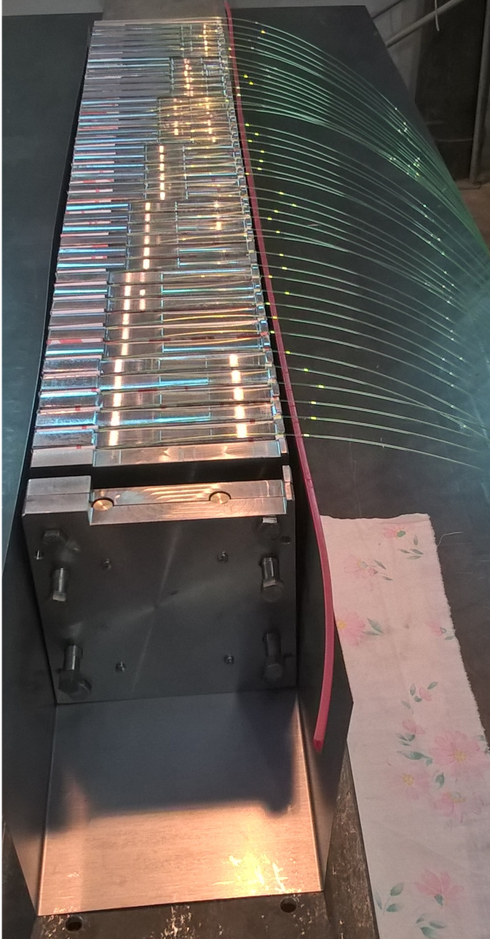
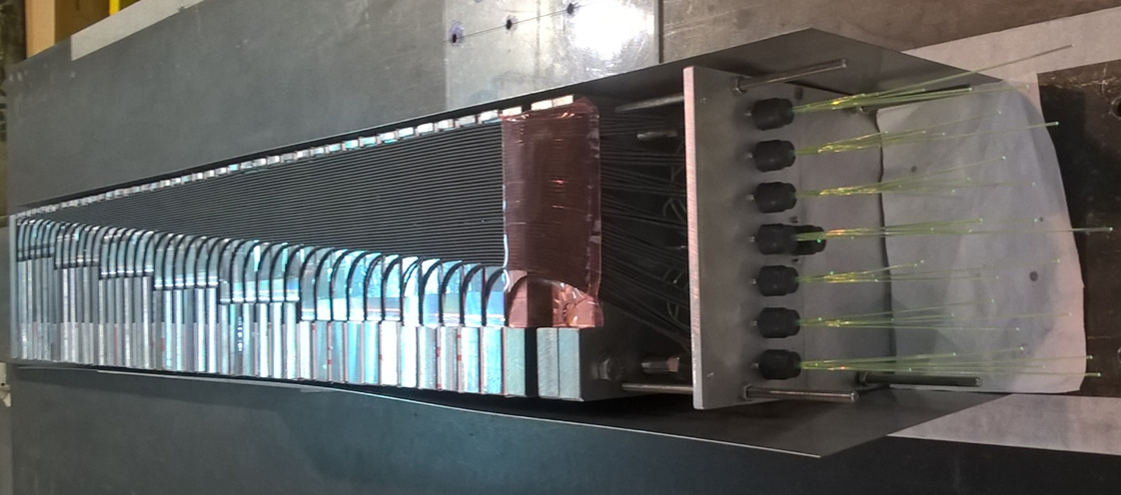
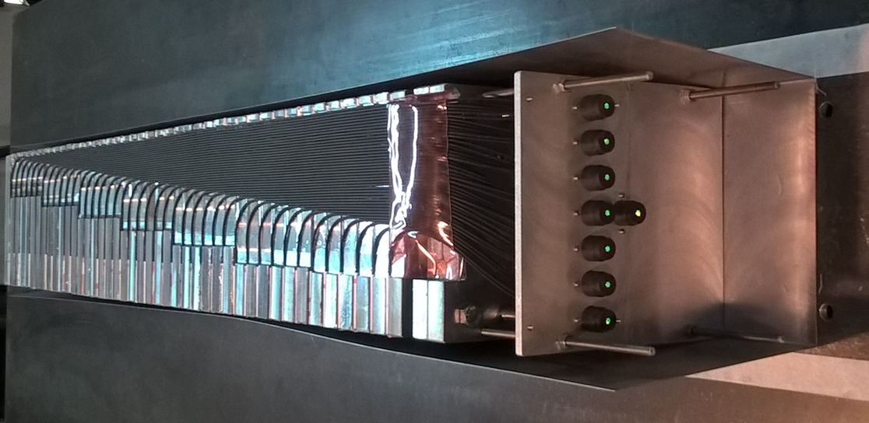
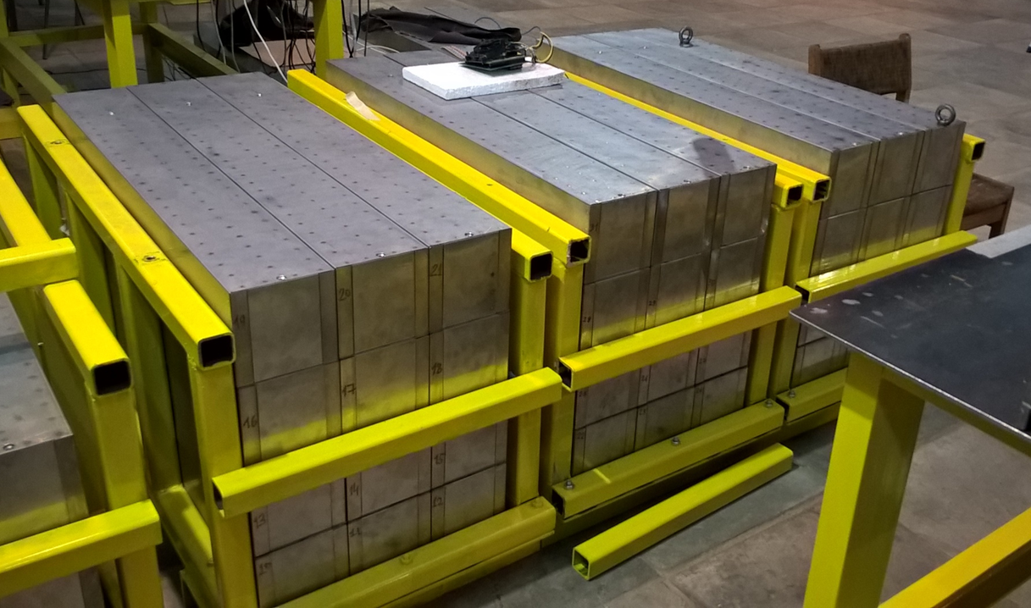
Stages of FHCal production: modules.
Lead and scintillators sandwiches in box.
Lead absorbers and mechanics.
WLS-fibers are aligned.
Optical connectors are polished.
At present, about 1/3 of FHCal modules are ready for the tests.
All FHCal modules will be ready in 2019.
Tests of modules with cosmic muons are done in parallel with the development of Front-End-Electronics and readout.

Slide 10
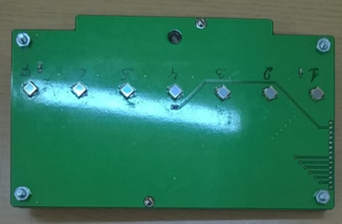
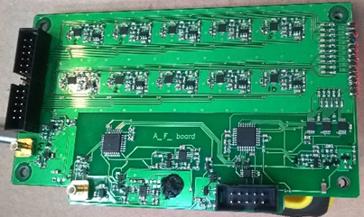
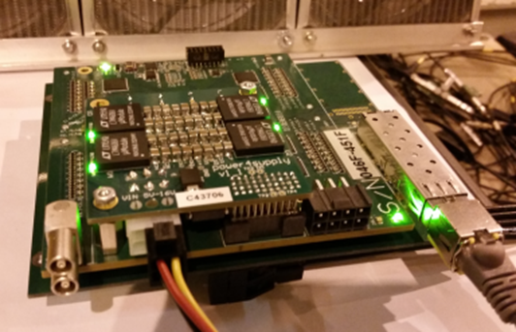
Photodiodes, FEE and readout electronics.
A first samples of FEE with MPPC photodetectors were developed and produced.
Photodetectors:
Hamamatsu MPPC: size – 3x3 mm²;
pixel -10x10 µm²;
PDE~12%.
Front-End-Electronics:
7 channels:
two-stage amplifiers; HV channels;
LED calibration source.
Amp
Integrator
ADC
MPPC
FEE
Δt ~ 50 ns
Δt ~ 200 ns
τ ~ 20ns
The readout electronics: FPGA based 64 channel ADC64 board, 62.5MS/s (AFI Electronics, JINR, Dubna).
Full readout chain was tested with cosmic muons and at beam!

Slide 11

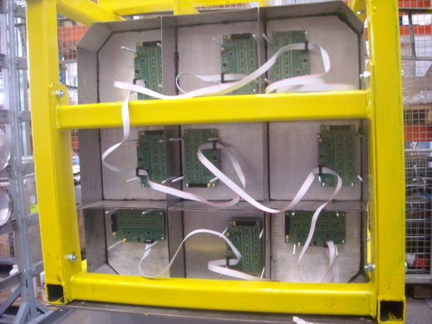
Test of calorimeter supermodule at CERN T9 line.
Proton momentum range: 3-10 GeV/c
Supermodule consists of 9 (3x3) CBM modules.
The FEE and readout are designed for MPD (BM@N) experiment.
Each module has 10 longitudinal sections with 10 SiPMs at the end.
Full size 60x60x160 cm³.
Weight ~ 4.5 tons.

Slide 12
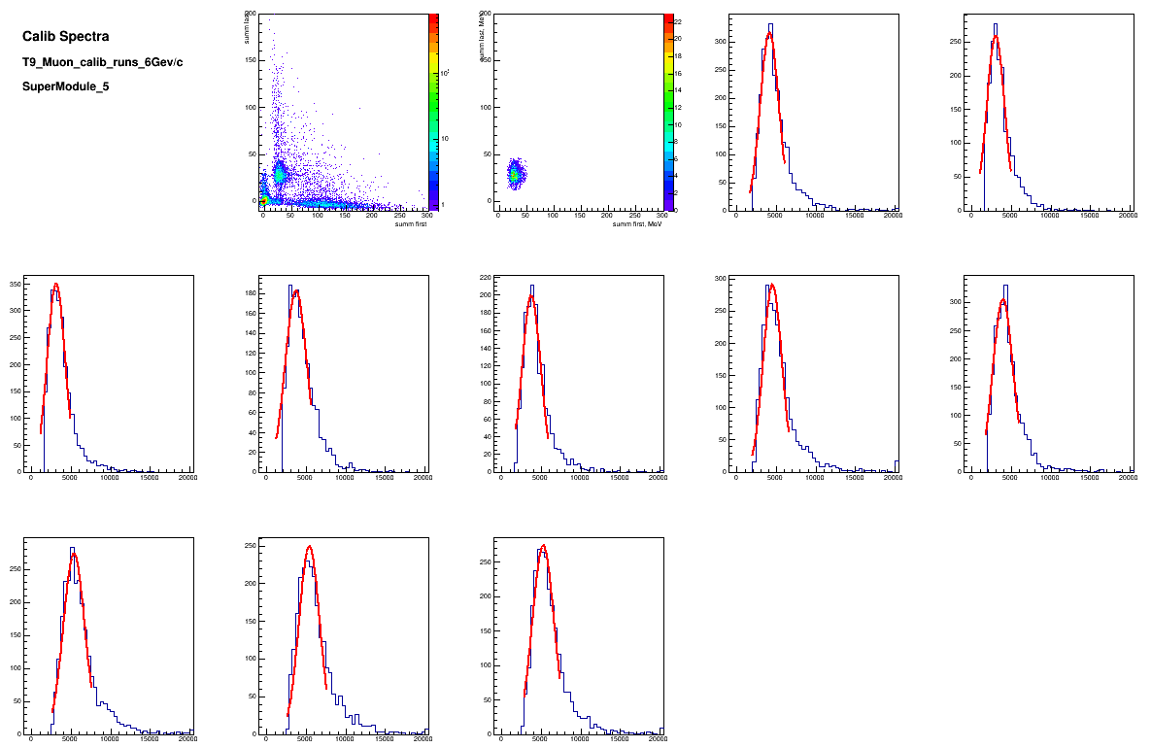
Calibration of longitudinal sections with beam muons, 6 GeV/c
Identification of muons – equal energy deposition in first and last half of modules.
Muons deposit
~5 MeV
in one section
E₂ [MeV]
Sect. 1
Sect. 2
E₂ [MeV]
E₁ [MeV]
E₁ [MeV]
Sect. 3
Sect.4
Sect. 5
Sect. 6
Sect. 7
Sect. 8
Sect. 9
Sect. 10
Muons energy deposition spectra in 10 sections
of central module.

Slide 13
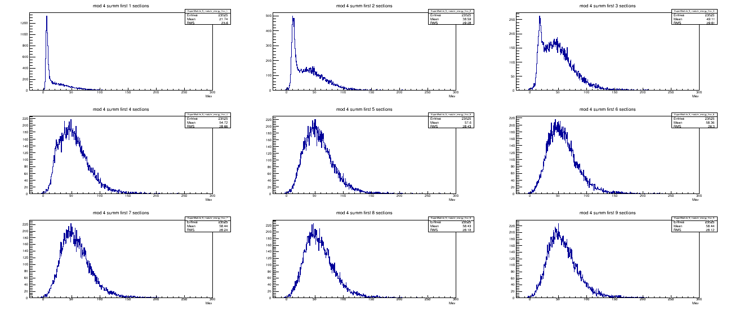
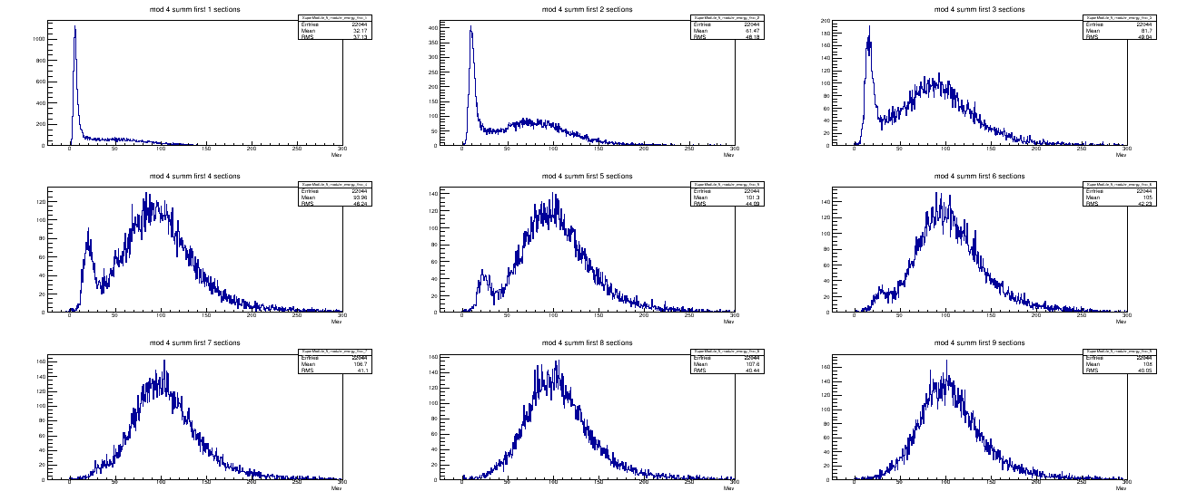
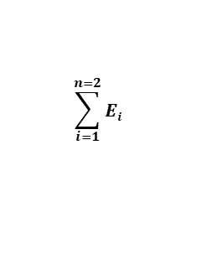
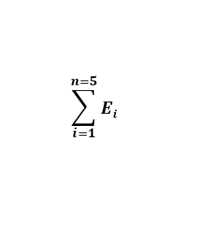
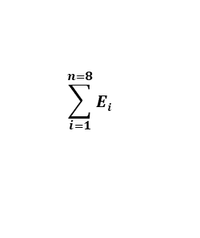
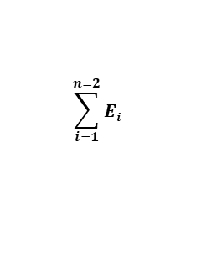
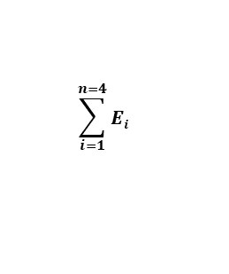
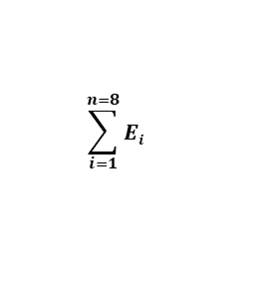
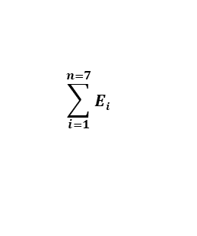
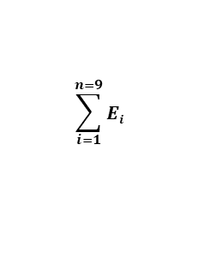
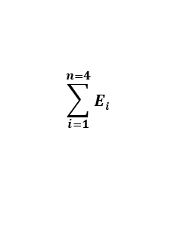
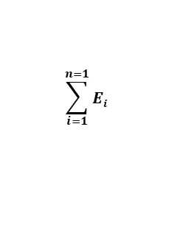
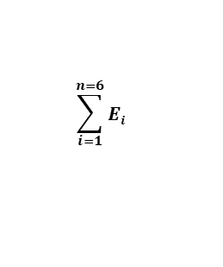
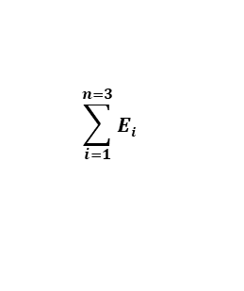
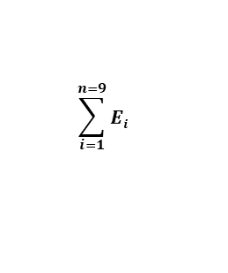
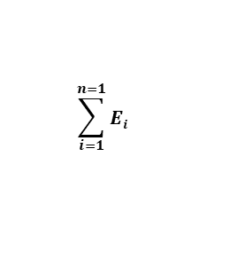
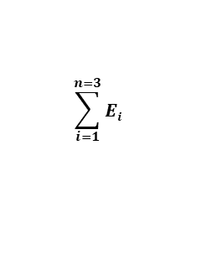
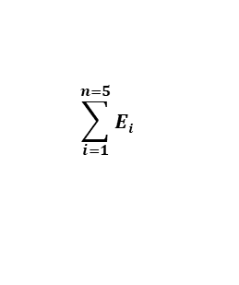
Spectra of energy sum in first n sections in central module,
protons 3 and 6 GeV/c.
p= 3 GeV/c
$$\sum_{i=1}^{n=1}{Ei}$$
$$\sum_{i=1}^{n=2}{Ei}$$
$$\sum_{i=1}^{n=3}{Ei}$$
Some part of protons has only ionizing energy loss without hadron shower in first sections.
MeV
MeV
MeV
$$\sum_{i=1}^{n=4}{Ei}$$
$$\sum_{i=1}^{n=5}{Ei}$$
$$\sum_{i=1}^{n=6}{Ei}$$
MeV
MeV
MeV
$$\sum_{i=1}^{n=7}{Ei}$$
$$\sum_{i=1}^{n=8}{Ei}$$
$$\sum_{i=1}^{n=9}{Ei}$$
MeV
MeV
p= 6 GeV/c
MeV
$$\sum_{i=1}^{n=1}{Ei}$$
$$\sum_{i=1}^{n=2}{Ei}$$
$$\sum_{i=1}^{n=3}{Ei}$$
In 7th section the low energy ionizing peak is disappeared. Energy spectrum has Gaussian shape.
MeV
MeV
MeV
$$\sum_{i=1}^{n=4}{Ei}$$
$$\sum_{i=1}^{n=5}{Ei}$$
$$\sum_{i=1}^{n=6}{Ei}$$
MeV
MeV
MeV
$$\sum_{i=1}^{n=7}{Ei}$$
$$\sum_{i=1}^{n=8}{Ei}$$
$$\sum_{i=1}^{n=9}{Ei}$$
MeV
MeV
MeV

Slide 14
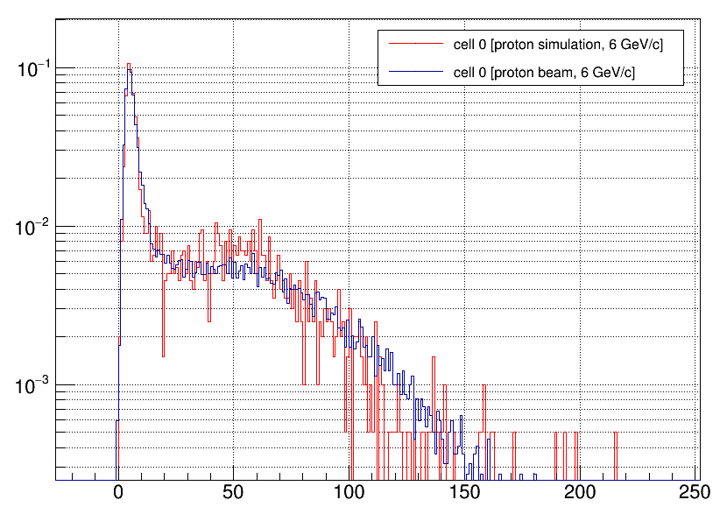
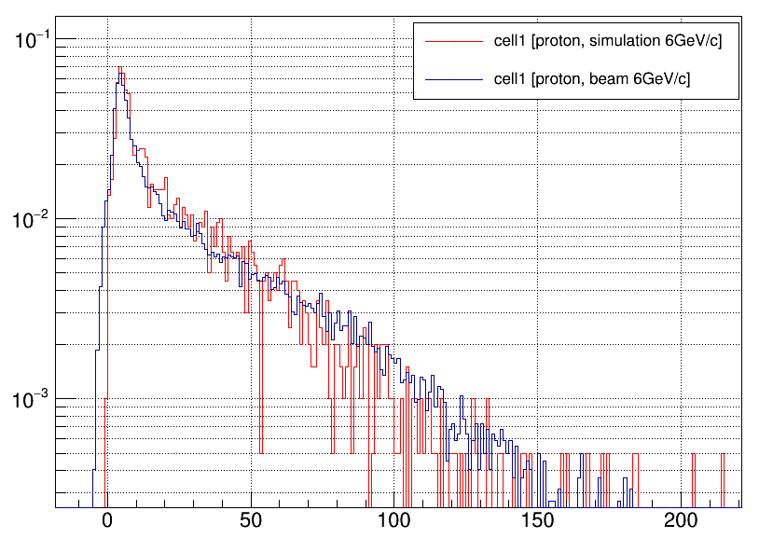
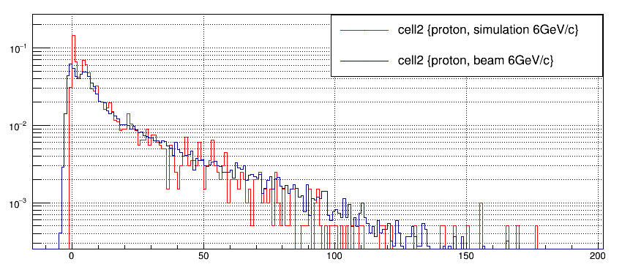
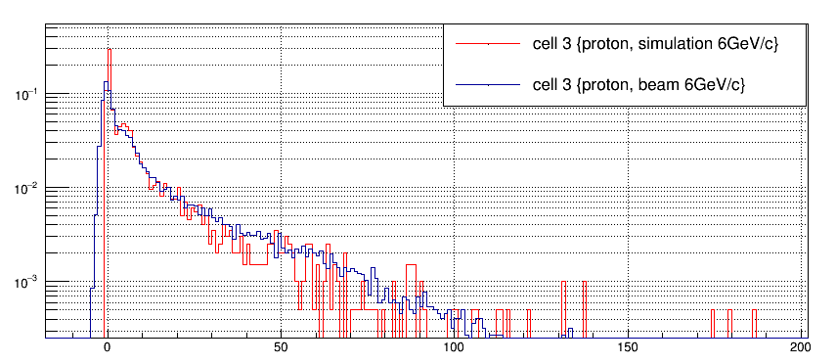
Comparison of amplitude spectra in sections, protons 6 GeV/c.
----- MC
----- experiment
----- MC
----- experiment
Section 1
Section 2
E [MeV]
E [MeV]
----- MC
----- experiment
----- MC
----- experiment
Section 3
Section 4
E [MeV]
E [MeV]
Experimental and simulation spectra are in good agreement.

Slide 15
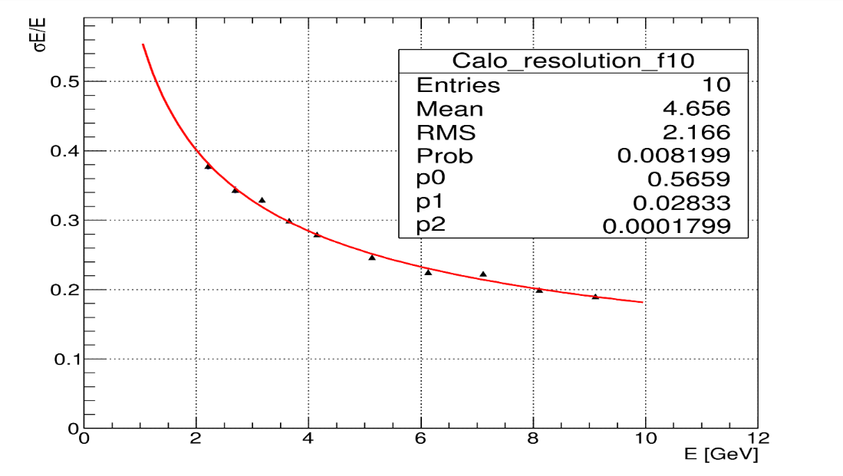
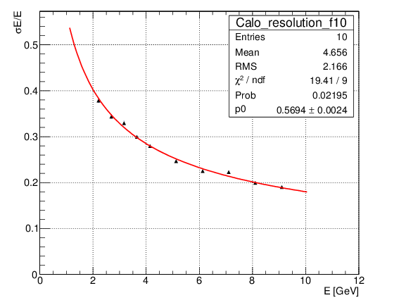
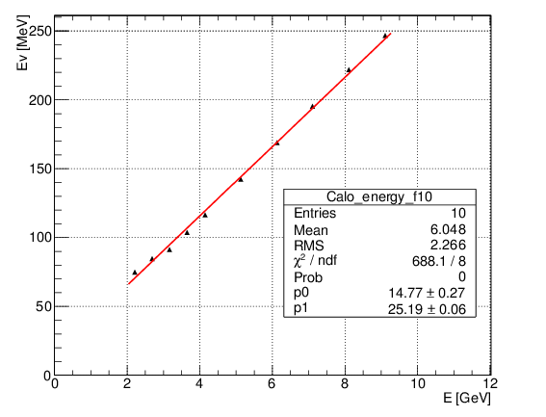


Energy resolution for full supermodule.
$\frac{σE}{E}=\frac{a}{\sqrt{E}}$⨁b ⨁ $\frac{c}{E}$
$$\frac{σE}{E}=\frac{a}{\sqrt{E}}$$
Linearity of response.
The stochastic term of ~56% practically doesn't depend on the fitting function.
Good agreement with MC results.
The noise term is almost zero.

Slide 16



Dependence of energy resolution on supermodule length.
Longitudinal profile of hadron shower in central module.
p= 6 GeV/c
The energy resolution for central module and for full supermodule is practically constant starting from the 7 longitudinal sections.
Central module
Full supermodule
Length of 4λ_{I} or 7 longitudinal sections is optimum for momentum range 3-6 GeV/c

Slide 17

Open issues.
Mechanical support.
FEE and readout. Final variant?
Simulations: detector performance and physics performance.
Calibration. Cosmic muons, geometry of tracks. Simulations.
Power supplies. Mounting of readout elements. Full integration to MPD.
Operation manpower.
Magnet pole with FHCal (left) and endcup detectors (right).

Slide 18


Proposition of FHCal for BM@N.
Present ZDC at BM@N
No beam hole.
central part consist of 36 modules with sizes 7.5×7.5 cm²,
peripheral part contains 68 modules of 15×15 cm².
Total number of modules - 104.
MPD/CBM synergy for BM@N: Why?
MPD modules + CBM modules
Modern technics;
Light yield ~x10 higher;
Detection of low energies;
Stable operation at high count rates;
Unification of approaches;
Experience in operation for later MPD/CBM experiments.

Slide 19



Variants of FHCal for BM@N.
Active beam dump;
Backscattered particles;
Problems with heavy fragments!
MPD modules
No active beam dump;
No backscattered particles;
No heavy fragments!
CBM modules
Event plane resolution: the same in both variants!

Slide 20



Problems with centrality.
Energy deposition is not monotonic in both cases even without beam hole!
Simulations: LA-QGSM
Au+Au@4.5 AGeV
Leak of heavy ions in beam hole.
What are these events?
Correlations between energy asymmetry and energy deposition are much worse than in case of MPD/NICA.
Some heavy ions with A>100 deposit energy through e.-m. ionizing loss without hadron cascade.
Centrality measurements are not simple in both geometries!

Slide 21



Conclusion.
The FHCal project is well developed.
But there are a few open questions.
New manpower for both hardware and software is desired!
First CBM module is already installed at BM@N.
Ar-peak in CBM module.
Shower profile
MeV
MeV
section#
Notes:
That is all. In conclusion I would like to say that:

Slide 22
Thank you!

