Slide 1

MPD physics simulation: status and plans
Vadim Kolesnikov
(VBLHEP, JINR)
on behalf of the group:
V.Vasendina, A.Mudrokh, V.Kireyeu, A.Zinchenko,
K.Shtejer, N.Geraksiev, M.Iieva, D.Suvarieva, L.Yordanova
MPD and BM@N Collaboration meeting
JINR, Dubna, April 11-13, 2018

Slide 2
Outline
Introduction
NICA/MPD goals for the period 2021-23
MPD physics cases for 2021-23: status of development
Summary

Slide 3
HIC experiments at finite μ_{B}: landscape prior to 2020
20??
NA60+ (SPS)
FUTURE
20??
CBM (FAIR SIS-300)
2025
CBM (FAIR SIS-100)
2020
MPD, BM@N (NICA)
NA60 (SPS)
PRESENT
BES II
STAR (RHIC)
STAR (RHIC)
HADES (GSI)
2
4
6
8
20
40
60
80
√S_{NN} [GeV]
1
10
10²

Slide 4
RHIC/STAR: BESII plans (2019-20)
In addition: BES II Fixed Target Mode
Proposal to extend CMS energy range
from 7.7 down to 3 GeV

Slide 5
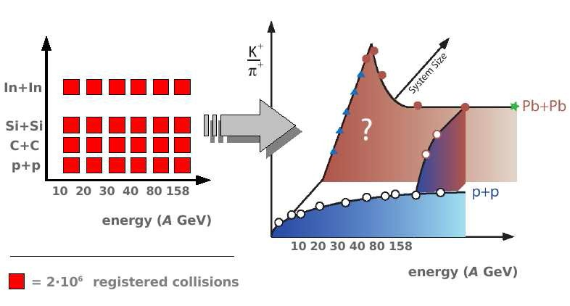
NA61/SHINE at the CERN/SPS plans (beyond 2020)
Data taking schedule:
• Taken data (green)
• Approved (red)
• Proposed extensions (gray)
NA61 Program:
2D energy-system size scan is aimed at the search for CEP
and unveil the properties of deconfinement phase transition
End of 2D energy-system size scan in 2017/18, data analysis up to 2020
Study of charm production after LS2 (not yet approved)

Slide 6
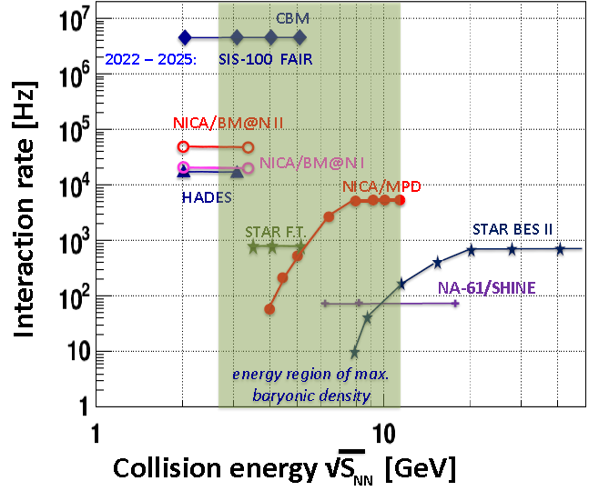
NICA : Structure, beam specie, and event rate
Beam | Nuclotron beam intensity (particle per cycle)
 | Current | Ion source type | at NICA
p | 3⋅10¹⁰ | Duoplasmotron | 5⋅10¹²
d | 3⋅10¹⁰ | --- ,, --- | 5⋅10¹²
⁴He | 8⋅10⁸ | --- ,, --- | 1⋅10¹²
d↑ | 2⋅10⁸ | SPI | 1⋅10¹⁰
⁷Li | 8⋅10⁸ | Laser | 5⋅10¹¹
^{11,10}B | 1⋅10^{9,8} | --- ,, ---
¹²C | 1⋅10⁹ | --- ,, --- | 2⋅10¹¹
²⁴Mg | 2⋅10⁷ | --- ,, ---
¹⁴N | 1⋅10⁷ | ESIS (“Krion-6T”) | 5⋅10¹⁰
⁴⁰Ar | 1⋅10⁹ | --- ,, --- | 2⋅10¹¹
⁵⁶Fe | 2⋅10⁶ | --- ,, --- | 5⋅10¹⁰
⁸⁴Kr | 1⋅10⁴ | --- ,, --- | 1⋅10⁹
¹²⁴Xe | 1⋅10⁴ | --- ,, --- | 1⋅10⁹
¹⁹⁷Au | - | --- ,, --- | 1⋅10⁹
Linac HILac
KRION
Booster (25 Tm)
storage of
(2 ÷ 4)×10⁹ ions,
acceleration
up to 600 MeV/u
Ion sources
Linac LU-20
Fixed Target Area
Stripping (80%) ¹⁹⁷Au³¹⁺ => ¹⁹⁷Au⁷⁹⁺
Nuclotron (45 Tm)
injection bunch
~ 2×10⁹ ions
acceleration up to
1 - 4.5 GeV/u
IP-2
Two SC collider rings
~ 2 x 22 injection cycles
22 bunches per ring
IP-1
Energy: √s_{NN}=4-11 GeV (Au,collider), up to 26 GeV (p+p), E/A=2-6 GeV (fixed target), Beams: from p to Au. L~10²⁷ cm⁻² c⁻¹ (Au), ~10³² cm⁻² c⁻¹ (p,d )

Slide 7
NICA/MPD experimental strategy in 2021-2023
Experimental strategy: energy and system size scan from 4 to 11(13,25) GeV to measure a variety of signals systematically changing collision parameters (energy & system size). Reference p+p data will be taken in the same experimental conditions.
Beam | CM Energy, AGeV | L 2021-23, cm⁻² c⁻¹ | L >2023, cm⁻² s⁻¹
Heavy ions (Au) | 11 | 5 . 10²⁵ | 10²⁷
Intermediate (Z/A~0.45) | 13 | 3 . 10²⁶ | 10²⁹
p | 25 | ~10²⁹ | 10³²
Limitations by the accelerator:
lower luminosity (w/o electron cooling for the collider) <10²⁶ @ 7-11A GeV and ~10²⁴ at 4A GeV
extra reduction by 40% because of a larger interaction region (beam diamond)
Event rates (rough estimates)
Au+Au (MinBias, duty factor=0.5) ~100 Hz at 7-11A GeV and only 2 Hz at 4A GeV. For a 10-day beam time
period per energy → ~ 90M collisions at 7-11 GeV
Intermediate: ~100M in 4 days at 7-11 GeV
Beam | Luminosity (cm ⁻² c ⁻ ¹) |  | Data sample per 1 week at √s = 4 GeV | Data sample per 1 week at √s = 11 GeV
 | √s=4 GeV | √s=11 GeV
¹⁹⁷Au | 7 .10²⁴ | 5 . 10²⁵ | 9.1 . 10⁶ | 6.3 . 10⁷
The Goal now is: to define a data taking scenario and potential probes for 2021-23

Slide 8
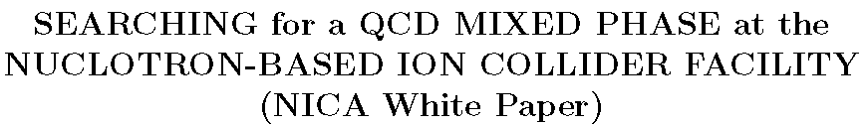


http://nica.jinr.ru
NICA is ideally suited for exploring the transition between the hadronic phase and
the new plasma phase. This exploration is the top priority of the NICA program
The first round of NICA experiments should concentrate on a variety of diagnostic observables that have already been employed in experimental programs at RHIC and SPS
The detector will collect simultaneously centrality-selected high-precision data on double differential spectra of identified hadrons. In consequence, freeze-out conditions will be
precisely established for collisions in the transition domain.
We recommend that the MPD detector at NICA will be optimized for the study of fluctuations
and correlations of bulk properties and that a primary goal will be to measure the excitation
functions and the dependence of fluctuations & correlations on centrality and system size.
In the second stage one should consider measurements of open-charm hadrons,
di-leptons, and di-photons at NICA.

Slide 9
MPD physics cases
Bulk properties, EOS
particle yields & spectra, ratios, femtoscopy, flow
measure: γ, π, K, p, Λ, Ω, (anti)particles, light nuclei
In-Medium modification of hadron properties
onset of low-mass dilepton enhancement
measure: ρ, ω, φ → e+e-
Deconfinement (chiral) phase transition at high ρ_{B}
enhanced strangeness production
Chiral Magnetic (vortical) effect, Λ polarization
QCD Critical Point
event-by-event fluctuations and correlations
Strangeness in nuclear matter
hypernuclei

Slide 10
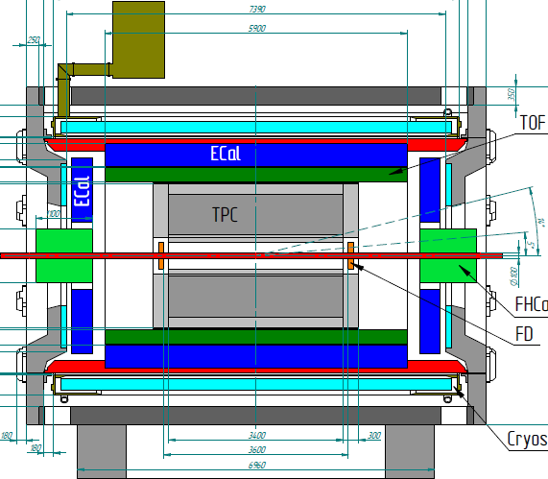
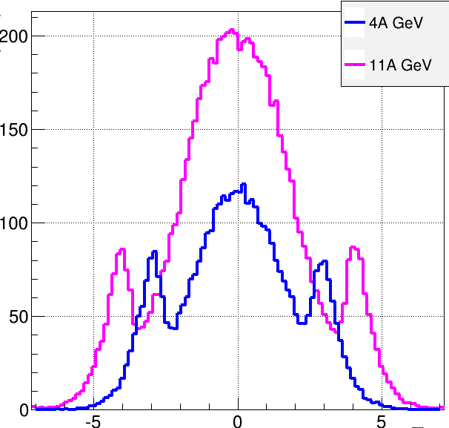
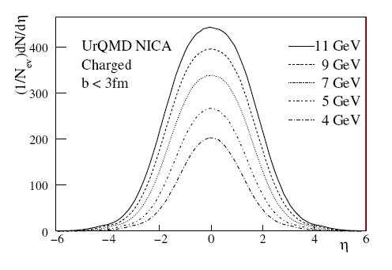
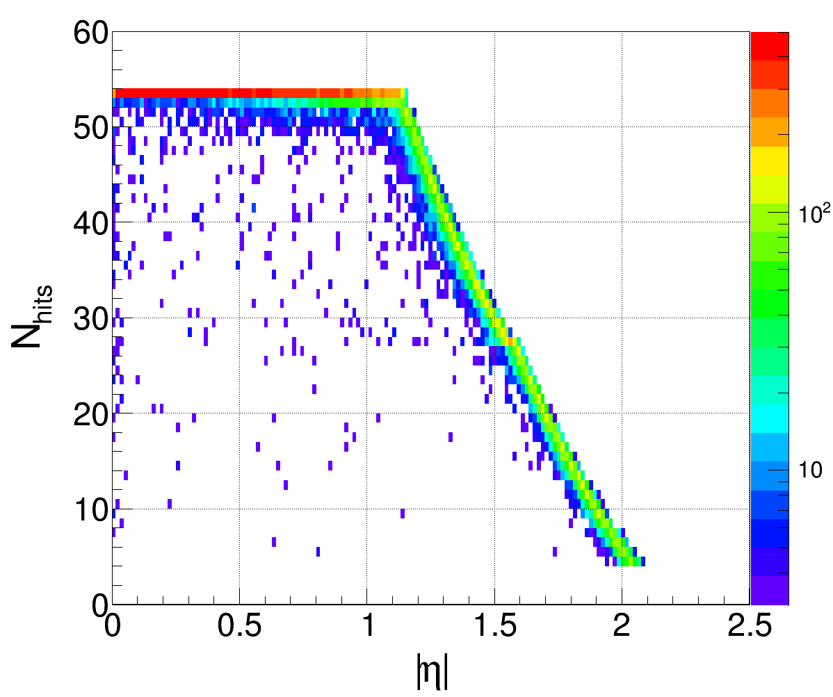
MultiPurpose Detector for A+A collisions @ NICA (Stage’1 setup)
η=1.2
MPD at Stage’1:
TPC tracking: |η|<1.6 (Npoints>15)
TOF & ECAL coverage: |η|<1.2
PID: combined |η|<1.2, 0.1<pT<4 GeV/c,
limited in 1.2<|η|<1.6 (only dE/dx)
Barrel: ~60% for charged (σ_{π}~1.3)
Phase-space coverage & event characterization
Low material budget, magnetic field – pT cutoff
Number of points – tracking and PID

Slide 11
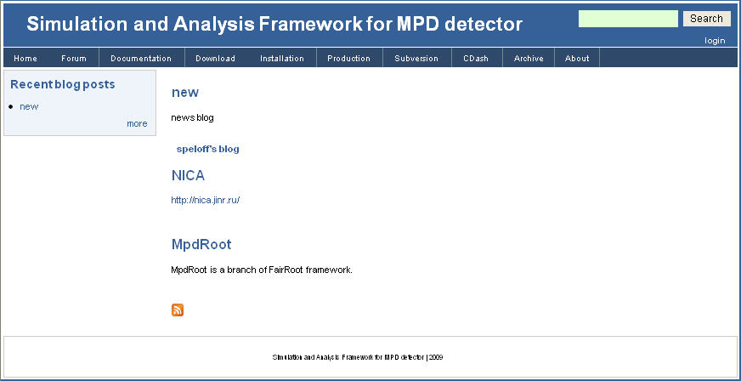
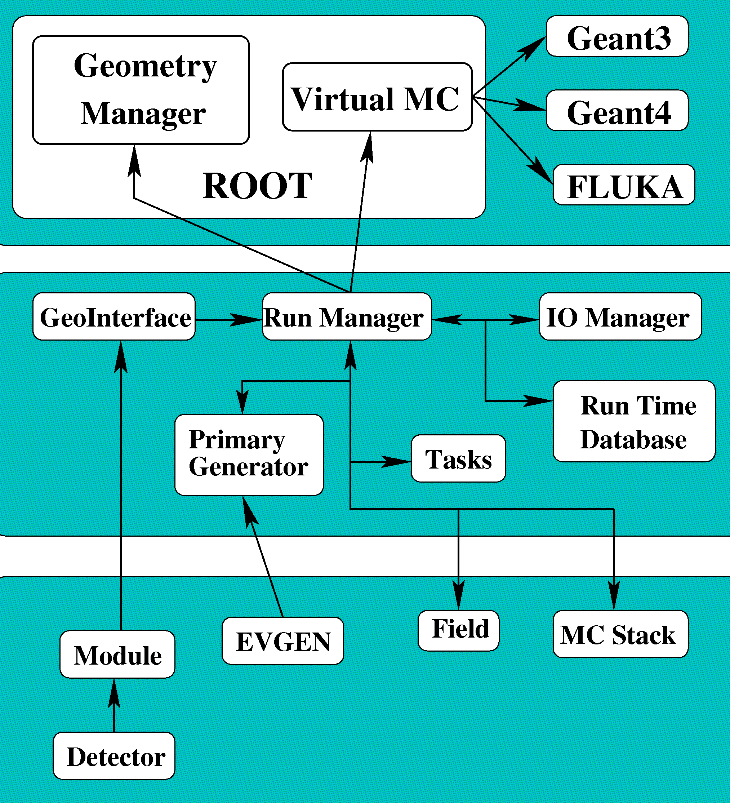
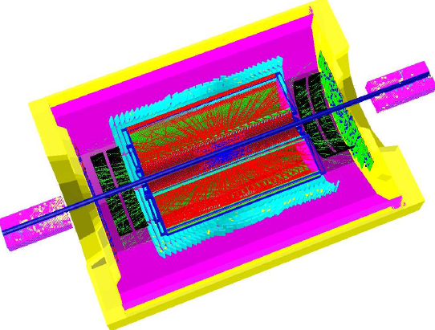
MPD simulation
Status of event reconstruction in MPD
Simulation of MPD physics cases
Detector geometry
Event generators
Transport (Geant3,4)
Response simulation
Reconstruction algorithms
Analysis tools

Slide 12
Event reconstruction chain in MPD
Tested with Monte Carlo data only, but can be applied to real data as well
Event reconstruction
Detector response simulation (TPC,TOF, FHCAL, ECAL)
Clustering, tracking, matching (TPC, TOF, ECAL)
Vertexing & pattern recognition (TPC)
Event characterization (FHCAL)
existing developing

Slide 13
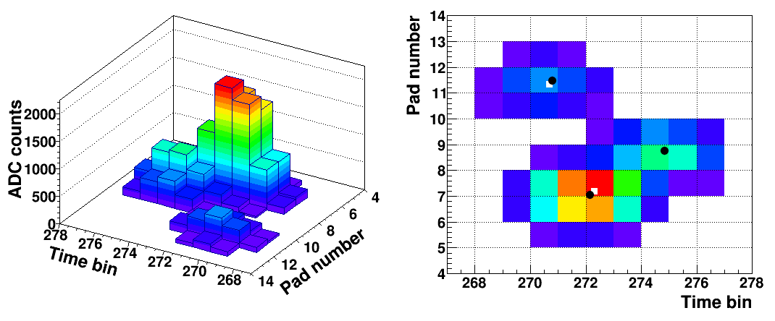
Realistic tracking in MPD
1 person
Microsimulation & tracking procedure
Primary ionization (ionization clusters)
Drift and diffusion of ionization electrons
Gas gain fluctuations (Polya distribution)
Pad response (charge distribution on pad plane)
Electronics shaping
Signal digitization (ADC overflow)
Bayesian unfolding for cluster topologies
Two-pass Kalman filtering
Primary & secondary vertexing with Kalman filtering
Well advanced part of the reconstruction chain
But! Maintained by a single person, no enough power
to test and develop for physics

Slide 14
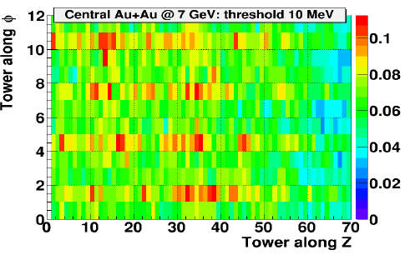
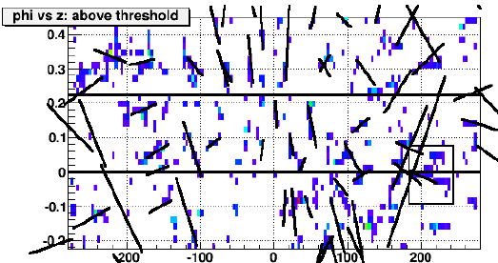
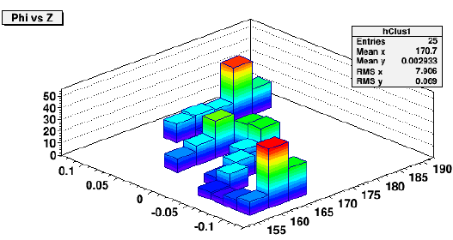
ECAL simulation : recent progress
1.5 person(s)
Detailed detector response in central Au+Au
(GEANT4 as a transport)
Cluster finder algorithms for different specie
(hadrons, electrons, gammas)
Matching of ECAL clusters to charged tracks
reconstructed in TPC
Was progressing slowly since was maintained by 2 persons
Significant extension of the ECAL group (China, ITEP, JINR)
and efforts dedicated to simulation&analysis – waiting for more
rapid progress

Slide 15
Comments to the MPD reconstruction
(from the physics analysis point of view)
There has to be a dedicated group (as a PWG, may be) responsible
for the event reconstruction and DST production
They have to have the group leader (Coordinator), clear vision and strategy
for the overall detector alignment/system-wise calibration/reconstruction/DST/etc.,
plus necessary software tooling in hands

Slide 16
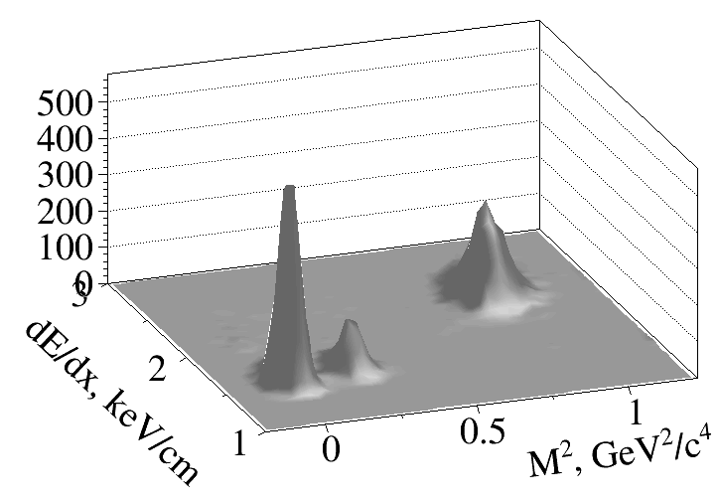
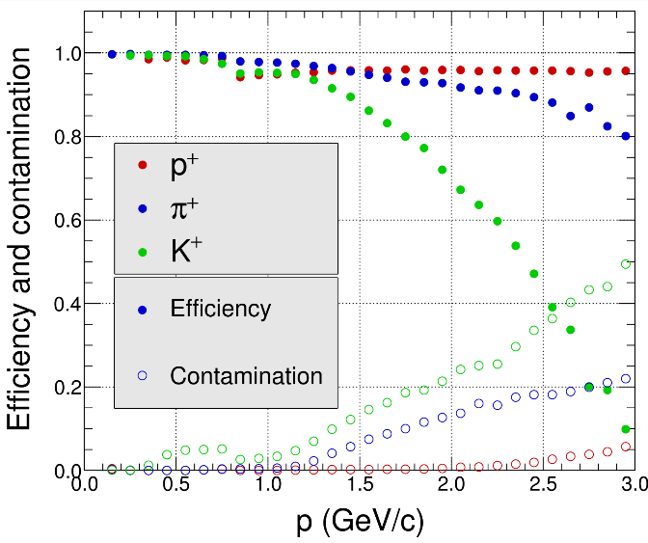
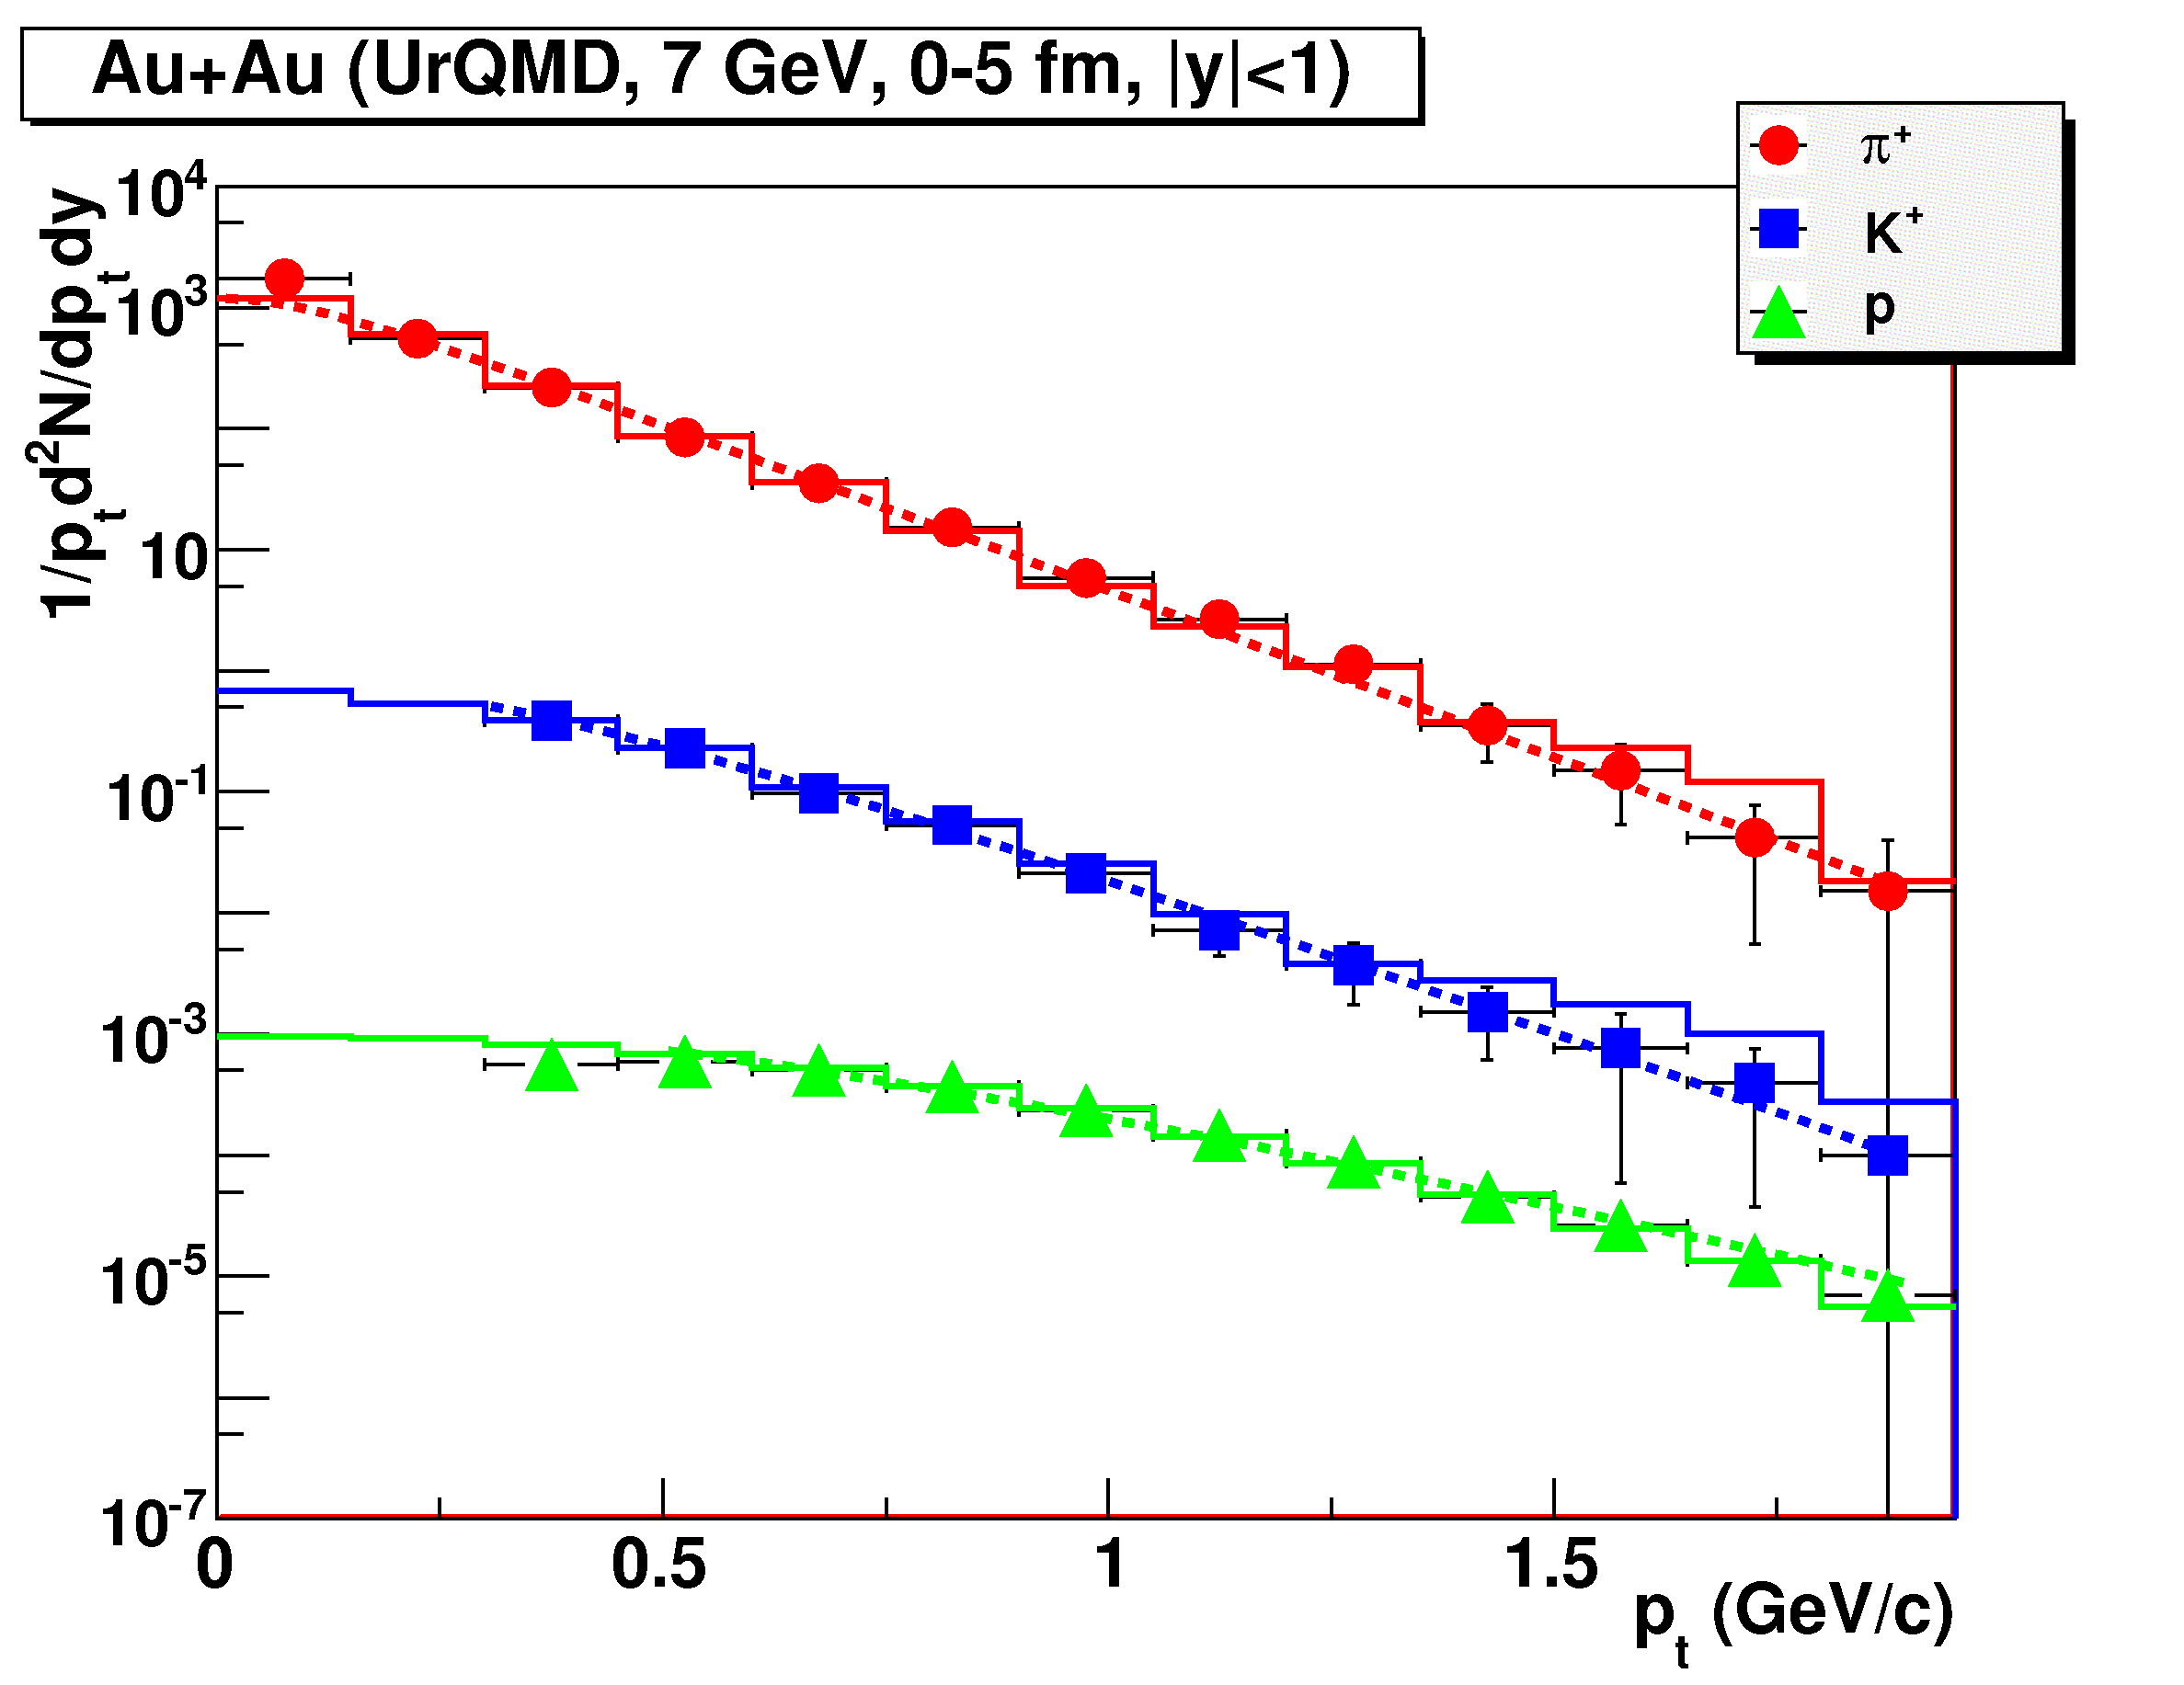
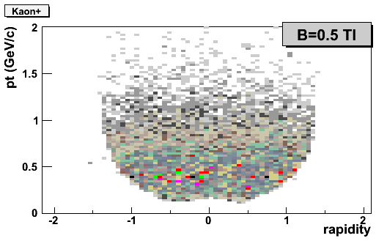
MPD performance study. Bulk properties (spectra & yields)
2 persons
Full reconstruction chain, realistic PID, corrections
Hadron spectra :large rapidity & pT-coverage
dE/dx+TOF
Hadron yields and spectra are good probes for Day’1 physics (source bulk properties, EOS, phase transition, reaction dynamics)
Fruitful and simple probes, though not trivial analysis (PID for rare specie like pbars, extrapolation issue, feeddown, etc.)

Slide 17
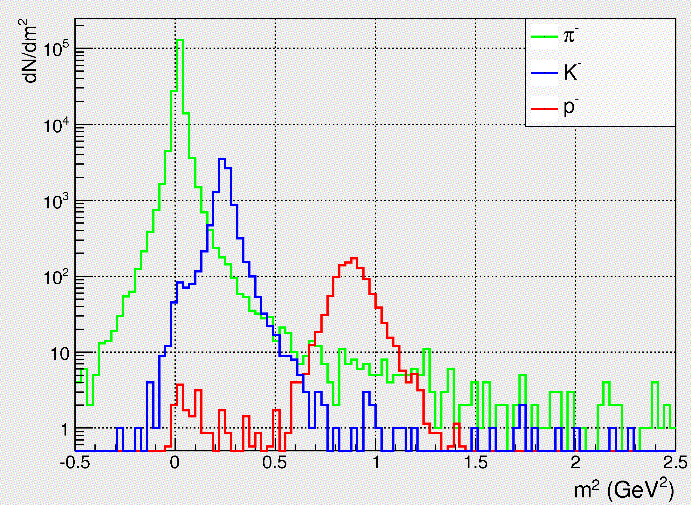
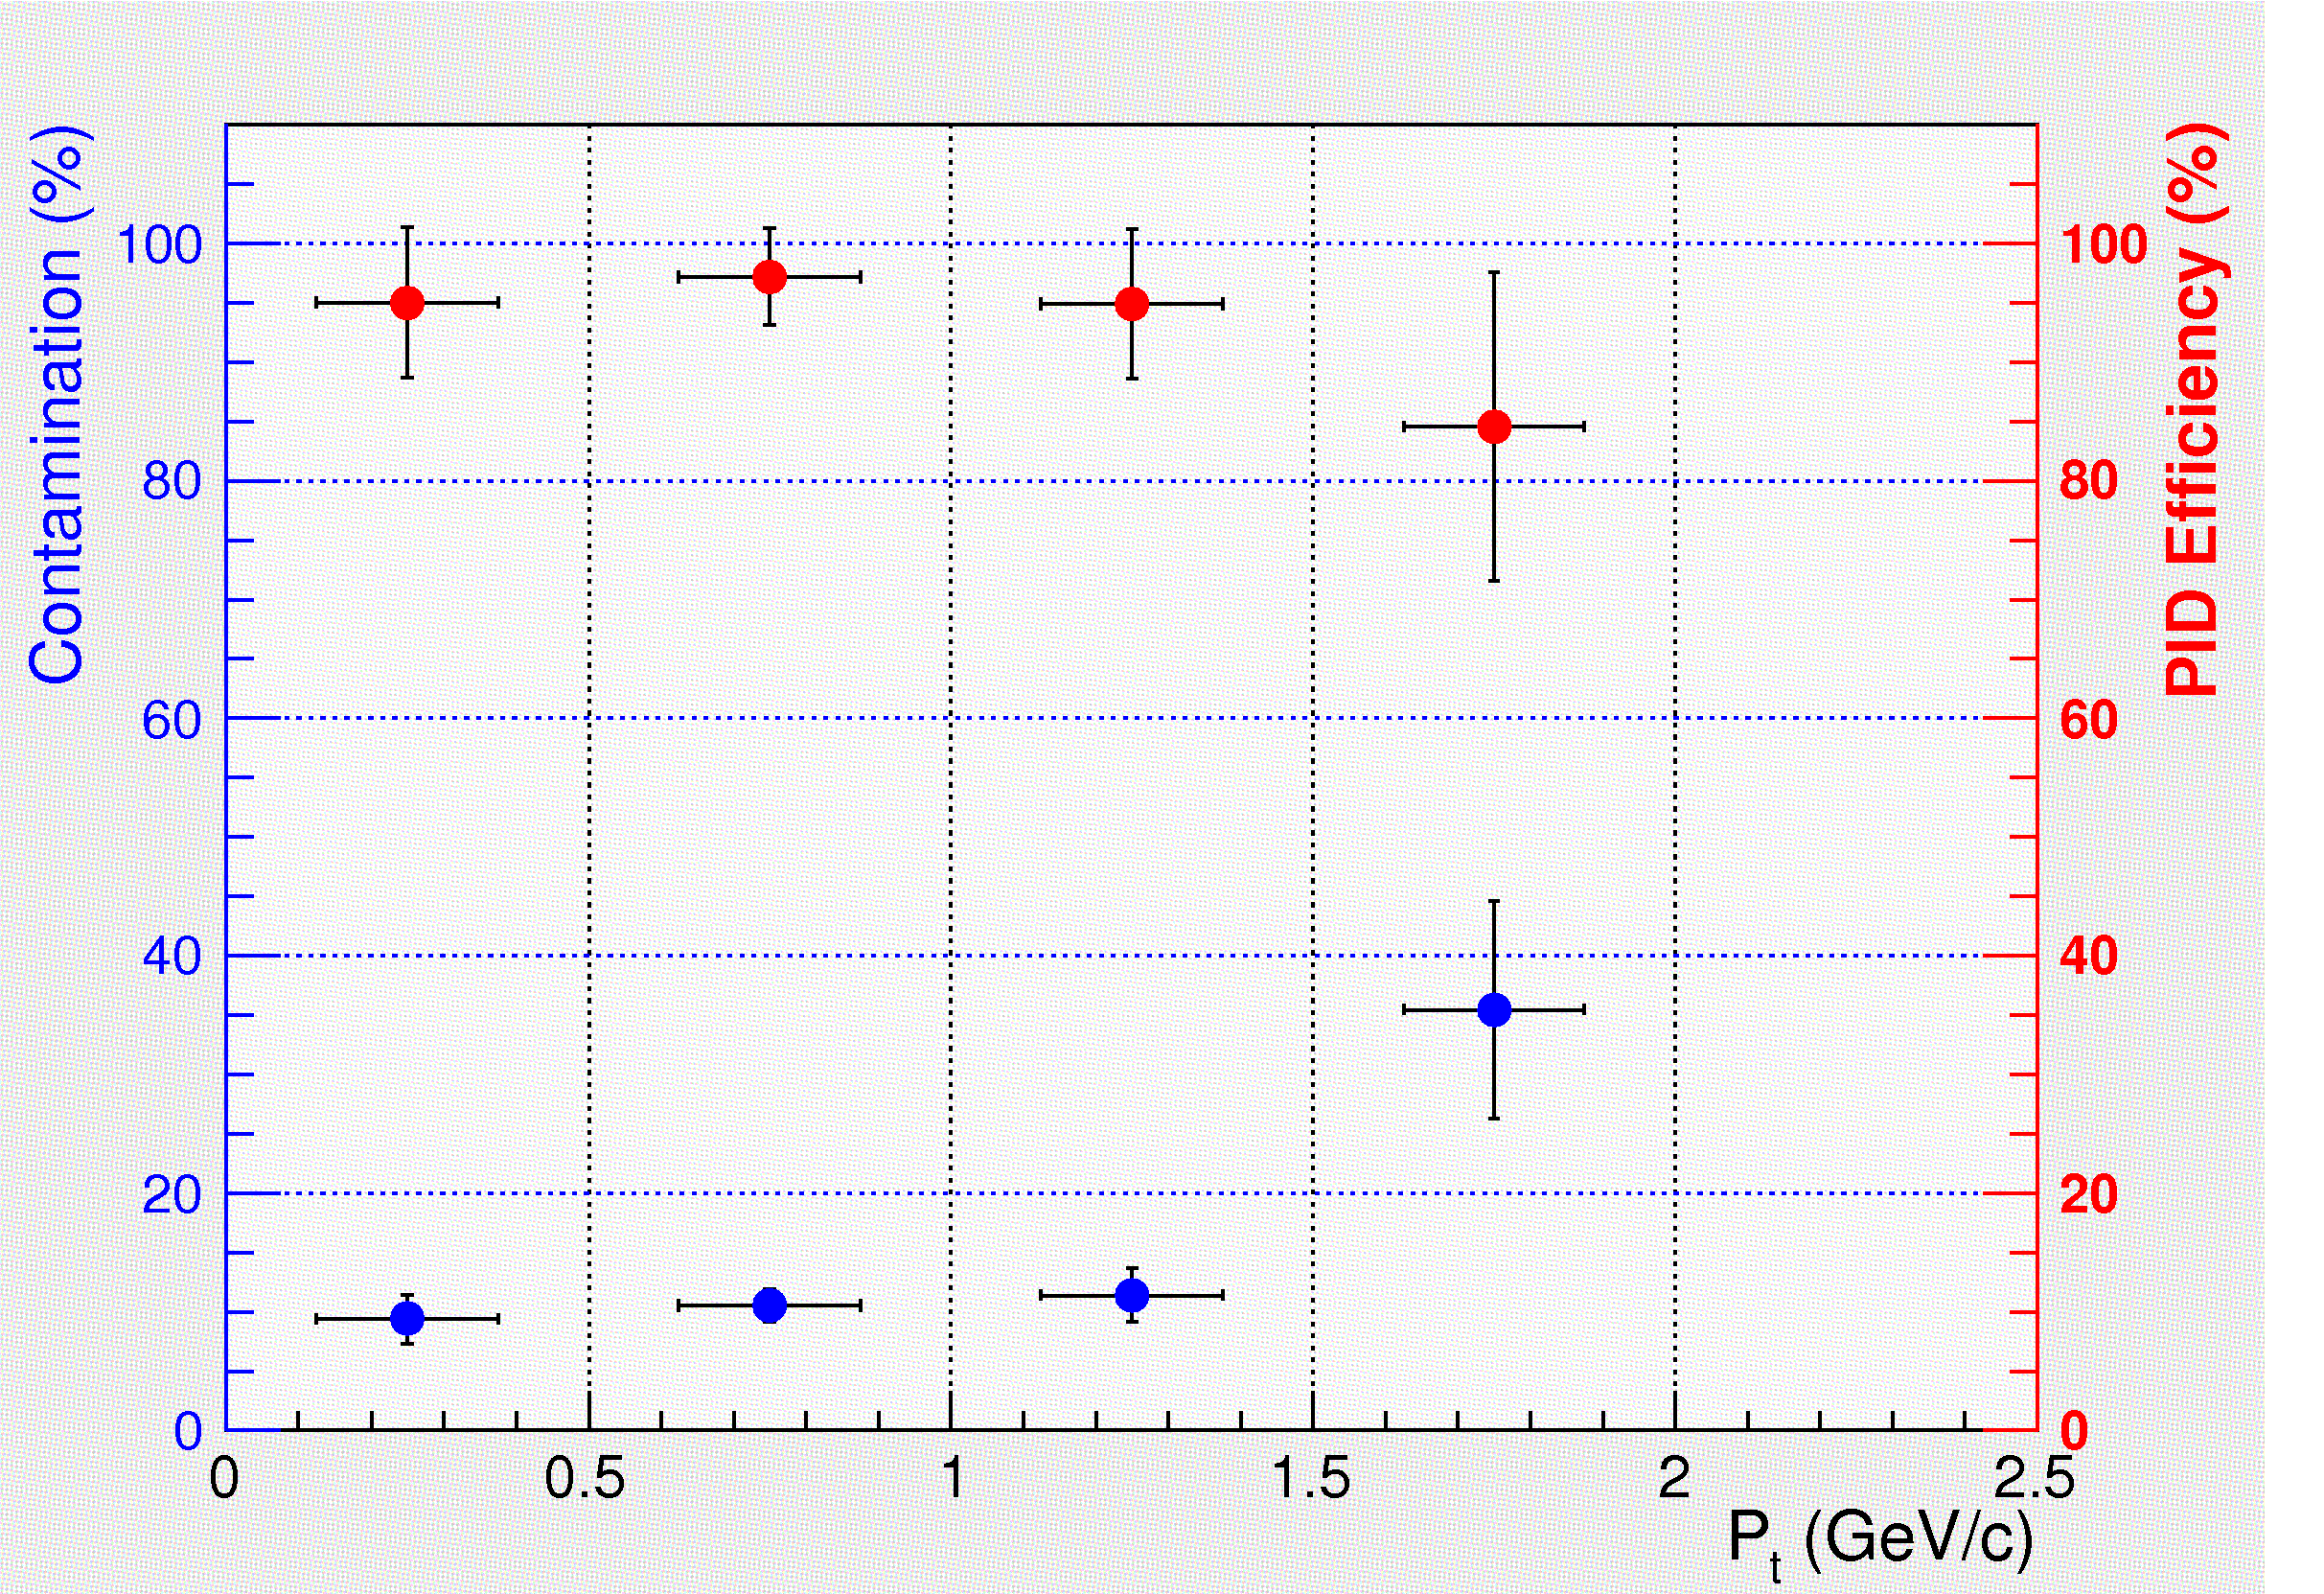
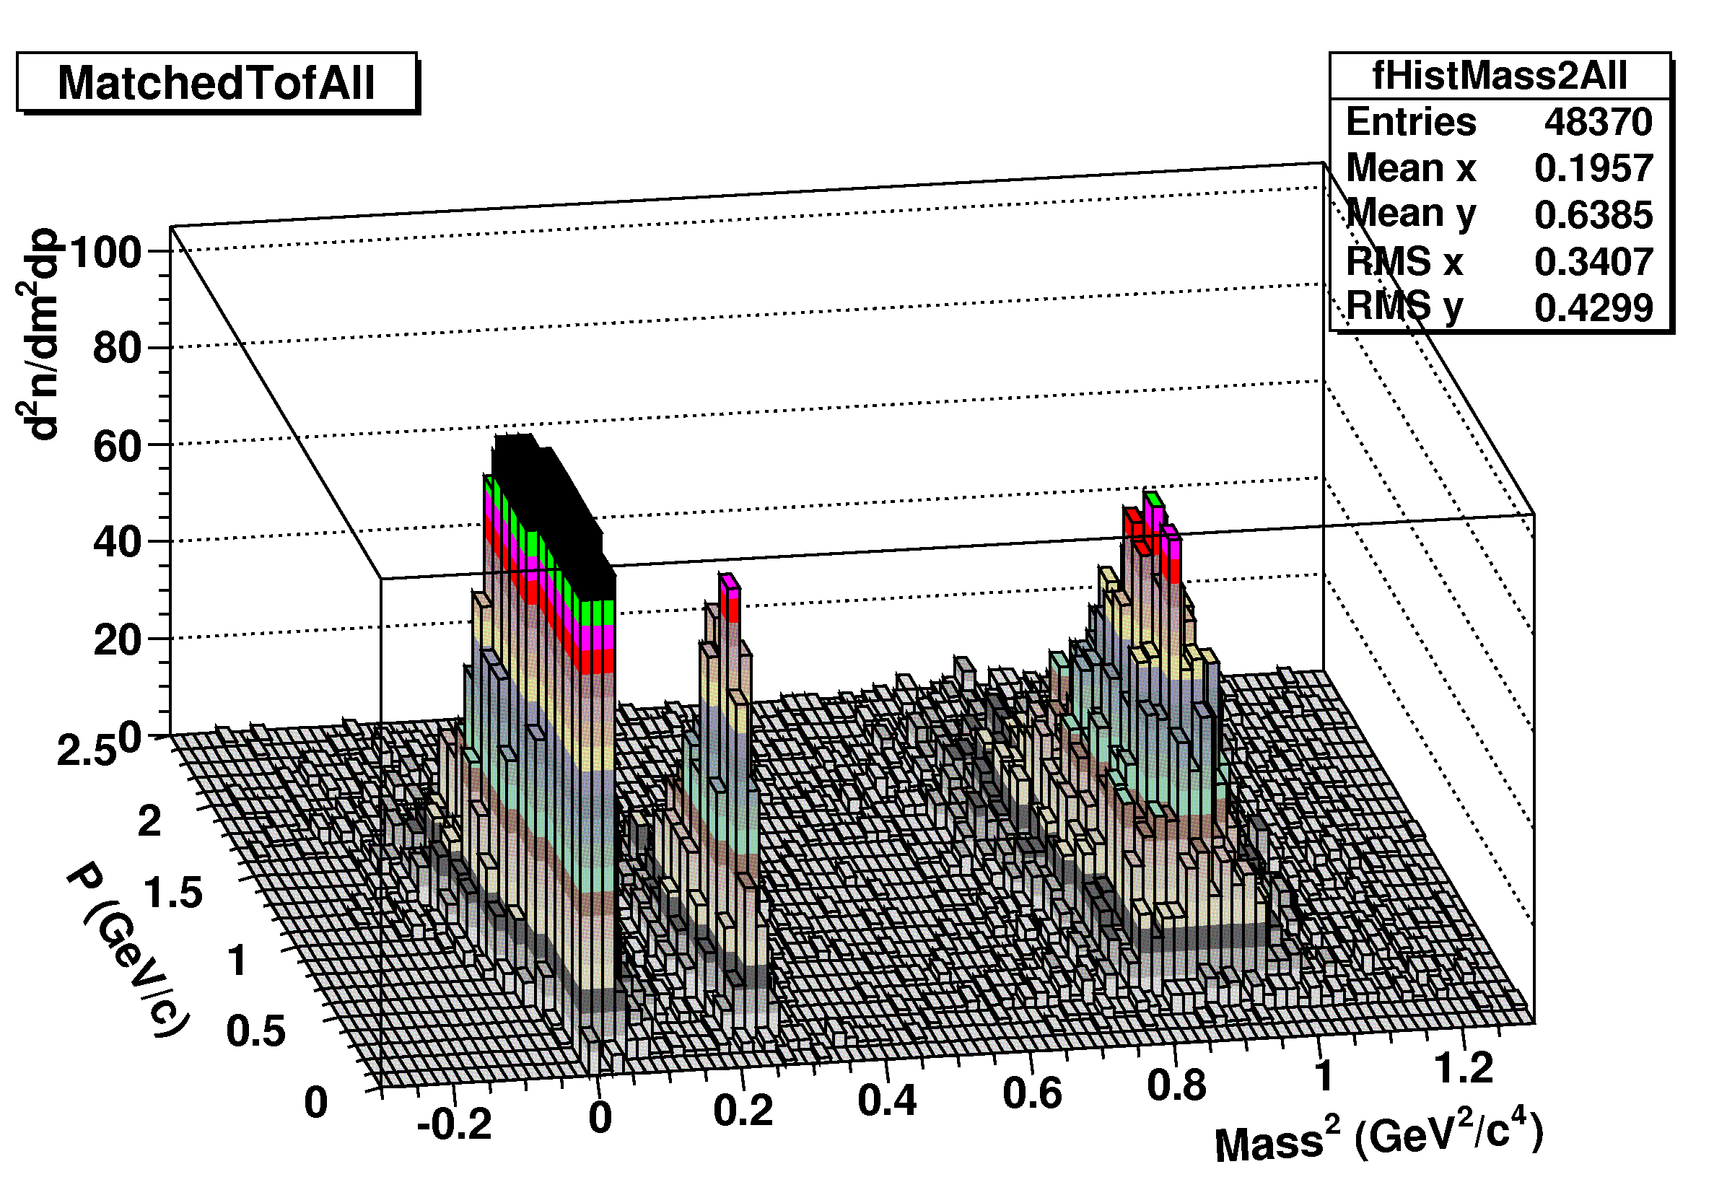
PID (TOF) performance for pbars
Fig.1. Mass-squared (from TOF) for
positively charged hadrons.
(UrQMD, central Au+Au @ √s=4 GeV)
p < 2 GeV/c
Fig. 1.
Fig. 2
Fig. 1
Antiprotons (constrains):
π-contamination at pT>2 GeV/c
which Increases with π/pbar
An annihilation trigger
from ECAL? (under study)
Fig.2. Mass-squared (TOF) for
negatively charged hadrons
(UrQMD, Au+Au at √s=11 GeV)
11

Slide 18
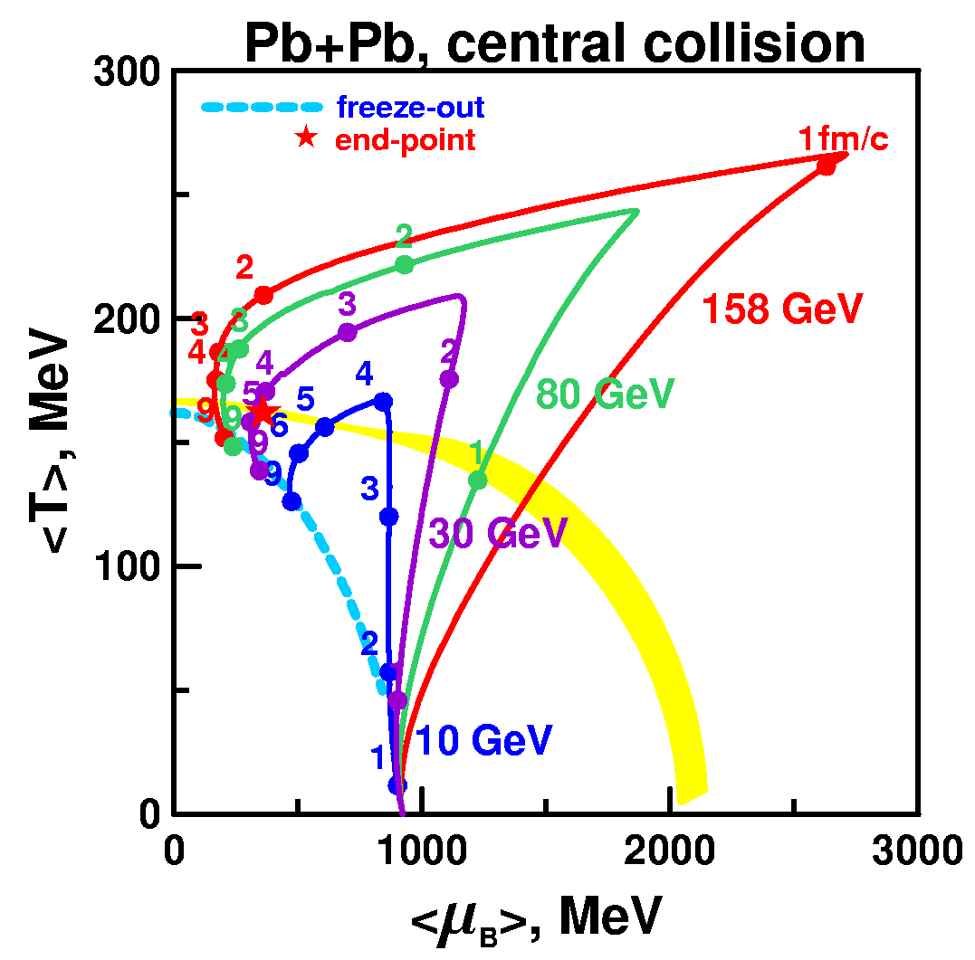
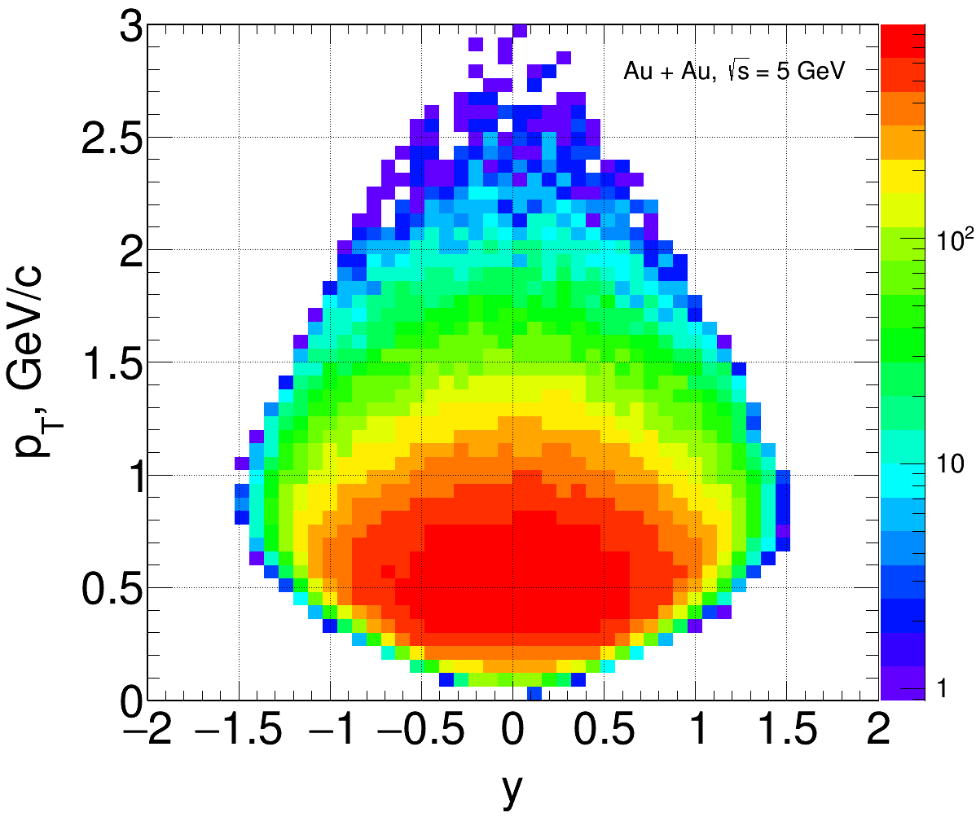
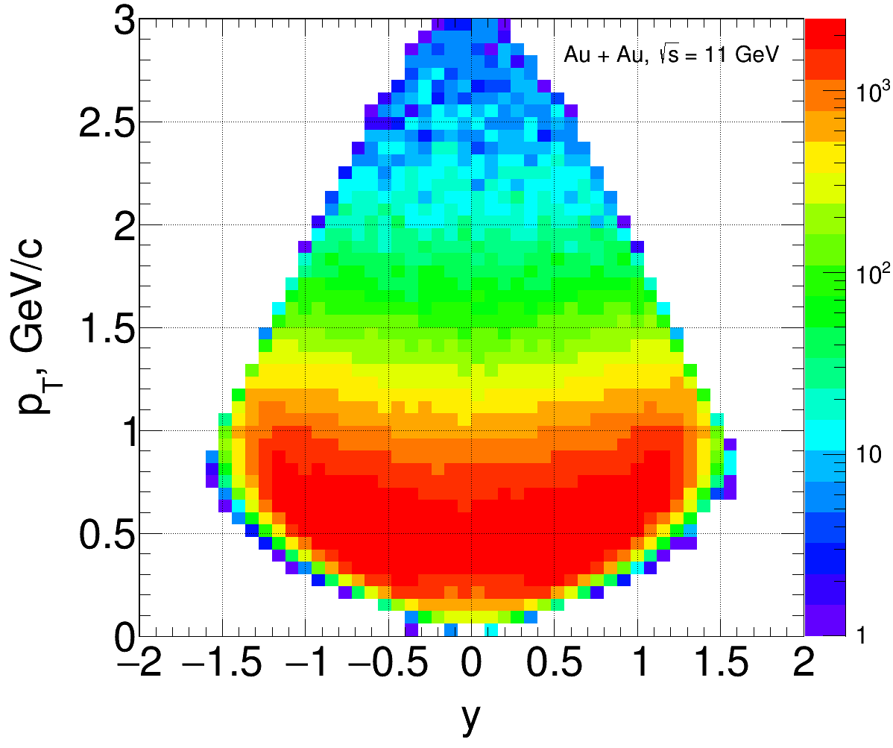
MPD performance. Critical End Point (CEP) @ MPD
Trajectories calculated by a 3-fluid
hydrodynamics (Toneev & Ivanov)
1 person
Observables - event-by-event fluctuations:
multiplicity, conserved charges
particle ratios, mean pT, baryon number, etc.
Experimental challenge: fluctuation signal may be suppressed due to final state interactions that washed out the signal. True CEP signal should show consistency in several observables!
Strong competence around us both in theory and analysis (Baku, Poland),
but we are not fully satisfied with the progress (1 person is involved)
MPD:
Large phase-space important for EvE fluctuations in CEP search
~ 55-65 identified protons per central Au+Au collision
Uniform midrapidity phase-space coverage (|y|<1, pT<2.5 GeV/c)
After 2023 with endcap coverage
(tracking+TOF+ECAL) – increase by ~20%

Slide 19
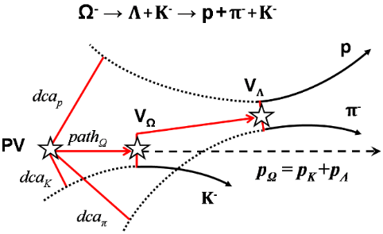
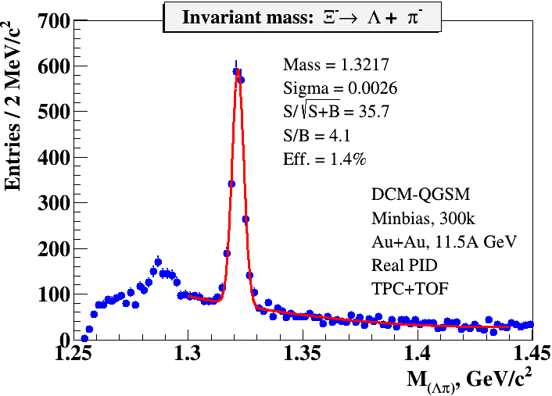
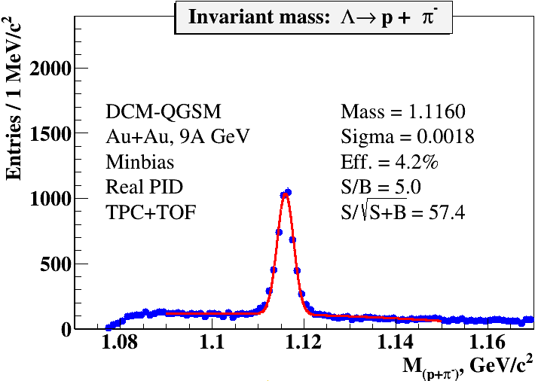
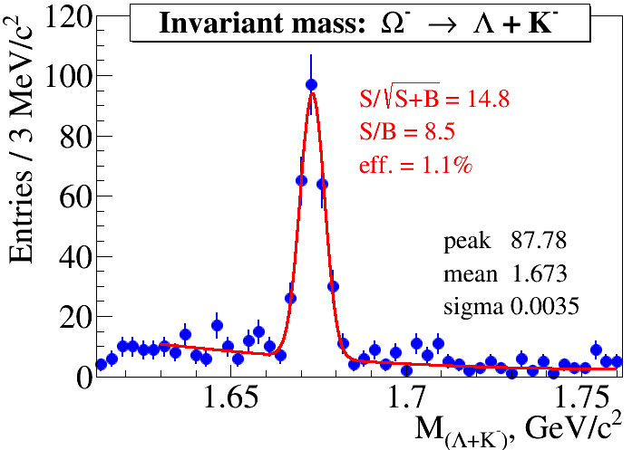
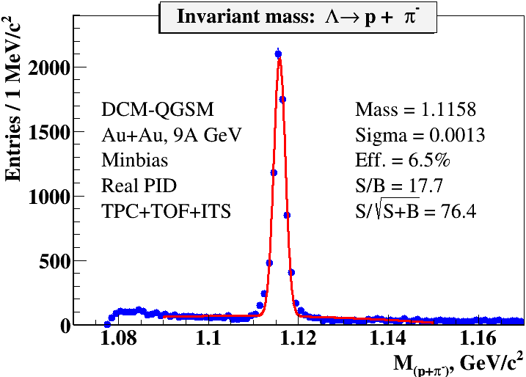
MPD performance: multi-strangeness
2 persons
~ 5 . 10 ⁵ central Au+Au at 9 GeV
Λ- candidates in the invariant mass
window ±3σ around the peak combined
with kaons
Topological cuts optimized to maximize
significance
Stage’1 MPD configuration (TPC+TOF)
Selection criteria dictated by the decay topology
w/o ITS
Hyperon yields for 1 week of running (Stage’1)
w ITS
Particle | Λ | anti-Λ | Ξ⁻ | anti-Ξ⁺ | Ω ⁻ | anti−Ω⁺
Yield | 3 . 10⁷ | 3.5 . 10⁵ | 1.5 . 10⁵ | 8.0 . 10³ | 7 . 10³ | 1.5 . 10³
Well advanced activity, optimal combination of seniors and juniors
Better coordination between JINR and outside contributors, code unification

Slide 20
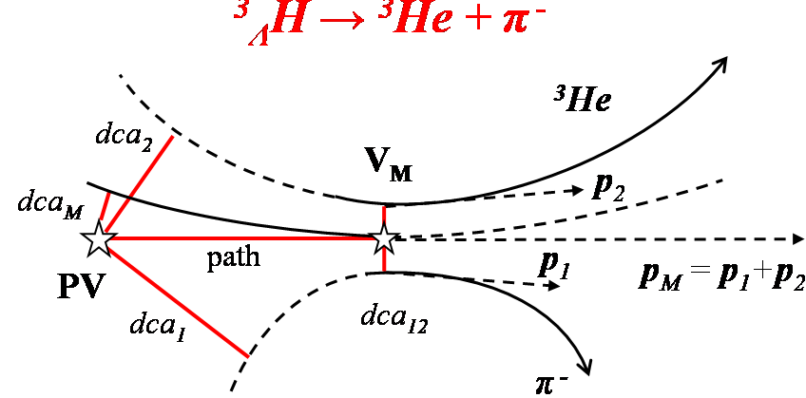
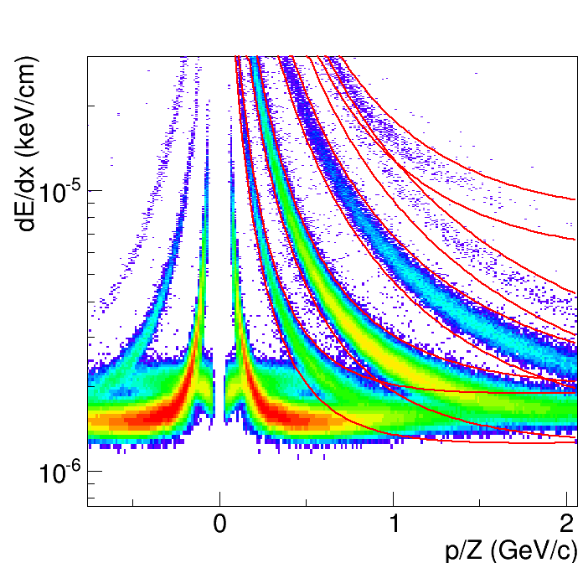
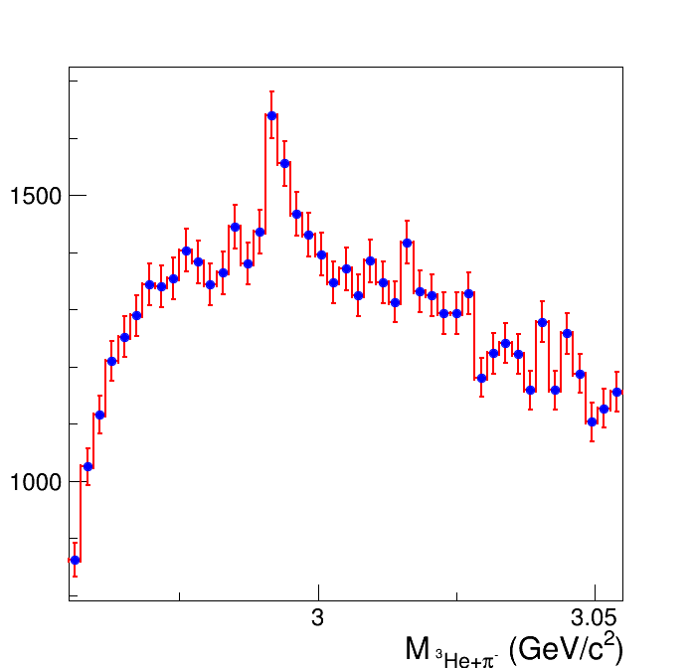
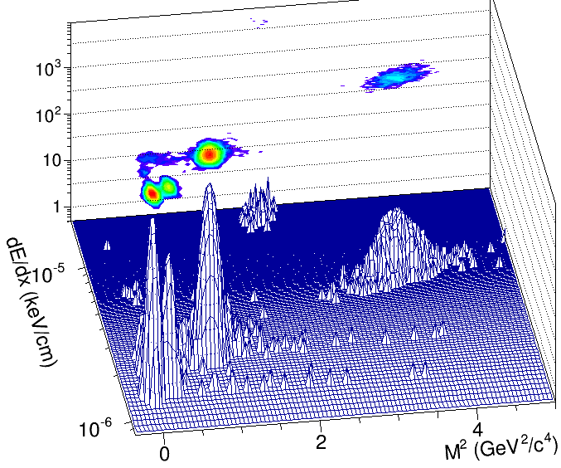
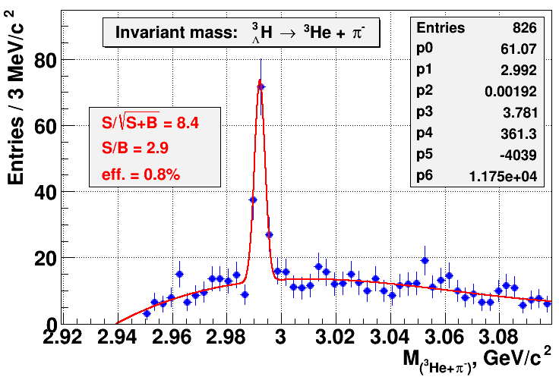
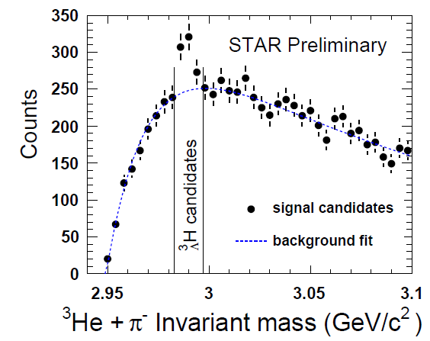
Hypertritons at NICA-MPD. Feasibility study
2 persons
Central Au+Au @ 5A GeV (DCM-QGSM)
Particles are selected within 3σ cuts in dE/dx (1) or
dE/dx -m² in momentum bins (2)
Secondary vertex finding with quality cuts for max. significance
³He
π K p d t
MPD
Min. # of cuts, cut values are
close to ones used by STAR
Max. # of cuts, parameters are
tuned for Max. Significance
P = 1 GeV/c
S/B = 0.15
p
³He
d
MPD
π⁻
Stage’2: Expected yield of ³_{Λ}H for MPD (1 week) @ 5A GeV: 9 . 10⁴
⁴_{Λ}He for MPD (1 week) @ 5A GeV: 1 . 10⁴

Slide 21
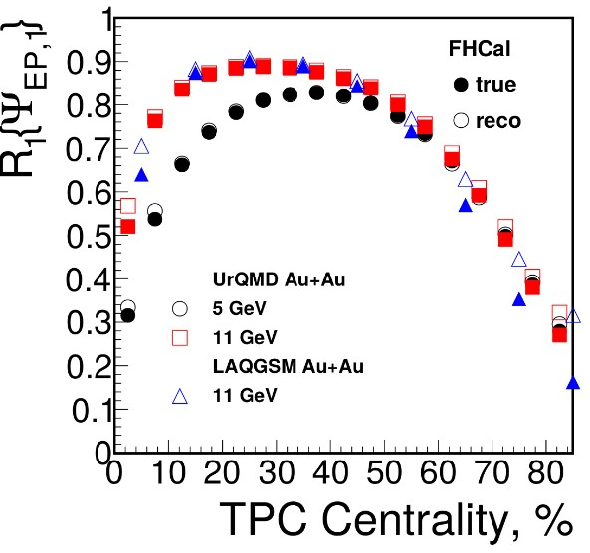
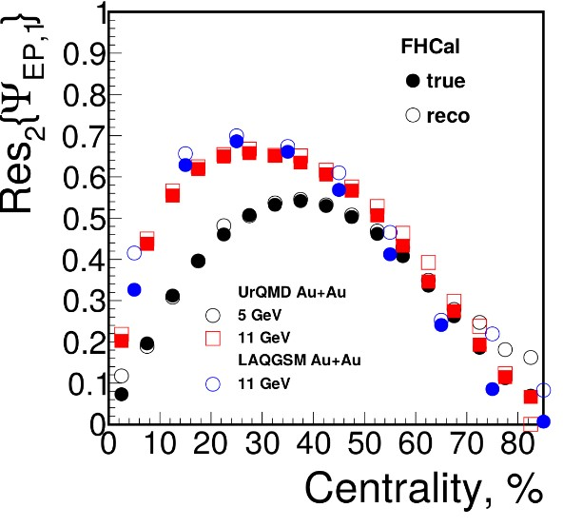
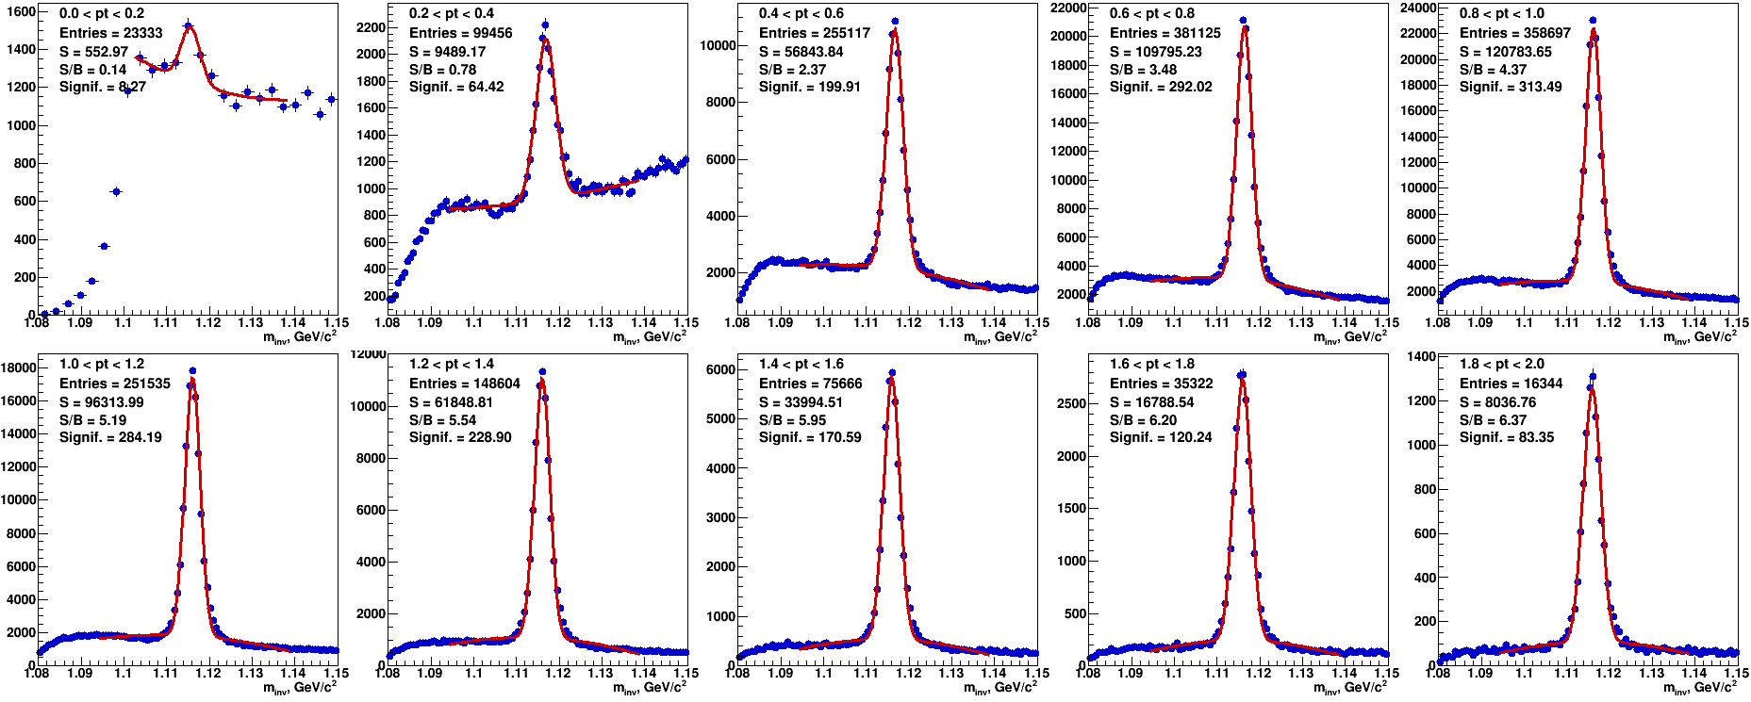
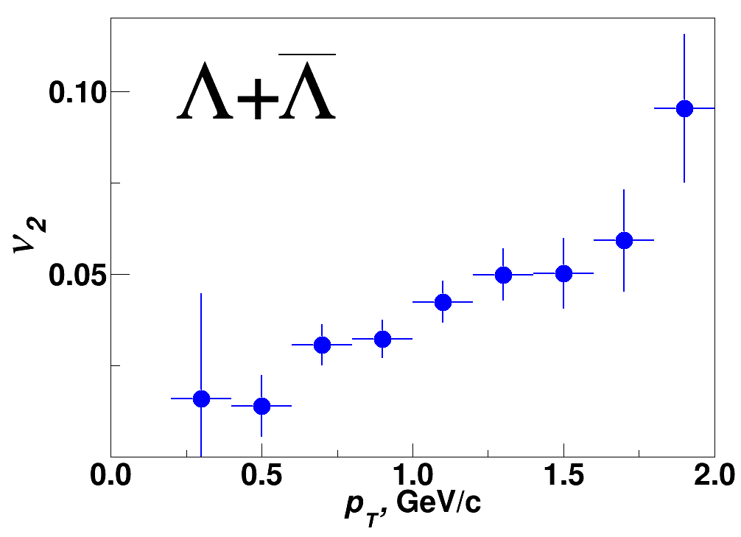
MPD performance: flow
MEPHI group + 2 persons
Event plane detector (FHCAL) coverage and transverse granularity
providing R1(R2) ~ 0.9 (0.7) for the reaction plane with the EP method
Well advanced activity, optimal combination of seniors and juniors
Better coordination between JINR and outside contributors, code unification
0<pT<0.2 GeV/c
1.8<pT<2.0 GeV/c

Slide 22
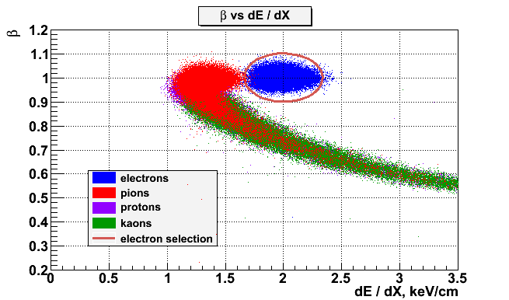
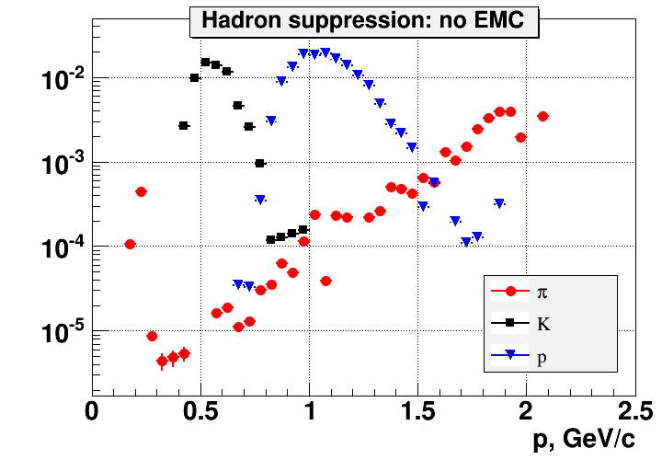
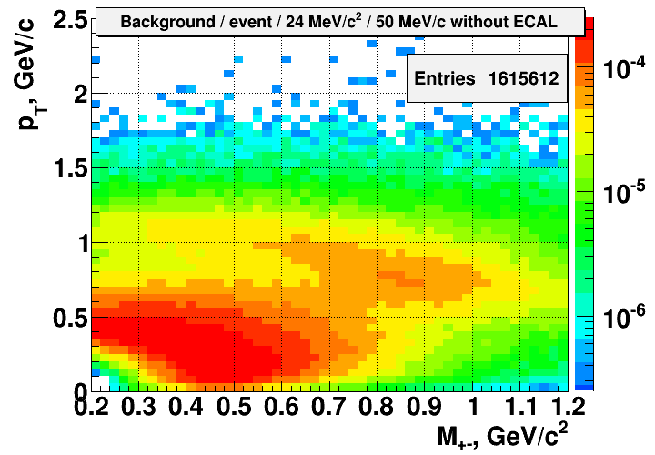
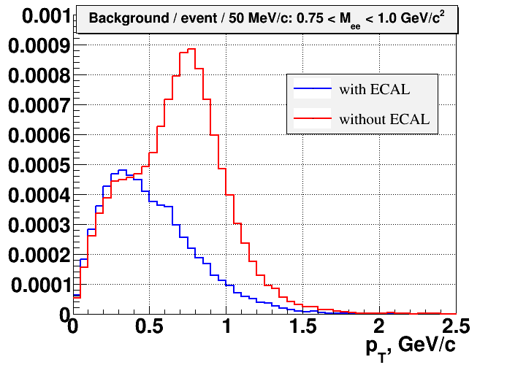
MPD performance for dileptons
2 persons + China + ITEP
Central Au+Au @ 7A GeV (Pluto + UrQMD) ,
Realistic tracking and PID (TPC,TOF,ECAL)
PID and quality cuts, Dalitz decay, pi0 and conversion suppression
Significant remaining contribution from hadrons
in dE/dx-TOF identified sample (common problem
for such kind of detectors)
Hadron suppression factor is not sufficient w/o ECAL!
STAR
MPD
Remaining hadron background contributes over the large M_{e+e-} range from p_{T} = 0.5 to 1.5 GeV/c

Slide 23
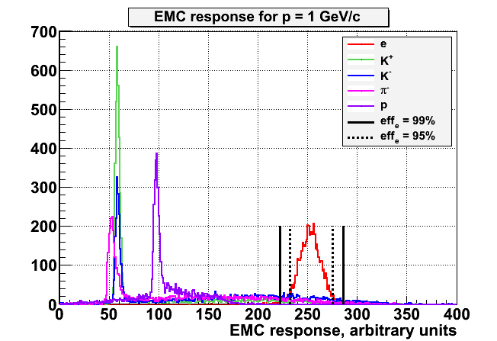
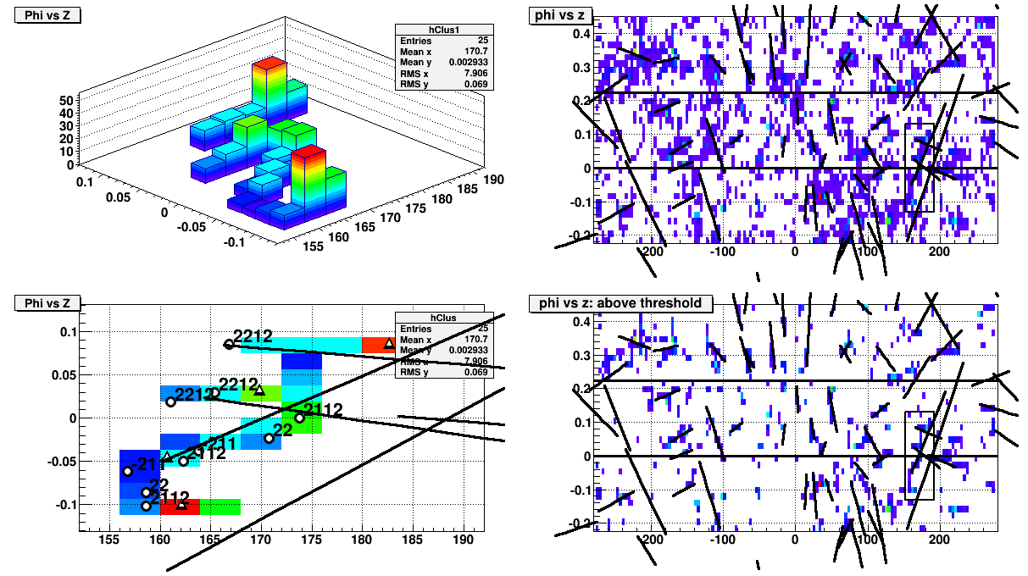
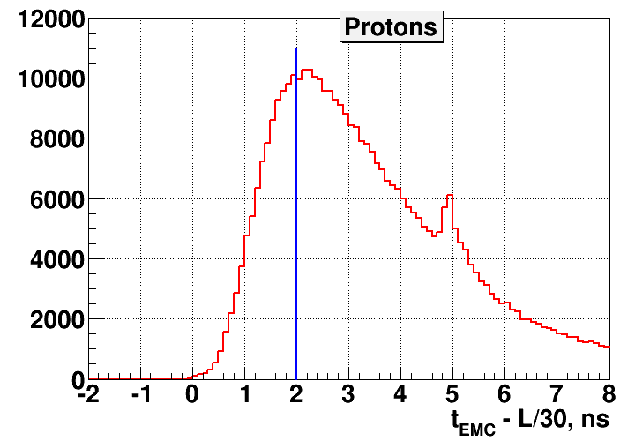
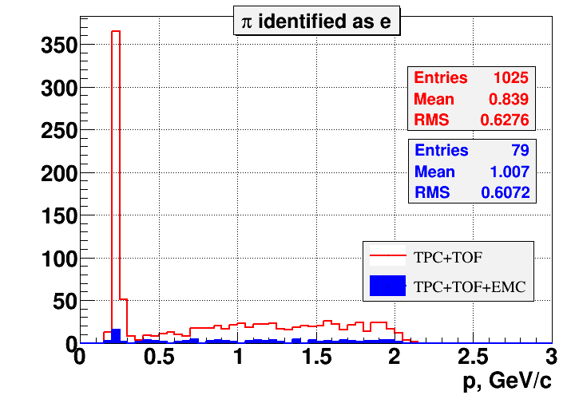
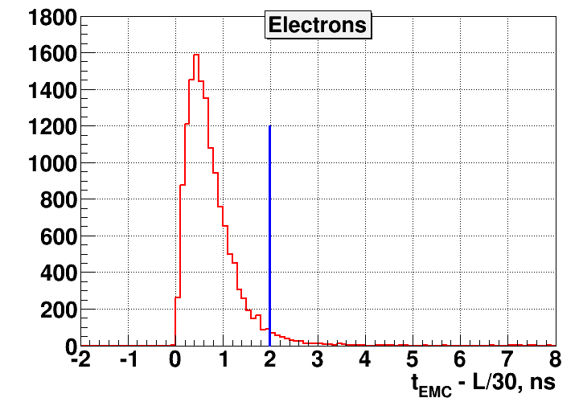
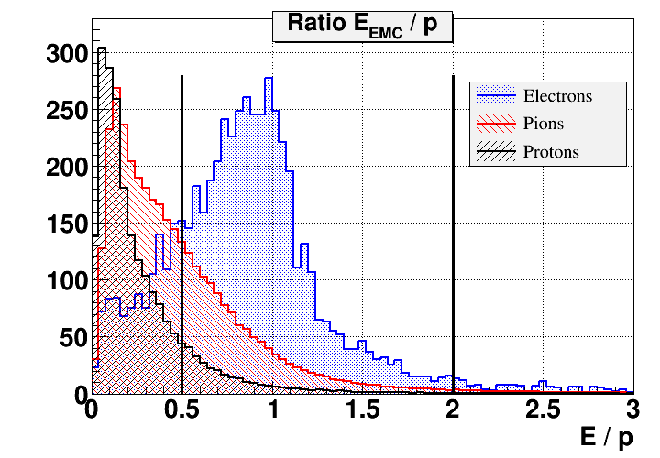
MPD performance for dileptons: ECAL function
Further hadron suppression with ECAL
Cluster finding, TPC – ECAL matching, etc.
Energy deposit and timing in ECAL
ECAL energy deposit
Extra h-suppression
factor with EMC:
up to 30 for protons
up to 13 for pions
up to 12 for kaons
ECAL timing
ECAL E/p

Slide 24
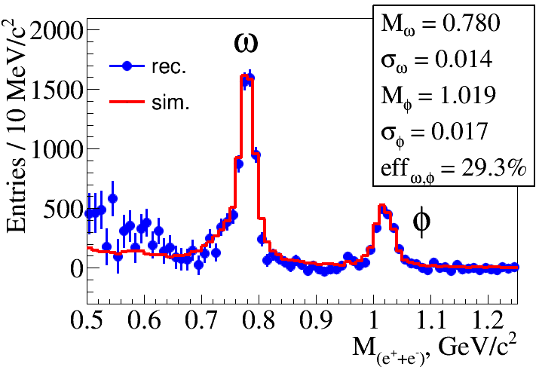

MPD prospects for dileptons
Signal-to-Background ratio
(0.2<Mi_{e+e-}<1.1) in A+A collisions
at NICA/MPD
R. Rapp – private communication
Invariant mass of dileptons (background subtracted): red-MC, blue- reco.
Particle | Yields |  | Decay mode | BR | Effic. % | Yield/1 w
 | 4π | y=0
ρ | 31 | 17 | e+e- | 4.7 . 10⁻⁵ | 35 | 7.3 . 10⁴
ω | 20 | 11 | e+e- | 7.1 . 10⁻⁵ | 35 | 7.2 . 10⁴
ϕ | 2.6 | 1.2 | e+e- | 3 . 10⁻⁴ | 35 | 1.7 . 10⁴
Estimate of dilepton yield in central Au+Au at m = 2 - 2.5 GeV/c²
√s_{NN} = 8 GeV 410 pairs/10 d
√s_{NN} = 6.3 GeV 54 pairs/10 d

Slide 25

MPD simulation: p+p collisions
1(!) person
Too many tasks for single person (models, trigger, efficiency, PID, performance, etc.).
More manpower is needed
p+p
p+p
Normal performance in vertex and track reconstruction in p+p
Reconstruction of strange hyperons from p+p collisions in the MPD detector is possible by combining charged tracks reconstructed in the TPC. A weak combinatorial background due to the low multiplicity from p+p.

Slide 26
Summary and outlook
Preparation for the NICA/MPD Day’1 physics is ongoing. Lack of the manpower in JINR can
be naturally solved by external groups contributions.
Structure and tasks of the MPD PWGs will be soon defined.
Should we wait for about 0.5-1 year until a spokesperson’s suggestion about MPD PWG?
Contact person for the collection of group’s interests in data analysis?
What is the vision about the MPD reconstruction? A dedicated group with the coordinator
or something else?
Thank you for your attention!

Slide 27
Spares

Slide 28






MPD reconstruction. TPC tracking performance
Track reconstruction – Kalman filtering technique
Tracking down to eta= 1.8(1.6) with Npoints>10(20)
Primary & secondary vertexing with Kalman filtering
formalism (sub-cm precision w/o vertex detector)
MPD tracking efficiency above 85% within |η|<2.0 && p_{t}>0.15 GeV/c
Δp/p < 3% at midrapidity

