Slide 1
MSU Contribution to MPD and BM@N
Mikhail MERKIN, Alexander KRYUKOV

Slide 2
Work in Progress and Plans
Physics:
flow effects and early dynamics
femtoscopic observables in HI collisions
relaxation of quark-hadron matter
multiplicity of charged particles
exotic multiquark hadrons in QCD at the nonzero chemical potential
diphoton and dipion diagnostics of the hot and dense matter
neutron stars and production of cascade-hyperons at BM@N.
exotic hypernuclei at MPD
Techniques and technologies:
development of techniques of tracking
detector control system for tracking components
sensor visual control system
development of stands, assembly and testing of modules of tracking system
alignment of tracking detectors for BM@N and MPD using test experimental data
Computing:
Extension of an existing information complex for NICA project:
computing resources.
local data storage
detector remote monitoring and control
Training of young specialists for BM@N, MPD and SPD. Preparation of special courses directed to physics of heavy ion interactions at NICA energies.

Slide 3
MSU Group
Gulnara Eyyubova,
Olga Kodolova,
Vladimir Korotkih,
Igor Lokhtin,
Ludmila Malinina (also in JINR),
Alexandre Snigirev,
Evgeny Zabrodin (also in UiO)
Dmitry Lanskoy,
Tatiana Tretyakova,
Dmitry Melikov,
Vladimir Kukulin
Maria Platonova
Edward Boos,
Anatoly Solomin,
Stanislav Shushkevich,
Mikhail Korolev,
Galina Bogdanova,
Vladimir Volkov,
Natalia Baranova,
Alexander Kryukov,
Petr Kharlamov,
Dmitry Karmanov,
Mikhail Merkin
PhD students and students

Slide 4
SINP MSU in NICA/MPD: physics tasks
G.Eyyubova, O.Kodolova, V.Korotkih, I.Lokhtin, L.Malinina (also JINR), A.Snigirev, E.Zabrodin (also UiO)
Investigation of flow effects, early dynamics and freeze-out in heavy ion collisions at NICA energies.
Study of femtoscopic observables in HI collisions at NICA energies.
Emission times for 1st order phase transition are larger than for crossover. We study the possibilities to extract this difference at the MPD using femtoscopy technique.
Investigation of the relaxation of quark-hadron matter to the equilibrium state in microscopic models. Extraction of equation of state (EoS) of nuclear matter produced at NICA energies.
Study of multiplicity of charged particles in various kinematic ranges available in the MPD detector.

Slide 5
Hypernuclear physics on the NICA facility (D. Lanskoy, T. Tretyakova):
Production of light double-strangeness (⁴_{ΛΛ}H, ⁵_{ΛΛ}H, ⁵_{ΛΛ}He) and neutron-rich hypernuclei for studying hyperonic interactions.
Study for the strange matter production in fixed target experiments BM@N at energies range 2-6 A GeV.
Exotic multiquark states and their properties in QCD (D. Melikov):
Study for selection criteria for QCD diagrams which contribute to multiquark poles.
Formulation of QCD sum rules for exotic states at nonzero chemical potential and study of modifications of properties of exotic states for NICA conditions.
Novel diphoton and dipion diagnostics for the dense and hot matter at NICA (V. Kukulin and M. Platonova ):
Light scalar meson (σ-meson) production in hadronic and nuclear collisions and chiral symmetry restoration (CSR) in hot matter.
γγ and ππ-signals at M _{γγ} ≈ M_{ππ}≈ 350 MeV for CSR diagnostics; the basic source: σ→γγ and σ→ππ.
Digamma and dileptons in high-energy collisions.

Slide 6
Development of software framework for alignment of tracking detectors of BM@N and MPD by the use of collision data
Track-based fine alignment of tracking systems was shown to be optimal method in large HEP experiments. Two main approaches:
global χ² minimization: best known implementation Millepede (least squares fit) by V.Blobel
advantage: efficient minimization
disadvantage: solving large linear problem can be computationally challenging
Kalman filter approach (successfully used in LHC experiments)
advantage: possibility to use the same approach for reconstruction and for alignment, no need to invert large matrix
disadvantage: need to update geometry with every track, some bookkeeping
A new and more detailed procedure of detection and measurement of the BM@N and MPD tracking detector misalignments is planned to be developed, based on Kalman filtering approach (instead of Millepede).
Common monitoring, computation and database updating mechanism is to be created, adjustable to particular detectors.

Slide 7
For each tracking detector:
develop specific computation mechanism variant on top of existing Kalman-filter-based track reconstruction
define / refine a set of misalignment types to be monitored; order misalignment types according to their influence on the tracking precision and for each type:
work out individual criteria for selection of tracks to be used, that maximize efficiency of its detection
create [software] trigger line for pre-selection of events enriched with the required tracks for each criterion
customize computation algorithm
determine periodicity of monitoring
define format of corrections storage in the UniDB
Final measurements of misalignments will be computed using global tracking, involving all detectors, vertex fitting and Λ⁰ mass constraint.
Prerequisites & dependencies:
track reconstruction is implemented using a Kalman filtering method
Monte Carlo simulation for a given detector is to be used for calibration and tuning.

Slide 8
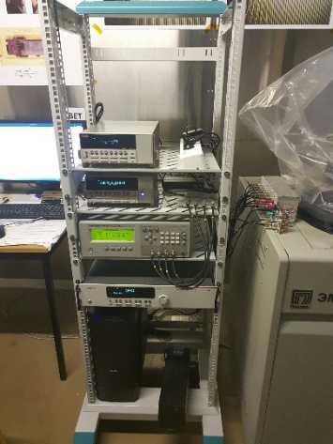
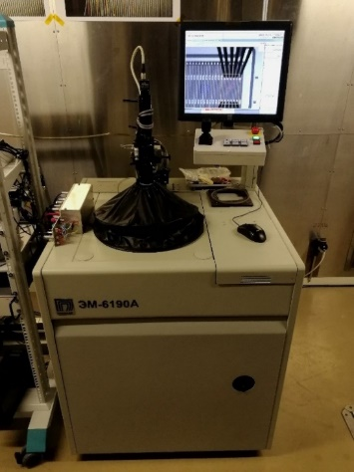
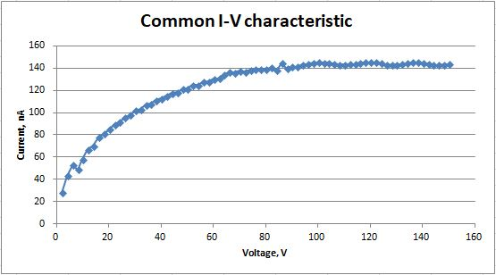
Supervision and software development for the VB LHEP DSSD probe automat
HPC and CiS vendors
300 double-sided silicon microstrip sensors acquired to be tested, 100 to be acquired
4 main sensor shapes
modules on 40 ladders in 10-12 configurations
sensors have been advanced to final design iteration together with GSI, CBM and LTU, Kharkov
Typical IV and CV curves from automatic strip-by-strip probing at VB LHEP supervised by MSU experts at VB LHEP

Slide 9
Detector Control System for ITS MPD
Detector Control System (DCS) will handle the configuration, monitoring and operation of all experimental equipment:
Detector operations: High voltages, low voltages, temperatures, etc.
Data acquisition: Frontend and backend electronics, readout network, etc.
Infrastructure: Cooling, ventilation, electricity distribution, detector safety, etc.
Interaction with the outside of ITS: Accelerator, safety system, technical services, etc.

Slide 10
Detector Control System for ITS MPD
Defined /to be defined:
sets of the controlled ITS parameters;
interfaces for slow control;
types of T, H and other sensors;
the hardware the providing data transfer from ITS to MPD DCS.
In case of the emergency change of critical controlled parameters the system immediately has to make the decision automatically by DCS
. At change of not critical parameters the system has to inform the operator and issue recommendations about possible decisions

Slide 11
Detector Control System for ITS MPD
The software protocol has to provide:
power on detectors and the reading-out electronics in the given sequence and with the required delays, both in automatic, and in test the modes;
measurement of currents of consumption of detectors and the reading-out electronics engineering.
- control of sensors and their connection to the concentrator, and data transmission in a control system of the detector MPD on the Ethernet interface;

Slide 12
Detector Control System for ITS MPD
The software basis on WinCC (TANGO CONTROLS) package have to :
operate power supplies on set to the program of measurements, according to the protocol;
take measurements of temperature, humidity, currents of consumption and the established power supply voltages;
provide various schemes of measurement;
carry out calculations and display results;
keep the measured data in Condition DB;
output system condition at specified time period or on request from MPD SCS

Slide 13
Thanks for your attention!

