Slide 1
Independent members:
Christian Beck - IPHC, Strasbourg, France
Sigurd Hofmann * - GSI, Darmstadt, Germany
Guinyun Kim * - KNU (Kyungpook National University),
Daegu, South Korea
Alexey Korsheninnikov - Kurchatov Institute, Moscow, Russia
Marek Lewitowicz (Chair) - GANIL, France
Vladimir Ostashko - INR, Kiev, Ukraine
Claude Petitjean - PSI, Villigen, Switzerland
Fabrice Piquemal - CENBG, Bordeaux, France
Ivan Štekl - IEAP CTU, Czech Republic
Emanuele Vardaci - UN, Naples, Italy
Zeblon Z. Vilakazi * - University of the Witwatersrand, Johannesburg, South Africa
Adam Sobiczewski - INS, Warsaw, Poland
* is not present at this meeting

Slide 2
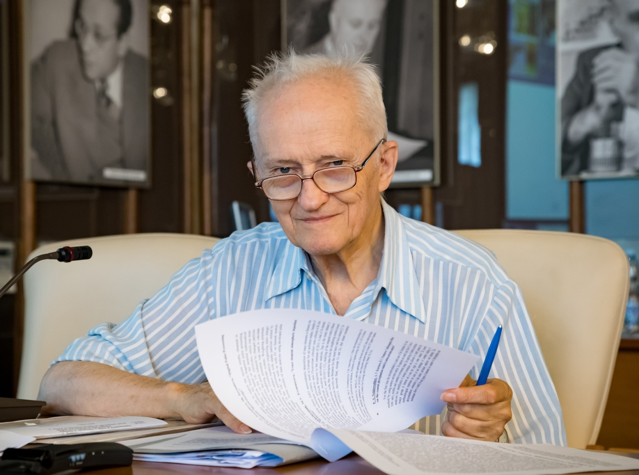
Adam Sobiczewski
21.08.1931 – 20.10.2017

Slide 3
Ex officio members appointed by the JINR:
Vadim Bednyakov - Director, DLNP
Sergey Dmitriev - Director, FLNR
Mikhail Itkis - Vice-Director, JINR
Valery Shvetsov - Director, FLNP
Nikolay Skobelev - Scientific Secretary of the PAC
Tatiana Strizh - Deputy Director, LIT
Victor Voronov - Director, BLTP

Slide 4
Programme Advisory Committee for Nuclear Physics
47th meeting, 17–18 January 2018
Wednesday, 17 January 2018
10:00 - 10:05 1. Opening of the meeting M. Lewitowicz
10:05 - 10:25 2. Implementation of the recommendations of the previous PAC meeting M. Lewitowicz
10:25 - 10:50 3. Information on the Resolution of the 120th session of the JINR Scientific Council (September 2017)
and on the decisions of the JINR Committee of Plenipotentiaries (November 2017) M. Itkis
10:50 - 13:10 4. Report on the theme "Non-Accelerator Neutrino Physics and Astrophysics" and proposals for their extension:
10:50 - 11:10 4.1 Project GERDA (G&M) K. Gusev
11:10 - 11:30 4.2 Project SuperNEMO Yu. Shitov
11:30 - 11:45 Coffee break
11:45 - 12:05 4.3. Project BAIKAL I. Belolaptikov
12:05 - 12:45 4.4. Projects conducted at the Kalinin Nuclear Power Plant:
12:05 - 12:25 4.4.1. Project DANSS V. Egorov
12:25 - 12:45 4.4.2. Project GEMMA-III A. Lubashevsky
12:45 - 13:10 4.5. Project EDELWEISS-LT, summary on the theme "Non-Accelerator Neutrino Physics and Astrophysics"
and proposals for their extension E. Yakushev
13:10 - 14:00 5. Visit to the Dzhelepov Laboratory of Nuclear Problems
14:00 - 15:00 Lunch break
15:00 - 15:20 6. Status of the Factory of Superheavy Elements V. Semin,
A. Popeko
15:20 - 15:40 7. Commissioning of the ACCULINNA-2 fragment separator A. Fomichev
15:40 - 16:10 8. Report on the theme "Theory of Nuclear Structure and Nuclear Reactions" and proposal for a new theme N. Antonenko
16:30 - 16:50 Coffee break
16:50 - 18:05 9. Scientific reports:
16:50 - 17:15 9.1. "Study of vorticity and hyperon polarization in nuclear collisions within the NICA energy range“ V. Toneev
17:15 - 17:40 9.2. "Application of multinucleon transfer reactions to the synthesis of neutron-rich nuclei“ A. Karpov
17:40 - 18:05 9.3. "Neutron activation analysis of arsenic and mercury content in human remains of the XVI-XVII centuries from
the Moscow Kremlin necropolis“ T. Panova,
A. Dmitriev
18:05 - 18:45 10. General discussion

Slide 5
Programme Advisory Committee for Nuclear Physics
47th meeting, 17–18 January 2018
Thursday, 18 January 2018
09:30 - 10:00 11. Meeting of the PAC members with the JINR Directorate (closed discussion)
10:00 - 10:40 12. Coffee break together with Poster presentations by young scientists
10:40 - 10:50 13. General conclusion on the poster presentations (closed)
Closed session:
10:50 - 12:40 14. Drafting of the PAC recommendations & Proposal for the agenda of the next PAC meeting
12:40 - 13:00 15. Presentation of the PAC recommendations
13:00 - 13:10 16. Closing of the meeting
19:00 - 21:00 Concert in the House of Scientists

Slide 6
Backup slides

Slide 7
Programme Advisory Committee for Nuclear Physics 47th meeting
Wednesday, 17 January 2018
Thursday, 18 January 2018
1. | Opening of the meeting | M. Lewitowicz
2. | Implementation of the recommendations of the previous PAC meeting | M. Lewitowicz (20 min.)
3. | Information on the Resolution of the 122nd session of the JINR Scientific Council (September 2017) and on the decisions of the JINR Committee of Plenipotentiaries (November 2017) | M. Itkis (25 min.)
4. | Report on the theme “Non-Accelerator Neutrino Physics and Astrophysics” and proposals for their extension:
 | 4.1. Project GERDA (G&M) Referees: F. Piquemal, C. Petitjean, Guinyun Kim, V. Garvin, Yu. Shitov | K. Gusev (20 min.)
 | 4.2. Project SuperNEMO Referees: F. Piquemal, C. Petitjean, J. Suhonen, A. Starostin, Yu. Efremenko | Yu. Shitov (20 min.)
 | 4.3. Project BAIKAL Referees: Z. Vilakazi, V. Ostashko, A. Olshevskiy, S. Troitsky | I. Belolaptikov (20 min.)
 | 4.4. Projects conducted at the Kalinin Nuclear Power Plant:
 | 4.4.1. Project DANSS Referees: I. Štekl, V. Ostashko, Guinyun Kim, A. Serebrov, Yu. Gurov | V. Egorov (20 min.)
 | 4.4.2. Project GEMMA-III Referees: Z. Vilakazi, F. Piquemal, S. Voronov, A. Barabash | A. Lubashevsky (20 min.)
 | 4.5. Project EDELWEISS-LT, summary on the theme “Non-Accelerator Neutrino Physics and Astrophysics” and proposals for their extension Referees: Z. Vilakazi, F. Piquemal, C. Petitjean, A. Gladyshev, D. Naumov | E. Yakushev (25 min.)
5. | Visit to the Dzhelepov Laboratory of Nuclear Problems | N. Skobelev V. Bednyakov
6. | Status of the Factory of Superheavy Elements Referees: S. Hofmann, M. Lewitowicz, V. Ostashko | V. Semin A. Popeko (20 min.)
7. | Commissioning of the ACCULINNA-2 fragment separator Referees: C. Beck, A. Korsheninnikov, E. Vardaci | A. Fomichev (20 min.)
8. | Report on the theme “Theory of Nuclear Structure and Nuclear Reactions” and proposal for a new theme Referees: C. Beck, A. Korsheninnikov, M. Lewitowicz, E. Vardaci | N. Antonenko (30 min)
9. | Scientific reports:
 | 9.1. “Study of vorticity and hyperon polarization in nuclear collisions within the NICA energy range” | V. Toneev (25 min.)
 | 9.2. “Application of multinucleon transfer reactions to the synthesis of neutron-rich nuclei” | А. Karpov (25 min.)
 | 9.3. “Neutron activation analysis of arsenic and mercury content in human remains of the XVI-XVII centuries from the Moscow Kremlin necropoleis” | T. Panova A. Dmitriev (25 min)
10. | General discussion | (40 min.)
11. | Meeting of the PAC members with the JINR Directorate (closed discussion)
12. | Poster presentations by young scientists
 | Coffee break (together with poster presentations)
 | General conclusion on the poster presentations
 | Closed session:
13. | Proposals for the agenda of the next PAC meeting
14. | PAC recommendations
15. | Closing of the meeting
 | Concert in the House of Scientists

