Slide 1
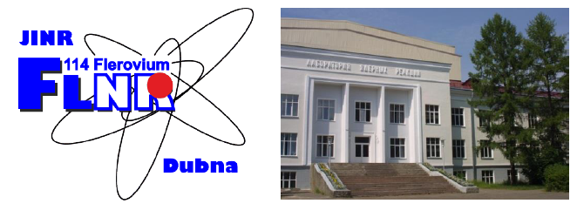

Status of the ACCULINNA-2
fragment separator
Andrey Fomichevª
for ACCULINNA-2 Collaboration
a – Flerov Laboratory of Nuclear Reactions, JINR, Dubna, Russia
b – Institute of Physics, Silesian University in Opava, Czech Republic
c – Bogolyubov Laboratory of Theoretical Physics, JINR, Dubna, Russia
d – GSI Helmholtzzentrum fur Schwerionenforschung, Darmstadt, Germany
e – National Research Center “Kurchatov Institute”, Moscow, Russia
f – Institute of Nuclear Physics PAN, Krakow, Poland
g – Skobel’tsyn Institute of Nuclear Physics, Moscow State University, Russia
h – Faculty of Physics, University of Warsaw, Warsaw, Poland
i – Fundamental Physics, Chalmers University of Technology, Goteborg, Sweden
j – All-Russian Research Institute of Experimental Physics, Sarov, Russia
k – Ioffe Physical Technical Institute, St. Petersburg, Russia
l – NSCL, Michigan State University, East Lansing, Michigan, USA
47th PAC meeting, January 17, 2018

Slide 2
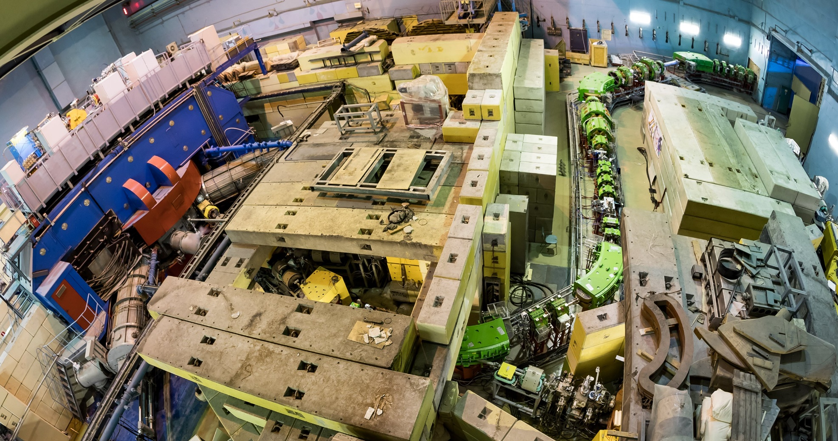
Moving ahead to the flagship experiment ⁷H
F2
F3-F5
F0
F1
Primary beam diagnostics along the line F0-F1 has been partly completed.
Radiation shell near movable gate at F3 was done; at F1-F2 area – 2018.
All communications at F3-F5 (electricity, water, air condition, reaction chamber etc.) were fully completed.

Slide 3
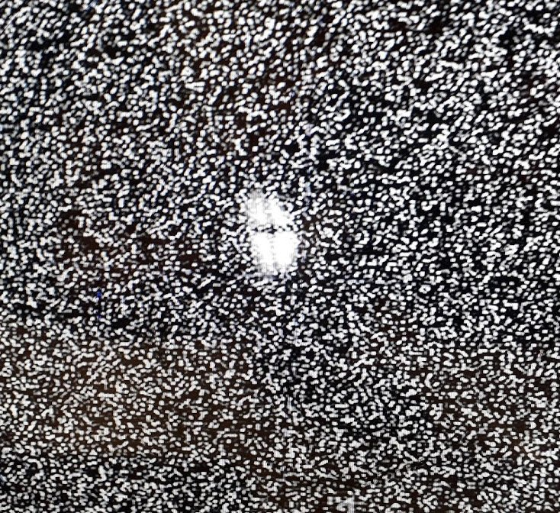
Primary beam diagnostics along the line F0-F1: Faraday Cups & Al₂O₃
Secondary Electron Emission Crids with POLAND electronics (since 2018)
¹⁵N primary beam profile near production target at F1 measured by luminophor (~ 7 mm in diameter).
Simplicity vs. disadvantages (I ~ 1÷50 enA, temporary data).
I ~ 10⁶ ÷ 10¹² ions/wire,
permanent data,
~ 0.5 mm accuracy

Slide 4
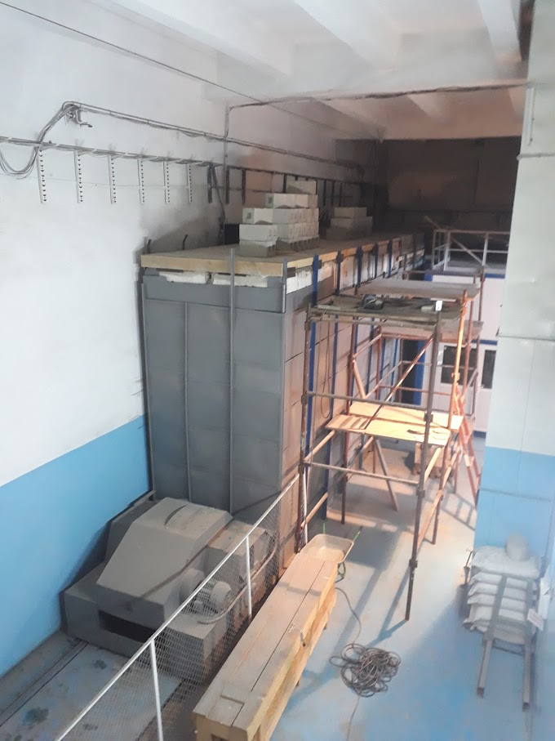
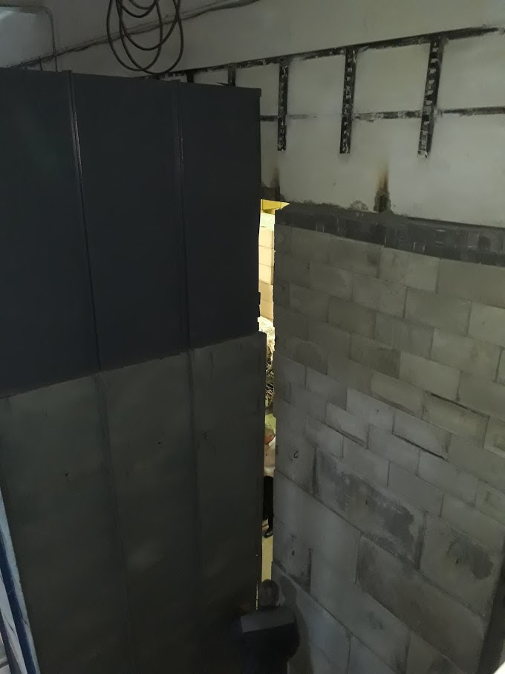
Radiation shell in the area of movable gate was significantly reinforced:
a) column 2x2 m; b) top of the gate ++> overlap with a wall (August 2017)
0.8 m
~1 m
2x2 m

Slide 5
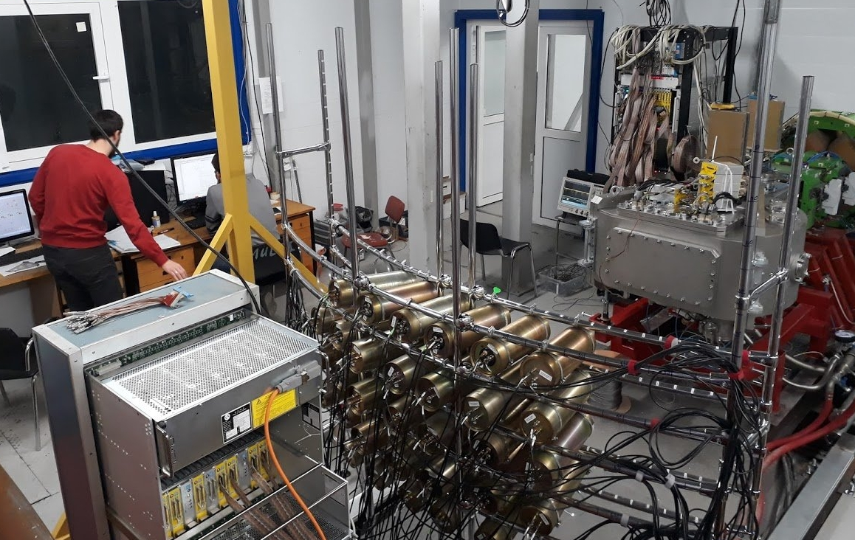
F3-F5 area was fully completed by communications, equipment and electronics
First experiment at ACCULINNA-2 was performed in December 2017 with ¹⁵N primary beam (E~49 AMeV & I~0.1 pμA on the production target, Be 2 mm)

Slide 6
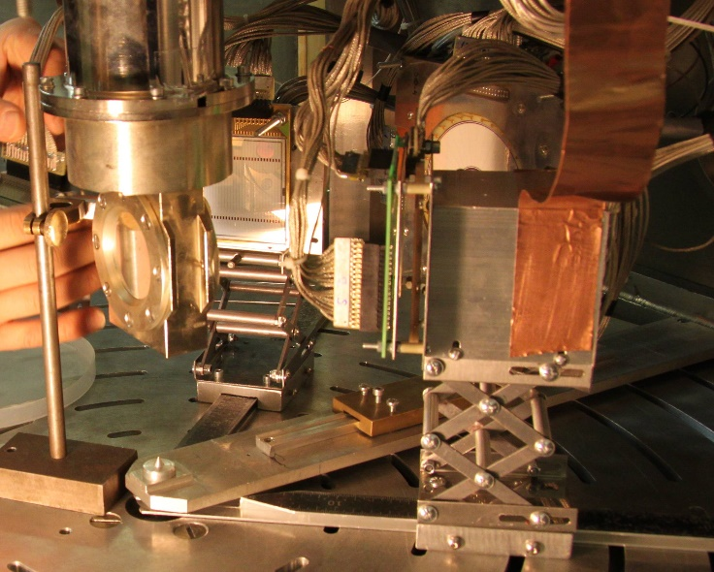
Plan on 2017: d(⁶He,³He)⁵H as a tool for the main run d(⁸He,³He)⁷H
* cross section values for the 1p and 1n transfer reactions in a wide θ_{CM}
** improvement in missing mass measurements via novel telescopes
⁶He
Si - 70 μ
Si - 1000 μ
CsI – 15 mm
(single)
Si - 22 μ
Si - 1000 μ
CsI – 45 mm
(16 units)
Stepantsov et al.,
NPA 738 (2004) 436
x4
June 14, 2017
46th PAC
~2
⁵H (left) and ⁵He (right) energy spectra depending on ³He-t coincidences

Slide 7
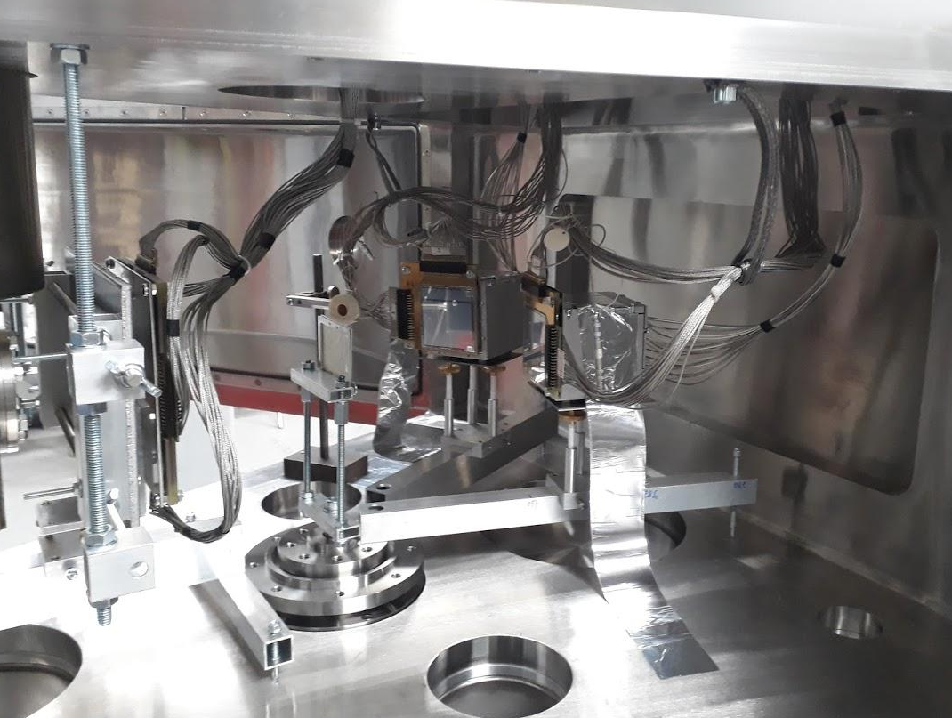
Experimental program in 2017 was a little bit modified:
⁶He+d (elastic and inelastic scattering in a wide θ_{CM}) instead of d(⁶He,³He)⁵H
Motivation: pure information about OP, more simple run, short expositions
Ø ~ 25 mm
2x10⁵ ⁶He/s @ 0.1 pμA
Δp/p = 3%
P ~ 75 %
E ~ 38 AMeV
⁹Li
⁸Li
⁶He
³H

Slide 8
Preliminary results of the first exposition in December 2017.
d-⁶He coincidences were measured in the following two ranges:
25-45 LABdeg (~130-90 CMdeg) and 60-80 LABdeg (~20-60 CMdeg)
Plan: 5-80 LABdeg (20-170 CMdeg) for both elastic and inelastic process

Slide 9

Plan for the year 2018:
⁶He+d elastic and inelastic scattering at θ_{lab} ~ 5-80 deg (~20-170 CMdeg)
Beta-delayed alpha decay of ¹¹Be: re-investigation with the use optical-TPC
d(⁶He,³He)⁵H invariant mass measurement and first attempt for d(⁸He,³He)⁷H

Slide 10
Beta-delayed alpha decay of ¹¹Be. Proposal given by Warsaw Univ.

Slide 11
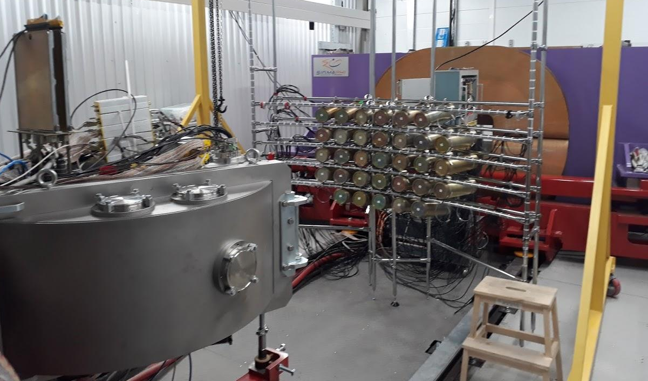
F5: Dipole magnet with related detector system (in progress)
F3: RF-kicker will be ready in the middle 2018
F5
F3
Frequency range (MHz) | 15 – 22
Peak voltage (KV) | 120
Gap (mm) | 70
Width of electrode (mm) | 120 min
Length of electrodes (mm) | 700
Cylinder diameter (mm) | 1200 max
Stem diameter (mm) | 120 max
Length of coaxial line (mm) | 1830
gap

Slide 12
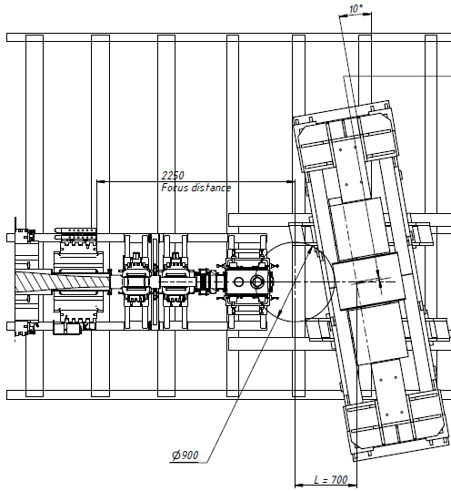
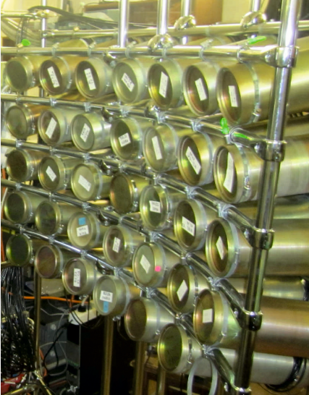
Plan on the end 2018:
d(⁶He,³He)⁵H & d(⁸He,³He)⁷H
Requests: intensive primary beam & dipole magnet with related detector system
Hodoscope X_Y~20x80 cm
(it should be done)
Decay tritons & RIB
Bρ = 0.4 ~ 1.0 Tm
Cone 0 ~ 14°
Si –telescopes for ³He
Bρ=1.0
Bρ=0.4
⁶He (⁸He)
E~35 AMeV
Neutrons,
Cone 0 ~ 14°
Stilbene modules
∅ 80x50 mm → 0.25° accuracy
7x6=42 → 64 units
D-target
1x10²¹ at/cm²
I(⁸He @ 35 AMeV) ~ 10⁵ pps ==> ~ 10 ⁷H events/day (missing mass + 1n)
in the ⁶He case at least 10 times more statistics is expected
Notes:
SIGMAPHI PRESENTATION - JUNE 2001

Slide 13
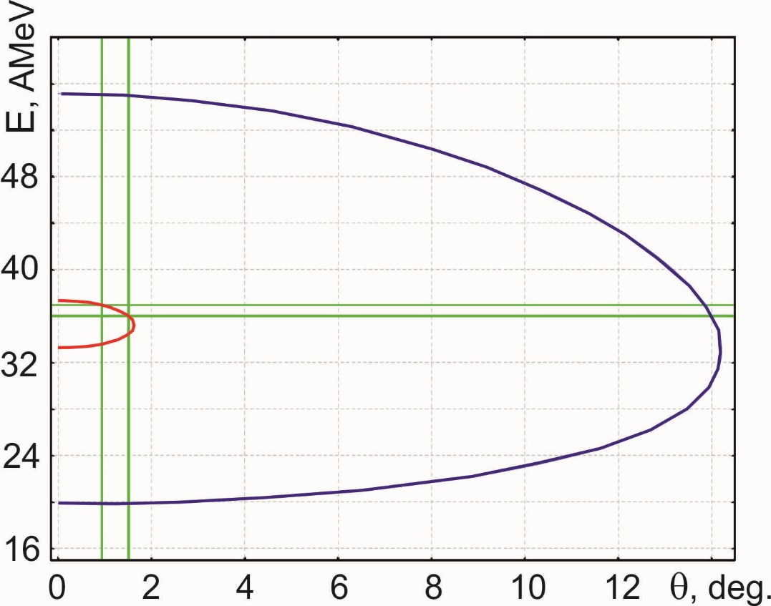
Plan on 2019:
²⁶S in the reaction p(²⁸S,t)²⁶S: I(²⁸S)~10³ pps, P~25%, E~38 MeV/A,
1 mm liquid H₂ , σ~200 μb/sr ==> ~ 10 events ²⁶S per week
Requests: RF-kicker &
zero angle spectrometer
p(²⁸S,t)²⁶S
²⁶S
tritons
²⁶S: T_{1/2} < 79 ns
Fomichev et al., IJMP E20(2011)1491

Slide 14
Summary and outlook
ACCULINNA-2 fragment separator commissioned in 2017 is now ready for day-one experiments.
The first-priority experimental program with RIBs is focused on ⁶He+d scattering, beta-delayed exotic decays of ¹¹Be and ^{5,7}H study.
Day-two experiment (with RF-kicker and zero angle spectrometer) will be aimed on ²⁶S observation in (p,t) reaction with ²⁸S.
Thanks for your attention

Slide 15
RIBs production rates in ¹⁵N(49.7 AMeV) + Be(2 mm) reaction
F1: I(¹⁵N) = 1 pnA @ 7 mm; F2: Δp/p = 2%, Wedge_Be = 1 mm
RIB | Energy, MeV/nucl. | Intensity, 1/s
¹⁴B | 37,7 | 120
¹²Be | 39,4 | 150
¹¹Li | 37,0 | 4
⁹Li | 33,1 | 1100
⁸He | 35,8 | 25
⁶Не | 31,5 | 2700
Main parameters (I, P, X_Y) are agree well with estimations
First experiments with RIBs started in 2017 (I < 0.1 pμA)
Experiments with intense primary beam (~ 1 pμA) will be able since 2018
Moving ahead to ⁷H via ¹¹Li or ⁸He
2018 - flagship exp.
¹²Be + d → ⁶Li + ⁸He (alpha transfer cross section)
⁶He + d → ³He + ⁵H (proton transfer cross section)

Slide 16
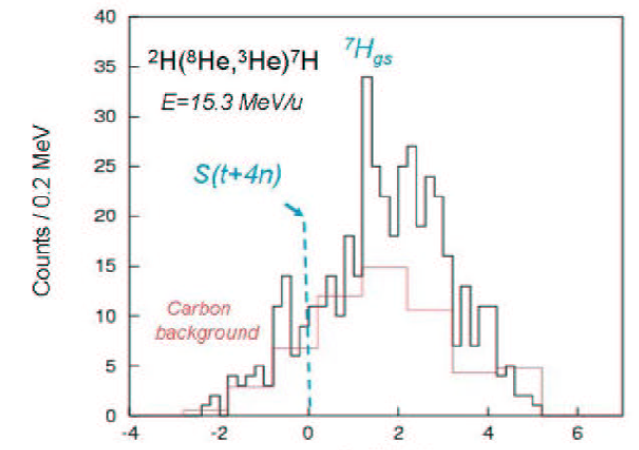
⁷H puzzle: each time only limits of σ were observed
p(⁸He,pp)⁷H
E=25 AMeV
Golovkov et al.,
EXON-2006 p.32
E=61 AMeV
coincidences
σ~15 μb/sr
Counts/1.5 MeV
Counts/0.6 MeV
Korsheninnikov et al.,
PRL 90(2003)
d(⁸He,³He)⁷H
d(⁸He,³Het)⁷H
E=15.3 AMeV
Fortier et al.,
EXON-2006 p.3
Nikolskii et al.,
PRC 81 (2010)
Counts/0.2 MeV
σ~30 μb/sr
σ~10 μb/sr
⁷H missing mass (MeV)
Caamaño et al. PRL 99(2007) ¹²C(⁸He,¹³N)⁷H ==>
E = 0.57
+0.42
MeV, Γ = 0.09
+0.94
MeV
-0.21
-0.06
 Drastically improvement of sensitivity in d(⁸He,³He)⁷H or p(⁸He,pp)⁷H
 ¹¹Li as a projectile and alpha transfer reaction d(¹¹Li,⁶Li)⁷H

Slide 17
Acculinna-2 since 2018
Request / Cost
Product name | T_{min} U400M | Beam, E, I | Method, equipment
²⁷S : P(β3p) – value/limit ²³Si : P(β³He) – yes/no/limit ²⁶S : observation, states | One week | ³²S, 52 AMeV, 0.2 − 0.5 pμA | OTPC, chopper & RF-kicker p(²⁸S,t)²⁶S missing mass & RF-kicker
¹⁷Ne : 2p decay for 3/2⁻ state Γ_{2p}/Γ_{γ} → 0.0002% ⁷Н : observation, states, 4n decay ¹⁰Li : Е and Γ for ground state | Two or more weeks | ²⁰Ne, 54 AMeV, 1.0 pμA ¹⁵N, 49 AMeV, 1.0 pμA | p(¹⁸Ne,d)¹⁷Ne* combined mass, zero angle spec. . d(⁸He,³He)⁷H d(¹¹Li,⁶Li)⁷H p(¹¹Li,d)¹⁰Li combined mass
¹⁰He : ¹³Li : ¹⁶Be : | Three or more weeks | ¹¹B³⁺, 34 AMeV, 4.0 pμA ²²Ne⁷⁺, 44 AMeV, 1.0 pμA | t(⁸He,p)¹⁰He t(¹¹Li,p)¹³Li t(¹⁴Be,p)¹⁶Be
Е, Γ, J^{π} of excited states, search for exotic decays 2n, 4n
tritium target, neutron array

Slide 18
ACC-2 @ U400M advantages:
Room temperature operating
Relatively low cost beam time
Runs during 3 and even more weeks are possible
Cryogenic targets ³He, ⁴He and all hydrogen isotopes
ToF length ~15 m
E_{RIB}, AMeV
Z

Slide 19
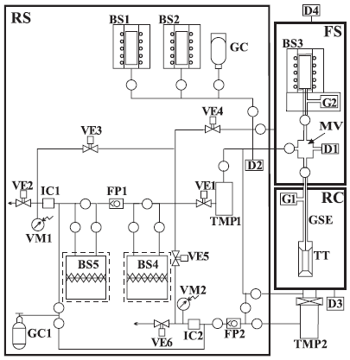
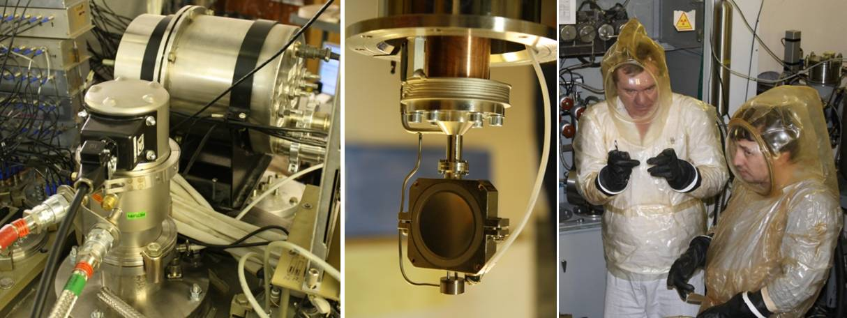
Physical unique targets H, He
Basic scheme of the complex.
FS—filling system; RS—tritium recovery and radiation
monitoring system; RC—reaction chamber; TT—tritium target; GSE—gas supply/evacuation line; BS1(2)—hydrogen (deuterium) source; BS3—tritium source; BS4, BS5—traps; GC, GC1—helium gas-cylinders; D1, D2—pressure gauges; D3, D4—vacuum gauges; FP1, FP2—vacuum pumps (BOC EDWARDS GVSP 30); TMP1, TMP2—turbo pumps (STR-300M); MV—measuring vessel (270 cm3); G1, G2—getters; VE1–VE6 valves (open circles show all other valves); IC1, IC2—ionization chambers; VM1, VM2—vacuum gauges blocking the gas release in ventilation in excess of a given level of the gas-specific volumetric activity.
A.A. Yukhimchuk et al.,
NIM A513 (2003) 439.
Gas:
ϕ=25 mm, d=3÷6 mm,
T=26 K, P=0.92 Atm,
x=3*10²⁰ Atm/cm²
Liquid:
ϕ=20 mm, d=0.4÷0.8 mm, w=2x8.4 μ stainless steel, x=1.1*10²¹ Atm/cm²
I ≤ 960 Ci (3.54*10¹³ Bq)

