Slide 1
The Unified Database for BM@N experiment data handling
The XXI International Scientific Conference of
Young Scientists and Specialists (AYSS-2017)
Gertsenberger K.
VBLHEP, Joint Institute for Nuclear Research
on behalf of the BM@N collaboration
30 November 2017

Slide 2
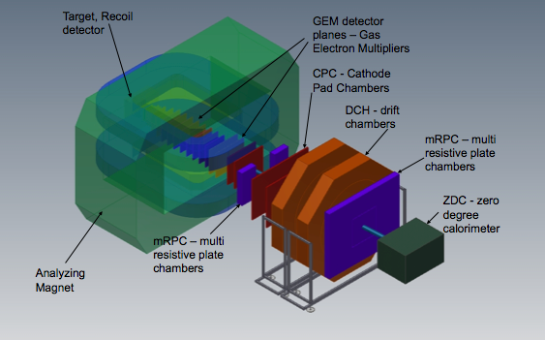
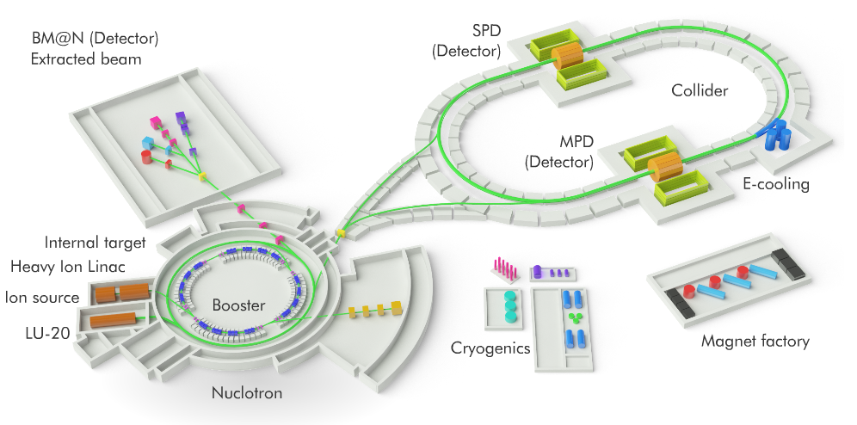
Nuclotron-based Ion Collider fAcility
Baryonic Matter at Nuclotron (BM@N)
Fixed target experiment: BM@N (2018)
Beams: from $p, {d, d}^{↑}$to${Au}^{79+}$
Collision energy: $E_{lab}$ = 2 – 6 AGeV
Gertsenberger K.

Slide 3
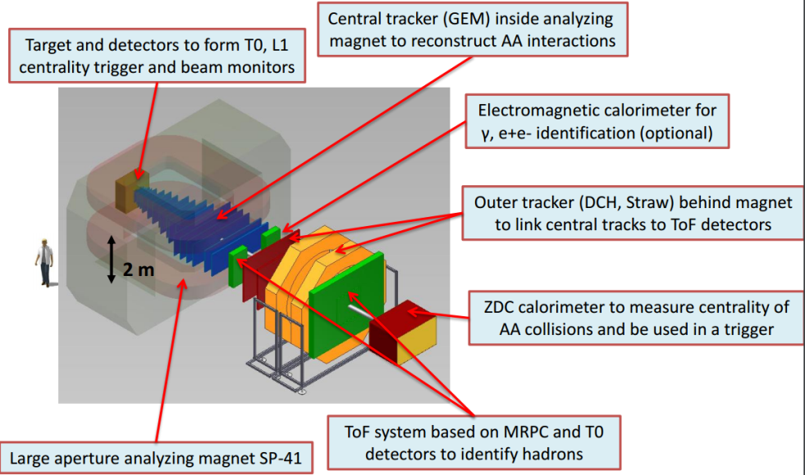
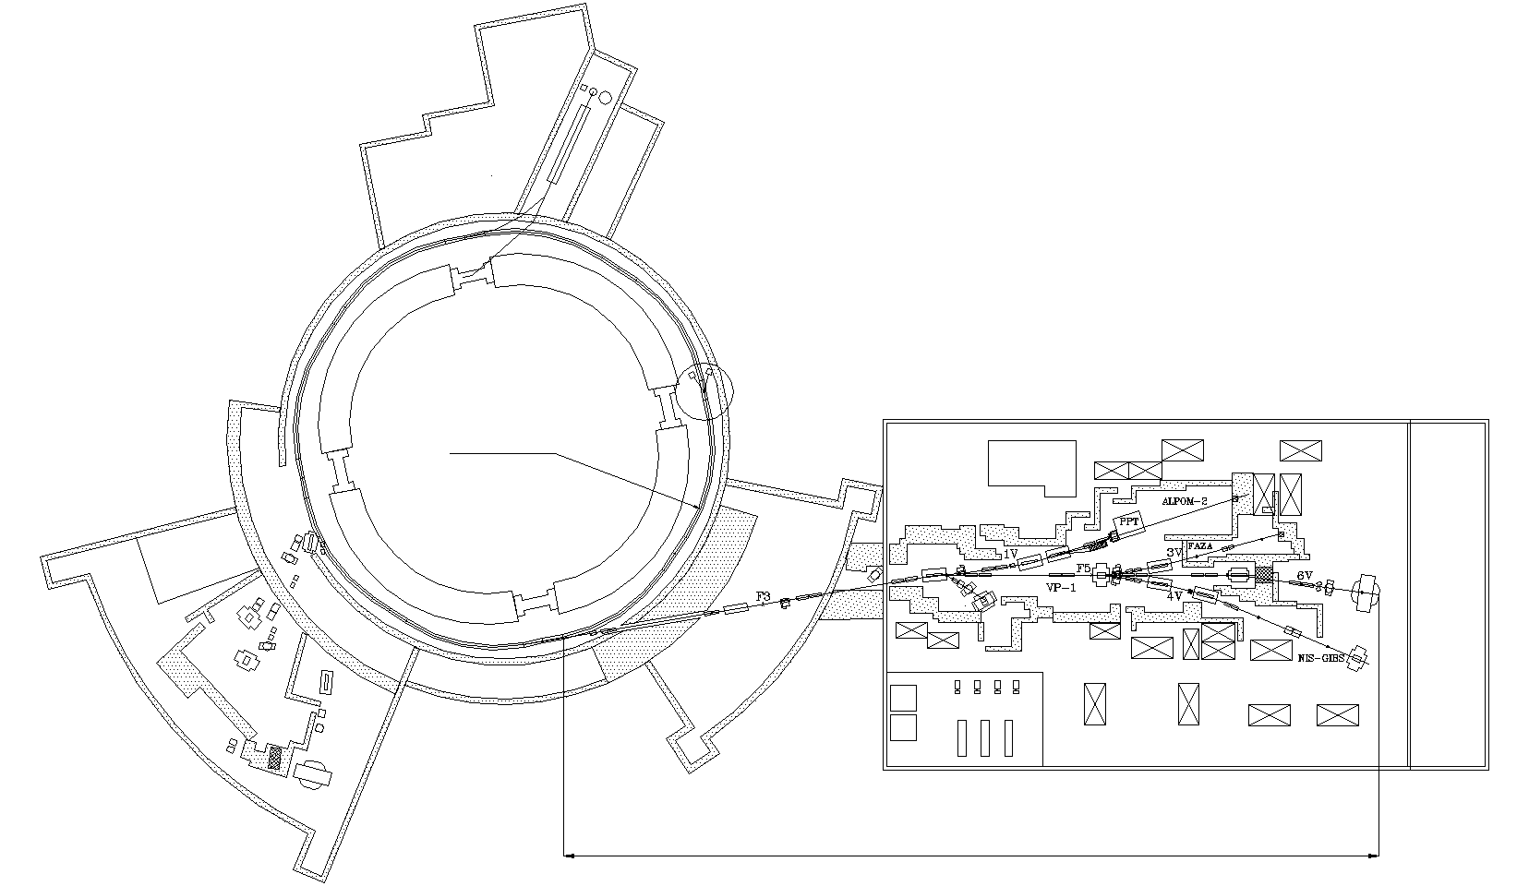
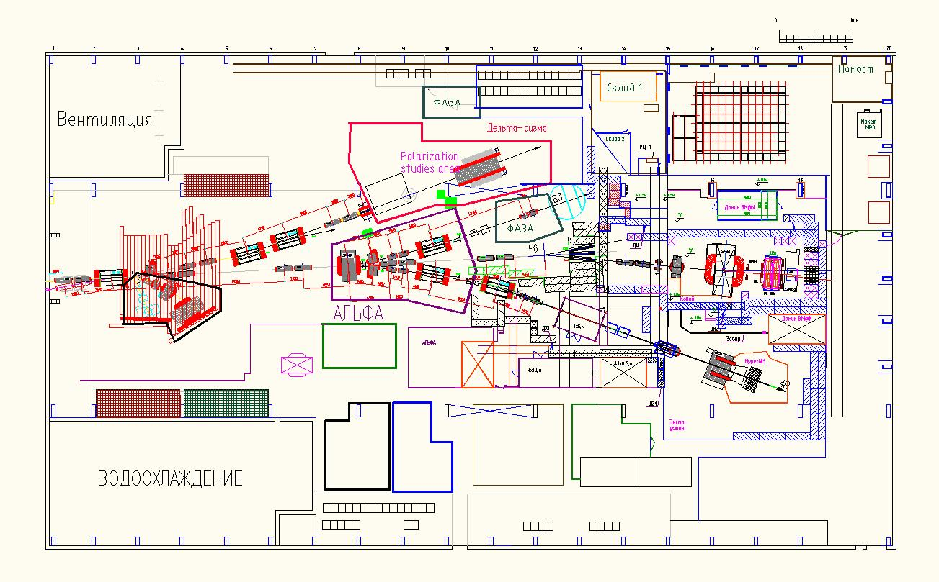
Baryonic Matter @ Nuclotron
BM@N physics program:
strange / multi-strange hyperon and hypernuclei production at the threshold
hadron femtoscopy
short range correlations
event-by event fluctuations
in-medium modifications of strange & vector mesons in dense nuclear matter
electromagnetic probes, states decaying into γ, e (with ECAL)…
Nuclotron
~160 m
Gertsenberger K.

Slide 4
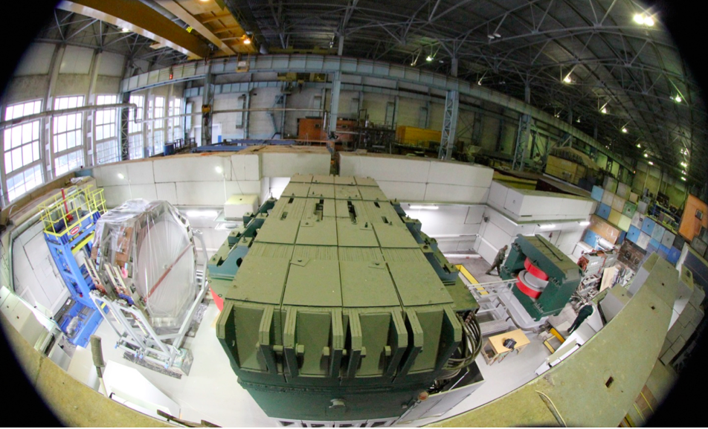
BM@N in Nuclotron runs (2015 - 2017)
Run – 51 (d,C) 22 Feb. - 15 Mar., 2015
Run – 52 (d) June 29 –June 30, 2016
Run – 53 (d) Dec. 9 – Dec. 23 , 2016
Run – 54 (C) Mar. 7 – Mar. 18 , 2017
Run – 55 will be conducted Feb. 2018
Technical
deutron and $C^{12}$ beams with T = 3.5 – 5.14 AGeV targets: C, Cu, Pb, Al, $C_{2}H_{4}$ or empty
Trace beams, measure beam profile and time structure
Test detector response T0+Trigger, MWPC, Si, GEM, ToF-400, DCH-1, DCH-2, ToF-700 and ZDC, ECAL modules, beam monitors
Test integrated DAQ and trigger system
Gertsenberger K.

Slide 5
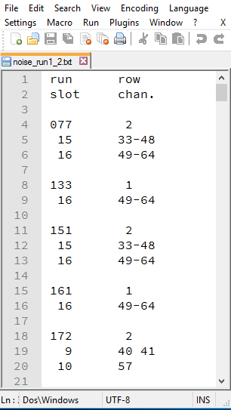
Multiple data of the BM@N experiment
~1000 raw files, ~2000 *.root files, various parameter data
e.g. noise channels
HTML
Excel
Text
Gertsenberger K.

Slide 6
Why should a database system be used?
The lacks of the file storing approach:
the usage of multiple files and different formats, duplication of information in different files lead to data isolation, redundancy and inconsistency
sequential, non-indexed access and search (not efficient)
no mechanism exists for relating data between these files
it is difficult to access and manipulate the data: one needs some dedicated programs
uncontrolled concurrent access by multiple users also often leads to inconsistencies
Gertsenberger K.

Slide 7
The purposes of the Unified Database
central data storage for offline data analysis in the high-energy physics experiments
unified access and data management for collaboration members
correct multi-user data processing
ensuring the actuality of the information being accessed (run parameters, detector geometries and positions, technical and calibration data, etc.), data consistency and integrity
excluding the multiple duplication and use of outdated data
automatic backup of the stored data
merged the existing databases to simplify access and administration
Gertsenberger K.

Slide 8
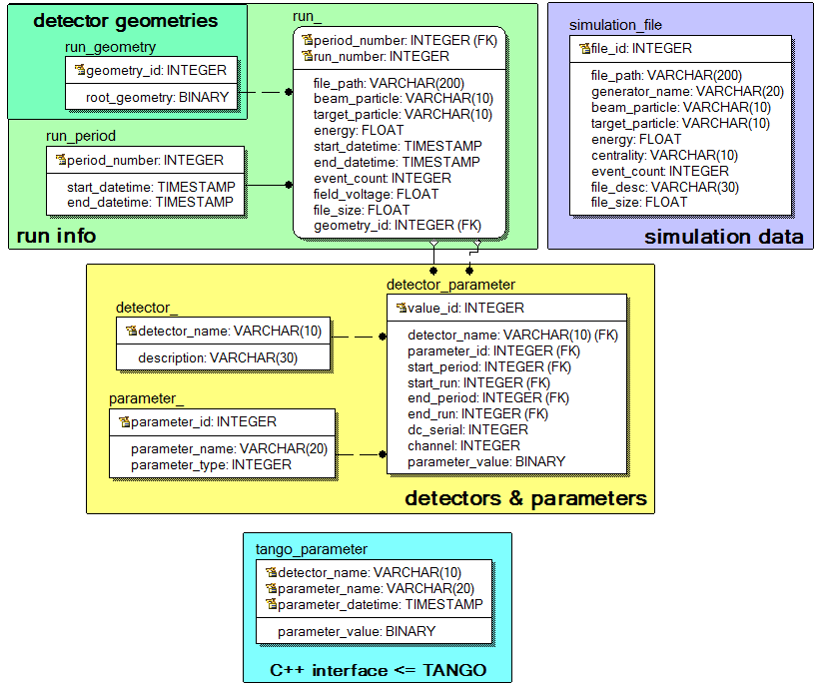
The Unified Database diagram
pointer to
SIM storage level
pointer to
RAW storage level
PostgreSQL DBMS
Gertsenberger K.

Slide 9
The data being stored in the parameter part
Configuration data is concerned with detector running mode, i.e. voltage settings as well as some programmable parameters for front-end electronics.
Calibration data describes the calibration and alignment of the subdetectors. Usually these quantities are evaluated by running offline algorithms.
Parameter data presents the state of the detector subsystems.
Algorithm data is used to control the way offline algorithms operate. It includes, for example, cuts for selection and noise channels excluded from the data processing.
Gertsenberger K.

Slide 10
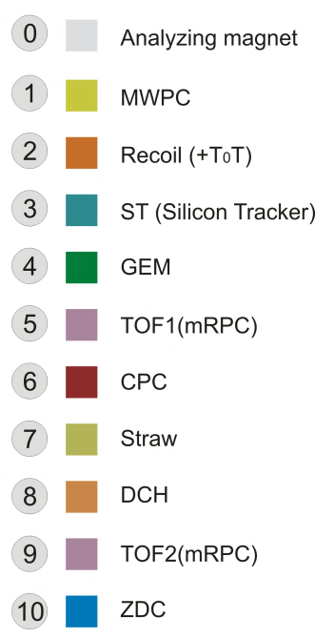
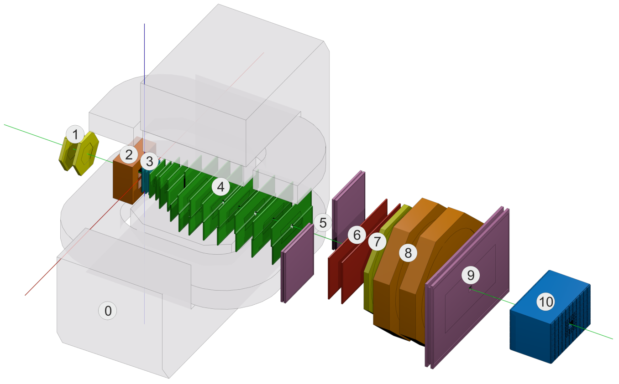
BmnRoot software
The software BmnRoot is developed for the BM@N event simulation, reconstruction of experimental or simulated data and following physical analysis of collisions of elementary particles and ions with a fixed target registered by the BM@N facility.
C++ classes, Linux OS support,
based on ROOT and FairRoot
BmnRoot has a runtime parameter manager which writes and initializes parameters from ASCII or ROOT files
Gertsenberger K.
Notes:
TOF-400, TOF-700

Slide 11
C++ database interface
Class wrappers for all database tables with many specific functions allow to access and manage the data without SQL statements in experiment software
UniDbRunPeriod – describes run periods (a set of runs) of the experiment
UniDbRun – run parameters (number, time, energy, beam, target, magnet field, file path, etc.)
UniDbRunGeometry – contains whole detector geometry in the ROOT format
UniDbDetector – detectors of the experiment (detector dictionary)
UniDbParameter – common information about detectors’ parameters presented on the previous slides and stored in the database (parameter dictionary)
UniDbDetectorParameter – values of detector parameters for experiment runs
UniDbSimulationFile – describes a set of generated simulation files
The main functions:
for data objects (static): Create, Delete, Get, Search, PrintAll.
for attributes (non-static): Getters and Setters functions, Print.
Gertsenberger K.

Slide 12
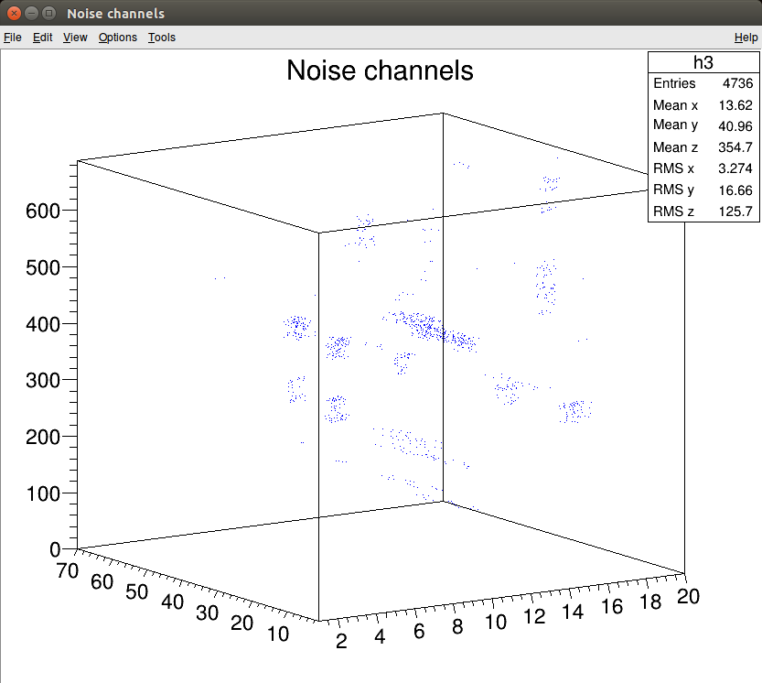
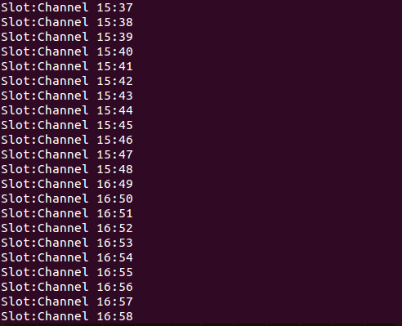
«Noise channels» parameter (example)
IIStructure* pValues = new IIStructure[32];
AssignIIStructure(pValues, 0, 15, 33, 48); // slot:15, channel:33-48
AssignIIStructure(pValues, 16, 16, 49, 64); // slot:16, channel:49-64
DbDetectorParameter::CreateDetectorParameter(run_number, "DCH1", "noise", pValues, 32);
DbDetectorParameter* pDetectorParameter = DbDetectorParameter::GetDetectorParameter(run_number, "DCH1", "noise");
if (pDetectorParameter != NULL)
{
IIStructure* pValues; int element_count = 0;
pDetectorParameter->GetIIArray(pValues, element_count);
// print values (slot:channel)
for (int i = 0; i < element_count; i++)
cout<<pValues[i].int_1<<":"<<pValues[i].int_2<<endl;
}
run
channel
slot
Gertsenberger K.

Slide 13
Additional tools of the database interface
UniDbConnection serves to open and close connections to the database
UniDbGenerateClasses generates skeleton classes for all tables of the database
UniDbParser parses existing data of the experiment from HTML, Excel and text files, and writes them to the Unified Database
UniDbSearchCondition forms criteria for selection of runs and detector parameters
UniDbTangoData gets hardware data from the Slow Control System (“Tango”) for selected time range (run number), detector and parameter defined by name
Unified
Database
connection
BmnRoot
Gertsenberger K.

Slide 14
Additional tools of the database interface
UniDbConnection serves to open and close connections to the database
UniDbGenerateClasses generates skeleton classes for all tables of the database
UniDbParser parses existing data of the experiment from HTML, Excel and text files, and writes them to the Unified Database
UniDbSearchCondition forms criteria for selection of runs and detector parameters
UniDbTangoData gets hardware data from the Slow Control System (“Tango”) for selected time range (run number), detector and parameter defined by name
C++ interface
w/o SQL
automatic code generation
Gertsenberger K.

Slide 15
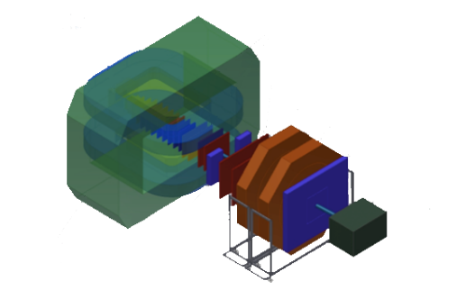
Additional tools of the database interface
UniDbConnection serves to open and close connections to the database
UniDbGenerateClasses generates skeleton classes for all tables of the database
UniDbParser parses existing data of the experiment from HTML, Excel and text files, and writes them to the Unified Database
UniDbSearchCondition forms criteria for selection of runs and detector parameters
UniDbTangoData gets hardware data from the Slow Control System (“Tango”) for selected time range (run number), detector and parameter defined by name
configuration data
calibration data
parameter data
algorithm data
Unified
Database
XML scheme
Gertsenberger K.

Slide 16
Additional tools of the database interface
UniDbConnection serves to open and close connections to the database
UniDbGenerateClasses generates skeleton classes for all tables of the database
UniDbParser parses existing data of the experiment from HTML, Excel and text files, and writes them to the Unified Database
UniDbSearchCondition forms criteria for selection of runs and detector parameters
UniDbTangoData gets hardware data from the Slow Control System (“Tango”) for selected time range (run number), detector and parameter defined by name
BM@N runs
detector parameters
e.g. energies
e.g. runs
BmnRoot
Gertsenberger K.

Slide 17
Additional tools of the database interface
UniDbConnection serves to open and close connections to the database
UniDbGenerateClasses generates skeleton classes for all tables of the database
UniDbParser parses existing data of the experiment from HTML, Excel and text files, and writes them to the Unified Database
UniDbSearchCondition forms criteria for selection of runs and detector parameters
UniDbTangoData gets hardware data from the Slow Control System (“Tango”) for selected time range (run number), detector and parameter defined by name
C++ database interface includes:
macros/ - ROOT macros for executing the tasks presented by the classes above
examples/ - numerous examples (ROOT macros) of using C++ interface to work with the BM@N database
docs/ - Unified Database documentation: Reference Manual, User’s Guide
Gertsenberger K.

Slide 18
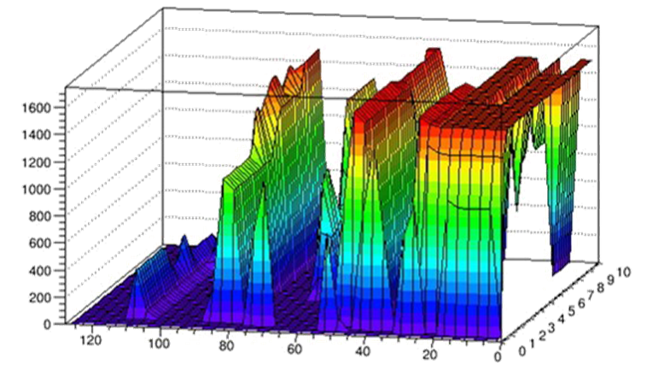
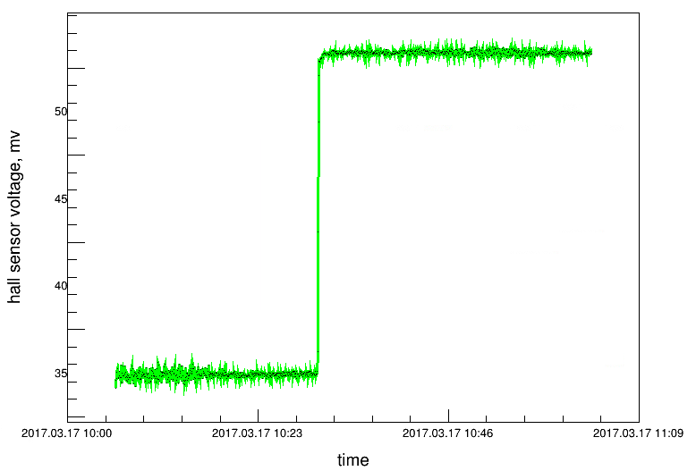
Getting “Tango” (hardware) data
UniDbTangoData interface gets hardware data from the BM@N Slow Control System
Main functions of the class:
Tango_Data* GetTangoParameter(char* detector_name, char* parameter_name, char* date_start, char* date_end);
void PrintData(Tango_Data* parameter, bool isGraphicPresentation = true);
(“ZDC”, “Vset”, “2015.03.13 23:40”, “2015.03.13 24:00”);
(“Magnet”, “field”, run 1886, run 1888);
hall sensor voltage, mv
voltage
time counter
ZDC tower number
time
Gertsenberger K.

Slide 19
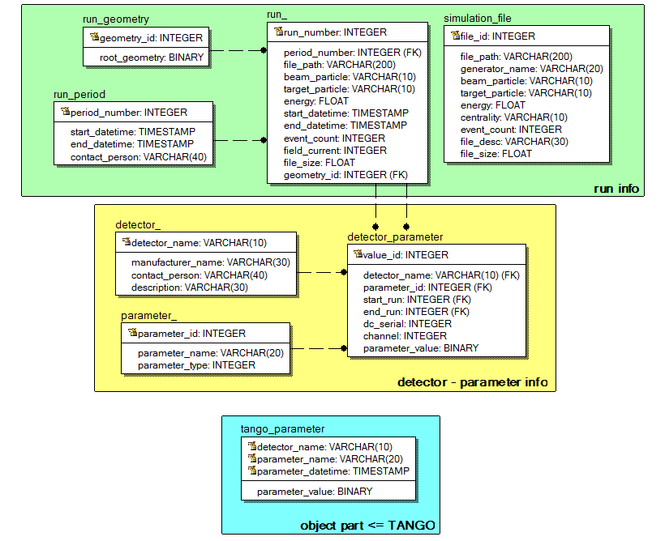
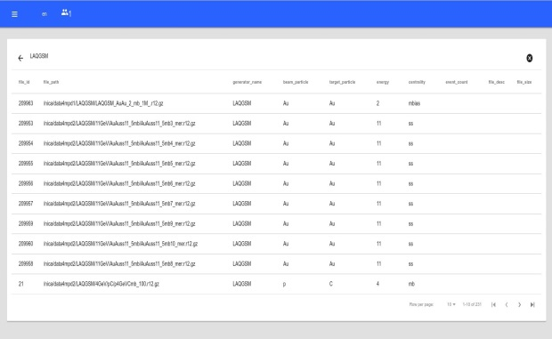
The Unified Database in offline data processing
detector simulation
raw data processing
event reconstruction
physics analysis
reading and changing data
BmnRoot
users
C++ database interface w/o SQL
(connect, SQL I/O)
Unified
Database
ROOT
PHP
UniDbTango class
Web-interface is under development
PostgreSQL
configuration
calibration
parameter and
algorithm data
Tango
Slow Control System
Gertsenberger K.

Slide 20
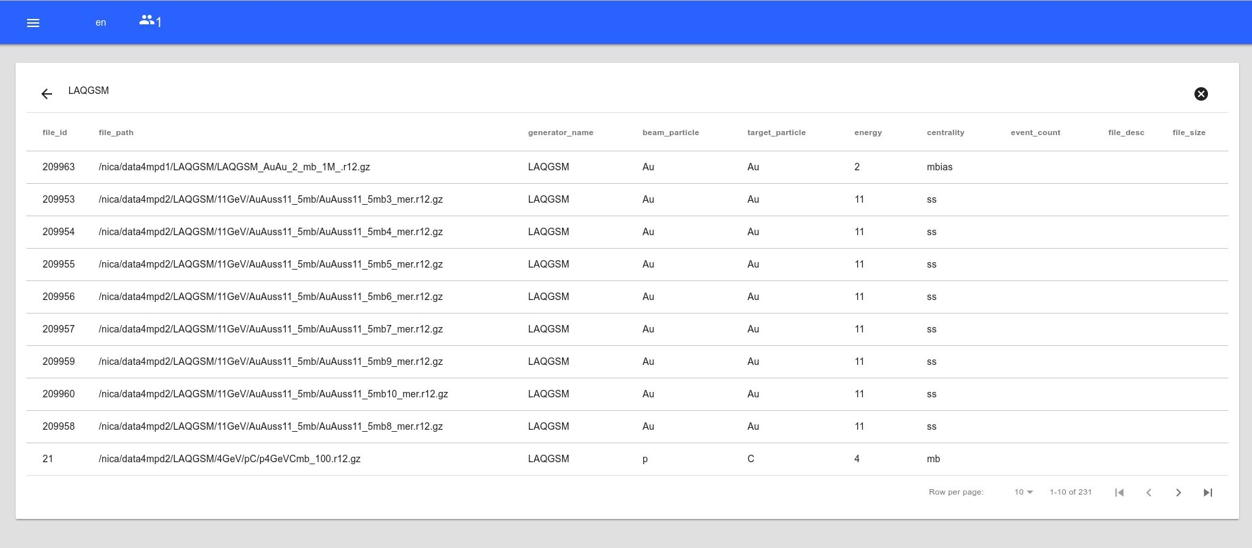
Web-interface of the simulation part
It contains paths to all simulated data files for different event generators
Easy search by many parameters
event generators:
UrQMD
QGSM
Hybrid UrQMD
vHLLE_UrQMD
3FD(Theseus)
…
1,2TB
~ 34 000 files
~ ${10}^{6}$ events/file
Gertsenberger K.

Slide 21
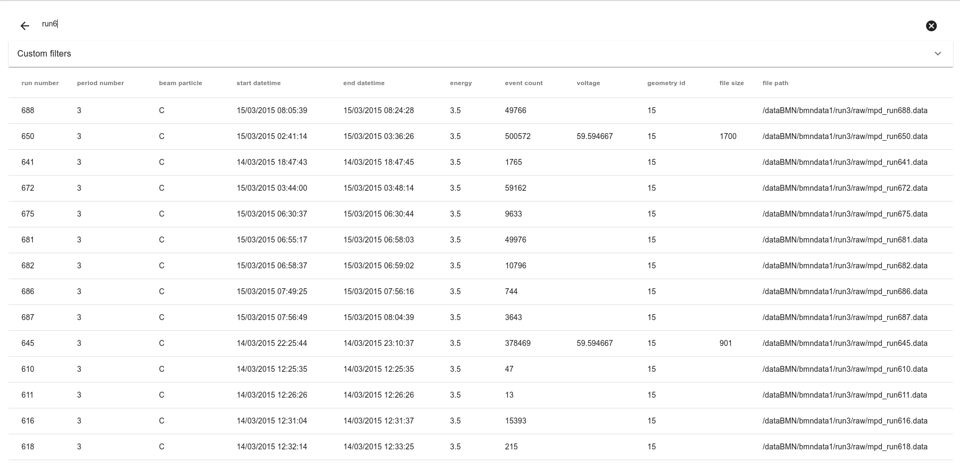
Web-interface of the experimental part
count of rows ~ 50k experimental data ~ 12TB
Gertsenberger K.

Slide 22
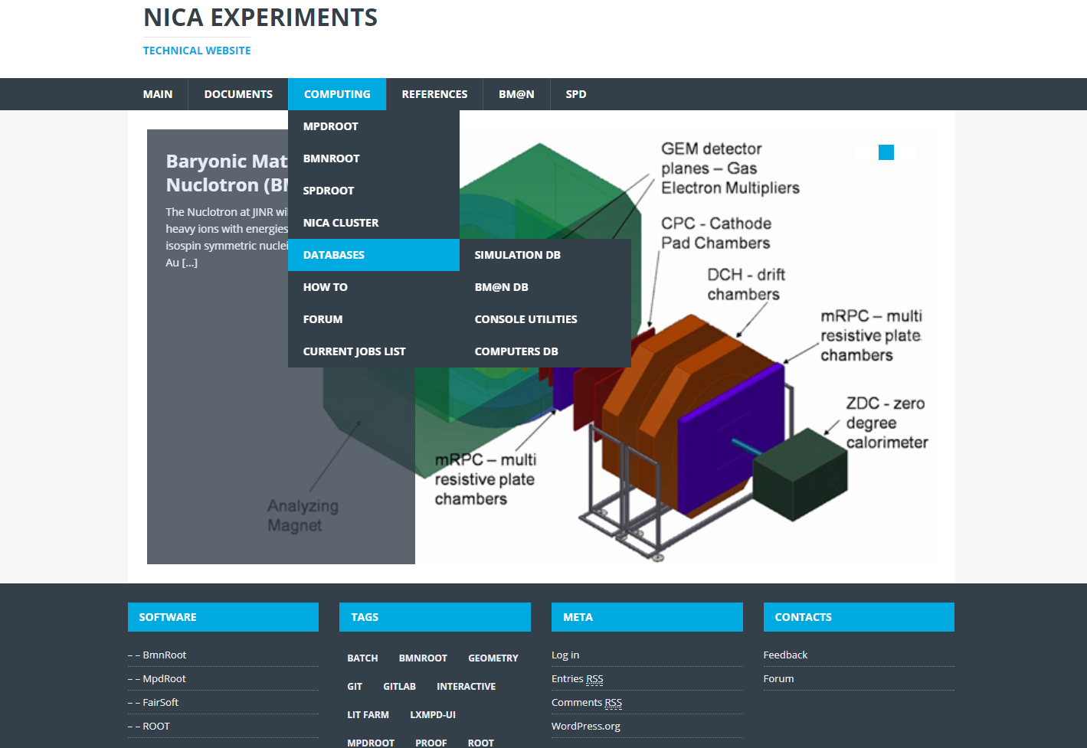
The «Databases» section on mpd.jinr.ru
Information
News
Forum
Mail-lists (updates, errors…)
Software repositories
Software tests dashboard
etc.
Gertsenberger K.

Slide 23
Conclusions
The BM@N database has been developed based on PostgreSQL and deployed in the cloud of the Laboratory of Information Technologies.
The Unified Database merged the existing databases and includes existing data of conducted BM@N runs from multiple files (binary, text, CSV, HTML and XML).
The developed database is a comprehensive data storage of the BM@N experiment, which provides unified user access and data management.
The C++ database interface has been implemented as a part of the BmnRoot environment to use it for offline raw data processing, reconstruction and physical analysis tasks. It provides the interface to manage data without SQL statements.
The Tango interface has been developed to get hardware data from the BM@N Slow Control System.
The Web interface is under development now to simplify reading and changing the experiment data for users.
A future version of the Unified Database can be used for the MPD/NICA experiment
Gertsenberger K.

Slide 24
The XXI International Scientific Conference of
Young Scientists and Specialists (AYSS-2017)
Thank you for your attention!
More information: mpd.jinr.ru
email: gertsen@jinr.ru
30 November 2017
Gertsenberger K.

