Slide 1

Kinetics of fullerene
aggregation in polar liquids
and their mixtures with water
T.V. Tropin, N. Jargalan, O.A. Kyzyma,
M.V. Avdeev, V.L. Aksenov
Frank Laboratory of Neutron Physics, Joint Institute for Nuclear Research, Dubna, Russia
The XXI International Scientific Conference of Young Scientists and Specialists,
JINR, Dubna, Russia, October 2-6, 2017

Slide 2
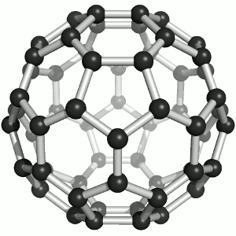
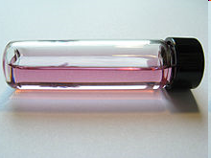
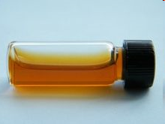
Fullerenes С₆₀ in solutions
С₆₀/C₆H₆
Dissolves in many liquids!
Molecular solutions of С₆₀
Cluster formation observed!
Colloidal solutions of С₆₀
(including water!)
1 nm
Perspective biomedical applications!
С₆₀/H₂O
Investigations of solutions of C₆₀ are interesting both from the viewpoint of fundamental investigations and for the perspective practical applications.

Slide 3
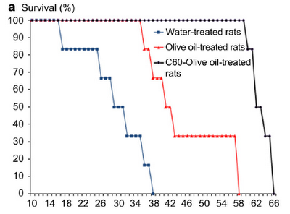
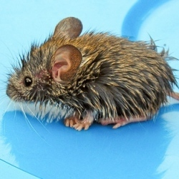
Fullerenes – perspective for biomedicine!
Cancer treatment
Hepatoprotective effect
Antioxidant, antitumor properties of fullerene-water solutions!
Synergetic effect with different drugs!
N. Gharbi, M. Pressac, et. al, “[60]Fullerene is a powerful antioxidant in vivo with acute or subacute toxicity” // Nano Lett, 5(12) 2578-2585, 2005.
S. Prylutska, I. Grynyuk, et. al, “C₆₀ fullerene as synergistic agent in tumor-inhibitory doxorubicin treatment” // Drugs in R&D 14 333-340 2014.
T.I. Halenova, I.M. Varenyuk, et. al, “Hepatoprotective effect of orally applied water-soluble pristine C₆₀ fullerene against CCl₄-induced
acute liver injury in rats” // RSC Advances 102 2016.

Slide 4
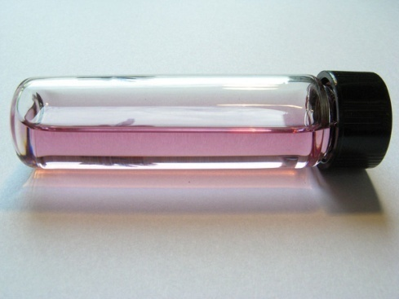
Obtaining fullerene-water solutions
From non-polar C₆₀ solution
From polar C₆₀ solution
Ultrasound treatment,
400-600 W, 20-50 kHz
C₆₀/N-methylpyrrolidone
(NMP)
H₂O
C₆₀ in an organic solution
Non-miscible with water
(benzene)
NMP< 0.005 vol.%
H₂O
NMP/nC₆₀
Stable colloidal solution
±
+
Smaller cluster sizes?
Easier in preparation!
NMP less toxic than benzene!
Similar medical effects
Similar stability

Slide 5
Investigate and describe cluster growth in C₆₀/NMP and C₆₀/NMP/H₂O solutions
Propose a qualitative description of the water addition to C₆₀ solution in polar solvent

Slide 6

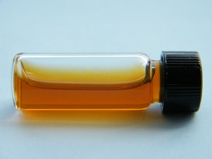



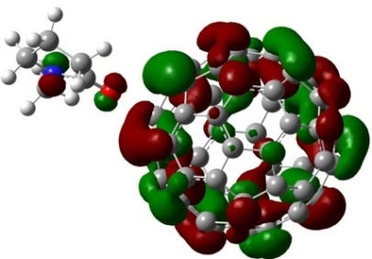

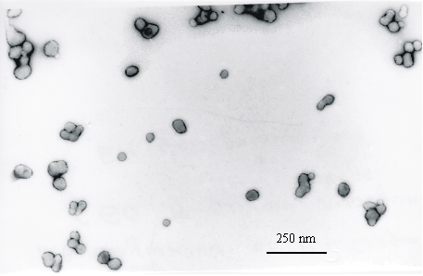
C₆₀/NMP solution: kinetic effects
Cluster formation and growth
Formation of charge-transfer complexes Solvatochromic effect
C₆₀-NMP complex, d=6.95 D
TEM image of C₆₀/polar-solvent
Absorption spectra of fullerene solution by UV-Vis spectrometry

Slide 7
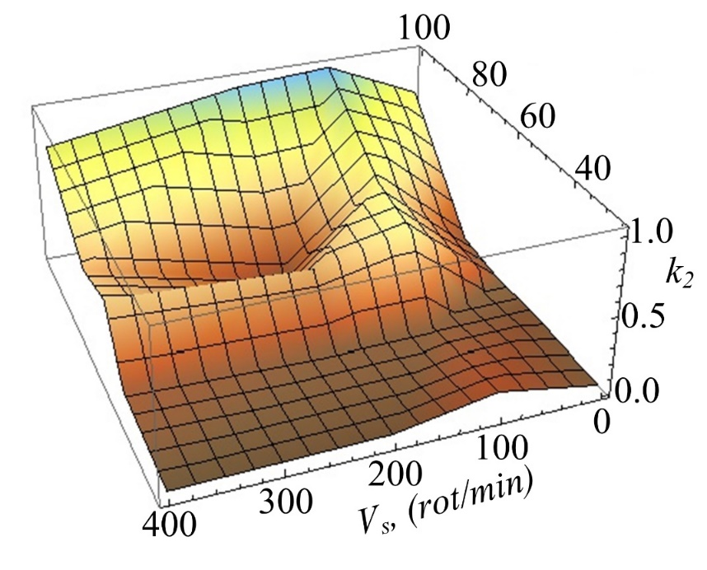
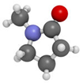
Dissolution and complex formation in C₆₀/NMP
Buger-Lambert-Beer law
not satisfied
A model treatment of UV-Vis spectra allowed determining both dissolution and complex formation rates with respect to temperature and stirring speed
N. Jargalan, T.V. Tropin et al., Nanosystems: physics, chemistry, mathematics, 2016, 7 (1), p. 99–103

Slide 8
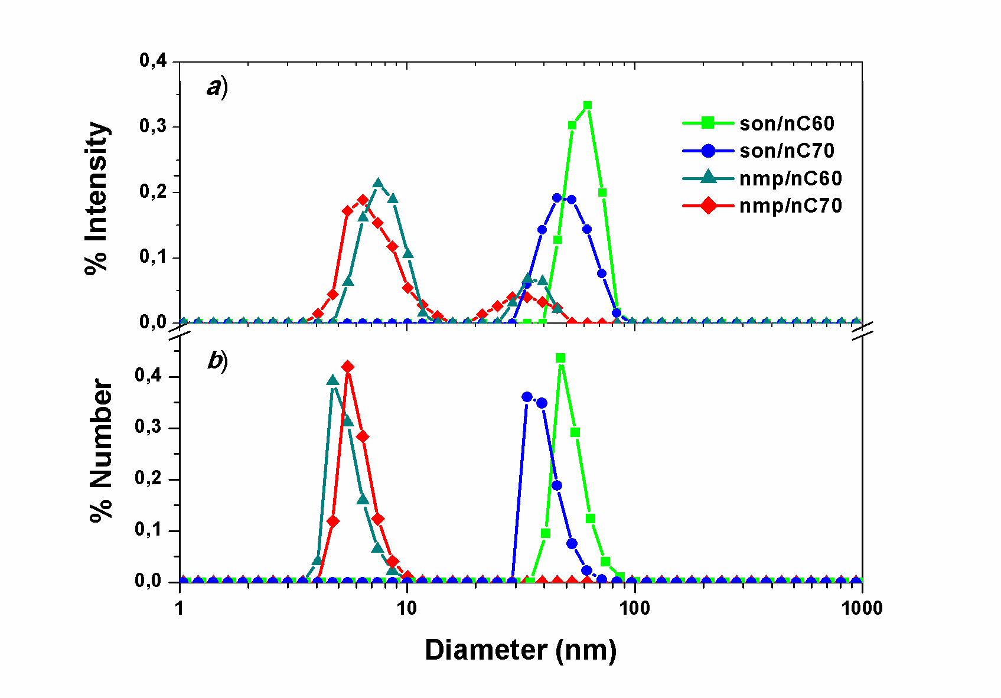
C₆₀/NMP and C₆₀/NMP/H₂O: DLS measurements
Pure C₆₀/NMP solution
C₆₀/NMP/water solutions
R_{clusters} < 50 nm
R_{clusters} > 100 nm
Time
Large clusters in “old” C₆₀/NMP solution detected;
Cluster decomposition effect takes place on water addition;
The effect bears a critical character (X>0.4)!
V.L. Aksenov, M.V. Avdeev, T.V. Tropin, et. al, // Physica B V.385–386 PP.795–797 2006
N. Jargalan, T.V. Tropin, M.V. Avdeev, et. al // Solid State Phenomena 2018 (accepted)
O.A. Kyzyma, M.V. Avdeev, O.I. Bolshakova // Environ Sci Technol 2018 (submitted)

Slide 9
Theoretical description

Slide 10
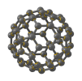
Modeling confined cluster growth in polar solutions of С₆₀
Cluster formation and growth takes place as a two-step process: complexes formation with solvent molecules, further clusters growth.
Solvent.
Addition of C₆₀, stirring.
Growth of huge С₆₀ clusters. Decrease of the monomers concentration.
Dissolution of С₆₀. Molecular solution under certain conditions.
Formation of С₆₀-solvent complexes, change of the color of solution.
Hours
Days
Model parameters and functions:
A(t‘) – concentration of C₆₀ complexes
c_{sat} – saturation concentration;
f(n,t‘) – cluster size distribution function;
τ,τ‘ – characteristic times of dissolution and complex formation.
Other model parameters: D, σ, c_{eq}.
Values of model parameters obtained from experiments.
The solutions of kinetic equations for real-time systems obtained via extrapolation procedure.
T.V. Tropin, M.V. Avdeev, O.A. Kyzyma, R.A. Yeremin, N. Jargalan, M.V. Korobov, V.L. Aksenov // Phys. Status Solidi B, V. 248, Nos. 11, pp. 2728-2731, 2011

Slide 11
Modeling real-size clusters in C₆₀/NMP
Cluster sizes: R>100 nm, n>10⁷ (…equations)!
Complex formation time ~hours, τ_{c}~10⁷!

Slide 12
Confined growth model master-curve
Evolution of mean cluster size, <r>
Master-curve for <r> and c_{mon}
Master-curve found for the <r> and c_{mon} dependence.
This allows modeling growth of real-size fullerene aggregates.
T.V. Tropin, M.V. Avdeev, V.L. Aksenov Cryst. Rep., 2018 (accepted)

Slide 13
Confined growth model cluster size distributions (CSD)
“Early” CSDs
“Late” CSDs
Lifshitz-Slyozov CSD
Master-curve found for the <r> and c_{mon} dependence. This allows modeling of real-size particles.
T.V. Tropin, M.V. Avdeev, V.L. Aksenov Cryst. Rep., 2018 (accepted)

Slide 14
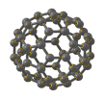
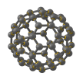
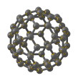
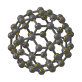
Water addition: cluster state reorganization
C₆₀/NMP
C₆₀/NMP/H₂O
Water addition
UV-Vis, SANS, DLS data, mass spectrometry…
>100 nm clusters
~30-50 nm clusters
C₆₀/NMP
H₂O
An effect with a critical character!

Slide 15
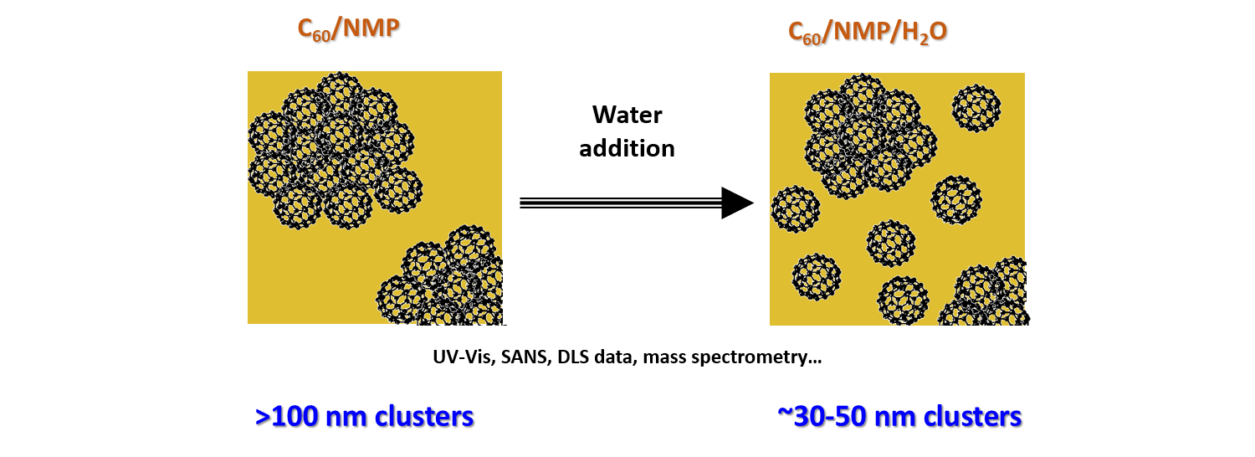
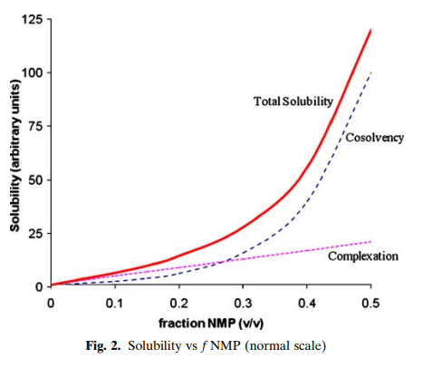
Cluster state reorganization: model approach
Sanghvi, R., et. al. Solubility improvement of drugs using N-methyl pyrrolidone. Amer. Assoc. of Pharm. Sci., 9(2), 366–376 2008.
How does solubility of complexes in NMP-water mixture change?!
An effect with a critical character!
X=0 – no water added;
X=1 – infinite amount of water added.
Effect of NMP: non-linear increase of water solubility of drugs!
Model of dissolution:
  C₆₀-NMP complexes have non-zero solubility in water,
  Diffusion coefficients and surface tension change proportionally with X.
- model parameter
T.V. Tropin, V.L. Aksenov JETP Letters 2018 (submitted)

Slide 16
Modeling C₆₀/POL dissolution by water
Change of the average cluster size <R> after water addition, depending on X for different values of model parameter: decreasing C₆₀-POL solubility in water.

Slide 17
Modeling C₆₀/POL dissolution by water
Change of characteristic concentration and relaxation time on dissolution affects the average cluster size in the desired way.
Model predictions:
Solubility in water: ← may be important for dialysis!
At dissolution rates above 1:1000 cluster sizes should not decrease!
T.V. Tropin, V.L. Aksenov JETP Letters 2018 (submitted)

Slide 18
Conclusions
Fullerene aggregates in NMP and NMP/H₂O were studied experimentally. Cluster sizes changes from >100 nm to
30-50 nm on water addition.
DLS, UV-Vis, SANS measurements. A model for kinetics of UV-Vis change.
A model approach for description of the kinetics of cluster growth in polar solutions of C₆₀ has been developed.
One-component segregation, confined growth (complex formation), master-curve approach, CSDs obtained for any t.
C₆₀/POL water dissolution model proposed.
Critical decomposition explained.
Model predictions for C₆₀-NMP complexes solubility in water,
and for the critical X value were obtained.
Calculations performed at the LIT/JINR HybriLIT cluster.
This work has been supported by the JINR grant for young scientists #17-401-03.

Slide 19
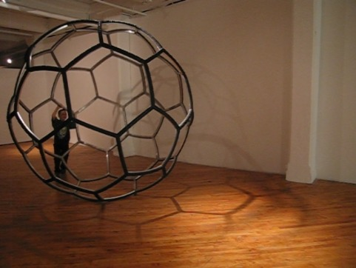
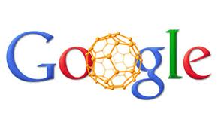
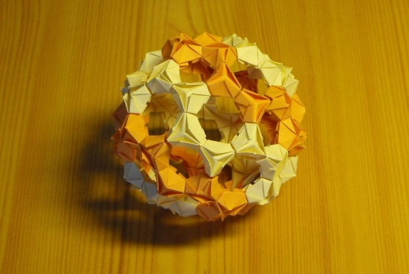
THANK YOU FOR ATTENTION!

Slide 20
Публикации
Т.В. Тропин, N. Jargalan, М.В. Авдеев, О.А. Кизима, D. Sangaa, В.Л. Аксенов // Физика твердого тела, Т. 56, вып. 1, С. 147-150, 2014.
Н. Жаргалан, Т.В. Тропин, М.В. Авдеев, В.Л. Аксенов // Поверхность. Рентгеновские, синхротронные и нейтронные исследования, 2015, №1, с. 16-20.
N. Jargalan, T.V. Tropin, M.V. Avdeev, V.L. Aksenov // Nanosystems: physics, chemistry, mathematics, V. 7 (1), pp. 99-103, 2016.
T.V. Tropin, J.W.P. Schmelzer, V.L. Aksenov // J. Mol. Liq., V. 235, pp. 172-177, 2017.
Т.В. Тропин, М.В. Авдеев, В.Л. Аксенов // Кристаллография 2018 (в печати).
N. Jargalan, T.V. Tropin, M.V. Avdeev, V.L. Aksenov, D. Sangaa // Solid State Phenomena, 2018 (accepted).
Т.В. Тропин, В.Л. Аксенов // Письма в ЖЭТФ, 2018 (submitted).

Slide 21
Разбавление водой – сравнение с МУРН
Сравнение теории с экспериментом по рассеянию нейтронов
V.L. Aksenov, M.V. Avdeev, T.V. Tropin, et. al. // Phys. B Condens. Matter. 385–386 (2006) 795–797. doi:10.1016/j.physb.2006.06.086

Slide 22
Разбавление водой – сравнение с МУРН
Сравнение теории с экспериментом по рассеянию нейтронов
V.L. Aksenov, M.V. Avdeev, T.V. Tropin, et. al. // Phys. B Condens. Matter. 385–386 (2006) 795–797. doi:10.1016/j.physb.2006.06.086

Slide 23
SANS signal modeling for C₆₀/NMP solution
Mean cluster size
Modeled SANS curves
Optimal conditions for SANS measurements
T. V. Tropin, N. Jargalan, et. al // Phys. Solid State. 56 (2014) 148–151

