Slide 1



Induction and repair of DNA double-strand breaks in hippocampal neurons of miсe of different age after exposure to ⁶⁰Со γ-rays in vivo and in vitro
Dubna State University
Joint Institute for nuclear research
Laboratory of radiation biology
R.A. Kozhina, V.N. Chausov, E.A. Kuzmina, A.V. Boreyko
Dubna, 2017

Slide 2
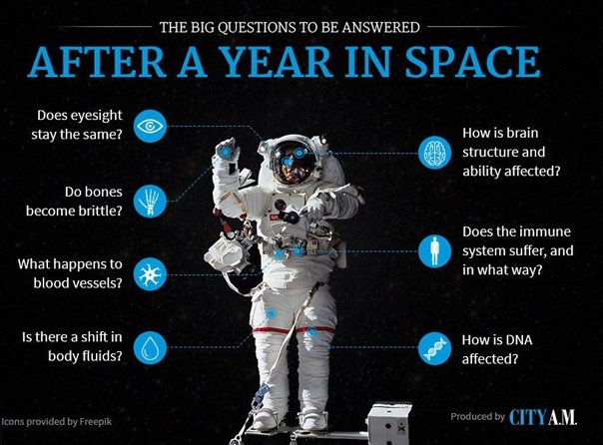

Slide 3
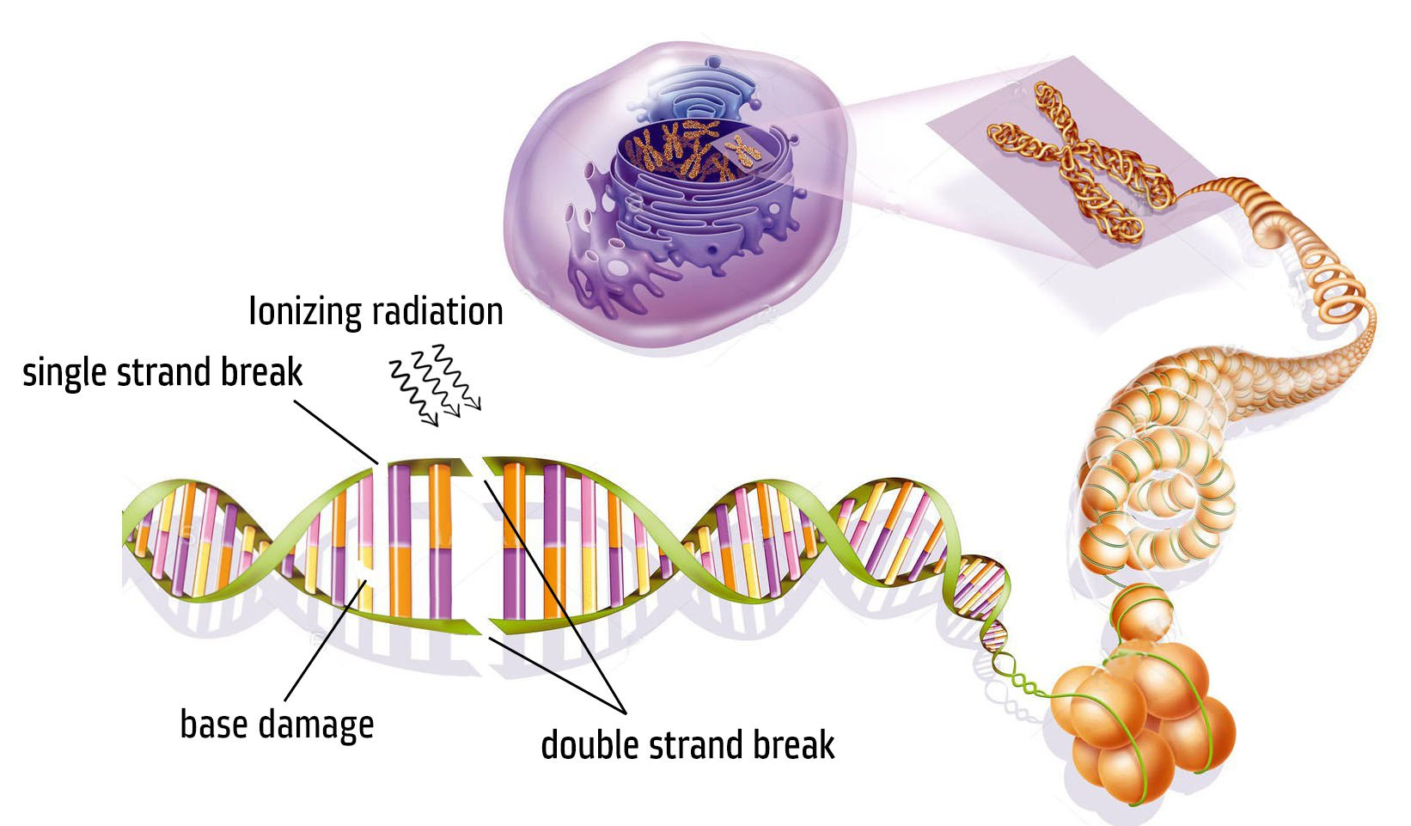
DNA damage

Slide 4

Aims
Study the ways of induction and repair DNA DSB in mice hippocampal neurons for γ-irradiation ⁶⁰Со.
Carrying out the comparison study of induction and repair of DSB DNA mechanism, which are formed by action of γ-irradiation ⁶⁰Со in vivo and in vitro.
Comparison of regularities of induction and repair damage in brain neurons of different age mice.

Slide 5
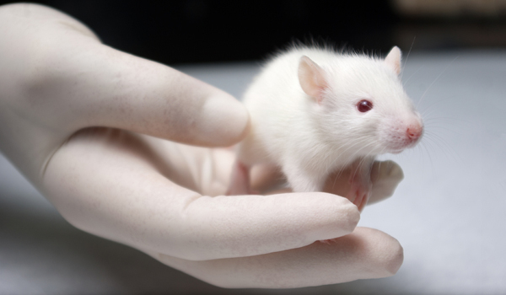
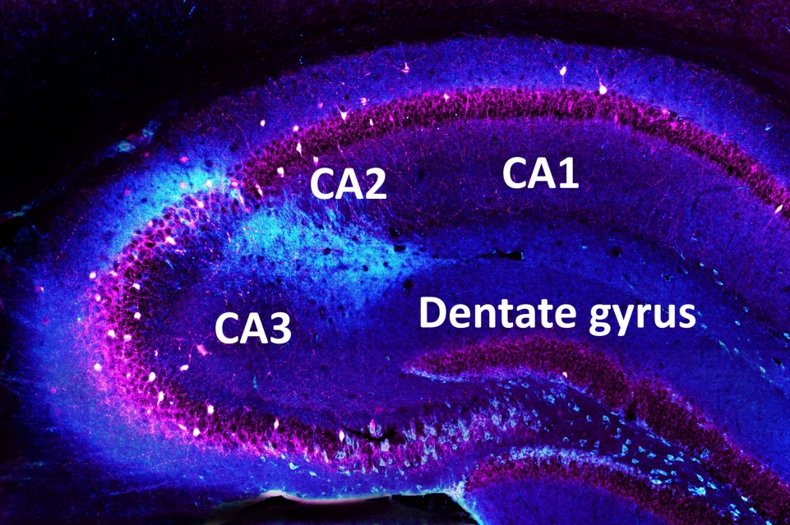
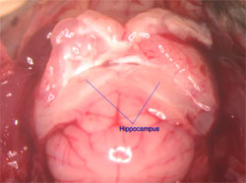
Research object
Line CBAxC57Bl, F1
Age: 8 weeks (in vivo), 48 weeks (in vitro)
Body weight 26-35 g
Sagittal section of the hippocampus
Mouse brain. Dorsal view

Slide 6
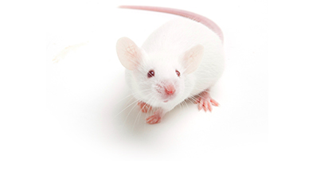
The research object
Hippocampal cells of mice
Spatial memory
Transition to long-term memory
Short-term memory
„Neurons are not restored“

Slide 7
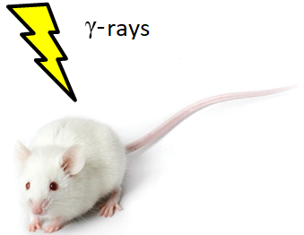
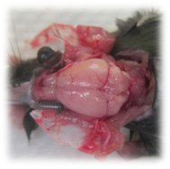
Experiment method
in vivo
in vitro
⁶⁰Со (Dosage rate: 0,01 Gy/s)
Mice were exposed
Hippocampus isolation
Preparation of single cell suspension
Hippocampus isolation
Preparation of single cell suspension
Single cell suspension was exposed
γ-rays

Slide 8
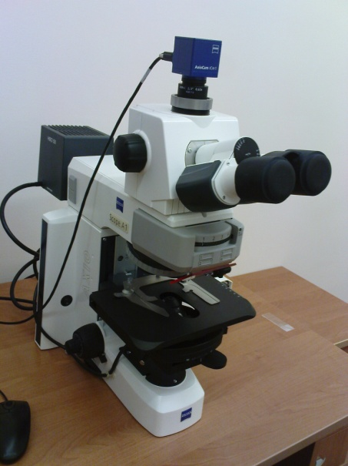

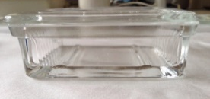
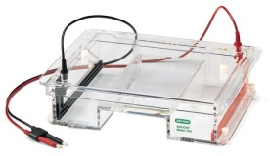

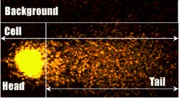
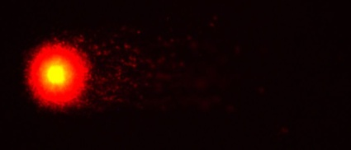
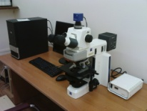
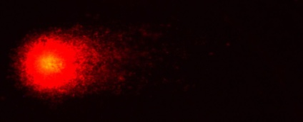
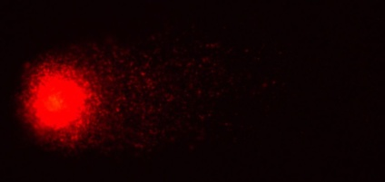
DNA comet assay
Preparation of agarose-coated slides
Lysing cells
Electrophoresis
0 Gy
Microscope visualization
2 Gy
Computer processing
4 Gy
5 Gy

Slide 9
Induction of DNA DSB
Mice age: 8 weeks

Slide 10
Induction of DNA DSB in different age mice
in vitro

Slide 11
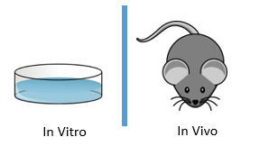
Bar chart of the distribution of hippocampal cells by the degree of DNA damage
in vivo
in vitro

Slide 12
Kinetics of DNA DSB repair (3 Gy)
Mice age: 8 weeks

Slide 13
Kinetics of DNA DSB repair in different age mice
Dose: 4 Gy

Slide 14
Summary
The number of DNA DSB in vitro > in vivo
DNA DSB yield in hippocampal cells of 8-weeks is bigger than in 48-weeks mice (in vitro)
In vivo repair kinetics - complex character
In vitro repair kinetics - exponential dependence

Slide 15
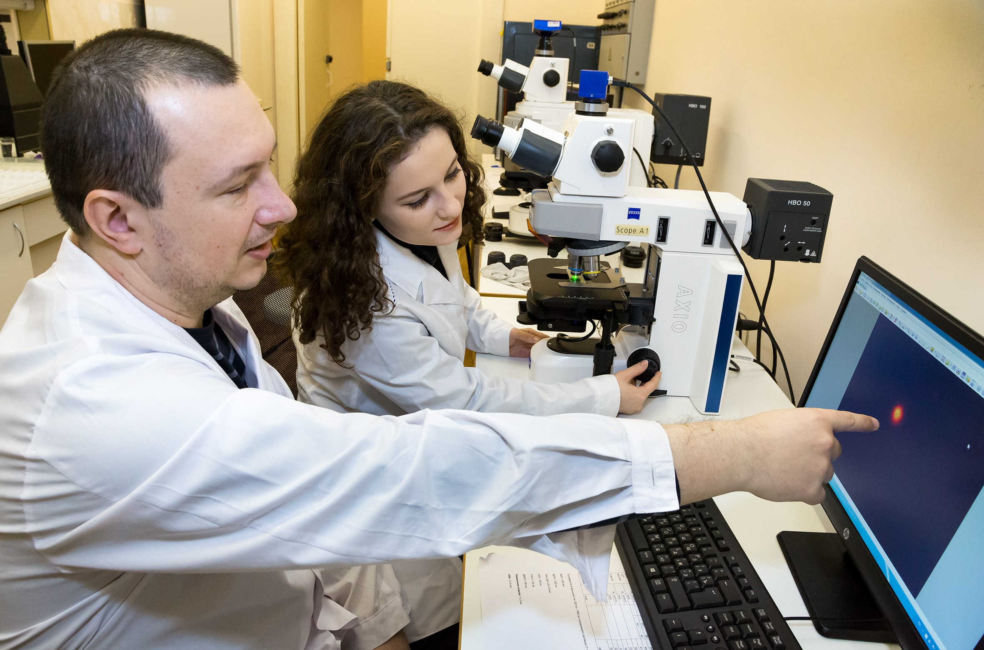
Thank you for attention!

