Slide 1
Magnetization reversal by superconducting current in SFS Josephson junctions
Ilhom Rahmonov ^{a,b}
In collaboration with: Yu. M. Shukrinov^{a,c}, K. Sengupta^{d}, A. Buzdin^{e}
ª Joint institute for Nuclear Research, Dubna, Moscow region, Russia
^{b} Umarov Physical and Technical institute, AS of Tajikistan, Dushanbe, Tajikistan
^{c} Dubna State University, Dubna, Moscow region, Russia
^{d} Dep. Theor. Phys. , Indian Association for the Cultivation of Science, Kolkata, India
^{e} University Bordeaux, LOMA UMR-CNRS Talence Cedex, France
30 November 2017
Dubna

Slide 2
Outline
1. Introduction
SFS structure and Josephson effect
Motivation of investigation
Theoretical model and equations
2. Reversal of magnetization by the superconducting current
Magnetization reversal with pulse current and magnetization dynamics
Magnetization reversal with Gaussian signal
Effect of parameters on the magnetization reversal
3. Conclusions

Slide 3
1. Introduction

Slide 4




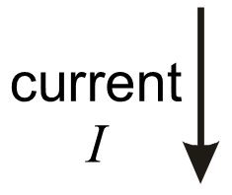

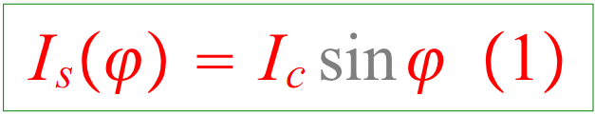



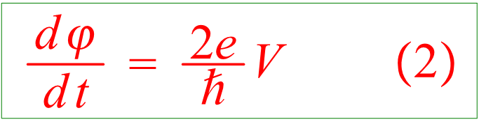
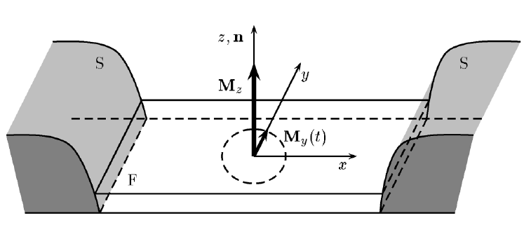

SFS structure and Josephson effect
► In the SFS Josephson junctions, the spin-orbit interaction in a ferromagnet
without inversion symmetry provides a mechanism for a direct (linear) coupling between the magnetic moment and the superconducting current
where
A. Buzdin, Phys. Rev. Lett. 101, 107005 (2008).
F. Konschelle and A. Buzdin, Phys. Rev. Lett. 102, 017001 (2009)

Slide 5

Motivation of investigation
Is it possible to control the magnetic moment using superconducting current?
Can we revers the magnetization using superconducting current?

Slide 6
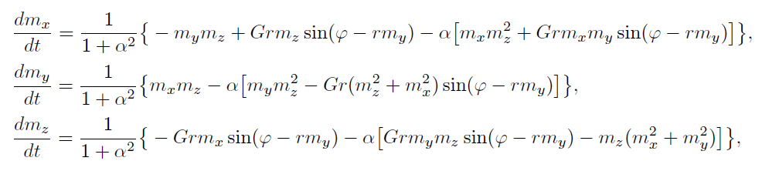


Theoretical model and equations

Slide 7
Reversal of magnetization by the superconducting current

Slide 8
Reversal of magnetization by the superconducting current
Yu. M. Shukrinov, I. R. Rahmonov, K. Sengupta and A. Buzdin
Appl. Phys. Lett. 110, 182407 (2017).

Slide 9
Dynamics of magnetization momentum

Slide 10
Magnetization reversal with Gaussian signal

Slide 11
Effect of parameters on the magnetization reversal

Slide 12
Conclusions
► We have demonstrated the magnetization reversal in SFS junction with the pulse and Gaussian superconducting current.
► We have shown effect of model parameters on magnetization reversal
►The presented results are published in Appl. Phys. Lett. 110, 182407 (2017).
Yu. M. Shukrinov, I. R. Rahmonov, K. Sengupta and A. Buzdin
Appl. Phys. Lett. 110, 182407 (2017).

Slide 13
Thank you for attention

