Slide 1


SPECIAL ASPECTS OF STRUCTURE OF COMPLEX OXIDES OF IRON AND MANGANESE UNDER HIGH PRESSURE
N.M. Belozerova, D.P. Kozlenko, S.E. Kichanov, S.S. Ata-Allah, Z. Jirak, M. Yehia, A. Hashhash, E.V. Lukin, B.N.Savenko
Notes:
I would like to present you report about the crystal and magnetic structure of nanostructured manganites under high pressure. This work performed in Frank laboratory of neutron physics in experimental team and in collaboration with Institute of Physics in Prague Czech Republic. Czech colleques obtained the samples which we were using in our study.

Slide 2
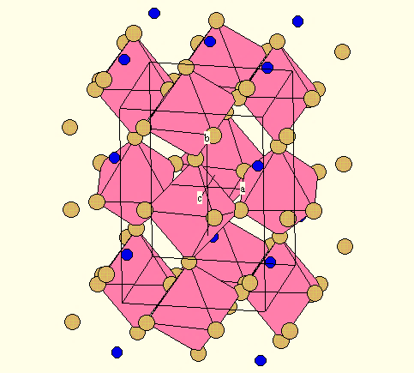
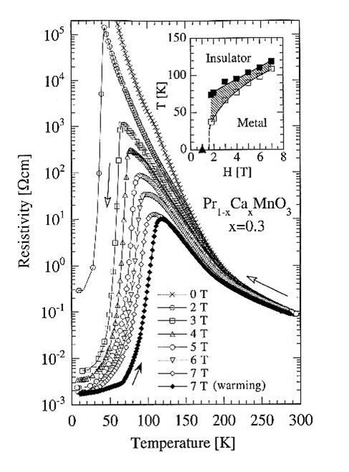
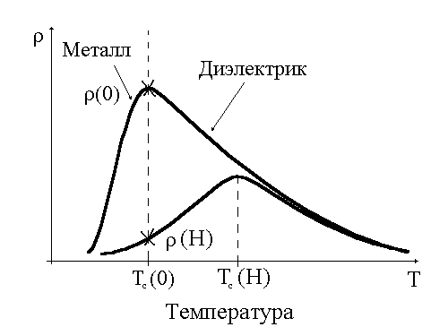
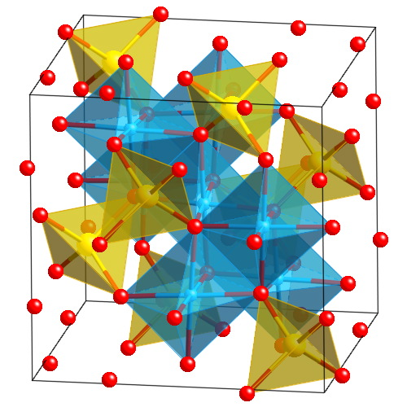
Physical properties of manganites and ferrites
Complex oxides of iron Zn_{x}Cu_{1-x}Fe_{1-y}Ga_{y}O₄ and manganese La_{1-x}Sr_{x}MnO₃ exhibit great variety of properties depending on the doping level and the particle size.
Metal
Insulator
Temperature
Notes:
As introduction let’s talking about physical properties of manganites and ferrites. Manganite of the perovskite type exhibit a great variety of properties depending on the doping level and the particle size. Special interest in such compounds caused by detected in them the effect of colossal magnetoresistance (CMR). It is a sharp drop in electric conductivity of the material under the influence of the external magnetic field. This fact give opportunity to using complex oxides of Fe and Mn in manufacture of magnetic media for storing information.

Slide 3
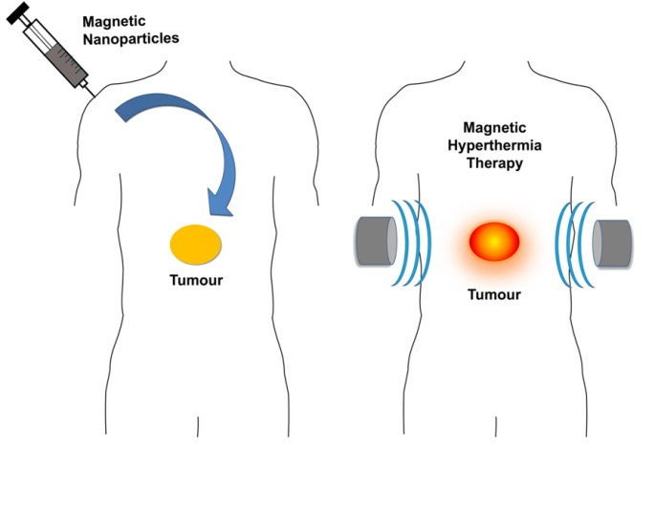


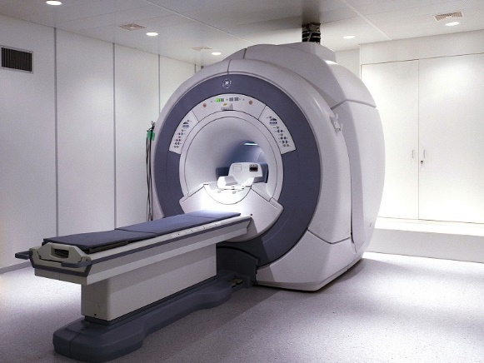

Nanostructured complex oxides: new word in biomedicine
Notes:
But the most interesting application exist for nanostructured complex oxides especially for manganites. This compound is promising materials for applications in biomedicine (as biomarker in the Magnetic Resonance Tomography and in magnetic hyperthermia, where nanoparticles administer in the human body and direct to the tumor. After that nanomanganites are heating and the tumor destroy).

Slide 4
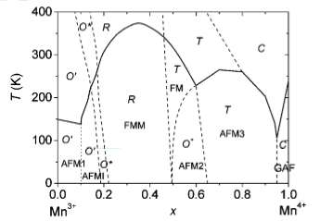
Nanostructured manganite: Physical properties
0.33
La_{0.72}Sr_{0.28}MnO₃
R ~ 47nm
La_{0.63}Sr_{0.37}MnO₃
Zn_{0.3}Cu_{0.7}Fe_{1.5}Ga_{0.5}O₄
Notes:
Also it has been discovered that nanostructured manganites La_{1-x}Sr_{x}MnO₃ (with doping level near x~0.33) have a rhombohedral structure both in the corresponding bulk samples. The magnetic structure of such compounds underexplored in contrast to bulk manganites which studied actively. So the objective of my work was study crystal and magnetic structure of nanostructured La-Sr manganites under high pressure by using neutron diffraction method. We took two samples with doping level x~0.28; 0.37 and carried out experiment.

Slide 5
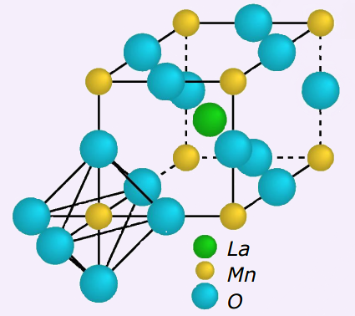
Experimental method:
Neutron Diffraction
Neutron is sensitivity to the light atoms such as oxygen. It is give as opportunity to determine location of oxygen with precision.
Another advantage of the neutron is sensitivity to the magnetic structure and dynamics of the magnetic substance.
Notes:
Why did we choose the neutron diffraction. It is well-known that neutrons is a good instrument for such investigations. First of all for study the crystal structure. Neutron sensitivity to the light atoms such as oxygen. It is give as opportunity to determine location of oxygen with precision. Another advantage of the neutron is sensitivity to the magnetic structure and dynamics of the magnetic substance.

Slide 6
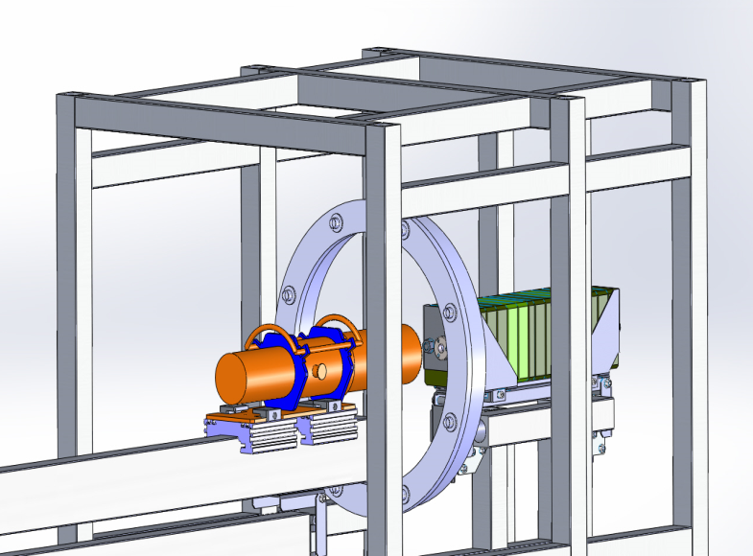
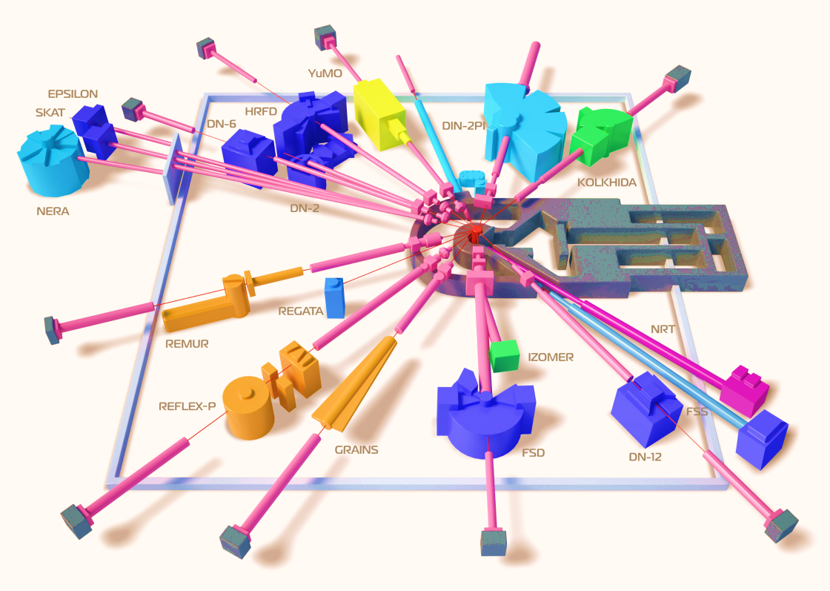
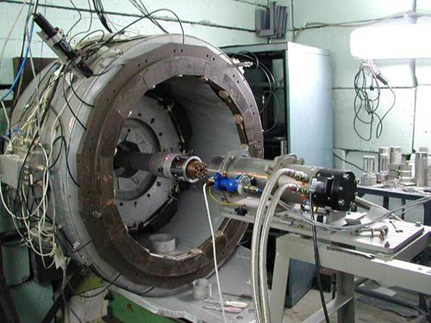
Experimental method: Neutron diffractometers DN-6 and DN-12
Notes:
Carry out such experiment under high pressure is difficult issue. This problem resolved in JINR. Therefore all experiments were performed in new diffractometer for investigation microsamples under high pressure DN-6 of pulse high-flux reactor IBR-2 in Dubna. High pressure on the sample created by using the high pressure cells with sapphire anvils.

Slide 7
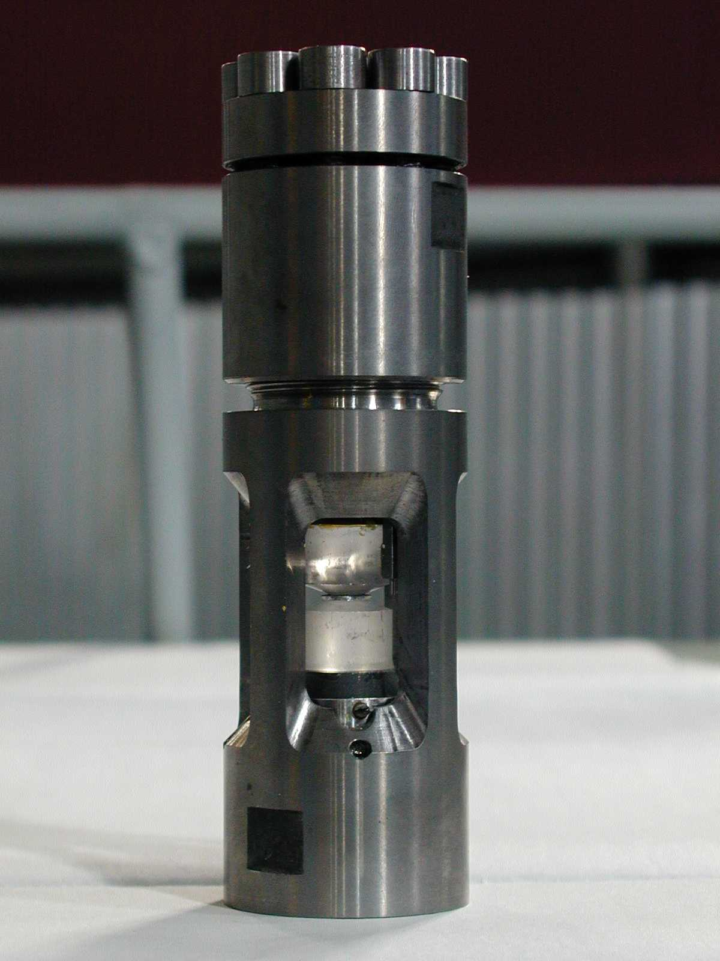
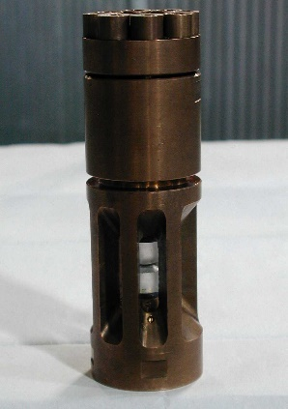
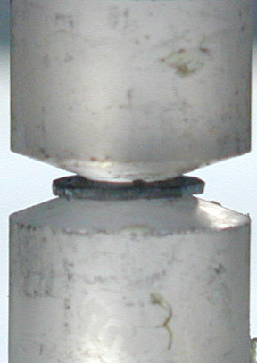
Experimental methods: High pressure cells
Maximum pressure is 8 GPa
Notes:
Carrying out investigation under high pressure is the unique method, which allows to observe the relation between the changing magnetic structure with the changing in crystal structure, that necessary for understanding the nature and mechanism of phenomena which take place in manganites. How did we do it? We took the sample and put it between two anvils. Then we increasing the pressure up to 8GPa.

Slide 8
Crystal structure of ferrite Zn_{0.3}Cu_{0.7}Fe_{1.5}Ga_{0.5}O₄
Atomic Occupations
A site: Zn | 0.30(1)
Fe | 0.68(3)
B site: Cu | 0.70(1)
Fe | 0.82(2)
Ga | 0.50(1)
Calculated Atomic Coordinates
O: x | 0.260(1)

Slide 9

Magnetic structure of ferrite Zn_{0.3}Cu_{0.7}Fe_{1.5}Ga_{0.5}O₄
T, K
P, GPa

Slide 10
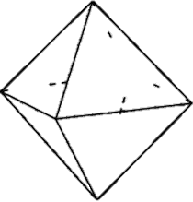
Crystal structure of manganite La_{1-x}Sr_{x}MnO₃
Mn
O
Notes:
What is about magnetic structure. In the ND spectra we see two magnetic peaks. One described as FM the second one – as AFM of A-type.

Slide 11
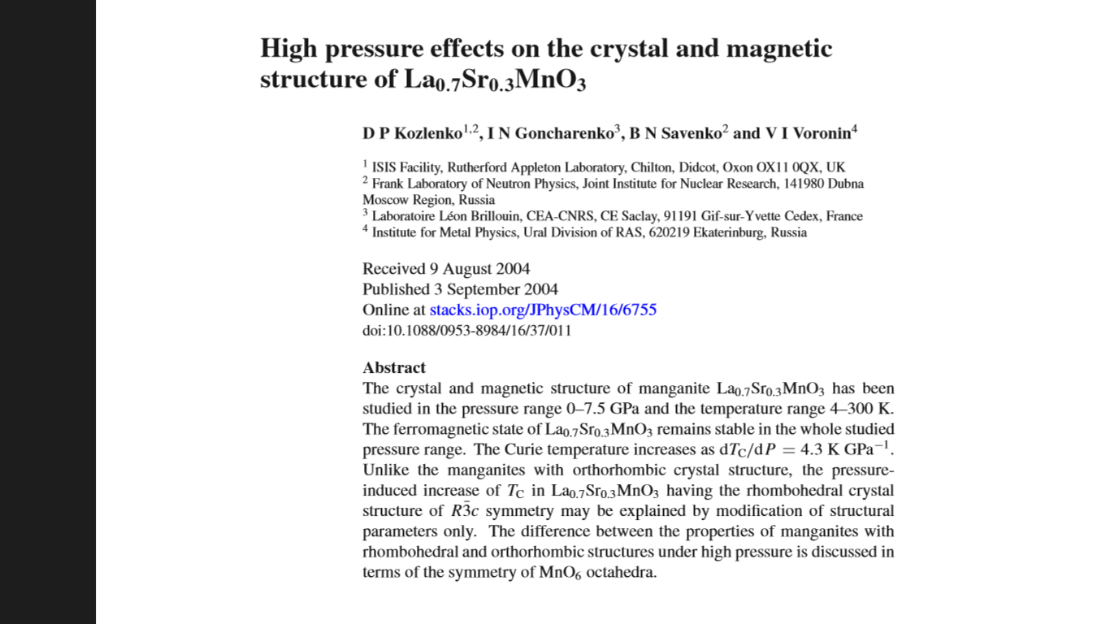
Magnetic structure of nanostructured manganites
La_{0.63}Sr_{0.37}MnO₃
La_{0.72}Sr_{0.28}MnO₃
FM
FM
AFM
AFM
Notes:
What we have? In both samples exist a big FM peak and a small AFM. We were surprised. Because in paper by Kozlenko et. al. shown bulk manganites exibit only ferromagnetic metallic state in the all pressure range up to 8 GPa. But we were observing AFM phase at ambient pressure.

Slide 12
Magnetic structure of nanostructured manganites
FM
AFM
Notes:
I calculate the magnetic moments and Curie of the FM phase. Here you see the temperature dependences of the magnetic moment of FM phase at different pressures. MM of FM phase decreasing under high pressure. The Curie temperature decreasing too.

Slide 13
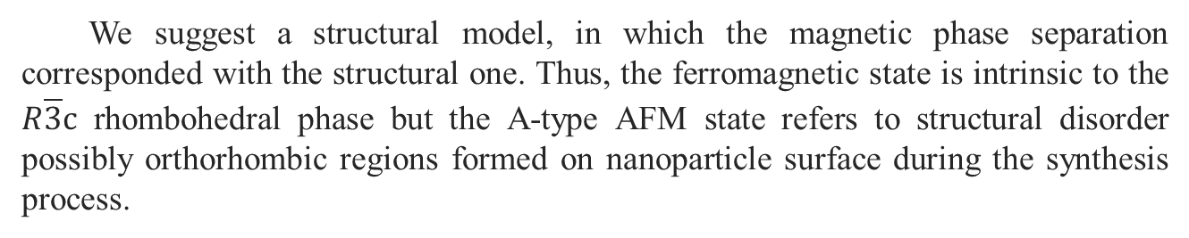
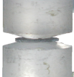
Structural model

Slide 14
Conclusion
By increasing the temperature and the pressure, a gradual suppression of the magnetic moments of iron ions in both A and B crystallographic sites in polycrystalline ferrite Zn_{0.3}Cu_{0.7}Fe_{1.5}Ga_{0.5}O₄ was observed. This effect corresponds to a magnetic phase transition from the ferrimagnetic state to paramagnetic one.
Magnetic structure of nanostructured manganites characterized by coexisting of ferromagnetic and A-type antiferromagnetic phases in contrast to bulk samples that exhibit only the ferromagnetic metallic state.
Size effects in nanostructured manganites dominate under the micro effects of double exchange.
Notes:
As the final I would like to show the main result of this work. Magnetic structure of nanostructured manganites characterized by coexisting of ferromagnetic and A-type antiferromagnetic phases in contrast to bulk samples that exhibit only the ferromagnetic metallic state. Suggested a structural model, in which the magnetic phase separation corresponded with the structural one. Size effects in nanostructured manganites dominate under the micro effects of double exchange.

Slide 15






Publications
Publications in journals:
S.E. Kichanov, N.M. Belozerova, Z. Jirak, D.P. Kozlenko, M. Kacenka, O. Kaman, E.V. Lukin, B.N. Savenko // «High pressure effects on the crystal and magnetic structure of nanostructured manganites La_{0.63}Sr_{0.37}MnO₃ and La_{0.72}Sr_{0.28}MnO₃»//Journal of Alloys and Compounds, 2015.
Z. Jirak, M. Kačenka, O.Kaman, M. Marysko, N.M. Belozerova, S.E. Kichanov, D.P. Kozlenko// «Role of Surface on Magnetic Properties of La_{1-x}Sr_{x}MnO_{3+δ} Nanocrystallites»// IEEE Transactions On Magnetics, 2015.
Z. Jirak, M. Kačenka, O.Kaman, M. Marysko, N.M. Belozerova, S.E. Kichanov, D.P. Kozlenko // «Core-Shell Magnetic Structure of La1-xSrxMnO3+δ Nanocrystallites» //IEEE Transactions On Magnetics, 2017.
D. P. Kozlenko, N. M. Belozerova, S.S. Ata-Allah, S. E. Kichanov, M. Yehia, A. Hashhash, E.V. Lukin, B.N. Savenko//"Neutron diffraction study of the pressure and temperature dependence of the crystal and magnetic structures of Zn0.3Cu0.7Fe1.5Ga0.5O4 polycrystalline ferrite”//Journal of Magnetism Magnetic Materials, 2018.
Reports by the results of the work performed:
International conference “Condensed matter research at the IBR-2”, 24 - 27 june 2014, Dubna, Moscow region, Russia.
42nd meeting, PAC for Сondensed Matter Physics 22–23 June 2015, Moscow region, Dubna.
Meeting and Youth Conference on the use of neutron scattering and synchrotron radiation in condensed matter "RNSI-KS-2014", 27-31 October 2014, Saint-Petersburg, Russia.
XIX International Scientific Conference of Young Scientists and Specialists «AYSS-2015", 16-20 February 2015, Dubna, Russia.
49th School of PNPI on condensed matter physics «FKS-2015", 16-21 March 2015, Zelenogorsk, Russia.
International scientific conference of young scientists "Lomonosov-2015" , 13-17 April 2015, Moscow, Russia.
Seventh International Student Summer School on Nuclear Physics – Science and applications (NUCPHYS-SC&APPL), 24 June – 4 July, 2015, Poznaǹ, Poland.
Notes:
The last remark. As result of this work was performed 2 articles for journals and several reports for conferences.

Slide 16
Thank you for attention!

