Slide 1



The XX International Scientific Conference
of Young Scientists and Specialists
(AYSS-2017)
DNA DOUBLE-STRAND BREAK REPAIR IN RAT CEREBELLUM PURKINJE NEURONS AFTER PROTON AND CO⁶⁰ γ-RAYS EXPOSURE
Bulanova T., Jezkova L., Kruglyakova E., Zadneprianetc M.,
Smirnova E., Boreyko A.
Joint Institute for Nuclear Research Laboratory of Radiation Biology
Dubna State University

Slide 2


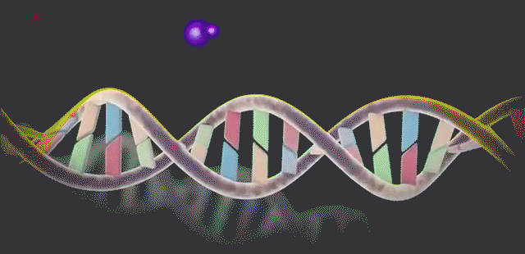
Introduction
Galactic cosmic rays
The modern concept of the radiation risk (Krasavin et al., 2013) of manned interplanetary flight incorporates influence of space radiation on the functions of CNS and not only on the delayed radiation effects of cancer .
Solar
energetic
particles
Possible space radiation risks for the CNS like
altered cognitive function (including detriments in short-term memory)
reduced motor function
behavioral changes
Heavy charged particle, electrons, γ−rays
DNA damages
Brain disfunction
connected with damage on molecular
and cellular levels

Slide 3
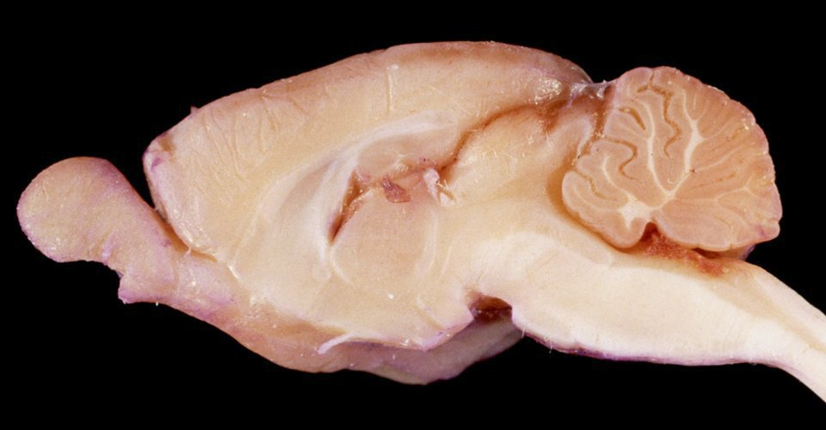
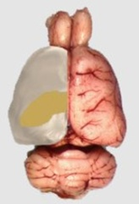

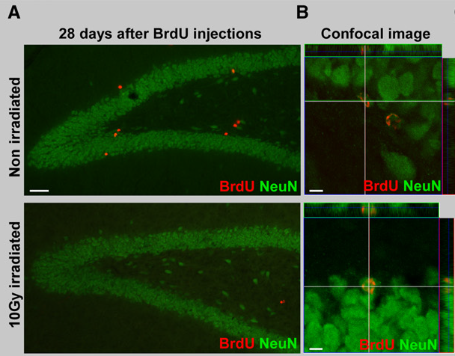
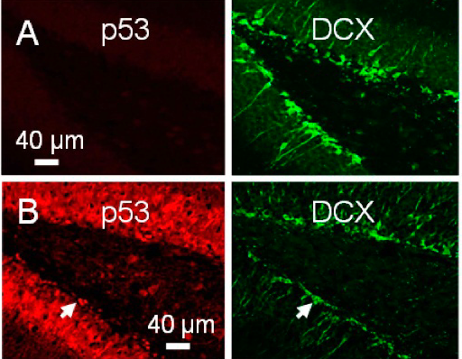
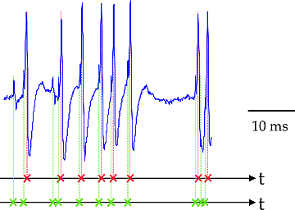
Cerebellum functions
IRRADIATION
Cerebellum
Cerebellum
Coordination
Voluntary and involuntary movement
Spatial and verbal memory
Marked changes in cell proliferation
Marked changes in cell proliferation
0 Гр
5 Гр
Reduction of neurons’ functional activity
0 Гр
Reduction of neurons’ functional activity
Impairment of hippocampal neurogenesis
10 Гр
Impairment of hippocampal neurogenesis
Li et al. 2016.
Kitamura et al., 2009
Neuroinflammation
Notes:
This problem is important today because
thematic justification – актуальность исследования
timeliness of the topic – актуальность темы
Urgency (?) -
On exploratory class missions, such as a mission to Mars, astronauts will be exposed to doses and types of radiation that are not experienced in low earth orbit (1–3). These cosmic rays are composed of protons, alpha particles and high-energy charged (HZE) particles. Exposure to NASA-relevant doses of HZE particles (<30 cGy) can disrupt cognitive performance. After exposure to HZE particles, performance deficits have been reported in novel object recognition (4), spatial learning and memory (5, 6), operant responding (7) and attention (8). For the most part, these tests of HZE-particle-induced disruptions have been conducted beginning 2–4 weeks postirradiation. However, it has not been determined whether exposure to HZE particles can exert acute effects on cognitive performance, i.e., within 4–48 h after exposure.
While exposure to HZE particles can disrupt learning and memory, past research, in which both learning and memory are evaluated after exposure, has not been designed to determine whether radiation exposure affects learning or memory or both. This problem arises because, as a consequence of the experimental designs that have been utilized, it is not possible to test for effects on learning without testing for memory (i.e., does the subject remember the task) or test for effects on memory without testing for learning (i.e., did the subject learn the task). The standard experimental design, in which cognitive testing occurs after irradiation, confounds learning and memory: the failure of a subject to make the appropriate response could reflect the effects of exposure on the ability of the subject either to acquire the response or to recall the acquired response. However, it is possible to design an experiment to test for the effects of exposure to HZE particles on memory independent of the effects on learning. Specifically, by conditioning the subject prior to irradiation, any disruption of performance must reflect the effects of radiation on memory and not learning because the learning precedes irradiation.
Exposure to NASA-relevant doses of HZE particles also produces acute oxidative stress and inflammatory responses in the central nervous system (CNS). HZE-particle-induced increases in the pro-oxidant NADPH–oxidoreductase-2 (NOX2) lead to disturbances of cellular redox homeostasis and cellular imbalances, which might lead to several cellular deleterious processes, including impairments in cognitive function and pathogenesis of neurodegenerative diseases (9–11). Similarly, oxidative stress is known to trigger inflammatory responses in the CNS and we have previously showed that HZE particles over activate microglial cells in critical areas of the brain, leading to an overproduction of pro-inflammatory cytokines as well as overexpression of cyclooxygenase-2 (COX2) (12). COX2 is an inducible enzyme that converts arachidonic acid to prostanoids in the brain and can alter memory function through inflammation in critical regions of the brain (13). Increases in brain COX2 are associated with “synaptic misfire” and delayed neuronal death, which may also contribute to impairments in memory and cognitive function and disease pathologies (14, 15).
The current experiments were designed to determine: 1. The acute effects of exposure to HZE particles (¹⁶O and ⁵⁶Fe) on cognitive performance; 2. Whether exposure to HZE particles affects learning or memory differentially; and 3. The relationship between acute changes in levels of NOX2 (a measure of oxidative stress) and COX2 (a measure of neuroinflammation) in specific brain regions and whether or not the changes in oxidative and inflammatory status in the brain are related to changes in cognitive performance, specifically HZE-particle-induced disruption of learning and/or memory. The specific particles (¹⁶O and ⁵⁶Fe) were selected because the linear energy transfer (LET) of these particles (12 keV/μm and 189 keV/μm, respectively) and the effective doses encompass a major portion of the cosmic ray spectrum to which astronauts will be exposed.
Hippocampus
Cranial radiation is known to inhibit proliferation and neurogenesis in the hippocampus, which has been related to learning and memory deficits in rodents and humans (Implications of irradiating the subventricular zone stem cell niche Vivian Capilla-Gonzalez^{a, b}, Janice M. Bonsuª, Kristin J. Redmond^{c}, Jose Manuel Garcia-Verdugo^{d}, Alfredo Quiñones-Hinojosaª)
Although white matter necrosis is uncommon with modern techniques,functional deficits,including progressive impairments in memory, attention, and executive function have become important, because they have profoun deffects on quality of life.
The hippocampus plays a key role in memory formation, learning, spatial processing and pattern separation (Squire et al., 1992, Burgess et al., 2002, Ekstrom et al., 2003,Kempermann, 2008, Clelland et al., 2009, Deng et al., 2010, Knoth et al., 2010 and Richard et al., 2013). Adult hippocampal neurogenesis, the process of generating new granule cell neurons in the hippocampus throughout life, has been identified as one of the major regulators of maintenance of brain plasticity, learning and memory (Deng et al., 2010, Castilla-Ortega et al., 2011, Kempermann, 2011, Burghardt et al., 2012, Lacefield et al., 2012 and Spalding et al., 2013). Conversely, disruption of hippocampal function and neurogenesis has been linked to impaired cognitive function and mood alterations (e.g., Lucassen et al., 2010 and Eisch and Petrik, 2012). (Chemotherapy, cognitive impairment and hippocampal toxicity (J. Dietrich^{a, ,} , M. Prust^{b}, J. Kaiser^{c})

Slide 4
Cerebellum cortex
Cerebellum cortex layers
Cerebellum cortex is formed by
3 layers
Granular cell layer
Granular neurons
Golgi cells
Purkinje cell layer
Purkinje neurons
Bergman glial cells
Molecular layer
Basket cells
Stellate cells
Molecular layer
Purkinje cell layer
Granular cell layer
The Purkinje neurons are one of the most important cell types in the cerebellar cortex which form the ultimate destination of the afferent pathways to the cerebellar cortex.
Calbindin+ Purkinje cells
Notes:
http://www.cellimagelibrary.org/images/39953
The cerebellar cortex is divided into three layers, the molecular layer (ML), the Purkinje cell layer (PCL) and the internal granule layer (IGL), which contain stellate and basket neurons (the ML), Purkinje cells and Bergman glia (the PCL), and granule neurons, Golgi cells and astrocytes (the IGL) respectively. White matter, containing fibre tracts, as well as astrocytes, oligodendrocytes, and deep cerebel-
The cerebellum is involved in the coordination of voluntary motor movement, balance and equilibrium and muscle tone.
Damage to the cerebellum can lead to: 1) loss of coordination of motor movement (asynergia), 2) the inability to judge distance and when to stop (dysmetria), 3) the inability to perform rapid alternating movements (adiadochokinesia), 4) movement tremors (intention tremor), 5) staggering, wide based walking (ataxic gait), 6) tendency toward falling, 7) weak muscles (hypotonia), 8) slurred speech (ataxic dysarthria), and 9) abnormal eye movements (nystagmus).
The cerebellum receives information from the sensory systems, the spinal cord, and other parts of the brain and then regulates motor movements. The cerebellum coordinates voluntary movements such as posture, balance, coordination, and speech, resulting in smooth and balanced muscular activity. It is also important for learning motor behaviors.
Cell Layers
The cerebellar granule cells are widely held to be the most abundantclass of neurons in the human brain. They give rise to specialized axons called parallel fibers that ascend to the molecular layer of the cerebellar cortex. The parallel fibers bifurcate in the molecular layer to form T-shaped branches that relay information via excitatory synapses onto the dendritic spines of the Purkinje cells.
The Purkinje cells present the most striking histological feature of the cerebellum. Elaborate dendrites extend into themolecular layer from a single subjacent layer of these giant nerve cell bodies (called the Purkinje layer). Inputs from local circuit neurons modulate the inhibitory activity of Purkinje cells and occur on both dendritic shafts and the cell body. The most powerful of these local inputs are inhibitory
complexes of synapses made around the Purkinje cell bodies by basket cells (see Figure 19.8A,B). Another type of local circuit neuron, the stellate cell, receives input from the parallel fibers and provides an inhibitory input to the Purkinje cell dendrites.
Finally, the molecular layer contains the apical dendrites of a cell type called Golgi cells; these neurons have their cell bodies in the granular cell layer. The Golgi cells receive input from the parallel fibers and provide an inhibitory feedback to the cells of origin of the parallel fibers (the granule cells).
The Purkinje cells receive two types of excitatory input from outside of the cerebellum, one directly from the climbing fibers and the other indirectly via the parallel fibers of the granule cells. The Golgi, stellate, and basket cells control the flow of information through the cerebellar cortex. For example, the Golgi cells form an inhibitory feedback that may limit the duration of the granule cell input to the Purkinje cells, whereas the basket cells provide lateral inhibition that may focus the spatial distribution of Purkinje cell activity. The Purkinje cells modulate the activity of the deep cerebellar nuclei, which are driven by the direct excitatory input they receive from the collaterals of the mossy and climbing fibers.

Slide 5
Research goals
Studying of the formation and elimination of radiation-induced DNA double-strand breaks on sections of paraffin-embedded rat brain tissue exposed to protons and Co⁶⁰ γ-rays
Investigation of the dose dependence of the formation radiation-induced DNA double-strand breaks on sections of paraffin-embedded rat brain tissue exposed to Co⁶⁰ γ-rays
Notes:
goal of research

Slide 6
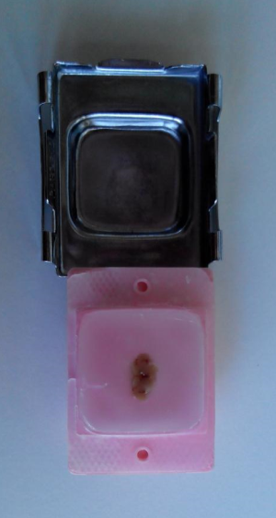
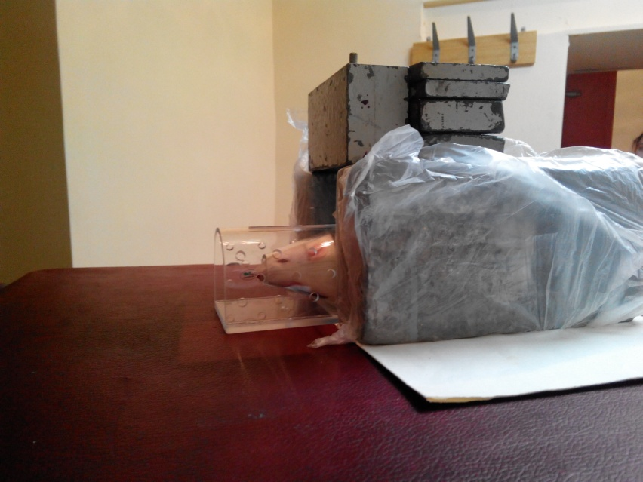
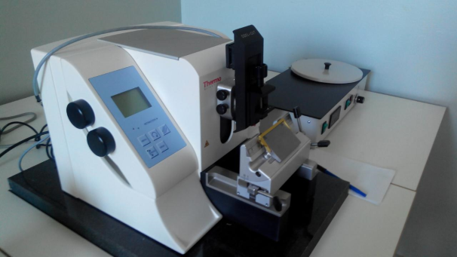
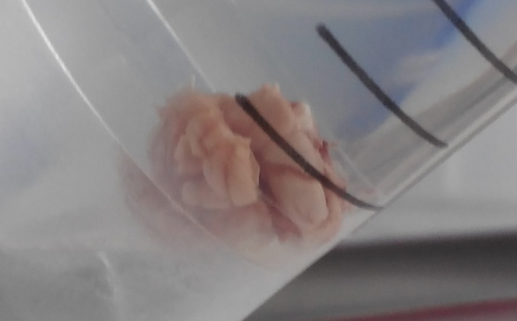
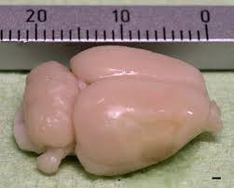
Experiment procedure
Irradiation
Irradiation
Brain extraction
Brain extraction
Fixation, 20 h
Fixation, 20 h
Paraffin embedding
Paraffin embedding
Microtomy
Microtomy
Immunohistochemical staining
Object | Sprague-Dawley, male and female 8-11 weeks
Irradiation | Head only irradiation with dose 1, 3, and 5 Gy with Co⁶⁰ γ-rays Teletherapy unit ROKUS-M Total irradiation with dose 1 Gy with protons (Е=170 MeV)
Immunohistochemical staining of rat brain tissue | the specific markers for visualization of the DNA DSBs - phosphorylated histone H2AX (γH2AX) and repair protein 53BP1

Slide 7
Dose-dependence of γH2AX/53BP1 foci after
irradiation with Co⁶⁰ γ-rays
The quantity of γH2AX/53BP1 foci in Purkinje neurons
γH2AX 53BP1 Merge
1 hour post-irradiation
1Gy
3Gy
5Gy
control
3
9
25
Контроль
53BP1
γH2AX
1000×magnification
Notes:
Dose dependence of IRIF
proteins can form foci by bringing together a group

Slide 8
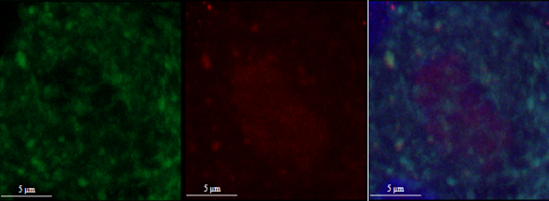
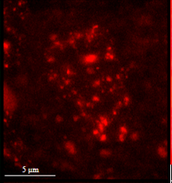
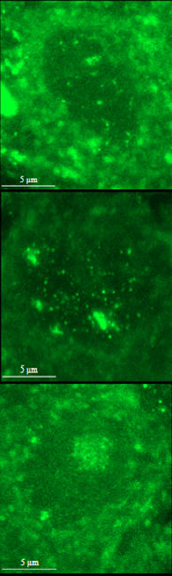
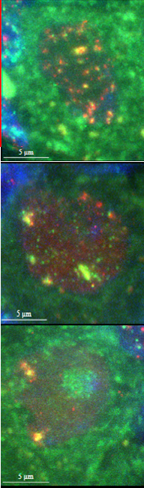

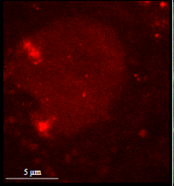
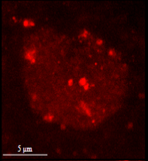


Repair kinetics of γH2AX/53BP1 foci after
irradiation with Co⁶⁰ γ-rays
control
FITC TR Merge
1h
4h
24h
control
3 Gy
γH2AX 53BP1 Merge
1h
4h
24h
53BP1
1000×magnification
γH2AX
1000×magnification
Notes:
На данном слайде представлена кинетика формирования и репарации радиационно-индуцированных фокусов белков gH2AX/53BP1 в ядрах клеток Пуркинье после облучения после облучения γ-квантами ⁶⁰Co в дозе 3 Гр через 1, 4 и 24 часа пострадиационной инкубации. Хорошо видно, что с течением времени количество фокусов в ядрах клеток Пуркинье сильно снижается и к 24 часам остается в среднем 2-3 фокуса на ядро.

Slide 9
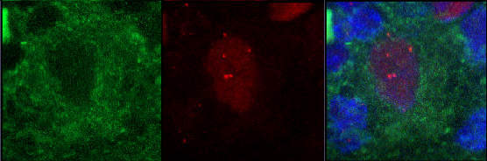
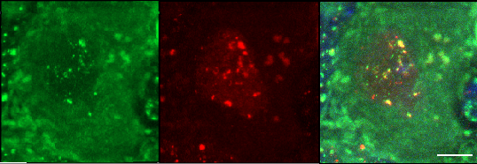
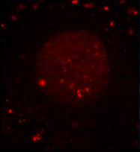
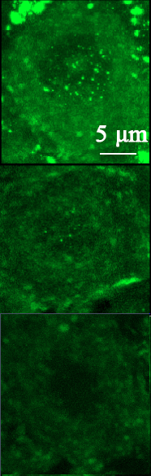
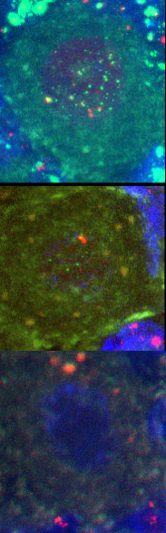
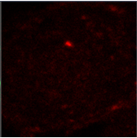
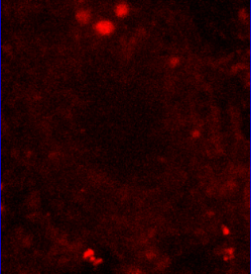
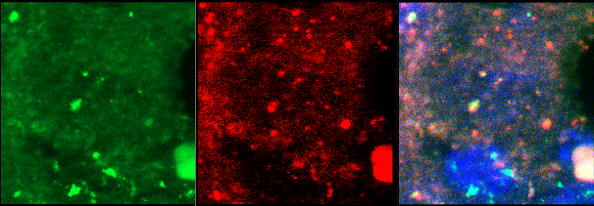
Repair kinetics of γH2AX/53BP1 foci after
irradiation with protons
control
1 Gy 1 h
1 Gy
γ-rays of Со⁶⁰
1,036 μm²
γH2AX 53BP1 Merge
1h
protons
1,568 μm²
24h
30 days
30
days
Average number of foci/cell
Protons 12,87 ±1,34
γ-rays of Со⁶⁰ 13,89 ± 0,872
53BP1
γH2AX
1000×magnification
Notes:
На данном слайде представлена кинетика формирования и репарации радиационно-индуцированных фокусов белков gH2AX/53BP1 в ядрах клеток Пуркинье после облучения после облучения γ-квантами ⁶⁰Co в дозе 3 Гр через 1, 4 и 24 часа пострадиационной инкубации. Хорошо видно, что с течением времени количество фокусов в ядрах клеток Пуркинье сильно снижается и к 24 часам остается в среднем 2-3 фокуса на ядро.
При воздействии γ–квантов ⁶⁰Со отмечается значительное снижение РИФ со временем после облучения и к 24 часам приближается к контрольному уровню. Выявлено, что выход γH2AX/53BP1 фокусов снижается в пострадиационный период по экспоненциальной кинетике. Схожая картина снижения количества РИФ наблюдается при воздействии протонов. Однако, остаточный уровень фокусов при воздействии γ-квантов ⁶⁰Co в дозе 3 Гр был достоверно выше, чем при воздействии протонов в дозе 1 Гр. Также получена дозовая зависимость увеличения числа РИФ 53BP1/γH2AX. Количественный анализ формирования РИФ 53BP1/γH2AX, проведенный на ядрах клеток Пуркинье путем трехмерного анализа флуоресцентных изображений коры мозжечка крыс, показал, что полученная дозовая зависимость имеет линейный характер. Показано, что размер 53BP1/γH2AX фокусов после воздействия протонов в дозе 1 Гр достоверно больше по сравнению γ–квантами ⁶⁰Со. Отмечено, что количество и размер 53BP1/γH2AX фокусов в коре варьируется в зависимости от типа клеток.

Slide 10
Conclusions
The effective elimination of the 53BP1/γH2AX foci in Purkinje neurons occurred 24 hours after γ-rays and proton irradiation reflecting the effective DNA DSB repair
  The quantity of 53BP1/γH2AX foci decreased exponentially with time post-irradiation both for γ-rays and for protons
Statistically significant difference in the 53BP1/γH2AX foci size after proton and γ-ray exposure has been observed: the proton-induced 53BP1/γH2AX foci are statistically larger (Mann-Whitney test, α=0,05) than the γ-induced ones
The dose dependence of γH2AX/53BP1 foci yield after γ-rays irradiation has been studied and found to be linear
Further prospects
We are planning to continue our study of the formation and elimination of radiation-induced γH2AX/53BP1 foci in paraffin-embedded rat brain slices after exposure to ionizing radiation of different quality
Notes:
Relatively large fraction of heterogenous neurons of adult rat brain contains stable and robust expression of 53BP1 and gH2AX foci. But 53BP1 and gH2AX foci was less brighter in the Purkinje cells then these foci in the surrounding cell nuclei. That could be explaned by unique chromatin organization in this cell (in some articles its suggested that the Purkinje cells have different mode of DNA packing)?
Also some nuclei exhibited only gH2AX foci what can be explained by lack of expression of 53BP1 in non-neuronal cells. More evidence for this speculation we will receive when use specific marker for non-neuronal cells.
Qualitative changes in irradiated rat brains have also demonstrated time and dose-dependent reductions in the quanitiy of radiation induced gH2AX-53BP1 colocalized foci.
The effective elimination of the induced 53BP1/γH2AX foci occurred 24 hours after gamma and proton irradiation.
•The quantity of 53BP1/γH2AX foci decreased exponentially with time post-irradiation both for γ-rays and for protons which indicates neuron cells effectively repaired the DNA DSBs after exposure to γ-rays or protons
•The dose dependence of radiation-induced colocalized γH2AX/53BP1 foci yield has been studied and found to be linear
•Statistically significant difference in the 53BP1/γH2AX foci size after proton and γ-ray exposure has been observed: the proton-induced 53BP1/γH2AX foci are statistically larger than the γ-induced ones.
Future investigations
We are planning to continue the investigation of formation and elimination radiation-induced γH2AX/53BP1 foci on the paraffin-embedded rat brain slices after exposure to ionizing radiation different quality

Slide 11

Thank you for attention!

