Slide 1




BM@N Software Progress and Issues while Data Processing
Analysis & Software Meeting of the BM@N Experiment (BA&SM-2023)
Konstantin Gertsenberger
V. Veksler and A. Baldin Laboratory of High Energy Physics
Joint Institute for Nuclear Research
12-13 September 2023
September 13, 2023

Slide 2





BM@N Software Contribution
Tagir AUSHEV, Peter KLIMAI, Alexander NOZIK, Mikhail ZELENYI, Olga NEMOVA, Igor DUNAEV, et alia
Event Metadata System, Event Display, Monitoring,…
Sergei NEMNYUGIN, Rinat NIZAMOV, Anastasia IUSUPOVA
Apptainer/Docker Containers for BmnRoot
Nikolay ERSHOV
Implementation of Fast Event Reconstruction based on NN/ML
BM@N
Software
Contribution
Arkadiy TARANENKO, Anton TRUTSE
Software corrections of the BmnRoot framework
Director: S. V. SHMATOV. Scientific Leader: V. V. KORENKOV
Igor ALEXANDROV, Evgeniy ALEXANDROV, Irina FILOZOVA, et alia
Development of the Geometry Database and Online Configuration Systems
Zarif SHARIPOV, Zafar TUKHLIEV. Automation of BM@N Alignment
Alexander AYRIYAN, Vladimir PAPOYAN
Implementation of Particle IDentification based on NN/ML
Spokesperson: Mikhail KAPISHIN
Konstantin GERTSENBERGER
Alexander CHEBOTOV, Ilya ROMANOV
BM@N Software “Group” (3 FTE)
2

Slide 3

BM@N Computing and Technical Contribution
NICA Computing Leader: Andrey DOLBILOV
Ilia SLEPNEV (LHEP Deputy Director for Computing)
BM@N DAQ & online farm support
Ivan SLEPOV
Support of the BM@N Information Systems and Services on the NC-cluster
BM@N
Computing & Technical
Contribution
Igor ZIRONKIN
BM@N distributed data processing with DIRAC File Catalogue
Director: S. V. SHMATOV. Scientific Leader: V. V. KORENKOV
Nikita BALASHOV: CVMFS Deployment, GitLab Services, Docker Containers
Igor PELEVANYUK: DIRAC workload management system and BM@N mass production
Dmitriy PODGAYNY, Oksana STRELTSOVA, Maksim ZUEV
HybriLIT and SC Govorun support
Daria PRIAKHINA, Vladimir TROFIMOV
Modelling System for BM@N computing infrastructure
3

Slide 4
Software Group Status
BM@N Software “Group” (3 FTE):
Konstantin GERTSENBERGER: software coordinator
20% coordination + 20% support + 60% code MB: 50% coordination + 30% support + 20% code
Development and support of the BmnRoot framework, Information Systems, Databases. BM@N services, distributed computing (&NICA-Scheduler), writing documentation, tutorials…
Alexander CHEBOTOV: software engineer (in JINR since 2018)
Improving web interface for the Condition Database, REST API interfaces to the Information Systems, Common Deployment System for the Information Systems, Auxiliary Services (File & Cluster Inspectors)…
Ilya ROMANOV: senior assistant (in JINR since 2022)
Online Processing System using FairMQ & DDS, Event Display, JINR SSO Integration
2.5 FTE
3 FTE
The BM@N Software “Group” must be increased from 3 to 6 FTE at least to support stable work of the BM@N software
2023 year

Slide 5

Concise Roadmap of the BM@N Software
Topic | Development Task | FTE/y
BM@N Computing | BM@N distributed data processing via WMS (DIRAC) | 0.25
 | BM@N distributed data processing using File Catalogue | 0.25
 | Workflow Service (AirFlow) integration with BM@N systems | 0.25
 | Dockers for BmnRoot: distributed processing | 0.25
 | Benchmarking and testing BM@N clusters to predict failures | 0.25
BmnRoot processing | Implementation of the Fast Event Reconstruction based on ML or NN | 0.5
BmnRoot processing | Development of miniDST format | 0.25
 | Implement Trigger Info format and write to the Condition Database | 0.25
 | Correcting error messages and memory bugs in BmnRoot | 0.25
IS + Services | Data Quality Assurance for online and offline (Jupiter Notebooks?) | 0.5
 | Modern Web Event Display for online and offline visualization | 0.25
IS + Services | Web system for publication and report activity | 0.25
 | Web Gallery for officially approved figures | 0.25
 | Institute a Project Management System | 0.15
 | And many other tasks: refinement and support, forgotten tasks, emerging tasks, transition to modern solutions (Web ED, e-Log redesign, NoSQL for Condition DB…) | 1 – 5
5

Slide 6
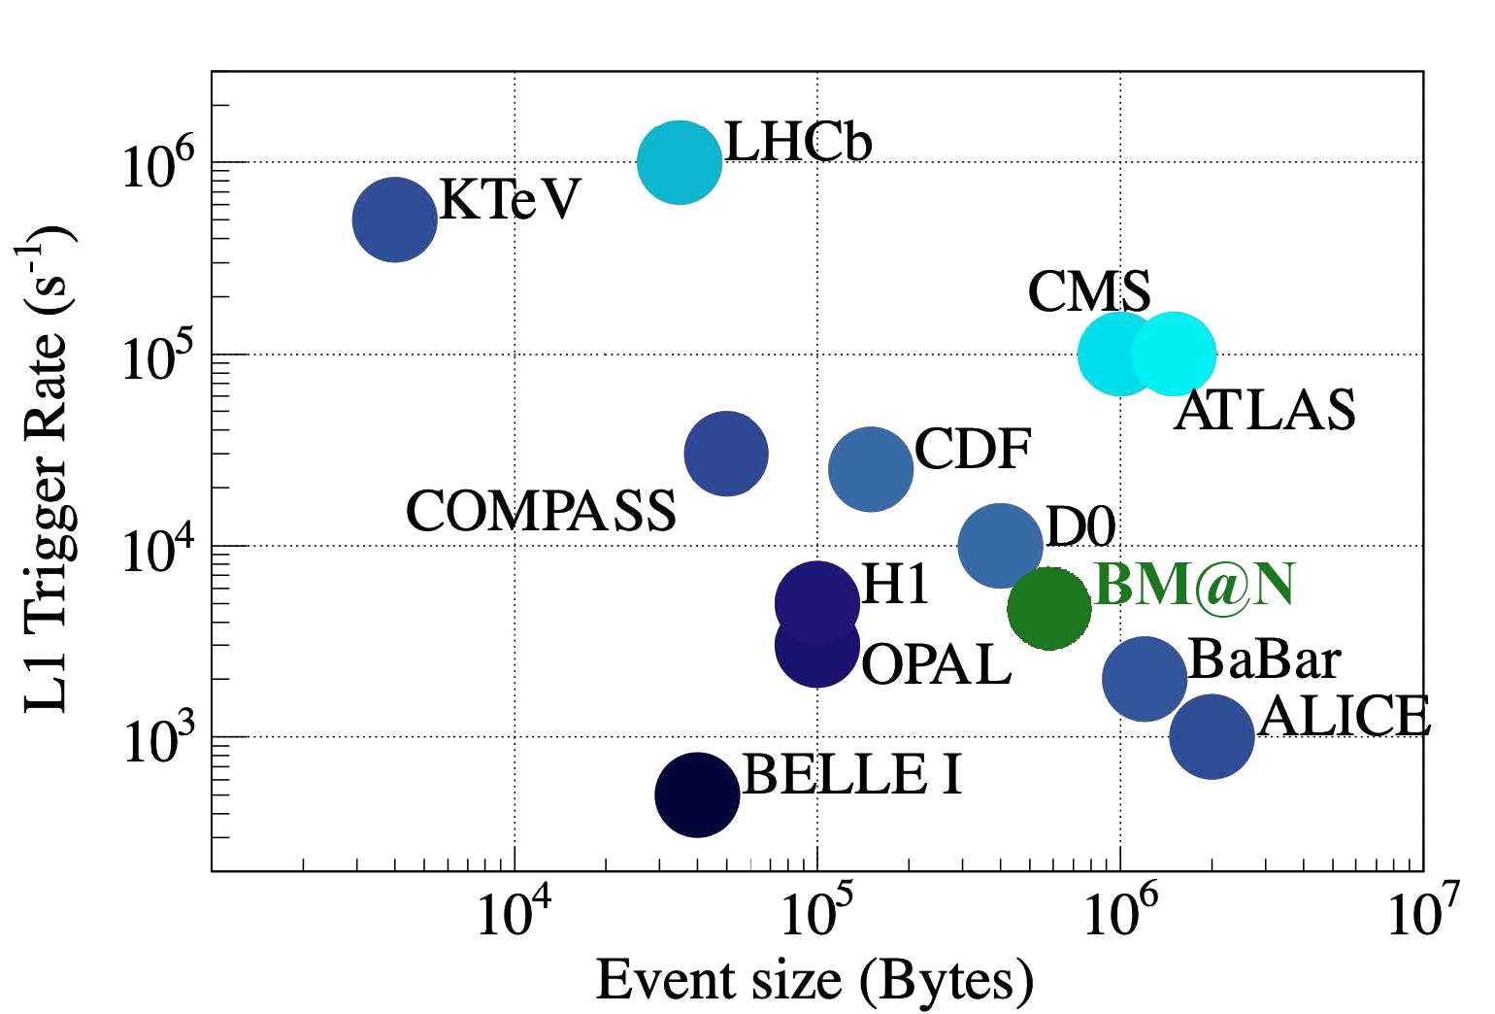
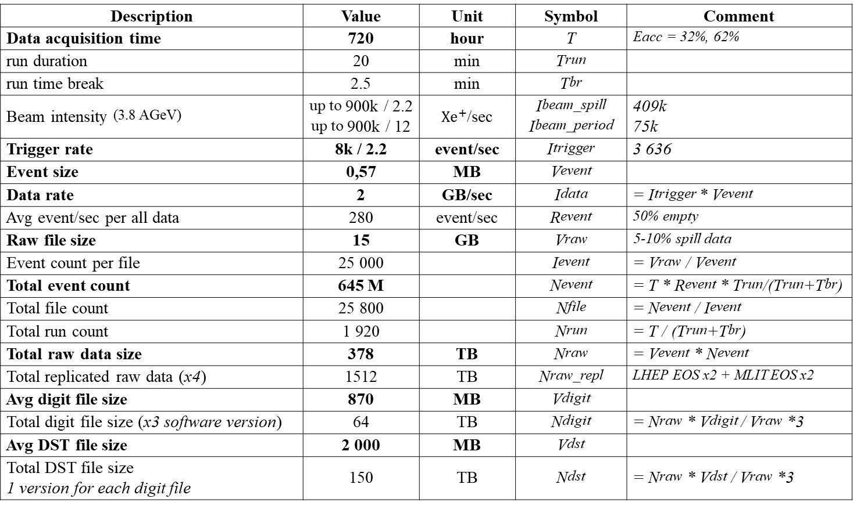
BM@N Run 8 Data Production
Description | Value | Unit | Symbol | Comment
Data acquisition time | 720 | hour | T | Eacc = 32%, 62%
run duration | 20 | min | Trun
run time break | 2.5 | min | Tbr
Beam intensity (3.8 AGeV) | up to 900k / 2.2 up to 900k / 12 | ${Xe}^{+}$/sec | Ibeam_spill Ibeam_period | 409k 75k
Trigger rate | 8k / 2.2 | event/sec | Itrigger | 3 636
Event size | 0,57 | MB | Vevent
Data rate | 2 | GB/sec | Idata | = Itrigger * Vevent
Avg event/sec per all data | 280 | event/sec | Revent | 50% empty
Raw file size | 15 | GB | Vraw | 5-10% spill data
Event count per file | 25 000 |  | Ievent | = Vraw / Vevent
Total event count | 645 M |  | Nevent | = T * Revent * Trun/(Trun+Tbr)
Total file count | 25 800 |  | Nfile | = Nevent / Ievent
Total run count | 1 920 |  | Nrun | = T / (Trun+Tbr)
Total raw data size | 378 | TB | Nraw | = Vevent * Nevent
Total replicated raw data (x4) | 1512 | TB | Nraw_repl | LHEP EOS x2 + MLIT EOS x2
Avg digit file size | 870 | MB | Vdigit
Total digit file size (x3 software version) | 64 | TB | Ndigit | = Nraw * Vdigit / Vraw *3
Avg DST file size | 2 000 | MB | Vdst
Total DST file size 1 version for each digit file | 150 | TB | Ndst | = Nraw * Vdst / Vraw *3
6

Slide 7
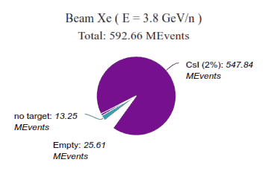
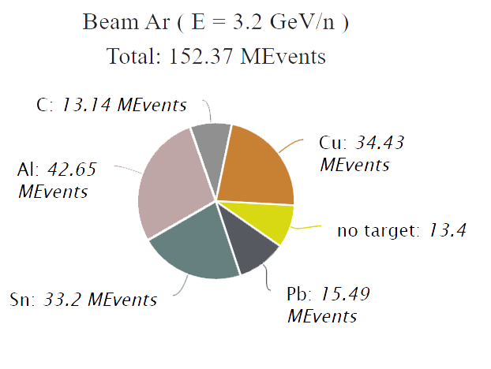
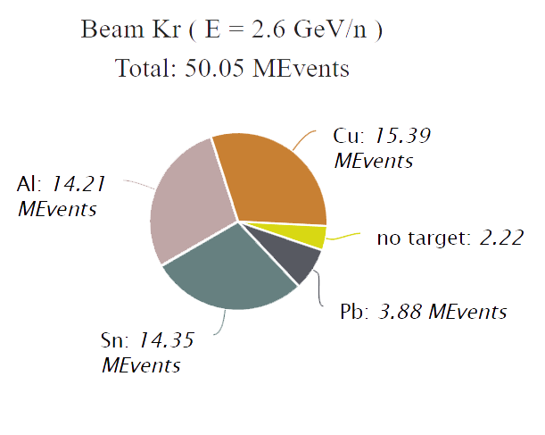
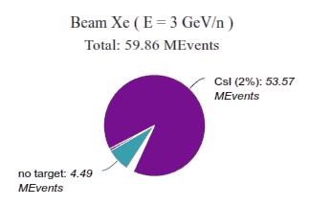
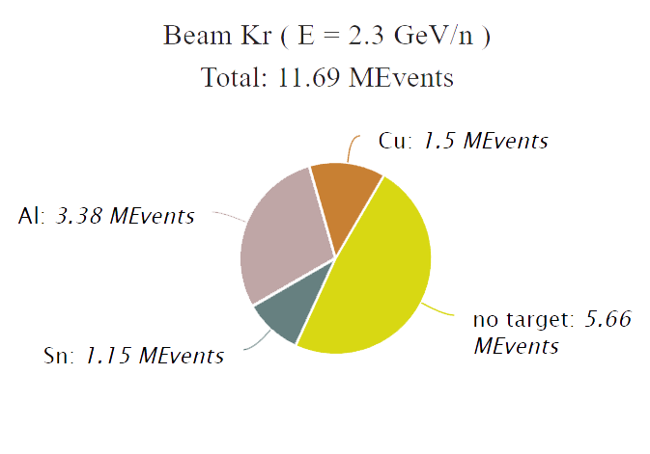
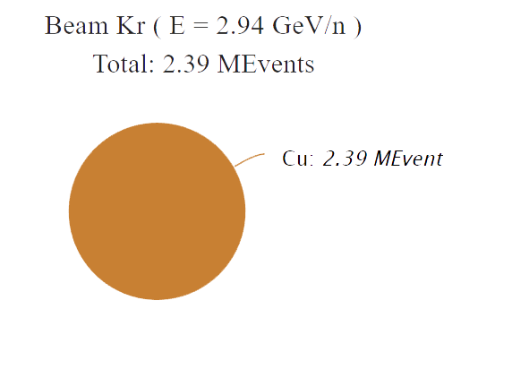
Data Collected in BM@N Run 8 (comparing with Run 7)
1st Physics BM@N Run
Two beam energy available for Xe-beam
CsI target is used as more similar to Xe
More than 600M events were collected
Technical BM@N Run 7
One beam energy available for Ar-beam and three for Kr-beam
Wide set of targets used: (C, Al, Cu, Sn, Pb)
BM@N Run 8
BM@N
Run 7
400 TB (x4)
62 TB (x4)
7

Slide 8
Components of BM@N distributed complex
computing platforms for the BM@N experiment
software distribution system as a central repository of the experiment software
data storages on distributed FS for experimental and simulated files
file and event catalogues organizing smart namespaces with metadata
workload management system for parallel task/job distribution
data transfer services enabling the transfer of large amounts of data between users and storages within the federal administration
workflow management service orchestrating task flows on data processing
information systems based on databases providing necessary information for offline and online processing
user interfaces (Web, API, CLI) to manage databases and distributed data processing
central authentication and authorization system to regulate access rights
monitoring system to control state of server nodes, databases and interfaces

Slide 9
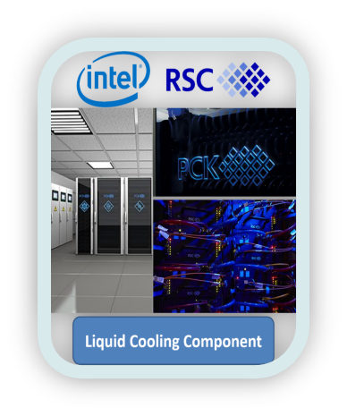
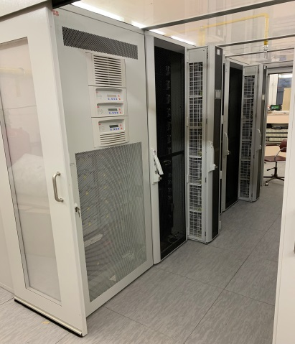
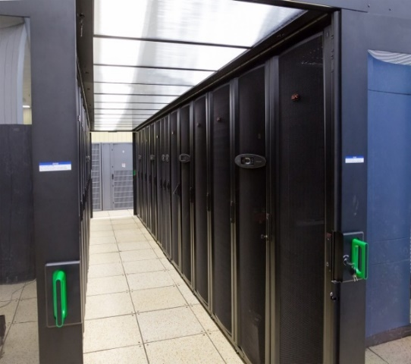
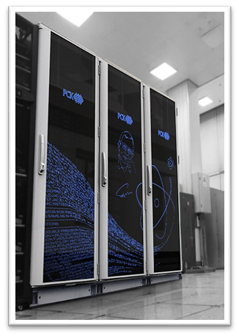
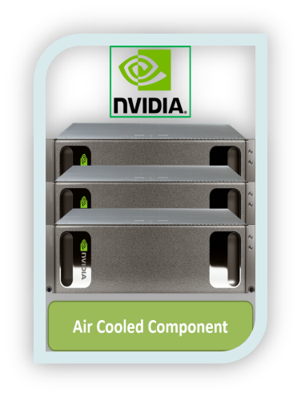

Computing Platforms for BM@N
GRID Tier1&2 Centres
lxui.jinr.ru (CICC)
(MLIT, b.134)
hydra.jinr.ru
(MLIT, b.134)
NICA Cluster
ncx[101-106].jinr.ru
(LHEP, b.216)
HybriLIT platform (SC «Govorun»)
OS: CentOS / Scientific Linux 7.9
Central Software Repository based on CVMFS for the experiments
EOS: 1 PB (replicated)
GlusterFS: 300 TB (for NICA)
Sun Grid Engine: 300 cores/user
EOS: 1 PB (replicated)
SLURM: 0 ‒ 2500 cores
(for NICA)
ZFS: 200 TB
Lustre (Hot Storage): 300 TBssd (for NICA)
SLURM: bmn – 192 cores
BM@N software have been installed & configured on JINR CVMFS
Automatic software deployment of the BmnRoot package on CVMFS with GIT CI

Slide 10
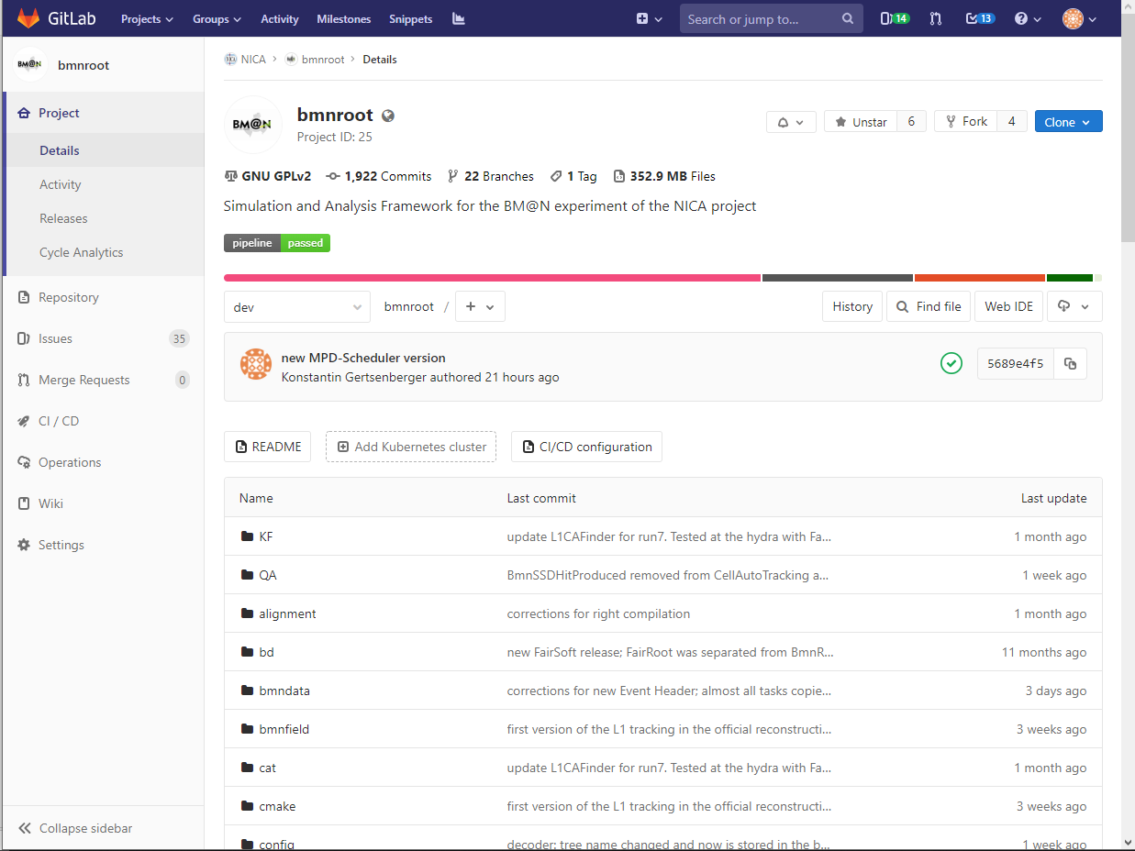








CVMFS - Software Distribution System
GIT: Version Control System
Repository branch protection
Role-based access control to projects
Issue Tracker
Automated Tests & Deployment
Software Distribution via CernVM File System
Read-only network file system with aggressive caching, optimized for software distribution via HTTP in a fast, scalable and reliable way
/cvmfs/nica.jinr.ru/
centos7
fairsoft
merge request
build package
test package
deploy
(rsync via transaction)
dev
fairroot
bmnroot
stage
ubuntu2004
fairsoft
fairroot
release
bmnroot
alma9
prod
fairsoft
fairroot
bmnroot

Slide 11





Cold Data Storages for BM@N
NICA cluster
NICA cluster
for BM@N offline
sync
duplicate
2018
now
BM@N data corruption
MLIT CICC
MLIT CICC
for BM@N offline
details in the report of Igor Pelevanyuk
Separated EOS storages using different versions and authorization methods
BM@N data duplication and inconsistency between periodical synchronization
↔ /eos/nica/bmn/[exp,sim] ↔
HybriLIT

Slide 12








File Catalogue Choice for BM@N
File Catalogues map a Logical File Name (LFN) to the Physical File Name (PFN) at distributed computing platforms
The native File Catalog (DFC) combines both replica and metadata functionality. In the DFC metadata can be associated with any directory, and subdirectories inherit the metadata of their parents
is a Distributed Data Management System initially developed for the ATLAS experiment in 2014 providing file and dataset catalogue and transfers between sites and staging capabilities, policy engines, caching, bad file identification and recovery, and many other features.

Slide 13



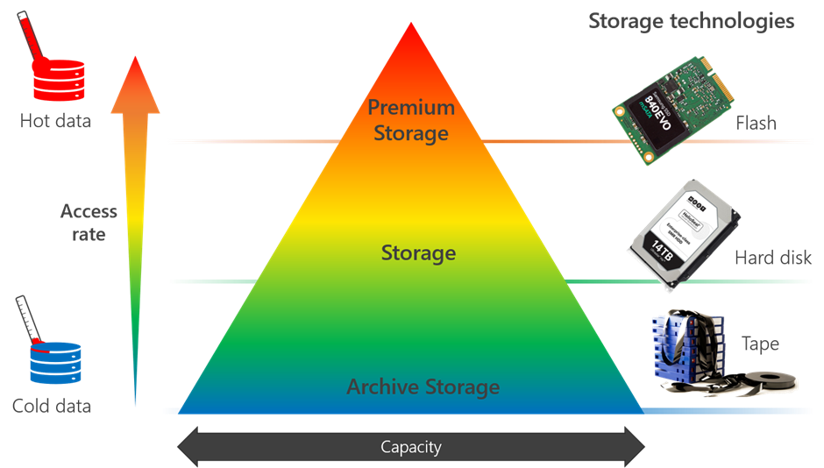

Hot Data Storages for BM@N
Hot Storage Benefits
Large File Processing: Raw data processing in the BM@N experiment requires an intermediate storage because of the big sizes of the data files
Speed: The faster storage speeds allow data to be accessed quickly, sufficiently speeding up the event processing
Less requirements for reliability: Information is stored on the hot storages is temporary. Thus, there is no risk of losing important information in the event of disk disruptions
for BM@N online
fast on SSD
NICA cluster
non-fast (slow HDD)
MLIT CICC
There is no hot storage
HybriLIT
fast on NVMe SSD

Slide 14
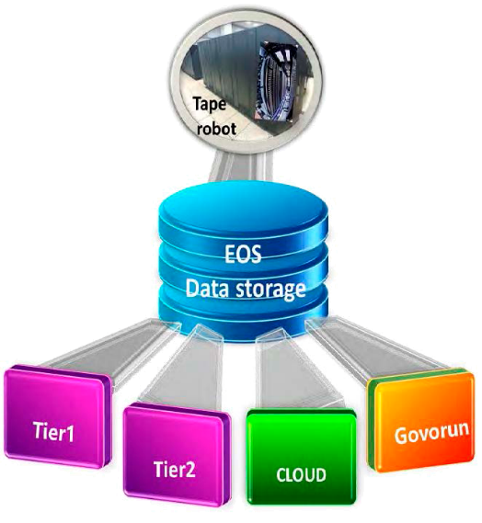
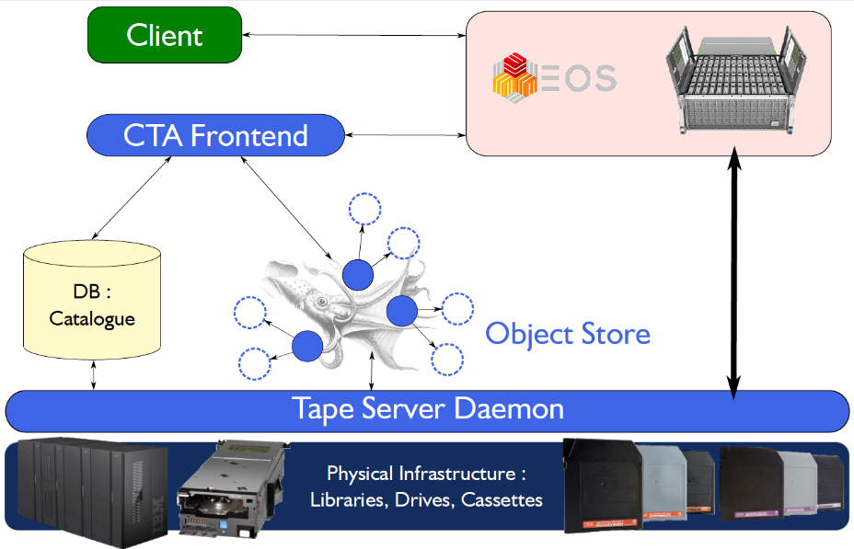
Archive (Tape) Storage for BM@N
EOS CTA Integration in MLIT
CTA tape is a new archive solution developed at CERN to replace Castor
Extends MLIT EOS with tape backend functionality
Tape robotic systems - a long-term storage for the NICA project
Tape “bringonline” exposed via EOS and XRootD protocols
Gfal2 XRootD plugin
Can be handled transparently by FTS
Advantages: long lifespan, cost of use, energy efficiency, security

Slide 15



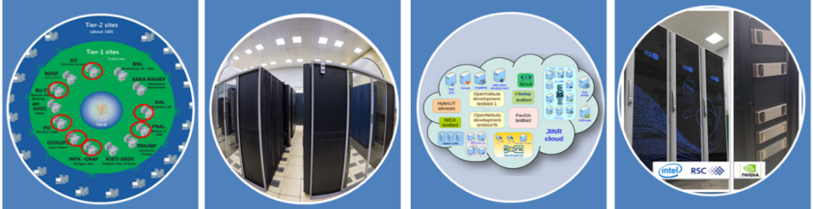
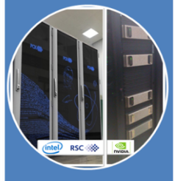
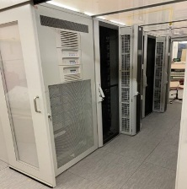
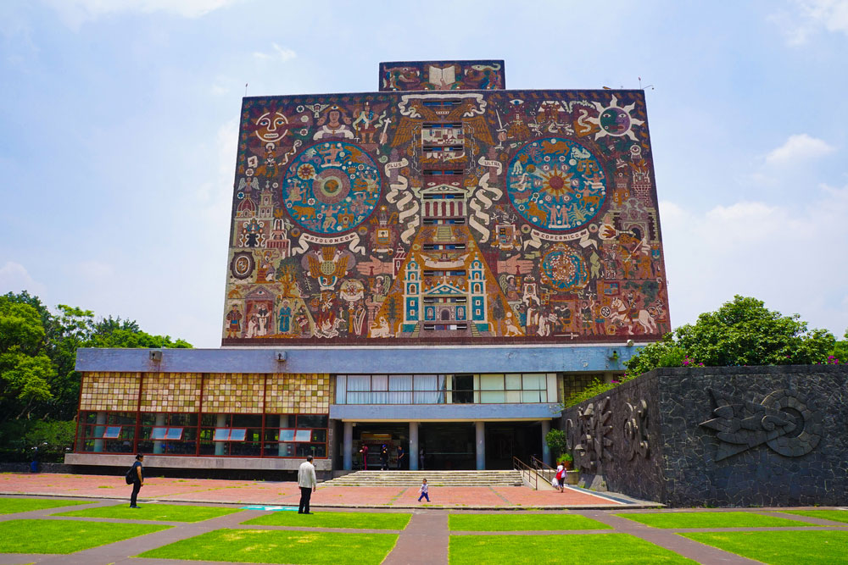
DIRAC Workload Manager for BM@N
Submit thousand of jobs to DIRAC Job Queue
User
Job
User
Job
User
Job
User
Job
User
Job
Collaboration members
User
Job
Pilot job
Pilot job
Pilot job
Pilot job
Pilot job
Pilot job
User Job
User Job
User Job
User Job
User Job
User Job
Igor Pelevanyuk
(September 13, 10:15)
Status of BM@N Mass Data Production for Run 8 using DIRAC
Tier-1
CICC/Tier-2
Clouds
Govorun
NICA Cluster
External Collaborators
15

Slide 16
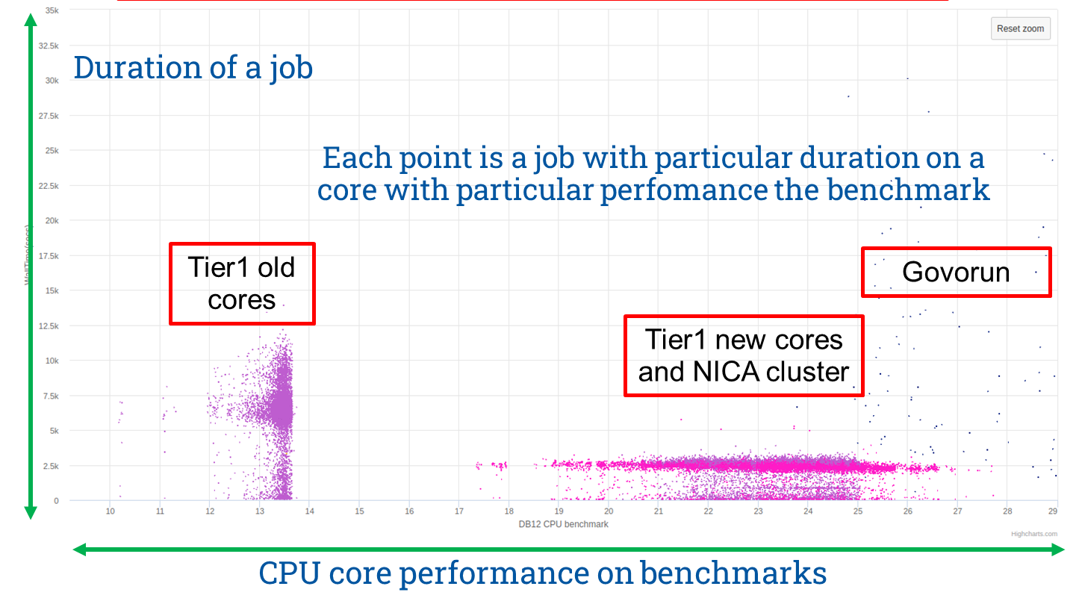
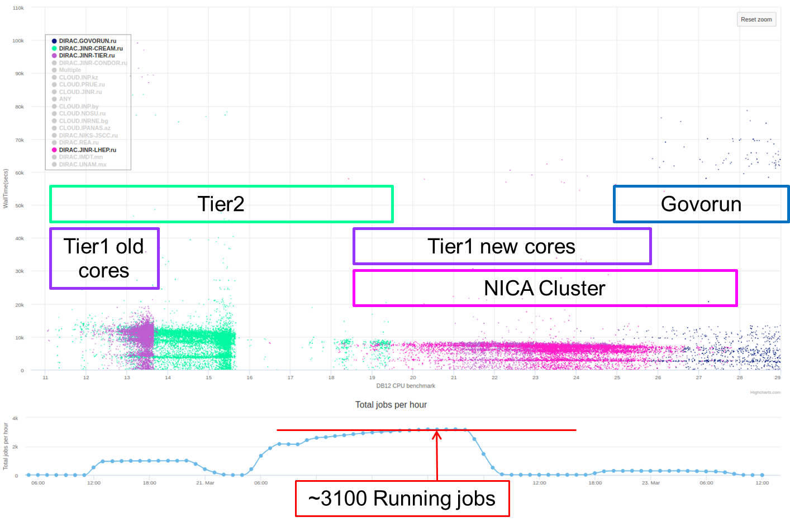
Mass Production with L1 via DIRAC (April 2023)
Total duration of Raw2Digi campaign – 20 hours (0.1 s/ev)
Quotas (cores):
Tier1: 1500 (for NICA)
Tier2: 1000 (for NICA)
Govorun: 192 (BM@N)
NICA cluster: 300 (per user)
NICA cluster: max 100 slots (big files)
Total duration of Digi2DST campaign – 30 hours (0.3 s/ev)
Total files: 30 741 Total raw size: 393 TB
Average transfer speed (20 streams): 1.92 GB/s
Total transfer duration: 2d 15h
Max transfer speed (R+W) EOS@MLIT: 7.5 GB/s
Disk usage: tmp file: 8 GB result file: 800 MB
Total disk usage per job (15 GB): 25 GB
RAM usage: 2 GB
Total wall time: 10 years
16

Slide 17
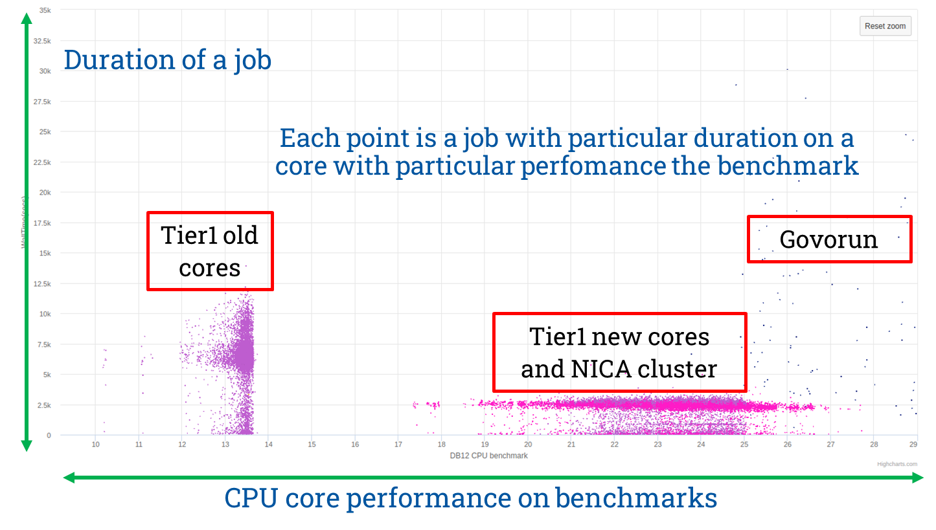
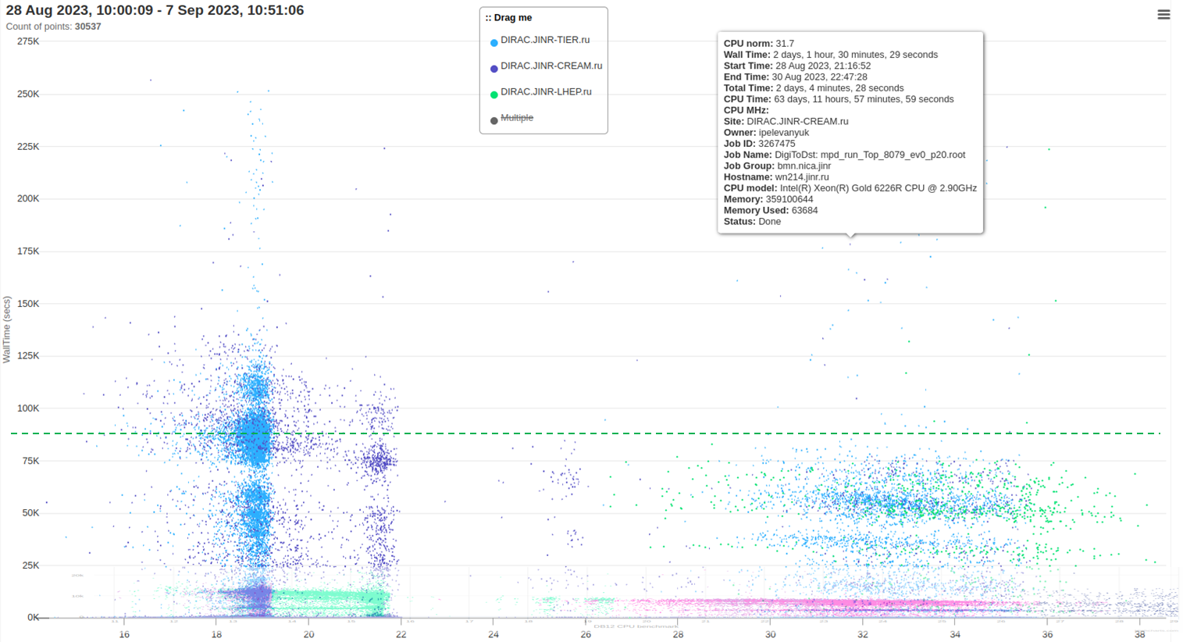
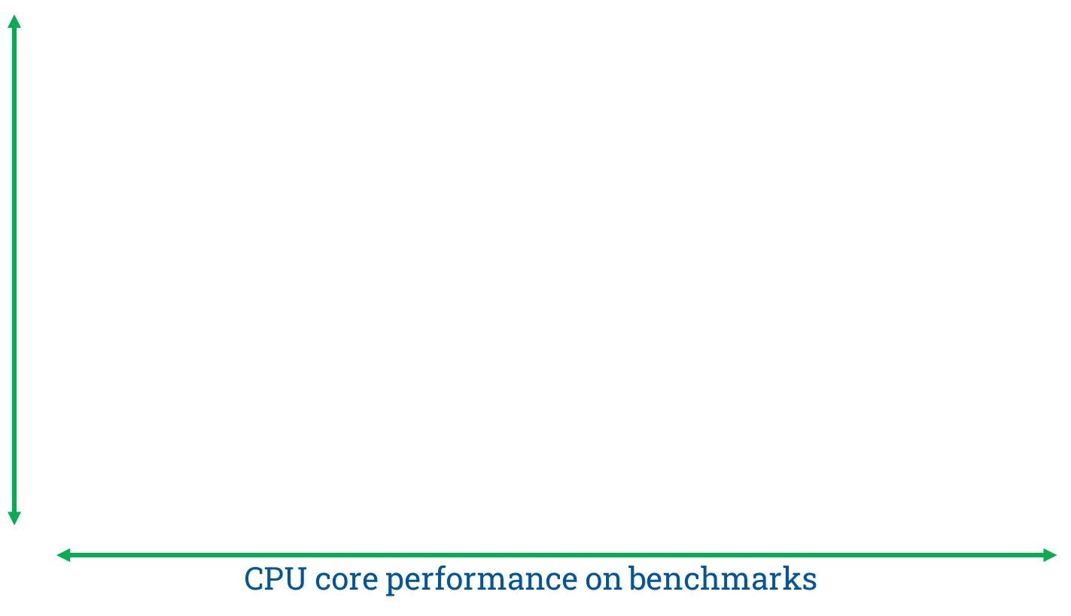
Mass Production with VF via DIRAC (August 2023)
Total duration of Raw2Digi campaign – 35 hours (0.16 s/ev)
Quotas (cores):
Tier1: 1500 (for NICA)
Tier2: 1000 (for NICA)
Govorun: 192 (BM@N)
NICA cluster: 300 (per user)
NICA cluster: max 100 slots (big files)
Total duration of Digi2DST campaign – 170 hours (3 s/ev)
Total files: 14 300
Max transfer speed (R+W) EOS@MLIT: 7.5 GB/s
Disk usage: tmp file: 8 GB result file: 800 MB
Total disk usage per job (15 GB): 25 GB
RAM usage: 2 GB
Total wall time after CM10: 70 CPU years
17

Slide 18




Scheme of BM@N Data Transfer
Checksum Catalogue (Adler32)
verification
verification
file:///ceph/bmn/run/…
root://ncm.jinr.ru//eos/nica/bmn/…
root://eos.jinr.ru//eos/nica/bmn/…
RAW
RAWsync
xrdcp
xrdcp (kinit)
DIGIsync DSTsync
BM@N Online Farm
(DDC, LHEP)
NICA Cluster
(NCX, LHEP)
CICC
(LXUI, MLIT)
xrdcp (kinit)
fpga.jinr.ru
Access protocols: XRootD, EOS, FUSE
Authentication protocol: Kerberos
DIGI
DST
file:///lustre/stor1/bmn/…
Raw data were cleaned
Physics runs are started with 6667
SC «Govorun»
(HYDRA, MLIT)
18

Slide 19
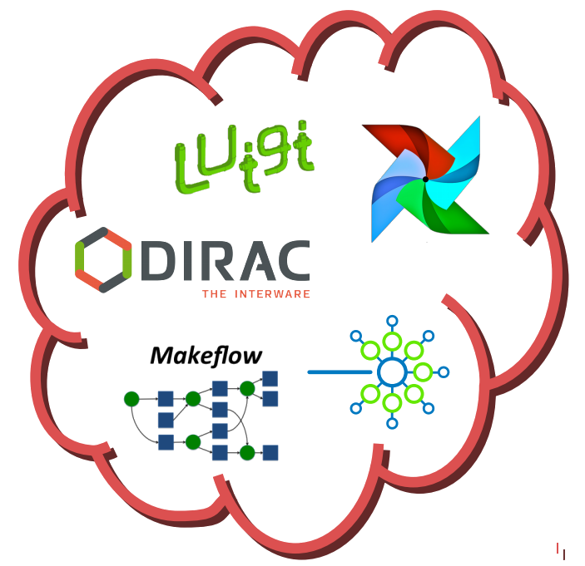

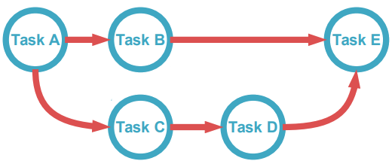
Workflow Management Services
https://airflow.apache.org
Airflow
Platform to author, schedule and monitor workflows (as code)
Python scripting to define Directed Acyclic Graphs (DAGs) as collections of tasks (Operators) with dependencies between them
DAGs can be given a regular schedule, triggered manually, or even trigger each other
Includes Flask-based web monitoring to visualize pipelines, monitor progress and troubleshoot issues
Uses Jinja2 templating and SQLAlchemy to write tasks that render templated strings e.g. in database query strings or bash scripts
Lightflow
dependencies
Ability to define dependencies between different tasks and scheduling them is a key
Gaining popularity as businesses increasingly have many complex Extract, Transform, Load (ETL) operations to schedule e.g. search, indexing/ranking, monitoring, statistics creation.
Operators
Sensors
Hooks
Defines the task in a DAG
Different operator types, e.g. Python, Bash, SQL
Operator that periodically executes a query
Won't complete until conditions are met
Defines the interface to some external system
Retrieves authentication stored in Airflow DB
*D. Dossett, M. Sevior. “Automating Calibration at the Belle II Detector
19

Slide 20
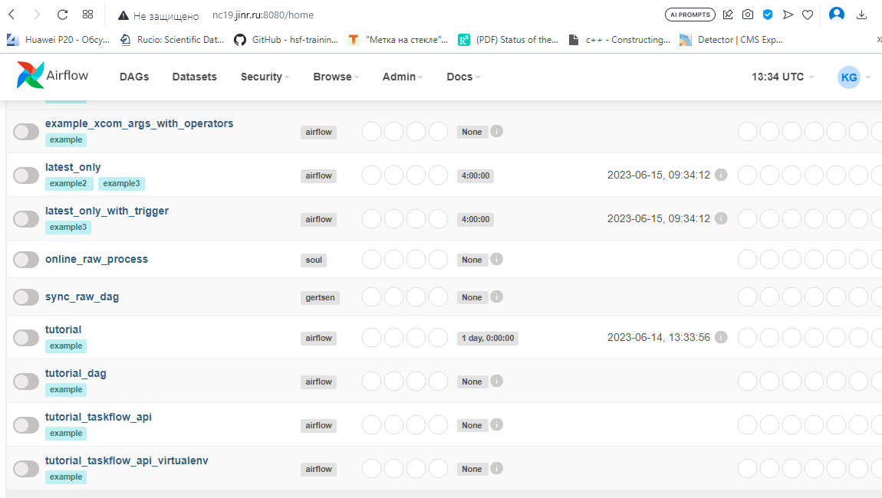
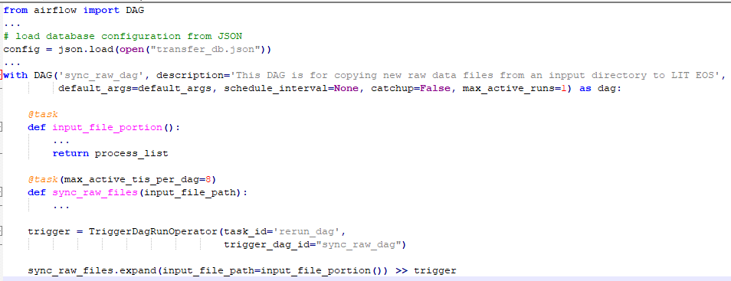

First steps in BM@N Workflow Management
Airflow deployed on the NC-farm
Used in BM@N Run 8 to transfer raw data emerging on the NICA-cluster to the LIT EOS storage and to check the integrity of the source and destination files
To be employed for managing online (for emerging raw data files) and offline data production via DIRAC
MC simulation pipeline
event filtering digitizing
reconstruction analysis
…
20

Slide 21
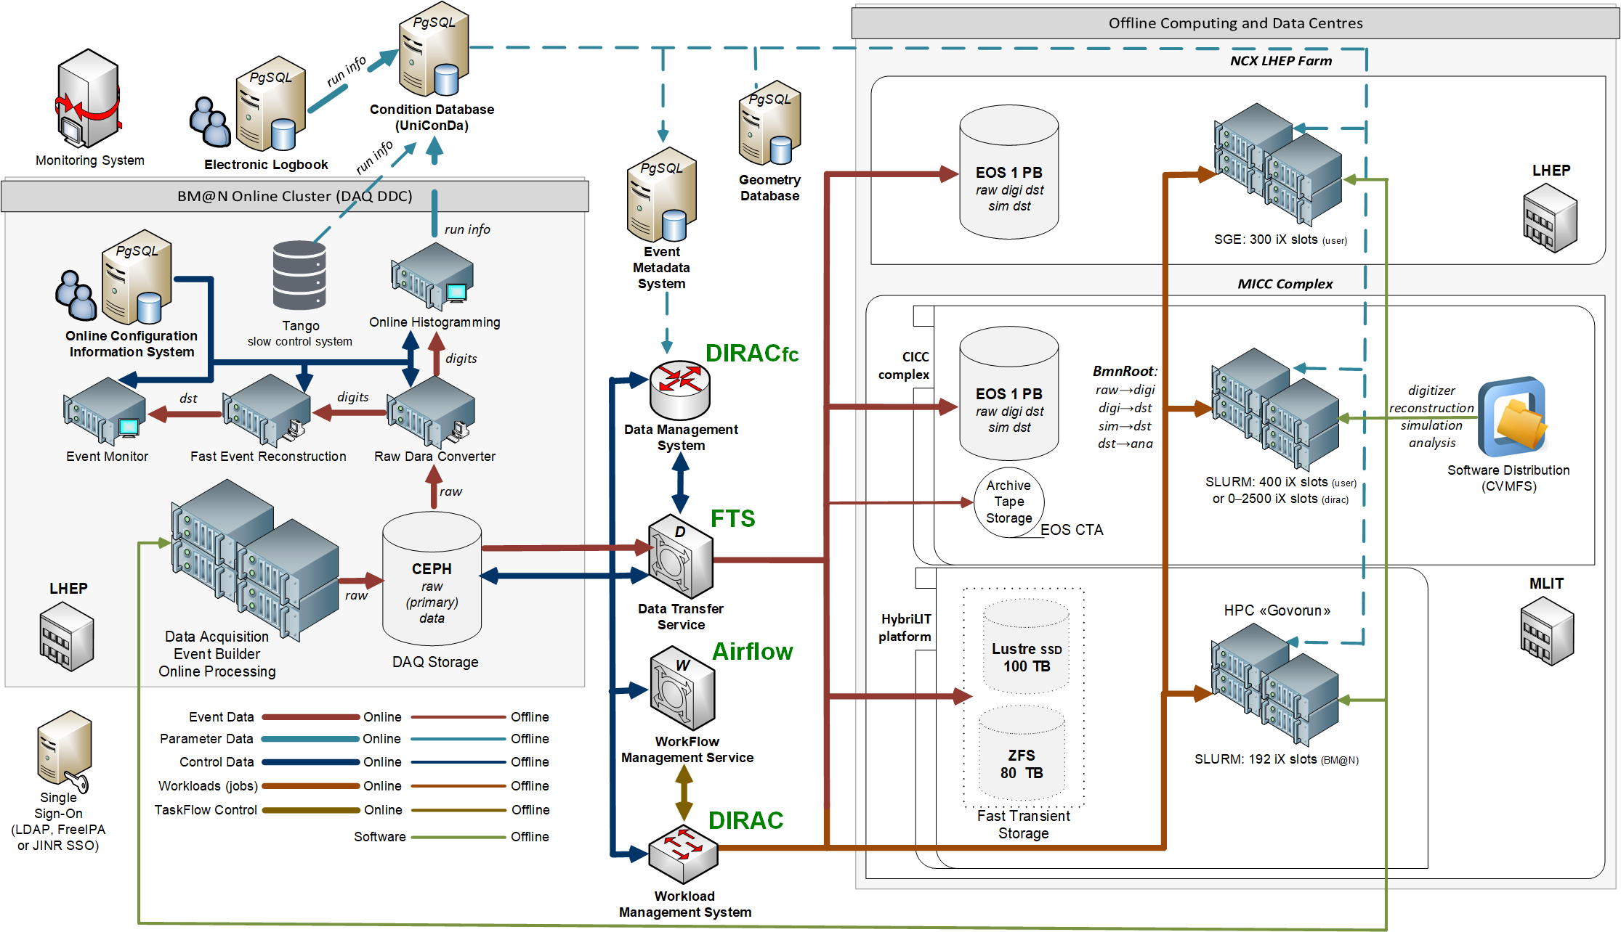
BM@N Computing Software Architecture
21

Slide 22

Complex of BM@N Information Systems
BmnRoot framework
Online DQA
Offline Processing…
bmn-online.jinr.ru
bmn-event.jinr.ru
Electronic Logbook
(since 2018)
Online Configuration
System
(since 2023)
bmn-elog.jinr.ru
Online & Offline
Information Systems
Event Metadata
System
(since 2023)
bmn-geometry.jinr.ru
bmn-uniconda.jinr.ru
Geometry Database
(since 2023)
Condition Database
(UniConDa)
(since 2015)

Slide 23
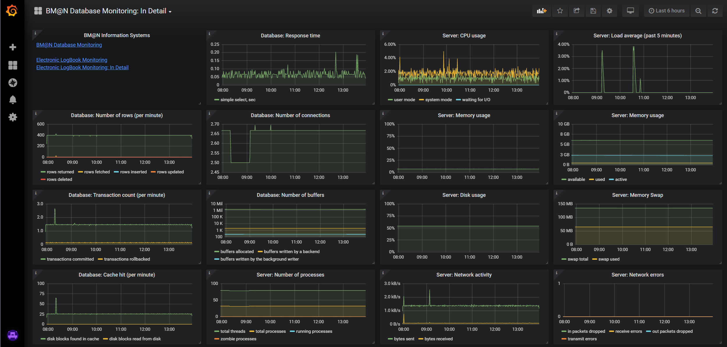



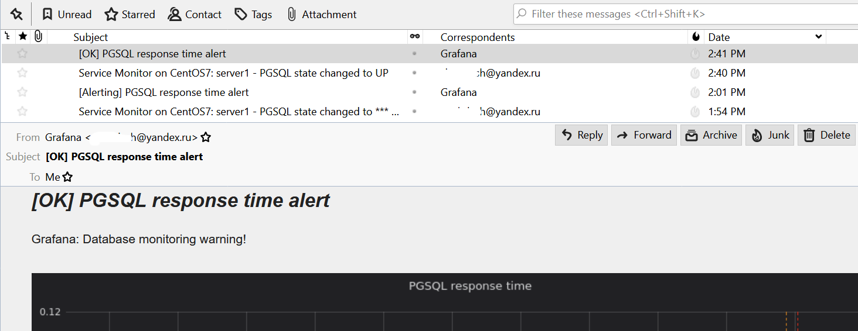
Monitoring System for BM@N software complex
mon-service.jinr.ru
Telegraf
  hosts
  databases
  web-sites
  Condition Database simple or detailed visualization
  Electronic Logbook simple or detailed visualization
  …
Email Alerting

Slide 24
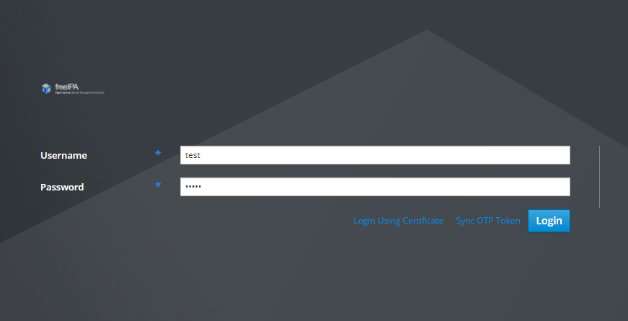

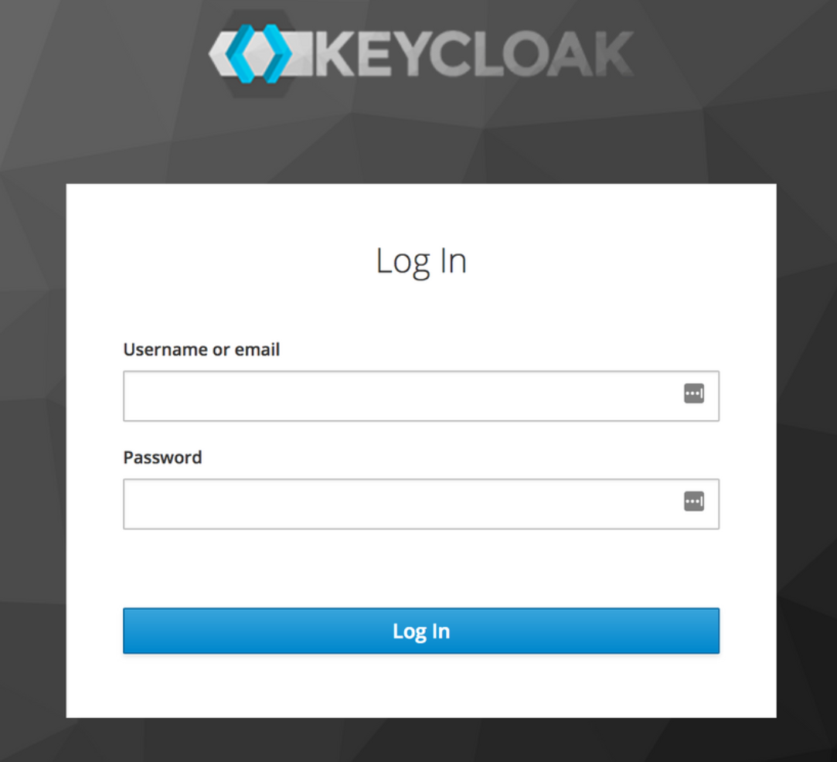


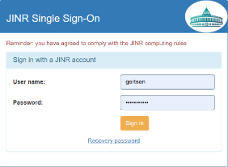
















Migration from FreeIPA to Keycloak Solution
user cabinet
staff
external users
bmn-ipa.jinr.ru
user cabinet
admins
FreeIPA
writers
staff
external users
login.jinr.ru
readers
bmn-user.jinr.ru
Wiki Document Server
54 Users
7 Services
Electronic Logbook
14 Groups
Condition Database
Geometry Database
Collaboration Members
Configuration
System
Event Catalogue
24

Slide 25


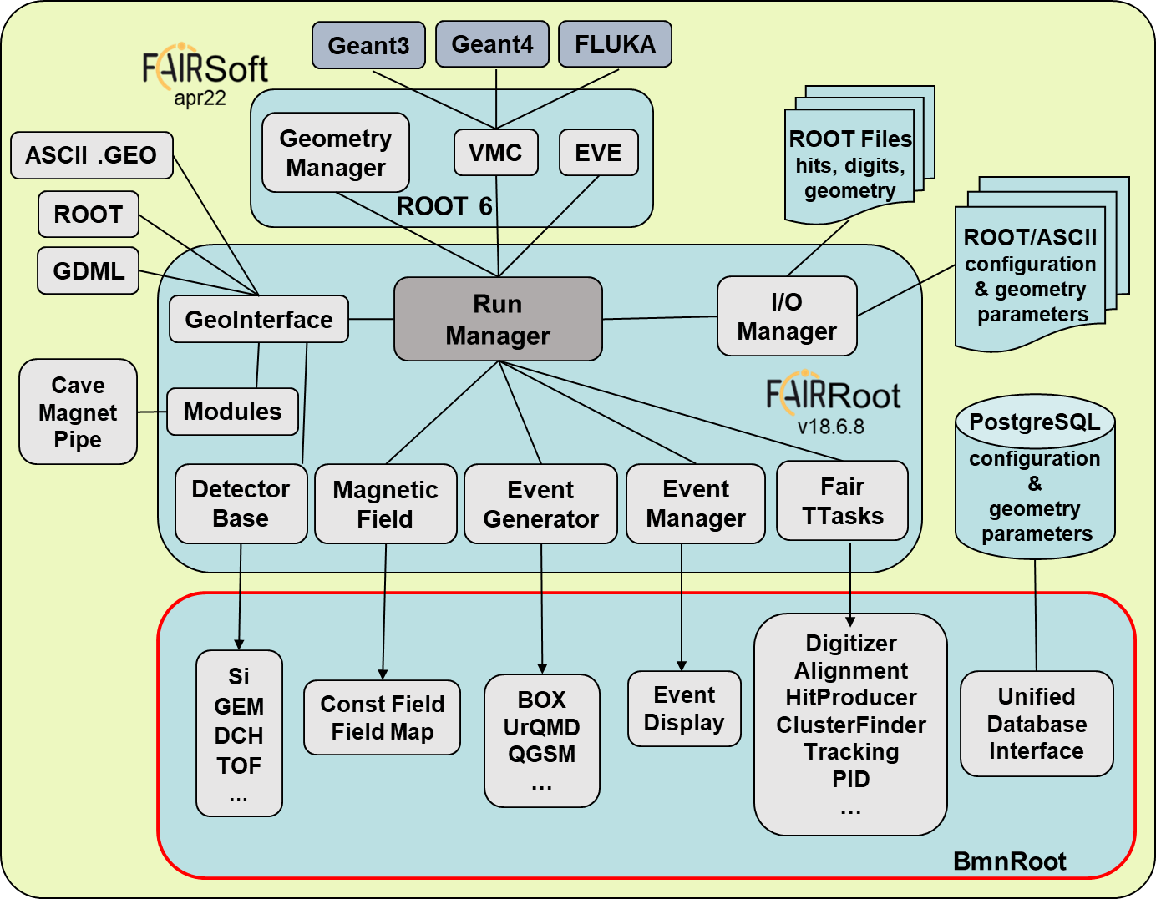
BmnRoot. Release Issue (23.11.0?)
to include latest simulation, reconstruction, analysis and software improvements to be employed for official mass production with Run 8 data
apr22
v18.6.8
Improvements of detector geometries, new field map, and simulation, converter and reconstruction tasks for Run 8
All improvements and new features will be described at the release tag
Mass production is currently being performed via DIRAC by Igor Pelevanyuk
L1Tracking or VectorFinder is chosen in the reconstruction. Two mass productions have been performed
BmnRoot supports RedHat 9
New installation script for FairSoft + FairRoot
bmn.jinr.ru/software-installation
6.26

Slide 26
BmnRoot. Release Preparation
Correct the current BM@N geometry employed in Run 8 to pass overlap test.
All macros, which are used for more than 1 collaboration member, must contain common logic and parameters without local input parameters, user paths, hardcoded global parameters:
No default input parameters for a concrete user (but for production)
No own local paths and local parameters
No inner logic for own local machine
Macros in the CVMFS repository are not writable for mass production
Strict separation of short summary output (by default) from debug output for individuals (macro output should be adapted for mass production)
fVerbose flag (SetVerbose function) must be used
Is progress in percents a good idea?
Compilation warnings should be corrected.
Raw Data Converter should be fixed to write correct run and raw file metadata.
Move SRC information from the databases and SRC macros from the main directory and pipelines.

Slide 27

BmnRoot. Event Data Model
DAQ Storage
raw data in a binary format
Geant 4, Fluka
Event Generators
(DCM-)SMM, QGSM, UrQMD…
raw_run.data
≈ 600 KB/event
digitizer
BmnDataToRoot.C
converter + decoder
simulation
run_sim_bmn.C
generator.dat
≈ 10 KB/event
RAW binary format
digi_exp.root
≈ 35 KB/event
digi_sim.root
GEN format
RAW ROOT format
DIGIT
ROOT format
reconstruction
run_reco_bmn.C
SIM
ROOT format
Storage Levels
dst_reco.root
≈ 90 KB/event
DST
ROOT format
persistent
transient
physics
analysis
macro/physics/
miniDST for PhA
Ilnur Gabdrakhmanov
(September 13, 09:55)
Status of the Raw Data Converter for Run 8 data processing

Slide 28
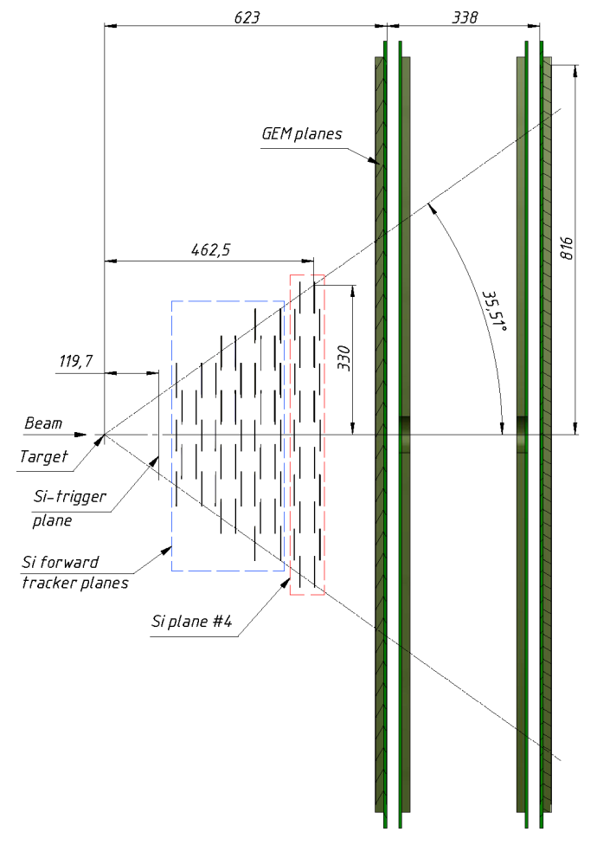
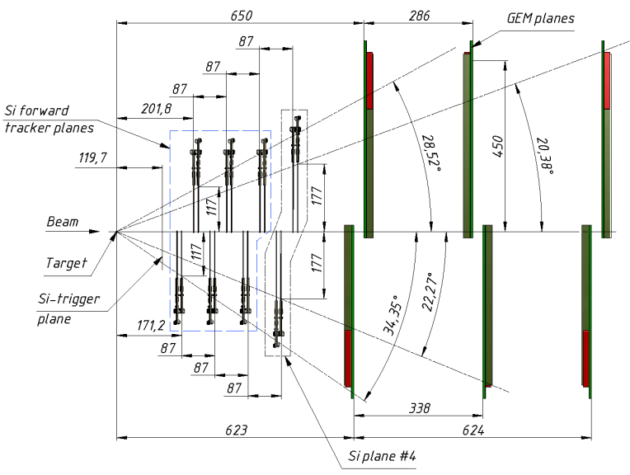
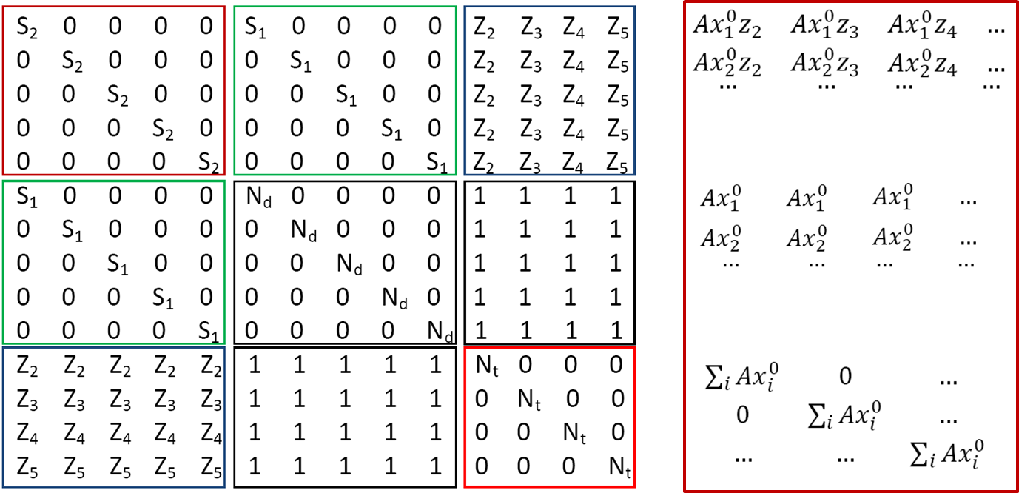
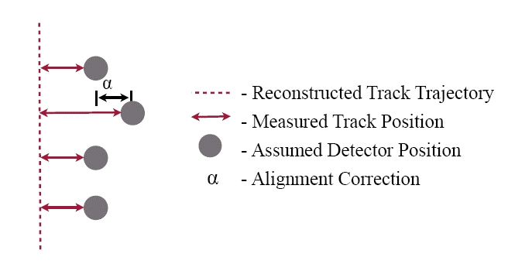
BmnRoot. Detector Alignment
Zarif Sharipov
(September 13, 11:05)
Status of geometry alignment of BM@N tracking detectors

Slide 29
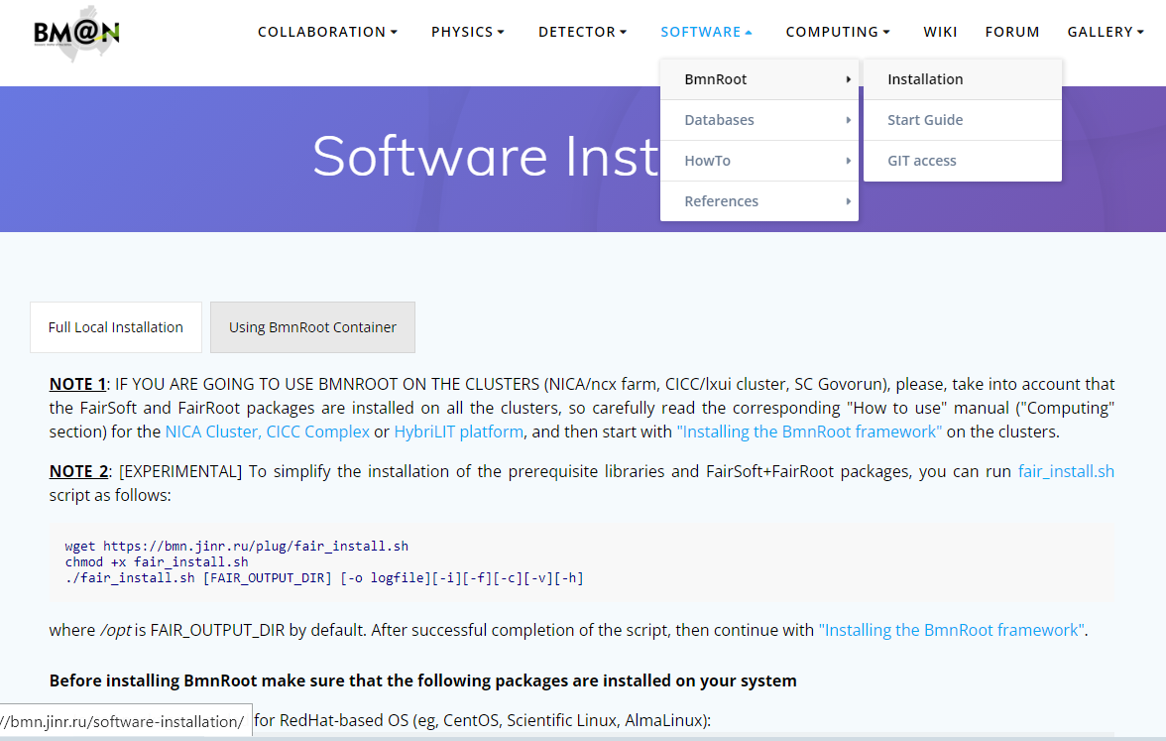
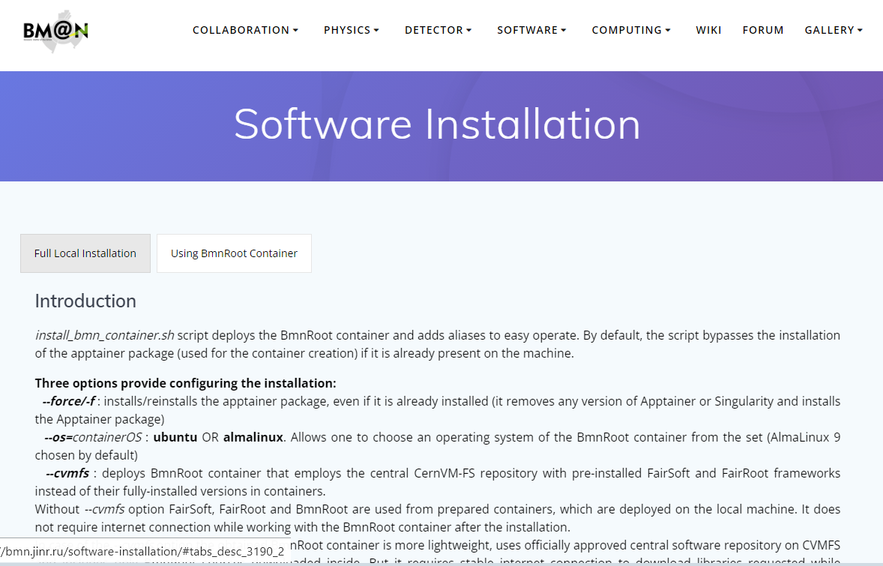

Docker/Apptainer Containers for BmnRoot
User Docker Containers with BmnRoot software
  base image = OS + FairSoft + FairRoot
  users do not need to install software – just run the BmnRoot container
  hosting computer can potentially run any operating system
  great for short-period students and fast analysis
  BmnRoot is automatically built and published with GitLab CI
Dockers for testing BmnRoot before MR in GitLab CI
  simplify CI-infrastructure using BmnRoot Pipelines
  quickly add any OS environments to CI pipelines (CentOS 7 / Ubuntu 20.04)
Apptainers for using BmnRoot Containers
  2 containers (on Ubuntu 22.04 & AlmaLinux 9) with full local installation
  2 containers with CernVM-FS client to the central JINR CVMFS repository
The Installation Procedure: https://bmn.jinr.ru/software-installation
Rinat Nizamov
(September 13, 10:35)
Using BmnRoot in Apptainer/Docker Containers

Slide 30




Evolution of the BM@N Services
Official BM@N Web Site
bmn.jinr.ru
Wiki Doc Server
bmn-wiki.jinr.ru
Forum System
bmn-forum.jinr.ru
NC cluster
login
login
HTTPS
HTTPS
Electronic Logbook
bmn-elog.jinr.ru
login
Condition Database
bmn-uniconda.jinr.ru
login
BM@N
Collaboration
HTTPS
HTTPS
login
login
Geometry Database
bmn-geometry.jinr.ru
Event Metadata
bmn-event.jinr.ru
login
Configuration System
bmn-online.jinr.ru
NC cluster
NICA-Scheduler
bmn-scheduler.jinr.ru
Tango Viewer
bmn-tango.jinr.ru
DAQ Data Center (C4n)
30

Slide 31
Software Strategy Risks
Software Fund
no financial fund, own motivation of the most software external participants
Staff
no full-fledged software group (management’s refusals)
Computing Resources
not enough stable work
not enough guaranteed resources for BM@N, for MP:
300 (ncx) + 192 (Govorun) cores out of 16K+ for NICA
no hot storage required for BM@N raw data processing
31

Slide 32
Conclusions
More than 600 millions of collision event (≈ 400 TB) were obtained in the first BM@N physics run, and it is expected that the amount of data will be increased in future runs, so the BM@N computing software architecture must be implemented to digest BM@N data.
The reliability of the cold data storages should be increased (at least, one month wasted). The absence of the hot storages leads to inability to process BM@N data on some resources. The tape storage is at the stage of commissioning by MLIT team.
BM@N data mass production is being successfully performed via the DIRAC workload management system. The integration of Dirac File Catalogue and Airflow is in progress.
Many information and software systems of the experiment have been involved in mass production for Run 8, and are moving to the online farm. The Monitoring System has been implemented to track and visualize their states, and send notifications. Migration from FreeIPA authentication/authorization system to the Keycloak solution is in progress.
BmnRoot Release 23.11.0 (?) should be issued to commit the latest BM@N simulation, reconstruction, analysis and software improvements to be employed for mass data processing for Run 8. Reconstruction time for one event with VF is too big.
The lack of the software fund, regular staff and computing resources poses serious risks for the BM@N data processing and analysis.

Slide 33
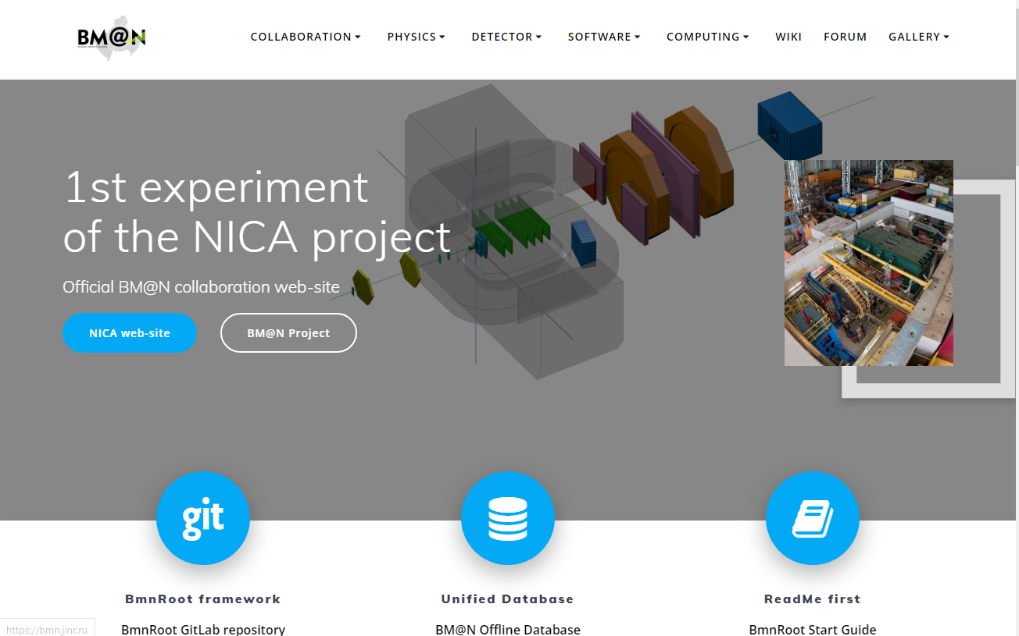
Official BM@N Web-site at bmn.jinr.ru
Collaboration
Information
Documents
Software
Databases
Computing Section (NICA Cluster, MICC Complex, HybriLIT & Govorun)
Guides, Manuals
Wiki
Forum
Gallery
News
BM@N Mail-lists
etc.

Slide 34
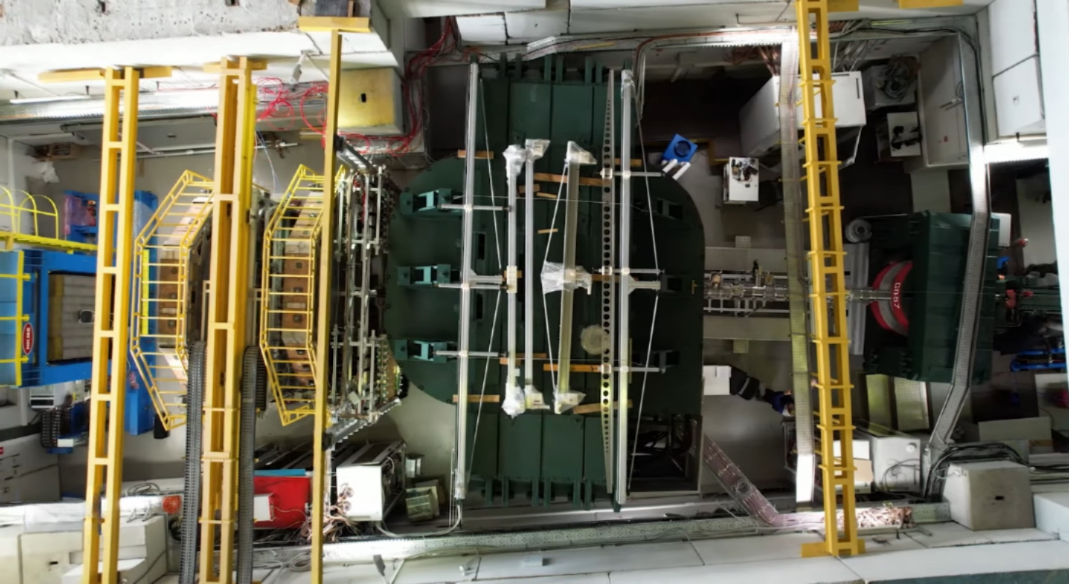

Thank you for your attention!
More information: bmn.jinr.ru
We are open for cooperation!
Email: gertsen@jinr.ru

