Slide 1
12-13 September 2023
Analysis & Software Meeting Of The BM@N Experiment
Migration of BM@N Information Systems and Services to the BM@N Online Cluster
Alexander Chebotov
Konstantin Gertsenberger
JINR, LHEP

Slide 2
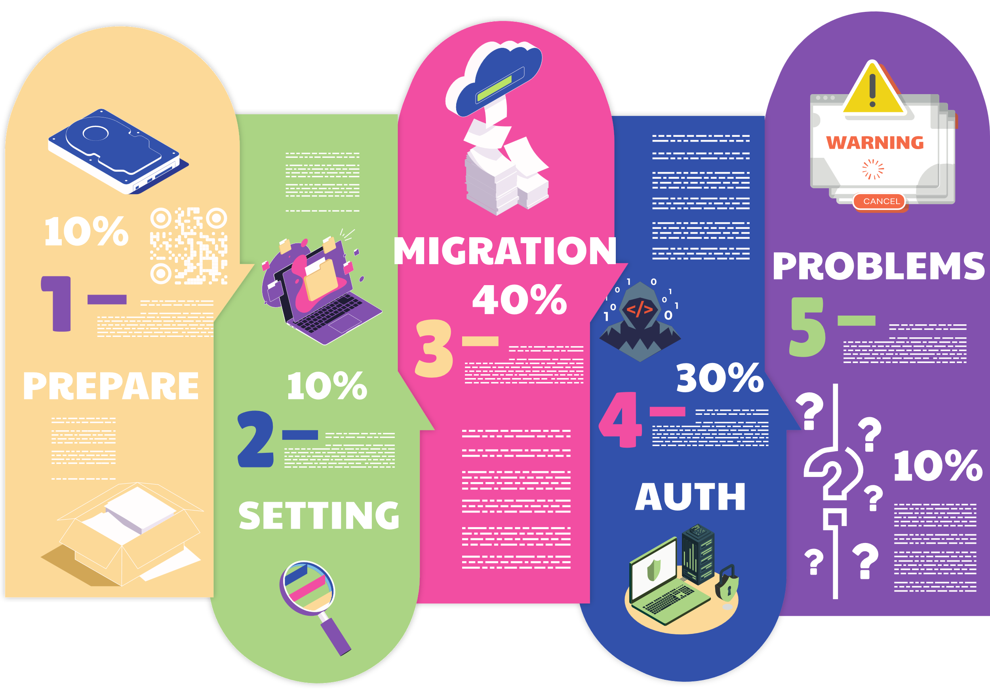
OUTLINE

Slide 3
The NC cluster is composed of dedicated physical server (bare-metal servers) grouped together to form a unified computing environment for high-performance task execution.
Performance: Bare-metal servers offer superior performance, making them ideal for compute-intensive tasks.
Low Latency: Bare-metal servers provide low latency, critical for real-time applications, due to the absence of virtualization.
Resilience: Clusters of bare-metal servers can be highly resilient with technologies like clustering and failover.
Administrative Complexity: Managing bare-metal servers can be more complex compared to virtualized environments like Proxmox.
Reverse Proxy

Slide 4
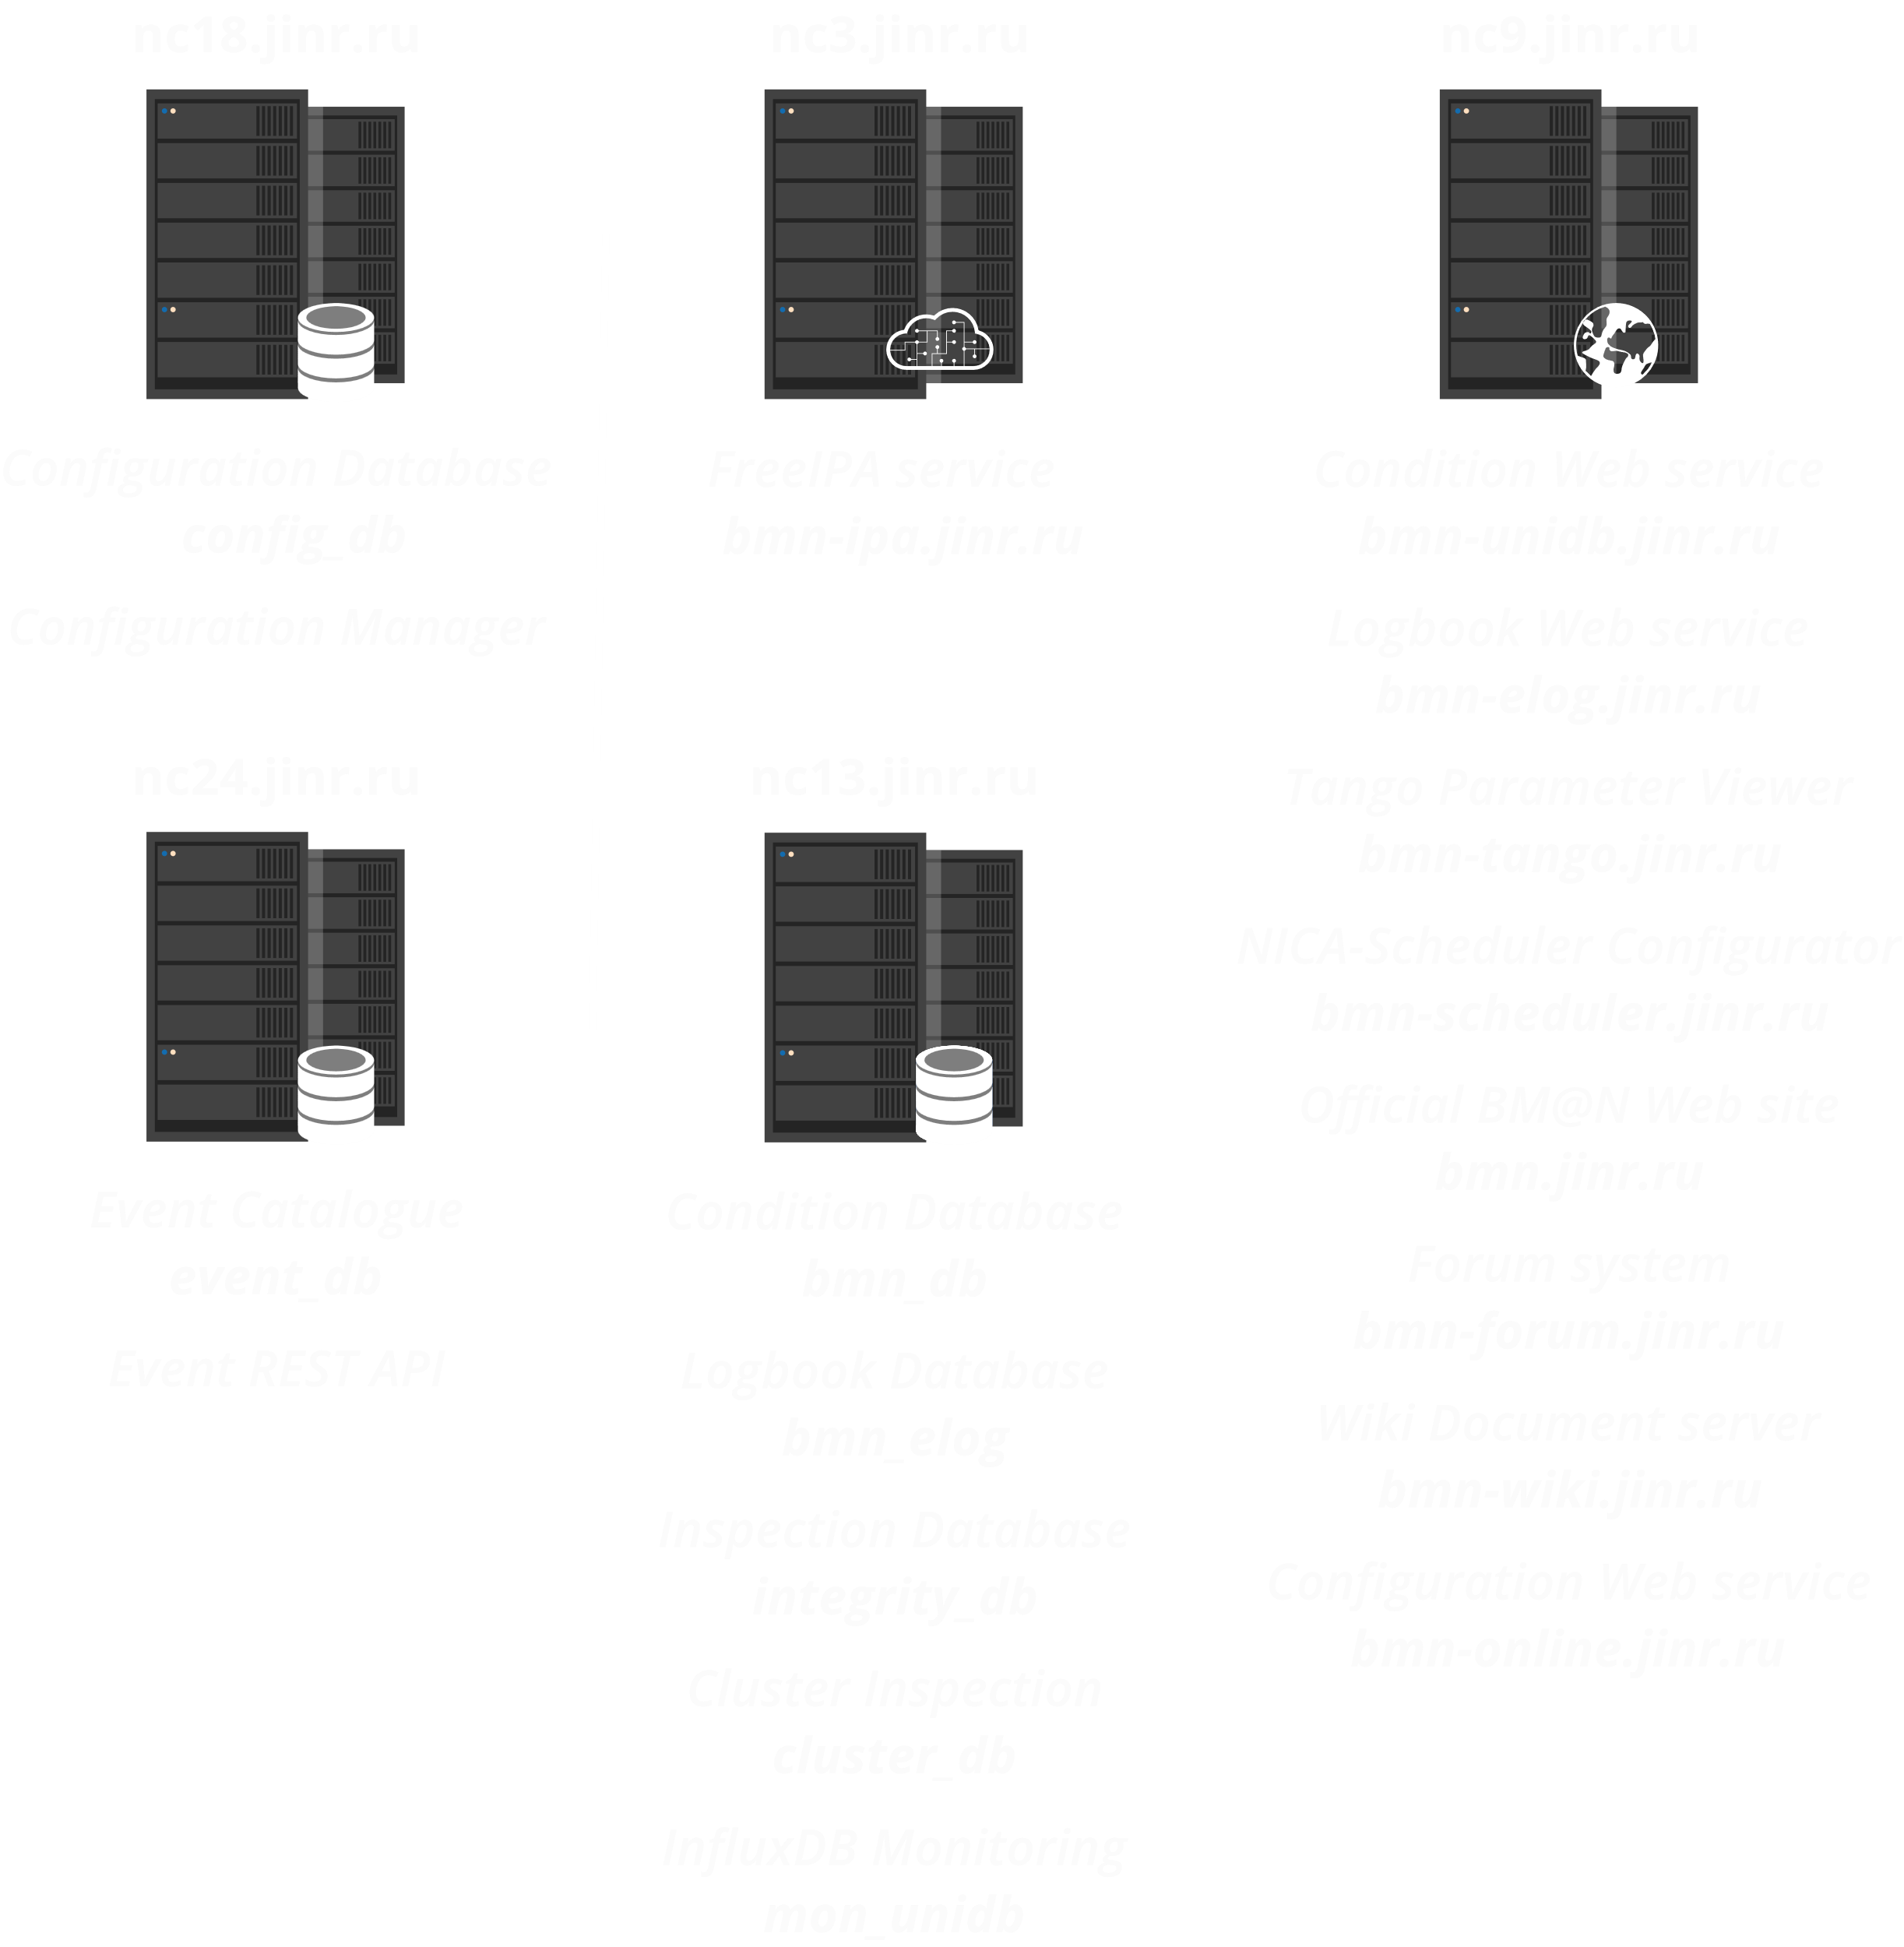
Cluster Migration Preparation
Migration Planning: Create a detailed plan for service and database migration.
Dependency Assessment: Identify dependencies between services and databases.
Phased Migration: Move services and databases gradually, starting with less critical ones.
Testing and Monitoring: Test and monitor migrated components, addressing issues promptly.
DNS Update: Update DNS settings to reroute traffic after successful migration.
Decommissioning: Gradually retire the original services and databases.
Ivan SLEPOV:
Administrator of the NC Cluster and Support for the BM@N Information Systems and Services

Slide 5
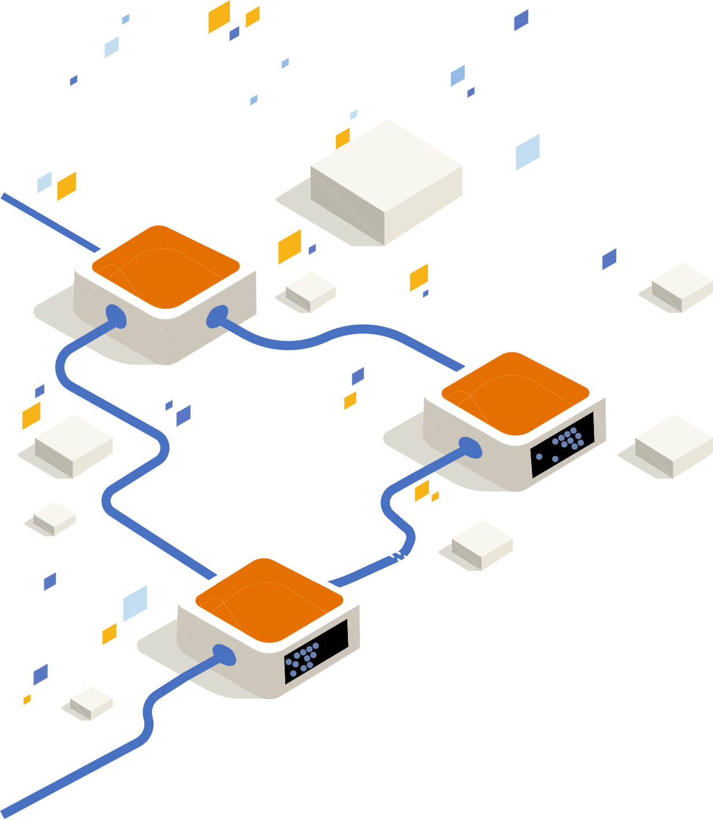
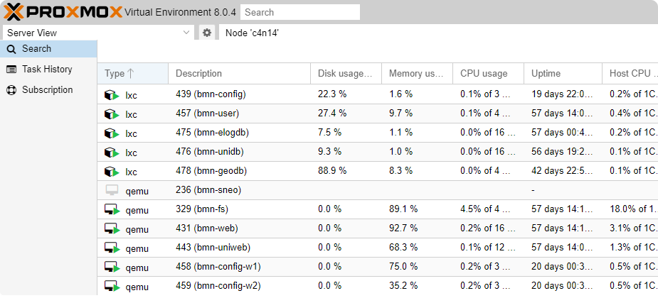
Online C4n Data Сenter
Proxmox is a virtualization and resource management platform that allows you to create VMs and containers using virtualization technologies such as KVM for VMs and LXC (Linux Containers) for containers.
Versatility: Support for virtual machines and containers.
High-Performance Storage: Utilizing Fast SSD Storage.
Convenient Interface: Web interface for managing all aspects of virtualization.
Clustering: Creating clusters for high availability and fault tolerance.
Backups and Recovery: Integrated tools for creating backups.
Performance: Good performance for virtual machines with KVM.
Free Software: Software based on open-source code.

Slide 6
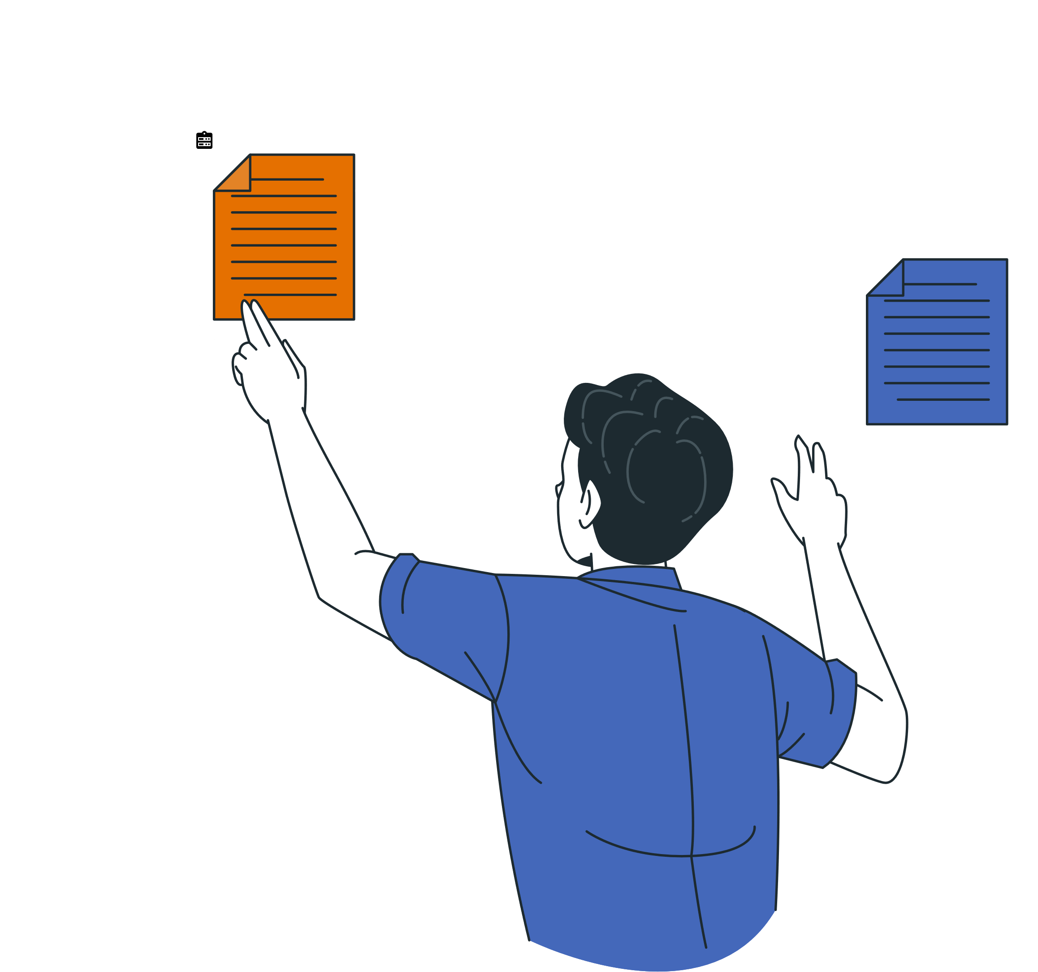
Moving To New Data Сenter

Slide 7
Briefly about the BM@N Information Systems and Services
The metadata system for physical events is built on the Event Catalog, which contains information about particle collisions and enables rapid selection of events for physical analysis based on specified criteria.

Slide 8
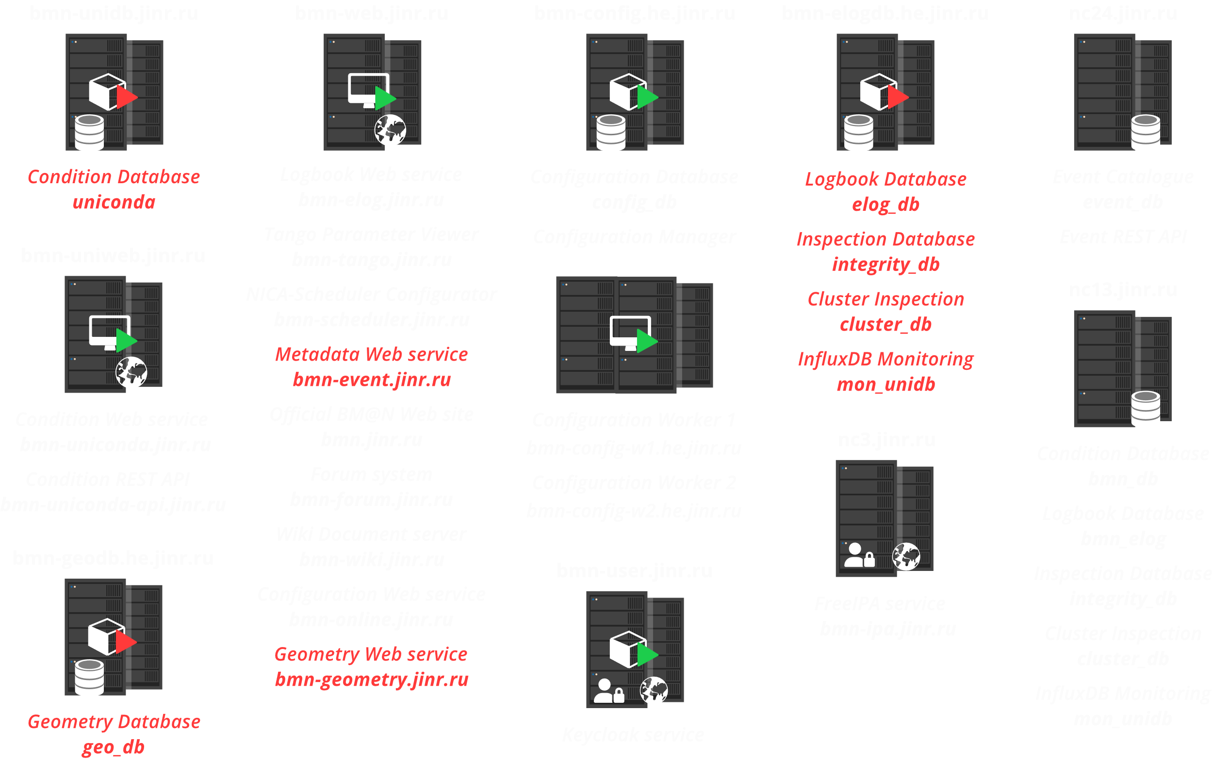
New Location
New Solutions
Software group:
Administrator and Support for the BM@N Information Systems and Services

Slide 9
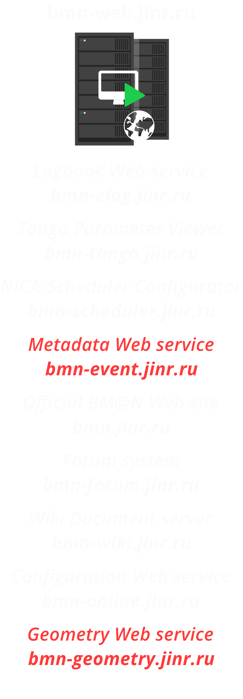
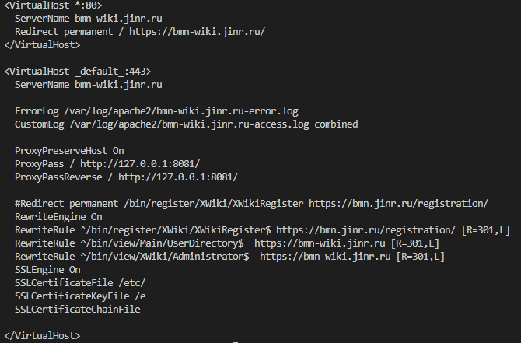
Unleashing Services on bmn-web.jinr.ru
Reverse Proxy
Docker

Slide 10
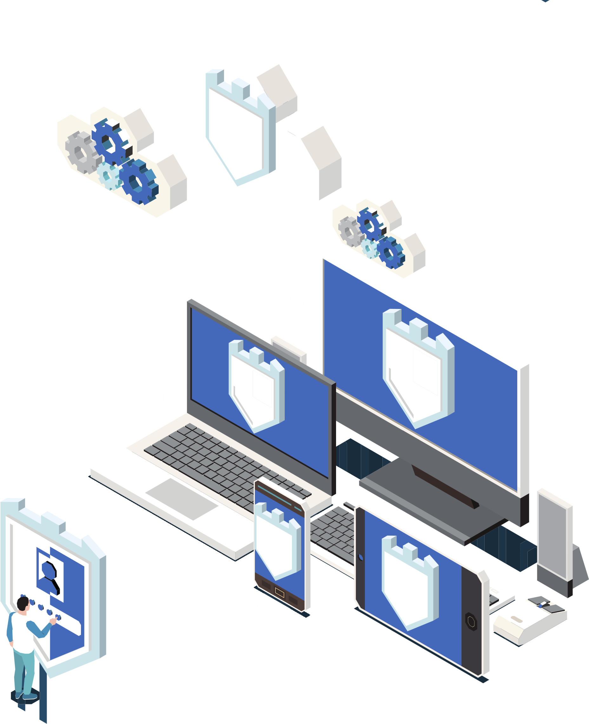
Authorization Services
Keycloak is a popular and powerful solution for ensuring security and authentication in your applications. It offers extensive capabilities for managing user access and data protection. Keycloak is based on two important protocols, OpenID Connect and OAuth 2.0

Slide 11
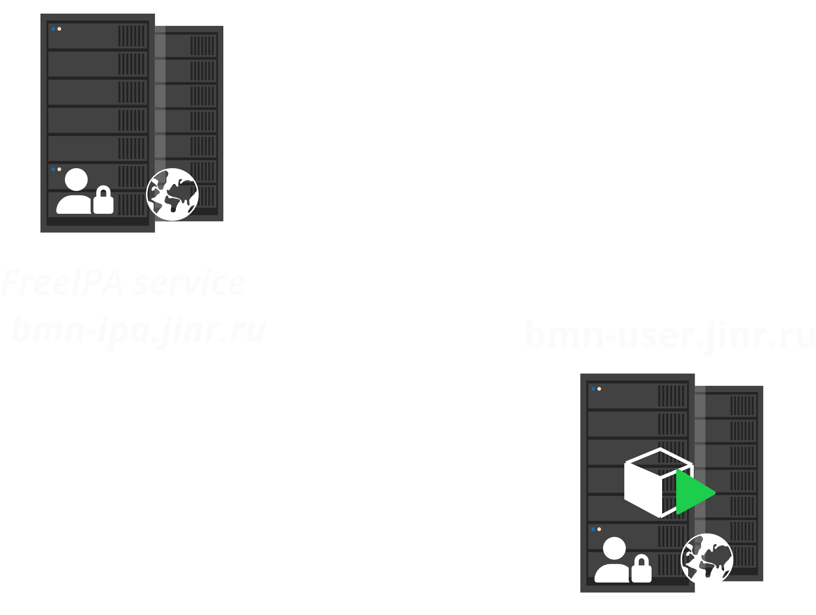
Which authentication will be officially chosen?
User Federations

Slide 12
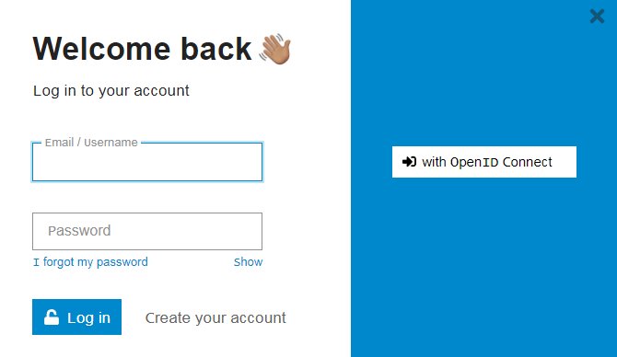
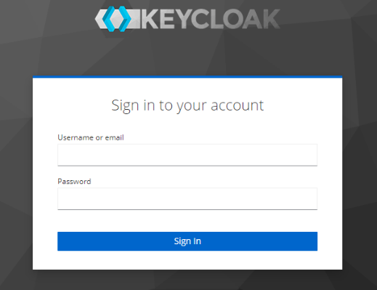
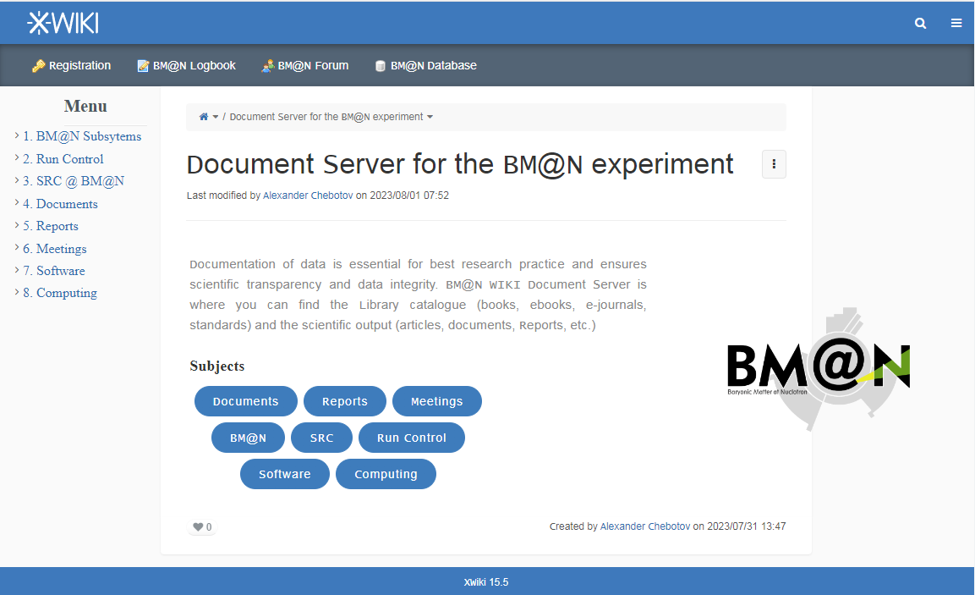
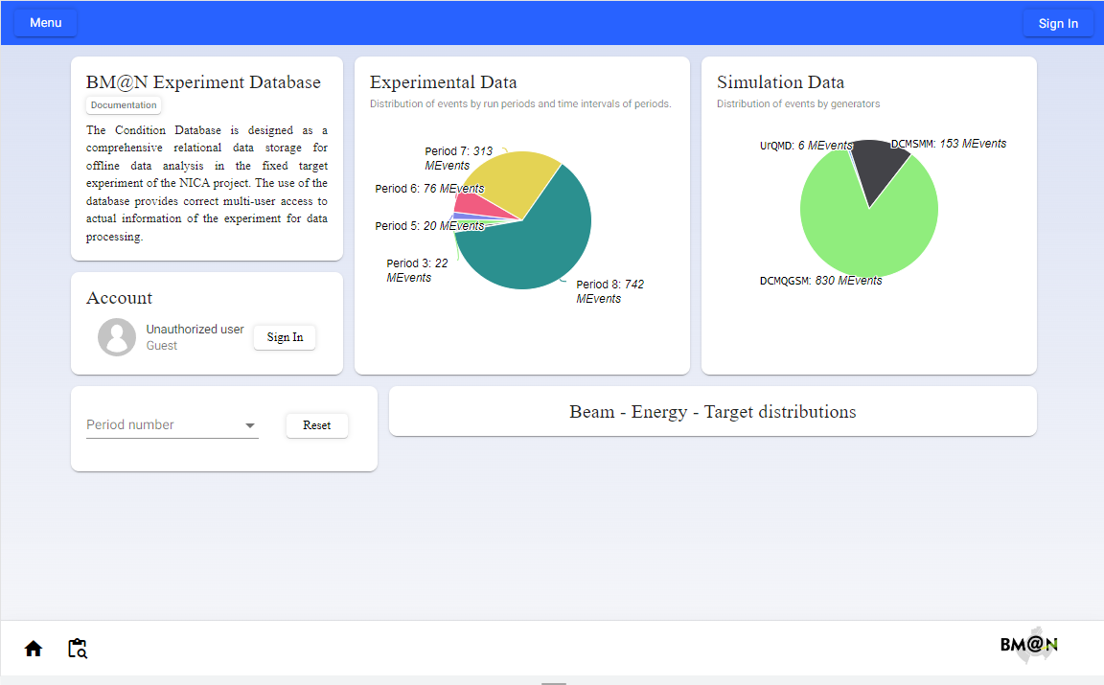
Elevating Services with Keycloak Integration

Slide 13
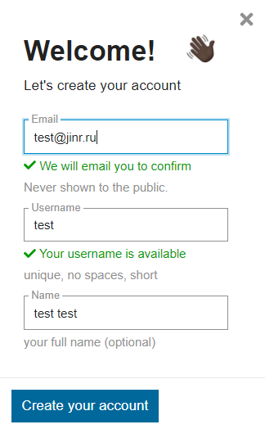
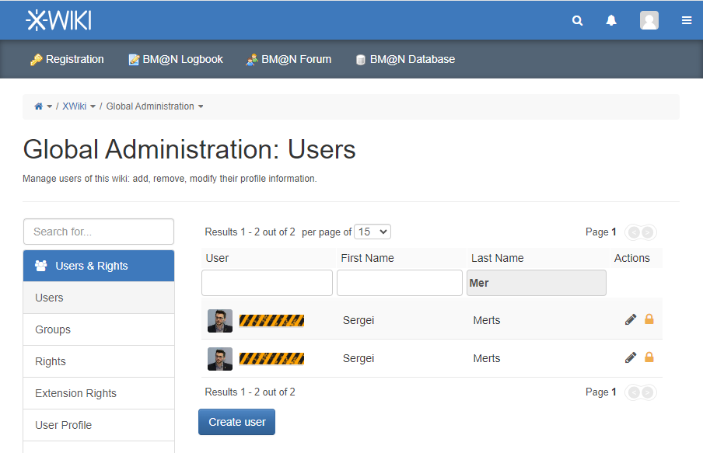
Found Small Problems: Moving Forward
Let's consider each of the listed issues:
Wiki Problem: When using Keycloak for authentication, user duplication occurs.
Forum Issues:
Registration on the forum happens redundantly.
Group mapping is missing
There is an issue with the OpenID plugin
Networking Problem: When transitioning from static IP addresses to DHCP in room 215, networking issues emerged.
Problem with nc3 Machine: The nc3 machine with outdated specifications, such as DDR2 memory, gradually causes problems.

Slide 14
Conclusions
We are actively advancing the process of relocating to a new location, and I am pleased to report that this process is proceeding successfully.
We are effectively implementing new services, systems, and databases.
Gradually, we are integrating these new services with Keycloak, which will enhance the authentication and authorization processes in our applications and provide a higher level of security.
We continue to work actively on resolving the presented issues, such as user duplication, forum problems, and network configurations. Our efforts are aimed at addressing these issues and ensuring the seamless operation of the system.

Slide 15
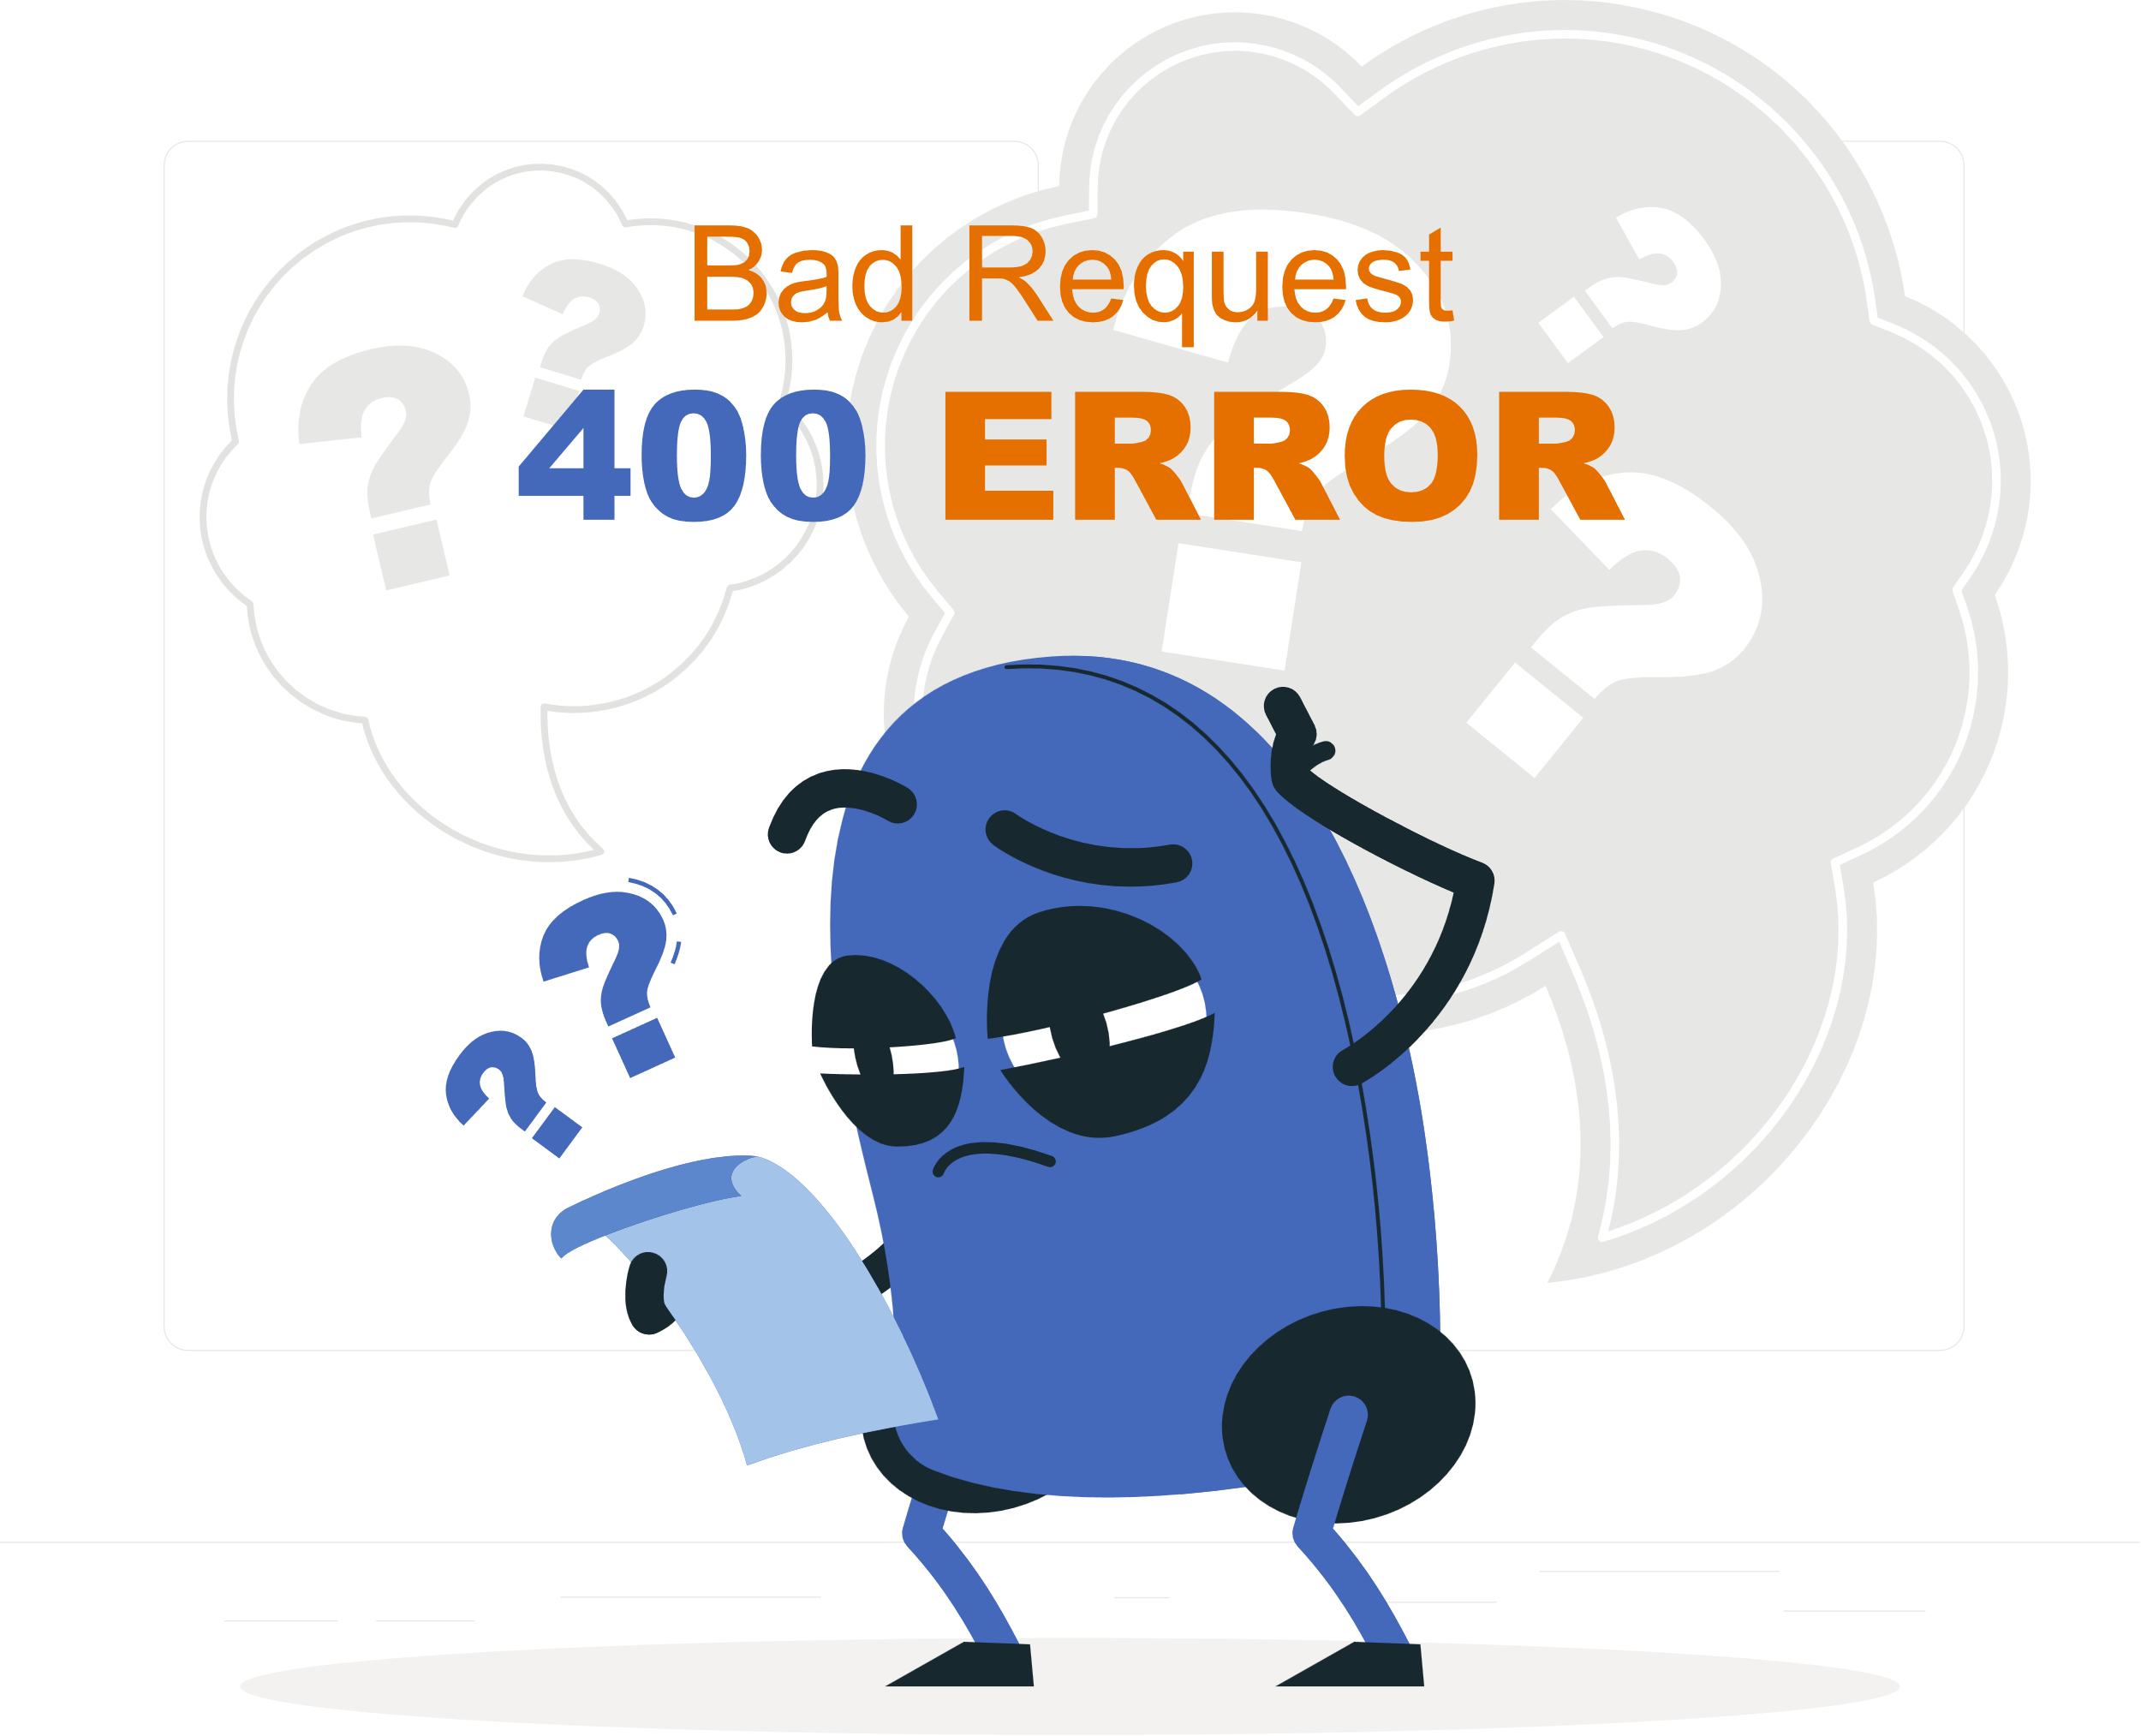
Thank you
for your attention!

