Slide 1
Status of geometry alignment of BM@N tracking detectors
Zarif Sharipov
Analysis & Software Meeting of the BM@N Experiment

Slide 2
Introduction to Alignment
Analysis & Software Meeting of the BM@N Experiment

Slide 3
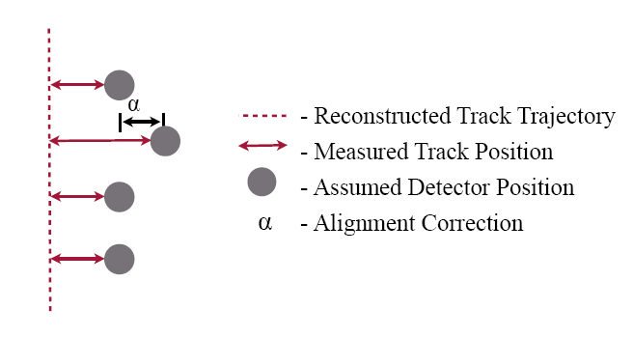
Introduction to Alignment
Analysis & Software Meeting of the BM@N Experiment

Slide 4
Introduction to Alignment
y
β
z
γ
α
x
Analysis & Software Meeting of the BM@N Experiment

Slide 5
Introduction to Alignment
.
o
Analysis & Software Meeting of the BM@N Experiment

Slide 6
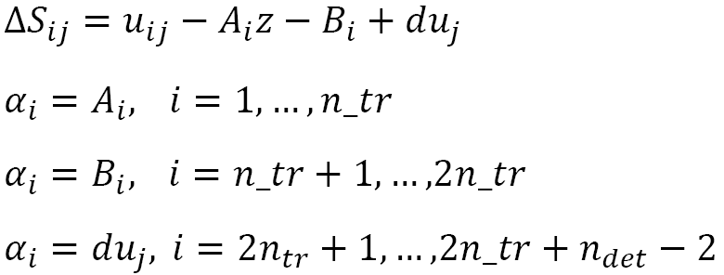
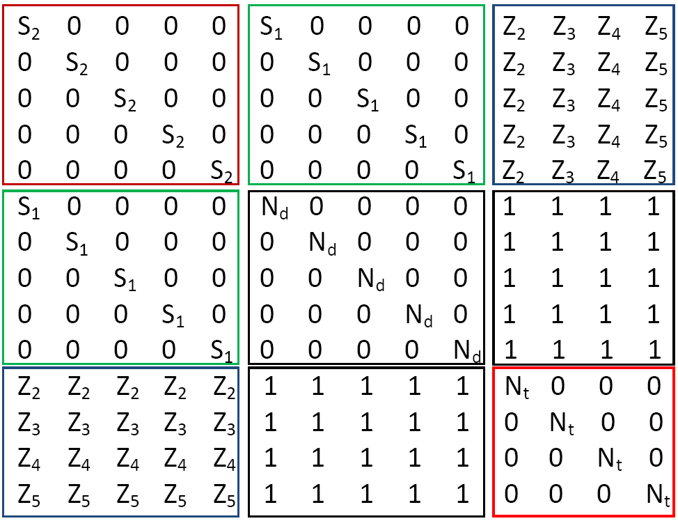
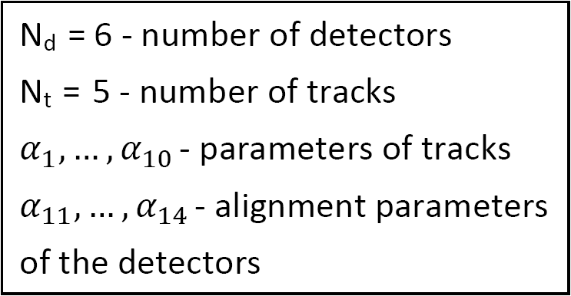
Alignment for x and y
Volker Blobel, Claus Kleinwort. A New method for the high precision alignment of track detectors (https://arxiv.org/abs/hep-ex/0208021)
https://www.desy.de/~kleinwrt/MP2/doc/html/draftman_page.html
Analysis & Software Meeting of the BM@N Experiment
Notes:
example

Slide 7
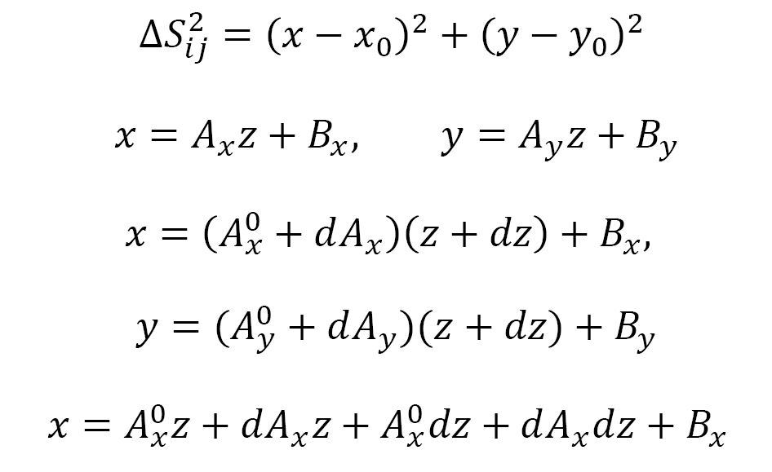
Alignment for x, y and z
Analysis & Software Meeting of the BM@N Experiment

Slide 8
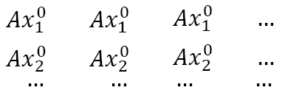
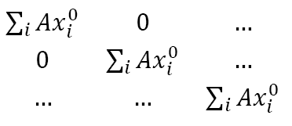
Alignment for x, y and z
Analysis & Software Meeting of the BM@N Experiment

Slide 9
Alignment for x, y and z
x
0
dx
x
0
dy
dz
Analysis & Software Meeting of the BM@N Experiment

Slide 10
Principle of alignment
IMSL Fortran Library
(https://www.imsl.com/products/imsl-fortran-libraries)
2. Eigen
(https://eigen.tuxfamily.org/index.php?title=Main_Page)
3. Millepede-II
( https://www.desy.de/~kleinwrt/MP2/doc/html/draftman_page.html)
Analysis & Software Meeting of the BM@N Experiment

Slide 11
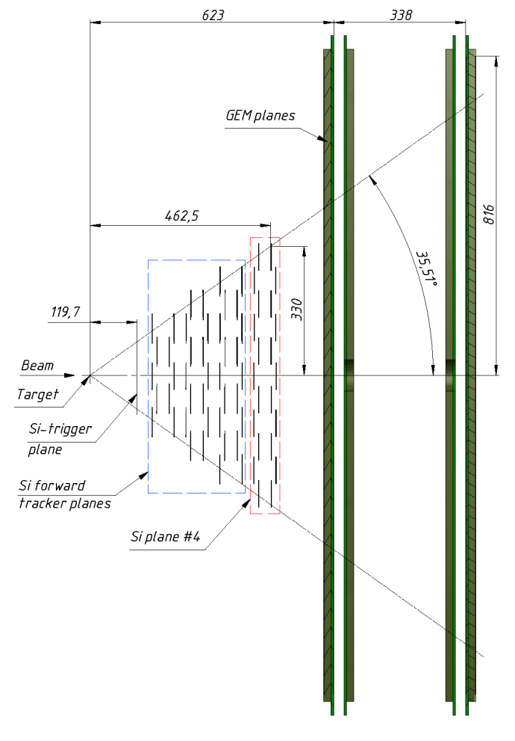
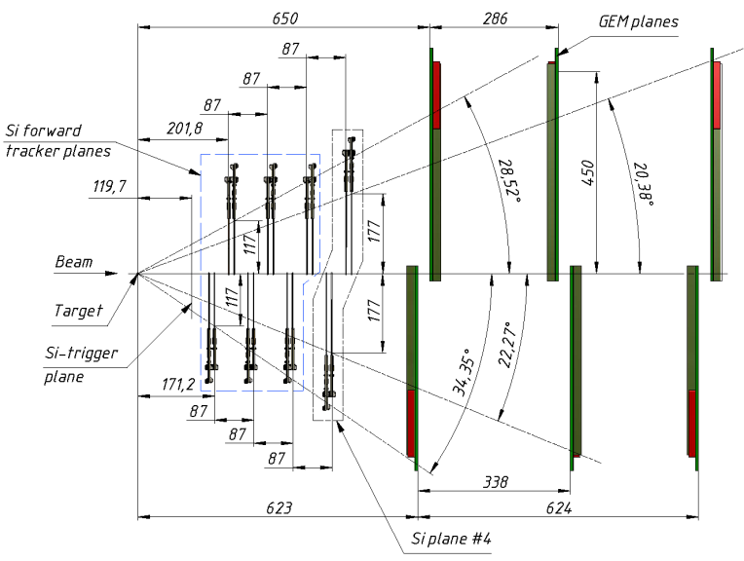
Schematic view of Forward Silicon detectors including 4th Si plane and first large apperture GEM stations in YZ (left) and XZ (right) projections.
Analysis & Software Meeting of the BM@N Experiment

