Slide 1
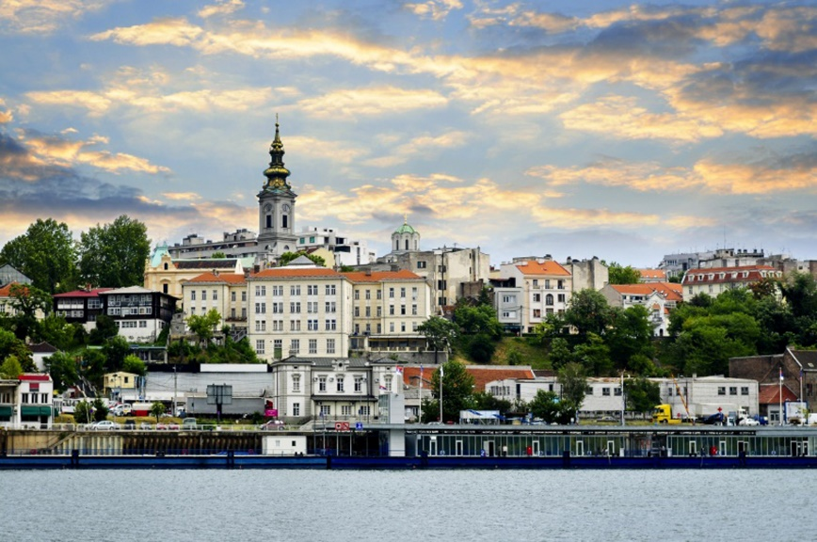
Collective Flow in Heavy-Ion Collisions
Arkadiy Taranenko (VBLHEP JINR, NRNU MEPhI)
NICA Days 2023, Belgrade, Serbia, October 2-3, 2023
Notes:
1
1
1
1
1
1
1

Slide 2
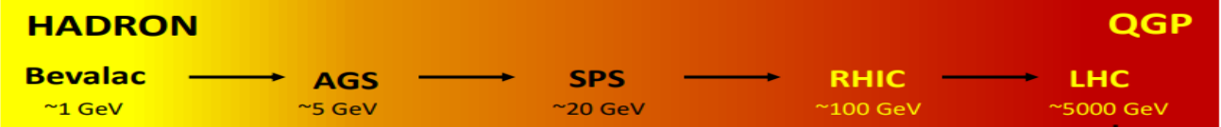
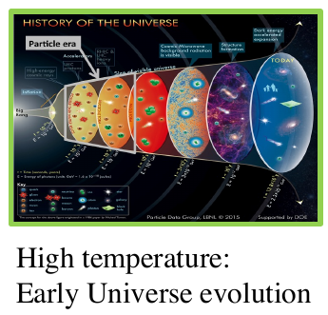
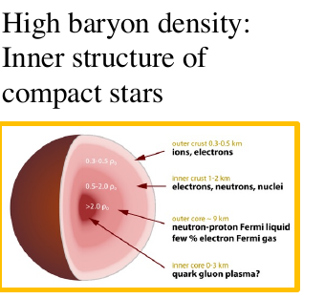
Relativistic Heavy-Ion Collisions and Quark Gluon Plasma (QGP)
It is the primordial form of QCD matter at high temperature or baryon density.
It was present during the first few microseconds of the Big Bang.
It provides an example of phase transitions which may occur at a variety of higher temperature scales in the early universe.
It can provide important insights on the origin of mass for matter, and how quarks are confined into hadrons.
M. Gyulassy, Nucl. Phys. A750, 30-63, 2005

Slide 3
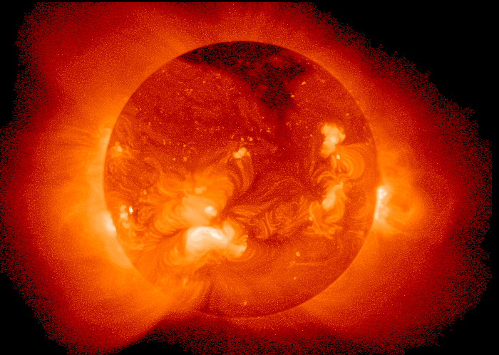
Temperature at the centre of the Sun ~ 15 000 000 K
A medium of 150-170 MeV is more than 100 000 times hotter !!!

Slide 4
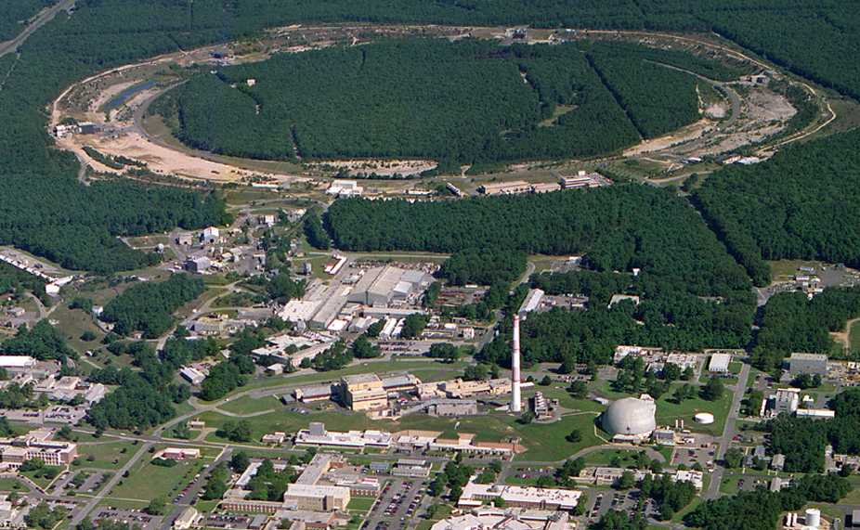

2005: Quark-Gluon Plasma is a “perfect liquid”
Relativistic Heavy-Ion Collider (BNL), Upton, NY (USA)
PHOBOS
BRAHMS
RHIC
PHENIX
STAR
v = 0.99995⋅c = 186,000 miles/sec
Au + Au at 200 GeV
AGS
TANDEMS

Slide 5
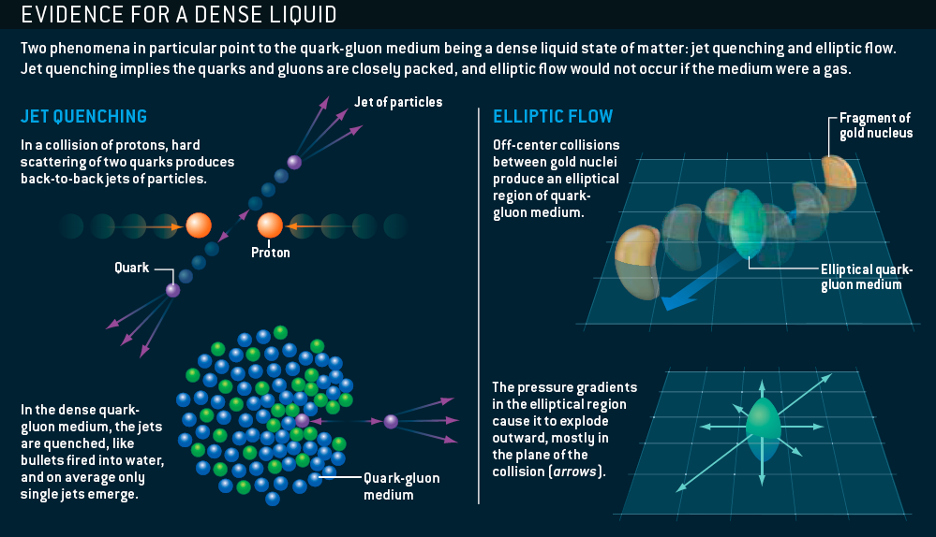
The sQGP Discovered at RHIC: 2005
M. Roirdan and W. Zajc,
Scientific American, May 2006

Slide 6
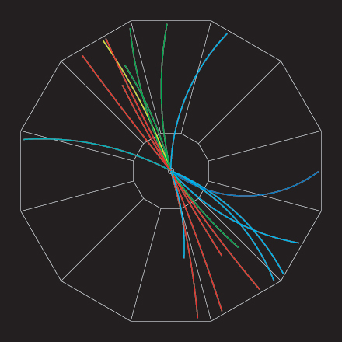
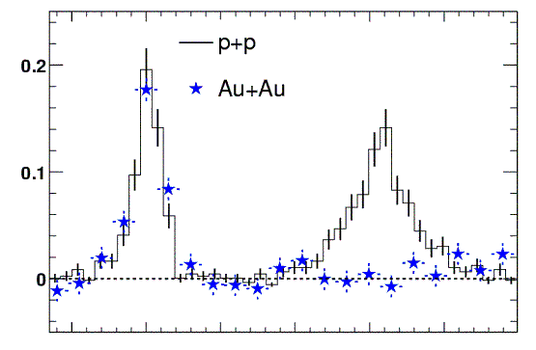
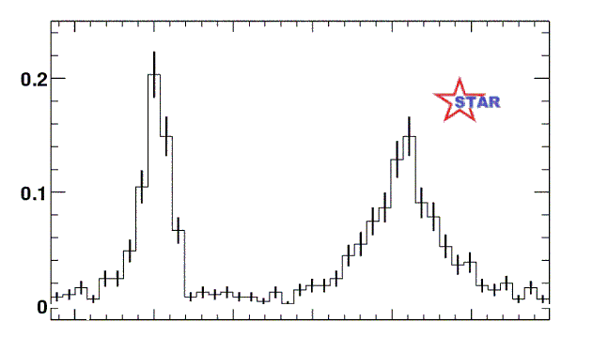
RHIC Experiment: “Jet quenching”
proton-proton jet event
Analyze by measuring (azimuthal) angle between pairs of particles
Number of pairs
0º
180º
Angle between high energy particles
In Au-Au collisions we see only one “jet” at a time !
How can this happen ?
Jet quenching!
q
q

Slide 7
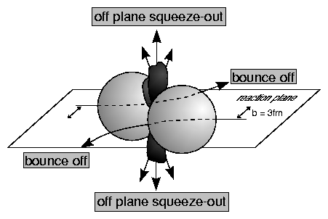
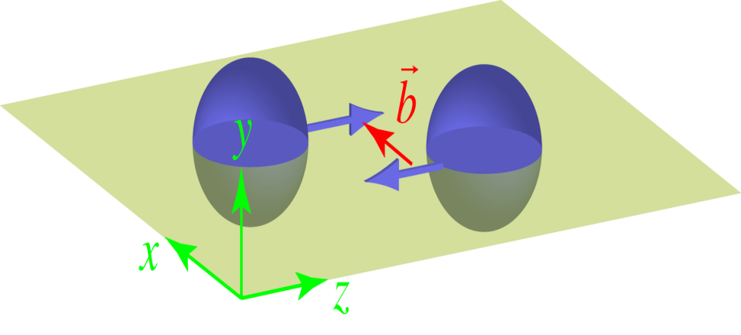
“Squeeze-Out” - First Elliptic Flow Signal in HIC
Diogene, M. Demoulins et al., Phys. Lett. B241, 476 (1990)
Plastic Ball, H.H. Gutbrod et al., Phys. Lett. B216, 267 (1989)
1989
Reaction plane
Reaction Plane
y
ɸ=φ-Ψ_{R}
v2 < 0
ψ_{R}
mid-rapidity
x
+/- 90deg

Slide 8
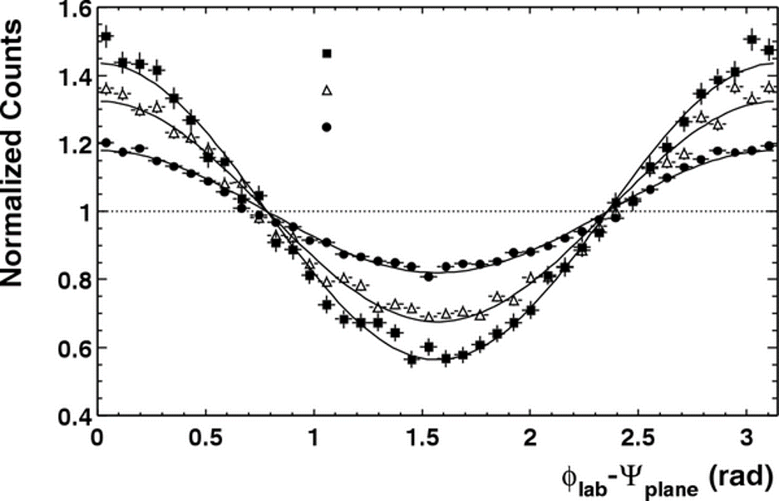
Azimuthal anisotropy of particles at HIC
y
Ф=φ-Ψ_{RP}
STAR, PRL90 032301 (2003)
b ≈ 10 fm
ψ_{RP}
b ≈ 6.5 fm
b ≈ 4 fm
x
4*v₂
b
Sergei Voloshin, Y. Zhang, Z. Phys. C70,(1996), 665
The sinus terms are skipped by symmetry arguments
From the properties of Fourier’s series one has
Fourier coefficients V_{n} quantify anisotropic flow:
v₁ is directed flow, v₂ is elliptic flow, v₃ is triangular flow, etc.
Term “flow” does not mean necessarily “hydro” flow – used only to emphasize the collective behavior of particles in event or multiparticle azimuthal correlation

Slide 9
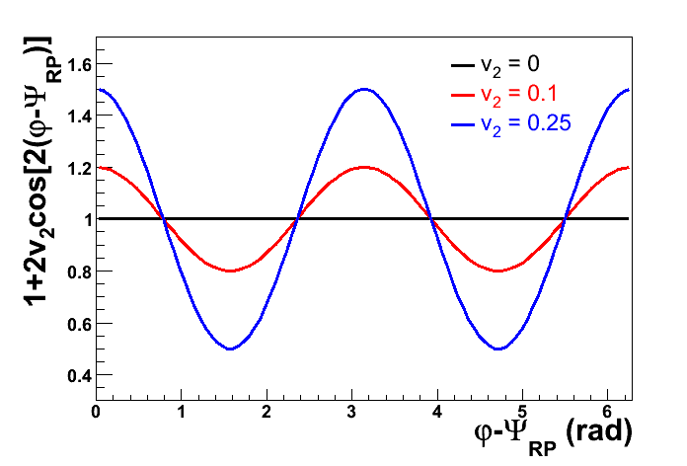
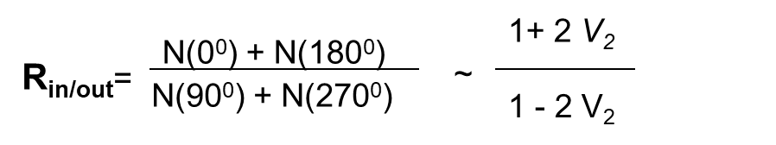
Elliptic Flow V₂
v₂ ≠ 0 - difference between the (||)[N(0⁰) + N(180⁰)] and
(⊥) [N(90⁰) + N(270⁰)] to
the impact parameter (b)
V₂= 0.25 → R_{in/out} = 3 ( 3 times more particles emitted in-plane than
out-of- the plane )
the impact
parameter
IN PLANE
v₂ > 0 → in-plane flow,
v₂ < 0 out-of-plane flow
OUT OF PLANE

Slide 10
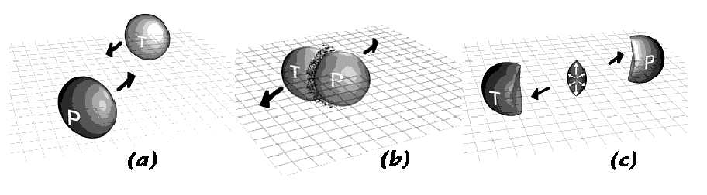
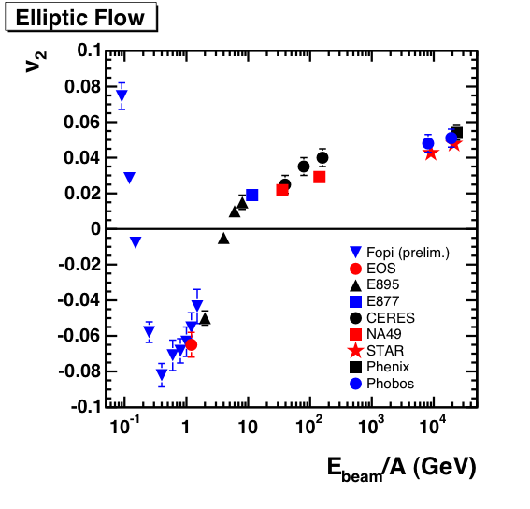
Excitation function of elliptic flow – 0.4-10 GeV (SIS/AGS) energies
Passage time: 2R/(β_{cm}γ_{cm})
Expansion time: R/c_{s}
c_{s}=c√dp/dε - speed of sound
( time for the development of expansion perpendicular to the reaction plane)
AGS
SPS
SIS
Delicate balance between:
1) Ability of pressure developed early in the reaction zone to effect a rapid transverse expansion of nuclear matter
2) Passage time for removal of the shadowing of participant hadrons by projectile and target spectators

Slide 11
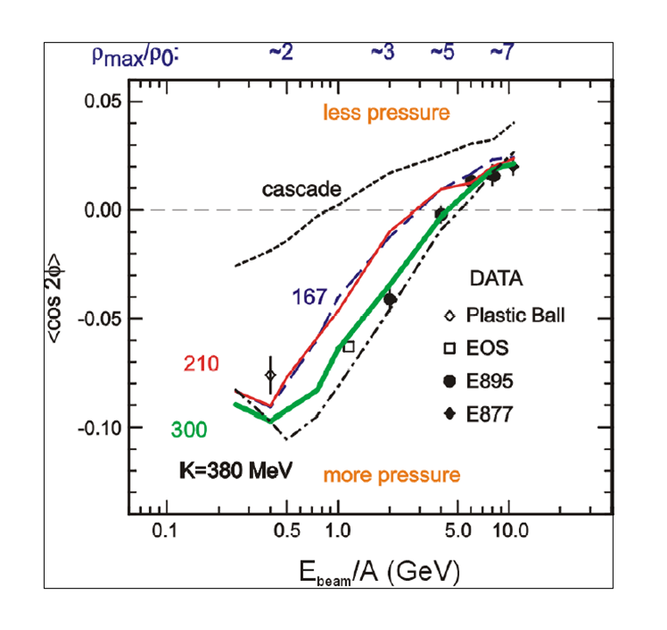
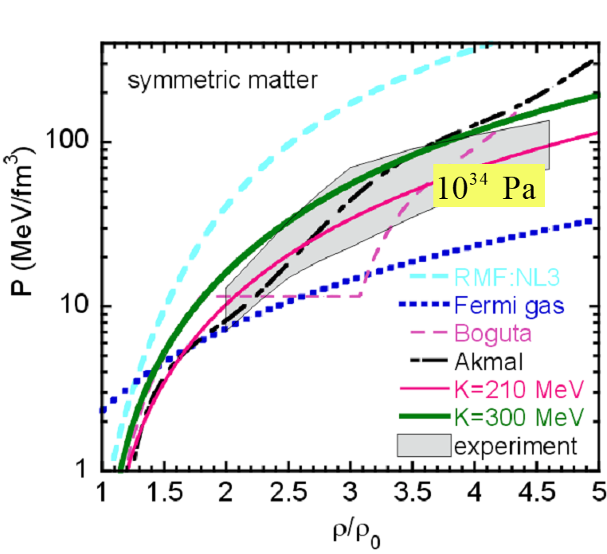
Flow at AGS: Constraints for the Hadronic EOS
Danielewicz, Lacey, Lynch, Science 298 (2002) 1592-1596
Passage time: 2R/(β_{cm}γ_{cm})
Expansion time: R/c_{s}
c_{s}=c√dp/dε - speed of sound
Flow at AGS/Nuclotron = Interplay of passage/expansion times

Slide 12
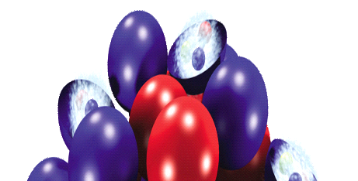
Elliptic flow at RHIC/LHC
“spectators”
b – impact parameter
“spectators”
Passage time: < 0.15 fm/c
Longitudinal and transverse expansion =>
no influence of spectator matter at midrapidity

Slide 13
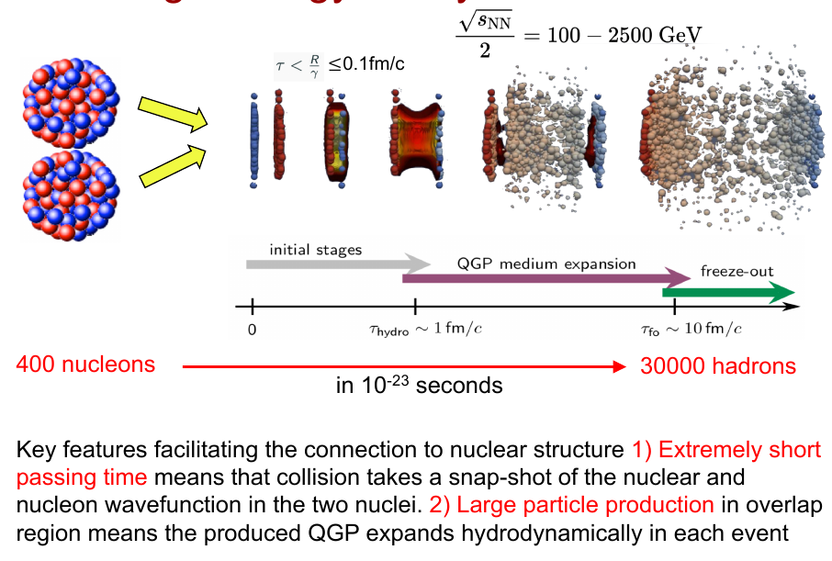

Slide 14
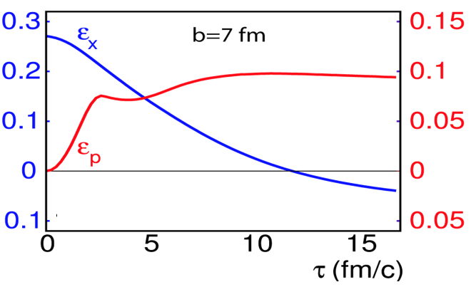
Elliptic Flow at RHIC
Z
Reaction plane
Y
X
  The initial spatial anisotropy ε_{X} evolves (via interactions and density gradients ) → Momentum-space azimuthal anisotropy ε_{p} = v₂
  Pressure gradient is largest in the shortest direction of the ellipsoid.
Signal is self-quenching with time
P_{y}
P_{z}
P_{x}

Slide 15
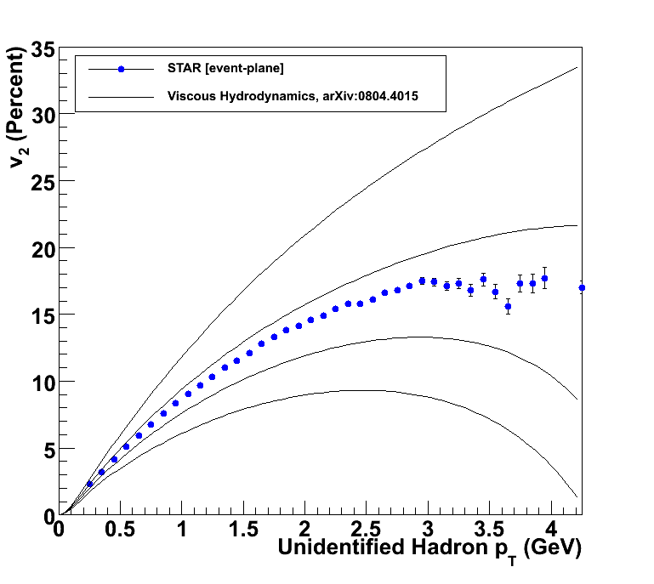
Relativistic viscous hydrodynamics compared to data
Luzum, Romatschke, Phys. Rev. C78, 034915 (2008)
η/s ~ 0
Lower Viscosity
↓
Less Dissipation
↓
More Flow
↓
Larger v₂
η/s = 1/4π
η/s = 2 x 1/4π
η/s = 3 x 1/4π

Slide 16

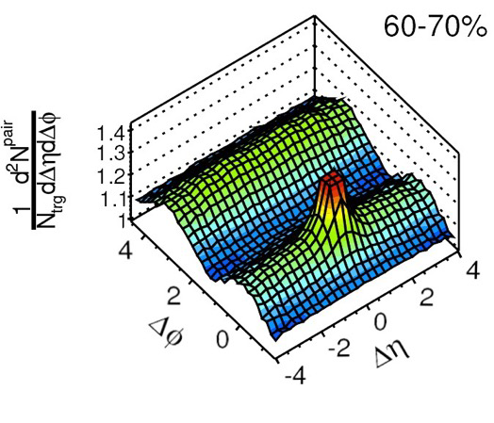
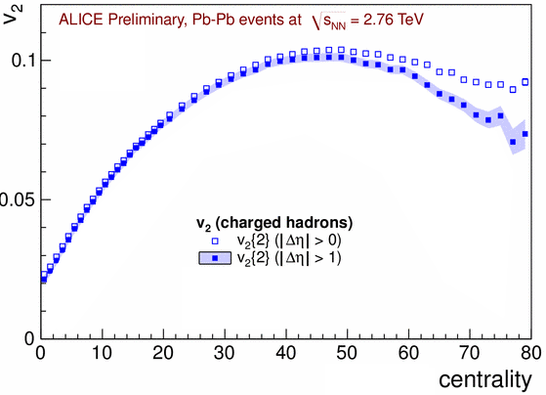
Two-particle correlations
Requires the suppression of non-flow contributions
(HBT, Jets & di-jets, Res. Decay, Mom. Consrv.)

Slide 17
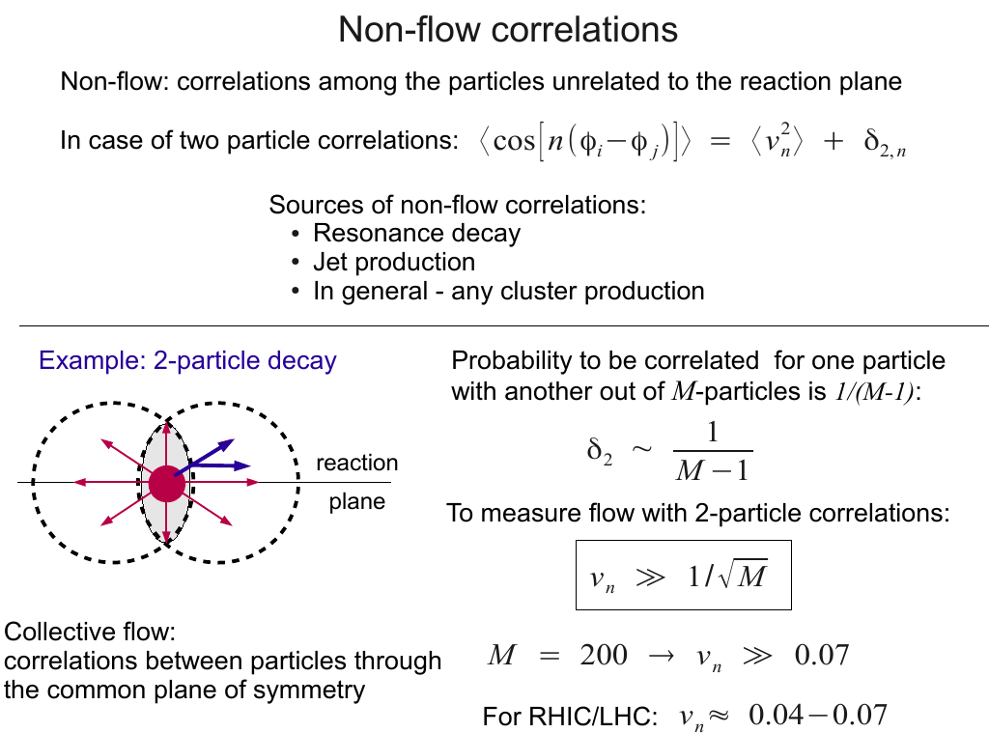

Slide 18
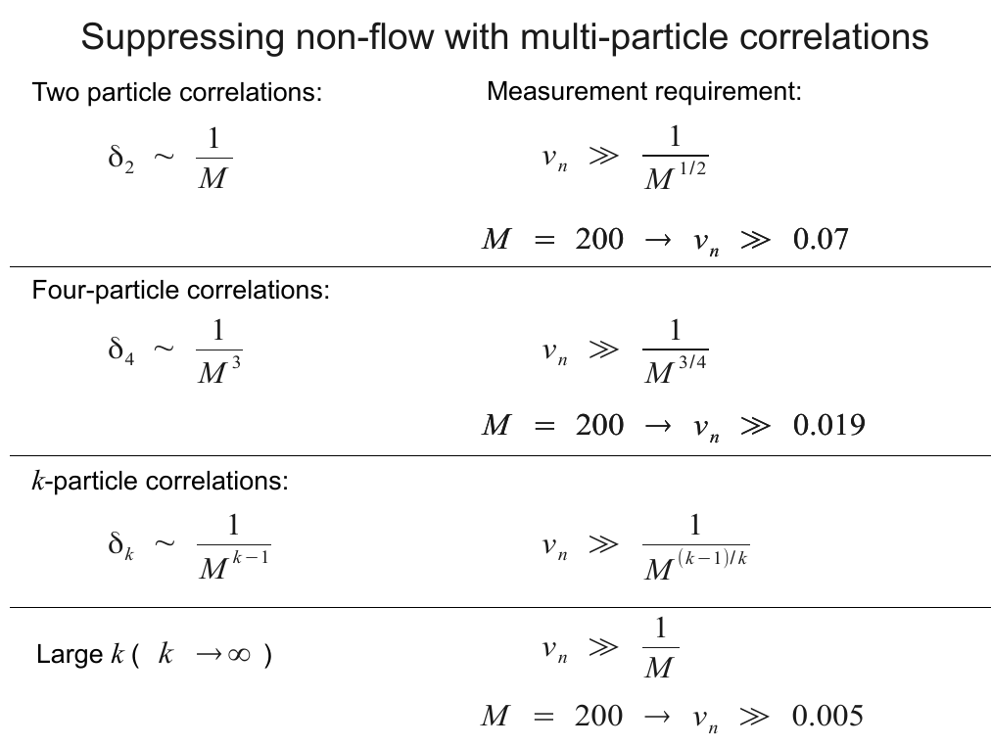

Slide 19
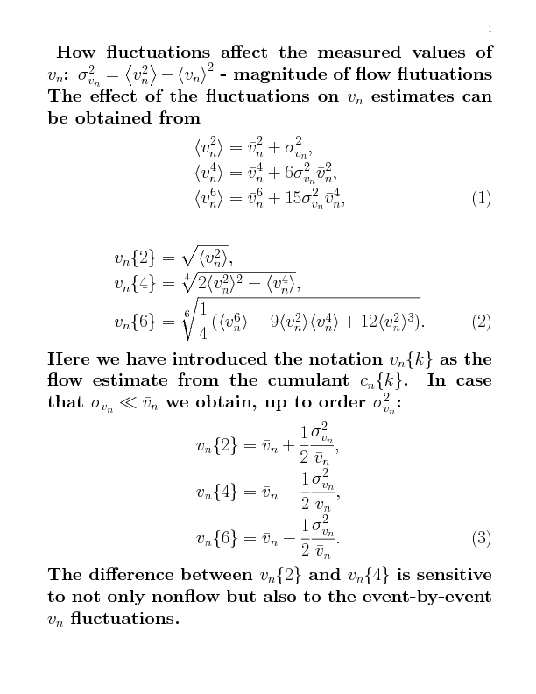
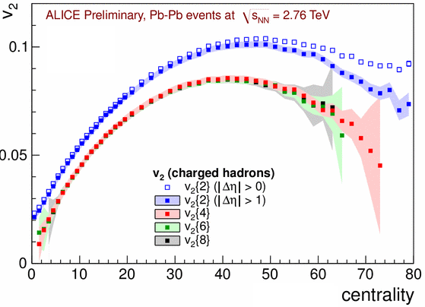
Elliptic flow from cumulants
The difference between v2{2} with and without η gap is driven by the contribution
from nonflow
The difference between 2- and multi-particle estimates is due to fluctuations
in the initial geometry
v2 {4} ≈ v2 {6} ≈ v2 {8}

Slide 20
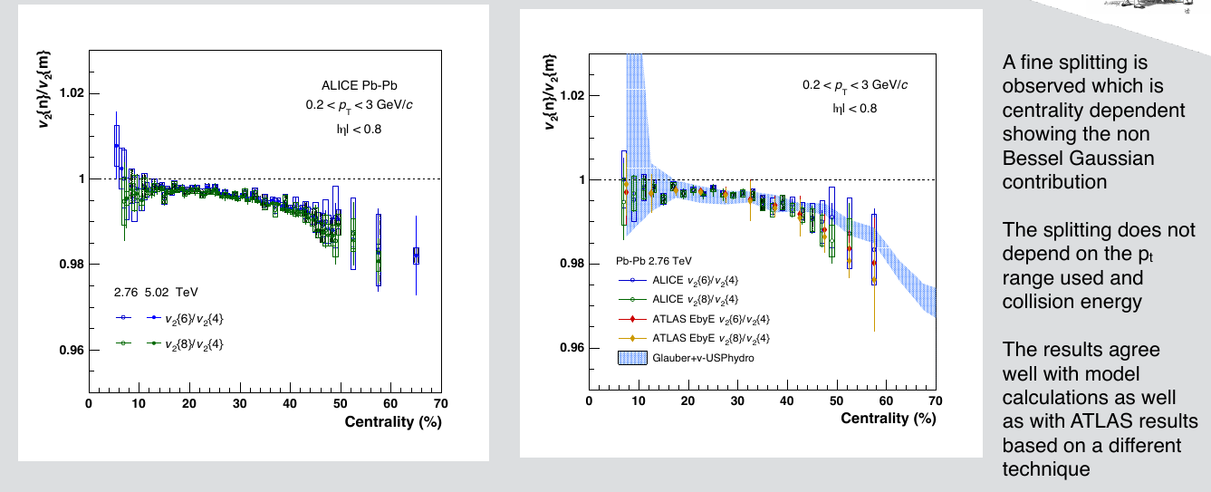

Slide 21
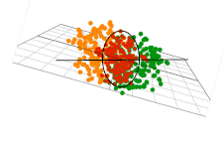
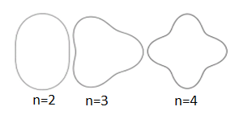

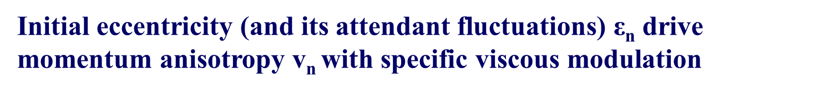
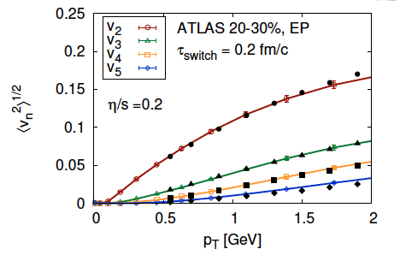
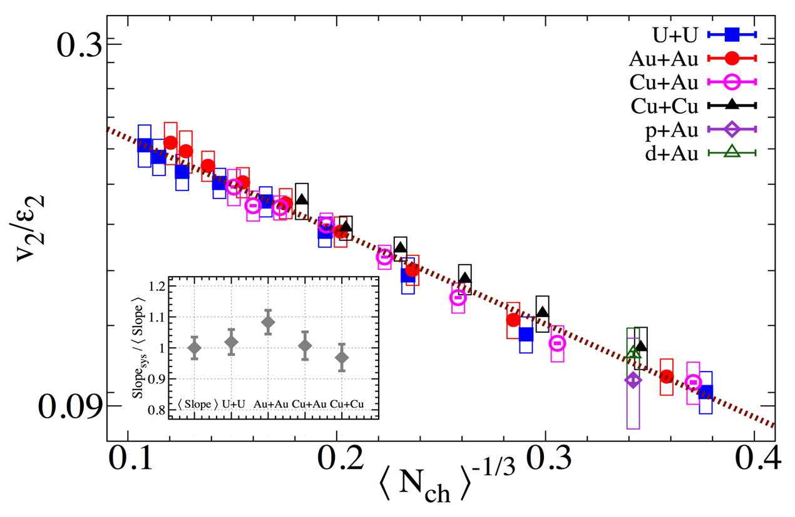
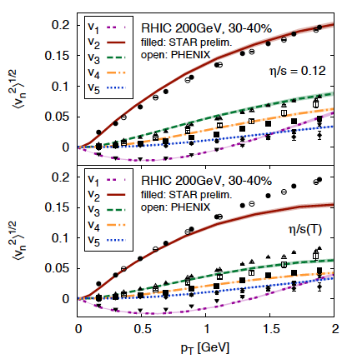
Anisotropic Flow at RHIC-LHC
Gale, Jeon, et al., Phys. Rev. Lett. 110, 012302
Phys. Rev. Lett. 122 (2019) 172301

Slide 22
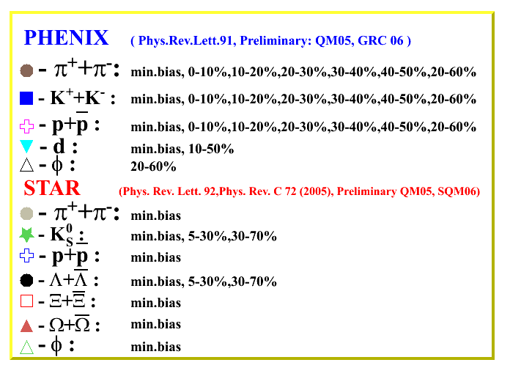
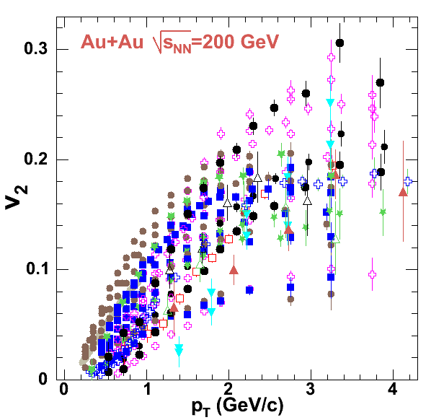
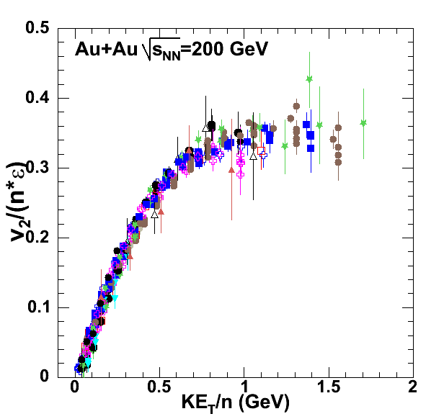
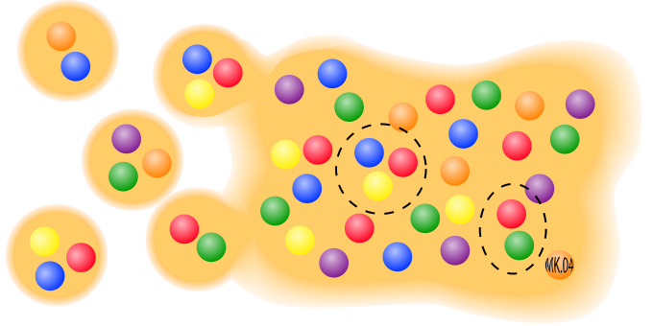

Anisotropic Flow at RHIC – scaling relations
= m_{T} – m
PoS 2006 (2006) 021
n=2 for mesons and n=3 for baryons

Slide 23

Evolution of the system created in RHIC/LHC
Fireball is ~10⁻¹⁵ meters across and lives for 5x10⁻²³ seconds
Initial state
QGP as a relativistic
fluid
Pre-equilibrium
dynamics
Hadronization
Transport/Freezeout
~20 fm/c
Time fm/c
0 fm/c
~1 fm/c
~10 fm/c
  Initial state (heavy Au+Au or Pb+Pb nuclei Lorentz contracted by ɣ~100 – RHIC, ɣ~ 1400 – LHC )
Pre-equilibrium state: hard parton scattering & jet production
Quark-gluon plasma formation: thermalization (viscous hydrodynamics)
Hadronization
Transport/Freeze-out: Rescattering & chemical freeze-out, Kinetic freeze-out (stop interacting)

Slide 24
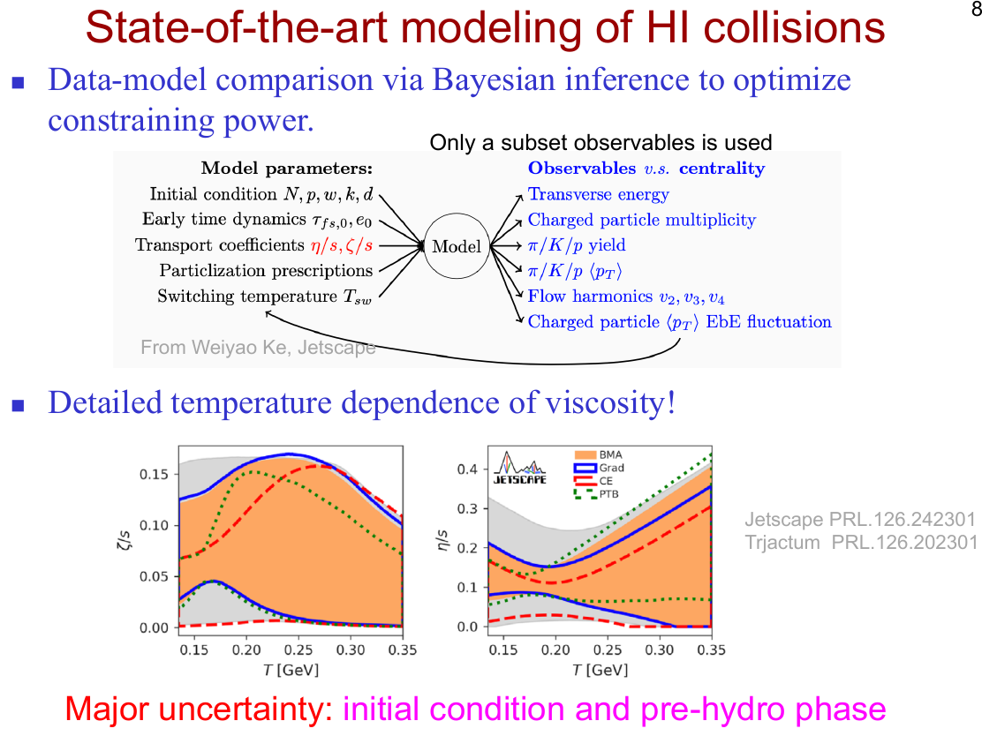

Slide 25

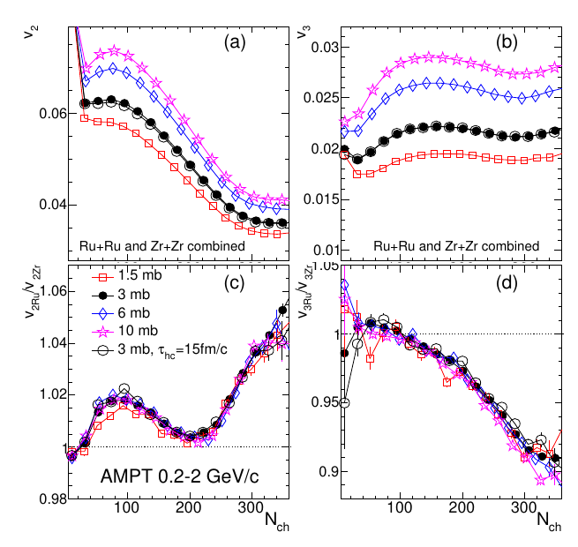
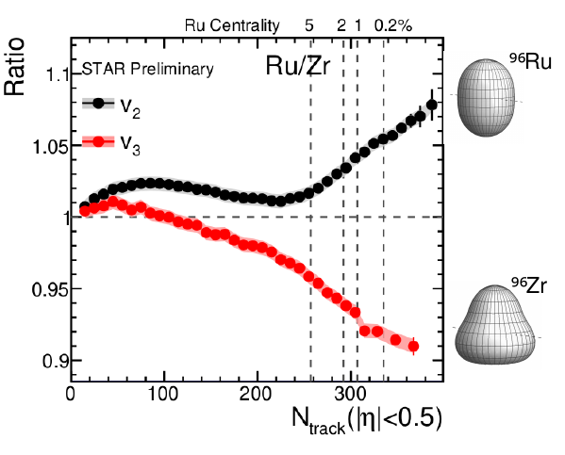
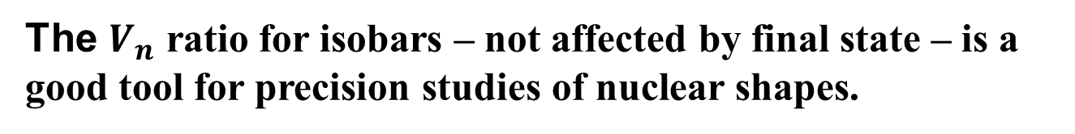
2022: Nuclear structure via $V_{n}$ ratio
Phys.Rev.C 105 (2022) 1, 014901 • e-Print: 2109.00131
The $V_{n}$ ratio for isobars – not affected by final state – is a good tool for precision studies of nuclear shapes.

Slide 26
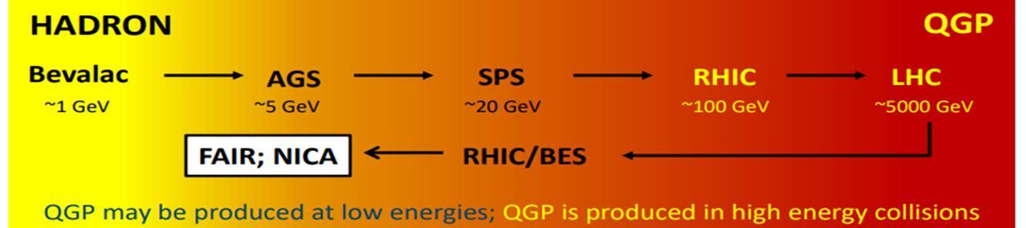
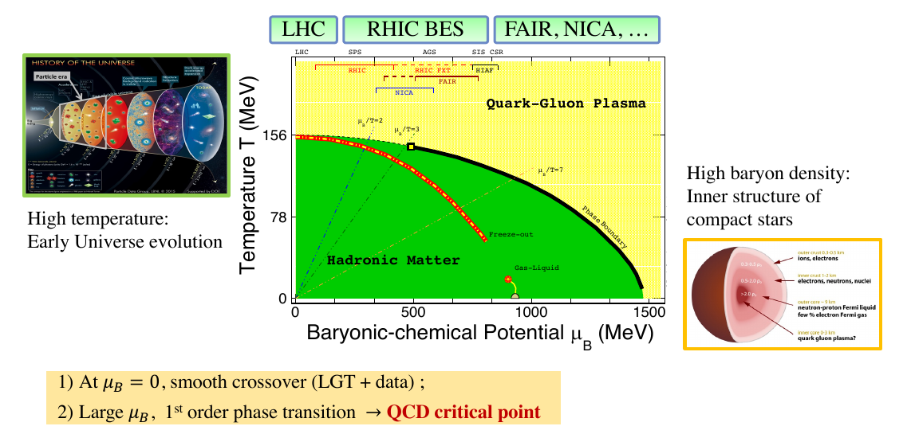
Relativistic Heavy-Ion Collisions and QCD Phase Diagram

Slide 27
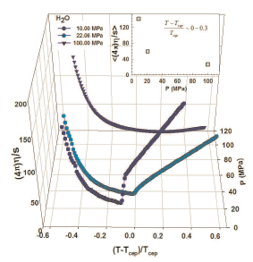
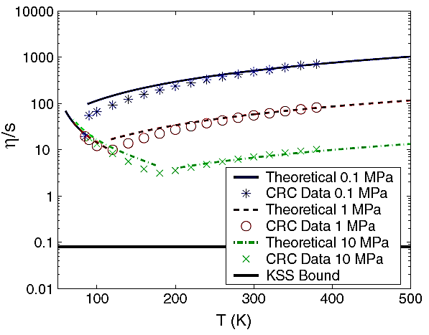
Possible signals for the CEP
Lacey et. al,
Phys. Rev.Lett. 98 (2007) 092301
arXiv:0708.3512 (2008)
Csernai et. al,
Phys.Rev.Lett. 97 (2006) 152303
A. Dobado et. al,
Phys. Rev. D 79, 014002 (2009)
H₂O
Argon
At the CEP or close to it, anomalies in the dynamic properties of the medium can drive abrupt changes in transport coeﬃcients
Anisotropic flow (v_{n}) measurements are an invaluable probe

Slide 28
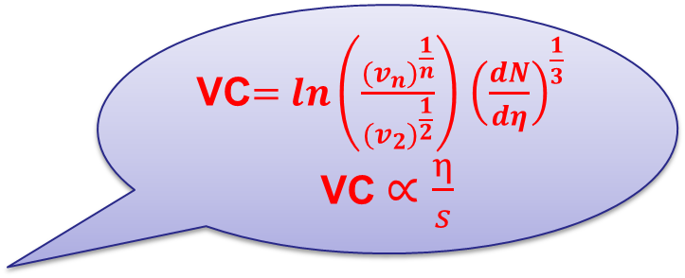
0.04
(a)
STAR Preliminary
Au+Au
0-40%
v₂/2
(b)
n = 3
0.3
v₃ v₄
STAR Preliminary
0.03
_{β}′ ′
0.2
v_{n}
0.02
0.01
0
0.1
10
100
10 100
√s_{NN}[GeV]
√s_{NN}[GeV]
V_{n} shows a monotonic increase with beam energy. The viscous coefficient, which encodes the transport coefficient (𝜼/𝒔), indicates a non-monotonic behavior as a function of beam energy.

Slide 29
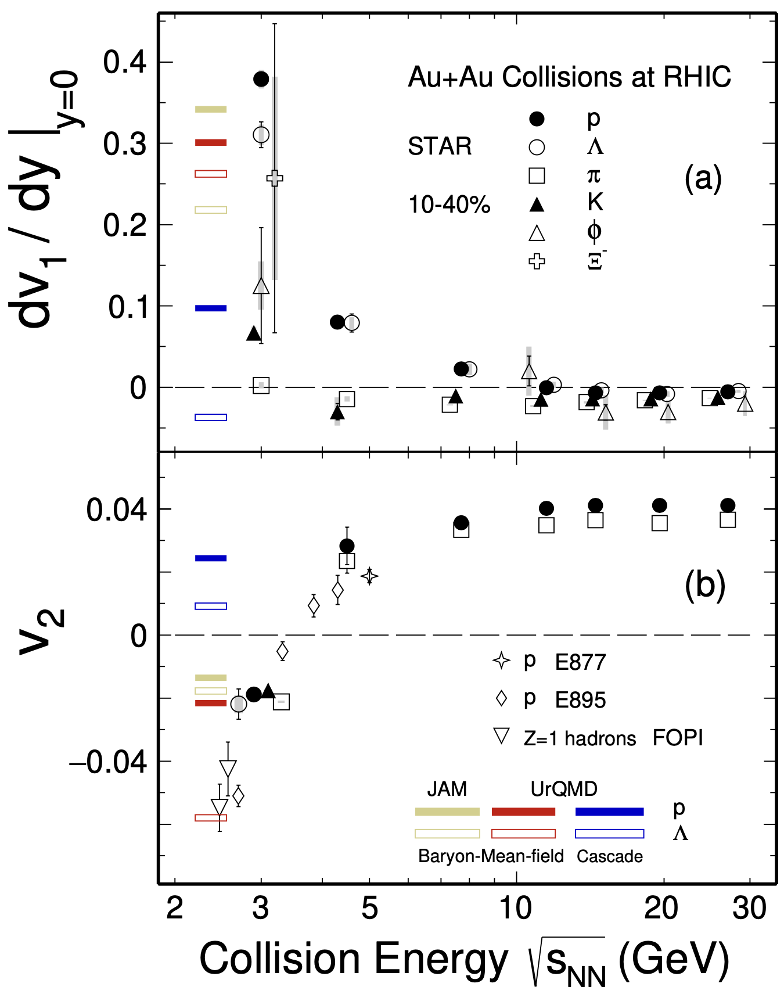




Anisotropic flow in Au+Au collisions at Nuclotron-NICA energies
M. Abdallah et al. STAR, Phys. Lett. B 827, 137003 (2022)
n]
BM@N
CBM
MPD
Anisotropic flow at FAIR/NICA energies is a delicate balance between:
The ability of pressure developed early in the reaction zone ($t_{exp}=R/{c_{s}}, c_{s}=c\sqrt{{dp}/{dε}}$) and
The passage time for removal of the shadowing by spectators ($t_{pass}={2R}/{γ_{CM}β_{CM}}$)

Slide 30




Elliptic Flow (v₂) at NICA energies: Models vs Data
at √s_{NN} ≥ 7.7 GeV pure string/hadronic cascade models underestimate v₂ – need hybrid models with QGP phase (vHLLE+UrQMD, AMPT with string melting,…)

Slide 31



Anisotropic Flow at Nuclotron/NICA energies: Models vs Data
Phys.Rev.C 103 (2021) 3, 034908
at √s_{NN} ≥ 3-4.5 GeV pure hadronic models give similar v₂ signal compared to STAR data

Slide 32

MPD Experiment at NICA
Bi+Bi: 50M at √s_{NN} = 9.2 GeV (prod. 25)
Centrality determination: Bayesian inversion method and MC-Glauber
Event plane determination: TPC, FHCal
Track selection:
  Primary tracks
  N_{TPC hits} ≥ 16
  0.2 < p_{T} < 3.0 GeV/c
  |η| < 1.5
  PID – ToF + dE/dx
Multi-Purpose Detector (MPD) Stage 1
See Peter Parfenov presentation at MPD Collaboration meeting

Slide 33



Performance of v_{1,2} of identified hadrons in MPD
UrQMD, Bi+Bi, $\sqrt{s_{NN}}$=9.2, 10-40%, reconstructed (GEANT4) – production 25
Reconstructed and generated $v_{1,2}$ of identified hadrons have a good agreement for all methods

Slide 34



The BM@N experiment (GEANT4 simulations for Xe+Cs(I) run )
FHCal
F3
Q{F2}
Q{F3}
Silicon + GEM
F2
TOF-700
F1
Q{F1}
TOF-400
Good agreement between reconstructed directed and elliptic flow of protons and pure model data
Notes:
Схема эксперимента хадес на слайде.
Траектории рожденных частиц регистристрируются трекинговой системой, состоящей из …
Импульс восстанавливается по отклонению частиц в магнитном поле
Идентификация производится при помощи детекторов времени пролета … которые регистрируют время пролета. Зная длину траектории можно вычислить массу частицы.
Спектаторы регистрируются детектором FW. Поскольку они отклоняются в плоскости реакции материей в области перекрытия, спектаторы используются для оценки угла плоскости реакции.
Всего столько статистики ...

Slide 35



BM@N (Baryonic Matter @ Nuclotron)
December 2022 – February 2023: first physics run with Xe+Cs(I) (3.0 AGeV (50 M events) и 3.8 AGeV (500 M events))

Slide 36
Collective Flow in Heavy-Ion Collisions: Summary
  Anisotropic Collective Flow is an important experimental observable to study the evolution of heavy-ion collision and properties of the strongly interacting matter.
  It provides access to:
  Equation of State of the produced matter
  Transport properties: shear/bulk viscosity, speed of sound
  Initial conditions in heavy-ion collisions
  Mechanism of hadronization
  Origin of the correlations between produced particles
  Feasibility study: MPD/MPD FXT/BM@N: will provide the detailed differential measurements of anisotropic collective flow with high efﬁciency.
36
Notes:
36
36
36
36
36
36
36
36

Slide 37
  Backup slides
37
Notes:
37
37
37
37
37
37
37
37

Slide 38



Azimuthal distributions at RHIC
b ≈ 6.5 fm
b ≈ 4 fm
“central” collisions
STAR, PRL90 032301 (2003)
midcentral collisions

Slide 39

Azimuthal distributions at RHIC
b ≈ 10 fm
b ≈ 6.5 fm
b ≈ 4 fm
peripheral collisions

Slide 40


2022: Imaging the initial condition of heavy-ion collisions and nuclear structure across the nuclide chart
The extraction of the properties of the QGP, is currently limited by our poor knowledge of the initial condition, in particular how it is shaped from the colliding nuclei
To exploit collisions of selected species to precisely assess how the initial condition changes under variations of the structure of the colliding ions. (https://arxiv.org/abs/2209.11042)

Slide 41

STAR BES-I and BES-II Data Sets

Slide 42
Possible signals for the CEP
Lacey et. al,
Phys. Rev.Lett. 98 (2007) 092301
arXiv:0708.3512 (2008)
Csernai et. al,
Phys.Rev.Lett. 97 (2006) 152303
A. Dobado et. al,
Phys. Rev. D 79, 014002 (2009)
H₂O
Argon
At the CEP or close to it, anomalies in the dynamic properties of the medium can drive abrupt changes in transport coeﬃcients
Anisotropic flow (v_{n}) measurements are an invaluable probe

Slide 43
0.04
(a)
STAR Preliminary
Au+Au
0-40%
v₂/2
(b)
n = 3
0.3
v₃ v₄
STAR Preliminary
0.03
_{β}′ ′
0.2
v_{n}
0.02
0.01
0
0.1
10
100
10 100
√s_{NN}[GeV]
√s_{NN}[GeV]
V_{n} shows a monotonic increase with beam energy. The viscous coefficient, which encodes the transport coefficient (𝜼/𝒔), indicates a non-monotonic behavior as a function of beam energy.

