Slide 1

Heavy Ion Physics
NICA Days, Belgrade
October 2-3, 2023
Itzhak Tserruya

Slide 2
Outline
LECTURE I
Introduction
  Why?
  QCD phase diagram
  Deconfinement and Chiral symmetry Restoration
  When and where?
  Centrality, Glauber model
  Nuclear modification factor
  Physics Menu
LECTURE II
Dileptons
  Motivation
  Challenges of measurement
  SPS results: CERES, NA60
  RHIC results: PHENIX, STAR
  Prospects

Slide 3
Introduction

Slide 4
Relativistic Heavy-Ion Collisisons: Why?
Simple argument: confinement of quarks inside hadrons cannot survive when the density of hadrons is large compared to that inside ordinary hadrons.

Slide 5
Nuclear matter
Normal nuclear matter density:
ρ = A / V_{N} V_{N} = 4/3 π R³ R = r₀A^{1/3} r₀ ~ 1.15 fm
= 0.16 nucleon/fm³
Normal nuclear matter energy density:
ε = Am_{n} / V_{N} m_{n} =0.94 GeV
= 0.15 GeV/fm³
What does this mean in terms of compactness of the nucleus? Fraction of the nuclear volume occupied by nucleons:
f = Av_{n}/V_{N} v_{n} = 4/3 π r_{n}³ r_{n} ~ 0.84 fm (charge radius of the proton)
~ 0.38
  ~60% of the nuclear volume is empty!
Close packing condition f =1:
ρ ~ 0.4 nucleon/fm³
QGP expected at a density ~10 times larger than the normal nuclear matter density:
ε ~ 2 GeV/fm³

Slide 6
Relativistic Heavy-Ion Collisisons: Why?
Simple argument: confinement of quarks inside hadrons cannot survive when the density of hadrons is large compared to that inside ordinary hadrons.
QGP: Primordial state of matter, existed in the early universe some ten microseconds after the big bang.

Slide 7
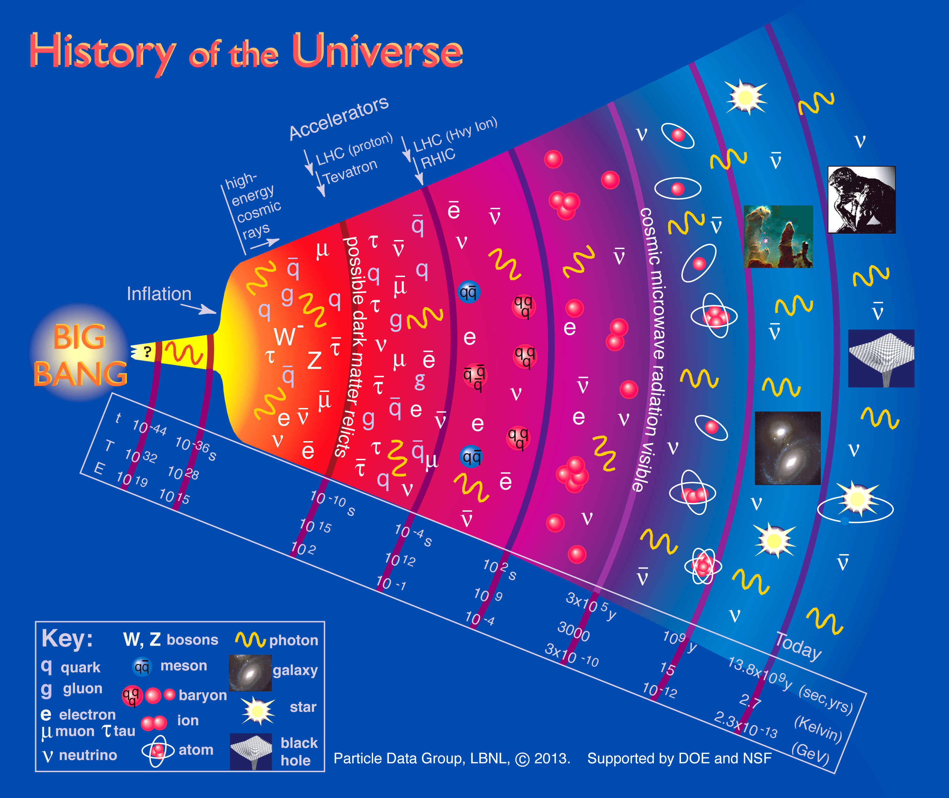
History of the Universe
Some ~10 µs after the Big Bang matter characterized by:
Temperature ~170 MeV (2.10¹² K) and density ~1 GeV/fm³ (10¹⁵ g/cm³)

Slide 8
Relativistic Heavy-Ion Collisisons: Why?
Simple argument: confinement of quarks inside hadrons cannot survive when the density of hadrons is large compared to that inside ordinary hadrons.
QGP: Primordial state of matter, existed in the early universe some ten microseconds after the big bang.
Study QCD under extreme conditions of temperature and density → Explore the QCD phase diagram, search for the QGP and study its properties.

Slide 9
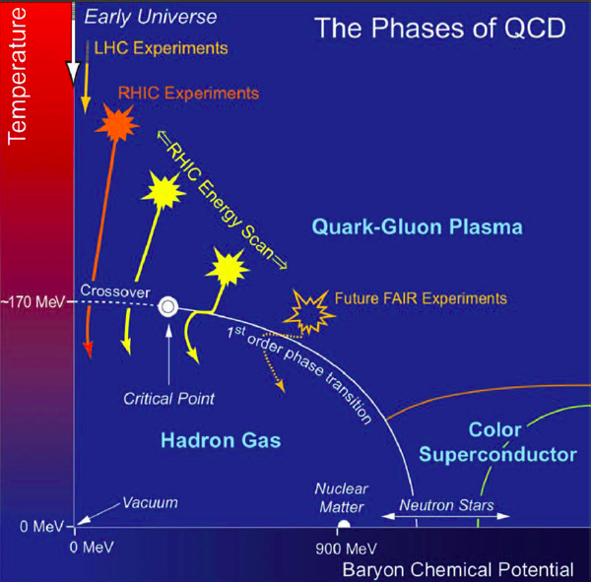
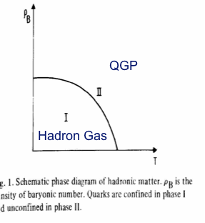
QCD Phase Diagram then and now
First schematic QCD phase diagram
Cabbibo and Parisi, PLB 59 (1975) 67
T
FAIR & NICA
ρ

Slide 10
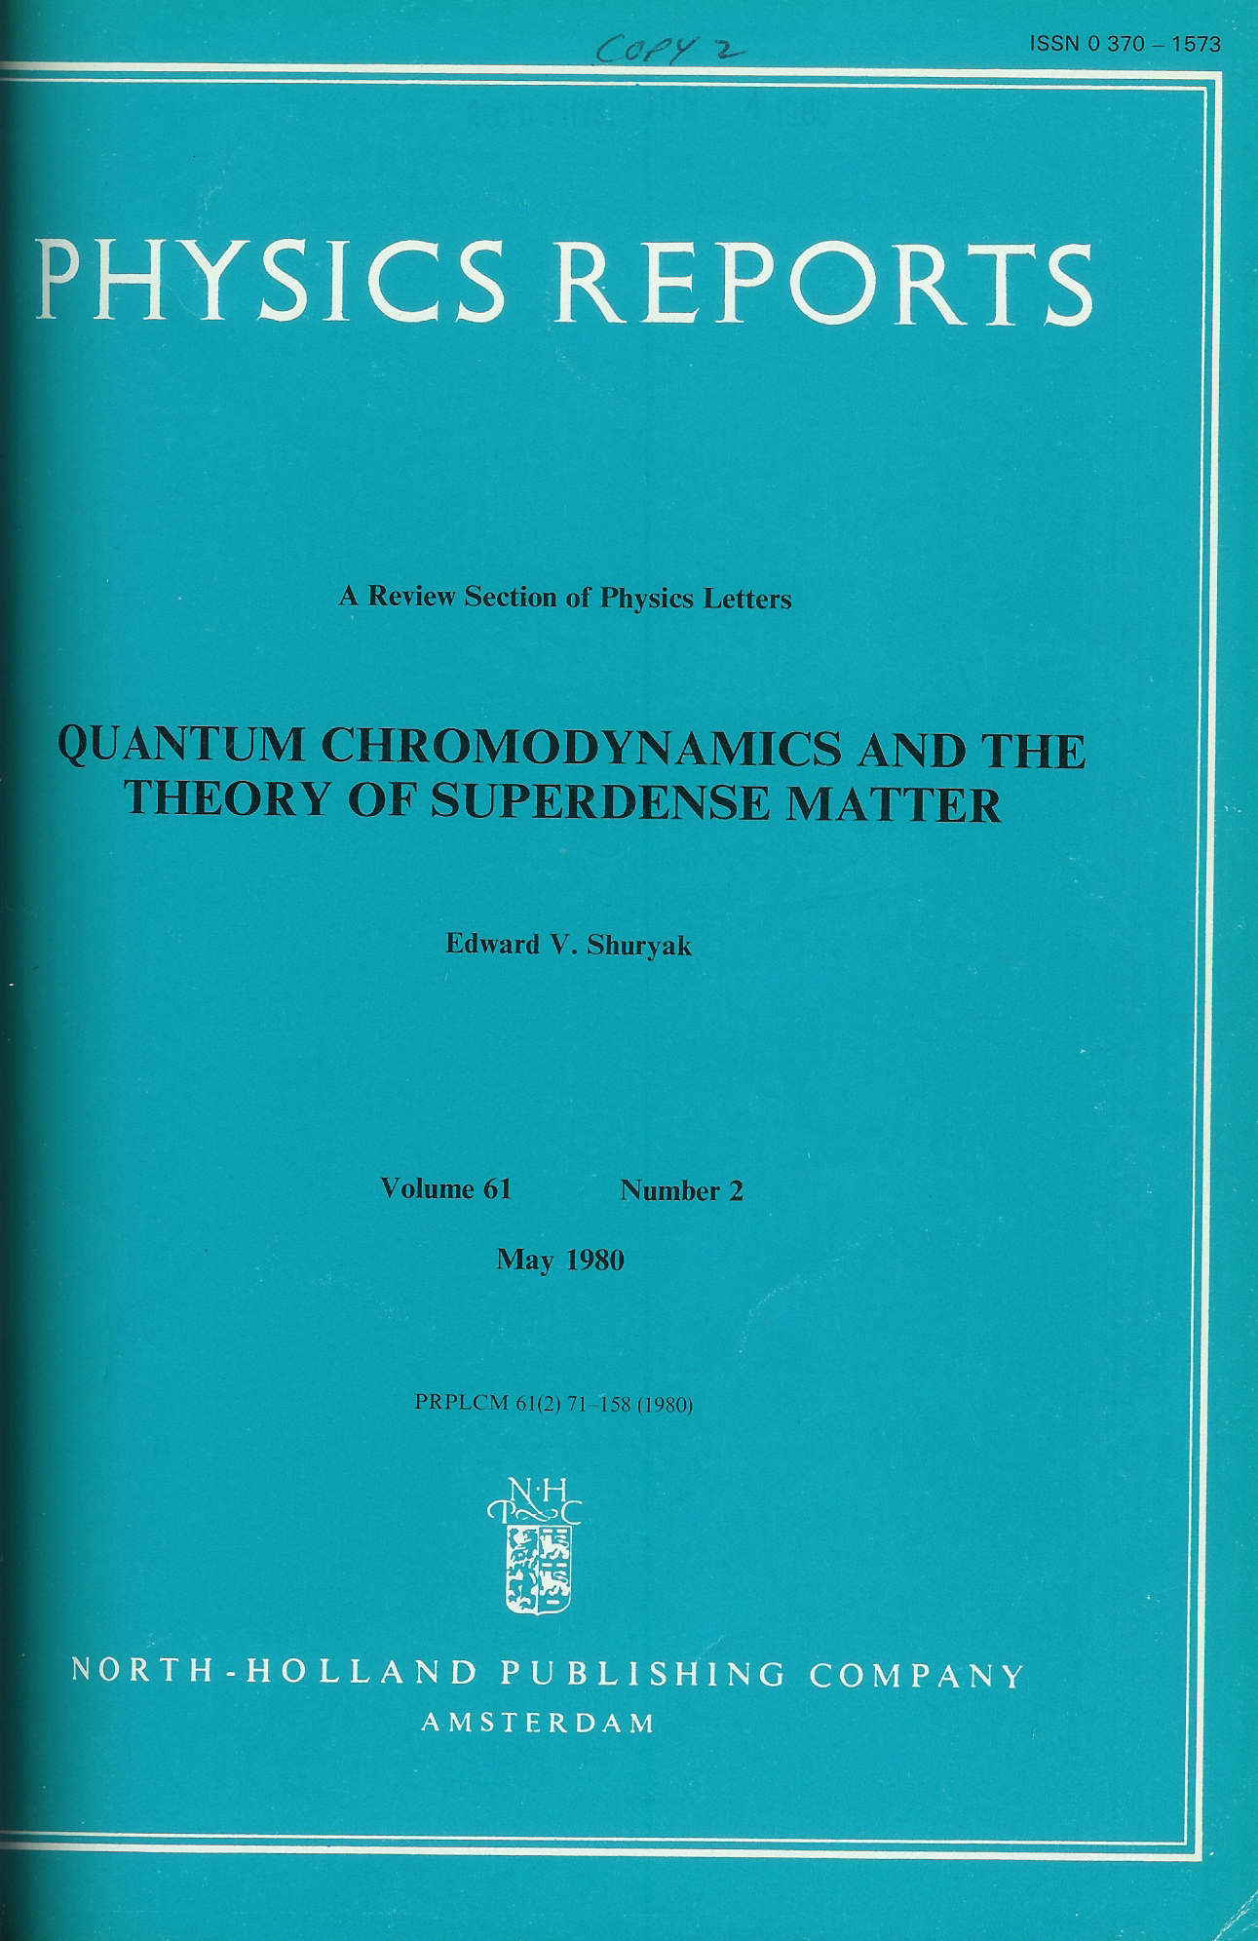
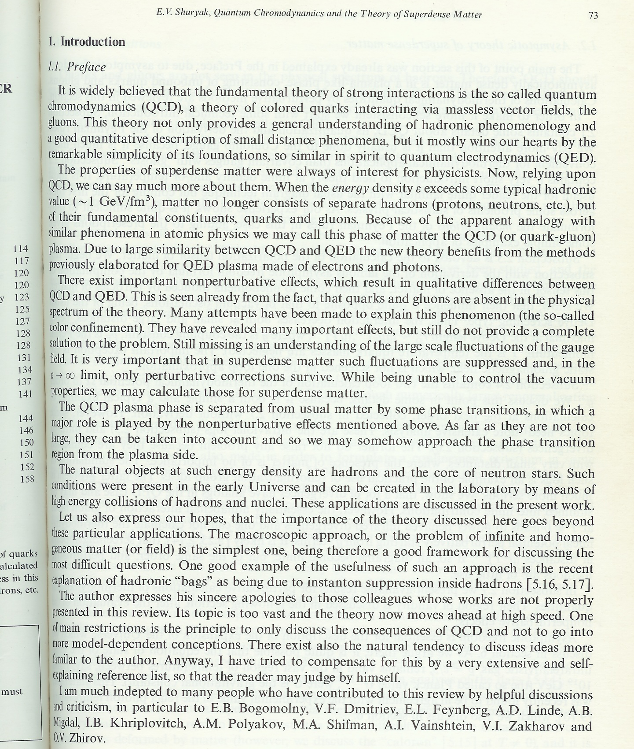
Coining of a name
Ed Shuryak - Physics Reports 1980
First review on QCD at extreme density conditions
“Because of the apparent
analogy with similar
phenomena in atomic
physics, we may call this
phase of matter the QCD
(or quark-gluon) plasma.”

Slide 11
Relativistic Heavy-Ion Collisisons: Why?
Simple argument: confinement of quarks inside hadrons cannot survive when the density of hadrons is large compared to that inside ordinary hadrons.
Primordial state of matter: existed in the early universe some ten of microseconds after the big bang.
Study QCD under extreme conditions of temperature and density → Explore the QCD phase diagram, search for the QGP and study its properties.
QGP predicted by numerical lattice QCD calculations.

Slide 12
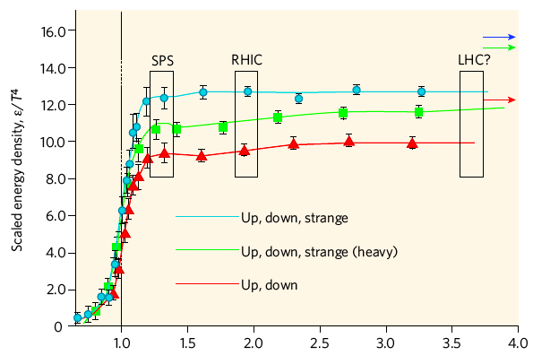
LQCD key result
  The QGP is predicted by numerical calculations of QCD on the lattice.
SB limit
PLB 478, 447 (2000)
T / T_{c}
Recent LQCD calculations show that the critical temperature is:
T_{c} (at μ_{B} = 0) = 156.5 $±$1.5 MeV
Bazavov et al., PLB 795,15 (2019)

Slide 13
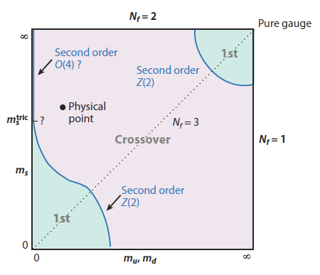
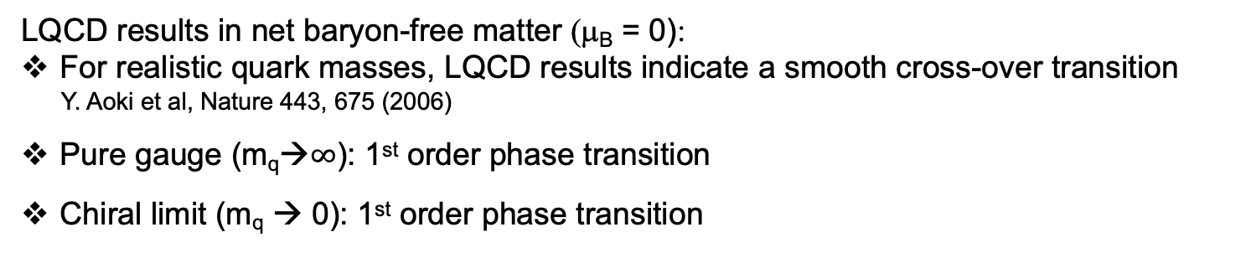
Order of the transition?
LQCD results in net baryon-free matter (μ_{B} = 0):
For realistic quark masses, LQCD results indicate a smooth cross-over transition
Y. Aoki et al, Nature 443, 675 (2006)
Pure gauge (m_{q}→$∞$): 1st order phase transition
Chiral limit (m_{q} → 0): 1st order phase transition

Slide 14
Hagedorn temperature: Limiting temperature of a hadronic system
Strong hint (prior to QCD): the concept of hadronic matter breaks down above a certain temperature (Hagedorn and Pomeranchuk 1965-68)
Hadronic states rapidly increase with mass. At large m the density of states grows exponentially:
with T_{H} ~ 170 MeV
Hagedorn originally interpreted T_{H} as the highest possible T of a hadronic system

Slide 15
Relativistic Heavy-Ion Collisisons: Why?
Simple argument: confinement of quarks inside hadrons cannot survive when the density of hadrons is large compared to that inside ordinary hadrons.
Primordial state of matter: existed in the early universe some ten of microseconds after the big bang.
Study QCD under extreme conditions of temperature and density → Explore the QCD phase diagram, search for the QGP and study its properties.
QGP predicted by numerical lattice QCD calculations.
Fundamental characteristics of the QGP:
  Deconfinement
  Chiral symmetry restoration

Slide 16
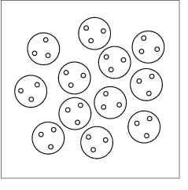
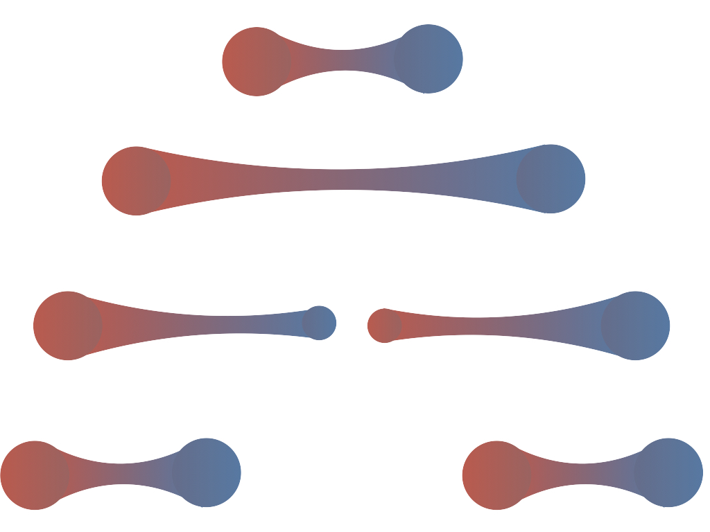

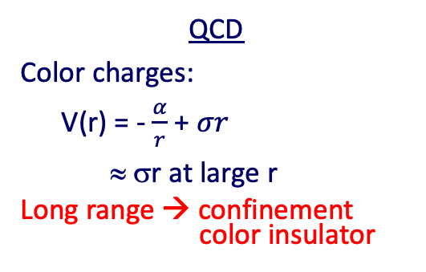
Deconfinement and Chiral Symmetry Restoration
QCD
Color charges:
V(r) = - $\frac{α}{r}$ + $σr$
≈ σr at large r
Long range → confinement
color insulator
QED
Electric charges:
HIGH DENSITY
V(r) ≈ σ/µ [ 1 - exp (-μr) ]
Screening → Deconfinement
color conductor
µ = 1/ r_{D}
r_{D} Debye screening radius
Partons free to move over a volume >> hadron size.

Slide 17
Screening in the QGP

Slide 18
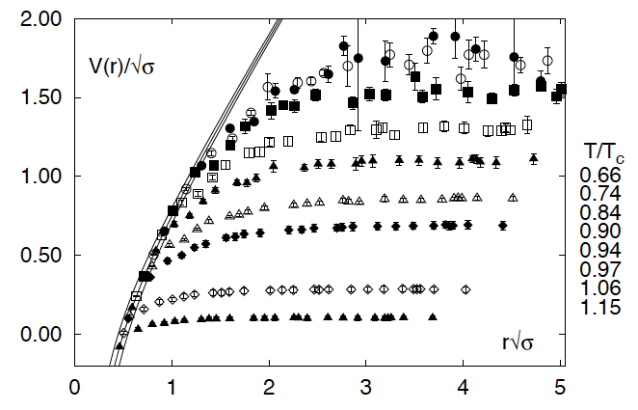
Screening in LQCD
The long-range confining potential is screened as the temperature increases
hep-ph/0103314 NP A698, 199 (2002)

Slide 19
Deconfinement and Chiral Symmetry Restoration
QCD
Color charges:
V(r) = - $\frac{α}{r}$ + $σr$
≈ σr at large r
Long range → confinement
color insulator
QED
Electric charges:
HIGH DENSITY
V(r) ≈ σ/µ [ 1 - exp (-μr) ]
Screening → Deconfinement
color conductor
µ = 1/ r_{D}
r_{D} Debye screening radius
Partons free to move over a volume >> hadron size.
Constituent mass M_{q} ∼ 300 MeV
Current mass m_{q}∼ 5-10 MeV
m_{e} → m_{eff}
Chiral Symmetry (app.) restored

Slide 20
QGP: How, When and Where

Slide 21
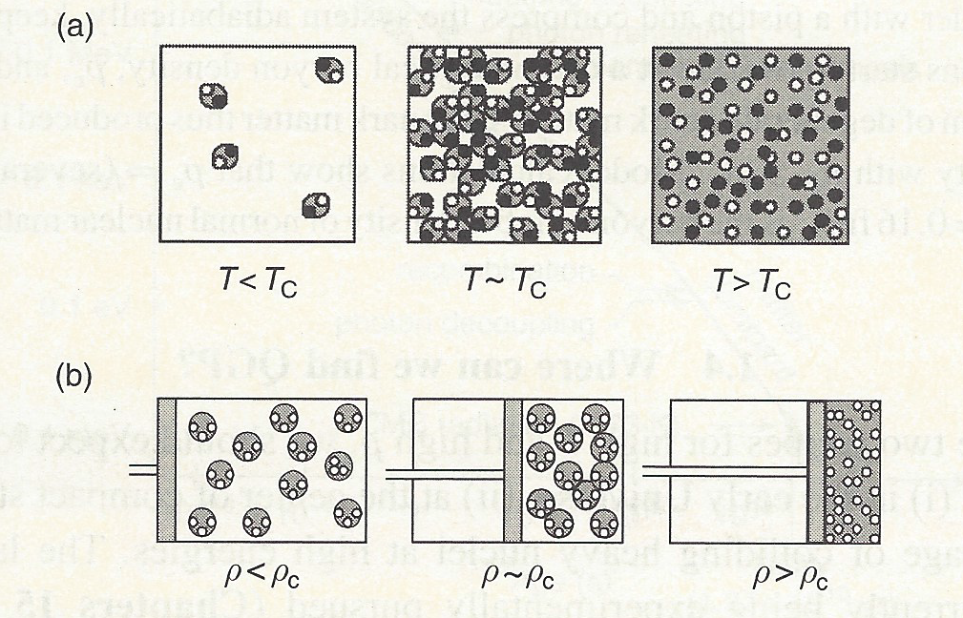
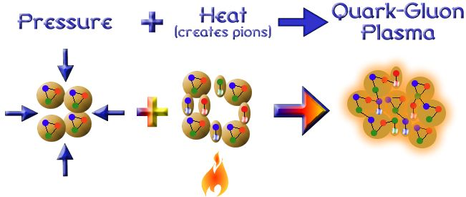
Quark Matter formation
Two recipes:
(a) at high T - Early universe
(b) at high baryon density – Neutron stars
Relativistic heavy ion collisions - A combination of the two recipes
Notes:
).

Slide 22
When and where
Short heavy-ion physics history
BEVALAC – LBNL 1972-1984 max. √s_{NN} = 2.2 GeV
SPS – CERN 1986-2000 √s_{NN} = 17.3 GeV
AGS – BNL 1988-1996 √s_{NN} = 4.8 GeV
SIS18 – GSI 1990 → √s_{NN} = 2.4 GeV
RHIC – BNL 2000-2025 √s_{NN} = 200 GeV
LHC – CERN 2010 → √s_{NN} = 5.02 TeV
NA35/49, NA44, NA38/50/51, NA45, NA52, NA57, NA60, WA80/98, WA97 …
Fixed target
E864/941, E802/859/866/917, E814/877, E858/878, E810/891, E896, E910 …
BRAHMS, PHENIX, PHOBOS, STAR
Collider
ALICE, ATLAS, CMS, LHCb
Near future
NICA – JINR 2024 √s_{NN} = 11 GeV
SIS100 – FAIR 2028? √s_{NN} = 5 GeV
Collider &
Fixed target
MPD, BM@N
CBM, HADES
Fixed target

Slide 23
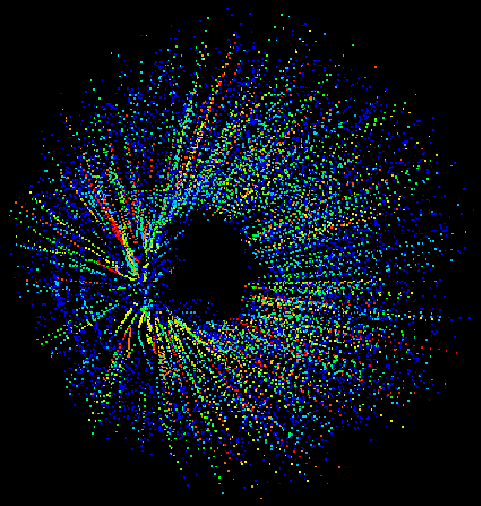
Spectacular events
Fixed target
CERES @ SPS
Pb – Au √s_{NN} = 17 GeV/c

Slide 24
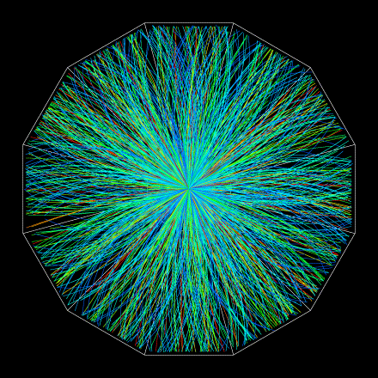
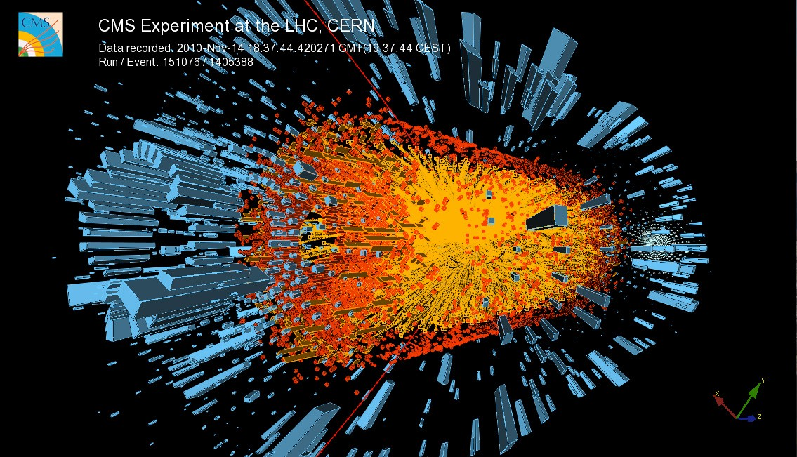
Spectacular events
Collider
STAR @ RHIC
Au+Au √s_{NN} = 200 GeV/c
CMS @ LHC
Pb+Pb √s_{NN} = 2.76 TeV/c

Slide 25
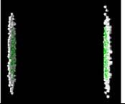
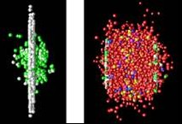
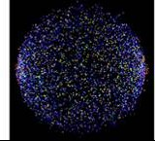
Collision simulation
Approach Phase
Collision
Passing through
After the collision
The ions are flat (instead of their usual spherical shape) due to Lorentz contraction.
The ions smash into one another and pass through each other. A large fraction of their initial energy is transformed into heat and new particles, forming eventually a QGP
Thousands of particles form as the area cools off. They are the clue to what happened inside the collision zone.

Slide 26
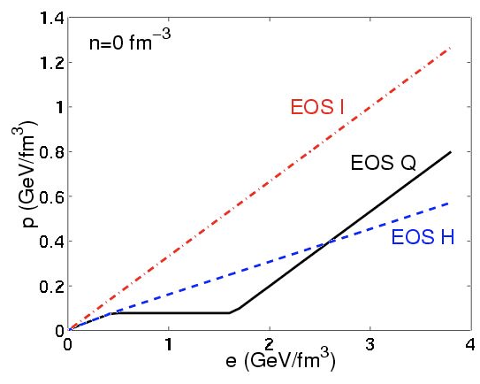
Collision Modeling
Three stages:
Initial conditions – Geometry
(Glauber, Gluon saturation, CGC)
Dynamical evolution – Hydro
Equation of state
Viscosity
Hadronization and Freezeout
Ideal gas (ε = 3p)
QGP
Typical hydro EoS
(Kolb, Heinz 2003)
Hadronic

Slide 27
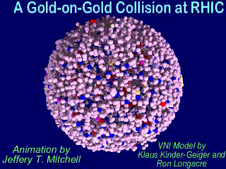
Collision simulation (II)

Slide 28
Geometry

Slide 29
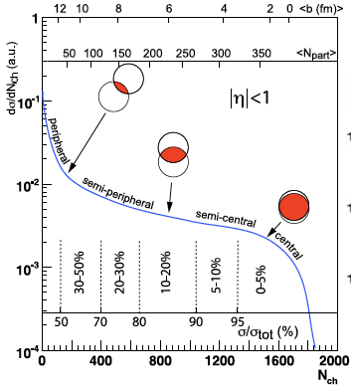
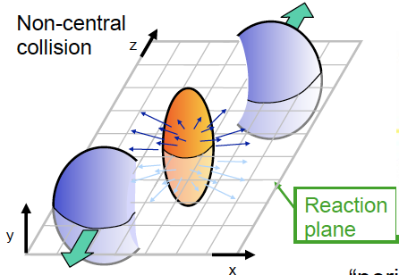
Geometry of Heavy-Ion Collisions
Collisions are not all the same
Spectators
Participants
Spectators
b
N_{participants}: number of nucleons in the overlap region
N_{collisions}: number of inelastic nucleon-nucleon collisions
Reaction plane: defined by beam axis and impact parameter
Centrality: percentile of the total cross section

Slide 30
Methodology
Impact parameter b, number of participating nucleons N_{part}, number of NN collisions N_{coll} are not directly measurable.
Experiments developed techniques based on the Monte Carlo Glauber model for determining <N_{part}> and <N_{coll}> as function of impact parameter.
RHIC centrality paper: Ann. Rev. Nucl. Part. Sci. 57, 205 (2007)
ALICE centrality paper: Phys. Rev. C88, 044909 (2013)
Since there is a monotonic connection between b and cross section, b is often expressed in terms of centrality i.e. percentiles of the cross section.
Centrality is used to relate experimental observables to the averages <N_{part}> and <N_{coll}> determined from the Monte Carlo Glauber calculations.
This procedure is essential to distinguish:
    Soft physics (large cross sections) ⍺ N_{part}
    Hard physics (small cross sections) ⍺ N_{coll}

Slide 31
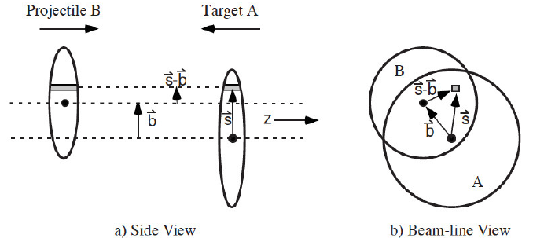
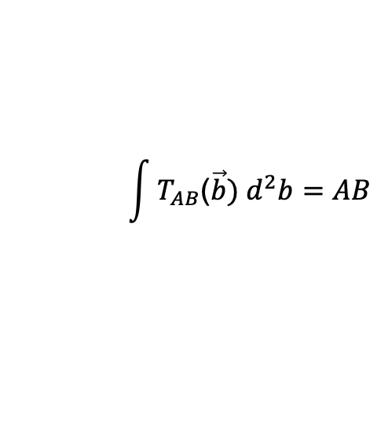
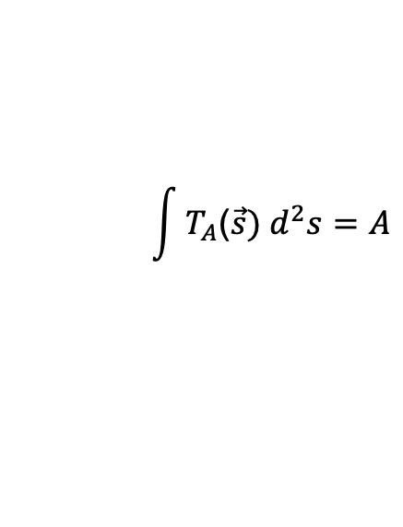

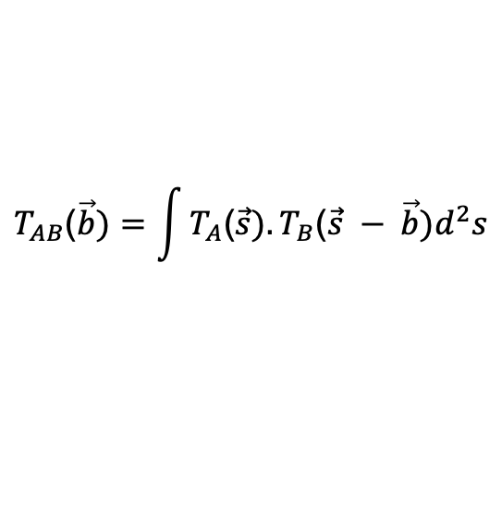
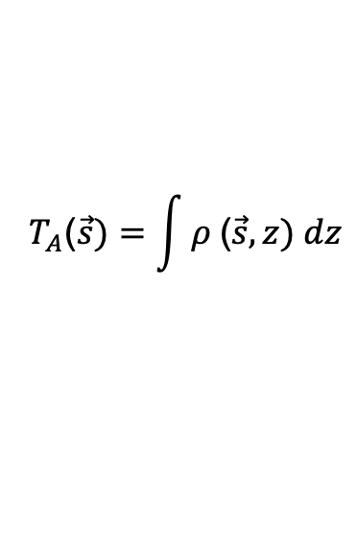
Analytic Glauber model
Applied to pA or AA collisions:
Assumptions: nucleons move in straight line trajectories
treat collisions as independent NN collisions
$$T_{A}\text{(}\vec{s})=\int{ρ \text{(}\vec{s}, z) dz}$$
$$\int{T_{A}\text{(}\vec{s}) d^{2}s=A}$$
Define nuclear thickness:
Normalization:
Nuclear overlap function:
$$T_{AB}\text{(}\vec{b})=\int{T_{A}\text{(}\vec{s}).T_{B}\text{(}\vec{s} − \vec{b})d^{2}s}$$
$$\int{T_{AB}\text{(}\vec{b}) d^{2}b=AB}$$
Number of collisions: $N_{coll}\left(\vec{b}\right)={ T}_{AB}{\left(\vec{b}\right) σ}_{NN}$

Slide 32

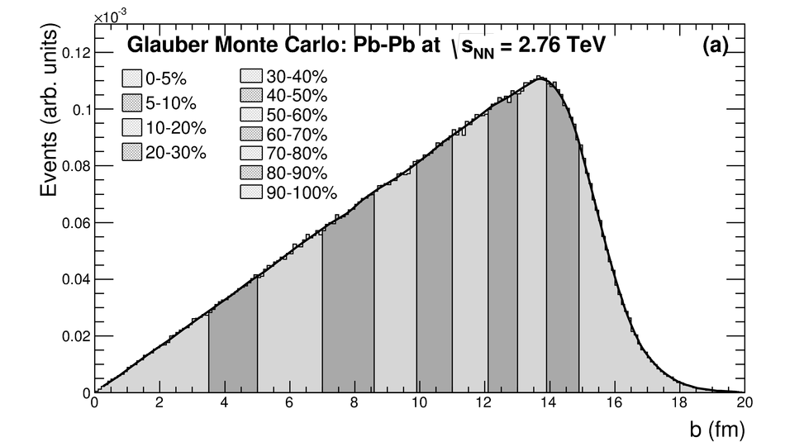
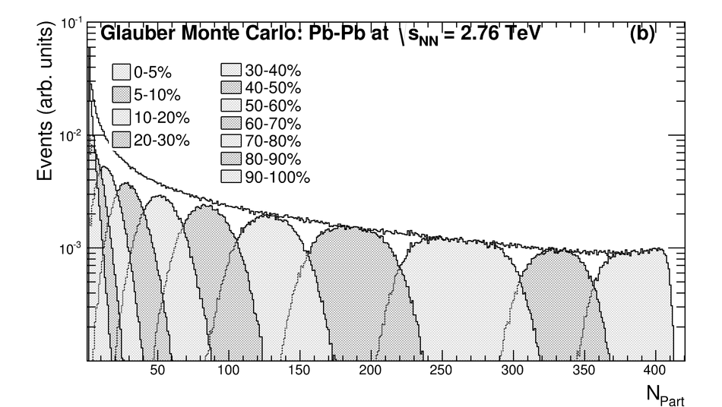
Monte Carlo Glauber Model
Virtues of MC Glauber approach (over analytic Glauber calculations):
simplicity and takes care of fluctuations.
MC-Glauber model calculations proceed as follows:
An impact parameter b for the collision is selected randomly from the geometrical distribution:
dP/db α dσ/db α b (up to a maximum b_{max} > 2R)
(ii) The position of the nucleons in the colliding nuclei are determined randomly following the nuclear density function ρ (r), modeled by a Woods-Saxon distribution:
(iii) Assume:
  nucleons travel on straight-line trajectories
  inelastic NN cross section, σ_{NN}, to be independent of the number of collisions a nucleon underwent previously, i.e. same cross section is used for all successive collisions.
(iv) Two nucleons from different nuclei collide if the relative transverse distance between their centers is less than: d < √σ_{NN}/π
The nucleons are tagged as having interacted, and the registers keeping track of N_{part}, and N_{coll} N are updated.
Impact parameter distribution: dN/db α b
ρ₀ normal nuclear density
R Radius of the nucleus
a Diffuseness or skin thickness of the nucleus

Slide 33
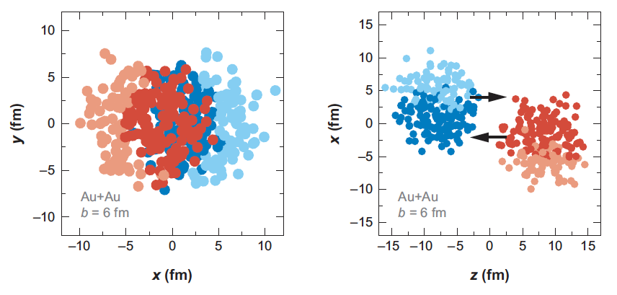
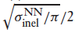
MC Glauber event
Au+Au at √s_{NN} = 200 GeV b = 6 fm
Transverse plane
Along the beam axis
The nucleons are drawn with radius
Darker circles represent participating nucleons

Slide 34
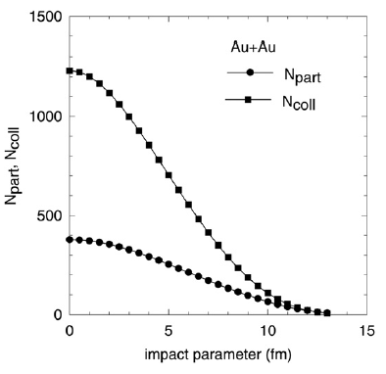
<N_{part}> and <N_{coll}>
√s_{NN}= 200 GeV Au+Au collision
Inelastic NN cross section σ_{NN} = 42 mb
a = 0.53 fm R_{Au} = 6.38 fm

Slide 35
Nuclear Modification Factor

Slide 36
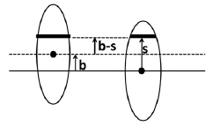


Nuclear modification factor
Rare processes should scale with N_{coll}
(small σ → no shadowing → N_{coll} is relevant quantity)
Zero effect hypothesis for hard processes: scale pp to AA with N_{coll}:
d²N_{AA}/dp_{T}dη (b) = N_{coll}(b) d²N_{pp} /dp_{T}dη = T_{AA}(b) σ_{pp} d²N_{pp} /dp_{T}dη
?
Nuclear overlap function:
$N$_{coll}(b) = T_{AA}(b)σ_{pp}
Quantify “effect” with nuclear modification factor:

Slide 37
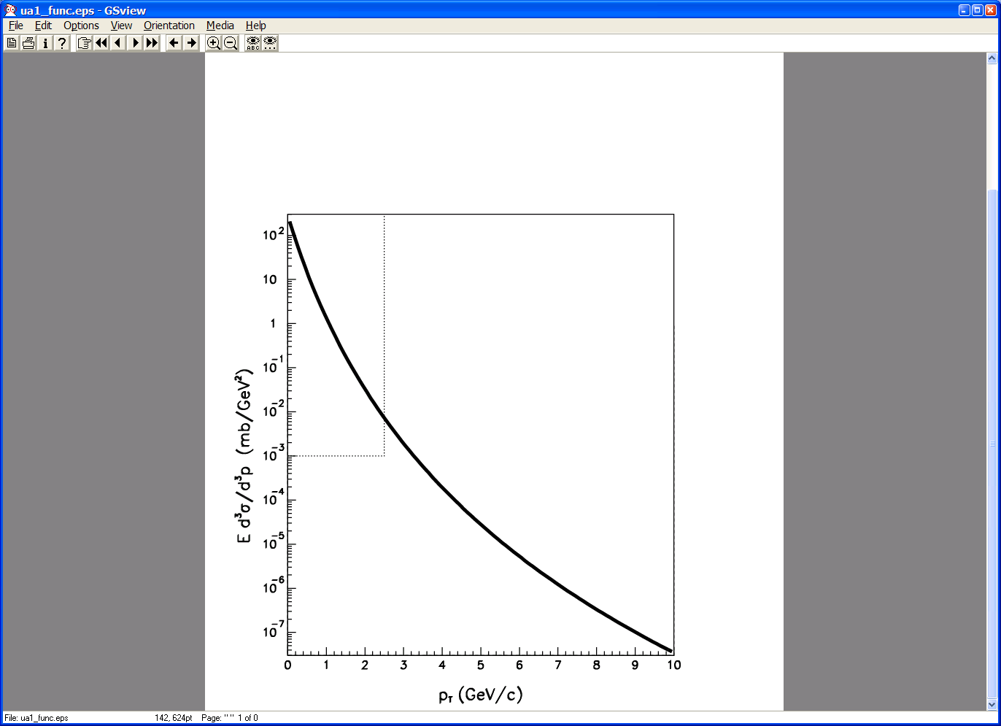
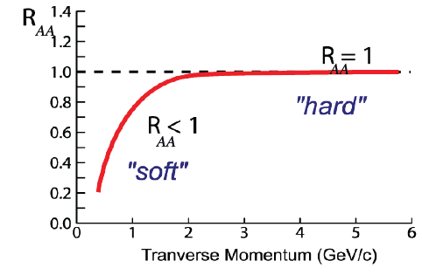
Expectations
If no “effect”:
R_{AA} < 1 at low p_{T} in regime of soft physics
R_{AA} = 1 at high-p_{T} where hard scattering dominates
“Effect” If R_{AA} < 1 at high-p_{T}

Slide 38
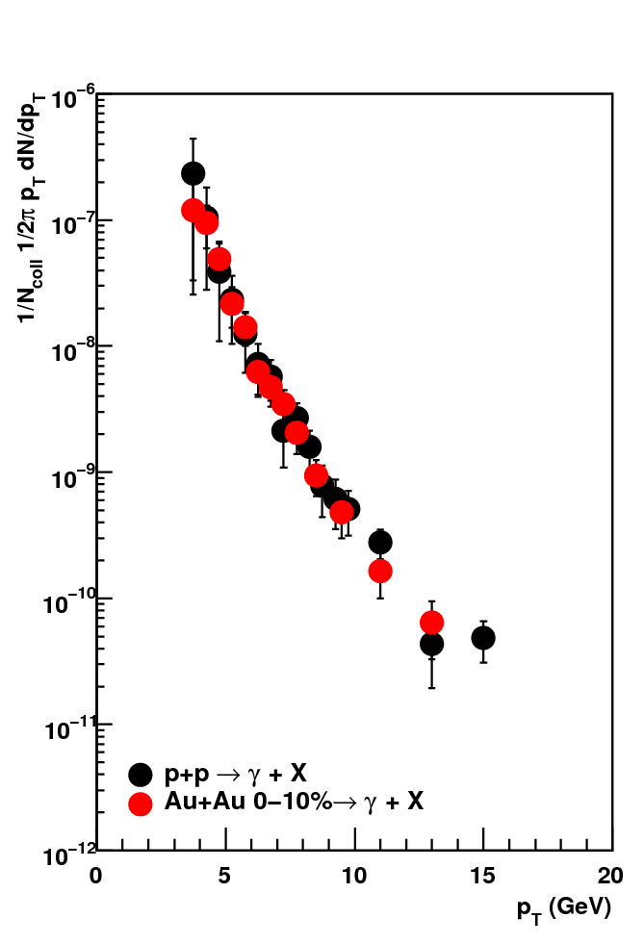
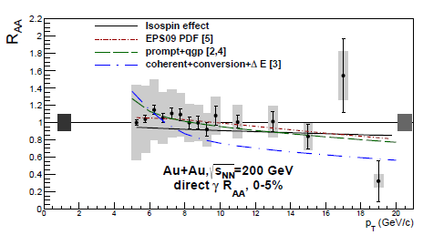

Glauber test at RHIC
Direct photon yield scales with N_{coll}
γ – PHENIX
PRL109, 152302 (2012)
PHENIX, PRL 94, 232301

Slide 39
Physics Menu

Slide 40
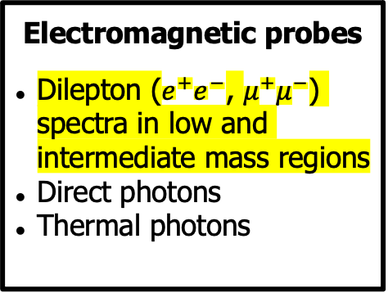
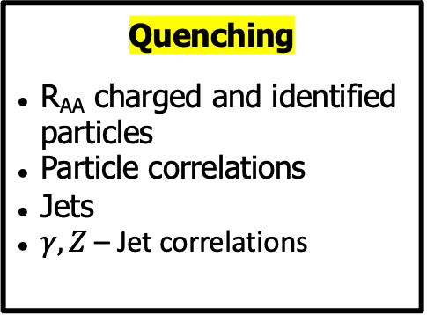
Observables Menu
Global observables
Total event multiplicity
Total event energy
Centrality determination
Total cross-section
Event plane determination
Spectator measurement
Spectra of light flavor
Light flavor spectra
Particle yields and yield ratios
Kinematic and chemical freeze-out
QCD Phase Diagram
Strangeness
Hyperons and hypernuclei
Correlations
Flow
Vorticity, Λ polarization
E-by-E fluctuation of multiplicity, momentum and conserved quantities
HBT, Femtoscopy
Forward-Backward corr.
Electromagnetic probes
Dilepton ($e^{+}e^{−}$, $μ^{+}μ^{−}$) spectra in low and intermediate mass regions
Direct photons
Thermal photons
Heavy flavor
Open charm
Charmonium
Bottomonium
Quenching
R_{AA} charged and identified particles
Particle correlations
Jets
$γ, Z$ – Jet correlations

