Slide 1

Heavy Ion Physics
NICA Days, Belgrade
October 2-3, 2023
Itzhak Tserruya

Slide 2
Outline
LECTURE I
Introduction
  Why?
  QCD phase diagram
  Deconfinement and Chiral symmetry Restoration
  When and where?
  Centrality, Glauber model
  Nuclear modification factor
  Physics Menu
LECTURE II
Dileptons
  Motivation
  Challenges of measurement
  SPS results: CERES, NA60
  RHIC results: PHENIX, STAR
  Prospects

Slide 3
Dileptons
      Motivation

Slide 4
Motivation
The Quark Gluon Plasma created in relativistic heavy ion collisions is characterized by two fundamental properties:
  Deconfinement
  Chiral Symmetry Restoration
Virtual photons i.e. dileptons (e⁺e⁻, μ⁺μ⁻) are sensitive probes of both properties and in particular dileptons are unique probes of CSR.
Thermal radiation emitted in the form of real photons or virtual photons (dileptons) provides a direct fingerprint of the matter formed (QGP and HG) and a measurement of its temperature.
QGP qq γ∗ l⁺l⁻
HG π⁺π⁻ ρ γ∗ l⁺l⁻

Slide 5
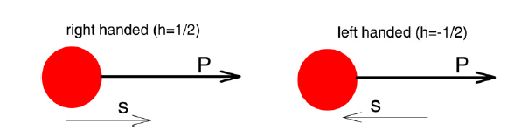
Chirality
What is chirality?
  Comes from the greek word “χειρ” meaning hand
  An object or a system has chirality if it differs from its mirror image.
Such objects then come in two forms, L and R, which are mirror images of each other.
Simple definition:
  The chirality of a particle is determined by the projection of its spin along its momentum direction (this is in fact the definition of helicity. In the high energy limit chirality ≈ helicity).
For massive particles, chirality is not conserved.

Slide 6
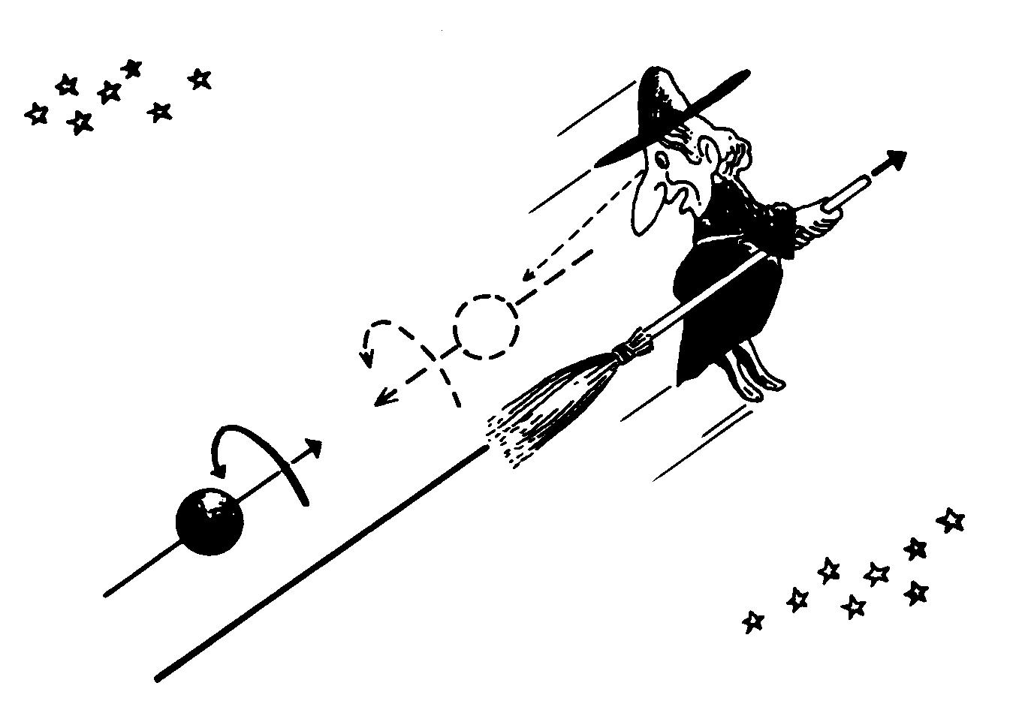
Chiral Symmetry
If a particle has mass both right- and left-handed components must exist.
The reason is that massive particles travel slower than the speed of light
and a particle that appears left-handed in a particular reference frame
will look right-handed from a reference frame moving faster than the
particle → chirality is not conserved
Right-handed
Left-handed

Slide 7

QCD and explicit chiral symmetry breaking
QCD, the theory of the strong interaction, is encoded in a one line Lagrangian:
q interaction with gluon field
Free quarks of mass m_{n} at rest
Free gluon field
The mass term m_{n}ψ_{n}ψ_{n} explicitly breaks the chiral symmetry of the QCD Lagrangian

Slide 8
Spontaneous Chiral Symmetry Breaking
Chiral limit: m_{u} = m_{d} = m_{s} = 0
In this idealized world, the interactions quark-gluon conserve the quark chirality. (left–handed u,d,s, quarks remain left-handed forever).
In the chiral limit:
all states have a chiral partner with opposite parity and equal mass
m_{u} and m_{d} are so small (m_{u} ≈ 4 MeV m_{d} ≈ 7 MeV) that our world should be very close to the chiral limit
In reality:
ρ (J^{P} = 1⁻) m=770 MeV chiral partner a₁ (J^{P} = 1⁺) m=1250 MeV →Δ≈500 MeV
For the nucleons the splitting is even larger:
N (1/2⁺) m=940 MeV chiral partner N* (1/2⁻) m=1535 MeV →Δ≈600 MeV
The differences are too large to be explained by the small current quark masses
Chiral symmetry is spontaneously (≡ dynamically) broken in nature
Quarks have large “effective” mass m_{u} ≈ m_{d} ≈ 1/3m_{N} ≈ 300 MeV/c²
Constituent quark masses

Slide 9
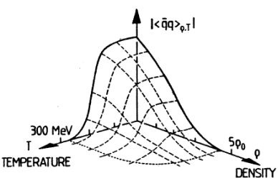
Chiral Symmetry Restoration
The spontaneous breaking is marked by a non-zero value of an order parameter, the quark condensate:
Numerical calculations of QCD on the lattice show that at high T (T>T_{C}) or high baryon densities (ρ>ρ_{C}), the quark condensate vanishes:
constituent mass → current mass
chiral symmetry (approximately) restored
Chiral partners (e.g. ρ and a₁) become degenerate
Coincides with the deconfinement phase transition?
How is the quark condensate linked to the hadron properties (mass and width)? How is the degeneracy of the chiral partners achieved?

Slide 10
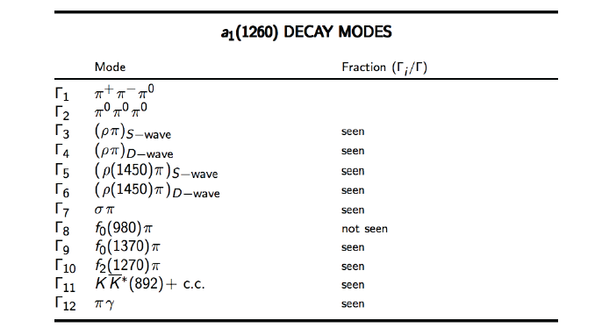
ρ – a₁
If CS is restored the masses of the a₁ and ρ mesons should become equal.
Problem: very hard to measure the a₁ meson
Experimental efforts focused on the ρ meson

Slide 11
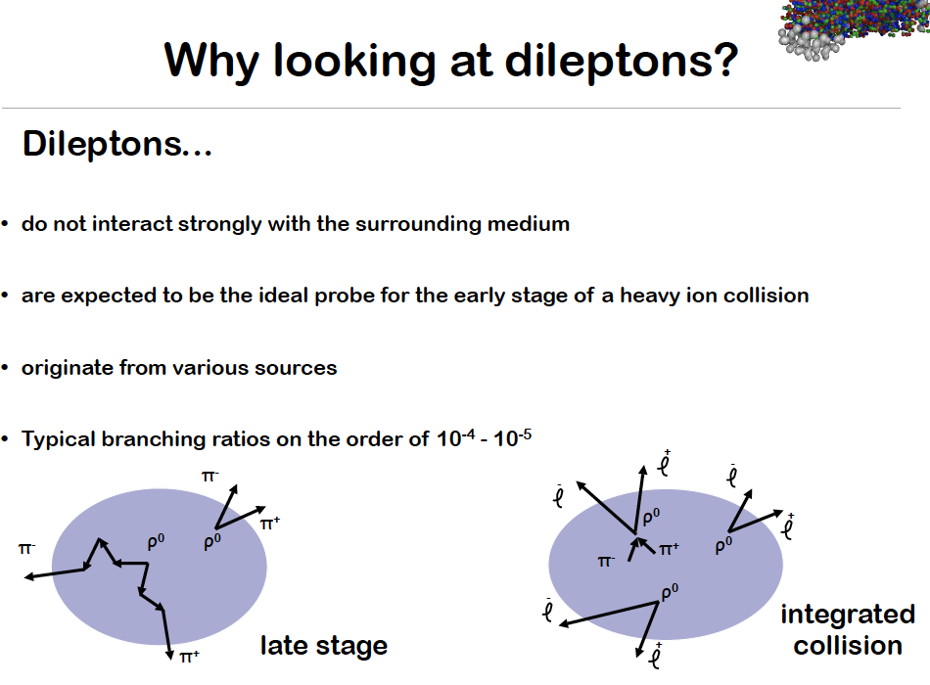
ρ → e⁺e⁻ decay and CSR
ρ → π⁺π⁻ BR ~100% ρ → e⁺e⁻ BR = 4.7 10⁻⁵
Low-mass dileptons are the best probes to look for CSR effects:
* Large mfp: → no final state interaction
carry information from place of creation to detectors.
m [MeV] Γ_{tot} [MeV] τ [fm/c]
ρ 770 150 1.3
ω 782 8.6 23
φ 1020 4.4 44
Best candidate: the ρ-meson
short lifetime compared to the medium lifetime (τ ≈ 10 fm/c)
can decay and be regenerated in the medium

Slide 12
Advantages and Chellenges
No final state interaction: large mfp compared to the size of the system. Once produced they leave the fireball without any further interaction
  carry direct information from place of production to
  detectors
Production rate strongly increasing function of T and density
  most abundantly produced at the early stage of
  the collisions
…But very difficult measurements
  large combinatorial background
Emitted by a variety of sources all along the history of the collision
  need a very good understanding of all these sources to disentangle the interesting ones.

Slide 13
The double challenge (I)
1. Experimental challenge
Need to detect a very weak source of e⁺e⁻ pairs
hadron decays (m>150 MeV/c² p_{T} > 200 MeV/c) ~ 10⁻⁶ / π⁰
in the presence of hundreds of charged particles
central mid-rapidity Au-Au collision at RHIC (dN_{ch}/dη) 650
and several pairs per event from trivial origin
πº Dalitz decays ~ 10⁻² / π⁰
+ γ conversions (assume 1% radiation length) 2 . 10⁻² / π⁰
huge combinatorial background ∝ (dN_{ch} / dy )²

Slide 14
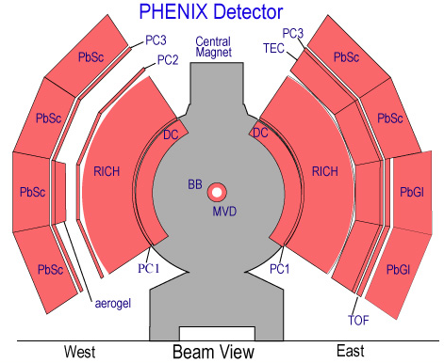
Combinatorial background
It often happens that only one electron is detected and the other is lost due to:
  limited geometrical acceptance
  low p_{T} particle curling in the magnetic field
  particle not reconstructed
Since the origin of each track is unknown, must pair all electrons with all positrons in the same event
Signal (S) and combinatorial Background (B)
B must be subtracted using a mixed event technique or using the like sign spectrum

Slide 15
Consequences of poor S/B ratio
♦ The signal is obtained by subtracting the combinatorial background (estimated by the like-sign pair yield or a mixed event technique) from the total unlike sign yield:
S = U – B
♦ The statistical error of S is not dictated by the magnitude of S but by the magnitude of the background. In the case S<<B
ΔS ≈ √2B
♦ It is useful to consider the “background free equivalent” signal, i.e. the signal with the same relative error as in a situation of zero background:
S_{bfe} = S² / 2B
A signal S = 10⁴ pairs measured with a S/B = 1/200 has the same relative statistical error as 25 pairs measured in free background conditions.
♦ The systematic uncertainty in S is dominated by the systematic uncertainty in B. Even if the event mixing technique is mastered to a fantastic precision of ±0.25%, the resulting systematic uncertainty in ΔS/S is ~50% (assuming S/B=1/200). Even in an infinite statistics measurement the systematic uncertainty will be very large.

Slide 16
The double challenge (II)
2. Analysis challenge
Electron pairs are emitted through the whole history of the collision ( from the QGP phase, mixed phase, HG phase and after freeze-out)
    need to disentangle the different sources.
    need excellent reference pp and dA data.
    need independent information about the known sources in nuclear collisions

Slide 17
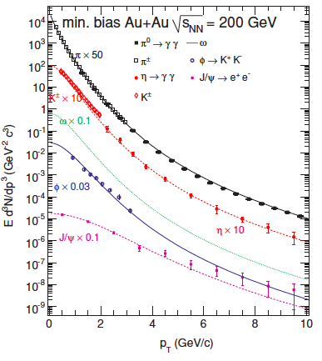

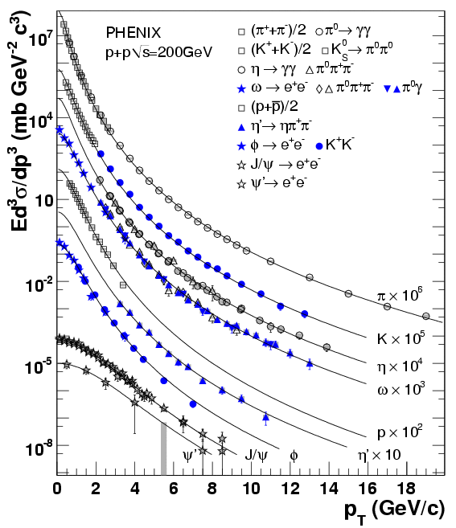
Au+Au Cocktail
Cocktail of known sources:
Dalitz decays:
  π⁰,η,η’ e⁺e⁻γ
  ω π⁰e⁺e⁻
Resonance decays:
ρ, ω, ϕ e⁺e⁻
Semi-leptonic decays of HF:
cc, bb e⁺e⁻
π⁰ and charged π data fit to a modified Hagedorn function:
Use m_{T} scaling for shape of other hadrons, normalize to measured data
Fits are done independently for each particle and each centrality
Open heavy flavor (c,b) contributions determined using PYTHIA fitted to pp data and scaled to Au+Au with N_{coll}

Slide 18
Au+Au Cocktail
Cocktail of known sources:
Dalitz decays:
π⁰,η,η’ e⁺e⁻γ
ω π⁰e⁺e⁻
Resonance decays:
ρ, ω, ϕ e⁺e⁻
Semi-leptonic decays of HF:
cc, bb e⁺e⁻

Slide 19
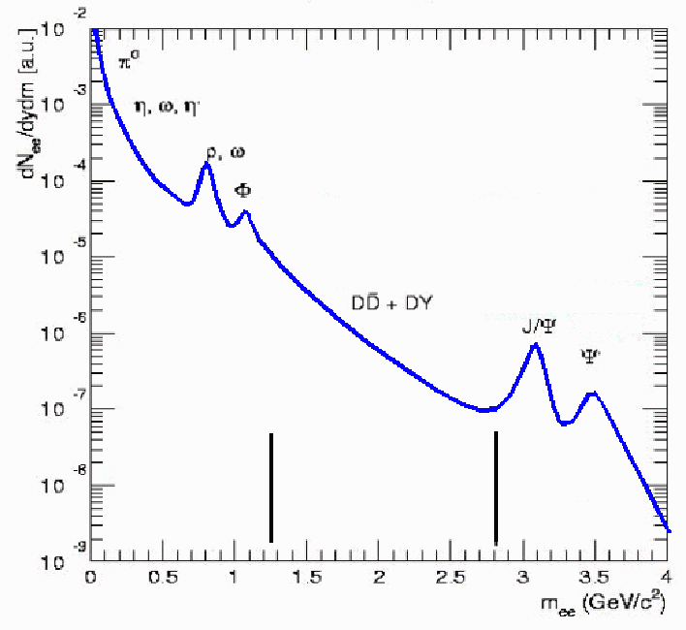
New physics expected in HI collisions
Low-mass region:
CSR
In-medium modification of LVM
HG thermal radiation
dN_{ee}/dydm [a.u.]
Intermediate mass region:
Charm in-medium modification
QGP thermal radiation
cc suppression
Low
Intermediate
High
m_{ee} (GeV/c²)

Slide 20
Dilepton Experiments

Slide 21
Dilepton experiments
20??
CBM (FAIR SIS-300)
202?
NA60+ (SPS)
FUTURE
2027
CBM (FAIR SIS-100)
2024
MPD, BM@N (NICA)
ALICE (LHC)
BES II
STAR (RHIC)
STAR (RHIC)
PRESENT
HADES (GSI)
2
4
6
8
20
40
60
80
√S_{NN} [GeV]
1
10
10²
PHENIX (RHIC)
PAST
CERES, NA60 (SPS)
DLS (BEVALAC)

Slide 22
SPS results:
CERES – low masses
NA60 – low and intermediate masses

Slide 23
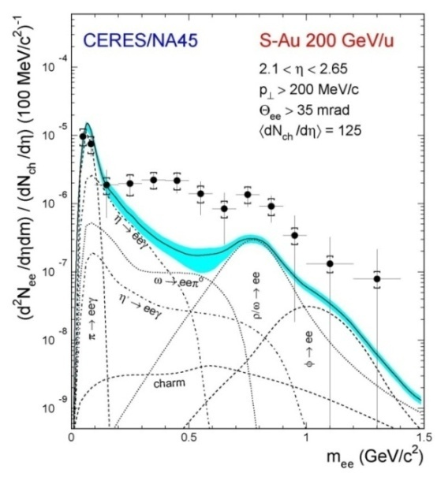
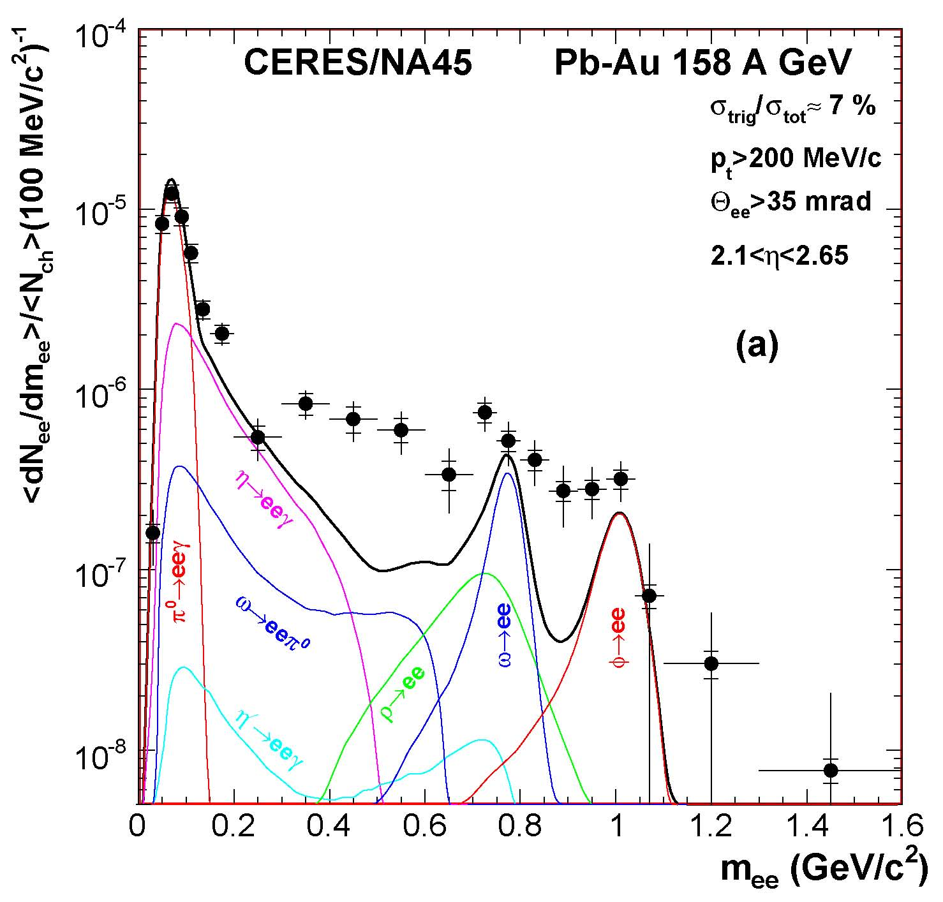
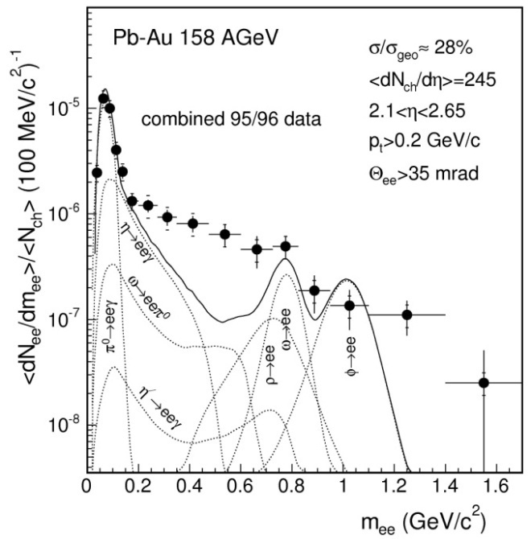
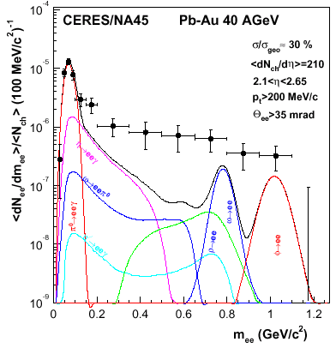
CERES Pioneering Results (I)
First CERES result
PRL 75, (1995) 1272
Last CERES result
PLB 666 (2008) 425
Better tracking and better mass resolution (Δm/m = 3.8%) due to:
Doublet of SiDC close to vertex
Radial TPC upgrade downstream of double RICH spectrometer
Strong enhancement of low-mass e⁺e⁻ pairs in all A-A systems studied
EPJ C41 (2005) 475
PRL 91 (2003) 042301

Slide 24
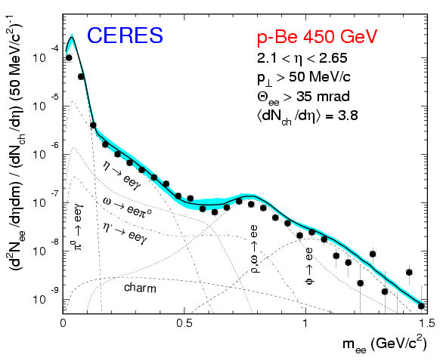
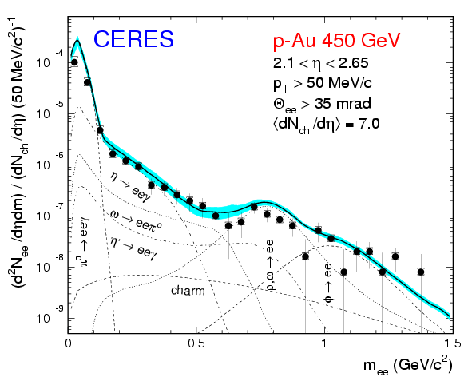
CERES Pioneering Results (II)
Last CERES result (2000 Pb run)
PLB 666(2008) 425
Strong enhancement of low-mass e⁺e⁻ pairs
(wrt to expected yield from known sources)
Enhancement factor (0.2 <m < 1.1 GeV/c² ): 2.45 ± 0.21 (stat) ± 0.35 (syst) ± 0.58 (decays)
No enhancement in pp
nor in pA
EPJ C4, 231 (1998)

Slide 25
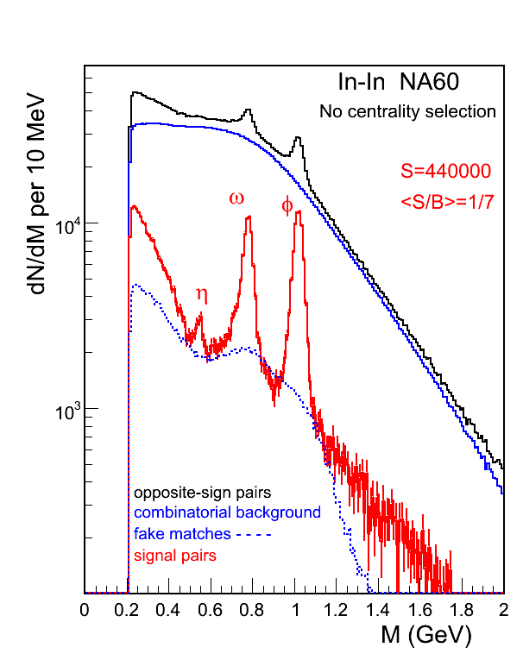
NA60 low-mass dimuons
In+In 158 A GeV
PRL 96, 162302 (2006)
Superb data!!!
Mass resolution:
23 MeV at the φ position
S/B = 1/7
ω, φ and even η peaks clearly visible in dimuon channel

Slide 26
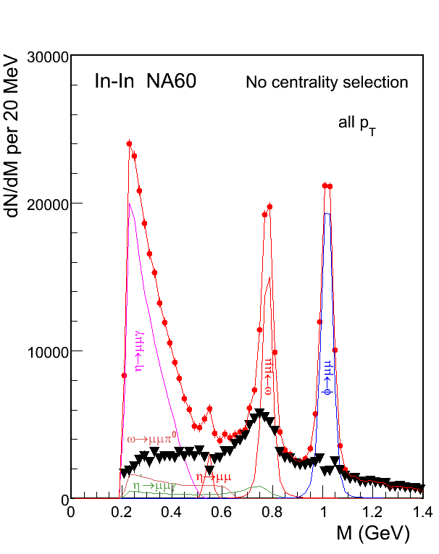
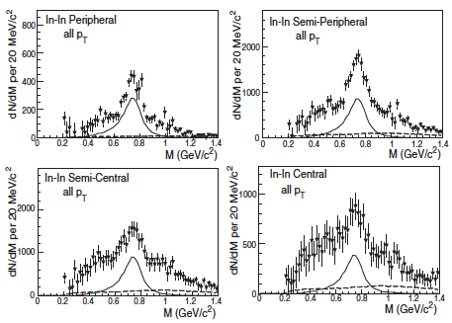
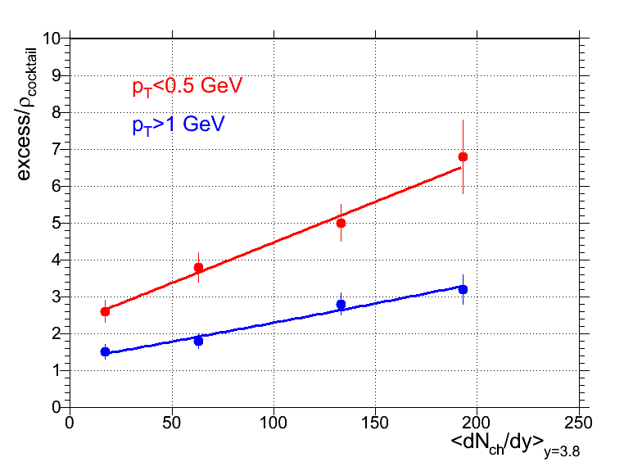
Low-mass excess
PRL 96, 162302 (2006)
Dimuon excess isolated by subtracting the hadron cocktail (without the ρ)
confirms and consistent with CERES results
rises and broadens with centrality
more pronounced at low p_{T}

Slide 27
Interpretation (s)?

Slide 28
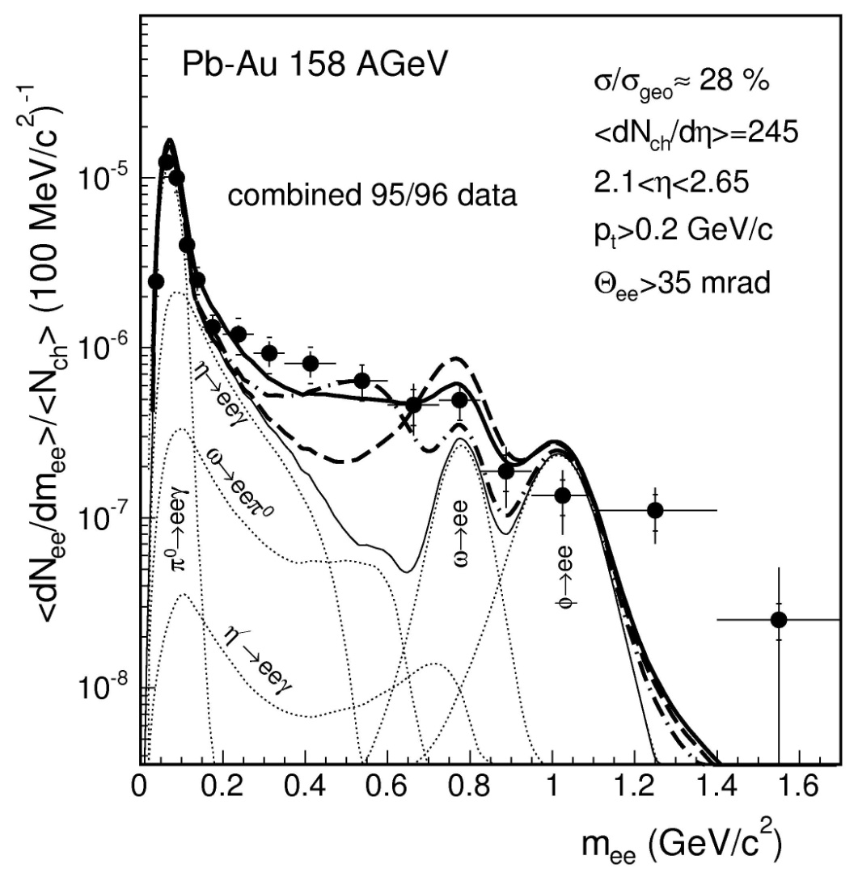
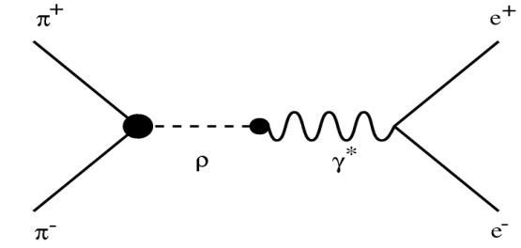
Dropping Mass or Broadening (I) ?
CERES Pb-Au 158 A GeV 95/96 data
* Invoke new source not present in pp or pA collisions:
π⁺π⁻ →ρ→ γ* → e⁺e⁻
thermal radiation from HG
* vacuum ρ not enough to
reproduce data
EPJ C41 (2005) 475

Slide 29
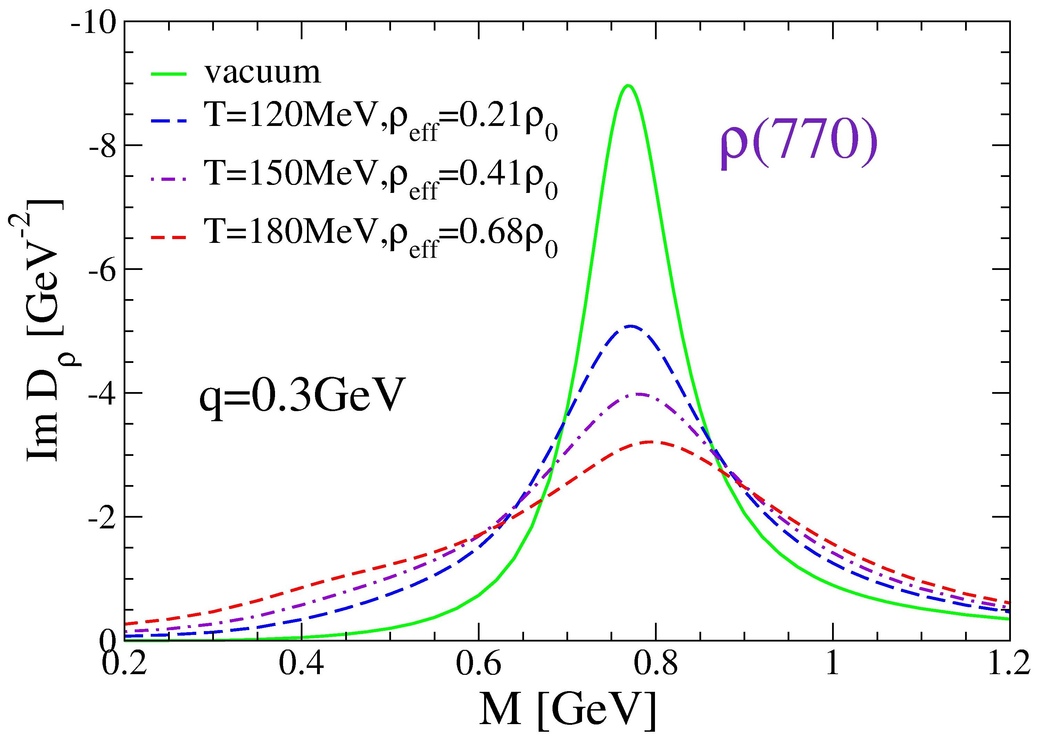
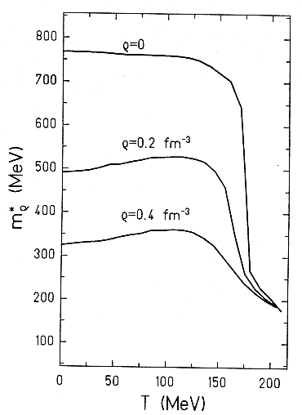
In-medium modification of the ρ meson
Dropping mass
Broadening
Brown-Rho conjecture that links hadron masses to the quark condensate.
Effective QCD Lagrangian, quarks are the relevant d.o.f.
Rapp & Wambach
Adv. Nucl. Phys. 25, 1 (2000)
ρ-meson scatters off baryons in
the high density medium → collision broadening.
Brown-Rho scaling PRL 66, (1991) 2720
Hatsuda & Lee PR C46, (1992) R34
At SPS both the mass drop and the broadening of the ρ-meson are due to the high baryon density.

Slide 30
Dropping Mass or Broadening (I) ?
* Interpretations invoke:
π⁺π⁻ →ρ→ γ* → e⁺e⁻
thermal radiation from HG
CERES Pb-Au 158 A GeV 95/96 data
* vacuum ρ not enough to
reproduce data
* in-medium modifications of ρ:
broadening ρ spectral shape
(Rapp and Wambach)
EPJ C41 (2005) 475
dropping ρ meson mass
(Brown et al)

Slide 31
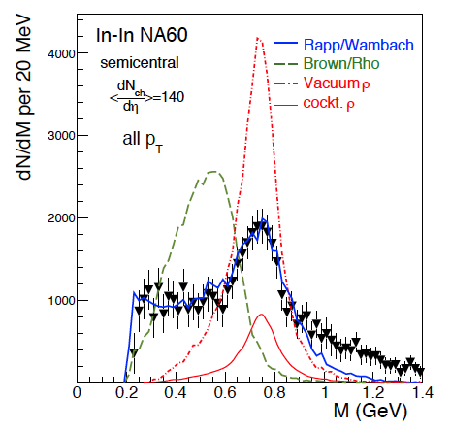
NA60 low-mass dimuons excess
PRL 96, 162302 (2006)
Isolate excess by subtracting the cocktail (without the ρ) from the data
Excess shape consistent
with broadening of the ρ
(Rapp-Wambach)
Dropping mass of the ρ (Brown-Rho) ruled out
Conclusions valid also as
a function of p_{T}
Is this telling us something
about CSR?

Slide 32
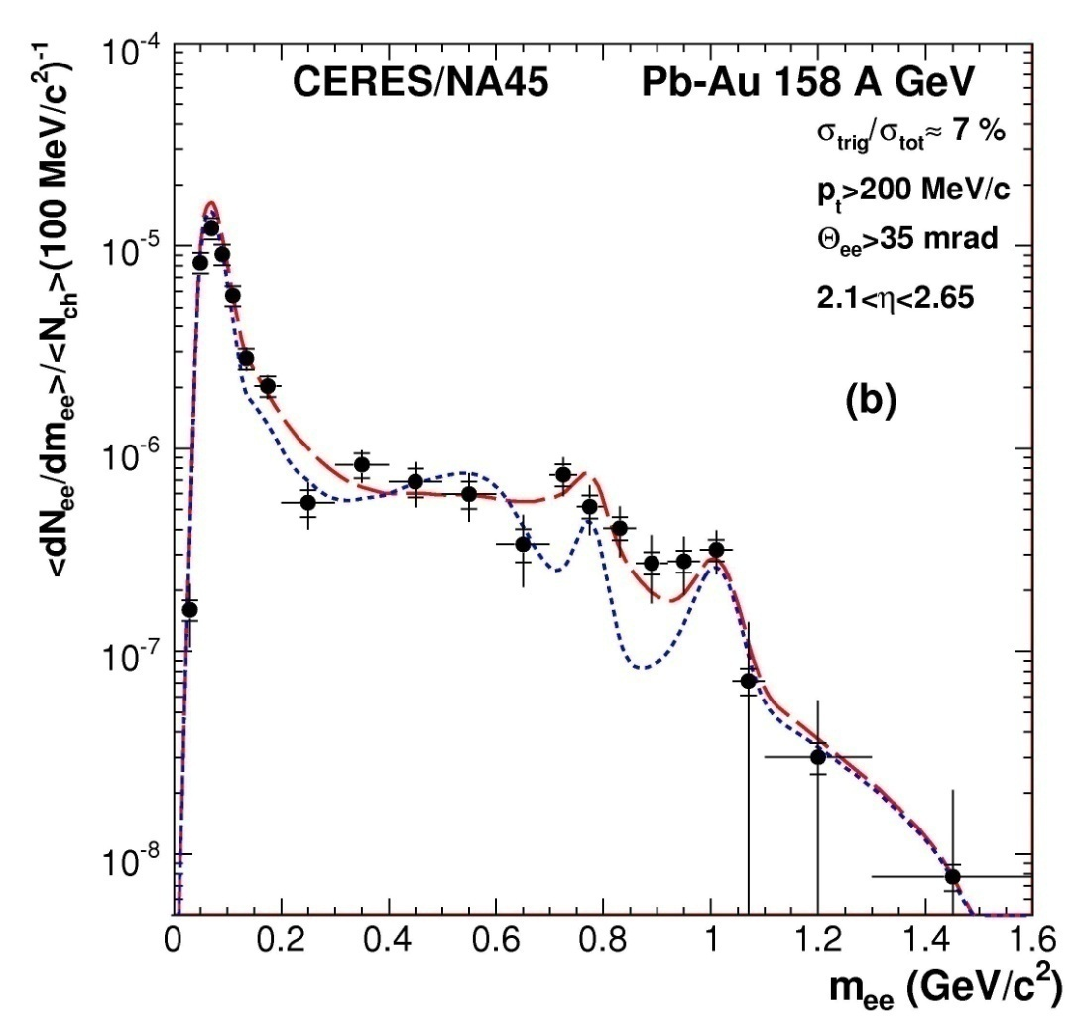
Dropping Mass or Broadening (II) ?
* Interpretations invoke:
π⁺π⁻ →ρ→ γ* → e⁺e⁻
thermal radiation from HG
CERES Pb-A 158 A GeV 2000 data
* vacuum ρ not enough to reproduce data
* in-medium modifications of ρ:
broadening ρ spectral shape
(Rapp and Wambach)
dropping ρ meson mass
(Brown et al)
PLB 666 (2008) 425
Data favor the broadening scenario.

Slide 33
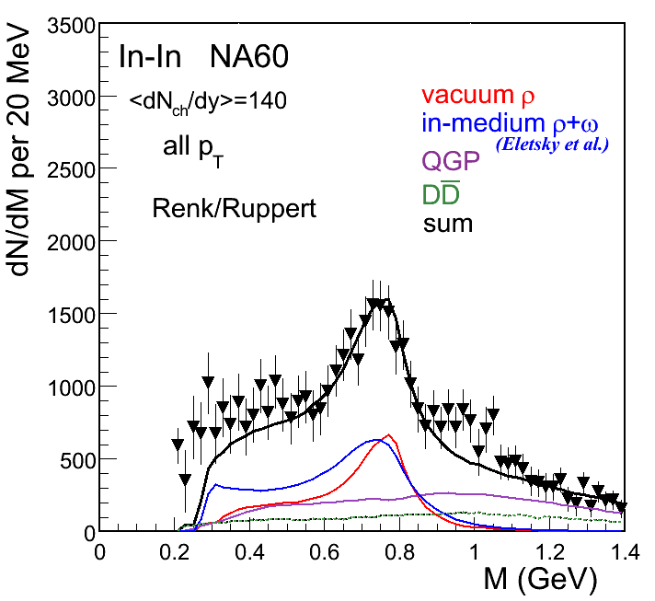
Origin of IMR excess
Renk/Ruppert, PRL 100,162301 (2008)
Dominant process in mass region m > 1 GeV/c²:
qq annihilation

Slide 34
Acceptance corrected invariant mass spectrum
Rapp and Hees PLB 753, 586 (2016)
LMR:
  Thermal radiation from HG: π⁺π⁻ → ρ → μ⁺μ⁻
      Resonances melt as the system approaches CSR?
    IMR:
      Thermal radiation from QGP: qq → μ⁺μ⁻

Slide 35
RHIC results
PHENIX, STAR
PHENIX: p+p d+Au and Au+Au at 200 GeV
STAR: p+p and Au+Au at 200 GeV
BES Au+Au at 62.4, 39, 27 and 19.6 GeV

Slide 36
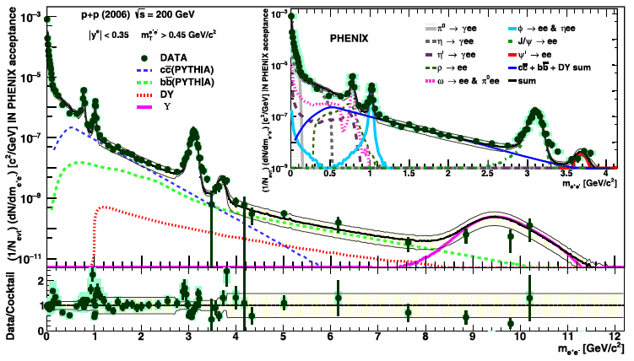
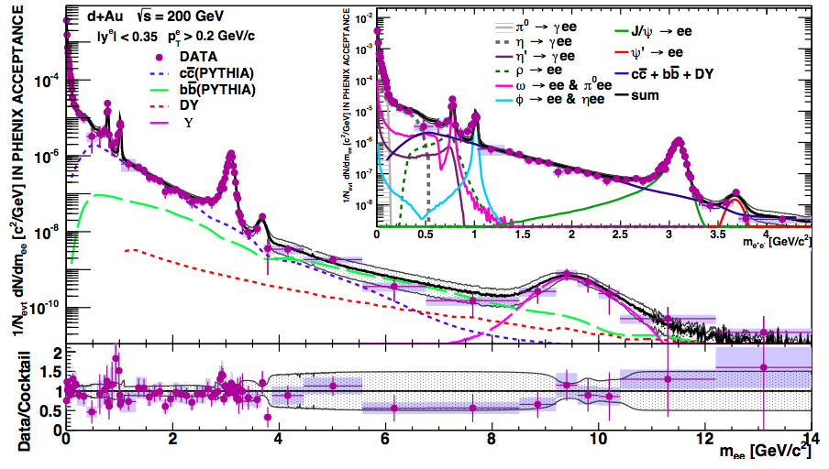
Dileptons in PHENIX: p+p and d+Au
PRC 96, 024907 (2017)
PLB 670, 313 (2009)
PRC 91, 014907 (2015)
Mass spectrum measured from m=0 up to m~10 GeV/c²
Very well understood in terms of:
  hadron cocktail at low masses
  heavy flavor + DY at high masses using PYTHIA

Slide 37
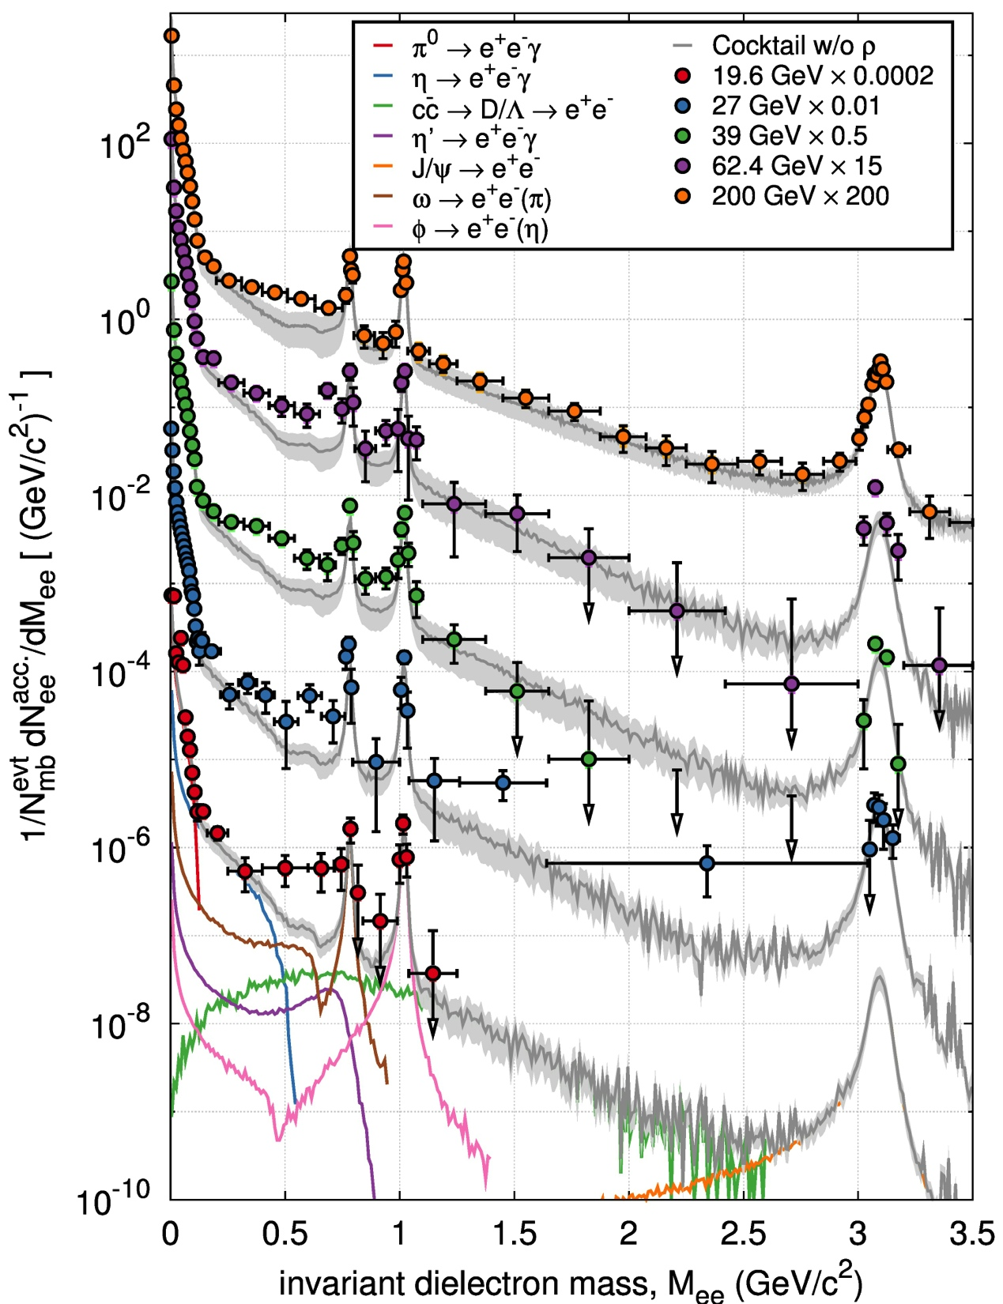
Dileptons in STAR: Au+Au
Centrality dependence
Beam energy scan
PRL 113, 22301 (2014)
PRC 92, 24912 (2015)
LMR: clear enhancement wrt to cocktail
small centrality dependence
observed at all energies down to 19.6 GeV
IMR: no clear picture

Slide 38
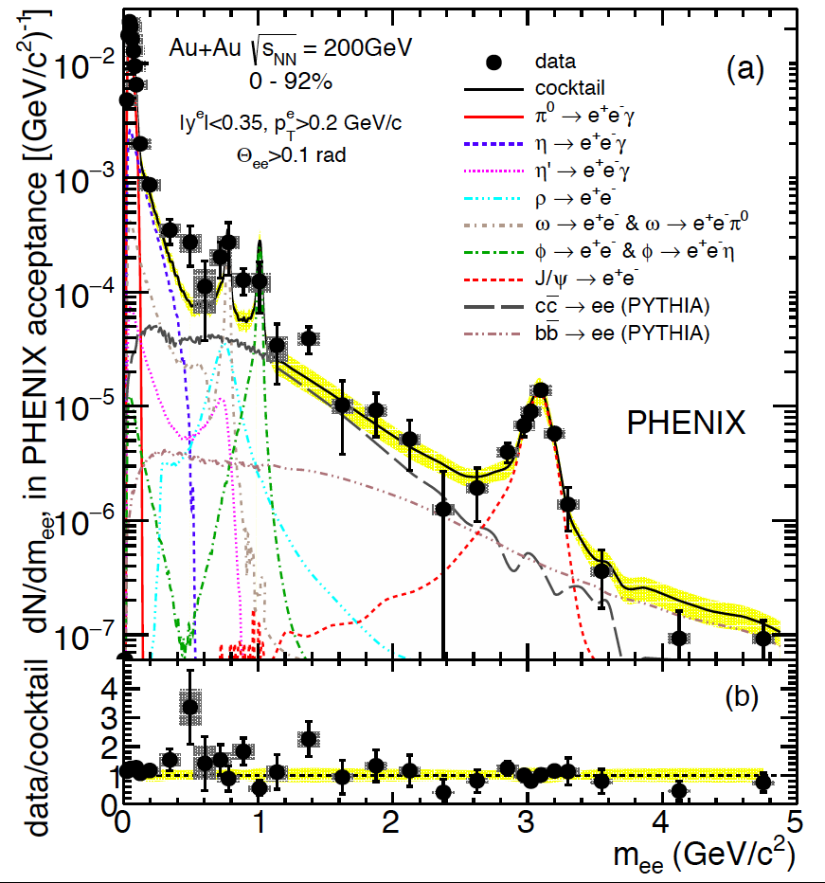
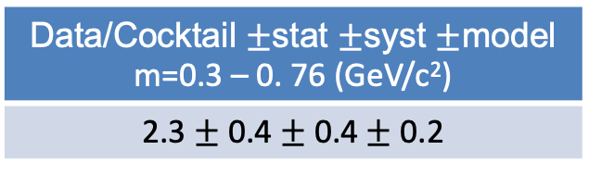
Dileptons in PHENIX: Au+Au
PRC 93, 014904 (2016)
HBD upgrade:
  Improved hadron rejection: 30% → 5%
  Improved signal sensitivity
New improved analysis
  Neural network
  Flow modulation incorporated in the mixed event using an exact analytical method
  Absolutely normalized correlated BG
MB Enhancement factor
Data/Cocktail $±$stat $±$syst $±$model m=0.3 – 0. 76 (GeV/c²)
2.3 $±$ 0.4 $±$ 0.4 $±$ 0.2
Consistent with STAR results
Notes:
the cocktail ha no rho here

Slide 39
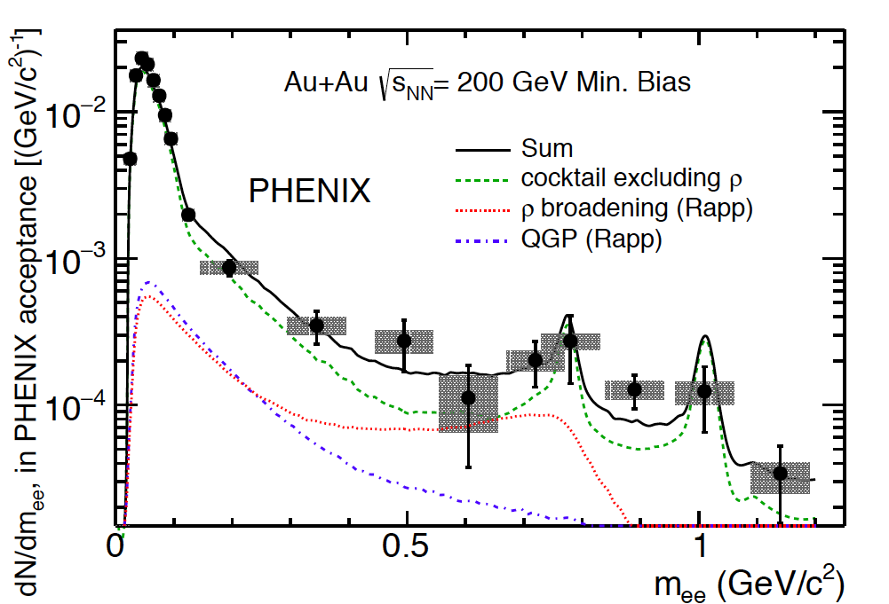
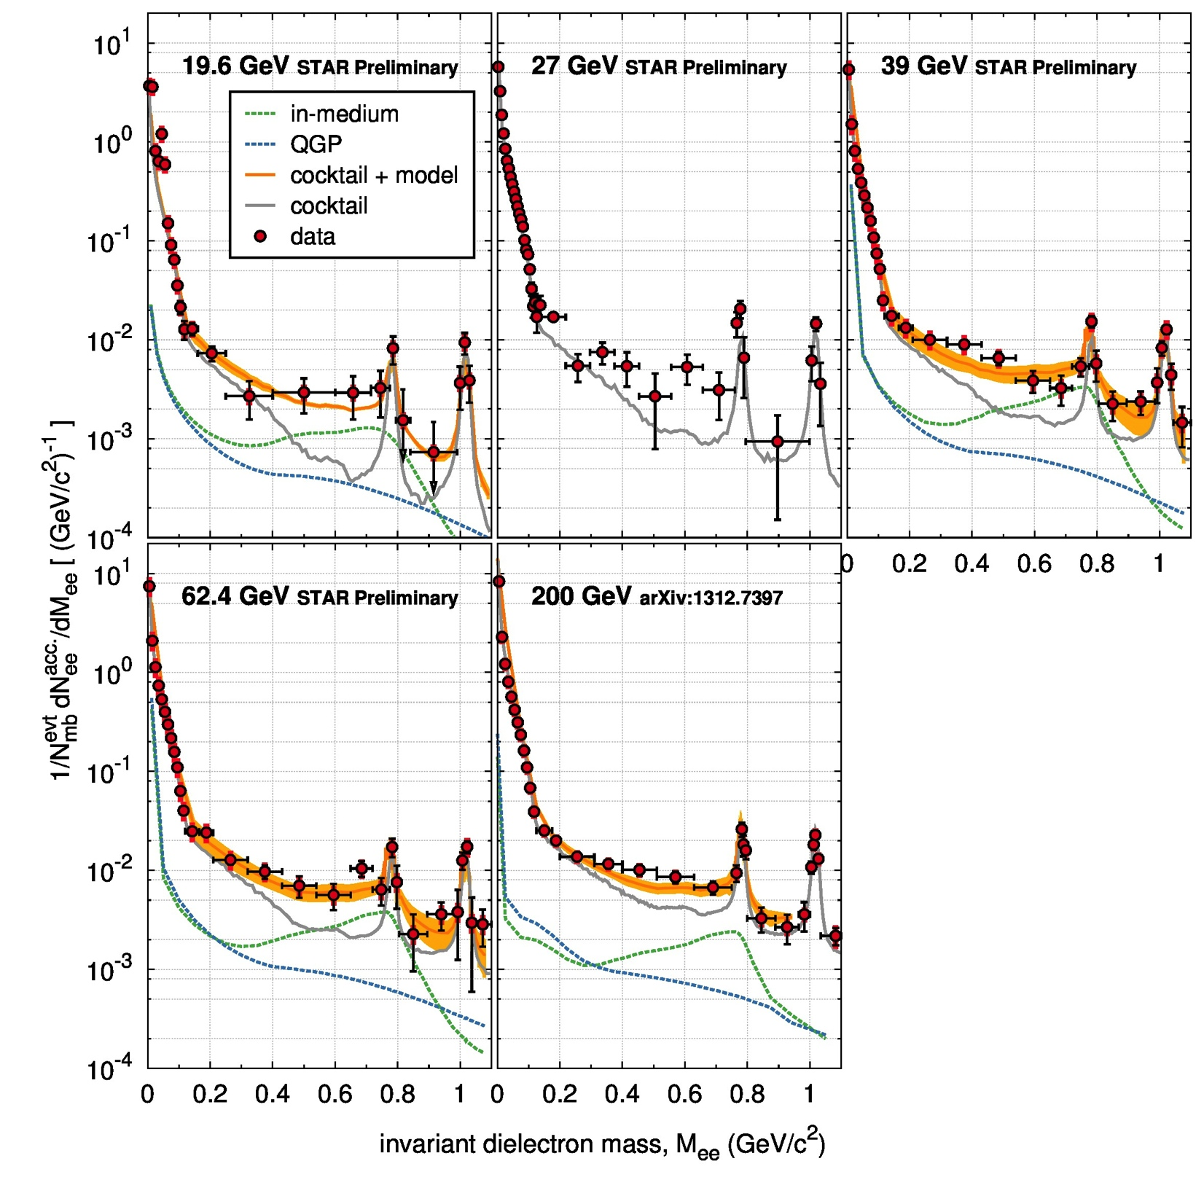
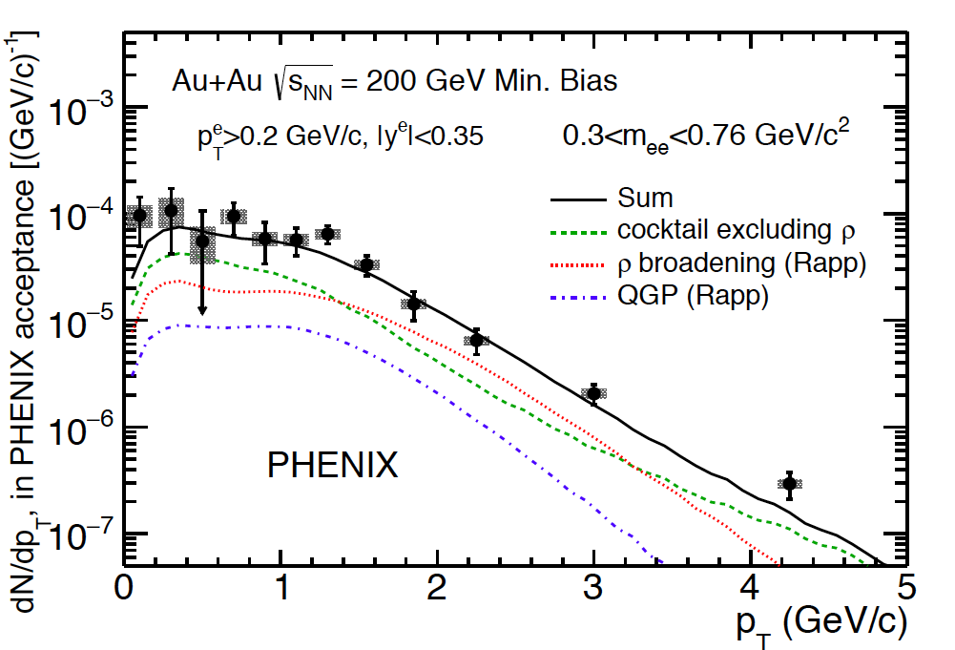
Comparison to Rapp model
Same model that describes the SPS data reproduces the dilepton excess all the way up to top RHIC energy

Slide 40
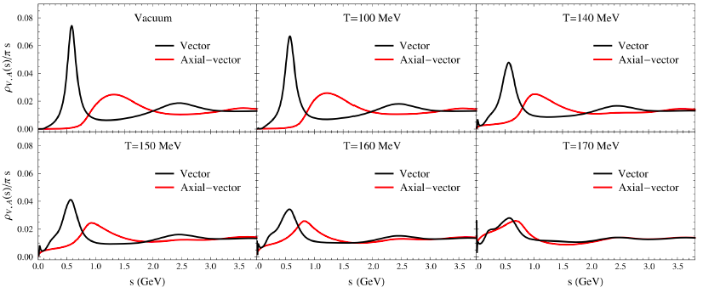
Dilepton measurements - Summary
NA60 data: Eur. Phys. J. C61, 711 (2009)
Curves: Rapp and Hees PLB 753, 586 (2016)
All HI systems at all energies studied show an excess of dileptons wrt to hadronic sources
Excess consistently reproduced by microscopic many body model (Rapp et al.)
LMR:
  Thermal radiation from HG
    π⁺π⁻ → ρ → μ⁺μ⁻
      Tracks the medium lifetime
    IMR:
      Thermal radiation from QGP
    qq → μ⁺μ⁻
      Provides a measurement of <T>
Hohler and Rapp PLB 73, 103 (2014)
Emerging picture for the realization of CSR: the ρ meson broadens in the medium, the a₁ mass drops and becomes degenerate with the ρ meson.
Effects exclusively observed in AA collisions

Slide 41
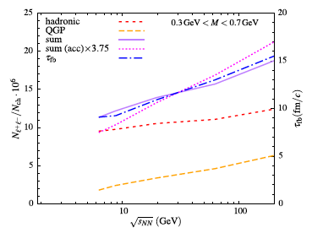
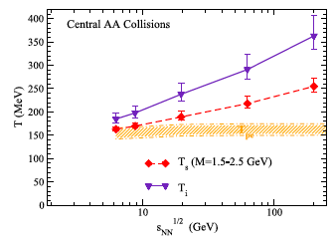
Prospects (I)
Onset of deconfinement? Onset of CSR? Energy scan of dilepton excess
  Integrated yield in the LMR tracks the fireball lifetime
  Inverse slope of the mass spectrum in the IMR provides a measurement of <T>
  First order phase transition?
  Thermal radiation down to √s_{NN} – 6 GeV ?
LMR as chronometer
IMR as thermometer
PLB 753, 586 (2016)

Slide 42
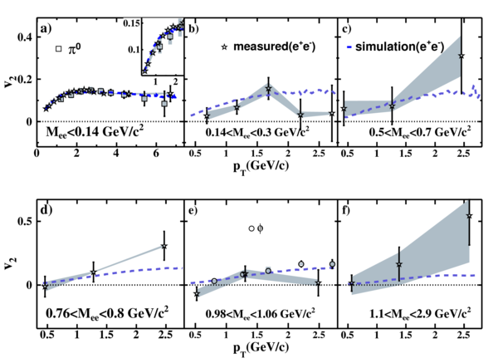
Prospects (II)
v₂ of thermal radiation
  Very challenging measurement
  Could provide an independent confirmation about the origin of the thermal radiation
Inclusive dielectron v₂
STAR PRC 90, 64904 (2014)
PHENIX, PRC 93, 014904 (2016)
Challenge: isolate the v₂ of the excess dileptons
MPD experiment well suited for dilepton studies

Slide 43
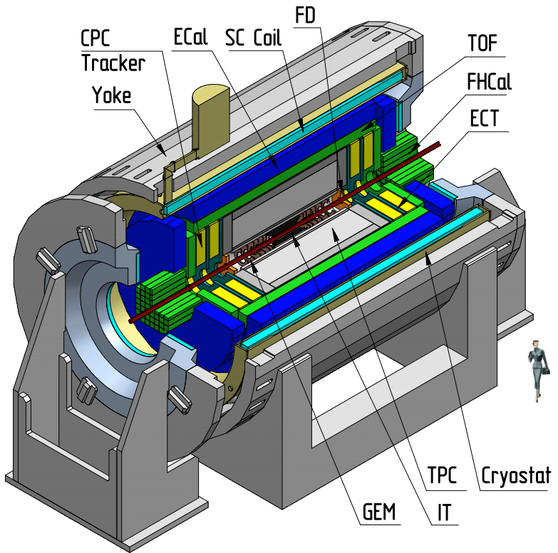
MPD at NICA
√s_{NN} = 4 - 11 GeV Expected to start operation in 2025

Slide 44
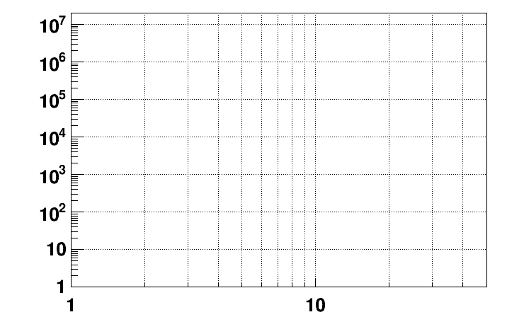
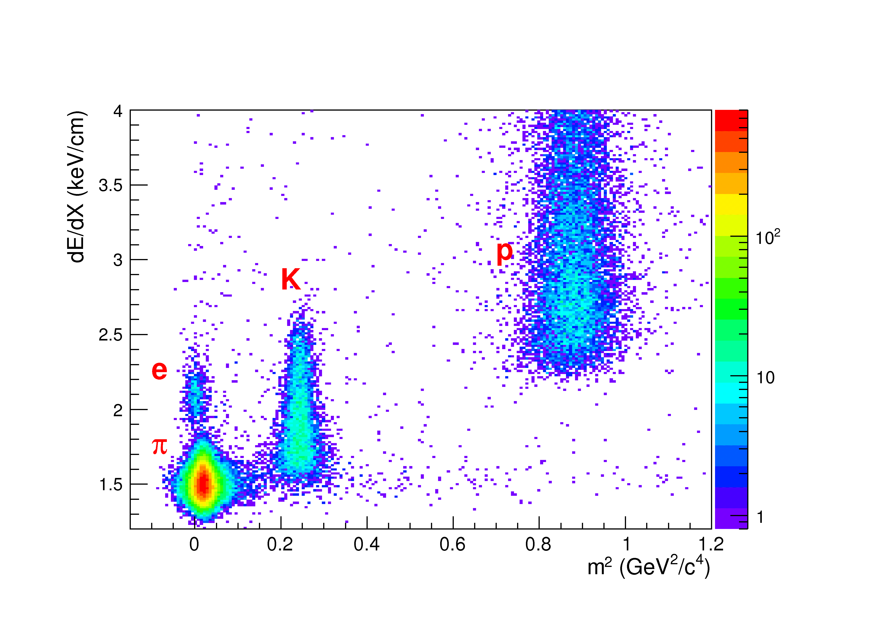
MPD Experiment
Interaction rate
Electron identification:
- TPC dE/dx
- ToF
- Ecal (E/p =1)
FAIR SIS-100 / CBM (2027)
NICA/BM@N
SPS / NA60+ (202?)
HADES
NICA/MPD (2024)
Interaction rate [Hz]
RHIC /STAR BES II
RHIC / STAR F.T.
+
+
+
SPS / NA-61
Collision energy √s_{NN} [GeV]
Challenge: overwhelming yield of combinatorial background dileptons from π⁰ Dalitz decays and γ conversions
Efforts underway to reduce the CB.

Slide 45
Summary
Dileptons are excellent probes of the high temperature and high density matter produced in RHI collisions.
Unique sensitivity to deconfinement and chiral symmetry restoration.
A lot of progress from the SPS and RHIC programs.
Emerging picture for the realization of CSR: the ρ meson broadens in the medium, the a₁ mass drops and becomes degenerate with the ρ.
Interesting prospects in the measurement of dileptons at low energies: onset of deconfinement, onset of CSR effects, first order phase transition?
The MPD detector is very well suited to address these questions.

