Slide 1
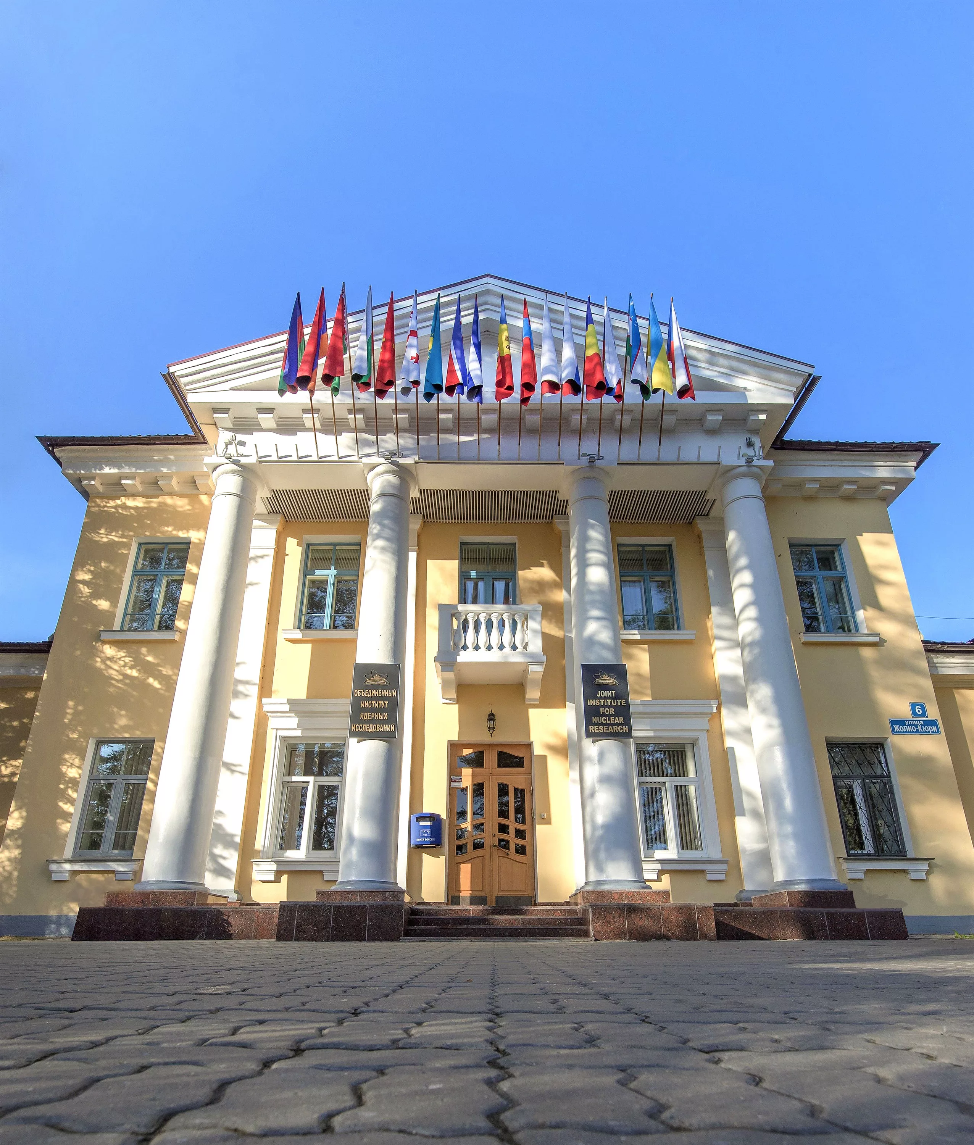

Joint Institute for Nuclear Research:
Next 7-year Program (2024-2030)
Grigory TRUBNIKOV
September 2023
Notes:
1
1

Slide 2
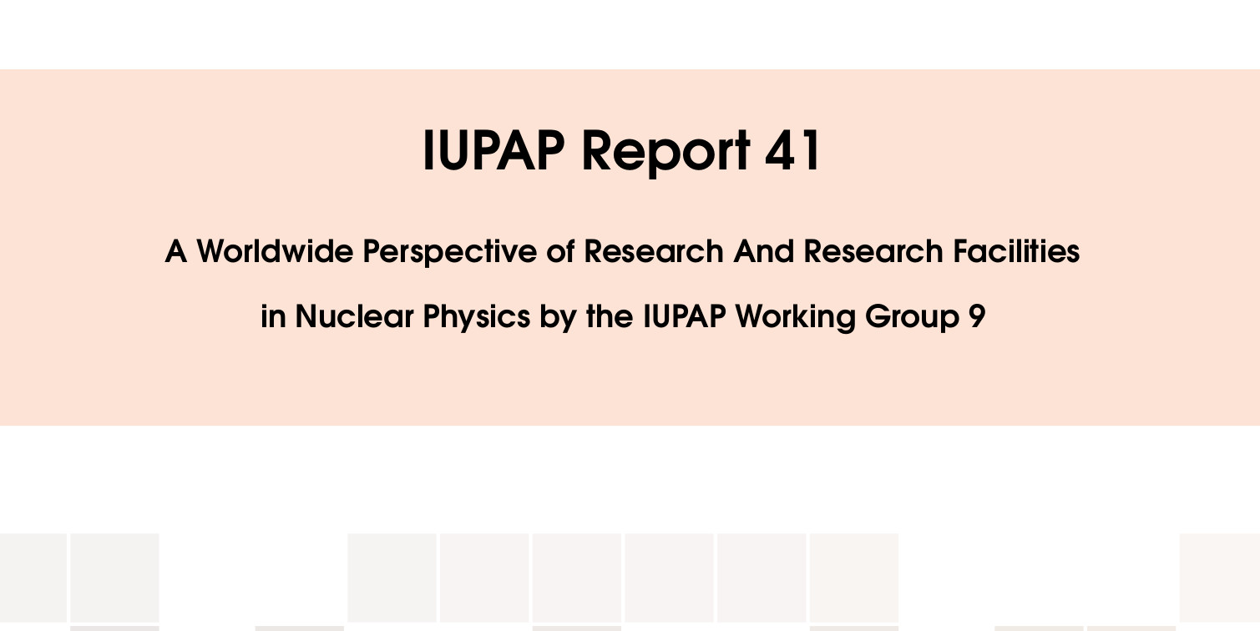



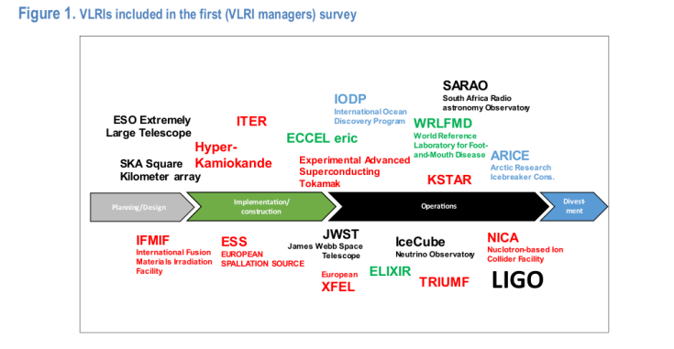
JINR research Infrastructure in the global scientific Landscape today
Taking beam energies of 1 GeV or greater, one has:
• fixed target heavy-ion experiments (CERN-SPS, SIS-GSI/FAIR);
• fixed target proton-nucleus studies (Fermilab, J-PARC);
• heavy ion collider experiments (BNL-RHIC, CERN-LHC
and in the future NICA);
• fixed target-lepton DIS experiments (CERN, JLab-CEBAF);
• DIS collider experiments (were at DESY, in the future possibly at EIC or LHeC);
• polarized beams (RHIC, future possibilities at eRHIC and JLEIC).
Superheavy element search:
The future race hunting for the 119th and 120th elements
will continue at the SHE factory at Dubna and RIKEN.
Baikal-GVD: ... the study of the flux of high-energy neutrinos
and the construction of a telescope with an effective volume of 1 km³...
The statutory for JINR fields of science occupy a priority position in the world scientific agenda and development of a large research infrastructure.
The analysis shows that almost half of modern projects in the field of basic sciences have accompanying programmes of applied research aimed at sustainable development goals (SDG). Worldwide international dimension, the multi-disciplinary scientific programme and large infrastructure projects of JINR harmoniously complement the global scientific agenda and the worldwide landscape of mega-science infrastructure, assuming, along with the main goals in the field of fundamental research, the achievement of certain SDG.

Slide 3
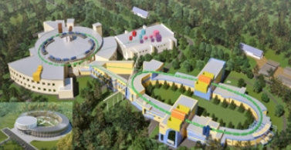
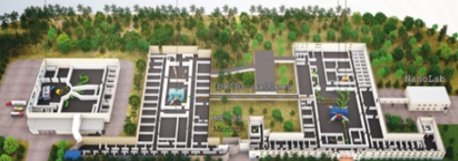
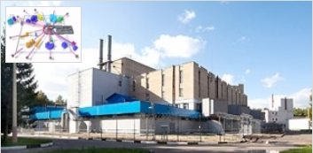
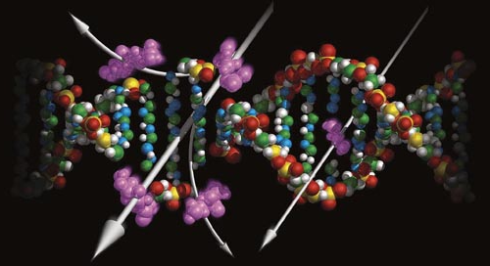
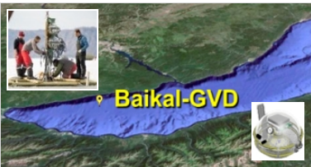
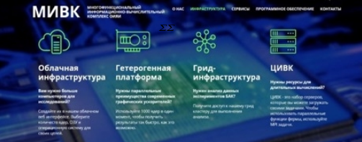
Implementation of the 7-year Plan for the Development of JINR (2024-2030)
Relativistic Heavy Ion & Spin Physics
NICA complex
Low Energy Nuclear Physics
SHEF& DRIBS-III project
Condensed matter research
and Neutron physics (IBR-2М)
Neutrino & Astroparticle physics
Baikal-GVD
IT and High Power Computing
MIC complex
Life Sciences
RadioBiology, AstroBio, BioMed
Notes:
3

Slide 4
THEORETICAL PHYSICS (BLTP)
Theory of
Fundamental
Interactions
Theory
of Atomic
Nucleus
Theory of
Condensed
Matter
Modern
Mathematical
Physics
Interlaboratory cooperation
Research and
educational project
DIAS-TH
“Dubna International
Advanced School of
Theoretical Physics”
VBLHEP Hot and dense nuclear matter in heavy-ion collisions
FLNP
Condensed Matter,
New materials
DLNP
Neutrino physics
FLNR
Superheavy and exotic nuclei
FLNR
Nanoporous 2D membranes,
Ion irradiation
MLIT
Lattice QCD calculations
DLNP Few-body systems,
Exotic nuclei
MLIT Computational methods for
nuclear physics and quantum chemistry
Human strategy:
Attraction of leading scientists
Attraction of young researchers
Stimulation of scientific activity
Scientific strategy:
Extension of international collaboration
Keeping up with current scientific trends
Interplay of research and education

Slide 5
In Relativistic Heavy Ion Physics, a promising experimental program at JINR is associated with the NICA megaproject, the task of which is to study hot and dense strongly interacting QCD matter, searching for a mixed phase and a critical point in the QCD phase diagram in order to shed light on a poorly studied region of the phase diagram and test the predictions of non-perturbative QCD and other theoretical models describing strongly interacting matter.
After the commissioning of the basic configuration of the NICA collider complex at the BM@N and MPD experimental installations, the implementation of a physical program to study hot and dense baryonic matter and phase transformations in it will begin. The energy region of the NICA collider is of particular interest because it corresponds to the maximum possible density of baryons at the moment of their “freezing out.” In this energy range, the system occupies the maximum volume of space-time in the state of a mixed phase of quark-gluon matter (coexistence of hadrons with free quarks and gluons).
In perturbative and non-perturbative QCD, the main tasks is to study properties of strong interactions by measuring the proton and deuteron spin structures at NICA-SPD project, as well as within the framework of JINR’s participation in the most important international collaborations (COMPASS/AMBER, BESIII, PANDA).

Slide 6
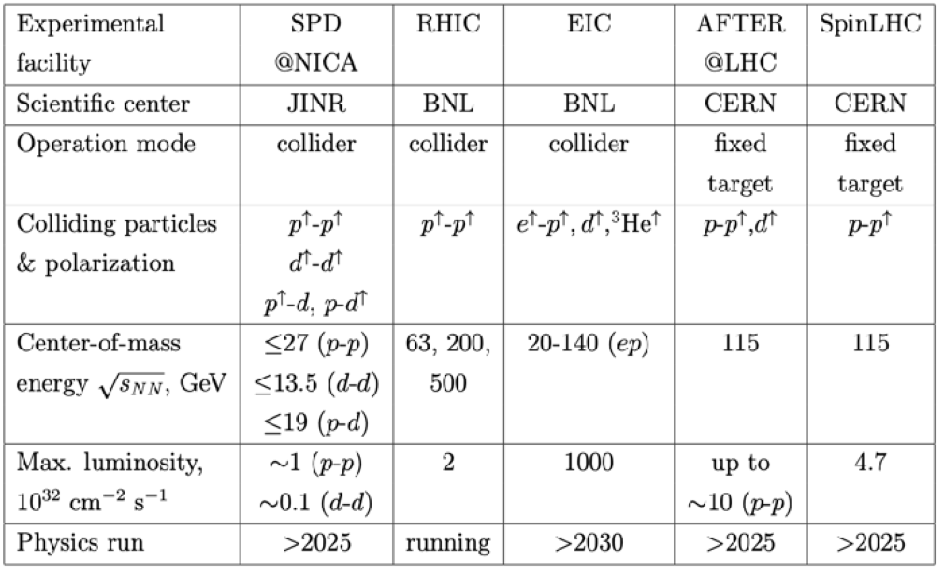

BM@N & MPD NICA SPD
The SPD experiment is aimed at studying the properties of strong interactions in the nonperturbative region, at measuring the proton and deuteron spin structures, and at the development of a three-dimensional model of the nucleon. It is unique in its methodology, breadth of coverage and variety of tasks.
MPD covers this interesting region providing powerful combination of large luminosity, collision energy and system size scan (including isobars), large and consistent acceptance, full centrality range.
NICA is complementary to existing and planned world facilities (FAIR, SPS), and will be a natural and necessary continuation and significant expansion of studies at RHIC BES.
Notes:
Advantages of the MPD & NICA
NICA covers an energy range where most important an interesting physics appears to take place - transition from hadronic to partonic effect dominance, possible appearance of first order phase transition in QCD phase diagram, transition from baryon to meson dominance in particle production. All of this is also connected to astrophysical studies which are strongly developing now and may pose additional questions for us. In summary there are a lot of interesting open questions and MPD has the capabilities to answer many of them.
MPD covers this interesting region providing powerful combination of large luminosity, collision energy and system size scan (including isobars), large and consistent acceptance, full centrality range.
NICA is complementary to existing and planned world facilities (FAIR, SPS), and will be a natural and necessary continuation and significant expansion of studies at RHIC BES.
Other facilities:
HADES and SIS18 provide energies below 3 GeV;
FAIR is not going to provide data before 2028 - so it will not provide data in timescale comparable to NICA;
SPS operates at higher energies, and is fixed target (and also mostly limited to highest centralities);
STAR BES (Beam Energy Scan) covered the energy range of 3-20, however:
- the data taking is finished,
- data sample of 100M at most energies may be
enough to "pose interesting questions", or
highlight the region of interest, but not provide
"definite answers",
- data below 8 GeV is in fixed-target mode,
- no collision system size scan was done,
- isobar run of RHIC showed new interesting physics
that may be explored at NICA.
BM@N
Baryonic Matter at Nuclotron (BM@N) experiment is focused on measurement of Au+Au collisions up to a kinetic beam energy of 3.8·A GeV in order to investigate the equation-of-state (EOS) and the microscopic degrees-of-freedom of QCD matter at neutron star core densities, as EOS defines relation between density, pressure, temperature, energy and isospin asymmetry of nuclear matter.
The “hot” topics of the experiment are:
Study isospin symmetric matter EOS at densities of ρ=3-5 ρ₀ (saturation density) by the following measurements:
- elliptic and direct flows of protons, mesons and hyperons,
- sub-threshold production of multi-strange hyperons and
anti-hyperons.
Constrain symmetry energy E_{sym} - difference between binding energy of isospin symmetric and asymmetric matter by the following measurements:
- collective flow of neutrons vs protons,
- sub-threshold production of particles with opposite isospin.
Searches for quark degrees-of-freedom and the critical endpoint of the first order phase transition at high baryonic densities.
Role of hyperons in neutron stars (ΛN and ΛNN interactions) by measurements of yields and lifetime of light hyper-nucleus at high baryonic densities.
О возможности изучения на NICA столкновений изобарных ядер, имеющих тот же атомный номер, но разный заряд: в частности - не можем ли мы столкнуть свинец-208 и висмут-208?
RICH закончил набор данных, но на последнем рабочем совещании (закрытом) они говорили об интересных результатах, которые могут быть очень важны для понимания структуры ядра. В этом плане низкие
энергии NICA могут быть дополнительным преимуществом. Если столкновения идут с большим прицельным параметром, то возникают
сильные электромагнитные поля и соответствующая физика - Chiral Magnetic Effect.
Есть давние работы по теме. Например, С.Волошин (Phys.Rev.Lett.105 (2010) 17230) предлагает сталкивать Ru-44 и Zr-40 (A=96).

Slide 7
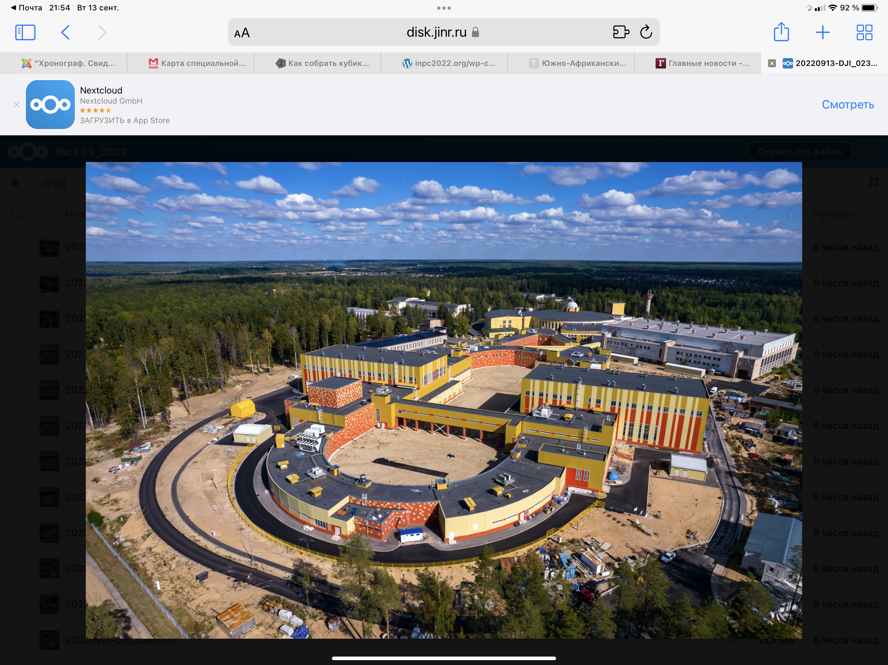
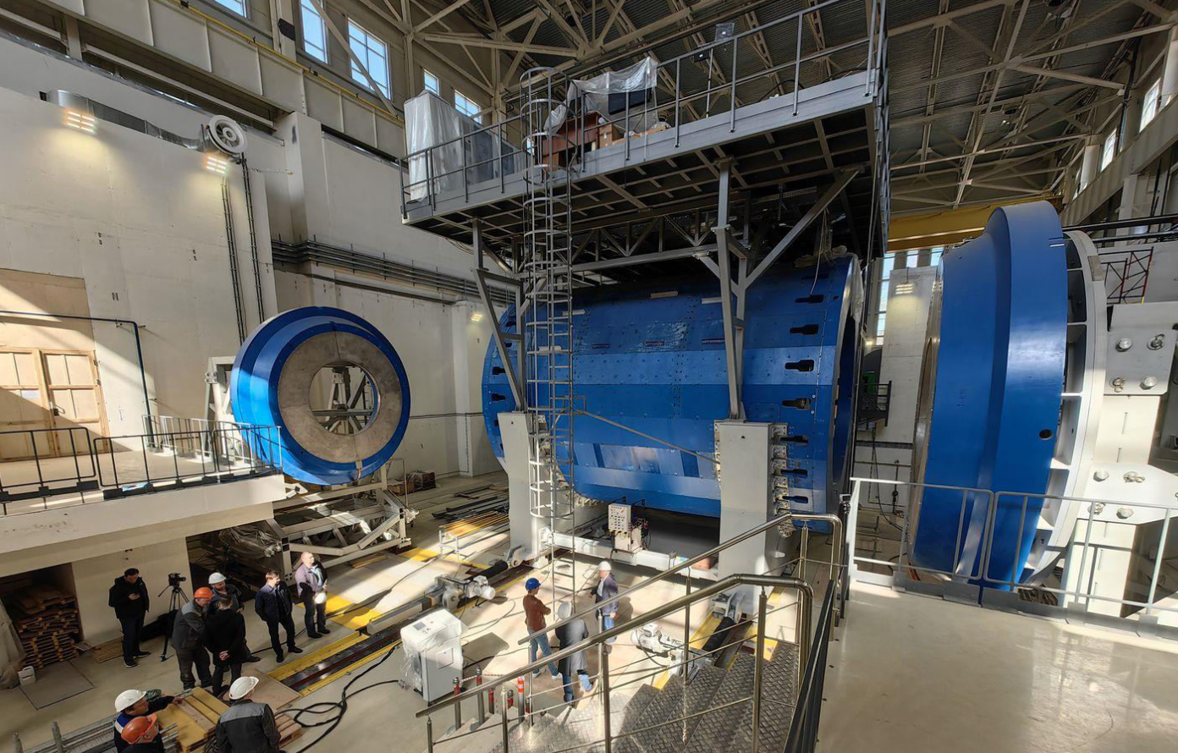
Relativistic Heavy Ion Physics and Study of nucleon structure. Near and Long-Term Future
The timely completion of the NICA project, its commissioning and steady and efficient operation.
Completion of the detectors: BM@N, MPD and SPD at NICA and successful data taking over the decades to come. JINR will make significant contribution to the basic configuration of the SPD detector.
After several years of running of MPD, an Upgrade is foreseen, responding to an increase in luminosity of NICA. Adding detectors in the forward region as planned.
Studies of possible future extension of NICA for acceleration of electrons, opening new physics potential via e-p and e-A collisions.
ARIADNA
BM@N
MPD
SPD
Notes:
For the next two decades, the principal focus in heavy ion physics and spin physics, that will influence to a large extent the JINR strategic development is the timely completion of the JINR flagship facility - NICA. The aim of the NICA project is to create a world-class experimental infrastructure for fundamental research in contemporary High Energy Physics (HEP), applied research, and in development of novel nuclear power technology. The format of close interlaboratory cooperation will contribute to the development of modern detectors and to further achievements in the area of high-temperature superconductivity. This base should be utilized by a global scientific community of users from member and non-member states of JINR.

Slide 8
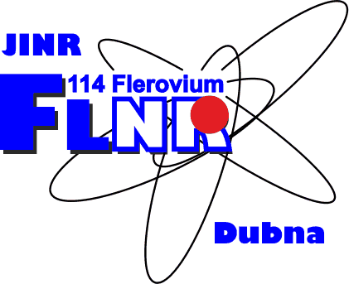
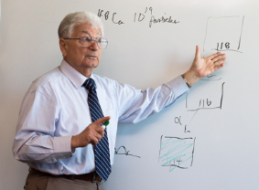
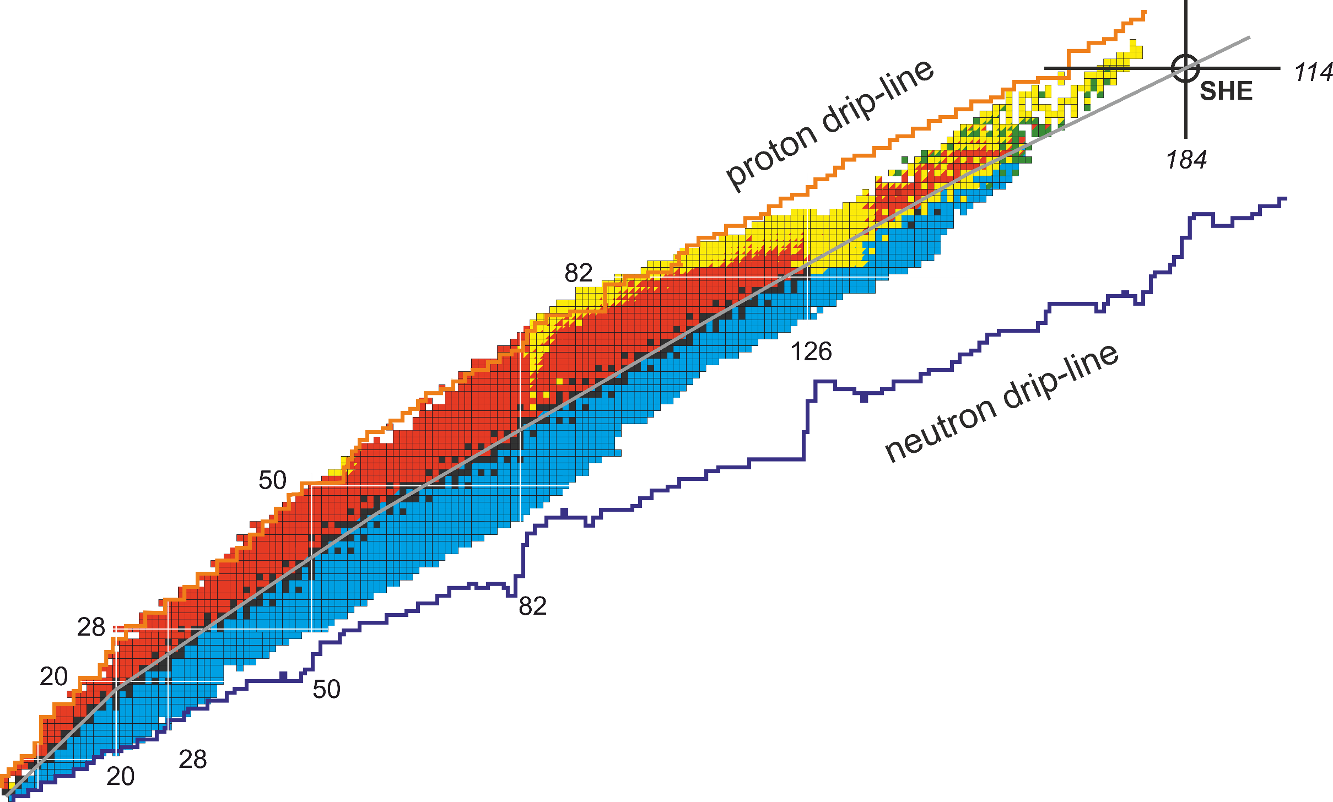





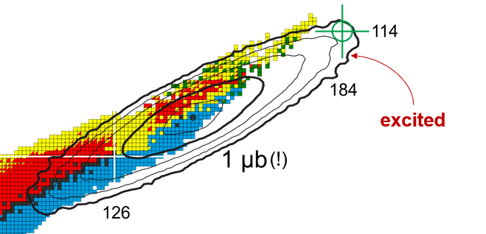
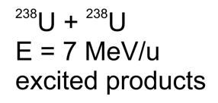
Research of synthesis of new nuclei:
Main areas of interest at Flerov Laboratory of Nuclear Reactions
Fusion:
+ any element (question of probability)
- lack of neutrons
Fragmentation:
+ very efficient and universal
- products are lighter than ²³⁸U
Fission:
+ neutron-rich products
- products are much lighter than ²³⁸U
Multinucleon transfer (MNT):
+ a way to unknown regions
- very, very complicated
technically
162
MNT?
Fusion
Fragmentation
Fission
Courtesy of Dr. A. Karpov
"Heaviest nuclei and atoms“
Yerevan, April 25-30, 2023
Light & super light exotic nuclei, neutron-rich hydrogen (^{5,7}H) and helium (^{8,10}He) isotopes)
Notes:
Основной частью программы ЛЯР им. Г.Н.Флерова на следующее десятилетие: поиск границ существования ядерной материи путем сосредоточения внимания на границах острова стабильности сверхтяжелых элементов (СТЭ) — области карты нуклидов, где могут быть обнаружены долгоживущие изотопы, изучение их свойств методами ядерной спектроскопии (α-, β-, γ-спектроскопии), а также их химических свойств, изучение механизмов различных ядерных реакций, приводящих к образованию новых, еще неизвестных ядер.
Для этого построена Фабрика СТЭ на базе ускорителя тяжелых ионов ДЦ-280 — лидера среди ускорителей такого типа в мире. Существенное повышение (в 20 раз) эффективности экспериментов необходимо для синтеза еще более тяжелых элементов 119 и 120, а также для изучения ядерных и химических свойств уже известных элементов.
Еще одним научным направлением в области СТЭ станет изучение реакций многонуклонных передач при столкновениях актинидов с энергией вблизи барьера, перспективных для синтеза новых нейтронно-избыточных изотопов тяжелых и сверхтяжелых элементов вплоть до линии бета-стабильности. На модернизированном ускорительном комплексе У-400Р будут созданы необходимые условия для углубленного изучения этих и других низкоэнергетических ядерных реакций с тяжелыми ионами.
ЛЯР ОИЯИ обеспечит продолжение экспериментальных исследований в области легких экзотических ядер, находящихся на границах ядерной стабильности, включая изучение ядерного гало, нейтронной шубы, кластерных состояний, экзотических мультинейтронных распадов (двухнуклонных виртуальных состояний, 2n- и 4n-радиоактивности), двухпротонной радиоактивности, поиск новых магических чисел, спектроскопию экзотических ядер и реакции с галоядрами.

Slide 9
Flerov Laboratory of Nuclear Reactions Program for the next decade:
Searching for the boundaries of the existence of nuclear matter by focusing on the boundaries of the island of stability of superheavy elements (SHE) – an area of the nuclide map where long-lived isotopes can be detected, studying their properties using nuclear spectroscopy methods (α-, β- , γ-spectroscopy), as well as their chemical properties, the study of the mechanisms of various nuclear reactions leading to the formation of new unknown nuclei. A significant increase (20 times) in the efficiency of experiments is necessary for the synthesis of even heavier elements 119 and 120.
Study of multinucleon transfer reactions during collisions of actinides with energy near the barrier, which are promising for the synthesis of new neutron-rich isotopes of heavy and superheavy elements up to the beta stability line. The modernized U-400R accelerator complex will create the necessary conditions for an in-depth study of these and other low-energy nuclear reactions with heavy ions.
Continuation of experimental research in the field of light exotic nuclei located on the boundaries of nuclear stability, including the study of the nuclear halo, neutron coat, cluster states, exotic multineutron decays (two-nucleon virtual states, 2n- and 4n-radioactivity), two-proton radioactivity, search for new magic numbers, spectroscopy of exotic nuclei and reactions with halonuclei.

Slide 10
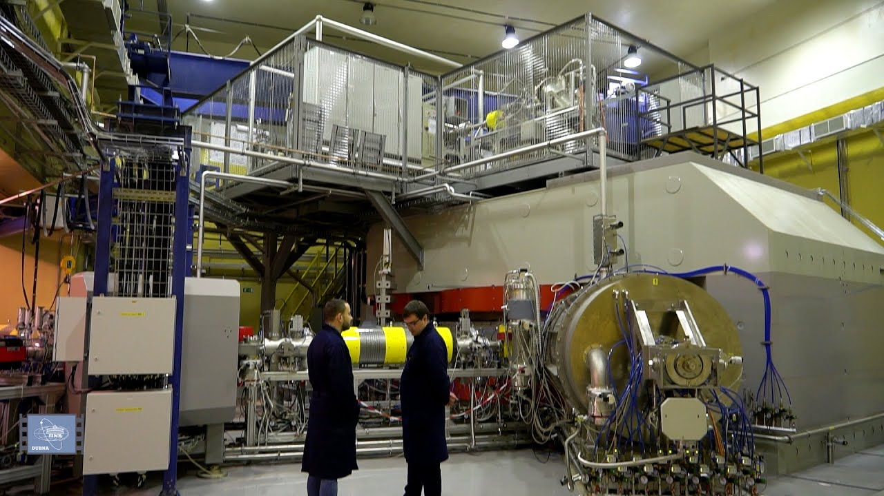
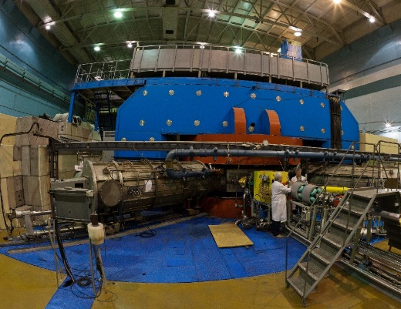
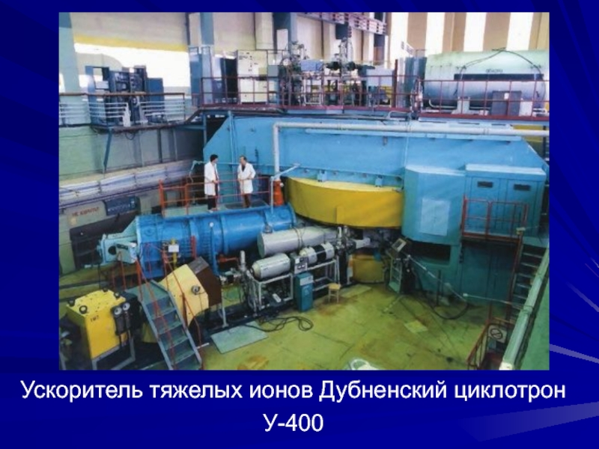
Synthesis of new elements @ SHE Factory
Radioactive Ion-Beam research Basic facility: U-400M
Nuclear reaction studies @ U-400R
Ambitions: up to 2.6 mA (U-beam)
10¹⁰⁻¹¹, smooth energy variation
Ambitions: E up to 80AMeV, I x 2
Operation from end of 2023
Upgrade in 2023-25. Operation from 2026
TARGETS:
Rosatom and ORNL (USA): Isotopically enriched heavy actinide materials;
Radiochemical Lab of class 1
Multinucleon transfer reactions:
Production of new isotopes of heavy,SH nuclei;
Study of properties of new nuclei.
Decay spectroscopy of heavy nuclei: actinides and light transactinides
Study of fusion-fission and quasifission reactions leading to heaviest nuclei
Low-energy and spontaneous fission of heaviest nuclei
Study of nuclei at high excitation energies (several hundred of MeV)
Nucleon halo, neutron skin;
Exotic decays:
b-delayed, 2p,2n radioactivity;
Soft excitation mode;
New magic numbers;
Spectroscopy of exotic nuclei;
Cluster states;
Reactions with RIBs;
Astrophysical applications.
BEAMS:
Production of high-intensity beams of ⁵⁰Ti, ⁵⁴Cr and others
New ECR-28 GHz (2024)
Notes:
Test reactions (2022-2023):
²³⁸U + ⁵⁴Cr → ²⁹²Lv*
²⁴²Pu + ⁵⁰Ti → ²⁹²Lv*
²⁴⁵Cm + ⁴⁸Ca→ ²⁹³Lv*
σ_{3n}= 4pb

Slide 11
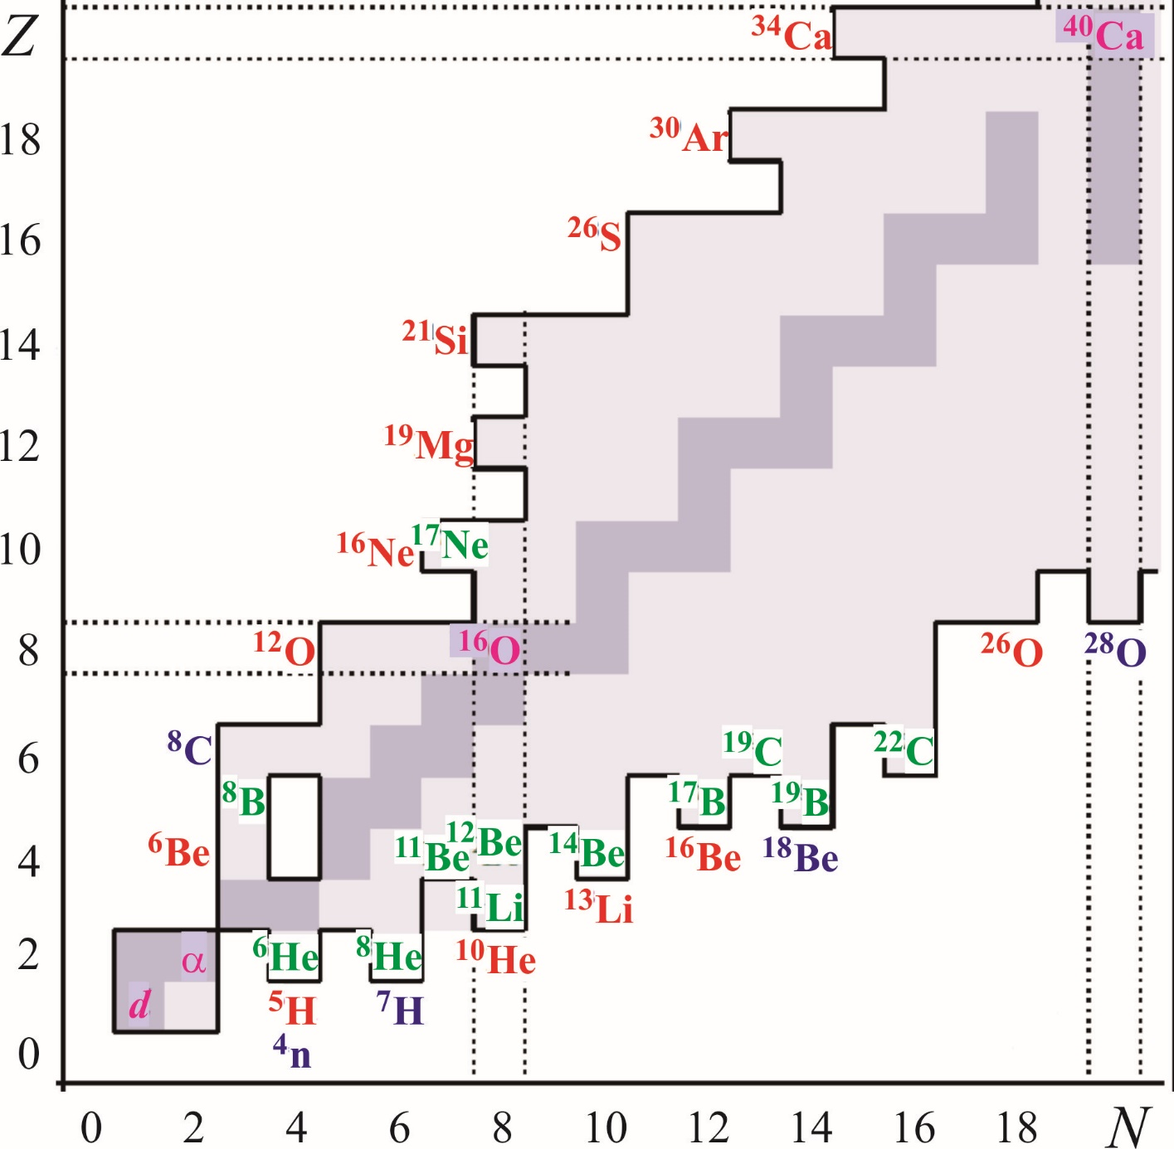
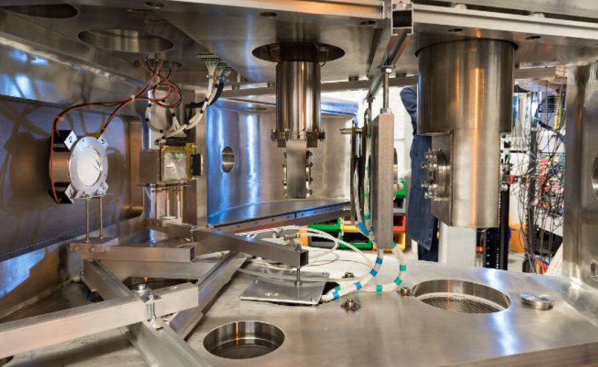
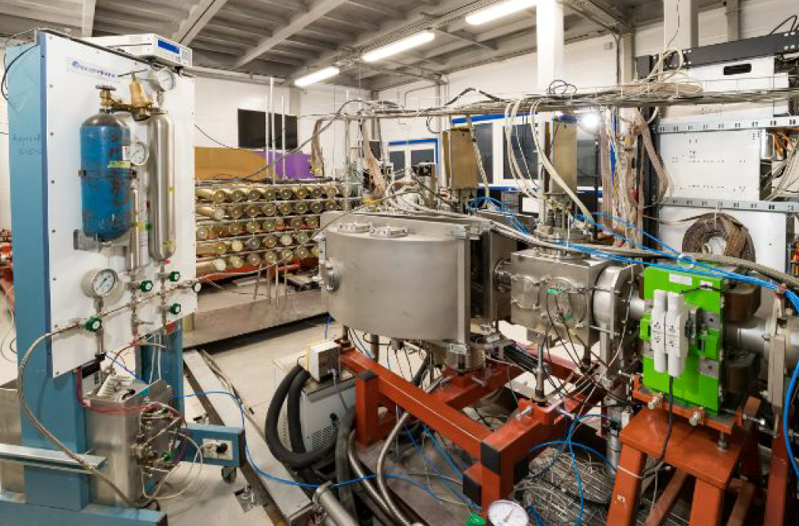
Experimental program with exotic nuclei (2018-2030)
Nucleon halo, neutron skin
Exotic decays: β-delayed, 2p, 2n radioactivity, etc.
Soft excitation mode
New magic numbers and intruder states
Spectroscopy of exotic nuclei
Cluster states
Reactions with RIBs
Astrophysical applications
Key instruments and methods:
- Exotic primary beams: (¹¹B, ¹⁵N, ¹⁸O, ³²S, ³⁶S, ³⁶Ar, ⁴⁸Ca)
- Exotic targets with a thickness 0.3÷15.0 mg/cm² (H₂, D₂, T₂, _{3,4}He)
- Detectors for charged and neutral particles (optical TPC*, neutron wall, scintillator arrays based on CsI, LaBr₃, Si-telescopes, etc.)
- Stage for beam purification (RF-kicker, Zero degree spectrometer)
Courtesy of Dr.D.Kamanin

Slide 12
The main directions in Particle Physics for JINR for the medium and long term are related to:
precision study of strongly interacting states, including structure, phase QCD states, new hadronic states, including exotic multiquark states;
study of the physics of electroweak interaction and flavor physics;
further progress in understanding the evolution of the Universe in collider experiments, including the search for dark matter;
astrophysical and cosmological observations and gravitational wave studies, multi-channel astronomy and the dark sector in non-accelerator experiments;
experimental and theoretical definition of a model that goes beyond the Standard Model;
The JINR research program in the field of neutrino physics and astrophysics is aimed at fundamental problems: identification of astrophysical sources of ultra-high energy neutrinos, mechanisms of formation and evolution of galaxies, determination of the neutrino mass hierarchy, origin of neutrino mass, restrictions on the CP violation phase, direct search dark matter, precision study of coherent elastic scattering of neutrinos on nuclei, etc.
Currently, it is believed that phenomena occurring in the Universe should be studied by simultaneously observing different signals. The Baikal-GVD project is one of the cornerstones of this approach. The TAIGA installation, a set of gamma-ray and muon telescopes located in Siberia, in the Tunka Valley, south of Lake Baikal, can be considered as an additional instrument from the point of view of multichannel astronomy.

Slide 13
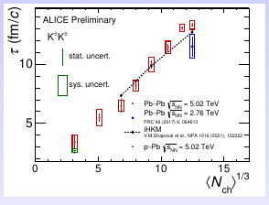
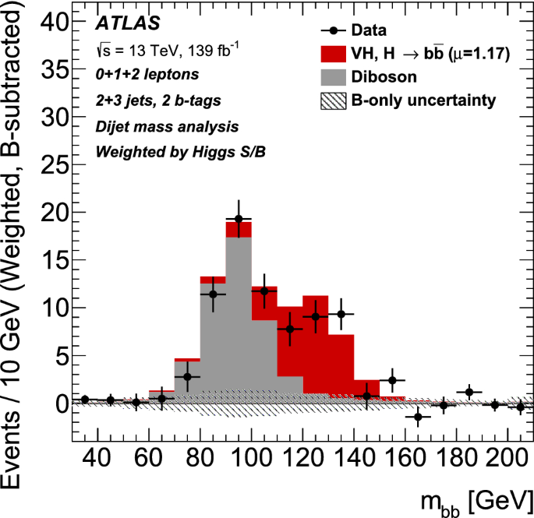
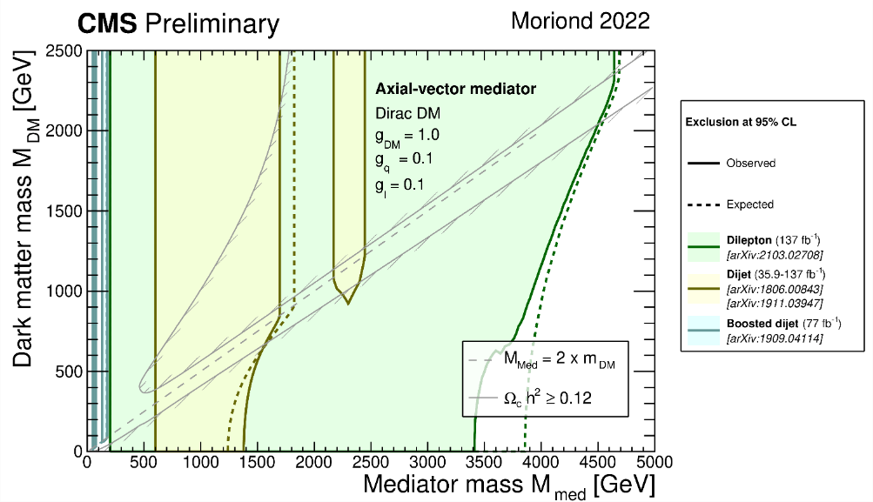
Selected Results from CERN and BNL in 2017-2023 (1)
ALICE:
Comprehensive study of the femtoscopic correlations;
Kaon emission time (τ) is obtained in 3D femtoscopic analysis of K±K± pair roduction (EPS-HEP 2023, Hamburg).
29 publications;
28 conference reports.
ATLAS:
First observation of the Higgs boson decay into a pair of b-quarks;
Limits on chiral W*/Z* bosons in Drell-Yan and two-jet processes;
Study of B_{c} state properties, Penta/Tetraquark states;
Measurements of BEC parameters.
50 publications;
36 conference reports.
CMS:
Searches for the Physics BSM including extra Higgs bosons, new gauge bosons, extra dimensions, etc. with dilepton/bbar + missing transverse energy signatures;
Search for Dark Matter;
SM tests with Drell-Yan processes and jets.
>100 publications;
140 talks at conferences and workshops;
Both, ATLAS and CMS teams made significant contribution to their detector’s Upgrade in Phase-I, now moving to Phase-2 Upgrade

Slide 14
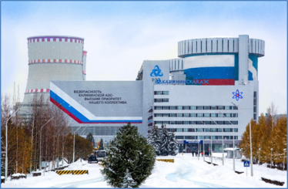
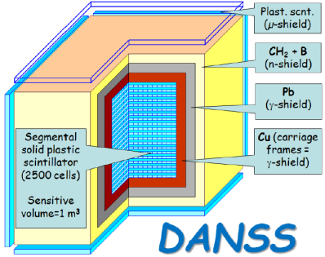
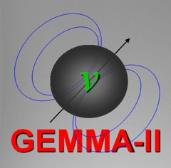
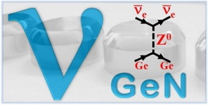





Non-accelerator neutrino physics and astrophysics
Scientific directions :
– Double beta decay, neutrino nature -- Majorana or Dirac; Nuclear matrix elements
– Fundamental neutrino properties (magnetic moment, mixture with a sterile state, etc)
– Monitoring of nuclear reactors with neutrino detectors
– Direct and indirect search for Dark Matter
– Investigation of galactic and extragalactic neutrino sources
– Atomic processes accompanying radioactive decay
– Applied directions of research
The major aims:
– BAIKAL-GVD: Observation of ultra-high energy astrophysical neutrinos; identification of their sources and nature
– DANSS: precision measurement of the spectrum of reactor antineutrinos
– RICOCHET: New physics with precision measurements at reactors.
– νGeN: search for magnetic moment of neutrino
– LEGEND: neutrinoless double-beta decay at 10²⁸ years
– Radiochemistry plus spectroscopy for astrophysics and nuclear medicine

Slide 15
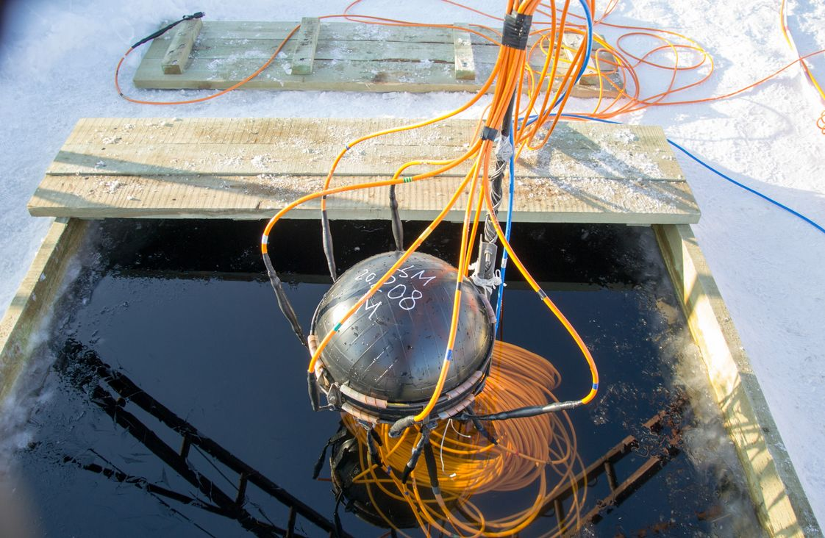
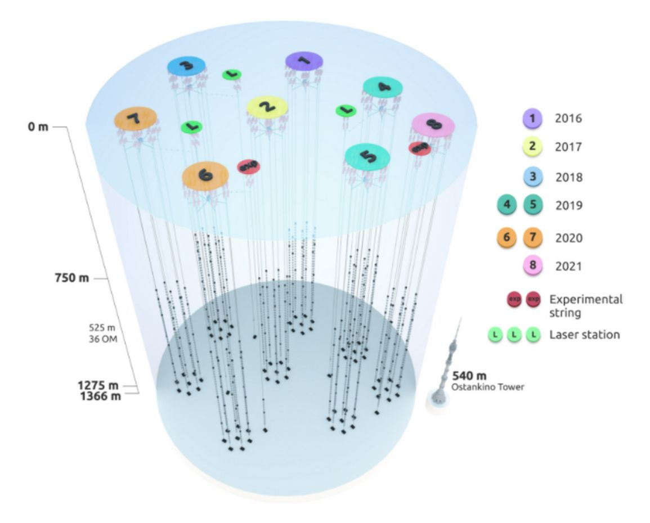
NEUTRINO AND ASTROPARTICLE PHYSICS
Project Baikal-GVD
Baikal-GVD: Identification of astrophysical sources of ultra-high energy (exceeding tens of TeV) neutrinos. Actuality: their sources are still unknown. The identification of sources will help to elucidate mechanisms of galaxies creation and evolution.
Main advantage of Baikal-GVD: pure and t-stable water. Angular resolution of muon tracks 0.3-0.5 grad (IceCube: 0.5-1), angular resolution of shower direction 2-3 grad (IceCube: 15),
Year | Number of clusters | Number of OMs
2016 | 1 | 288
2017 | 2 | 576
2018 | 3 | 864
2019 | 5 | 1440
2020 | 7 | 2016
2021 | 8 | 2304
2022 | 10 | 2880
2023 | 12 | 3456
2024 | 14 | 4032
2025 | 16 | 4600
The second phase of the Baikal-GVD neutrino telescope will begin at the turn of 2025 and is scheduled for completion in 2030, when the facility will have more than 20 clusters (approximately 6000-7000 optical modules) with an effective volume of about or above 1 km3.
Baikal-GVD: flagship experiment of JINR with a leading role in the collaboration.
Gain new experience in the detector design, construction, deployment, maintenance, simulation and data analysis. Expected breakthrough discoveries.
SAC: light sensors, data transmission, radio-antennas + optics => New Quality and Efficiency

Slide 16
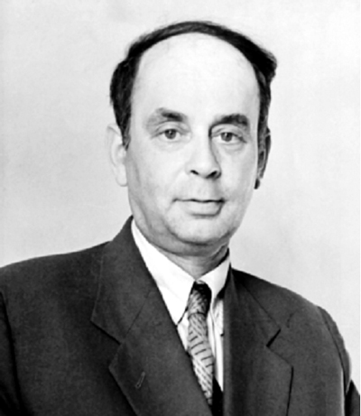
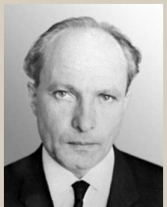
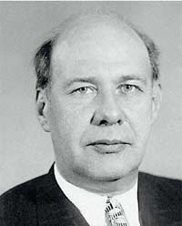
Neutron Nuclear Physics and Condensed Matter Research @ JINR
UCN physics;
  Neutron lifetime;
  Weak equivalence principle check. EDM?
  Neutron quantum states in gravitational field;
Neutron scattering for condensed matter studies @ IBR-2;
  Diffraction at high pressure;
  Soft matter;
  Nanostructurized magnetic materials;
  Energy selective neutron radiography and tomography;
Nuclear physics with neutrons @ IREN, IBR-2 & external sources;
  Nuclear data for engineering and astrophysics;
  Fundamental symmetries violation in neutron-nucleus interaction;
  Applied research;
I.M. Frank
F.L. Shapiro
D.I. Blokhintsev
Frank Laboratory of Neutron Physics
Notes:
В современной науке нейтроны используются для изучения фундаментальных взаимодействий и симметрий, структуры и свойств атомных ядер, но в настоящее время наиболее широко — в физике конденсированного состояния вещества, молекулярной биологии, структурной химии, материаловедении, в системах неразрушающего контроля объемных материалов и промышленных изделий. Кроме того, нейтроны сверхнизких энергий также являются весьма перспективным инструментом для исследований в области физики элементарных частиц и изучения фундаментальных взаимодействий.
Предметом исследования нейтронной физики является также свойства самого нейтрона как элементарной частицы. Большое значение для физики слабого взаимодействия имеет точное измерение времени жизни нейтрона (в тч для загадки Барионной асимметрии Вселенной). Многие расширения Стандартной Модели предсказывают наличие у нейтрона ненулевого ЭДМ, а также существование нейтрон-нейтронных осцилляций. Изучение квантовых уровней энергии нейтронов в гравитационном поле Земли, а также изучение нарушения фундаментальных симметрий в реакциях нейтронов с ядрами (о временной инвариантности, т.е. проверке CPT теоремы).
Нейтронная спектроскопия в гравитационном поле позволила получить результаты космологического масштаба, касающиеся некоторых экзотических теорий темной материи и темной энергии.
Схема эксперимента по наблюдению квантовых уровней энергии нейтронов в гравитационном поле Земли. Ультрахолодные нейтроны влетают в узкий зазор между плитой и поглотителем и, подпрыгнув несколько раз, долетают до счетчика нейтронов. Если высота прыжков составляет доли миллиметра, эти прыжки описываются уже не классической, а квантовой физикой. Измеряя поток нейтронов в зависимости от ширины зазора, можно обнаружить квантование нейтронного движения по вертикали.
Десять лет назад было экспериментально доказано, что за счет силы тяжести лежащие на подложке ультрахолодные нейтроны обладают квантовыми уровнями энергии, наподобие электронов в атоме.
В начале 2000-х годов квантование уровней энергии было экспериментально продемонстрировано еще в одном, довольно необычном, случае — для ультрахолодных нейтронов в поле тяжести Земли. Нейтрон со скоростью порядка несколько метров в секунду хорошо отражается от обычного твердого вещества. Поэтому если его, условно говоря, «положить» на горизонтальную плиту, то он будет находиться в потенциальной яме, ограниченной снизу отражающей плитой, а сверху — потенциальной энергией. В этой потенциальной яме у нейтрона будут квантованные уровни энергии с энергиями порядка пикоэлектронвольта (в триллионы раз меньше, чем энергии электронов в атоме). Эти уровни энергии и были впервые зарегистрированы в 2001 году.
полезно еще раз подчеркнуть два аспекта этой работы. Во-первых, в очередной раз подтверждается мысль, что аккуратные измерения очень тонких лабораторных эффектов позволяют сделать выводы, касающиеся устройства всей Вселенной. В частности, в описанной работе измерения нейтронов позволили ограничить экзотические модели темной энергии и темной материи. Во-вторых, нейтроны в этом исследовании играют особую роль. В отличие от заряженных частиц и от нейтральных атомов, ультрахолодные нейтроны практически не чувствуют «обычных» сил, вызванных межатомным взаимодействием или электрическим полем. Это помогает нейтронам чувствовать другие силы — гравитацию и гипотетические «пятые силы». Именно поэтому уже первые измерения спектроскопии нейтронов в гравитационном поле позволили получить ограничения, превосходящие возможности обычной атомной спектроскопии.

Slide 17
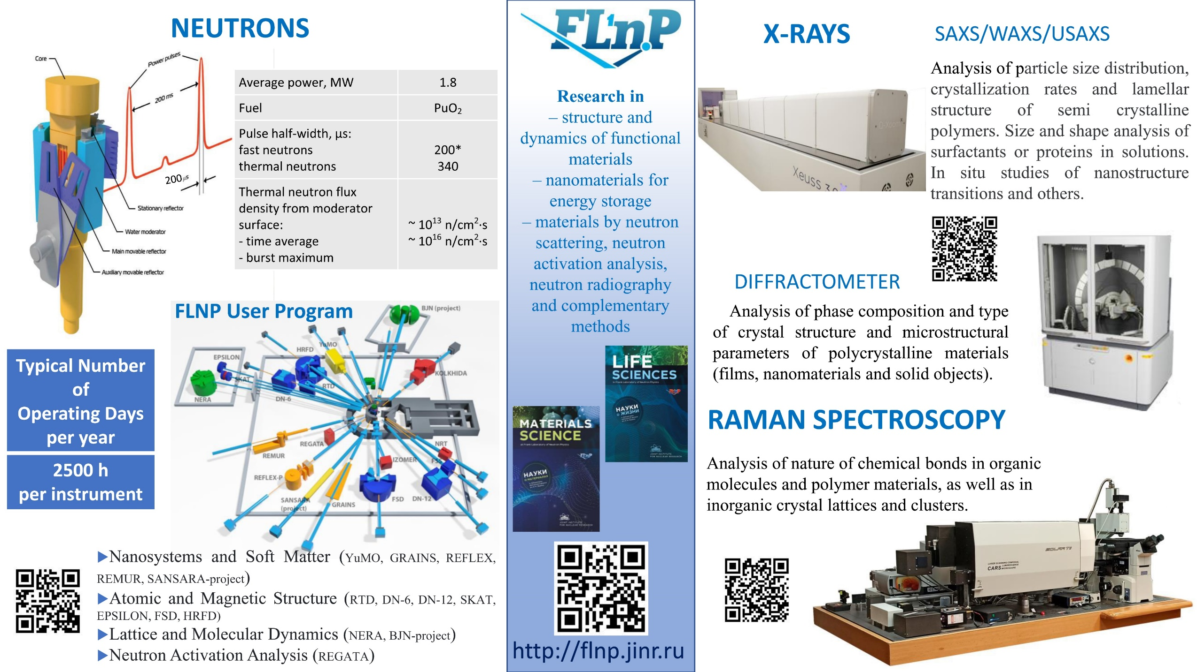
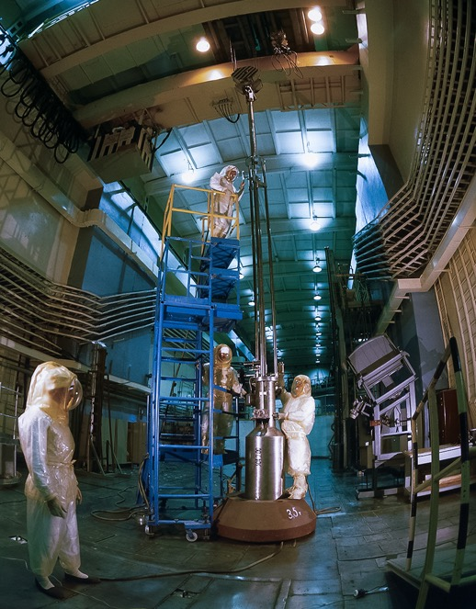
Facilities
Pulsed Reactor (IBR) and Neutron Spectrometers
Intense REsonance Neutron Source (IREN)
Van der Graaf Electrostatic Accelerator (EG-5)
Multimodal Optical Platform (CARS)
courtesy of Dr. D.Chudoba

Slide 18

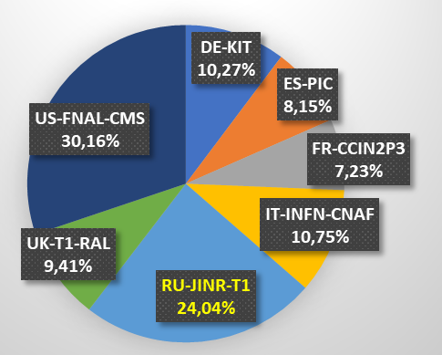
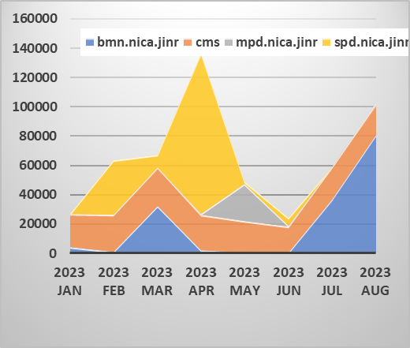
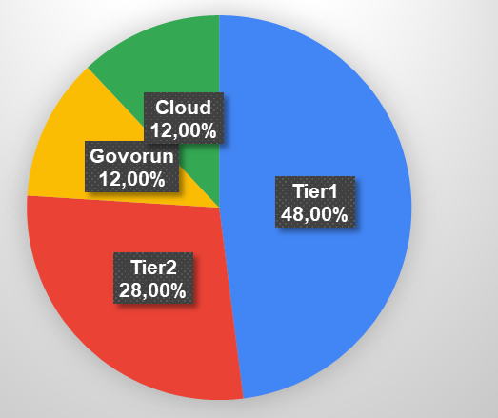
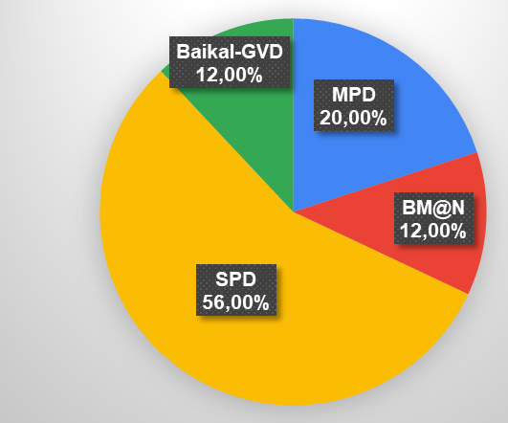
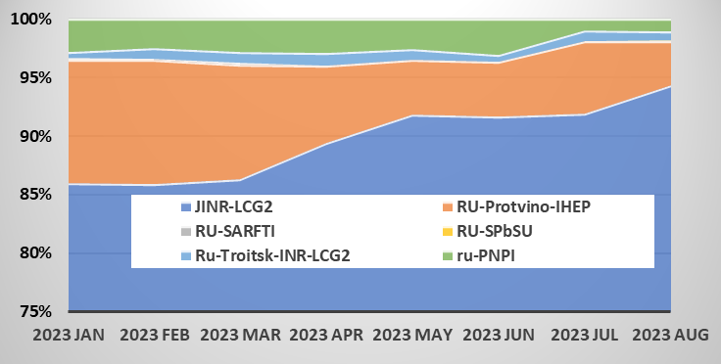
MICC – Grid Infrastructure and DIRAC
In 2023, the JINR Tier1 site for CMS is ranked second (24%) among Tier1 world centres for CMS. JINR Tier1 is also used for the MPD, BM@N and SPD experiments.
In 2023, DIRAC is the only system that includes all key MICC components. DIRAC serves as an intermediate layer between users and various computing resources, ensuring their efficient, transparent and reliable use, providing a common interface to heterogeneous resources.
At the moment, DIRAC is used to support the collaborations of the NICA experiments: MPD, BM@N and SPD, as well as the Baikal-GVD neutrino telescope.
Distribution by CPU Work (HS23 hours) among CMS Tier1 worldwide
Distribution by the number of jobs completed on Tier1 by CMS, BM@N, MPD and SPD
MPD
CMS
The JINR Tier2 output is the highest (89.3%) in the Russian Data Intensive Grid.
Distribution by the normalized CPU time among the MICC components: Tier1, Tier2, Cloud and Govorun for jobs sent via DIRAC in 2023
Distribution by the normalized CPU time among MPD, BM@N, SPD and Baikal-GVD for jobs sent via DIRAC in 2023

Slide 19
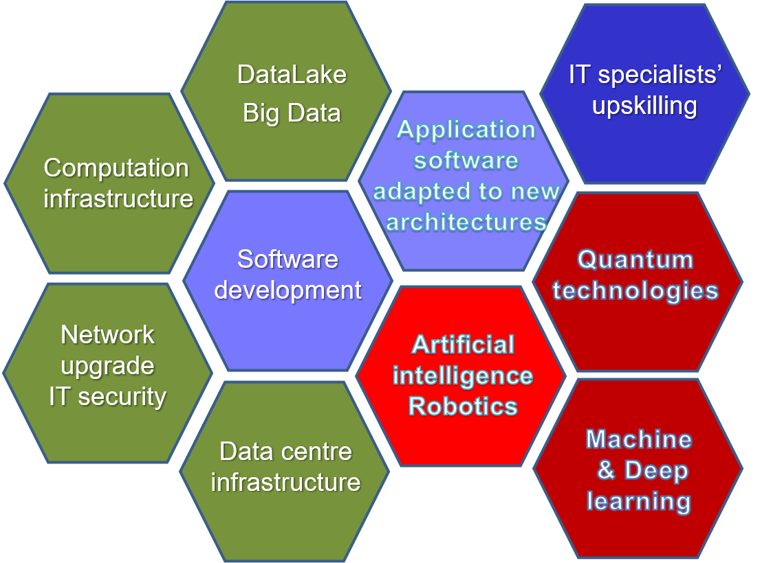
Strategy for Information Technology and Scientific Computing at JINR
Scientific IT ecosystem:
Steady implementation/upgrades of
Networking (Tb/s range)
Computing infrastructure within the Multifunctional Information & Computing Complex (MICC) and
“Govorun” Supercomputer,
NICA Tier0-Tier1-number of Tier2;
Baykal, NOvA, JUNO – all types of resources
LHC@HL-LHC: Tier1 for CMS, Tier 2 for ATLAC, ALICE
Data center infrastructure,
Data Lake & long-term storage for all experiments.
The development of new data processing and analysis algorithms based on
ML/DL,
artificial intelligence,
Big Data
Quantum technologies.
The coordinated development of interconnected IT technologies and computational methods
A variety of means will be used for IT specialists upskilling.

Slide 20
Researchers of JINR are active participants of the of state-of-the-art international accelerator projects: LHC, XFEL, FAIR, RHIC, GANIL, INFN, IMP CAS, HIAF, EIC, ILC, CLIC, FCC, etc. We will focus on R&D in the following areas:
BEAM PHYSICS AND ACCELERATOR TECHNOLOGIES
– highly charged intense ion sources for generating heavy-ion beams (Z > 40+);
– superconducting magnetic technologies: high-field magnets with fields up to 14–20 T, fast-cycling high-field magnets (B > 4 T, ramp 4-10 T/s), high-current cables and windings (I_cr > 30 kA);
– studies in the field of high-temperature superconductivity, R&D of ”Dubna SC” cable technologies;
– efficient fast cooling systems for intense hadron beams (~ 10 - 100 ms);
– superconducting RF structures (RFQ and DTL) and cryomodules for intense p- and i- beams;
– research in the field of colliding beam accelerators. Problems of future colliders (FCC, ILC, CpeC, etc.);
– R&D on beam therapy (flash, pencil beam, light ions, neutrons);
– development of modeling methods (including using AI methods) of beam dynamics with the real electromagnetic fields in accelerator structures and in-flight beam parameters, deep machine learning for operation.
Progress for the implementation depends on the coordination of priorities/resources, which must be carried out in close Interlaboratory JINR cooperation and involving centers from Member States.
It is feasible within the framework of the dedicated All-Institute theme for the period 2024–2030.

Slide 21
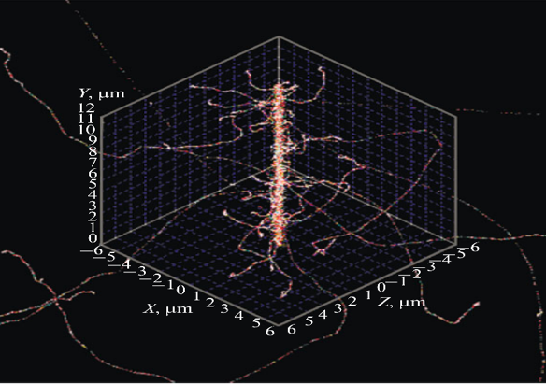
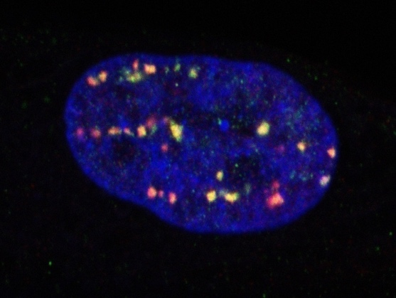
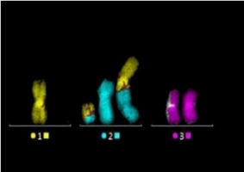

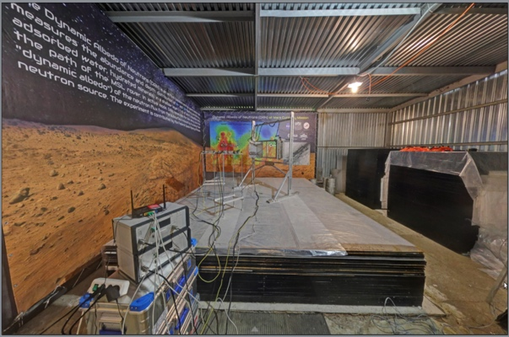
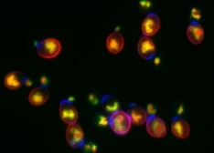
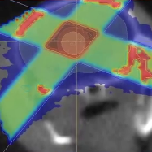
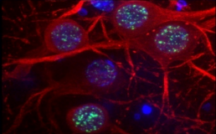

RADIATION RESEARCH IN LIFE SCIENCES
Mathematical Modeling
Main Research Fields:
Molecular Radiobiology
Radiation Cytogenetics
Radiation Physiology
Radiation Research
Radiation Genetics
Clinical Radiobiology
Radiation Neuroscience
Astrobiology

Slide 22







JINR’s radiation sources for radiobiological studies
Phasotron:
protons 170 MeV
U-400M cyclotron:
heavy ions 50 MeV/u (Li-Ne)
Nuclotron: heavy ions 0.3-1 GeV/u (H – Kr)
cyclotron MSC230
(since 2024):
protons up to 230 MeV
IBR-2, IREN: neutrons
SARRP: X-ray
Linac200:
electrons 20-200 MeV

Slide 23
IUPAP Report, WG-9 and C-12 (Summer 2023):
The key physics issues that have led to the nuclear science facilities existing or being planned:
• The nuclear physics as studied from its beginning; nuclear structure and nuclear reactions, the formation of the elements throughout the universe including the super-heavy elements.
• The structure of the nucleon consisting of quarks and gluons within the Standard Model.
• Fundamental symmetries leading to physics beyond the Standard Model and with the study of neutrino properties through neutrino-less double beta-decay and neutrino oscillations.
• Nuclear energy in the era of climate change and global warming.
• Applications of nuclear physics to the benefit of society, e.g. as in nuclear medicine.

Slide 24





INNOVATIONS: International Centre for Nuclear Technologies Research
Radiation Biology @ LRB, OMICS, neuro-RB studies, radiation neuroscience. Approaches to increase radiosensitivity: pharmaceuticals, transgene systems, targeted delivery and radionuclide;
ARIADNA. Applied beams@NICA: radiobiological studies (400-800 MeV/n); irradiation of electronics and material science (3; 150-350 MeV/n); nuclear physics (1-4.5 GeV/n);
DC140 cyclotron: Space electronics testing, radiation material science, new generation of track membranes;
MSC230 cyclotron: research and beam therapy: treatment planning; radiomodificators for γ− and p- therapy, flash-therapy, pencil beam (10 µA, >5 Gr/l @ 50 ms pulse).
Radiochemical Laboratory Class-I for production of radioisotopes (Ac²²⁵, ^{99m}Tc), nuclear medicine R&D in photonuclear reactions @ 40MeV e-accelerator.
DC-140 (construction phase)
MSC-230 (general view)
Notes:
24

Slide 25


Slide 26








Big Science
Machine learning
Plant disease detection platform pdd.jinr.ru
Hydrogen energy
New materials and proton-exchange
membranes improvement
Implant development
Biocompatible implants
for corneal transplantation
Proton therapy
New 230 MeV superconducting
medical cyclotron
Membranes
Track membranes for water analysis
and filtration Cassette module for
immunoenzyme preparations and vaccines
Tomography
semiconductor detectors for "coloured"
computer tomography
Carbon supersites
Mobile facility for measuring soil carbon content
based on the tagged neutron method
for Business
The strategic goal of innovative development of JINR “2030”
is to become one of the leading centres
of knowledge transfer among the Member States
of the Institute. Such a centre should be capable
of achieving significant results in compliance with their technological priorities, increasing interest in expanding applied research at the basic facilities
of JINR, demonstrating the significance of the results of fundamental science for society.
The flagship initiative
of the Institute in the development
of R&D infrastructure
is the creation of the Innovative Centre for Nuclear Physics Research in radiation biology, biomedical technologies, radiation materials science, ecology, and information systems.

Slide 27

2030+

Slide 28


Directions of the Personnel Strategy 2024‒2030
- Staff renewal (continuing education)
- Harmonizing age structure
- Significant growth of Associate staff.
Moscow Regional Physics and Mathematics Lyceum named after Academician V. G. Kadyshevsky
Main actions:
JINR University Center
Schools and Practices
Associated staff
JEMS, InfoCenters
PhD, Fellowships
Science communications
Moscow State University Branch in Dubna.
Departments of Elementary Particle Physics and Department of Fundamental Nuclear Interactions.
Departments at MIPT, MEPhI, SPbSU, Dubna University and several others.

Slide 29
JINR regional cooperation approach – cluster programs. Research & Education
Middle East
and Northern Africa region
JINR country
Egypt – member state
10 partner organizations
Hub organization
AAEA
MoU since 2016
Southwest Balkans
JINR country
Bulgaria – member state,
Serbia – associated member
5 partner organizations
Partners in region
3 Croatia
2 Slovenia
1 Montenegro
1 Northern Macedonia
BulgariaSerbia
China
Cuba
Egypt
Vietnam
India
Asia and South Pacific
JINR country
Vietnam – member state
10 partner organizations
Special Partner – China (24+18)
Partners in region
5 Thailand
1 Indonesia
Latin American region
JINR country
Cuba – member state
4 partner organizations
Special Partner – Mexica (7)
Partners in region
17 Brazil
2 Argentina
3 Chile
1 Ecuador
1 Peru
RSA
South African region
JINR country
South Africa – associated member
10 partner organizations
Partners in region
1 Botswana
Area of potential interests: East and Central Africa
Rwanda – East Africa Institute for Fundamental Research (ICTP partner), Centre of Nuclear Science and Technologies
Kenya – headquarter of the African Academy of Sciences
ROSATOM strategic partners: Namibia, Angola, Ghana, Kenya, Uganda
South Asian region
Partners in region
24 India
3 Pakistan
1 Bangladesh
1 Sri Lanka
Notes:
Региональный подход к международному сотрудничеству является эффективным способом развития контактов с новыми партнерами и этот подход уже используется для развития контактов в странах арабского мира. В 2019 году начата работа на пространстве АСЕАН. Также большой объем партнерской сети у ОИЯИ в Латинской Америке. Наряду с перечисленными приоритетными регионами, ОИЯИ имеет определенные наработки в Южной Азии, на Юге Африки и на Юго-Западных Балканах. Как правило, работа с регионом опирается на опыт одной из стран Института, являющейся «точкой притяжения» для региональной научно-исследовательской сети. Наиболее действенным инструментом расширения контактов ОИЯИ в регионах является программа долговременных стажировок на конкурсной основе. Данный подход не является новым, с конца 60х годов он успешно работал под названием «стипендиаты ОИЯИ». Благодаря возможности привлечения кадров из стран-неучастиц, обеспеченной поддержкой КПП, в настоящий момент в Институте работают сотрудники более чем из 30 стран мира. Позвольте мне обратиться к Вам, уважаемые Полномочные представители, за очередным подтверждением мандата дирекции в продолжении зарекомендовавшей себя практики долговременных стажировок для стран-неучастниц.

Slide 31
Milestones of the 2024-2030
Reliable, ecosafe, globaly demanded Research Infrastructure (NICA, FLNR, IBR-2M, B-GVD, MICC): annual beam operation_av => +30%, N_users => +30%, N_publ => +20-30%.
JINR Human Capital (Staff) => + 1500 employes. (620 M$ => 820 M$ || 38% => 44%)
New Innovative Facilities: MSC-230 ~15M$, DC140 ~ 7M$, ARIADNA@NICA ~ 13M$
Feasibility Studies for New Large-Scale Projects: RCL, NEIF, NEPTUN, FRIB, others.
Budget (Integral) growth: 1.5 B$ => 2 B$
New quality and significant attractiveness of JINR2030:
Intellectual ECOSYSTEM ”Digital JINR”
New Educational Standards: Higher School in Dubna, Lyceum;
Development of a social environment: medicine, comfortable urban environment (>100 new flats), ”Ratmino” Guest House;
New countries in the orbit of JINR: Full Members,
Associate and Cooperative States. Proactive ISTC and Communications.

Slide 32

2020 | 2023 | 2026 | 2029 | ~ 2032 | ~ 2035 | ~ 2038
DRIBS, SHE-Factory
Operation and development
FRB @ Flerov Lab
R&D
Feasibility Studies + R&D
Decision
Phased construction
Operation
NICA MPD
Construction
Operation
upgrade
Operation
NICA SPD
R&D + Design
Construction and commissioning
Operation
upgrade
NICA - III (EIC, others)
Feasibility Studies + R&D
International Program + R&D
Technical design and prototyping
Operation
DNS-IV
Technical design and prototyping
Decision
Construction
Operation
Baikal - GVD
Construction and data acquisition
upgrade and data acquisition
Operation
ν & AP Physics
International scientific program
Life Science
Formulation of Internati-onal scientific program
International scientific program
FCC, ILC, GWI, …
Participation in Feasibility Studies, advanced R&D
Decision
Participation in construction
Innovation center
R&D + Design
Construction
Operation and regular modernization
Thank you for your attention and support!

Slide 34
RISKS and MITIGATION
Subject to the principle of reciprocity, the Institute will continue to fulfill all its obligations, will consistently pursue a policy of Open Access to its research infrastructure and scientific data (Open Science), strictly follow internationally recognized standards of scientific expertise and legal support of intellectual property.
The main financial risk for the development of JINR for 2024-2030, associated with the geopolitical situation, is the incomplete and/or untimely fulfillment of the Member-country contributions, the reduction of member states and non-payment of contributions by states where membership was suspended for an indefinite period. Such factors, first of all, will affect the reduction of JINR's human capital, a decrease in the value of its assets and competitiveness, and a significant shift in the timing of achieving scientific results that directly affect the scientific visibility of the Institute's member countries.
Attracting new states with strong and dynamically developing economies to orbit of JINR is the most important area of ​​work to prevent the development of negative scenarios for realization of financial risks.
The Sum of Contributions are to be increased by 5% annually to fully cover the $1,944.6 million cost.
In case of insignificant indexation of the amount of contributions, we have: underfunding of certain stages of work on large scientific projects (NICA-SPD in the first place, about $ 45 million, DRIBs-III Radiochemical Laboratory - class 1 - about 8.5 M$), Life Science and external cooperation up to 10 M$, reduction of experimental time (10-20 M$, as well as cancellation of the involvement of about 200 highly qualified scientists and specialists (36 M$).Even after these cardinal cuts for the JINR Development Program, the budget will have a deficit of about 100 M$.
Notes:
Основные риски и маневры
При соблюдении принципа взаимности Институт продолжит выполнять все взятые на себя обязательства, будет последовательно проводить политику открытого доступа к своей исследовательской инфраструктуре и научным данным (Open Science), неукоснительно следовать международно-признанным стандартам научной экспертизы и правовой поддержки интеллектуальной деятельности. Основным финансовым риском развития ОИЯИ на 2024-2030 гг., связанным с геополитической обстановкой, является неполное и/или несвоевременное выполнение взносов стран-участниц, сокращение числа государств-членов и неуплата взносов государствами. Такие факторы, в первую очередь, повлияют на сокращение человеческого капитала ОИЯИ, снижение стоимости его активов и конкурентоспособности, а также существенное смещение сроков достижения научных результатов, что напрямую влияет на научную значимость самих стран-участниц Института. Привлечение на орбиту ОИЯИ новых государств с динамично развивающейся экономикой является важнейшим направлением работы по предотвращению развития негативных сценариев реализации финансовых рисков.
Сумма взносов должна увеличиваться на 5% ежегодно и ежегодно наполняться, чтобы полностью покрыть расходы в размере 1.944,6 M$. При меньшей индексации суммы взносов будет недофинансирование отдельных этапов работ по крупным научным проектам: NICA-SPD около 45 M$, DRIBS-III Радиохимическая лаборатория - 1 класс - около 8,5 M$, Life Science и внешнее сотрудничество до 10 M$, сокращение времени проведения экспериментов: 10-20 M$, а также отмена привлечения около 200-300 высококвалифицированных ученых и специалистов - 36 M$. Даже после этих кардинальных сокращения на Программу развития ОИЯИ дефицит бюджета составит около 100 M$.

Slide 35






NEW 7-YEAR JINR DEVELOPMENT PLAN FOR 2024–2030
DEVELOPMENT OF LARGE RESEARCH INFRASTRUCTURE:
NICA collider and experiments MPD, SPD, ARIADNA
DRIBs-III (Factory STE, U-400R, DC-140, RHL-1 class)
IBR-2M, New neutron source
Telescope BAIKAL-GVD
WORK OF INTERNATIONAL COLLABORATIONS, NEW COUNTRIES
Completion of the creation of a large research infrastructure: megascience “NICA” (collaborations BM@N, MPD, SPD), neutrino observatory “Baikal-GVD”, new experimental complex U-400R, new innovative nuclear physics installations (medicine, energy).
Large-scale international interdisciplinary research at existing large installations: SHE factory, IBR-2 reactor with a complex of spectrometers, a computing complex with a Govorun supercomputer, Laboratory of Radiation Biology - biomedicine and radiobiology, innovative research.
JINR
CENTRE

Slide 36










Electron-ion collider E-NICA
The Facility will allow you to explore/discover:
Parton density distribution function
DVCS, Compton-Bethe-Heitler process
Bjorken sum rule,
Ji's sum rule
Dirac and Pauli form factors, axial and pseudo-scalar form factors
Spin asymmetry of beams
Charge asymmetry of beams
Electric dipole moment
The Inner Strangeness of Nucleons
Right currents
 | p | e
${Energy }_{max}$, $GeV$ | 13.6 | 7.5*
Bunch intensity | 2${·10}^{11}$ | ${2.5·10}^{11}$*
$U_{0}$, $MeV$ | - | 20
$ε_{x,y}$, мм$·$мрад | 5${·10}^{−7}$ | 6${·10}^{−8}$*
$$β_{x,y}^{∗}$$ | 0.6 | 5.0
$E_{CM, max}$, $GeV$ | 20*
Circumference, m | 503.04 | ∼503
Luminosity, ${см}^{−2}c^{−1}$ | 1${·10}^{34}$
* MORE DETAILED OPTIMIZATION IS REQUIRED WITHIN THE PROJECT IMPLEMENTATION
POSSIBLE PARTNERS: BINP (“SKIF”), NRC KI (“SILA”), NIIEFA
E.Syresin
E-NICA
EIC

Slide 37



Detector technology in fore-front experiments
ATLAS – calorimeters; muon spectrometer
of high-granularity timing detector,
enlargement of Micromegas technology.
ALICE – upgrade of PHOton Spectrometer.
CMS – muon system, calorimeters,
high-granularity endcap calorimeter.
ATLAS: Large Micromegas module production
COMET, NA62 - ultra-thin (12 µm) straw;
large area of straws in vacuum.
EDELWEISS – low radioactivity materials.
SuperNEMO - scintillator detectors;
low background measurements
with HPGe & BiPo d-etectors.
GERDA - automation of det. movement in gloves box.
PLI - New method to measure surface inclination
with nano-radian accuracy
MPD –TPC, TOF based on MRPC,
ECal with projection geometry.
required in
gravitational waves detect. (LIGO, VIRGO, Einstein),
colliders (LHC, NICA),
early warning of earthquakes.
BM@N, RD-51 – GEM chambers.
JUNO – high resolution liquid scintillators
DUNE – light detection in LAr TPC

Slide 38










The DC-140 accelerator complex
The applied research infrastructure for Life/Applied science activities at FLNR:
Ion-implantation nanotechnology and radiation materials science. | Track membranes and the heavy ion induced modification of materials. | Testing of electronic components (avionics and space) for radiation hardness.
Technical characteristics and peculiarities of DC-140:
range of ions | O to Bi
A/Z ratio | 7.35 – 8.25 and 4.9 – 5.5
beam intensities | up to 1х10¹² s⁻¹
ion energies | 2.124 and 4.8 MeV/nucleon
ion frequency | Single value f = 8.632 MHz
harmonic number | h = 3 (f=2.877MHz) h = 2 (f=4.316 MHz)
number of experimental beam lines | 3
'‘beam cocktail'' option (quick switching between ion species)
Simplicity of operation

Slide 39





Energy accumulator for 3-5 MJ based on high-temperature superconductive solenoid
Angular oscillation of the surface with 2.4*10⁻¹¹ rad/Hz^{1/2} @ frequency range: 10⁻³ – 10Hz) Precision laser inclinometer. Using for Long-Term Earthquake Prediction.
Notes:
Весной 2022 года в зале MPD были установлены два компактных прецизионных лазерных инклинометра (CPLI). Получены данные о микросейсмической активности техногенного характера, определены амплитуды углов колебаний пола в зале МПД.
Мониторинг колебаний основания зала МПД и опор магнитооптических элементов коллайдера NICA будет продолжен с установкой дополнительных МПЛ. В дальнейшем будут определены крупнейшие источники микросейсмических шумов и реализованы компенсирующие обратные связи элементов ускорителя для стабилизации орбит пучков и области их взаимодействия.

Slide 40
Draft expenses of the Seven-Year Plan for 2024-2030
by types of expenses
820.0 М$
Personnel
(42.3%)
634.8 M$
Material costs for scientific activities (32.7%)
1 940.3 М$
236.8 M$
Material infrastructure costs (12.2%)
118.0 M$
Reserve funds
(6.1%)
45.3 M$
International cooperation (2.3%)
85.4 M$
Service costs
(4.4%)

Slide 41
Draft expenses of the Seven-Year Plan for 2024-2030
by fields of research (including overheads)
405.7 M$
Nuclear physics (20.9%)
749.8 М$
Elementary particle physics and high-energy heavy-ion physics
(38.6%)
248.1 M$
Condensed matter physics (12.8%)
1 940.3 М$
72.6 M$
Radiation research in life sciences (3.8%)
93.6 М$
Theoretical physics (4.8%)
132.3 M$
Information technology (6.8%)
30.2 М$
Organization of scientific activity. Educational programme (1.6%)
99.7 M$
Physics and technology of charged particle accelerators (5.1%)
108.3 M$
Applied innovation activity
(5.6%)

