Slide 1

PAC on Particle Physics
58th Meeting:
Report to Scientific Council
JINR, September 21-22, 2023
Itzhak Tserruya

Slide 2
58th PAC-PP agenda June 21-22, 2023
Highlights of the meeting:
JINR News
Update reports on NICA, MPD, BM@N and SPD
Reports from the LHC experiments ALICE, ATLAS and CMS
Extension of projects:
NA64, SCAN-3, BES-III, TAIGA, JUNO, NOVA/DUNE, MICC
New projects:
Mathematical methods for data analysis, AMBER

Slide 3
JINR News
JINR Vice-Director V. Kekelidze highlighted the resolution of the 133rd session of the JINR Scientific Council (held in February 2023) relevant to particle physics and the decisions of the JINR Committee of Plenipotentiaries (held in March 2023).
The PAC fully supports the steps taken by the JINR Directorate to increase the participation of Mexican researchers in JINR activities, strengthen cooperation with scientific organizations and universities in China, maintain a high level of cooperation with research organizations from all European countries in order to promote the international status of the Institute and overcome the difficulties of this challenging time.

Slide 4
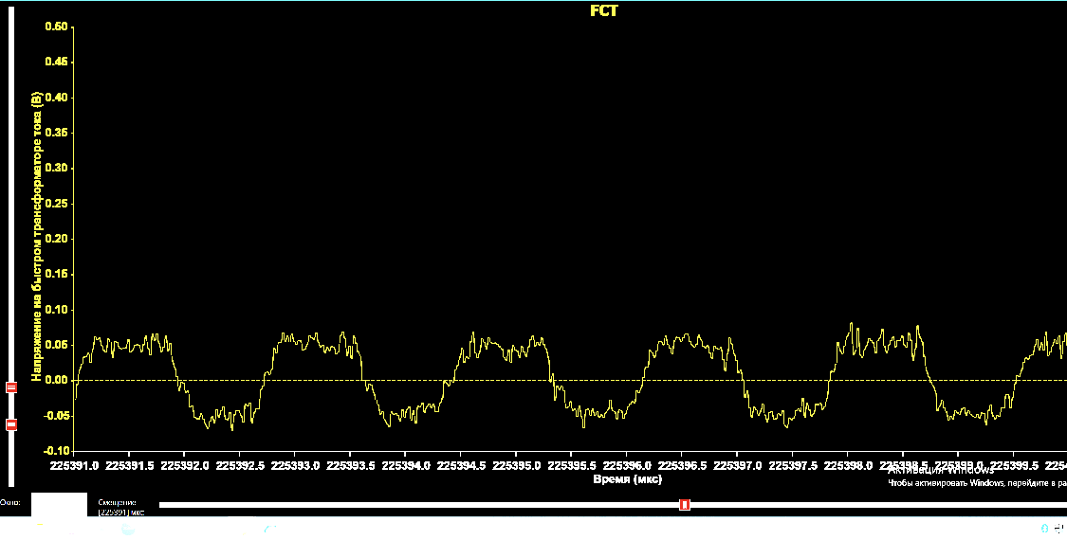
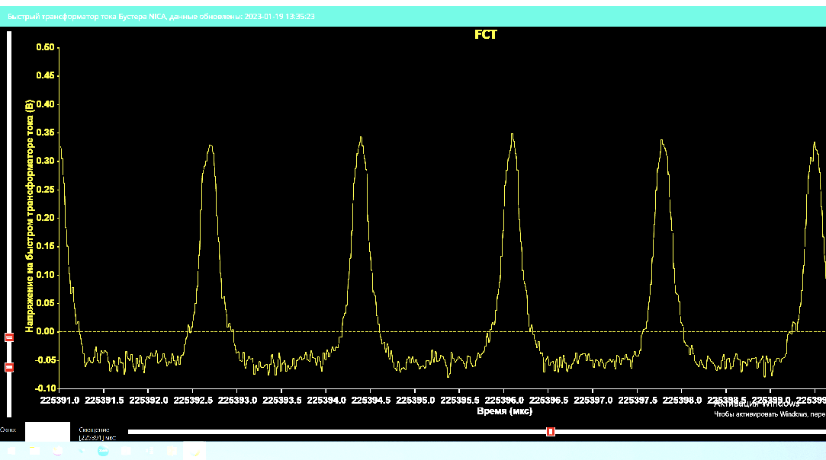
Report on the Nuclotron-NICA project
Anatoly Sidorin
The Committee congratulates the accelerator team for the very successful 4th technical run and thanks the speaker for the detailed analysis of the resources and equipment, including the electron cooling, that were put into operation and improved the performance of the accelerator complex.
The PAC notes the various delays incurred by the current geopolitical situation, among them the delays in the completion of infrastructure work at the collider building and in the construction of transfer lines from the Nuclotron to the NICA collider. The PAC acknowledges the efforts of the JINR and NICA managements to mitigate these delays and takes note of the resulting revised schedule, which now expects the first beams at the NICA collider in 2025.
Booster electron cooling
Without cooling
With cooling
Cooling time ~100 ms

Slide 5
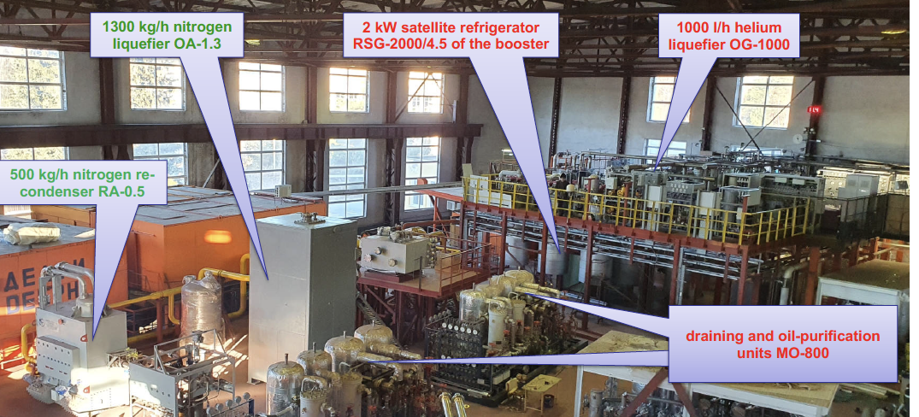
Infrastructure Developments
Nikolay Agapov
All the new equipment at the main transformer substation “Dubna” 110/6 kV was installed and put into operation. The available power of the substation is now doubled to 40.8 MW, fully meeting the needs of the NICA complex.
The cryogenic subsystems of NICA are now combined into a single complex using cryogenic pipelines, a significant part of which has been tested for leaks and is ready for operation.
The installation of engineering and research equipment in the new NICA buildings – the collider and the compressor station – is nearing completion.
Central Cryogenic Plant

Slide 6
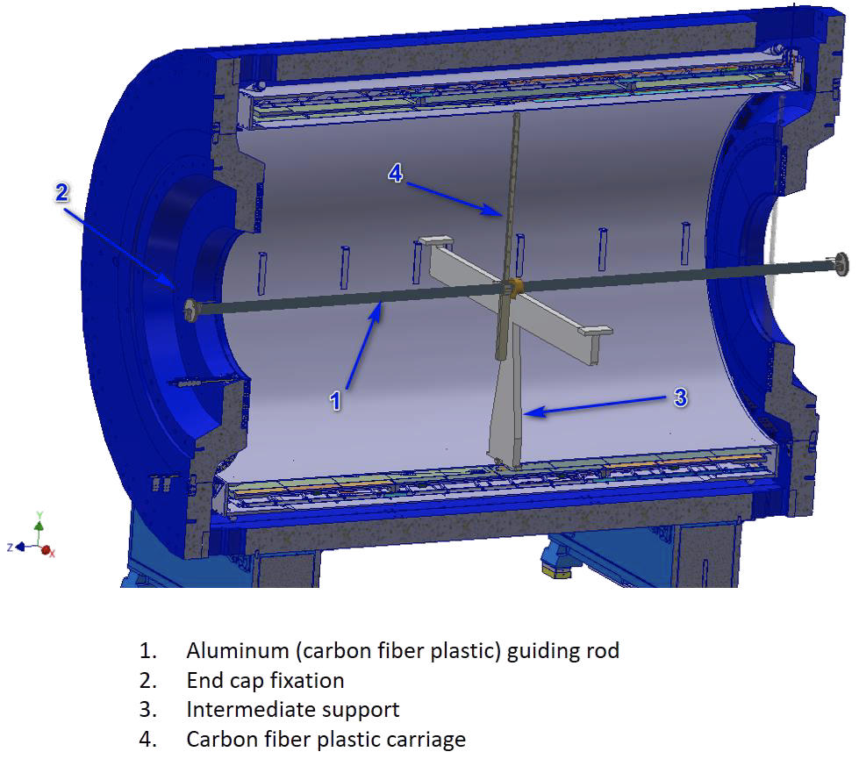
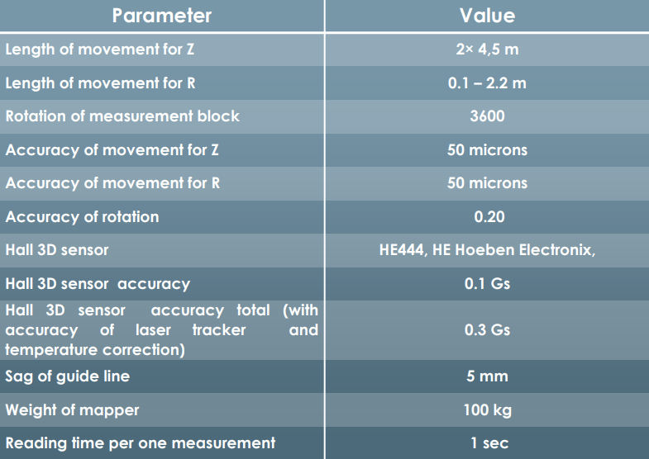
Report on MPD
Victor Riabov
The production of all components of the MPD first-stage detector is progressing, even though the schedule is delayed due to problems with supplies of many components from European companies.
The time-projection chamber, the time-of-flight system and 40 out of 50 half-sectors of the electromagnetic calorimeter remain on track to be installed in 2024.
The most critical task is still cooling and testing of the large superconducting solenoid of MPD. Cooling to liquid nitrogen and liquid helium temperatures will start in September. Magnetic field measurements will start in March 2024 and will take three months for different field configurations using the mapper produced by Novosibirsk INP.
The PAC congratulates the team on finding viable solutions for the critical issues arising for many aspects of the detector construction, assembly and commissioning.
Novosibirsk INP mapper specifications

Slide 7
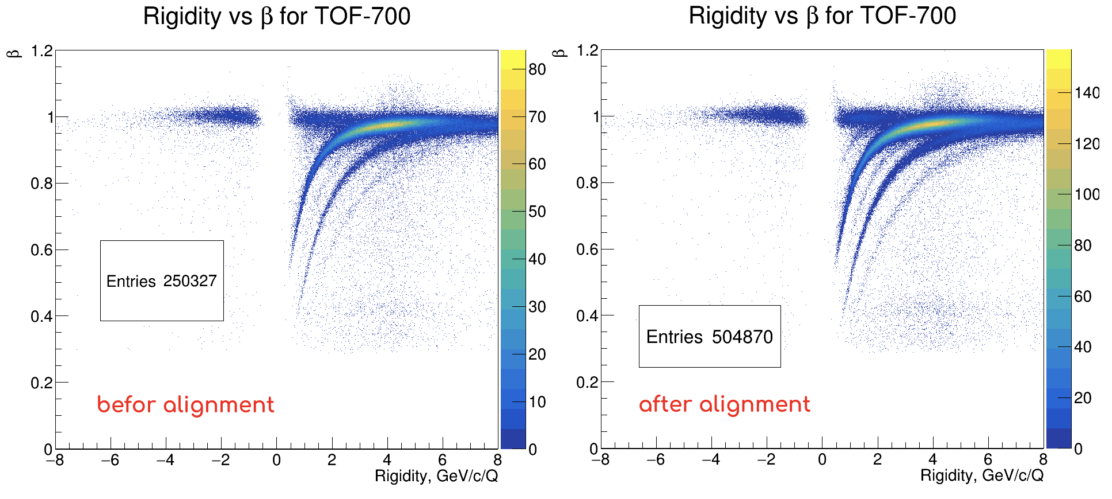
Report on BM@N
Mikhail Kapishin
The PAC congratulates the BM@N Collaboration for the first and successful physics run of the BM@N detector in its full configuration. The experiment recorded over 550 million Xe+CsI interactions at 3.8 AGeV and 3.0 AGeV .
The identification of Λ-hyperons, K⁰_{S} mesons and charged particles was considerably improved after alignment, calibration of tracking and time-of-flight detectors, and the first data reprocessing. The event centrality was evaluated using the forward hadron calorimeter and the fragment hodoscope.
The PAC emphasizes the lack of manpower for ongoing analysis of the recorded data. At the same time, the PAC encourages the BM@N team to concentrate its efforts on getting the first physics results for the Xe run data.
π⁺
K⁺
p
t
³He
d/⁴He

Slide 8
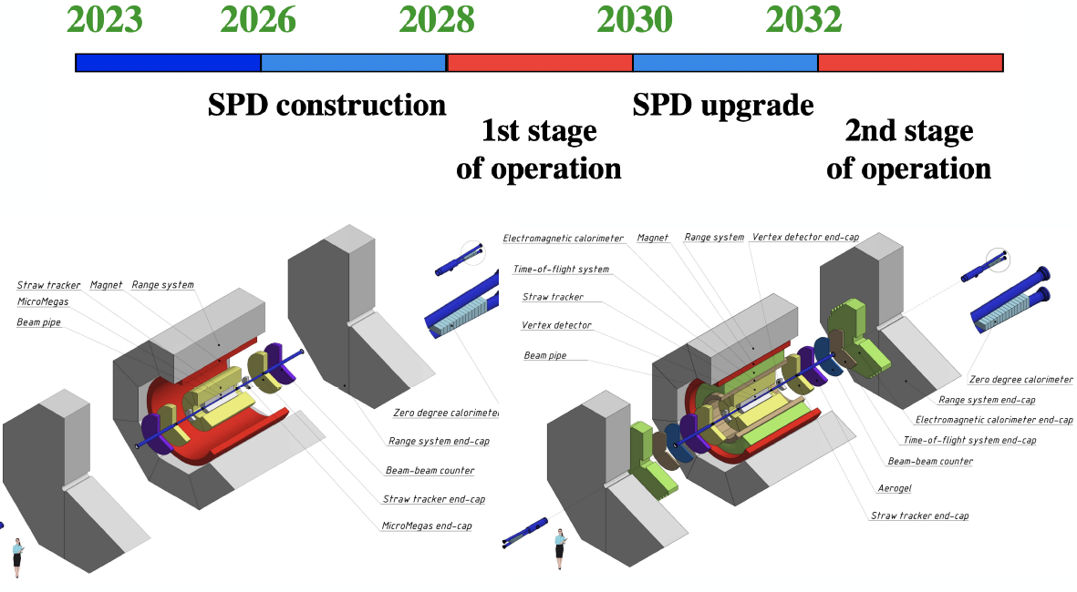
SPD Report – Towards TDR
Alexey Guskov
The layout of the detector has been adopted taking into account new opportunities opened up by the increased permissible load on the floor of the experimental hall.
The SPD team is making efforts to find and develop substitute equipment, components, and technical solutions needed to build the detector.
Preparation of documentation for the superconducting SPD solenoid is underway.
The PAC reiterates its recommendation to the JINR management on the need to resume the activities of the international SPD Detector Advisory Committee.
The PAC encourages the SPD team to proceed with the preparation of the TDR.

Slide 9
Reports from the LHC experiments
Reports presented by:
  ALICE – Boris Batyunya
  ATLAS – Tatiana Lyubushkina
  CMS – Vladimir Karjavin
The PAC heard detailed reports on the activities of the JINR groups involved in the three LHC experiments, ALICE, ATLAS and CMS with emphasis on their scientific and detector upgrade contributions.

Slide 10
Reports on ongoing projects (I)
NA64 – Dmitry Peshekhonov
A leading experiment searching for new physics below the electroweak scale,
Recommendation:
The PAC appreciates the involvement of the JINR team in the project, its theoretical motivation, its responsibilities in the detector operation, the development and support of the straw tracker, the DAQ operation, and the data taking and analysis.
The PAC supports further participation of the JINR team in the NA64 experiment and recommends its continuation for the period from January 2024 to June 2026 with ranking A.
SCAN-3 – Sergey Afanasiev
Study of highly excited nuclear matter formed in dA interactions by observing the decay of the excited nucleus into a pair of energetic particles emitted at an angle close to 180⁰.
Recommendation:
The PAC feels that a firm recommendation cannot be made at this time.
As a project approved in 2019 and seeking extension, the PAC requests the JINR team to return to it at the next session of the PAC with a clear proposal and a clear presentation outlining the original goals of the project in 2019, the achievements over the past four years, and its plans for the requested extension period.

Slide 11
Reports on ongoing projects (II)
BESIII – Igor Denisenko
The BESIII experiment at IHEP (Beijing, China) is primarily aimed at studying the spectroscopy of light hadrons and charmonia, open charm physics, and the physics of the τ-lepton
Recommendation:
The PAC appreciates the important contributions of the JINR group, and in particular the plans to continue the study of charmed quarks in the future SPD experiment at NICA. The PAC recommends that JINR continue its participation in the BESIII project for the period from January 2024 to June 2028 with ranking A.
TAIGA – Artur Borodin
The TAIGA gamma-ray observatory is designed to study gamma radiation and charged cosmic rays in the energy range of 10¹³ eV – 10¹⁸ eV
Recommendation:
The PAC encourages the JINR TAIGA team to collaborate with the JINR BAIKAL team in the data analysis, in particular in the search for events with similar and complementary characteristics.
The PAC recommends that JINR continue its participation in the TAIGA project for the period from January 2024 to January 2029 with ranking A.

Slide 12
Reports on ongoing projects (III)
JUNO – Dmitry Naumov
The JUNO experiment is focused on determining the neutrino mass ordering and to provide the most precise measurements of 3 neutrino oscillation parameters (Δm²₃₁, Δm²₂₁ and sin²2θ₁₂).
Recommendation:
The PAC appreciates the important contributions and the visible participation of the JINR team in the JUNO reactor neutrino experiment, which is at the commissioning stage, and recommends that JINR continue its participation in JUNO for the period from January 2024 to January 2027 with ranking A.
NOvA / DUNE – Lyudmila Kolupaeva
NOνA's main goal is to observe the oscillation of muon neutrinos to electron neutrinos and to provide a precise measurement of the mixing angle θ₂₃, and the mass splitting Δm²₃₂.
The DUNE experiment, currently under construction in the USA, can be considered the ultimate neutrino oscillation detector/observatory, with a scale comparable to that of the LHC experiments and a similar cost, to be operated as a facility for decades.
Recommendation:
The PAC appreciates the important scientific missions of the NoVA and DUNE experiments, and the strength of the JINR team participating in these two projects.
The PAC recommends the continuation of JINR’s participation in the NOvA experiment and supports the preparation work for the DUNE project for the period from January 2024 to January 2027 with ranking A.

Slide 13
Reports on ongoing projects (IV)
MICC – Vladimir Korenkov
MICC (Multifunctional Information and Computing Complex) aims at providing modern computing facilities to the JINR scientists.
Recommendation:
The PAC recognizes the decisive role of MICC in the scientific research and the needs of modern computing power and data storage systems.
The PAC recommends extending the project “Multifunctional Information and Computing Complex” for the period from January 2024 to January 2031 with ranking A.

Slide 14
Reports on new projects
Mathematical Methods for Data Analysis – Sergey Shmatov
The project aims at developing general mathematical methods and software with the widespread use of artificial intelligence and machine learning techniques for modeling physical processes and experimental facilities, processing and analyzing experimental data
Recommendation:
The PAC notes the ever-growing role that software, algorithms, machine learning techniques, and computational physics play in modern science, including high-energy physics, nuclear physics, and related fields.
The PAC recommends opening the project in 2024 for the period from January 2024 to January 2027 with ranking A.
AMBER – Alexey Guskov
AMBER is dedicated to the study of the internal structure and properties of hadrons, including a precise measurement of the electromagnetic radius of the proton.
Recommendation:
Taking into account the synergy between the rich physics programmes of the AMBER and NICA SPD experiments, including the benefit of training young researchers in the AMBER experiment while the SPD is under construction, the PAC recommends the participation of the JINR team in the AMBER experiment for the period from January 2024 to June 2026 with ranking A.

Slide 15
Poster presentations by young scientists
The PAC reviewed 13 posters presented in Zoom breakout room mode by young scientists from VBLHEP, BLTP, and DLNP. The PAC was very pleased with the overall good quality of the posters.
The Committee selected the report: “The correction system of the NICA Booster guiding magnetic field” made by M. Shandov to be presented at this session of the Scientific Council.

Slide 16
Next PAC-PP Meeting – June 21-22, 2023
The next meeting of the PAC-PP is scheduled for January 22-23, 2024.
The following items are proposed to be included in the agenda of the next meeting:
  Status report on the Nuclotron-NICA project
  Status report on infrastructure issues including the Nuclotron
  Status report from the Coordinator of the Nuclotron experimental programme
  Status report on the MPD project
  Status report on the BM@N project, including in particular physics results from the Xe run
  Report on the preparation of the SPD TDR
  Progress reports on JINR’s participation in the LHC experiments
  Consideration of new projects
  Reports and recommendations on the projects to be completed in 2023
  Posters from young physicists

Slide 17
Thank you!

