Slide 1
Programme Advisory Committee for Condensed Matter Physics
57th meeting (15-16 June 2023)
Dénes Lajos Nagy
134th session of the JINR Scientific Council, 21-22 September 2023

Slide 2
Agenda of the 57th meeting of the PAC
Thursday, 15 June 2023
Friday, 16 June 2023

Slide 3
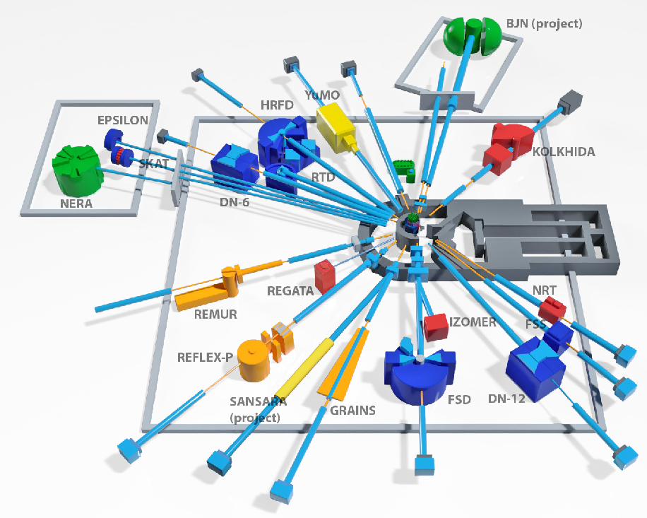
Proposal for opening the new large infrastructure project
"Pulsed neutron source and spectrometers"
The PAC took note of the proposal to open a new large research infrastructure project (LRIP) “Pulsed Neutron Source and Spectrometer Complex” and a project “Development of the IBR-2 facility with a complex of cryogenic moderators” presented by Egor Lychagin. The main objective of the project is to increase the efficiency of the use of the IBR-2 nuclear research facility in implementing the experimental research programme, to ensure the operational reliability and safety of the reactor.
During the period of implementation of the project, scientific and technical support services will be provided to ensure the safe operation of the reactor facility, and a large amount of scientific and technical work and experimental studies related to the commissioning of the cryogenic moderator complex will be performed.
Recommendation. The PAC supported the opening of the new LRIP “Pulsed Neutron Source and Spectrometer Complex” and the project “Development of the IBR-2 facility with a complex of cryogenic moderators” for the period 2024–2028.

Slide 4
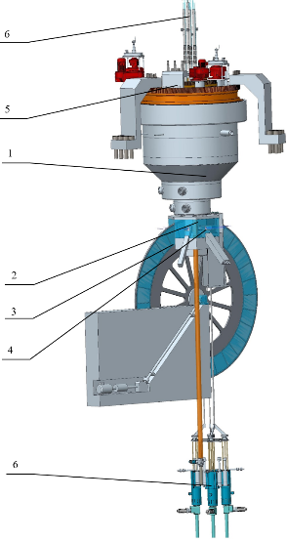
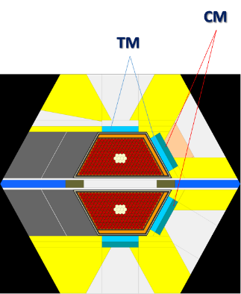
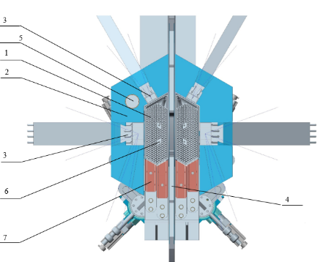
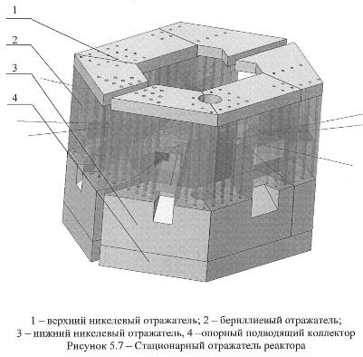
Proposal for opening the new large infrastructure project
"New advanced neutron source at JINR"
The PAC took note of the proposal to open a project “New advanced neutron source at JINR” presented by Maksim Bulavin. In accordance with the work plans, the following research and development work is being carried out: study of the pulsed reactor dynamics, development of neptunium nitride fuel and the fuel rods based on it, optimization of the design of the reactivity modulator and the reactor vessel in terms of reducing thermal loads and shape changing, development and implementation of a list of R&D to support the development of a preliminary design, including the main systems of the reactor facility, a complex of cryogenic moderators, development of a scientific programme, and a complex of spectrometers based on it. The PAC was satisfied with the detailed description of the work plans for the implementation of the project.
Recommendation. The PAC recommended opening the project for the period 2024–2028.
1 – reactor;
2 – stationary reflector;
3 – reactivity modulator;
4 – moderators;
5 – rotary plugs;
6 – CPS actuators;
7 – RS of RSS
Power 10-15 МW
Fuel 500 kg
Average flux 10¹⁴ n/cm²/s
Flux in pulse 10¹⁶ n/cm²/s

Slide 5
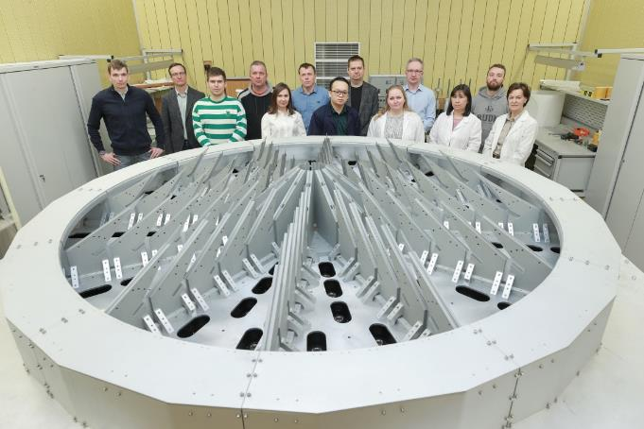
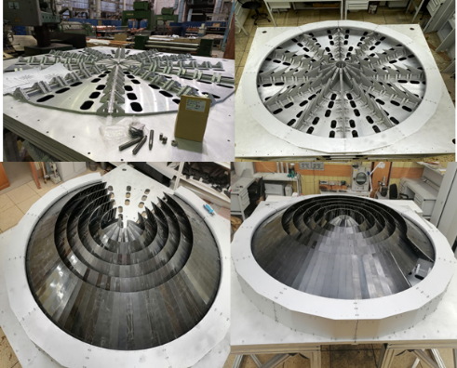
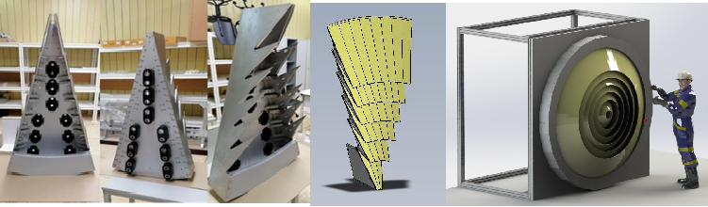
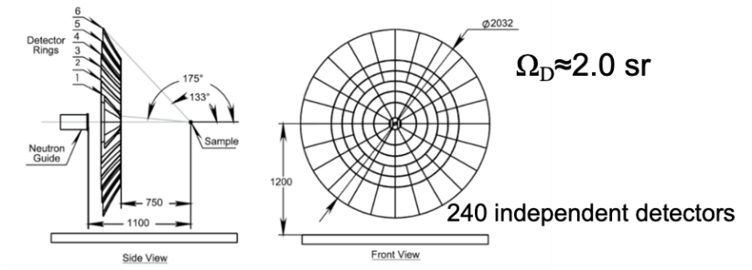
Proposal for opening the project "Scientific and methodological research and developments for condensed matter investigations with IBR-2 neutron beams"
The PAC took note of the report by Viktor Bodnarchuk with the proposal to open a project “Scientific and methodological research and developments for condensed matter investigations with IBR-2 neutron beams” in the frame of the LRIP “Pulsed Neutron Source and Spectrometer Complex”. The project is dedicated to improving the раrаmеtеrs and реrfоrmаnсе of ехрегimеntаl setups, expanding the scope of thеir аррliсаtions as wеll as to the development of their elements and components.
Recommendation. The PAC supported the opening of the new project for the period 2024–2028.
Schematic of the large-aperture backscattering detector.

Slide 6
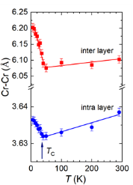
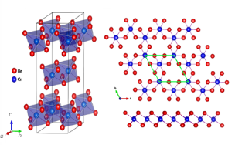
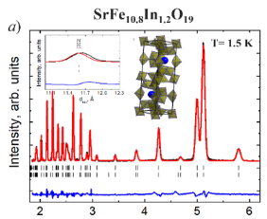
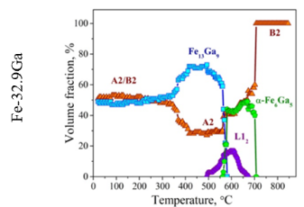
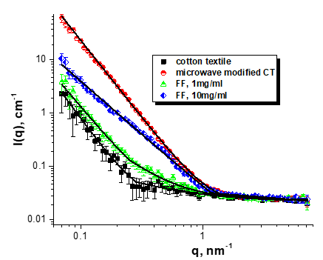
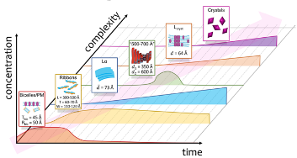

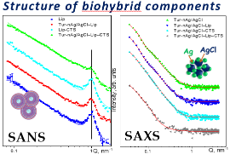
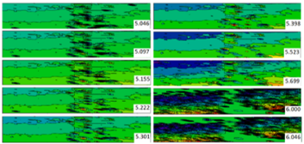
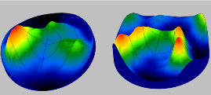
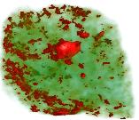
Proposal for opening the project "Investigations of functional materials and nanosystems using neutron scattering"
The PAC took note of the report by Denis Kozlenko with the proposal to open a project “Investigations of functional materials and nanosystems using neutron scattering” with subprojects “Study of the structure and dynamics of functional materials and nanosystems at the IBR-2 spectrometer complex” and “Development of an inelastic neutron scattering spectrometer in inverse geometry BJN (Bajorek–Janik–Natkaniec) at the IBR-2 reactor”.
The PAC noted that understanding the connection between the matter’s structure and its physical and chemical properties at the microscopic and atomic scale is crucial in various scientific disciplines such as condensed matter physics, materials science, chemistry, geophysics, engineering, biology, and pharmacology.
Recommendation. The PAC recommended opening the project with the subprojects for the period 2024–2028.

Slide 7
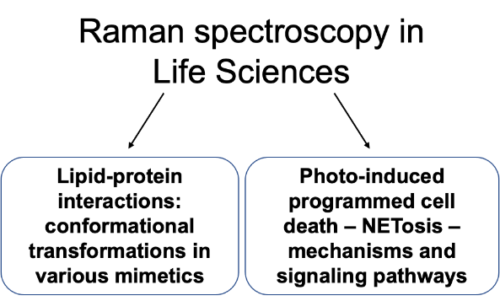

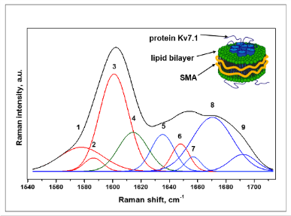
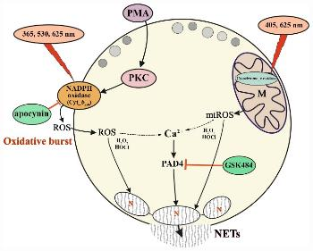
Proposal for opening the project "Nanobiophotonics"
The PAC took note of the report on concluding the project “Biophotonics” and opening a new project “Nanobiophotonics” presented by Grigory Arzumanyan.
Based on the results presented in the report, the PAC noted significant progress in the implementation of activities on this project and especially the advances in the field of life sciences.
The PAC considered the research programme of the proposed new project as promising and modern, interdisciplinary in nature, and aimed at both fundamental and practical studies. The PAC welcomed the start of closer collaboration on these topics with other JINR laboratories and with external biomedical organizations as well.
Recommendation. The PAC recommended opening the new project for the years of 2024–2028.
3 items on Raman spectroscopy
Sample activities
Raman spectroscopy – a protein secondary structure tool
Spectroscopy and microscopy of NETosis
Deconvulation of the raman spectrum of the Kv7.1
protein presented in lipodisc
Proposed mechanism of NETosis induced by UV-A and visible light wavelengths

Slide 8
Proposal for opening the project “Novel semiconductor detectors for fundamental and applied research”
The PAC took note of the report on extending the project “Novel semiconductor detectors for fundamental and applied research” presented by Georgy Shelkov. This project aims to create hardware and software components for the development of detection systems based on novel energy-sensitive hybrid pixel detectors and radiodiagnostic equipment based on them.
The PAC noted that, in particular, the proposed activities mainly focus on the development of the in-house microchip and the manufacture of new energy-sensitive semiconductor X-ray image detectors and devices.
The proposed extension of the project is relevant and can be successfully implemented.
Recommendation. The PAC recommended the extension of the project for the period 2024–2028.

Slide 9
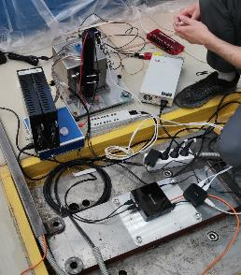
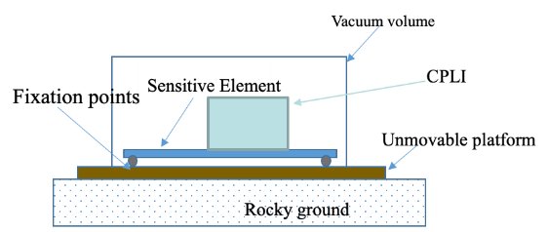
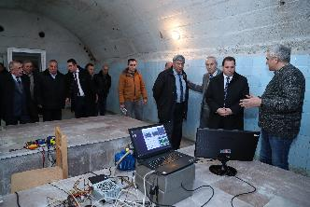
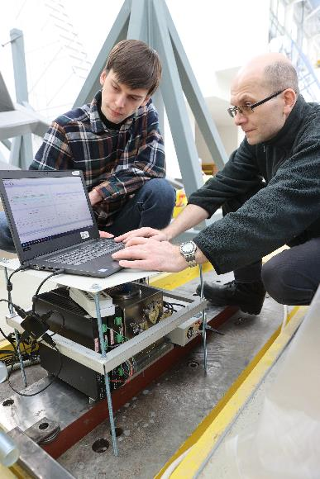
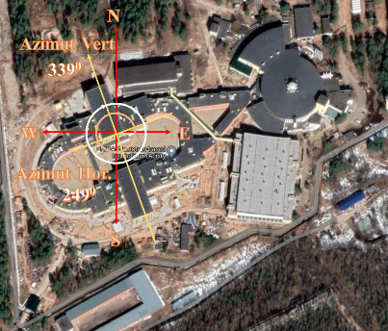
Proposal for extending the project “Precision laser metrology
for accelerators and detector complexes”
The PAC took note of the proposal to extend the project “Precision laser metrology for accelerators and detector complexes” presented by Mikhail Lyablin.
The proposal is a continuation of the ongoing support project for the NICA collider complex.
The project has two goals: first, long-term monitoring of the surface under the NICA accelerator and of the influence of microseismic noise, and the improvement of stabilization. Second, a network of inclinometers will be installed in the regions of seismic activity to measure variations in the angles of inclination. The scientific objective and technical approach are well presented and seem feasible within five years.
Recommendation. The PAC recommended that the project be extended for the period 2024–2028, addressing the issues raised by the reviewers.
Base of the CPLI

Slide 10
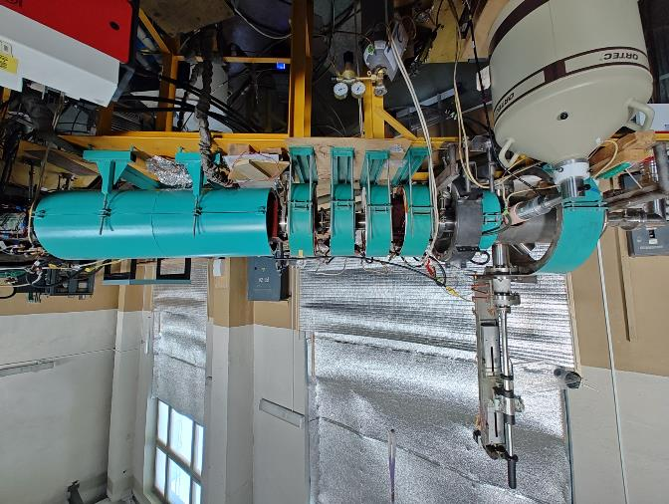
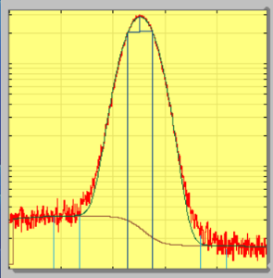
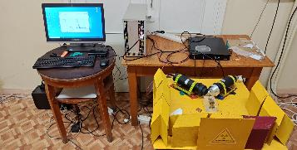
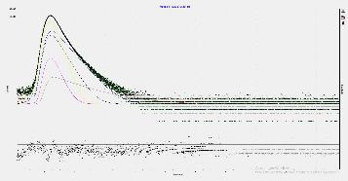
Proposal for extending the project “Development of experimental techniques and applied research with slow monochromatic positron beams (PAS)”
The PAC took note of the report on extending the project “Development of experimental techniques and applied research with slow monochromatic positron beams (PAS)” presented by Alexey Sidorin.
The PAC noted the high demand for PAS methods, including the Doppler broadening of the annihilation line (DBAL) method on a beam as well as the positron annihilation lifetime spectroscopy (PALS) method in the classical formulation.
The PAC welcomed the involvement of employees from other countries in the work on the project. The implementation of the programme presented in the project will bring this facility to a qualitatively new level, opening up new opportunities for experimental research in the field of condensed matter physics and materials science.
Recommendation. The PAC recommended that the project be extended for the period 2024–2028.
Example of data obtained in PALS method
Example of spectrum

Slide 11
Proposal for extending the project “Design and development of a test zone for methodological studies of detectors at the linear electron accelerator in DLNP”
The PAC took note of the proposal to open a project “Design and development of a test zone for methodological studies of detectors at the linear electron accelerator in DLNP” presented by Said Abou El-Azm.
The project is dedicated to the development of scientific infrastructure for experimental studies with accelerated electron beams of the LINAC-200 accelerator. The two channels of LINAC-200 will be used for equipment testing and for other applied and educational purposes. The PAC noted that it is necessary to have an electron beam with all diagnostics for monitoring the beam parameters, as well as the necessary equipment to deal with target control and data analysis with target.
Recommendation. The PAC recommended opening the project for its implementation in 2024–2028.
5-25 MeV
40-200MeV

Slide 12
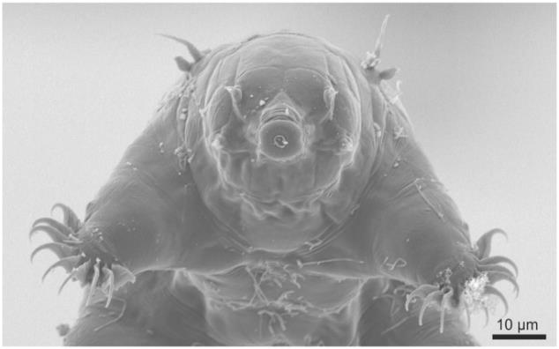
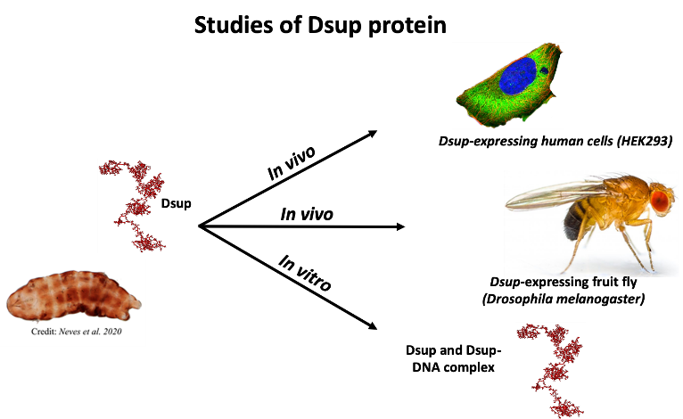
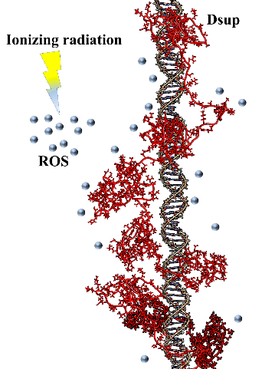
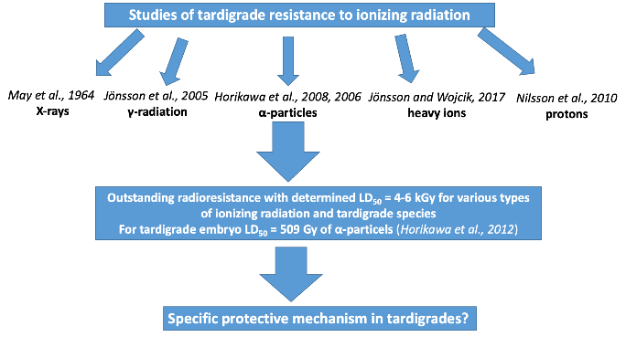
Proposal for opening the project “Protection against physical and chemical stresses with tardigrade proteins (TARDISS)”
The PAC took note of the proposal to open a project “Protection against physical and chemical stresses with tardigrade proteins (TARDISS)” presented by Mikhail Zarubin. The PAC noted the ambitious goals of studying the radio- and cryoprotective properties of the Dsup protein in living systems and in vitro, developing model living systems with induced expression of the Dsup protein, and creating high-tech materials modified with this protein.
Recommendation. The PAC recommended opening the project for its implementation in 2024–2028.
Sørensen-Hygum et al. 2018
Tardigrades posses developed neural system with brain, muscle, digestive and other systems consisting of differentiated tissues.
Hypothetical molecular mechanisms of Dsup action in tardigrade

Slide 13
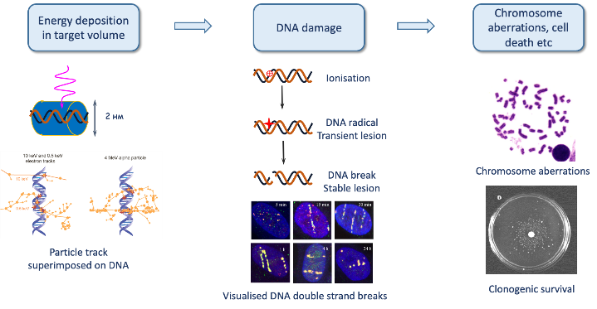
Proposal for opening the project “Molecular, genetic and organismal effects of ionizing radiation with different physical characteristics” and “Radiation biophysics and astrobiological research”
The PAC took note of the proposals to open projects “Molecular, genetic and organismal effects of ionizing radiation with different physical characteristics” and “Radiation biophysics and astrobiological research” presented by Pavel Lobachevsky and Alexey Chizhov, respectively.
The aim of the first of these projects is to study the regularities and mechanisms of molecular, genetic and organismal effects of ionizing radiation with different physical characteristics.
The second project is aimed at solving a number of fundamental problems in radiobiology and astrobiology, as well as practical tasks related to the development of radiation medicine.
Recommendation. Given the complexity of the projects as well as the module in which the authors convince of their feasibility, the PAC recommended opening the projects for their implementation in 2024–2028.
Radiation biophysics
Improving methods of irradiation and dosimetry in radiobiological experiments
Automation of data processing of radiobiological experiments
Mathematical modeling of radiation-induced effects
Astrobiological research
Study of abiogenic synthesis of prebiotic compounds
Search for microfossils and organic compounds in meteorites

Slide 14
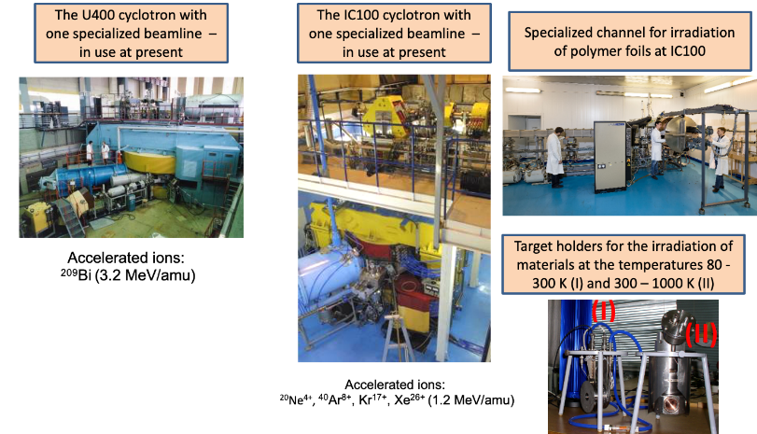
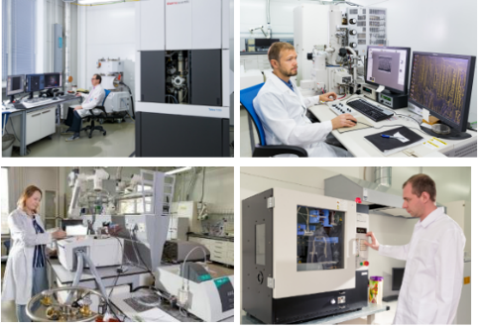
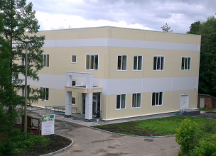
Proposal for opening the project “Radiation tolerance of materials to high intensity heavy ion beams impact” and “Nanocomposite and functional track-etched membranes”
The PAC took note of the proposal to open projects “Radiation tolerance of materials to high intensity heavy ion beams impact” and “Nanocomposite and functional track-etched membranes” presented by Pavel Apel.
The first project is focused on the systematic study of the structural effects caused by swift heavy ions in materials with potential nuclear and nanotechnological applications in order to shed light on the fundamental mechanisms and subpicosecond kinetics of the resulting excitations. The second project on track-etched membranes (TMs) demonstrates an example of industrial application of ion-track technology. The project outcomes will include the implementation of new and elaboration of existing routes of membrane modification for the production of composite and hybrid TMs for targeted applications in nanofluidics, sensing technologies, green energy harvesting, and biomedicine.
Recommendation. The PAC recommended opening the projects for their implementation in 2024–2028.

Slide 15
Written proposals on projects
The PAC took note of the written proposals to open or extend the projects “Methods of computational physics for the study of complex systems” for 2024–2026, and “Complex materials”, “Mathematical models of statistical physics of complex systems”, “Nanostructures and nanomaterials”, “Quantum field theory methods in complex systems” for 2024–2028.
Recommendation. The PAC recommended that these projects be opened or extended for the requested periods.

Slide 16
Scientific report
The PAC heard with interest the scientific report “Neutron-diffraction studies of structural phase transition in alloys” presented by Tatiana Vershinina.
The PAC thanked the speaker for the excellent report.

Slide 17
Virtual presentations by young scientists
The PAC reviewed 12 virtual presentations made by young scientists in the field of condensed matter physics and related fields.
The virtual poster presentation “Proximity effects at superconducting and ferromagnetic heterostructures” made by Vladimir Zhaketov was selected as the best presentation of the session.
The PAC also noted two more virtual poster presentations of a high level: “High pressure effect on crystal, magnetic structure and vibrational spectra of van der Waals material” by Olga Lis, and “The effects of high pressure on the crystal structure and vibration spectra of layered perovskite-like Nd₂Ti₂O₇” by Asif Asadov.
Recommendation. The PAC recommended the poster “Proximity effects at superconducting and ferromagnetic heterostructures” to be presented at the session of the JINR Scientific Council in September 2023.

Slide 18
Next meeting of the PAC
The next meeting of the PAC for Condensed Matter Physics is scheduled for 25–26 January 2024.
The preliminary agenda for the next meeting of the PAC includes:
report by the PAC Chair on the implementation of the recommendations above;
report by the JINR Directorate on the sessions of the Scientific Council in September 2023 and of the Committee of Plenipotentiaries in November 2023;
progress in the development of the concept for a new neutron source of JINR;
status reports on the upgrade of FLNP instruments;
status and future of the FLNP user programme;
discussion of the project assessment template;
information about scientific meetings;
scientific reports (not more than three);
poster (or virtual presentation) session.

Slide 19
Thank you for your attention

