Slide 1
The Correction System of the NICA Booster Guiding Magnetic Field
M. M. Shandov
134 SC JINR, September 27, 2023
Report as recommended by the 58th meeting of the PAC for Particle Physics
Veksler and Baldin Laboratory of High Energy Physics,
Joint Institute for Nuclear Research, Dubna, Russia

Slide 2
Introduction
Outlines
NICA Booster
Design. Fields Calculations. Magnetic Measurements
Conclusion
Magnetic Measurements of the Lattice Magnets
Corrector Magnets Systems of the NICA Booster. Main Goals
Investigation of the Magnetic Structure Characteristics
CO Correction Algorithms
DA Calculations

Slide 3
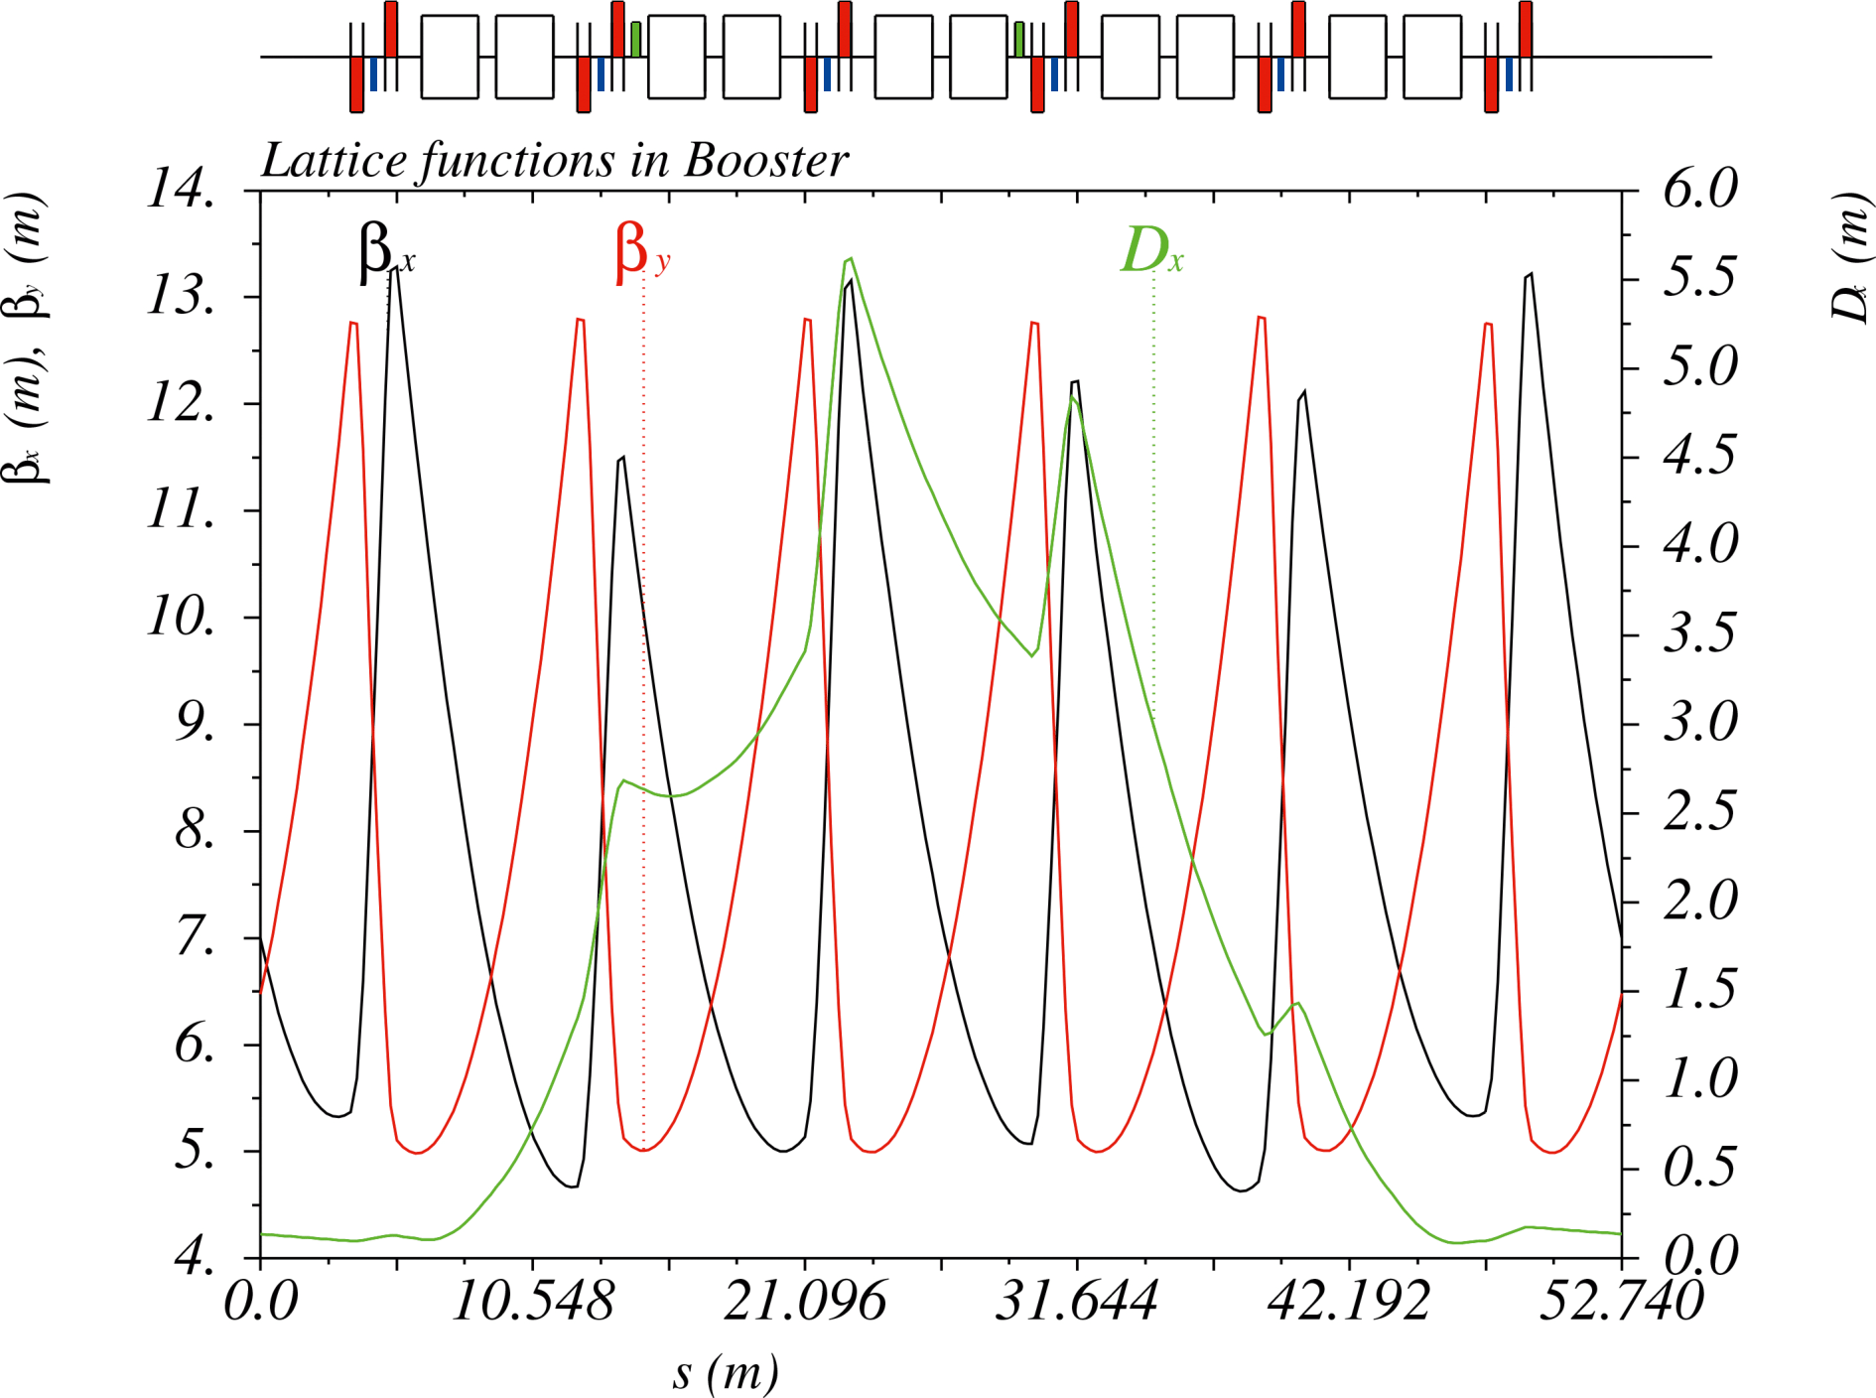
NICA Booster. Main Parameters
Ion | $${Au}^{31+}$$
Magnetic rigidity, $T⋅m$ at injection maximum | $$1.6$$ $$25.0$$
Circumference, $m$ | $$210.96$$
Number of super-periods | $$4$$
Number of DFO periods | $$24$$
Betatron tune ${ν_{x}}/{ν_{y}}$ | $${4.80}/{4.85}$$
Chromaticity ${ξ_{x}}/{ξ_{y}}$ | $${−5.10}/{−5.50}$$
Transition energy $γ_{tr}$, $GeV/u$ | $$3.25$$
Emittances hor/vert $6σ$, $π mm⋅mrad$ at injection after acceleration | $${15}/{15}$$ $${<11}/{<1.5}$$
RMS momentum spread, ${10}^{−3}$ at injection after acceleration | $$±1$$ $$±0.22$$
Revolution period, $μs$ at injection after acceleration | $$8.5$$ $$0.89$$
Technical specifications of the “Object "Booster" NICA”, 2019

Slide 4
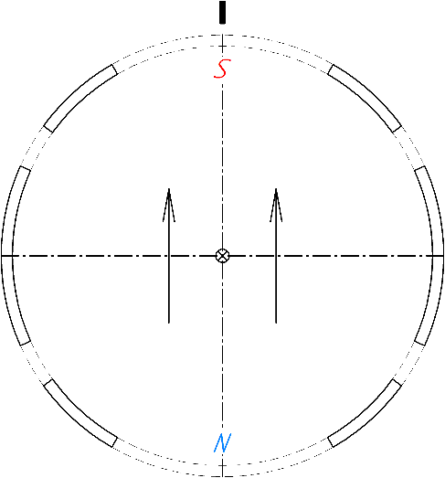
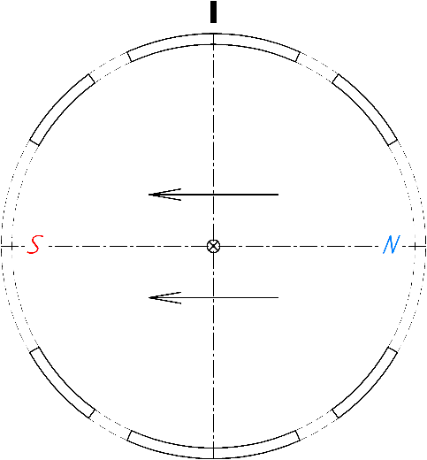
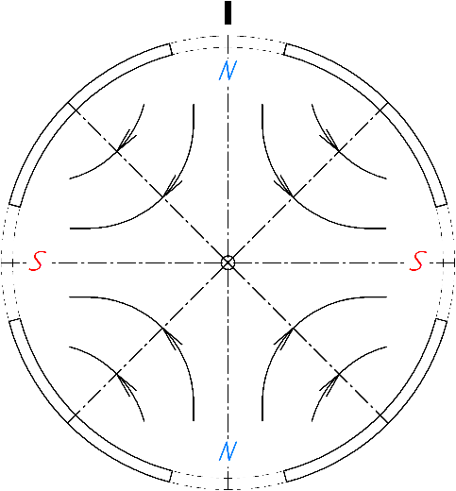
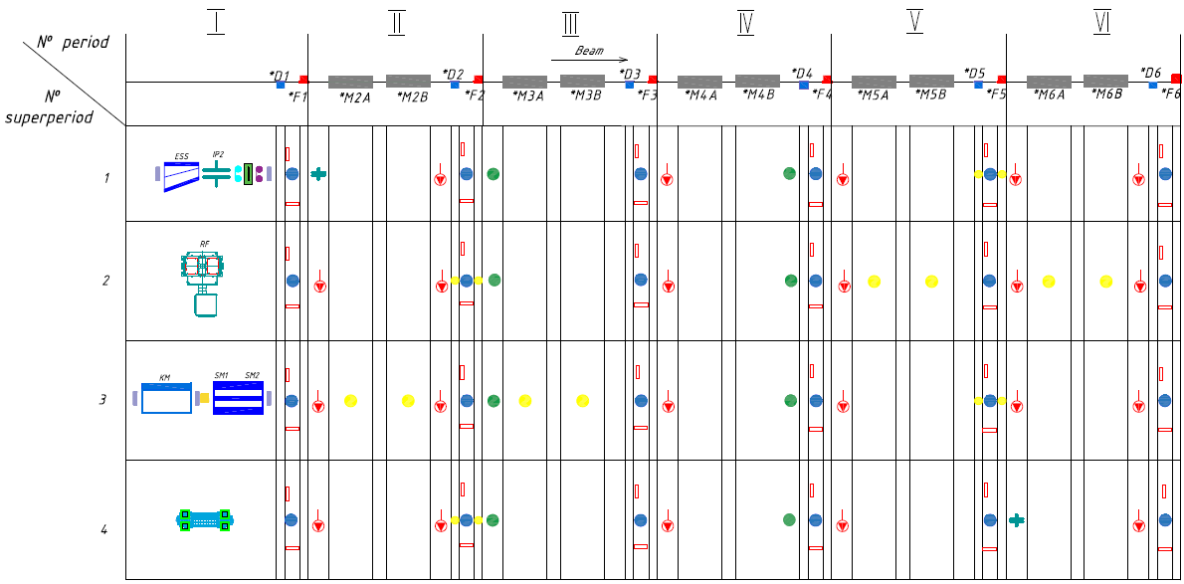
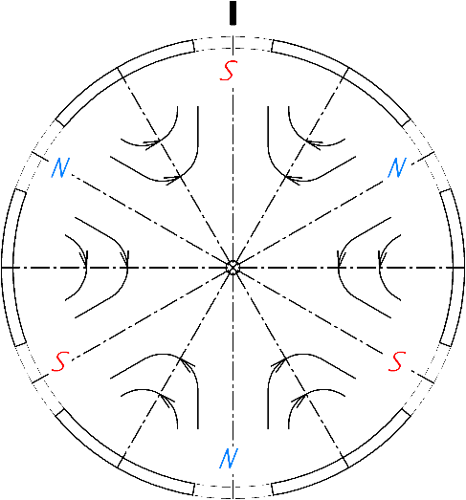
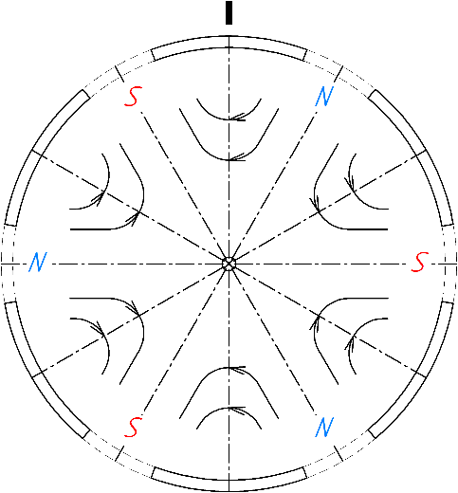
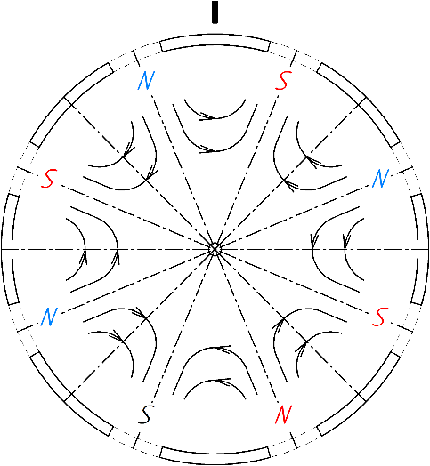
Correctors in the Booster Lattice
“Normal” Dipole
“Skew” Dipole
“Skew” Quadrupole
— Dipole correctors: 24
— Multipole correctors: 8
Total: 32 correctors
“Normal” Sextupole
“Skew” Sextupole
“Normal” Octupole

Slide 5
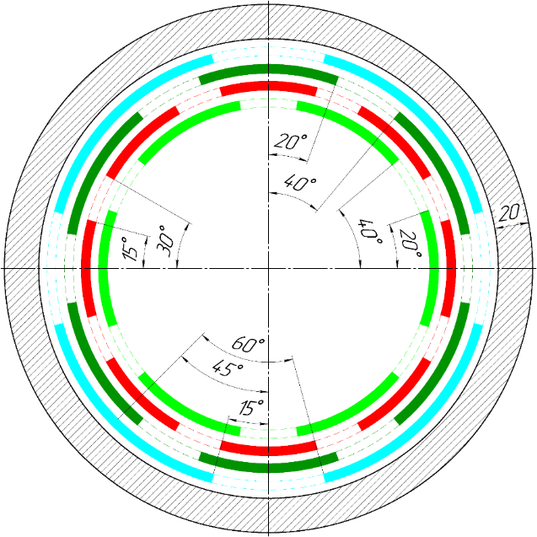
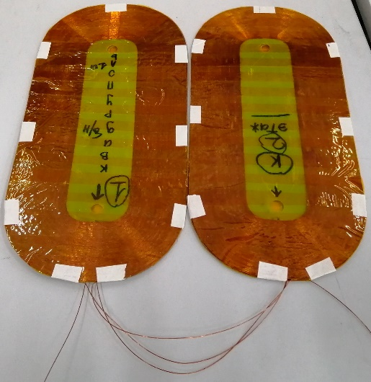
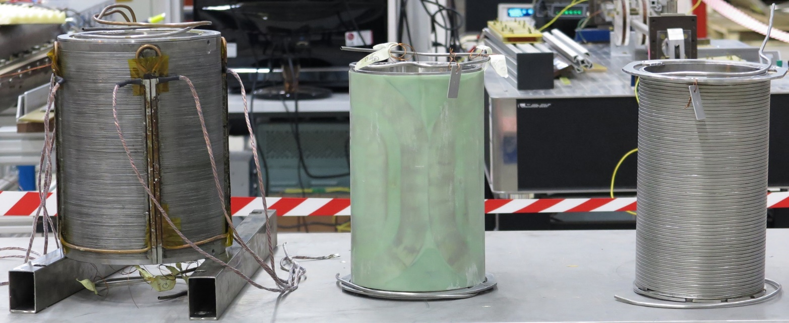
Goals of the System. Magnet Design
Field Types | Corrections goals | Field | Ampere-turns
“Normal” dipole ($b_{0}$) | Horizontal orbit | 0.08 T | 5500
“Skew” dipole ($a_{0}$) | Vertical orbit | 0.08 T | 5500
“Skew” quadrupole ($a_{1}$) | Betatron tune coupling | 0.6 T/m | 4200
“Normal” sextupole ($b_{2}$) | Chromaticity | 130 T/m² | 3900
“Skew” sextupole ($a_{2}$) | Optics errors | 130 T/m² | 3900
“Normal” octupole ($b_{3}$) | Fringe field influence | 1200 T/m³ | 2400

Slide 6
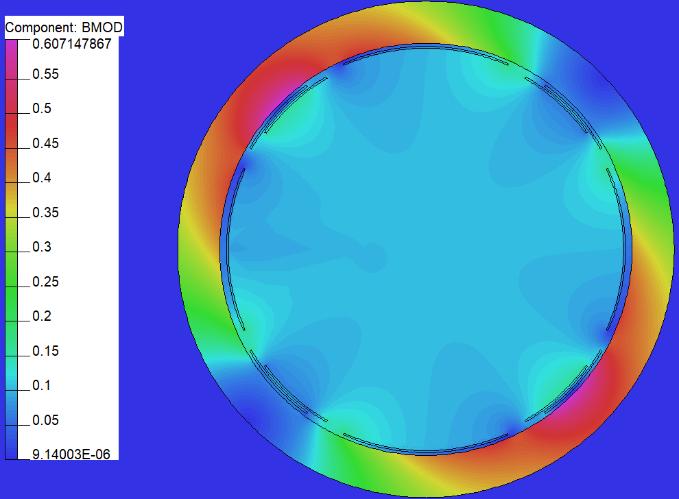
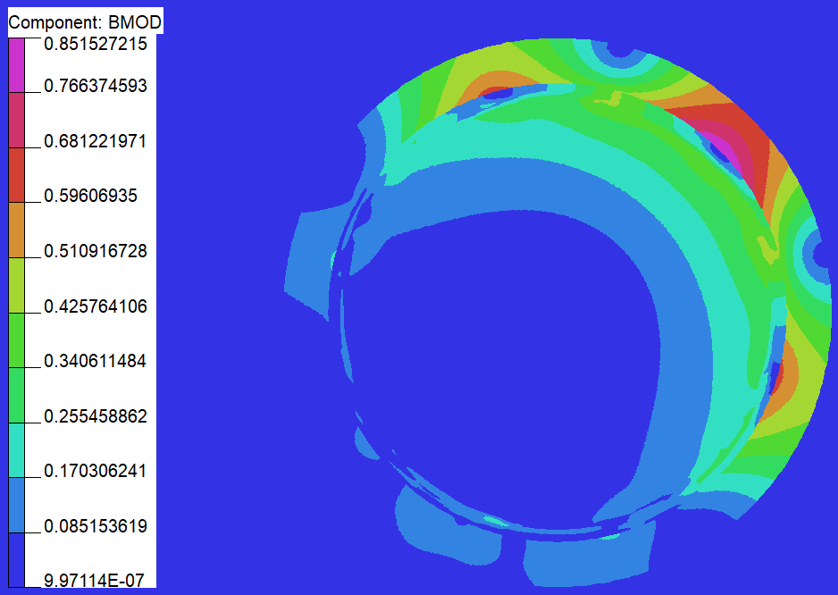
2D FEM Calculation. Results
Field @R=30 mm [T]
Calculation | Dipole ($b_{0},$ $a_{0}$) | Quadrupole ($b_{1},$ $a_{1}$) | Sextupole ($b_{2},$ $a_{2}$) | Octupole ($b_{3}$)
Analytic (vac.) | 0.03857 | 0.01676 | 7.413*10⁻³ | 2.007*10⁻³
FEM 2D (vac.) | 0.03486 | 0.01661 | 7.451*10⁻³ | 2.010*10⁻³
δ | 10.51 | 0.91 | 0.50 | 0.17
Analytic (yoke) | 0.07204 | 0.03239 | 0.01342 | 3.321*10⁻³
FEM 2D (yoke) | 0.07334 | 0.03232 | 0.01336 | 3.313*10⁻³
δ | 1.78 | 0.21 | 0.42 | 0.17
$$δ=\left|\frac{B_{FEM}−B_{an.}}{B_{FEM}}\right|⋅100\%$$
Analytic calculation:
Bio-Savart law
Image-Current method
Dipole Corrector
Multipole Corrector

Slide 7
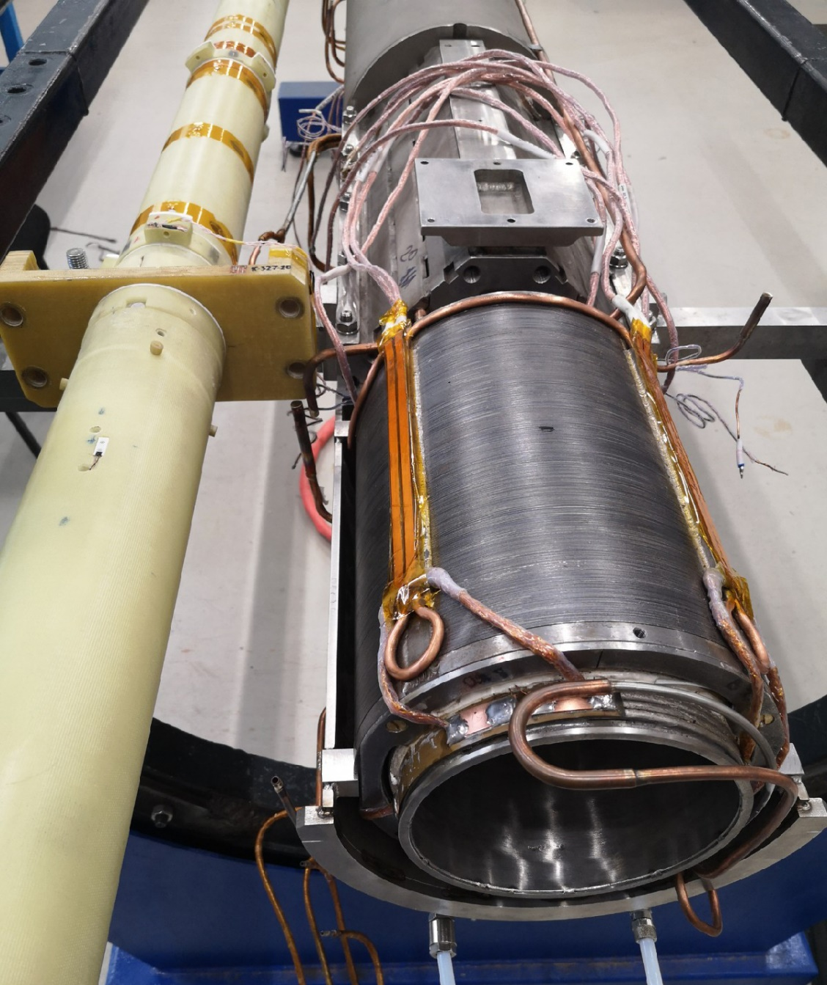
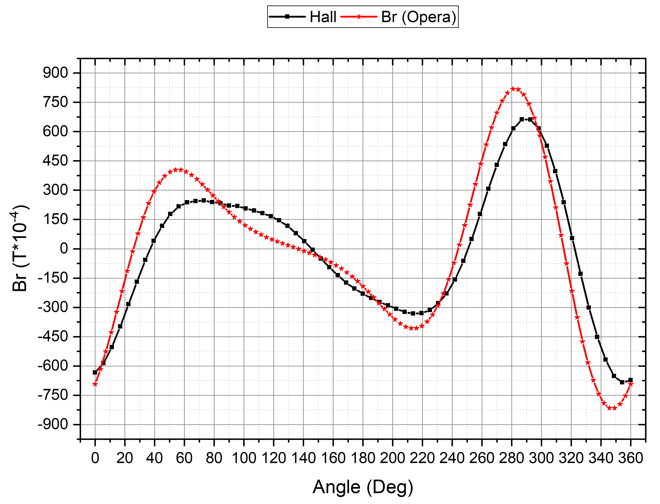
Magnetic Measurements
Field @R=41 mm
Field Type | Measurements | FEM 2D
Quadrupole ($a_{1}$) | 0.03834 | 0.04422
$$\text{Sextupole}\text{ (}b_{2}\text{)}$$ | 0.02111 | 0.02548
$$\text{Sextupole}\text{ (}a_{2}\text{)}$$ | 0.01028 | 0.02501
Octupole ($b_{3}$) | 7.766*10⁻³ | 8.446*10⁻³

Slide 8
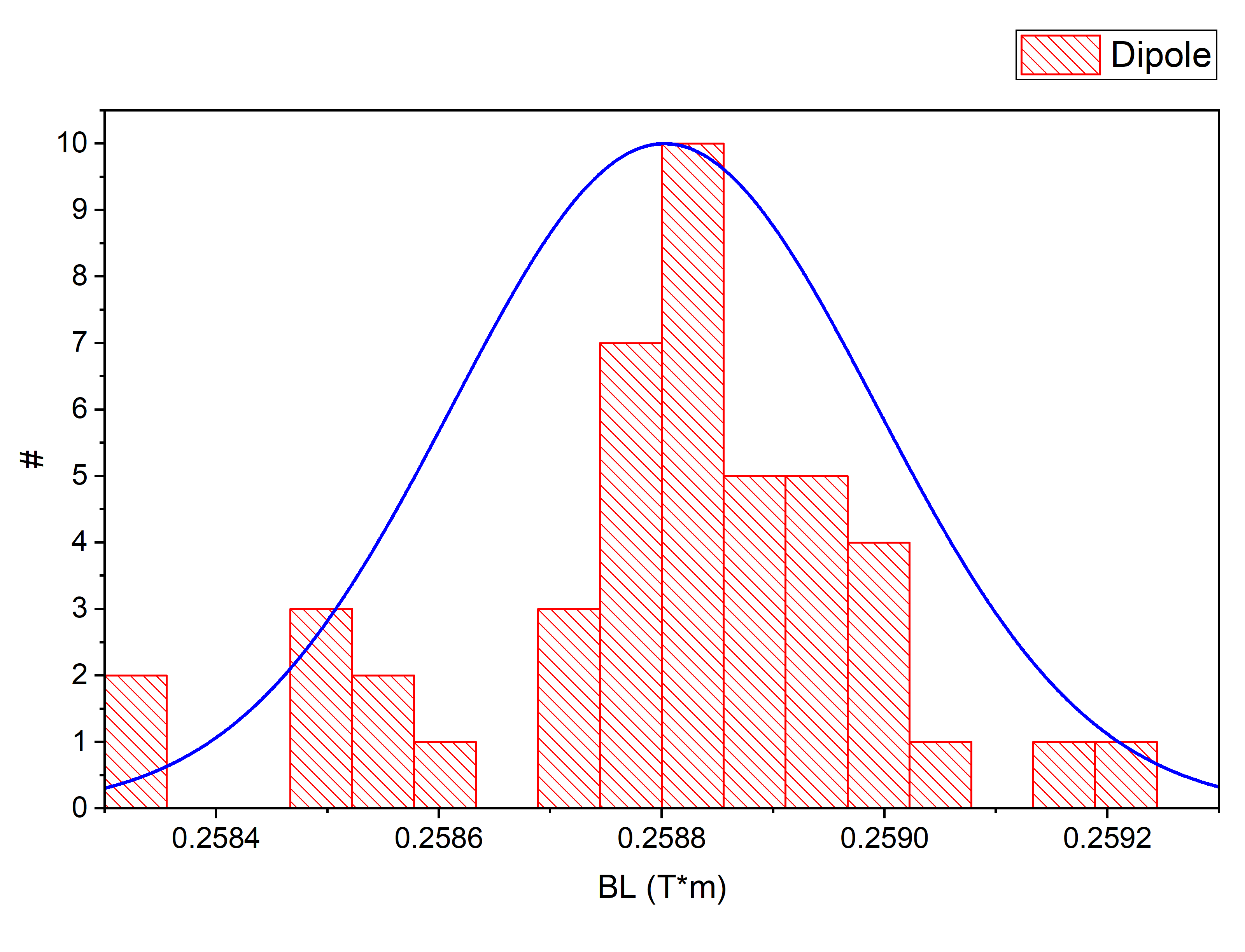
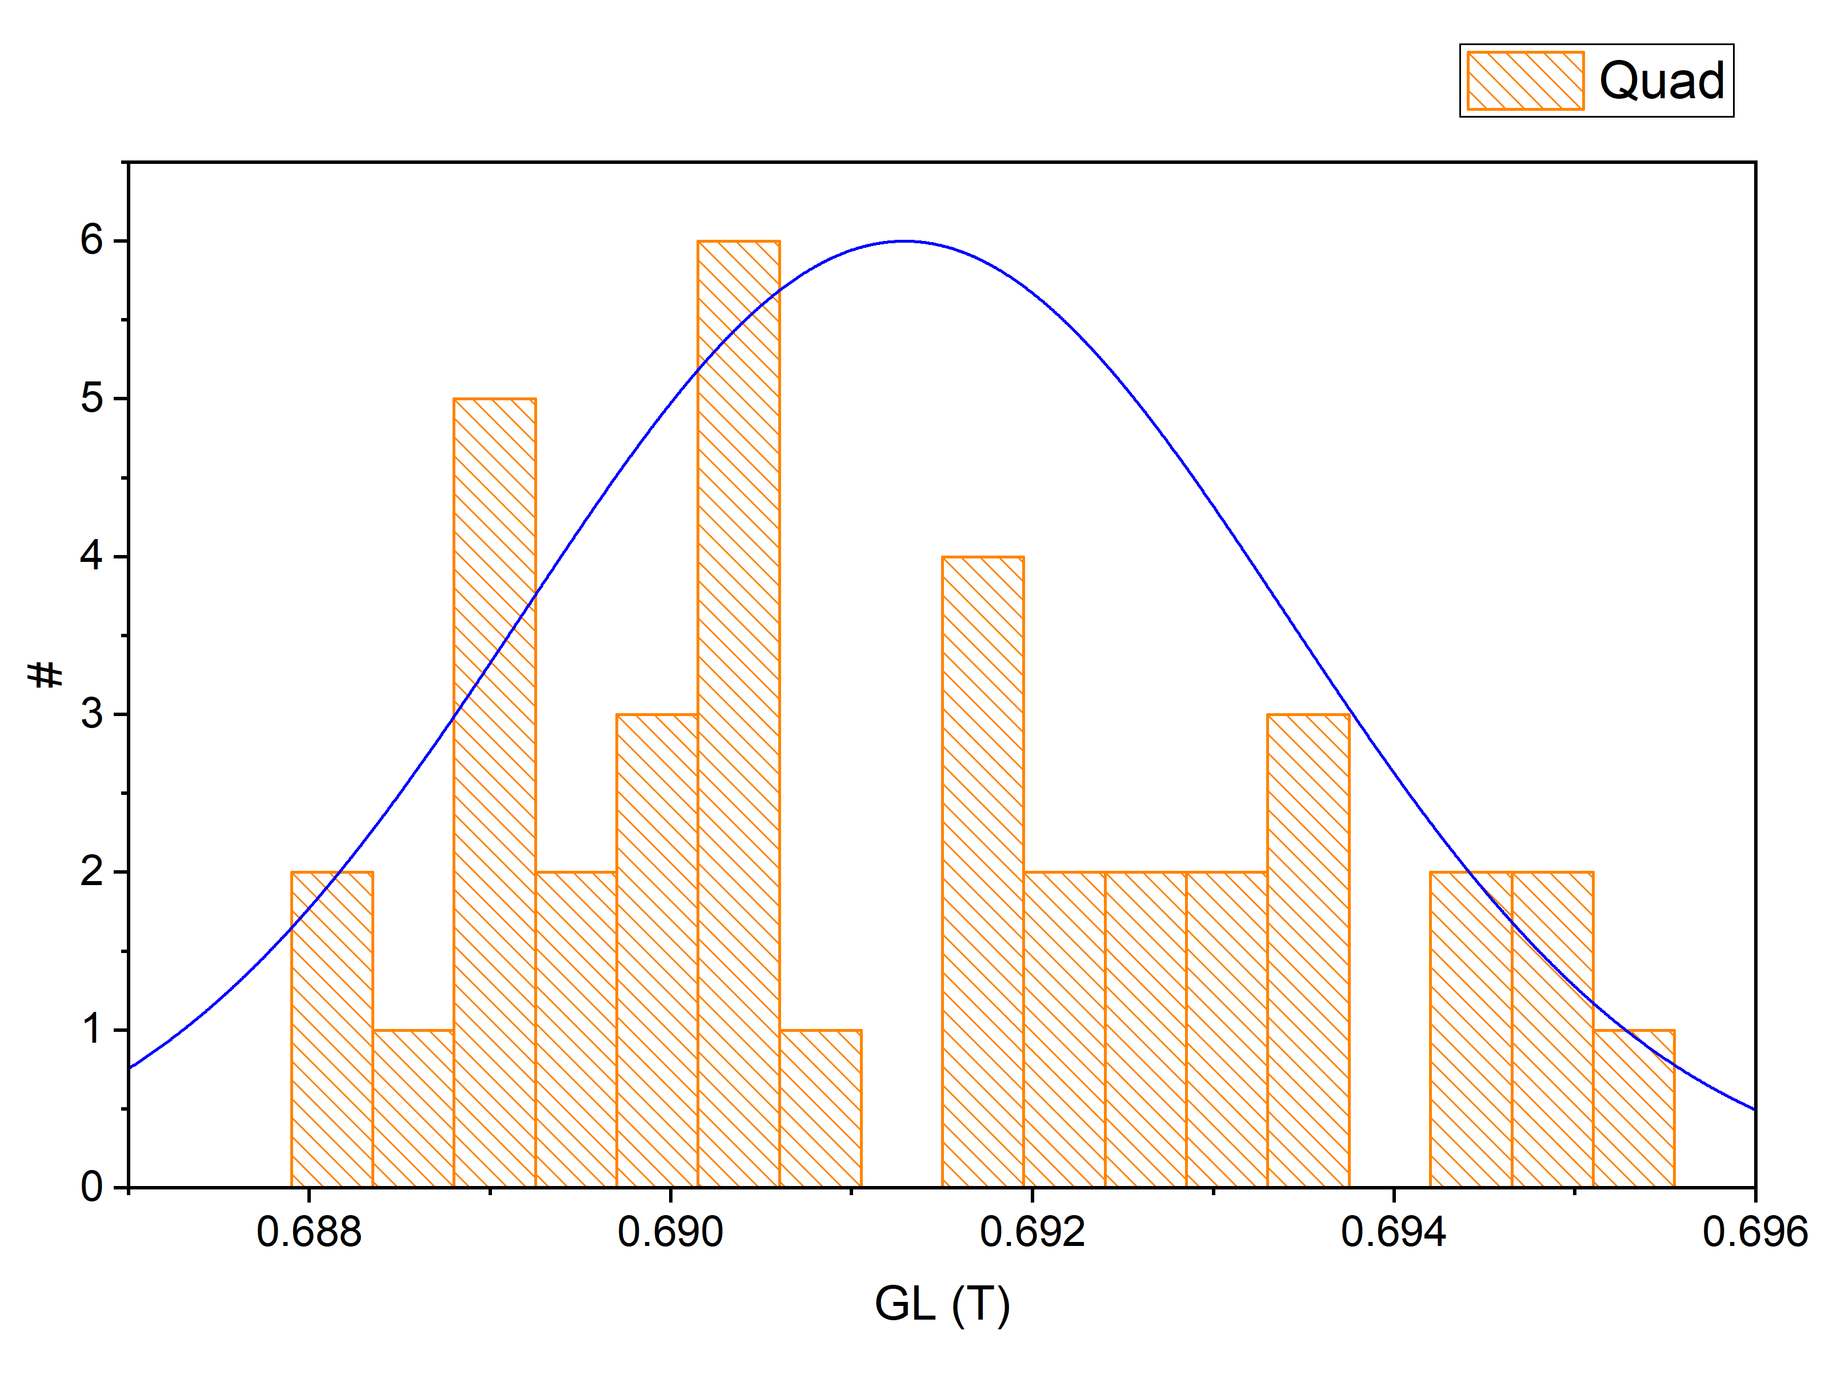
Magnetic Measurements. Booster
45 dipole magnets
24 doublets of quadrupole magnets
Parameter | Dipoles |  | Quadrupoles
 | Mean | SD | Mean | SD
Injection Energy (1.6 $T⋅m$)
$α$ (tilt), mrad | -1.3 | 1.7 | — | 0.1
$dX=dY$, mm | — | — | — | 0.1
$B_{0}L \left(B_{1}L\right)$, T*m | — | 0.19 | — | 0.06
$$b_{2}∗{10}^{−4}$$ | -0.8 | 0.6 | -2.1 | 4.6
$$a_{2}∗{10}^{−4}$$ | — | — | 1.3 | 4.3
$$b_{3}∗{10}^{−4}$$ | — | — | 7.6 | 3.1
$$b_{5}∗{10}^{−4}$$ | — | — | 4.9 | 0.6
$${b(a)}_{n}=\frac{1}{n!}\frac{r_{ref}^{n}}{B_{ref}}\frac{∂^{n}B_{y}(x)}{∂x^{n}};b{\left(a\right)}_{n}^{int}=\frac{\int_{−∞}^{∞}{b{\left(a\right)}_{n}(s)}}{L_{eff}}, n=0,1…$$

Slide 9
Dynamic Aperture
Dynamic aperture (DA) – domain of the particles are located (coordinates) in 6D phase space, where their motion in electromagnetic field of the facility is stable under the influence perturbations:
the perturbations are systematic and random errors of the lattice magnets and RF-stations
space charge force
impedance of the beam pipe etc.
Only transvers DA are considered (without the synchrotron motion)
Let us introduce the concept of the maximal initial amplitude of a particle oscillation:
$$A_{x,y}\left(s\right)⟺\left(x,x^{′},y,y^{′}\right): ∀N_{turn}, ∃A_{x,y}\left(s\right)>A_{x,y}^{′}\left(s\right), N_{turn}∈ℤ^{+}$$
$A_{x,y}^{′}\left(s\right)$ – geometric acceptance of the facility
The following tasks are necessary solved for checking this condition:
find DA by numerical simulation
estimate the effect of the different perturbation on the DA value
compare this value with the acceptance of the facility
Calculation for 2D and 4D betatron motion are presented:
the particle tracking $2^{10}$ turns to build-up the phase-plane plot $\left(x,p_{x}\right), (y,p_{y})$ and correspondence the tune vs. initial amplitude $ν_{x/y}=f(x/y)$ (2D DA)
the particle tracking 5000 turns to calculate 4D DA

Slide 10
2D DA. Results
The DA value is defined as the area inside the phase trajectory:
$$A_{ψ}=\int_{0}^{2π}{\int_{0}^{R\left(ψ\right)}{dR⋅dψ=\frac{1}{2π}}\int_{0}^{2π}{R{\left(ψ\right)}^{2}⋅dψ}}→\lim_{N→∞}{\frac{1}{N}\sum_{n=1}^{N}{{\left[R_{n}\left(ψ\right)\right]}^{2}}≡\left\langle R(ψ)\right\rangle }[π⋅mm⋅mrad]$$
Calc. Type | $$\left(\hat{x},{\hat{p}}_{x}\right)$$ |  | $$\left(\hat{y},{\hat{p}}_{y}\right)$$
 | Sext. Off | Sext. On | Sext. Off | Sext. On
Injection Energy (1.6 $T⋅m$)
No errors | $$400(∞)$$ | $$400(∞)$$ | $$400(∞)$$ | $$400(∞)$$
Total | $$310$$ | $$140$$ | $$340$$ | $$320$$
Total+Rnd | $$310$$ | $$160$$ | $$330$$ | $$260$$
Extraction Energy (25 $T⋅m$) | -0,8 | 0,6 | -2,1 | 4,6
No errors | $$400(∞)$$ | $$400(∞)$$ | $$400(∞)$$ | $$400(∞)$$
Total | $$190$$ | $$220$$ | $$320$$ | $$250$$
Total+Rnd | $$180$$ | $$180$$ | $$310$$ | $$250$$
(x,x’)

Slide 11
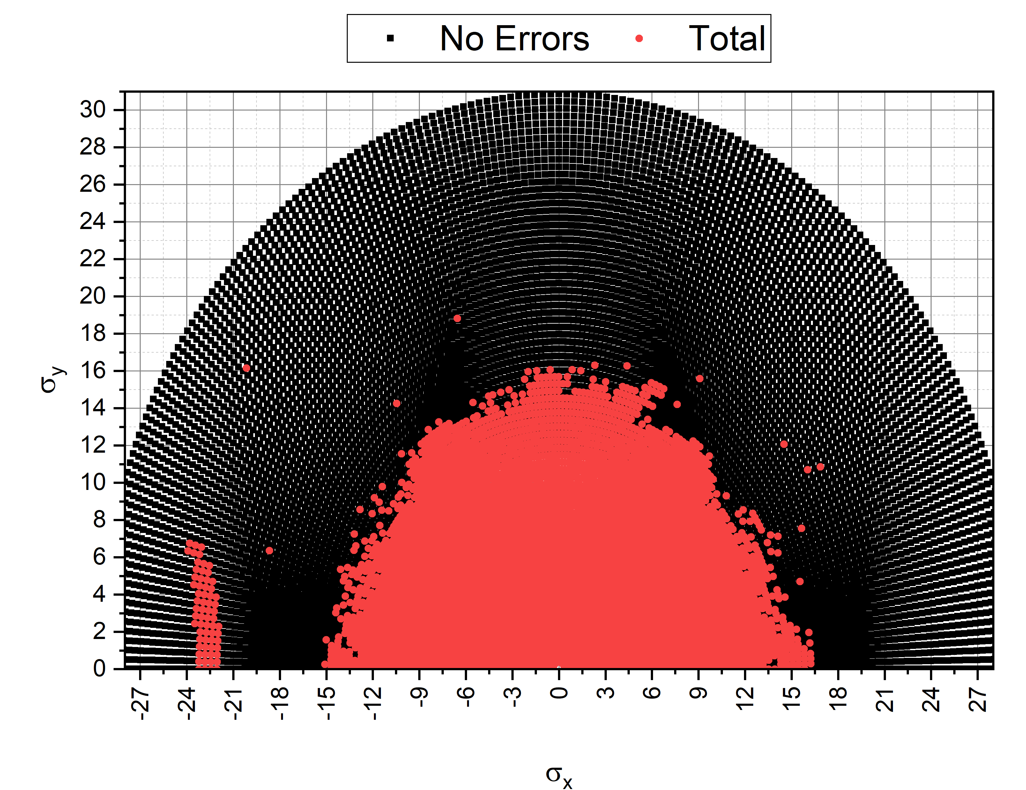
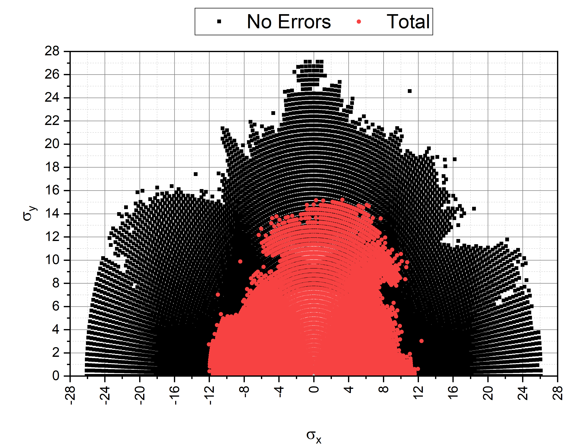
4D DA. Results
Initial coordinates:
$$x_{0}=r_{i}\cos{θ_{j}}, y_{0}=r_{i}\sin{θ_{j}}, 0≤θ_{j}≤π; ε_{x}=\frac{x_{0}^{2}}{β_{x}},ε_{y}=\frac{y_{0}^{2}}{β_{y}}$$
At each azimuth: $r(θ)≈r[θ_{j}]→\max_{i}\left\{r_{i}\left(θ_{j},N\right)\right\}$
$$A_{r,θ}=\frac{1}{π}\int_{0}^{π}{r(θ)⋅dθ}→\lim_{N→∞}{\frac{1}{N}\sum_{n=1}^{N}{{\left[r_{n}\left(θ\right)\right]}^{2}}≡\left\langle r(θ)\right\rangle }[m]$$
Calculation Type | $$\text{1}\text{.}\text{6 }T⋅m$$ |  | $$\text{25} T⋅m$$
 | Sext. Off | Sext. On | Sext. Off | Sext. On
No errors | $$79.0(∞)$$ | $$63.3$$ | $$79.0(∞)$$ | $$63.3$$
Total | $$37.4$$ | $$34.7$$ | $$38.3$$ | $$36.3$$
Total+Rnd | $$37.2$$ | $$35.0$$ | $$38.6$$ | $$36.6$$

Slide 12
CO correction Algorithms
The method of least squares (m≠n)
Inverse matrix (m=n)
SVD algorithms (m≠n)
Harmonics correction

Slide 13
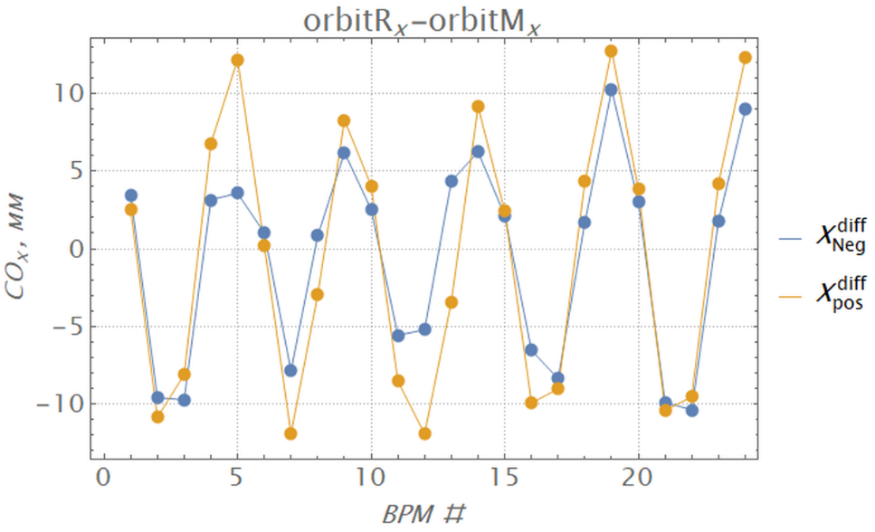
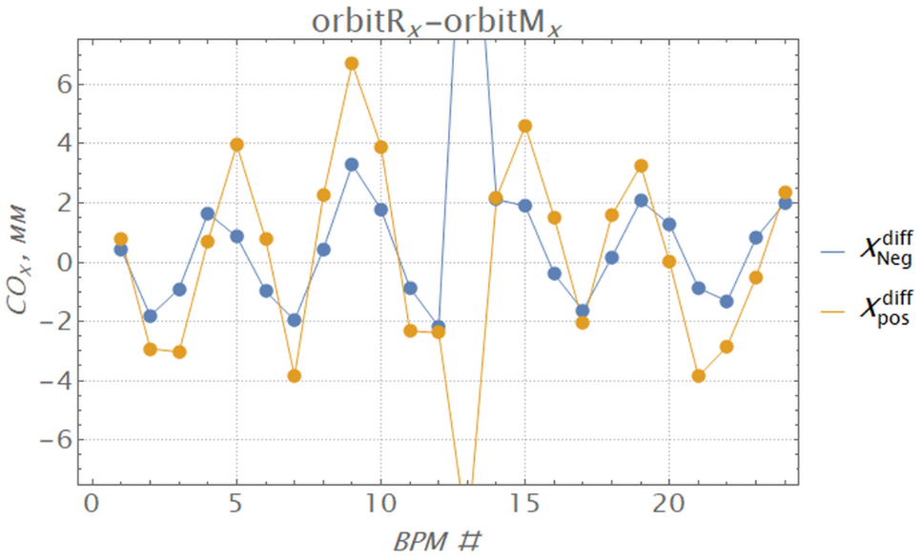
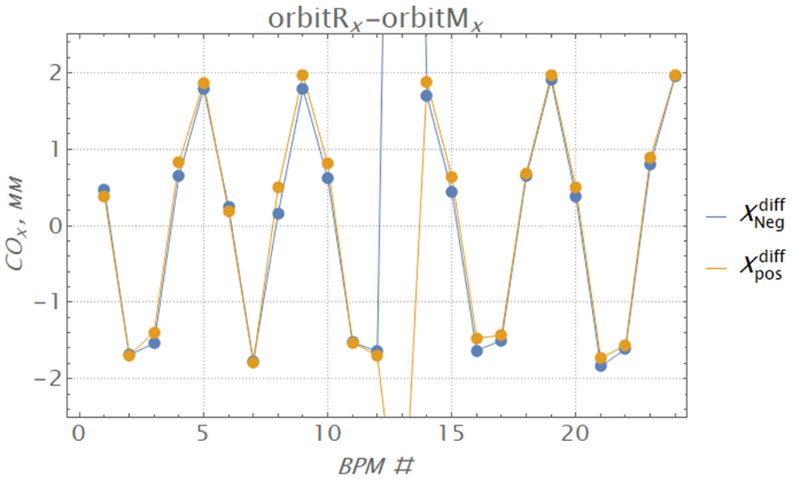
Diff. Orbits. Orbit Response Matrix
Steerer 2S1H. Working point: ${ν_{x}}/{ν_{y}}={4.88}/{5.39}$
Шаг 1
Шаг 3
Шаг 5
Differential Orbits Measurements
$$Z_{i}^{diff}=Z_{i}^{pert}−Z_{i}^{init}$$
Developed and tested software for the ORM measurements
The measurement time on the Booster was $≈30÷40 min$ (cycle 3.2 sec)
Orbit Response Matrix (ORM)
$$\left(\begin{matrix}R_{xx} & R_{xy} \\ R_{yx} & R_{yy}\end{matrix}\right)\left(\begin{matrix}θ_{x} \\ θ_{y}\end{matrix}\right)=\left(\begin{matrix}x \\ y\end{matrix}\right) or \vec{z}=R\vec{Θ},$$
$$R_{zz,ij}=\frac{z_{i}^{diff}}{θ_{z,j}},R_{xy,ij}=\frac{x_{i}^{diff}}{θ_{y,j}},R_{yx,ij}=\frac{y_{i}^{diff}}{θ_{x,j}}$$

Slide 14
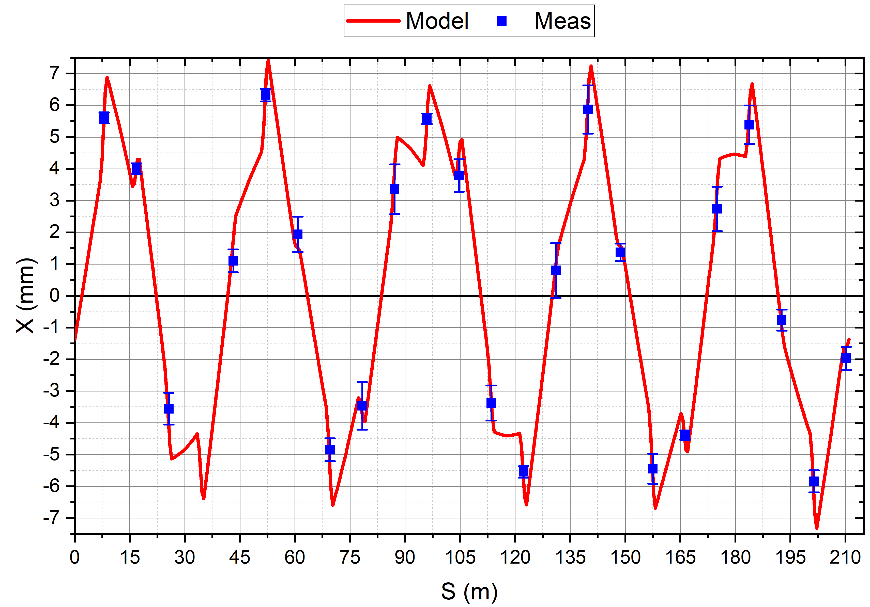
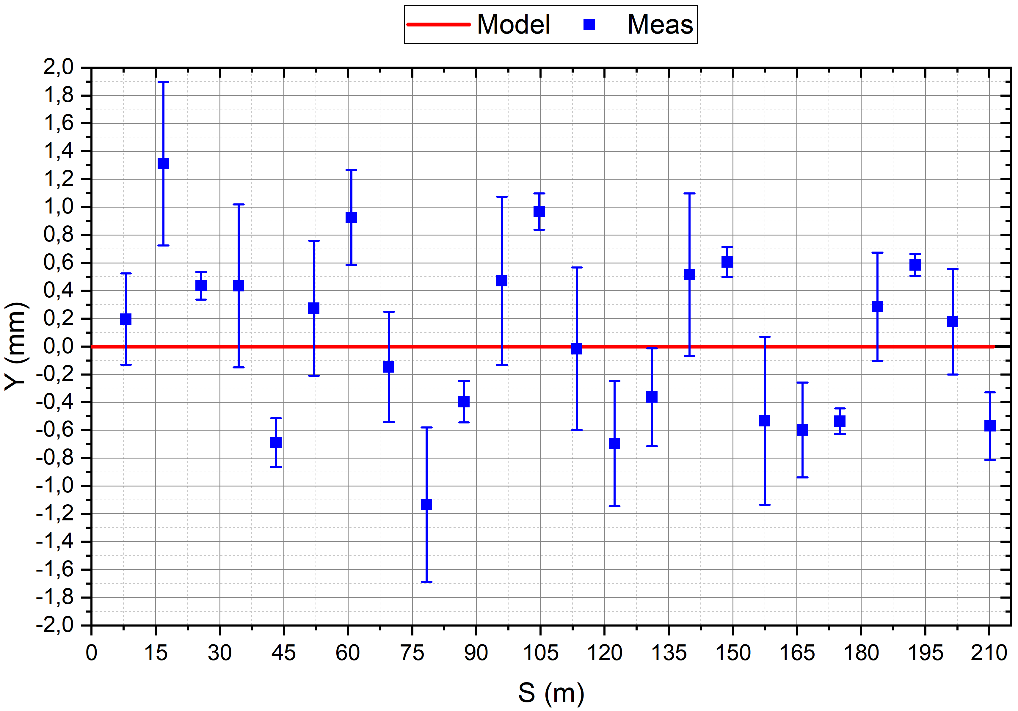
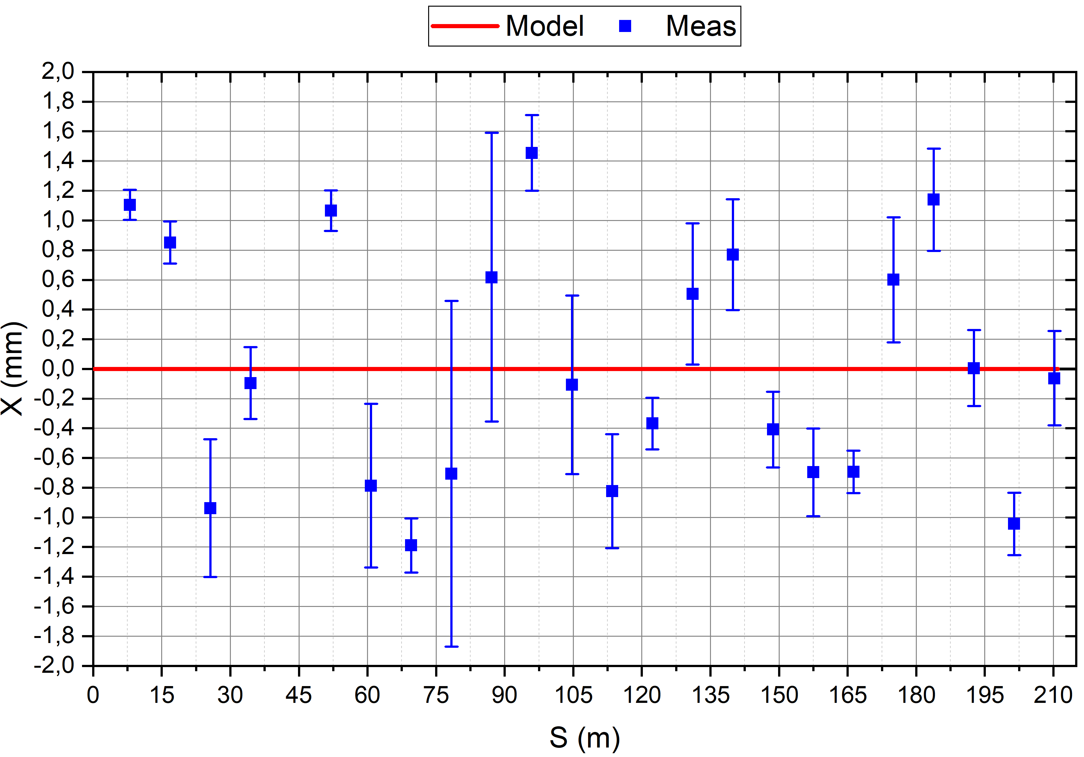
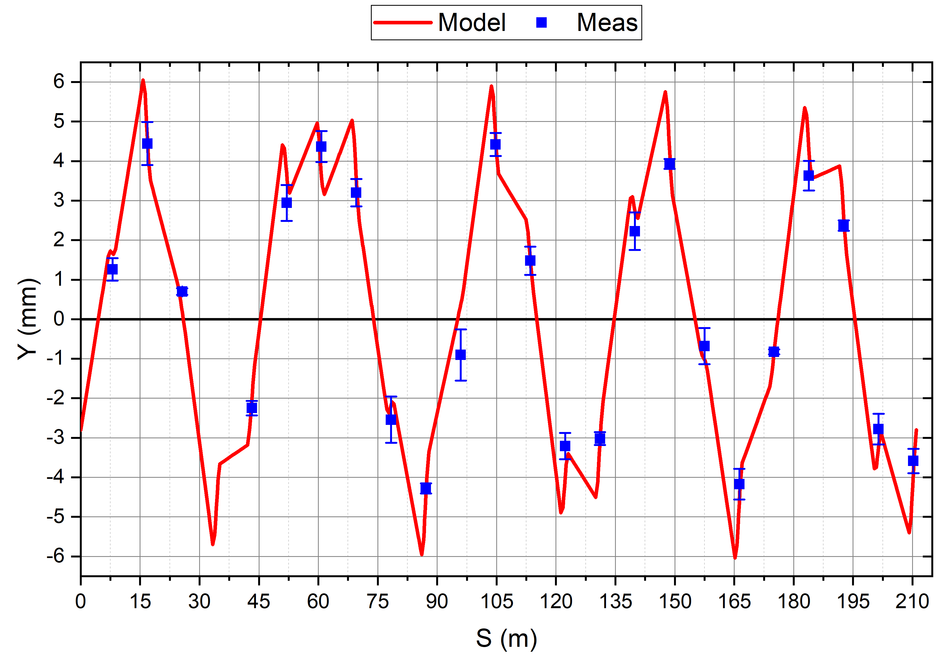
Differential Orbits Measurements
Steerer 2S5H
$$±1 A$$
Steerer 1S1V
$$±1 A$$

Slide 15
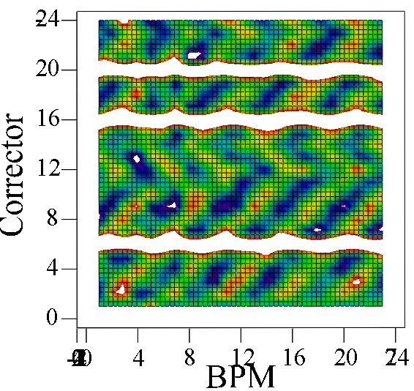
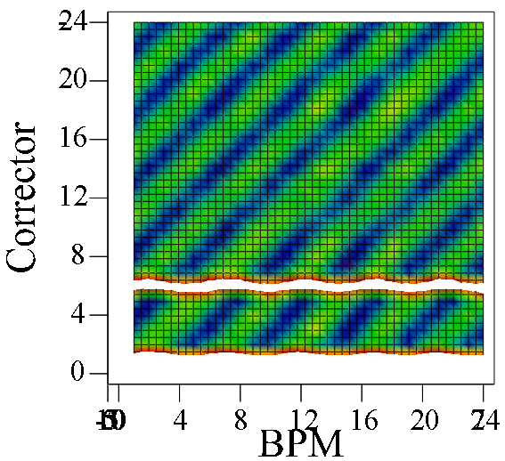
Steerers Polarities
Horizontal plane
3 wrong polarities were found
Vertical plane

Slide 16
Modelling
Accuracy of compatibility with the model $<3 \%$
$L_{eff}^{corr}=0.24 m$ correspond to 3D calculations

Slide 17
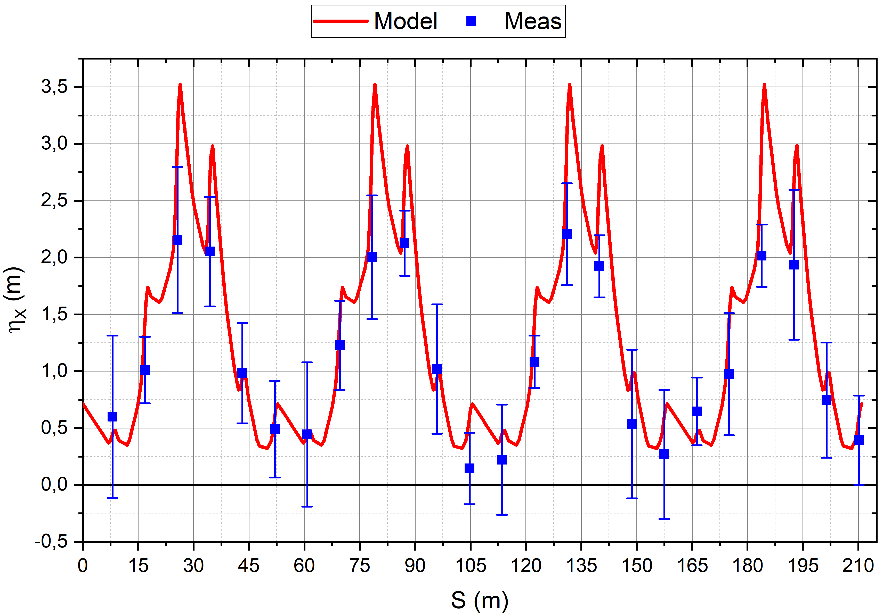
Dispersion
Linear case:
$$ΔX\left(s\right)=D_{x}\left(s\right)\frac{Δp}{p}⇔D_{x}\left(s\right)=−η\frac{Δx\left(s\right)}{Δf/f_{0}},$$
$$η=α−\frac{1}{γ^{2}}−slip factor; \\ α−momentum compaction factor$$
Accuracy of compatibility with the model $<3 \%$ at $D_{x}>1 m$
CO correction increase the measurement accuracy

Slide 18
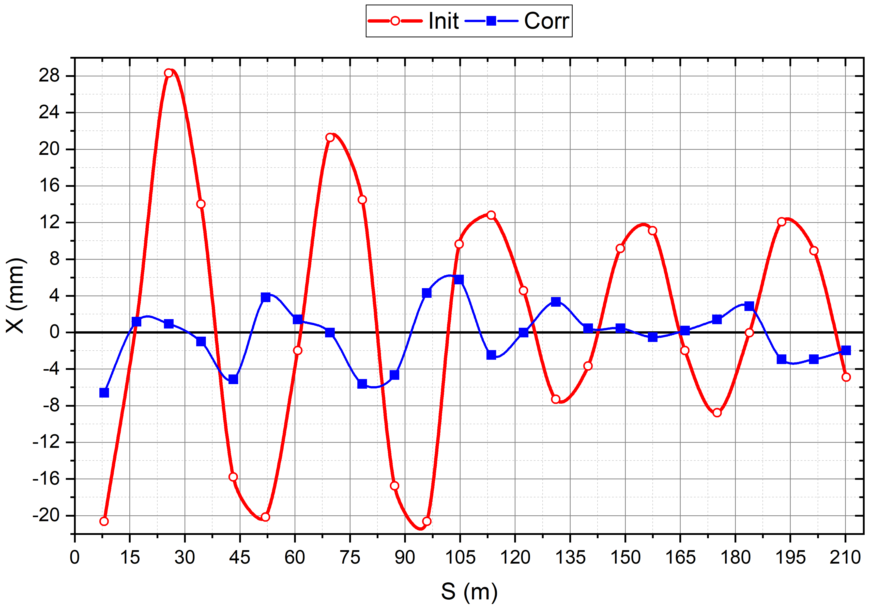
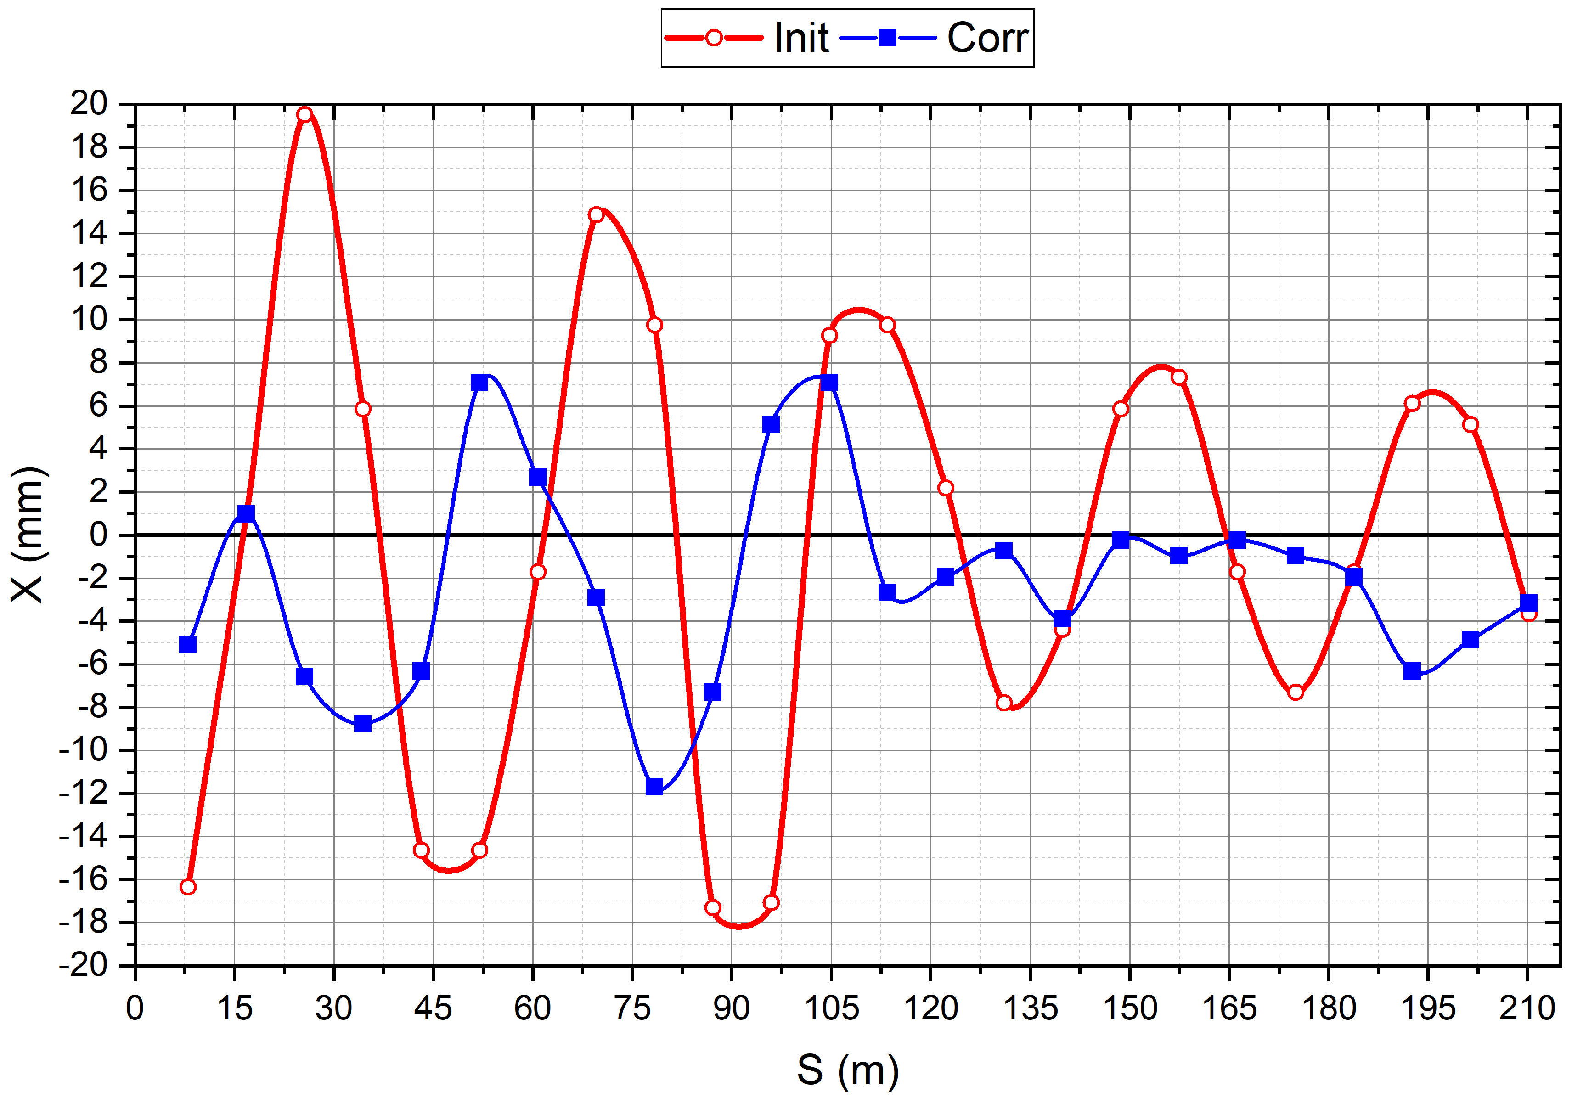
CO Correction. Dynamic Mode
Dynamic correction mode of CO correction was demonstrated
First time at the NICA injection complex
Developed software and measured ORM used
Main limitation:
3 steerers not used, minimal operating current $±0.3 A$ (injection)
Injection. CO $±6 mm$
Extraction. CO $±12 mm$

Slide 19
Conclusion
The calculations of magnetic fields (analytical and 2D FEM) were carried out. Correlation of results with relative accuracy $<1÷2 \%$ was observed for the analytical and FEM models. The production of Booster corrector magnets (including magnetic measurements) has been completed M. M. Shandov et. al, Correctors’ Magnets for the NICA Booster and Collider // PEPaN Letters, v.17, 2020
CO distortions caused by field errors observed from magnetic measurements are $≤±8 mm$
The corrected CO distortions up to$≤±1÷2 mm$ were established by the presented CO correction algorithms
Required dipole kicks: 0.3% (max=1%) or 0.12 A (max 0.4 A) M. M. Shandov & S. A. Kostromin, Closed Orbit Correction Algorithms of the NICA Booster // Physics of Atomic Nuclei , 85, 2022

Slide 20
Conclusion
The Booster lattice model was developed in the MAD-X software
The methodology for DA calculations has been tried and tested. The 2D DA exceeds the horizontal and vertical acceptance
The tune vs. initial amplitude dependencies were obtained. Agreement with the behavior of particles in the corresponding phase space the dependencies was get
The 4D DA value 12σ was obtained. The maximal initial amplitudes in the $\left(x,0\right)$ and $\left(y,0\right)$ directions correspond to the 2D DA calculation results M. M. Shandov & S. A. Kostromin, Simulation of the Dynamic Aperture of the NICA Booster Synchrotron Based on Magnetic Measurement Data // PEPaN Letters, v.19, 2022

Slide 21
Conclusion
Developed and implemented software for measuring differential orbits and ORM ($30÷40 min$; cycle 3.2 sec)
ORM measured and Polarity check
Compatibility with the model:
Accuracy $<3 \%$ at $D_{x}>1 m$
$L_{eff}^{corr}=0.24 m$ correspond to 3D calculations
CO correction demonstrated:
Local bump $<±3 A$ $CO≈±10 mm$
Dynamic correction of CO correction was demonstrated for the first time. CO $±6 mm$ (Inj.), $±12 mm$ (Extr.)
M. M. Shandov et. al, Investigation into the Magnetic Structure Characteristics of the NICA Booster in Commissioning Runs with the Beam in 2020–2022 // PEPaN Letters, v.20, 2023

Slide 22
THANK YOU FOR ATTENTION !!!

Slide 23
Spare Slides

Slide 24
Tracking Parameters
Calculation for 2D and 4D betatron motion are presented:
the particle tracking $2^{10}$ turns to build-up the phase-plane plot $\left(x,p_{x}\right), (y,p_{y})$ and correspondence the tune vs. initial amplitude $ν_{x/y}=f(x/y)$ (2D DA)
the particle tracking 5000 turns to calculate 4D DA
Calculation results separates into the follow types:
without errors: No errors
misalignment errors: Allign
misalignment errors and deviation of the integral value of the main magnetic field: Allign+Int
only mean values of all error types: Total
the mean and standard deviation values of all error types (2000 “drawing”): Total+Rnd
Calculation conditions:
the harmonics of the magnetic field were determined as absolute thin multipole elements at each of the magnet edges
the initial tracking point in the center of the straight section of the first superperiod (the injection point into the Booster)
the initial state vector in phase-space was defined as: $s_{0}={\left(x_{0},p_{x0},y_{0},p_{y0}\right)}^{T}$

Slide 25
2D DA
The use of the Poincaré and Hénon mapping (sections) is a common technique for analyzing complex dynamical systems
transformation of coordinates $x_{0}=\left(x_{0},p_{x0}\right)↦x_{1}=\left(x_{1},p_{x1}\right)\left(ℝ^{2}↦ℝ^{2}\right):$ Poincaré mapping $\left(ℳ\right):\{ℳ:x_{n+1}=ℳ^{\left(1\right)}\left(x_{n}\right), ∀n∈ℤ^{+}\}$
transformation of the when passing through all elements of the accelerator: one-turn map$M=ℳ^{n}∘ℳ^{n−1}∘…∘ℳ^{2}∘ℳ^{1}$
the set of all of the one-turn maps $\{M_{1},M_{2},…,M_{n}\}$: Poincaré section. For a periodical lattice structure: $x\left(s_{0}\right)=x\left(s_{L}\right)=x\left(s_{0}+L\right)⇒x\left(s_{L}\right)=M^{N}\left(x\left(s_{0}\right)\right), ∀N∈ℤ^{+}$
The Hénon map and action-angle variables $\left(J, ψ\right)$ could be obtained by transformation to the Normal (Jordan) form of the Floquet solution (Floquet transform):
$$\left(\hat{x},{\hat{p}}_{x}\right)=𝒜^{−1}∘\left(x,p_{x}\right), 𝒜=\left(\begin{matrix}\sqrt{β} & 0 \\ −\frac{α}{\sqrt{β}} & \frac{1}{\sqrt{β}}\end{matrix}\right)$$
the radius of the phase-space trajectory: $R= \sqrt{2J}$
one-turn mapping is corresponded to a rotation in the phase-space by an angle$ψ=2πν$
the axis of rotation is an elliptic stable point
closed phase trajectories are the one-dimensional Kolmogorov–Arnold–Moser tori

Slide 26
Orbit Response Matrix
Basic relationships
$$z\left(s_{0}−s_{i}\right)=θ_{z}\frac{\sqrt{β(s_{i})β(s_{0})}}{2\sin{(πQ_{z})}}\cos\left({πQ}_{z}−\left|μ\left(s_{i}\right)−μ\left(s_{0}\right)\right|\right)$$
$\vec{z}=R \vec{Θ}, R=\left(\begin{matrix}R_{xx} & R_{xy} \\ R_{yx} & R_{yy}\end{matrix}\right)$, $R_{zz,ij}=\frac{Δz_{j}}{θ_{z;i}}$
For the periodical structure of the facility: $C_{ij}=R_{ij}{\left(1−R_{jj}\right)}^{−1}$
For m steerers and n BPMs: $\left(\begin{matrix}\begin{matrix}x_{1} \\ x_{2}\end{matrix} \\ ⋮ \\ x_{n}\end{matrix}\right)=\left(\begin{matrix}C_{11} & C_{12} & ⋯ & C_{1m} \\ C_{21} & C_{22} & ⋯ & C_{2m} \\ ⋮ & ⋮ & ⋱ & ⋮ \\ C_{n1} & C_{n2} & ⋯ & C_{nm}\end{matrix}\right)\left(\begin{matrix}\begin{matrix}θ_{1} \\ θ_{2}\end{matrix} \\ ⋮ \\ θ_{m}\end{matrix}\right)$
CO corrections problem: $\vec{Θ}={R(C)}^{−1}{\vec{z}}_{ref}$

Slide 27
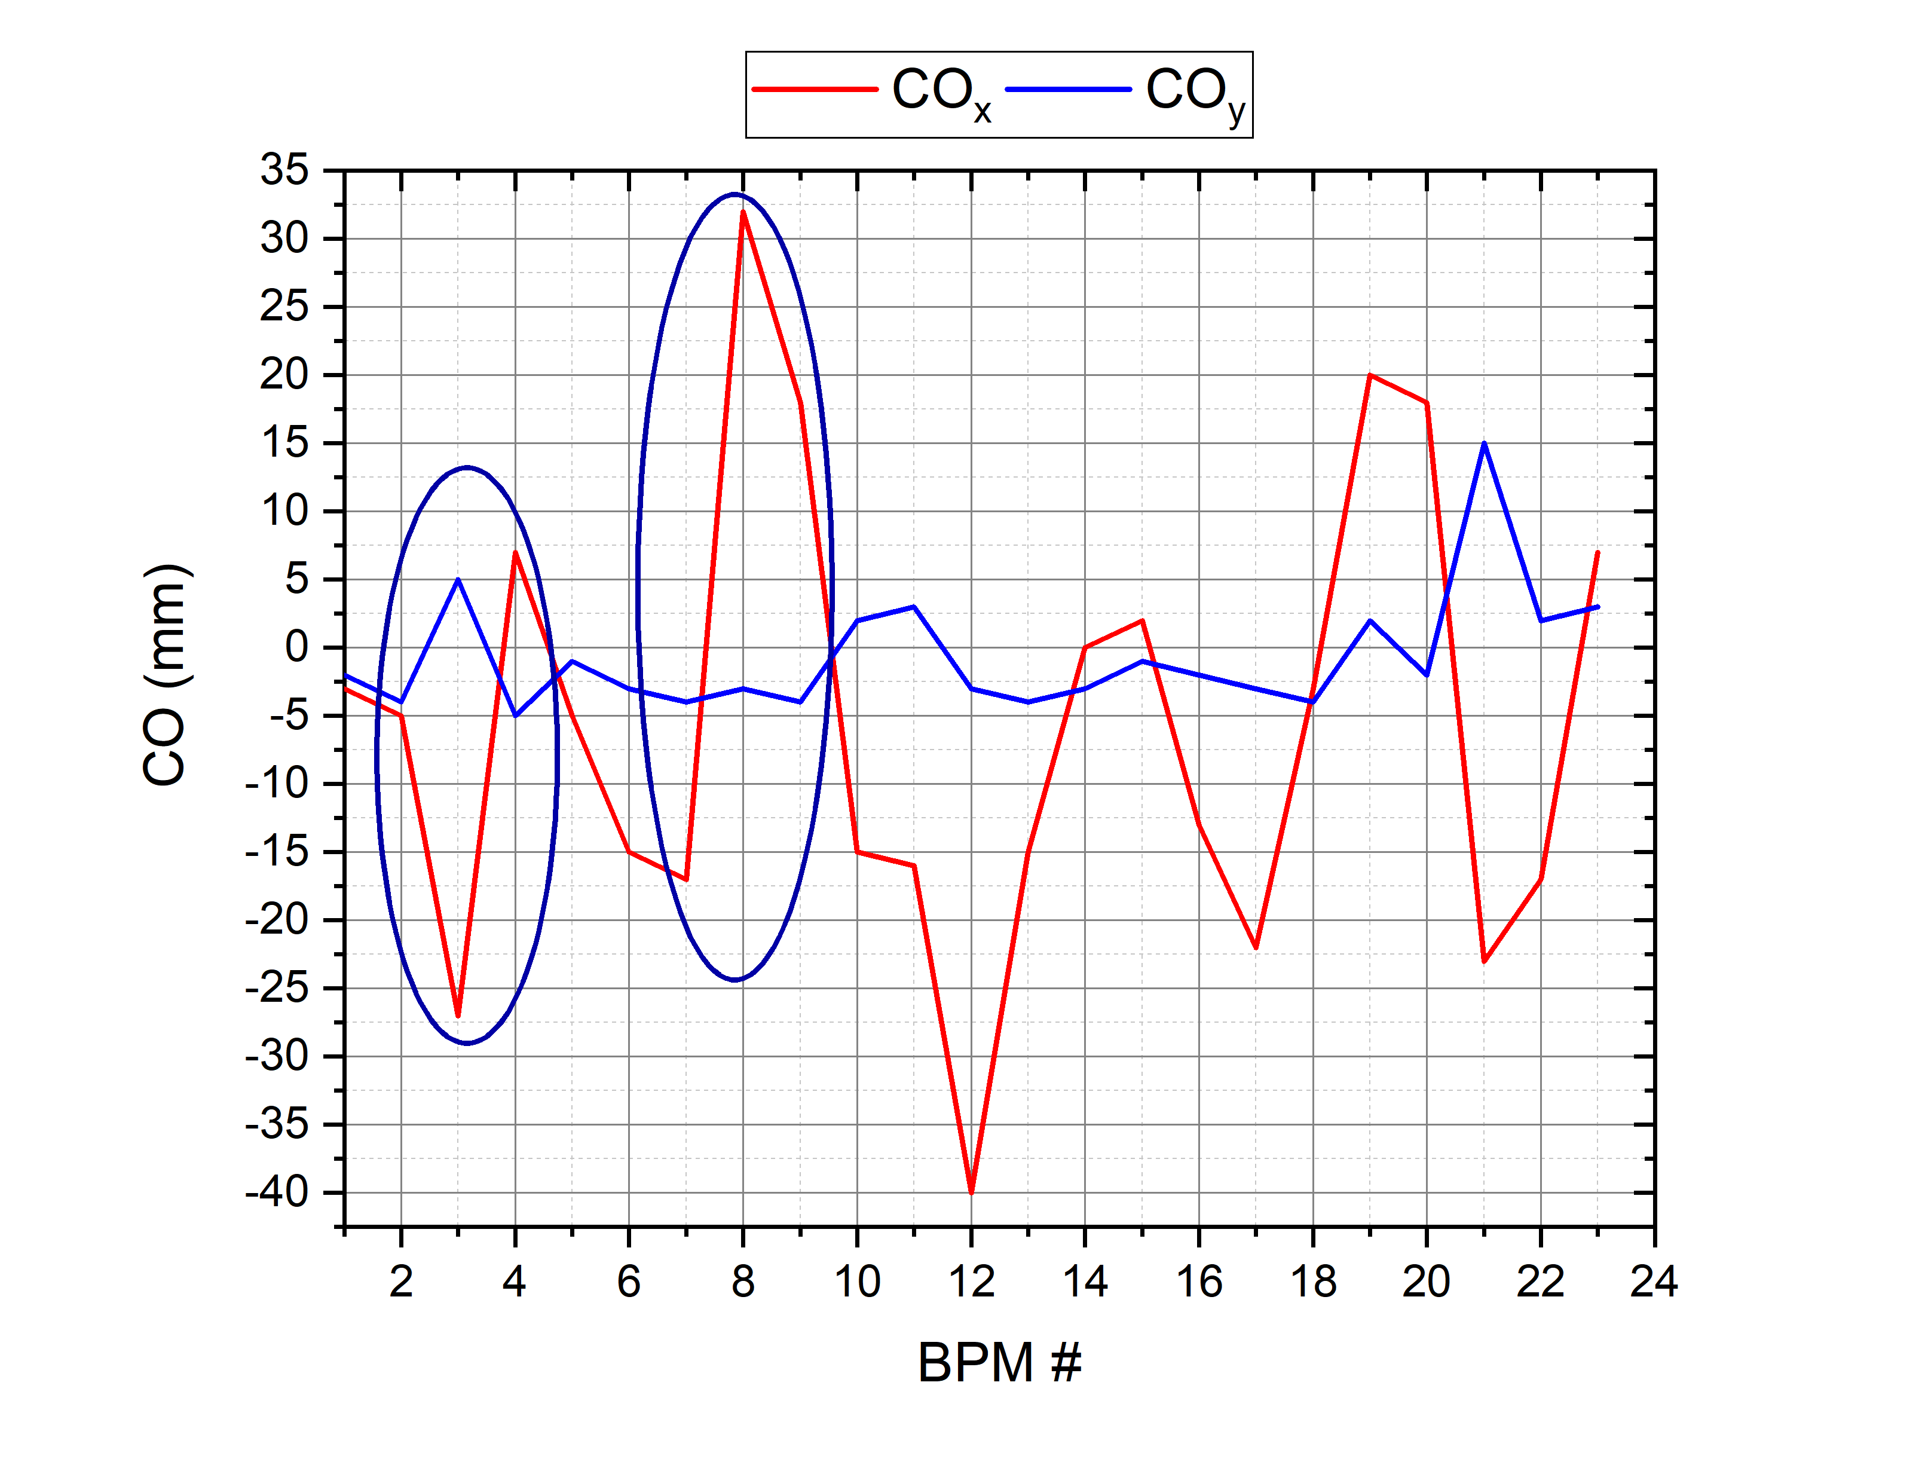
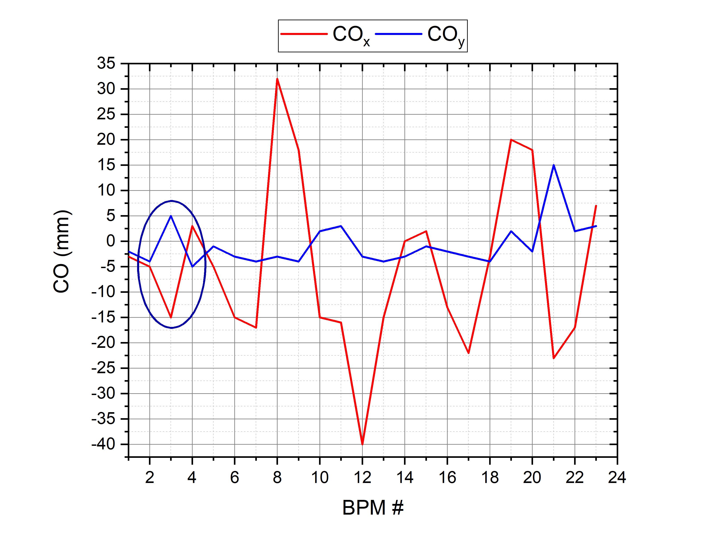
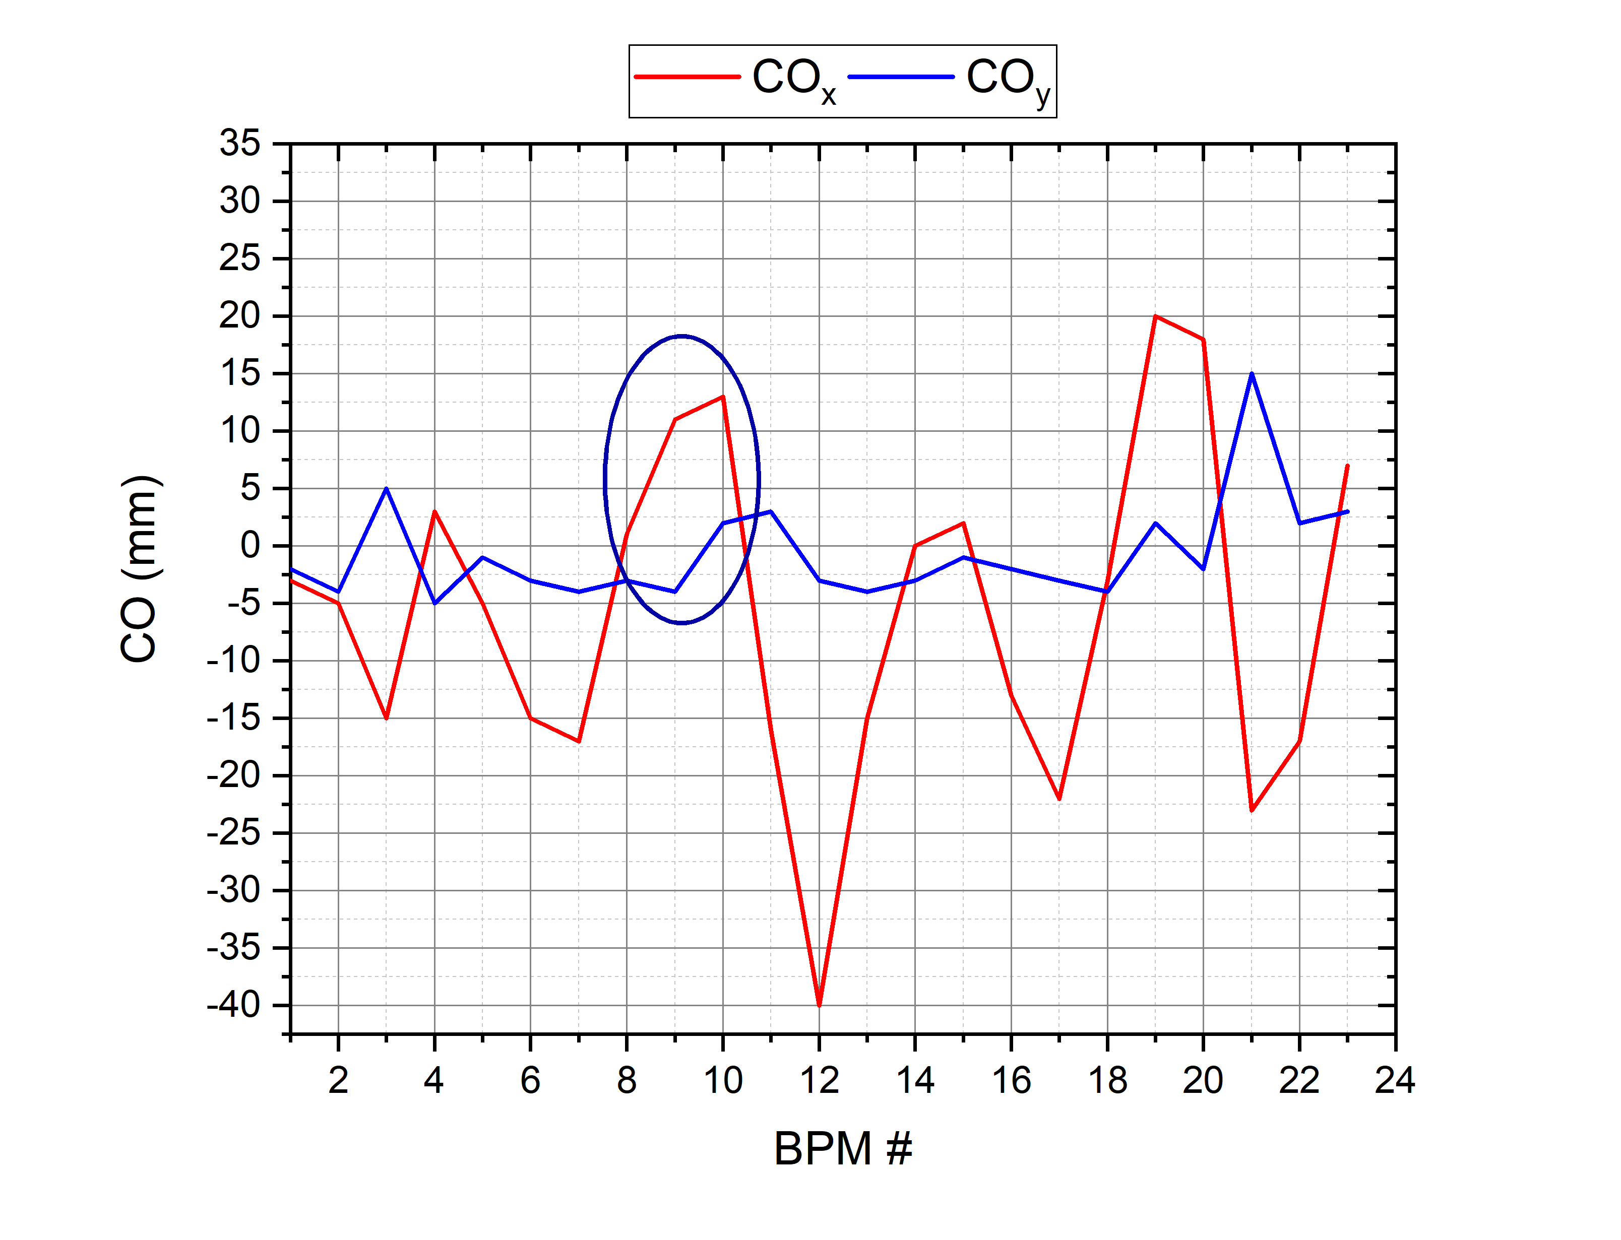
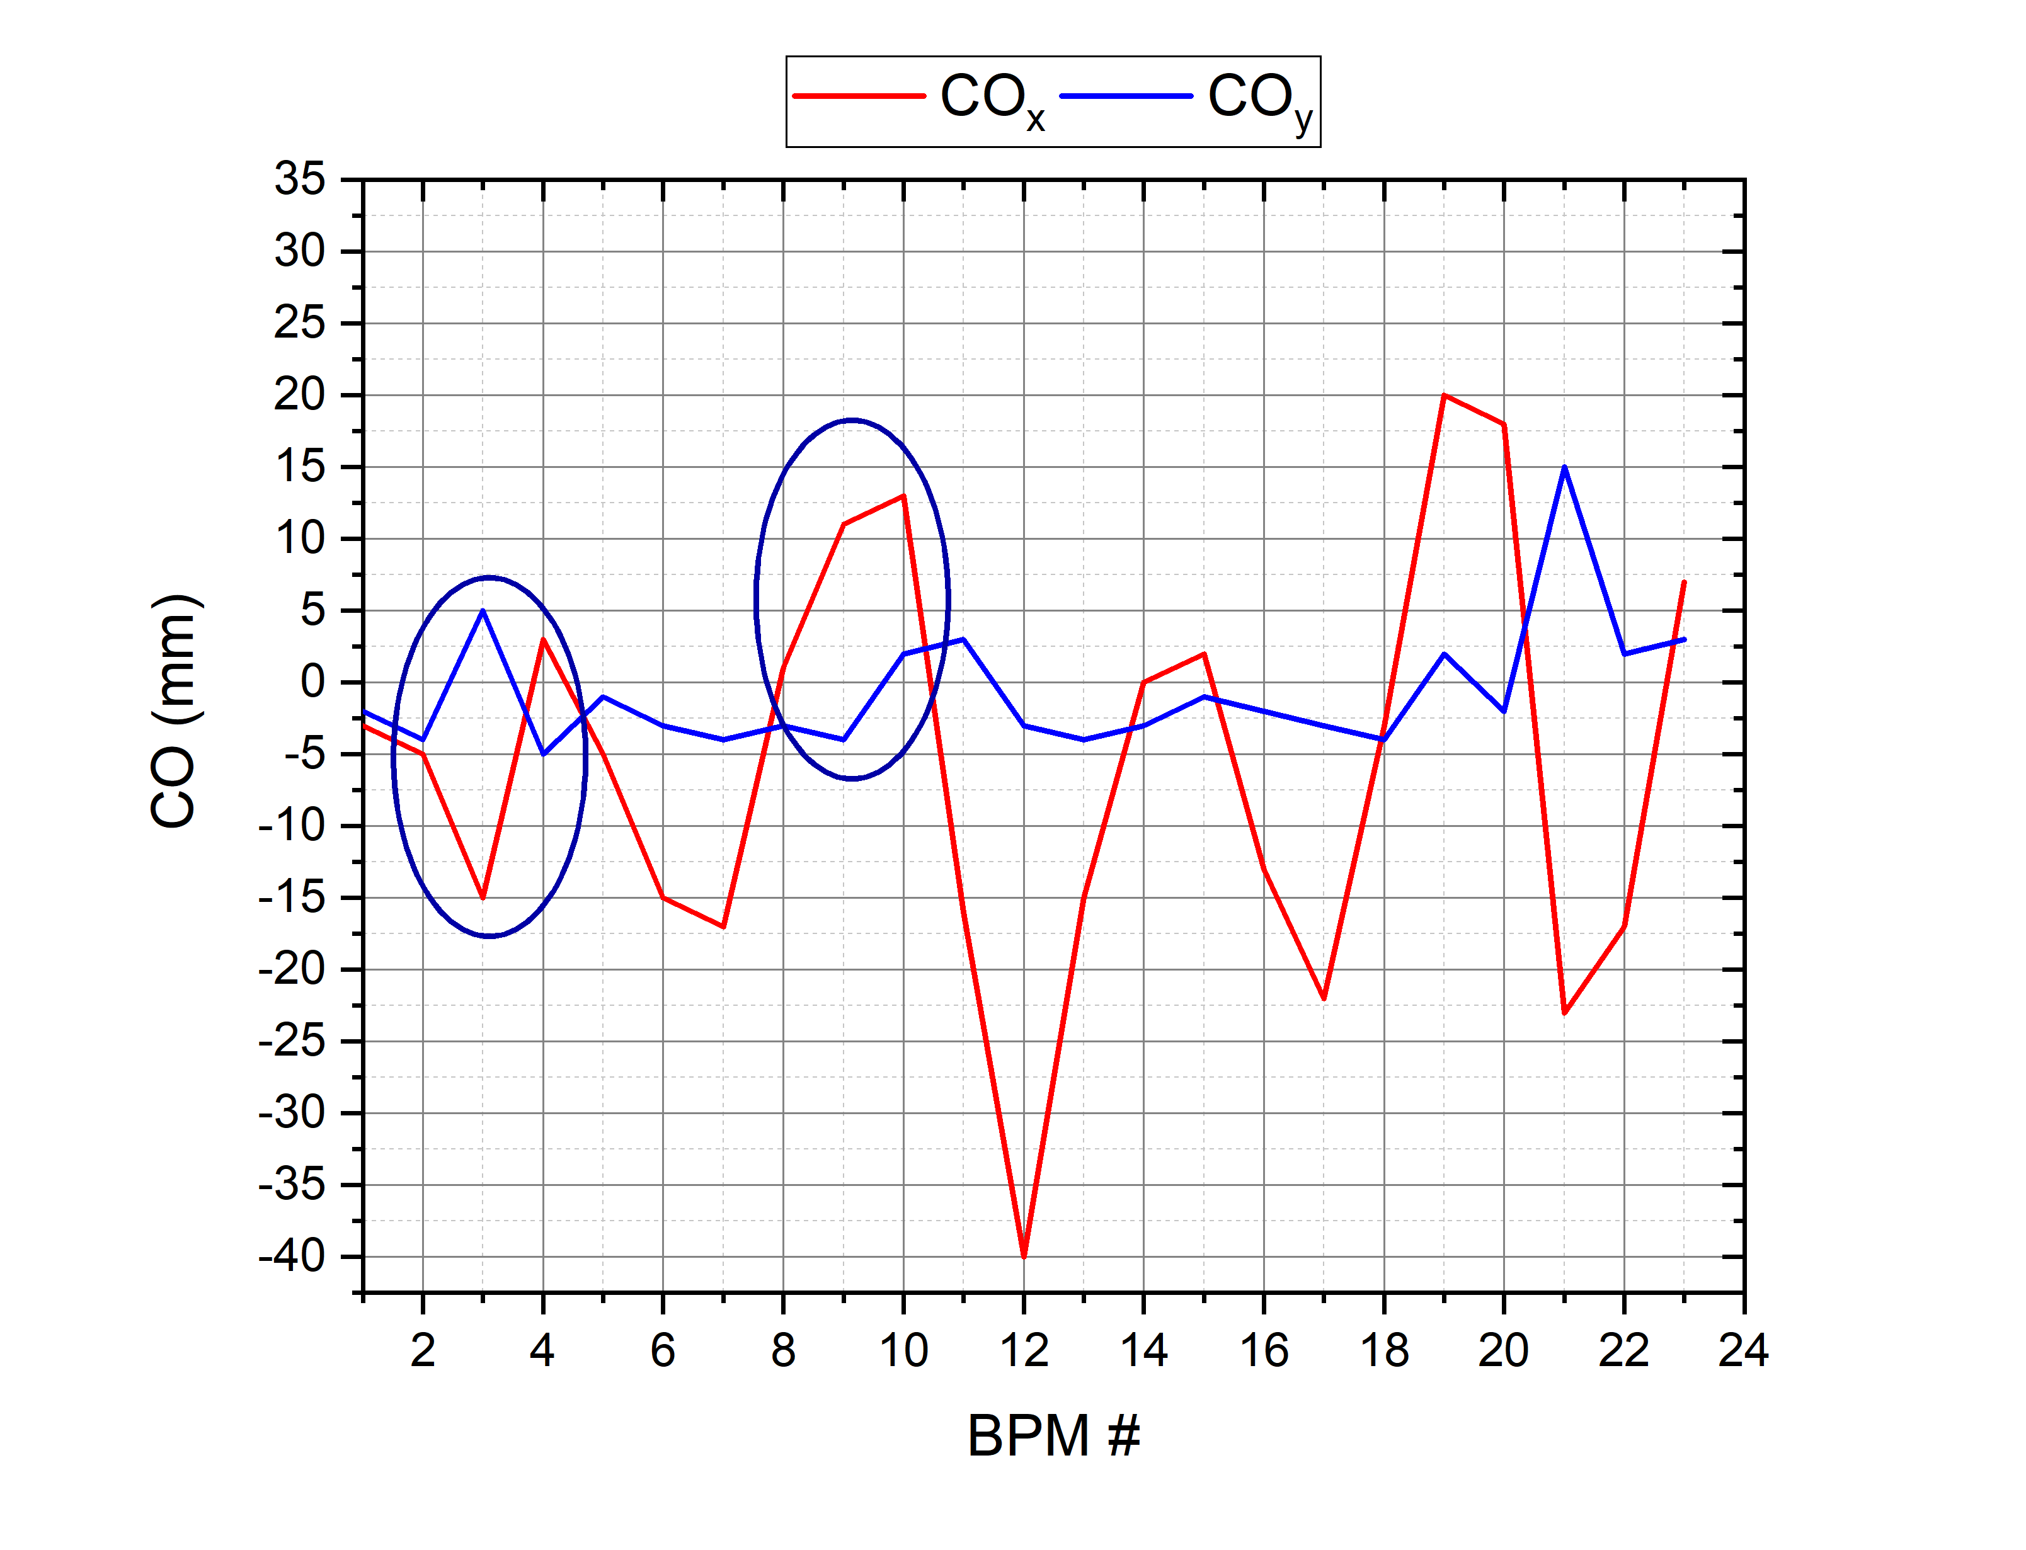
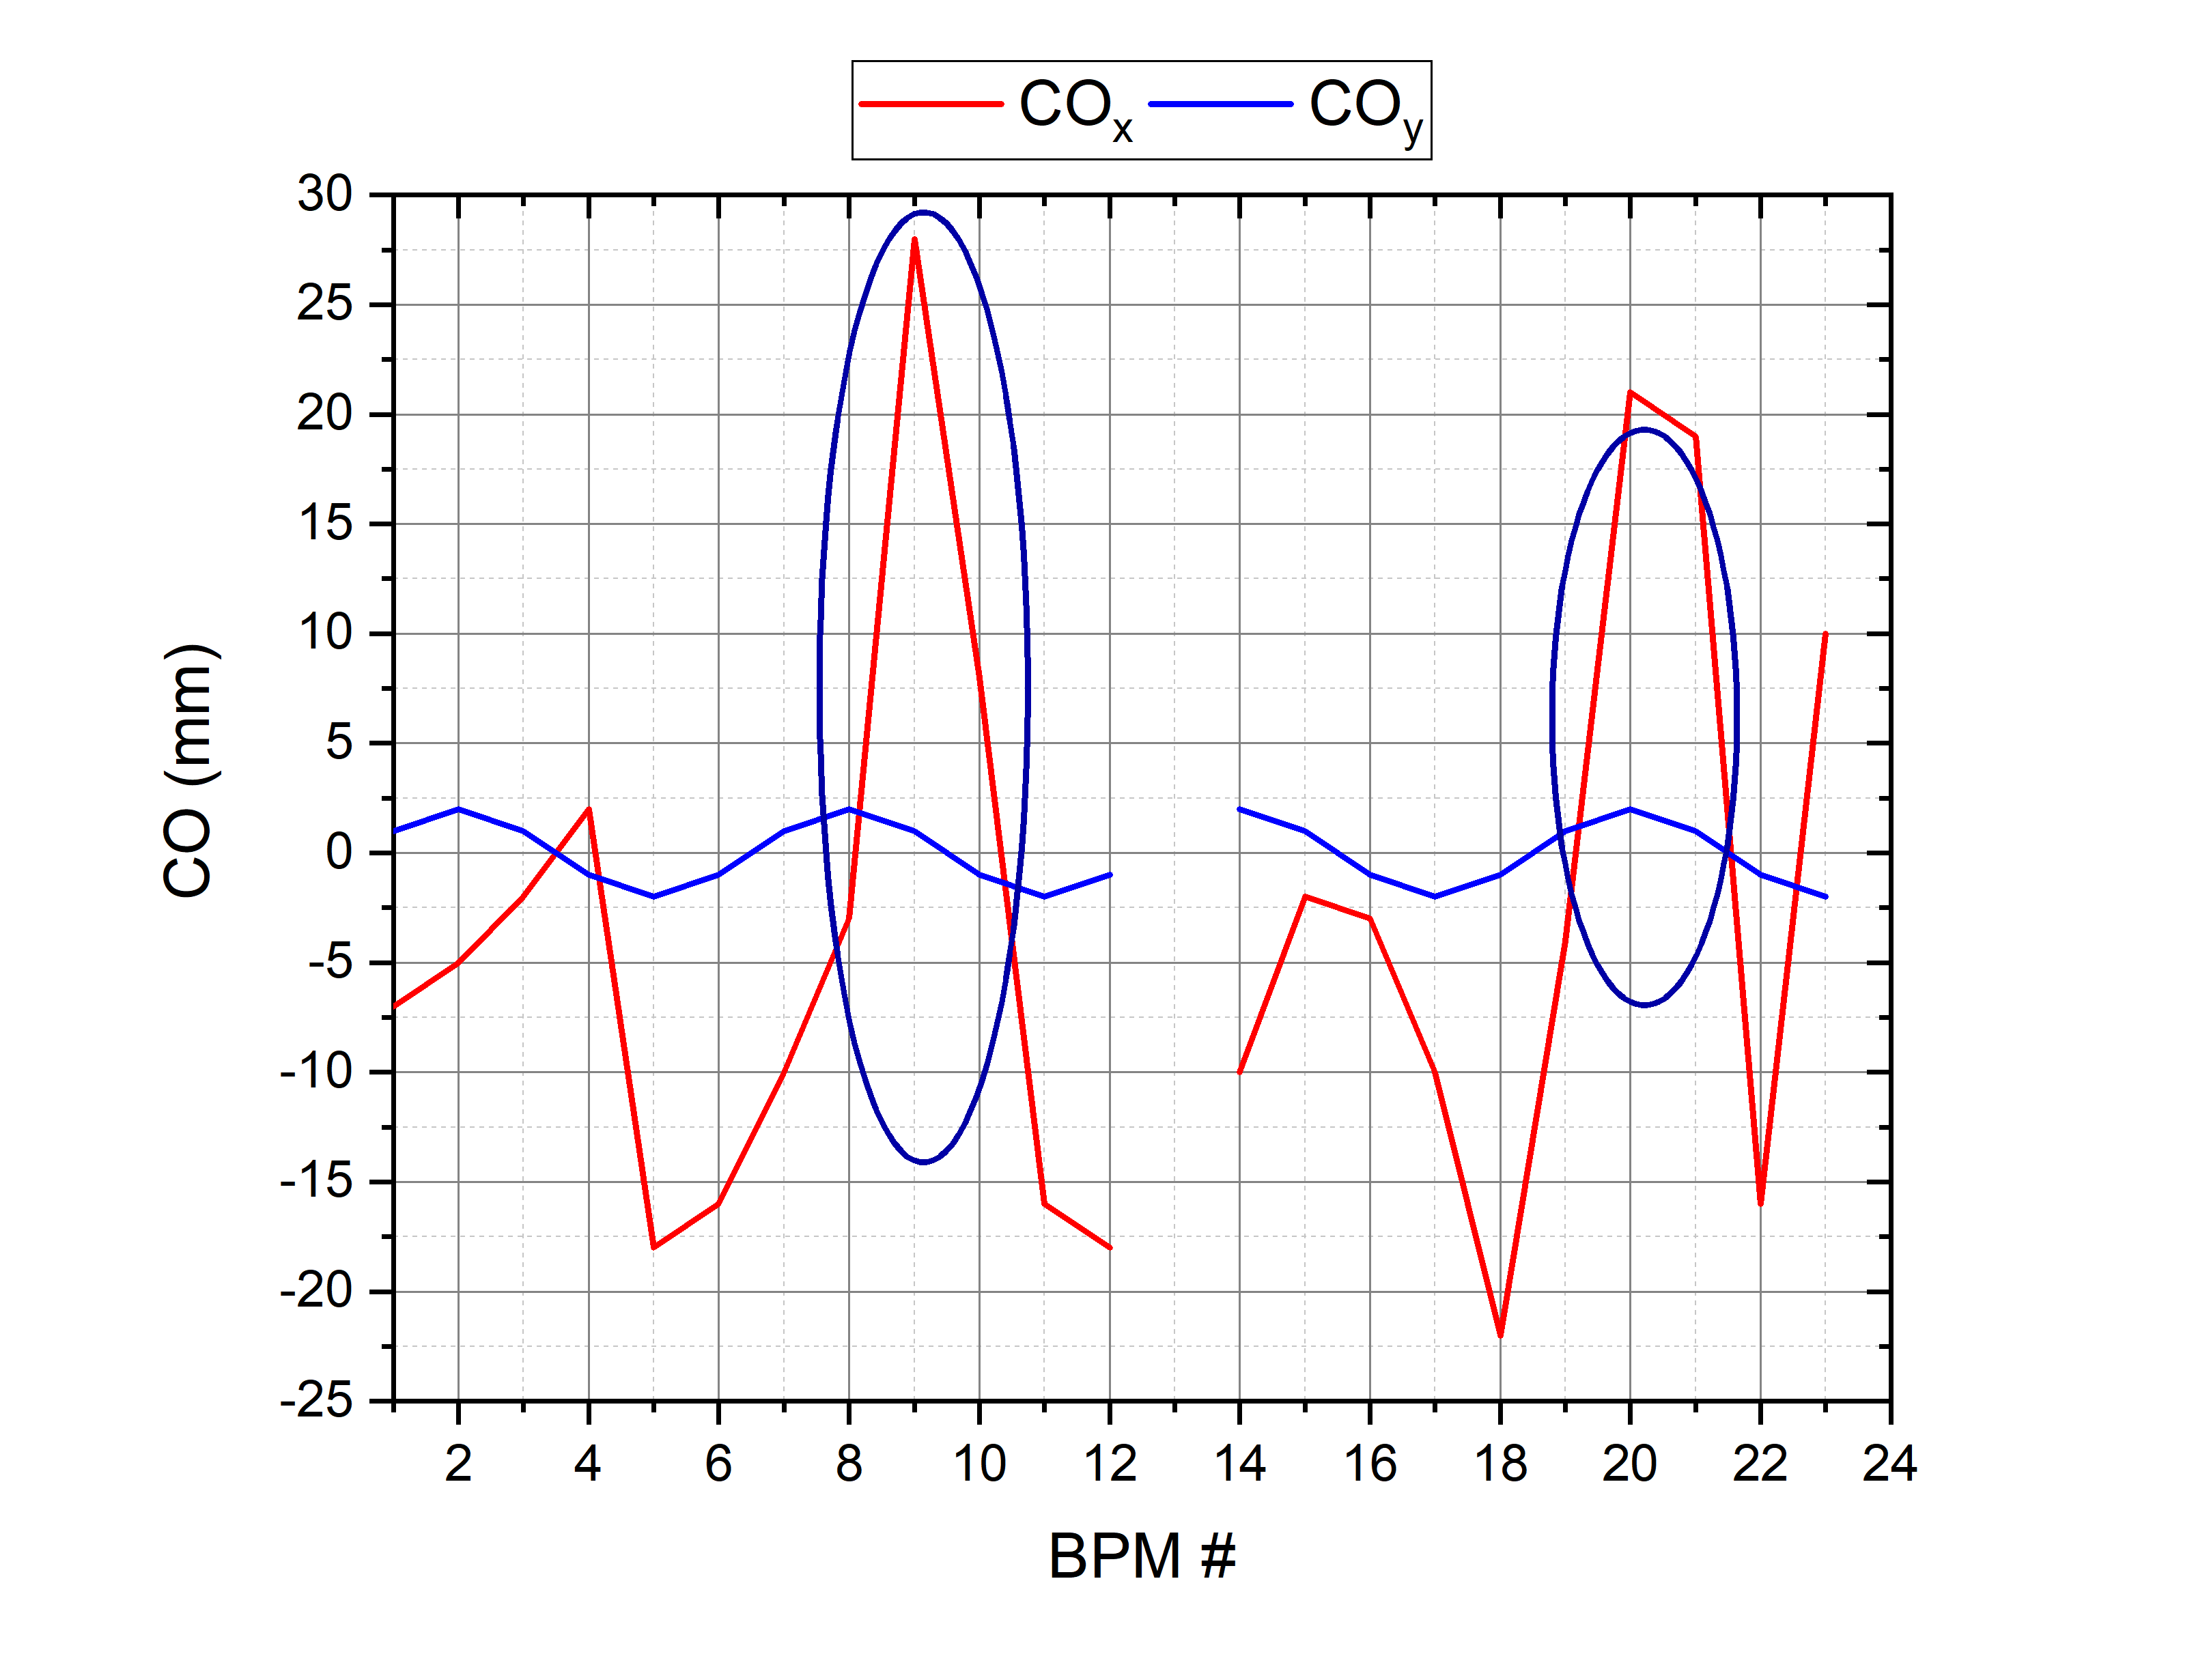
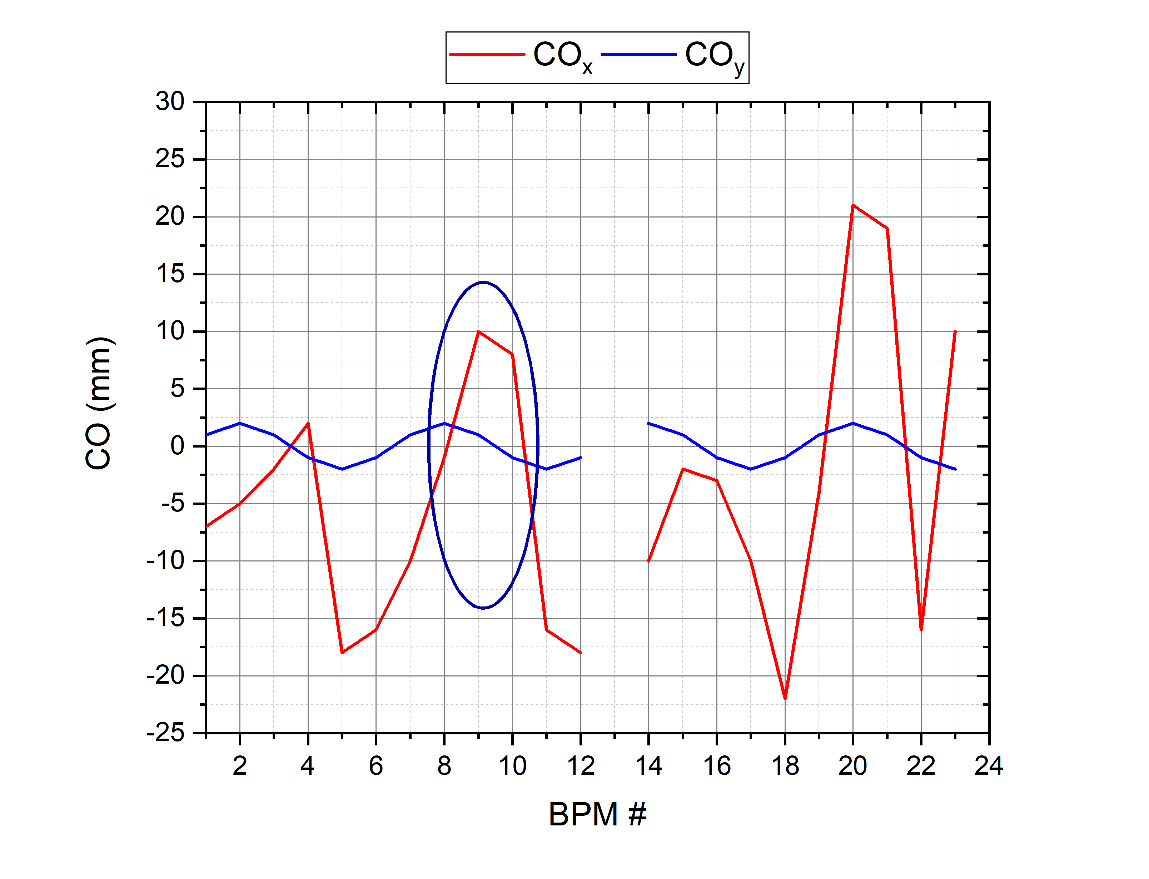
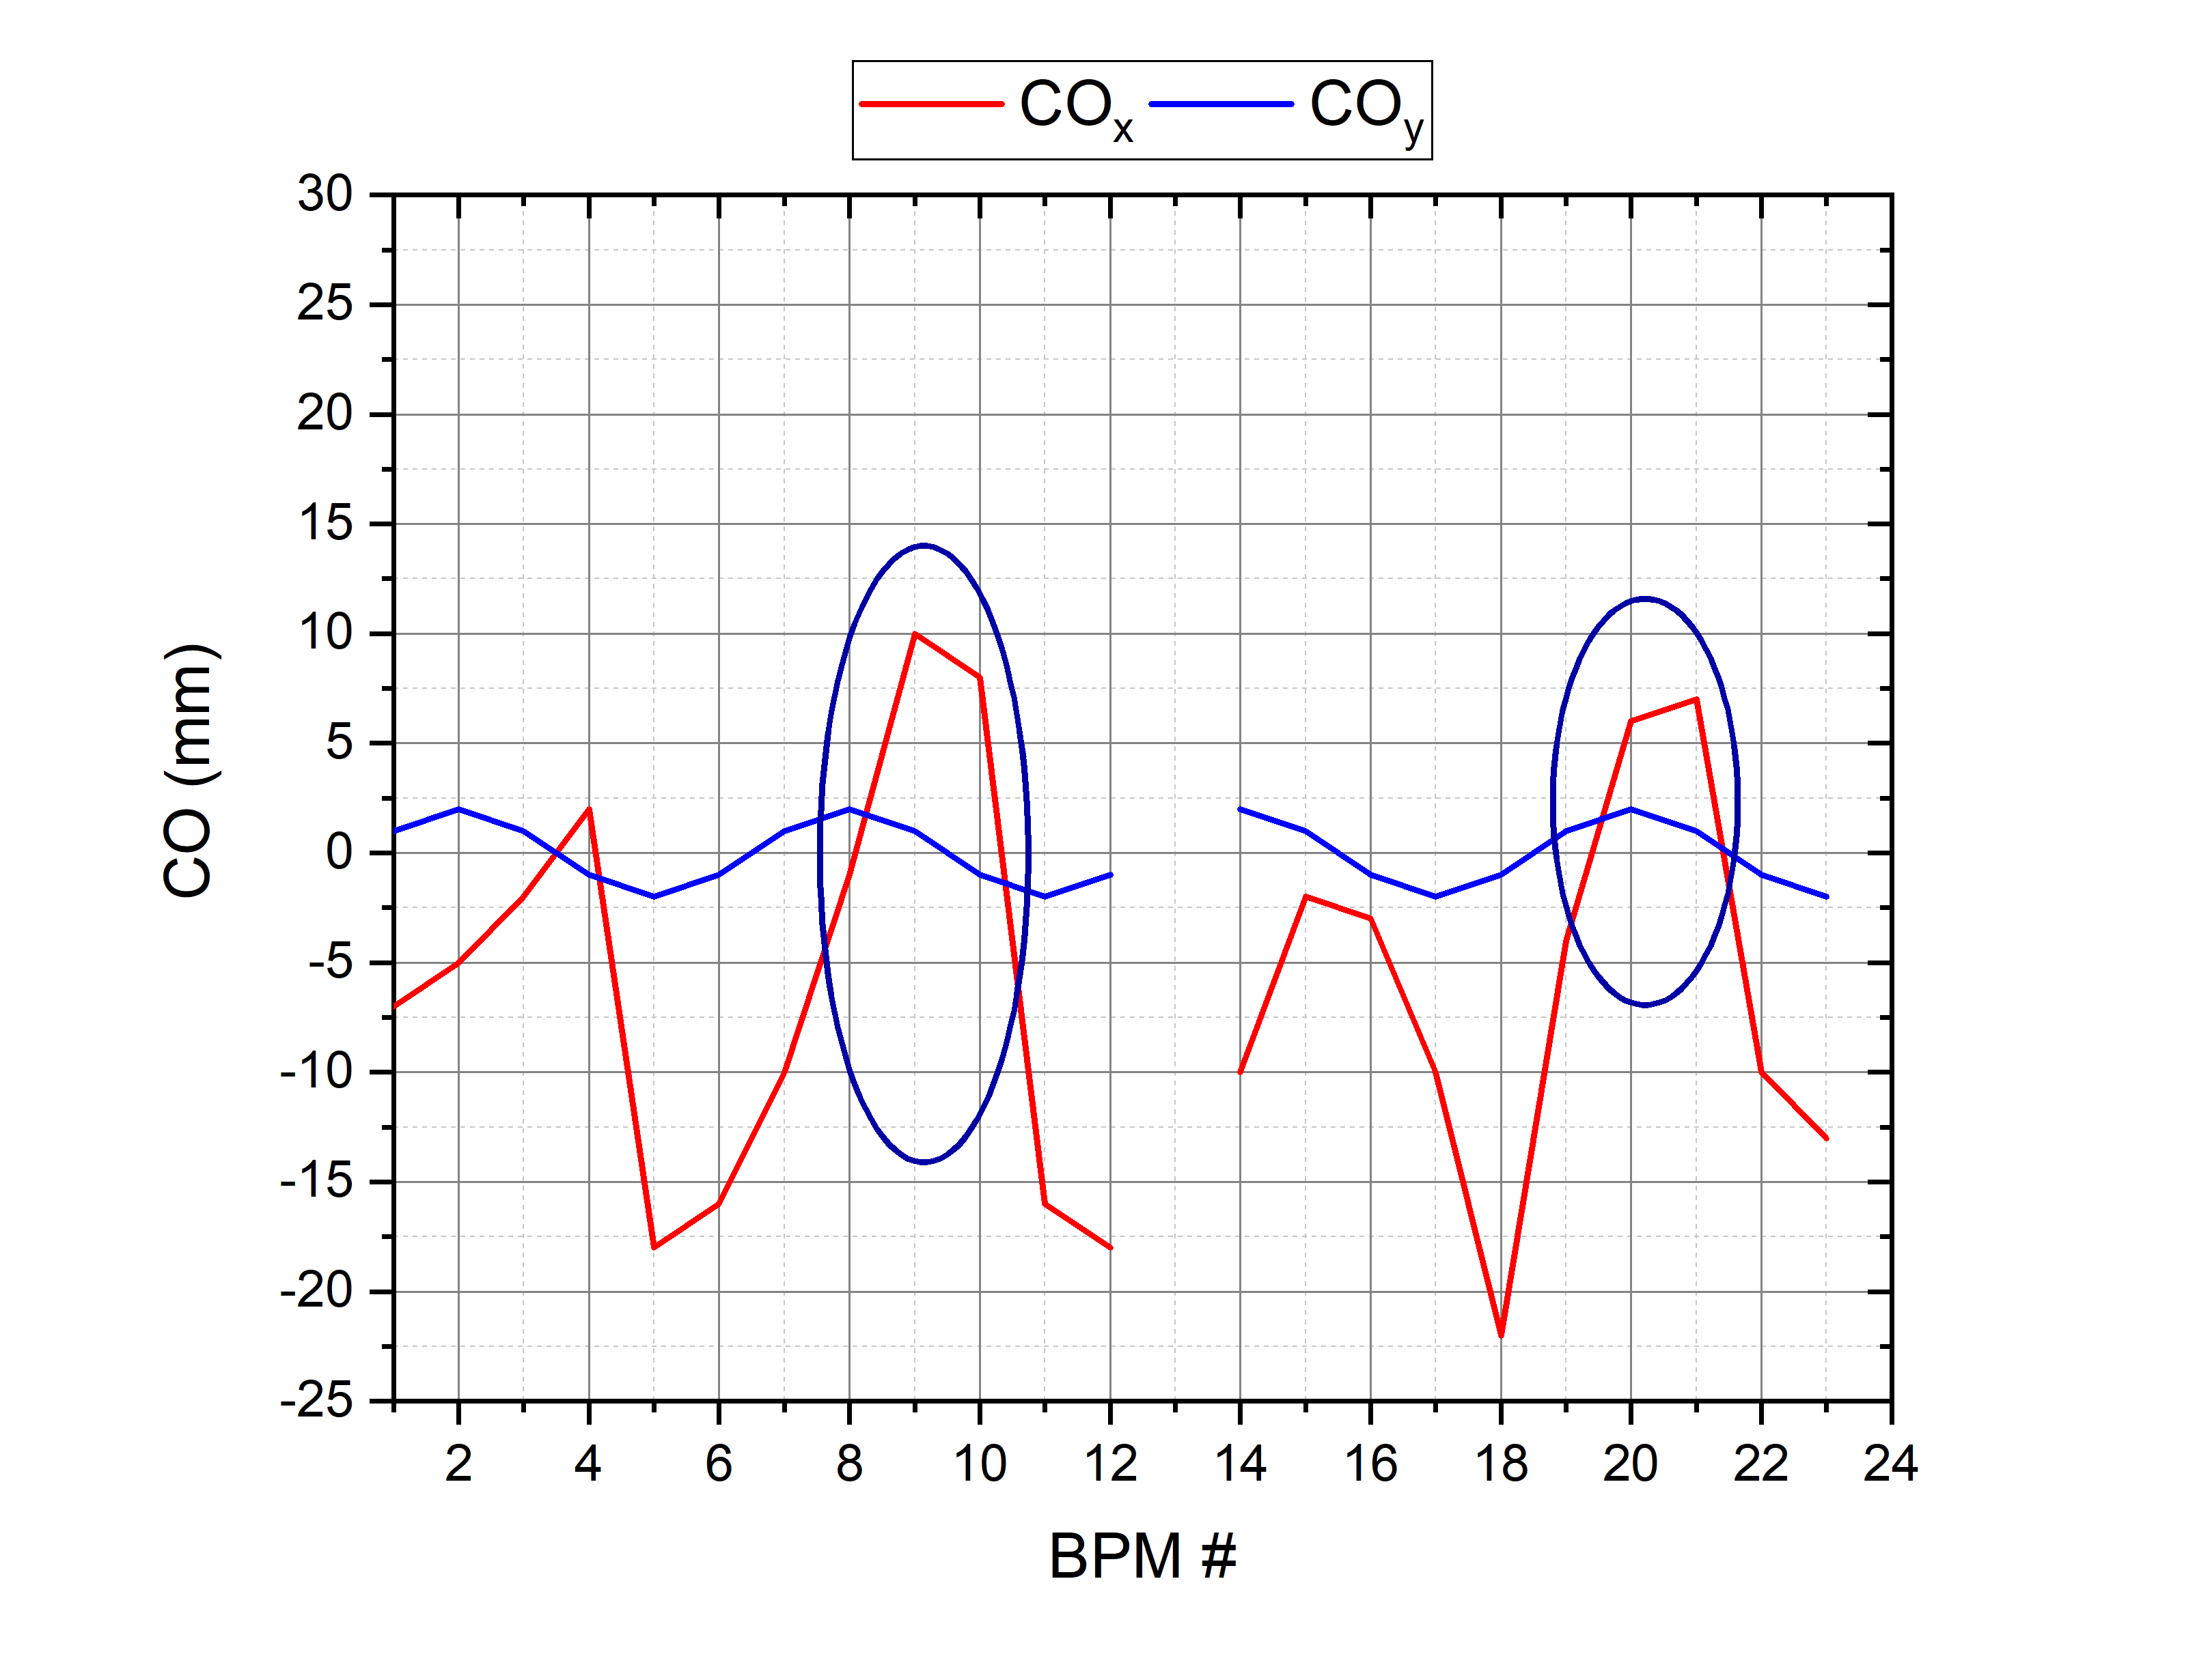
Bump Orbit
$${ν_{x}}/{ν_{y}}={4.88}/{5.39}$$
$${ν_{x}}/{ν_{y}}={4.80}/{4.85}$$

