Slide 1

JOINT INSTITUTE FOR NUCLEAR RESEARCH
Frank Laboratory of Neutron Physics
PROXIMITY EFFECTS AT SUPERCONDUCTING AND FERROMAGNETIC HETEROSTRUCTURES
Zhaketov Vladimir
134th session of the Scientific Council at JINR, 21-22 September, 2023. Dubna, Russia.

Slide 2
COLLABORATION
Zhaketov V., Nikitenko Yu., Aksenov V. – JINR, Russia
Norov D. – Moscow State University, Russia
Khaydukov Yu. - Max-Planck-Institute, Germany
Devyaterikov D., Kravtsov E. - Institute of Metal Physics, Russia
2 / 17

Slide 3
OUTLINE
Polarized neutron reflectometry
Rare-earth elements for spintronics
Influence of superconductivity on helimagnetism
3 / 17

Slide 4
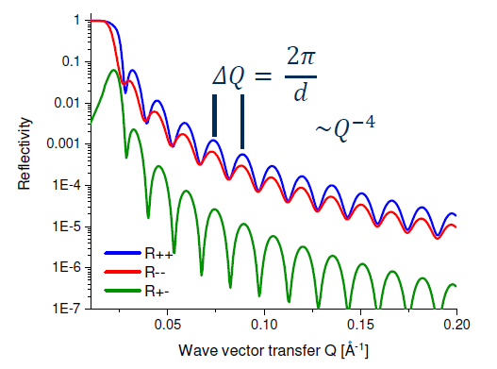







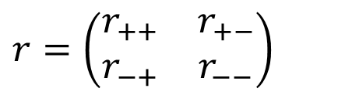



POLARIZED NEUTRON REFLECTOMETRY
Off-specular scattering
Polarized neutron reflectometry – experimental method for investigation of metallic low-dimensional heterostructures, polymer films, biological systems, free surface of liquids, magnetic fluids etc.
GISANS
$$U=U_{nuc}+U_{mag}$$
$$U_{mag}=−μB=\left|μ_{n}\right|σB$$
$$q_{z}$$
$$r=\left(\begin{matrix}r_{++} & r_{+−} \\ r_{−+} & r_{−−}\end{matrix}\right)$$
$$α_{f}$$
$$R^{±±}\sim SLD(z)±B\left(z\right)cos⁡[φ(z)]$$
$$R^{+−}\sim B\left(z\right)sin⁡[φ(z)]$$
incoming
neutron
$$H$$
$$φ$$
$$α_{i}$$
$$B$$
4 / 17

Slide 5
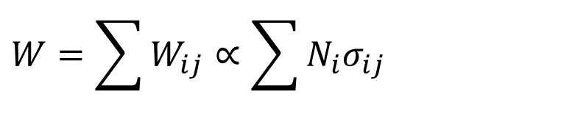
REGISTRATION OF SECONDARY RADIATION
$$W=\sum{W_{ij}}∝\sum{N_{i}σ_{ij}}$$
detector of secondary radiation
i – isotope, j – type of secondary radiation
Neutron
detector
$$n$$
Charged particles (n, α); (n, t); (n, p)
Gamma-quanta (n, γ)
Fission fragments (n, f)
Spin-flip neutrons
Noncoherent scattered neutrons by nuclei
Inelastically scattered neutrons
Diffusely scattered neutrons on medium inhomogeneities
sample
    $$I_{i,j}(k_{z0})\sim \int{\frac{{|\left.ψ(z,k_{z0}\right)|}^{2}⋅Im(u)}{{|\left.ψ_{0}(k_{z0}\right)|}^{2}⋅k_{0}}}N_{i}(z)dz$$
Registration of secondary radiation in neutron reflectometry makes it possible to determine the isotopic profiles of elements.
Zhaketov V.D. et al. // Journal of Surface Investigations, vol. 15, no. 3, pp. 549-562 (2021)
Zhaketov V.D. et al. // Journal of Surface Investigations, vol. 13, no. 3, pp. 478-487 (2019)
5 / 17

Slide 6
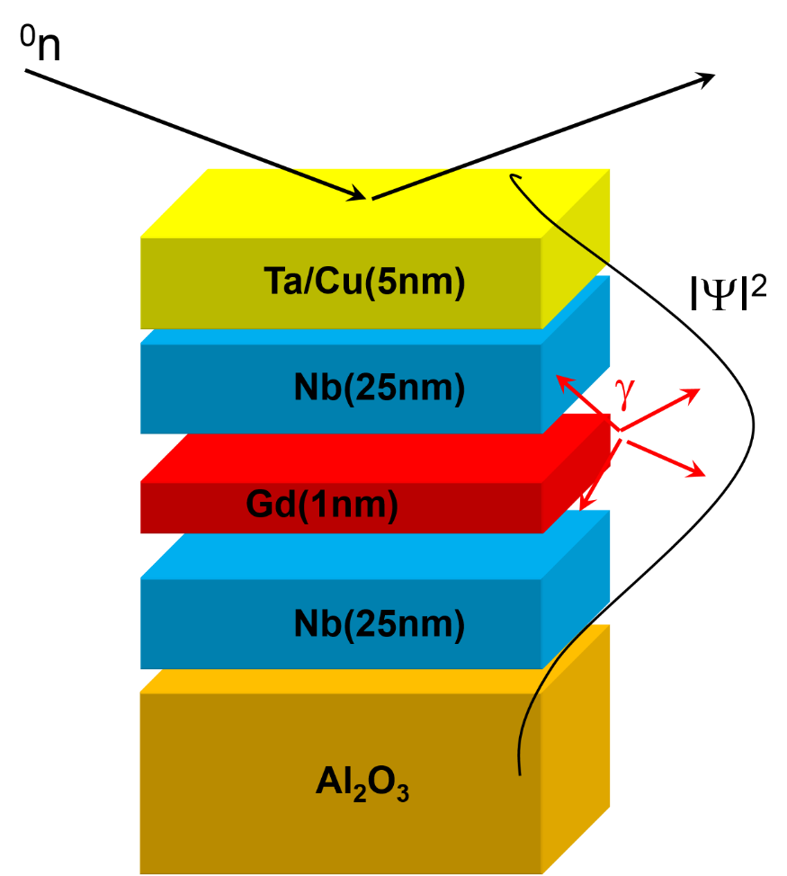
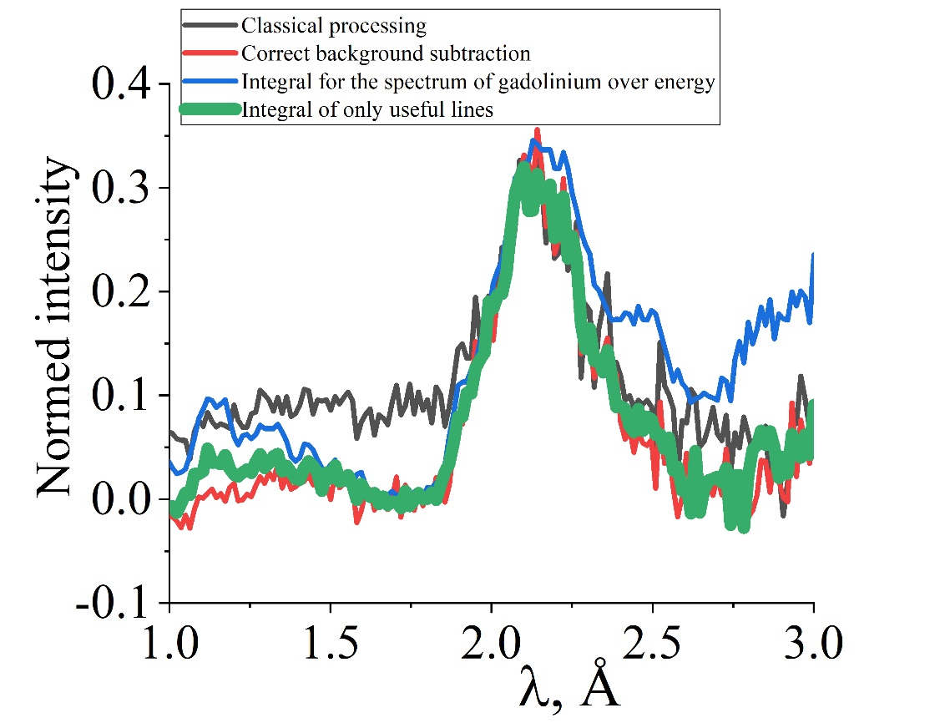
GAMMA RADIATION SIGNAL FROM AN ULTRATHIN LAYER OF GADOLINIUM
@ Khaydukov
A gamma radiation signal was obtained from an ultrathin (1 nm) layer of gadolinium placed in a neutron resonator. The mass of gadolinium used in the experiment (3 micrograms) is 25 times less than in the previous experiment (Zhang et al., PRL 72 (1994)).
The work was performed on the REMUR spectrometer (IBR-2, Dubna) in collaboration with colleagues from JINR (Dubna), IPM RAS (Yekaterinburg), and MPI FKF (Stuttgart)

Slide 7



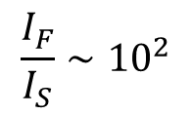



PROXIMITY EFFECTS IN THE PHYSICS OF SUPERCONDUCTIVITY
Normal metal / superconductor
Ferromagnet / superconductor
Inverse proximity effect
$$N$$
$$ψ$$
$$S$$
$$Ψ(x)$$
$$1$$
$$H$$
$$Ψ_{0}$$
$$b$$
$$ψ_{N}(x)=ψ_{N0}⋅e^{−\frac{x}{ξ_{N}}}$$
$$h$$
$$S$$
$$F$$
$$0$$
$$x$$
$$∆E=k_{B}T$$
$$F$$
$$S$$
$$x$$
$$0$$
$$−d_{S}$$
$$0$$
$$ξ_{n}$$
$$ξ(T)$$
$$x$$
$$d_{F}$$
$$ψ_{F}(x)=ψ_{F0}{∙e}^{−\frac{x}{ξ_{F1}}}{∙e}^{−i\frac{x}{ξ_{F2}}}$$
$$E_{ex}≫k_{B}T$$
Magnetic states of S-FM systems under the influence of proximity effects
Low-dimensional systems
$$d\sim ξ$$
F
Influence of magnetism on the superconducting properties of the system
$$\frac{I_{F}}{I_{S}}∼{10}^{2}$$
$$I∼T_{с}$$
S
Influence of superconductivity on the magnetic properties of the system
$$d_{F}\sim ξ_{F}$$
$$d_{F}≪d_{S}$$
S-FM structure
Inhomogeneous S-FM structure
Inhomogeneous structures?
$$d_{cl}>ξ_{F}$$
$$d∼1÷{10}^{3} \text{nm}$$
7 / 17

Slide 8
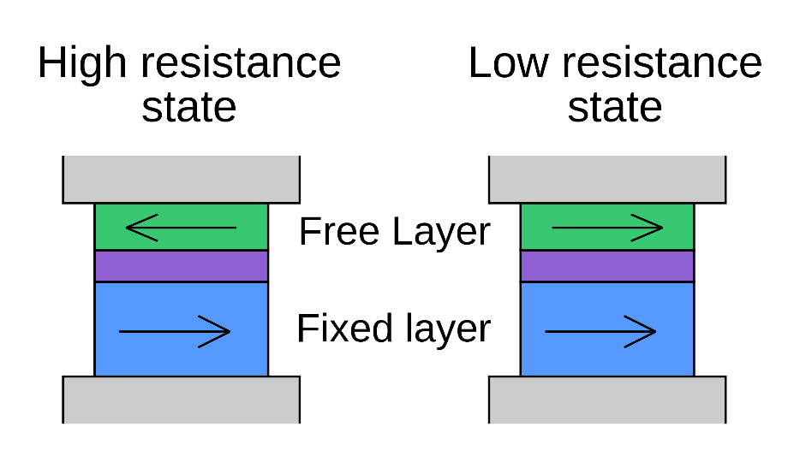
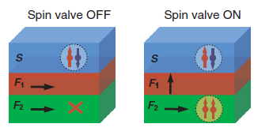
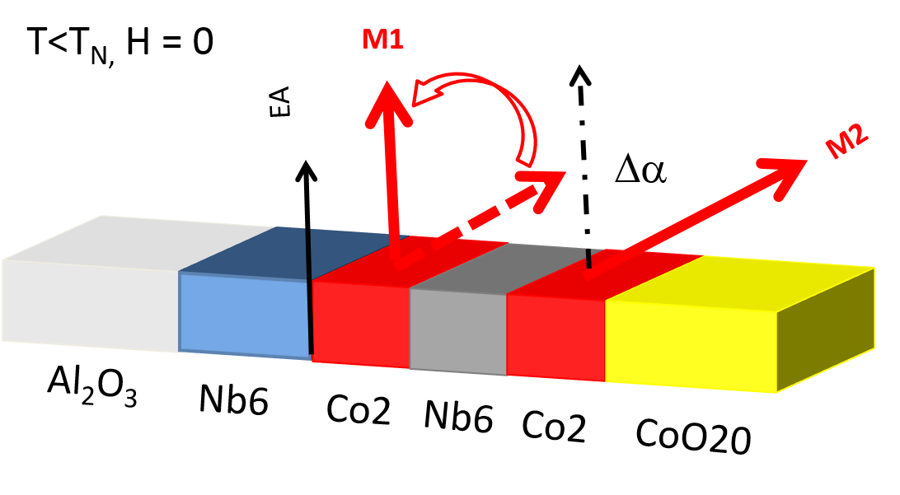



SUPERCONDUCTING SPIN VALVES
1. Scheme of classical spin valve
3. Controlling magnetism
FM
M₁
FM
M₁
SC
SC
FM
M₂
FM
M₂
2. Superconducting spin valve
4. Non-collinear spin valves
v
$$T_{c}^{∥}$$
$$T_{c}^{⊥}$$
$$T_{c}^{∥}>T_{c}^{⊥}$$
A. Singh et al. // Physical review X 5, 021019 (2015)
A. Golubov, M. Kupriyanov // Nature Materials, Vol. 16, Feb. 2017
Yury Khaydukov et al. // EU Patent application 21153254.4-1212
8 / 17

Slide 9
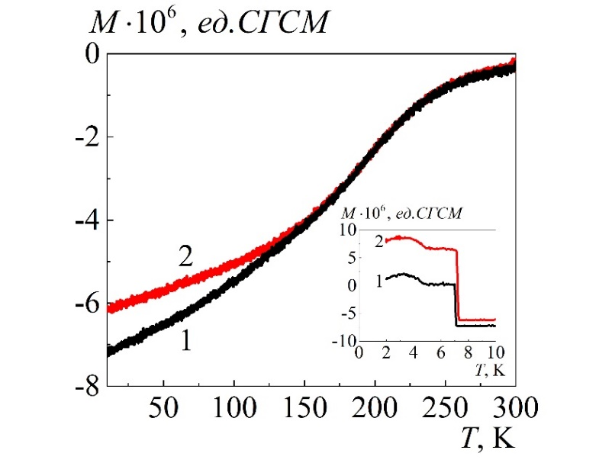
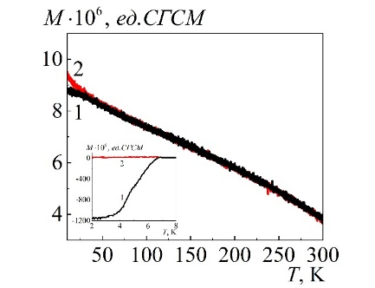
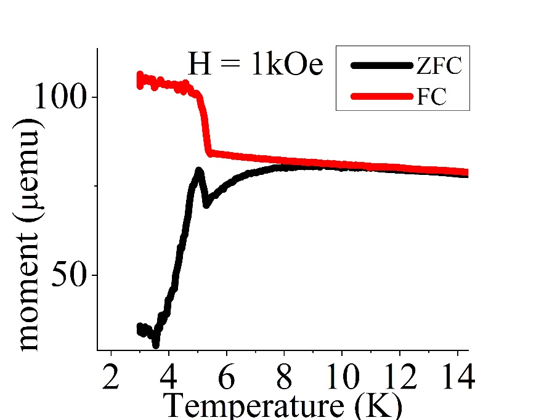
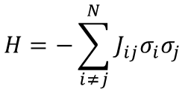
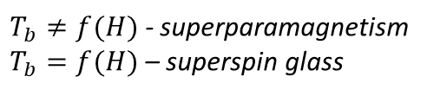

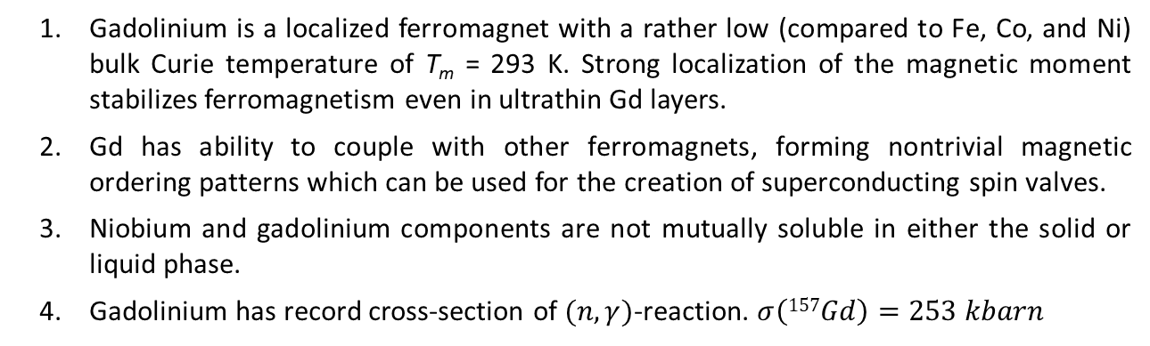

RARE-EARTH ELEMENTS (GADOLINIUM) FOR SPINTRONICS
$$H=−\sum_{i≠j}^{N}{J_{ij}σ_{i}σ_{j}}$$
Gadolinium is a localized ferromagnet with a rather low (compared to Fe, Co, and Ni) bulk Curie temperature of T_{m} = 293 K. Strong localization of the magnetic moment stabilizes ferromagnetism even in ultrathin Gd layers.
Gd has ability to couple with other ferromagnets, forming nontrivial magnetic ordering patterns which can be used for the creation of superconducting spin valves.
Niobium and gadolinium components are not mutually soluble in either the solid or liquid phase.
Gadolinium has record cross-section of $(n,γ)$-reaction. $σ\left(157Gd\right)=253 kbarn$
magnetic
particles
RKKI
$T_{b}≠f(H)$ - superparamagnetism
$T_{b}=f(H)$ – superspin glass
CGS units
M. Knobel et al. // JNN, vol. 8, 2836-2857, 2008
CGS units
Ta(20nm)
1 – ZFC
2 - FC
1 – ZFC
2 - FC
V(150nm)
Fe_{1-x}V_{x}(1nm)
Gd($d_{f}$)
$$T_{b}$$
V, Cr (1.2nm)
Nb(25nm)
Fe_{1-x}V_{x}(1nm)
x 12
Nb(150nm)
Si(0.5mm)
Al₂O₃
Nb/FeV/V
H=20 Oe - T_{b}≈150 K
Nb/FeV/V
H=1000 Oe - T_{b}≈50 K
[Nb/Gd]x12
H=1000 Oe - T_{b}≈8 K
Zhaketov V.D. et al. // JETP, vol. 129, No.2, pp. 258-276 (2019)
Khaydukov Yu.N. et al. // Phys. Rev. B, 97, 144511 (2018)
9 / 17

Slide 10
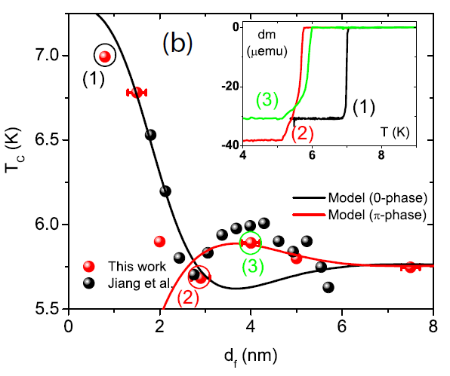
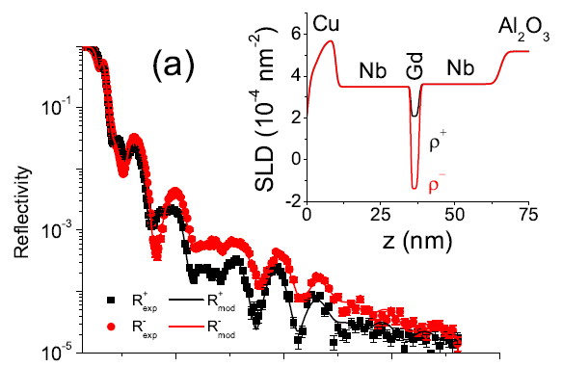
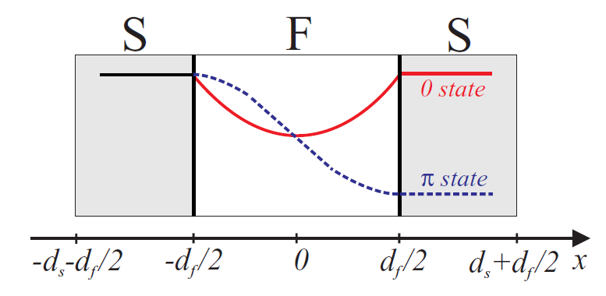






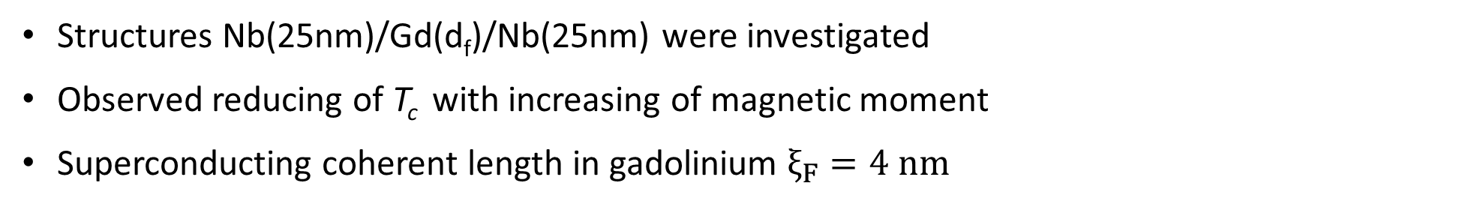

EFFECT OF MAGNETISM ON SUPERCONDUCTIVITY IN NB/GD/NB TRILAYERS
Structures Nb(25nm)/Gd(d_{f})/Nb(25nm) were investigated
Observed reducing of T_{c} with increasing of magnetic moment
Superconducting coherent length in gadolinium $ξ_{F}=4 nm$
$$T_{c}\sim M_{F}^{−1}$$
$$M_{F}=d_{F}∙B_{F}$$
$$T=6.2 К$$
$$H=4 кЭ$$
Dependance $T_{c}=f(d_{f})$
$$ξ_{F}=4 nm$$
Q(nm⁻¹)
$$d_{F}<ξ_{F}$$
10 / 17
Khaydukov Yu.N. et al. // Phys. Rev. B, 97, 144511 (2018)

Slide 11
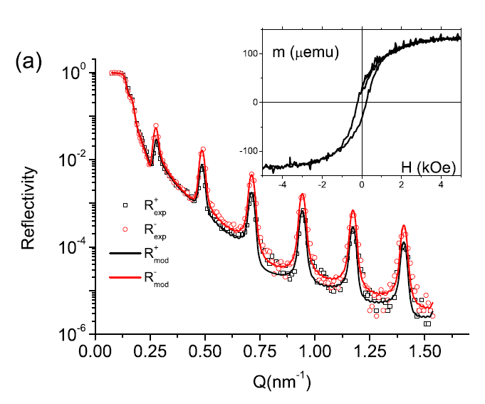
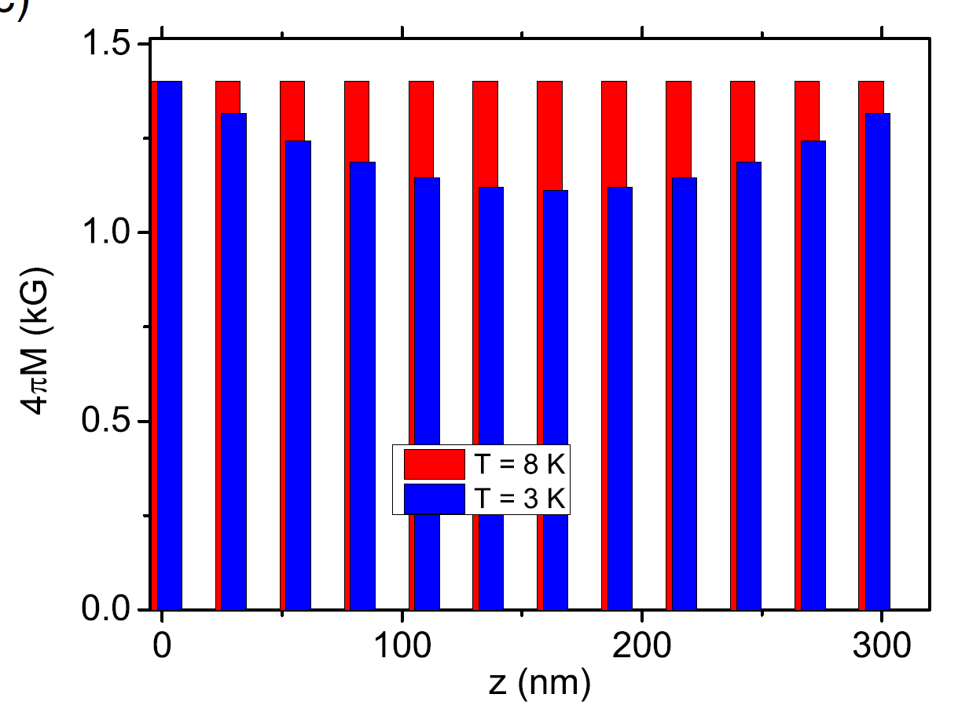
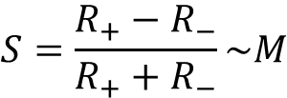

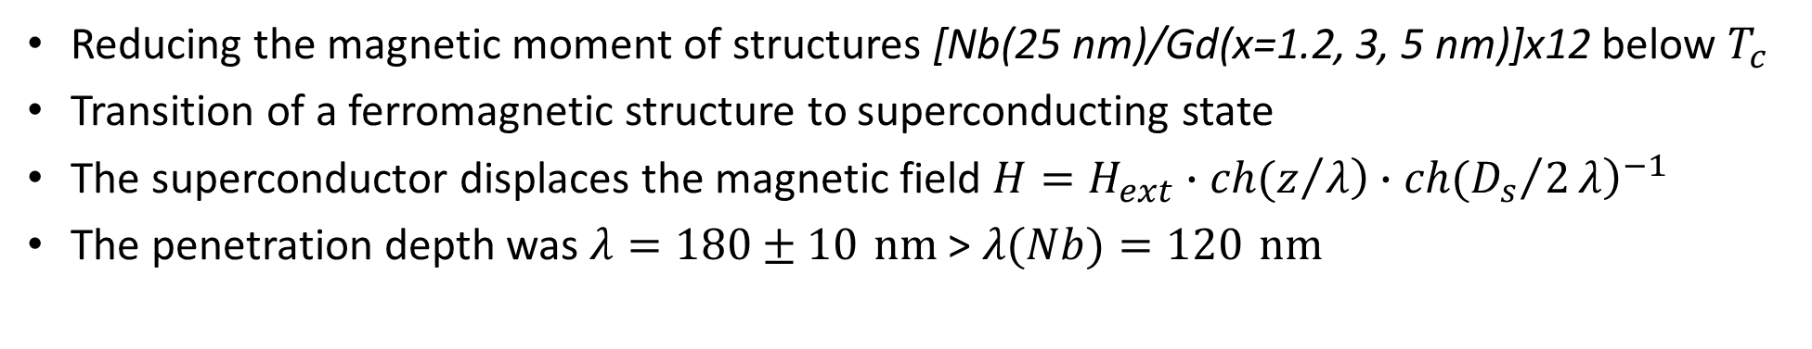



DIAMAGNETISM OF PERIODIC FERROMAGNETIC-SUPERCONDUCTING STRUCTURE
Reducing the magnetic moment of structures [Nb(25 nm)/Gd(x=1.2, 3, 5 nm)]х12 below $T_{c}$
Transition of a ferromagnetic structure to superconducting state
The superconductor displaces the magnetic field $H=H_{ext}∙\left.ch(z/λ\right)∙{\left.ch({D_{s}}/2λ\right)}^{−1}$
The penetration depth was $λ=180±10 nm$ > $λ(Nb)=120 nm$
$$d_{f}=3 nm$$
$$T=7 К, H=4.5 kOe$$
Gd($d_{f}$)
$$H=661 Oe$$
Nb(25nm)
x 12
$$S=\frac{R_{+}−R_{−}}{R_{+}+R_{−}}\sim M$$
Al₂O₃
Results of experimental data fitting
11 / 17
Khaydukov Yu.N. et al. // Phys. Rev. B, 99, 140503 (2019)

Slide 12
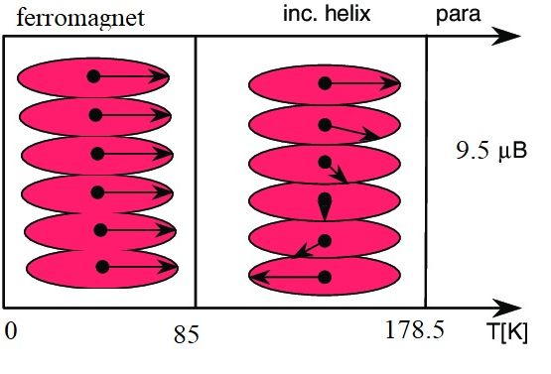
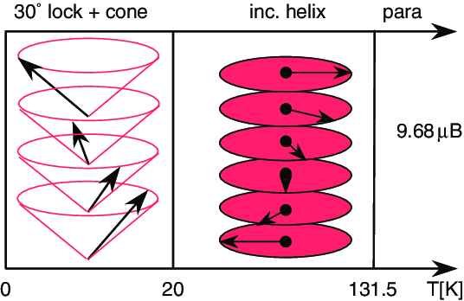
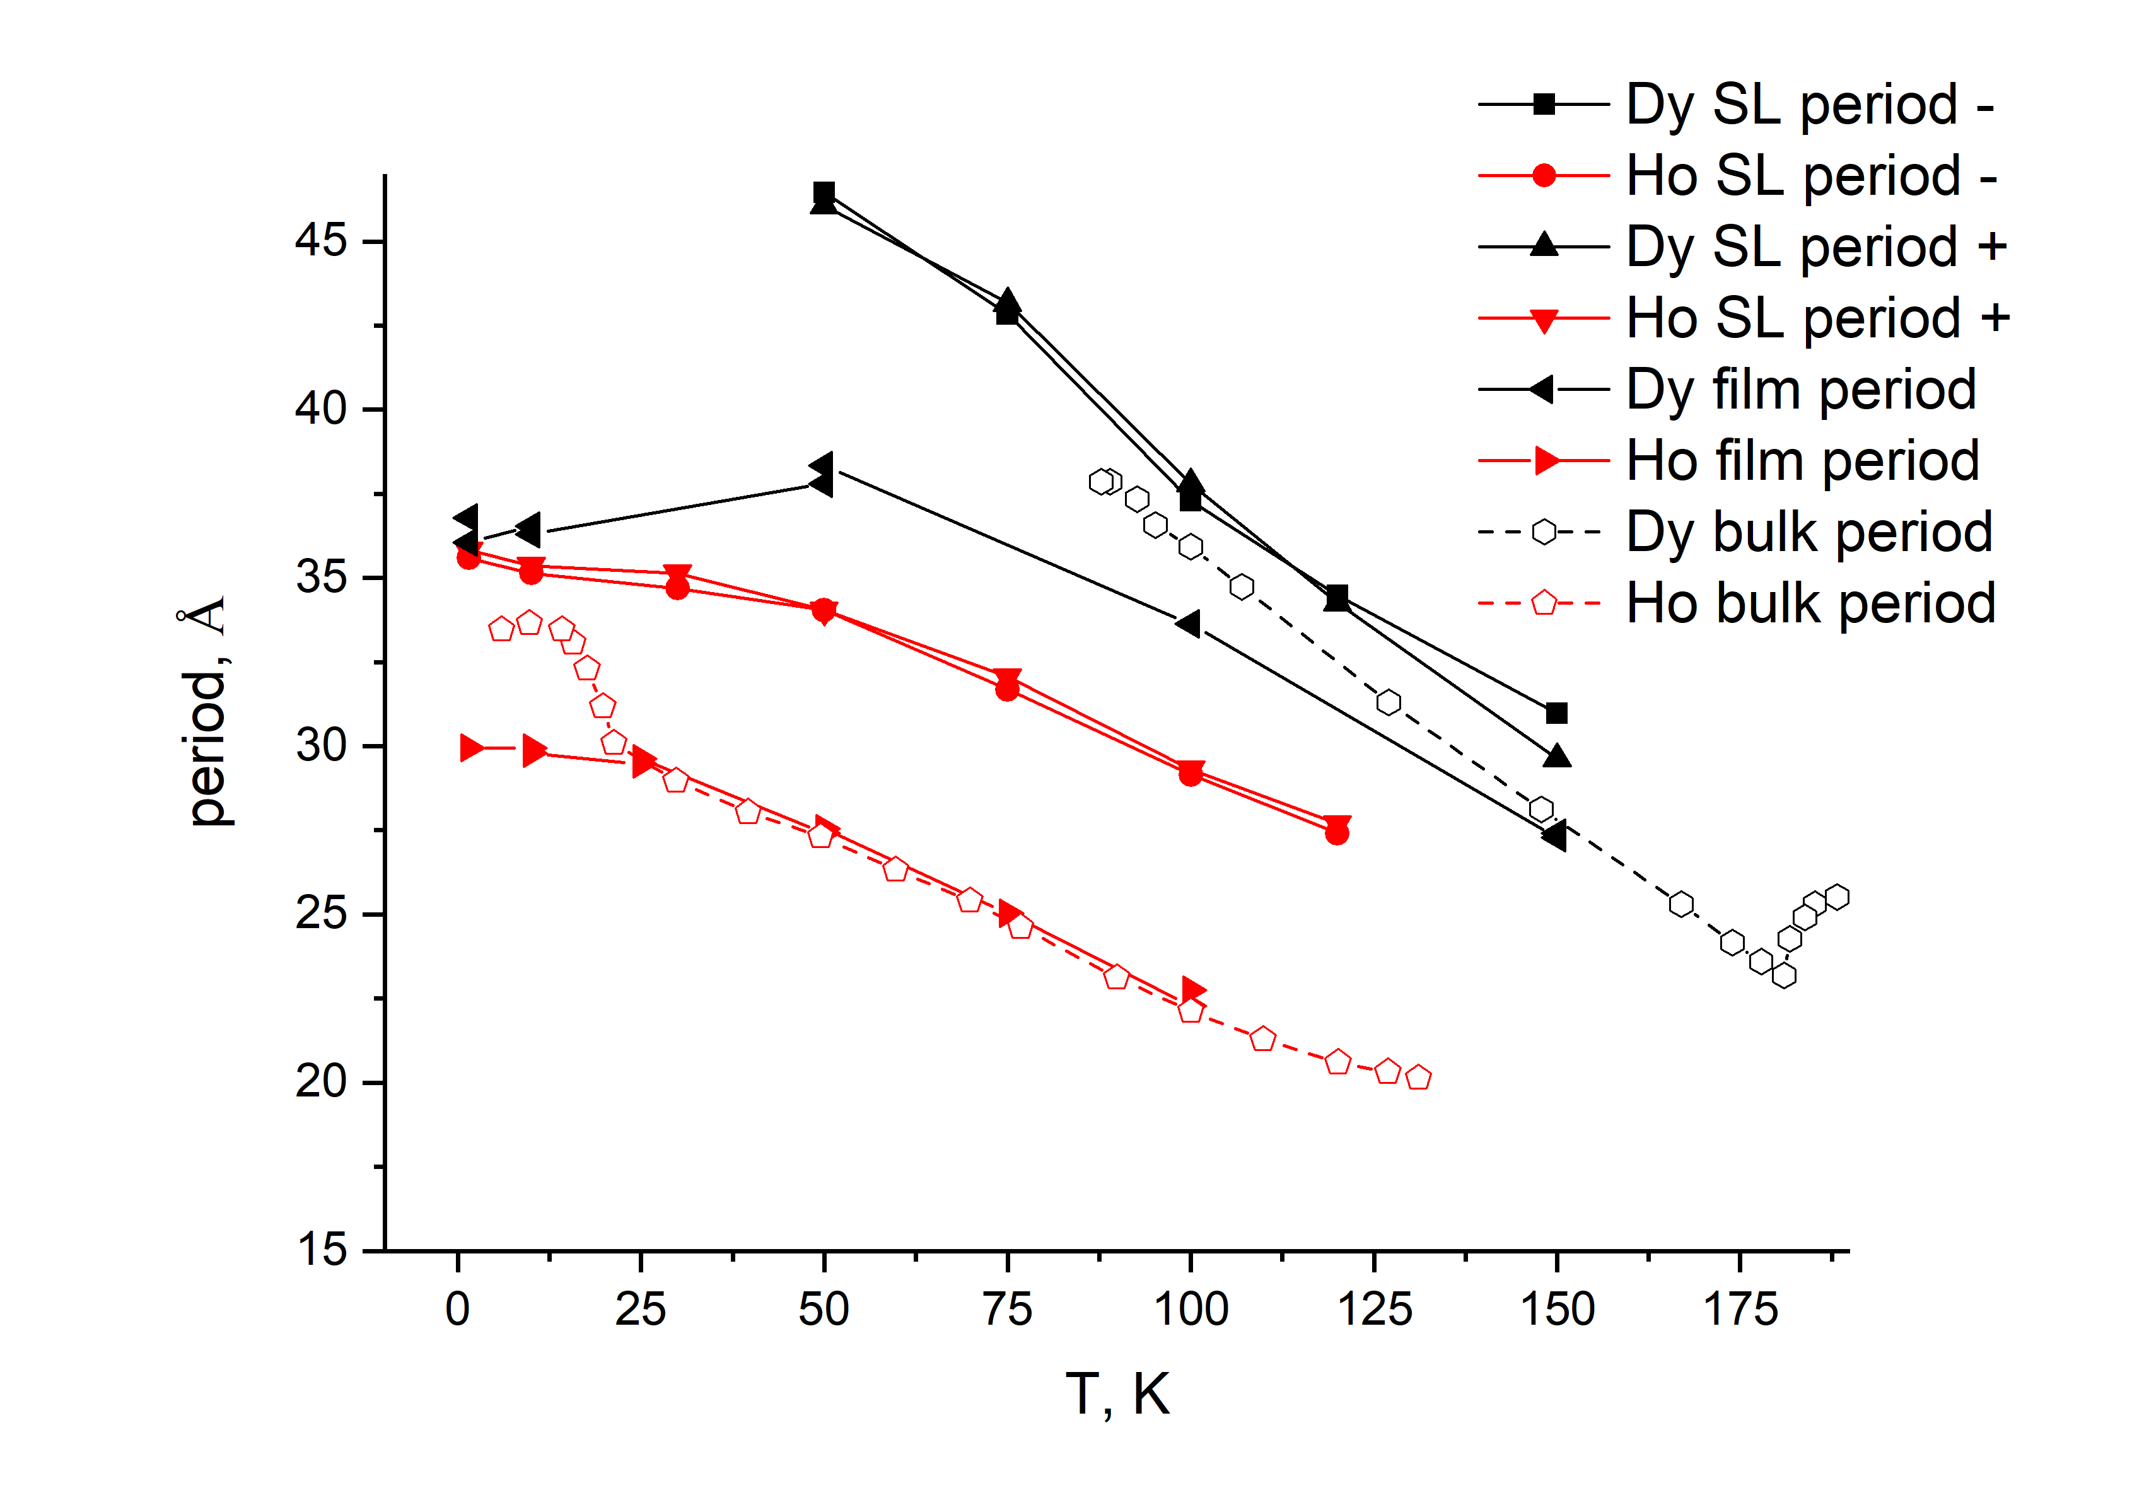
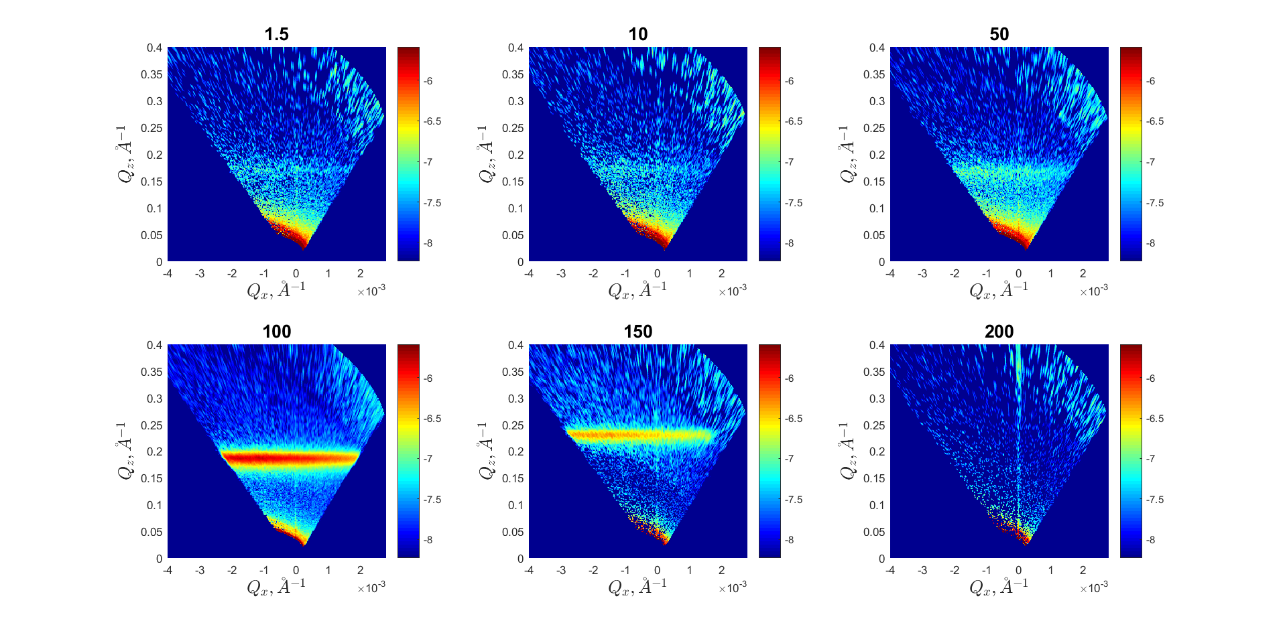
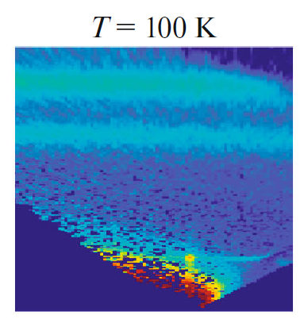
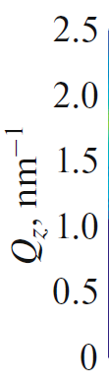
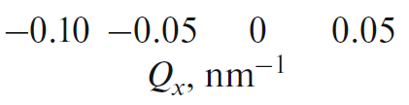
FURTHER PERSPECTIVE – RARE EARTH METALS DYSPROSIUM AND HOLMIUM
Investigated structures:
1) Dy (2000 Å)
2) Ho (2000 Å)
3) [Dy (60 Å)/Ho (60 Å)]×34
Dy
Ho
T=
T=
[Dy (60 Å)/Ho (60 Å)]×34
Dy (2000 Å)
Dy (2000 Å)
Ho
Dy
Systems with nontrivial magnetic ordering are promising for studies of proximity effects, since they have low phase transition temperatures
Devyaterikov D.I. et al. // Journal of Surface Investigations, Vol. 16, No. 5, pp. 839-842 (2022)
Devyaterikov D.I. et al. // Physics of Metals and Metallography, Vol. 122, No. 5, pp. 465-471 (2021)
12 / 17

Slide 13
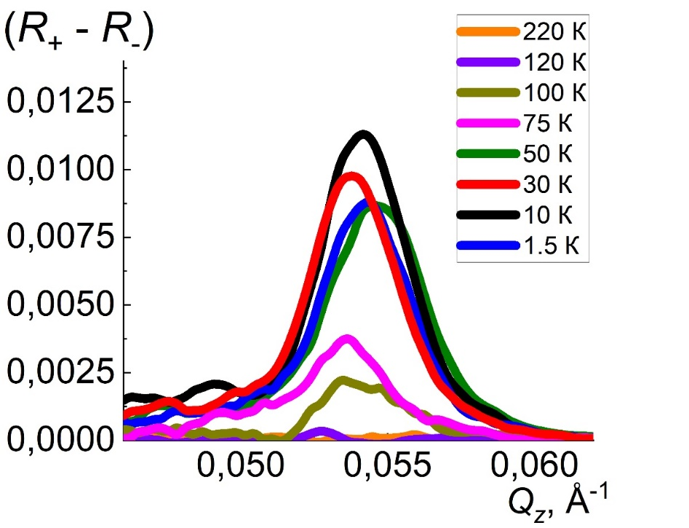

EFFECT OF SUPERCONDUCTIVITY ON HELIMAGNETIC ORDERING
$$S=R_{+}−R_{−}\sim M$$
N.G. Pugach et al. // Phys. Rev. Appl. 18, 5, 054002 (2022).
N.G. Pugach et al. // arXiv:2110.00369v1
It can be seen that with decreasing temperature, S increases, which indicates that with decreasing temperature, the helimagnetic ordering transforms into a fan one, since the collinear component of the magnetization increases.
PNR data for structure
[Dy (60 Å)/Ho (60 Å)]×34/ Nb (60 Å)
But at $T=1.5 К< T_{c}(Nb)$ the opposite behavior is observed, i.e., a decrease in S, which indicates the recovery from the fan phase - helimagnetic. This behavior is due to the fact that the helimagnetic phase is more favorable for the existence of superconducting correlations.
13 / 17
Zhaketov V.D. et al. // Solid state physics, 2023, 65, 7

Slide 14
EFFECT OF SUPERCONDUCTIVITY ON HELIMAGNETIC ORDERING
Nb(10nm)
Dy(6nm)
x 34
Ho(6nm)
T↓
T↓<T_{c}(Nb)
Nb(40nm)
S-leakage
Al₂O₃
Nominal structures
Helimagnetic ordering
Fan ordering
Helimagnetic ordering
14 / 17

Slide 15
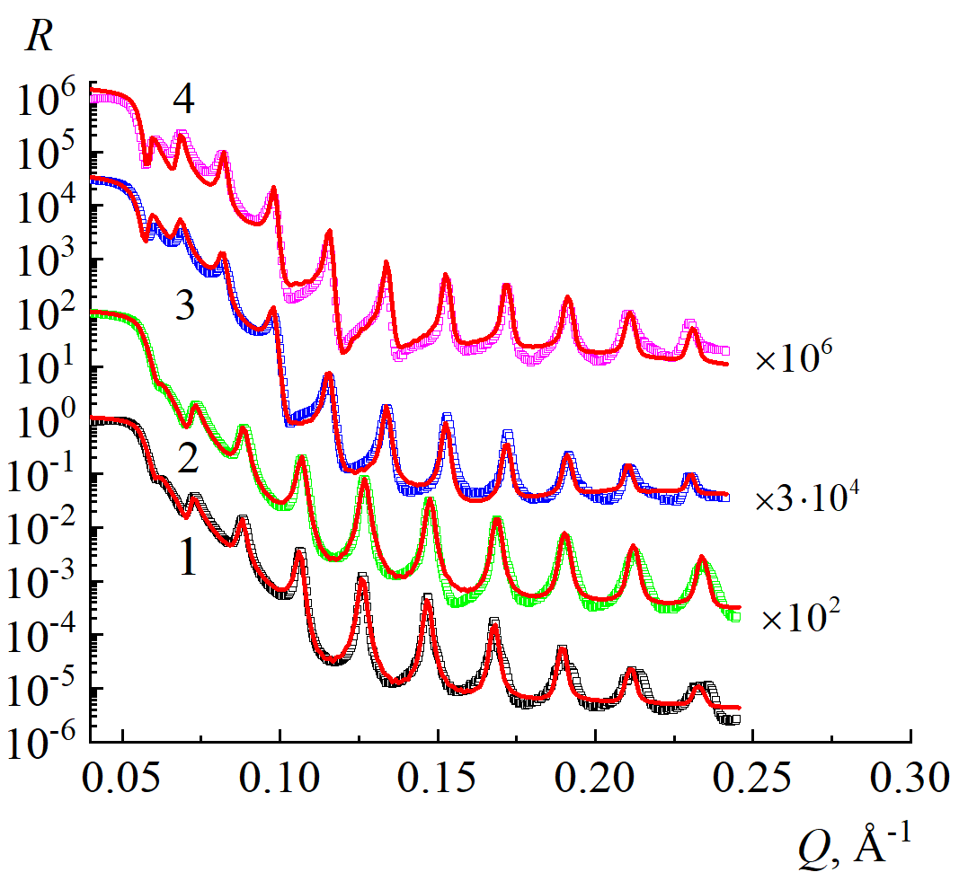
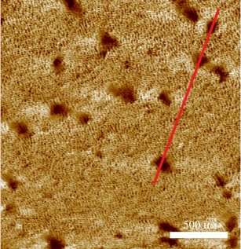
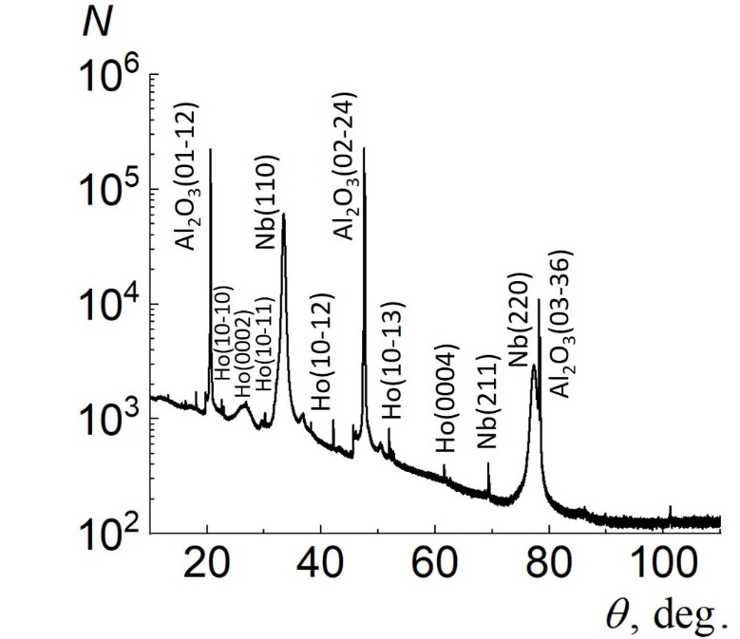
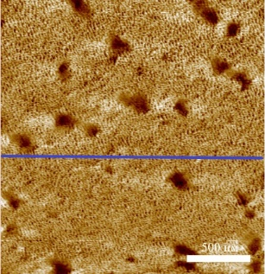
STRUCTURAL PROPERTIES OF NB/DY AND NB/HO SUPERLATTICES
Trilayer systems:
The interlayer boundaries are characterized by the root-mean-square roughness amplitude for all layers no more than R_{q}~1.5 nm. The data demonstrate the homogeneity of these systems at the level of Nb/Gd structures.
Al₂O₃(R, A- plane)//Nb(250Å)/RE(1÷10Å)/Nb(250Å)/Ta(30Å)
Superlattices:
Al₂O₃(R, A- plane)//[Nb(250Å)/RE(20,40,60Å)]x12/Nb(50Å)
RE=Dy, Ho
Nb(5nm)
Khaydukov Yu.N. et al. // Phys. Rev. B, 99, 140503 (2019)
Khaydukov Yu.N. et al. // Phys. Rev. B, 97, 144511 (2018)
1 - [Nb(25 nm)/Dy(2 nm)]₁₂,
2 - [Nb(25 nm)/Ho(2 nm)]₁₂,
3 - [Nb(25 nm)/Dy(6 nm)]₁₂,
4 - [Nb(25 nm)/Ho(6 nm)]₁₂.
X-ray reflectometry
Atomic force microscopy
X-ray diffraction

Slide 16
Conclusion
One of the effective methods for studying magnetism of heterostructures is polarized neutron reflectometry, which makes it possible to obtain chemical and magnetic depth profiles with nanometer resolution. Registration of secondary radiation make possible to determine distribution of separate elements.
Rare-earth elements are perspective element for creation of devices for spintronics. Main reasons: good interfaces between boundaries and weak magnetism. Correlations length of superconductivity for Gd 4 nm. It has been observed diamagnetism for periodic superconducting ferromagnetic Gd/Nb system.
Further prospects are connected with the study of the dysprosium and holmium as helimagnet elements with non-trivial magnetic order for creation of spintronics devices. Changing of magnetic orderding under influence of superconductivity was demonstrated for system Nb/[Dy/Ho].
16 / 17

Slide 17
Thank you for your attention!

