Slide 1
134th session of the Scientific Council
Memberships of the PACs

Slide 2
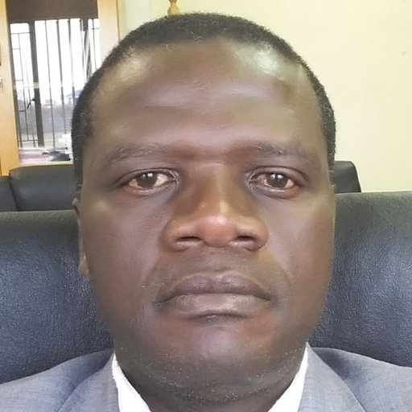
Memberships of the PACs
Proposals of the JINR Directorate
PAC for Nuclear Physics
On the proposal by the representative to the JINR Committee of Plenipotentiaries from the Republic of South Africa, Imraan Patel, to appoint Makondelele Victor Tshivhase, (iThemba LABS, Somerset West, South Africa), as a new member of the PAC for Nuclear Physics for a term of three years.
Dr Tshivhase is a nuclear scientist who previously directed the Center for Applied Radiation Science and Technology (CARST) at North-West University, and specializes in the study of radioactive contamination of water and soil, cancer risk mapping, and methods for removing radiation from the environment.
In 2023, Dr Tshivhase was appointed as the Director of iThemba LABS.

Slide 3
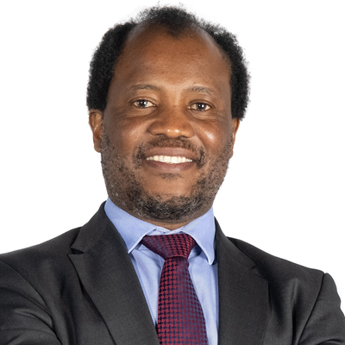
Memberships of the PACs
Proposals of the JINR Directorate
PAC for Nuclear Physics
To thank the outgoing member Zeblon Vilakazi (Wits University, Johannesburg, South Africa) for his dedicated work as member of the PAC for Nuclear Physics since 2009.

Slide 4
The JINR Directorate asks the Scientific Council
to approve this proposal

