Slide 1
HONORARY DOCTORS OF JINR
proposal by the JINR Directorate

Slide 2
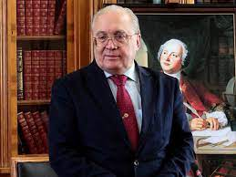
NOMINEE
Academician Professor Victor Antonovich Sadovnichy - Rector of the Lomonosov Moscow State University (Lomonosov MSU), prominent Russian scientist in Mathematics, Mechanics and Computer Science areas. His research activity is focused on mathematical modeling and mathematical methods of information processing. He has made a considerable contribution to the development of Spectral Theory of Differential Operators by arriving at final conclusions in the theory of differential operators' traces that have become a part of the respective sections of modern functional analysis.
Full member of the Russian Academy of Science. Department of Mathematics, Applied Mathematics and Computer Science Section since 1997. Member of Presidium of RAS.
President of the All-Russian Union of Rectors
Member of the JINR Scientific Council for many years.
JINR and Lomonosov MSU have been working together for many years to train scientific personnel for fundamental research in the JINR member countries at two departments of the Faculty of Physics of MSU SINP:
Department of Elementary Particle Physics (Head of the Department – scientific director of JINR, Academician V.A. Matveev);
Department of Fundamental Nuclear Interactions (Head of the Department is JINR Director, RAS Academician G.V. Trubnikov).
We have joint plans to establish two more new departments: Big Data Sciences, Radiochemistry and Radiobiology
Notes:
2

Slide 3
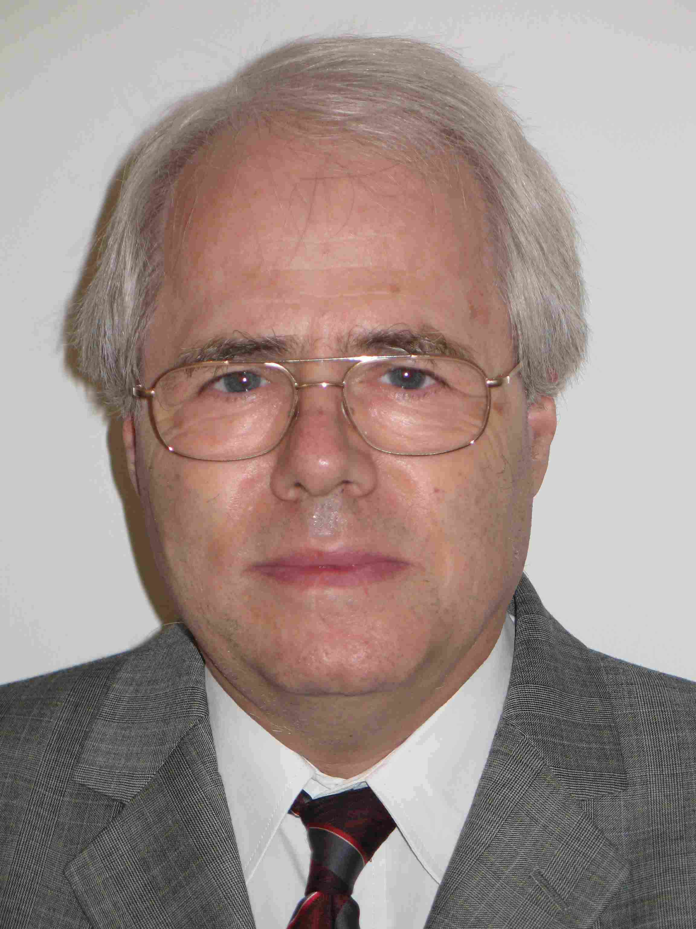
NOMINEE
Professor Dénes Lajos Nagy, Research Professor Emeritus of the Wigner Research Centre for Physics of the Hungarian Research Network (HUN-REN), is a prominent Hungarian scientist in the field of Mössbauer spectroscopy and nuclear resonant scattering of synchrotron radiation for determining the magnetic layer and domain structure of multilayers, and modelling the formation and transformation of domain patterns in these systems. Prof. Nagy also works in close cooperation with colleagues from FLNP in the field of neutron reflectometry on magnetic layers and domain structure of multilayers.
Member of the JINR Scientific Council since 2002.
Member of the JINR Programme Advisory Committee for Condensed Matter Physics in 2000-2008, then from 2012 to the present. Since 2017 Prof. Nagy is the Chair of this PAC.
Full professor at the Institute of Physics, Department of Atomic Physics of the Eötvös Loránd University, Budapest in 1998-2013, superannuated professor at the Eötvös Loránd University, Budapest since 2013.
Mössbauer spectroscopist at the KFKI Research Institute for Particle and Nuclear Physics and its successors since 1967.
JINR and Wigner RCP have had fruitful cooperation for many years, including through joint cooperation in the international arena with multilateral projects, such as the Compact Muon Solenoid at LHC, and in the field of theoretical, nuclear, elementary particle, relativistic nuclear, and condensed matter physics, as well as in networking, computing, computational physics and radiation, and radiobiological research.
Notes:
3

Slide 4
The JINR Directorate asks the Scientific Council
to support awarding the title of Honorary Doctor of JINR to
Acad. Prof. Victor Antonovich Sadovnichy
(Lomonosov MSU)
Prof. Dénes Lajos Nagy
(Wigner RCP, Hungarian Research Network)
for their outstanding contribution to the advancement of science,
promoting international scientific cooperation and popularization of science.

