Slide 1
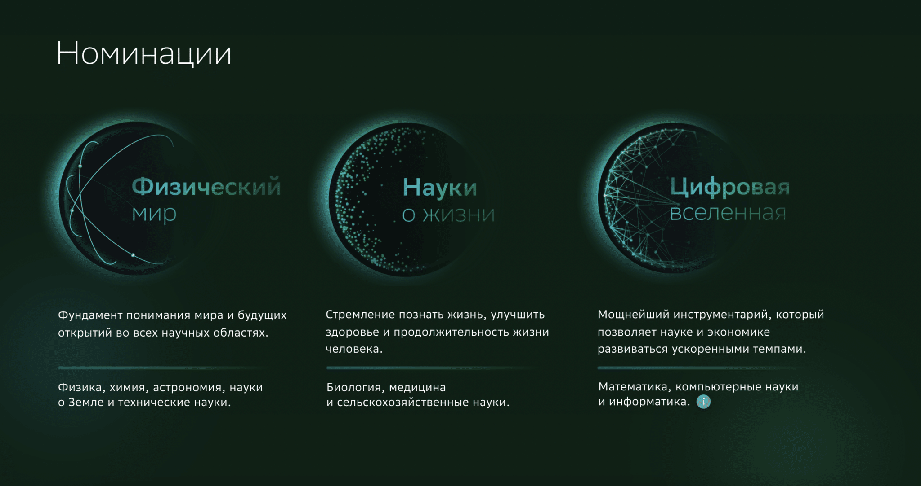
2022
acad. Yuri Oganessian won the Sber Scientific Prize for his fundamental work on the synthesis of superheavy elements and contribution to the formation of the accelerator experimental basis that provide the prospect for revolutionary nuclear technologies.

Slide 2
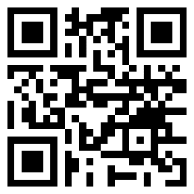
OGANESSON Award 2023
FOUNDERS Yuri Oganessian and JINR
The award was created at the suggestion and expense of RAS Academician Yuri T. OGANESSIAN, and established at the Joint Institute for Nuclear Research, in 2023.
AWARDED ANNUALLY
FOR SIGNIFICANT ACHIEVEMENTS in theoretical and experimental research in physics, chemistry, biology, and applied problems.
FOR CREATIVE ENDEAVOURS
that popularise science by means of educational and scientific activities.
Individual scientific, engineering, and technical specialists or teams (no more than 3 people), whose contribution was decisive in solving scientific problems and popularisation projects, can participate in the COMPETITION for the Award.
AUTHORS of scientific papers, published lecture courses, articles, as well as popular science and art works aimed at popularising science.

