Slide 1
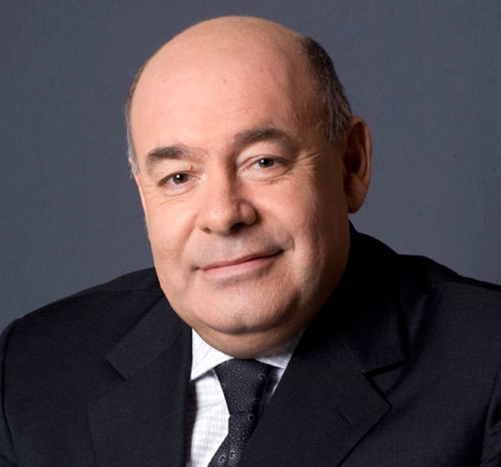
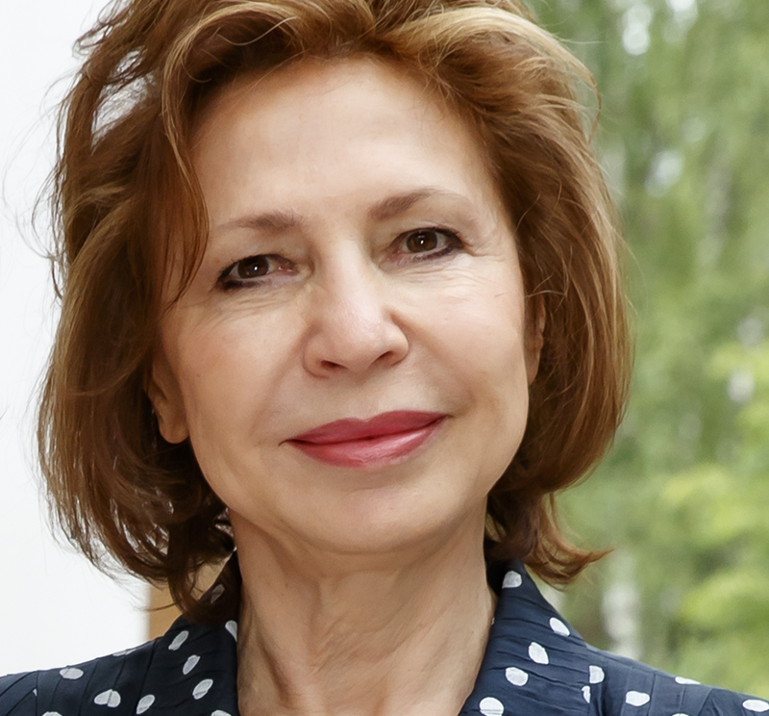
OGANESSON 2023 Award laureates
Ana María
CETTO KRAMIS
Mikhail Y.
SHVYDKOY
Vasily V.
SEMIN
Valeria
PERSHINA
Physics professor at the National Autonomous University of Mexico and JINR Scientific Council member.
For outstanding scientific works in quantum mechanics and theoretical physics, for great personal contribution to the strengthening of global scientific cooperation for peace and sustainable development.
Doctor of Arts. Art director of the Moscow Musical Theatre. Cultural, social, and state worker.
For outstanding personal contribution to the development of international scientific and cultural cooperation, and the popularisation of modern science achievements in mass media.
Head of the Scientific and Experimental Department of the Flerov Laboratory of Nuclear Reactions Accelerator Complex at JINR.
For significant personal contribution at the beginning of his scientific career to the creation of new primary experimental facilities at JINR, providing breakthrough scientific results in nuclear physics.
Chemistry professor at GSI, Darmstadt, Germany.
For theoretical studies of the electronic structure and chemical properties of superheavy elements of Mendeleev's Periodic Table.

