Slide 1
Радиационные испытания концентратора данных на базе ПЛИС Artix-7 для кремниевой трековой системы установки BM@N Шитенков М.О., Дементьев Д.В., Леонтьев В.В., Шереметьев А.Д., Мурин Ю.А.

Slide 2
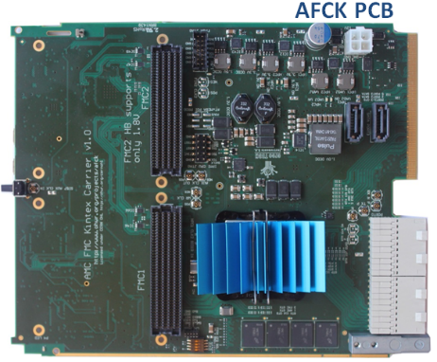
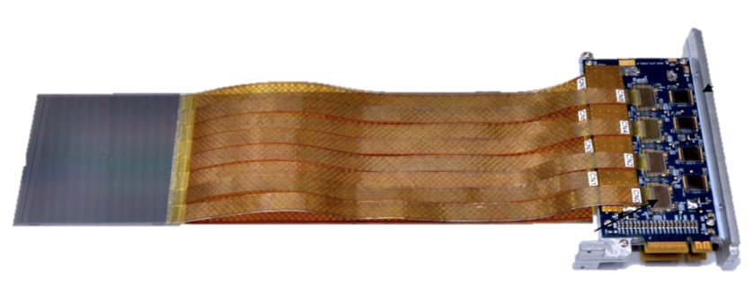
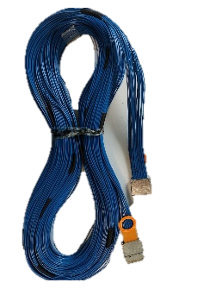
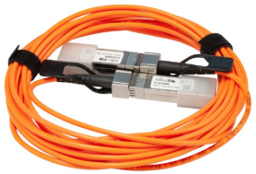
Introduction
GBTxEmulator is a board for readout data from modules of the Silicon Tracking System.
x3
STS module
Twinax cable
10m long
Optical fiber
GBTx-Emulator
DPB
STS Readout system
Task:
Tests of the SEU rate of the GBTxEmulator board based on FPGA Xilinx Artix7;
SEU mitigation core integration and testing;
GBTxEmulator error rate estimation in BM@N environment.

Slide 3
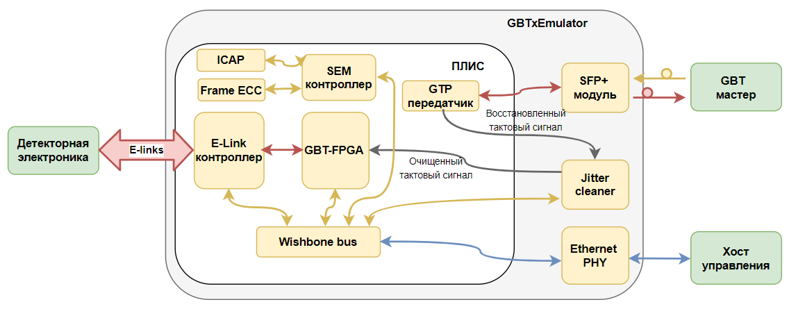
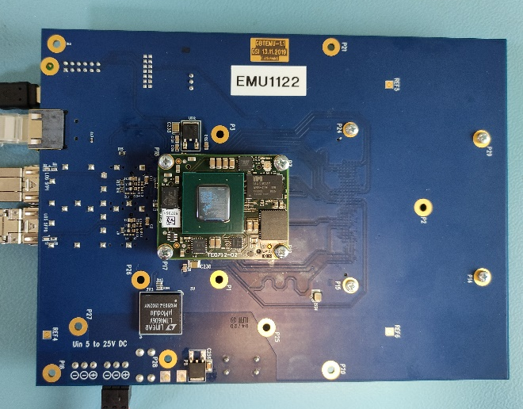
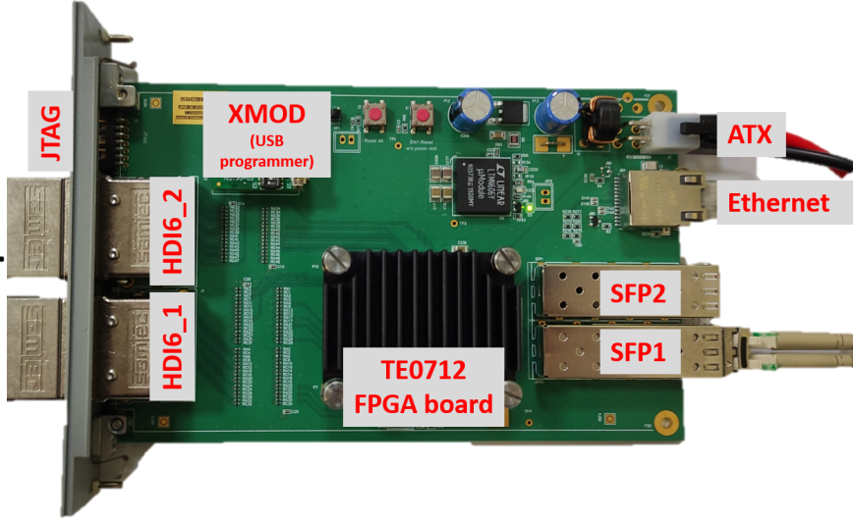
GBTxEmulator
FPGA based interface between the Front-End Electronics and the Data Processing board
Features:
Provides GBTx ASIC functionality;
Fast time deterministic transport of downlink massages;
high-speed transmission of hit data in the uplink direction;
FPGA platform: Trenz TE0712-02-100-2C from Xilinx;
4.8 Gb/s link optical links connecting with the DPB;
Control interface: IPbus via 100 Mb/s Ethernet, UART, JTAG;
E-Link interface:
48 E-Links with 80 Mb/s data rate;
6 clocks (40 MHz);
6 downlink.
Block diagram of the Firmware GBTxEMU
Power
IPbus
Front-end
GERI
Trenz TE0712-02-100-2C
FPGA Artix7
XC7A200T
GBTxEmu v.2.1
GBTxEmu v.2.2

Slide 4
Interactions of Radiation with Electronic Devices
The effects of radiation on electronic devices and materials depend on:
Type of radiation (photon, electron, ion, neutron, …)
Rate of interaction
Type of material (Silicon, GaAs)
Component characteristics (process, structure,…)
Consequences
Ionization: Total ionizing Dose (TID) and Single Event Effect (SEE)
Displacement Damage (DD or TNID)

Slide 5
Main radiation effects

Slide 6
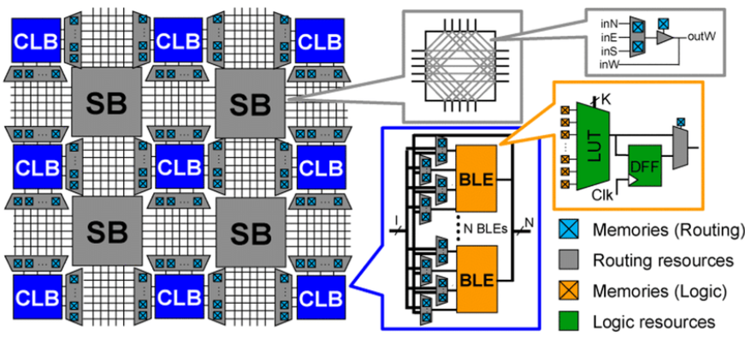
Improve FPGA SEU Robustness
Static RAM
FPGA architecture
Mitigation layer | Strategy | Protection
Logic level | Triple module redundancy | Fabric USER Logic
 | Soft error mitigation | Configuration memory
Device level | Flash scrubbing | Multi-boot with 6 copies
 | Remote JTAG | Scrubbing FPGA or FLASH
Board level | Remote power control | Individual remote power on\off

Slide 7
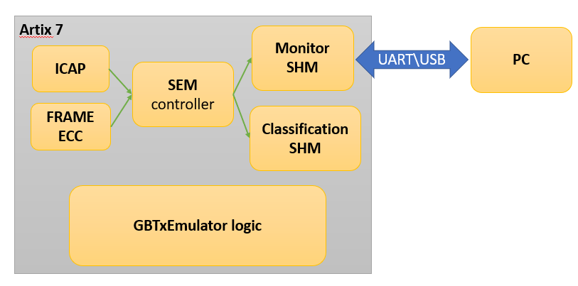
Soft error mitigation
The main drawback for SRAM-based FPGAs is the vulnerability of the configuration memory.
• Soft Error Mitigation IP (SEM)
• SEM makes use of built-in primitives for the detection and correction of SEUs on the configuration memory (CRAM)
• It is a controller that brings together the ECC FRAME, the ICAP and provides an external interface.
• ECC/CRC error detection – error correction
• 13-bit Hamming code
• UART interface for status/error reporting
• SEM can detect two bit failures per frame
• It cannot correct BRAM and Flip Flops
Block diagram of the SEU mitigation interface

Slide 8
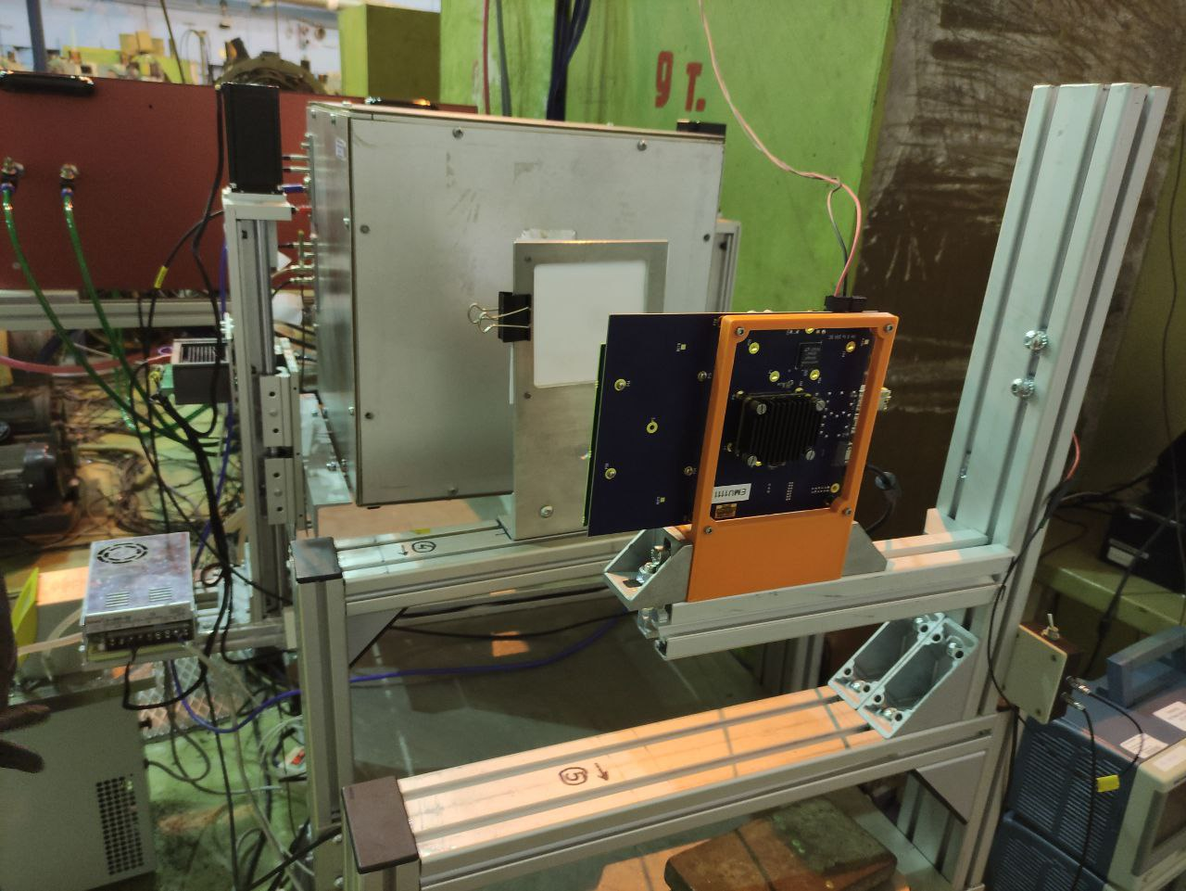
GbtxEmulator radiation test
1000 MeV proton beam (SC-1000 @ PNPI);
Beam diameter: 20 mm;
Time: 45 hours;
Flux: 1*10⁴ - 5*10⁶ cm⁻² s⁻¹
FPGA
Controlled parameters:
SEU CRAM rate;
Error classification;
Power supply current;
Flux.
BEAM
GBTxEmulator board

Slide 9
SEU & MBU cross section
Total: 2666 SEU; 126 MBU;
Fluence 5,7*10¹⁰;
TID: 1,18 kRad
SEU Cross Section: (3,94 ± 2) E-15 cm²/bit
MBU Cross Section: (2,58 ± 1.3) E-16 cm²/bit

Slide 10
Comparison Cross Section with other experiments
Facility/Beam | $σ,$ CRAM, [cm²/bit] | $σ,$ BRAM, [cm²/bit]
ПИЯФ (1000 MeV Proton) | 3.94 × 10−15 | N/A
LANSCE (Xilinx, WS Neutron 1-800 MeV) | 6.99 × 10−15 | 6.32 × 10−15
CERN H4 (HE Hadron) | 1.50 × 10−14 | 1.40 × 10−14
TSL (180 MeV Proton) | 8.29 × 10−15 | 8.19 × 10−15
TSL (WS Neutron) | 6.55 × 10−15 | N/A
LANSCE (WS Neutron 1-800 MeV) | 6.89 × 10−15 | 6.15 × 10−15
Good correlation!

Slide 11
SEU rate in BM@N environment
Radiation background is 200 times higher than normal background.
Time: 5 years with 3 months beam time
TID: 40 Rad (Total Ionizing Dose)
NIEL: 4*10⁹ n/cm²; (Non-Ionizing Energy Loss)
Neutron flux: 100 cm⁻²s⁻¹
Hadron flux (>20 MeV): 1 cm⁻²s⁻¹
MTBF (mean time between failures for CRAM): 8 h (recoverable), 126 h (unrecoverable)
Location racks with GBTxEmu
E. Letvinenko ( FLUKE simulations)

Slide 12
Conclusion
Operation of the FPGA based GBTxEmulator board in the radiation environment was tested;
Usage of the board with existing firmware in BM@N environment was proved;
Artix-7 XC7A200T SEU Cross Section (3,94 ± 2) E-15 cm²/bit (1000 Mev protons)
Mean time between failures: 8 h (soft mitigation), 126 h (full system reboot)
SEU – 95% (recoverable with implemented logic); MBU – 5% (unrecoverable, only detection and reboot);
After the experiment, GBTxEmulator is fully functional ( TID_{collect} >> 30 times >> TID_{BM@n}). Safe dose (< 5 kRad)

