Slide 1
Information about the forced stop of the Nuclotron Run # 55th and plans for 2018
H. Khodzhibagiyan
PAC PP, JINR, Dubna, 31 January 2018

Slide 2
Stoppage of the 55th Run
The reason for the forced stoppage of the 55th Run of the Nuclotron in November 2017 was the depletion of the resource of helium purification unit from the oil and water impurities.
The manufacturer of the refrigerator did not provide oil vapor monitoring in the helium stream after the purification unit, so it was impossible to determine when the unit's resource was spent.
Oil fumes after passing the purification device enter into the heat exchanger and freeze on its walls. After a power failure, the helium compressor stopped and the top part of the heat exchanger was warmed up. The oil on the walls of the upper part of the heat exchanger melted, flow down, accumulated, froze and blocked the channels of the lower cold part of the heat exchanger. Continuation of the Nuclotron operation without repairing its cryogenic system became impossible. The 55th Run of the Nuclotron was stopped on November 03th, 2017.

Slide 3
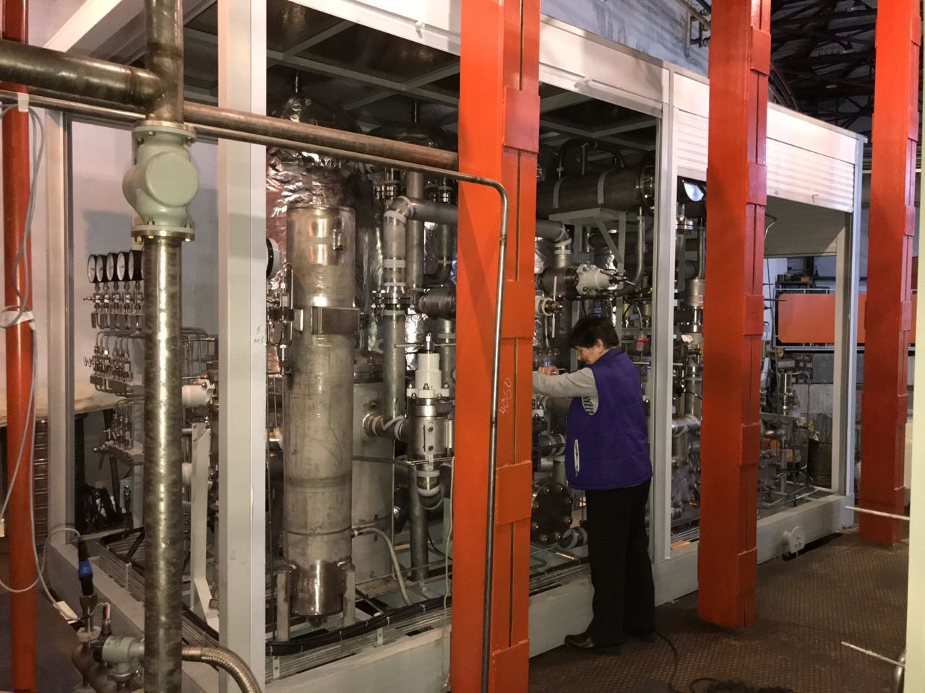
Repairing of the Nuclotron cryogenic system
VBLHEP developed and implemented a plan for the rapid repair of the Nuclotron cryogenic system:
The helium purification unit that has spent the resource was replaced by a new one in December 2017.
- The heat exchange equipment was washed from the oil with Freon and then purified from Freon and water by blowing with air and gaseous helium.

Slide 4
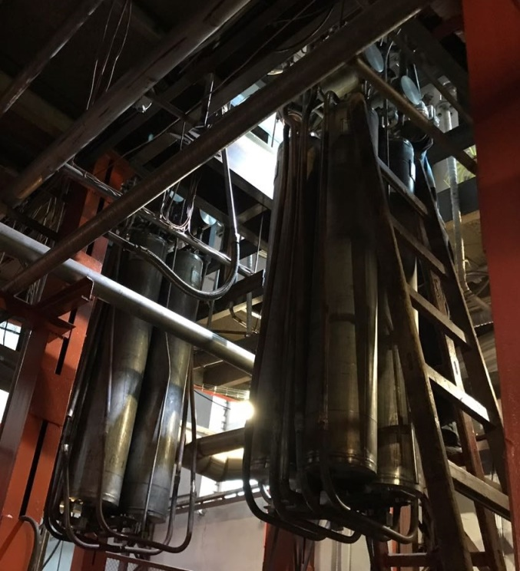
Repairing of the Nuclotron cryogenic system
18 absorbers with contaminated charcoal were replaced with new ones in December 2017 and January 2018.
In the past weekend, on January 28 the operating capacity of the Nuclotron cryogenic system was successfully verified by trial liquefaction of helium.
- In a short time it is planned to manufacture and install a device for measuring the amount of oil and water vapor in the helium stream after the purification unit in order to exclude such a breakdown in the future.

Slide 5
Plans for 2018
The Nuclotron Run is scheduled for February 05th 2018.
The liquid helium production for the facility for testing of the NICA superconducting magnets was restored in last week.
During the repair of the cryogenic complex, the tests of magnets were carried out due to the purchase of liquid helium, which allowed to keep the readiness of the Booster magnets for mounting in the tunnel in September 2018.

Slide 6
Thank you for attention

