Slide 1
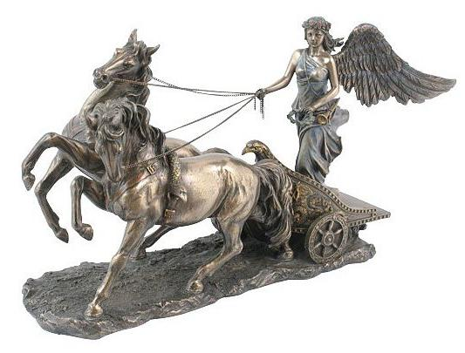
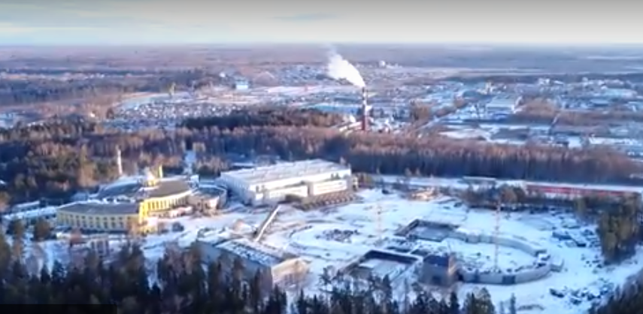
Report on the infrastructure developments, including the Nuclotron
N.N.Agapov

Slide 2
PRESENTATION OUTLINE
Main directions of the NICA infrastructure developments:
Construction of buildings
Development of liquid helium and liquid nitrogen plants
Operation of the facility for assembling and cryogenic testing of SC-magnets
Modernization of electricity systems

Slide 3
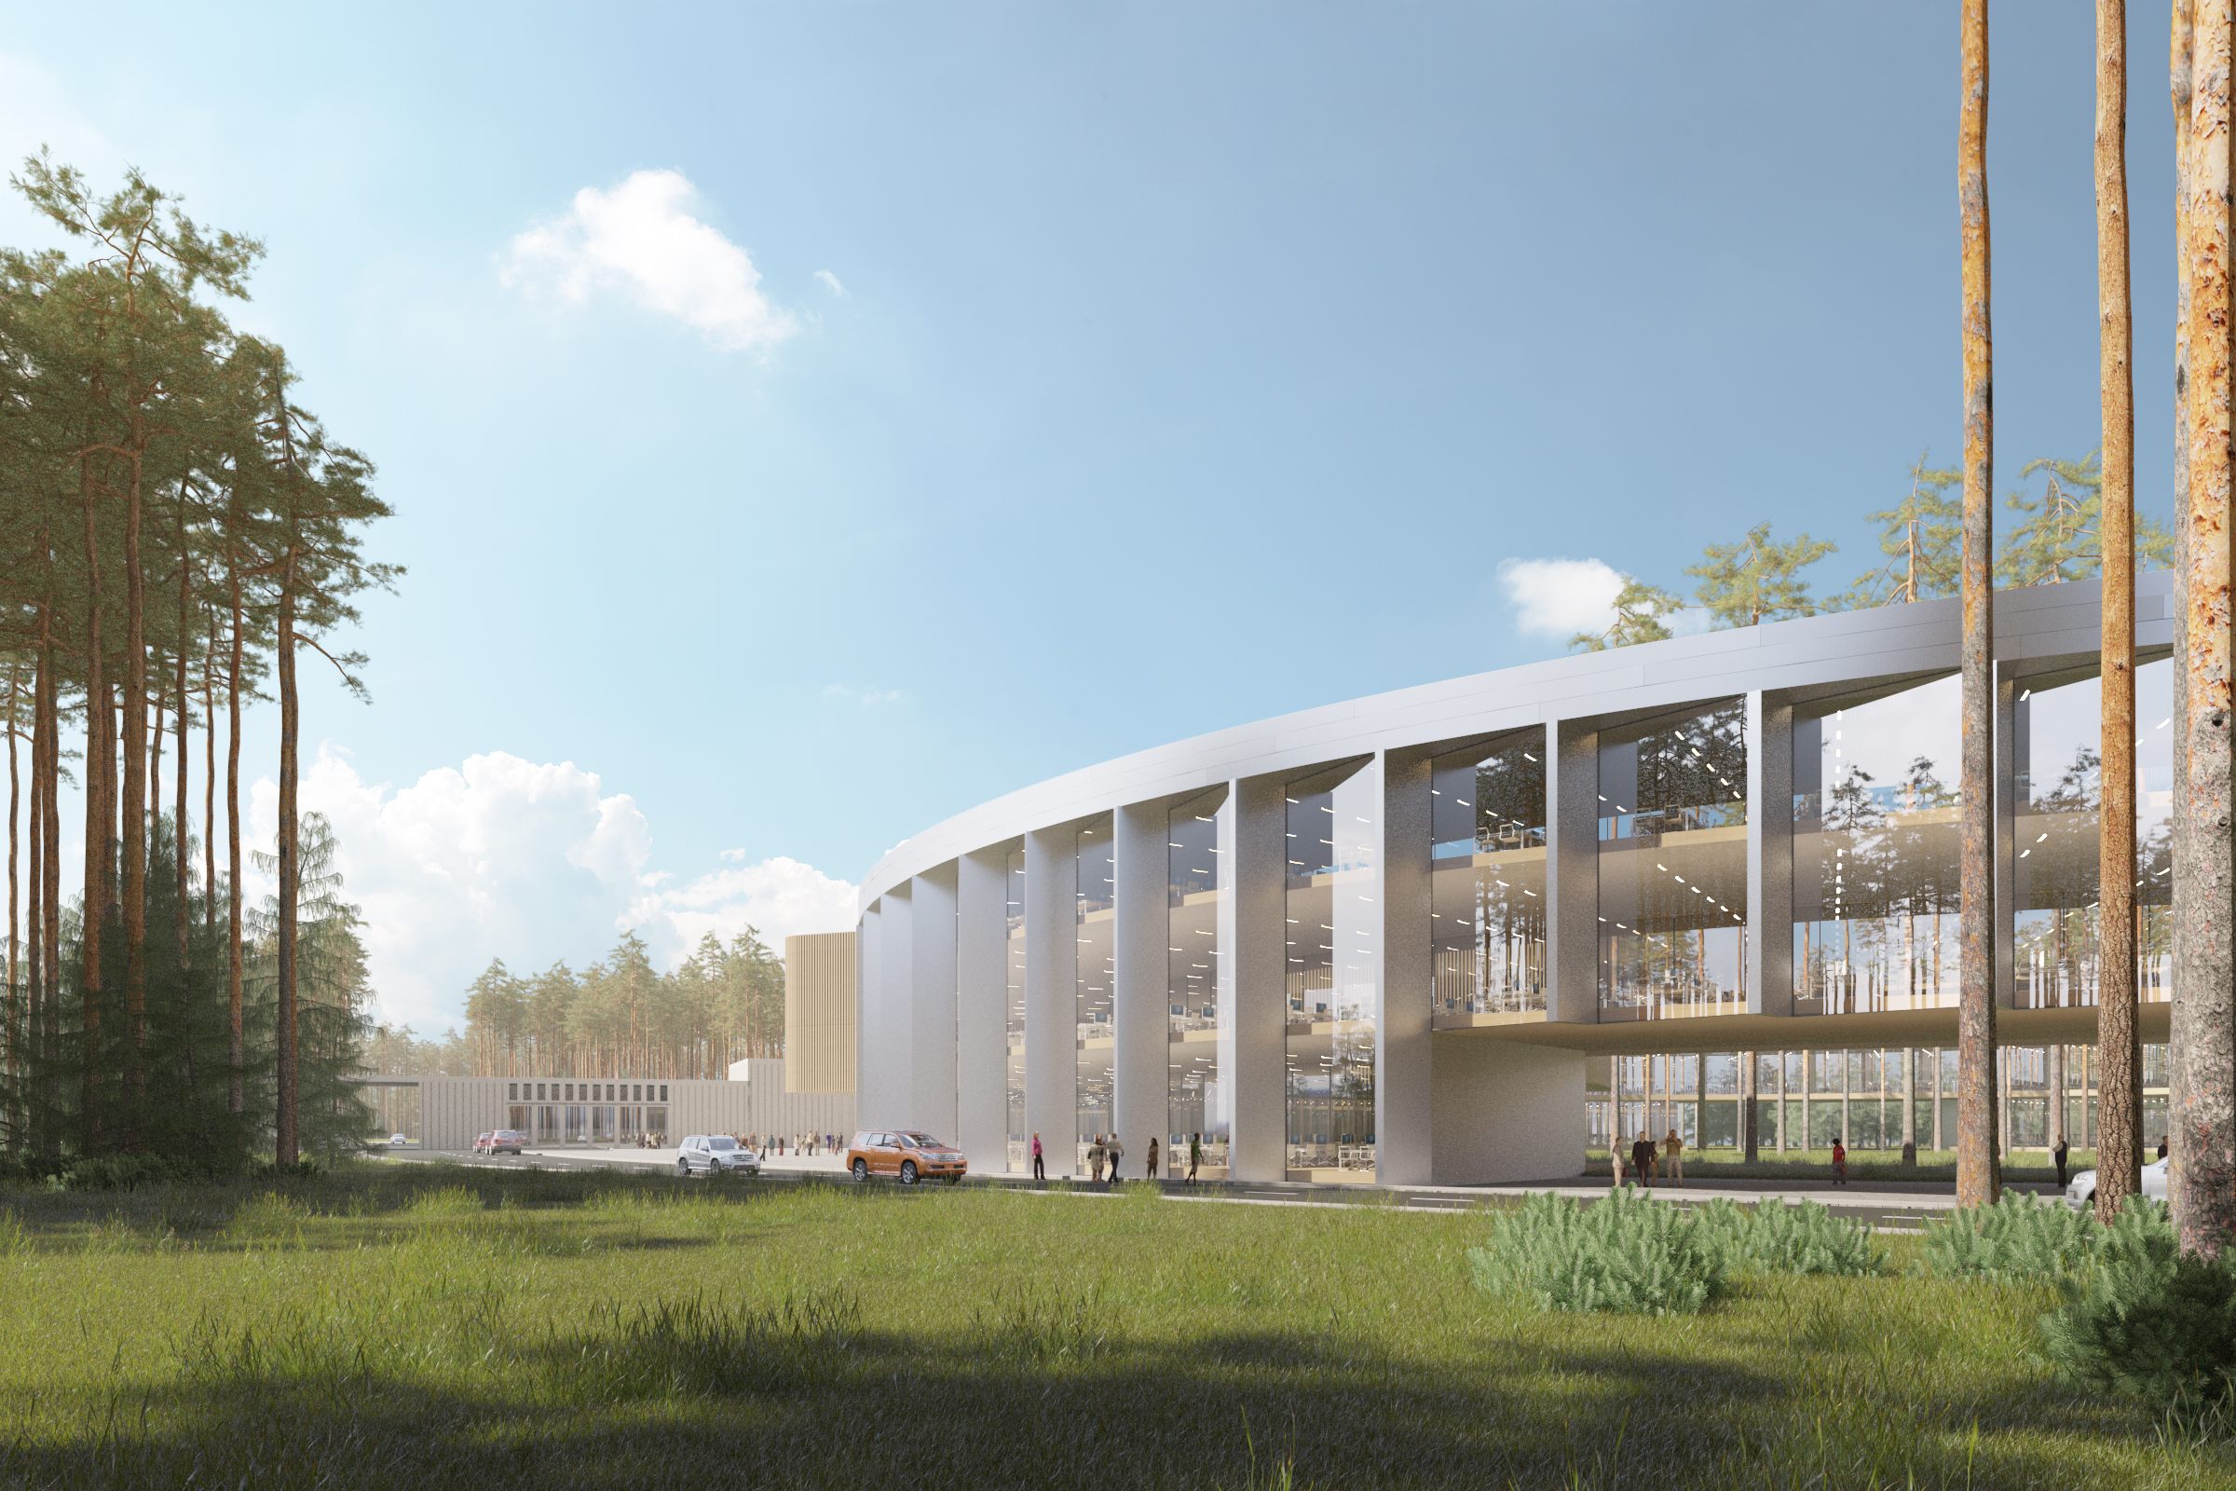
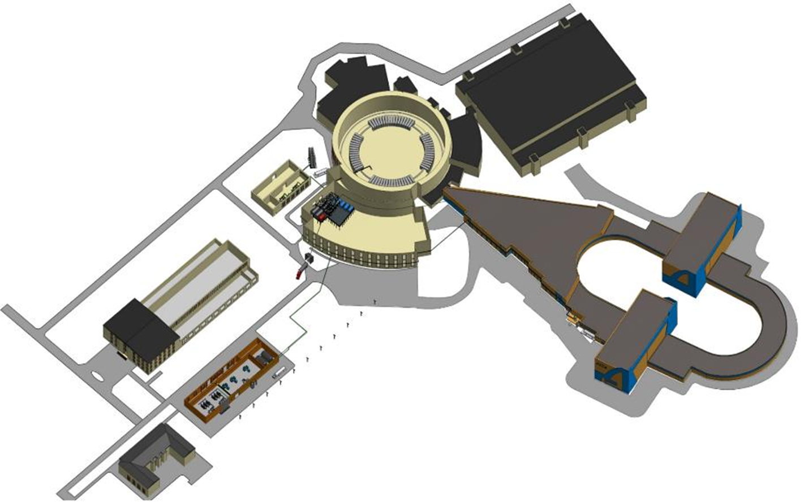
New buildings of the NICA complex
Collider building
NICA innovation center
New compressor hall building

Slide 4
Report on the construction of the collider building
Total number of workers at the construction site in different months 2017
Reinforced concrete works
Excavation and road construction
Piled work
November 2017

Slide 5
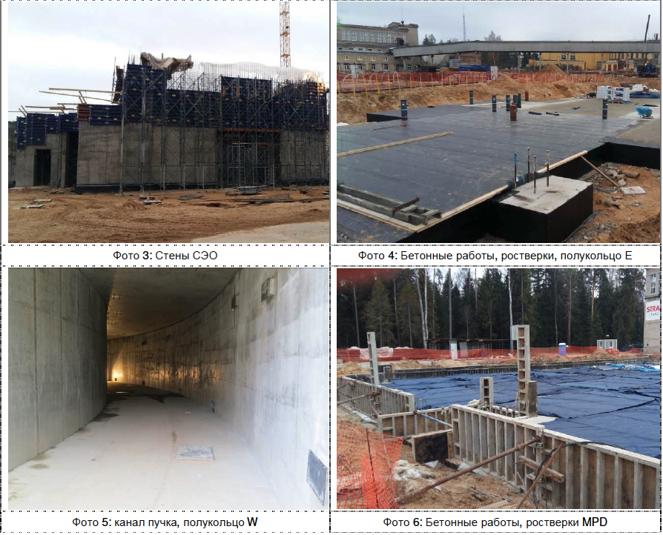
Reinforced concrete works

Slide 6
Reinforced concrete works at SPD

Slide 7
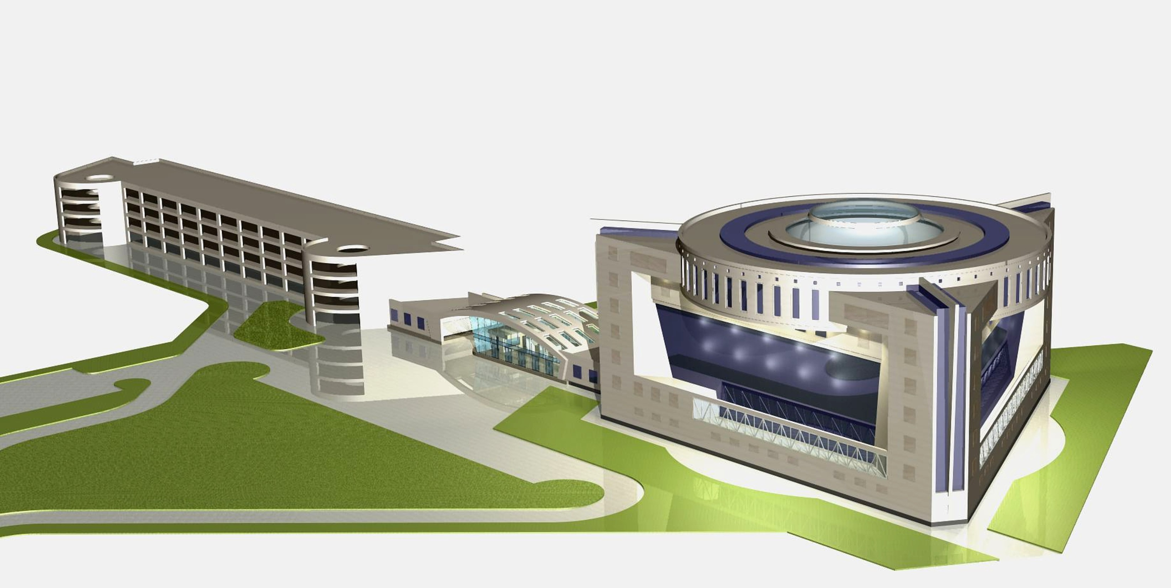
NICA innovation center
Design Institute
“ARENA”

Slide 8
Existing compressor building 4,4 MW
New compressor building
9,6 MW

Slide 9
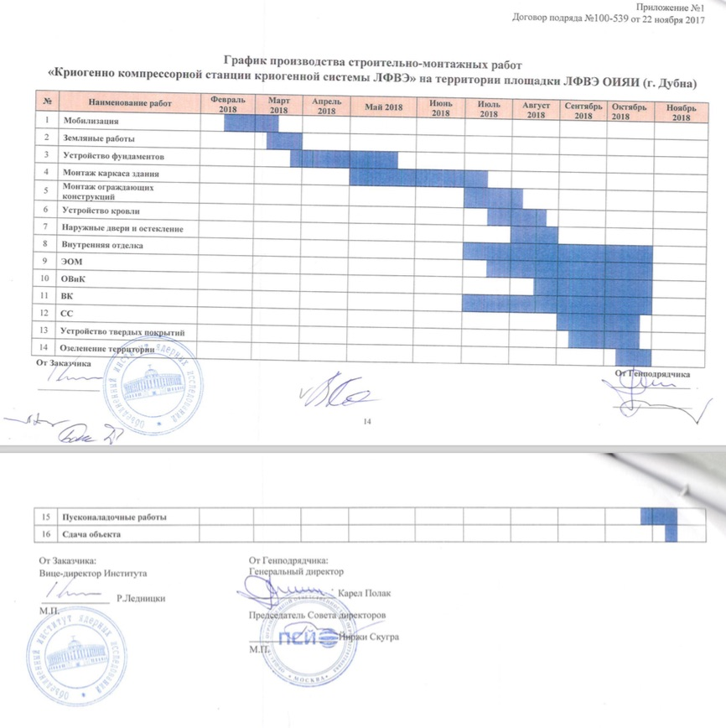
Construction plan of the new compressor station (Open Company “PSJ” – Czech Republic)

Slide 10
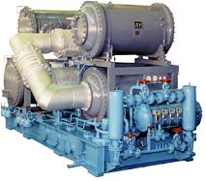
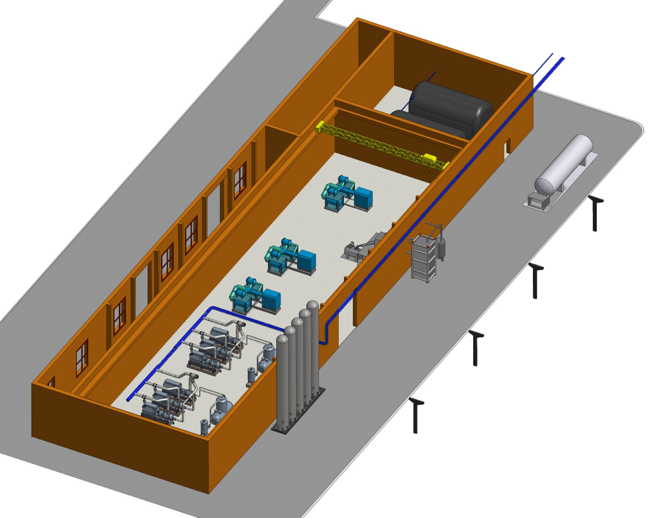
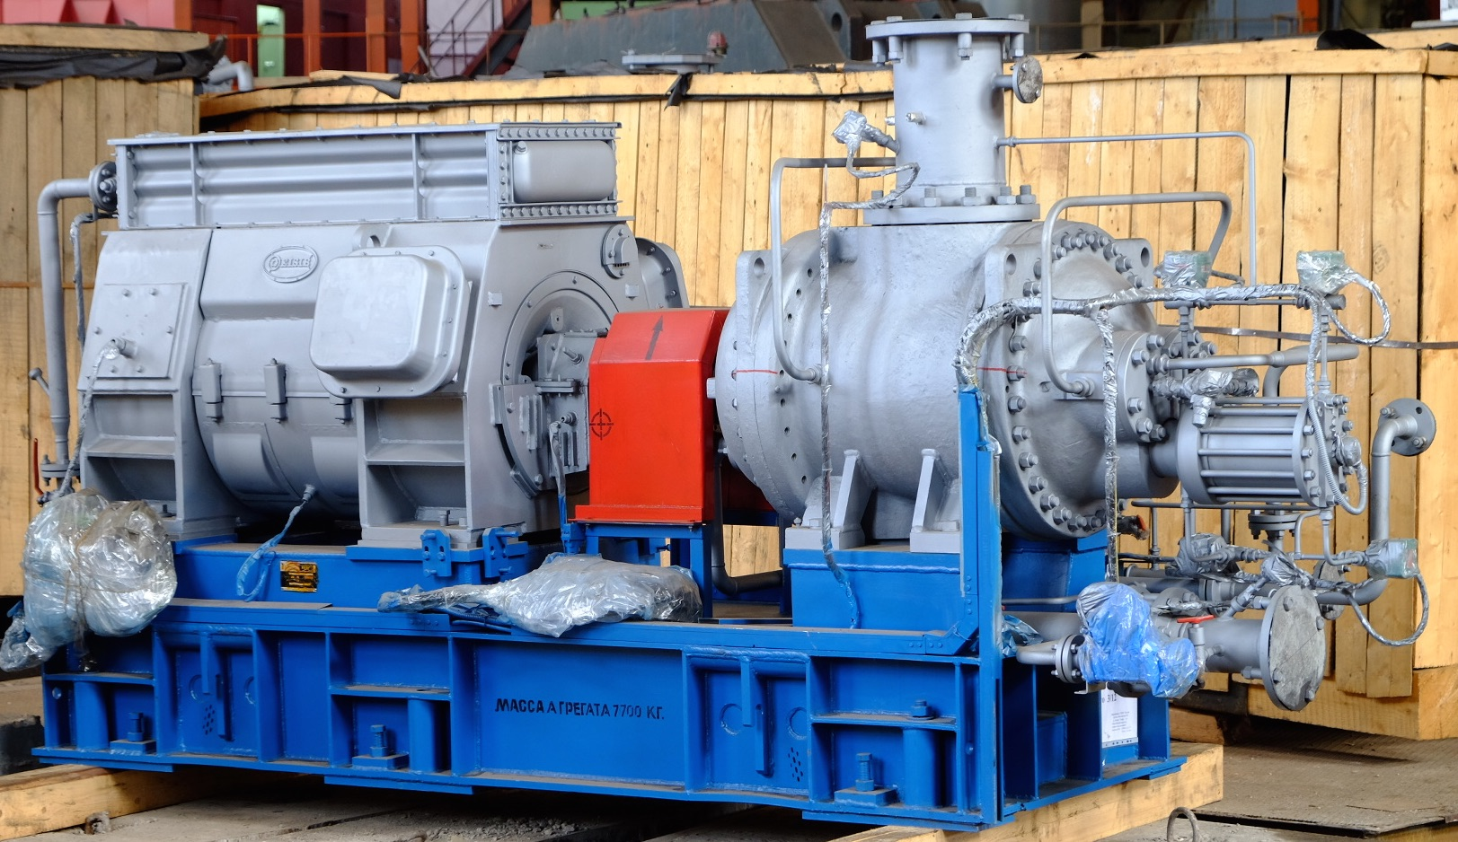
Nitrogen turbo compressor “Aerocom2-179/18”
Capacity of compressor, Nm³/h | 10740
Inlet pressure, MPa | 0.102
Inlet temperature, °C | 30
Outlet pressure, MPa | 1.8
Outlet temperature, °C | 40
Temperature of cooling water, °C | 20
Installed power of electric motor, kW | 1800
200 m3 nitrogen gas bags
Nitrogen turbo compressors
SAMSUNG SM-5000
Helium screw compressors “Kaskad-110/30”
30 m3 LN2 reservoir with pumps
Capacity (Nm³/h) | 6600
Outlet pressure (MPa) | 3.0
Total power of electric motors (kW) | 1600
Voltage (V) | 6000
Number of compression stages | 2
Speed (rpm) | 2970
Flow rate of cooling water, m³/h | 78
1300 kg/h nitrogen liquefier
Nitrogen receivers

Slide 11
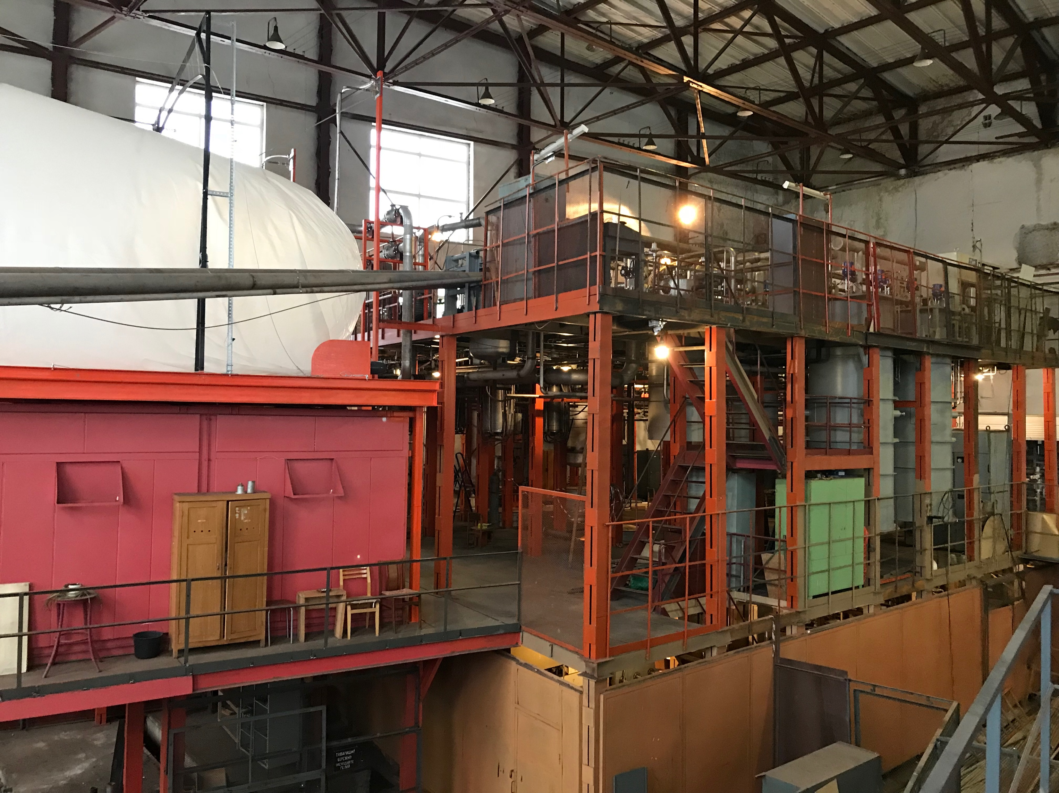
Existing liquid helium plant
Helium refrigerators 2 X 2000 W
--------------------------
Helium liquefier
1000 L/h

Slide 12
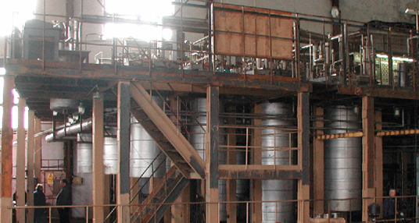
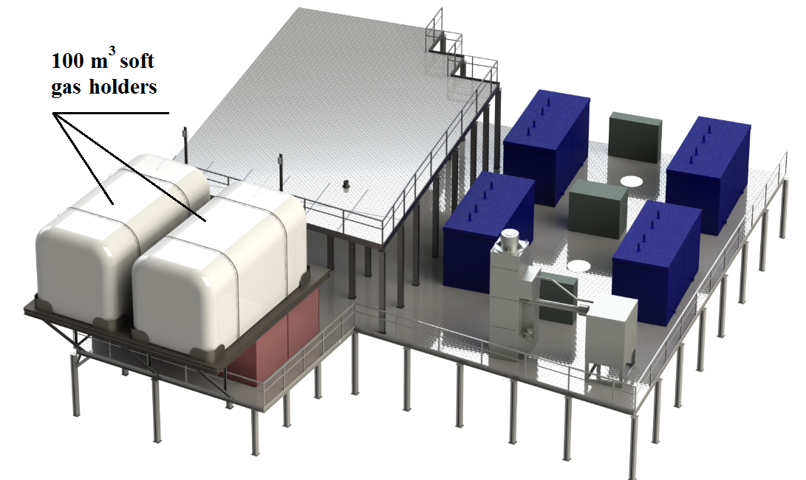
New equipment on the central cryogenic station
Existing liquid helium plant
100 m3 gas holders
100 m3 gas holders
100 m3 gas holders
100 m3 gas holders
Drying and oil purification units
100 m3 gas holders
100 m3 gas holders
Liquid nitrogen
re-condenser

Slide 13
Cryogenics of the NICA accelerator complex
Nuclotron
Booster
500 kg/h nitrogen re-condenser RA-0.5 of the Nuclotron and booster
drying and oil-purification units MO-800
two satellite refrigerators
of the collider
1000 l/h helium liquefier OG-1000
satellite refrigerator
of the booster
2x6600 Nm³/h helium screw compressors
40 m³ liquid helium tank
1300 kg/h nitrogen liquefier OA-1.3
Collider
3x10740 Nm³/h nitrogen turbo compressors
500 kg/h nitrogen re-condenser RA-0.5 of the collider

Slide 14
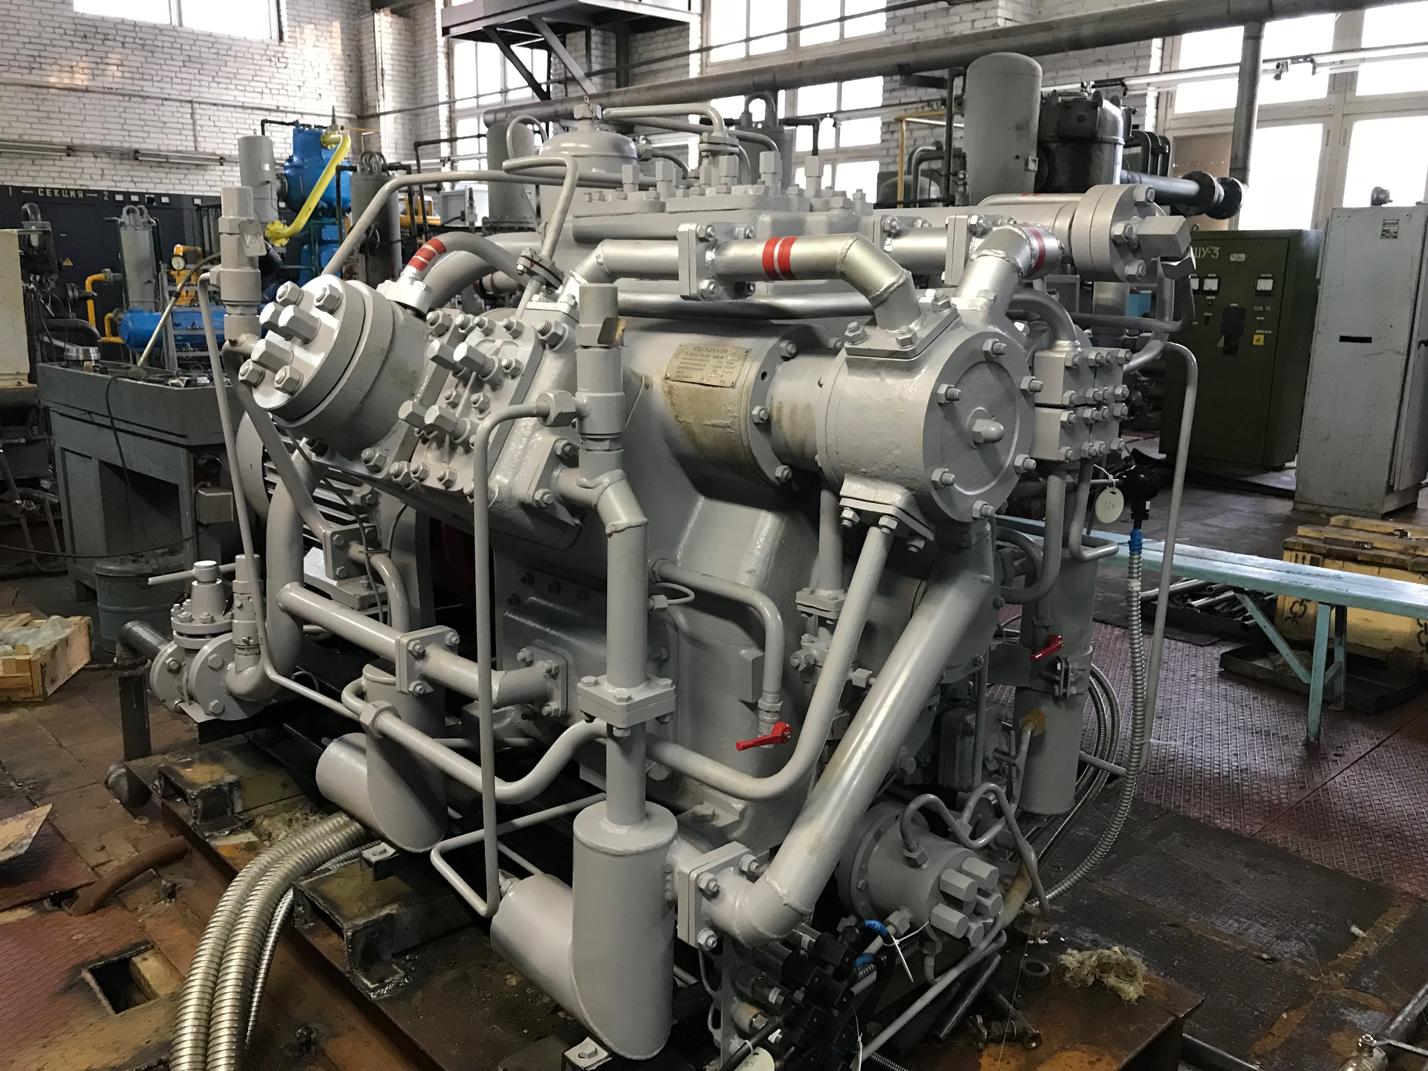
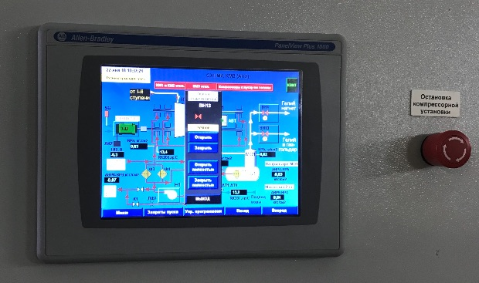
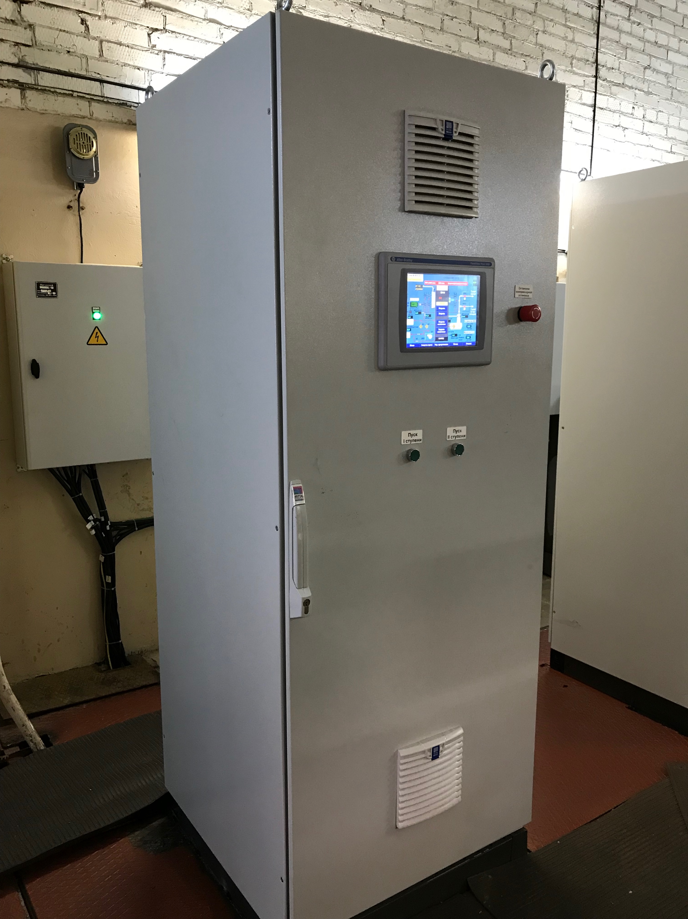
Workability maintaining of equipment that has been operating for a long time at Nuclotron
New automation system for screw helium compressor CASCADE-80/25 has been installed and commissioned
New high-pressure helium compressor for injection into the receivers has been mounted

Slide 15
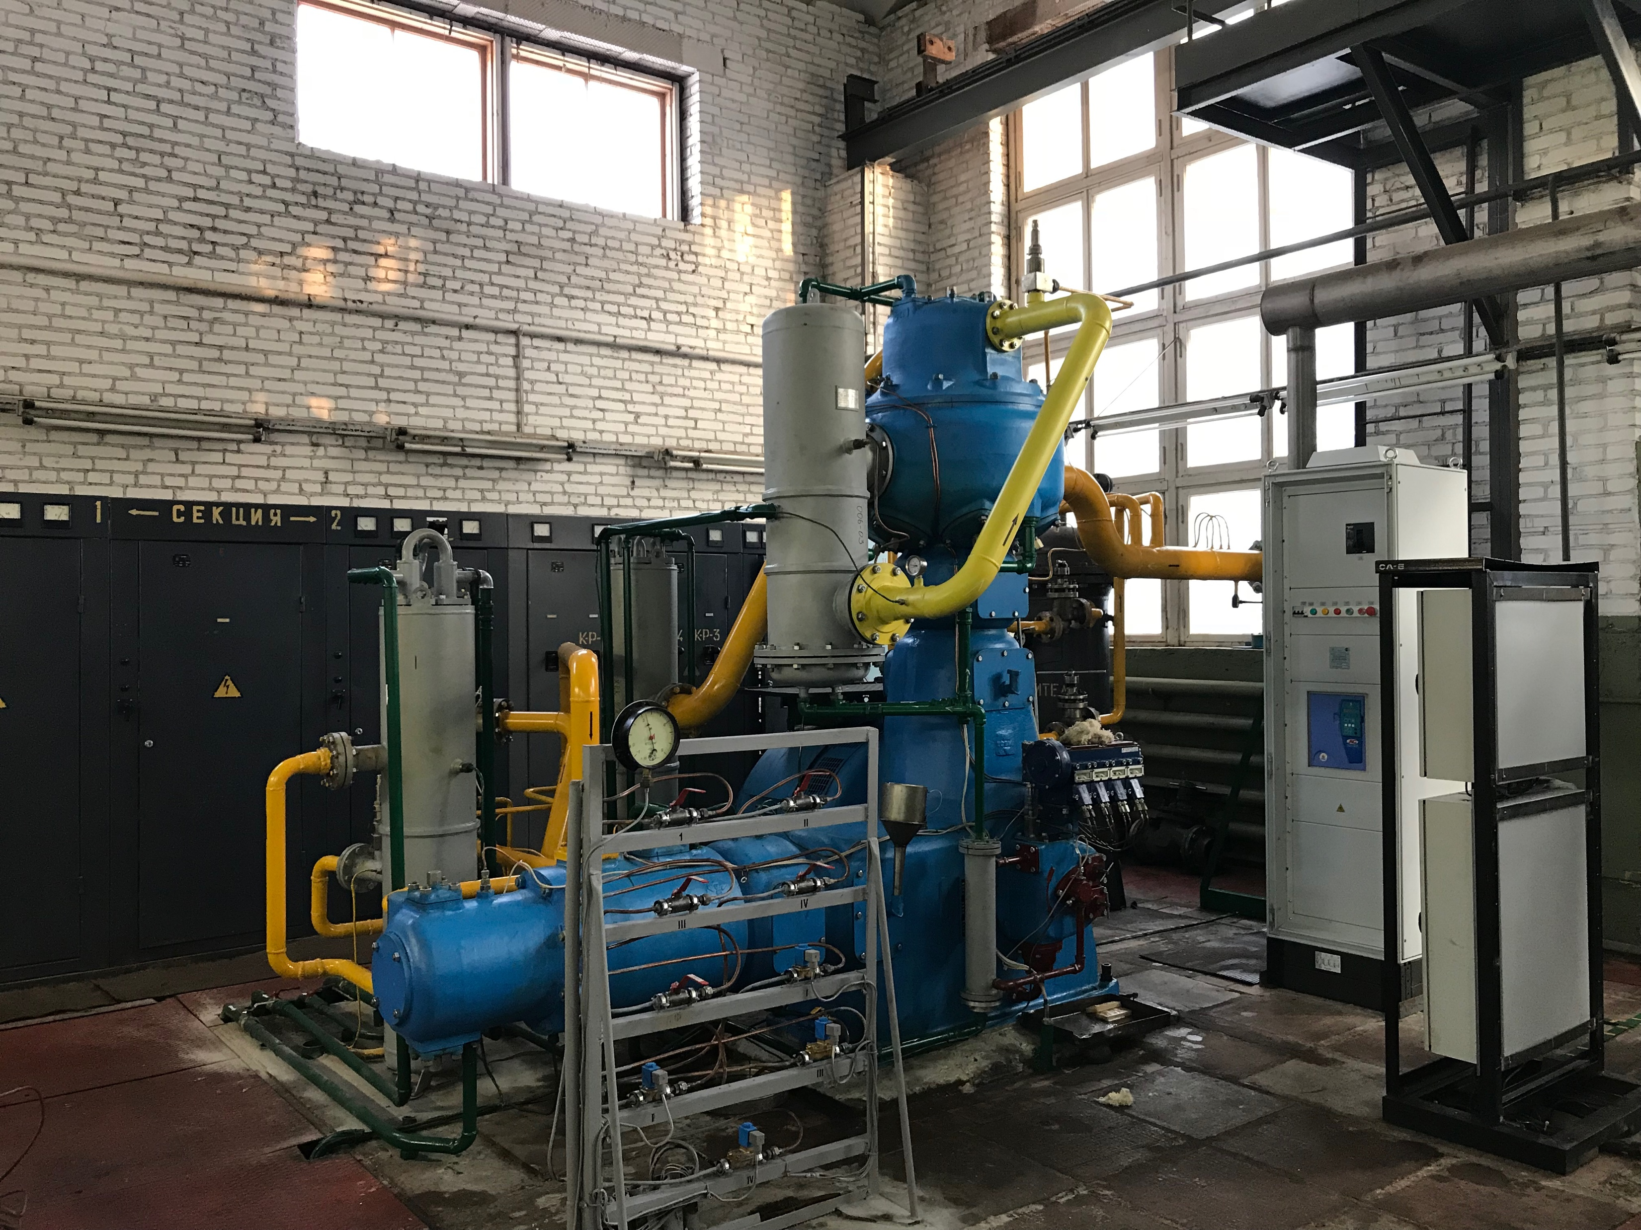
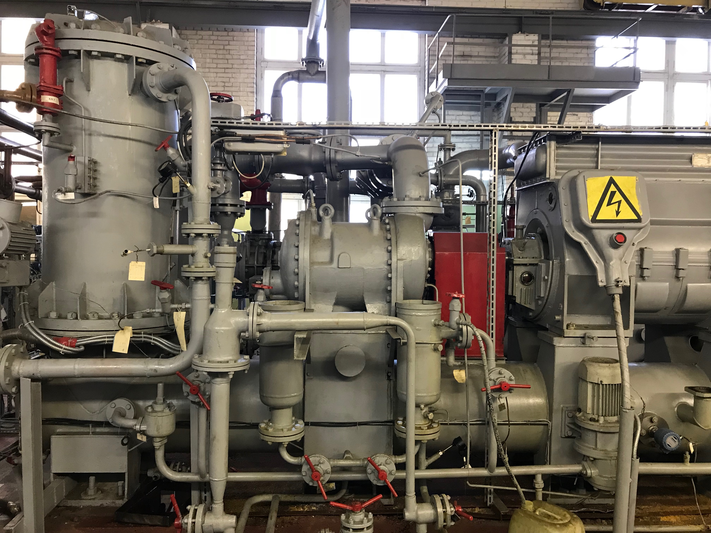
Workability maintaining of equipment that has been operating for a long time at Nuclotron
New 4-stage piston helium compressor with capacity of 1200 m3/h was assembled and put into operation instead of the old one that spent their resources
Major renovation of the second stage of the screw compressor CASCADE-80/25 at the factory in Kazan and its putting in operation

Slide 16
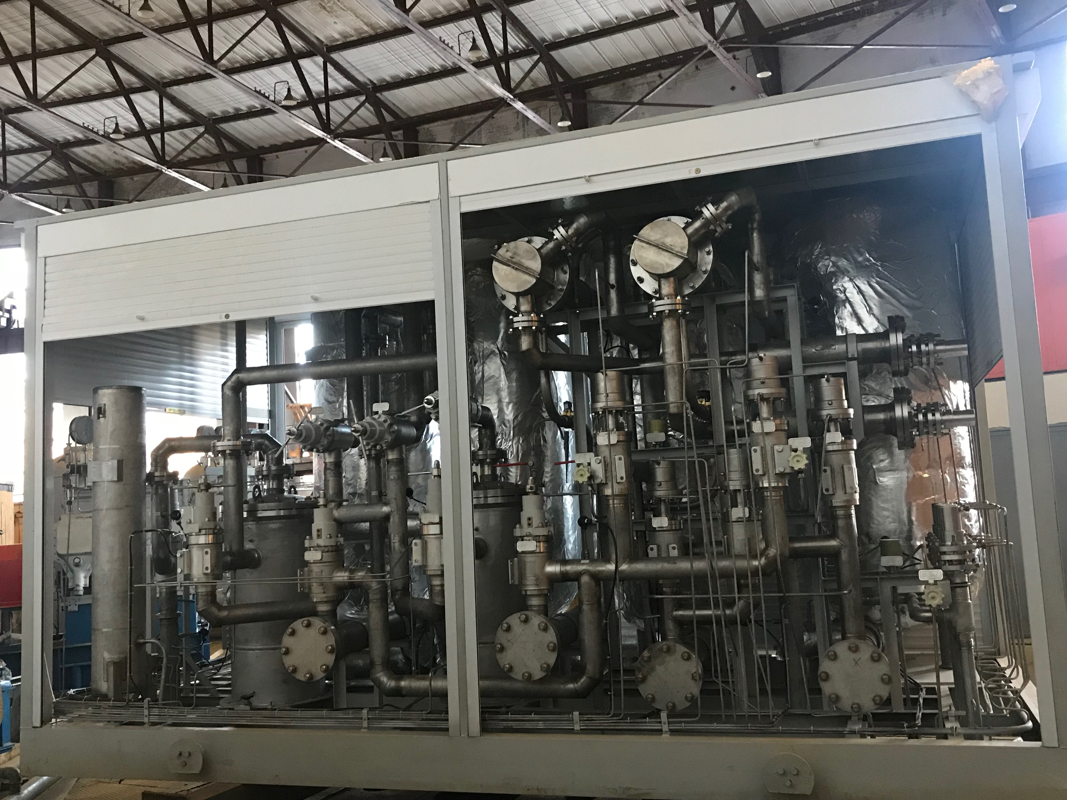
Upgrading of the purification system of two refrigerators that operate for Nuclotron
The purification system for compressed helium flow at Nuclotron refrigerators consist of three stages:
The first one operates at “room” temperature and removes water and oil vapours.
The second deletes oxygen and nitrogen impurities, its operation temperature is 77 K
The last stage is intended to remove neon and hydrogen molecules and operates at 24K
By today, all of these purification systems are brand new. This will allow in future continuous operation of the existing Nuclotron refrigerators at the NICA complex

Slide 17
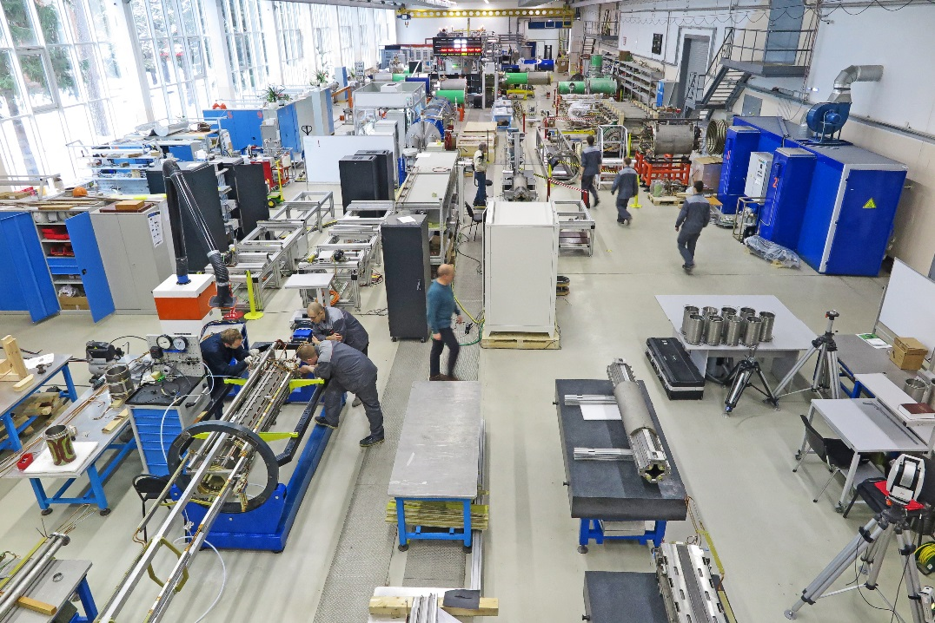
Line for assembling and cryogenic testing of SC-magnets
Main production areas:
Incoming inspection zone
SC cable production hall
SC coils production hall
Area for assembling the magnets
Area for the magnetic measurements under the room temperature
Leakage test area
Area for mounting the SC-magnets inside cryostats
Cryogenic tests bench

Slide 18
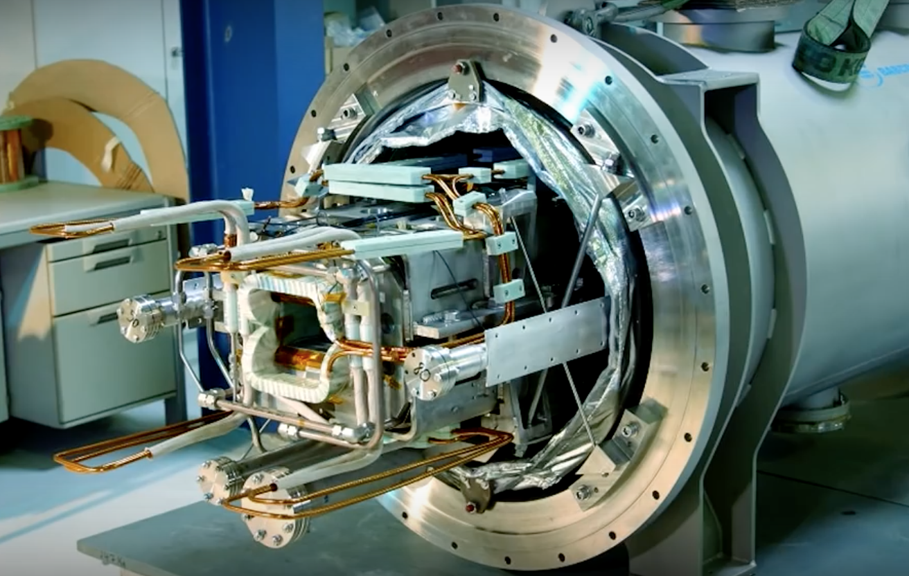
Production plans
80% of the magnetic-cryostat system of Booster has been realized.
40 dipole magnets for NICA Booster
48 quadrupole magnets with multipole correctors for NICA Booster
80 dipole magnets for NICA Collider
86 quadrupole magnets with multipole correctors for NICA Collider
175 quadrupole magnets with multipole correctors for SIS100 synchrotron (FAIR project)
Total 429
type | required | manufactured |  | tested
dipole | 40 |  | 42 | 33
quadrupole | 48 |  | 48 | 6
correctors | 32 |  | 2 | 2

Slide 19
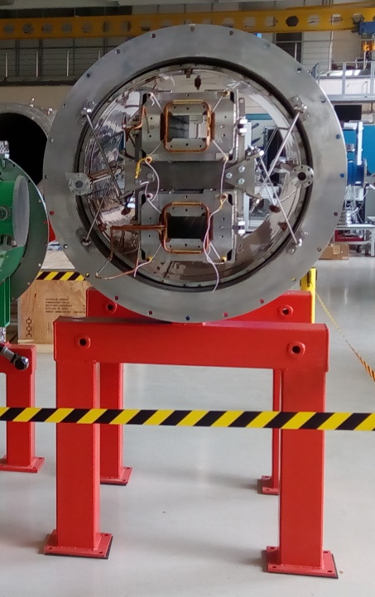
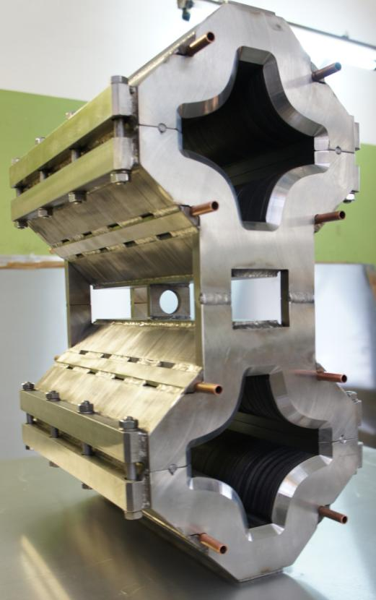
For the NICA Collider, the creation and testing of prototypes of the magnets was completed in 2017
Serial production of the superconducting two-aperture magnets and cryostats was started.
The production of a superconducting wire for magnets and bellows for cryostats has been finished.

Slide 20
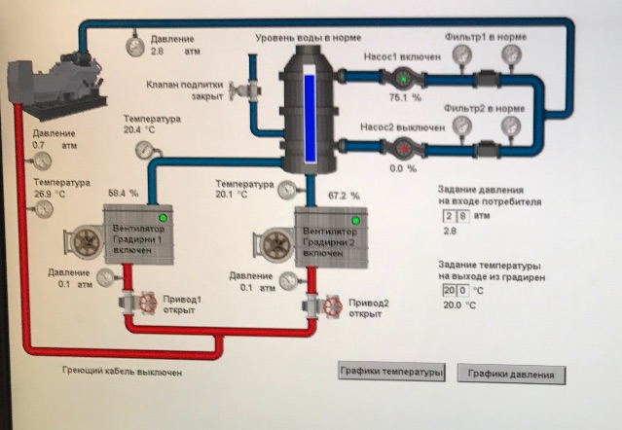
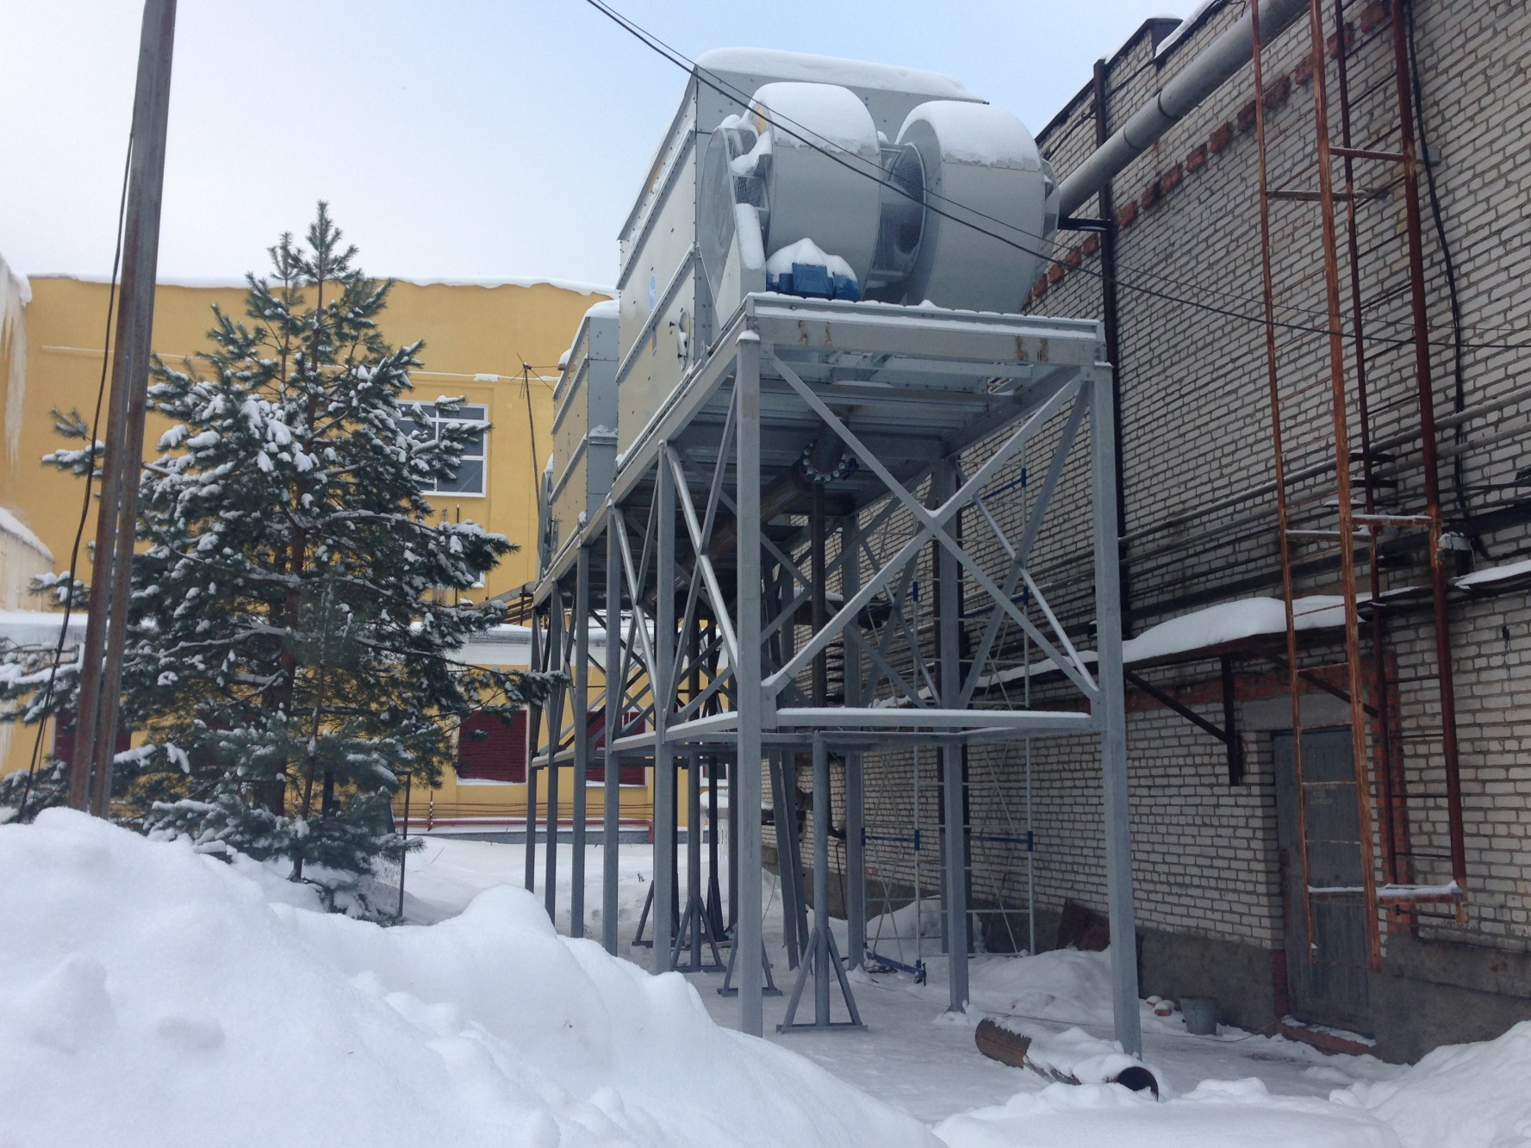
Water chilling systems on the base of cooling towers
Circulating water cooling system for the Nuclotron compressor hall operates automatically

Slide 21
Power distribution of the transformer station
 | Users | Power, MW
1 | Booster | 1.6
2 | Collider | 9.0
3 | New compressor hall | 9.6
4 | Computer cluster | 1.0
5 | Nuclotron | 1.4
6 | Channels of the bld. 205 | 1.6
7 | Facility for assembling and cryogenic tests of the SP magnets bld. 217 | 1.1
8 | Lab’s infrastructure | 4.4
9 | Eastern thermal station | 0.8
10 | Centre of innovative developments | 1.8
11 | Dubna city users | 8.5
 | TOTAL | 40.8

Slide 22
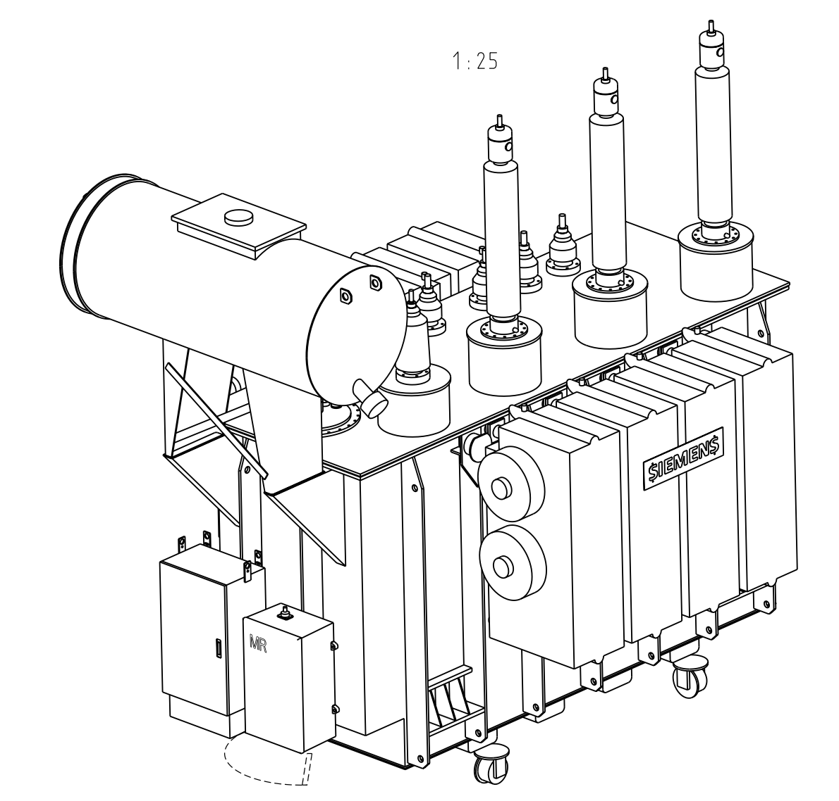
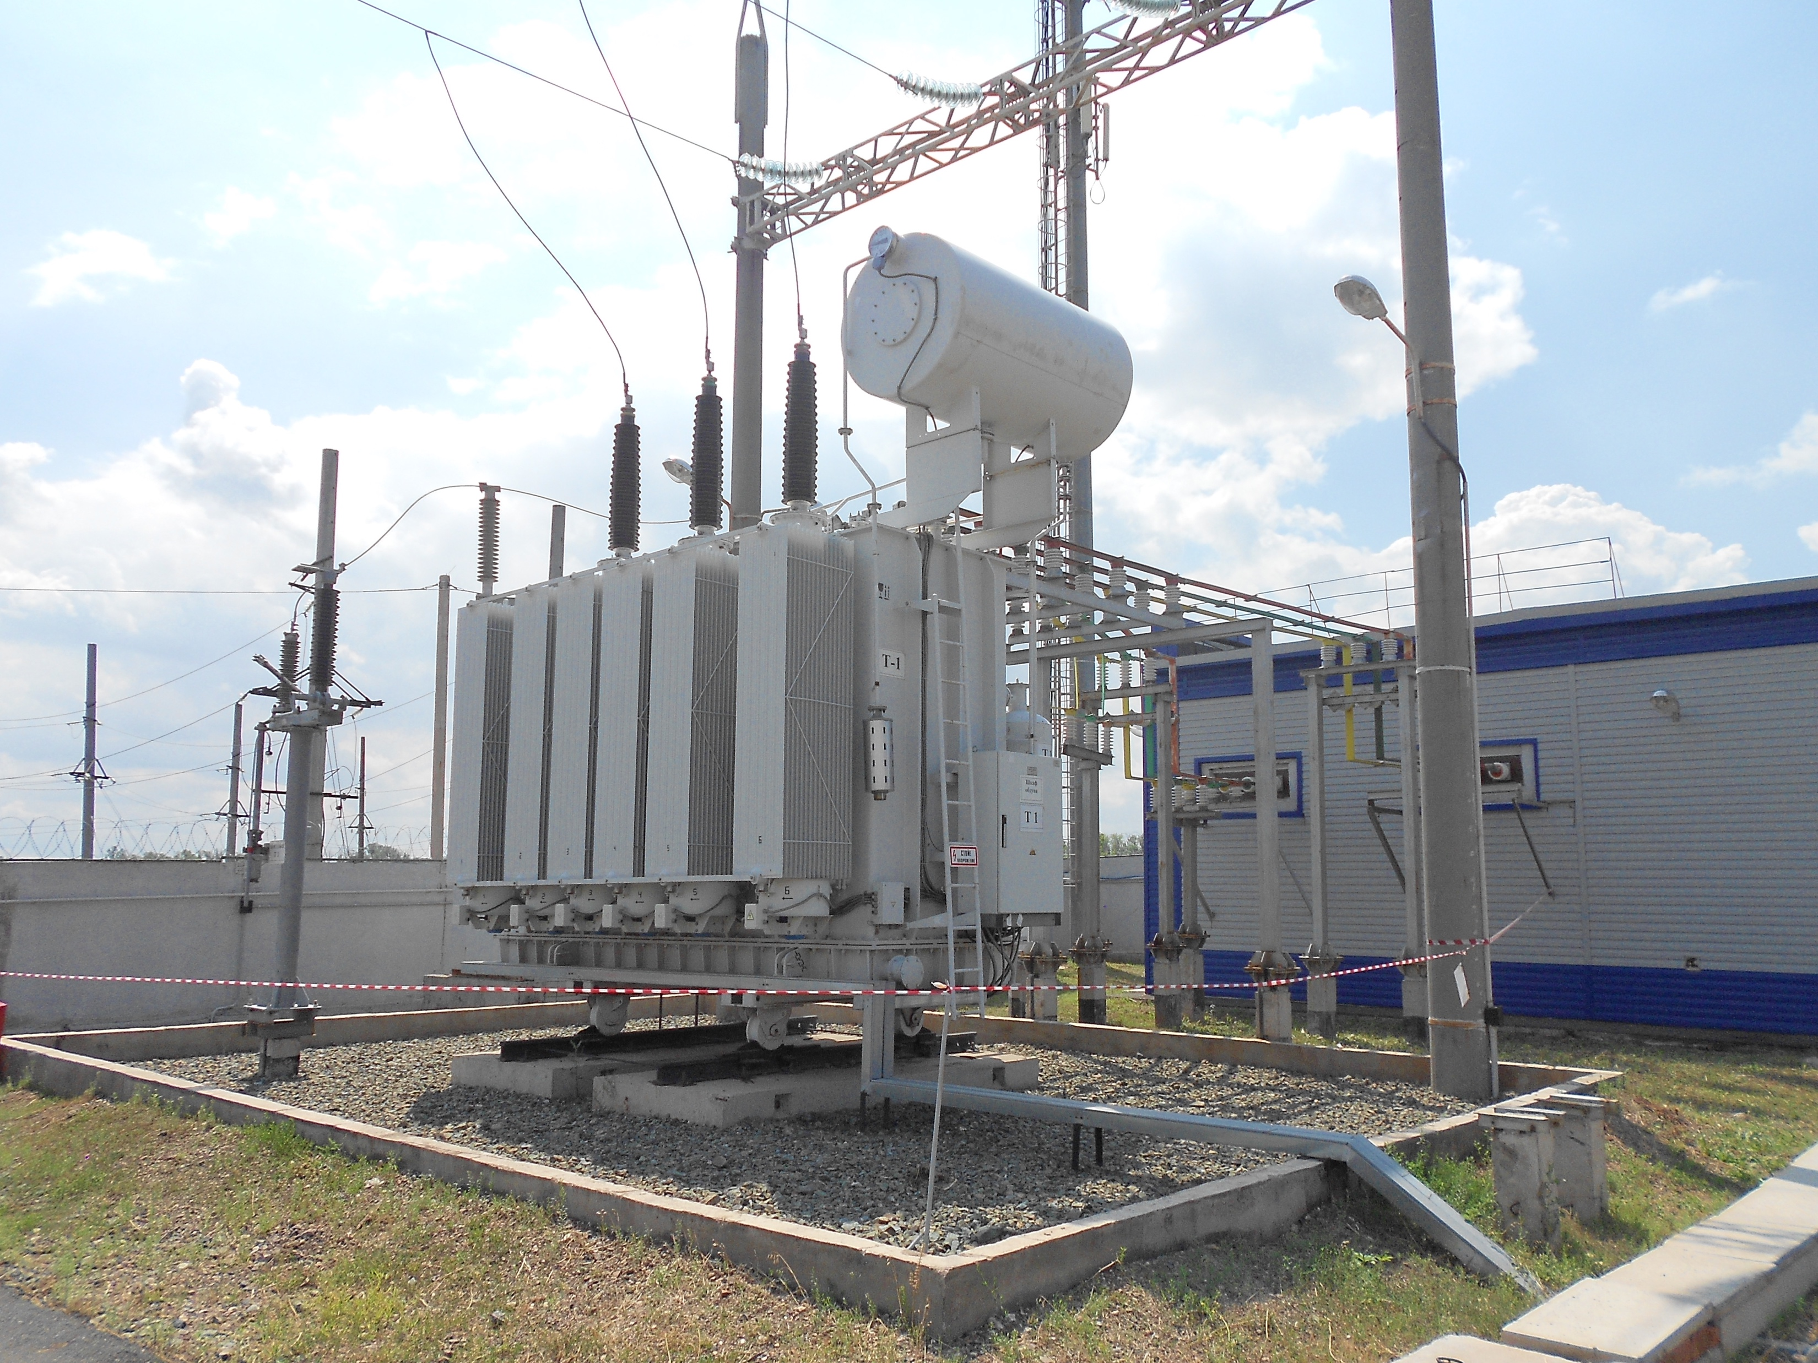
JSC "Siemens Transformers" (Voronezh, Russia)
Rated power 40 MVA
Maximum rated voltage 126 kV
Total mass with oil 52 t
Mass of oil 11 t
Shipping weight 45 t
Dimensions 5.5x3.5x5.0 m

Slide 23
Programs of technical re-equipment of the Lab electrical systems

Slide 24
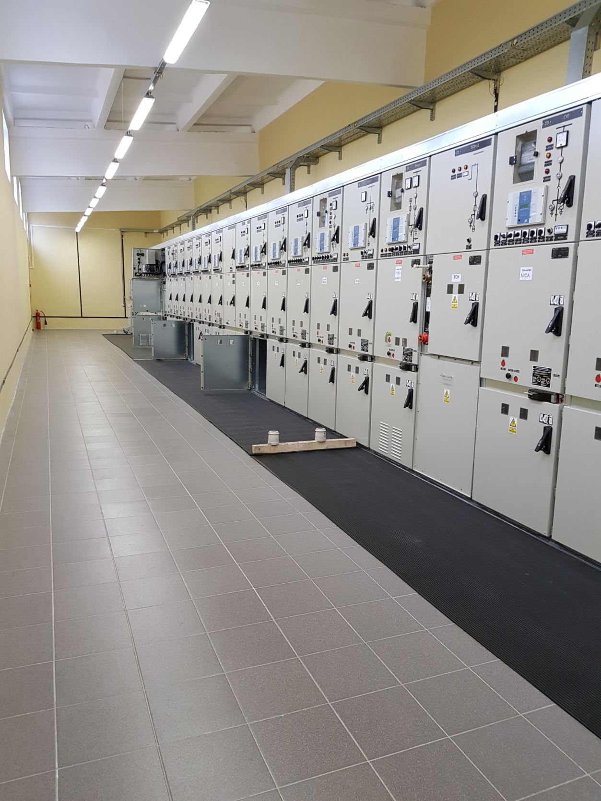
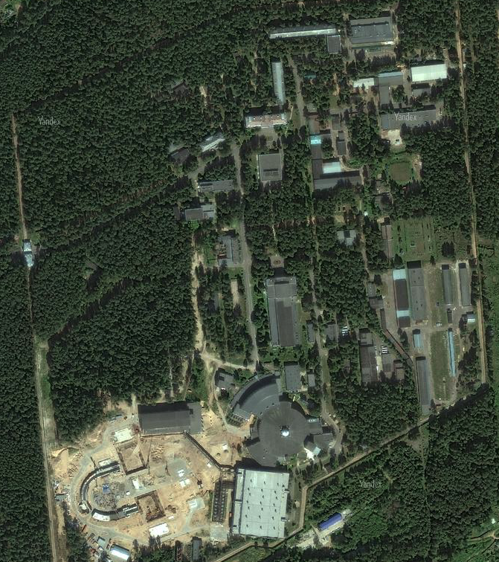
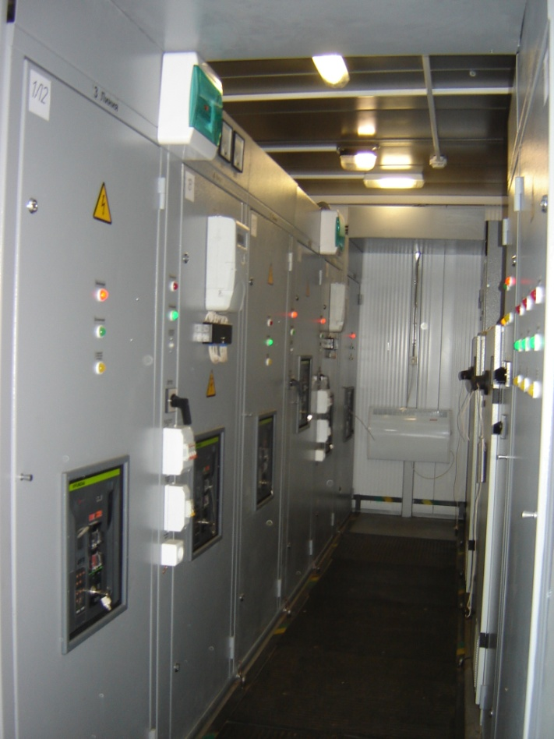
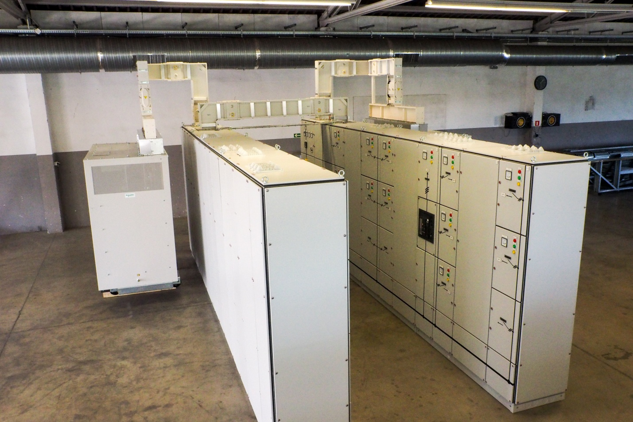
Commissioned 6 kV electrical substations
Substation 13
(10,1 MW)
Substation 42
(0,8 MW)
Substation 15
Substation 11
(1,0 MW)

Slide 25
6 kV substations subject to reconstruction
Substation 42
(14 MW)
Substation 15
(8,0 MW)
Substation 15
Substation 12
(1,7 MW)

Slide 26
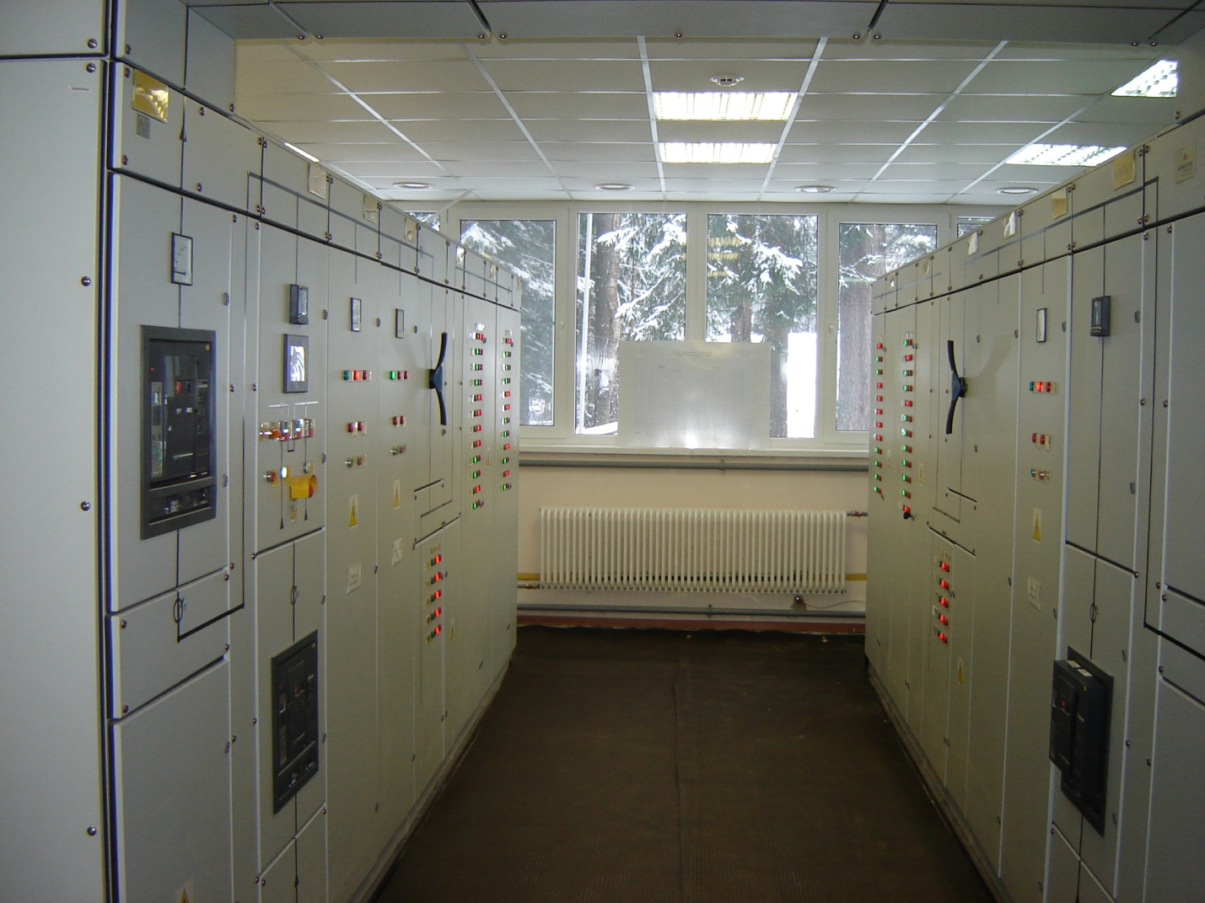
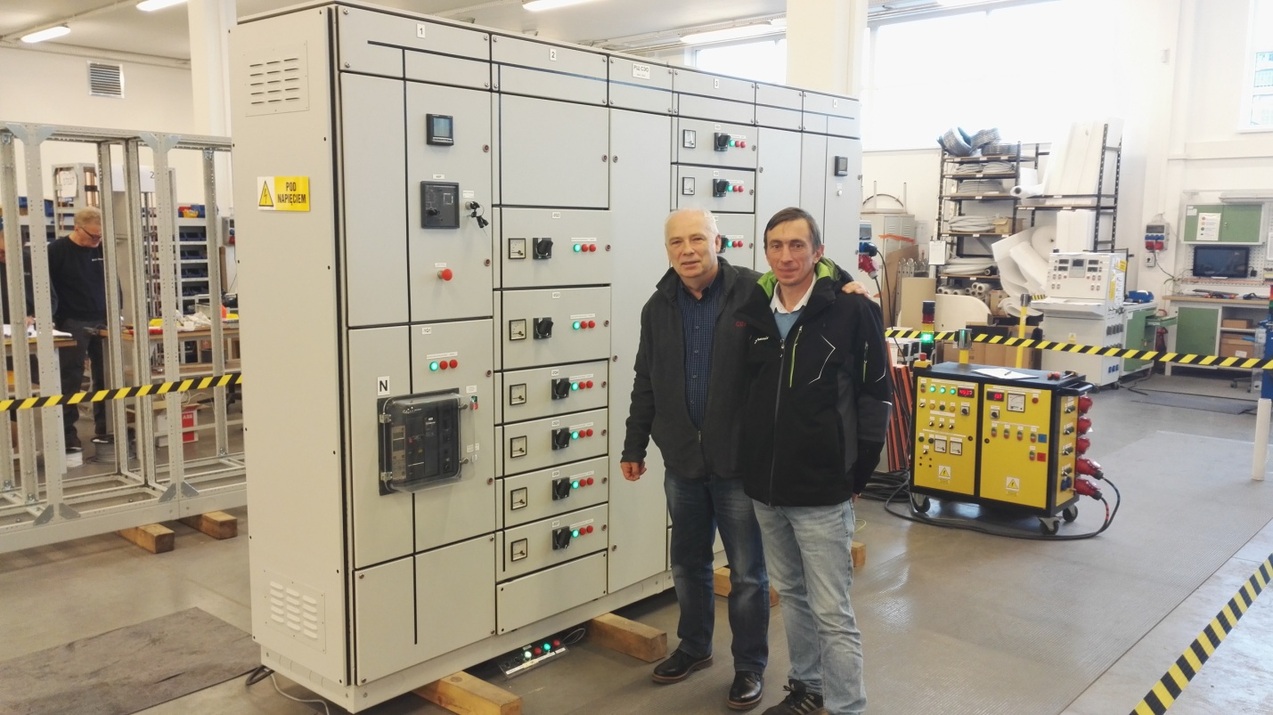
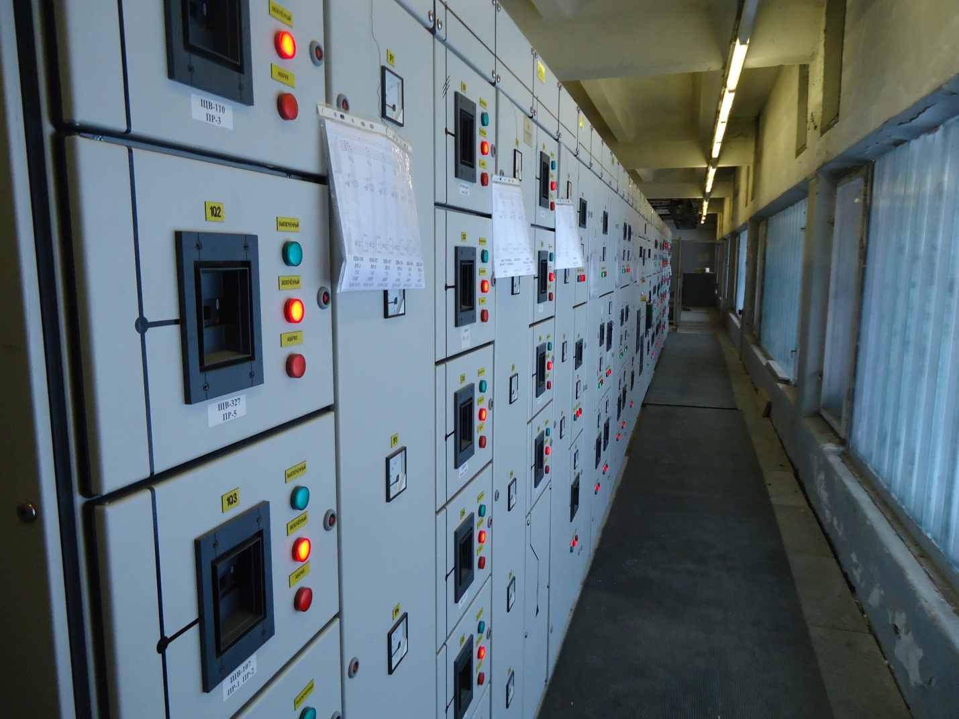
New switchboards
Switchboard for 216 and 217 buildings
Switchboard for 216 and 217 buildings
Switchboard for electron cooling system
Substation 15
Switchboard at 205 building

Slide 27
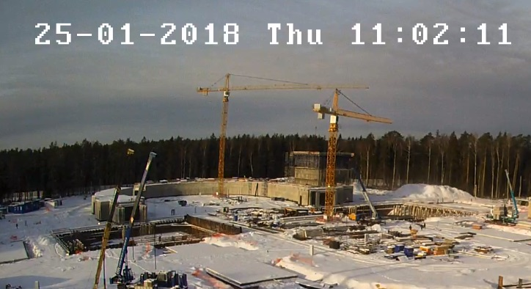
Thank you for your attention!
http://nucloweb.jinr.ru/nucloserv/205corp.htm

Slide 28
Подстанция 13
(10,1 МВт)
Подстанция 21
(14 MВт)
Подстанция 42
(0,8 МВт )
Подстнция 12
(1,7 MВт)
Подстанция 15
(8,0 MВт)
Substation 15
Подстанция 11
(1,0 MВт)

