Slide 1
JINR grant
(#6, Flow and Global characteristics of collisions) intermediate report
Taranenko, M. Mamaev, I. Segal, V. Troshin, D. Idrisov, P. Parfenov, A. Demanov

Slide 2
Main topics of the grant:
Service work for the MPD collaboration in terms of supporting and further improving existing methods for determining centrality based on Glauber Monte Carlo and Inverse Bayes methods. Development of a common framework for centrality determination (TPC+FHCAL).
Analysis of collective flow using fully reconstructed model data for the Bi+Bi system at an energy of 9.2 GeV in the center of mass frame. Verification and validation of the new versions of heavy-ion collision models.
Development, maintenance, support and documentation of the software for the collective flow analysis in the MPD experiment, using both two- and many-particle methods. Further development of the universal QnTools package.

Slide 3
Reports in the MPD Cross-PWG in 2023 related to the grant
17.01: D. Idrisov “Centrality determination sensitivity to multiplicity cuts”
14.02: V. Troshin “FFD and FHCal comparison for flow analysis in the MPD experiment”
14.02: I. Segal “Centrality determination with Monte-Carlo sampling procedure for spectators energy”
28.03: D. Idrisov “Correlation between mean transverse momentum and anisotropic flow in models at NICA energy range”
11.07: A. Demanov “Elliptic and triangular flow for identified hadrons from the vHLLE+UrQMD for BiBi@9.2 GeV (Request 32)”
05.09: M. Mamaev “Performance study of the anisotropic flow measurements with fixed-target mode of the MPD experiment at NICA”
19.09: D. Idrisov “Centrality determination method in nuclear collisions by using hadron calorimeter”
19.09 A. Taranenko JINR grant (#6, flow and global characteristics of collisions) intermediate report1

Slide 4
Reports on the conferences and other events/Publications in 2023
INFINUM-2023 (23.02-03.03):
A. Taranenko “What we can learn from particle flow in HICs?”
P. Parfenov “The heavy-ion program at the upgraded Baryonic Matter@Nuclotron Experiment at NICA”
LomCon-2023 (24-30.08):
I. Segal “Mehods for centrality determination in heavy-ion collisions with the BM@N experiment”
P. Parfenov “Anisotropic flow and its scaling properties at Nuclotron-NICA energies”
V. Troshin “Performance of FFD detector for anisotropic flow analysis with the MPD experiment”
M. Mamaev “On the proton directed and elliptic flow in the few-GeV heavy ion collisions with BM@N”
ISHEPP-2023 (18-23.09):
A. Taranenko “Anisotropic collective ﬂow measurements from LHC to SIS”
A. Demanov “Elliptic flow fluctuations at NICA energy range”
P. Parfenov “Performance study of the anisotropic flow measurements of identified charged hadrons with fixed-target mode of the MPD experiment at NICA “
M. Mamaev “Directed and elliptic flow of protons in the heavy ion collisions at 2-4 GeV”
I. Segal “Methods for centrality determination in heavy-ion collisions based on Monte-Carlo sampling of spectator fragments “
NICA Days 2023, XII MPD Collaboration meeting (2-7.10,2023)
A. Taranenko Collective Flow in Heavy-Ion Collisions
P. Parfenov , PWG3 Summary
Publications: A special issue of Particles (ISSN 2571-712X). - 5 publications https://www.mdpi.com/journal/particles/special_issues/physics_performance

Slide 5
Main topic 1: Centrality determination in the MPD experiment using spectator energy for MC-Glauber and inverse Bayes methods

Slide 6
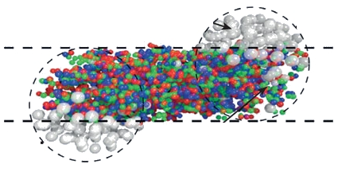
Motivation for centrality determination
Evolution of matter produced in heavy-ion collisions depends on its initial geometry
Goal of centrality determination: map (on average) the collision geometry parameters to experimental observables (centrality estimators)
Centrality class S₁-S₂: group of events corresponding to a given fraction (in %) of the total cross section:
(projectile)
spectators
participants
(target)
spectators

Slide 7
Centrality determination based on Monte-Carlo sampling
For multiplicity
of produced particles
used in HADES, CBM, BM@N, NA61/SHINE
For any spectators based observable
used in CBM, BM@N
For spectators energy from hadron calorimeters
used in NA61/SHINE
MC-Glauber
distribution
Full Monte-Carlo (real data) distribution
Get (N_{part}, N_{coll}) from MC-Glauber
Get (N_{spec}, b) from MC-Glauber
Calculate N_{a}=fN_{part}+(1-f)N_{coll}
Calculate
(A_{tot} ) - at t=∞
Sample hadron calorimeter response (S_{i}) N_{spec} times from
Gauss(μ, k)
Evaluate χ²
between dN/dE_{MC/data} and dN/dE_{Gl}
Sample (A_{frag},N_{Afrag})
for (A_{tot}, N_{spec}, b)
Scan phase space of parameters to find their values for minimum of χ²
Sample multiplicity of produced particles (S_{i}) N_{a} times from NBD (μ, k)
Sample (E_{frag},y_{frag})
for (A_{frag})
Sample S_{frag} for (E_{frag},y_{frag})
Result: total S_{tot}
Extract relation between geometry parameters and centrality estimator

Slide 8
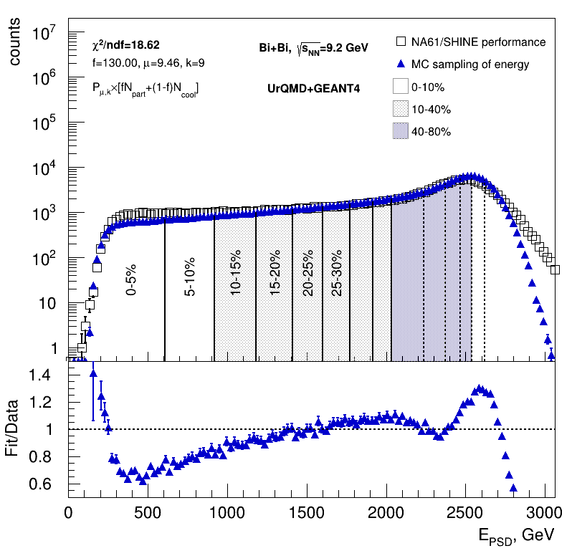
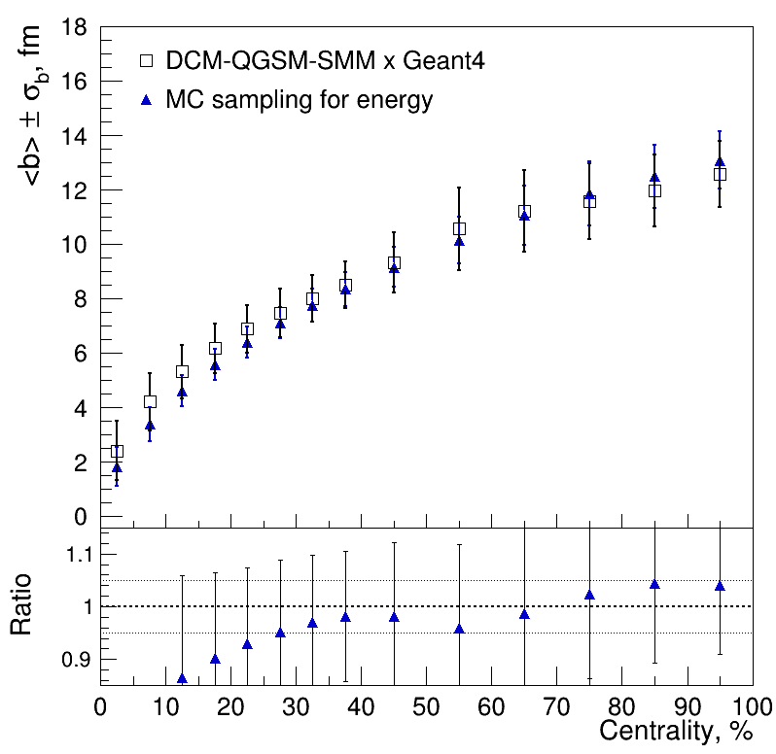
Simplified MC sampling for hadron calorimeters
Pb+Pb @ 13A GeV/c
Gauss(𝜇, k) + f/N_{spec}
N_{spec} E_{PSD}
𝜒²/NDF=18.62, 𝜇=9.46, k=9, f=130
E_{min}= 200 GeV, E_{max}= 3000 GeV
NA61/SHINE performance
Pb+Pb @ 13A GeV/c
NA61/SHINE performance
Pb+Pb @ 13A GeV/c
Simplified procedure for spectators energy is tested on NA61 data
Gauss distribution can not reproduce energy distribution in the most central collisions
Possible improvements are now under investigation

Slide 9
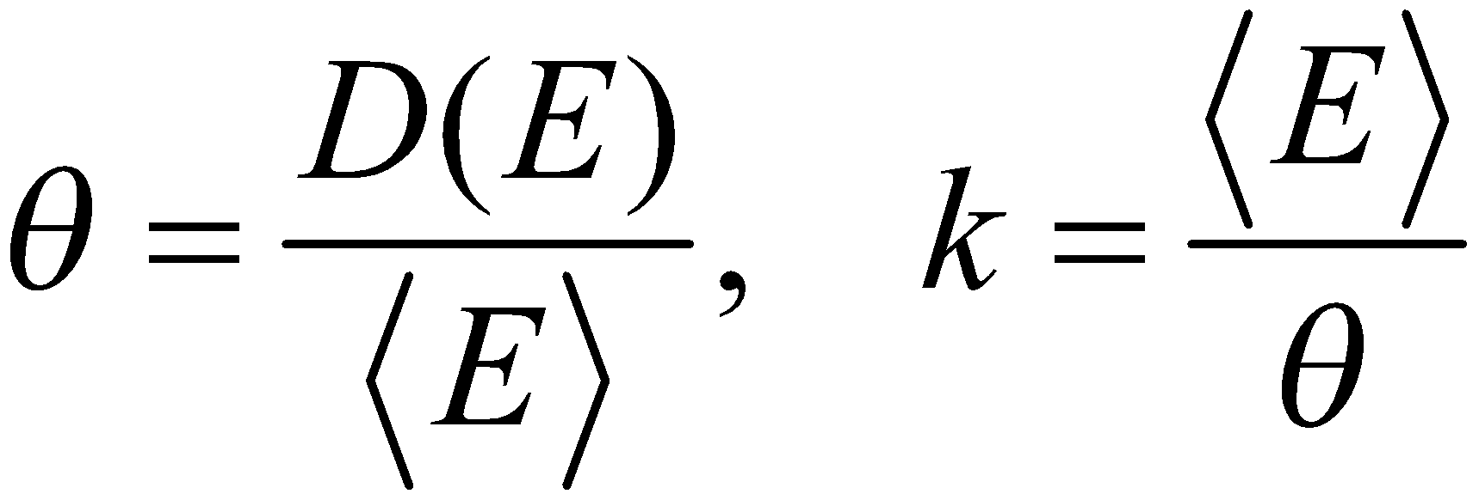
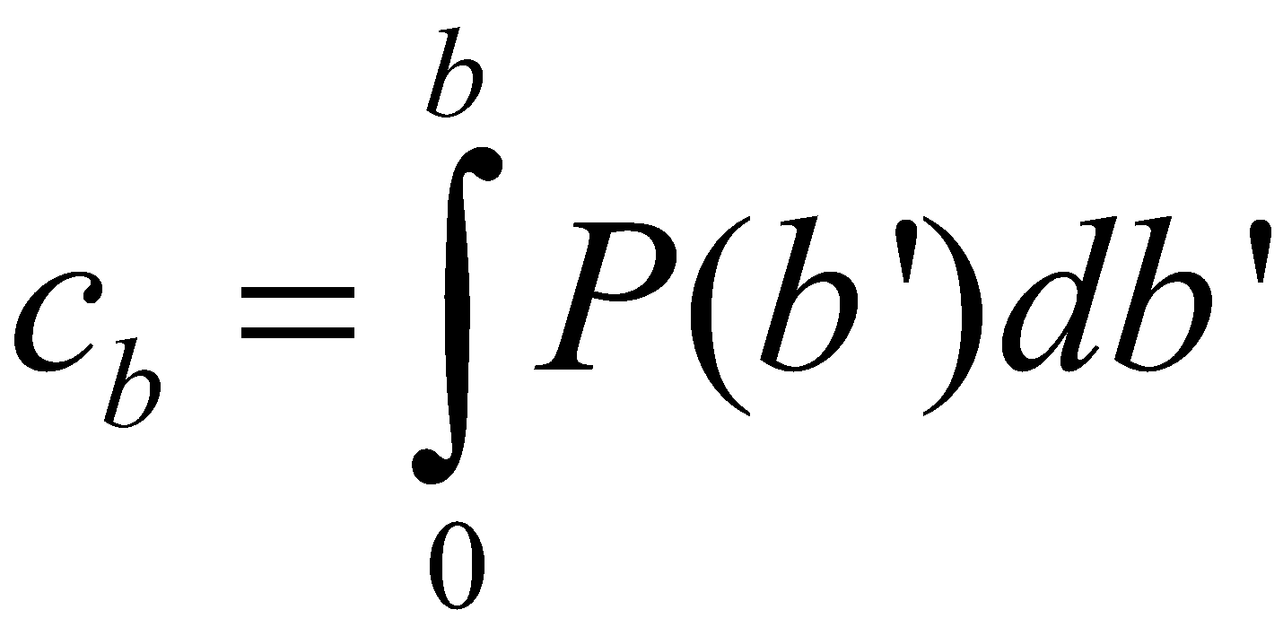
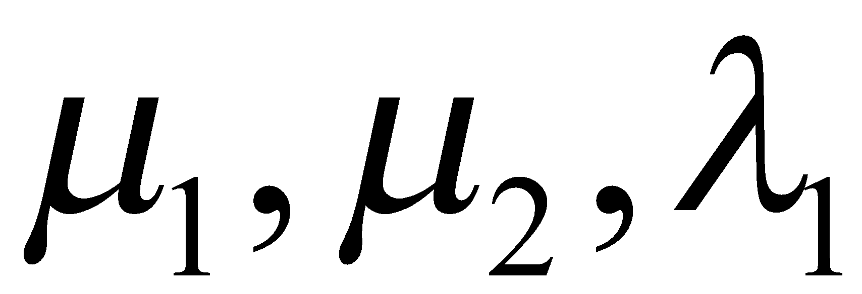
The Bayesian inversion method (Γ-fit): main assumptions
Relation between multiplicity N_{ch} and impact parameter b is defined by the fluctuation kernel:
2 main steps of the method:
Fit experimental (model) distribution with P(E)
– centrality based on impact parameter
– average value and variance of energy
Three fit parameters
Construct P(b|E) using Bayes’ theorem:
P(b|E) = P(b)P(E|b)/P(E)
– average value and variance of energy from the model
These quantities can be approximated by polynomials
Notes:
the ratio of the fluctuation to the average value is equal to a constant
In the ehd

Slide 10
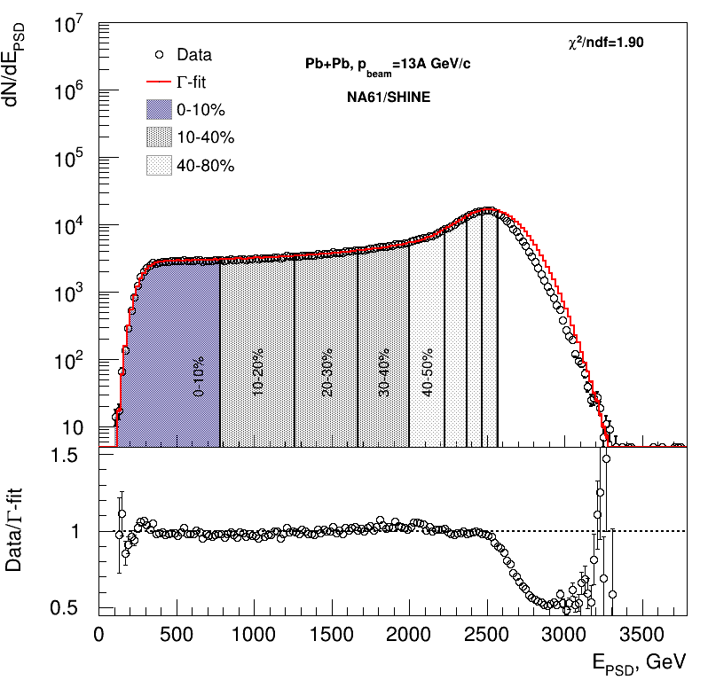
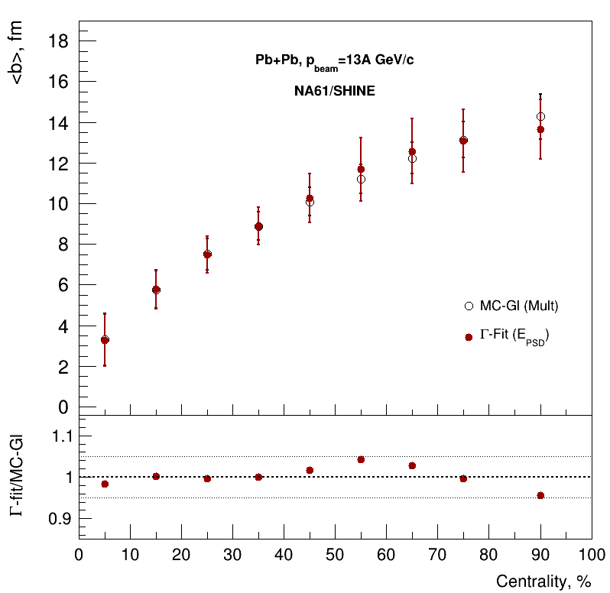
Comparison with MC-Glauber fit
There is agreement within 5%.
Good agreement between fit and data.

Slide 11
Summary for main topic 1
Software implementation of MC Glauber and Г-fit with multiplicity based fitting procedure is used for MPD
Relation between impact parameter and centrality classes is extracted
Centrality determination procedures based on MC sampling of spectators energy are developed
and tested based on NA61/SHINE data for both MC-Glauber and inverse Bayes approaches
Results are tuned on the spectator production implemented in the DCM-QGSM-SMM model
Simplified procedure for hadron calorimeters based on Gauss distribution is also proposed for MC-Glauber approach
Work in progress
Investigate the effect on centrality determination due to the fragment loss
in beam hole of the MPD FHCal
Introduce detailed parametrization for steps of centrality determination procedure
and improve current parametrization
Apply this procedure for MPD FHCal simulations

Slide 12
Main topic 2: Performance for anisotropic flow measurements using UrQMD model (req. 25) for the second collaboration paper

Slide 13
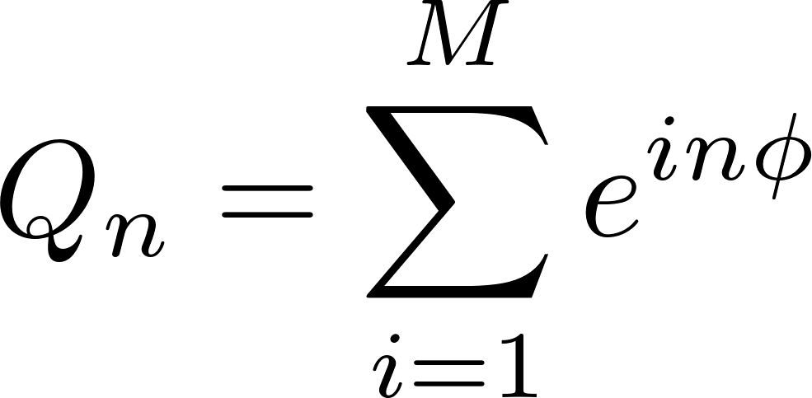
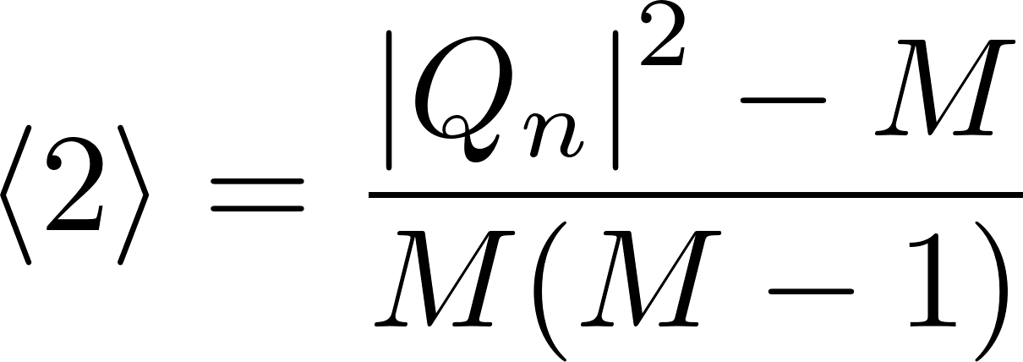
Methods for v_{n} measurements
Sub-event 2-particle Q-cumulants v2{2}: Δη=0.1 is applied between 2 sub-events A, B to suppress non-flow
4-particle Q-cumulants v2{4}
Event plane method: Δη=0.1
Here: 𝜔_{i} - p_{T,i} transverse momentum of the i-th track in the TPC
𝜑_{i} - azimuthal angle of the i-th track in the TPC
Ψ_{n}- event plane angles
Method’s details described in PRC 83 (2011), 044913 , EP method: Phys.Rev.C 77 (2008) 034904

Slide 14
Performance of v₁ (pT,y) measurements

Slide 15
Performance of v₂(pT) measurements
Results using reconstructed tracks (reco) are consistent with results obtained from MC particles (true) for both v₁, v₂ and all used methods (EP, SP, Q-Cumulants)

Slide 16
Main topic 2: Anisotropic flow measurements using vHLLE+UrQMD hybrid model (req. 32)

Slide 17
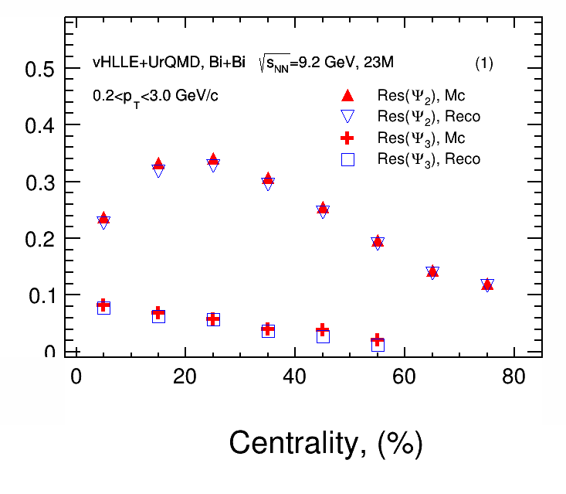
Event plane Resolution
Resolution
2 sub event: Δη=0.1
Anisotropic flow is measured as follows:
TPC
West
Δη
East
We do not measure the Ψ₃ resolution after to 60% centrality
Ψ₃ resolution are smaller than Ψ₂
Good agreement between R_{MC}(Ψ_{n}) and R_{reco}(Ψ_{n})
-1.5 0 1.5
η

Slide 18
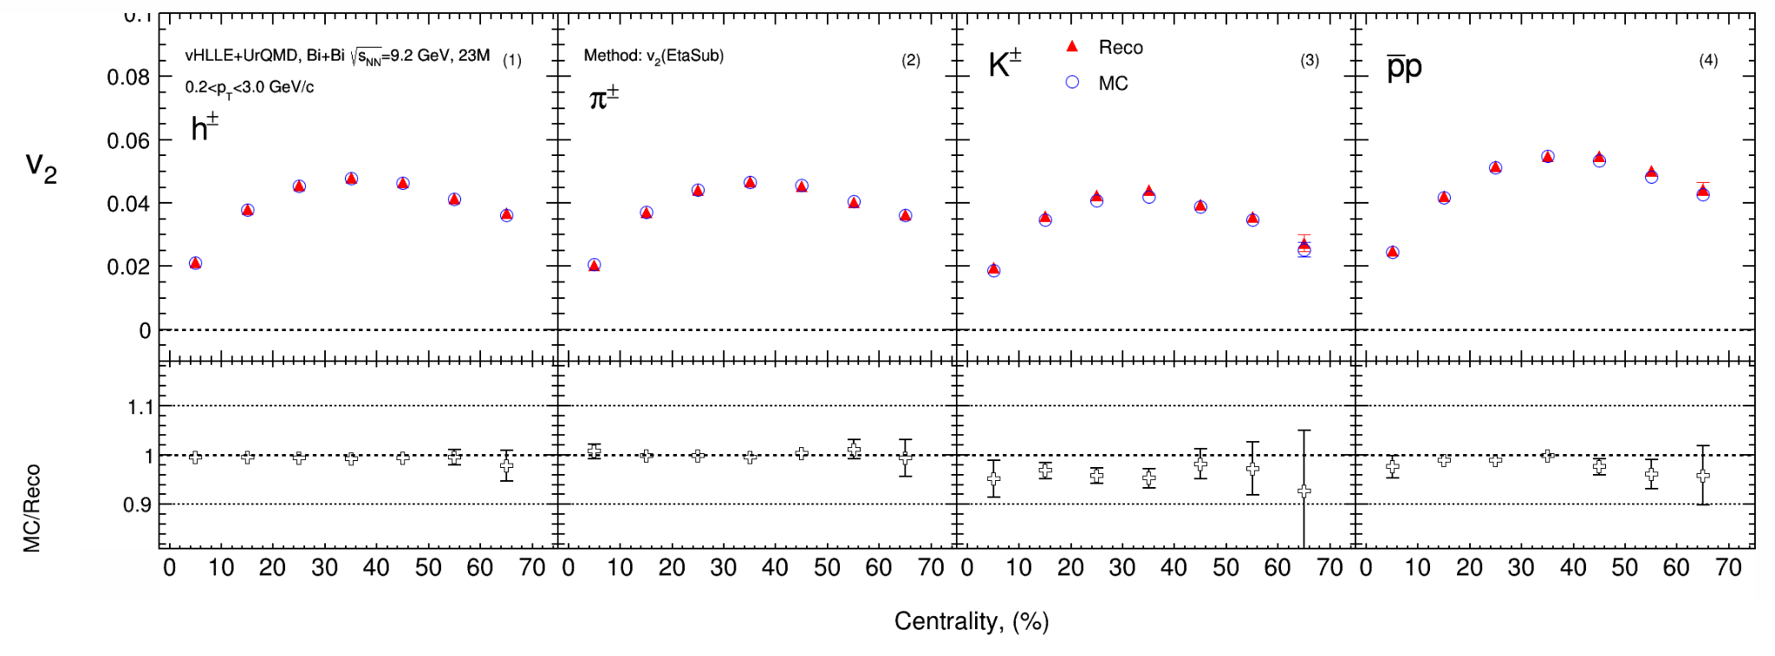
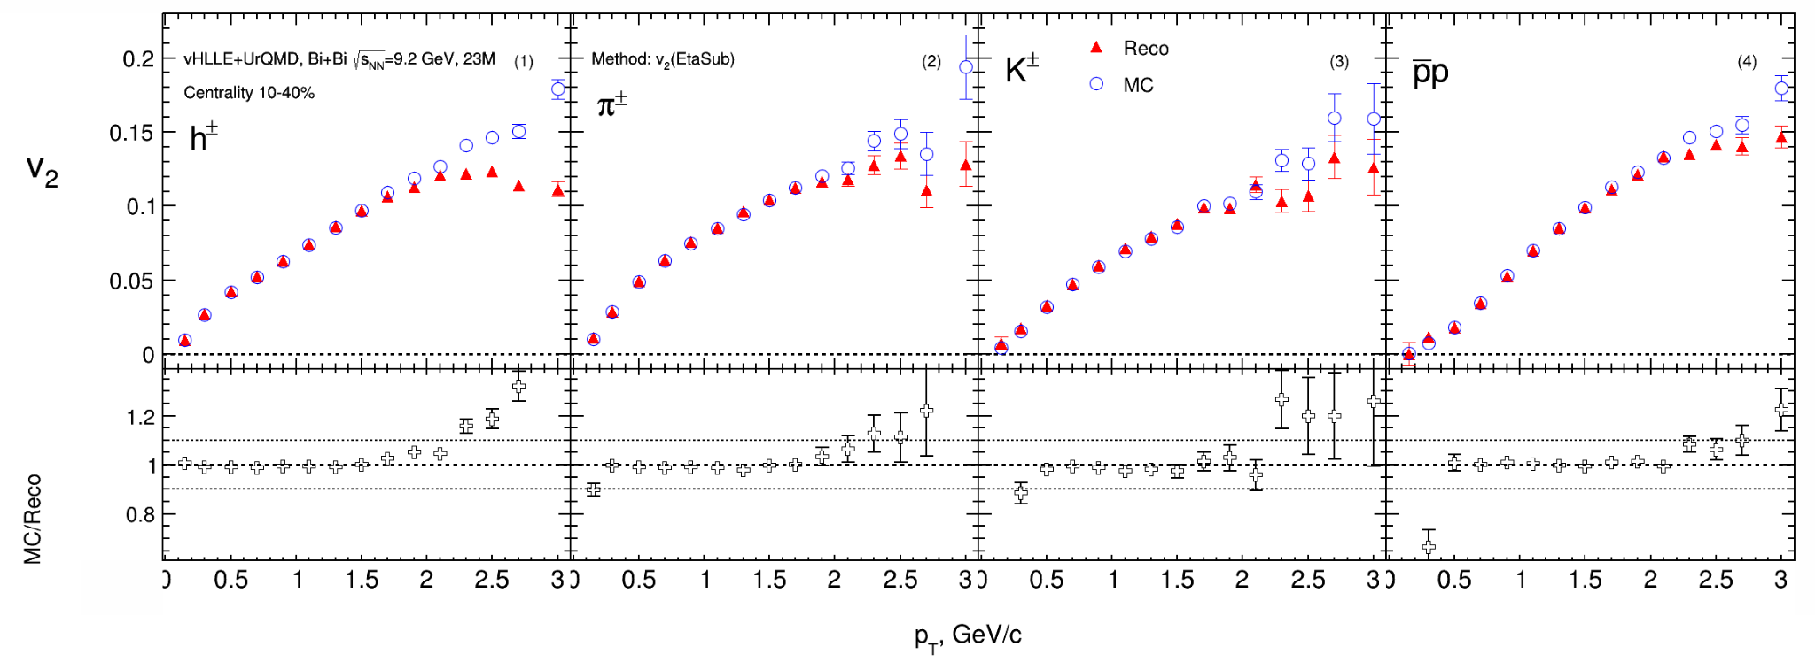
Comparison of Reco and MC: v₂ eta-sub EP
Cuts:
Charged particles only
Primary
|η|<1.5
Δ η = 0,1
p_{T} >0.2 GeV/c
|DCA|<3σ
nTPC hits ≥ 16
PID: PDG code
good agreement of the v_{2,mc} with v_{2,reco} data
The difference at large p_{T} between v_{2,mc} and v_{2,reco} (non-flow?)

Slide 19
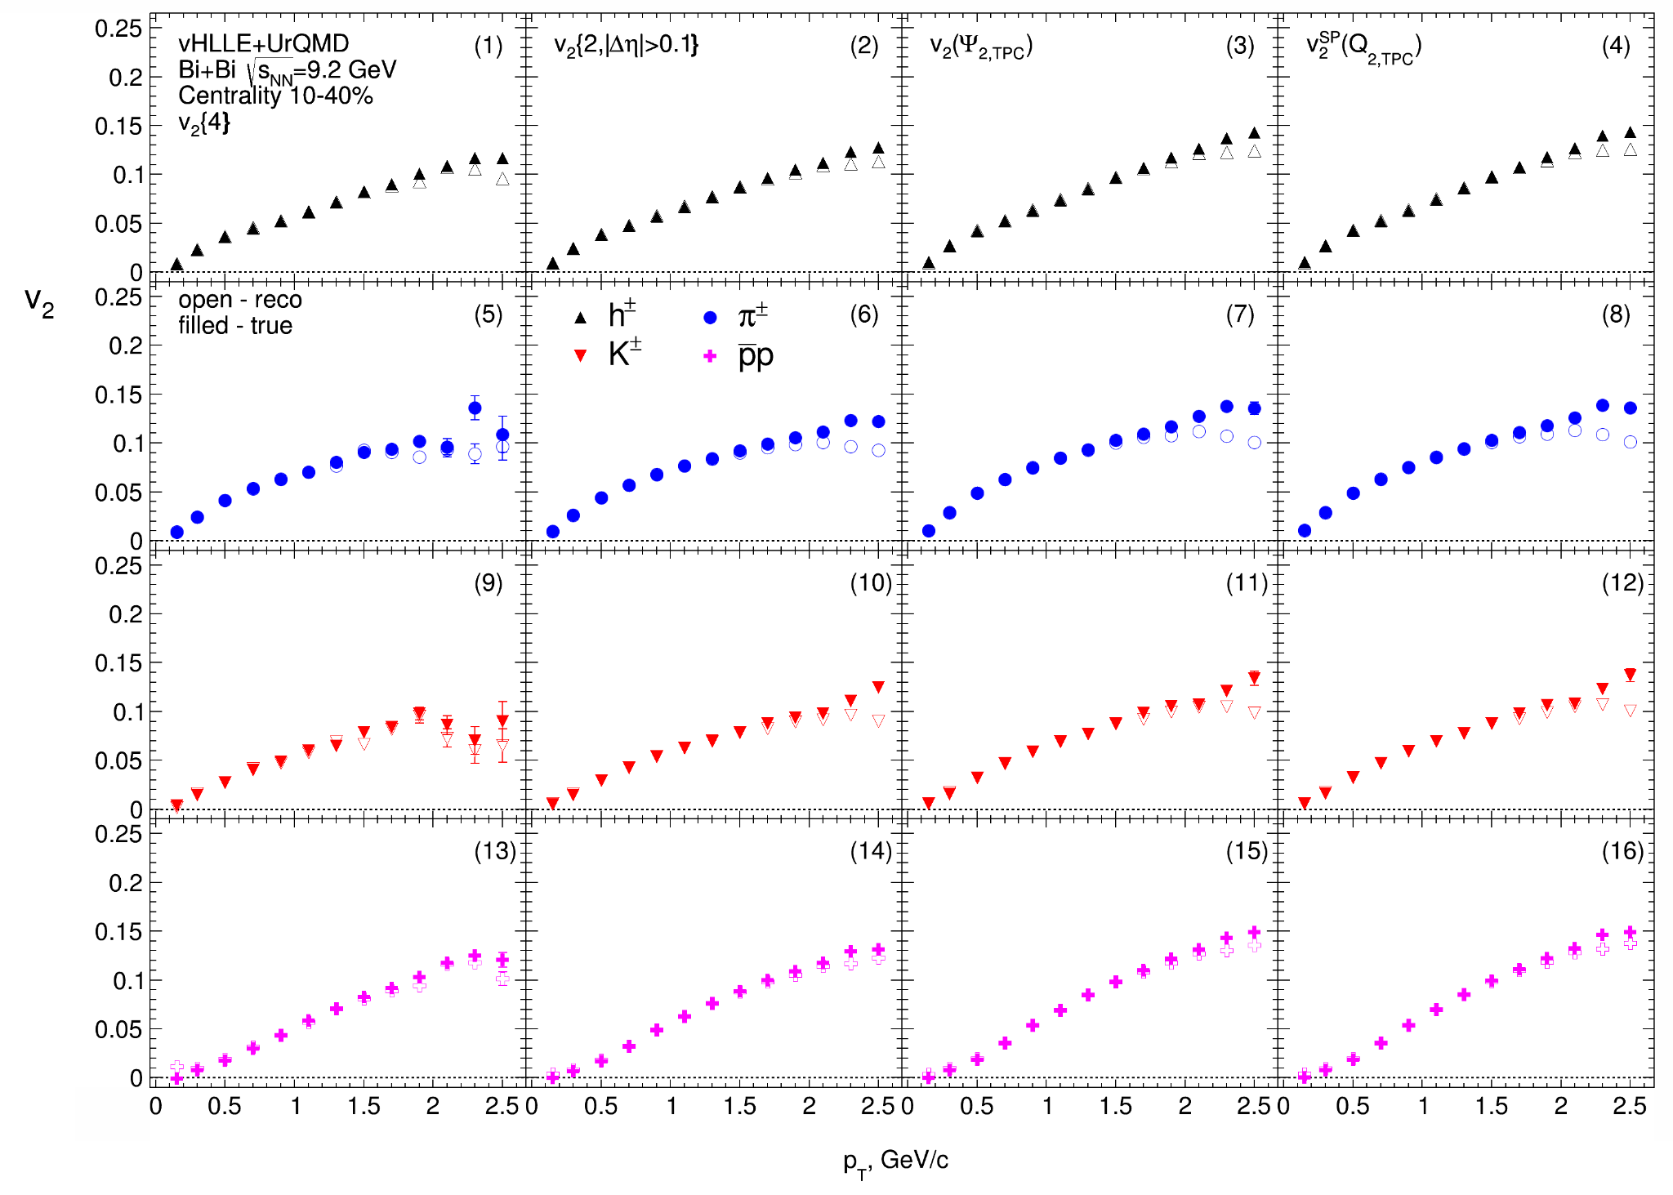
Comparison of Reco and MC: v₂ eta-sub EP
Cuts:
Charged particles only
Primary
|η|<1.5
Δ η = 0,1
p_{T} >0.2 GeV/c
|DCA|<3σ
nTPC hits ≥ 16
PID: PDG code
good agreement of the v_{2,mc} with v_{2,reco} data
The difference at highp_{T} between v_{2,mc} and v_{2,reco} (non-flow)

Slide 20
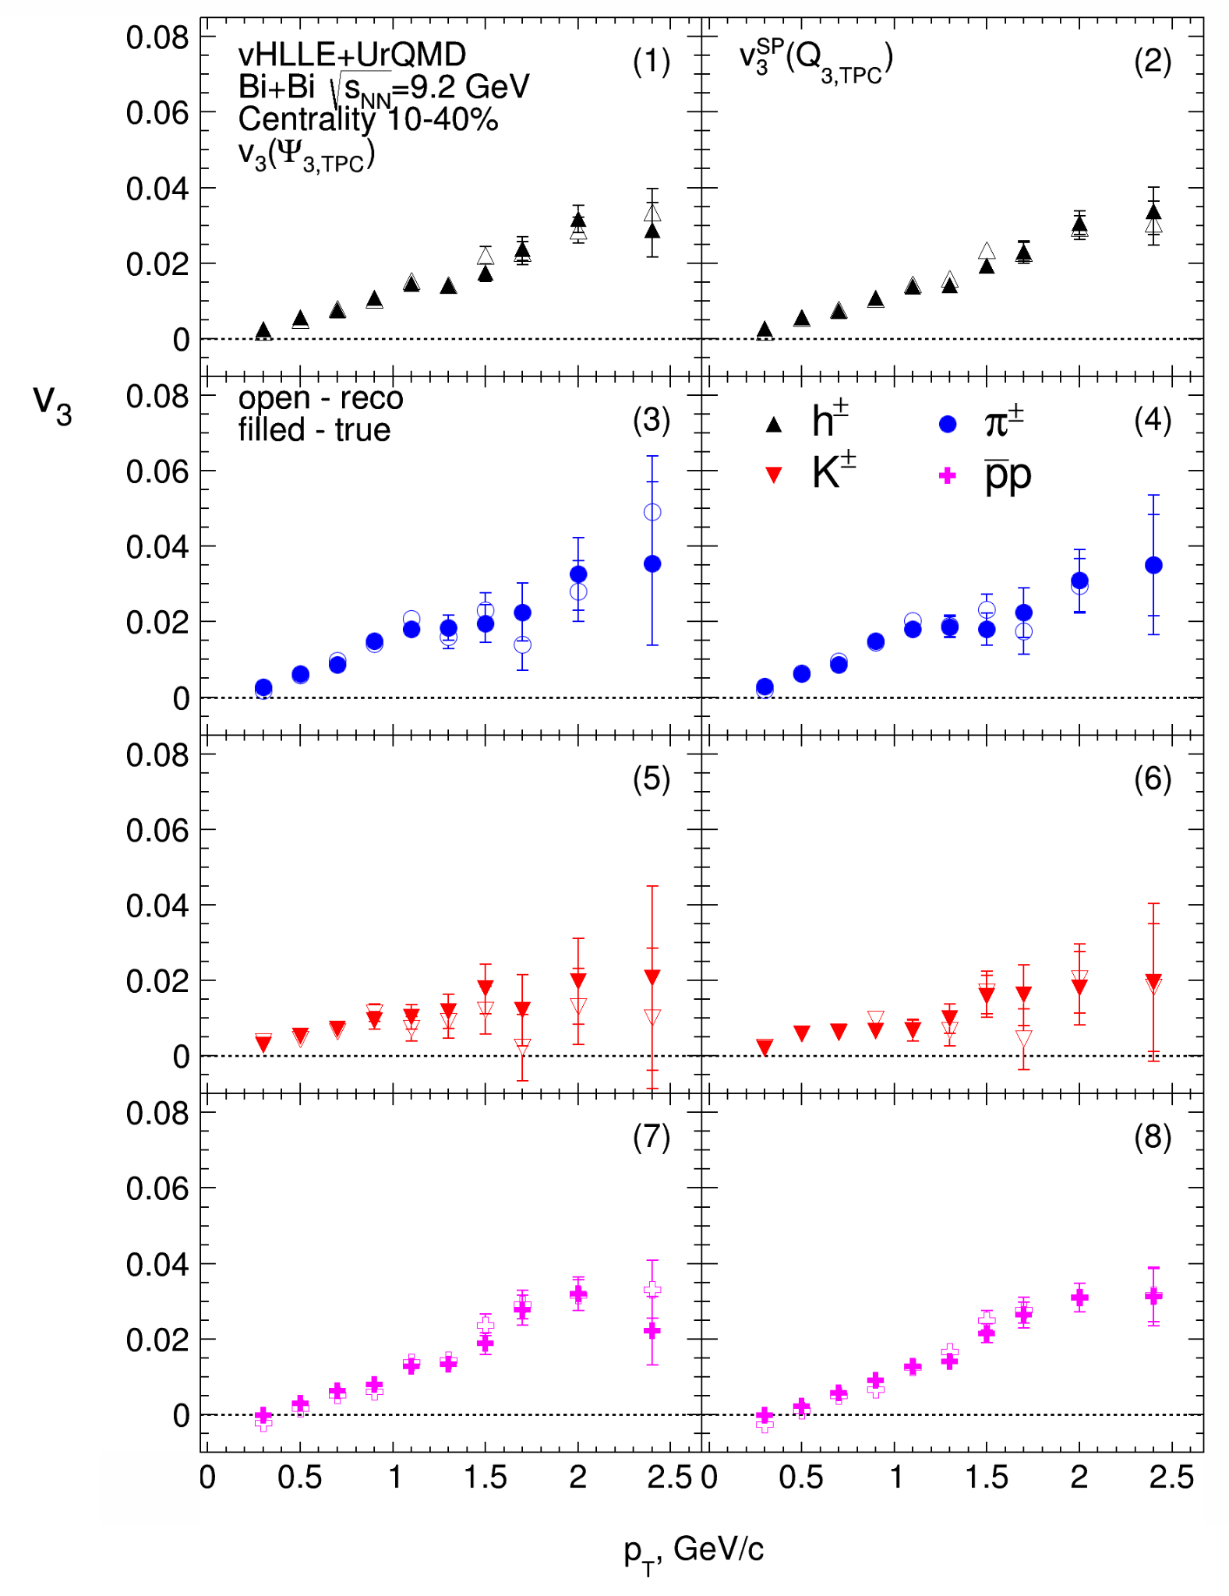
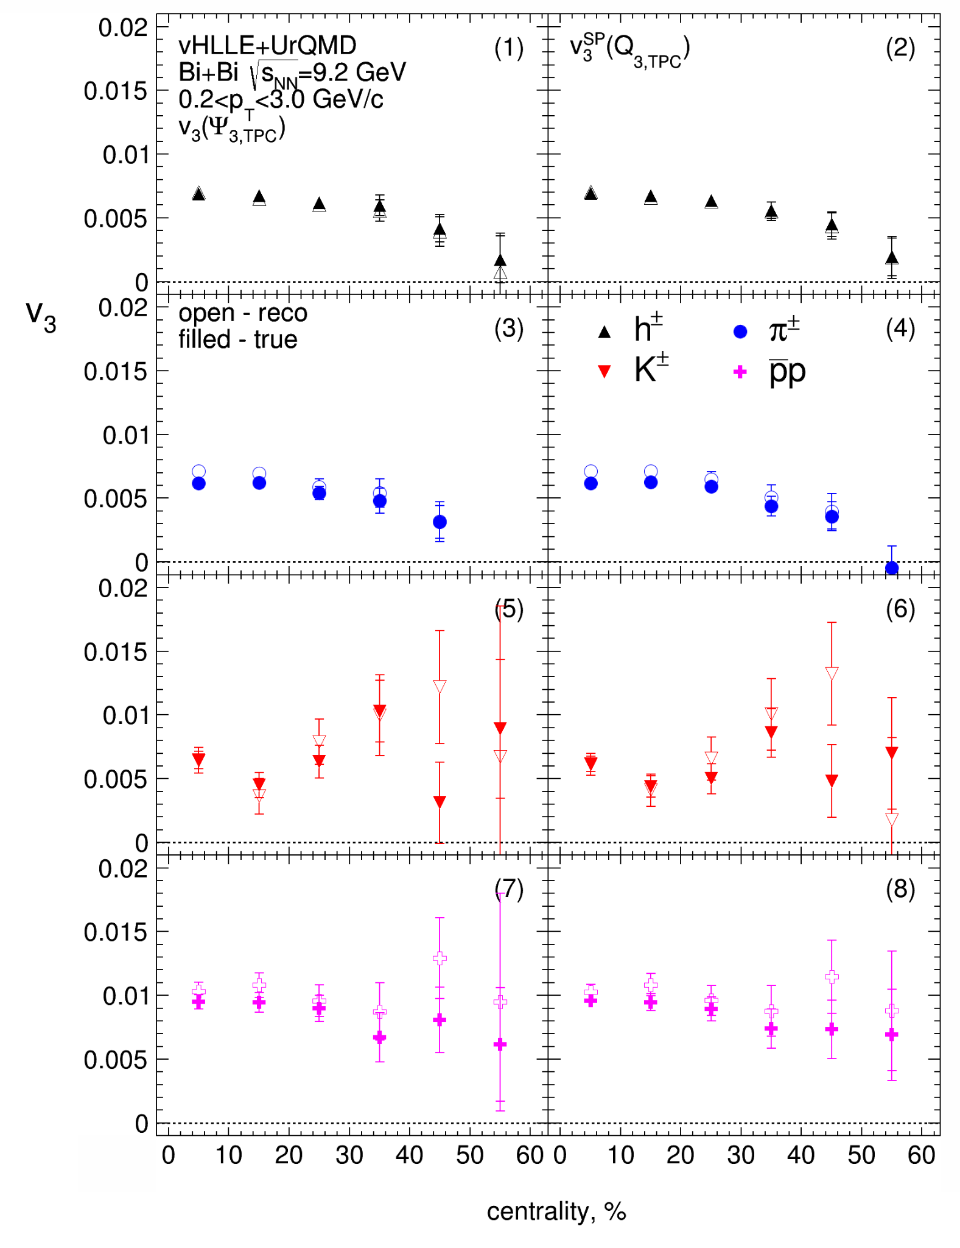
Comparison of Reco and MC: v₃ eta-sub EP
Cuts:
Charged particles only
Primary
|η|<1.5
Δ η = 0,1
p_{T} >0.2 GeV/c
|DCA|<3σ
nTPC hits ≥ 16
PID: PDG code
Good performance for $v_{3}$ measurements
More statistics needed for more precise $v_{3}$ measurements

Slide 21
Summary for main topic 2
Flow measurements for UrQMD model (req. 25):
Directed and elliptic flow measurements were done using several methods: event plane, scalar product and Q-Cumulant.
Results are ready for the second collaboration paper
Flow measurements for vHLLE+UrQMD model (req. 32):
Observed outlier events in the distribution Mult vs b - typical for this model
Centrality classes have been determined using the Inverse Bayes method. For this model, flow measurements (without cut on Mult vs b) are possible up to 50-60%
There is a good agreement between v_{2,mc} and v_{2,reco}. But there are differences at large p_{T} region - contribution from non-flow.

Slide 22
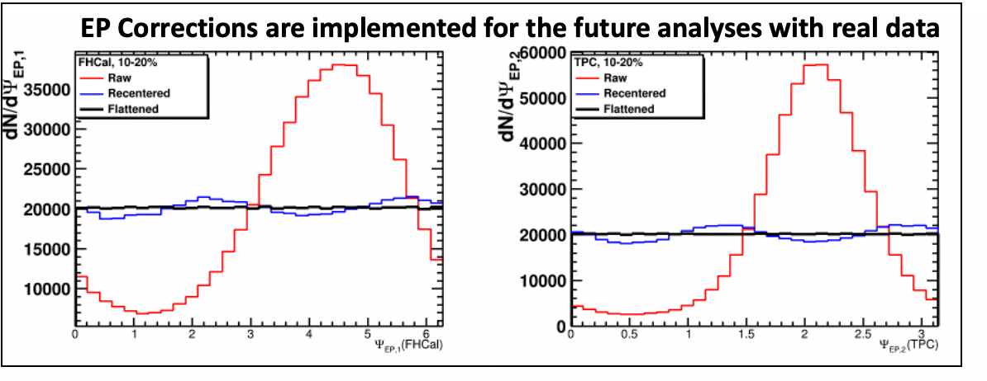
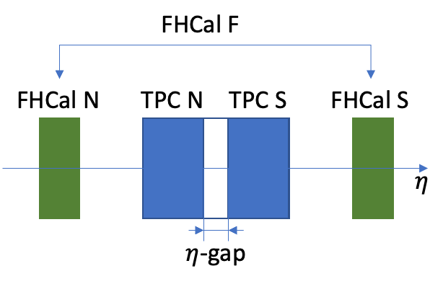
evPlane wagon for EP measurements in MPD
evPlane wagon is implemented into MPD Analysis Framework and is already being used in the collaboration
Wagon for the flow measurements (Event Plane method) is on its way

Slide 23
Main topic 3: Performance of the FFD detector in anisotropic flow measurements

Slide 24
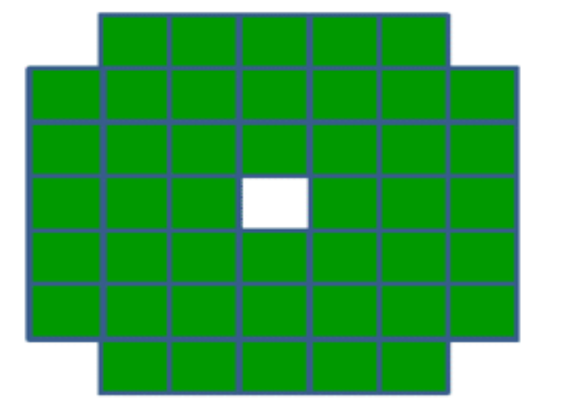
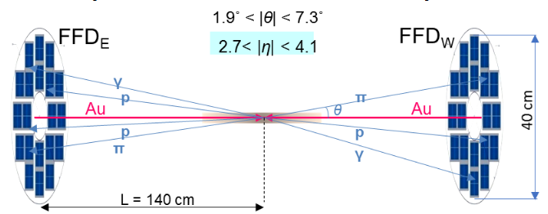
FHCal and FFD detectors
The FFD consists of two sets of Cherenkov counters located at ±140 cm from the nominal interaction point. Each set has 20 physical detectors with 4 read-out channels each. As a result, the total number of read-out channels is 2 sides 80 channels = 160 channels.
FHCal consists of two sets of hadron calorimeters in pseudorapidity region 2<|η|<5
Each set has 44 modules form azimuthal symmetry. Total number of modules 88.

Slide 25
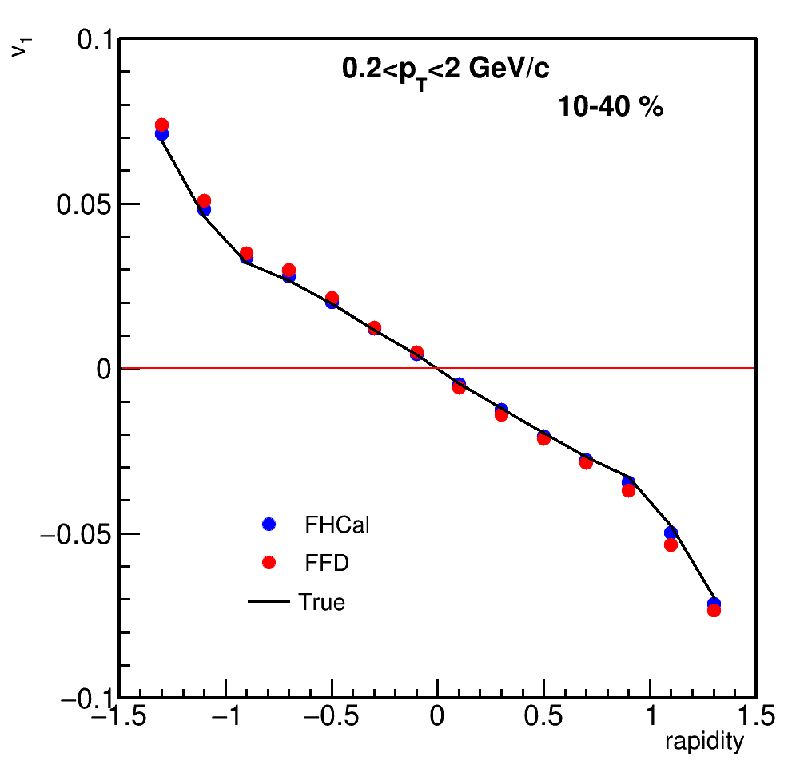
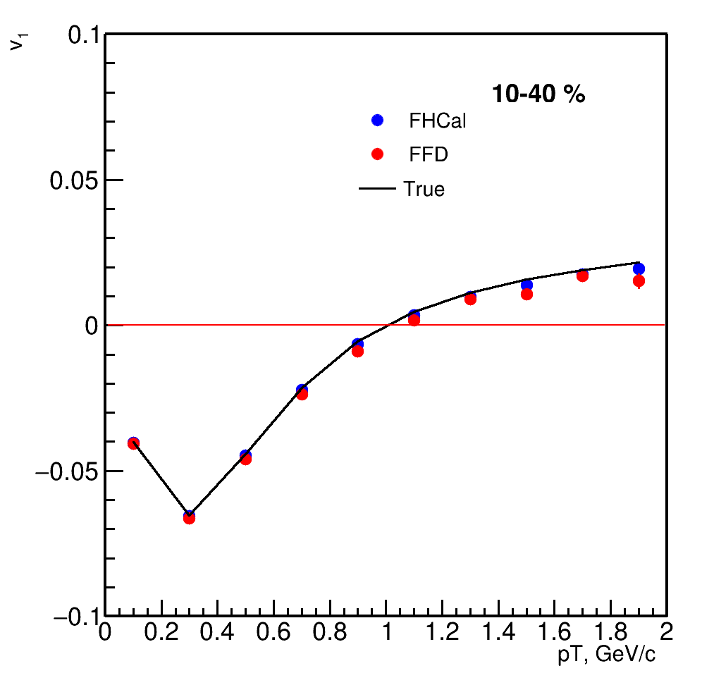
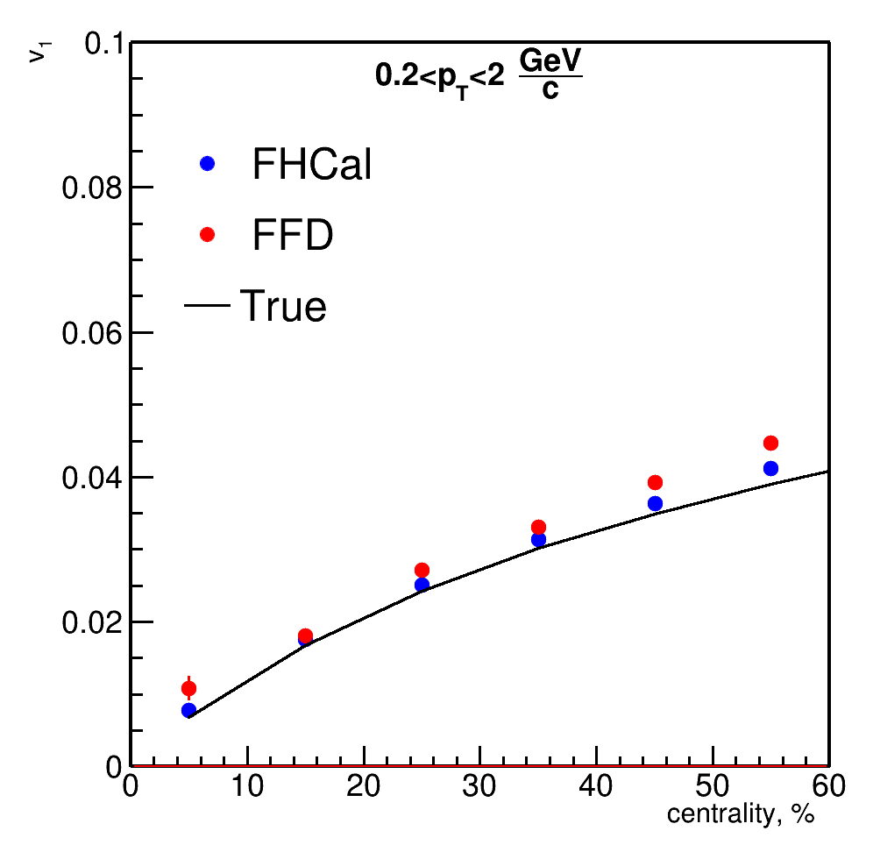
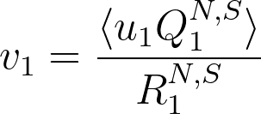
Directed flow of charged hadrons with FHCal and FFD
FHCal and FFD have consistent results; both can be used for directed flow measurements.

Slide 26
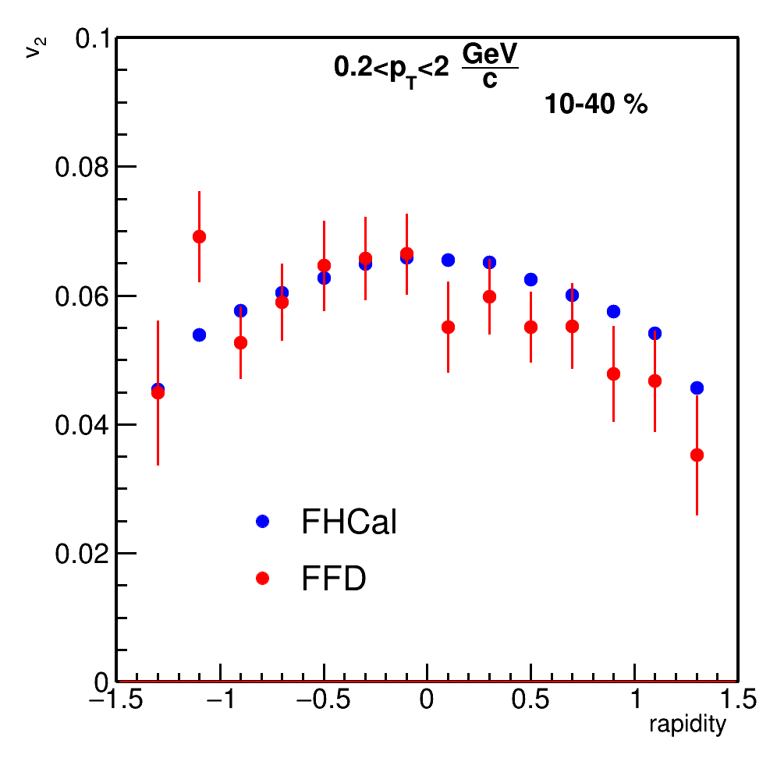
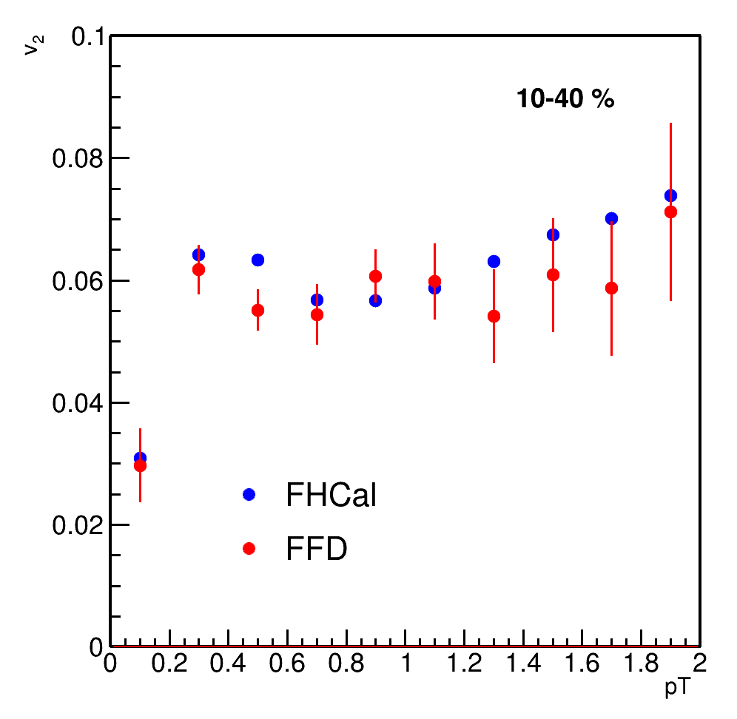
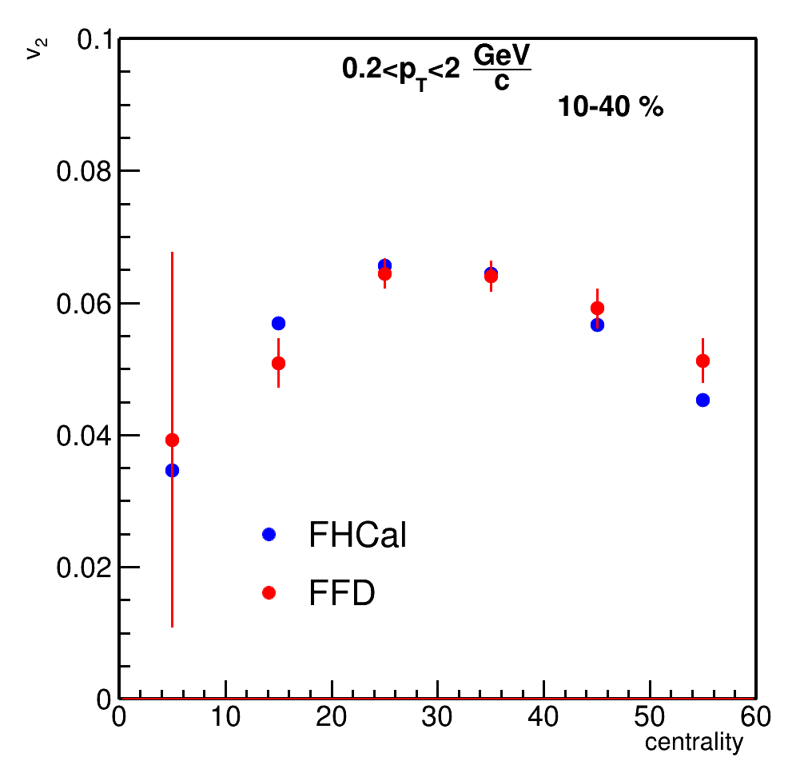
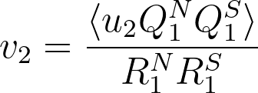
Elliptic flow of charged hadrons with FHCal and FFD
Due to low Resolution FFD need more statistics than FHCal for elliptic flow measurements.

Slide 27
Main topic 3: Performance study for the anisotropic flow measurements in the MPD experiment with the fixed-target mode (MPD FXT)

Slide 28
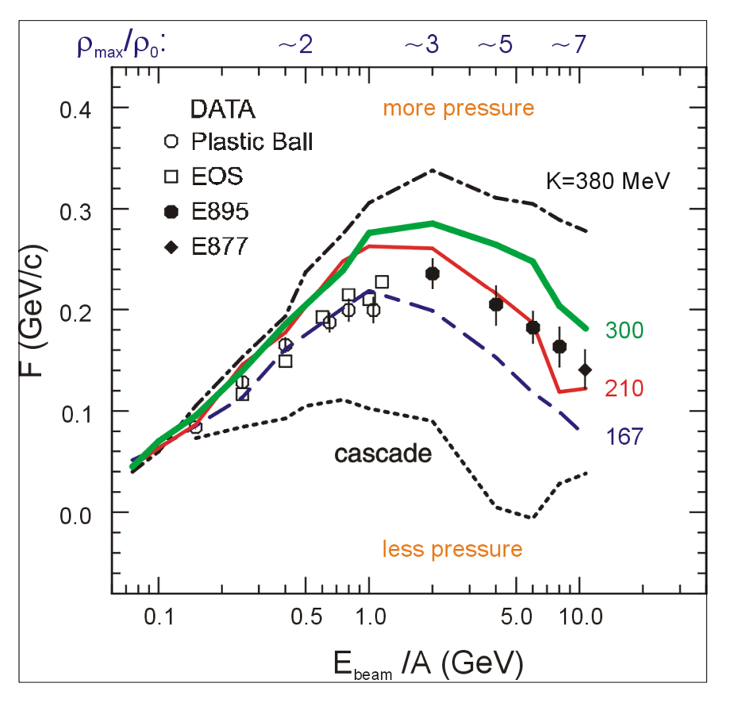
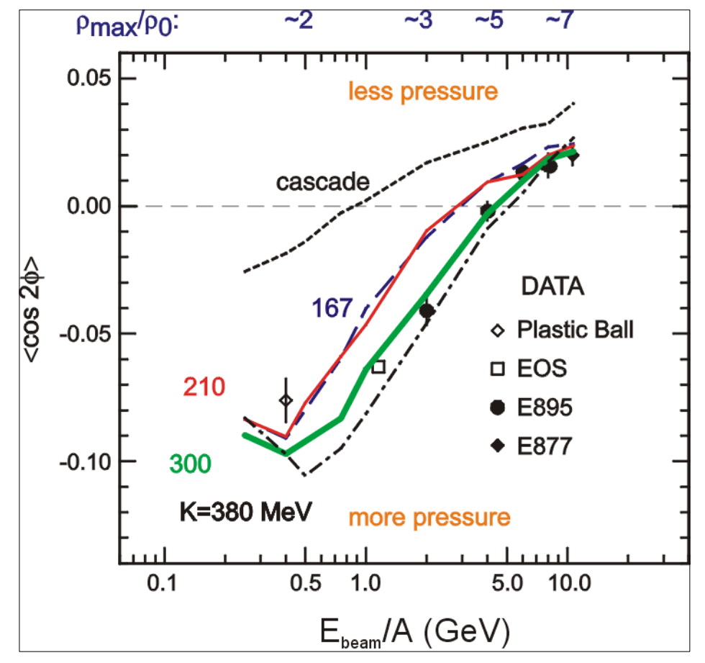
Flow performance study for MPD in fixed-target mode
MPD FXT
MPD FXT
BM@N
MPD
BM@N
MPD
P. DANIELEWICZ, R. LACEY, W. LYNCH 10.1126/science.1078070
The flow data from E895 experiment have ambiguous interpretation:
v₁ suggests soft EOS while v₂ corresponds to hard EOS
Additional measurements are essential to clarify the previous measurements
Notes:
There were measurements of collective flow in the past and the results are ambiguous to interpret
On this slide a comparison between theoretical calculations on directed and elliptic flow on energy and actual experimental data is presented. As you can see, data points are on better agreement with hard EOS in the case of v1 and for v2 the situation is opposite.
Thus we need more precise measurements to clarify the previous data

Slide 29
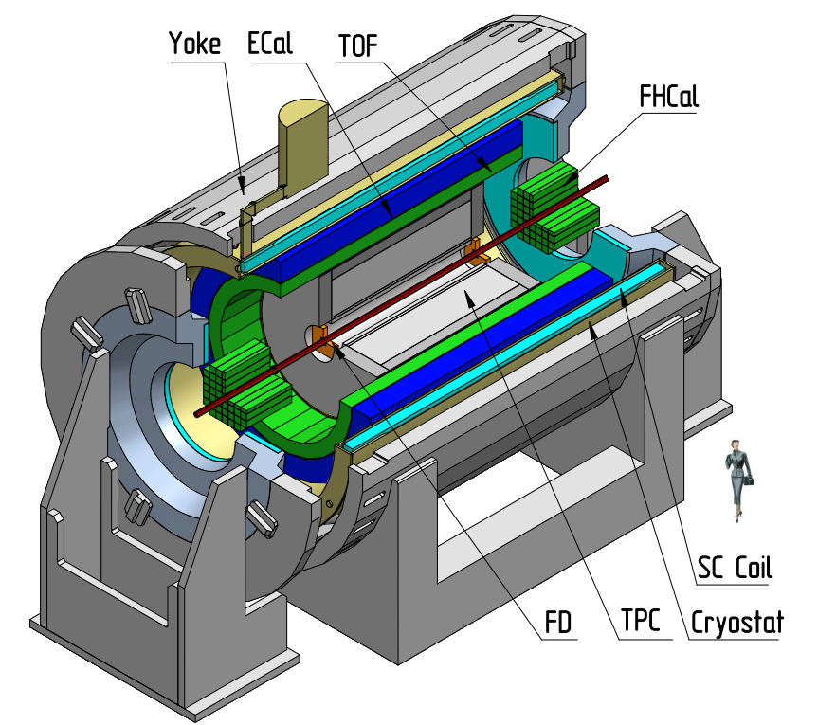
MPD in Fixed-Target Mode (FXT)
Model used: UrQMD mean-field
Bi+Bi, E_{kin}=1.45 AGeV ($\sqrt{s_{NN}}$=2.5 GeV)
Bi+Bi, E_{kin}=2.92 AGeV ($\sqrt{s_{NN}}$=3.0 GeV)
Bi+Bi, E_{kin}=4.65 AGeV ($\sqrt{s_{NN}}$=3.5 GeV)
Point-like target
GEANT4 transport
Particle species selection via true-PDG code of the associated MC particle
Beam
Target (z=-115 cm)

Slide 30
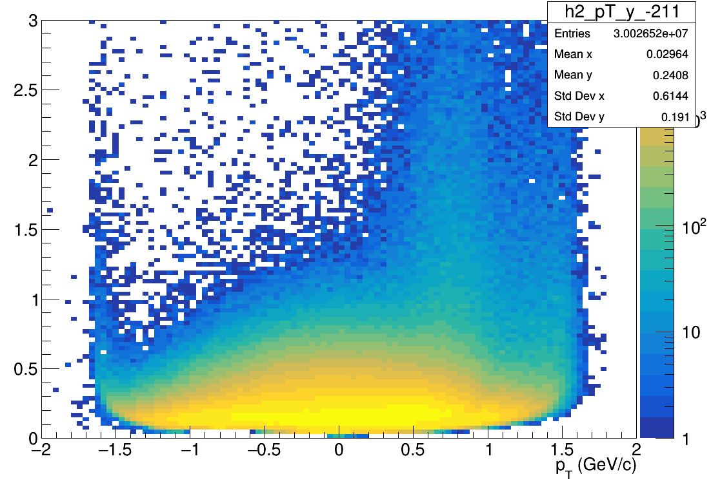
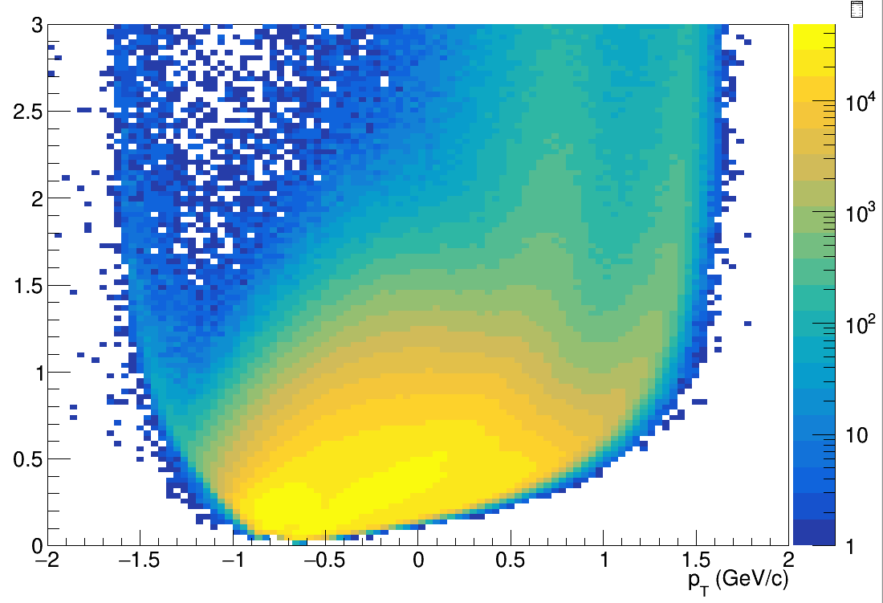
Flow vectors
F3
Q{F2}
F2
Modules of FHCal divided into 3 groups
F1
From momentum of each measured particle define a u_{n}-vector in transverse plane:
Q{F1}
Q{F3}
π-
p
where φ is the azimuthal angle
Sum over a group of u_{n}-vectors in one event forms Q_{n}-vector:
Additional subevents from tracks not pointing at FHCal:
Tp: p; -1.0<y<-0.6;
Tπ: π-; -1.5<y<-0.2;
Ψ_{n}^{EP} is the event plane angle
Notes:
Let’s introduce flow vectors. Every particle in event represent as un vector in transverse plane, where phi is azimuthal angle of particle’s momentum. Summation over this un-vectors results with Qn vector, which is directed to symmetry plane of the event. This plane is called Event plane, and the transverse angle of this plane is called event plane angle relatively.

Slide 31
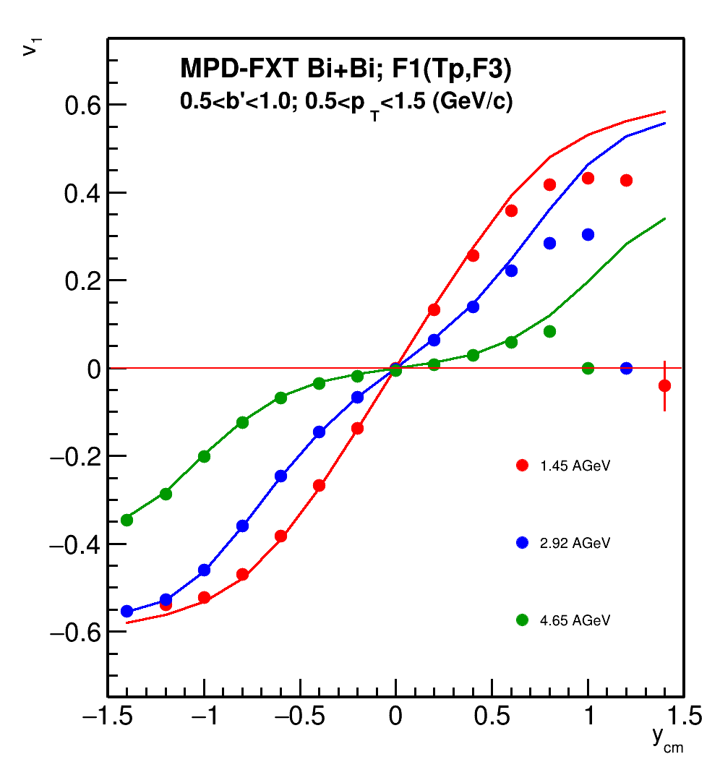
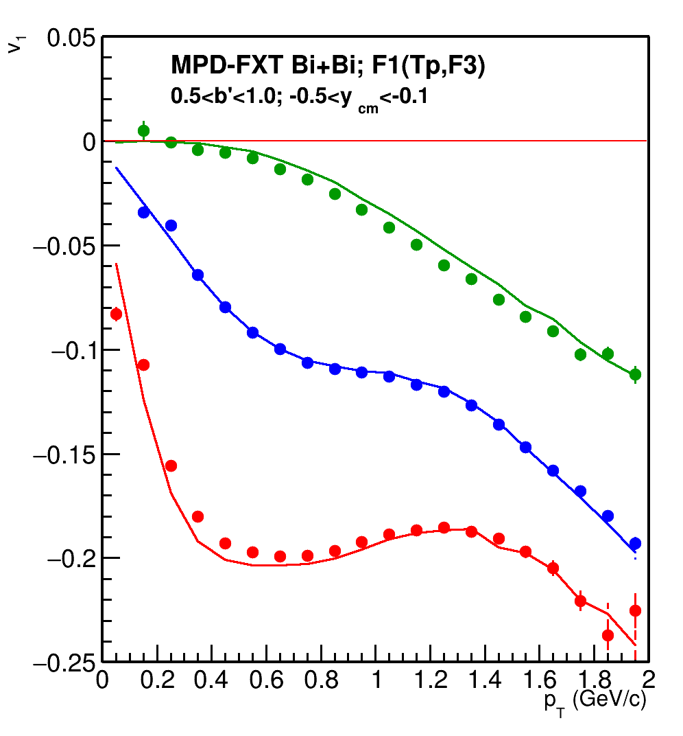
MPD-FXT: v₁ for protons
v₁ is consistent with model signal for y < 0.5
No efficiency corrections were applied yet

Slide 32
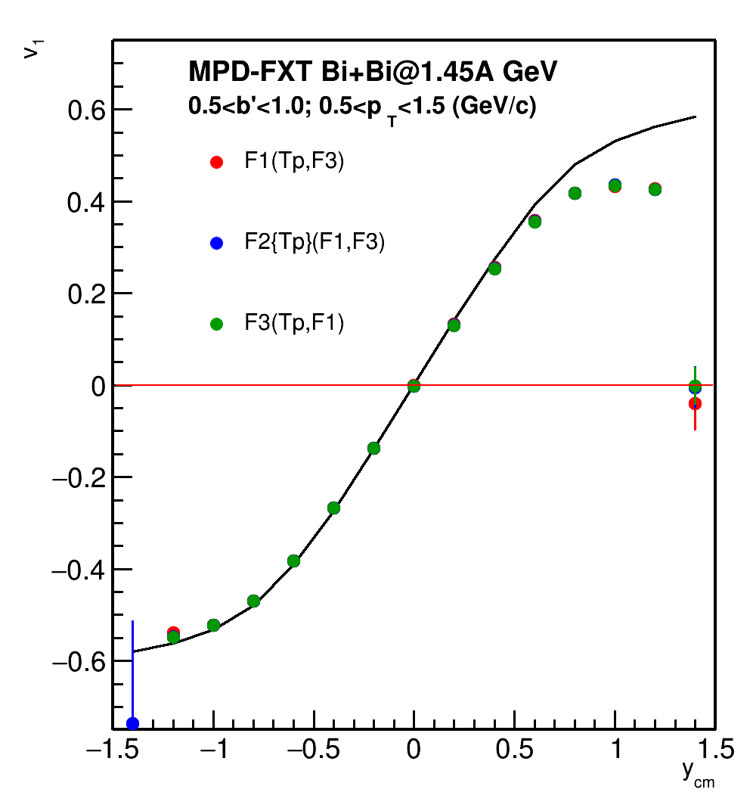
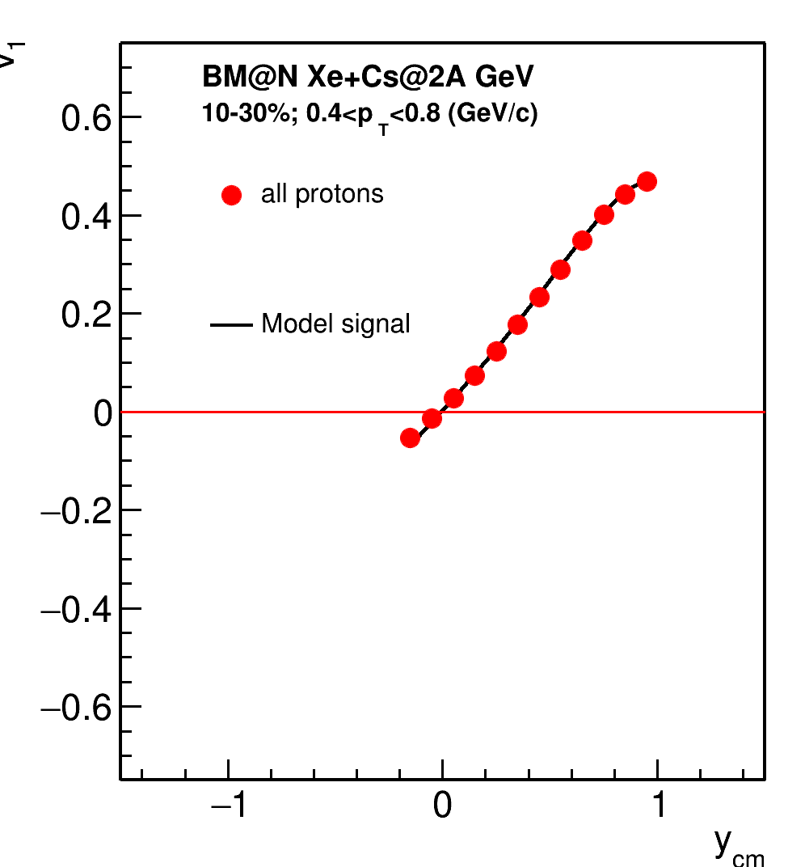
BM@N vs MPD: v₁ vs y for protons
See M.Mamaev’s talk at ISHEP-2023
and at Cross-PWG 5.09.2023
MPD has better coverage in backward rapidities and close to y_{beam}

Slide 33
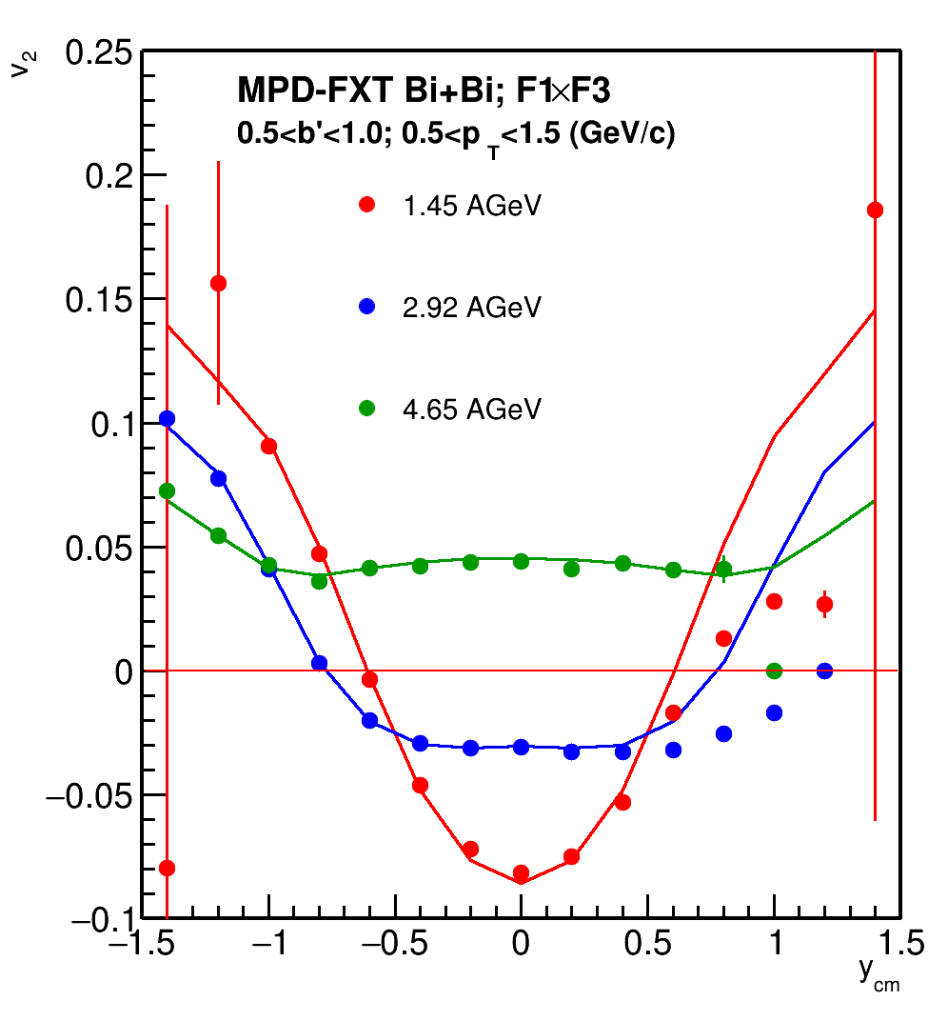
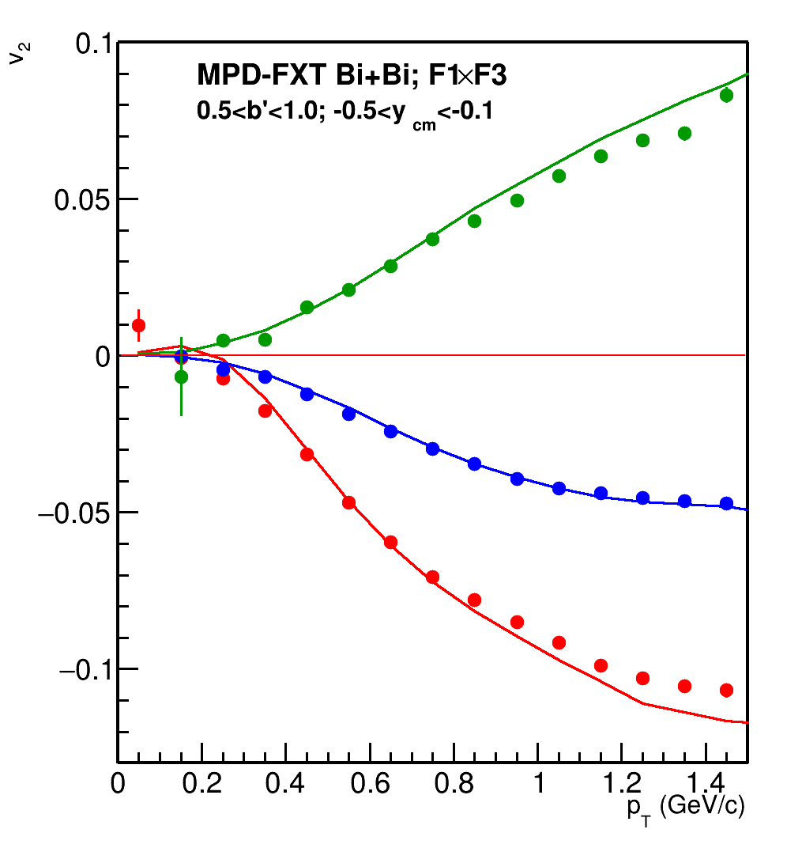
MPD-FXT: v₂ for protons
v₂ is consistent with model signal for y < 0.5
No efficiency corrections were applied yet

Slide 34
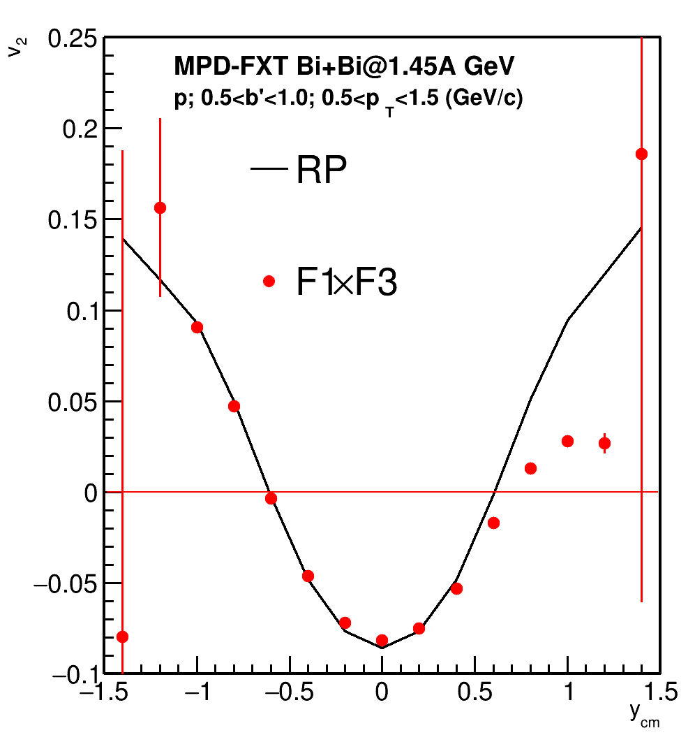
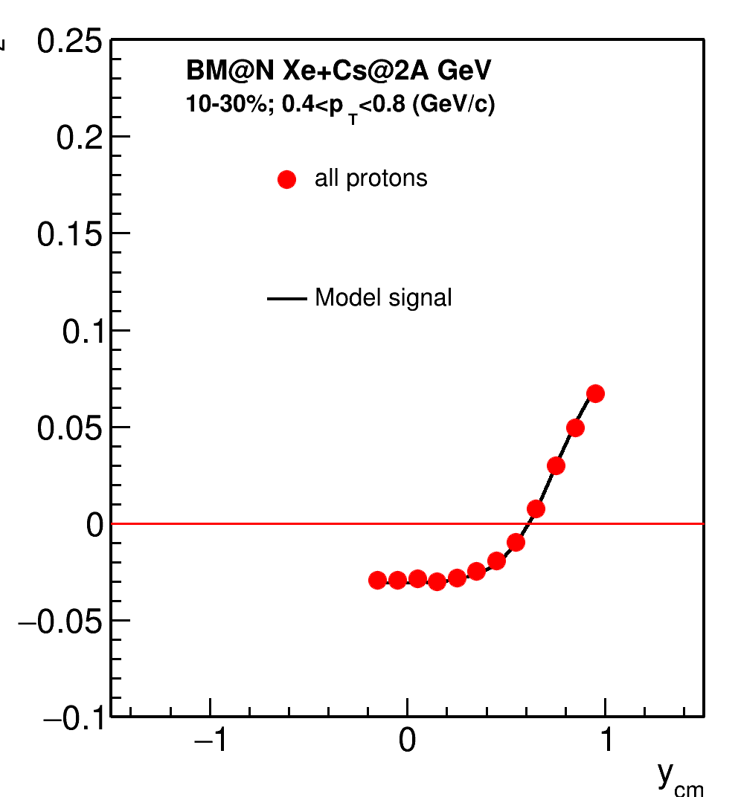
BM@N vs MPD: v₂ vs y for protons
See M.Mamaev’s talk at ISHEP-2023
and at Cross-PWG 5.09.2023
MPD has better coverage in backward rapidities and close to y_{beam}

Slide 35
Summary for the main topic 3
Performance study for v_{n} measurements using FFD detector:
Event plane Resolution of FFD is much more smaller than FHCal resolution;
Good agreement for 2 and 3 sub event methods
FFD has extremely small Resolution for 2-nd harmonic
FFD can be used for directed flow measurements
FFD needs more statistics than FHCal for elliptic flow measurements due to low resolution
Performance study for v_{n} measurements in MPD-FXT:
For each particle species v₁ and v₂ are consistent with the model signal mostly in backward rapidities
Official production for different beam energies (√s_{NN}=2.5, 3.0, 3.5 GeV 10-11 M min bias events each) has been requested for the further studies

Slide 36
Thank you for your attention!

Slide 37
Backup

Slide 38
Main topic 2: Elliptic flow fluctuations at NICA energies

Slide 39
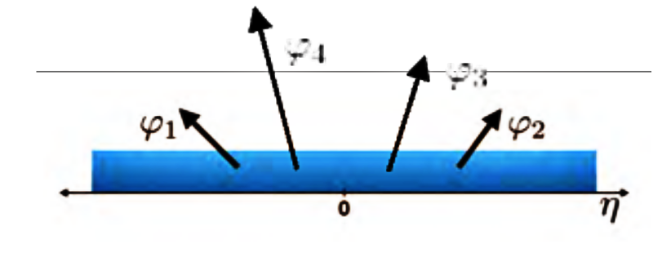
Methods for v_{n} measurements
Sub-event 2-particle Q-cumulants v2{2}: Δη=0.1 is applied between 2 sub-events A, B to suppress non-flow
4-particle Q-cumulants v2{4}
Method’s details described in PRC 83 (2011), 044913 , EP method: Phys.Rev.C 77 (2008) 034904

Slide 40
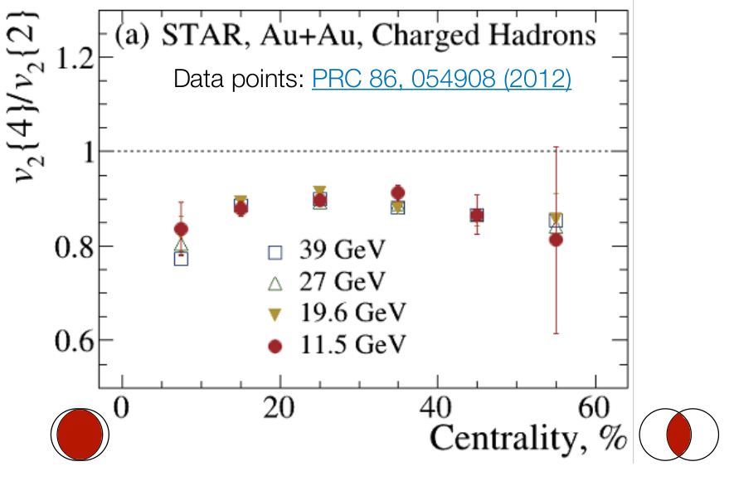
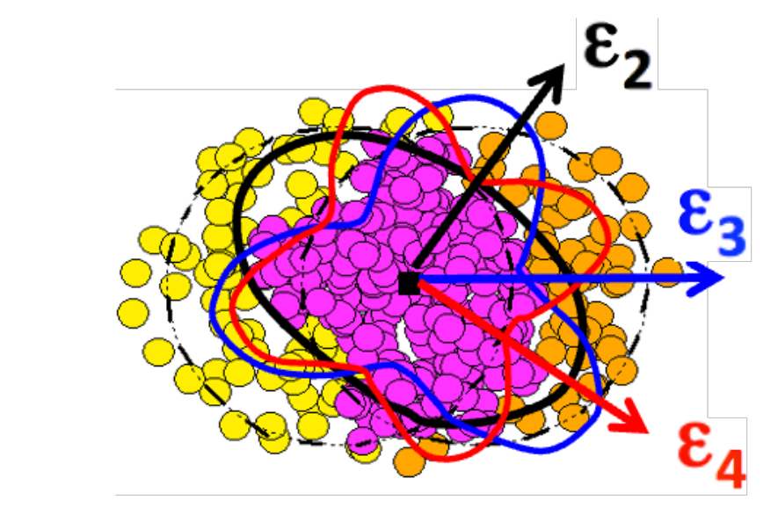
Motivation of elliptic flow fluctuation study
Indicate a dominated initial state driven uctuations σ_{ε2}
Provide constraints for IS models and shear viscosity η(T/s)
v₂ fluctuations at GeV
observed in STAR:
Weak dependence on collision energy
How about v2 fluctuations at NICA energies?

Slide 41
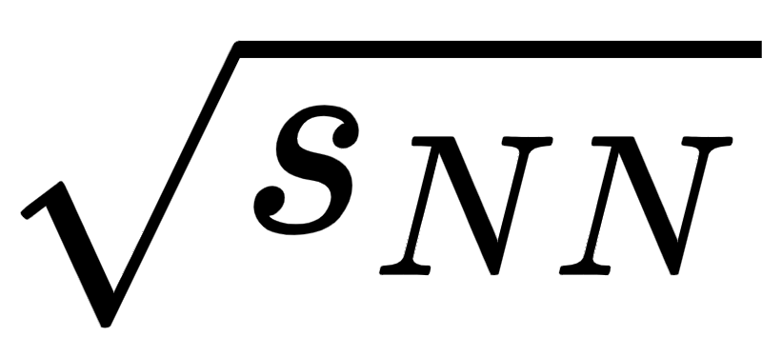
v₂ fluctuations at = 5 - 11.5 GeV
v₂ fluctuations decrease with decreasing energy more strongly than at = 11.5-39 GeV
The energy dependence of the v₂{4}/v₂{2} is stronger for protons than for pions

Slide 42
Relative v₂ fluctuations of identified hadrons
Weak dependence between v₂{4}/v₂{2} of protons and pions at 11.5 GeV
The difference between v₂{4}/v₂{2} of protons and pions increases with decreasing energy

Slide 43
Main topic 3: Study of the corrections for the non-uniform acceptance in the flow measurements and their application for the MPD experiment

Slide 44
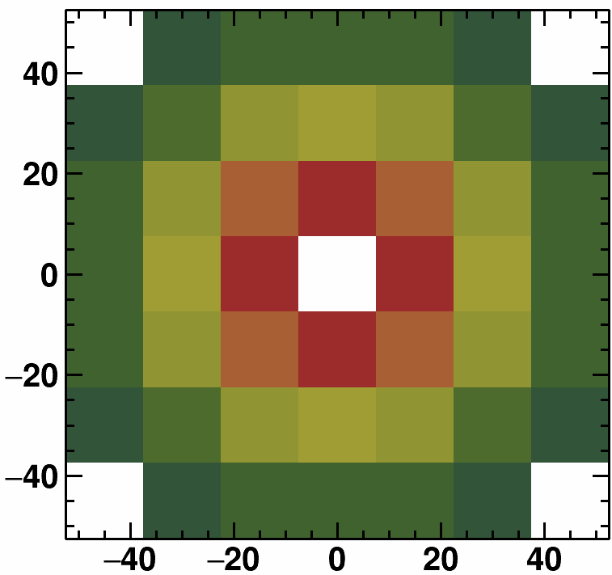
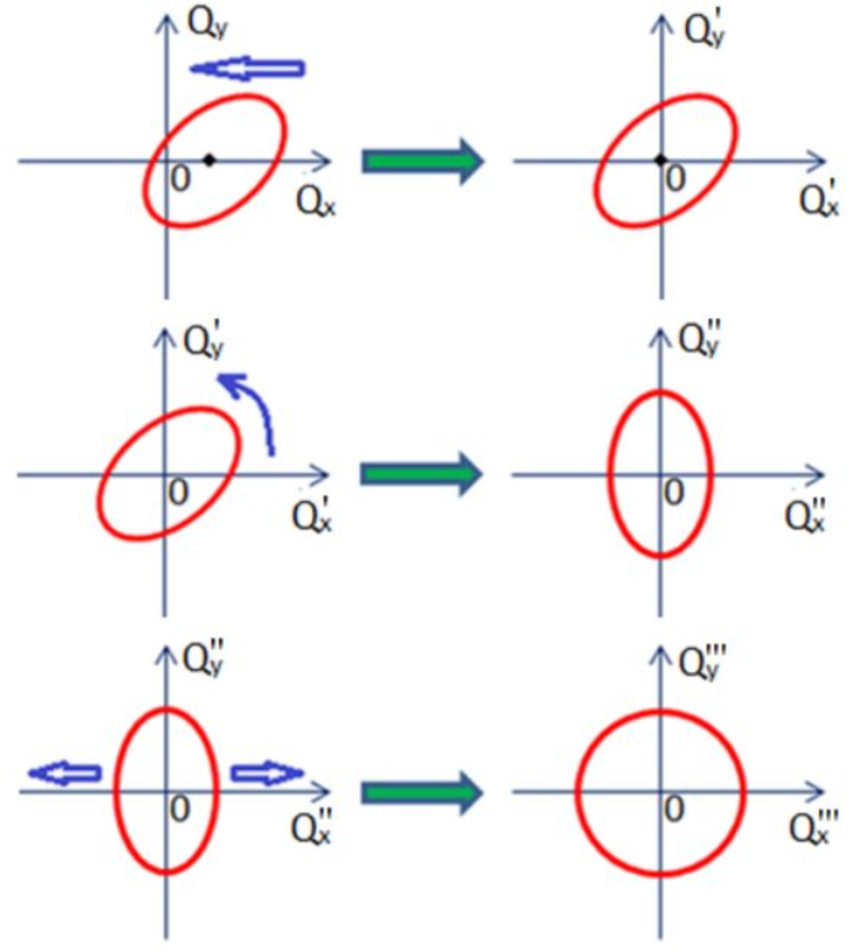
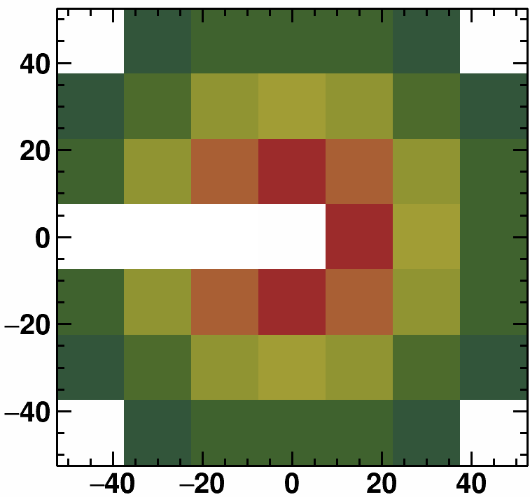
Non-uniform acceptance corrections
FHCal
Correction for non-uniform azimuthal acceptance
TPC
Recentering
Twist
Rescaling
Acceptance filter
TPC
FHCal
Corrections are based on method in: I. Selyuzhenkov and S. Voloshin PRC77, 034904 (2008)
Modules 23, 24, 25 (L) and 19, 20, 21 (R) are off

Slide 45
Effects of non-uniformity corrections; v₁ protons

Slide 46
Effects of non-uniformity corrections; v₂ protons

Slide 47
Correlation between global polarization and directed flow of 𝝠-hyperon

Slide 48
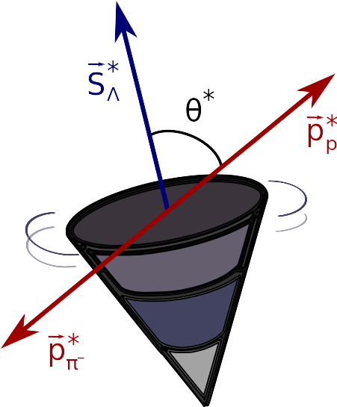
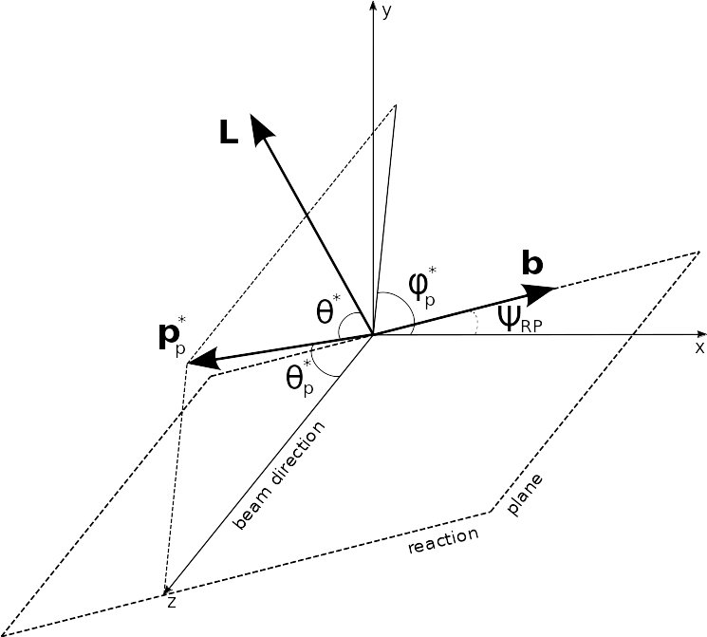
Global hyperon polarization
w.r.t. reaction plane (RP)
Emerges in HIC due to the system angular momentum
Measured through the weak decay (1)
P
(1)
* — denotes Lambda rest frame
θ* — angle between the decay particle and polarization direction
(Value updated in 2019)

Slide 49
Global Polarization at Nuclotron-NICA energies
Predicted and observed global polarization signals rise as the collision energy is reduced:
NICA energy range will provide new insight
- splitting of global polarization
Comparison of models, detailed study of energy and kinematical dependences, improving precision
Probing the vortical structure using various observables
9.2 GeV
MPD
S. Singha, EPJ Web Conf. 276 (2023) 06012

Slide 50
Correlation between P_{y} and v₁
Pearson correlation coefficient represent linear correlation between two sets of data from -1 to 1
|y|<1
0.5<p_{T}<3 GeV/c

Slide 51
P_{y} vs p_{T} and P_{y} vs y in centrality classes
Bi-Bi 9.2GeV PHSD
Weak dependence on p_{T}
Highest signal in mid-rapidity

Slide 52
v₁ vs p_{T} and v₁ vs y in centrality classes
Bi-Bi 9.2GeV PHSD
Small signal of directed flow
Better to investigate p_{T}>1.2 GeV/c

Slide 53
Pearson correlation coefficient between P_{y}, v₁ and N
N - multiplicity of Primary Λ
Weak centrality dependence of Pearson correlation coefficient

Slide 54
Pearson correlation coefficient between P_{y}and v₁
Bi-Bi 9.2GeV PHSD
moderate linear dependence between P_{y}and v₁
increasing with p_{T}
highest for 0.5<y<1

Slide 55
Summary
Small v₁ in mid-rapidity and for 0<p_{T}<1 GeV/c
Weak p_{T} dependence for P_{y}, highest signal in mid-rapidity
Moderate linear dependence between P_{y} and v₁
Effect of multiplicity of Primary Λ is negligible
Outlook
Further investigation of different effects in correlation between P_{y} and v₁
Search another correlation parameter

Slide 56
Simplified MC sampling for hadron calorimeters
DCM-QGSM-SMM x Geant4
PbPb @ 13A GeV/c
counts
MC sampling of energy
PbPb @ 13A GeV/c
counts
Shapes of energy and impact parameter distributions are similar
Width of distribution for energy is larger than for multiplicity
Possible decrease of width will be study

Slide 57
NA61/SHINE experimental setup
Data samples:
Pb-Pb @ p_{beam} = 13A GeV/c
data from 2016 physics run
DCM-QGSM-SMM x Geant4
Subsystems
Multiplicity: TPCs
Spectators energy: PSD
M.Baznat et al. PPNL 17 (2020) 3, 303
participants
projectile spectators

Slide 58
General distributions: Event
Charged only
|η| < 0.5
Observed a non-physical tail in the distribution Mult vs b

Slide 59
General distributions: Tracks
MC
Reco

Slide 60
Centrality determination
The reasonable fit quality and good agreement of the impact parameter distribution with the model data for 0-60% centrality classes.

Slide 61
Comparison of Reco and MC: v₂{2,|Δ η|>0.2}
Cuts:
Charged particles only
Primary
|Δ η| = 0,1
Δ η = 0,1
p_{T} >0.2 GeV/c
|DCA|<3σ
nTPC hits ≥ 16
PID: PDG code
good agreement of the v_{2,mc} with v_{2,reco} data
The difference at large p_{T} betwin v_{2,mc} and v_{2,reco} (non-flow ?)

Slide 62
Comparison of Reco and MC: v₂{4}
Cuts:
Charged particles only
Primary
|η|<1.5
Δ η= 0,1
p_{T} >0.2 GeV/c
|DCA|<3σ
nTPC hits ≥ 16
PID: PDG code
good agreement of the v_{2,mc} with v_{2,reco} data
The difference at large p_{T} betwin v_{2,mc} and v_{2,reco} is less than for other methods -> Not affected by the non-flow effects

Slide 63
More information: https://inspirehep.net/literature/757158

Slide 64
FHCal & FFD event plane Resolution for v₁
2 sub event
BiBi@9.2 GeV UrQMD
3 sub event
FFD resolution are smaller than FHCal
2 and 3 sub event has good agreement with True Resolution

Slide 65
FHCal & FFD event plane Resolution for v₂
Extrapolation to obtain R₂
FFD resolution is extremely small.

Slide 66
The BM@N experiment (GEANT4 simulation for RUN8)
FHCal
Silicon + GEM
TOF-700
TOF-400
neutron
x=0
ion
proton
Square-like tracking system within the magnetic field deflecting particles along X-axis
Charge splitting on the surface of the FHCal is observed due to magnetic field
Notes:
Схема эксперимента хадес на слайде.
Траектории рожденных частиц регистристрируются трекинговой системой, состоящей из …
Импульс восстанавливается по отклонению частиц в магнитном поле
Идентификация производится при помощи детекторов времени пролета … которые регистрируют время пролета. Зная длину траектории можно вычислить массу частицы.
Спектаторы регистрируются детектором FW. Поскольку они отклоняются в плоскости реакции материей в области перекрытия, спектаторы используются для оценки угла плоскости реакции.
Всего столько статистики ...

Slide 67
BM@N vs MPD: p_{T}-y acceptance
π-
p
MPD has greater coverage of backward area (even covers projectile spectators)
and MPD covers midrapidity region
BM@N has greater coverage of forward area
y_{cm}=0
y_{cm}=0

Slide 68
BM@N vs MPD: η-φ acceptance
MPD
BM@N
MPD has more uniform acceptance along φ-axis
BM@N has non-uniform acceptance due to square-like shape of the tracking system

Slide 69
Flow methods for v_{n} calculation
Method helps to eliminate non-flow
Using 2-subevents doesn’t
Tested in HADES:
M Mamaev et al 2020 PPNuclei 53, 277–281
M Mamaev et al 2020 J. Phys.: Conf. Ser. 1690 012122
Scalar product (SP) method:
👎
Where R₁ is the resolution correction factor
Symbol “F2(F1,F3)” means R₁ calculated via (3S resolution):
Symbol “F2{Tp}(F1,F3)” means R₁ calculated via (4S resolution):
Notes:
In this work two methods of flow calculation are used: Event plane for cross-checks and scalar product for the analysis. In the first method, one estimates event plane angle and measures mean cosine of particles azimuthal angle. Then, resolution of event plane estimation is applied. Resolution is calculated with random sub event method. In the scalar product the correlation between flow vectors are calculated and then, the resolution correction is applied estimated with 3-sub event method.

Slide 70
SP: R₁ for FHCal spectator plane
EP R₁~0.8
Good agreement between R₁ calculated using different combinations of Q-vectors with significant rapidity separation

Slide 71
BM@N vs MPD: v₁ vs y for protons
BM@N has better coverage in positive rapidities close to y_{beam}

Slide 72
BM@N vs MPD: v₂ vs y for protons
2A
BM@N has better coverage in positive rapidities close to y_{beam}

Slide 73
MPD-FXT: v₁ for π+
v₁ is consistent with model signal for y < 1; We need more statistics

Slide 74
MPD-FXT: v₂ for π+
v₂ is consistent with model signal for y < 0; We need more statistics

Slide 75
MPD-FXT: v₁ for π-
v₁ is consistent with model signal for y < 1; We need more statistics

Slide 76
MPD-FXT: v₂ for π-
v₂ is consistent with model signal for y < 0; We need more statistics

Slide 77
Anisotropic transverse flow
Spatial asymmetry of energy distribution at the initial state is transformed, through the strong interaction, into momentum anisotropy of the produced particles.
In the experiment reaction plane angle Ψ_{RP} can be approximated by
participant Ψ_{PP} or spectator Ψ_{SP} symmetry planes.
Notes:
At the start I would like to describe theory basics in this study. The initial geometry of colliding nuclei has spatial asymmetry, that is transformed into the momentum anisotropy of produced particles through the strong interaction. We can describe this anisotropy in transverse plane with Fourier series expansion of particle distribution with respect to reaction plane angle, defined by beam axis and impact parameter, and the expansion coefficients are named flow coefficients. In the experiment we can approximate reaction plane angle by participant plane angle or spectator projectile or target plane angles.

Slide 78
Anisotropic transverse flow in heavy-ion collisions at Nuclotron-NICA energies
Strong energy dependence of dv₁/dy and v₂ at SNN =4-11 GeV.
Anisotropic flow at FAIR/NICA energies is a delicate balance between:
The ability of pressure developed early in the reaction zone and
Long passage time (strong shadowing by spectators).
Differential flow measurements v_{n}( SNN , centrality, pid, p_{T}, y) will help to study:
effects of collective (radial) expansion on anisotropic flow
interaction between collision spectators and produced matter
baryon number transport
Several experiments (MPD, BM@N, STAR FXT, CBM, HADES, NA61/SHINE) aim to study properties of the strongly-interacted matter in this energy region.
BM@N
CBM
MPD
M. Abdallah et al. [STAR Collaboration] 2108.00908 [nucl-ex]
Notes:
Why we need to study this at the MPD experiment? Lattice QCD calculations predict both the deconfinement phase transition and chiral symmetry restoration to be happened at high enough energy densities. Experimental data on hadron production properties at SPS (CERN) suggest that this transition occurs within the NICA energy range. As you can see on this slide directed and elliptic flow has strong energy dependence in energy range of the BM@N, CBM and MPD experiment. We can study flow depends on energy, transverse momentum, rapidity, centrality and type of particle. It will help to study effect of radial expansion on anisotropic flow, interaction between collision spectators and produced particles by dependencies on centrality. NICA has overlapping zone in energy range with another experiments, that get us possibility to compare our results in this points to check correct work of the experiment.

