Slide 1
ACCELERATION COMPLEX
NICA VS LHC

Slide 2
Comparisons
Work Environment
Control Rooms
Organizational Structure
Operation
Exploitation
Associated Standards

Slide 3
Work Environment
Standards
Structure
Comparable Parameters

Slide 4
LHC VS NICA Standards
LHC Access system divided into:
NICA Access system divided into:
LHC Access Control System (LACS)
(based on the Siemens 400FH series failsafe
Programmable Logic Controllers.)
LHC Access Safety System (LASS)
(Evolynx software was modified to suit the specific requirements of the LHC access control.)
NICA Access Control System
(TANGO)
NICA Access Safety System
(limited information)

Slide 5
LHC VS NICA Structure
LHC:
High-energy proton-proton collider for particle physics.
has a circumference of approximately 27 kilometers
It contains 4 experimental facilities (ALICE, ATLAS,CMS,LHCb)
The LHC is a superconducting accelerator

Slide 6
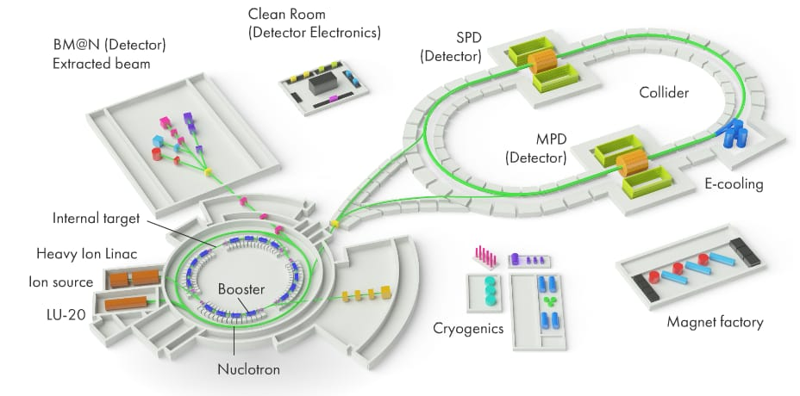
NICA Structure

Slide 7
LHC VS NICA Comparable Parameters
Parameters
Location
Accelerator Type
Environmental Impact
International collaboration
Research goals

Slide 8
 | LHC | NICA
Location | Geneva, Switzerland | Dubna, Russia
Accelerator Type and purpose | Circular proton-proton and heavy-ion collider | Heavy-ion accelerator
Environmental impact | Energy consumption and radiation impact | Handling of nuclear materials and radiation
International collaboration | International collaboration with CERN | International collaboration with JINR
Research goals | High-energy physics and particle collisions | Properties of nuclear matter and the behavior of strongly interacting particles at high densities

