Slide 1
A comparison of Detector Control Systems at the BM@N experiment in JINR and the ALICE experiment at CERN

Slide 2
BM@N and ALICE – General Comparison
BM@N
ALICE
First experiment at the accelerator complex of NICA Nuclotron
Aim - To study interactions of relativistic heavy ion beams with fixed targets
Nuclotron kinetic energy of ions - 1 to 6 GeV per nucleon
Maximum kinetic energy for
ions with (Z/A) of 1/2 is 6 GeV per nucleon,
heavy ions with Z/A ~ 1/3 is 4.5 GeV per nucleon
protons is 13 GeV
Beam line between the Nuclotron and the BM@N experiment is around 160 meter in length
It comprises 26 elements of magnetic optics: 8 dipole magnets and 18 quadruple lenses
The planned intensity of the gold ion beam at BM@N is few 106 ions/s.
The acquisition rate of non-peripheral collisions is expected to range from 20 to 50 kHz
Detector dedicated to heavy-ion physics at the Large Hadron Collider (LHC)
Aim - To study the physics of strongly interacting matter at extreme energy densities, where a phase of matter called quark-gluon plasma forms.
Generate temperatures more than 100 000 times hotter than the centre of the Sun.
Protons and neutrons "melt", freeing the quarks from their bonds with the gluons.
ALICE collaboration studies the quark-gluon plasma as it expands and cools
The ALICE collaboration uses the 10 000-tonne ALICE detector – 26 m long, 16 m high, and 16 m wide – to study quark-gluon plasma. The detector sits in a vast cavern 56 m below ground

Slide 3
Distributed Control System
Platform for automated control
Helps with the operation of a plant or industrial process
Combines the following into a single automated system
Human machine interface (HMI)
Logic solvers
Historian
Common database
Alarm management
Common engineering suite

Slide 4
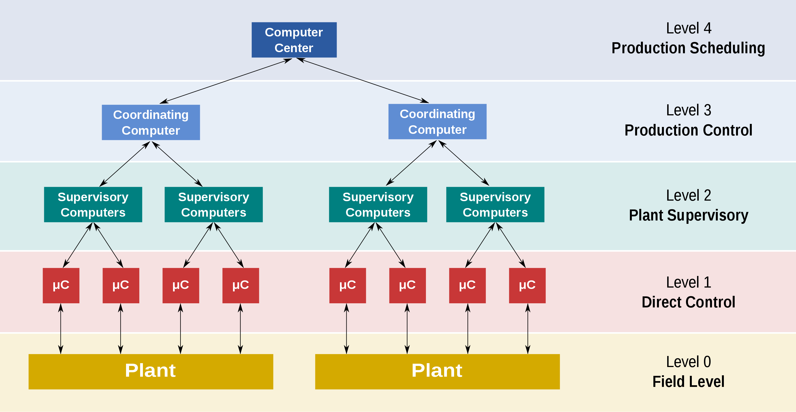

Slide 5
BM@N and Alice Comparison – DCS
BM@N
ALICE
Control mechanisms are facilitated through various graphical user applications (GUI apps), enabling shifters to efficiently manage and regulate subsystems
the DCS operates under different modes, with sub-detector states being localized for tailored status information
specialized automation includes the implementation of a control loop to regulate the temperature of front-end chips
The DCS employs a graphical representation for alarms, with different colors denoting distinct conditions
number of alarms lies in the hundreds, spanning scenarios from hardware disconnection to voltage operations
shift leaders play a central role in providing guidance and directives for effective resolution
the front-end electronics comprise 3276 front-end cards (FEC), each designed for specific tasks
Monitoring relies on a 12-bit SCA (Successive Approximation) ADC, encompassing various measurements.
Includes RTD temperature sensors, a low tolerance reference resistor for precise internal current source measurement, internal temperature sensing, shunt resistors for voltage line inputs, voltage measurements for regulators, and VTRx photocurrent measurements
SCA manages power on/off for SAMPAs (Signal APd Readout ASICs) through GPIO signals, GBTx (Gigabit Transceiver) configuration (GBTx1 post-power-up), and potentially required GBTx tuning (GBTx0)
Common Readout Unit (CRU) monitoring through aliECS includes aspects like MPO optical power, link status, temperatures, and potential voltages.

Slide 6
Why use Distributed Control System?
Real-time Monitoring and Control
Data Acquisition and Management
Safety Measures and System Protection
Experiment Integration
Environmental Monitoring
Remote Access and Control
Adaptability and Scalability
Data Analysis Support

Slide 7
BM@N and Alice Comparison –Architecture
BM@N
ALICE
Autonomous entity within the experimental setup
Data Acquisition (DAQ) system and the Trigger System function as distinct and independent bodies
Decomposition style ensures that the DCS, DAQ system, and Trigger System operate cohesively
Maintain separate management structures.
The front-end layer consists of industrial computers, intellectual controllers, and crates
Directly manage equipment and gather data from sensors
The service layer comprises high-level TANGO devices that represent complete subsystems
The client layer presents the accelerator complex state to the operator, visualizes acquired data, and empowers the operator to execute control actions
The Experiment Control System (ECS) supervises the Detector Control System (DCS)
Logical part of the ALICE control framework
Includes DCS, DAQ, TRG, and HLT, are interconnected through the ECS, forming a cohesive control layer
ECS synchronizes and coordinates these systems, along with the LHC machine
Multiple subsystems, each focused on specific devices like Low Voltage (LV), High Voltage (HV), Front End and Readout Electronics (FEE), etc
150 sub-systems, comprising around 1200 network-attached devices and 270 VME and power supply crates
FEE sub-system, distinctive and specific to detectors, employs the Front End Device (FED) as a standardized access mechanism

Slide 8
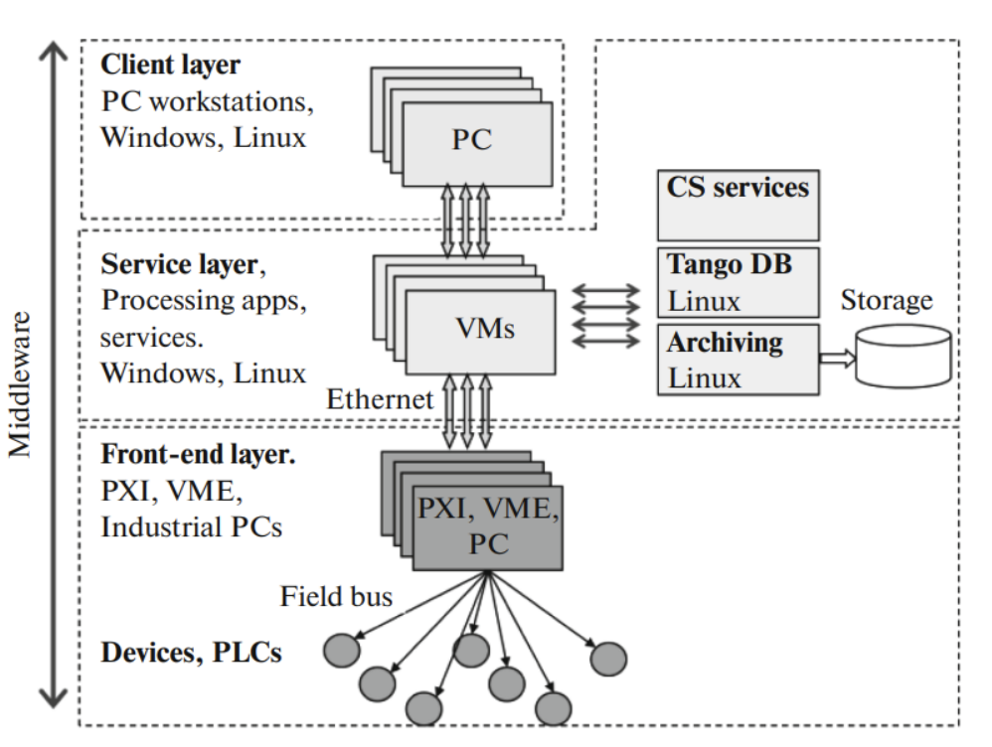
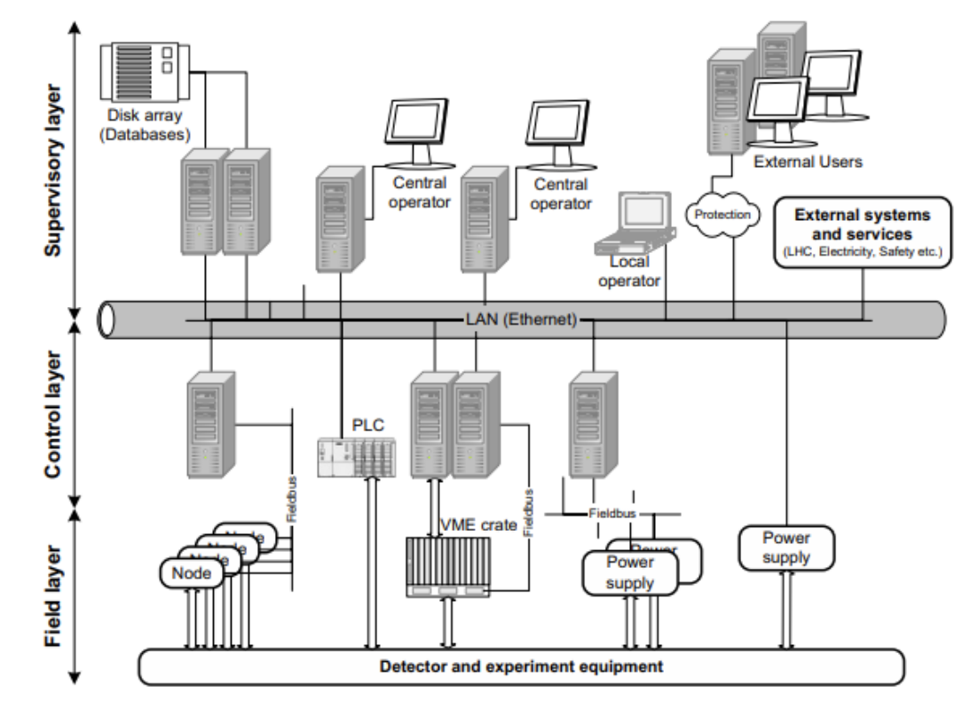
ALICE
BM@N

Slide 9
BM@N and Alice Comparison – GUI
BM@N
ALICE
Organized and navigable hierarchy of panels
Swift access to various sub-detector systems from the main panel, enhances user interaction
No labelling of objects
Denomination of symbols employs color coding, transitioning from green to red in case of errors, ensuring easy recognition of critical states.
Including critical system parameters, real-time status updates, and visual representations of the experiment's components
Optimizing efficiency by catering to specific roles rather than individual preferences
Linux Debian-based operating system suited for TANGO Control system
Facilitate efficient navigation, provide vital information at a glance, and enable swift decision-making in the operation and management of the experiment's complex systems.
Standardized Graphics User Interface (GUI)
Serves as a central control hub, ensuring consistent aesthetics and functionality across all DCS components
Upheld through the provision of tools and guidelines
Includes a hierarchy browser for seamless navigation, alert overview for quick identification of critical situations, and direct access to the Finite State Machine (FSM) and status monitoring
For standard actions, the FSM mechanism is employed, while for more specialized tasks, direct interactions occur through the WINCC framework.
Role-based access control mechanism(overall reliability and safety of the system)

Slide 10
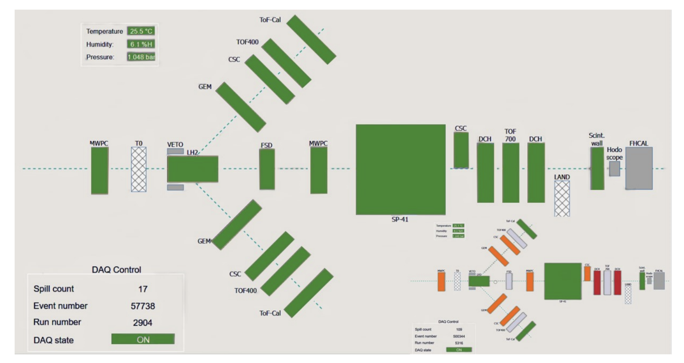
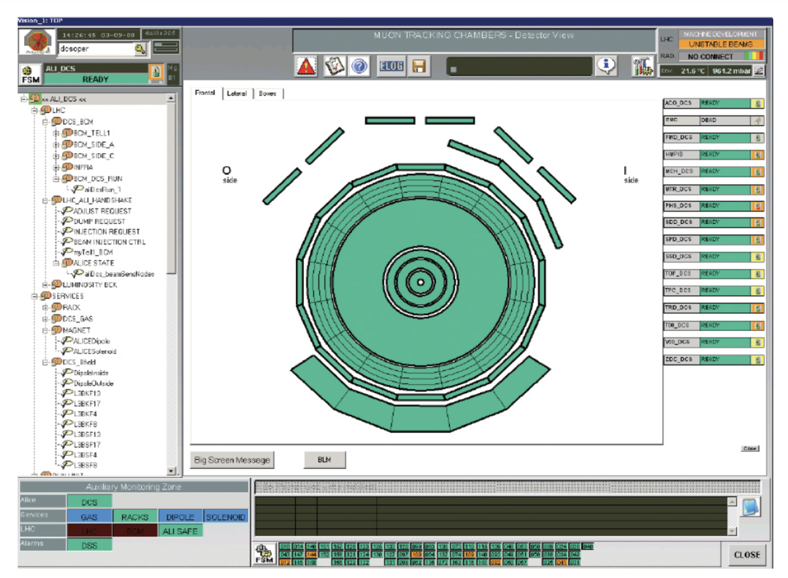
ALICE
BM@N

