Slide 1
A Comparative Analysis of Work Environment In LHC And NICA Complexes

Slide 2
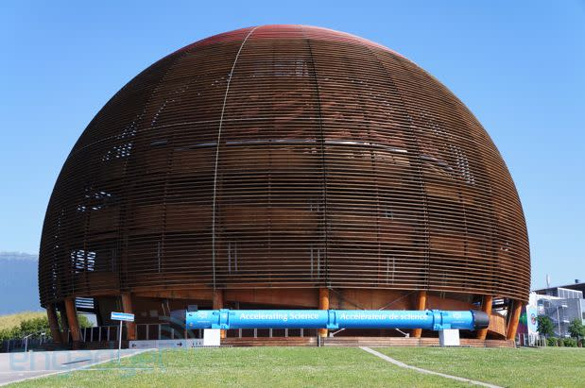
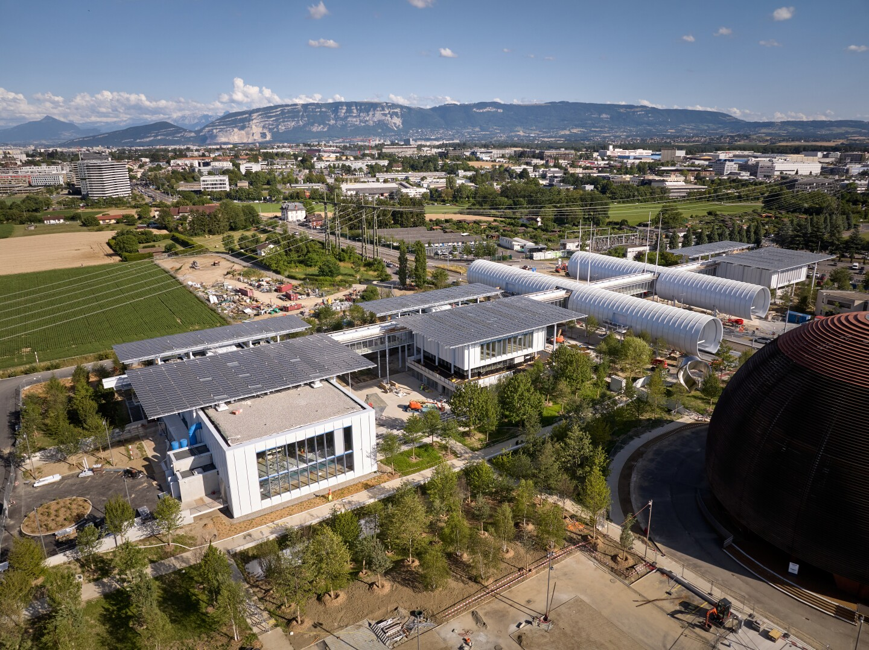
LHC
Work Environment Analysis in LHC
Operator Responsibilities in Control Room at LHC

Slide 3
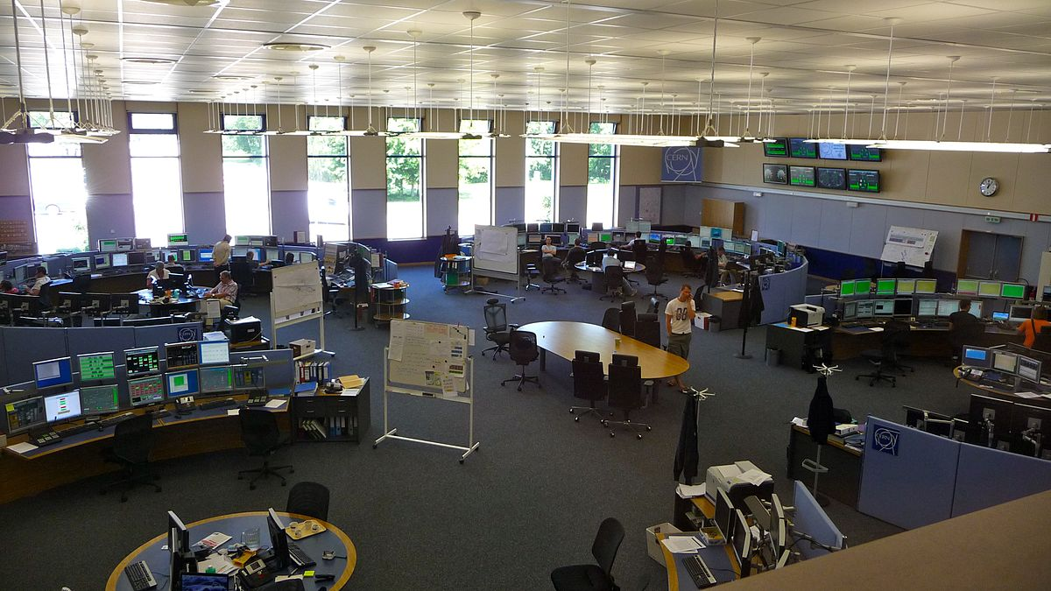
Architectural Configuration of Control Room
A capacious expanse measuring 600 m2 has been thoughtfully allocated as a singular domain.
Each faction assumes distinct roles and attendant responsibilities within the operational ambit
The ceiling height is set at twice the standard size to facilitate efficient circulation of conditioned air throughout the enclosure.
External windows are integrated, giving access to natural lighting.

Slide 4
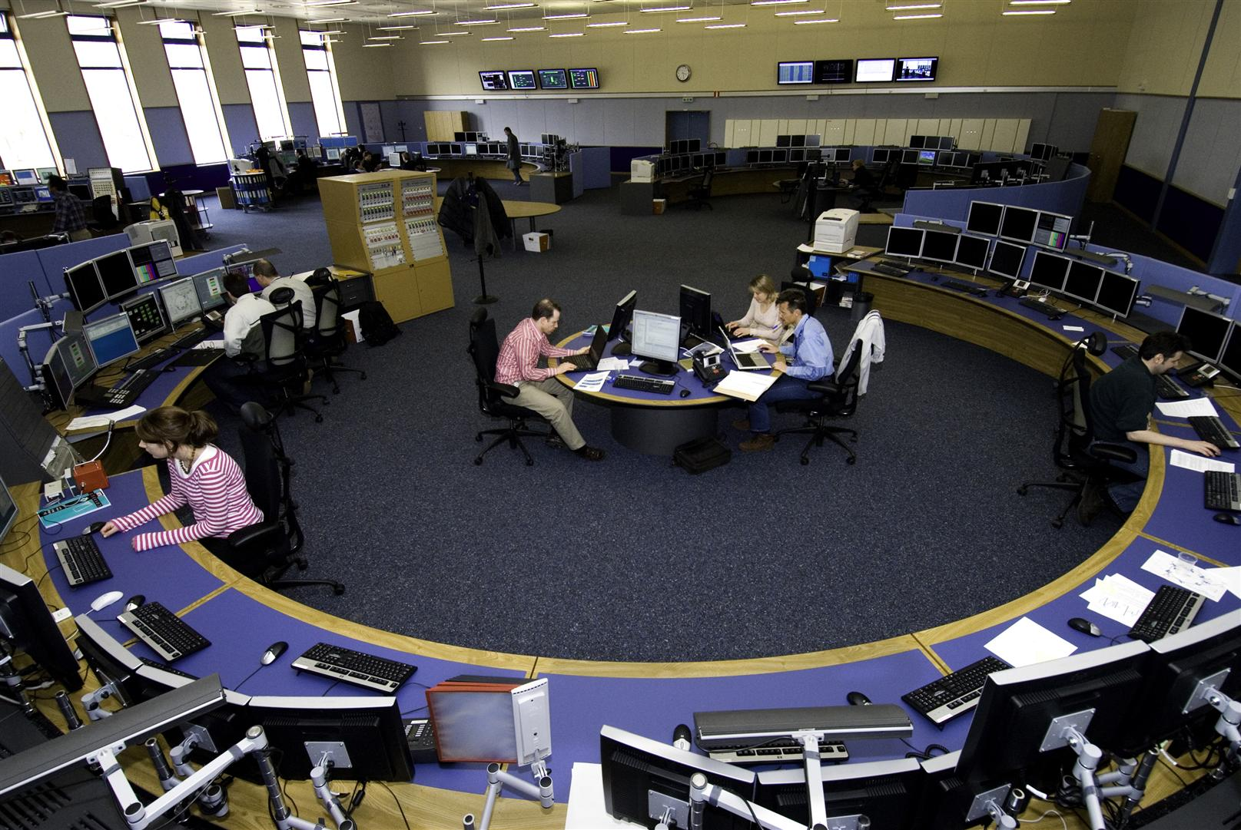
Architectural Configuration of Control Room
There is continuity of operations that extends around 24/7 interval.
In normal operating mode there are up to 11 operations personnel during any given shift cycle.
During the accelerator shutdown phases, CCC remains operational with a limited staff presence of 2 to 4 individuals, ensuring the uninterrupted provision of essential services.

Slide 5
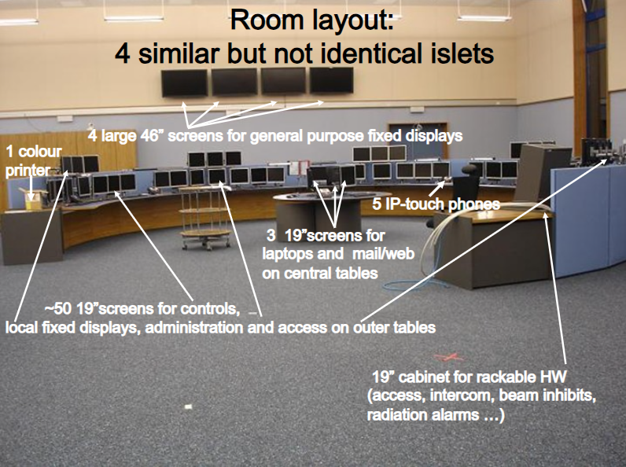
Architectural Configuration of Control Room

Slide 6
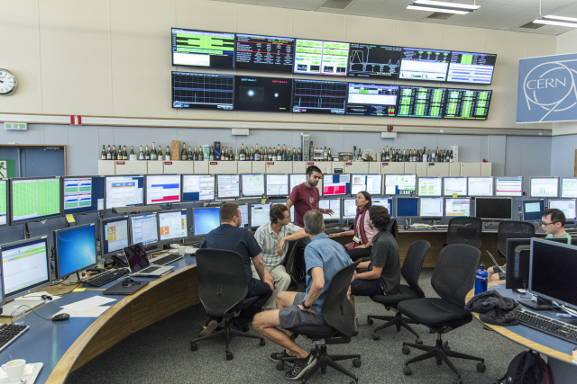
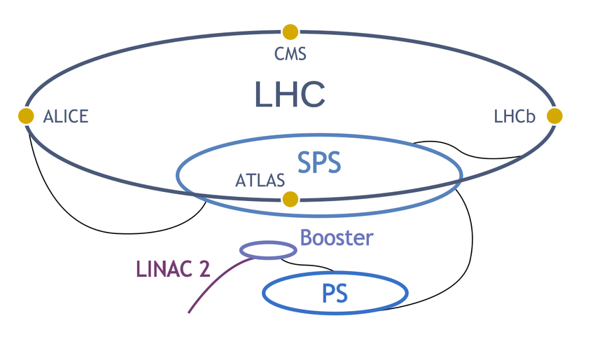
Responsibility of the operators in LHC
Linear Accelerators
PSB: Proton Synchrotron Booster
PS: Proton Synchrotron
SPS: Super Proton Synchrotron
Antiproton Decelerator
associated transfer lines

Slide 7
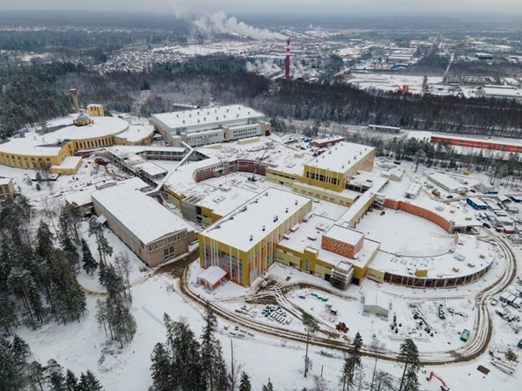
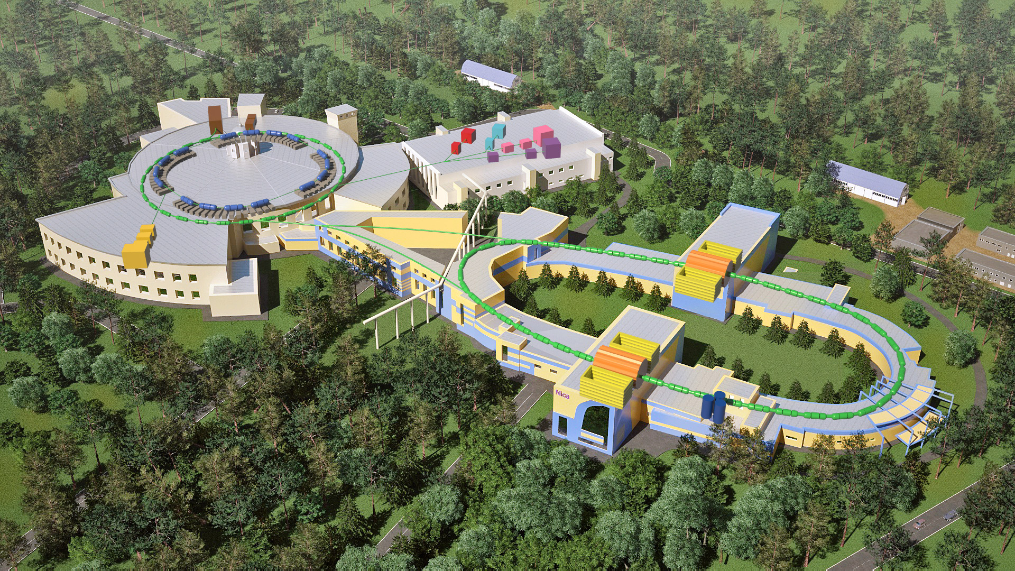
NICA
Work Environment Analysis in NICA
Operator Responsibilities in Control Rooms at NICA

Slide 8
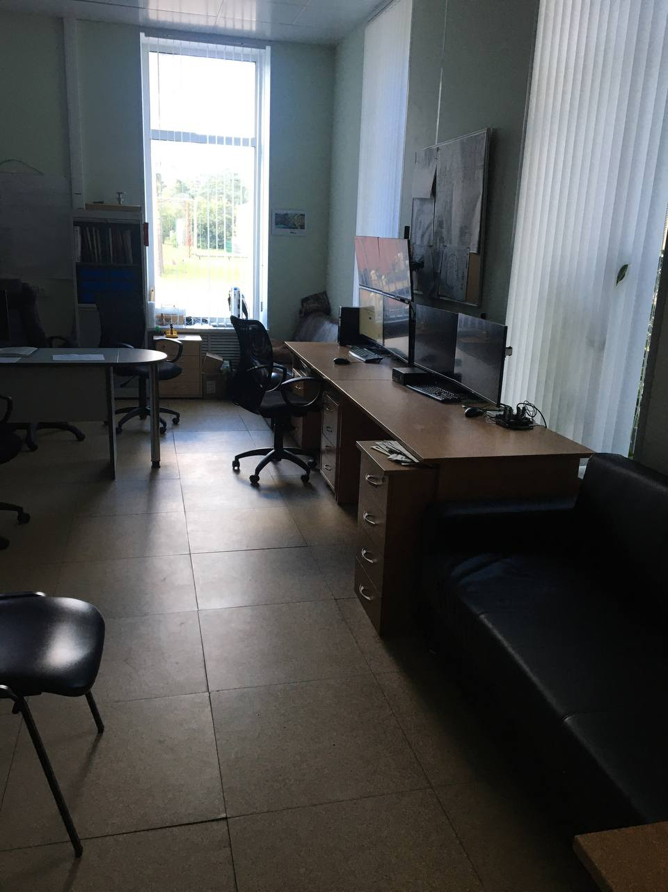
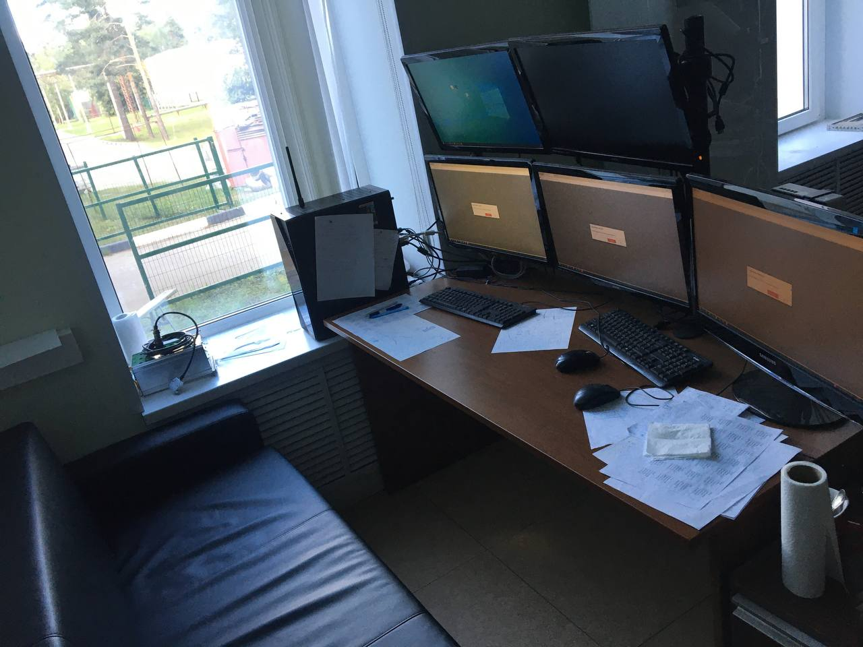
Architectural Configuration of Control Rooms
There are 7 control rooms in NICA complex, each tailored to fulfill operational requisites.
The control room ranges in size from approximately 5 to 25 m2, providing space to deploy the equipment and personnel needed to carry out their assigned tasks.
the various control rooms adhere to fundamental infrastructure standards, such that,
Fast internet connection
Essential services
Adequate computer facilities

Slide 9
Architectural Configuration of Control Rooms

Slide 10
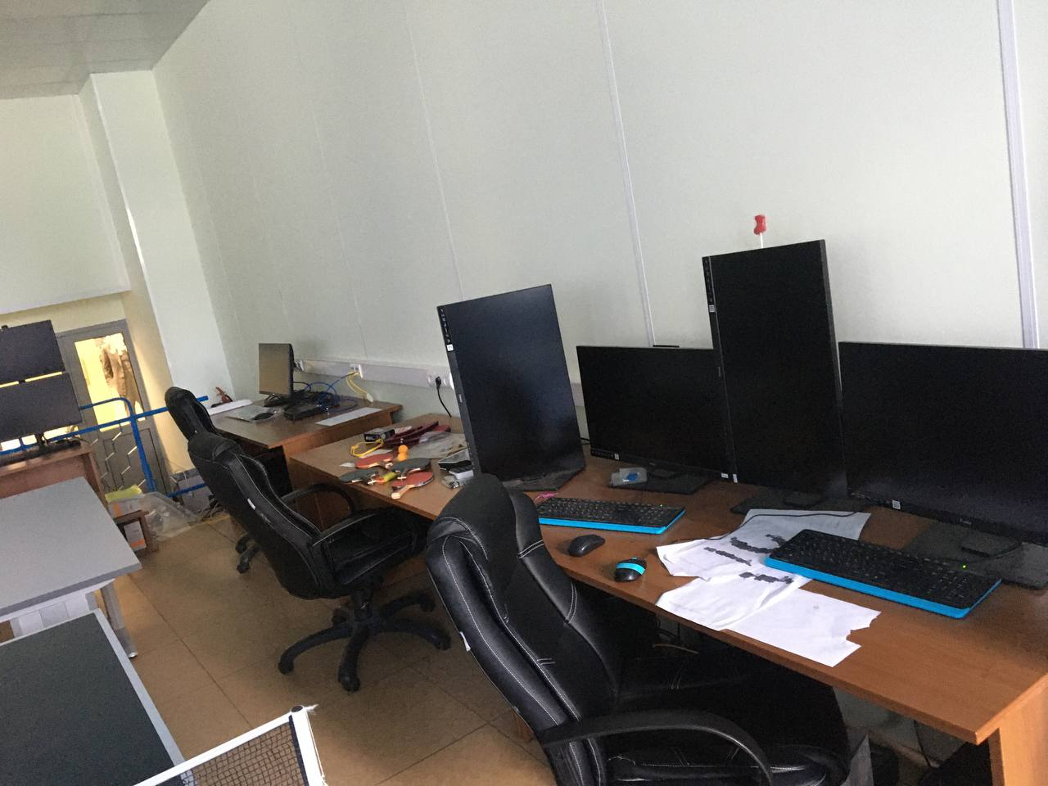
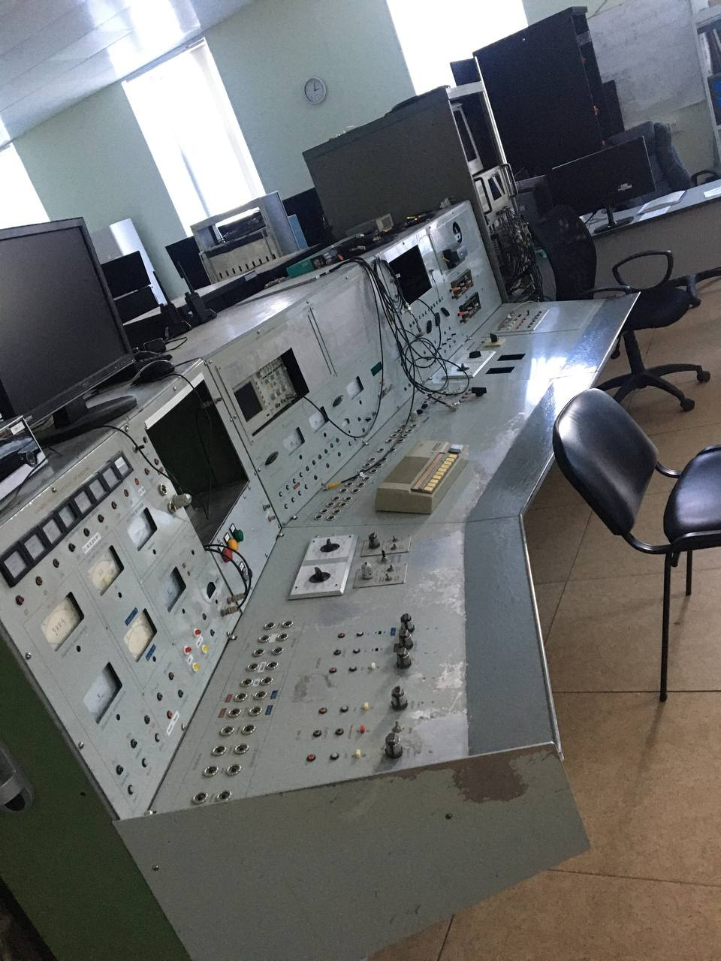
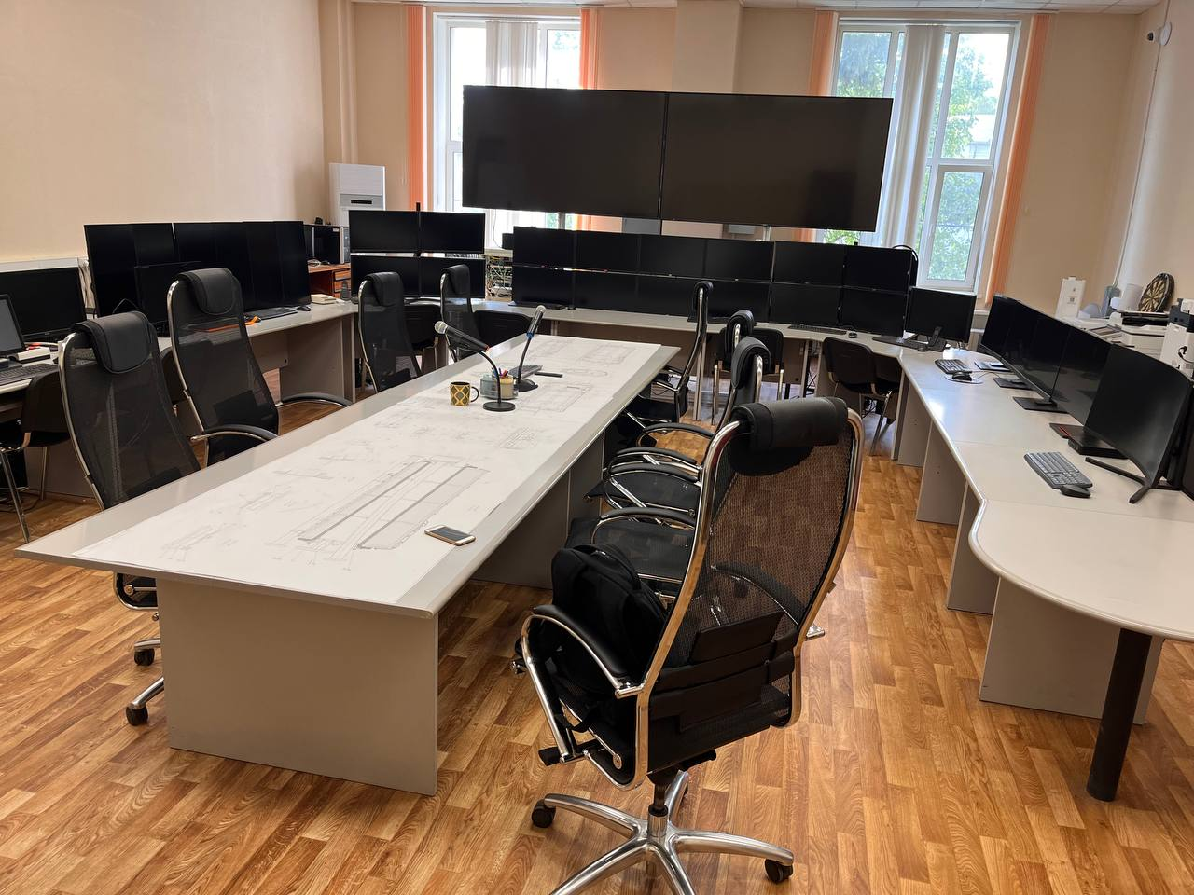
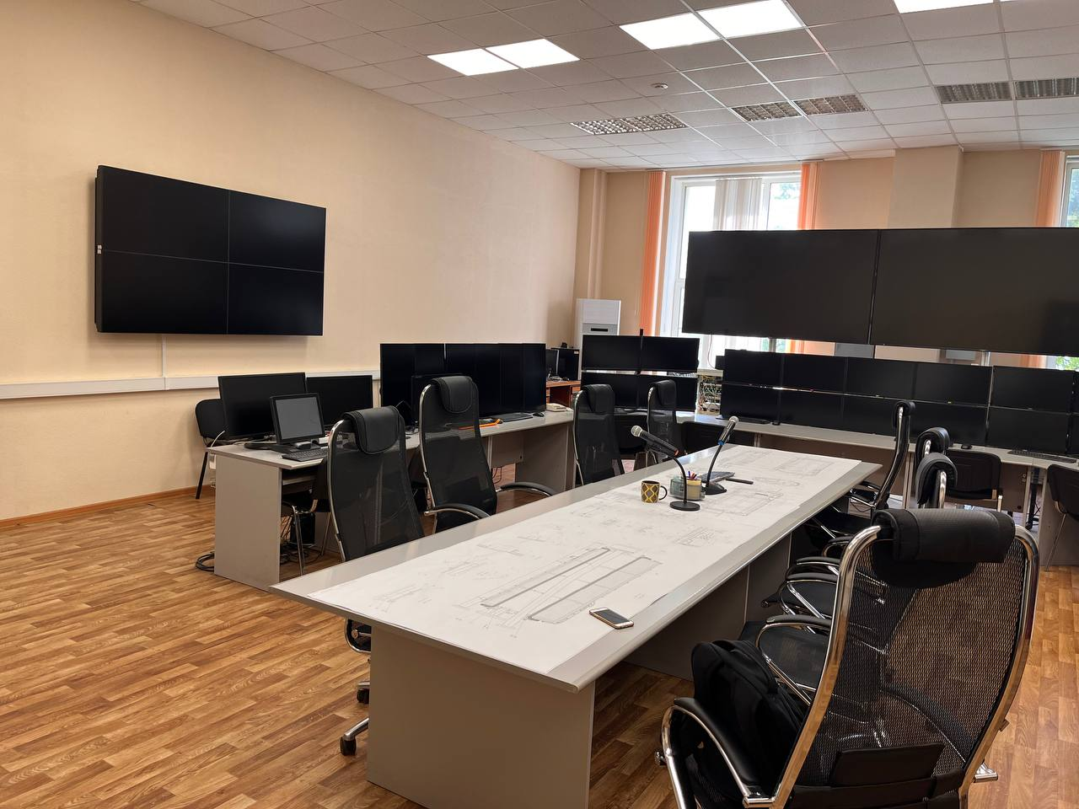
Architectural Configuration of Control Rooms
There is continuity of operations that extends around 24/7 interval.
It is noteworthy that control rooms exhibit suboptimal infrastructure and ventilation systems, which may affect the overall quality of the work environment.

Slide 11
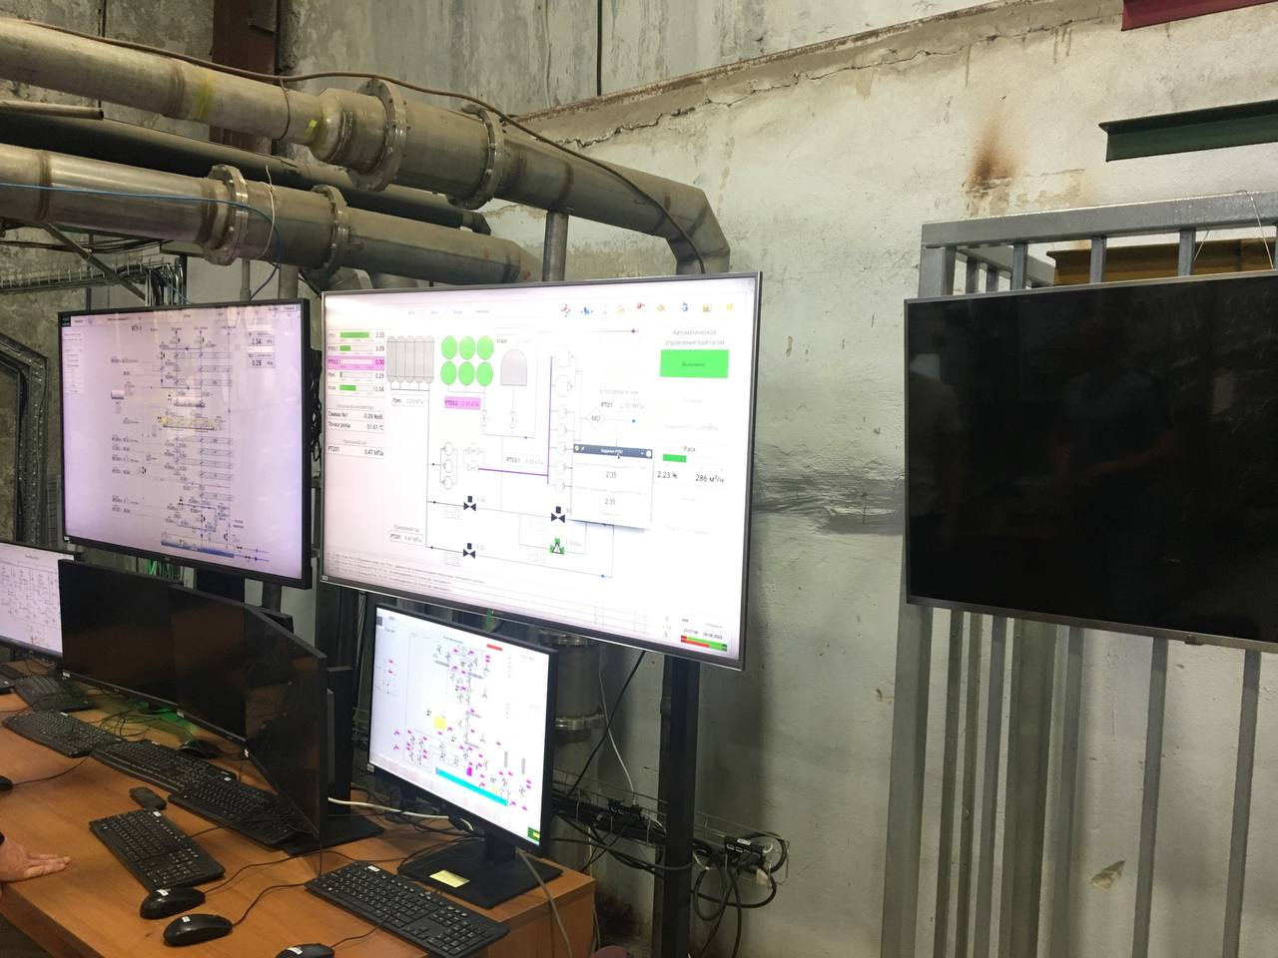
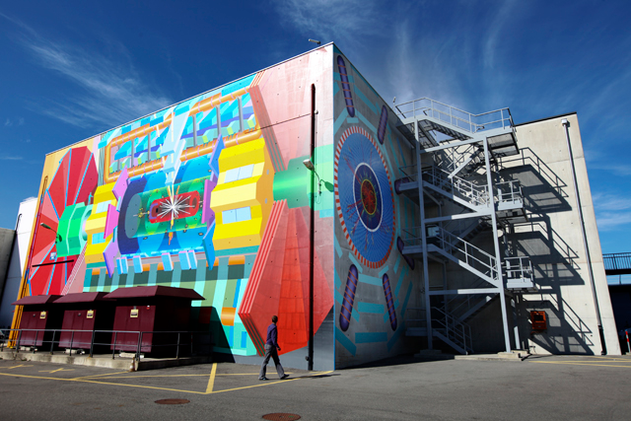
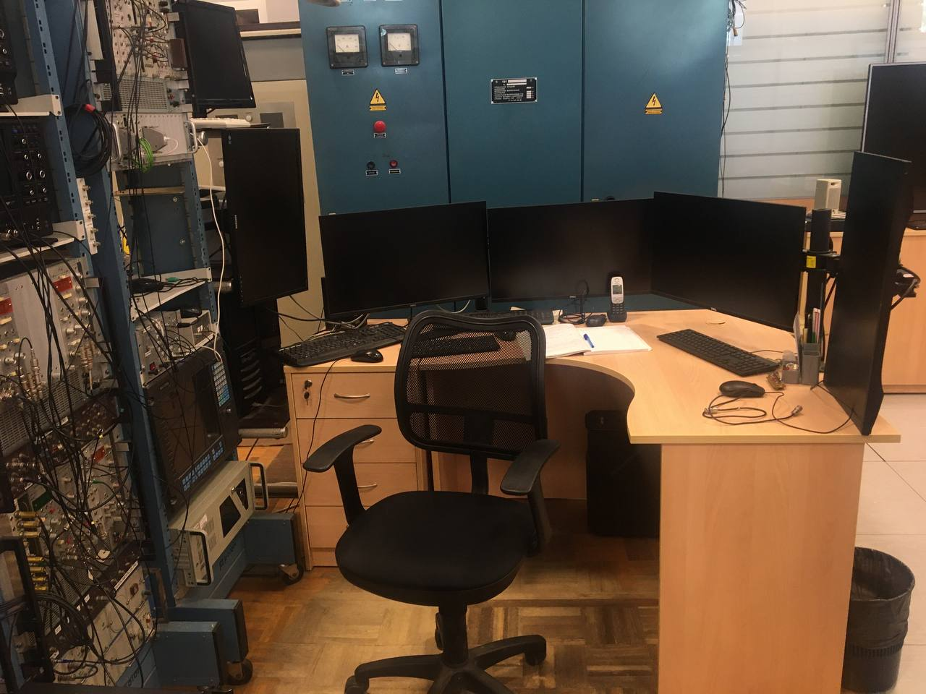
Responsibility of the operators in NICA
Accelerator Operation
Safety and Security
Experimental Setup
Data Acquisition
Troubleshooting
Beam Delivery
Maintenance and Repairs
Documentation
Communication
Training
Adherence to Regulations

Slide 12
Areas for Improvement for NICA
Raising infrastructure standards
Improve ventilation systems
Improving working conditions.

