Slide 1
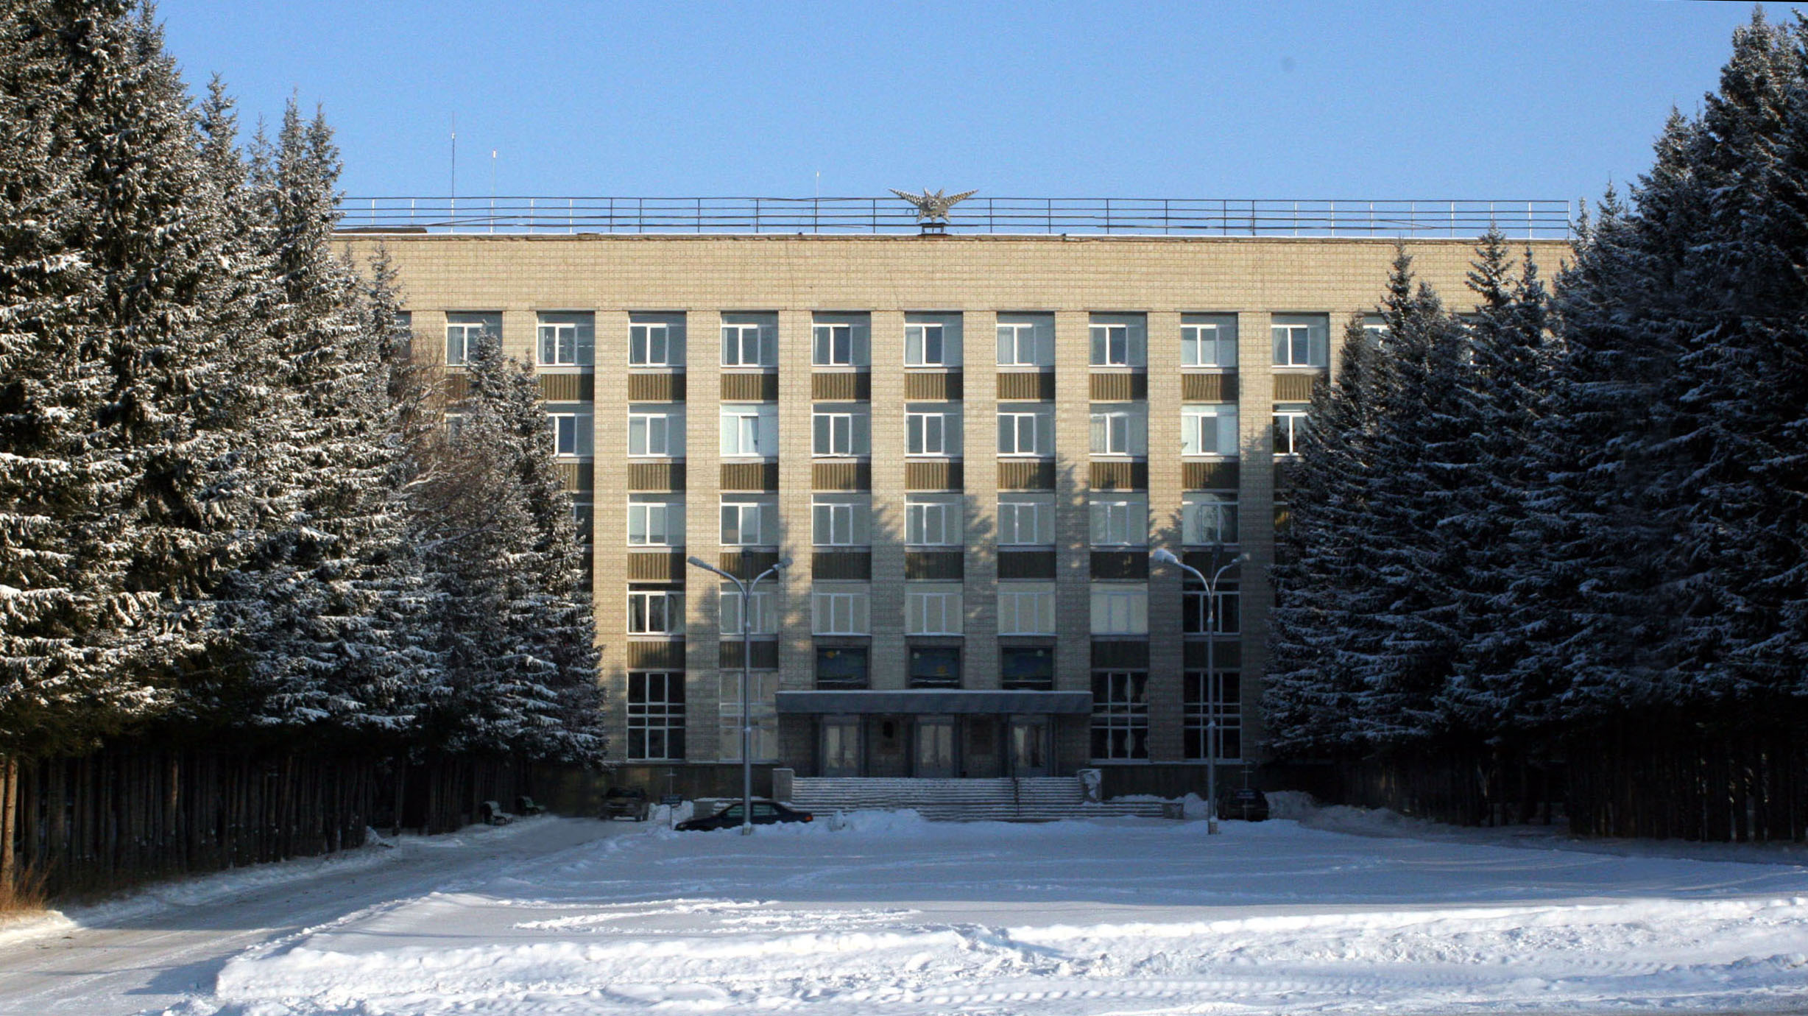
The Budker Institute of Nuclear Physics

Slide 2
Schedule of assembling of the PANDA solenoid
No. | Name of work | Place | Term | Participants | Date
1 | Yoke and frame assembling | Assembling area | 6 weeks | Assembling team, 4+1 Survey team, 2 | 02 2022
2 | Installation of the cryostat with cold mass into yoke and control Dewar | Assembling area | 8 weeks | Assembling team, 4+1 Survey team, 2 X-ray control, 2/TUEV expert | 03 - 04 2022
3 | Power supply and extraction energy system | Assembling area | 4 weeks | Assembling team, 2+1 | 10 2022
4 | Moving the solenoid to beam position | Assembling and beam area | 2 weeks | Assembling team, 2+1 Survey team, 2 | 1 2023
5 | Installation of a cable channel | Beam area | 3 weeks | Assembling team, 2+1 | 2-3 2023
6 | Connection of the cryogenic system helium plant with solenoid | Beam area | 4 weeks | Assembling team, 4+1 X-ray control, 2/TUEV expert | 2-3 2023
7 | SAT PANDA solenoid including magnetic field measurements | Beam area | 8 weeks | Commissioning team, 2+2 | 3-5 2023
8 | Moving the solenoid to assembling area | Assembling and beam area | 2 weeks | 2+1 | 5 2023

Slide 3
Yoke assembling procedure

Slide 4
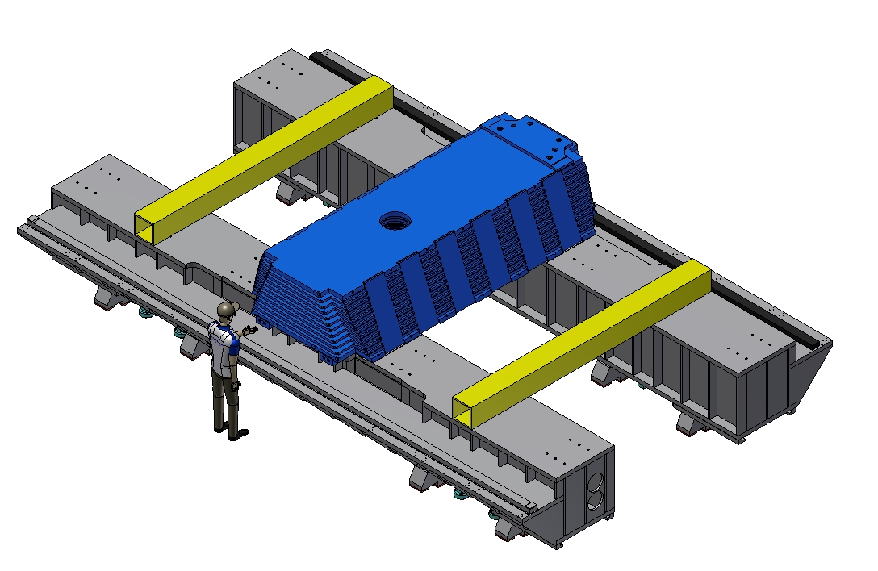
Yoke assembling procedure
Weight octant – 20,4 t
Installation and alignment of the first W1 octant.

Slide 5
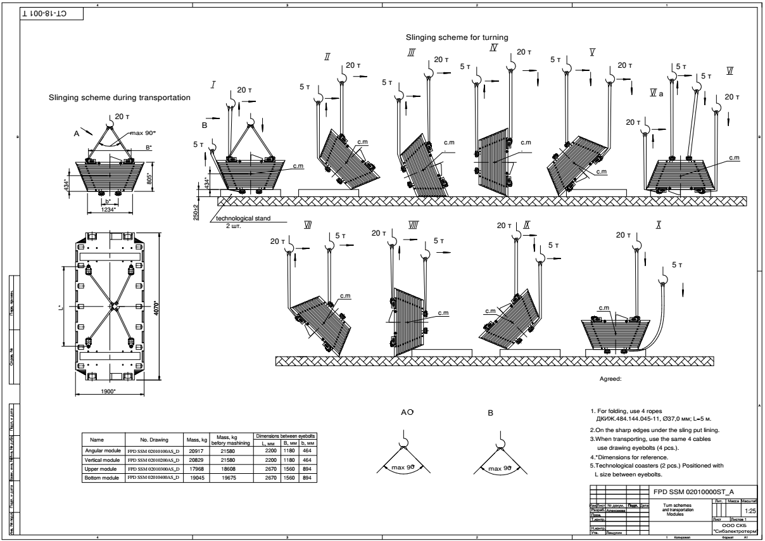
Yoke assembling procedure
Slinging scheme for turning.

Slide 6
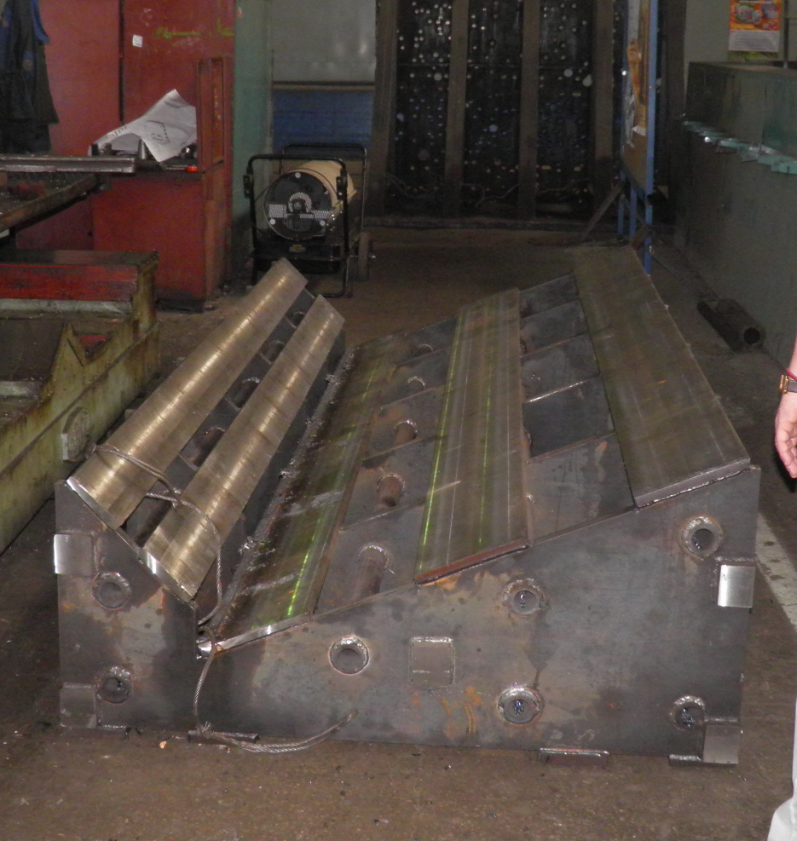
Yoke assembling procedure
Slinging scheme for turning.

Slide 7
Yoke assembling procedure
6290
Installation of the beams of the frames.

Slide 8
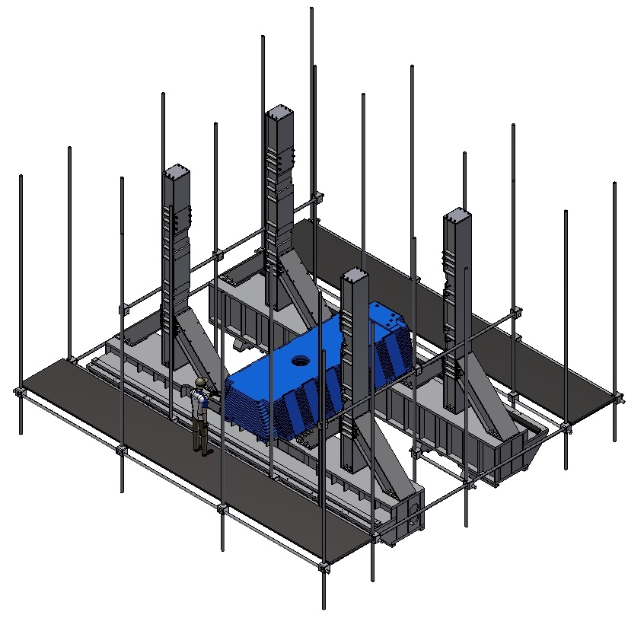
Yoke assembling procedure
6290
Installation of a scaffold.

Slide 9
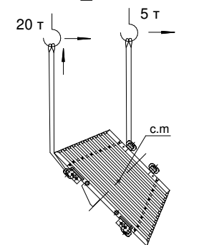
Yoke assembling procedure
Weight octant – 20,8 t
6290
Installation of the W2 angle octant.

Slide 10
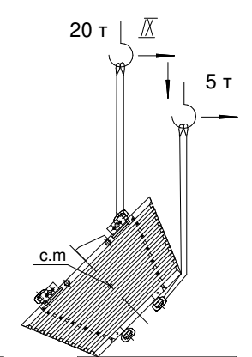
Yoke assembling procedure
Weight octant – 20,8 t
6290
Installation of the W8 angle octant.

Slide 11
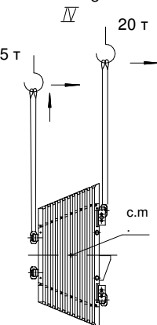
Yoke assembling procedure
Weight octant – 20,8 t
6290
Installation of the W3 vertical octant.

Slide 12
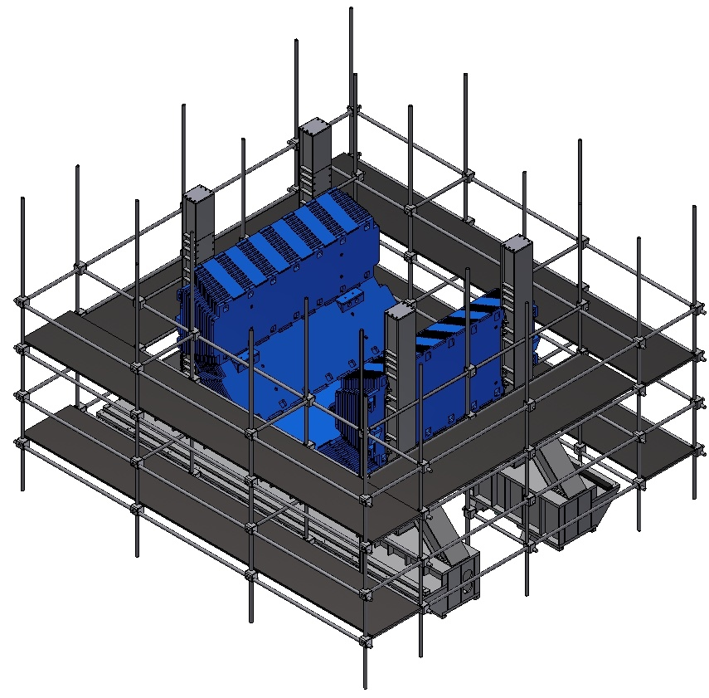
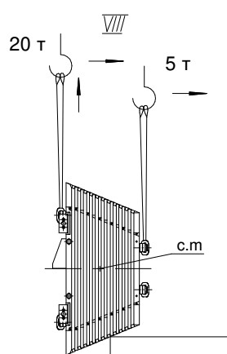
Yoke assembling procedure
Weight octant – 20,8 t
6290
Installation of the W7 vertical octant.

Slide 13
Yoke assembling procedure
Weight octant – 20,8 t
6290
Installation of inner supports.

Slide 14
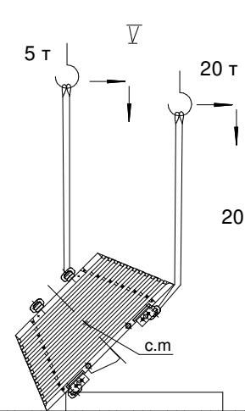
Yoke assembling procedure
Weight octant – 20,8 t
6290
Installation of the W4 angle octant.

Slide 15
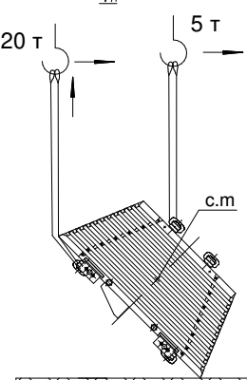
Yoke assembling procedure
Weight octant – 20,8 t
6290
Installation of the W6 angle octant.

Slide 16
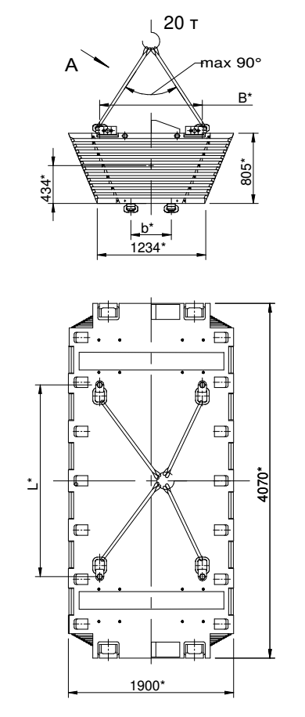
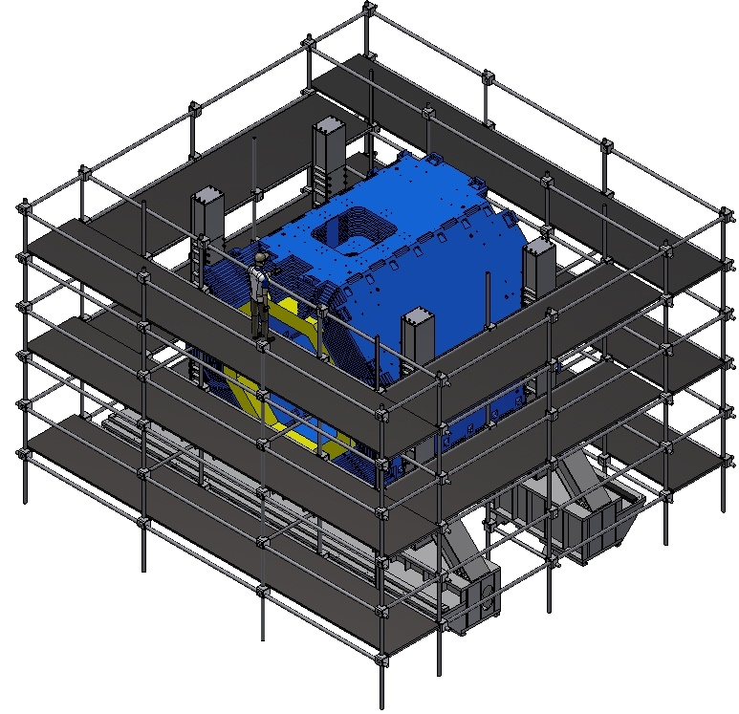
Yoke assembling procedure
Weight octant – 18,9 t
6290
Installation of the W5 upper octant.

Slide 17
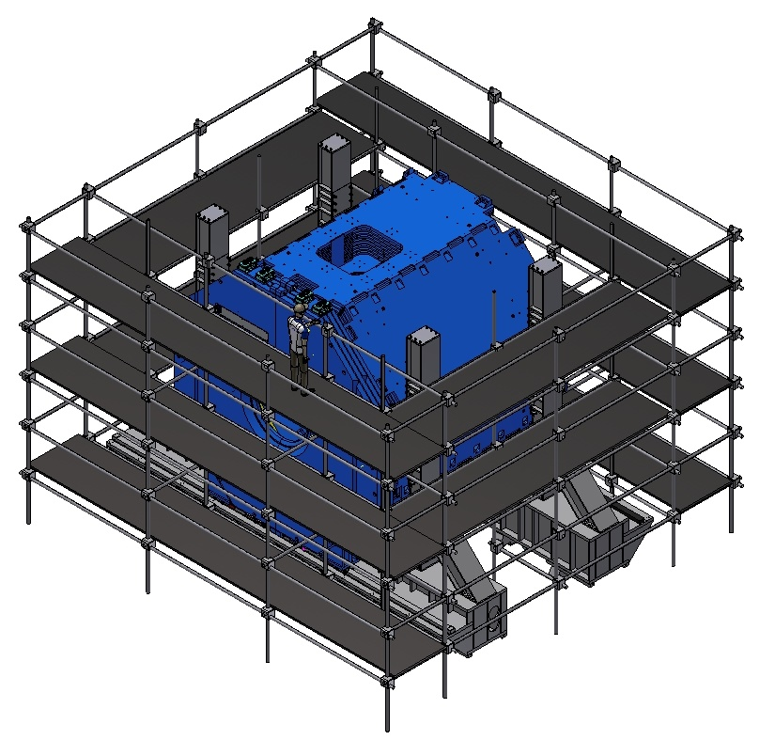
Yoke assembling procedure
Weight octant – 22,8 t
Installation of the Upstream door.

Slide 18
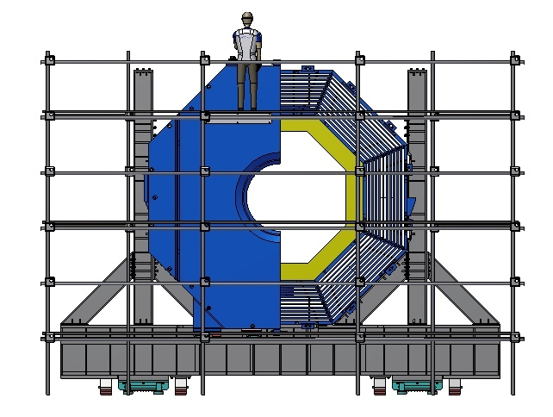
Yoke assembling procedure
Weight octant – 22,8 t
Installation of the Upstream door.

Slide 19
Yoke assembling procedure
Weight octant – 20,9 t
Installation of the Downstream door.

Slide 20
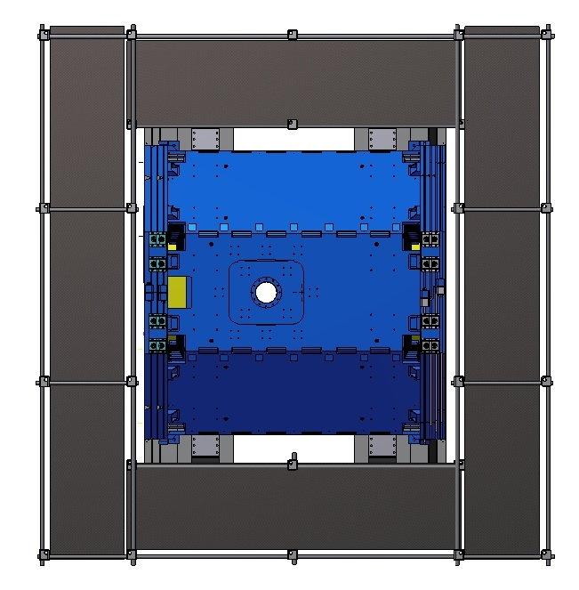
Yoke assembling procedure
Top view.

Slide 21
Yoke assembling procedure
Dismount of the scaffold.

Slide 22
Yoke assembling procedure
Open the wings of the doors and dismount of the inner supports.

Slide 23
Yoke assembling procedure
The Yoke in assembly.

Slide 24
Installation procedure of the Magnet into the Iron Yoke

Slide 25
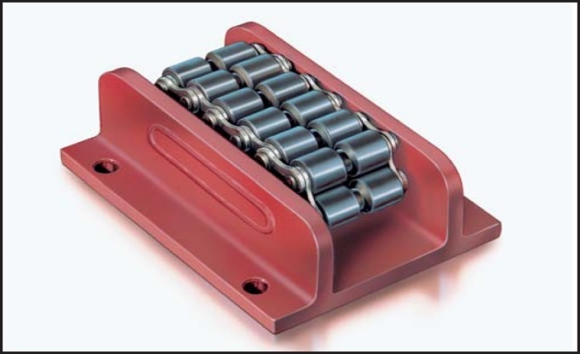
Magnet assembly procedure
For installation of the magnet into Yoke it is possible to use an I-beam steel hot-rolled with parallel faces of shelves 70B2 (697 x 260 mm) GOST 26020-83.
The length of the beam is L = 9 m.
To roll the magnet inside of the yoke, Roller skate Boerkey model AM-H are used to open doors
Rail

Slide 26
Installation procedure of the Magnet into the Iron Yoke
Tooling for installation of the Magnet into the Iron Yoke.

Slide 27
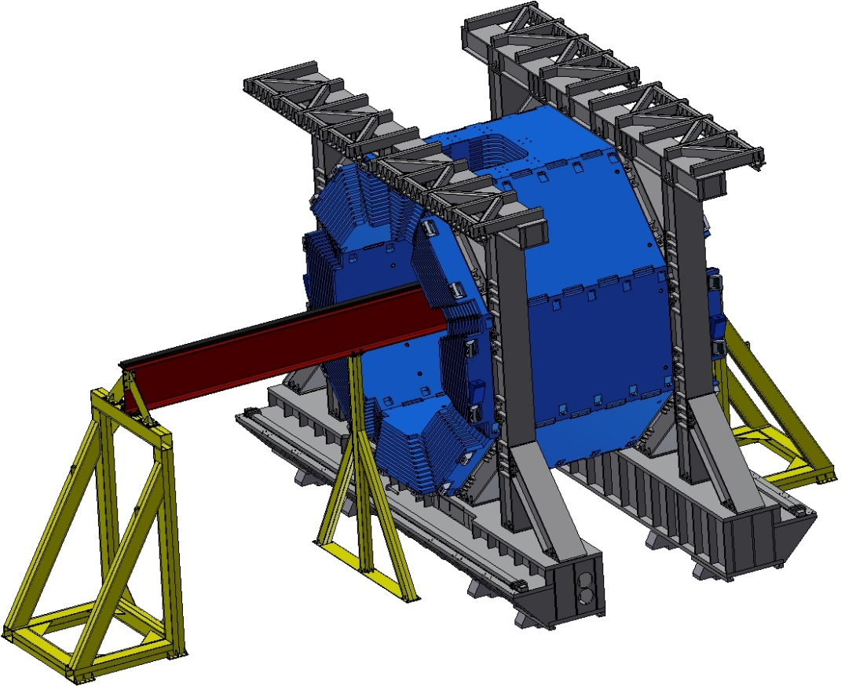
Installation procedure of the Magnet into the Iron Yoke
Preparation of the tooling for moving of the magnet.

Slide 28
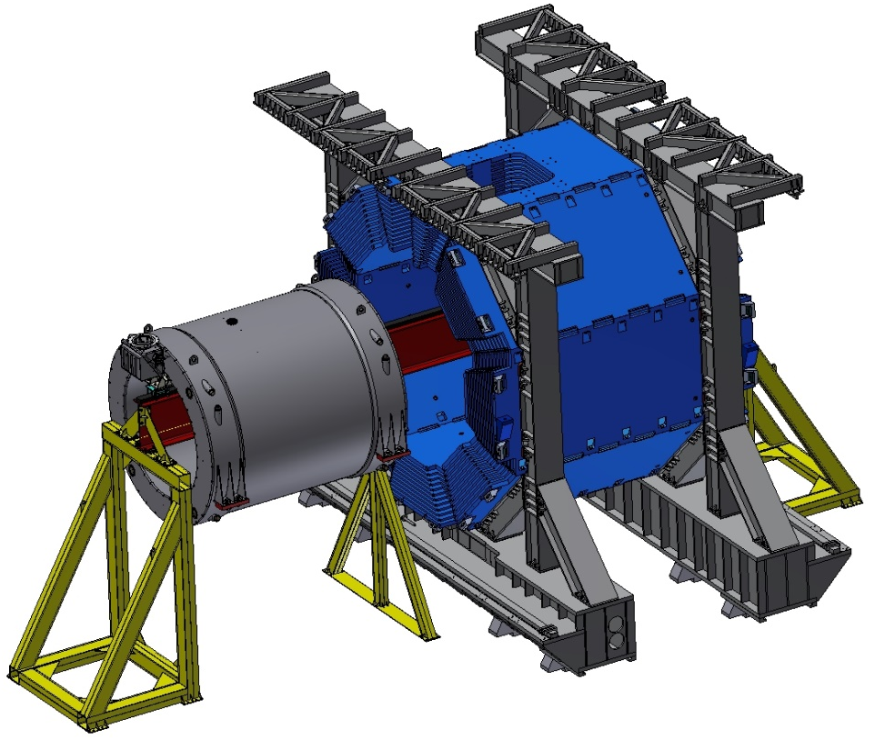
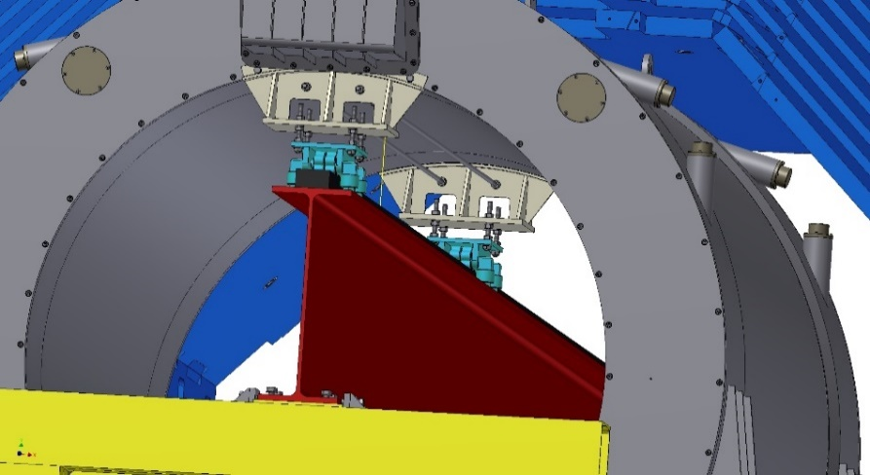
Installation procedure of the Magnet into the Iron Yoke
Install the magnet on the beam.

Slide 29
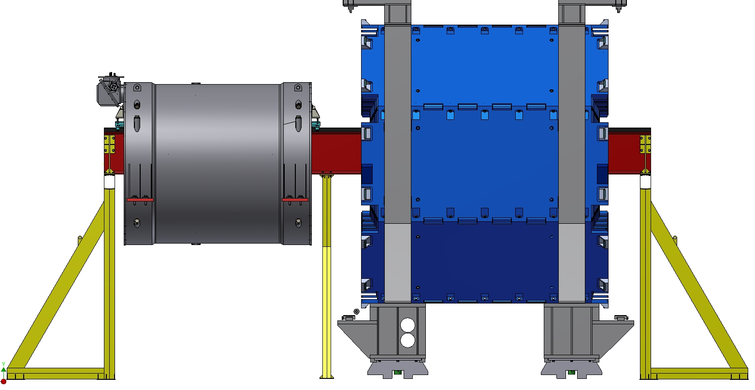
Installation procedure of the Magnet into the Iron Yoke
Install the magnet on the beam.

Slide 30
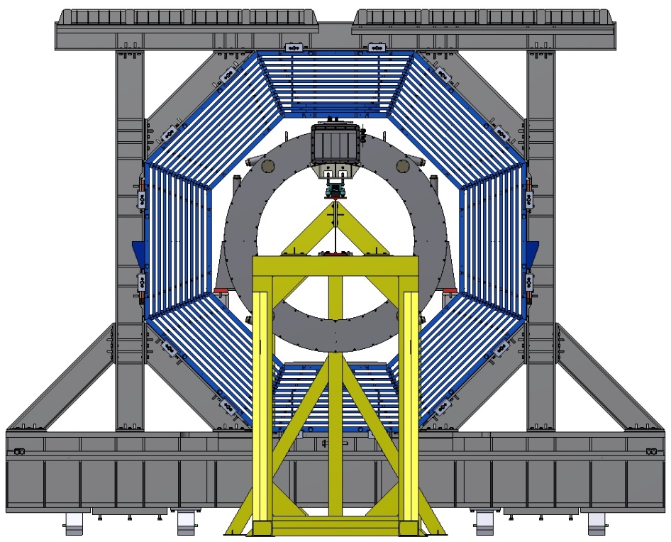
Installation procedure of the Magnet into the Iron Yoke

Slide 31
Installation procedure of the Magnet into the Iron Yoke
Remove an average support of the tooling.

Slide 32
Installation procedure of the Magnet into the Iron Yoke
Install and align of the cryostat into the yoke.

Slide 33
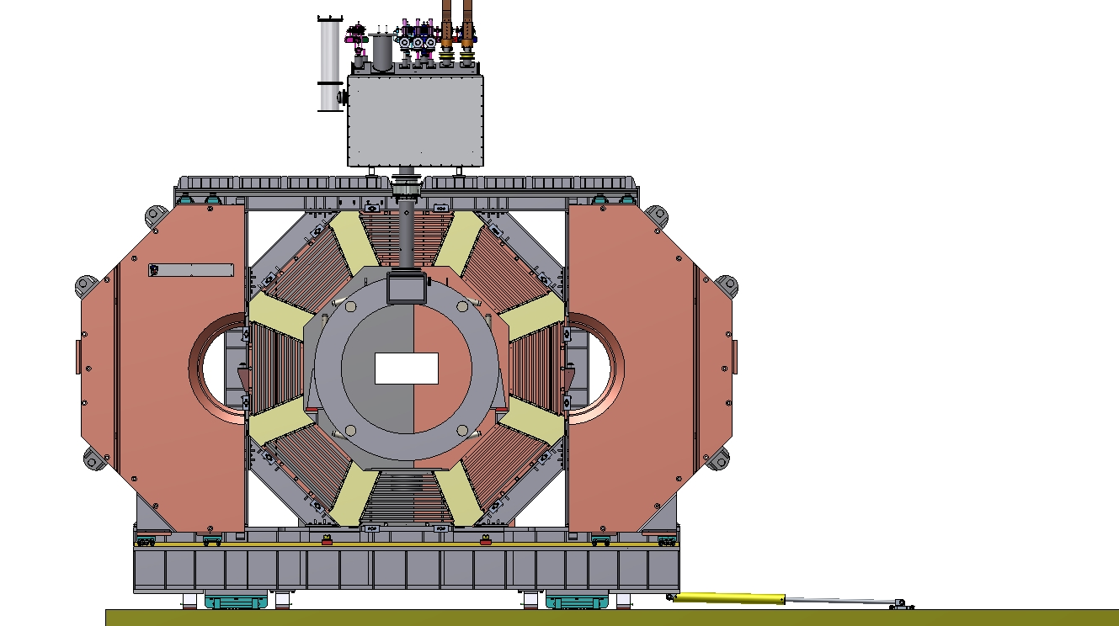
Installation procedure of the Magnet
Install and connect of the Control Dewar with the magnet by a transfer line.

Slide 34
Procedure for the PANDA Solenoid Power Cable Laying
The PANDA Solenoid Power Cabling intended for power supply of a superconductive solenoid and connection the solenoid with Energy Extraction System (EES). The maximal current is 5.1 kA. The value of a summary cross section of the cables is 3200 mm2.
The views of the PANDA Solenoid Power Cable laying are shown in the Figure 1.

Slide 35
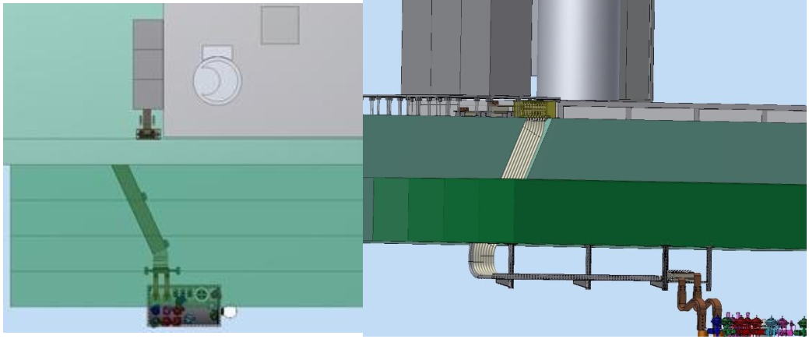
Procedure for the PANDA Solenoid Power Cable Laying
Power supply and EES racks
Cable layout
Control Dewar with current leads

Slide 36
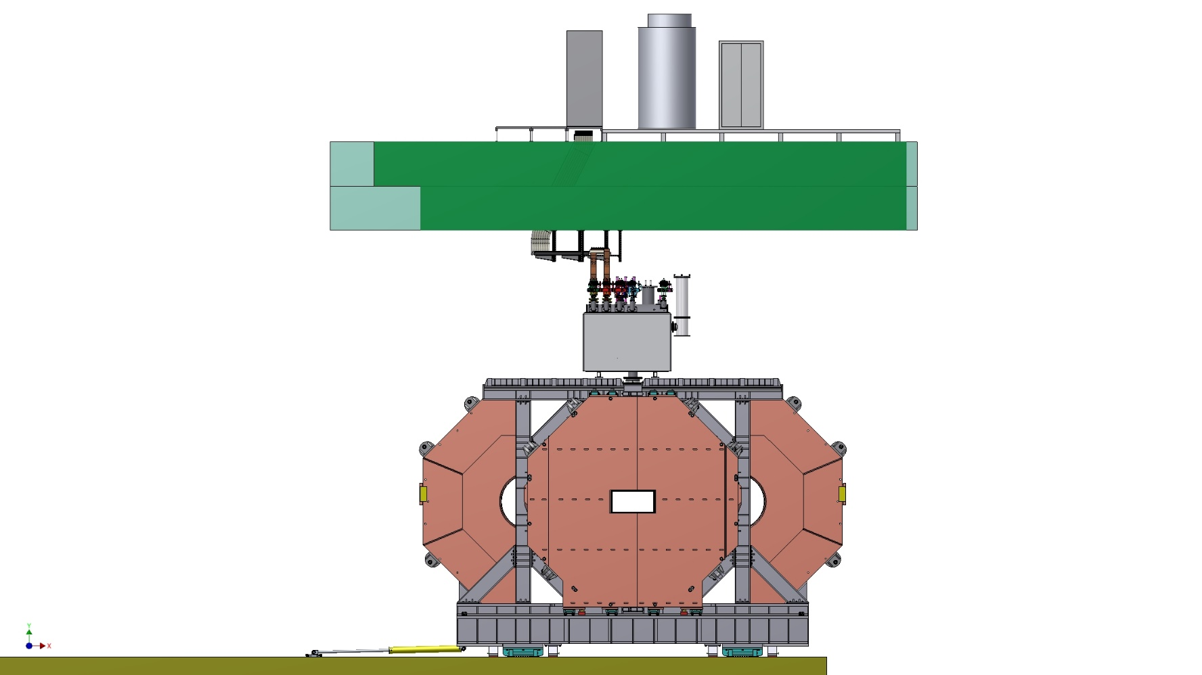
Procedure for the PANDA Solenoid Power Cable Laying
Power supply and EES racks
Concrete ceiling
Cable layout
Control Dewar with current leads
Yoke with solenoide

Slide 37
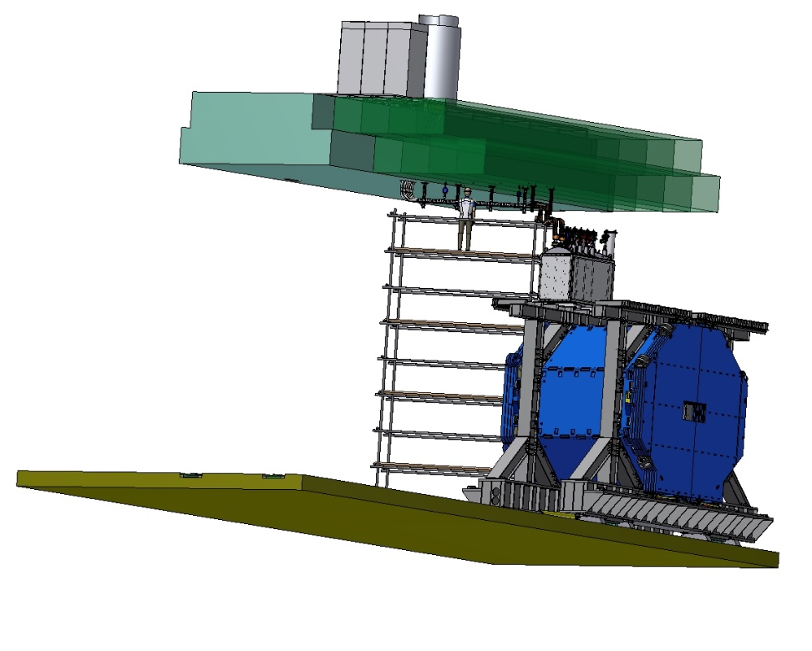
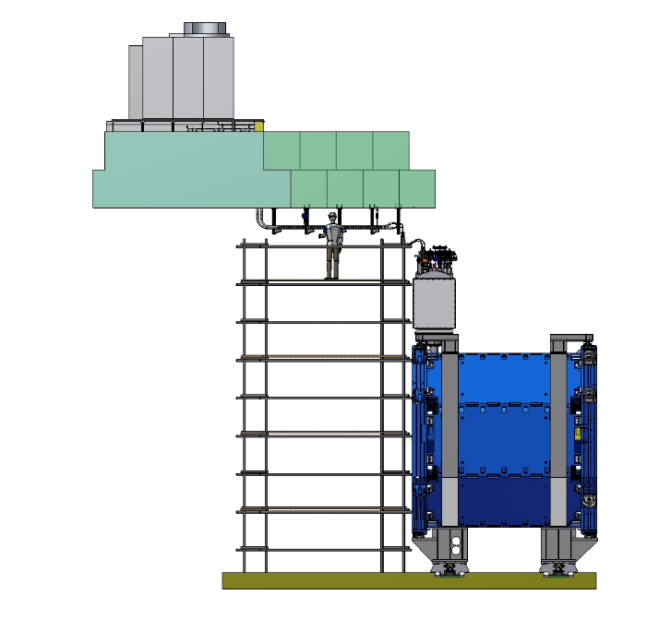
Procedure for the PANDA Solenoid Power Cable Laying

Slide 38
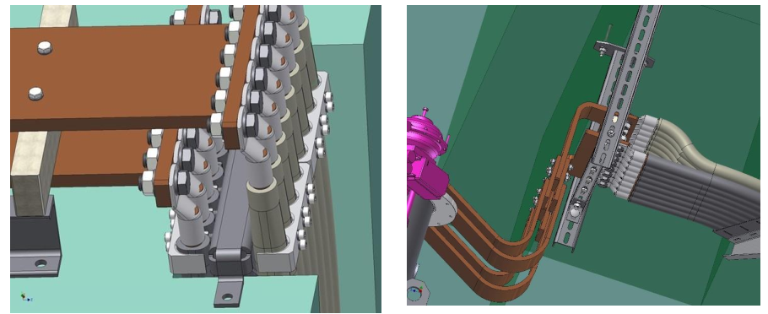
Procedure for the PANDA Solenoid Power Cable Laying
Connect all cable lugs with the busbars.

Slide 39
Site tests of the Magnet
After assembly of the PANDA yoke on the frame, the critical geometrical dimensions of the assembly shall be carefully checked according to the tolerances of the relevant drawings.
After installation of the cryostat into yoke the position of the cryostat versus the yoke shall be checked as well as the dimensions according to appropriate magnet assembly drawings including the survey reference system.
Cryostat and cold mass tests
Pressure Tests
Pressure tests must be carried out for all components of cryogenic system of PANDA solenoid magnet at ambient temperature according to AD2000 and PED. The concerned relief valves shall be blocked for the period of the tests.
Leakage test of the piping
Leak tests should be carried out with a helium leak detector on all process piping and vacuum shells according to specified requirements at ambient temperature. These include:
Leak test of cryostat;
with vacuum in refrigerant circuits;
with 125 kPa helium in the process pipes.

Slide 40
Site tests of the Magnet
Testing the instrumentation
All instrumentation must be controlled in the best possible way.
X-ray Tests of Welds
All welds on the process pipes done by the provider at the FAIR’s site shall be X-rayed 100% before the pressure and leak tests are done.
Electrical tests
Ground insulation of the coil and coil resistivity shall be measured.
Ground insulation tests shall be applied using a voltage of 2 kV for one minute.
The insulation resistance shall be greater than 10 MΩ.
The electrical resistance of all coils shall be measured at ambient temperature.
The insulation between the instrumentation lines and the superconductive windings has to be tested with 500 V for one minute, at room temperature .
Cryogenic tests
Quench detection tests
Magnetic fields measurements

Slide 41
Thank you for your attention!

