Slide 1
ISO 11064

Slide 2
ISO 11064-3
ISO 11064 is divided into 8 parts.
Part 1 – Principles for the design of control centers
Part 2 – Principles for the arrangement of control suites
Part 3 – Control room layout
Part 4 – Layout and dimensions of workstations
Part 5 – Displays and controls
Part 6 – Environmental requirements for control centers
Part 7 – Principles for the evaluation of control centers
Part 8 – Ergonomic requirements for specific applications

Slide 3
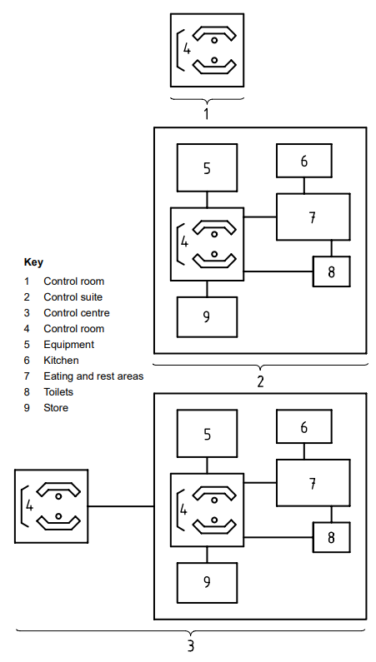
Schematic Illustrations Of Control Room, Control Suite And Control Centre
Control Centre
Combination of control rooms, control suites and local control stations which are functionally related and all on the same site
Control Suite
Group of functionally related rooms, co-located with the control room, and including it, which house the supporting functions to the control room, such as related offices, equipment rooms, rest areas and training rooms
Control Room
Core functional entity, and its associated physical structure, where control room operators are stationed to carry out centralized control, monitoring and administrative responsibilities

Slide 4
General Considerations For Control Room Layout
Architectural considerations
Entrances/Exits
Main entrances and exits should not form part of the working visual fields of the control room operator.
Entrances and exits should not be positioned behind the control room operator.
Personnel safety
Features, such as guard-rails and handrails, should be provided to minimize safety hazards in control rooms where various floor levels are found.
Future expansion
Control rooms should allow for expansion: provision for expansion will be influenced by such factors as the built-in life-span of the control room and predicted changes in workload or logistics: typically allowance for approximately 25 % increase in working positions.

Slide 5
General Considerations For Control Room Layout
Operational considerations
Task analysis
Room layouts should be based on an agreed set of principles derived from operational feedback
Team working
The layout of control rooms, where many of the control room operators work, should facilitate team working opportunities and social interaction for operators
Organizational factors
The control room layout should reflect the allocation of responsibilities and the requirements for supervision.
Operational links
Optimizing key operational links, including sightlines, or direct speech communication should be a goal in control room layouts

Slide 6
General Considerations For Control Room Layout
Workstation arrangements
Room layout
Control rooms which exhibit either overcrowding of work positions, or widely dispersed work positions, are not recommended.
Layouts should allow, wherever practical, direct verbal communication between the control room operators and avoid excessively short separations between adjacent operators
Consistency
Control rooms with similar functions and in the same plant or facility, such as occur in a control complex, should adopt the same ergonomic principles of room layout to facilitate decision-making and teamwork.

Slide 7
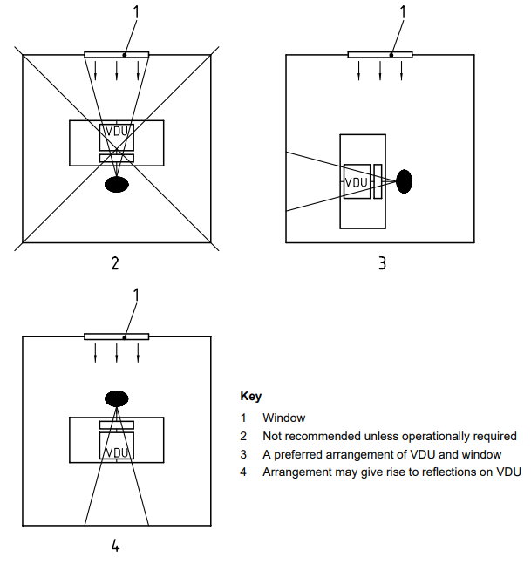
General Considerations For Control Room Layout
Workstation arrangements
Body size
Room dimensions and control workstation layout dimensions and features, shall take account.
Windows
Control room operators using visual displays should not be facing windows unless these windows are a primary information source.
The location of control workstations where windows are behind the operator should be avoided since this may give rise to reflections on the display screen.

Slide 8
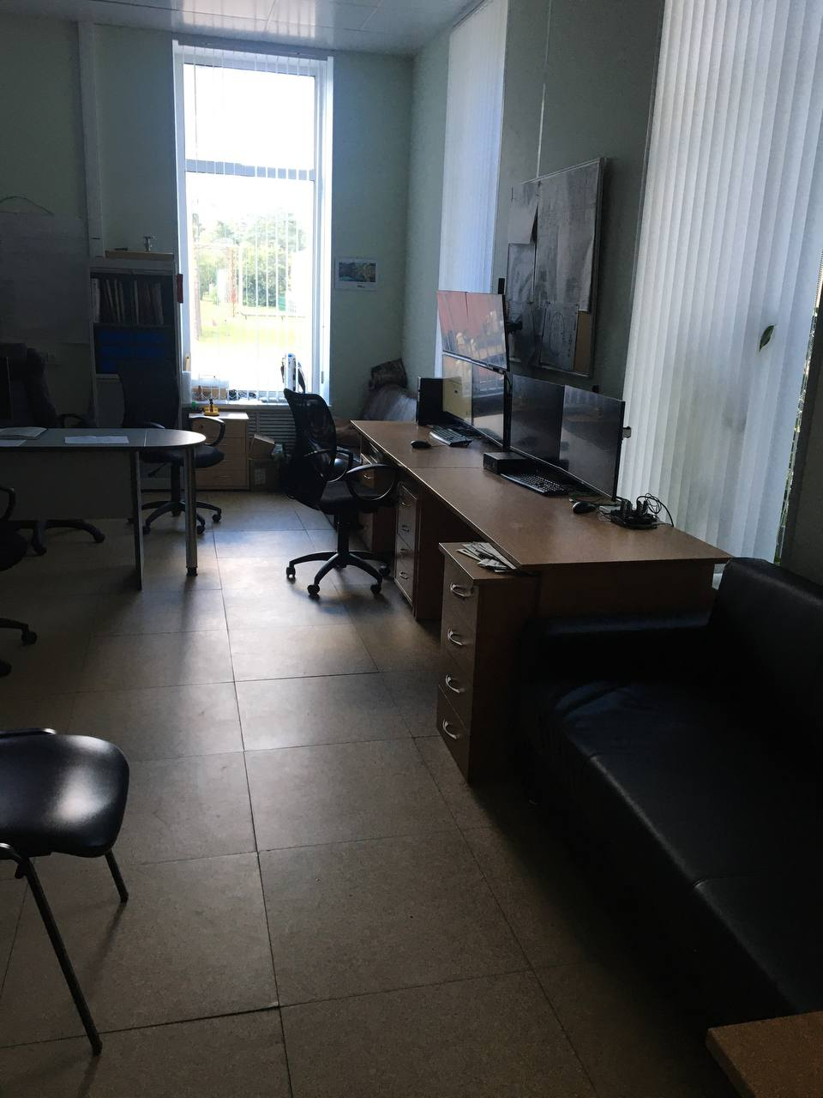
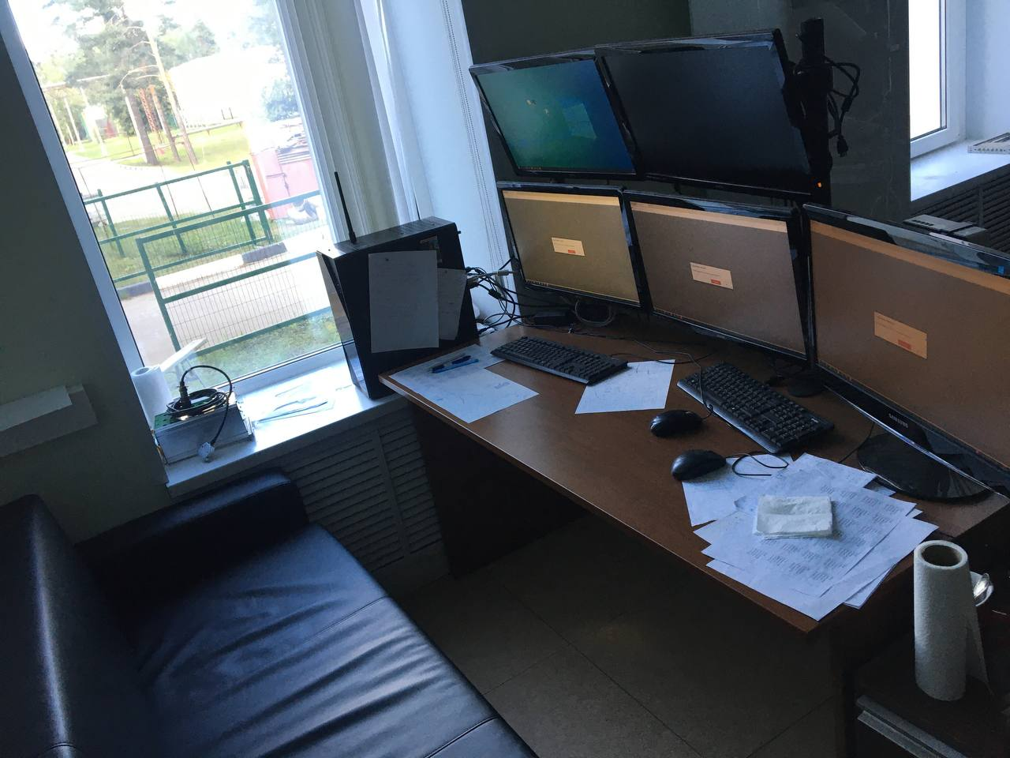
General Considerations For Control Room Layout

Slide 9
General Considerations For Control Room Layout
Off-workstation shared visual displays
The layout of the control room shall ensure that all off-workstation visual displays, necessary for the control room operators’ task, are visible from all relevant control workstations.
Circulation of personnel and maintenance access
Where it is anticipated that the supervisory positions will give rise to additional circulation from outside the control room, it is recommended that these positions be located close to main entrances
All aspects of control room layout shall take account of the requirements for maintenance access

Slide 10
General Considerations For Control Room Layout
Verification and validation of control room layout
Verification is the process of determining that something has been designed and constructed according to a defined specification.
Verification and validation should be integrated with the design process and should be performed in parallel with top level design, detailed design and during the development of prototypes.
Verification and validation should be an iterative process during the development of the design.
Documentation
Evaluation criteria and decisions based on ergonomic principles should be documented and securely stored so that future modifications can take proper account of these factors.

Slide 11
Architectural/building recommendations
Plan space provision
The selection of a space for a control room should be based on the usable area, not the gross area.
Obstructions and structural features, such as pillars and awkward corners, within a proposed/planned control area, will severely reduce the available space and could result in sub-optimal work layouts.
A heuristic value for planning floor-space allocation is to allow for 9 m 2 to 15 m2 per working position(for single workstations or clusters of workstations)
In some control rooms, where large, shared overview displays are a dominant operational feature, space allocations of up to 50 m2 have been measured.
Square, circular and hexagonal spaces are preferred for the arrangement of functional groups, because they offer the potential of maximizing the number of links.

Slide 12
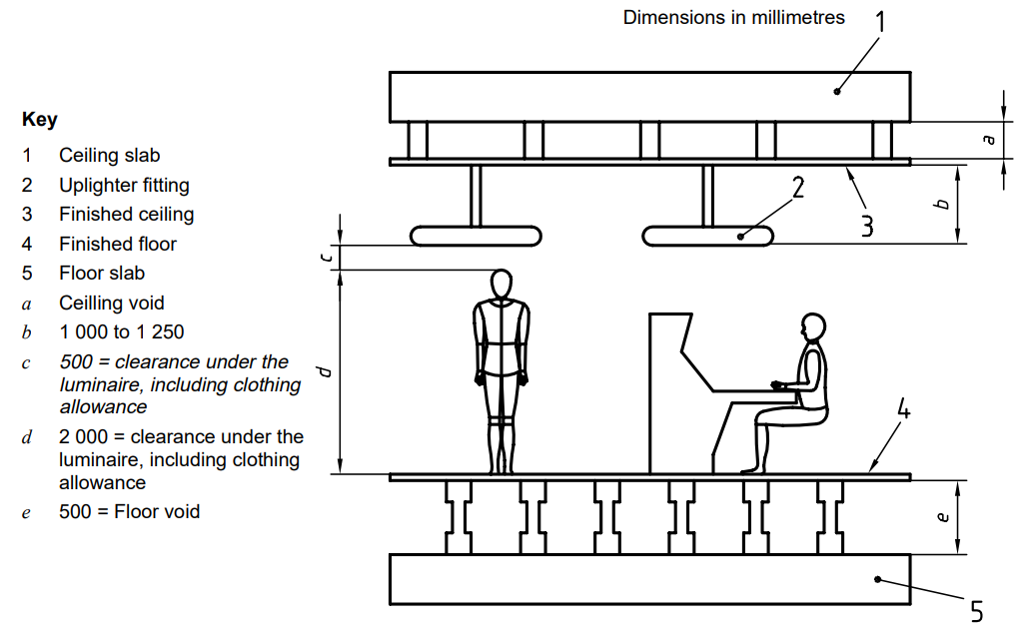
Architectural/building recommendations
Vertical space provision
Control rooms with a single finished floor height offer greater flexibility for future change and for the movement of equipment and personnel.
For a given control area, single height ceilings are preferred.

Slide 13
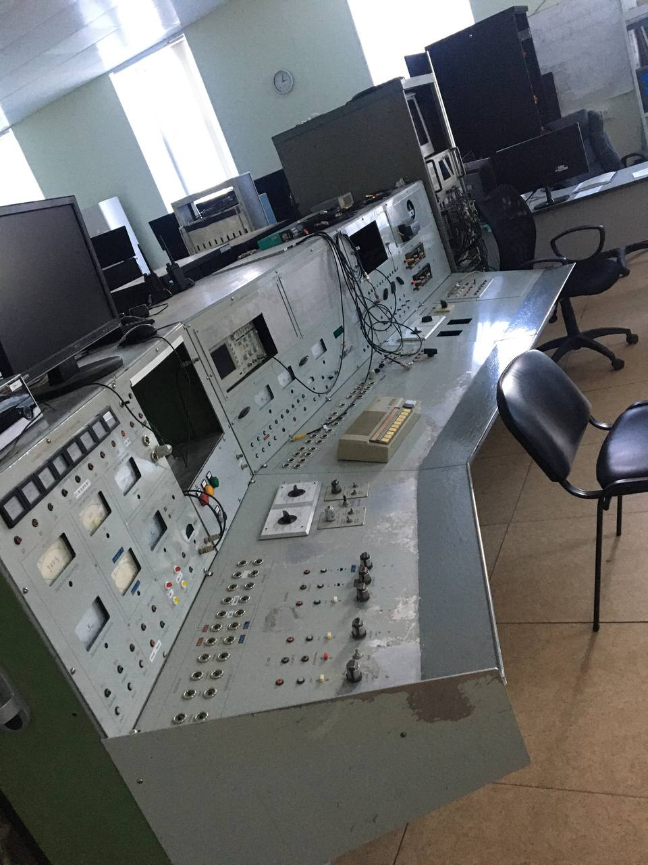
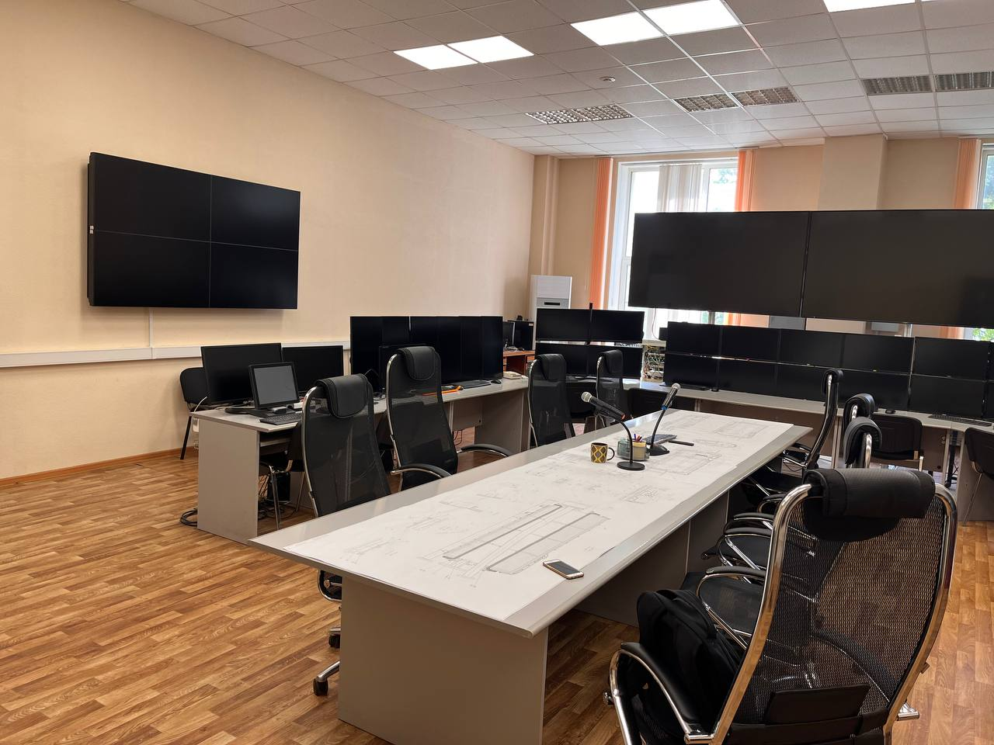
Architectural/building recommendations

Slide 14
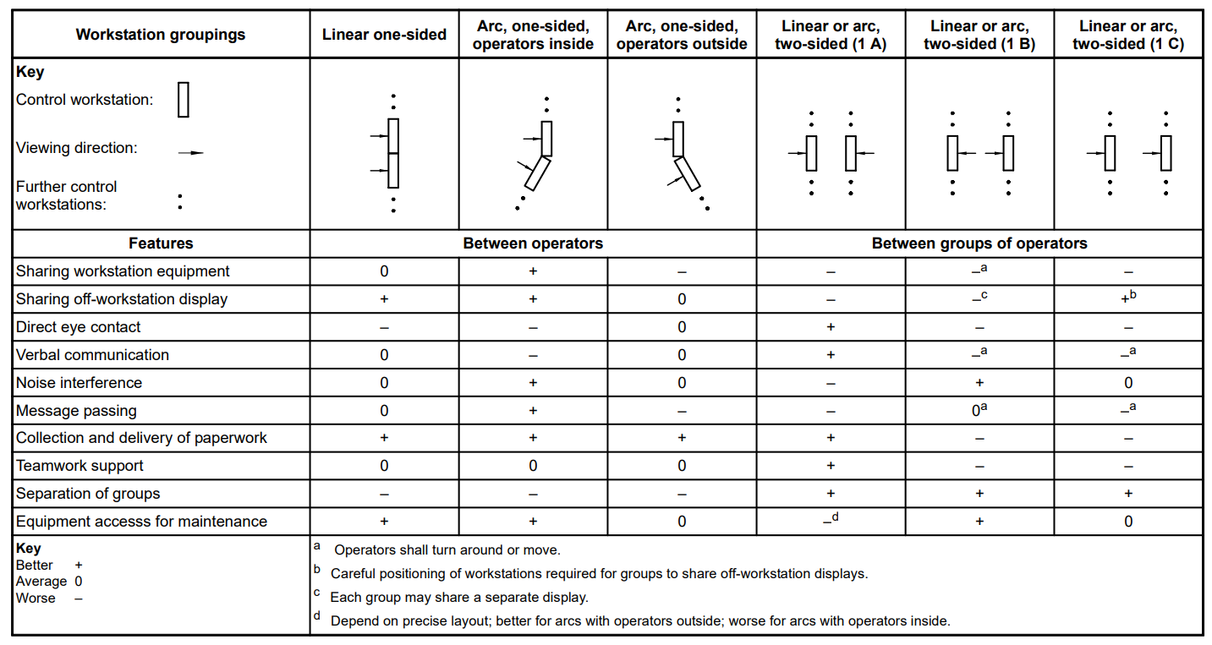
Examples Of Control Room Layout
General workstation groupings

Slide 15
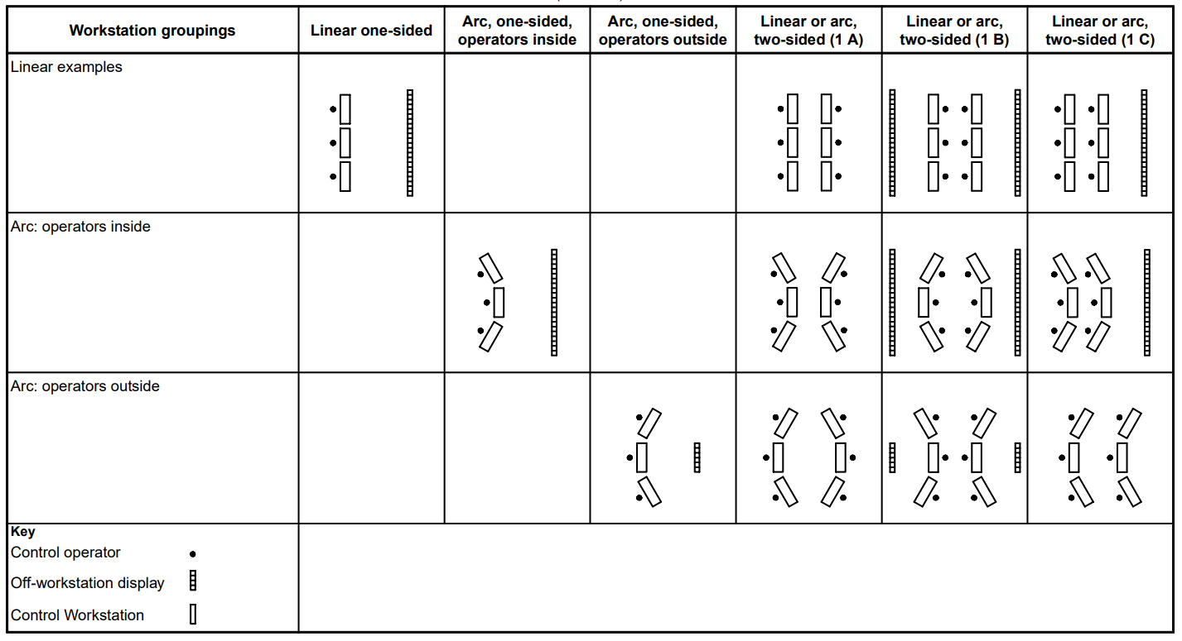
Examples Of Control Room Layout
General workstation groupings

Slide 16
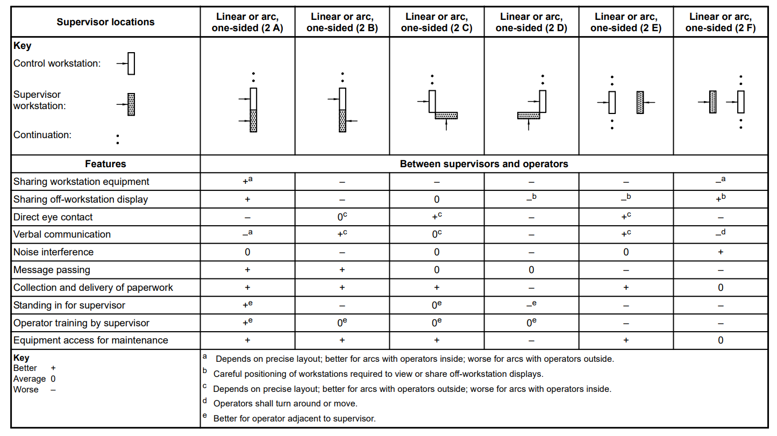
Examples Of Control Room Layout
Workstation groupings and supervisor positions

Slide 17
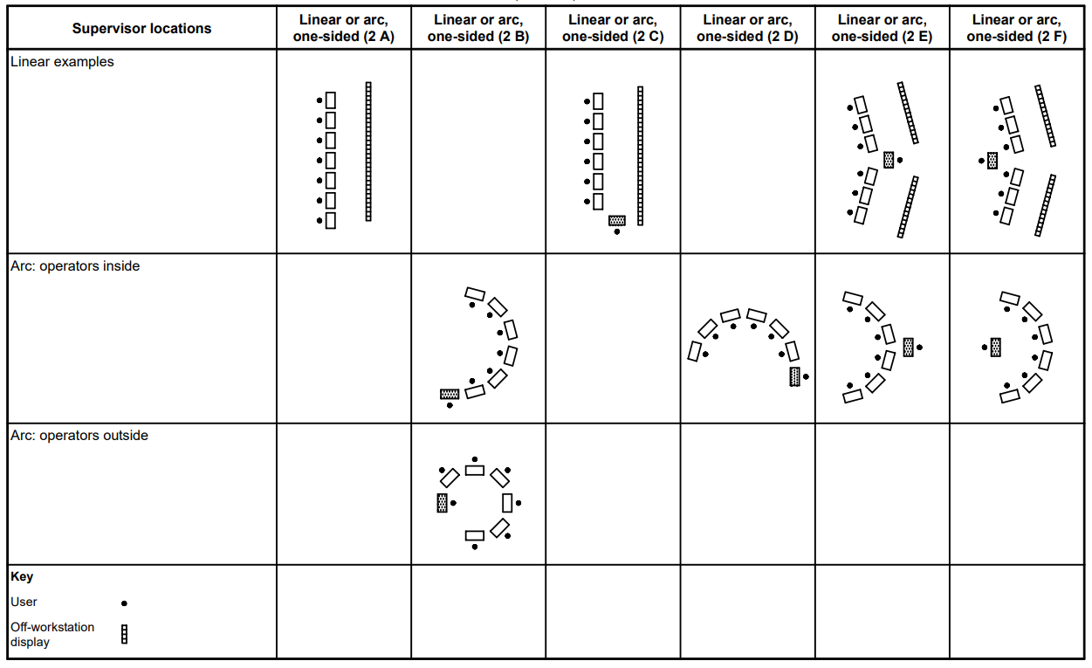
Examples Of Control Room Layout
Workstation groupings and supervisor positions

Slide 18
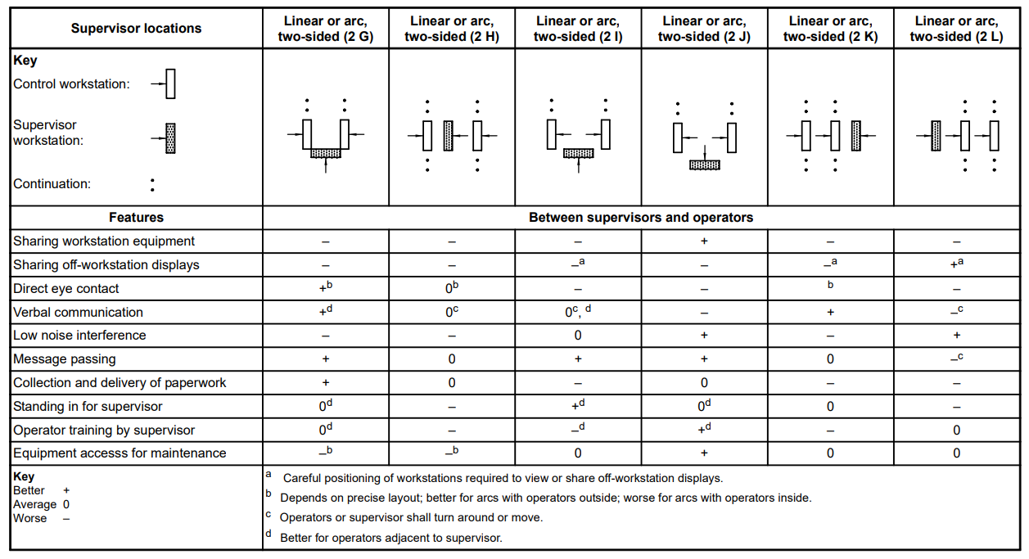
Examples Of Control Room Layout
Workstation groupings and supervisor positions

Slide 19
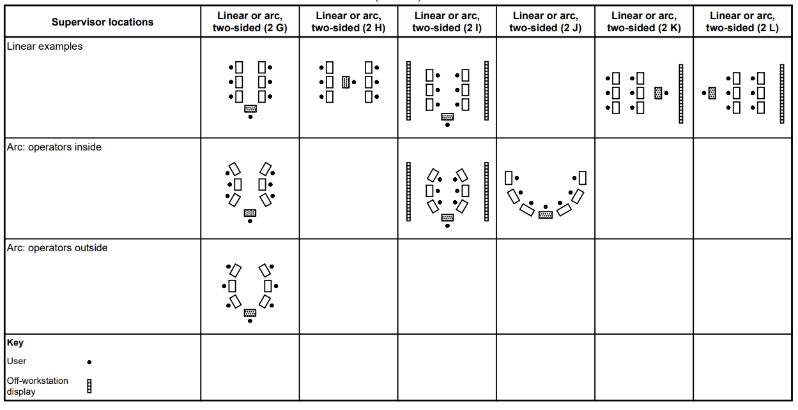
Examples Of Control Room Layout
Workstation groupings and supervisor positions

