Slide 1
Detector Control Systems (DCS)
To represent actual low degree of automation on BM@N at JINR

Slide 2
DCS Decomposition of BM@N
The DCS of BM@N primarily composes of 5 Parts
Hardware
Software
Logicware
Infoware
Organizeware
This is majorly taken into consideration at four different levels
Field Level
PLC
Server
Suspension Level

Slide 3
Hardware
For collection Displaying and processing of Data along with control
Involves The Field level, PLC, Server and Supervision Level
Comprises physical devices and instruments necessary for the operation and monitoring of detectors and experimental systems.
This includes sensors, actuators, data acquisition systems, communication interfaces, and other devices that interact with the experiment's physical components.
Hardware elements collect data from detectors, trigger mechanisms, and other experiment-specific instruments, transmitting this information to the software layer for processing and analysis.

Slide 4
Software
Firmware operation system basic software protocols application software SCADA
Involves The Field level, PLC, Server and Supervision Level
Encompasses a range of programs, algorithms, and scripts designed to control and manage the experiment's hardware components.
This includes control algorithms that regulate detector parameters, trigger conditions, and data acquisition processes.
Moreover, software interfaces provide user-friendly platforms, such as Human-Machine Interfaces (HMIs), through which experiment operators and researchers interact with the DCS.
The software layer enables real-time control, data visualization, and automated responses to various experimental conditions.

Slide 5
Logicware
Logical Components for the automation of workflow
Involves PLC, Server and Supervision Level
Composes of logical rules, scripts, and decision-making processes that govern the behaviour of DCS.
It involves defining conditions, thresholds, and actions that the system should take in response to specific events or measurements.
Logicware ensures that the DCS reacts appropriately to anomalies, deviations, or critical events, thus maintaining the experiment's integrity and safety.
For instance, logicware can dictate emergency shutdown procedures if certain conditions are met, preventing potential equipment damage.

Slide 6
Infoware
Structured design, Operational configuration information in the final GUI
Involves Server and Supervision Level
Includes managing and processing the vast amount of data generated by detectors and experiment components.
It includes data processing algorithms, storage solutions, and data analysis tools.
Infoware ensures that collected data is organized, archived, and made accessible for further analysis, interpretation, and collaboration among researchers.
Additionally, infoware may involve data visualization tools to help researchers comprehend complex datasets.

Slide 7
Organizeware
Technological information, user’s manual, basically the operating personnel
Involves only the supervision level of the DCS
It establishes roles, responsibilities, and communication channels among individuals involved in operating, maintaining, and utilizing the system.
This structure encompasses researchers, engineers, operators, and other stakeholders who collaborate to ensure the efficient operation of the DCS.
Clear lines of communication and well-defined responsibilities are essential to effectively manage the DCS throughout the experiment's lifecycle.
In essence, the constitution of the DCS in high-energy physics experiments is a holistic framework that synergistically combines hardware, software, logicware, infoware, and a well-structured organization.
This comprehensive approach ensures that experiments are conducted with precision, reliability, and safety, allowing researchers to extract valuable insights from the intricate world of particle interactions.

Slide 8
Hardware components of the DCS system of BM@N
DCS DAQ and Trigger system
The DCS of the BM@N setup operates independently without any direct involvement in the other steps of the process.
The DAQ and trigger system are present as distinct and independent bodies managing their own designated responsibilities.
Even though they operate independently from each other, their combined action is what leads to the cohesive operation of the BM@N experiment

Slide 9
Hardware components of the BM@N DCS
Three layers of the BM@N control system components can be distinguished:
(1) The front-end layer consists of industrial computers, intellectual controllers, and crates that directly manage equipment and gather data from sensors. The front-end computers execute low-level TANGO programs responsible for data acquisition, equipment manipulation, and the abstraction of protocol and connection intricacies from higher-layer components.
(2) The service layer comprises high-level TANGO devices that represent complete subsystems. These devices gather data from front-end TANGO devices, process it, and implement algorithms to regulate larger subsystems. These high-level programs offer a standardized TANGO interface for whole subsystems, enabling client software to execute commands, access attributes, and perform read and write operations without necessitating knowledge of the underlying subsystem structure. Additionally, the service layer supplies a suite of services crucial for the efficient operation of the control system, encompassing administration, management of control system hardware and software, monitoring, data archiving, and development services.
(3) The client layer presents the accelerator complex state to the operator, visualizes acquired data, and empowers the operator to execute control actions. The aim is to offer a comprehensive interface enabling the operator to access the entire accelerator complex control, with the added capability to navigate to its individual components.

Slide 10
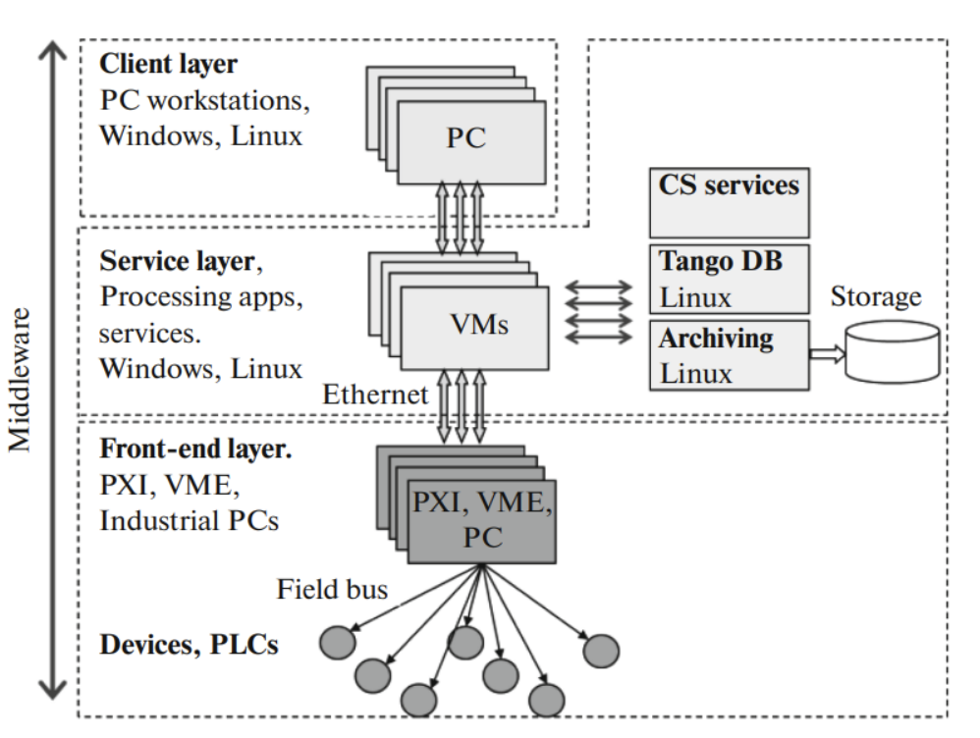

Slide 11
Hardware Components Quantitative List
Number of Detectors Involved in the BM@N Experiment | 10 (Some detectors have their own localized control systems and operate independently with minor feedback from the DCS.)
Number of Crates | 8
Number of Embedded Computers or Network Devices | 54
Number of Control Computers or Servers | 2 (1 main server and 1 reserve server)
Number of SCADA Systems | TangoControl (sole SCADA system employed)

Slide 12
Number of External Services Monitored by the DCS
The DCS effectively monitors several critical external services to ensure the smooth operation of the experimental environment. These services include:
- Electricity Supply - Backup Power Systems
- Temperature Levels - Humidity Levels - Radiation Levels
The DCS ensures the continuous monitoring of these vital parameters, contributing to the overall safety and stability of the experiment facility.

Slide 13
Manuscript Preparations
Refer Google sheets for updates and clarifications regarding BM@N
Information updation and corrections

