Slide 1
DETECTOR CONTROL SYSTEM FOR FORWARD DIFFRACTIVE DETECTOR
By
Alaa ElSadieque

Slide 2
ALICE (A Large Ion Collider Experiment) is a heavy-ion collision experiment in the Large Hadron Collider (LHC) at CERN (European Organization for Nuclear Research). It is designed to study the physics of strongly interacting matter, in particular the properties of Quark Gluon Plasma (QGP) by collisions of proton-proton (p-p), lead-lead (Pb-Pb), and proton lead (p-Pb) at high energies. ALICE comprises various detectors and is currently under upgrade for Run 3

Slide 3
As part of this upgrade, ALICE Diffractive (AD)was replaced by FDD, and it is part of ALICE’s Fast Interaction Trigger (FIT) project. Therefore, upgrading the AD to FDD detector implies developing a new control system (FDD-DCS)

Slide 4
Fast interaction trigger
The FIT detector serves as an interaction trigger onlineluminometer, initial indicator of the vertex position, and the forward multiplicity counter . The FDD detector is part of one of the three sub-detectors that make up ALICE’s FIT project, together with FT0 and FV0 detectors (Fig. 1). FDD will contribute with the measurements of the time and luminosity of collisions. It will be used mainly for the study of diffractive physics.

Slide 5
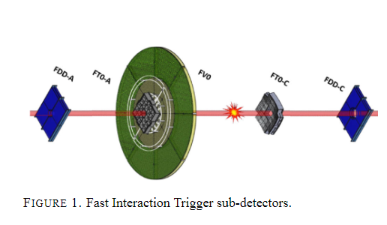

Slide 6
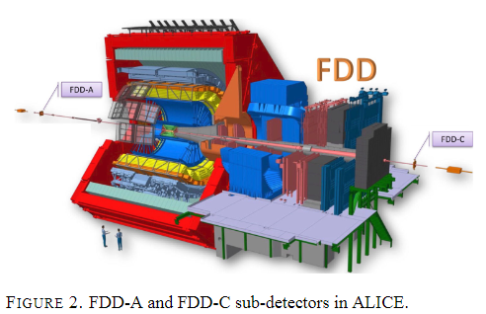
The forward regions (A and C sides) of the ALICE cavern (Fig. 2) were assigned to the FDD detector for operation during Run 3 of the Large Hadron Collider (LHC).

Slide 7
The FDD detector consists of two sub-detectors called FDD-A and FDD-C (Fig. 3). Each of them includes two detector layers, and each layer consists of four scintillator modules arranged around the LHC beam pipe to collect the particles emerging during collisions. The FDD-A and FDD-C designations refer to the installation positions at both ends of the ALICE site concerning the interaction point (IP).

Slide 8
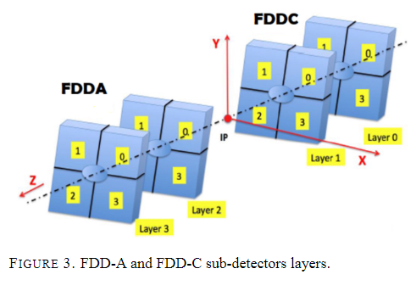

Slide 9
Software architecture
The DCS will monitor the status of the FDD-A and FDD-C sub-detectors. It will also supervise the electronics present in such experiment, for instance: PM, TCM, and the infrastructure of the experiment, such as the power supply devices and the temperature of the crates where various electronic devices are located.

Slide 10
Hardware architecture
The FDD-DCS has the following hardware architecture
(Fig. 4):
•The supervision layer consists of Operator Nodes (ON) that provide the user interfaces to the operators and it is located in ALICE control room.
•The process control layer consists of Worker Nodes number of nodes
(WN), PLCs and PLC-like devices that interface to the experiment equipment. It is located in the Counting Room (CR).
•The field layer comprises field devices such as power supplies, field bus nodes, sensors, actuators, and more. This layer is located in the ALICE cavern.

Slide 11
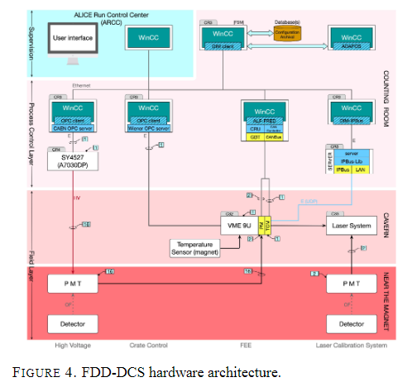

Slide 12
Hardware of the FDD-DCS
The hierarchy of the CAEN A7030DP high voltage boards used to power the PMTs was configured in the FDD-DCS using the SCADA system. Such CAEN boards are inserted in the CAEN crate SY4527 located in Counting Room 4 (CR4)

Slide 13
Logical of the FDD-DCS
Another part of the development of the control system that was done is to configure the logical hierarchy corresponding to the PMTs of the FDD detector on side A and side C of the cavern of the ALICE experiment. This is necessary for the control system to identify the 16 PMTs (Fig. 5) and read the data from such PMTs during collisions.

Slide 14
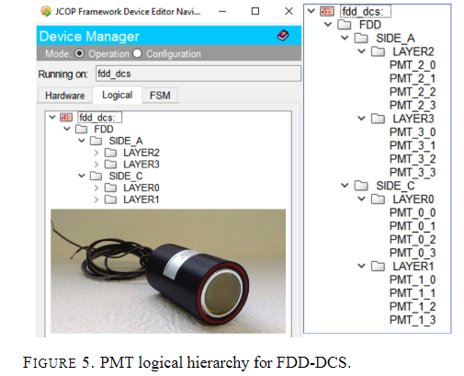

Slide 15
Finite state machine of the FDD-DCS
The hierarchy of Finite State Machines (FSM) was defined for the upper node and the control nodes of the FDD detector on both sides, as well as that of the PMTs. This is required for the control system to monitor the status of the FDD-A and FDD-C sub-detectors, as well as send ON (SWITCH ON) or OFF (SWITCH OFF) commands to the 16 PMT

Slide 16
User interface and alarms
FDD-DCS main panel
FDD-A and FDD-C sub-panels
CAEN boards temperature

Slide 17
FDD-DCS main panel
Using the WinCCOAsoftware, the first version of the main panel of the FDD-DCS has been developed (Fig. 6). The DCS must have a main control panel to be managed by an operator of the ALICE experiment’s central control system to monitor the detector’s general status during collisions

Slide 18
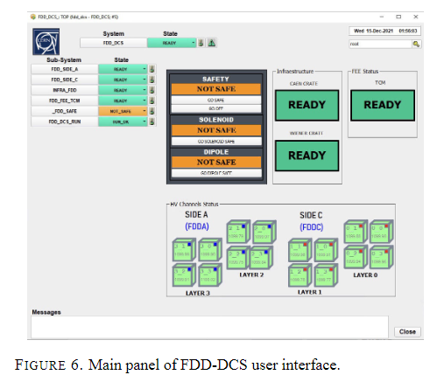

Slide 19
FDD-A and FDD-C sub-panels
The first version of the panel to monitor and control the A
and C side of the FDD detector was also developed.
The main panel of DCS must have sub-panels of control that allow the operator to obtain more details of the status of the different parts of the detector and control such parts as well.
For example:
•In the FDD-A and FDD-C sub-panels, the operator can set and read the voltage and current applied by the high voltage boards to the PMTs.
•It can also monitor and control the status for each photomultiplier of the FDD-A and FDD-C sub-detectors.

Slide 20
CAEN boards temperature
Alarms were defined in such a way that the DCS operator can identify on the main panel if any of the sides of FDD detector has any type of problem:
•For example, the detector’s green background of layer 1 of side C (Fig. 6) indicates that it is working correctly. However, the background changes to gray if there is a problem with that part of the detector.
•The operator can obtain more details of the problem by accessing the alarm panel. For example, the problem could be related to the temperature of the high voltage board for the FDD detector.
Voltage and current for PMTs
Another example of an alarm that was defined is the voltage level received by the PMTs connected to the FDD detector on side A and side C:
•The alarm is triggered either when the voltage level is above or below the set value.
•The same applies to the current level received by the PMTs.

Slide 21
Comments and outlook
The FDD detector was successfully constructed and installed in 2021. The FDD detector will increase the time resolution compared with AD detector used in Run-2 (2015-2018), and it will provide triggers at level zero for ALICE.
The software and hardware architecture already proposed will allow the release of a fully operative DCS for the FDD detector to comply with the new Online-Offline infrastructure requirements of the ALICE experiment.
Finite State Machine testing is ongoing with WinCC-OAR© software and high voltage boards. Finally, the Detector Control System development for FDD is progressing according to the plan and is expected to be ready for commissioning starting 2022

Slide 22
Forward Diffractive Detector control system for Run 3 in the ALICE experiment
ALICE detector control system The DCS for ALICE is based on the WinCC Open Architecture (WinCC-OA) software system and on the JCOP (Joint Controls Project) Framework software package that provides tools (FSMs, database access, access control, basic user interfaces, configuration, etc.) for DCS development.

Slide 23
The JCOP Framework was developed at CERN by members of the four major LHC experiments (ATLAS, CMS, ALICE and LHCb) and a CERN support group to reduce the effort and cost to develop the DCS. Experimental equipment such as power supplies and readout devices can easily be integrated in WinCC-OA by using JCOP Framework
The installation of new FEE for Run 3 required the development of the whole Front-End DCS subsystem. The Front-End modules in the ALICE
experiment use the CERN developed GigaBit Transceiver (GBT) link to transfer detector signals to the DCS and the O2 systems. GBT links are controlled by the Common Readout Units (CRU) installed in the FLPs. Here, the physics and DCS data (control, monitoring, and conditions data) are passed to the ALICE Low Level Front-End (ALF) interface.
Communication between the WinCC-OA systems and the ALFs is managed by the Front-End Device (FRED) module (see Fig. 7), which provides the translation of high-level WinCC-OA commands to ALF low-level commands and unpacks the ALF data before they are published to the WinCC-OA

Slide 24
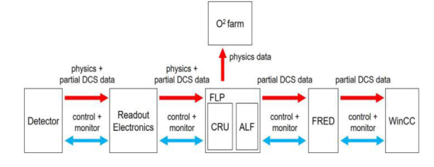
Fig. 7. The ALF-FRED role in the DCS data stream

Slide 25
The new DCS for ALICE has been developed to follow the O2 strategy. Data flow from the DCS to O2 is managed by the ALICE Data Point Service (ADAPOS). Its task is to collect data on detector’s operating conditions, which is required for the further stages of reconstruction. The basic unit of data in WinCC-OA is called a Data Point (DP). A data point can contain a temperature, current or voltage reading, typically from a single device or channel. It also can store very complex structures of different types of data. When the state of a data point changes, ADAPOS passes the new value to the EPN farm of the O2 facility (Fig. 8)

Slide 26
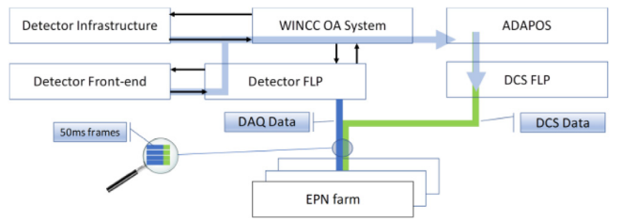
Fig. 8. The ADAPOS service in the O2 architecture

Slide 27
Note:
Online–Offline (O2 ) system The ALICE experiment scenario for Run 3 foresees an increase of the raw data rate by a factor of one hundred, up to 3.5 TB/s, as well as a continuous readout mode with simultaneous data processing. Due to the high interaction rates, it is not possible to store the detector data on disk and perform the processing once the run ends; therefore, data will be processed immediately with the combined Online–Offline (O2 ) computing facility to cope with these new processing requirements. Fig. 9 shows the general data flow in the O2 system: The First Level Processors (FLPs) read the raw data from the detectors’ readout electronics and reduce their volume by splitting them into physics and slow control data. Physics data are transferred from the FLPs to the Event Processing Nodes (EPNs) at a rate of 500 GB/s. EPNs process the raw data online while performing reconstruction tasks. Only reconstructed data are transferred to storage. O2 also provides the Framework for simulation and analysis

Slide 28
Fig. 9. Diagram of the O2 data flow.

Slide 29
This communication is based on the Distributed Information Management (DIM) system, supported on the WinCC-OA platform at CERN. For each value, a corresponding DIM service is created, and the published value is updated on each change. Information from the individual detectors is stored in a data structure containing all ALICE information recorded in a 50 ms interval. These data are later merged with the DCS information provided by the ADAPOS and the common DCS FLP (fig.8)

Slide 30
FDD-DCS hardware components
Every detector in ALICE consists of many complex instruments, among which are commercial hardware devices like voltage boards and crates as well as specific custom devices as the FEE. FIT FEE consists of the Trigger & Clock Module (TCM) and the Processing Module (PM) boards Furthermore, ALICE is located underground, with strong ionizing radiation and a magnetic field present during collisions. Therefore, the operation of ALICE must be automated as much as possible and the control and monitoring must be done remotely. FDD-DCS controls, verifies, and configures the FDD subdetector equipment. These tasks are accomplished mainly by sending commands and reading the status of the equipment from the ALICE Run Control Center (ARC). Alternatively, FDD-DCS can be accessed from outside the ALICE experiment site with any computer connected to internet with the proper credentials for remote operation.

Slide 31
In ALICE's Central DCS, a unified FSM structure is established for all subdetectors' top nodes, ensuring common states for easy centralized control. This allows non-expert operators to command all subdetectors simultaneously. Specific equipment-related states for individual subdetectors are defined independently. The control hierarchy follows a top-down approach from Central Unit (CU) to Detector Unit (DU). The DU FSMs are designed first, considering device parameters and data, followed by CU FSMs in a bottom-up fashion. The FDD control system adopts a detector-oriented hierarchy, customizing control based on detector components and subsystems like high voltage and control server software. The hierarchy branches into A and C side detector arrays and includes infrastructure items like TCM board, HV, FEE crates, and safety subsystems.

Slide 32
Conclusion
The Forward Diffractive Detector (FDD) was constructed, installed, and integrated into the ALICE experiment in 2021–2022. Its software and control systems enable safe operation, monitoring, and automated configuration of FDD hardware (high voltage, laser calibration, FEE) based on LHC run types. The system categorizes, monitors, and saves operational physics parameters and FEE-generated data to the ALICE database for later reconstruction during analysis. FDD is contributing to LHC Run 3, providing essential level-zero triggers for ALICE detectors and extending pseudorapidity coverage for studies of ultra-peripheral collisions. By the end of 2022, FDD successfully participated in van der Meer scans and Pb–Pb collision tests. The FDD-DCS, improved over AD-DCS, integrates new laser calibration and Control Server systems. The FDD-DCS is operational and integrated into the Central DCS in the ALICE Run Control Center, with ongoing enhancements by the team.

Slide 33
The ALICE Detector Data Link was developed to meet all data transmission requirements between detectors and the ALICE data acquisition system]. The first version of the protocol, called DDL1, is a 2.125 Gb/s full duplex multipurpose fibre link. It allows bidirectional transmission of data between the FEE and the data acquisition system. During data acquisition, information flows from the FEE to the DAQ, while each time a new run is started, it is possible to send configuration control messages to the detector via the opposite communication channel.
The DDL1 consists of three main components, shown in Figure 10 below.
The physical medium is a multimode optical fibre. The detectors are connected to the DAQ farm via optical fibres of varying lengths up to 200 m. The DDL1 is a point-to-point protocol, i.e., each SIU is directly connected to a channel of the RORC via the optical fibre.

Slide 34
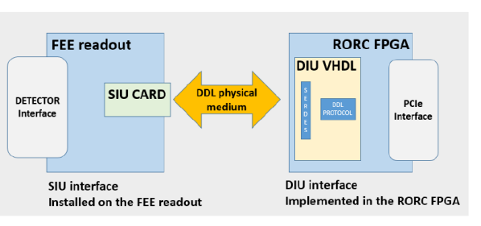
Figure 10: DDL1 components in data taking configuration between FEE and DAQ.

Slide 35
ALICE – Time Projection Chamber Particle Detector
The Time Projection Chamber (TPC) is ALICE's main tracking detector, comprising a gas-filled cylinder with MWPC readout, 557,568 pads, and 4,356 FEE cards. Data from FEE cards is sent to 216 readout control units (RCUs), connected to ALICE's DAQ system. The TPC's maximum electronic readout rate is around 320 Hz. The SAMPA chip, a 130-nm ASIC device, consolidates functions of PASA and ALTRO ASICs, doubling channels to 32 and supporting continuous readout. SAMPA transmits data at 1.2 Gbit/s via four 320 Mbit/s links to a GBTx ASIC, which multiplexes input into a 4.8 Gbit/s optical link to a Common Readout Unit (CRU). The SAMPA incorporates the GBT Slow Control ASIC (GBTSCA), managing configuration for all SAMPA chips on a front-end board. The system design for Run 3 (planned for 2020) is depicted in Figure 11.

Slide 36
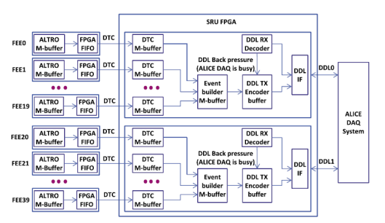
Figure 11 Block Diagram of SRU

