Slide 1

Work organization
focusing on Standards

Slide 2
Parameters
Number of control rooms covered
Number of supervisors & junior operators present and their role covered
Number of shifts covered
Number of people available in case of emergency
Required experience (required experience:………………………)
Technical Training courses ( number of online, offline & hybrid courses) not completely covered
Other training that includes ( engaging the team, working on their communication skills and teamwork)
Attendance and assigned tasks ( do they have a specific system for this) found a paper (included)
Evaluation system ( do they evaluate the people working each shift)
The channels of communication between them ( how do they communicate with each other)
Meetings protocol (if they need to discuss something how do they do this)
Research and development (R&D) department ( how many people, what are their roles and how many shifts do they have do they work online or offline )
agencies ( what kind of agencies support them or cooperate with them)
How do they do an interview for new candidates ( Telephone interviews, Panel interviews, tests, face to face)
How many tasks are done autonomously included
Do they give workers a special support ( medical insurance, financial support when needed)
Hierarchy of accelerator workers covered
Number of accidents with respect to the total working hours included
Number of shutdowns ( in LHC they experienced 2 shutdowns)
Number of facilities that are working
How long technical stops take place included
Intervention management included

Slide 3
Planning application in LHC
People in charge of different services need primarily to organize teams and assign them roles, i.e. the period of time where they are responsible for a certain task. This could be a week of supervision as well as a daily task like an eight hour shift in one of the control rooms.

Slide 4
Planning application in LHC
The “Planning Dashboard” allows any user to create a customized view of the available services they use. Lists are maintained by persons responsible for each system, so all personnel can quickly know at any time who is on duty or who is currently responsible for a specific service.
Planning dashboard

Slide 5
Autonomous inspections and measurements in LHC
Train Inspection Monorail (TIM)systems, able to perform autonomously different missions as visual inspections, radiation survey, civil infrastructures monitoring through photogrammetry, fire detection as well as survey measurements of accelerator devices as collimators and superconducting magnets.
In 2017 there are two TIM units in operation in the LHC, that in the past years have run more than one thousand kilometers and performed more than 50 successful missions, including radiation dose measurements, temperature, oxygen and tunnel structure monitoring with HD cameras.
TIM has productively replaced humans in tasks such as radiation measurements, visual inspections and tunnel structural monitoring, reducing the exposure of personnel to hazards and increasing the machine uptime of the LHC.(safety)

Slide 6
Number of accidents with respect to the total working hours
In LHC after the first shutdown:
The 3.4 millions of working hours, only 64 minor accidents have been recorded in the underground areas.

Slide 7
Technical stops in LHC
regular maintenance (preventive and corrective) of the different systems is programmed during technical stops: 4 technical stops of 5 days, each 2 months long and a longer stop of 13 weeks during the winter

Slide 8
Intervention management in LHC
During the first year of operation, each coordination team of the different facilities implemented its own tool: excel sheets, SharePoint lists, ADI (Active Directory Integration)
This variety and disparity of tools was problematic for the users, especially those intervening in the different facilities.
As an example, more than 1’000 persons per day request an access to the LHC machine during technical stops, and two operators in the Central Control Centre had to give clearance for the intervention.

Slide 9
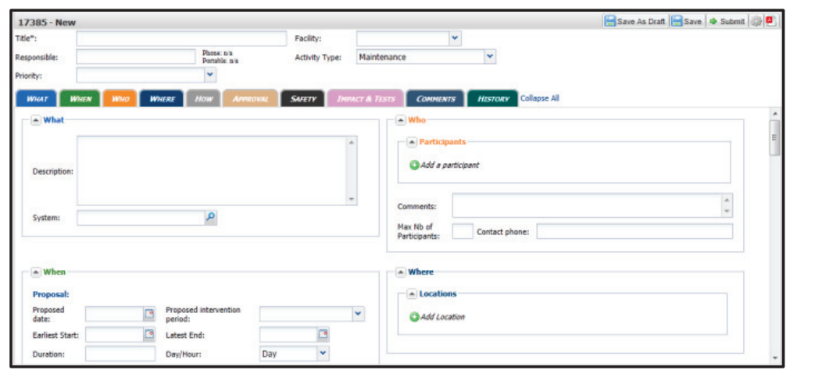
Intervention management in LHC
In November 2011 the new tool, IMPACT (for Intervention Management Planning & Activity Coordination Tool) was implemented.

Slide 10
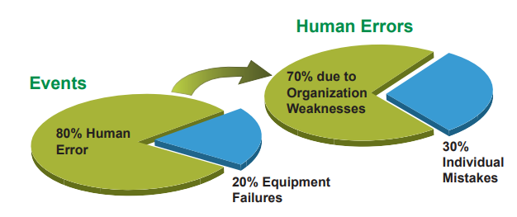
improving performance<<<< improving organization

Slide 11
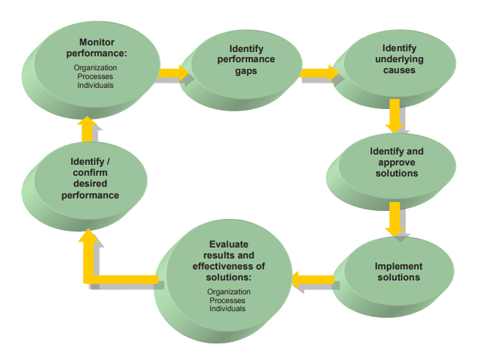
Improving performance cycle

