Slide 1
Physical Environment
For control Rooms

Slide 2
Scope
Layout → Previous presentation ”ISO 11064-3”
Thermal Environment
Air Quality
Lighting Environment
Acoustic Environment
Vibration
Interior Design

Slide 3
Thermal Environment
The design of an appropriate thermal environment needs to take account of such factors as building design, operator activities and climatic factors. The following should be taken into account
Operators number and shift patterns
The nature of operator activities
The typical clothing to be worn by operators
Heat dissipation generated by the equipment and lighting
The orientation of control room in respect of solar gain
Thermal transfer from external walls
The number of doors and windows
The potential for shielding direct sunlight
The geographical location of the building

Slide 4
Thermal Environment
Summer | winter
The operative temperature should be between 23 °C and 26 °C | The operative temperature should be between 20 °C and 24 °C
The vertical air temperature difference between 1,1 m and 0,1 m above floor should be less than 3 °C | The vertical air temperature difference between 1,1 m and 0,1 m above floor should be less than 3 °C
---- | The surface temperature of the floor should normally be between 19 °C and 26 °C
The mean air velocity should be less than 0,15 m/s | The mean air velocity should be less than 0,15 m/s
---- | The radiant temperature asymmetry from windows or other cold vertical surfaces should be less than 10 °C
The relative humidity should be between 30 % and 70 % | The relative humidity should be between 30 % and 70 %

Slide 5
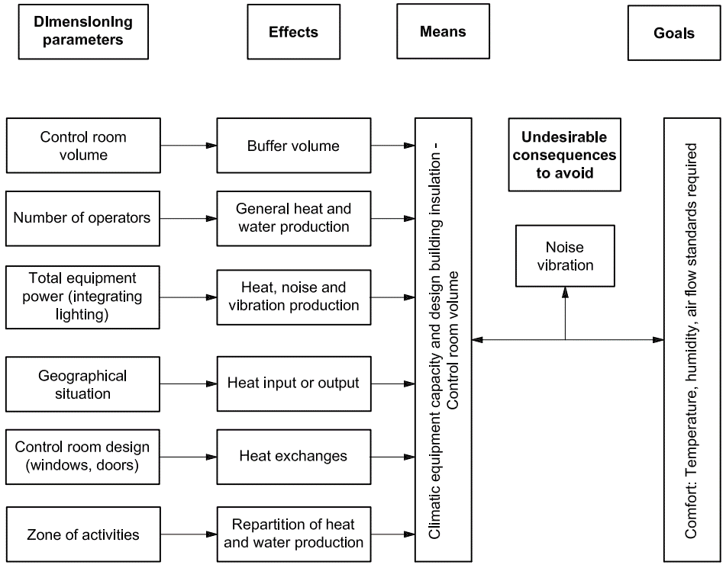
Thermal Environment
Main factors in design of thermal environments

Slide 6
Air Quality
Airflows shall be controlled such that personnel do not suffer direct air draughts. In order to help achieve this, the air velocity shall be checked.
Extractor grilles should be located to encourage even distribution of air throughout the room.
Air conditioning/air handling systems should be designed so as to minimize noise from the system.
The rate of air change (the relation between the capacity of the HVAC system and the physical volume of the control room) shall be adjusted in order to maintain good air quality.

Slide 7
Air Quality
The following protective measures should be taken into account when designing air provision systems for control room environments:
The selection of non-toxic construction material
An appropriate air change rate which will reduce the concentration of the impurities
The presence of specific safety procedures and personal protective equipment in case of suspected specific risk.
The installation of gas detection systems
The installation of fire extinguishing systems using non-toxic products.

Slide 8
Air Quality
The control room should be supplied with outdoor air in sufficient quantities to dilute internally generated pollutants.
8 l/s (29 m 3 /h) of outdoor air supply per person is sufficient for a no-smoking environment.
Carbon dioxide concentrations should not exceed 1,8 g/m 3 when the control room is at full occupancy.

Slide 9
Lighting Environment
The design of lighting should
Optimize visual performance at the workplace
Enhance legibility of information from both active and passive displays
Enhance the comfort and the health of the operator
Facilitate the reading of vertical and horizontal printed material at workstations
Facilitate the reading of wall maps or reference material
Facilitate the reading of illuminated displays on control consoles

Slide 10
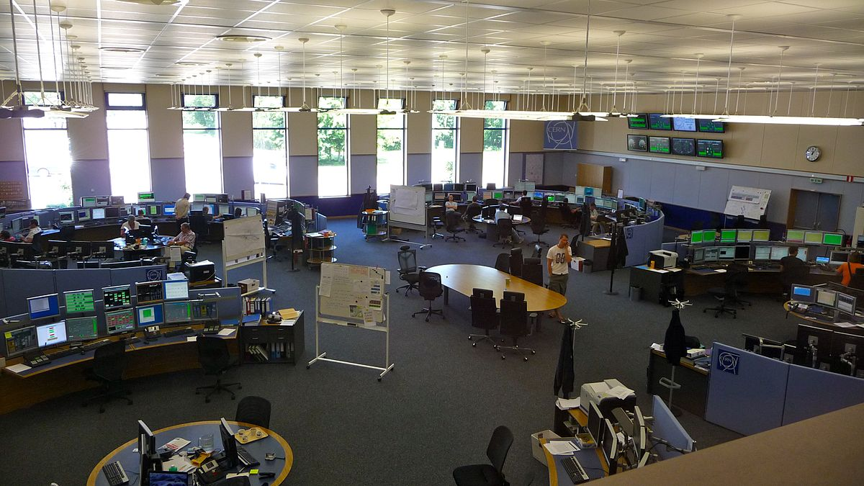
Lighting Environment
Natural references, such as daylight through outside windows and plants, should be used to enable control room staff to maintain linkage with the external world.
The location of any windows, skylights and fixed luminaries should minimize the potential for generating reflections and glare.

Slide 11
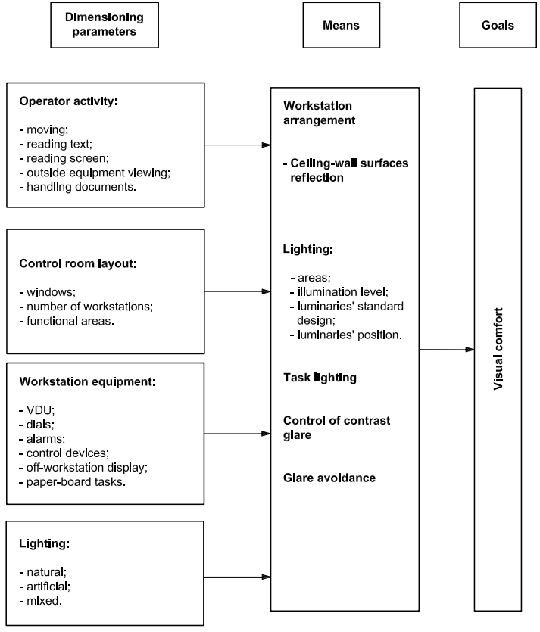
Lighting Environment
Main factors in the design of lighting environments

Slide 12
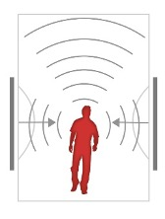
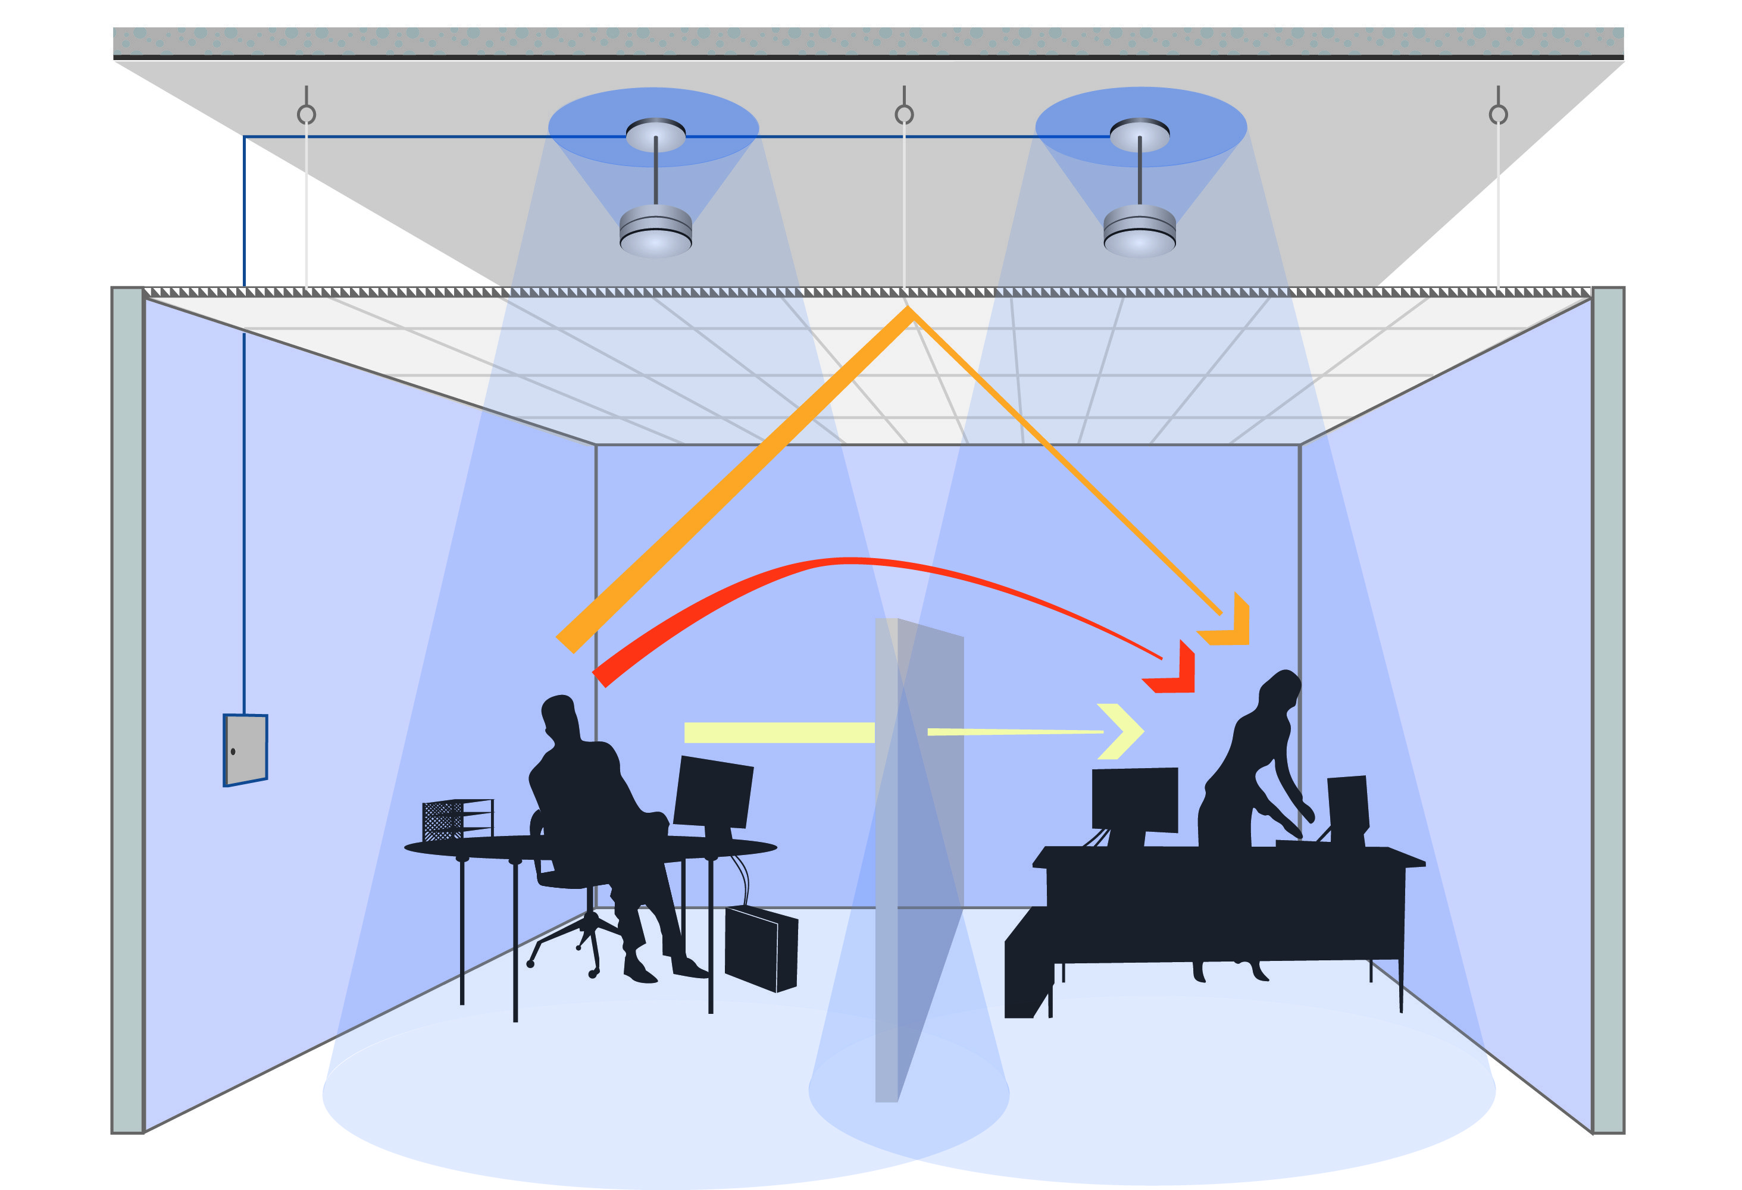
Acoustic Environment
In order to optimize the acoustic environment, the control room should be designed to
Reduce noise levels in the general environment around the control room
Reduce sound levels within the control room
Acoustic design should take account of the following operational needs
Verbal communications between operators
Telephone conversations
Hearing alarms
Interference with cognitive functions, such that domestic radios
Minimising operator annoyance

Slide 13
Acoustic Environment
The ambient noise in the control room should not exceed 45 dB.
The background level should be in the range 30 dB to 35 dB, to maintain a degree of aural privacy.

Slide 14
Vibration
Control rooms should be positioned as far as possible from sources of vibration such as back-up generators and compressors.
Insulation shall be used to protect control-room operators and their associated equipment from vibration transmitted from the general environment.
the control-room floor, walls and ceilings should be isolated from vibrating structures by vibration absorbers.

Slide 15
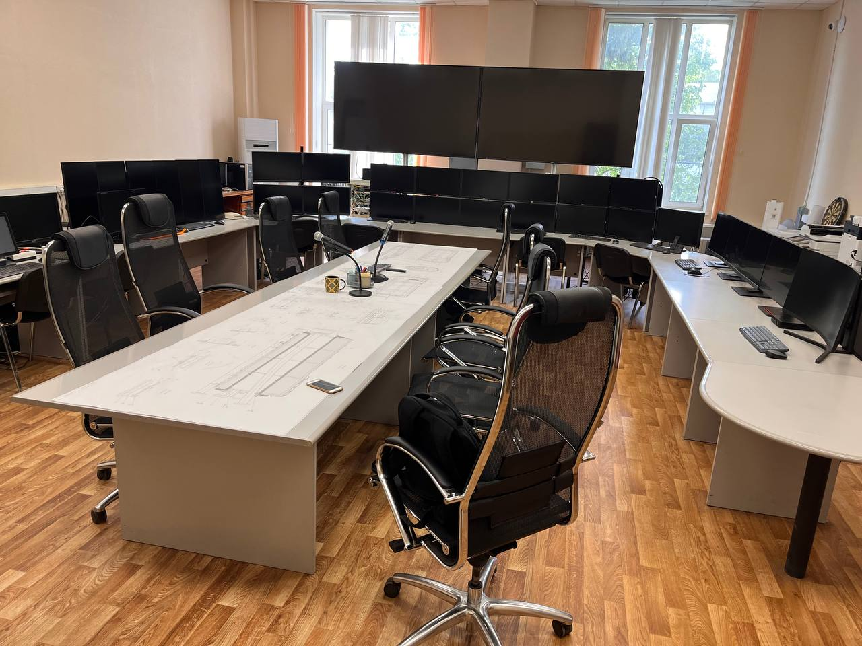
Interior Design
Colours, textures and materials should be selected to provide a pleasant working environment.
The selection of control operator seating should be based on ergonomic criteria. The choice of color and finishes should be made with long-term and 24-hour usage and associated wear-and-tear in mind.
Wall finishes should be pale rather than bright and the colours selected to avoid psychological effects.
The excessive use of either dark or light finishes on building structures or on furniture should be avoided.

Slide 16
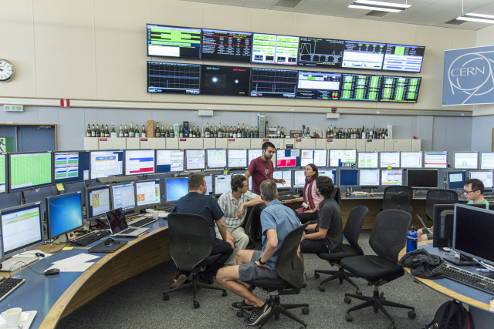
Interior Design
Where glare from windows is unavoidable, means shall be provided to enable the impact to be minimized by the use of, for example, adjustable blinds or tinted glazing.
The use of matt or non-reflective surfaces, and low brightness reflector assemblies for luminaries, should be taken into account when planning the control room design.
Large differences in colour contrast should be avoided on workstations, general furniture and equipment finishes.

Slide 17
Interior Design
In selecting materials and finishes for the control areas the following should be considered.
The reflectance value of the floor finishes should be between 0,2 and 0,3.
Wall finishes should have a surface reflectance of between 0,50 and 0,60. The surface reflectance value should not fall below 0,50, as values below this can increase the contrast between the ceiling and walls, contribute to a gloomy environment, and increase electric light power consumption.
The glazing bars and solid areas of the partitions should have a similar reflectance value (0,5 to 0,6) to the periphery walls.
Where indirect lighting systems are used, ceilings should be white, should be of matt finish and should have a minimum surface reflectance of 0,8.

