Slide 1
ALICE Detector Control System (DCS)
By Alaa ElSadieque

Slide 2
DCS Functionality:
Interface for modifying high and low voltages, monitoring power supply, electronics statuses, temperature, pressure, etc.
Records sensor readings in a database for analysis.

Slide 3
DCS Data Storage and Accessibility
Data Storage Guidelines:
Two guidelines for storing values in the database:
Stored when a threshold on percent variation is passed.
Stored every 5 minutes to track smaller variations and system stability.
Accessing Data:
Readings accessible online via Siemens WinCC applications.
Offline access for reconstruction and performance studies.
ALICE web interface (DARMA) allows database queries and data file downloads.

Slide 4
Upgrade Strategy for Run 3
Physics Goals:
Precision measurements of QGP through heavy-flavor transport, quarkonia, and di-leptons.
Requires zero bias trigger for data collection.
Upgrade Components:
New Inner Tracking System (ITS).
Major Time Projection Chamber (TPC) upgrade with GEM detectors.
Smaller diameter beam pipe.
Readout electronics, forward trigger detectors, and online system upgrades.

Slide 5
Automation in Detector Control System
Automation Focus:
DCS enables remote control and monitoring, reducing manual intervention.
Automated data storage triggered by percent variation and time intervals.
O2 performs parallel on-the-fly data reduction, enhancing automation.
Benefits:
Efficient handling of increased data rates.
Enables precision measurements with minimal manual intervention.

Slide 6
ALICE Physics Motivation
Objective:
Explore the physics of quark-gluon plasma (QGP) in extreme conditions of energy density and temperature.
LHC as an Ideal Platform:
Net baryon density in central region mimics early Universe conditions.
Highest achievable initial temperature and energy density.
Abundance of perturbatively calculable hard QCD processes.
ALICE's Role:
Systematically study observables to characterize global features of the created state.
Constrain theoretical models through comprehensive measurements.

Slide 7
Key Physics Topics in ALICE
Focus Areas:
Measurement of heavy-flavour hadrons, quarkonia, strangeness production, and low-mass dileptons at low pT.
Study of jets and their constituents.
Diversity in Collisions:
Not limited to Pb–Pb; includes lighter ions (Xenon, Oxygen) for wider energy density range.
Dedicated proton-nucleus runs to separate cold nuclear matter effects from QGP effects.
Statistical Challenges:
Many measurements have a small signal-over-background ratio, requiring large statistics with minimum-bias data.
LS2 upgrades enable a two-orders-of-magnitude increase in statistics.

Slide 8
ALICE Central Barrel Overview
Geographical Coverage:
Central barrel covers ±45°, pseudo-rapidity range |η| < 0.9 over full azimuth.
Magnetic Field:
Embedded in a large magnet providing a solenoidal field up to 0.5 T.
Bends charged particle paths for momentum measurements.
Detector Components:
Inner Tracking System for particle identification and momentum measurement.
Time Projection Chamber for cylindrical tracking.
Transition Radiation Detector for particle identification.
Time Of Flight counters for PID array.
Electromagnetic Calorimeter, Photon Spectrometer, and high-momentum inclusive particle identification counters.

Slide 9
ALICE Central Barrel Components
Inner Tracking System (ITS):
Innermost layer for precise particle tracking and identification.
Time Projection Chamber (TPC):
Cylindrical tracking for momentum measurement.
Transition Radiation Detector (TRD):
Contributes to particle identification.
Time Of Flight (TOF) Counters:
Large area PID array for precise identification.
Electromagnetic Calorimeter and Photon Spectrometer:
Single-arm detectors for specific measurements.
High-Momentum Inclusive Particle Identification Counters:
Optimized array for identifying high-momentum particles.

Slide 10
Overview of Inner Tracking System (ITS)
Role of ITS:
Most central detector in ALICE, surrounding the 800 µm thick beryllium beampipe.
Key functions include localizing primary vertex, reconstructing secondary vertices, tracking low-momentum particles, and improving momentum and angle resolutions.
ITS in Run 1 and Run 2:
Comprised six cylindrical layers of silicon detectors.
Covered pseudorapidity range |η| < 0.9 for vertices within ±60 mm of the nominal Interaction Point (IP).
Limited readout rate of about 1 kHz with 100% dead time.

Slide 11
Limitations and Requirements for Run 3
Limitations of Run 1 and Run 2 ITS:
Poor readout rate capabilities restricting usage in Run 3 physics program.
Inadequate for the full Pb–Pb collision rate and collecting required reference data in p–p collisions.
Upgrade Imperative:
Long Shutdown 2 in 2021 saw a complete replacement of the ITS for Run 3.

Slide 12
Run 3 ITS Upgrade
New ITS Configuration:
Consists of 7 concentric cylindrical layers of Monolithic Active Pixel Sensors (MAPS).
Utilizes CMOS imaging technology (similar to digital camera sensors).
Each ALPIDE chip covers an area of 15x30 mm2 with a granularity of 30 x 30 µm.
Spatial Resolution and Active Area:
Achieves a spatial resolution of 5 µm, exceeding ALICE ITS requirements.
Active area spans approximately 10 m2, segmented into 12.5 billion pixels.

Slide 13
ALPIDE Chip and Detector Design
ALPIDE Chip:Developed by ALICE, the chip is a novel monolithic active pixel sensor.
Collects charge signal and hosts readout circuit in the same silicon substrate.
Detector Construction:ALPIDE chips are tiled in staves and assembled on cylindrical supports.
First detection layer closer to the IP due to a smaller outer radius of the beam pipe.
Last layer at a radius of 430 mm.

Slide 14
Enhanced Capabilities of Run 3 ITS
Performance Improvements:
Spatial resolution of 5 µm meets and exceeds requirements.
Readout rates of 100 kHz for Pb–Pb and 1 MHz for p–p collisions.
Impact parameter resolution improved by a factor of three in the transverse plane and five along the beam axis.
Significance for ALICE Physics Program:
Enables unprecedented precision in measuring heavy-flavour hadrons down to zero pT.
Enhances ALICE's capability to study QGP in Run 3 collisions.

Slide 15
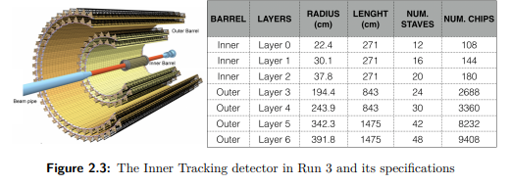

Slide 16
Time Projection Chamber (TPC) Overview
Role of TPC:
Main tracking and particle identification detector in the central barrel.
Cylindrical in shape, covering an acceptance of 2π in azimuthal angle and |η| < 0.9 in pseudo-rapidity.
Specifications:
Gaseous detector with an internal volume of 88 m3.
Inner radius of about 85 cm, outer radius of about 250 cm, and length of 500 cm along the beam direction.
Gas mixture: 90% Ne and 10% CO2.

Slide 17
TPC in Run 1 and Run 2
Detector Structure:
Divided into two drift regions by a central high-voltage electrode.
Active volume divided into Inner ReadOut Chambers (IROC) and Outer ReadOut Chambers (OROC).
Drift electrical field allows electrons to drift towards end plates for readout.
Performance in Run 1 and Run 2:
Multi-Wire Proportional Chambers (MWPC) with cathode pad read-out.
Slow detector with a maximum readout rate of 3.5 kHz.

Slide 18
Challenges for Run 3 and TPC Upgrade
Challenges:
Anticipated minimum bias event rate of 50 kHz for Pb–Pb in Run 3.
Slow readout rate and space charge effects would distort electron drift paths.
Existing TPC limitations necessitated an upgrade.
Upgrade Objectives:
Enable continuous operation for 50 kHz Pb–Pb collisions.
Mitigate space charge distortions and improve dE/dx performance.

Slide 19
TPC Upgrade Implementation
Replacement with GEM Detectors:
Multi-Wire Proportional Chambers replaced with Gas Electron Multiplier (GEM) detectors.
New read-out electronics designed for continuous read-out mode.
Gas Mixture Modification:
Gas mixture changed to Ne(85.7%)-CO2(9.5%)-N2(4.8%) to reduce ion backflow.
Ion backflow probability less than 0.5% at operational gas gain of 2000.

Slide 20
Readout System and Electronics
Frontend and Readout Electronics:
Signals read by 524,160 pads forming the anode plane of GEM chambers.
Each pad connected to a front-end electronics channel.
SAMPA ASIC developed for signal processing, based on ALTRO and S-ALTRO developments.
Data Throughput:
Unprecedented data throughput of 3.28 TB/s through 6552 optical links.

Slide 21
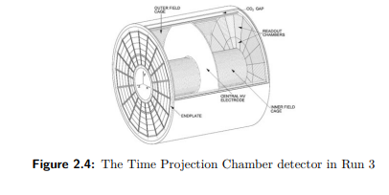

Slide 22
Transition Radiation Detector (TRD) Overview
Functionality:
Performs electron identification for momenta above 1 GeV/c.
Triggers on high momentum electrons and jets, providing a trigger decision in about 7 µs.
Design Specifications:
Cylindrical gaseous detector, 7m long, 7m diameter, and 750 m3 active volume filled with xenon-CO2 mixture.
522 modules divided into 18 sectors, each with 5 stacks and 6 layers per stack.

Slide 23
TRD Structure and Layout
Detector Structure:
Composed of Multi-Wire Proportional Chambers (MWPC) with over 500 drift chambers.
Around 1.15 million readout channels, each sampling the signal in 20 time bins.
Spatial Resolution:
Good spatial resolution of 500 µm enhances momentum resolution of the track.

Slide 24
TRD Performance and Complementarity
Performance Benefits:
Improves momentum resolution in conjunction with ITS information.
Facilitates correct detection of open charm, open beauty, and vector mesons.
Complementarity with Muon Spectrometer:
Complementary to the Muon Spectrometer for studying quarkonia and open heavy-flavored mesons in the electronic channel.

Slide 25
TRD Design Challenges
Pb–Pb Interaction Rate:
Designed to cope with a Pb–Pb interaction rate of 10 kHz.
Maximum track multiplicity of 8000 charged particles per rapidity unit.
Readout Rate Limitations:
Readout rate limited to few hundred Hz.

Slide 26
TRD Upgrade Strategy
Upgrade Objectives:
Accommodate higher data-taking rates without relying on triggers.
Improve readout time with existing Front-End Electronics (FEE).
Limitations:
Upgrade of FEE hardware not feasible during LS2 without significant reconstruction.

Slide 27
Data Readout Optimization
Optimization Strategy:
Reduce data readout time with existing FEE by changing its mode of operation.
Limit the amount of event data read from the FEE.
Performance Impact:
Extensively studied to validate the strategy for tracking and electron identification.

Slide 28
Enhanced Readout System
Hardware Upgrade:
Utilization of ALICE Common Read-Out Unit (CRU) for increased bandwidth to the DAQ system.
Operational Advantages:
Enables optimized FEE data format readout at the full minimum bias event rate.

Slide 29
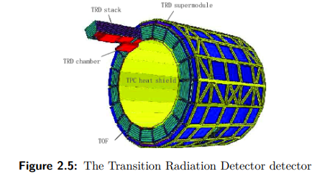

Slide 30
Time-Of-Flight (TOF) Detector Overview
Objective:
Enhance Particle Identification (PID) in momentum intervals not well covered by other ALICE detectors.
Measurement:
Measures particle time of flight with a precision better than 100 ps.
Important for identifying pions, kaons, protons in the intermediate pT region (0.2 GeV/c ÷ 2.5 GeV/c).
TOF Detector Technology
Technology Used:
Multigap Resistive Plate Chamber (MRPC) strip detector.
Gaseous detectors with soda-lime glass resistive electrodes and multiple gas gaps.
Design:
Double-stack design with two stacks, each with five gas gaps (250 µm thick).
Average time resolution less than 50 ps.

Slide 31
TOF Array and Readout System
Array Configuration:
Cylindrical array in the pseudorapidity region -0.9 < η < 0.9.
Consists of 1593 MRPC strips divided into 18 azimuthal sectors.
Readout Channels:
Each MRPC strip segmented into two rows of 48 pickup pads, totaling 96 pads per strip.
152,928 total readout channels for low detector occupancy.
Front-End and Electronics
Front-End Cards:
Hosts fast amplifier and discriminator NINO.
Output signals transmitted to VME electronics crates.
VME Electronics Crates:
Four VME crates per each of the 18 sectors.
Contains nine TDC Readout Module (TRM) cards, along with other cards for data readout and trigger elaboration.

Slide 32
TOF Readout Rate Limitations
Readout Rate Limit:
TOF readout rate during Run 1 and 2 limited to 40 kHz by VME system throughput.
Limitations imposed by the time needed to transfer data from HPTDCs.
TOF Upgrade Strategy
Limitations in Upgrade:
Modifications requiring removal and disassembly not feasible during Long Shutdown 2.
Primary Upgrade Focus:
Eliminate restrictions on HPTDC readout rate.

Slide 33
TOF Readout Rate Upgrade
HPTDC Readout Rate:
Upgrade focuses on increasing HPTDC readout rate.
TRMs and HPTDCs located inside TOF supermodules.
Data Transfer Enhancement
Data Transfer Improvement:
Data transferred from DRM modules to DAQ via the DDL link.
Reengineered modules with a more performant FPGA chip and a new version of the DDL link.

Slide 34
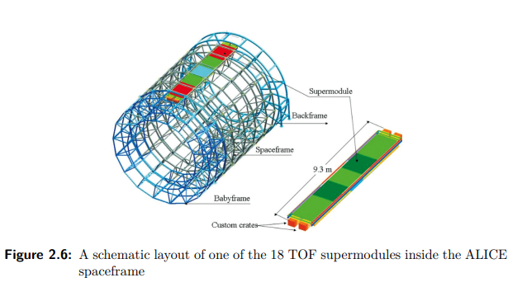

Slide 35
High Momentum Particle Identification Detector (HMPID) Overview
Objective:
Identify charged particles (pions, kaons, protons) with large momentum.
Enhanced PID Capability:
Complements PID from energy loss (ITS and TPC) and time-of-flight measurements (TOF).
Enables identification up to higher momenta: π/K and K/p discrimination up to 3 GeV/c and 5 GeV/c, respectively.
HMPID Structure and Geometry
Geometry:
Single-arm geometry covering about 5% of the central barrel phase space.
Active area of 11 m2, covering one unit in pseudorapidity |η| < 0.5 and 5% of TPC acceptance.
Components:
Ring-Imaging Cherenkov counters with radiator medium and photon detector.
7 RICH counters based on Multi Wire Proportional Chambers (MWPCs) with CsI-activated pad segmented photocathodes.

Slide 36
Particle Identification Process in HMPID
Cherenkov Radiation:
Fast particle crossing liquid C6F14 radiator produces Cherenkov photons.
Detected by the photon counter for particle identification.
Enhanced Particle Discrimination:
Improves identification of high-momentum particles beyond the capabilities of other detectors in ALICE.
HMPID Upgrade - Targets for (Anti)-Deuteron Inelastic Cross Section
New Functionality (Since 2021):
Equipped with two aluminum targets for measuring (anti)-deuteron inelastic cross section.
Readout Rate:
Maximum readout rate during Run 1 and Run 2 was 2.5 kHz for central Pb–Pb collisions.

Slide 37
Readout Upgrade Strategy
Electronics Upgrade:
No planned upgrade during LS2.
Integration into the new ALICE read-out architecture for backward compatibility.
Parallelization:
Potential to increase rate significantly by parallelizing readout cycles.
Replacement of DDL and RORC cards with new generation (DDL3 and RORC3).
Collaboration and Data Integration
Data Handling:
Depending on achievable readout rate, data may be downscaled.
Information combined with other central detectors at the event building stage.
Collaboration and Synergy:
Collaborative efforts within ALICE to optimize overall detector performance.

Slide 38
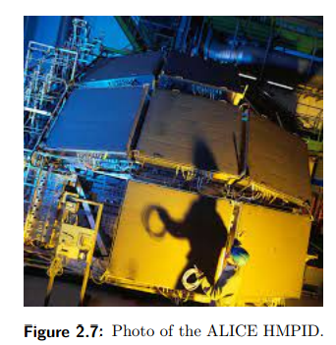

Slide 39
ALICE Forward Detectors Overview
Introduction:
Forward detectors play a crucial role in global event characterization and triggering for ALICE experiments.
During Run 1 and Run 2, ALICE used the Zero Degree Calorimeter (ZDC), Photon Multiplicity Detector (PMD), Forward Multiplicity Detector (FMD), and V0 Detector.
Upgrades were undertaken during LS2 to enhance triggering techniques for measuring hard processes.
Zero Degree Calorimeter (ZDC) Introduction
Purpose:
Measures energy deposited by spectator nucleons to determine the overlap region in nucleus-nucleus collisions.
Provides information in various collision systems: nucleus-nucleus, proton-nucleus, and proton-proton runs.
Components:
Two sets of hadronic calorimeters for spectator neutrons (ZN) and protons (ZP).
Forward EM calorimeters (ZEM) for discriminating collision centrality.

Slide 40
ZDC Operation Principle
Spaghetti Calorimeters:
Dense absorbers with interspersed quartz optical fibers.
Cherenkov light produced by charged particles in the shower detected in fibers.
Detector Layout:
ZN and ZP have different dimensions and absorber materials due to specific requirements.
Fast Response:
Suitable for triggering with a fast intrinsic emission process.
ZDC Upgrade - Electronics and Readout
Upgrades During LS2:
Electronics upgraded to provide data for a 50 kHz Pb–Pb interaction rate without dead time.
Replacement of NIM and VME modules with digitizers having on-board FPGAs.
Redesigned ZRC:
ZDC Readout Card (ZRC) redesigned for Run 3 and readout by the ALICE Common Read-Out Unit (CRU).
Improved Data Processing:
Digitizers integrate signals, provide a time-stamp of arrival times, and eliminate dead time.

Slide 41
Fast Interaction Trigger (FIT) Detector
Introduction:
New addition during LS2 to enhance triggering techniques.
Designed for low background and improved precision in measuring hard processes.
Role:
Ensures effective triggering for measuring hard processes with reduced signal background.
Collaboration and Synergy
Collaborative Efforts:
ALICE forward detectors undergo upgrades and enhancements collaboratively to optimize overall performance.
Continuous improvement and adaptation to evolving experimental needs.

Slide 42
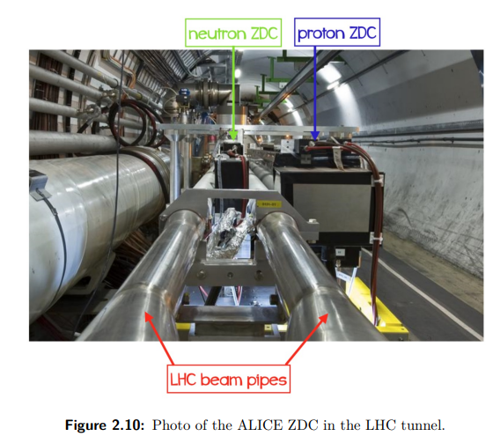

Slide 43
Detector Upgrade Summary
Detectors Not Fully Upgraded:
EMC
PHS
HMP
CPV
TRD
Electronics and Communication Protocols:
EMC, PHS, HMP use RD12 TTC protocol.
TRD uses TTC-PON, requiring RD12 TTC triggers.
CPV receives signals over GBT links.

Slide 44
Readout Limitations:
All detectors cannot meet the required data readout rate.
BUSY signals generated, informing CTP of trigger reception issues.
Trigger Inputs to CTP:
39 trigger inputs from listed detectors.
BPTX contributes 2 inputs at L0 latency.
Some detectors offer multiple inputs for various triggers.
Automation Control System:
Focus on the automation of detector control systems.
Highlights detector operation latencies, trigger levels, and connections in following Table .

Slide 45
Charged Particle Veto Detector Upgrade Overview:
Purpose:
Designed to prevent detection of charged particles on the PHOS front surface.
PHOS comprises 17,920 lead tungstate crystal-based analogue detection channels.
Structure:
CPV has three separate modules, each covering an area of 200 x 230 cm², positioned atop PHOS modules.
Integrated Preamplifier:
Preamplifier integrated with PIN photodiode, optimized for low energies (up to 10 GeV).
Readout Plans:
PHOS aims to upgrade readout firmware to 30 - 40 kHz.
CPV readout speed targets to match or exceed PHOS capabilities.

Slide 46
Event Size and Readout Rate:
ALICE CPV typical event size for Pb-Pb particles is 1.3 Kbytes.
Current maximum event readout rate: 10 kHz at 1% occupancy.
FEE System Development:
New FEE system under development to address technical limitations.
Aims to detect more than 10 nb⁻¹ Pb-Pb collisions at luminosities up to 6 x 10²⁷ cm⁻² s⁻¹.
Expected to reduce FEE power dissipation and footprint by over 50%.
Sync with PHOS and Improved Photon Identification:
New FEE architecture optimized for CPV to synchronize events recorded by PHOS and CPV.
Enhances photon identification in PHOS by suppressing charged clusters.
Implementation Timeline:
New FEE system installation planned for the Charged Particle Veto detector during Run 3, which began in 2021.
Upgrade addresses higher collision rates of 50 kHz for Pb-Pb collisions with a peak luminosity of 6×10²⁷ cm⁻² s⁻¹.
Note: The upgrade aims to optimize CPV performance and align with increased data acquisition requirements.

Slide 47
Trigger and Clock Module (TCM) and Processing Module (PM) - Comparable Parameter Analysis:
Functionality:
FIT TCM and PM: Receive and combine pre-trigger information, generate final triggers, and distribute to ALICE CTP. Distribute high-quality clock signal for synchronization.
Muon Identifier MID: Data transmitted to dedicated servers (FLP nodes) for compression, merging, splitting into Sub-Time Frames, and storage before forwarding to EPN.
Connection to DAQ System:
FIT FEE Modules (PM and TCM): Connected via GBT optical link with 4.8 Gb/s data transfer speed per link.
Muon Identifier MID: Utilizes DELL POWEREDGE R740 rack servers as FLP nodes for data processing.
Data Transfer Rate:
FIT FEE Modules: Achieve 4.8 Gb/s per link, allowing transfer of one 128-bit word per bunch crossing. Practical rates of up to 5 MHz feasible considering overhead.
Muon Identifier MID: Processes and analyzes subdetector data instantly on EPN.
Occupancy Consideration:
FIT FEE Modules: Operate at a collision rate of up to 40 MHz considering detector occupancy and data structure overhead.
Muon Identifier MID: Utilizes FLP nodes to compress and store data until forwarding to EPN, ensuring real-time analysis.

