Slide 1
Физика фундаментальных взаимодействий
СВЕРХТЯЖЕЛЫЕ ЯДРА И ЭЛЕМЕНТЫ
Ю.Ц. Оганесян
Лаборатория Ядерных Реакций
Объединенного Института Ядерных Исследований
Научная сессия секции ядерной физики ОФН РАН
1-5 апреля, 2024 г. ОИЯИ, Дубна, Моск. обл.

Slide 2
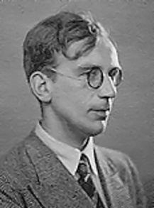
Let's start with Georgiy Gamow's model where nuclear matter is an electrically charged liquid, and the atomic nucleus is a drop of this liquid.
In fact, the density of nuclear liquid
is 10¹⁵ times more than that of water
George Gamow 1928
This was the first theoretical model of the atomic nucleus.
G Gamow 1928
Yuri Oganessian “SH Nuclei and Elements”, Session of the NP Section of RAS, Apr.1-5, 2024 JINR, Dubna

Slide 3
Presentation of the nuclei as a drop of charged liquid
with constant density allowed to create:
Theory of alpha decay G. Gamow (1928)
Famous formula for the binding energy of the nuclei
C.F. von Weizsäcker (1934)
Theory of the nuclear fission
N. Bohr and J.A. Wheeler (1939)

Slide 4
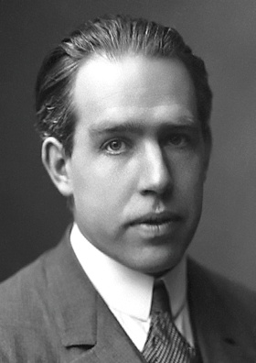
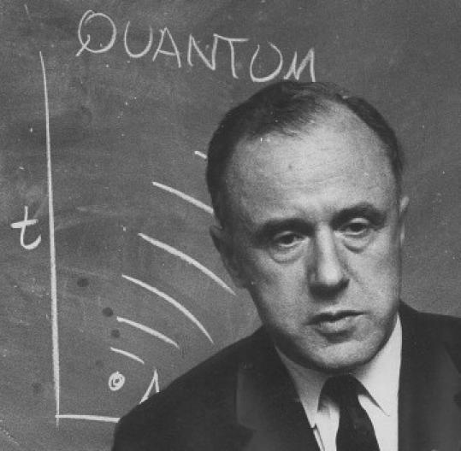
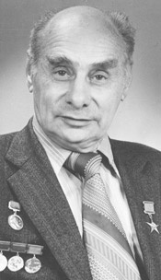
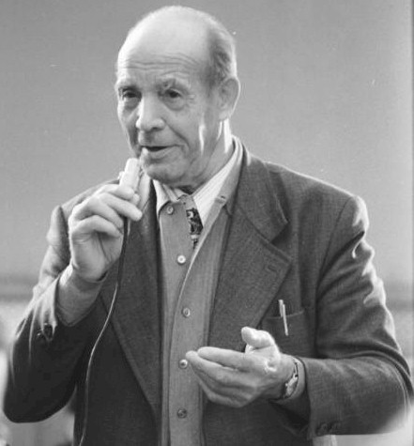
Nuclear fission
N. Bohr
J.A. Wheeler
1939
1940
G.N. Flerov
B_{f}=6 MeV
10¹⁶ years (exp.)
3.10⁻²⁰ s
B_{f}=0
Z≥100
K.A. Petrzhak
Yuri Oganessian “SH Nuclei and Elements”, Session of the NP Section of RAS, Apr.1-5, 2024 JINR, Dubna

Slide 5
Nuclear shells and
the “magic numbers”
Spontaneous
Fission
About 3000 nuclei
are known today
²⁰⁸Pb
Z=82
protons
126
¹⁰⁰Sn
Now let us consider the
nuclei heavier than lead
50
⁵⁶Ni
82
Among them
9 nuclei are doubly magic
⁴⁰Ca
¹³²Sn
28
50
20
“doubly magic”
nuclei
⁷⁸Ni
8
28
2
20
⁴⁸Ca
neutrons
2
8
¹⁶O
⁴He
Yuri Oganessian “SH Nuclei and Elements”, Session of the NP Section of RAS, Apr.1-5, 2024 JINR, Dubna

Slide 6
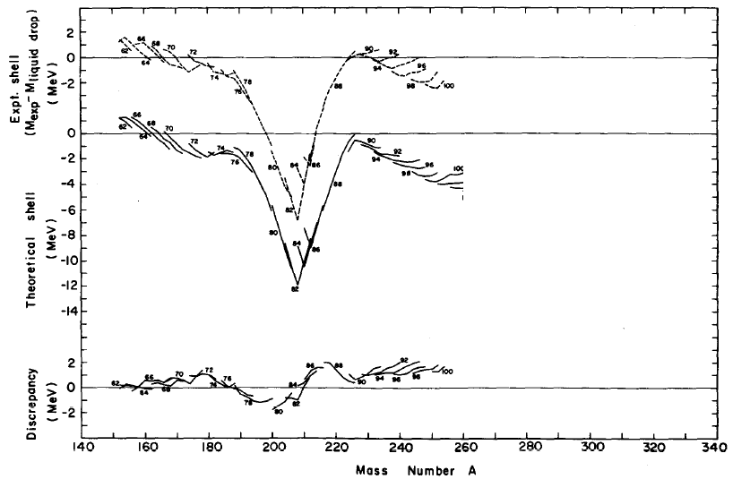
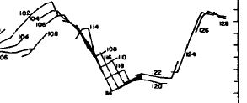
Shell effect in the nuclear ground states (mass defect)
Nilsson, Thompson, and Tsang, 1969
²⁰⁸Pb
Experiment
Theory
Z=108
N=162
Z=114
N=184
Sobiczewski A, Gareev F A and Kalinkin B N
1966 Phys. Lett. 22, 500
Z=82
N=126

Slide 7
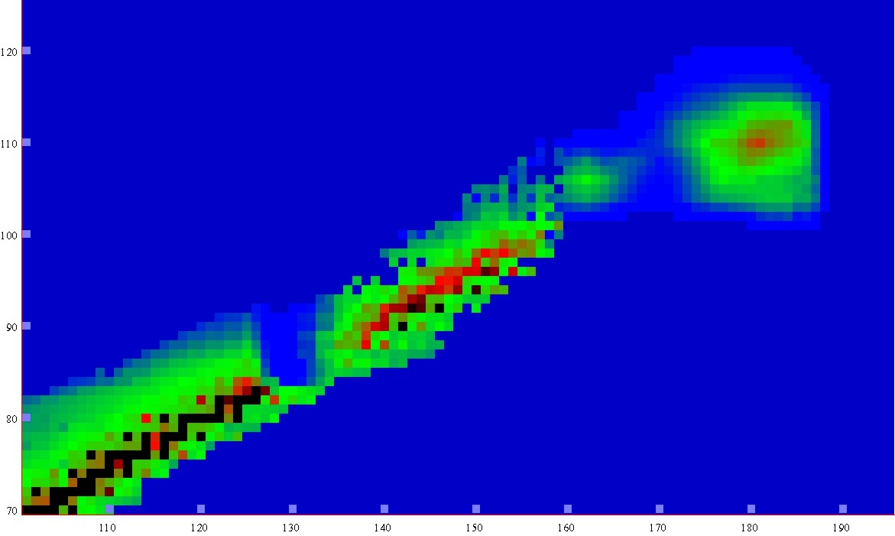
Half-lives
Macroscopic theory
-5
0
5
10
15
LogT_{1/2} s
New lands
New lands
1μs
1s
1h
d
1Myear
Island of
Stability
120
Island of
Stability
A limit of SHE
existence
Shoal
110
shoal
Proton number
T_{1/2} ≤ 10⁻¹⁴ s
Peninsula
100
peninsula
Sea of Instability
90
Continent
continent
80
70
100
110
120
130
140
150
160
170
180
190
Neutron number
Notes:
7

Slide 8
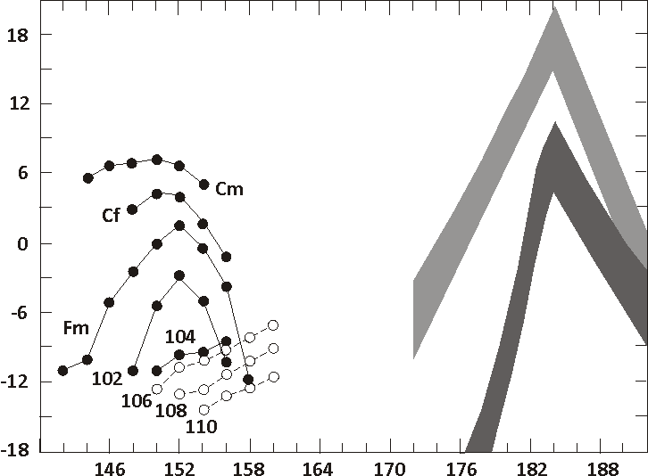
Fiset and Nix
(1972)
Age of Earth
Log of the Spontaneous Fission Half Lives (years)
1 y
?
Randrup et al.
(1974)
1 s
Z=114
```````````````````````````
1 μs
1 μs
Z=114
Z=110
Neutron number
Yuri Oganessian “SH Nuclei and Elements”, Session of the NP Section of RAS, Apr.1-5, 2024 JINR, Dubna

Slide 9
Search SHE in Nature

Slide 10
The eternal question:
Is it possible to obtain superheavy elements in the r-process?
Hs
β⁻
β⁻
Pu
U
Th
Pb
β⁻
waiting
point
We get an answer:
Not exluded, but not much!

Slide 11
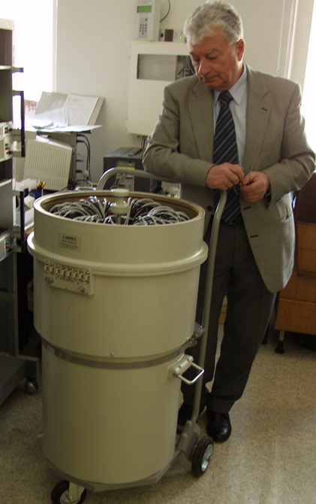
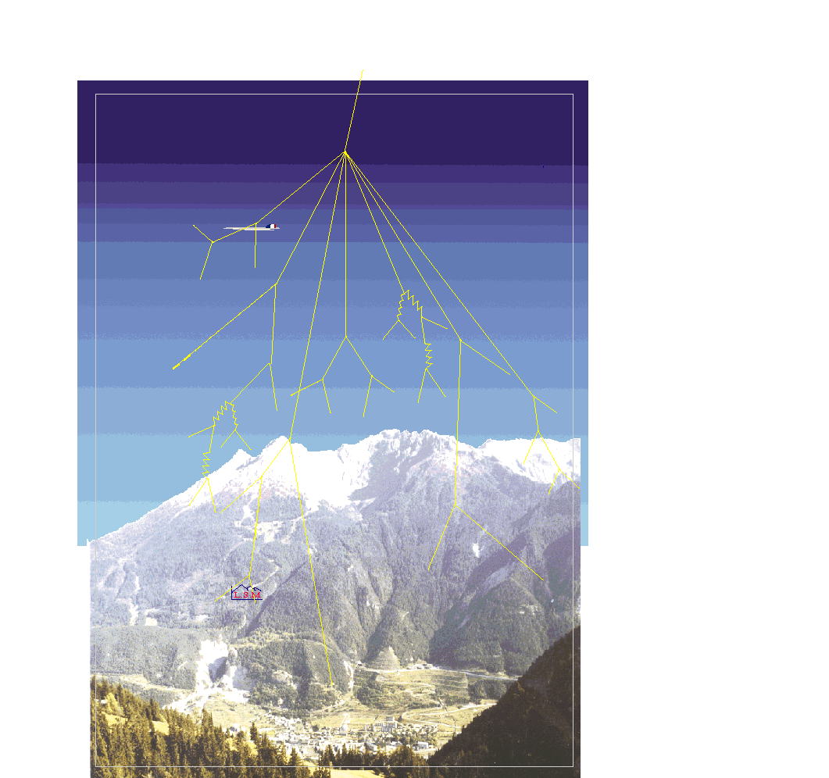
Search spontaneous fission decays
in 550 g of Os-sample
Modan, France
Fréjus peak
4000 m
(w/eq)
The long-lived Hs
is
less than 10⁻²² g/g
in the Earth's crust

Slide 12
Yuri Oganessian “SH Nuclei and Elements”, Session of the NP Section of RAS, Apr.1-5, 2024 JINR, Dubna

Slide 13
Synthesis of SHE

Slide 14
Reactions of synthesis
Act.+⁴⁸Ca
Cold fusion
Nh
Light ions
targets
Neutron
capture
Yuri Oganessian “SH Nuclei and Elements”, Session of the NP Section of RAS, Apr.1-5, 2024 JINR, Dubna
Notes:
14
14

Slide 15
Reaction of synthesis
artificial element made in
high flux nuclear reactor,
²⁴⁴Pu, ²⁴⁸Cm, ²⁴⁹Bk …
target
n
48
288
292
from
accelerator
244
to separator
Ca
Pu
Fl
Fl
projectiles
n
n
rare and very
expensive isotope of Ca
fusion & cooling
Yuri Oganessian “SH Nuclei and Elements”, Session of the NP Section of RAS, Apr.1-5, 2024 JINR, Dubna

Slide 16
Dubna Gas-Filled Recoil Separator
A_{CN}-x
E_{R}
EVR
TOF
E_{R}
θ_{R} = 0⁰ ± 2.5⁰
50/s
⁴⁸Ca-beam
5·10¹²/s
²⁴⁹Bk-target
350 μg/cm²
Adam Sobiczewski, Acta Phys. Pol. B 41, 157 (2010).

Slide 17
Summary decay properties of the Z-even isotopes observed
in ²³⁸U, ^{240,242, 244}Pu, ^{245, 248}Cm and ²⁴⁹Cf + ⁴⁸Ca reactions
Yu Ts Oganessian and V K Utyonkov,
Rep. Prog. Phys. 78 (2015) 036301
2000-2010
Yuri Oganessian “SH Nuclei and Elements”, Session of the NP Section of RAS, Apr.1-5, 2024 JINR, Dubna

Slide 18
Summary decay properties of the isotopes of elements 113, 115, and 117
observed in ²³⁷Np, ²⁴³Am and ²⁴⁹Bk + ⁴⁸Ca reactions
2010-2014
These 10 radioactive families are our wealth
Yuri Oganessian “SH Nuclei and Elements”, Session of the NP Section of RAS, Apr.1-5, 2024 JINR, Dubna

Slide 19
Alpha - decay
Theory I. Muntian, Z. Patyk, and A. Sobiczewski
Phys. At. Nucl. 66, (2003)
Z-even
Exp.
Z-even

Slide 20
Spontaneous fission
even-even isotopes
R. Smolańczuk, PR. C 56 (1997) 812
SHN
SF critical
zone
Yuri Oganessian “SH Nuclei and Elements”, Session of the NP Section of RAS, Apr.1-5, 2024 JINR, Dubna

Slide 21
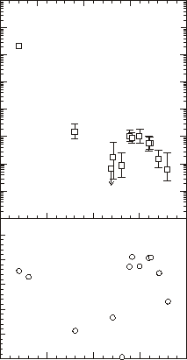
10⁶
Macro-microscopic theory
&
experiments
10⁴
²⁴⁴Pu+⁵⁰Ti
²⁴⁶Cm+⁴⁸Ca
Total EVR’s cross sections (pb)
10²
10⁰
SHE
119
10⁻²
The most
pessimistic forecast
0.5
120
0.0
B_{n} – B_{f} (MeV)
-0.5
-1.0
-1.5
CN survival ~ exp(B_{n}-B_{f})
-2.0
100
105
110
115
120
Atomic number

Slide 22
a nuclei with
Z ≥ 120 and A ≥ 300
may exist!
T_{1/2} = 0.7 ms
A=294
protons →
A=254
T_{1/2} = 50 ms
neutrons →
Yuri Oganessian “SH Nuclei and Elements”, Session of the NP Section of RAS, Apr.1-5, 2024 JINR, Dubna
Notes:
22

Slide 23
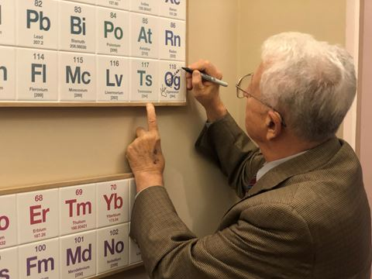
Lobby of the Royal Society of Chemistry

Slide 24
Conclusion
With Z more than 40% larger than that of Pb,
the heaviest stable element, we see an impressive
extension in nuclear survivability.
The fundamentals of the modern theory
concerning the mass limits of nuclear matter
have obtained experimental verification
Yuri Oganessian “SH Nuclei and Elements”, Session of the NP Section of RAS, Apr.1-5, 2024 JINR, Dubna
Notes:
Текст на слайде

Slide 25
Chemistry

Slide 26
Meanwhile, the discovery of the SHE,
like the opening of the Pandora's box, has poured out
many unexpected problems.
among them:
Where are the super heavy elements located
in the Periodic Table?
Where is the boundary of the Periodic Table
and how many elements can it contain?
Yuri Oganessian “SH Nuclei and Elements”, Session of the NP Section of RAS, Apr.1-5, 2024 JINR, Dubna
Notes:
Текст на слайде

Slide 27
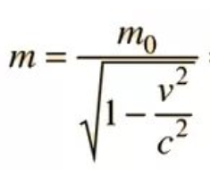
“Relativistic effect” in the electronic structure
of the heaviest elements
4.0
m/m₀
Z=174
3.0
R
2.0
Z=118
Au
standard
114
1.0
NR
0.0
0.2
0.4
0.6
0.8
1.0
v/c
Yuri Oganessian “SH Nuclei and Elements”, Session of the NP Section of RAS, Apr.1-5, 2024 JINR, Dubna

Slide 28
Relastivistic contraction
Z=118
n=2
n=3
n=4
n=1
Electron density (a.u.)
n=5
non
relativistic
correlation
effects
n=6
n=7
nucleus
Distance (in a_{B})
Yuri Oganessian “SH Nuclei and Elements”, Session of the NP Section of RAS, Apr.1-5, 2024 JINR, Dubna

Slide 29
Noble gases
P. Schwerdtfeger, W. Nazarewitz et al. (2020)
boiling
R
melting
room
temperature
Temperature (K)
NR
V. Pershina, V.M. Shabaev.et al.(2020)
Rn
Kr
Xe
Ne
Ar
He
Atomic number
Yuri Oganessian “SH Nuclei and Elements”, Session of the NP Section of RAS, Apr.1-5, 2024 JINR, Dubna

Slide 30
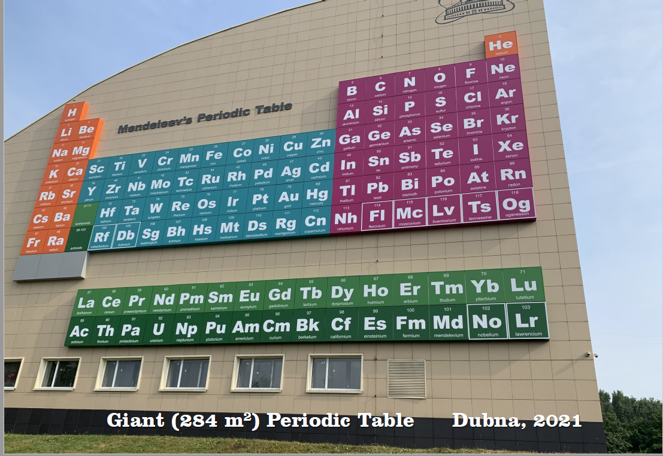
Is element 118 a noble gas?
121

Slide 31
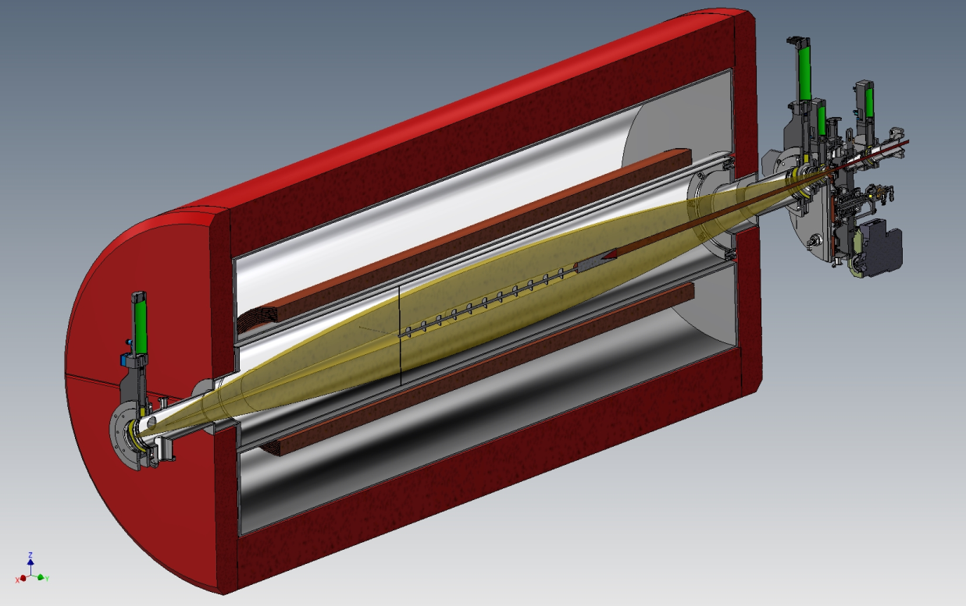
Fast & super fast chemistry of SHE
Z | Isotope | Half-life
112 | ²⁸³Cn | 3.6 s
113 | ²⁸⁴Nh | 0.9 s
114 | ²⁸⁷Fl | 0.5 s
114 | ²⁸⁹Fl | 1.9 s
115 | ²⁸⁸Ms | 0,16 s
116 | ²⁹³Lv | 57 ms
117 | ²⁹⁴Ts | 51 ms
118 | ²⁹⁴Og | 0.6 ms
Dubna 2007
New SC-separator GASSOL
rotating
target
axial screens
EVRs
axial screens
Super fast chemistry
Yuri Oganessian “SH Nuclei and Elements”, Session of the NP Section of RAS, Apr.1-5, 2024 JINR, Dubna

Slide 32
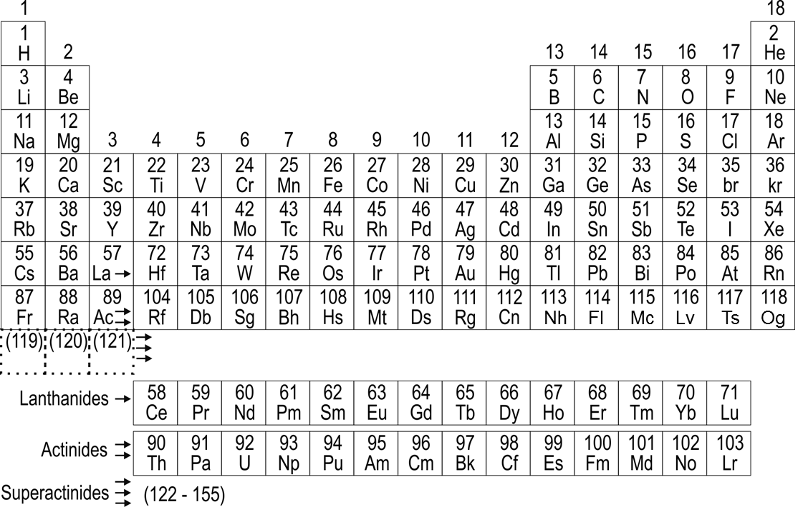
Periodic Table
calculated in the relativistic approximation
SHE
known
next
118
Og
(119)
(120)
(121)
121
122
123
The group difference will be greatly depressed or disappear
Superactinides
122
123
. . .155
Yuri Oganessian “SH Nuclei and Elements”, Session of the NP Section of RAS, Apr.1-5, 2024 JINR, Dubna

Slide 33
SHE-Factory

Slide 34


SHE
The SHE-Factory
&
its purposes

Slide 35
SHE-Factory
TARGETS
Isotope production:
Pu 240-244
Cm 245-248
Bk-249
Cf-249-251
BEAMS
SETUPS
New accelerator & high beam dose of :
Ca-48
Ti-50
Cr-54
Ni-64
separators & detectors
of the new generation
Factor 3-5
is closely linked
to the intellect
To be increased
10 times
Factor 10-20
High-flux isotope reactor
SM-3 at Dimitrovgrad
New accelerator
DC-280
3 experimental halls
5 ion beam channels
Recoil
Separators
DGFRS-2
DGFRS-3
GASSOL (making)
New
Highly productive isotope
separator in Sarov
New
New
New
ROSATOM
isotopic enrichment of elements for acceleration
in Lesnoy
New

Slide 36
We talked about:
New Elements
120
120
119
Ts
118
Z
2010
Lv
Mc
²⁹⁸Fl
Fl
Nh
Cn
110
²⁷⁰Hs
110
²⁵²Fm
100
New Isotopes
²³⁸U
90
140
150
160
170
N
180
190
Yuri Oganessian “SH Nuclei and Elements”, Session of the NP Section of RAS, Apr.1-5, 2024 JINR, Dubna

Slide 37
126
We want:
To expand the genus of SHE
(new elements and isotopes)
2. To see something that we
have not seen before
(rare decays and other properties)
The
NEW YORKER
Projectile
Z > 20
???
Z
118
we are here
⁴⁸Ca - traction
112
170
175
180
184
N
Yuri Oganessian “SH Nuclei and Elements”, Session of the NP Section of RAS, Apr.1-5, 2024 JINR, Dubna

Slide 38
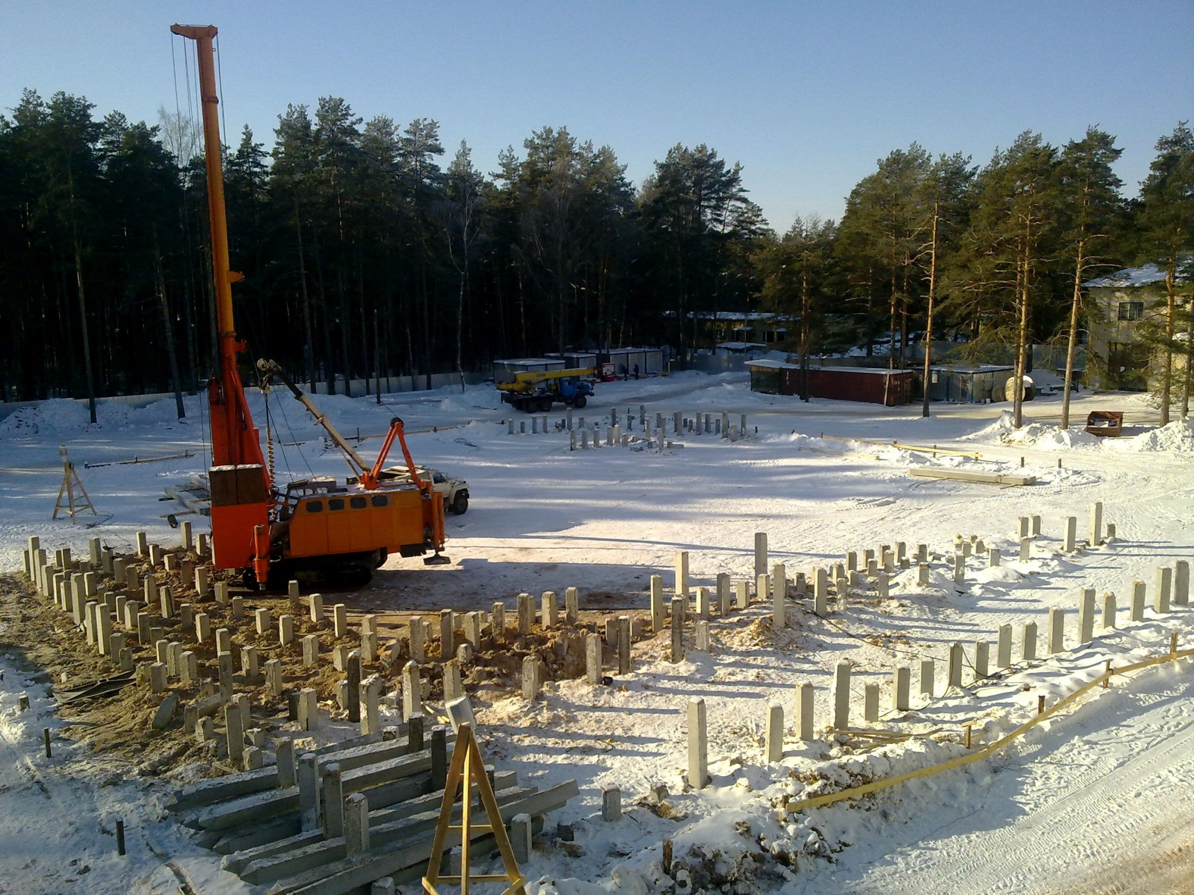
March 2012, Dubna
Yuri Oganessian “SH Nuclei and Elements”, Session of the NP Section of RAS, Apr.1-5, 2024 JINR, Dubna

Slide 39
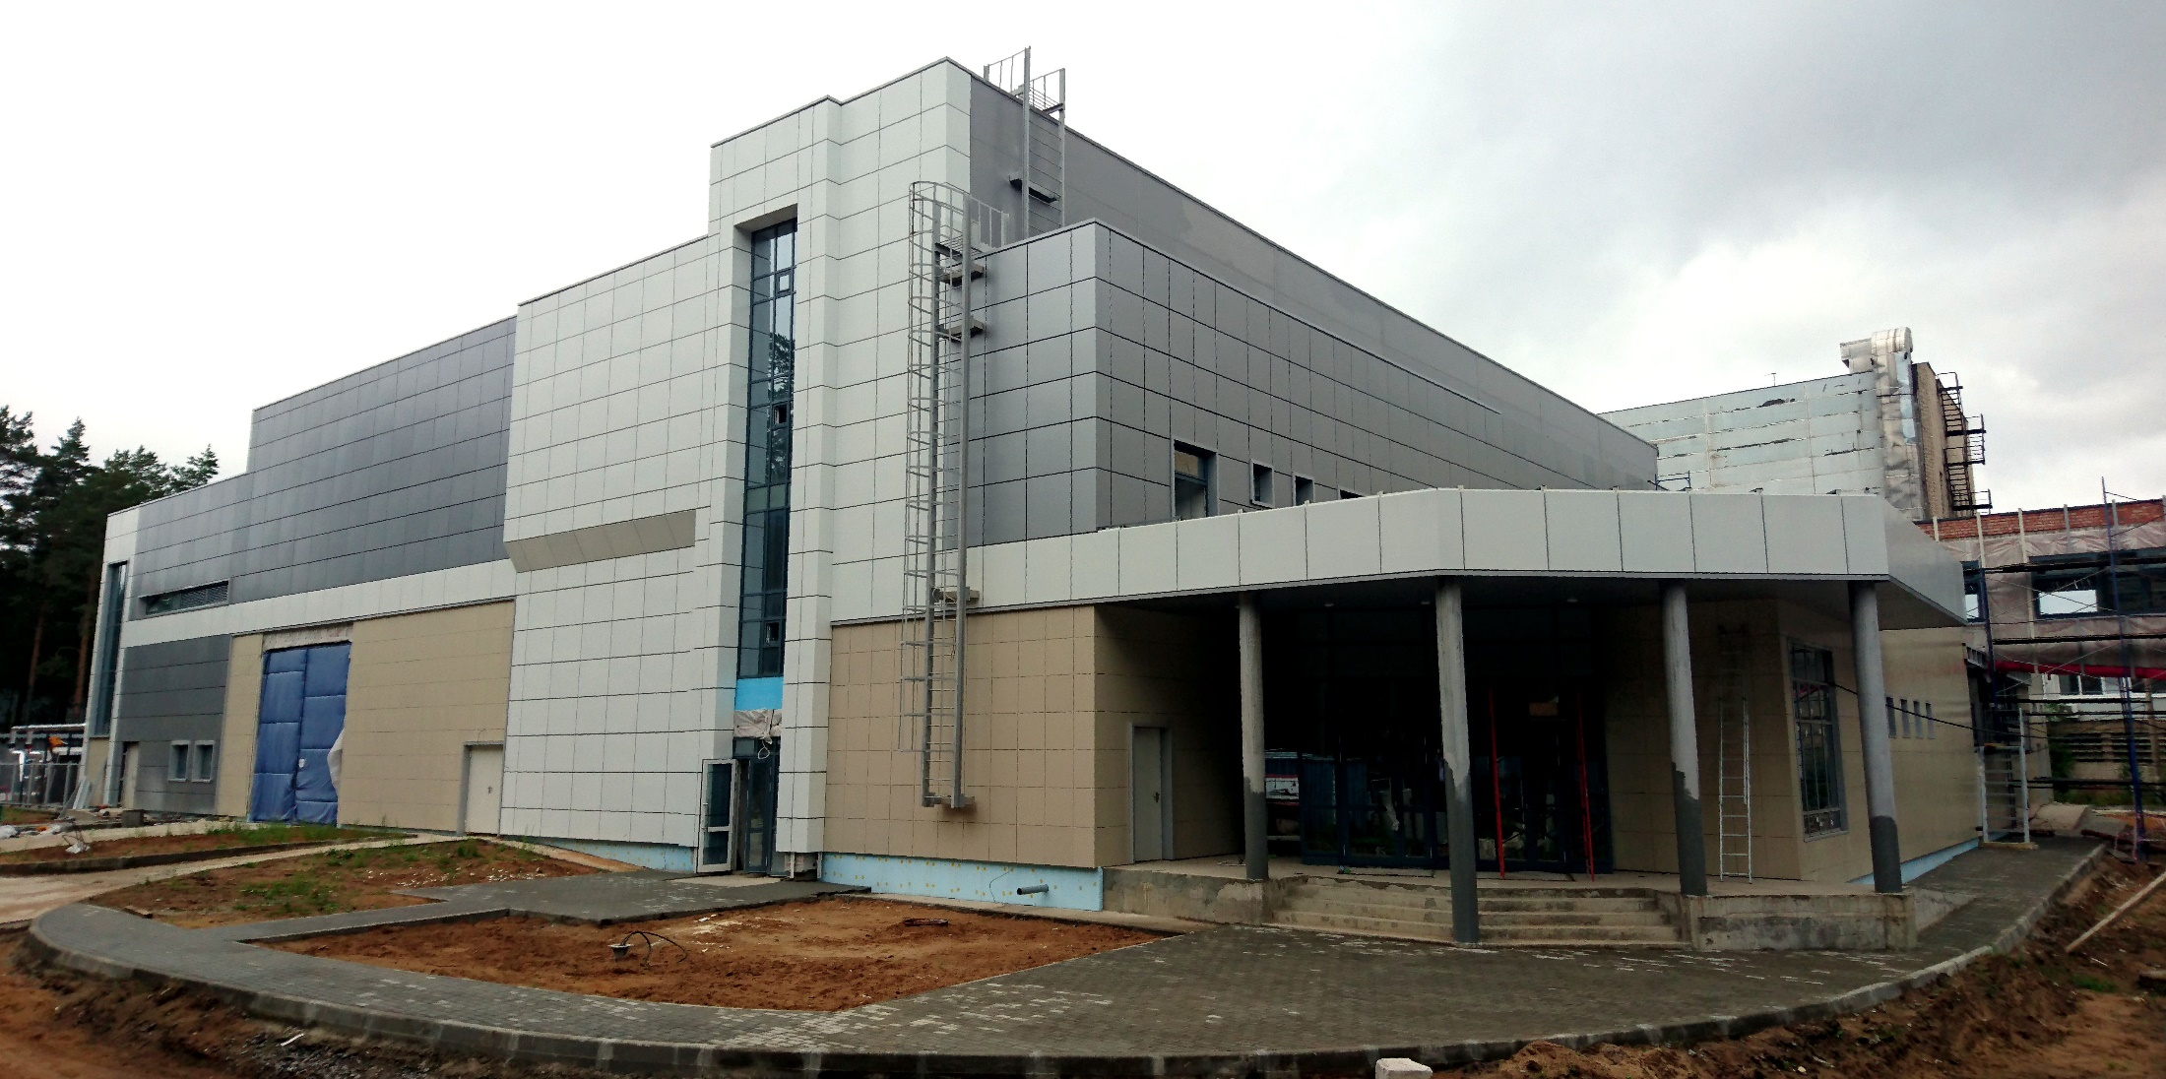
August 2017, Dubna
SHE-Factory
Yuri Oganessian “SH Nuclei and Elements”, Session of the NP Section of RAS, Apr.1-5, 2024 JINR, Dubna

Slide 40
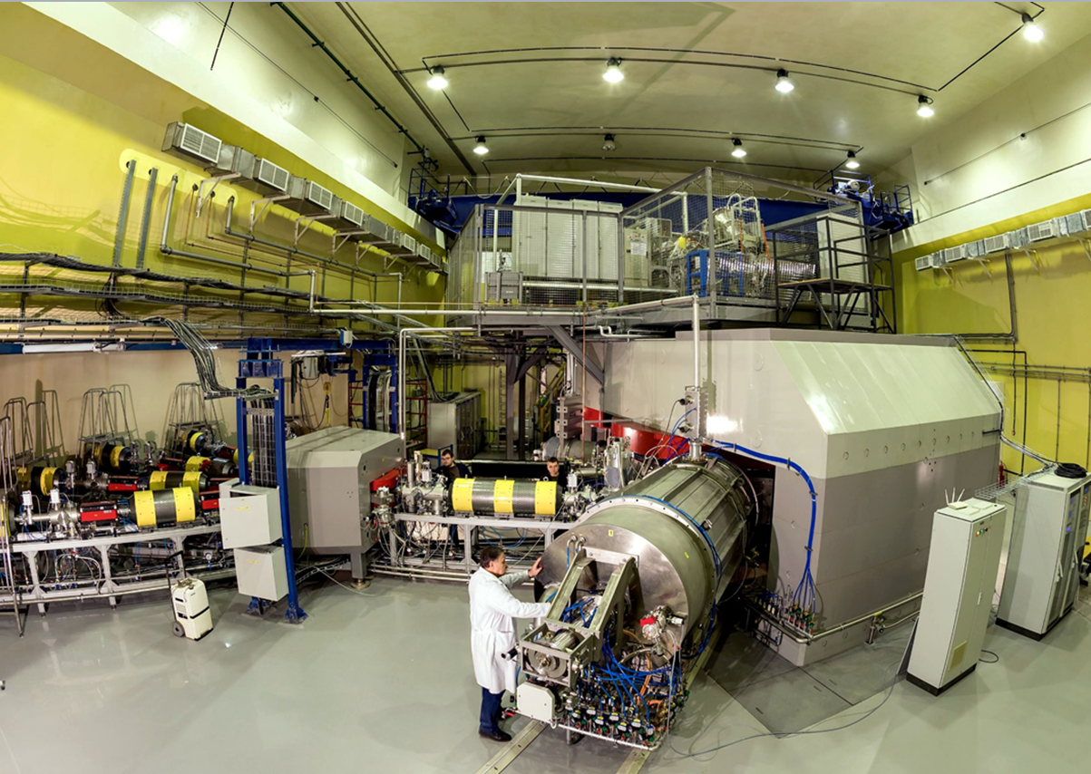
⁷Li – ⁴⁸Ca – ¹³⁶Xe | 10 pµA
²³⁸U | 0.01 pµA
March 2018, Dubna
New cyclotron DC-280
Yuri Oganessian “SH Nuclei and Elements”, Session of the NP Section of RAS, Apr.1-5, 2024 JINR, Dubna

Slide 41
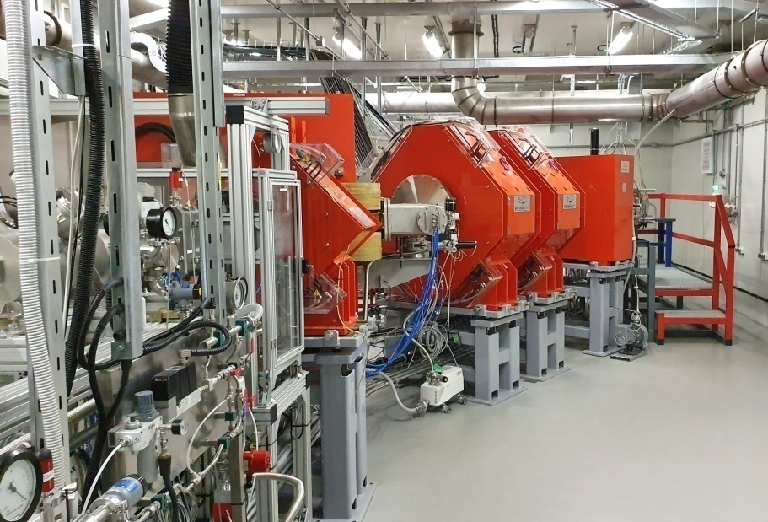
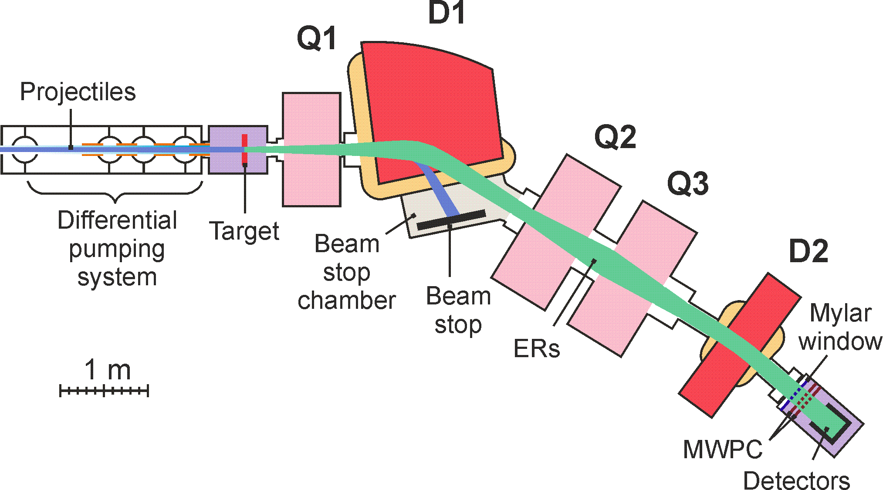
New Dubna gas-filled recoil separator
Transmission of EVR is
Increased by factor of 2
Suppression of background is
Increased by factor of 200

Slide 42
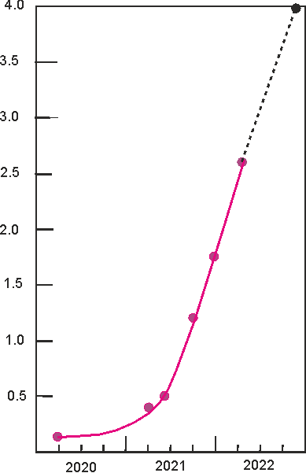
Progress at SHE-Factory
4.0
designed
3.5
Luminosity
(target 30 mg)
3.0
Luminosity (10³¹/cm²ˑs)
2.5
FLNR JINR (Dubna, RF)
then…
LRNL (Berkeley, USA)
GSI (Darmstadt, Germany)
RIKEN (Tokyo, Japan)
GANIL (Caen, France)
2.0
now at Factory
1.5
DC-280 + DGFRS-2
1.0
0.5
previous level
0.0
2000
2020
2021
2022
year
Yuri Oganessian “SH Nuclei and Elements”, Session of the NP Section of RAS, Apr.1-5, 2024 JINR, Dubna

Slide 43
⁵⁴Cr + ²⁴⁸Cm → 3n + ²⁹⁹120
⁵⁰Ti + ²⁴⁹Bk → 3n + ²⁹⁶119
New Elements
298
Fl
known nuclei
It is most likely that the new elements
will be an alpha emitter (T_{α}<<T_{SF} )
Yuri Oganessian “SH Nuclei and Elements”, Session of the NP Section of RAS, Apr.1-5, 2024 JINR, Dubna

Slide 44
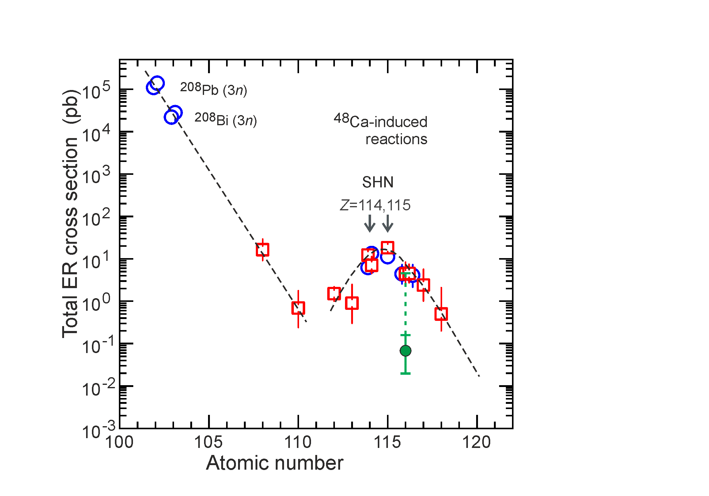
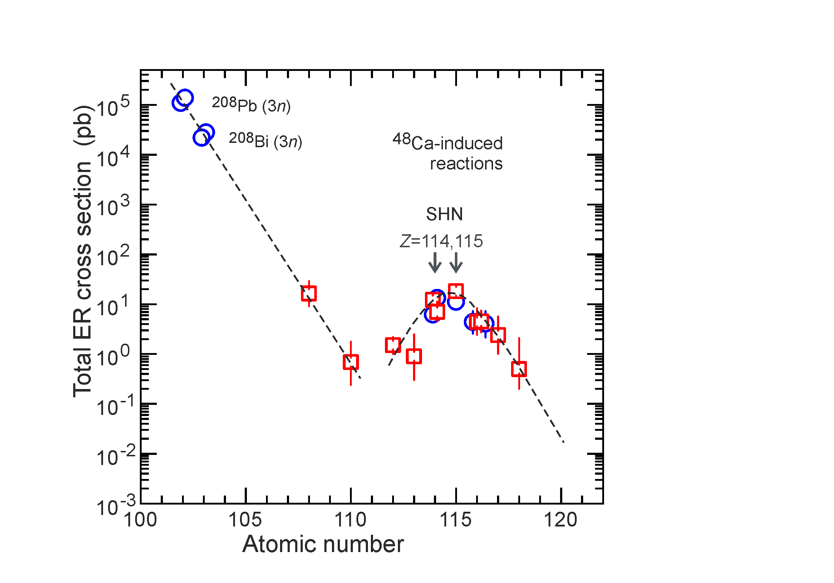
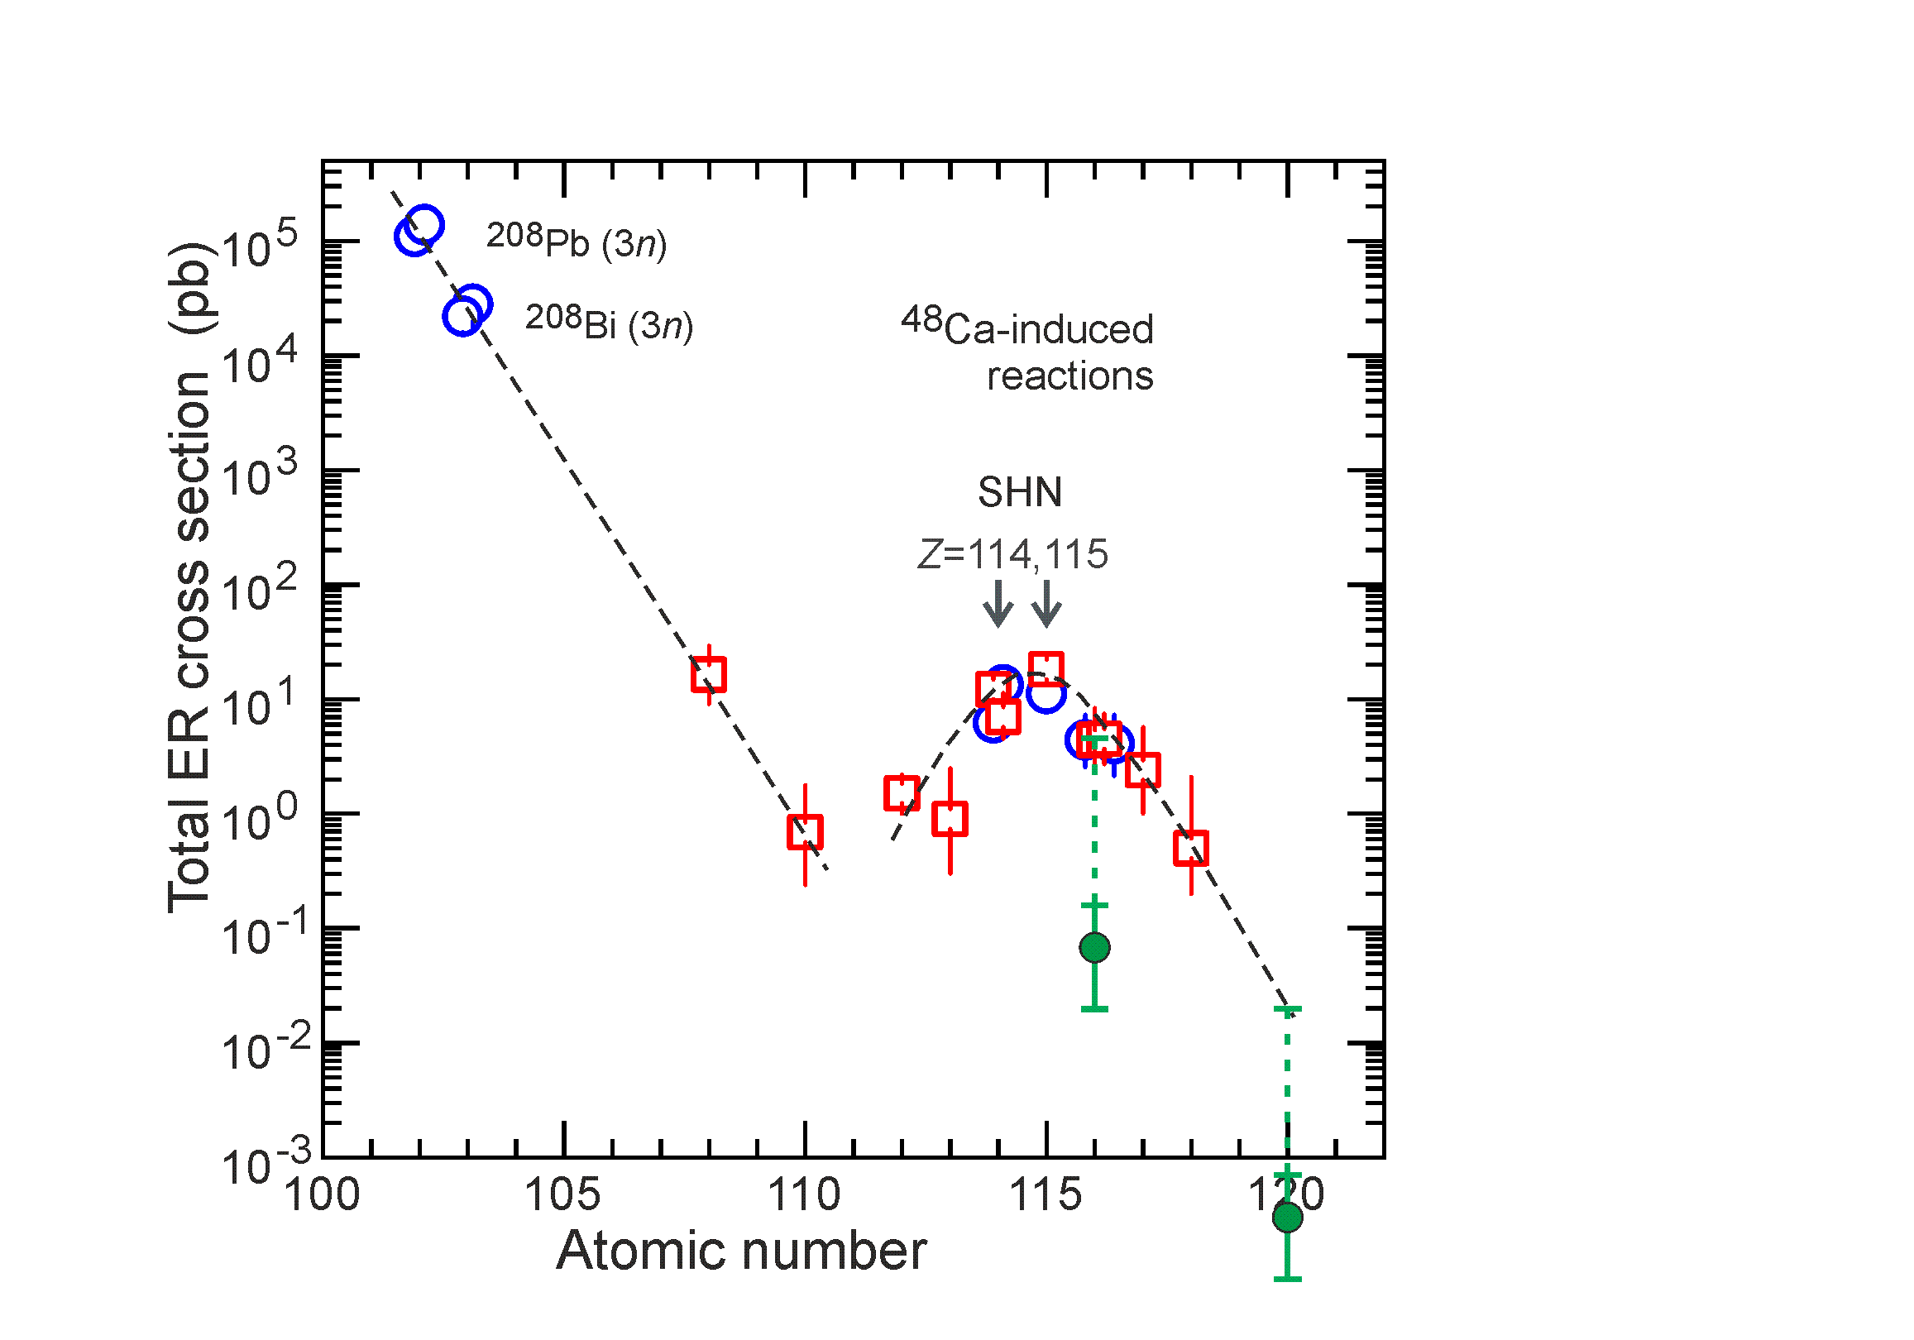
Synthesis of element 120 and consequences
U 400 DGFRS-! →
⁴⁸Ca
Now FACTORY →
⁵⁴Cr
1 event/100 d
0.5 – 0.7 fb
Yuri Oganessian “SH Nuclei and Elements”, Session of the NP Section of RAS, Apr.1-5, 2024 JINR, Dubna

Slide 45
Thank you!

