Slide 1
Modern trends of high energy accelerators development
Anton Bogomyagkov, Eugene Levichev
Budker Institute of Nuclear Physics
Novosibirsk, Russia
JINR, Dubna, 1 - 5 April 2024

Slide 2
Too many projects and proposals…
Large Hadron Collider
CEPC/SppC
International Linear Collider
Compact Linear Collider
Novosibirsk Super Charm Tau Factory
Too many proposals. We apologize we cannot consider them all.

Slide 3
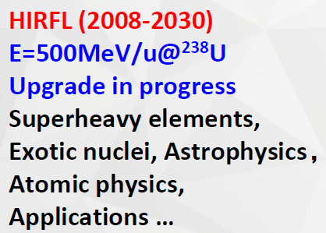
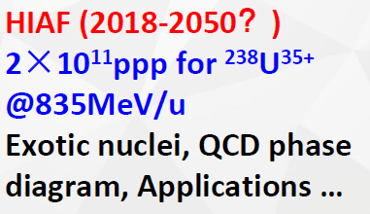
How to reveal trends?
Easy, just look at our Chinese colleagues…
Yi-Fang Wang, Director IHEP CAS, 16/09/2022
Existing Acc Projects

Slide 4
China accelerator proposals
Accelerator project
Notes:
5 accelerator projects were given to government.

Slide 5
Review results
Credits to Jie Gao
Higgs Factory
(talk by Jie Gao)
Nuclear physics facility
(talk by Lijun Mao)
Super Tau-Charm Factory
X-fel for gamma Compton source
SCALE:
Gigascience
Megascience
Midiscience
Megascience
Isotope separation facility
Midiscience

Slide 6
Size classification
►Gigascience: extremely large facilities (~10…100 km).
LHC upgrade HL-LHC, HE-LHC, LHeC; lepton linear colliders ILC (Japan), CLIC, FCC-ee, FCC-hh and FCC-he (CERN); CEPC/SppC (China), etc.
►Megascience: large facilities (~0.5-10 km).
Super KEKB Factory (Japan); SCTF (Russia), STCF (China), NICA (Dubna), EIC (USA), CNUF (China), FAIR (Darmstadt), etc.
►Midiscience: middle-size facilities (~100-500 m).
HIGGS2 (Duke University), MEDAUSTRON (Vienna), CNAO (Pavia), INOK (Sarov), VEPP-6 (Novosibirsk), etc.
►Miniscience: small facilities (< 100 m).
VEPP-2000 (Novosibisrk), μμ-tron (Novosibirsk), DERICA (Dubna), IOTA (USA), ELENA (CERN), LEPTA (Dubna), etc.

Slide 7
Disclaimer
Since all future projects are still evolve, their parameters (and even configuration) we will present below may differ from those you know.

Slide 8
Gigascience
►Extremely large facilities (~10…100 km).
LHC upgrade HL-LHC, HE-LHC, LHeC; lepton linear colliders ILC (Japan), CLIC, FCC-ee, FCC-hh and FCC-he (CERN); CEPC/SppC (China), Muon Collider Higgs Factory, XCC FEL-based γγ-collider, etc. Z-factory collider in Protvino?

Slide 9
Future Circular Colliders (FCC) Study - CERN

Slide 10
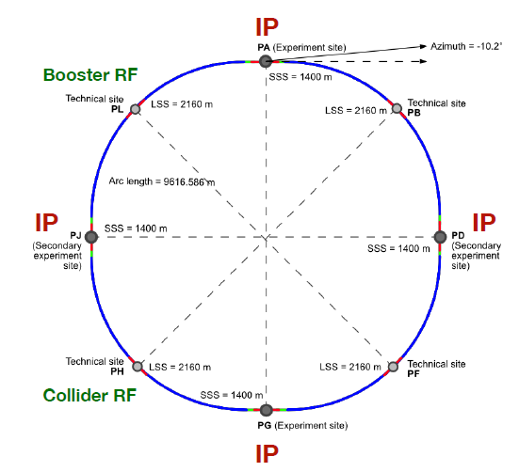
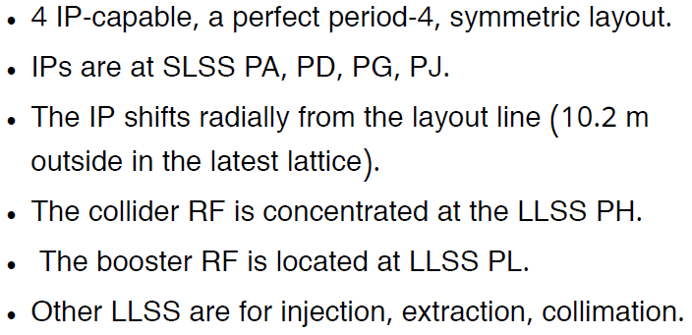
FCC-ee key features and layout
Crab Waist collision technology is a major trend to increase luminosity in FCC-ee as well as in all other future electron-positron colliders

Slide 11
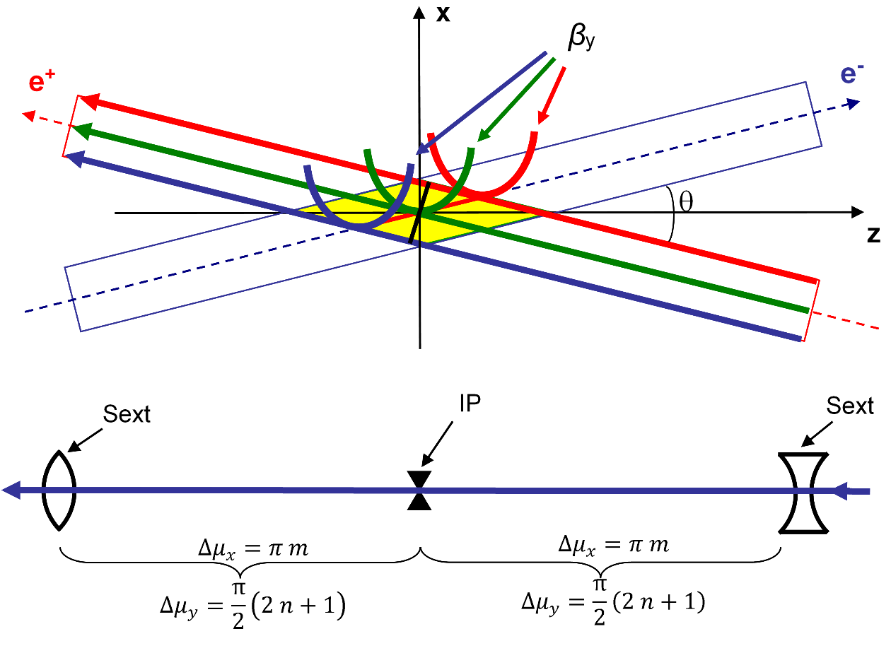
Crab Waist (P.Raimondi, 2006)
Luminosity $L=\frac{γ}{2er_{e}}⋅\frac{I_{tot}ξ_{y}}{β_{y}^{∗}}R_{H}$
Large Piwinski angle: $φ=\frac{σ_{z}}{σ_{x}}\tan\left(\frac{θ}{2}\right)$
Transverse beam separation in parasitic IPs
distance between bunches is not limited by beam-beam
Interaction area length $L_{i}≪σ_{z}$
$β_{y}^{∗}≈L_{i}≪σ_{z}$ no hour-glass
CRAB waist (CRAB sextupoles) suppresses betatron and synchro-betatron resonances
$ξ_{y}∼0.2$
x
+
-
e
L_{i}
e
θ
φ ∙σ_{x}
z
2σ_{z}
2σ_{x}

Slide 12
CW vs Head-on
Interaction area
Int.area
Head-on (almost)
Crab-Waist
We can not squeeze the beams due to Hour Glass effect
We can squeeze the beams, increase particle density and luminosity

Slide 13
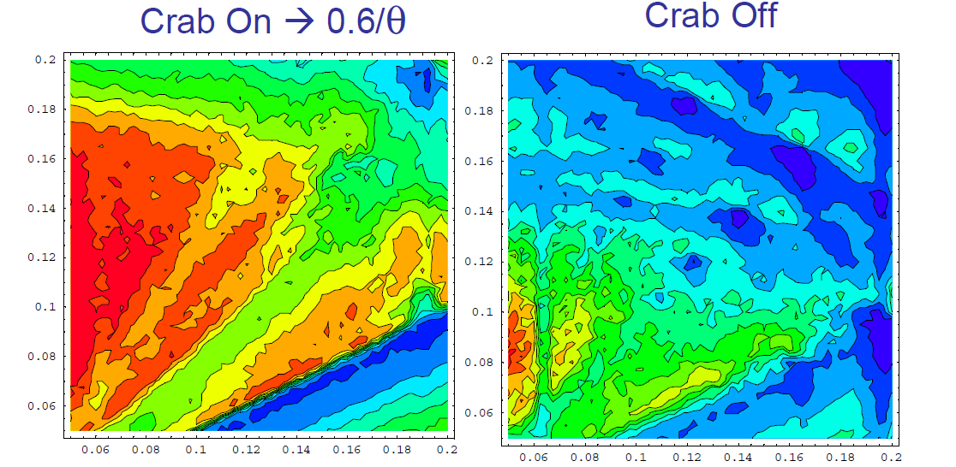
Luminosity plot vs betatron tunes
Red area = high luminosity

Slide 14
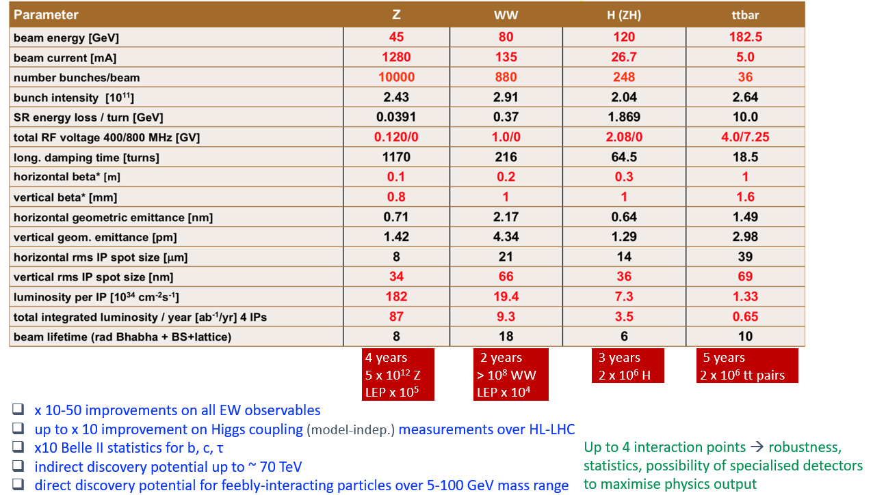
FCC-ee main parameters

Slide 15
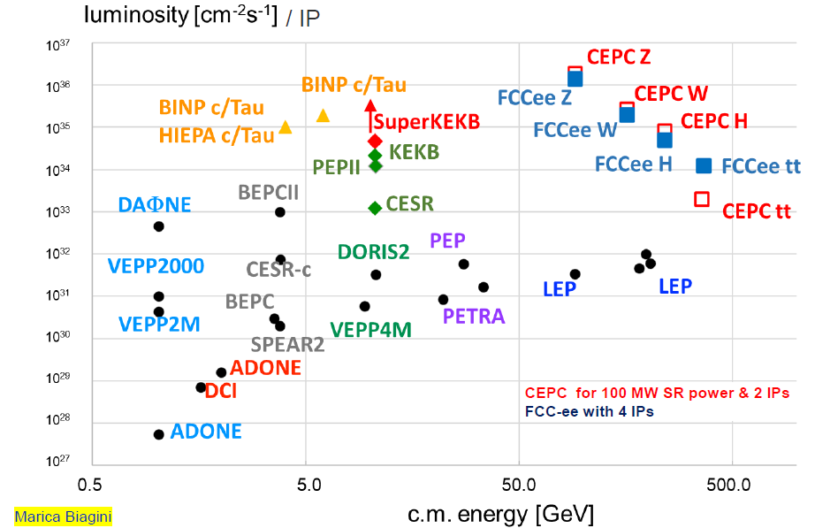
FCC-ee is the second now…
Presently Chinese CEPC exceeds FCC-ee in the peak luminosity!
As it seems, too long design study at first improves parameters but after some time starts to degrade them (like asymptotic series approximation) ☹

Slide 16
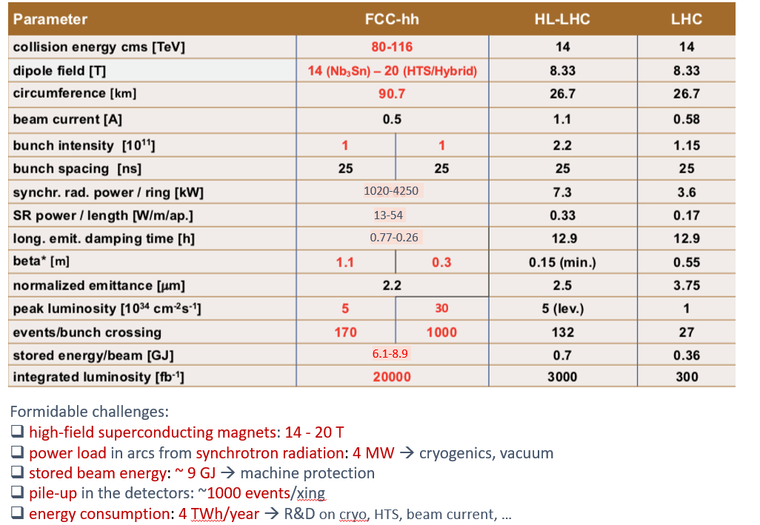
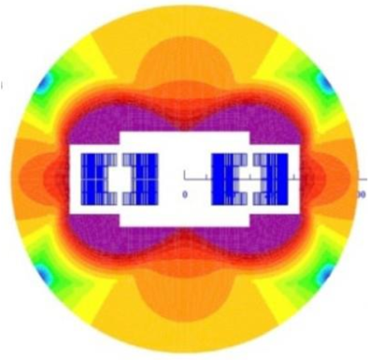
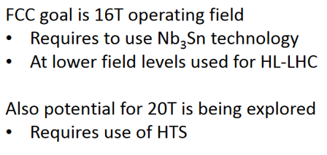
FCC-hh main parameters
Crucial issue for all extremely high energy hadron colliders is high field superconducting magnet.

Slide 17
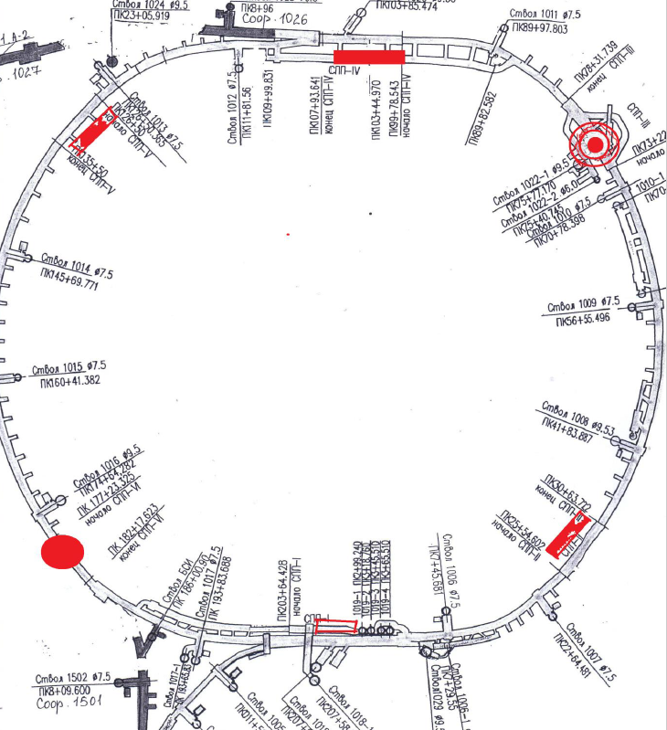
Gigascience in Russia?
Z-Factory in Protvino

Slide 18
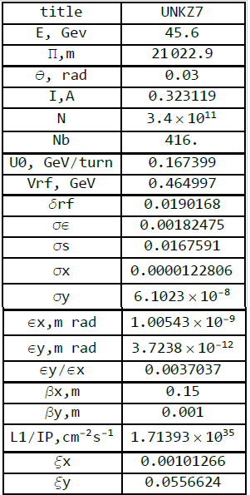
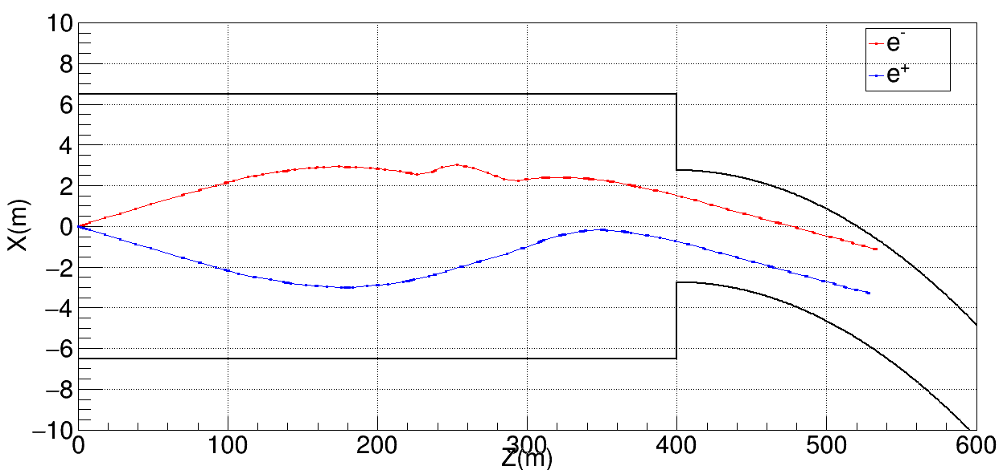
Gigascience in Russia?
Z-Factory in Protvino: first trial.
Ready infrastructure drastically reduces the cost. Currently, construction work is very expensive!

Slide 19
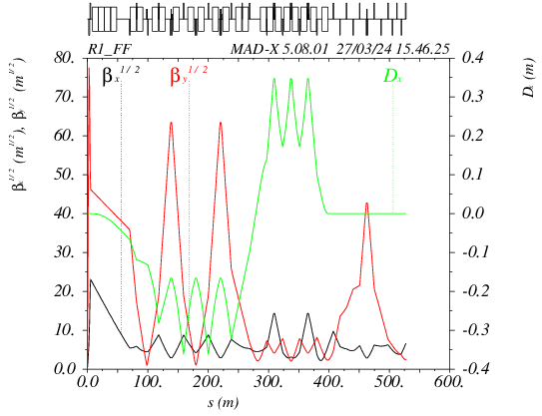
Gigascience in Russia?
Z-Factory in Protvino: first trial.
CCSY
CRAB
CCSX
IP
Notes:
Optics functions figure, trajectories in FF

Slide 20
Megascience
►Large facilities (~0.5-10 km).
Super KEKB Factory (Japan); SCTF (Russia), STCF (China), NICA (Dubna), EIC (USA), CNUF (China), FAIR (Darmstadt), etc.

Slide 21
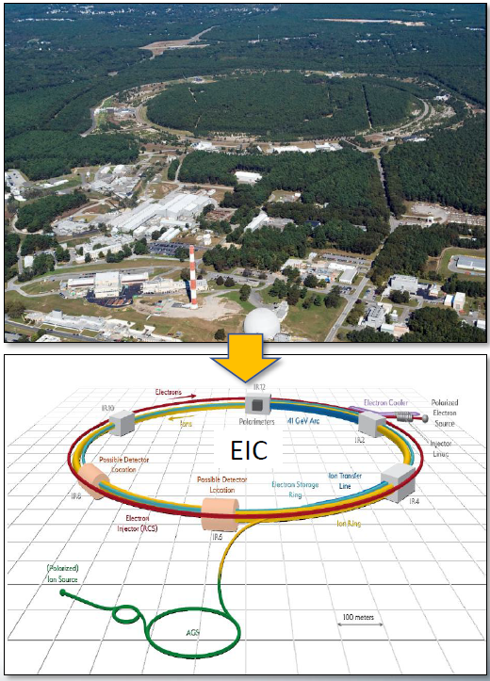
EIC design concept (BNL, USA)

Slide 22
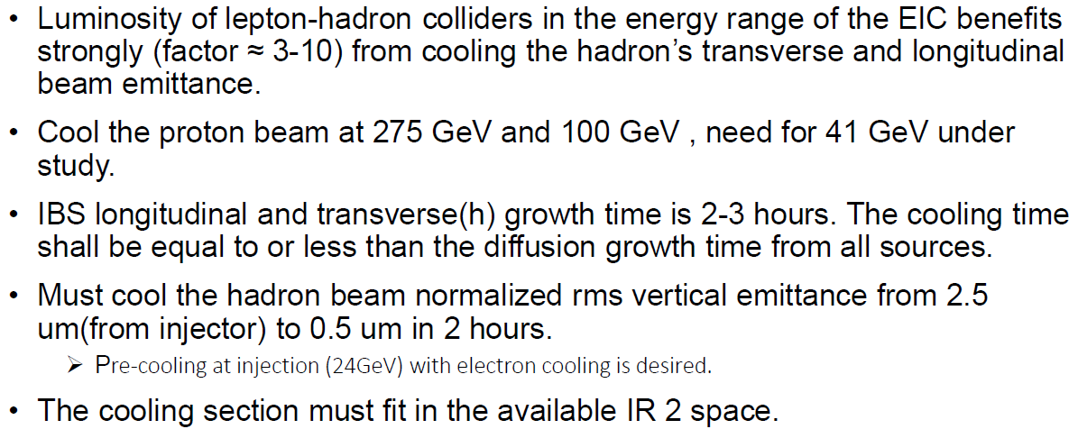
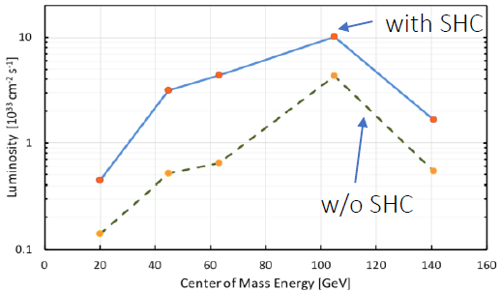
EIC: cooling is necessary
Intrabeam scattering (IBS): Lorentz boosted Coulomb scattering inside bunches
Higher charge and smaller emittances increase IBS growth rate
IBS rates for EIC parameters ~2 hour
Beam cooling methods needed to counteract IBS
The EIC cooler requires up to 150 MeV electron beam with average electron current of ~100 mA (15 MW)
Requires design of a world-class SRF ERL
Electron/hadron beams separate and rejoin each other (adjustable R₅₆)
Electron source/accelerator must be extremely “quiet” (no substructure, no noise, etc.)

Slide 23
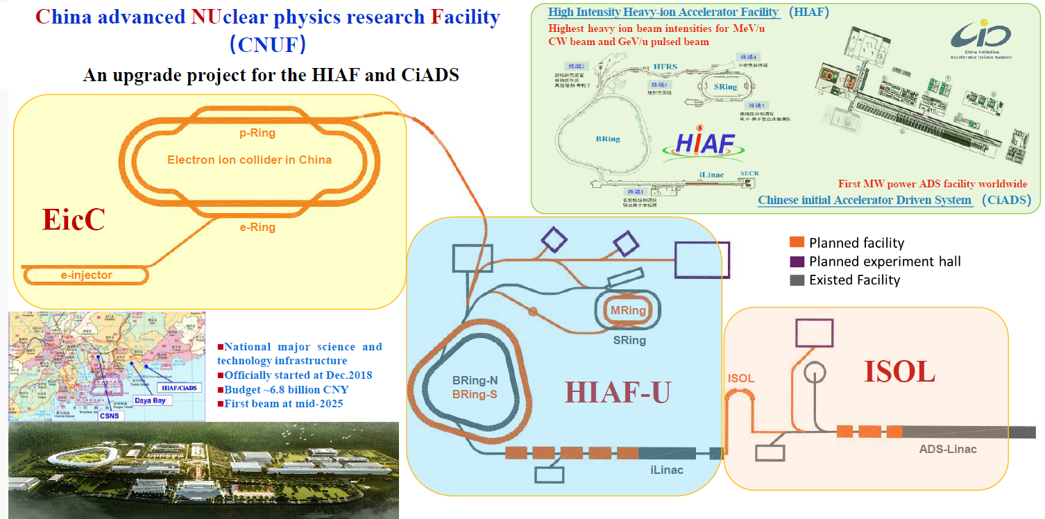
CNUF (China)

Slide 24
CNUF parameters
Scientific tasks and accelerator trends
HIAF-U
Nuclear matter research (high int. high power beams + fixed target)
High energy density physics (2 MJ ns-scale short bunches + multimodal fixed target)
Strong field QED research (merging collision of U isotopes)
Muon physics and applications
ISOL (isotope separation online)
Very neutron rich nuclides research (N-rich nuclides generated online and post acceleration >100 MeV/n)
High intensity low energy muon research (ADC linac + high power target)
EIC
Internal structure of nucleon (rapid replacement head-on collision E_{cm}=15-20 GeV, L = 5-6×10³³ cm⁻²s⁻¹, high-energy cooling and spin manipulations)

Slide 25
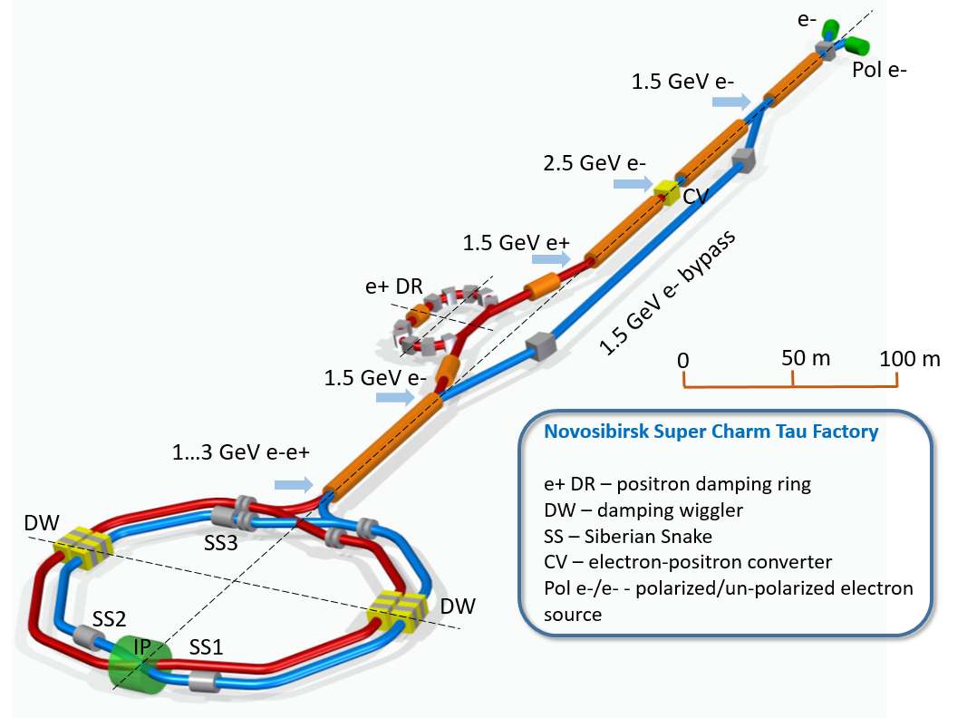
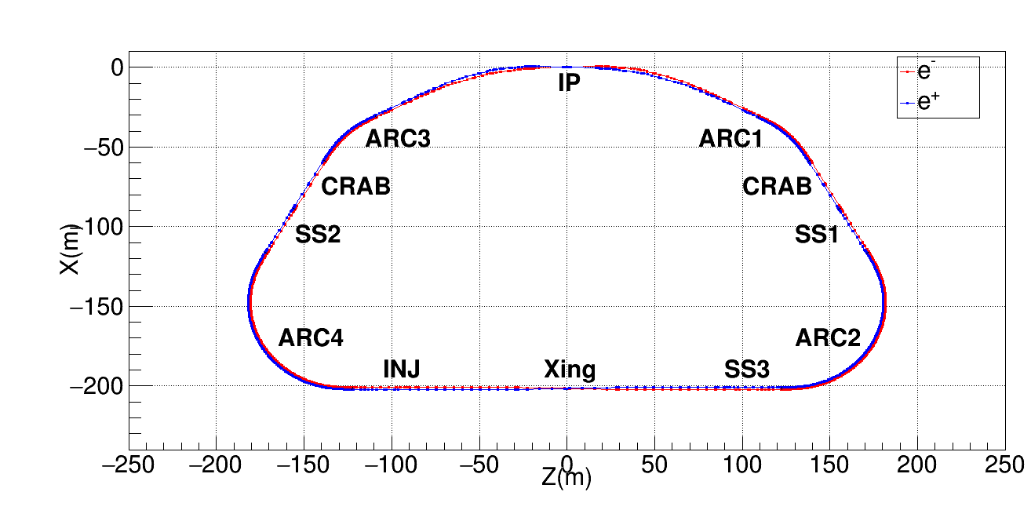
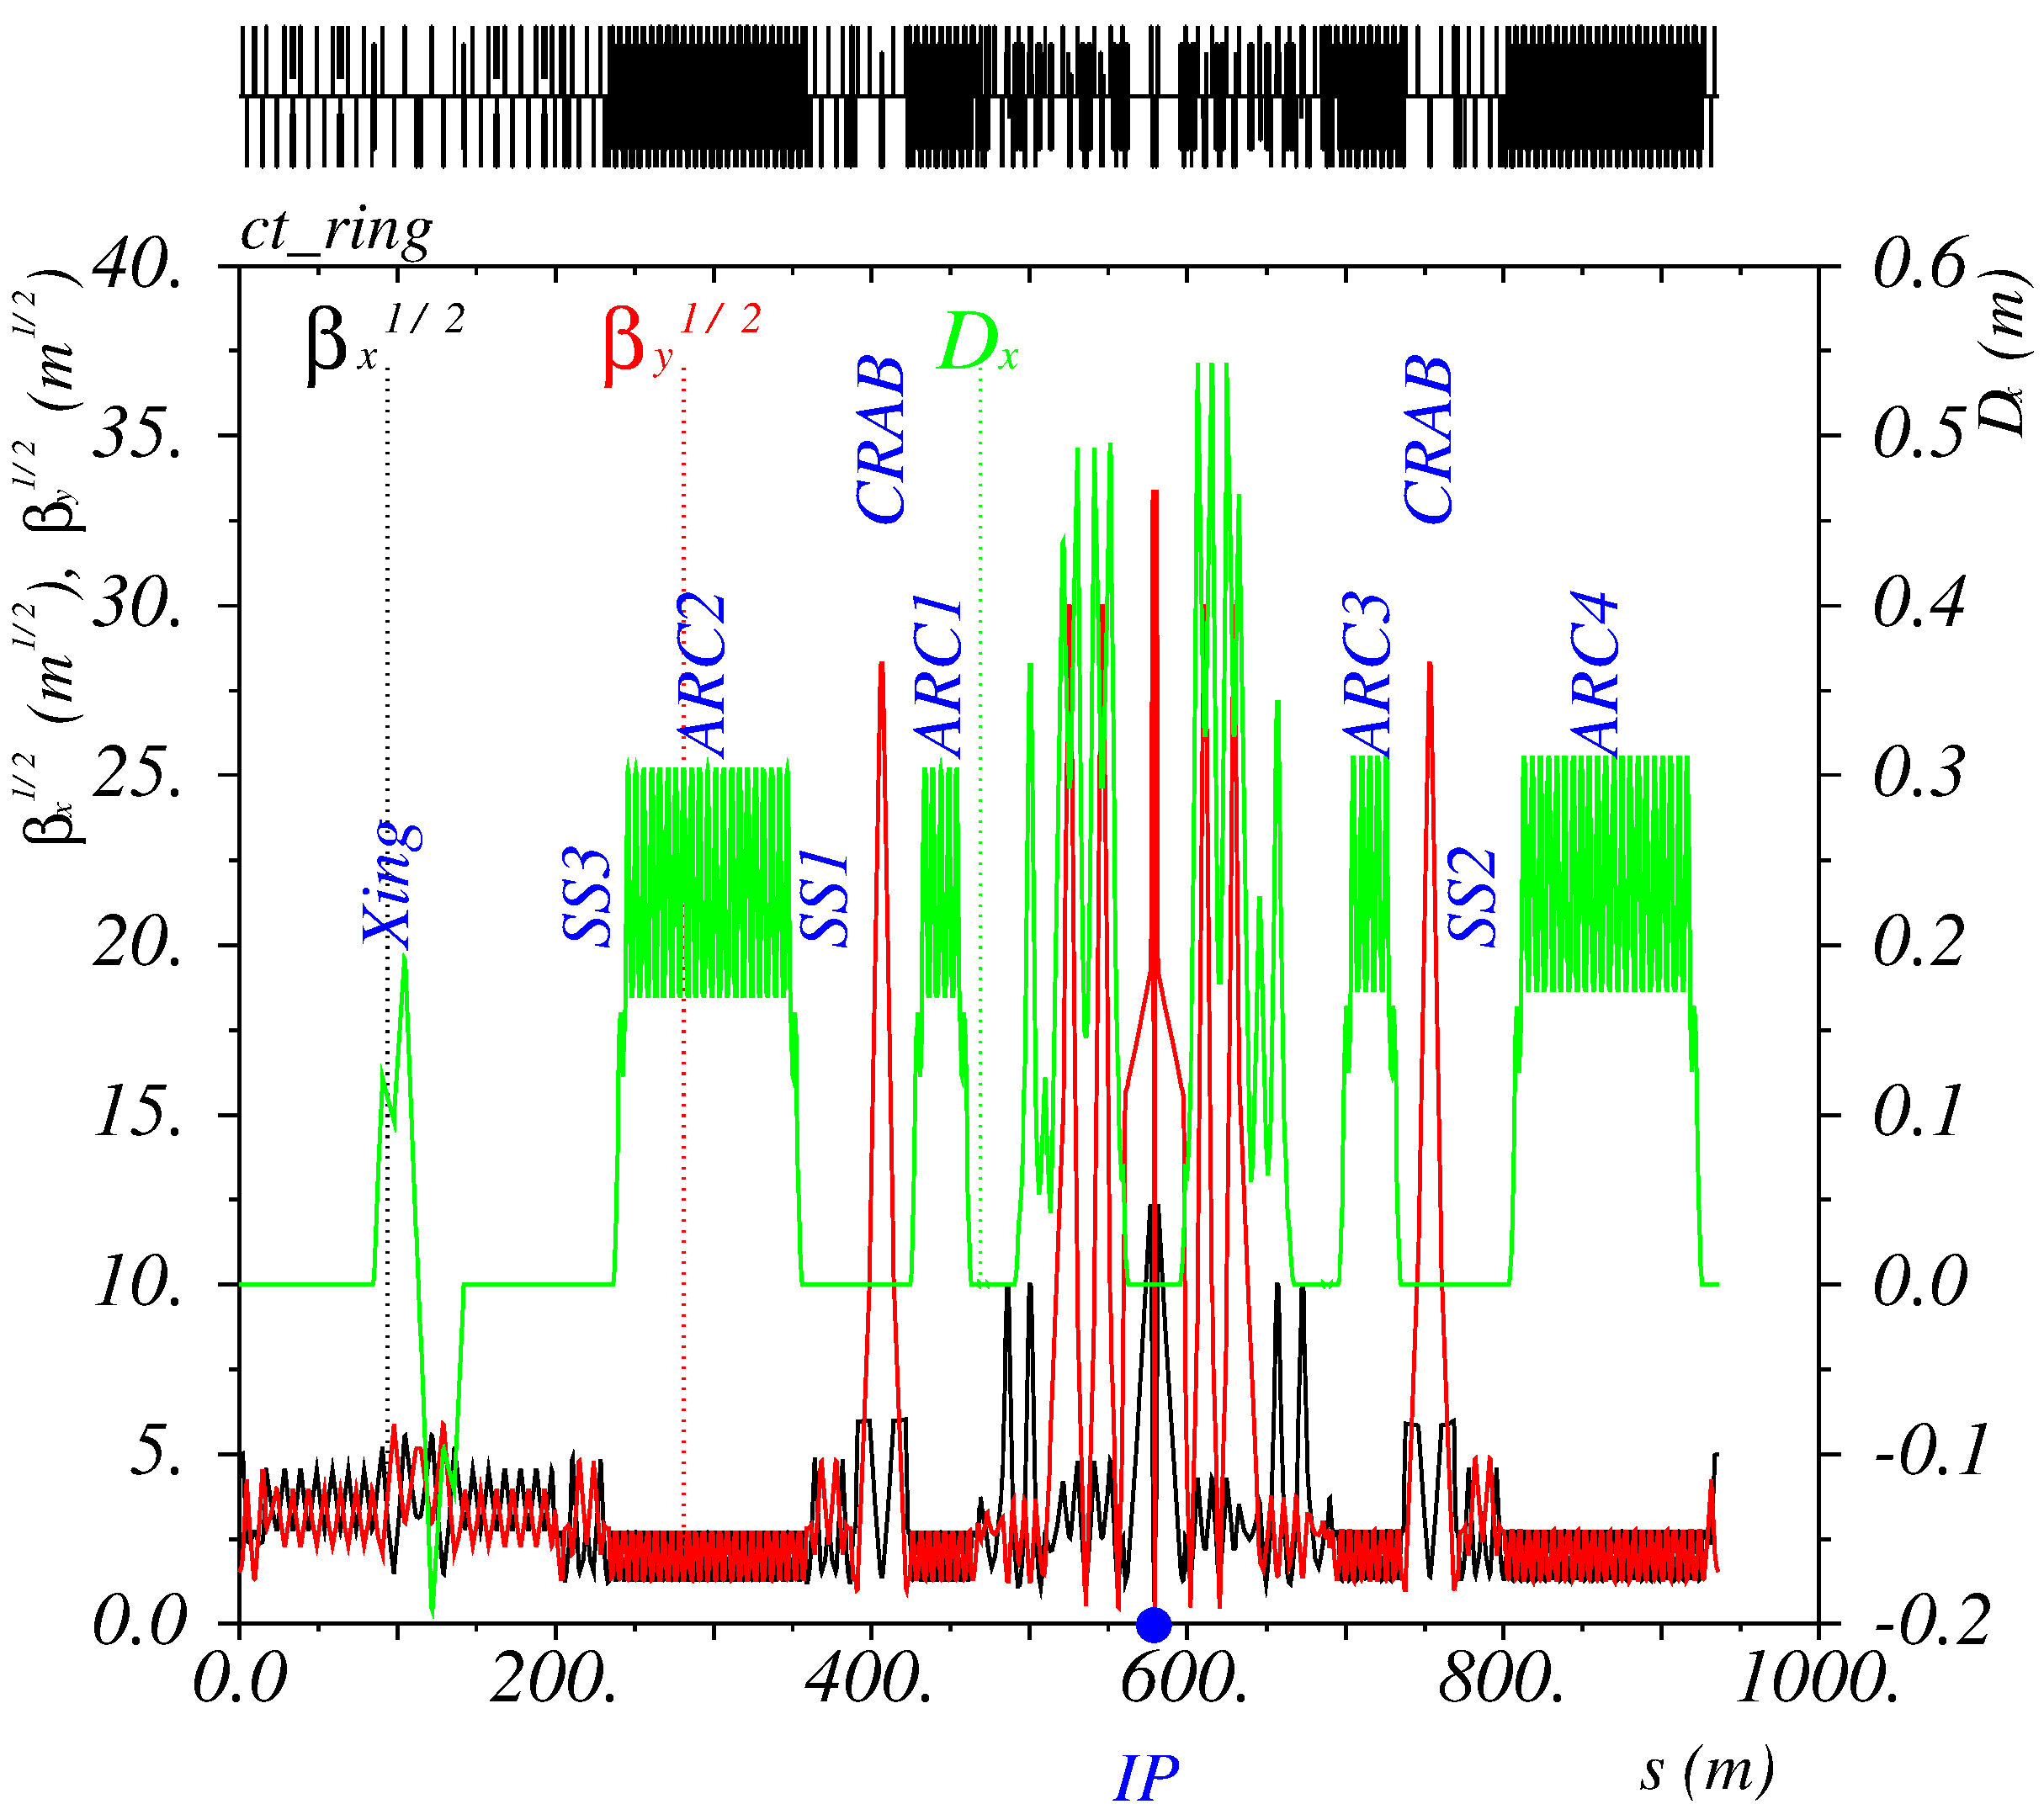
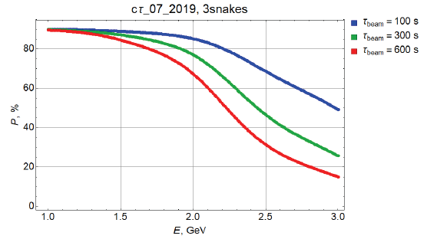
Super Charm Tau Factory (Russia)

Slide 26
SCTF parameters
E(MeV) | 1500 | 2000 | 2500 | 3000 | 3500
$Π$(m) | 935.874
$F_{RF}$(MHz) | 350
$2θ$(mrad) | 60
$β_{x}^{∗}/β_{y}^{∗}$ (mm) | 100/1
$ε_{y}/ε_{x}$(%) | 10 | 0.5 | 0.5 | 0.5 | 0.5
I(A) | 2.9 | 1.64 | 2.5 | 2.7 | 2.9
$N_{e/bunch}×{10}^{−10}$ | 6 | 3.25 | 5 | 5.3 | 5.8
$N_{b}$ / q | 941/1093 | 983/1093 | 983/1093 | 983/1093 | 974/1093
$U_{0}$(keV) / $V_{RF}$(kV) | 91 / 750 | 288 / 2000 | 504 / 3000 | 820 / 3900 | 1266 / 5000
$ν_{s}$ | 0.0108 | 0.0152 | 0.0166 | 0.0172 | 0.018
$δ_{RF}$(%) | 1.3 | 1.83 | 1.97 | 1.97 | 1.98
$σ_{e}×{10}^{3}$ (SR/IBS+WG) | 0.27/0.9 | 0.36/1.1 | 0.5/1.2 | 0.5/1.2 | 0.6/1.3
$σ_{s}$(mm) (SR/IBS+WG) | 3.6/17 | 4.7/15 | 6/14 | 7/14 | 8/14
$ε_{x}$(nm) (SR/IBS+WG) | 2.0/2.9 | 3.5/3.5 | 5.5/3.2 | 7.9/4.1 | 11/5.7
$L_{HG}×{10}^{−35}\left(cm^{−2}s^{−1}\right)$ | 0.29 | 0.4 | 1 | 1 | 1
$ξ_{x}/ξ_{y}$ | 0.003/0.03 | 0.002/0.06 | 0.002/0.08 | 0.002/0.065 | 0.002/0.05
$τ_{Touschek}$ (s) | 304 | 304 | 302 | 560 | 1100
$τ_{Luminosity}$ (s) | 12000 | 5000 | 3000 | 3200 | 3500

Slide 27
Super Tau Charm Factory (China)

Slide 28
Midiscience
►Middle-size facilities (~100-500 m).
HIGGS2 (Duke University), MEDAUSTRON (Vienna), CNAO (Pavia), INOK (Sarov), VEPP-6 (Novosibirsk), etc.

Slide 29
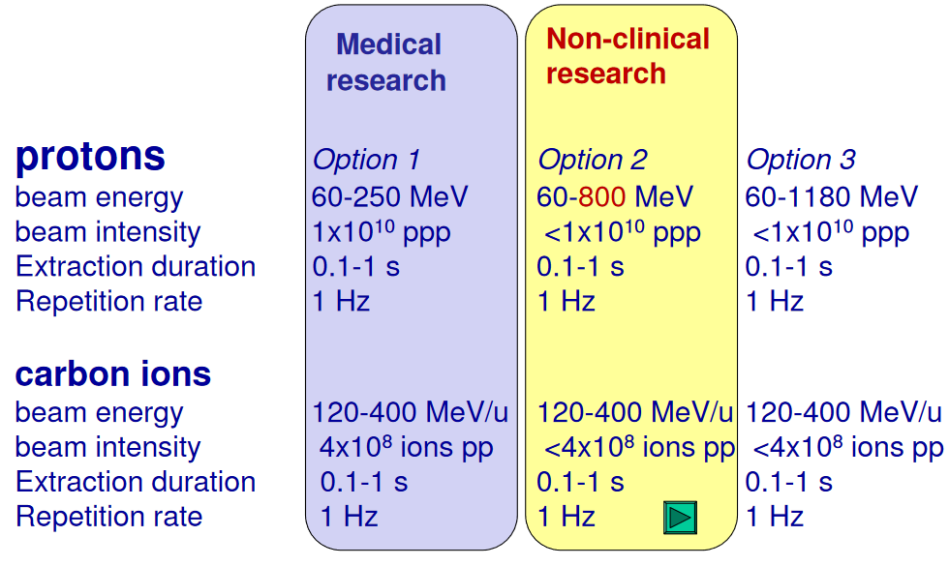
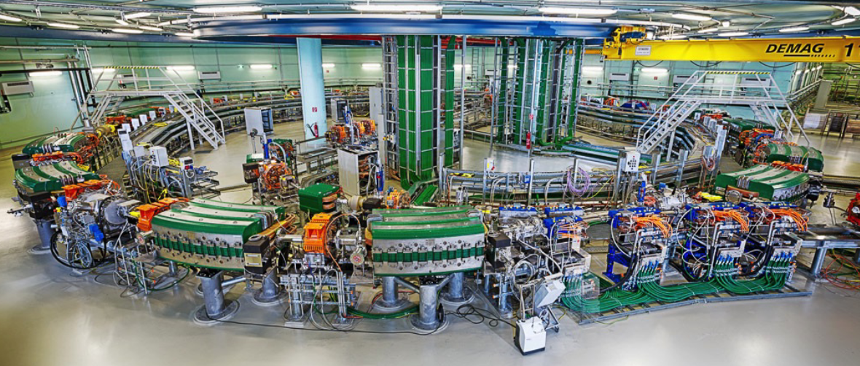
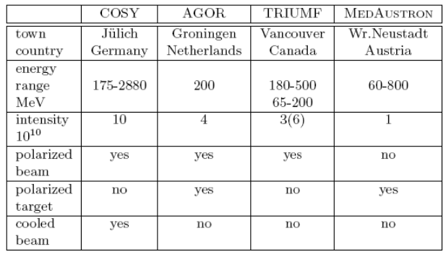
MedAustron (Vienna)
Surprisingly, hadron therapy synchrotrons can provide by-product nuclear physics experiments!
MedAustron parameters are compatible with dedicated facilities

Slide 30
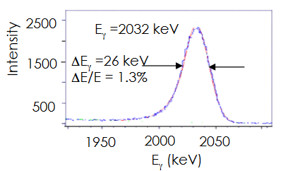
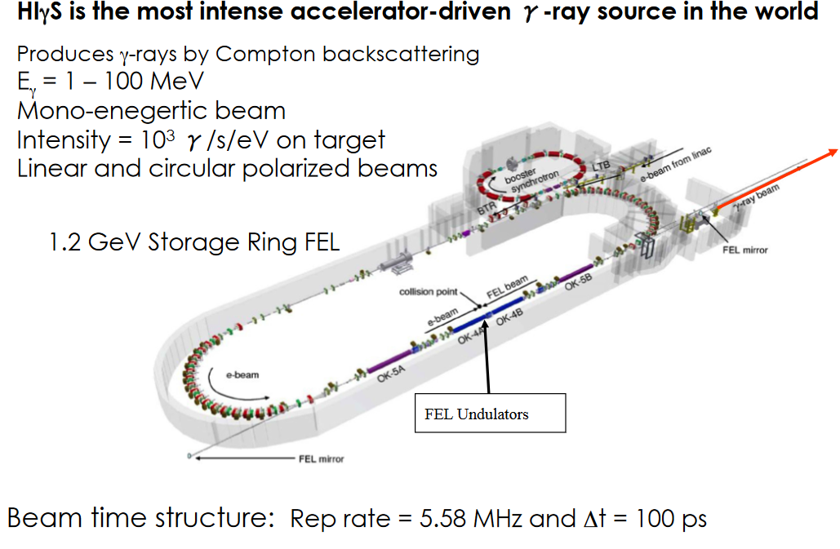
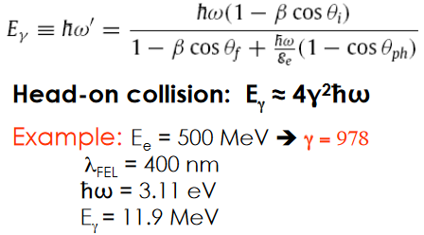
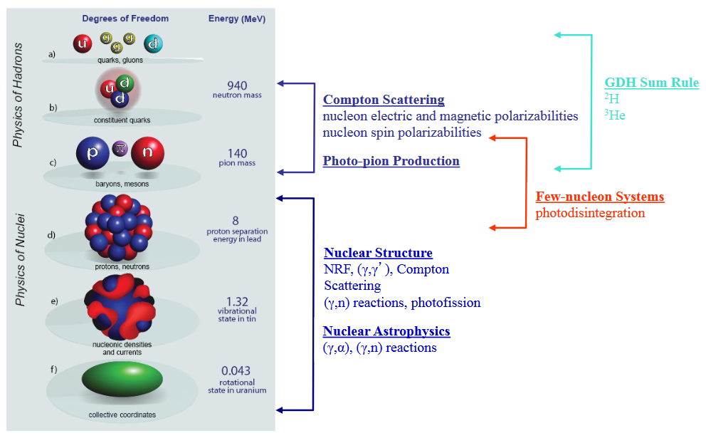
HIγS (Duke U., USA)

Slide 31
Miniscience (<100 m)
►Small facilities (< 100 m).
VEPP-2000 (Novosibisrk), μμ-tron (Novosibirsk), DERICA (Dubna), IOTA (USA), ELENA (CERN), LEPTA (Dubna), etc.
Is there a chance to develop a small size but interesting accelerator?

Slide 32
IOTA (USA)

Slide 33
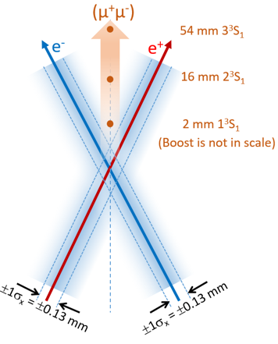
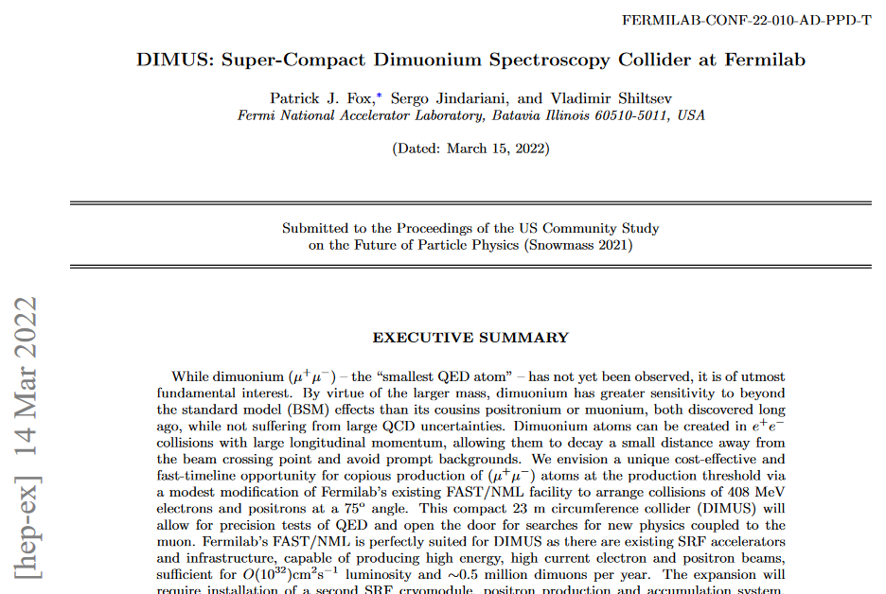
Novosibirsk μμ-tron
μμ-tron is a low energy very compact electron-positron collider proposed at BINP to discover and study a dimuonium atom.
Dimuonium, bimuonium or true muonium is a lepton atom (μ⁺μ⁻).
From 6 leptonic atoms (e⁺e⁻), (μ⁺e⁻), (μ⁺μ⁻), (τ⁺e⁻), (τ⁺μ⁻), (τ⁺τ⁻) only two (e⁺e⁻), (μ⁺e⁻) were observed.
Dimuonium is pure QED system (no strong interaction, calculable).
Very compact (large $m_{μ}$), more sensitive to new physics than other exotic atoms.

Slide 34
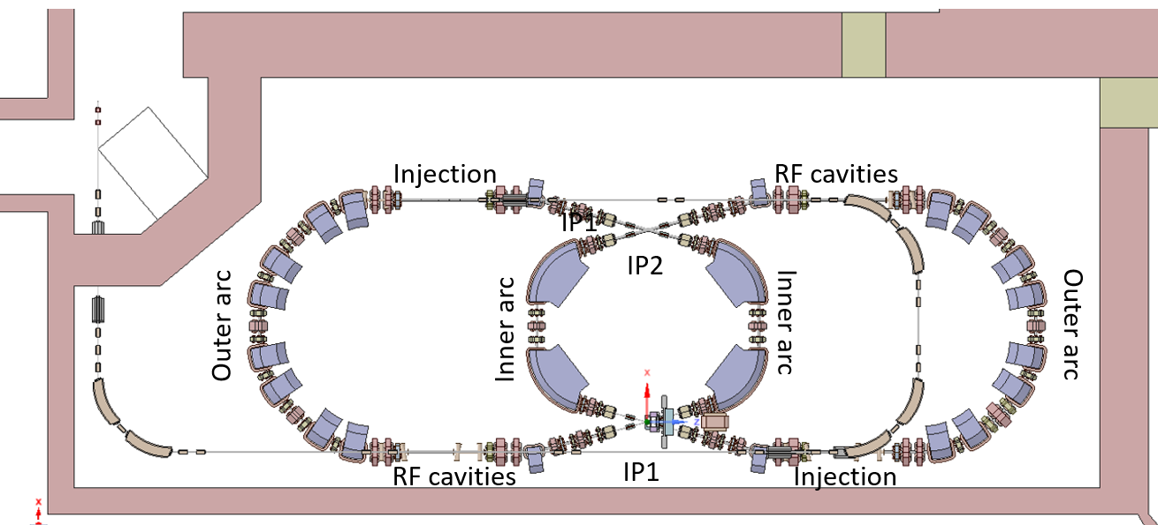
μμ-tron layout
6 m

Slide 35
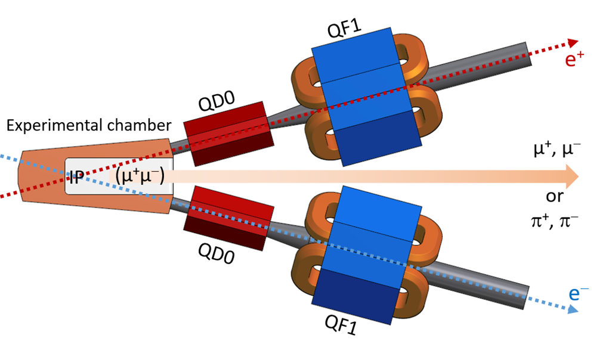
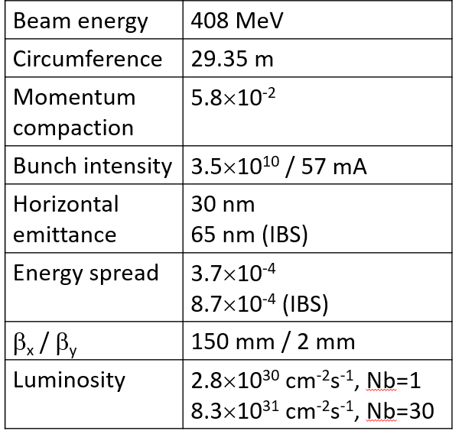
μμ-tron parameters
Notes:
Машины одного эксперимента, но дешёвые.

Slide 36
SUMMARY
No hints for New Physics search. Any sizes and energies are appropriate.
Since LHC found no New Physics at high energy, other ingredients are welcome: high precision and luminosity, rare species and conditions (polarization, monochromatization, etc.).
Accelerators providing studies in the frame of the Standard Model are also important.
As usually, new ideas are wanted!
State support program for HEP infrastructure and study in Russia is highly desirable (example: ФНТП нейтронных и синхротронных исследований).
Notes:
Федеральная научно-техническая программа

