Slide 1
Исследование глобальной поляризации лямбда гиперонов в столкновениях тяжелых ядер в эксперименте MPD.
Трошин В.^{1,2}, Парфенов П.^{1,2},Колесников В.^{1,2}, Тараненко А.^{1,2}, Теряев О.¹ , Воронюк В.¹, Зинченко А.¹
(1- ОИЯИ, 2 - НИЯУ МИФИ) Научная сессия секции ядерной физики ОФН РАН
1-5 апреля 2024
Работа поддержана: грантом РНФ № 22-12-00132, Мега грант NICA 2024-2025.

Slide 2
Outline
Introduction
Δφ-method
Generalized invariant mass fit method
Results
Summary

Slide 3
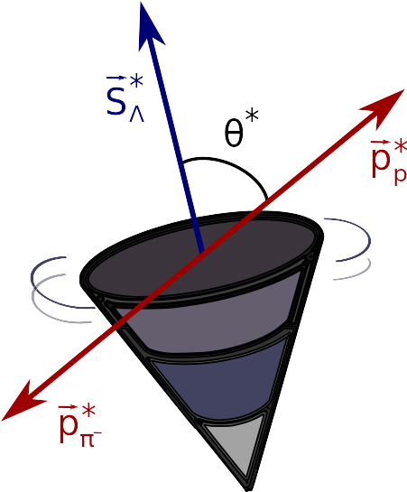
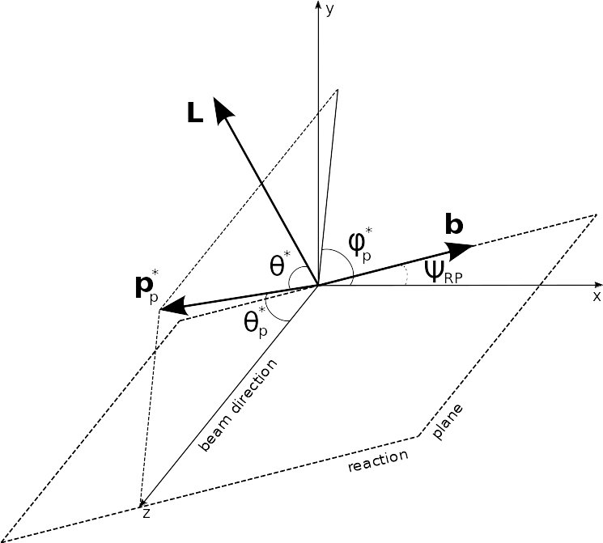
Global hyperon polarization
w.r.t. reaction plane (RP)
Emerges in HIC due to the system angular momentum
Measured through the weak decay:
P
* — denotes hyperon rest frame
θ* — angle between the decay particle(proton) and polarization direction
hyperon decay constant

Slide 4
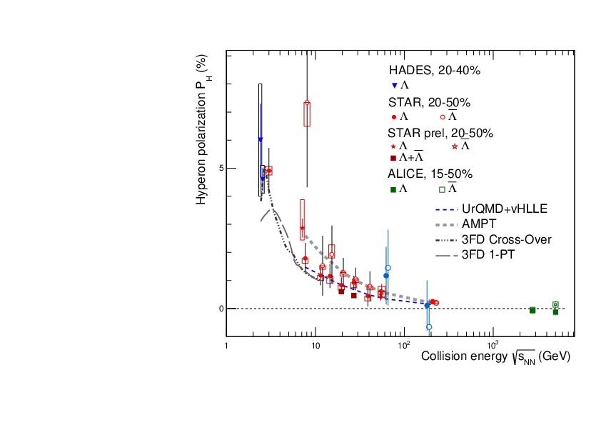
Global Polarization at Nuclotron-NICA energies
Predicted and observed global polarization signals rise as the collision energy is reduced:
NICA energy range will provide new insight
- splitting of global polarization
Comparison of models, detailed study of energy and kinematical dependences, improving precision
Probing the vortical structure using various observables
9.2 GeV
MPD
FXT-MPD
S. Singha, EPJ Web Conf. 276 (2023) 06012
J. Adam et al. (STAR Collaboration), Phys. Rev. C 98, 014910 (2018)
O. Teryaev and R. Usubov, Phys. Rev. C 92, 014906 (2015)

Slide 5
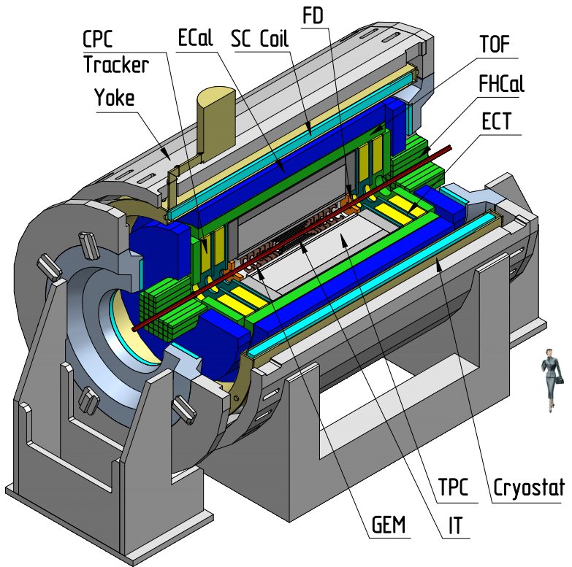
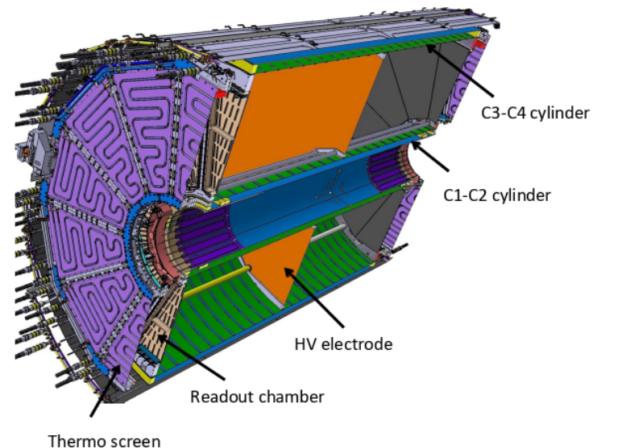
MPD detector
4π spectrometer designed to work at high luminosity in the energy range of the NICA collider (4-11 GeV)
Сapable of detecting of charged hadrons, electrons and photons.
Precise 3-D tracking system and a high-performance particle identification system based on the time-of-flight measurements and calorimetry.
Forward Hadron Calorimeter (FHCal) allow to reconstruct projectile and target spectator symmetry planes
Time Projection Chamber (TPC) is a main tracking detector, overlapping pseudorapidity region |η| <1.5 with high particle reconstruction efficiency for p_{T} > 0.1 GeV/c

Slide 6
Monte-Carlo simulation
MC
simulation
PHSD
N.S. Tsegelnik, E.E. Kolomeitsev, V. Voronyuk, Phys.Rev.C 107 (2023) 034906
N.S. Tsegelnik, E.E. Kolomeitsev, V. Voronyuk, Particles 2023, 6, 373-384
MC simulation using PHSD generator
Bi-Bi @ 9.2GeV, 15M MB events, b [0,12]fm
Global hyperon polarization
Thermodynamical (Becattini) approach
Hyperon polarization vector (P = {P_{x},P_{y},P_{z}})
Detector
simulation
GEANT 4
F. Becattini, et. al. Ann. Phys. 338 (2013) 32
Transfer of polarization during hyperon decays (feed-down effect)
Anisotropic decay of Λ hyperons:
Event
reconstruction
MPD

Slide 7
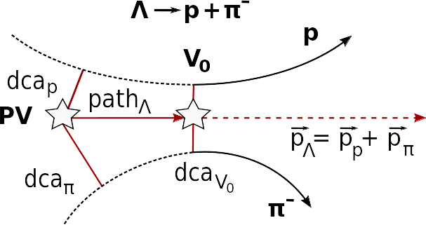
Measurements of global hyperon polarization
Polarization can be measured using the azimuthal angle of proton in Lambda rest frame φ*
PV — primary vertex
V₀ — vertex of hyperon decay
dca — distance of closest approach
path — decay length
Determine centrality
Determine event plane ( , )
Reconstruct Lambda
Measure global polarization

Slide 8
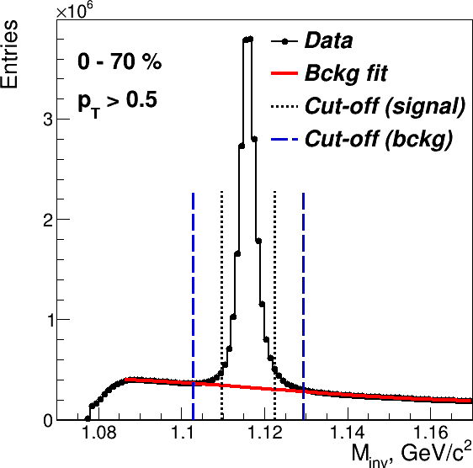
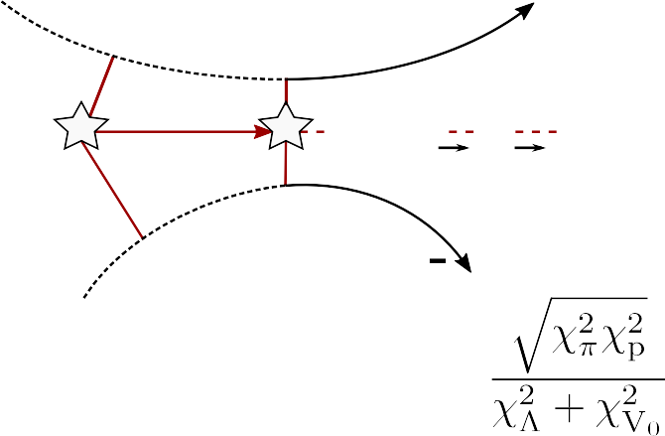
Λ selection
Fitting procedure (sideband method):
Global fit (Gauss + Legendre polynomials)
Background fit in sidebands (± 7σ)
Signal Cut-off: <M>± 3σ
Λ selection criteria:
«ω»-selection (1 parameter)
«χ»-selection (5 parameters)
Λ ^{p}+π
V₀
p
dca
PV
p
path_{Λ}
p_{Λ}= p_{p}+ p_{π}
dca_{π}
dca_{V0}
π

Slide 9
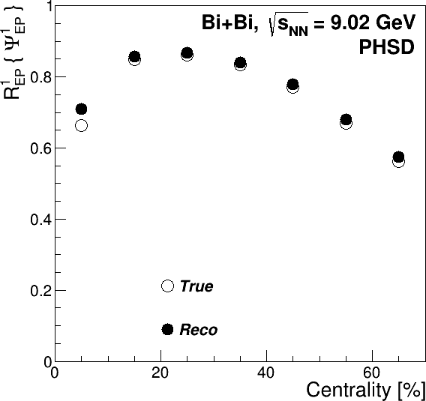
Event Plane (EP) measurements
9.2 GeV
Good performance for EP measurements using FHCal is observed for PHSD model Bi+Bi at 9.2 GeV
True: w.r.t. reaction plane (RP) angle
Reco: determined using sub-event method
approximation to full event

Slide 10
Δφ-method
Obtain invariant mass distribution in bins of
Net amount of Λ in each bin
Distribution of
Fit of the distribution to get → P_{Λ}
dN/dΔφ_{P}*
_{θ} *
-φ*
p
beam direction (z)
x
impact parameter
b
y

Slide 11
Δφ-distribution: centrality 20-50%

Slide 12
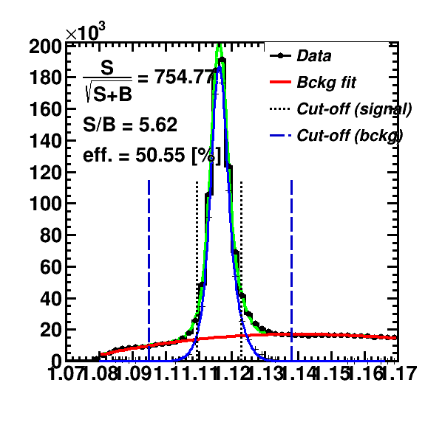
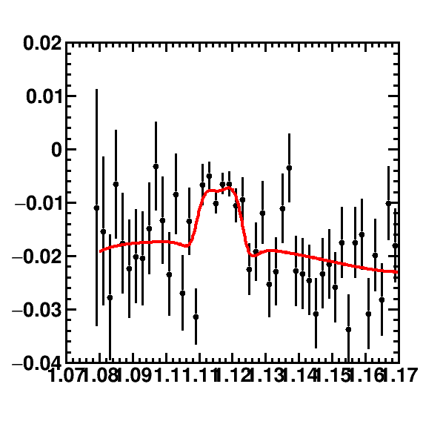
Inv. mass fit method
Use invariant mass distribution
Calculate Sig/All, Bg/All ratios
Fit <sin(𝚿_{EP} - φ_{p}*)> as a function of inv. mass:
Use P^{S}(p_{T}) = <sin(𝚿_{RP} - φ_{p}*)>^{S} to find P_{H}:

Slide 13
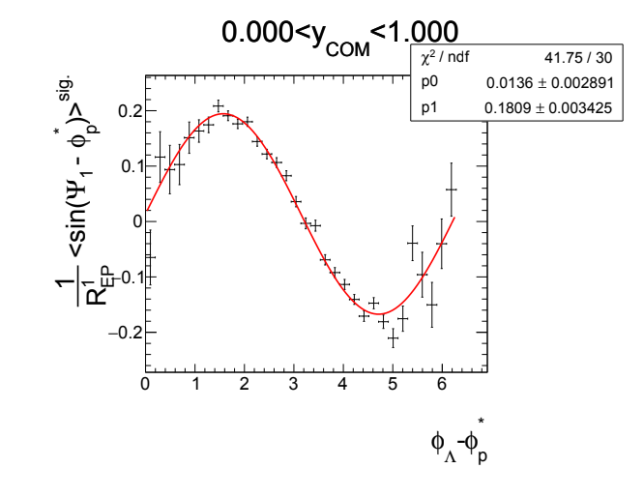
Generalized inv. mass fit method
Fit P^{S} = <sin(𝚿_{RP} - φ_{p}*)>^{S}
in bins of φ_{Λ} - φ_{p}* for η>0, η<0 using formula:
This fit corrects effects of directed flow and acceptance contributions to P_{H}
We use generalized inv. mass fit method further in this work
M.S. Abdallah et al. (STAR Collaboration), Phys. Rev. C 104, L061901 (2021)

Slide 14
Systematics
For Δφ-method:
σ for fitting signal at all distributions: 3± 0.5σ
Resolution: comparison of 2-sub event and 3-sub event
Δφ bins: 20±4
Bg polarization: fit the Bg in Δφ bins instead of Sig
For Gen inv mass fit method:
σ for fitting signal at all distributions: 3± 0.5σ
Resolution: comparison of 2-sub event and 3-sub event
φ_{Λ} - φ_{p}* bins: 16±4
Bg polarization: fit the <sin(𝚿_{RP} - φ_{p}*)> with pol0 and pol1

Slide 15
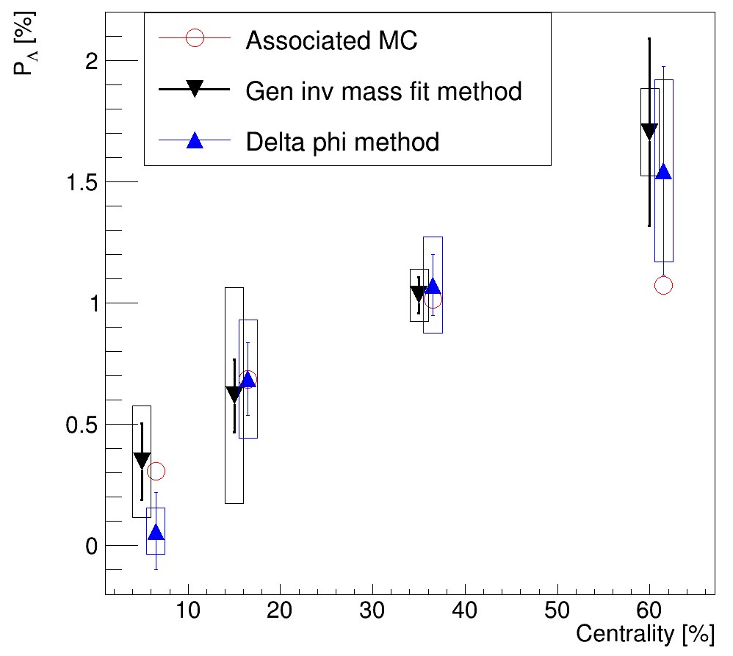
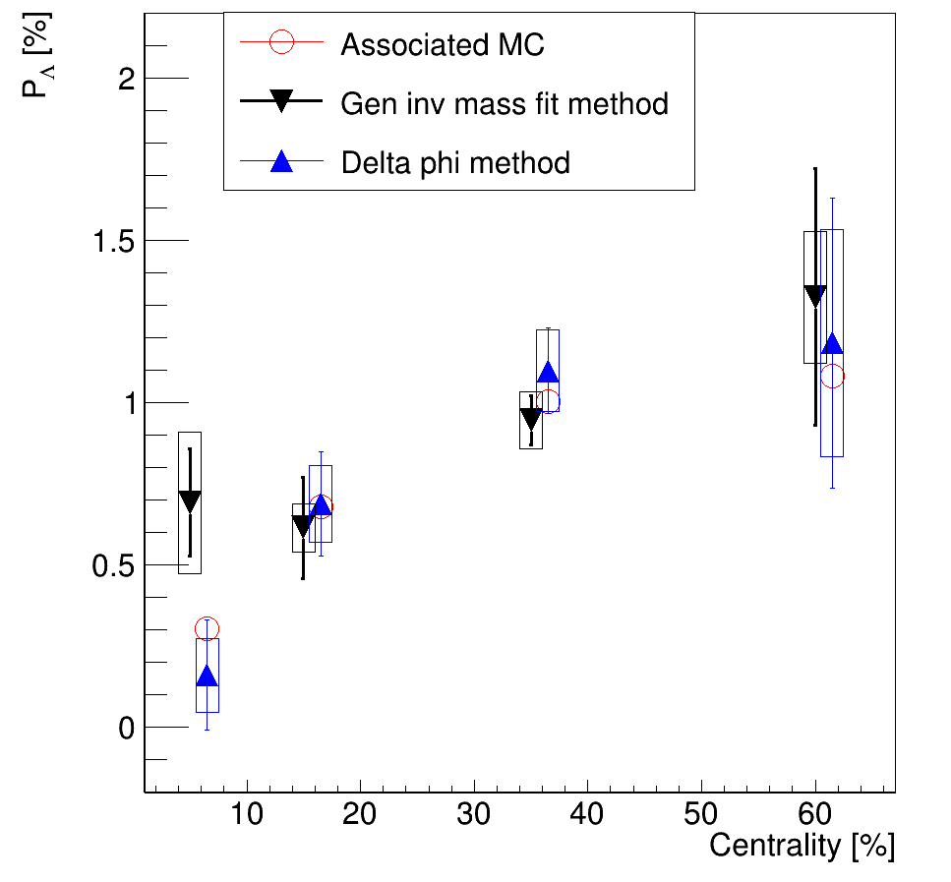
Centrality dependence of P_{Λ}
p_{T}>0.5 GeV/c
p_{T}>0.5 GeV/c
«ω»-selection
«χ»-selection
Both methods have a good agreement with Associated MC

Slide 16
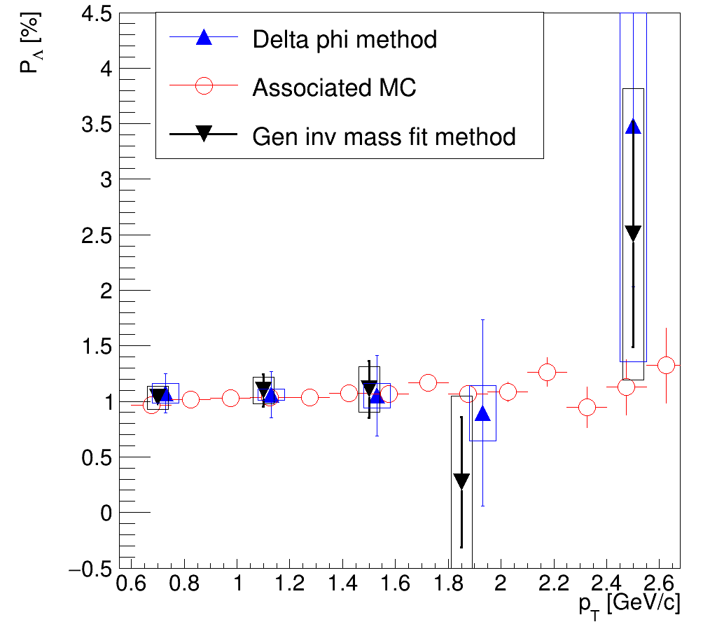
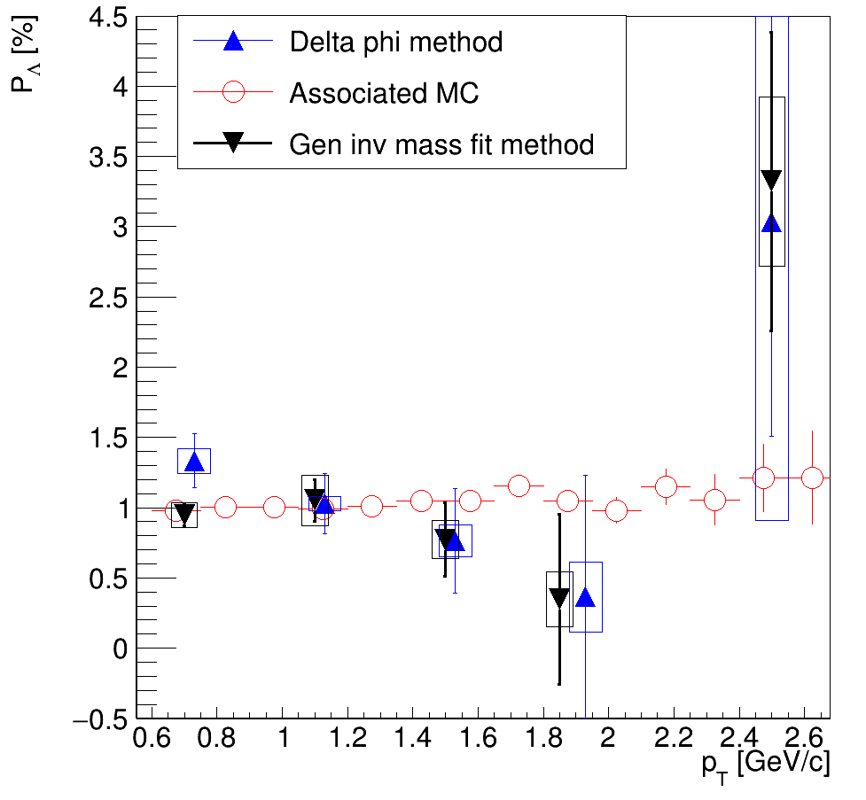
p_{T} - dependence of P_{Λ} for centrality 20-50%
«ω»-selection
«χ»-selection
Both methods have a good agreement with Associated MC
Need more statistics to study high p_{T} region

Slide 17
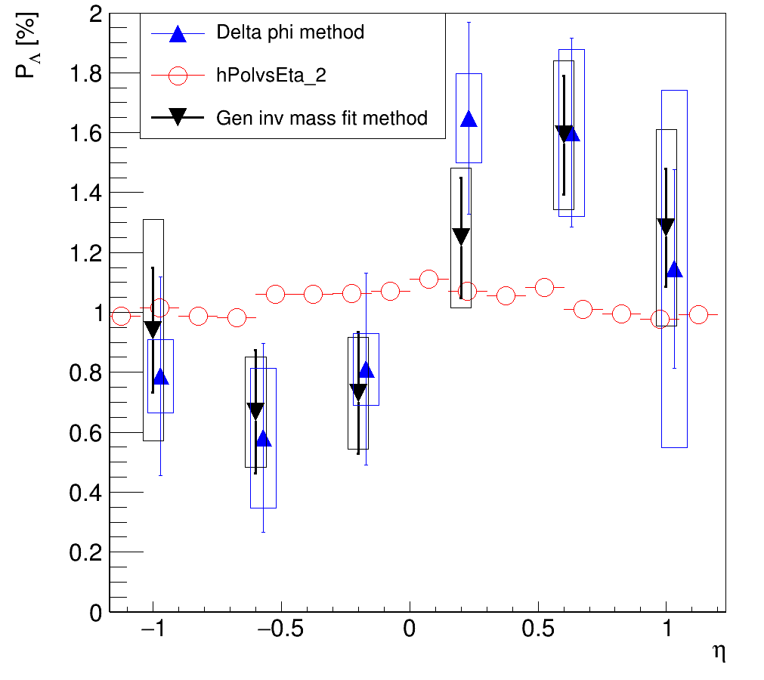
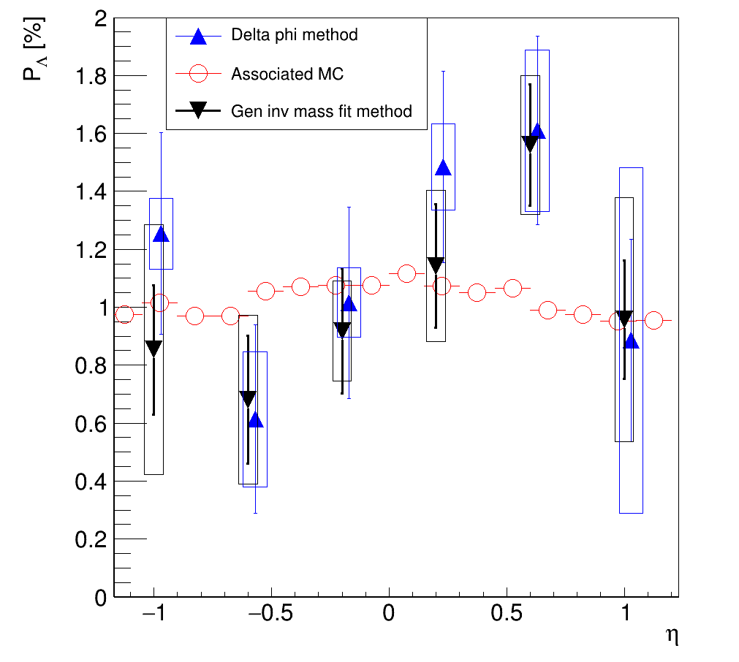
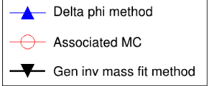
η-dependence of P_{Λ} for centrality 20-50%
p_{T}>0.5 GeV/c
p_{T}>0.5 GeV/c
«ω»-selection
«χ»-selection
Both methods have an agreement with Associated MC
Need more statistics to study η-dependence

Slide 18
Summary
Implementation of generalized invariant mass fit method
Gen inv. mass fit method is used in STAR collaboration and takes into account the effects of non-uniform acceptance and v₁ - may be applicable in fixed-target program at MPD
Both methods have a good agreement with Associated MC
The statistics size of 15M events is not enough for p_{T}-η measurements
Outlook
Analysis of systematics
-global polarization measurements
Performance study with larger statistics(30-50M events)
Thank you for your attention!

Slide 19
BACKUP

Slide 20
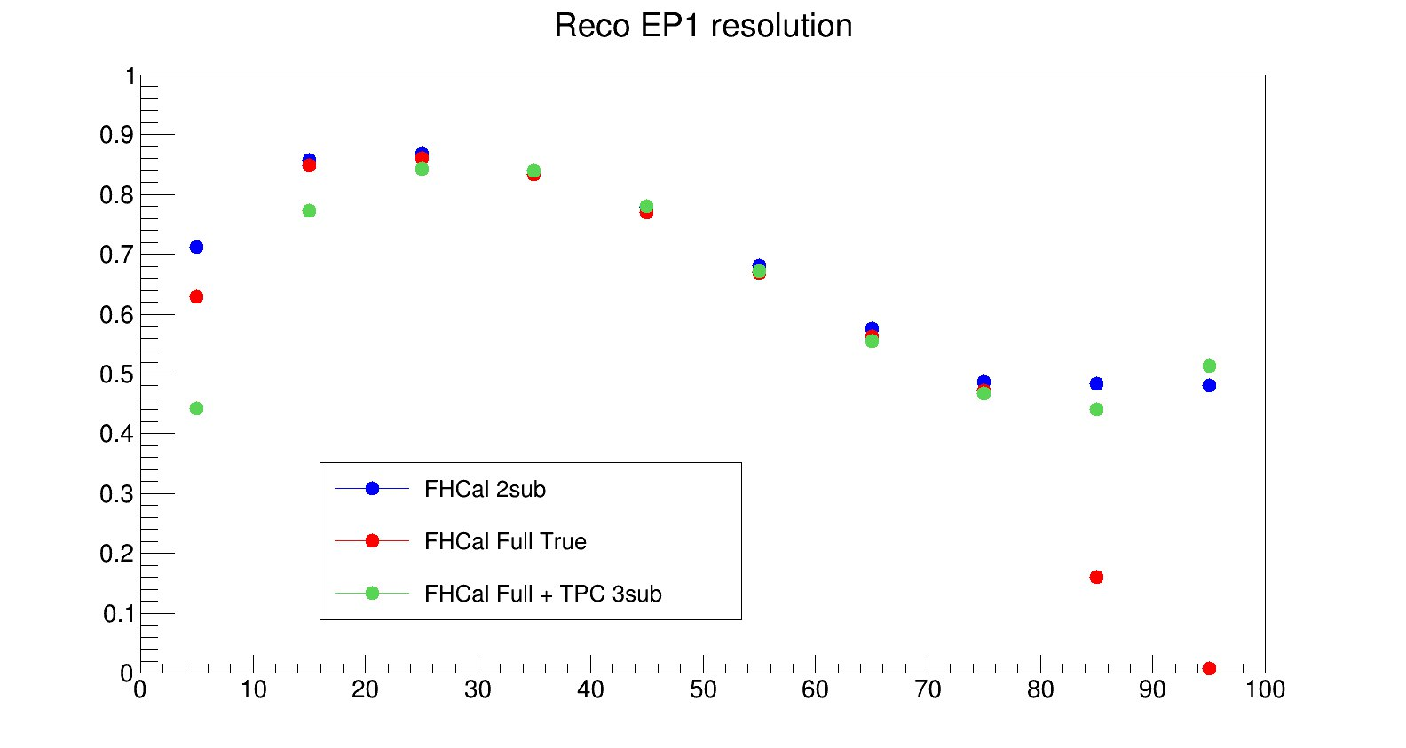
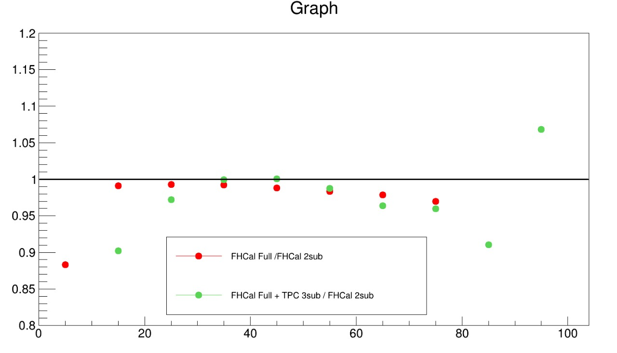
Resolution measurements
R₁
Ratio
Centrality, %
Centrality, %
(1)
FHCal Full True from Eq. (1)
FHCal 2sub event from Eq.(2)
FHCal Full + TPC 3sub from Eq.(3)
F - FHCal, T - TPC, N,S - right and left part of detector
Eq.(4) - extrapolation to full event
(2)
(3)
(4)

Slide 21
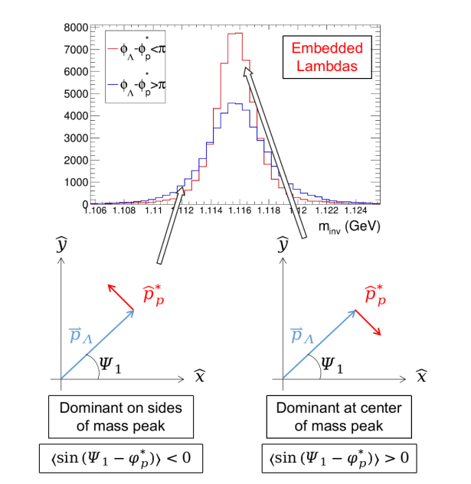
Generalized inv. mass fit method
This method can deal with tracks crossing: daughter particles tracks with opposite charges are bended in the opposite directions in the magnetic field, and these tracks may cross each other -> creates 2 peaks distribution. Solution: fit Sig with 2 gausses
Warning: with detector asymmetry it would provide the effect of v₁ on the polarization measurements and odd pseudorapidity dependence
M.S. Abdallah et al. (STAR Collaboration), Phys. Rev. C 104, L061901 (2021)

Slide 22
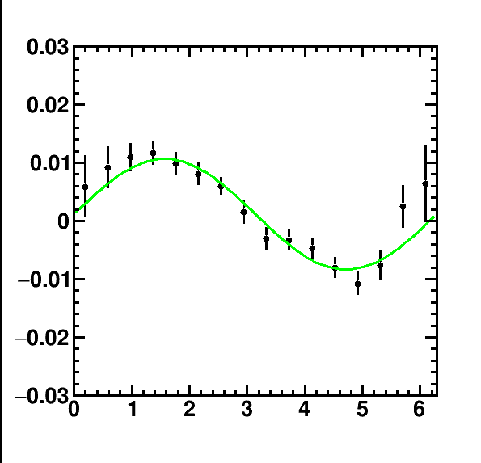
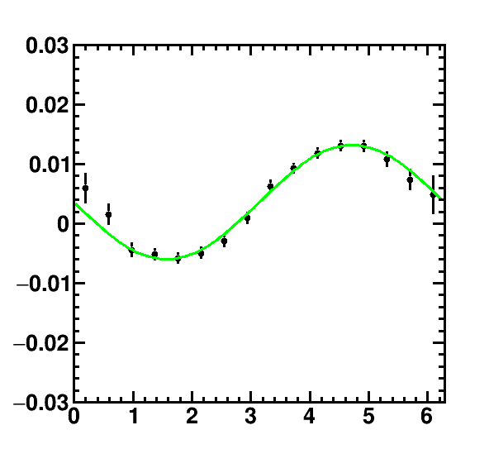
Examples pseudorapidity
0 < η < 0.4
-0.8 < η < -0.4

