Slide 1
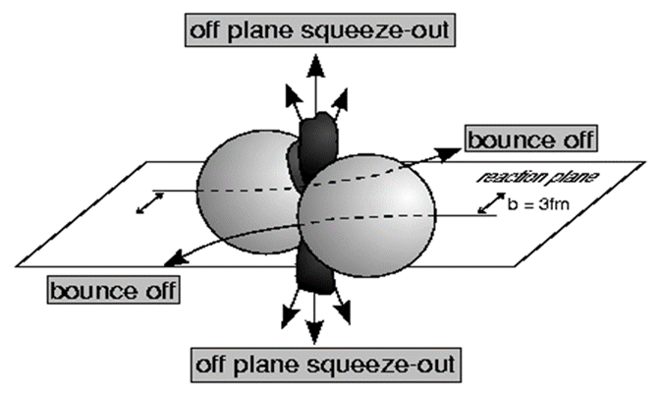
Измерения анизотропных коллективных потоков от LHC до NICA
Аркадий Тараненко (НИЯУ МИФИ, ЛФВЭ ОИЯИ)
Научная сессия секции ядерной физики ОФН РАН, посвященная 300-летию Российской Академии Наук, ОИЯИ, 1-5 апреля 2024
Notes:
1
1
1
1
1
1
1

Slide 2
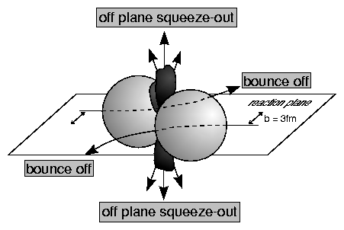
Azimuthal anisotropy of particles at HIC 1989-2024
y
Ф=φ-Ψ_{RP}
ψ_{RP}
b
x
Sergei Voloshin, Y. Zhang, Z. Phys. C70,(1996), 665
The sinus terms are skipped by symmetry arguments
From the properties of Fourier’s series one has
Fourier coefficients V_{n} quantify anisotropic flow:
v₁ is directed flow, v₂ is elliptic flow, v₃ is triangular flow, etc.
Term “flow” does not mean necessarily “hydro” flow – used only to emphasize the collective behavior of particles in event or multiparticle azimuthal correlation

Slide 3
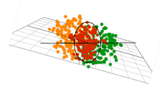
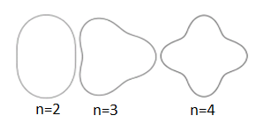

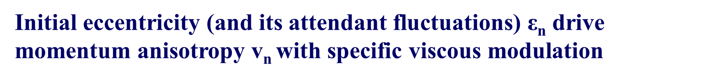
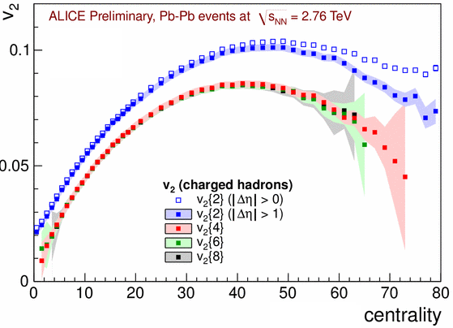
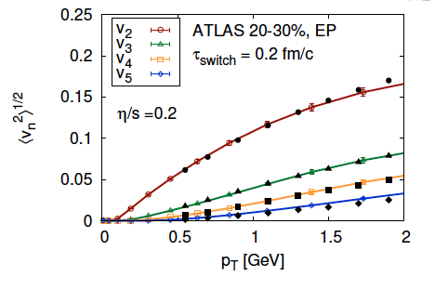
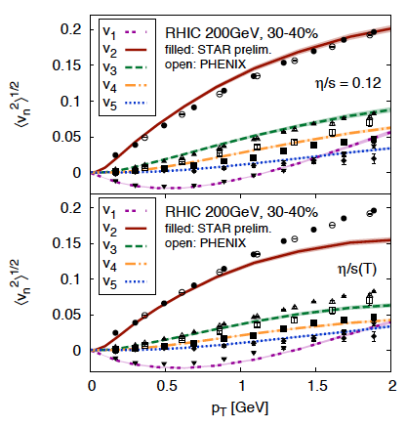
Anisotropic Flow at RHIC-LHC
Gale, Jeon, et al., Phys. Rev. Lett. 110, 012302
3
Flow and non-Flow, Fluctuations

Slide 4
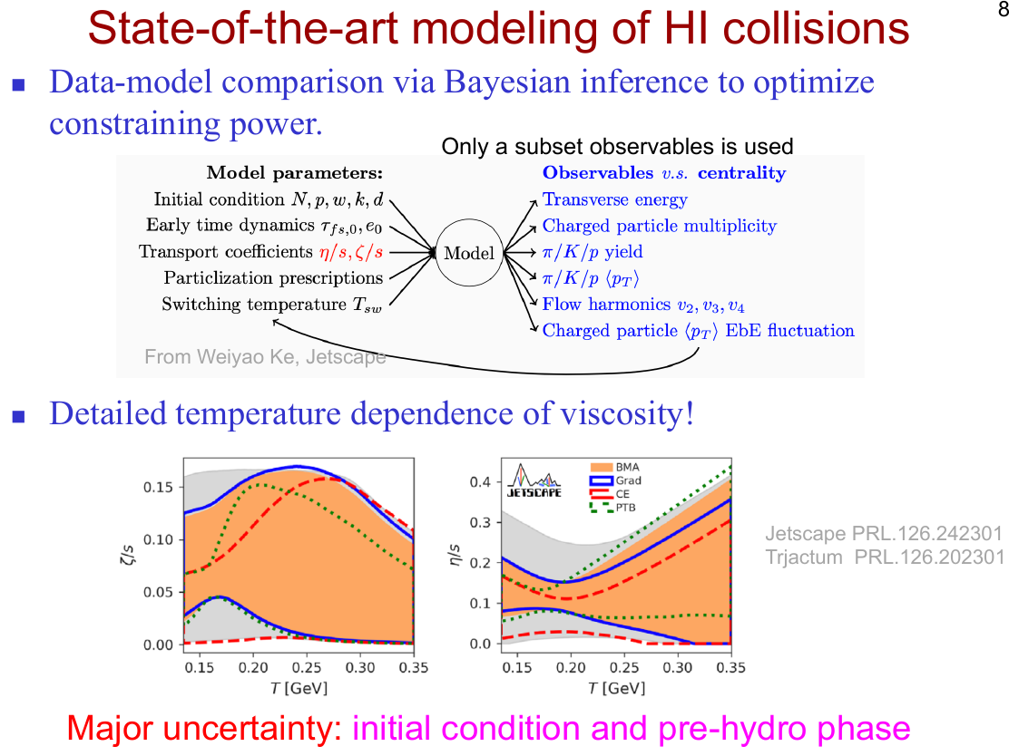
4

Slide 5
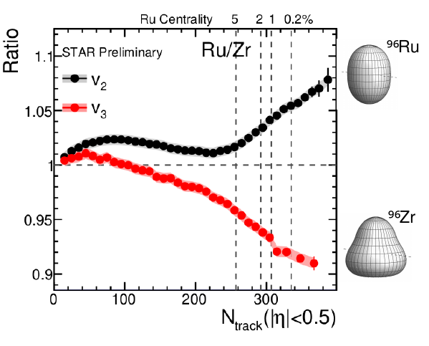
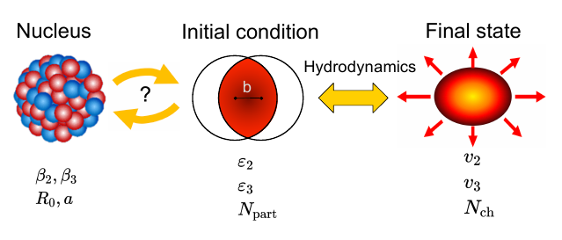
2011-2020
Nucleon substructure matters
2020-2024
5

Slide 6
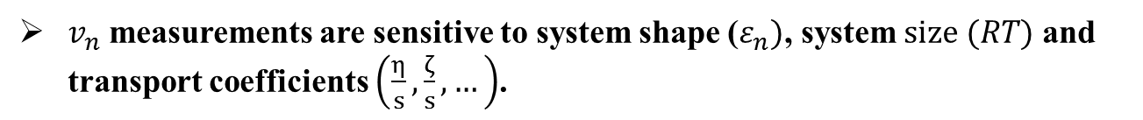
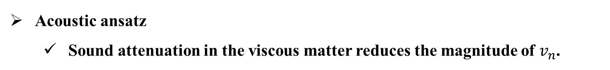
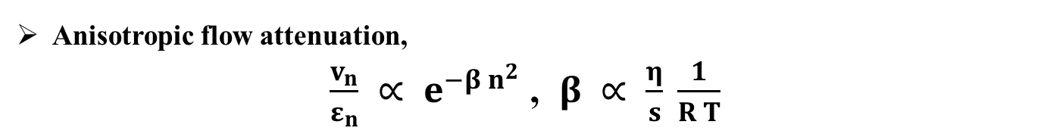
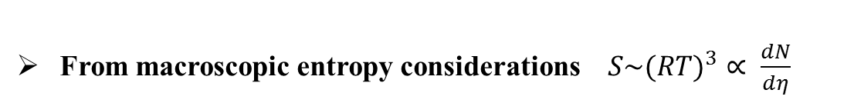
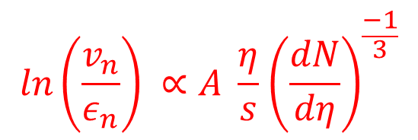







Anisotropic Flow at RHIC/LHC is acoustic
PRC 84, 034908 (2011)
P. Staig and E. Shuryak.
arXiv:1305.3341
Roy A. Lacey, et al.

Slide 7
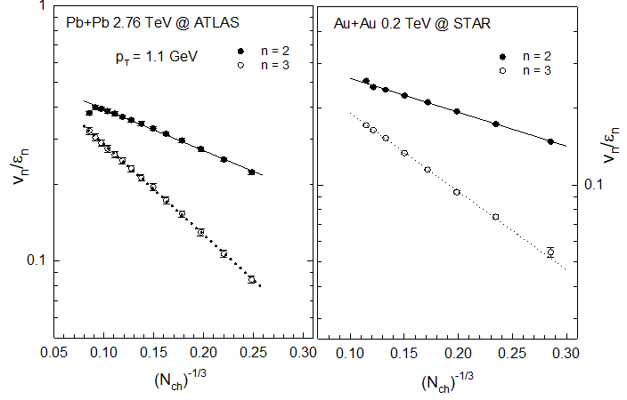

Acoustic Scaling –

Slide 8
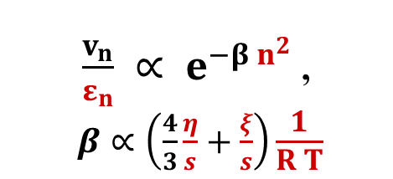
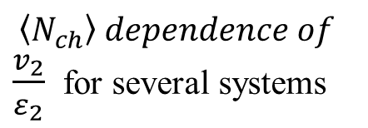
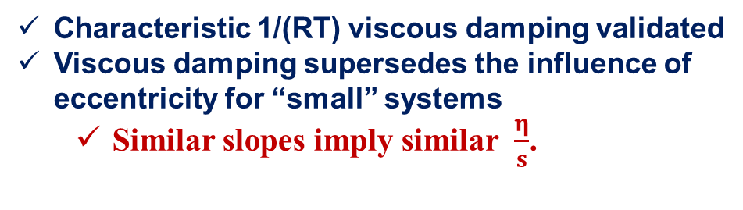
Flow is acoustic
STAR, Phys. Rev. Lett. 122 (2019) 172301

Slide 9
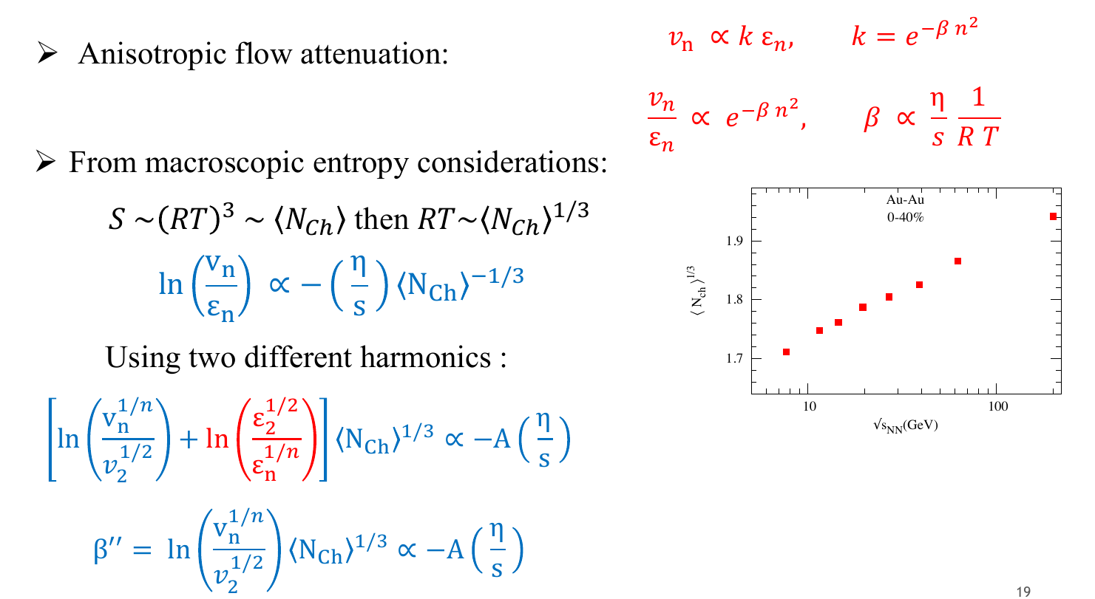
Beam energy dependence of V_{n}

Slide 10
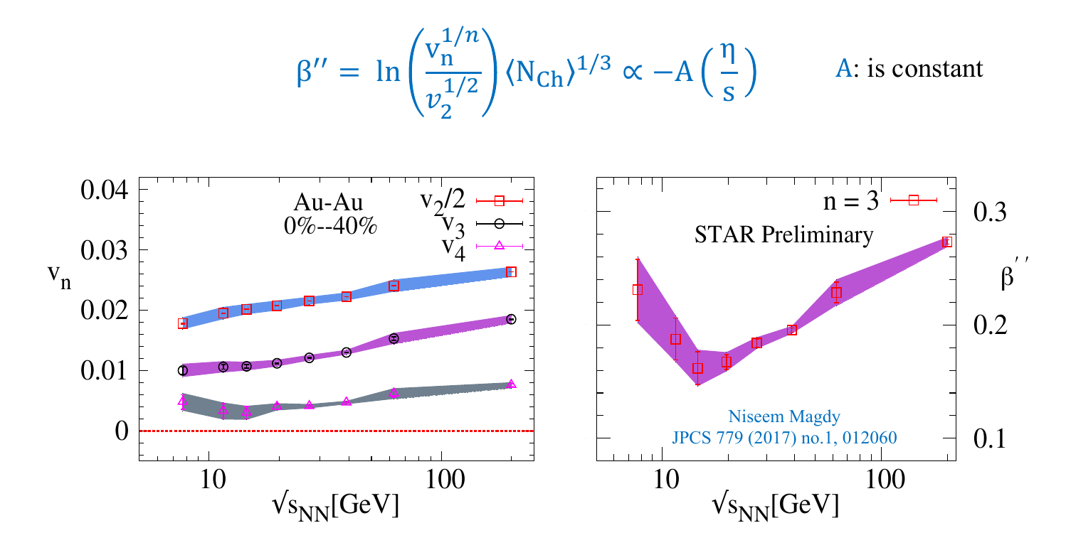
Beam energy dependence of V_{n}
V_{n} shows a monotonic increase with beam energy. The viscous coefficient, which encodes the transport coefficient (𝜼/𝒔), indicates a non-monotonic behavior as a function of beam energy.

Slide 11
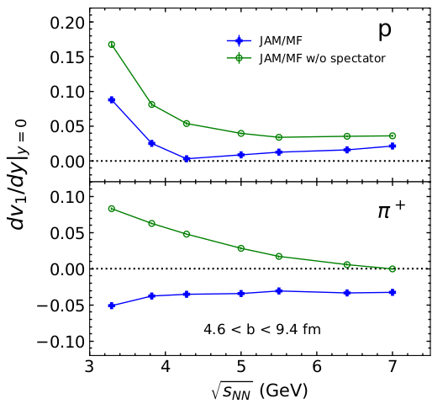
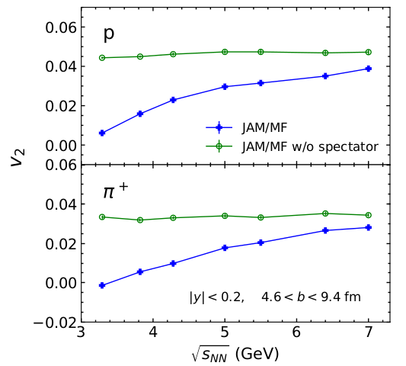
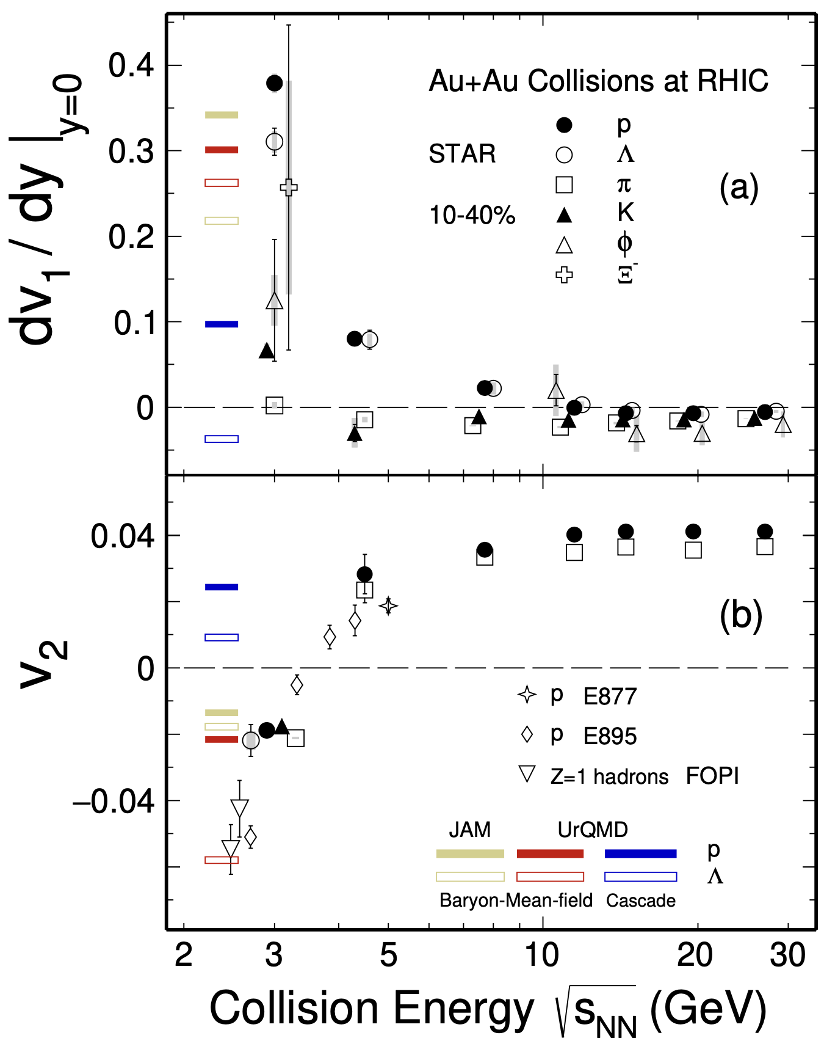

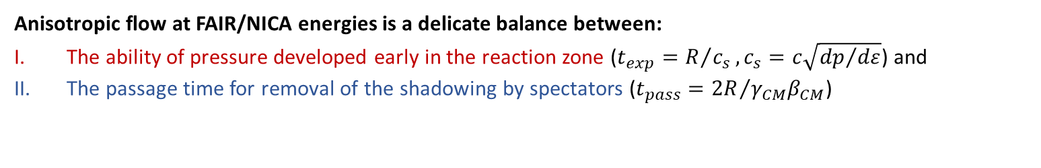
Anisotropic flow in Au+Au collisions at Nuclotron-NICA energies
M. Abdallah et al. STAR, Phys. Lett. B 827, 137003 (2022)
n]
BM@N
CBM
MPD
Anisotropic flow at FAIR/NICA energies is a delicate balance between:
The ability of pressure developed early in the reaction zone ($t_{exp}=R/{c_{s}}, c_{s}=c\sqrt{{dp}/{dε}}$) and
The passage time for removal of the shadowing by spectators ($t_{pass}={2R}/{γ_{CM}β_{CM}}$)

Slide 12
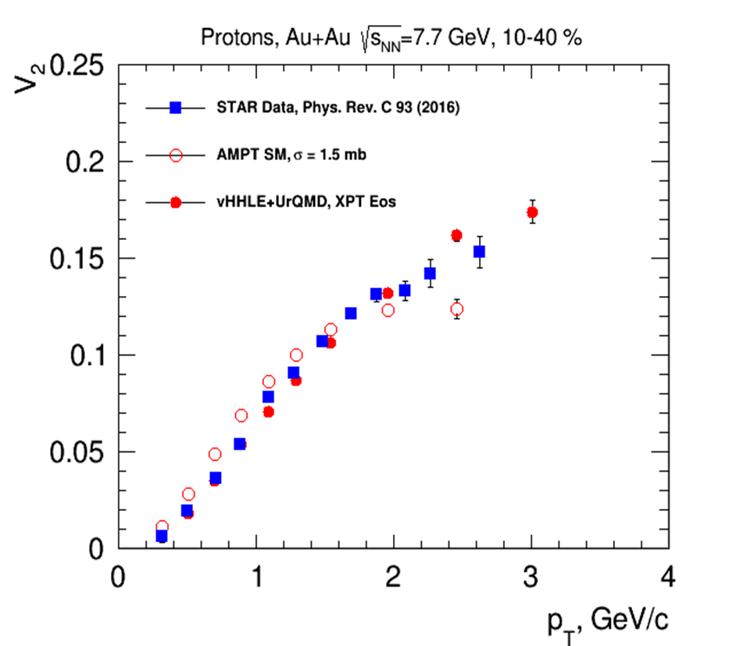
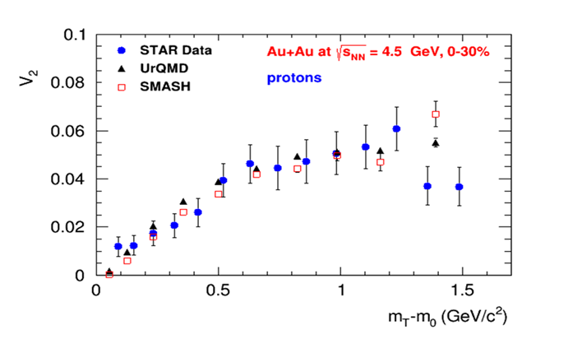
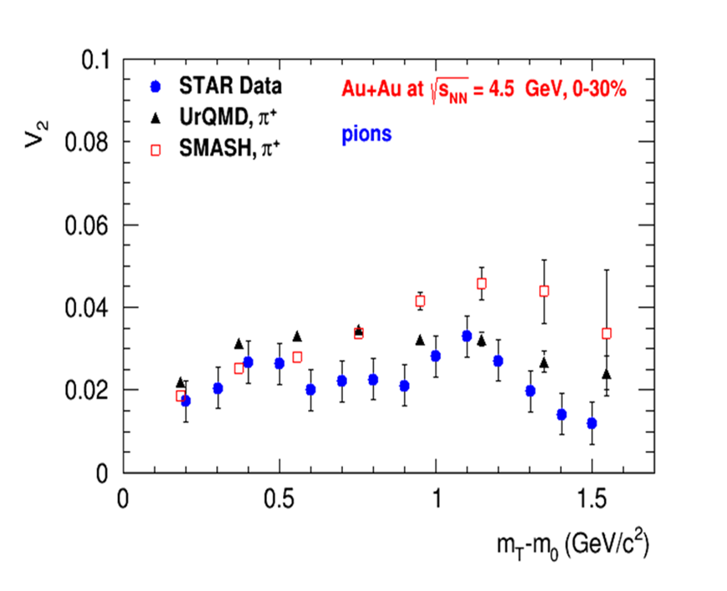
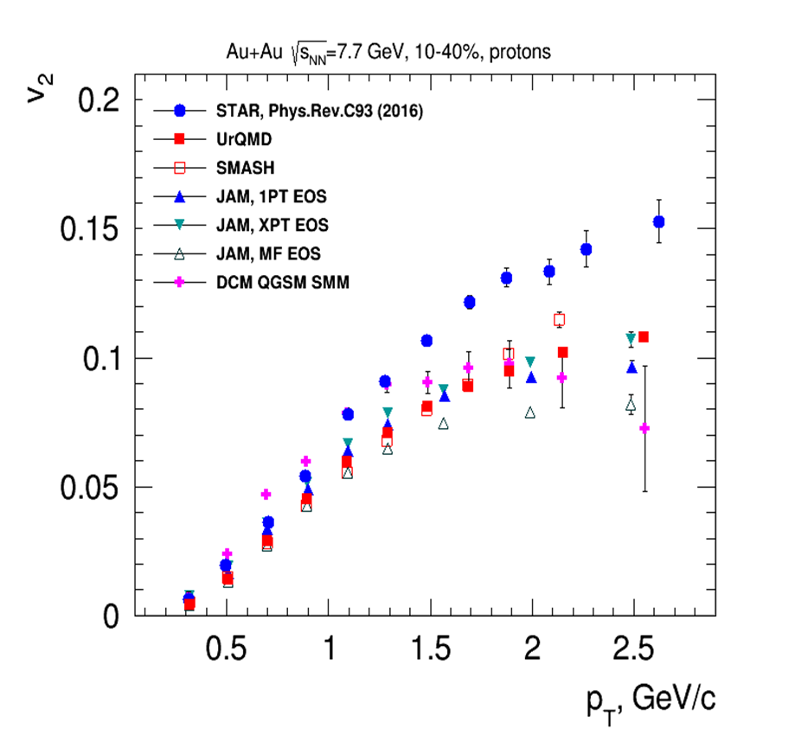
Elliptic Flow (v₂) at NICA energies: Models vs Data
at √s_{NN} ≥ 7.7 GeV pure string/hadronic cascade models underestimate v₂ – need hybrid models with QGP phase (vHLLE+UrQMD, AMPT with string melting,…) at √s_{NN} ≥ 3-4.5 GeV pure hadronic models give similar v₂ signal compared to STAR data

Slide 13
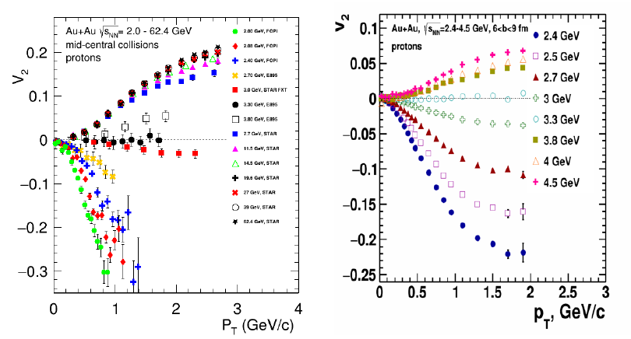

Anisotropic flow in Au+Au collisions at Nuclotron-NICA energies
Anisotropic flow at FAIR/NICA energies is a delicate balance between:
The ability of pressure developed early in the reaction zone ($t_{exp}=R/{c_{s}}, c_{s}=c\sqrt{{dp}/{dε}}$) and
The passage time for removal of the shadowing by spectators ($t_{pass}={2R}/{γ_{CM}β_{CM}}$)

Slide 14
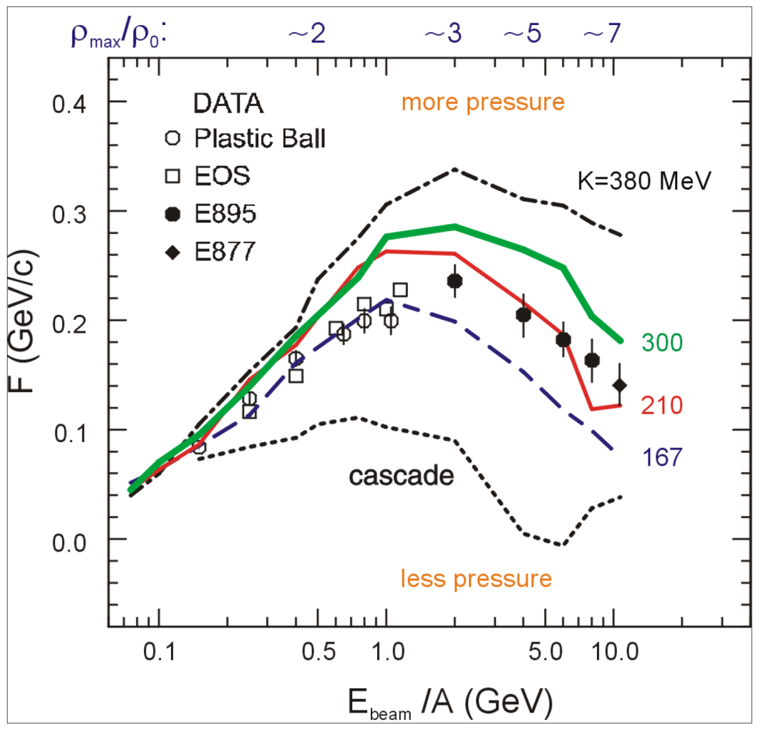
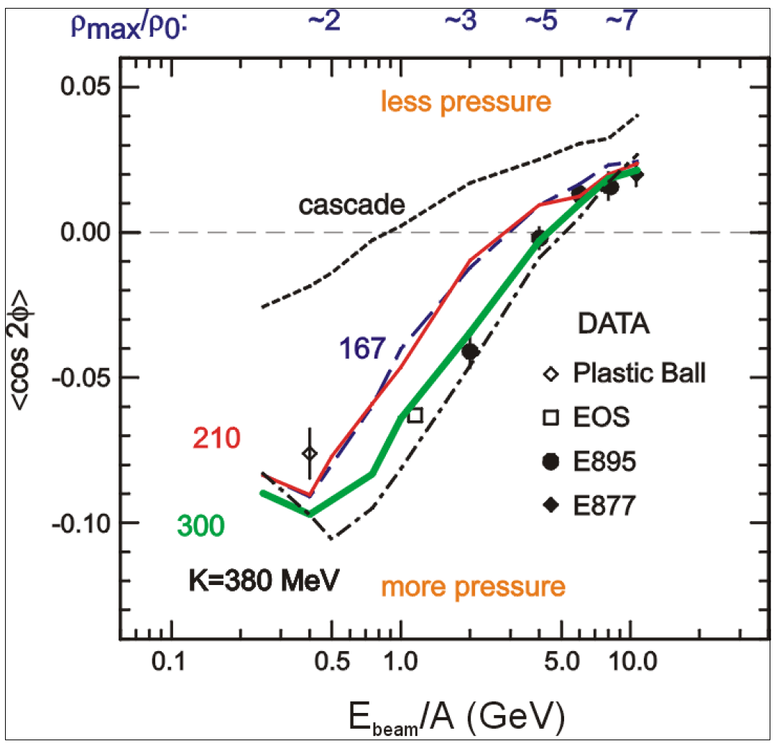
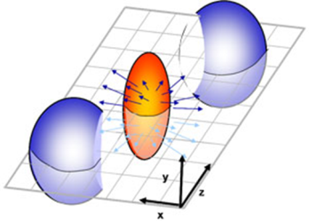
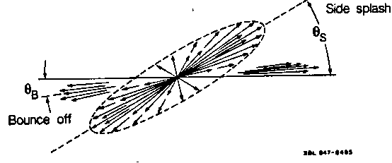
Nuclear incompressibility from collective proton flow
P. Danielewicz, R. Lacey, W.G. Lynch, Science 298 (2002) 1592
Soft EOS
Hard EOS
Transverse in-plane flow:
Elliptic flow:
F = d(p_{x}/A)/d(y/y_{cm})
14
dN/dΦ ∝ (1 + 2v₁ cosΦ + 2v₂ cos2Φ)

Slide 15
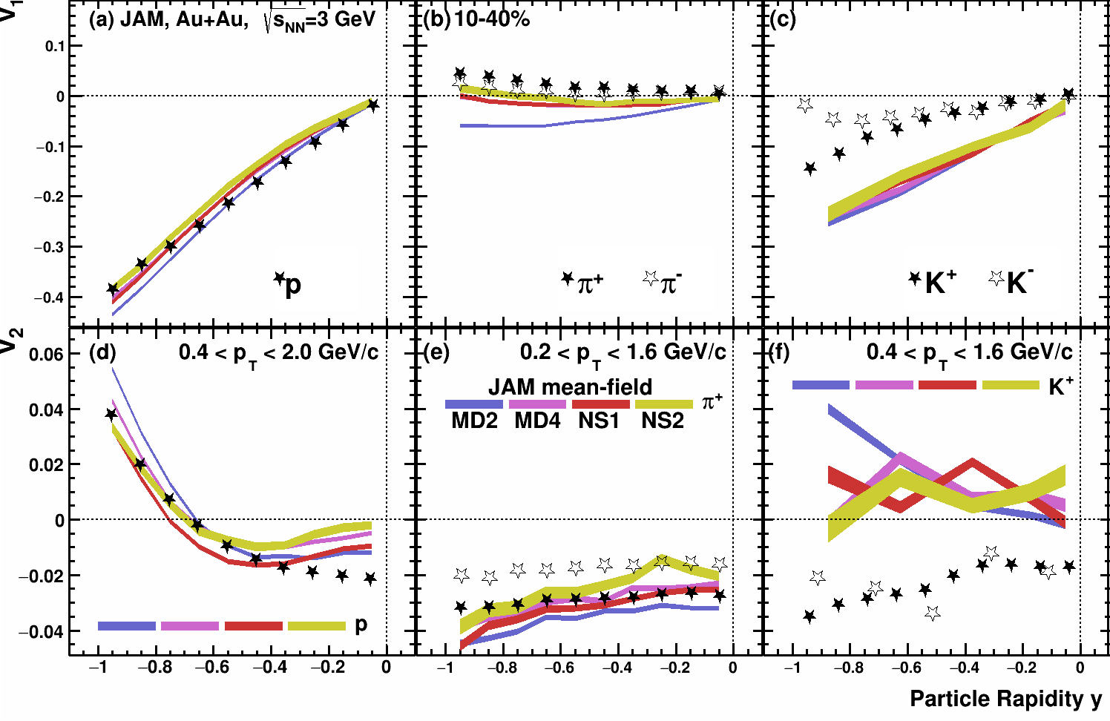
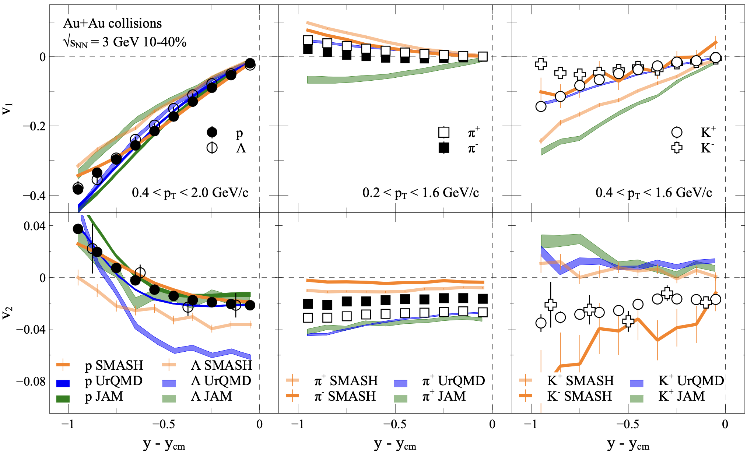
$v_{1,2}\left(y\right)$in Au+Au $\sqrt{s_{NN}}$=3 GeV: model vs. STAR data
A. Sorensen et. al., arXiv:2301.13253 [nucl-th] (2023)
P. Parfenov, Particles 5, no.4, 561-579 (2022)
Models do not describe all particle species equally well
$v_{1}$, $v_{2}$ of protons are described by JAM, UrQMD (hard EOS) and SMASH (hard EOS with softening at higher densities)

Slide 16
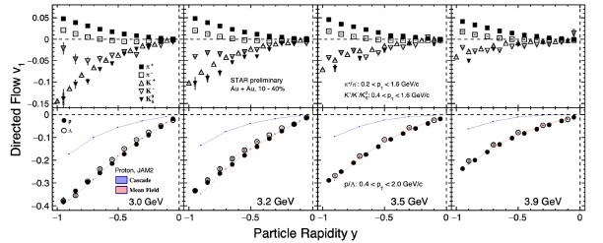
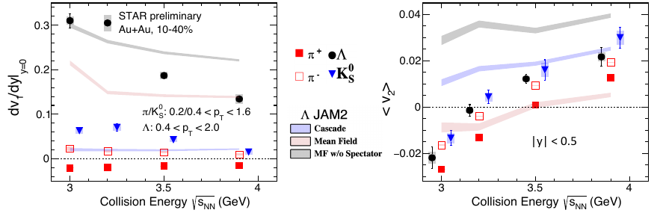
New STAR results from BES – II program were presented at QM2023

Slide 17
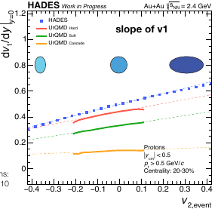
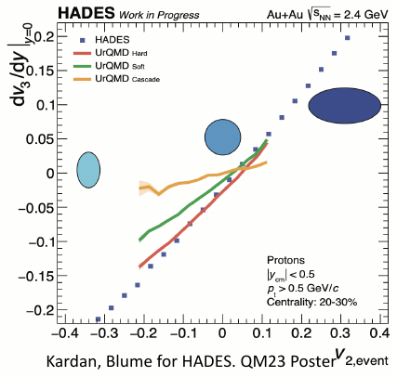
New HADES results

Slide 18
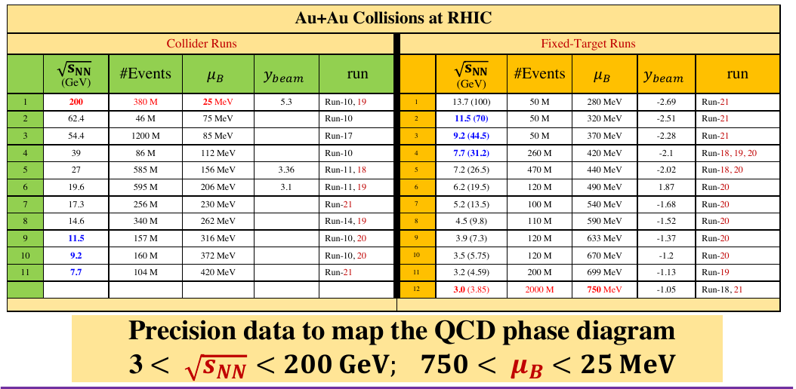
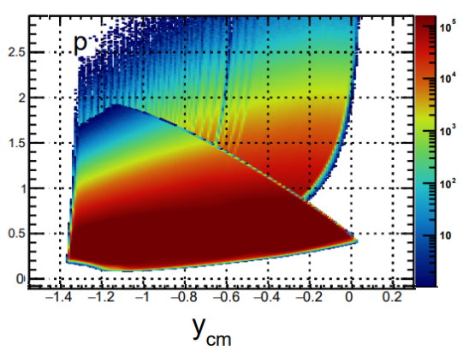
RHIC BES programs
Data taking by STAR at RHIC: 3 < $\sqrt{s_{NN}}$< 200 GeV (750 < μ_{B} < 25 MeV)
Au+Au @ 3.9 GeV
A very impressive and successful program with many collected datasets, already available and expected results
Limitations:
  Au+Au collisions only
  Among the fixed-target runs, only the 3 GeV data have full mid-rapidity coverage for protons (|y| < 0.5),

Slide 19
Summary and outlook
Measurements of anisotropic flow, flow fluctuations, correlations
between flow of different harmonics are sensitive to many details of the initial conditions
and the system evolution. It may provides access to the transport properties of the medium: EOS, sound speed viscosity, etc.
v_{n} at NICA energies shows strong energy dependence:
  At √s_{NN}=4.5 GeV v₂ from UrQMD, SMASH are in a good agreement with the experimental data
  At √s_{NN}≥7.7 GeV UrQMD, SMASH underestimate v₂ – need hybrid models with QGP phase
  Detailed JAM model calculations for differential measurements of v_{n} at √s_{NN} = 2.4-4.5 GeV
  The multi-differential high-statistics data from STAR/HADES/BM@N/MPD should enable a direct extraction of the EOS parameters at high baryon density via a Bayesian fit of the models to the data.
BM@N/NICA energies are very interesting: transition between hadronic and partonic matter?
19
Notes:
19
19
19
19
19
19
19
19

Slide 20
Back-up slides

Slide 21
21

Slide 22
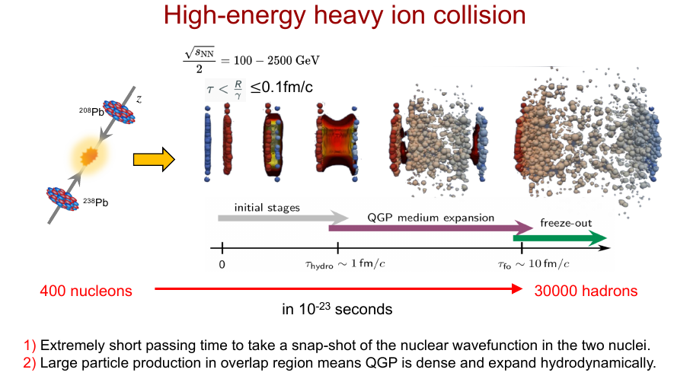
22

Slide 23
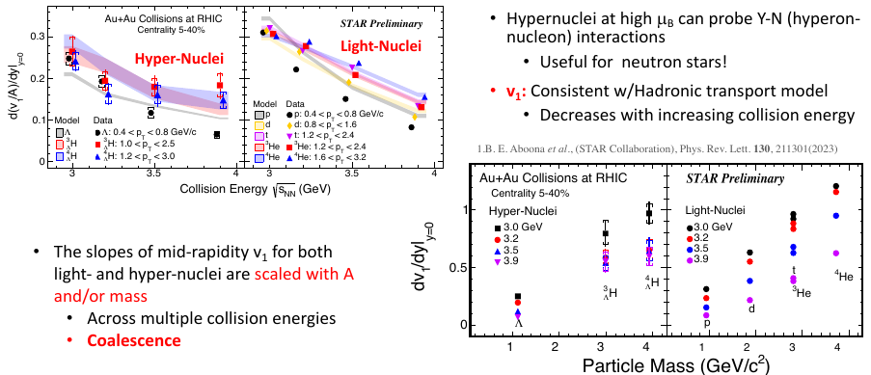

Slide 24
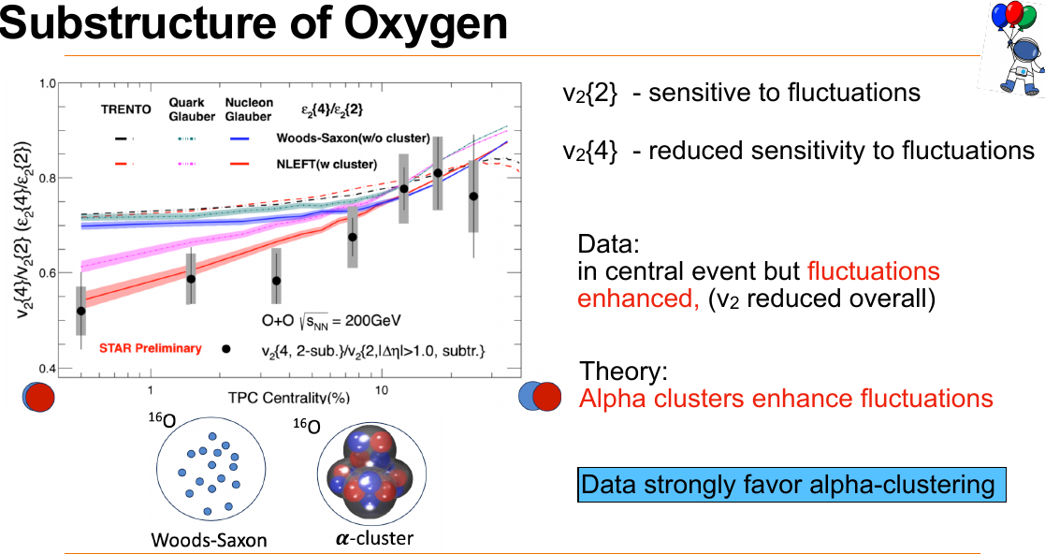

Slide 25
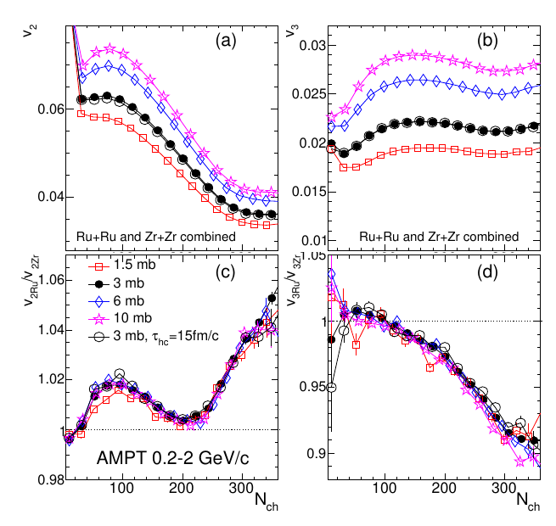
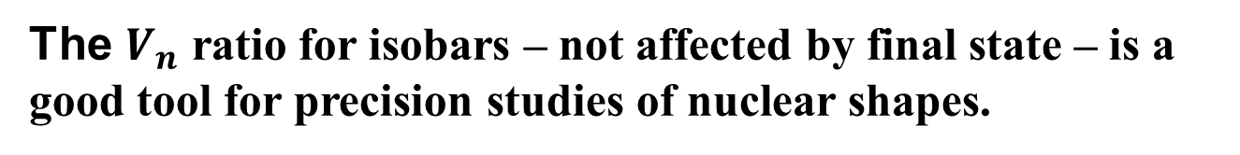
Phys.Rev.C 105 (2022) 1, 014901 • e-Print: 2109.00131

Slide 26
RHIC BES programs
Data taking by STAR at RHIC: 3 < $\sqrt{s_{NN}}$< 200 GeV (750 < μ_{B} < 25 MeV)
Au+Au @ 3.9 GeV
A very impressive and successful program with many collected datasets, already available and expected results
Limitations:
  Au+Au collisions only
  Among the fixed-target runs, only the 3 GeV data have full mid-rapidity coverage for protons (|y| < 0.5),

Slide 27
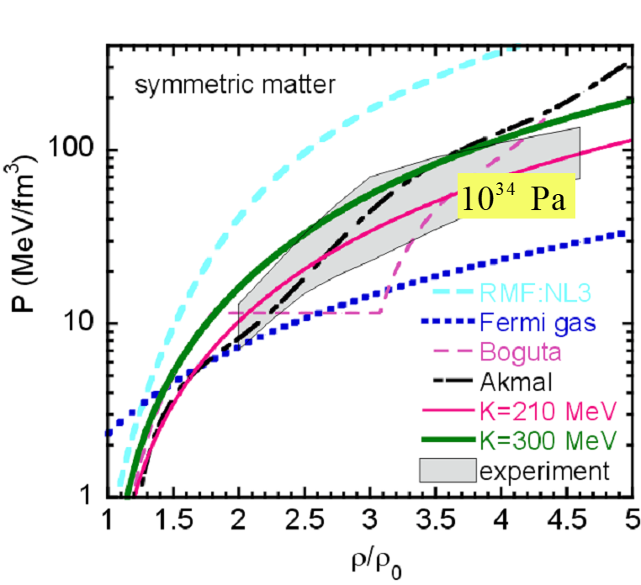
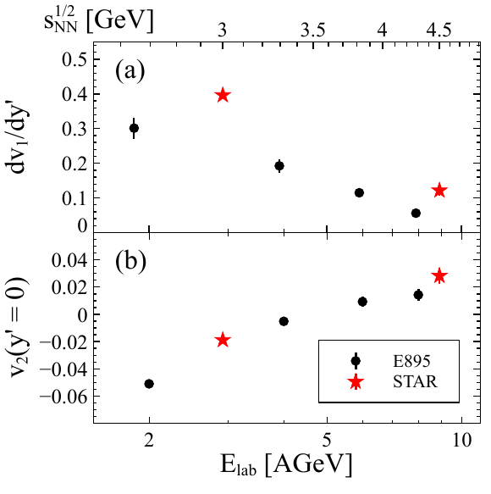

Flow at AGS: Constraints for the Hadronic EOS
Danielewicz, Lacey, Lynch,
Science 298 (2002) 1592-1596
https://arxiv.org/abs/2208.11996
The main source of existing systematic errors in $v_{n}$ measurements is the difference between results from different experiments. New STAR measurements from BES II will provide better constraints for the Hadronic EOS

Slide 28

$v_{n}\left(y\right)$in Au+Au $\sqrt{s_{NN}}$=2.4 GeV: cascade models
P. Parfenov, Particles 5, no.4, 561-579 (2022)
Kinematic cuts:
V_{1,3}(y): 1.0 < pT < 1.5 GeV/c
V_{2,4}(y): 1.0 < pT < 1.5 GeV/c
Cascade models fail to reproduce HADES experimental data

Slide 29


$v_{n}\left(y\right)$in Au+Au $\sqrt{s_{NN}}$=2.4 GeV: model vs. HADES data
P. Parfenov, Particles 5, no.4, 561-579 (2022)
Kinematic cuts:
V_{1,3}(y): 1.0 < pT < 1.5 GeV/c
V_{2,4}(y): 1.0 < pT < 1.5 GeV/c
Good agreement for $v_{n}\left(y\right)$
Higher harmonics are more sensitive to different EOS than $v_{1}$

Slide 30


$v_{n}\left(p_{T}\right)$in Au+Au $\sqrt{s_{NN}}$=2.4 GeV: model vs. HADES data
Experimental data points:
Phys. Rev. Lett. 125 (2020) 262301
Kinematic cuts:
V_{1,3}(p_{T}): -0.25 < y < -0.15
V_{2,4}(p_{T}): -0.05 < y < 0.05
Not a good agreement for $v_{n}(p_{T})$
$v_{3,4}$ are more sensitive to different EOS than $v_{1}$

